Slide 1
Optimizing Target Solvent Composition for RIR-MAPLE Deposition of
Hybrid Perovskites
Fiona Wolfe-Roberts
Home Institution: North Carolina State University
Host Institution: Duke University
Joshua O. Ayeni^{1,2}, Adrienne D. Stiff-Roberts^{1,2}
University Program in Materials Science and Engineering, Duke University, Durham, NC, USA
Department of Electrical and Computer Engineering, Duke University, Durham, NC, USA

Slide 2
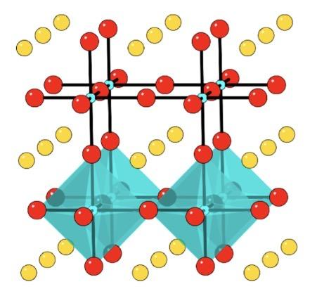
Hybrid Perovskites
ABX₃ crystal structure
typically A = organic cation, B = metal, X = halogen
Ex: phenethylammonium lead iodide
Many ideal semiconductor characteristics within a single material:
tunable direct band gap
benign grain boundaries
high optical absorption
high charge mobility
Making them promising for use in devices
such as:
solar cells
photodetectors
LEDs
batteries
lasers
Saparov, B., Mitzi, D. B. Chemical Reviews 2016, 116 (7), 4558–4596.

Slide 3
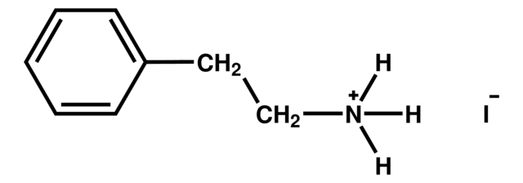
Thin-Film Processing
Stiff-Roberts, A. D., Ge, W. Applied Physics Reviews 2017, 4 (4).
Solution processing of multiple layers:
Solution processing dissolves the precursors in solvent which is deposited on a substrate.
Not suitable for deposition of multiple layers
Vapor processing directly vaporizes the precursors, eliminating the need for solvents.
Risk of high-energy degradation of precursors
Ideal: two layers of distinct film
Reality: a smeared film without distinct interface
phenethylammonium iodide (PEAI): phenethylammonium lead iodide precursor

Slide 4
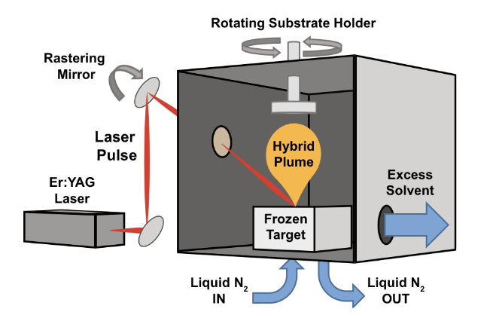
RIR-MAPLE
Resonant Infrared Matrix-Assisted Pulsed Laser Evaporation
Barraza et al. Journal of Electronic Materials 2017, 47 (2), 917–926.
Mixed-processing technique
a matrix solvent absorbs the laser energy, eliminating degradation of the precursors
Thin-film growth
Target composition
(for phenethylammonium lead iodide):
Precursors (PEAI and PbI₂)
Perovskite ingredients
Dimethyl sulfoxide (DMSO)
Primary solvent to dissolve precursors
Low vapor-pressure solvent to prevent sublimation in vacuum
Monoethylene glycol (MEG)
Matrix solvent containing hydroxyl bonds for resonant laser absorption
Ablation
ns pulses
2Hz
2.94µm (IR)
Active target cooling (87K)

Slide 5
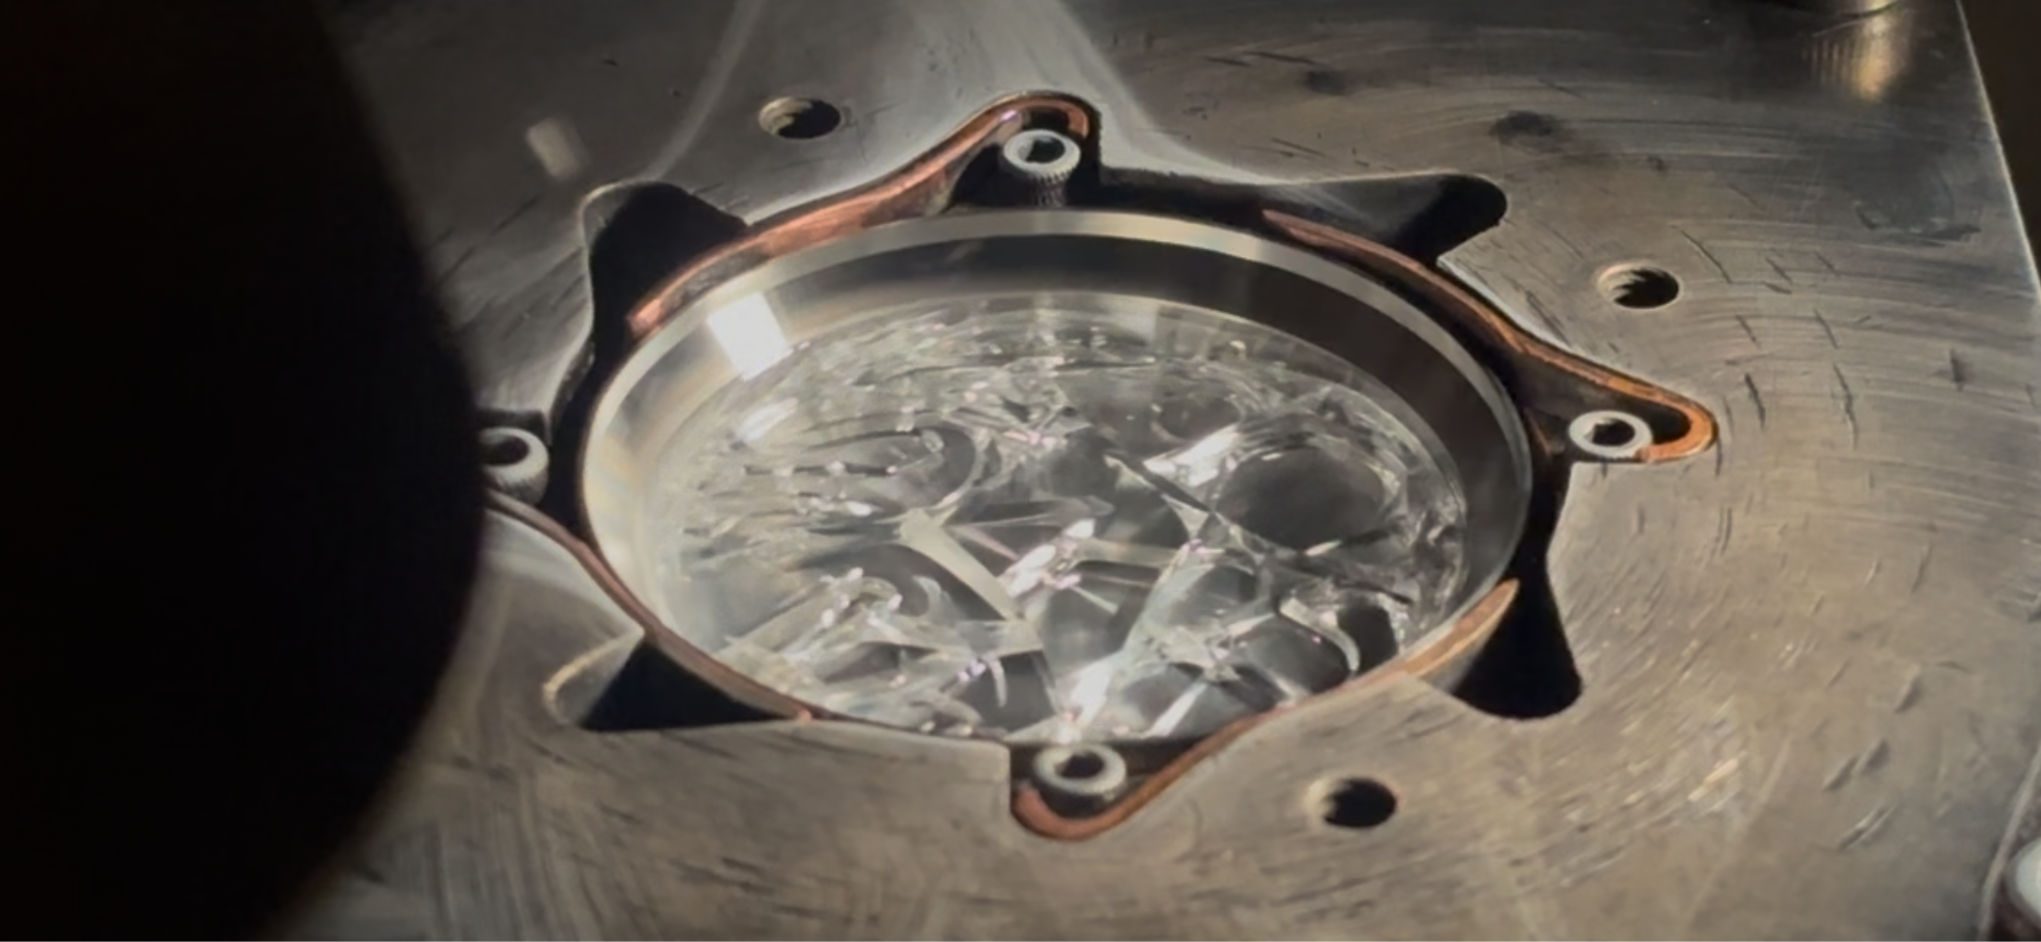
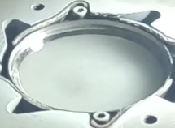
Target Phase
With this target composition:
During deposition under vacuum, the target has been observed transforming from a solid to a gel-like phase
Phase change of the target is not ideal for throughput
This behavior is unexpected and uncontrolled
3 hours of constant pulsed laser ablation
Pre-deposition target (solid)
Post-deposition target (gel)

Slide 6
Target Phase
With this target composition:
During deposition under vacuum, the target has been observed transforming from a solid to a gel-like phase.
Phase change of the target is not ideal for throughput
This behavior is unexpected and uncontrolled
Goal:
Improve RIR-MAPLE consistency and throughput by controlling the target phase over time.
Project Description:
Model RIR-MAPLE deposition using COMSOL Multiphysics to understand the thermal behavior and gel-like phase.
3 hours of constant pulsed laser ablation
Pre-deposition target (solid)
Post-deposition target (gel)

Slide 7
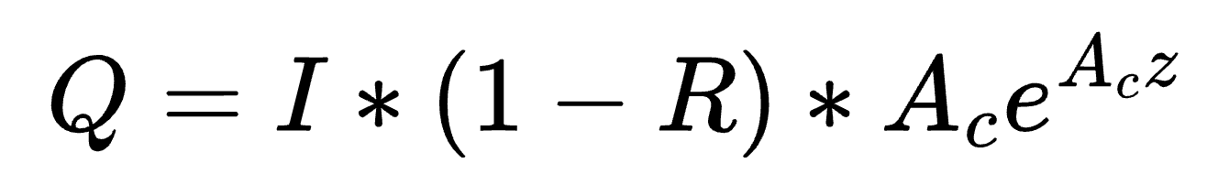
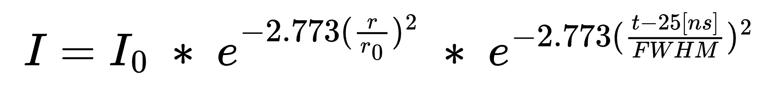
Modeling a Pulsed Laser
Lacatus et al. Proceedings of 2013 Comsol Conference, Rotterdam, 2013
The laser pulses are modeled as heat (Q) deposited in some volume:
Intensity (I), Gaussian in space and time and repeats at the pulse frequency of 2Hz
Reflectivity (R)
Absorption coefficient (A_{c})
z coordinate (z), target surface at z = 0
Intensity:
Maximum intensity (I₀), 1.86e11 W/m²
r coordinate (r), laser incident at r = 0
time (t)
spot size (r₀), 1mm
temporal FWHM, 14ns
Gaussian in space and time

Slide 8
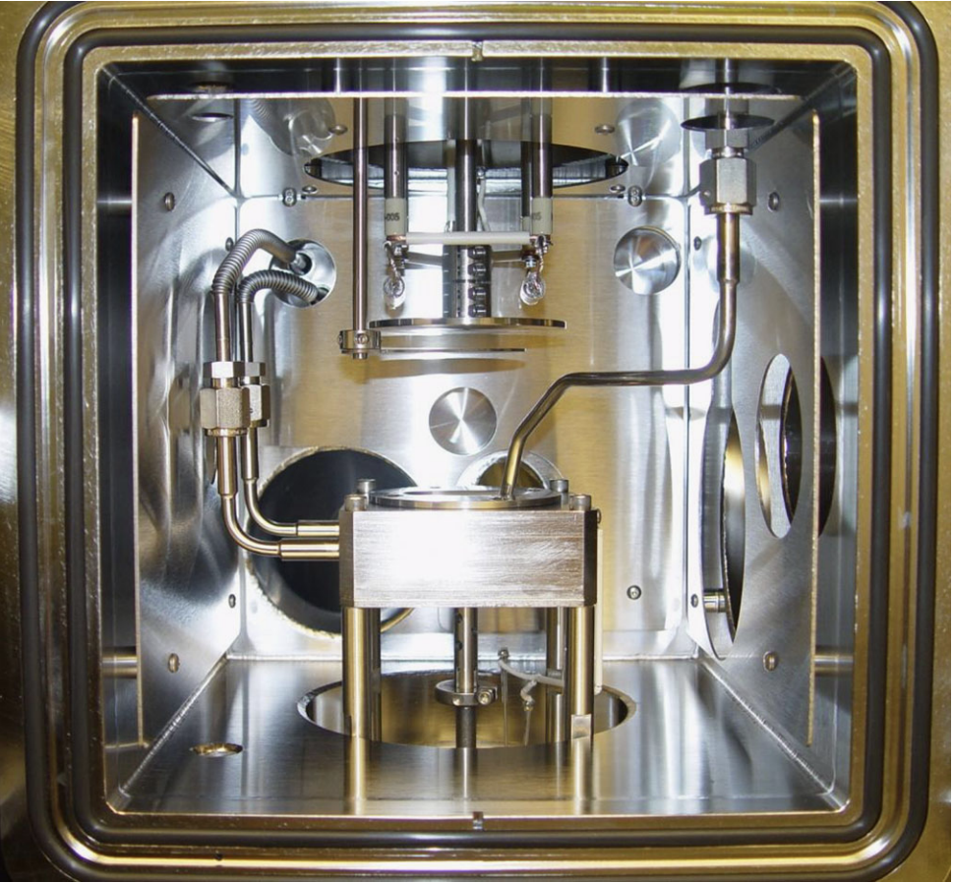
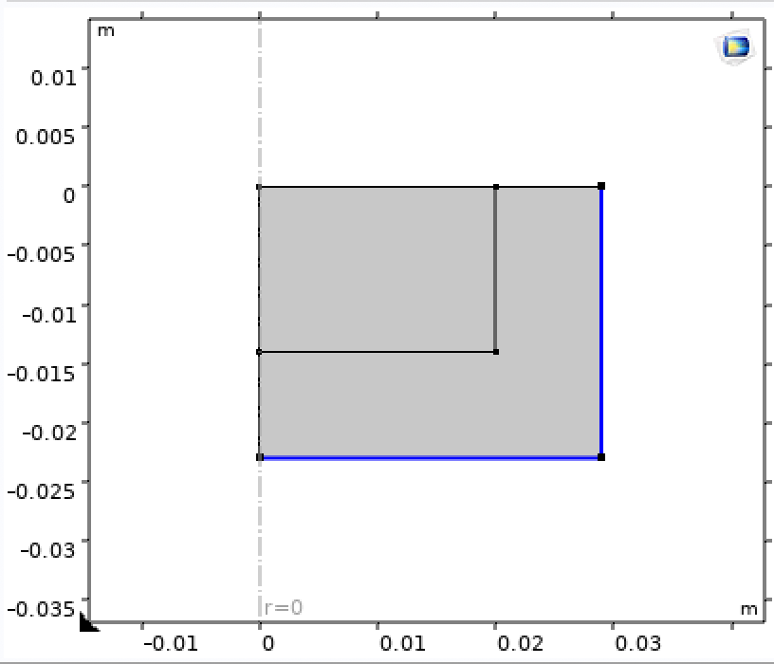
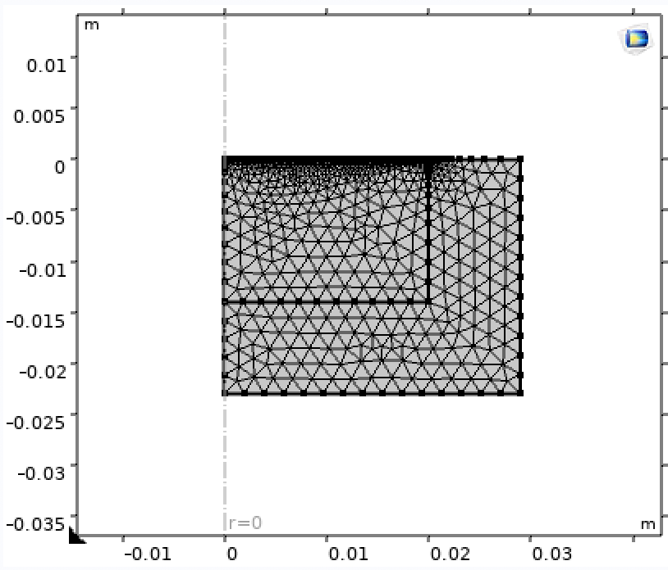
COMSOL Model Development
The chamber is modeled as axisymmetric to reduce computation
Blue boundaries are held at 87K
Meshing and time stepping were optimized to capture the ns pulses
Model geometry:
target holder and housing
Full chamber
Meshed geometry
target
stainless steel
Greer, J. A. Applied Physics A 2011, 105 (3), 661–671.

Slide 9
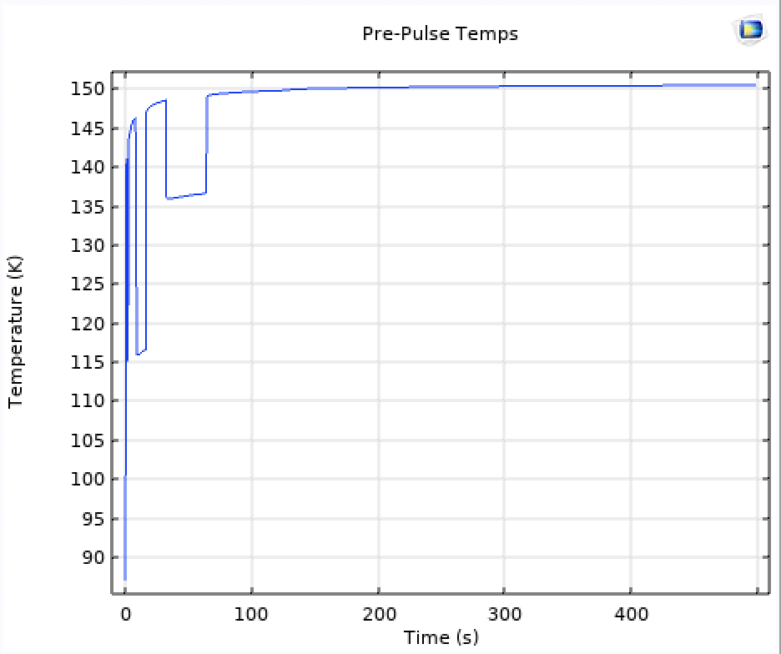
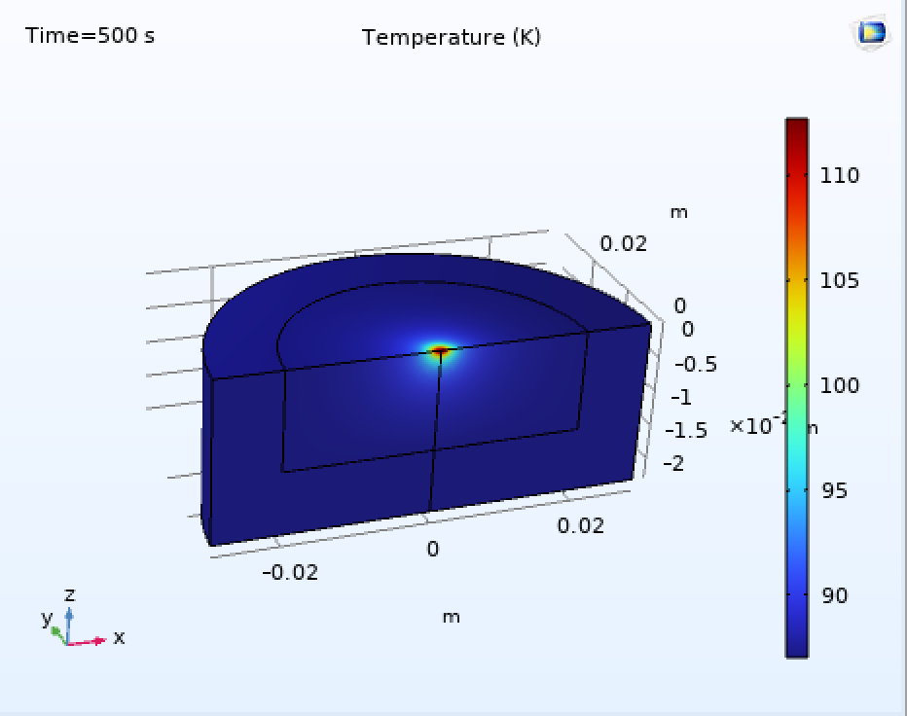
Heat Build-Up
at r = 0, z = 0
Maximum T ≈ 150K
Parameters used:
Material Property | Value (50/50 MEG/DMSO)
Absorption coefficient | 1565 cm⁻¹ [1,2]
Reflectivity | 0.031 [2]
Heat Capacity | 1004 J/(kg*K) [3,4]
Thermal Conductivity | 0.20 W/(m*K) [5,6,7]
Density | 1.07 g/cm³ [8,9,10]
Temperature over time
(first ~8 minutes of deposition)
Thermal profile after 1000 pulses (~8 minutes of deposition)
Significant heat build-up throughout deposition is likely.

Slide 10
A Glassy Target
Our solvents are strong glass formers.
liquid
liquid
Critical Cooling Rate (R_{c})
Cooling rates higher than R_{c} will bypass crystal nucleation and allow vitrification (glass formation) to occur.
cooling at R ≤ R_{c}
cooling at R > R_{c}
Characteristics of glass:
Amorphous, nonequilibrium nature of a liquid, physical properties of a solid
May not behave consistently with time and temperature changes during deposition
  relaxation, melting
crystalline solid:
packed in a
stable lattice
glassy solid:
the liquid phase
“frozen in time”
Wowk, B. Cryobiology 2010, 60 (1), 11–22.

Slide 11
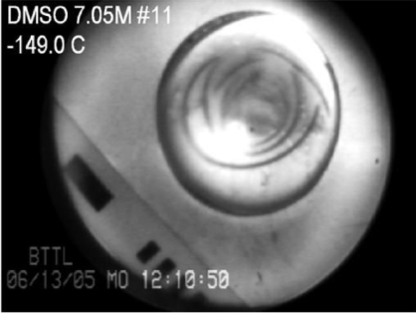
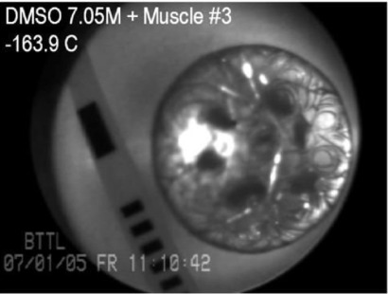
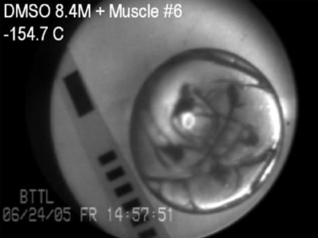
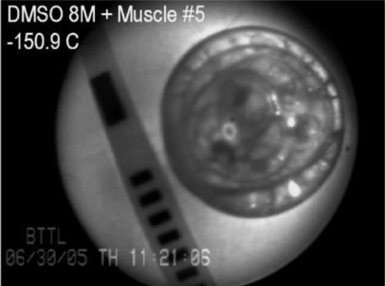
Visual Evidence of a Glassy Target
Our 50/50 MEG/DMSO target after freezing, pre-deposition
Glassy DMSO from literature
curved, irregular fractures
transparent appearance
Rabin et al. Cryobiology 2006, 53 (1), 75–95.

Slide 12
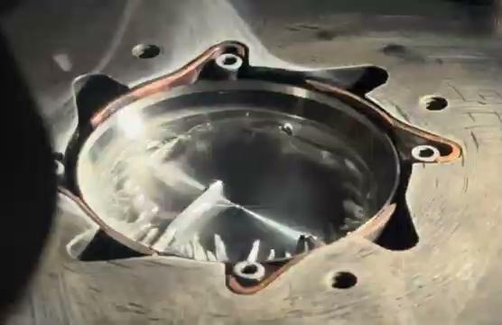
Vitrification

Slide 13
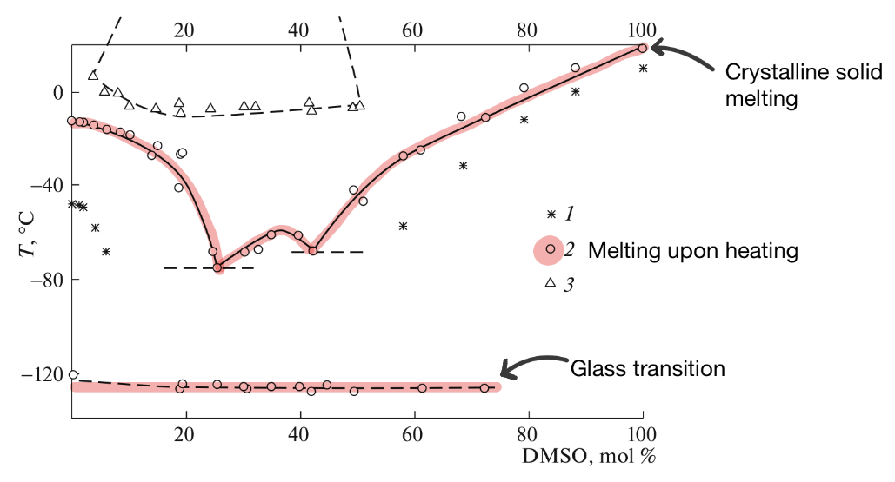
Glassy vs. Crystalline Solvents
MEG/DMSO Phase Diagram
Hypothesis: A crystallized target would remain solid despite heat build-up throughout deposition.
Solonina et al. Russian Journal of Physical Chemistry A 2018, 92 (5), 918–921.

Slide 14
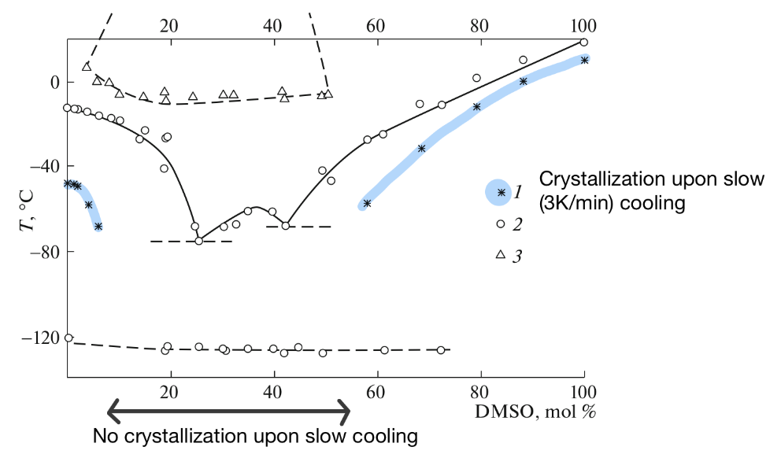
Optimizing Solvent Ratio
MEG/DMSO Phase Diagram
Hypothesis: A crystallized target would remain solid despite heat build-up throughout deposition.
Increasing DMSO should encourage crystallization.
our standard 50/50 volume ratio
Solonina et al. Russian Journal of Physical Chemistry A 2018, 92 (5), 918–921.

Slide 15
Optimizing Solvent Ratio
MEG/DMSO Phase Diagram
Hypothesis: A crystallized target would remain solid despite heat build-up throughout deposition.
Increasing DMSO should encourage crystallization.
Differential Scanning Calorimetry (DSC) to find R_{c} for different solvent ratios of MEG/DMSO (solvents only to avoid exposure to lead in precursors).
our standard 50/50 volume ratio
Solonina et al. Russian Journal of Physical Chemistry A 2018, 92 (5), 918–921.

Slide 16
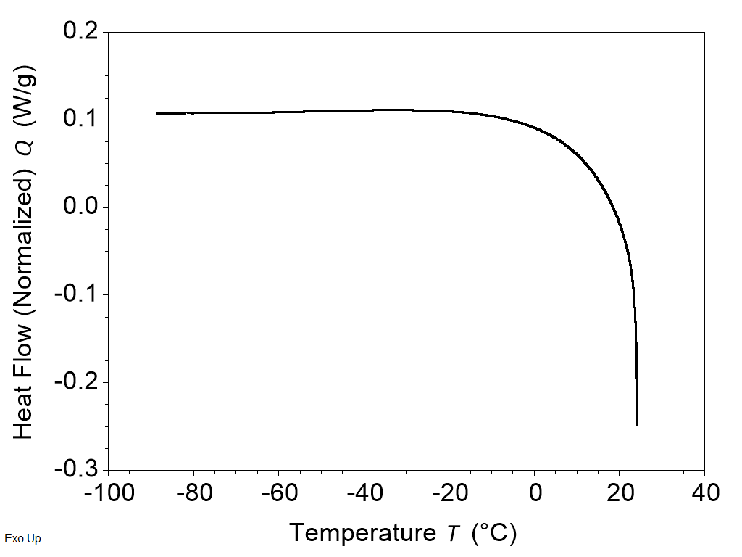
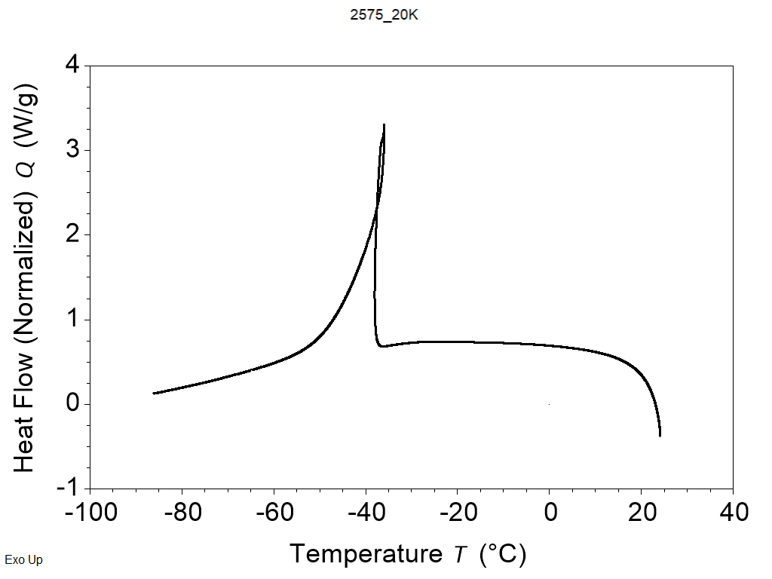
Differential Scanning Calorimetry
Solvents only
Samples were subjected to increasing cooling rates (3, 5, 10, 15, … , 40K/min) until crystallization was no longer observed.
Volume Ratio MEG/DMSO | R_{c} (K/min)
95/5 | 10-15
50/50 | No crystallization
40/60 | No crystallization
35/65 | 10-15
30/70 | 40+
25/75 | 40+
20/80 | 40+
DSC heat flow curve showing no crystallization in 50/50 at 3K/min
DSC heat flow curve showing crystallization peak in 25/75 at 20K/min
Ratios with R_{c} ＞ 10-20°K/min (our cooling rate) are likely well suited for crystallization.
25/75 was tested in a target used for deposition.
Our cooling rate: 10-20°K/min

Slide 17
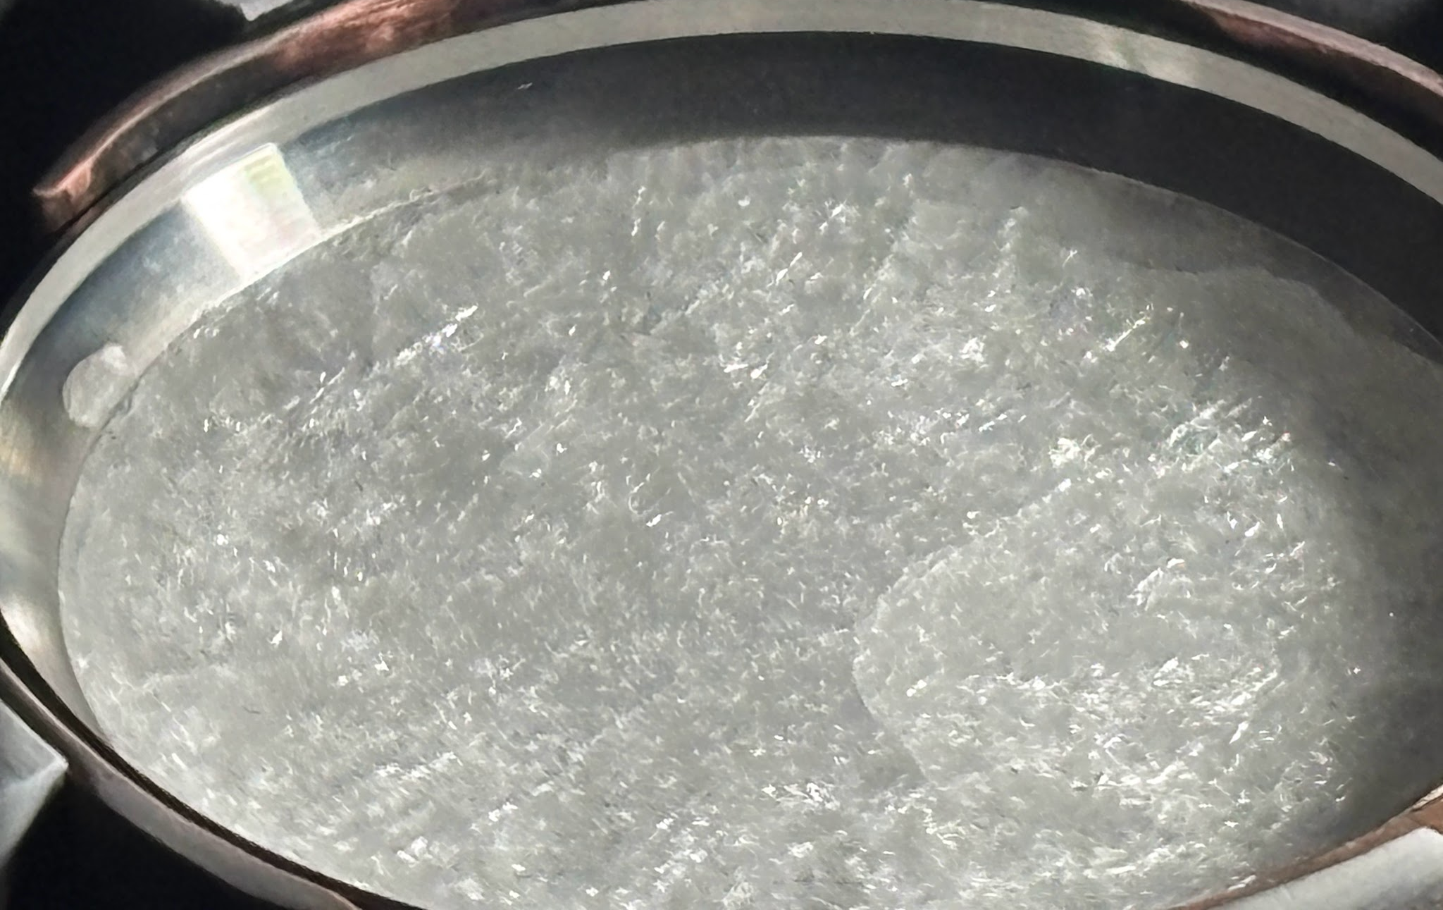
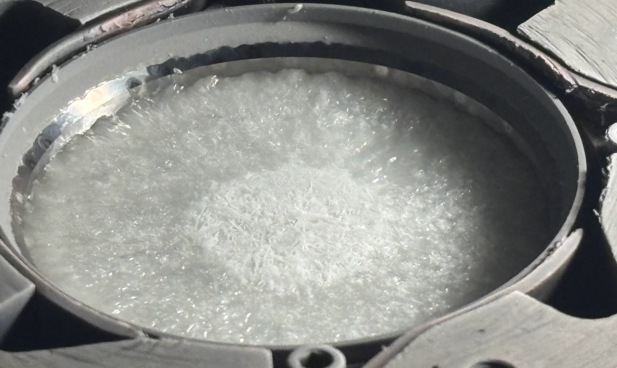
Deposition with an Optimized Solvent Ratio
Target composition: 25/75 MEG/DMSO by volume + precursors
3 hours of constant pulsed laser ablation
Pre-deposition target (solid)
Post-deposition target (solid!)
The optimized target composition successfully crystallized during freezing and remained solid throughout deposition.

Slide 18

Crystallization
2x speed

Slide 19
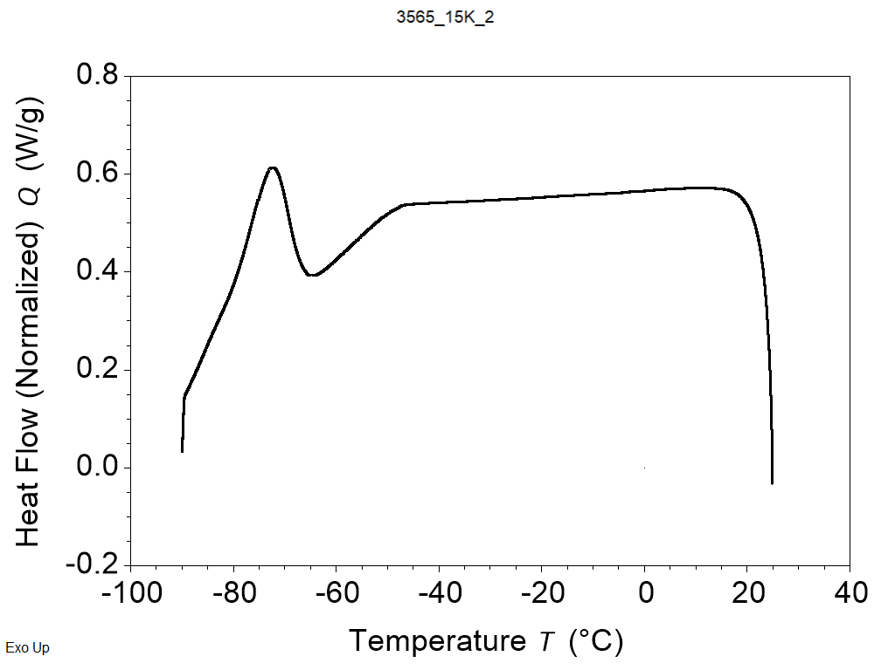
Intermediate Ratios
Solvents only
Films deposited from a 25/75 solvent ratio showed smaller grain sizes than those from 50/50
Intermediate ratios may still give a crystalline target while increasing grain size
Intermediate ratios gave weaker crystallization peaks than 25/75
Volume Ratio MEG/DMSO | R_{c} (K/min) | Deposited Film Grain Size (nm)
95/5 | 10-15
50/50* | No crystallization | 130-136
40/60 | No crystallization
35/65 | 10-15
30/70 | 40+
25/75* | 40+ | 131-170
20/80 | 40+
weakly crystallizing 35/65 at 15K/min
*tested with deposition
Our cooling rate: 10-20°K/min
(Depends on freezing gas)

Slide 20
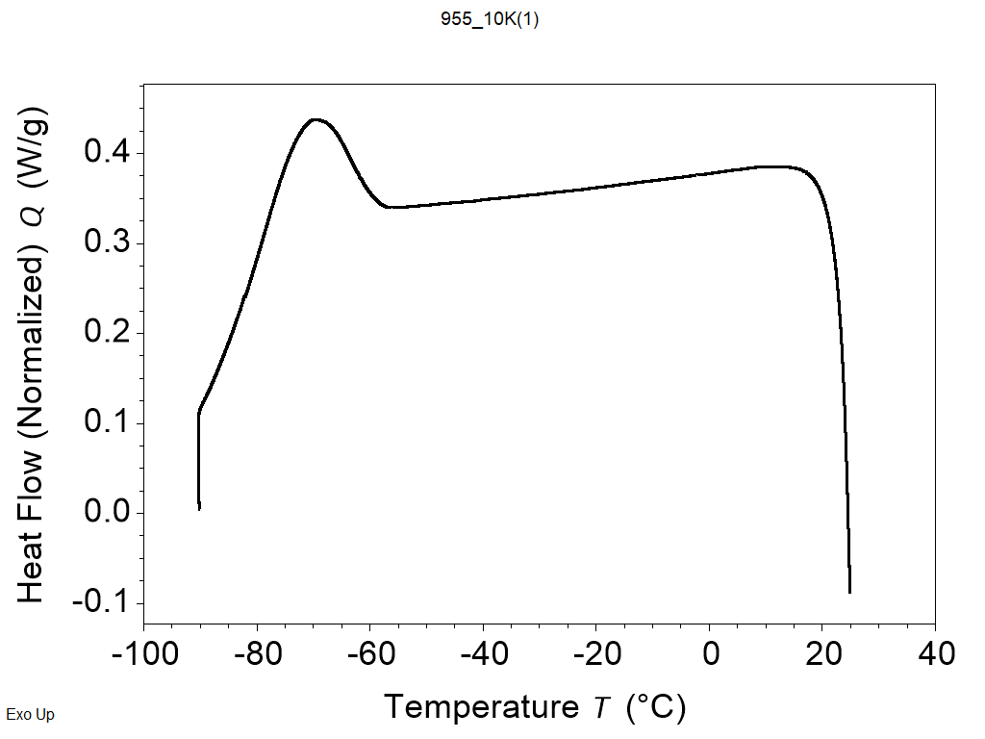
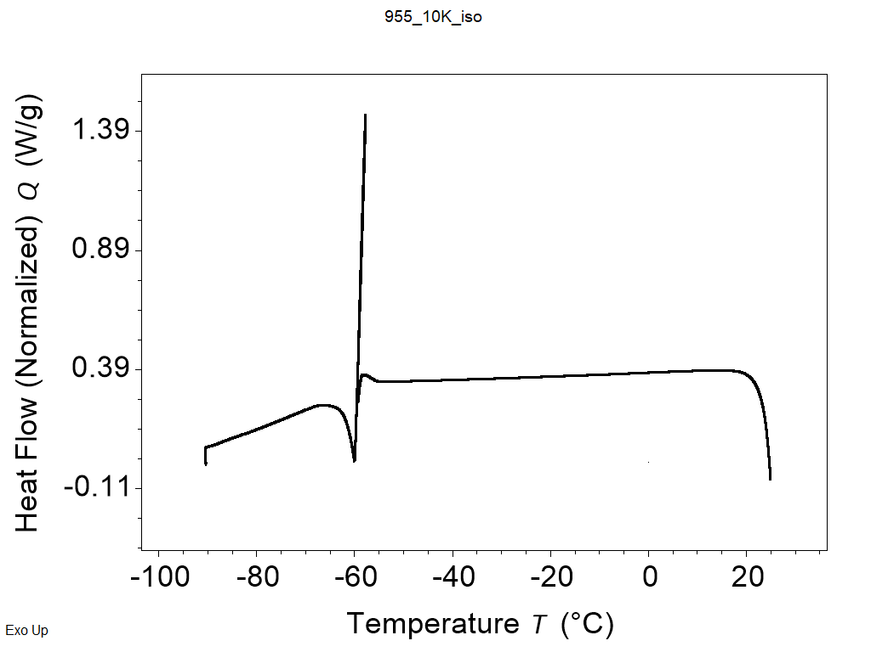
Isothermal Crystallization
95/5 at 10K/min
No pause: weak crystallization
10 min pause at -60C: strengthened crystallization
This technique could be incorporated into the cooling procedure to strengthen crystallization in intermediate ratios.

Slide 21
Summary
50/50 MEG/DMSO
The target was observed transforming into a gel during deposition, an uncontrolled behavior.
The cause was identified as forming a glassy target instead of crystalline during freezing.
A target with an optimized solvent ratio successfully crystallized and remained solid throughout deposition.
The results of this work will allow us to better control the target stability through the solvent ratio parameter.
Pre-deposition glassy target (solid)
Post-deposition target (gel)
25/75 MEG/DMSO
Pre-deposition crystalline target (solid)
Post-deposition crystalline target (solid)

Slide 22
Future
Volume Ratio MEG/DMSO | R_{c} [K/min]
95/5 | 10-15
50/50 | No crystallization
40/60 | No crystallization
35/65 | 10-15
30/70 | 40+
25/75 | 40+
20/80 | 40+
RIR-MAPLE deposition from intermediate ratios should be carried out to look for increased grain size.
  An isothermal pause in the cooling procedure could be utilized to strengthen crystallization of intermediate ratios.
The COMSOL model should be developed further to explore how chamber conditions (background gas and pressure) affect the target.

Slide 23
Thank You!
I would like to thank my mentor, Joshua O. Ayeni, and my P.I., Dr. Adrienne D. Stiff-Roberts, for their support and guidance throughout this project.
Please reach out to me: ffwolfer@ncsu.edu
This material is based upon work which is supported by the National Science Foundation (award numbers 2447827, 2447828, 2447829, ECCS-2025064, and NSF CMMI-2227551). Any opinions, findings, and conclusions or recommendations expressed in this material are those of the author(s) and do not necessarily reflect the views of the National Science Foundation.

Slide 24
References - Material Properties
Refractive index of C2H4(OH)2 (Ethylene glycol) - Otanicar. Refractiveindex.info. https://refractiveindex.info/?shelf=organic&book=ethylene_glycol&page=Otanicar (accessed 2026-07-27).
Informatics, N. O. D. Dimethyl Sulfoxide. https://webbook.nist.gov/cgi/cbook.cgi?ID=C67685&Type=IR-SPEC&Index=4#IR-SPEC (accessed 2026-07-27).
Clever, H. L.; Westrum, E. F. Dimethyl Sulfoxide and Dimethyl Sulfone. Heat Capacities, Enthalpies of Fusion, and Thermodynamic Properties. The Journal of Physical Chemistry 1970, 74 (6), 1309–1317. https://doi.org/10.1021/j100701a027.
Takeda, K.; Yamamuro, O.; Tsukushi, I.; Matsuo, T.; Suga, H. Calorimetric Study of Ethylene Glycol and 1,3-propanediol: Configurational Entropy in Supercooled Polyalcohols. Journal of Molecular Structure 1999, 479 (2–3), 227–235. https://doi.org/10.1016/s0022-2860(98)00873-4.
Ehrlich, L. E.; Feig, J. S. G.; Schiffres, S. N.; Malen, J. A.; Rabin, Y. Large Thermal Conductivity Differences between the Crystalline and Vitrified States of DMSO with Applications to Cryopreservation. PLOS ONE 2015, 10 (5), e0125862. https://doi.org/10.1371/journal.pone.0125862.
Alharbi, S.; Kumar, K. Thermal Conductivities of Ethylene Glycol, Propylene Glycol, and Glycerol. ASME Journal of Heat and Mass Transfer 2025, 147 (9). https://doi.org/10.1115/1.4068565.
Zhang, H.; Zhao, G.; Ye, H.; Ge, X.; Cheng, S. An improved hot probe for measuring thermal conductivity of liquids. Measurement Science and Technology 2005, 16(7), 1430-1435.
Egorov, G. I.; Makarov, D. M. The Bulk Properties of Ethylene Glycol-Dimethylsulfoxide Mixtures over the Temperature Range 278–323 K at P = 0.1 MPa. Russian Journal of Physical Chemistry A 2008, 82 (10), 1778–1784. https://doi.org/10.1134/s003602440810021x.
Lunkenheimer, P.; Loidl, A.; Riechers, B.; Zaccone, A.; Samwer, K. Thermal Expansion and the Glass Transition. Nature Physics 2023, 19 (5), 694–699. https://doi.org/10.1038/s41567-022-01920-5.
Solanki, P. K.; Rabin, Y. Perspective: Temperature-Dependent Density And Thermal Expansion Of Cryoprotective Agents. Cryoletters 2022, 43 (1), 1–9. https://doi.org/10.54680/fr22110110112.

Slide 25
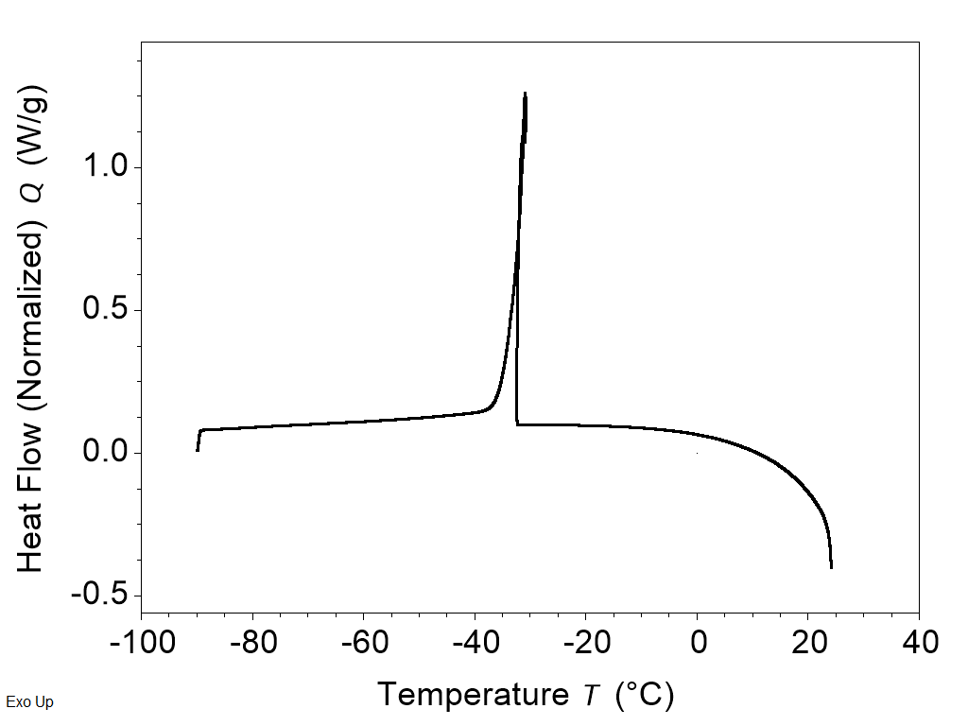
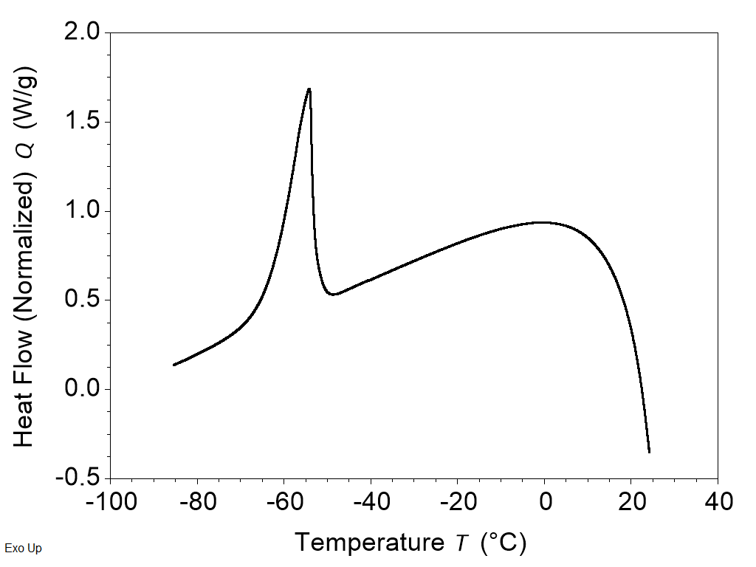
Cooling Rate vs. Crystallization
25/75 at increasing cooling rates
3K/min
20K/min
40K/min
weakening crystallization

Slide 26
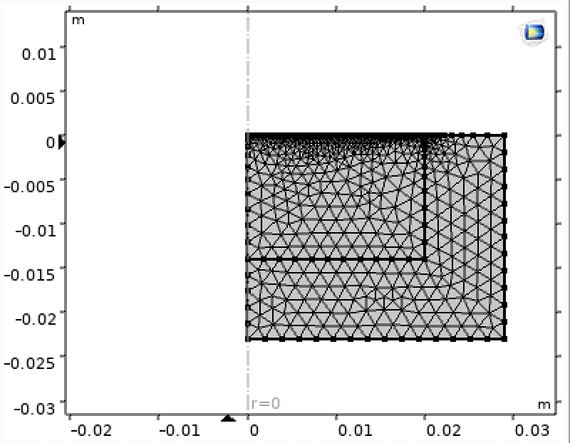
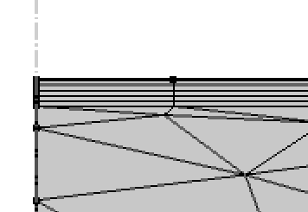
Model Optimization
general element size
total boundary thickness
# boundary layers
boundary element width
The time step must be fine enough to capture the 14ns pulse but coarse enough to span the 0.5s between pulses without unnecessary computational expense.
Meshing and time stepping were optimized to capture the pulses

Slide 27




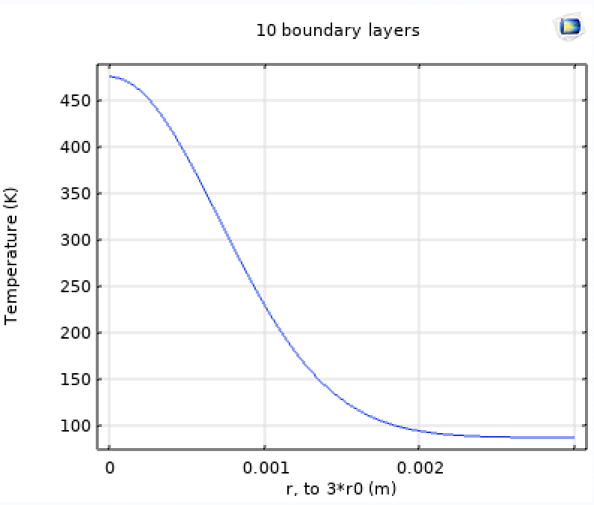
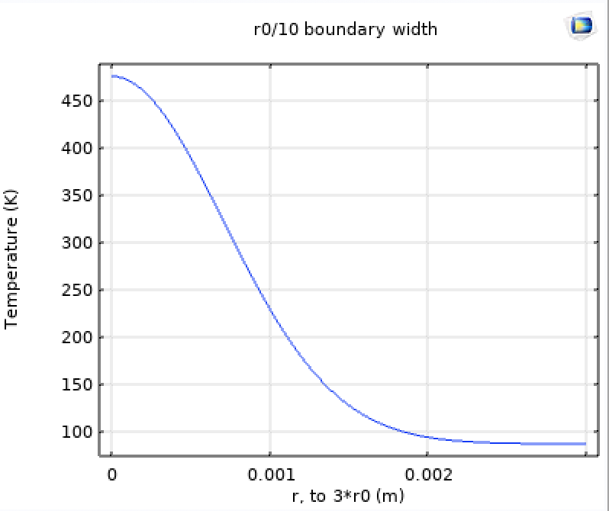
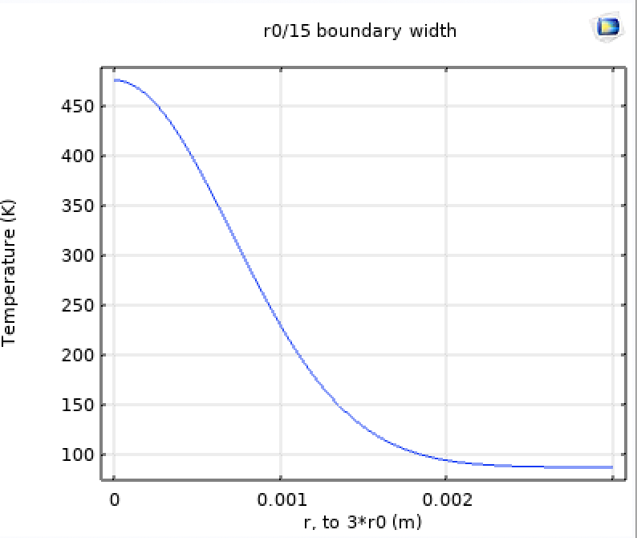
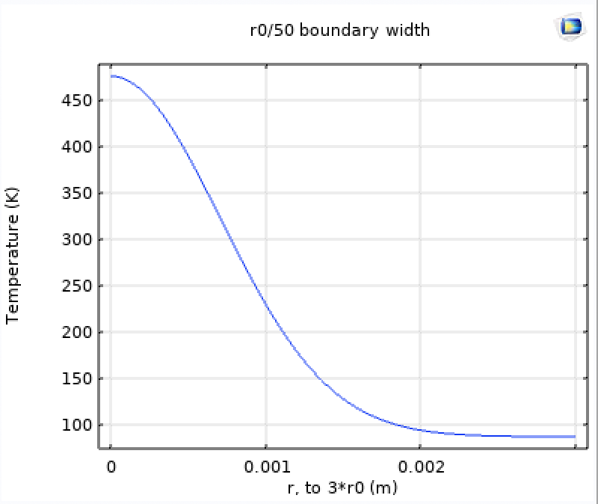
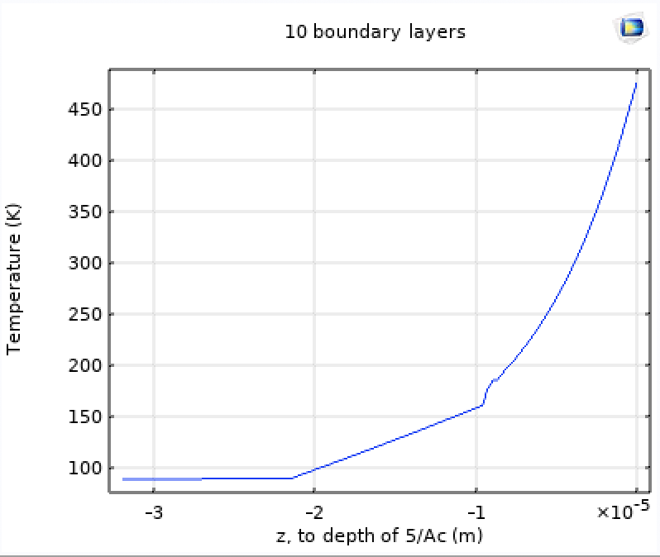
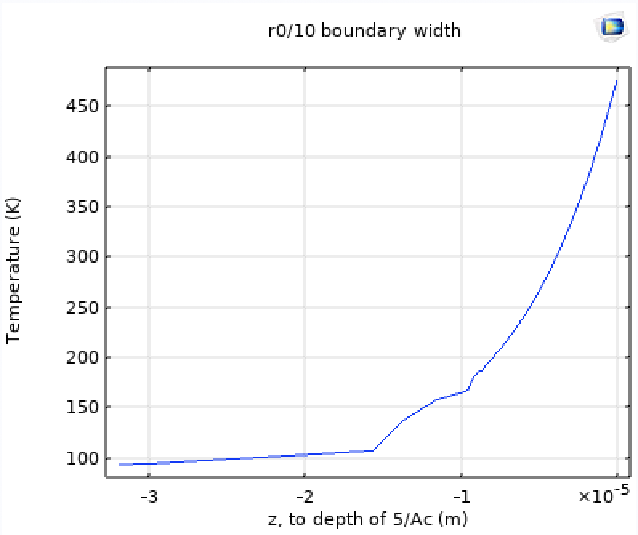
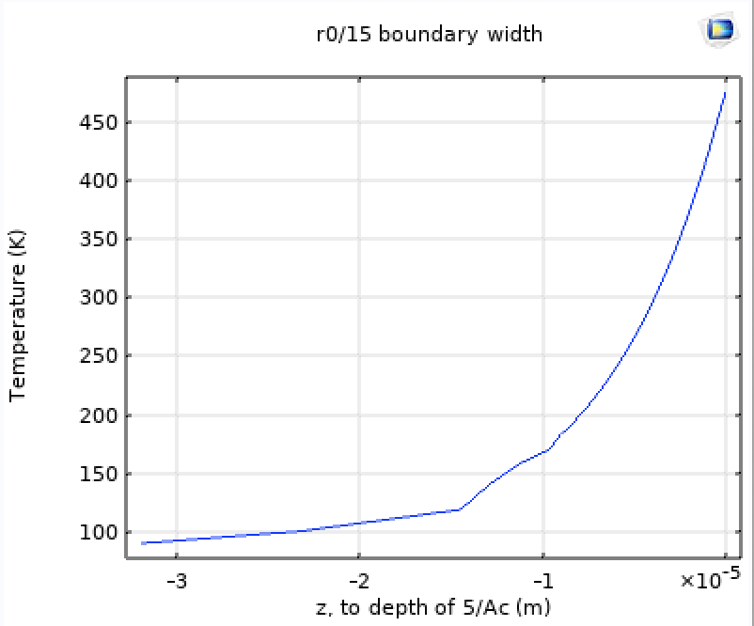
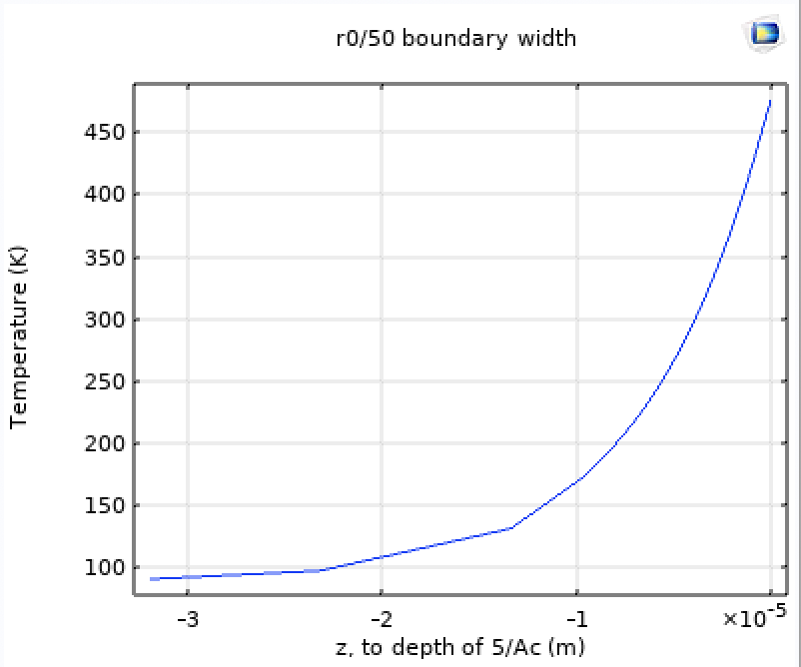
Optimization Study Example
boundary width: r₀/5
DOF solved for: 7,200
boundary width: r₀/10
DOF solved for: 14,000
boundary width: r₀/15
DOF solved for: 20,500
boundary width: r₀/50
DOF solved for: 70,000
first-pulse temp
radial
z-axis

