Slide 1


Development of 3D Printed Stamps for Extracellular Nitric Oxide Gradient Quantification via Single Walled Carbon Nanotubes
Jake Loos, Nicky Tagoe, Nicole Iverson
Department of Biological Systems Engineering University of Nebraska – Lincoln

Slide 2
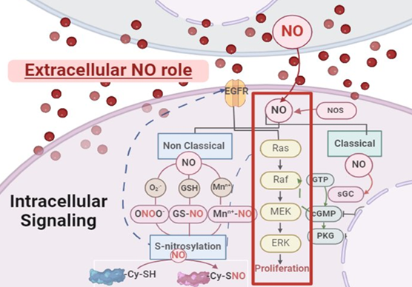

The Role of Nitric Oxide
Nitric Oxide (NO) is a critical signaling molecule within the body. Its effects vary depending on concentration
In MDA-MB-231 cancer cells, NO has been linked to variance in tumor growth, adhesion, and proliferation
Quantification of NO levels can be difficult due to high reactivity and short half life (0.05-1 msec)

Slide 3
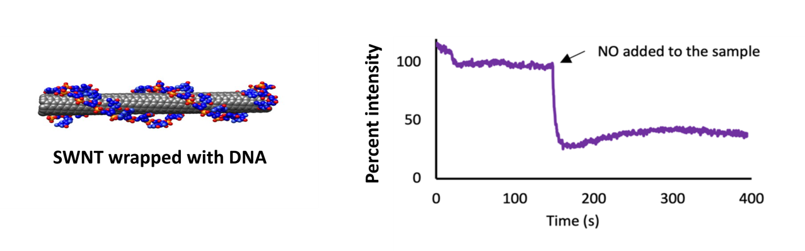

SWNT and Nitric Oxide
Single Walled Carbon Nanotubes (SWNT) when wrapped with (AT)15 quantify NO release in real time via monitoring fluorescence.
Once ambient levels of NO are restored, SWNT fluorescence quickly recovers to baseline levels
However, without a consistent seeding pattern for cells, statistical analysis on NO production is impossible to accurately quantify
Seeding must be delicate enough to not strip the SWNT off their platform

Slide 4
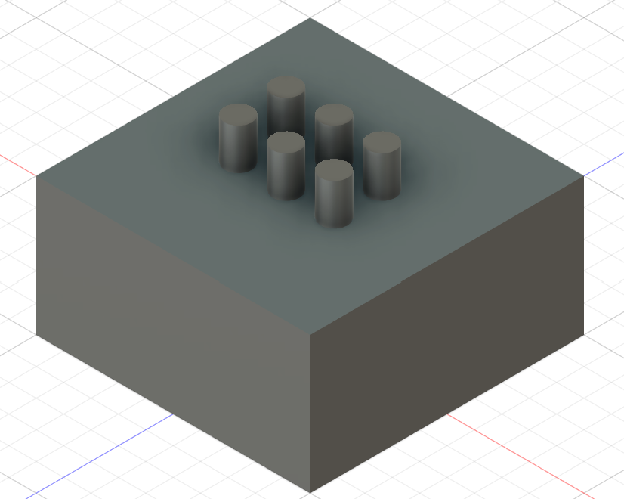
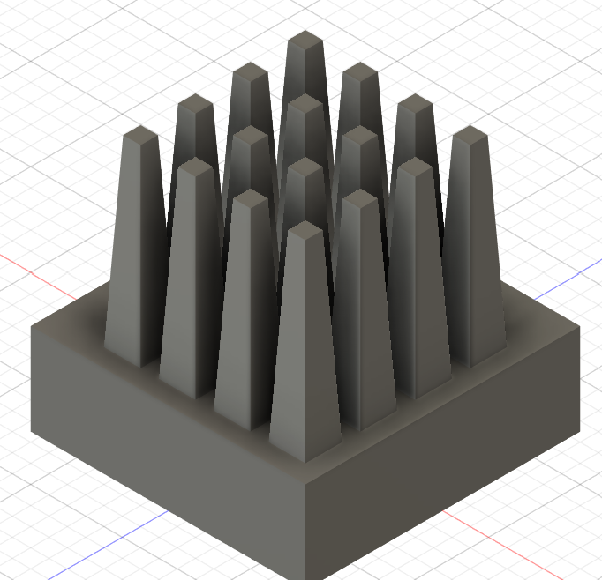
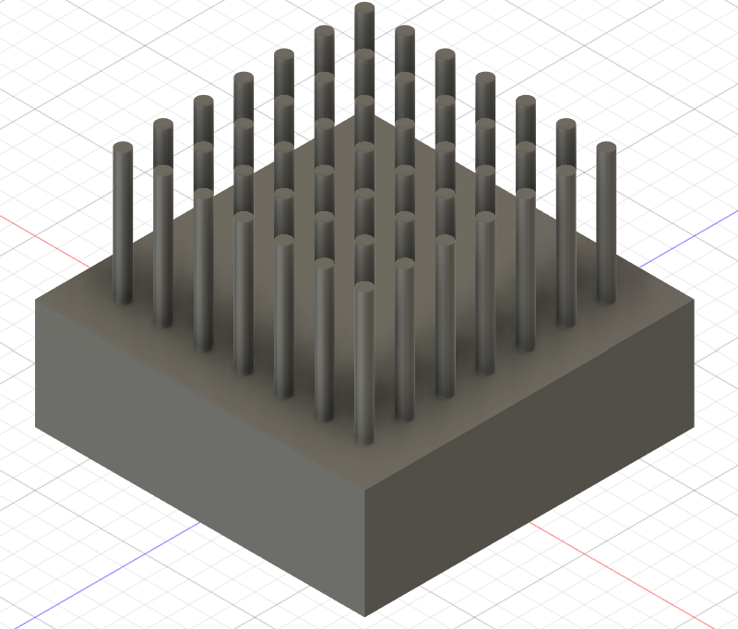
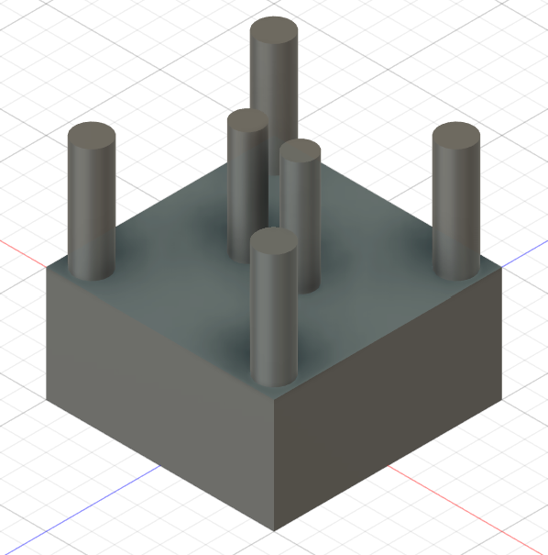
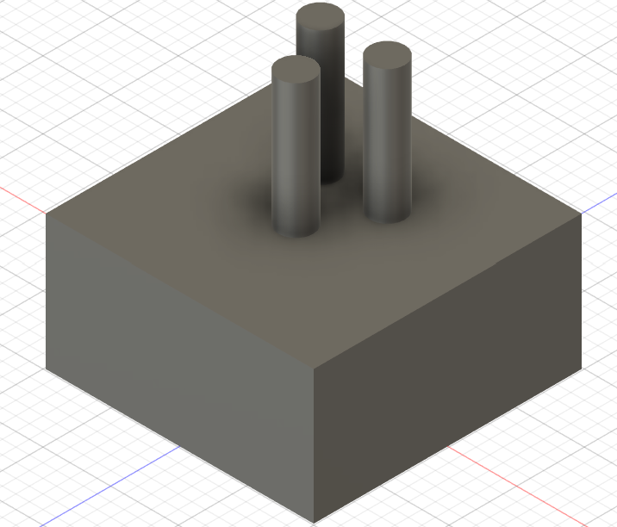
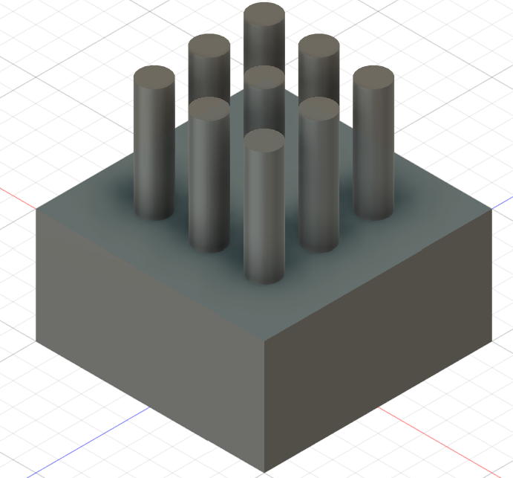
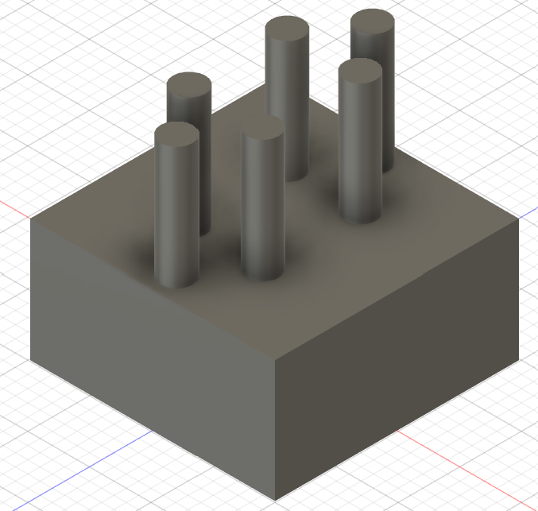
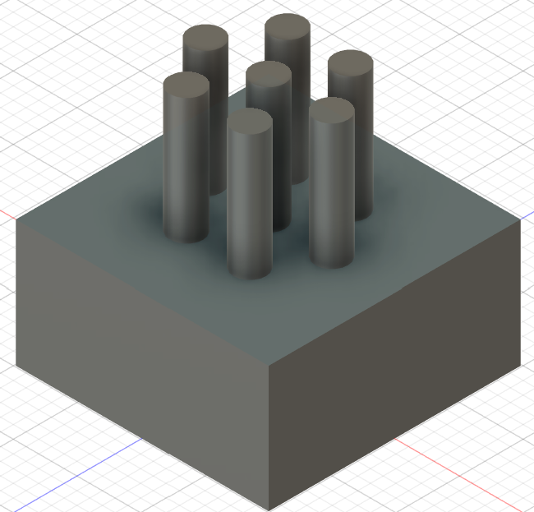
Stamps For Reproducible Analysis
Need a reproducible way to seed cells to analyze data
Based initial designs on our ideas and drawing from literature review
Revised designs to get to the final set of stamps

Slide 5
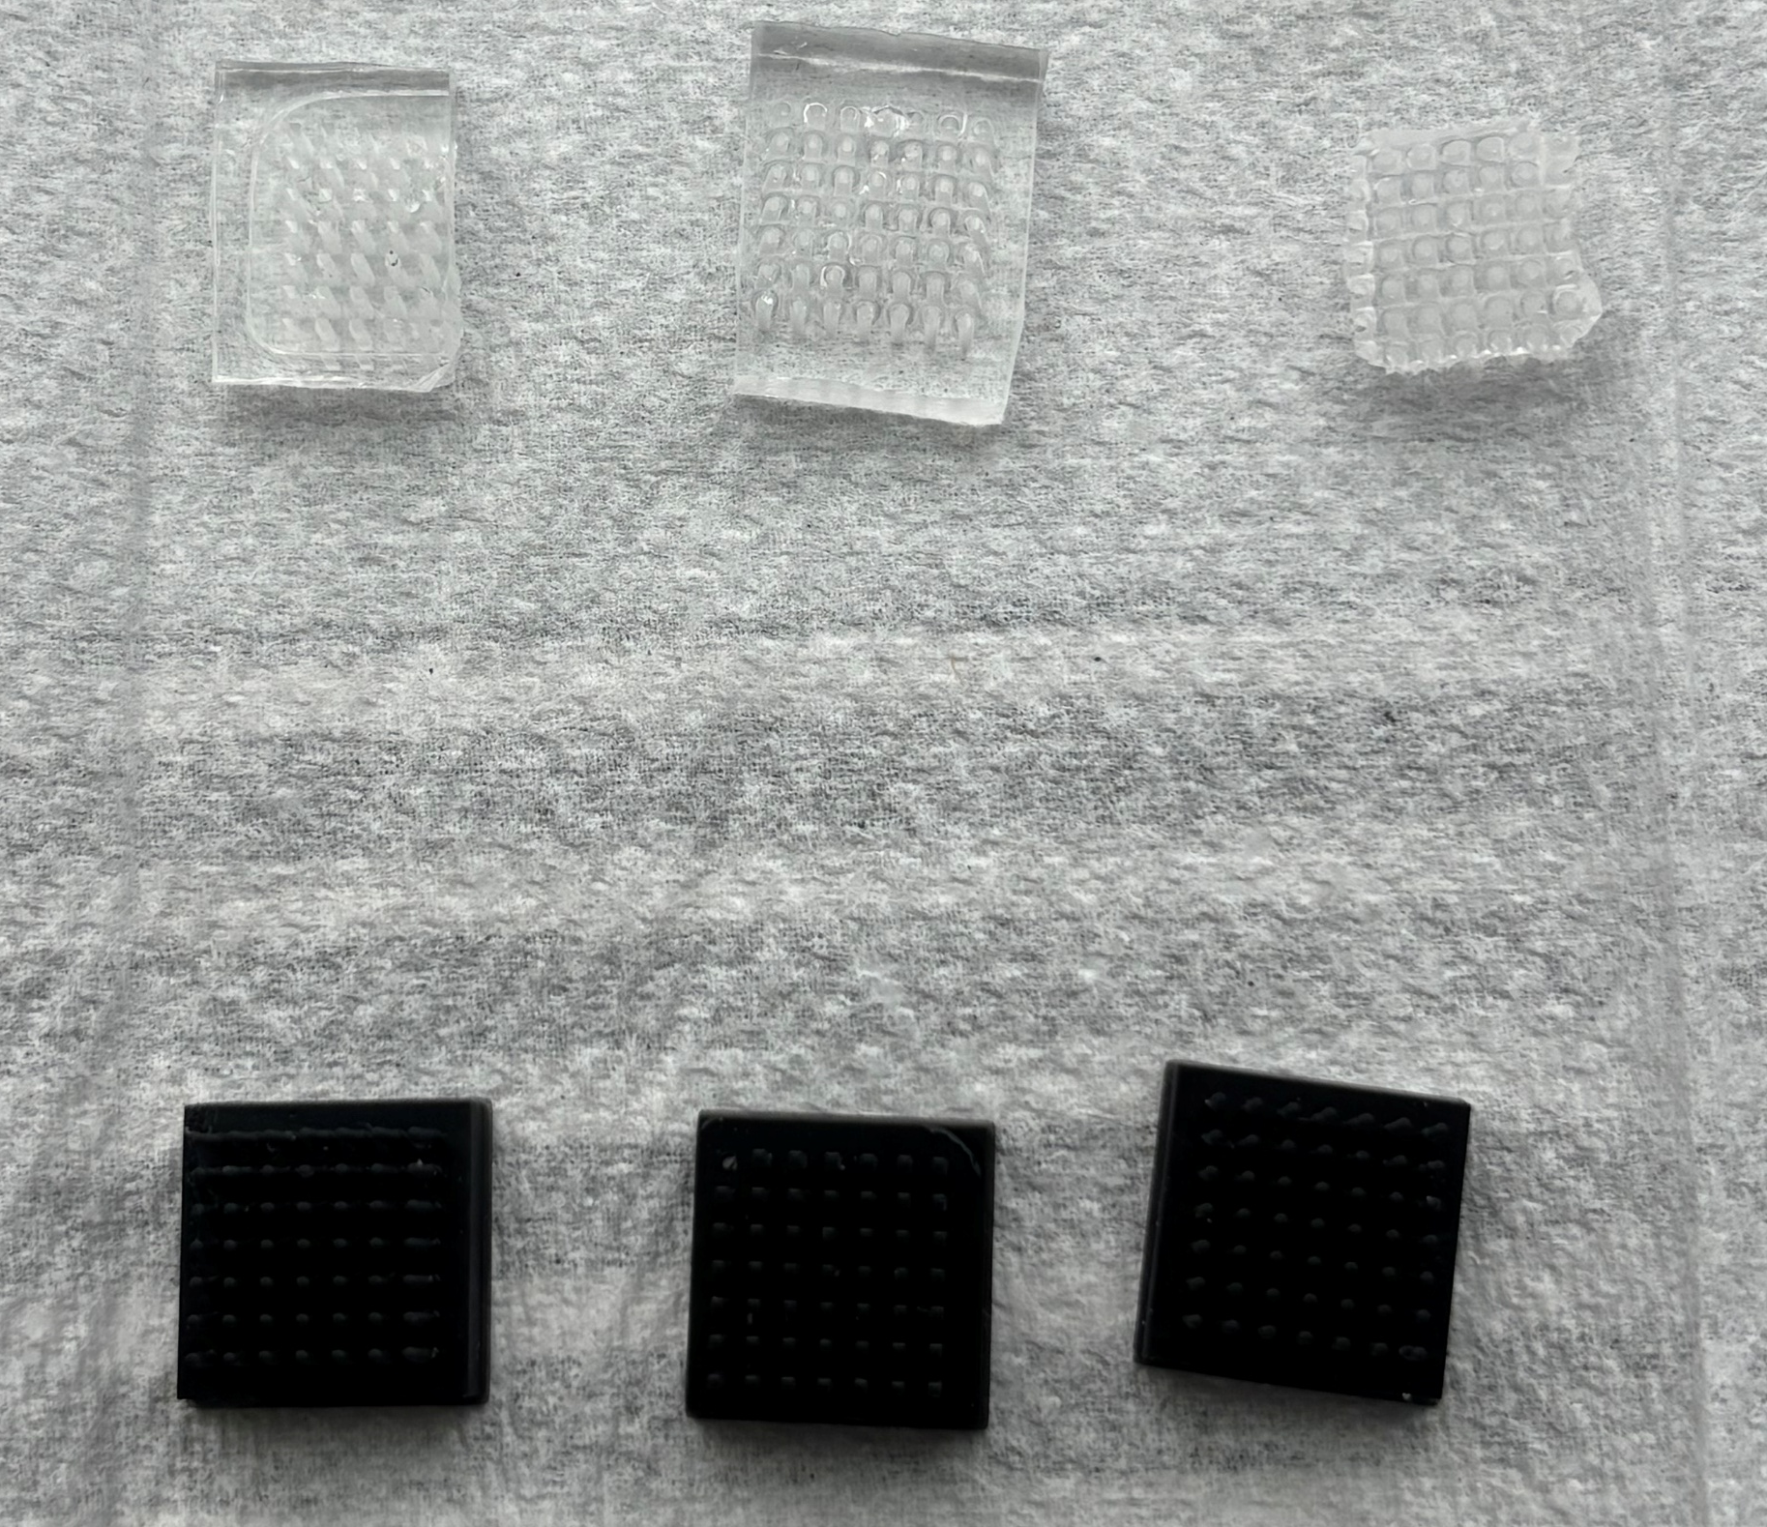
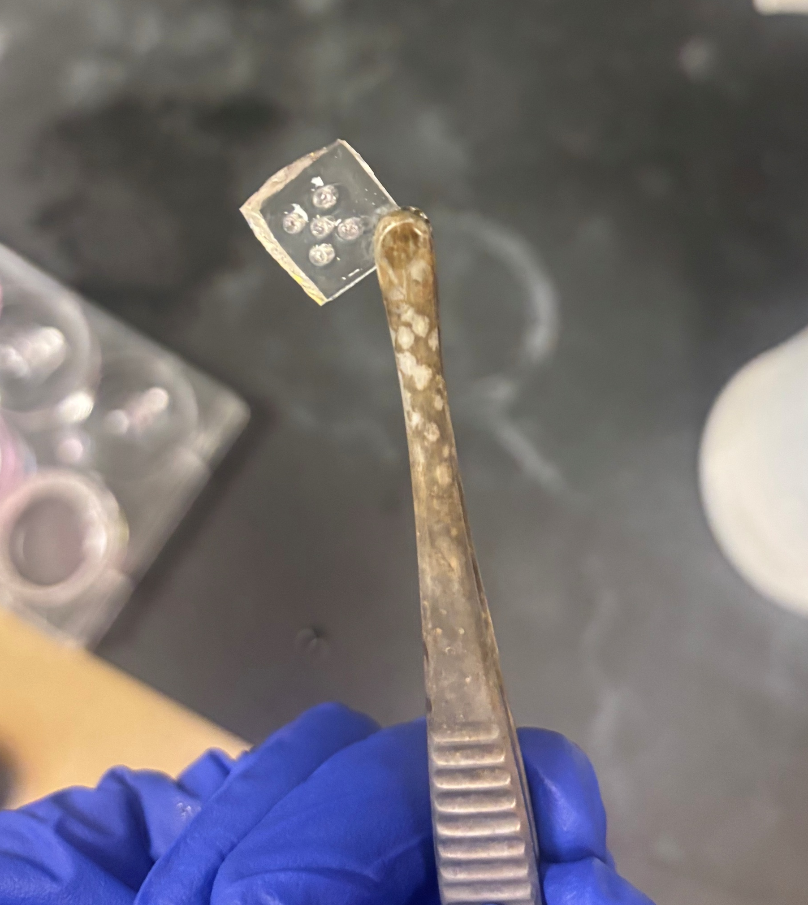
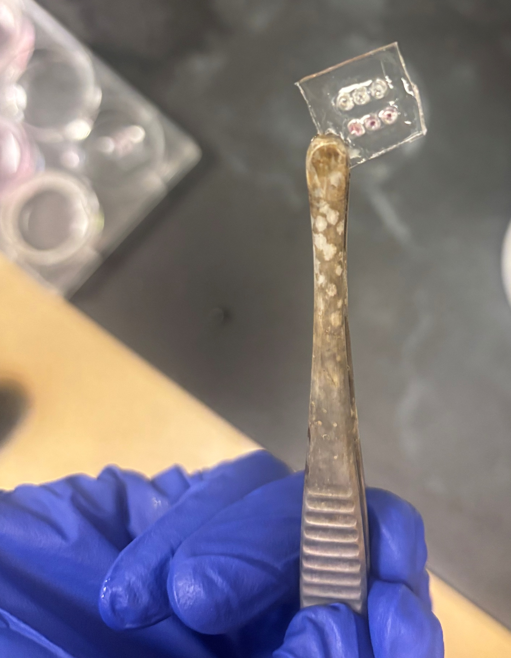
Stamps For Reproducible Analysis (cont.)

Slide 6
Optimizing Stamp Well Spacing
Interwell spacing was a key consideration in stamp design
  Too little, and the wells didn’t properly form
  Too far, and they were difficult to view together
Other factors affecting well formation were stamp material, PDMS depth, and number of wells

Slide 7
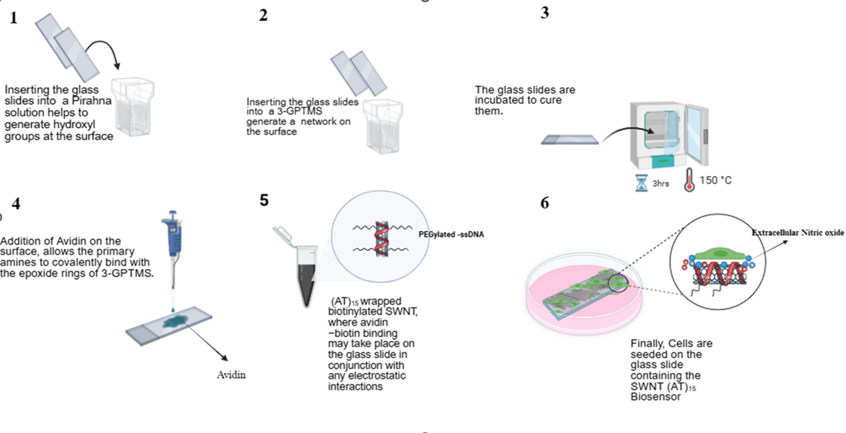
Fabricating SWNT Platforms

Slide 8
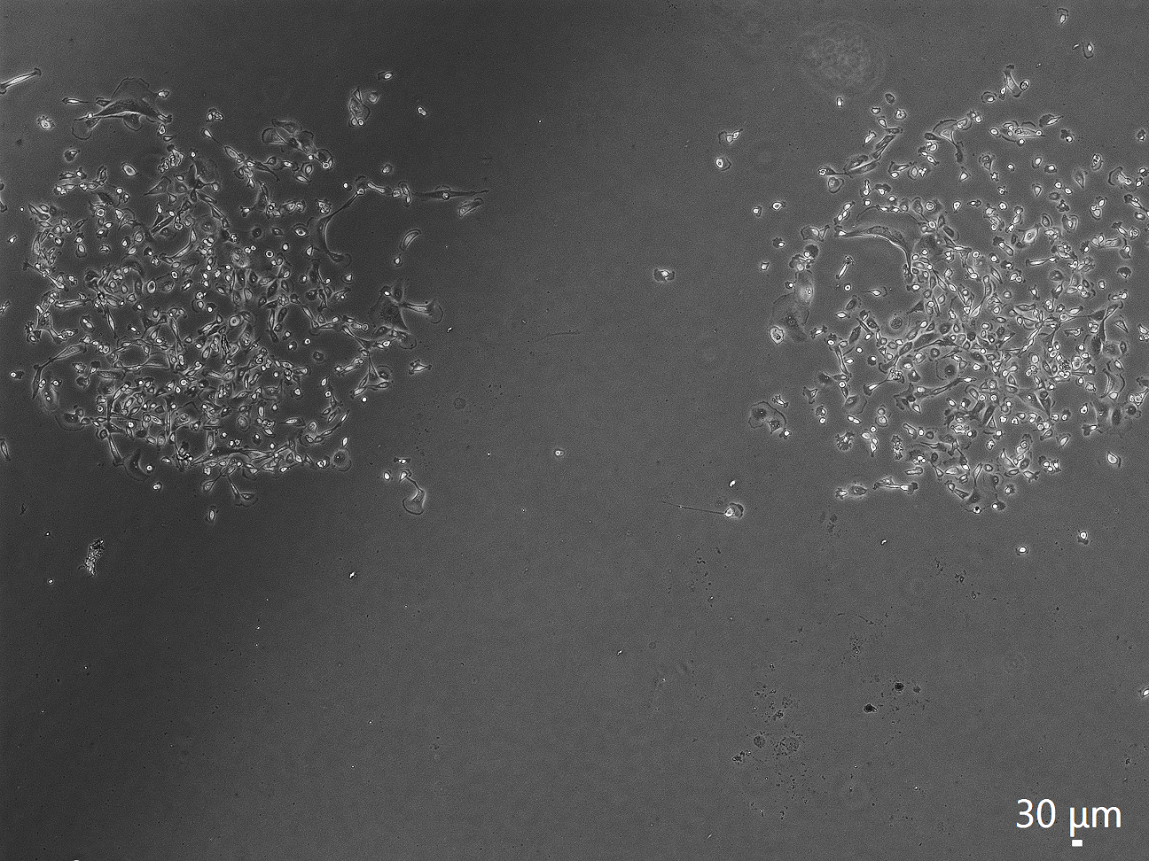
Seeding Cells in PDMS Substrates Onto Platforms
Reduced depth
Once PDMS substrates were made, the next step was seeding cells
Issues arose with PDMS well depth
  Too thick, and the cells wouldn’t seed
By reducing the PDMS thickness to about 1 mm, seeding was greatly improved
Seeding in wells!

Slide 9
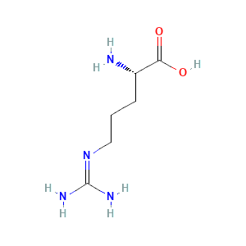
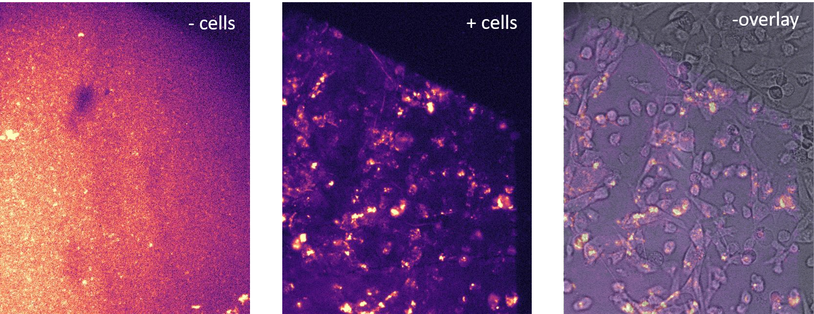
Inducing NO production with L-Arginine
L-Arginine can be used to induce NO production
Ran trials at 2 mM, 4 mM, and 6 mM to determine ideal amount for MDA-MB-231 cells
Found at all concentrations cells survived, with highest NO production coming from 6 mM

Slide 10
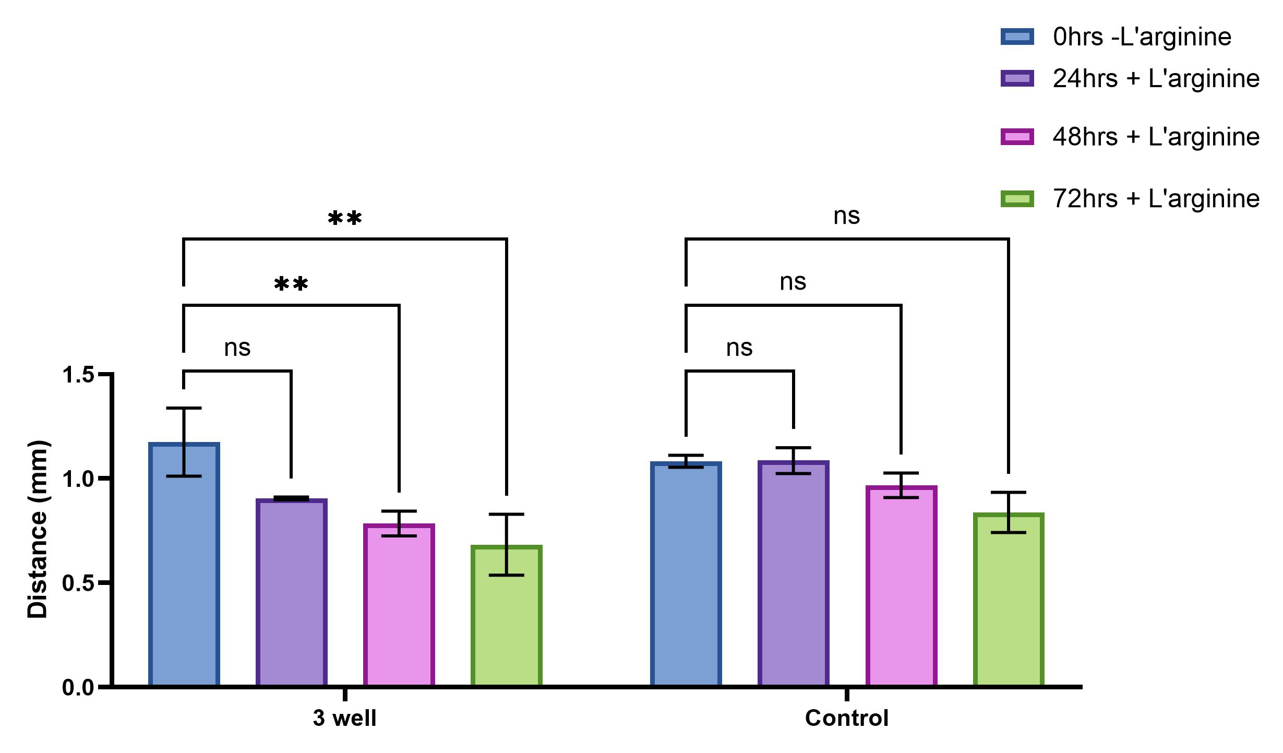
L-Arginine Treatment Trials

Slide 11
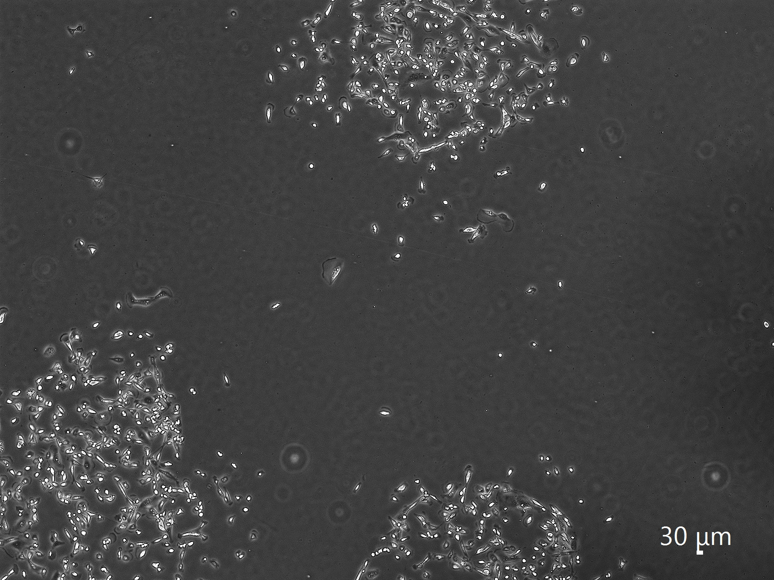
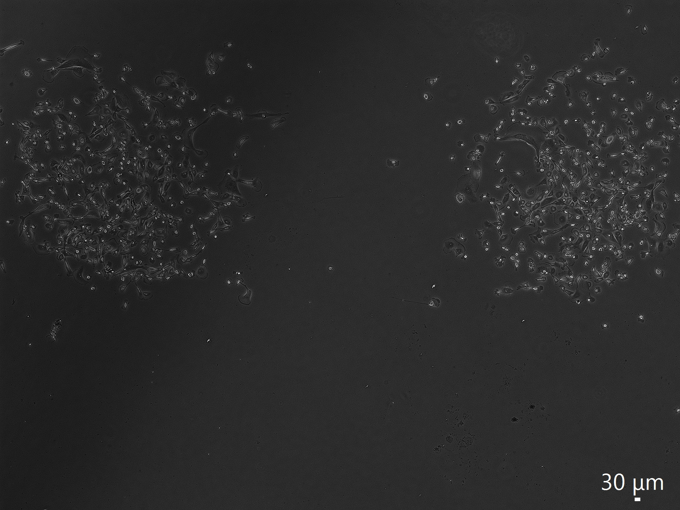
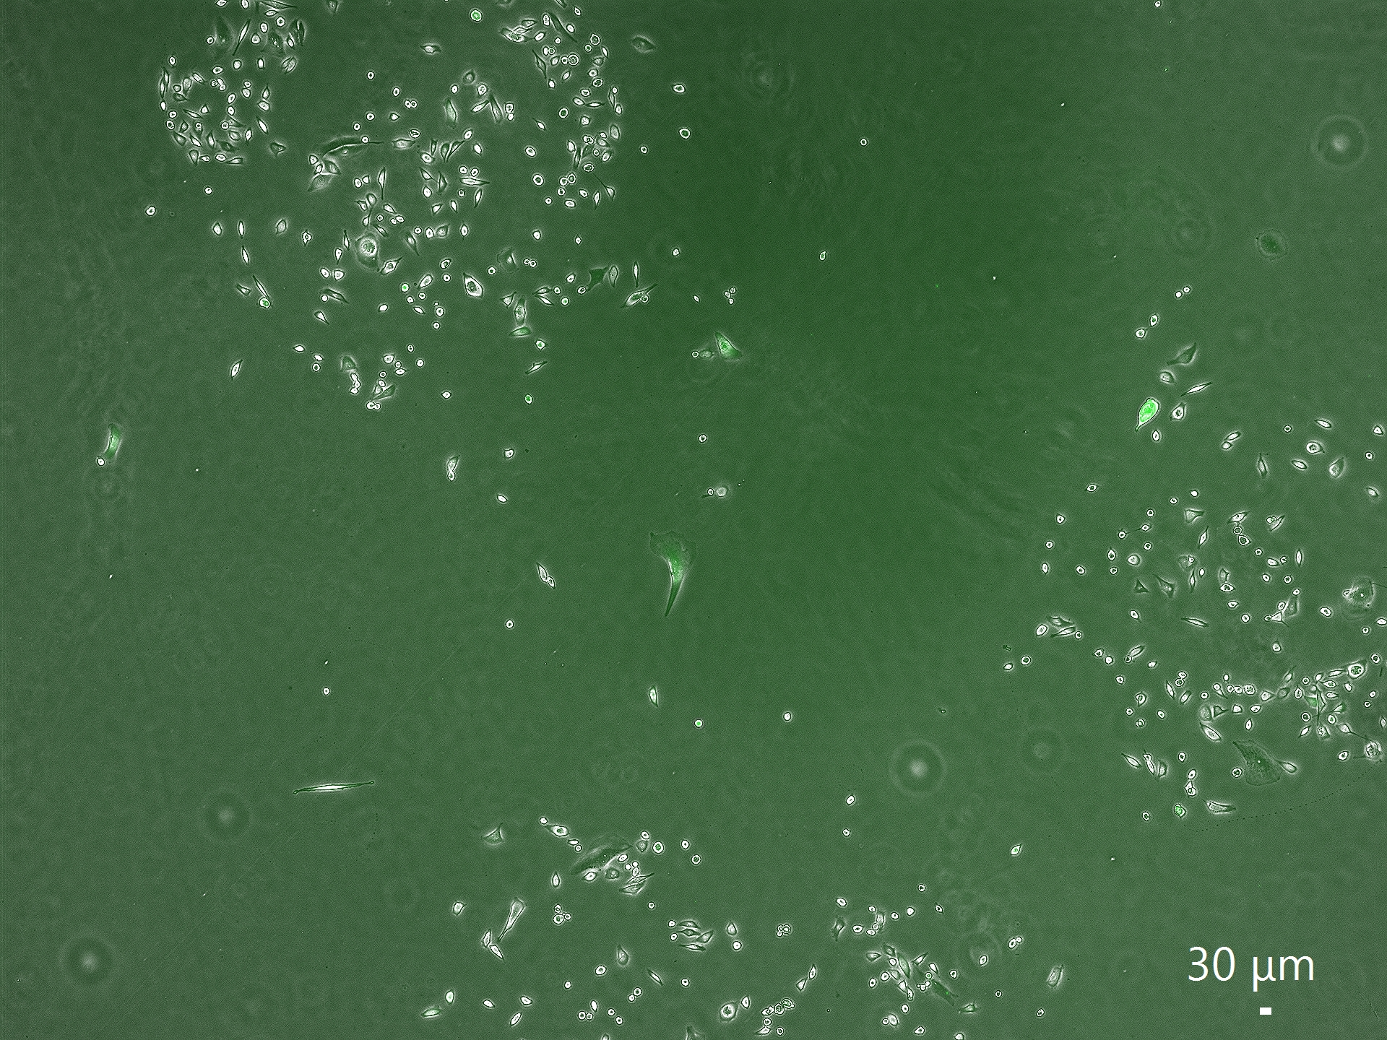
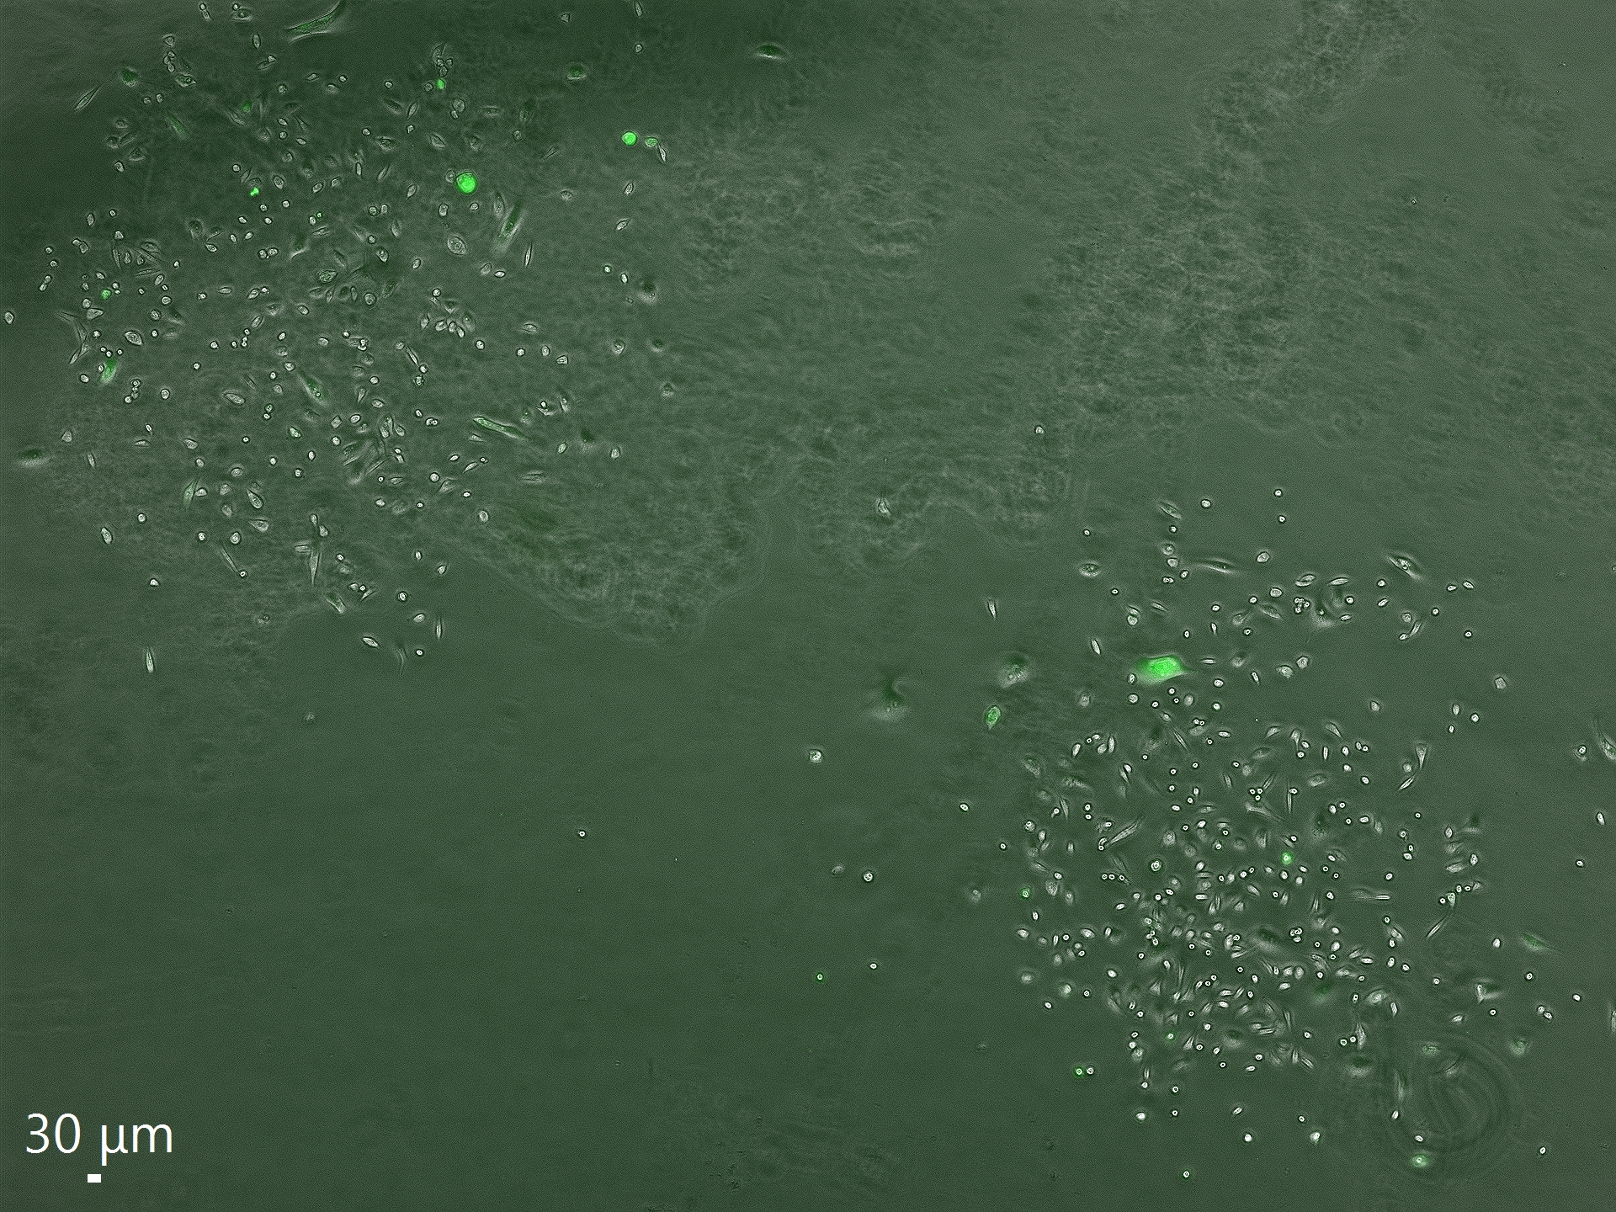
L-Arginine Treatment Trials (cont.)
Visualized NO production from cells using DAF-FM Diacetate dye (green overlay in images)
By using SWNT fluorescence for imaging, can get several real time checkpoints of NO production throughout treatment

Slide 12
Summary
Shallower PDMS allow more cells to reach the bottom of the wells and seed in the desired pattern
Induction of NO production corresponded with cell clusters growing toward each other, suggesting a relationship between the two
Stamps with additional wells and spatial designs have been prepared with confirmed functionality, allowing for future collection of data on spatial arrangement’s effect on NO gradients.
Additional lines of cancer cells will be acquired to see how their emissions differ from the aggressive MDA-MB-231 strain. Noncancerous cells will also be tested

Slide 13


Acknowledgements
This project was supported in part by NSF REU grant 1960137 and National Institute of Health grant 5R35GM138245. Thank you to the Iverson Lab members for their support on this project.

Slide 14
Thank You

