Slide 1
Chiral/Achiral Spacer Mixing in Copper-Based Hybrid Halide Perovskites
Griffin Cook
North Carolina State University
University of North Carolina at Chapel Hill
Camryn Gloor, Liang Yan, Wei You

Slide 2
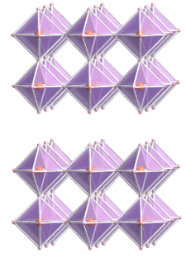

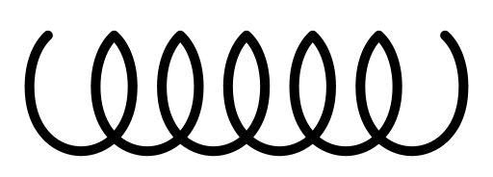
Project Background
Hybrid Organic-Inorganic Perovskites (HOIPs)
Traditional 3D perovskites have the ABX₃ formula, with
BX₆ octahedra
Hybrid perovskites use organic spacers, often at the A site.
Incorporating organic spacers can reduce the dimensionality of the structure to 2D, 1D, or 0D.
Spacer
X. Li et al., Chem. Rev. 2021, 121, 2230.
Copper HOIPs and Spintronics
Magnetic properties, alongside chirality induce spin selectivity (CISS), make copper HOIPs ideal candidates for spintronic applications.
e⁻
e⁻
e⁻
e⁻
Chirality + Magnetism

Slide 3
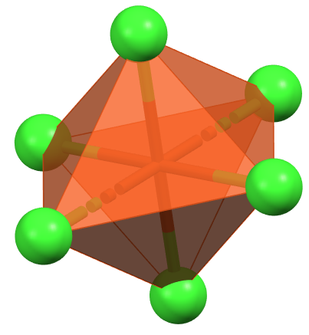
Background Cont.
This project explores the mixing of chiral and achiral organic spacers and the effect of copper-based HOIPs and their chiral properties.
+
Chiral Effect
“R-MPEA” “BA”
Inorganic Organic

Slide 4
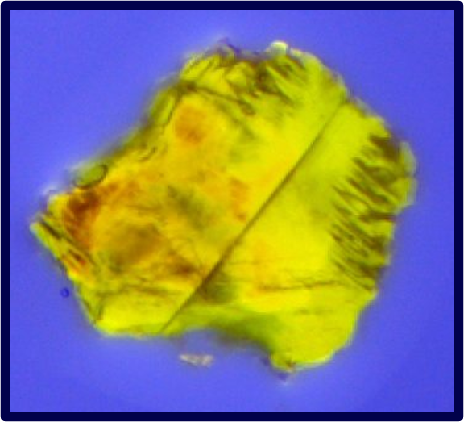
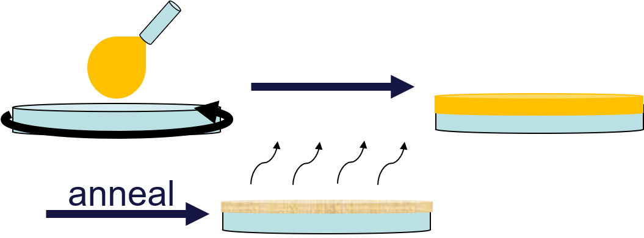
Single Crystals and Thin Films Were Synthesized
Thin Films
Spin coating of precursor solutions onto quartz substrate was used to create thin films.
System presents a low absorbance despite adequate thickness (~200nm).
Films were used to measure circular dichroism.
Proper phase formation was confirmed with powder X-ray diffraction.
Single Crystals
- Pure R-MPEA and BA single crystals were not studied as their structures have already been found.
Slow cooling of a highly saturated aqueous precursor solution was used.
Solution was cooled from 90ºC to 10ºC at a rate of 1ºC an hour.
May require further refinement as organic spacers were unable to be resolved through SCXRD.

Slide 5
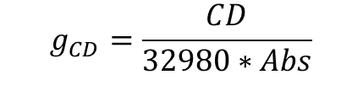
Chiral Properties Were Analyzed
Circular Dichroism (CD) gives us insight into the chiral intensity of the HOIP.
There is dampening in the CD of the mixed phase.
There is a change in peak types and position from the pure chiral to the mixed phase
PXRD confirms thin films were of proper phase through comparison with simulated spectra
$$g_{CD}=\frac{CD}{32980∗Abs}$$

Slide 6
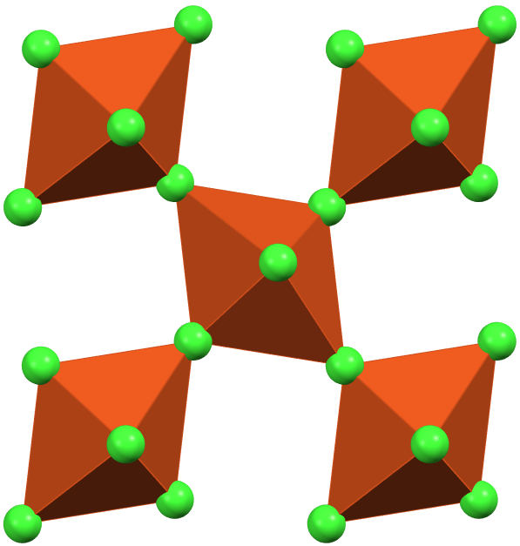
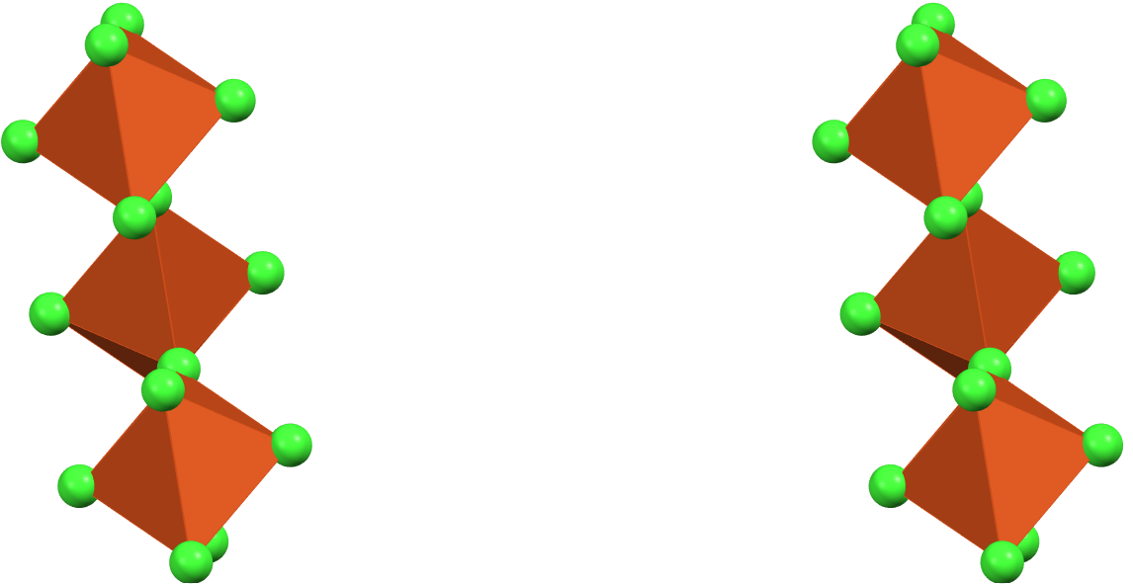
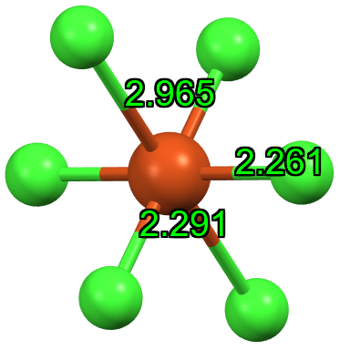
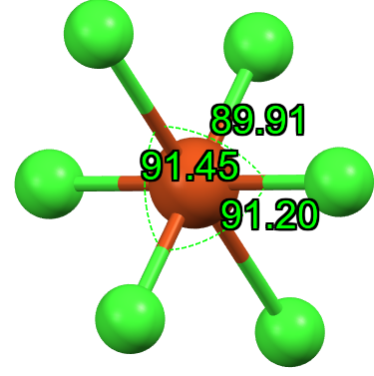

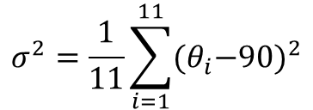
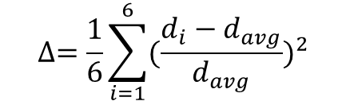
Inorganic Structure Was Resolved
Distortion Calculations
$$∆=\frac{1}{6}\sum_{i=1}^{6}{{(\frac{d_{i}−d_{avg}}{d_{avg}})}^{2}}$$
Bond Length
$$σ^{2}=\frac{1}{11}\sum_{i=1}^{11}{{{(θ}_{i}−90)}^{2}}$$
Bond Angle
Organic spacers could not be resolved, inorganic framework could.
Possibly due to poor crystal quality or irregular arrangement of the spacers.
$$θ=\frac{180−θ_{B−X−B}}{2}$$
Octahedral Tilt
Chiral
Mixed
Achiral
Δ = 0.0259
σ² = 29.8428º
θ = 6.065º
Δ = 0.0168
σ² = 1.2911º
θ = 4.615º
Δ = 0.0157
σ² = 1.8014º
θ = 5.985º

Slide 7
Conclusions and Future Steps
Conclusions
CD changes within the show trend with distortion parameters.
Structure requires further analysis to fully explain reason for CD changes.
PXRD patterns suggest proper phase formation in all steps.
While unexplained, this phenomena could give insight into the behaviors of copper HOIPs
Future Steps
Refinement of single crystals and/or TEM analysis to fully resolve crystal structure.
Test the effects of spacer mixing on magnetic properties such as magnetic CD.
Test smaller achiral spacers to further analyze the various effects of spacer mixing.

Slide 8
Thank You!
Thank you to Camryn Gloor, Yan Liang, Wei You, and the rest of the You group at UNC for the guidance and mentorship given throughout this project!
Thank you to Xiaotong Li, Carson Campbell, and the rest of the Li group at NC State for mentorship on previous projects that greatly improved my knowledge going into this project!
Thank you to Phillip Strader, NSF, RTNN, and all those who made this project possible!
This material is based upon work which is supported by the National Science Foundation (award numbers 2447827, 2447828, 2447829, CHE-2117287 and ECCS-2025064). Any opinions, findings, and conclusions or recommendations expressed in this material are those of the author(s) and do not necessarily reflect the views of the National Science Foundation.

