Slide 1


Advanced Packaging Validation Technology
PI: Dr. Seung Joon Paik, Dr. Yogendra Joshi
Mentor: Junyoung Kim
REU: Nathan Pak
Notes:
Add more numbers, graphs, fancy

Slide 2
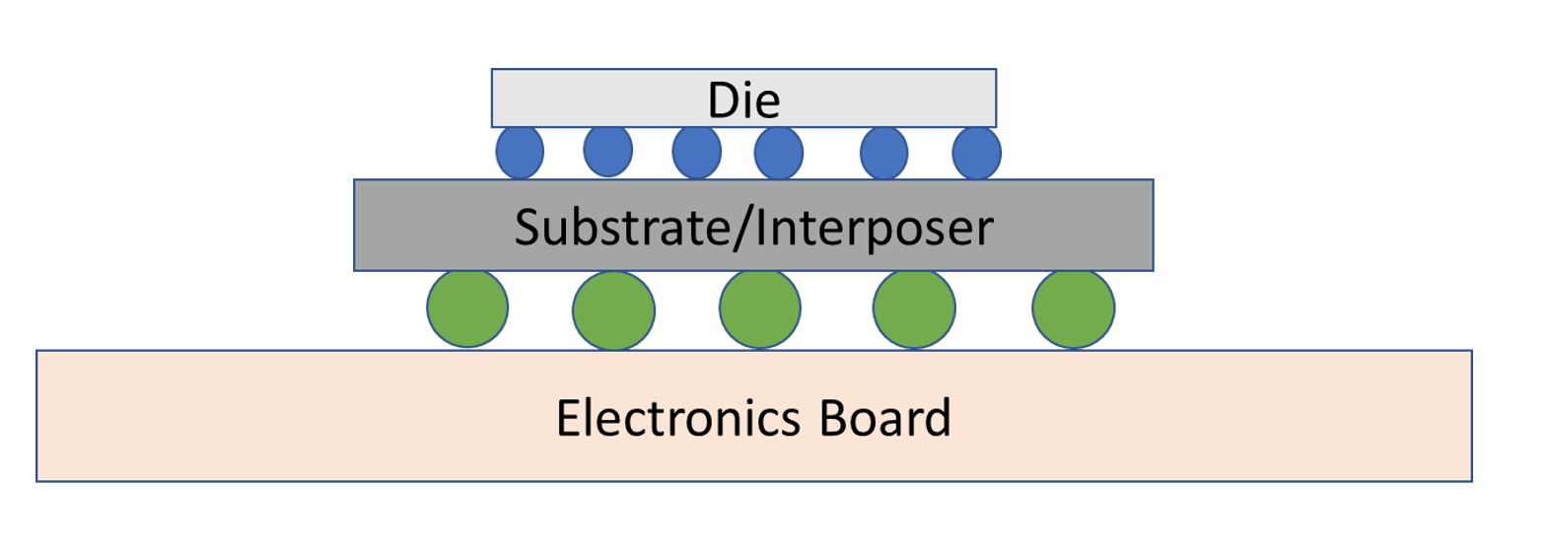
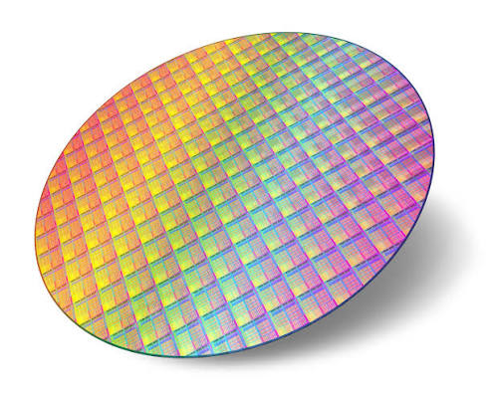
What is Packaging?
  The structure supporting a die
    Protects the die from drops, corrosion, static electricity, etc.
    The connections around a die
    Allows the chip to be integrated into a printed circuit board (PCB)
Silicon Wafer
Notes:
What is a die, how is it made, how we can interact with it, end user

Slide 3
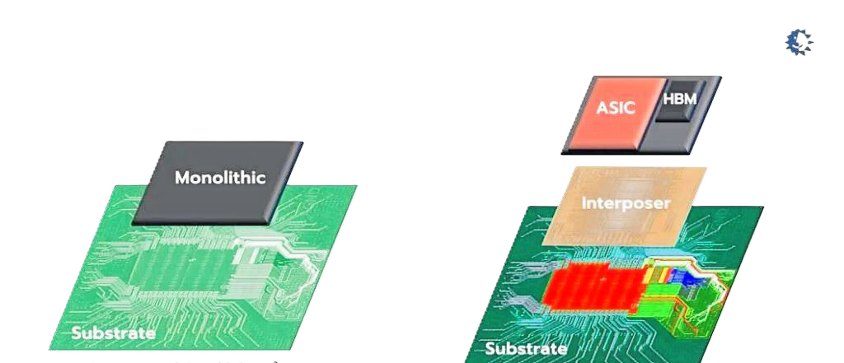
What is Advanced Packaging?
Combining multiple chiplets into one package, rather than one large chip
Decreases latency
  Shorter travel distances, more connections
More efficient method of manufacture
  Whole chip does not rely on one defect

Slide 4
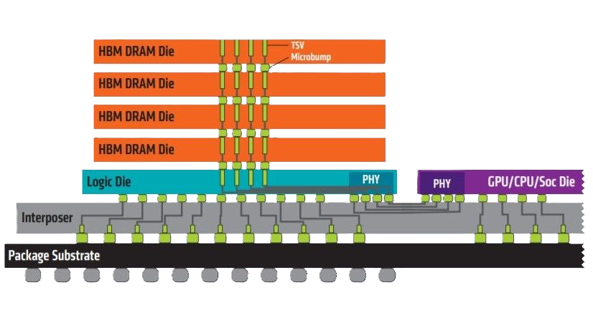
Advanced Packaging Applications
Nvidia announced Vera Rubin at Computex 2026
Can power agentic artificial intelligence (AI)
Utilizes High Bandwidth Memory (HBM), which relies on advanced packaging

Slide 5

What is Validation Technology?
Validate connections within the package
Non-Destructive Validation Technology
  Previously relied on cross section analysis and KGD (known good die) and other limited techniques
    Methods such as acoustic microscopy, X-ray tomography, etc.
Notes:
Chip might work, reliability unsure bad

Slide 6
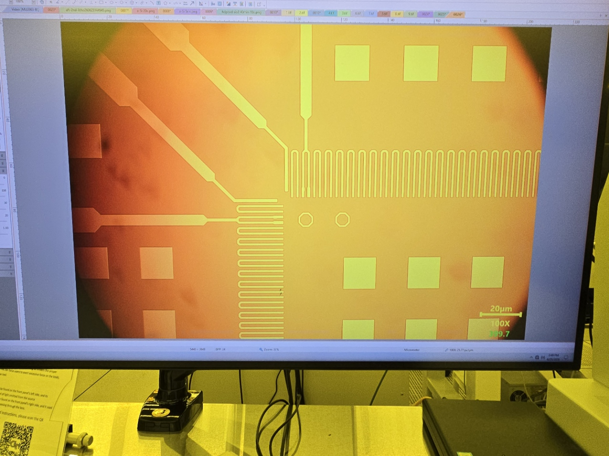
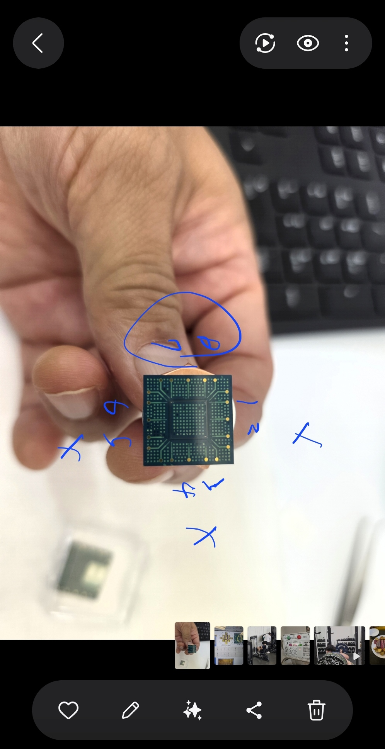
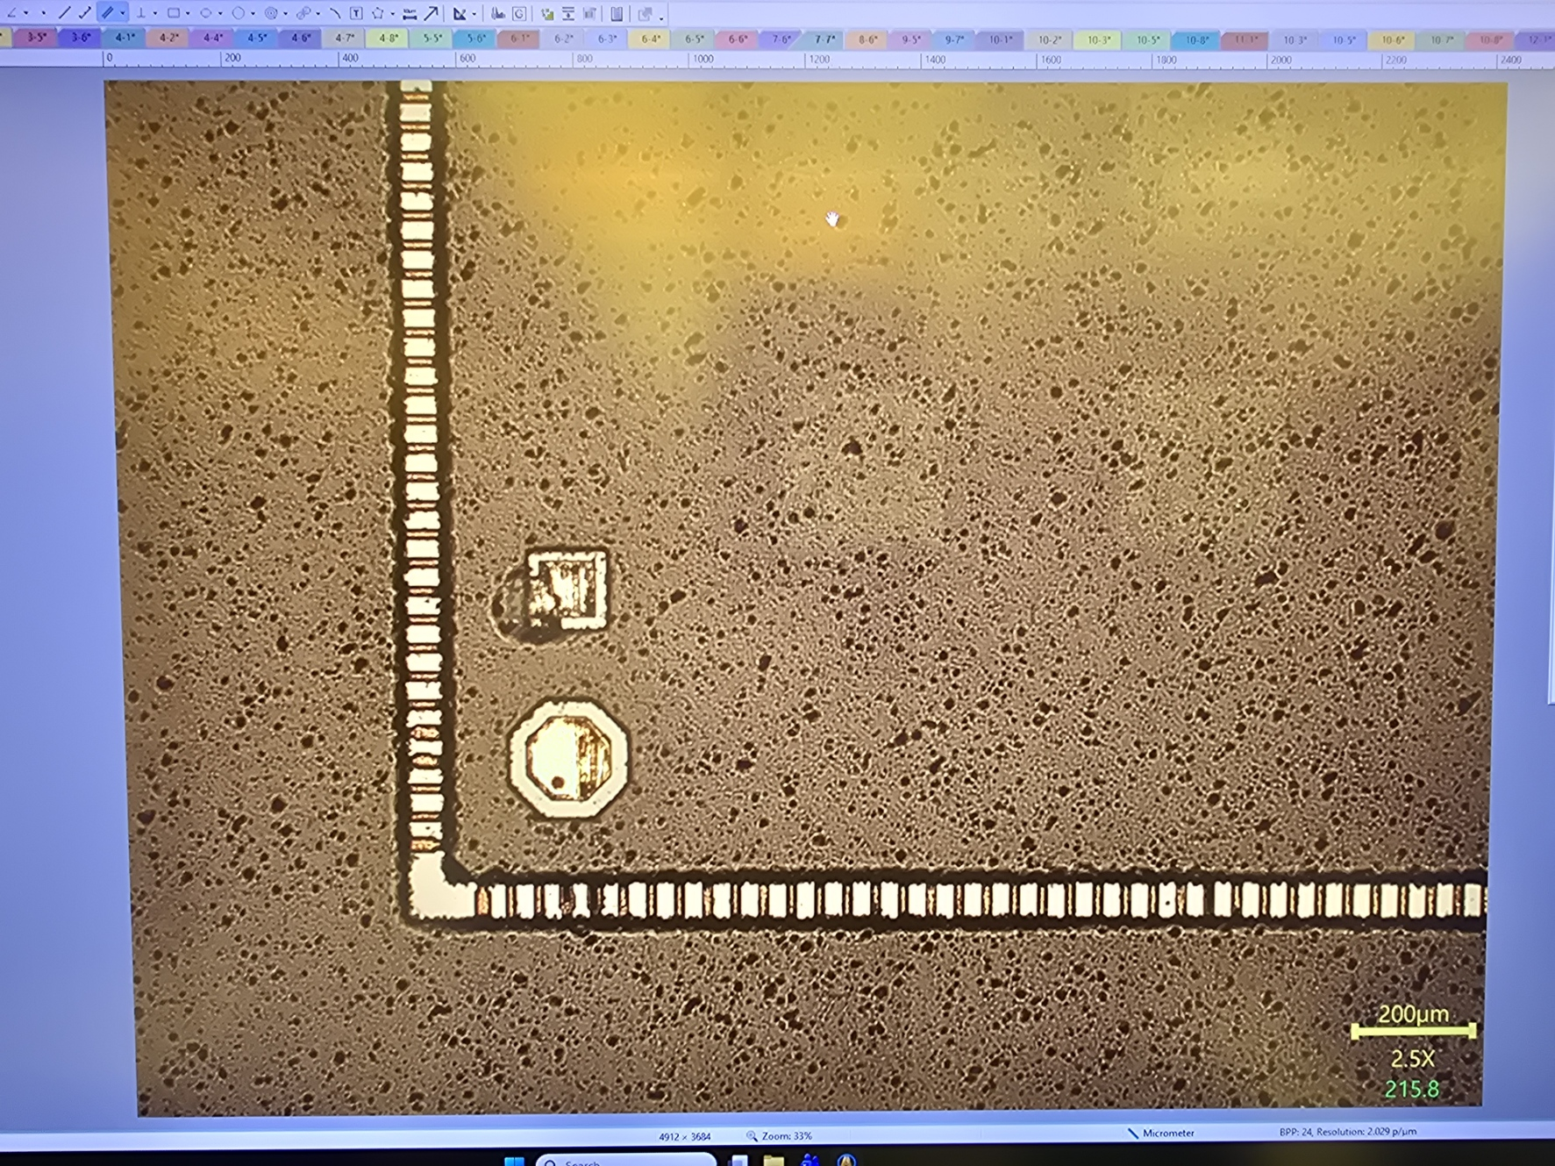
Test Vehicle Fabrication
Single chip structure (monolithic)
Utilizes daisy chaining to emphasize defects
Uses MB50 test die (50 micron pitch)
MB50
17mm
50um
Single Coupon
Notes:
What is a coupon, add scale to pictures, and in zoomed image spacing, try adding title under image

Slide 7
Process
(h) Solder Mask Coating
Au
(e) Surface Finish
Solder Mask (Dryfilm)
(a) Cleaning & Oxidation
Ni
SiO2
SiO2
Silicon
Ti/Cu
Silicon
SiO2
(b) Seed Layer Deposition
Silicon
Ti/Cu
(i) Lithography and Dicing
SiO2
(f) PR Liftoff
Silicon
(c) Photolithography
Ti/Cu
SiO2
SiO2
PR
Silicon
Silicon
Ti/Cu
SiO2
(j) Flip Chip Bonding
Silicon
(g) Seed Layer Etching
MB50
(d) Cu Electroplating
Underfill
Cu
SiO2
Ti/Cu
Silicon
SiO2
SiO2
Silicon
Silicon
Notes:
I’ve been working on highlighted parts

Slide 8
My Contributions
Oxidation
  Create a dielectric seed layer to prevent electrical interaction with silicon
Photolithography
  Deposit a pattern for electrical paths
Metallization
  Create adhesion layers between silicon oxide and copper paths
  Deposit a corrosion resistant surface finish
(a) Cleaning & Oxidation
Au
(e) Surface Finish
Ni
SiO2
Silicon
Ti/Cu
(b) Seed Layer Deposition
SiO2
Silicon
Ti/Cu
SiO2
Silicon
(f) PR Liftoff
(c) Photolithography
Ti/Cu
PR
SiO2
Silicon
Ti/Cu
SiO2
Silicon

Slide 9
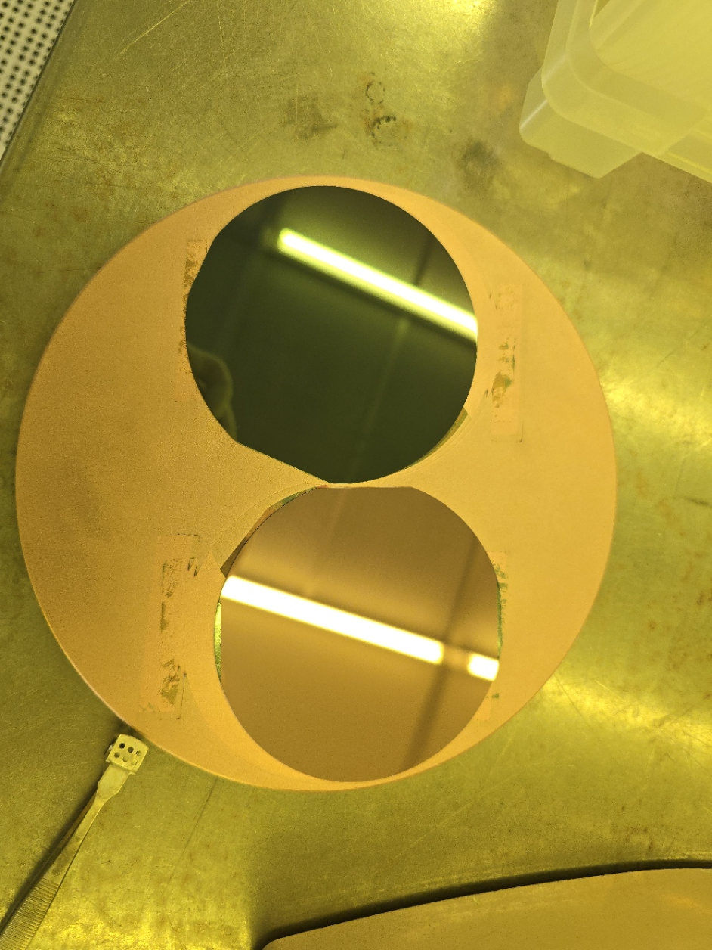
Current Progress
Silicon wafers oxidized (2 micron) and seed layer deposited (1.5 micron)
Notes:
Add more details with what I did about this

Slide 10
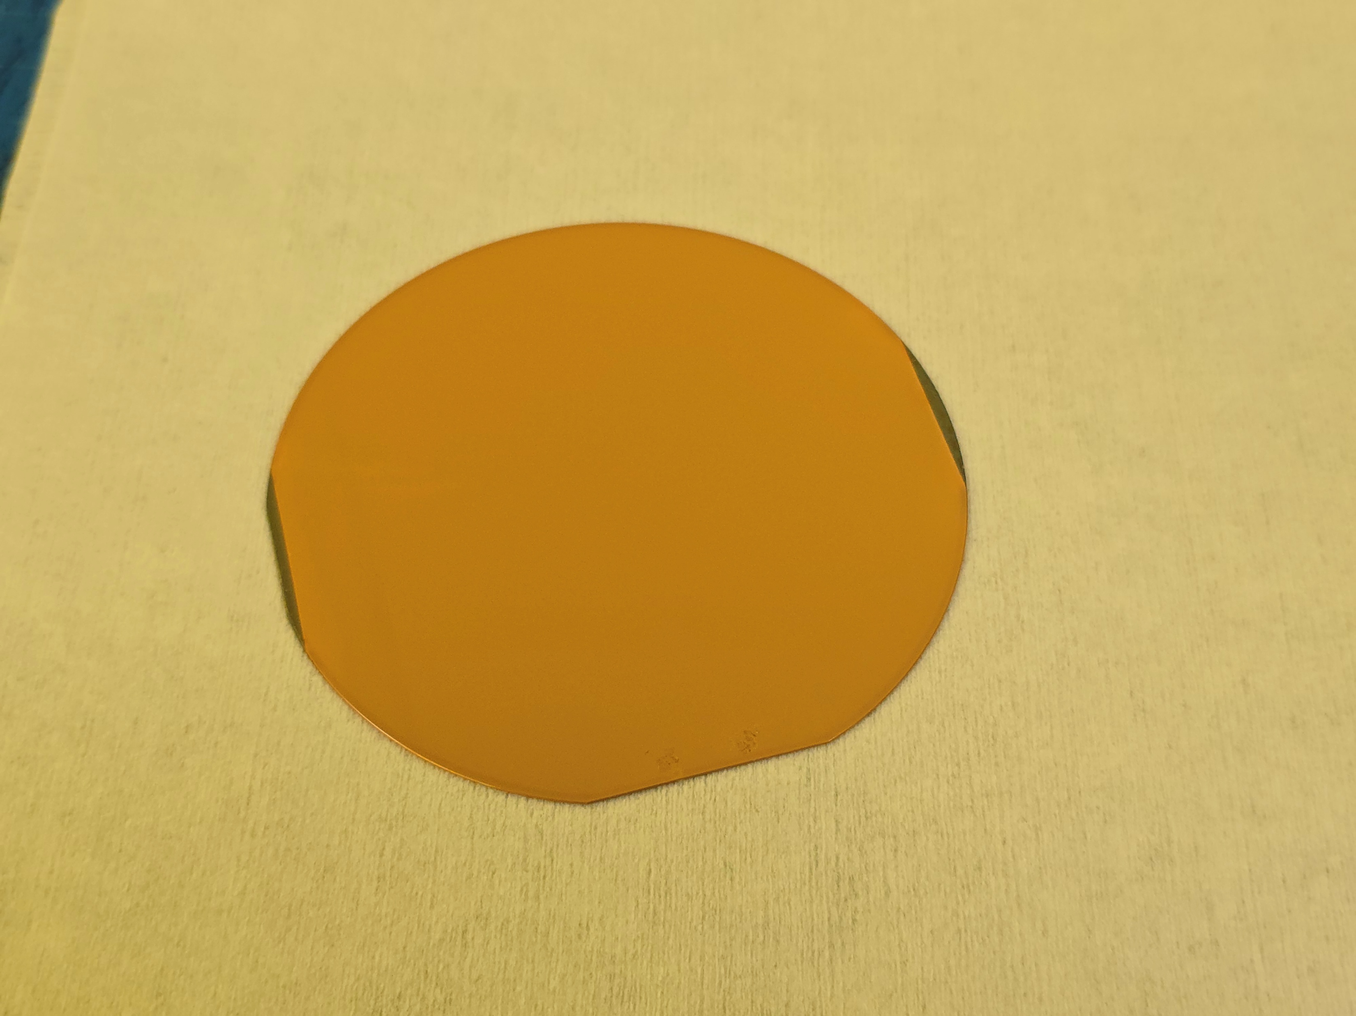
Current Progress
Wafer photoresist coated
  SPR220 at 1000RPM for 40 seconds
  Recipe edited for edge bead removal at 4000RPM for 1 second
  Thinner than needed for process (>14 um), at 10-11 um

Slide 11
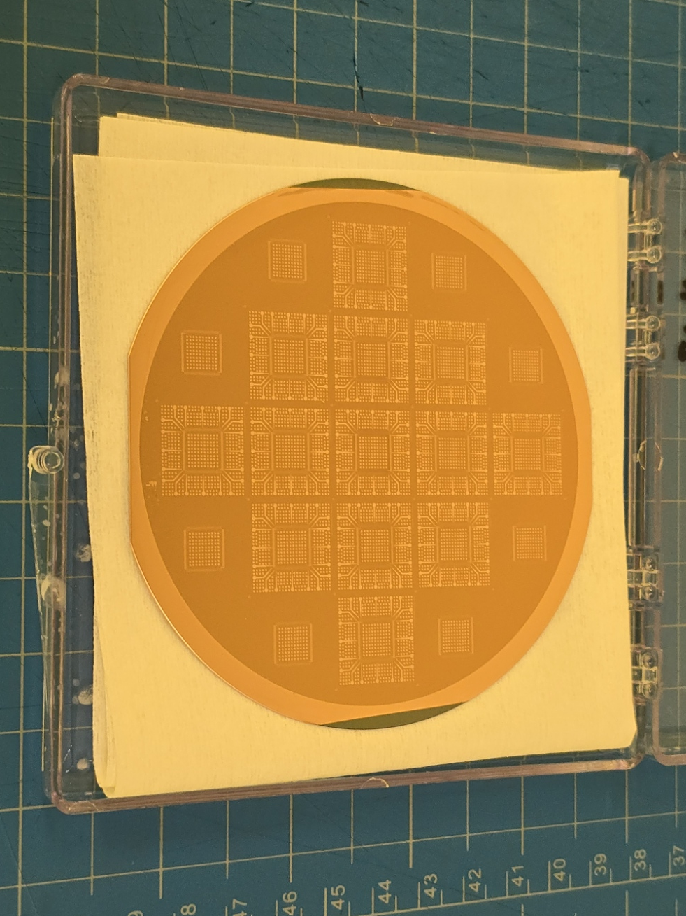
Current Progress
Exposed and developed, next step is electroplating

Slide 12
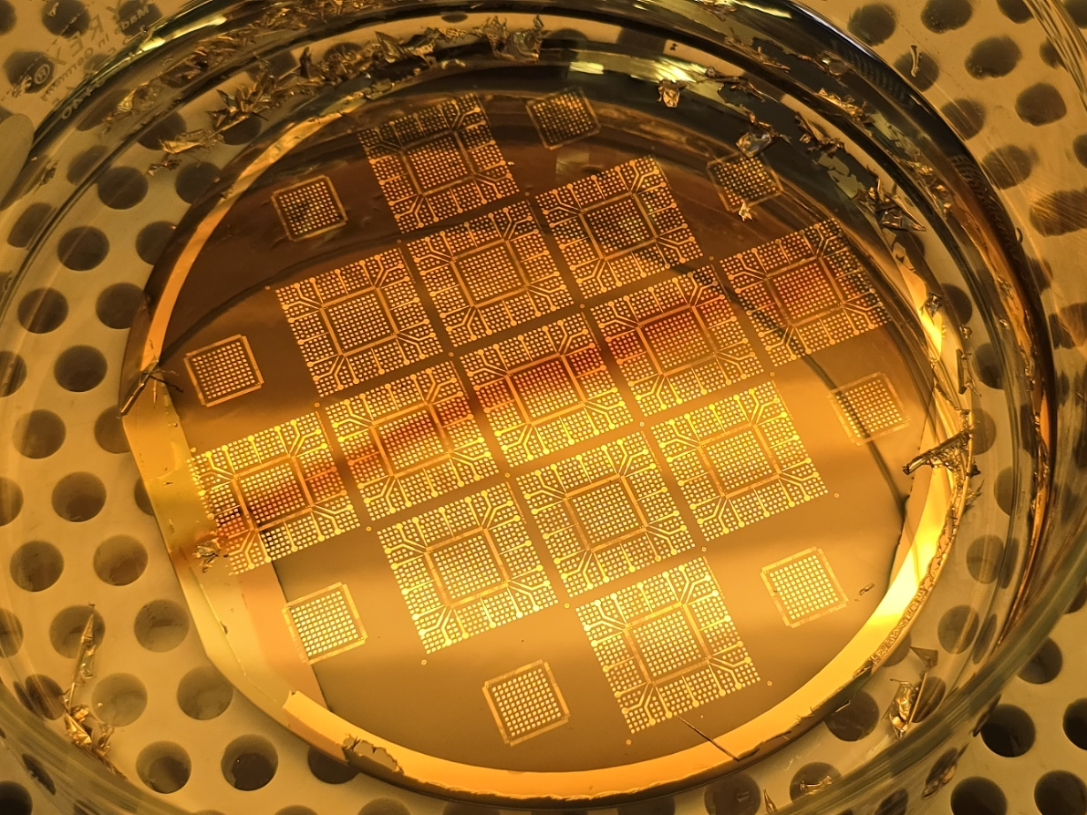
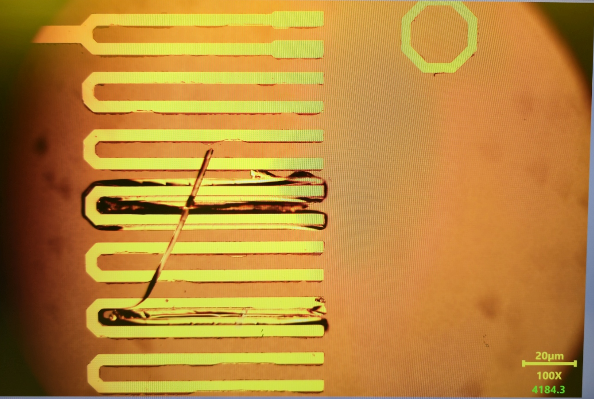
Current Progress
Surface finish tests
Nickel (3000A) and gold (1000A)

Slide 13
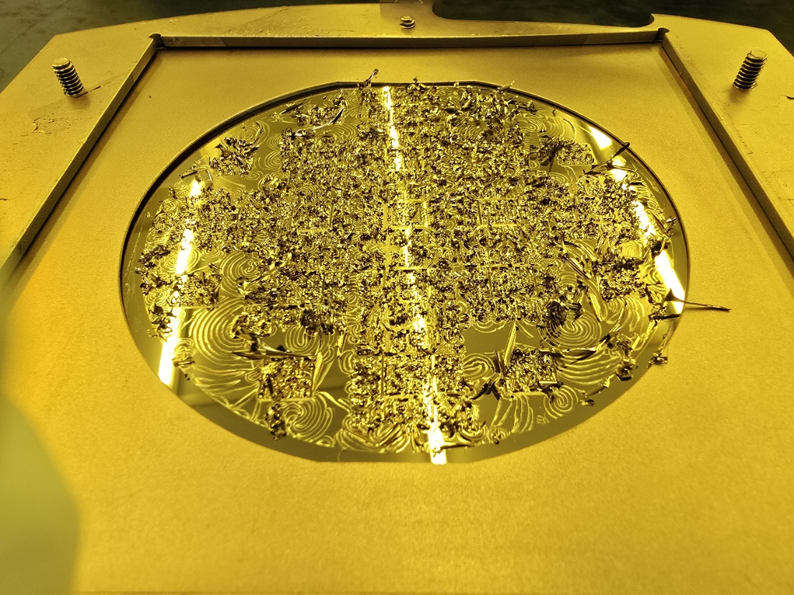
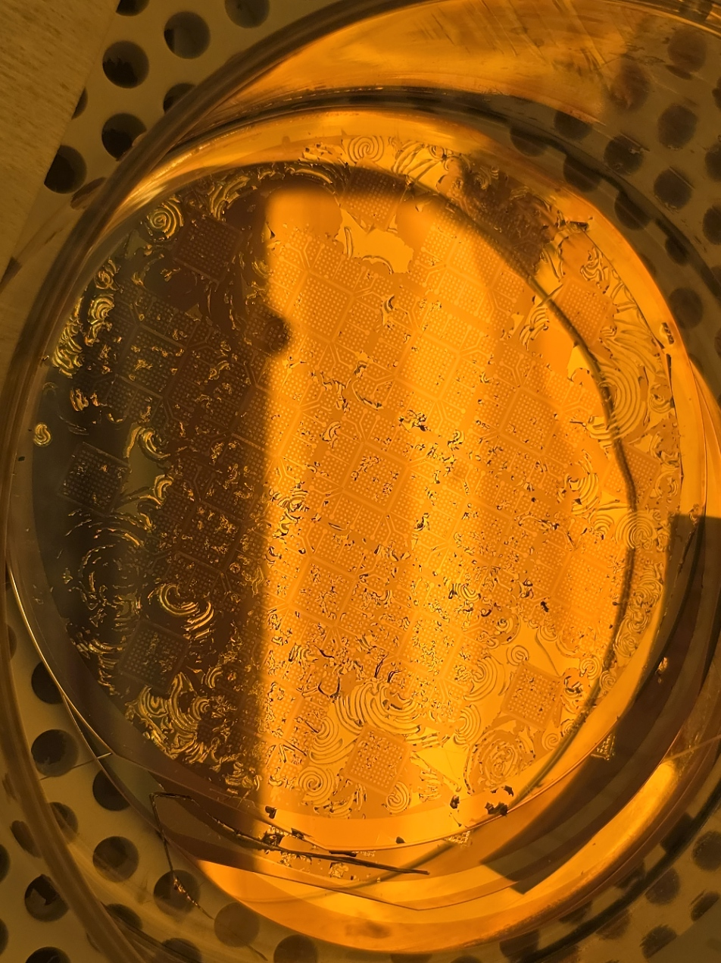
Current Progress
Surface finish tests
Titanium (200A), nickel (3000A), and gold (1000A)

Slide 14
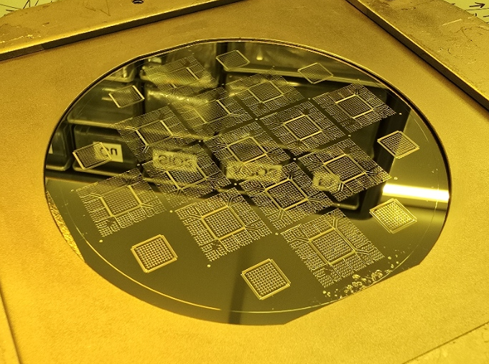
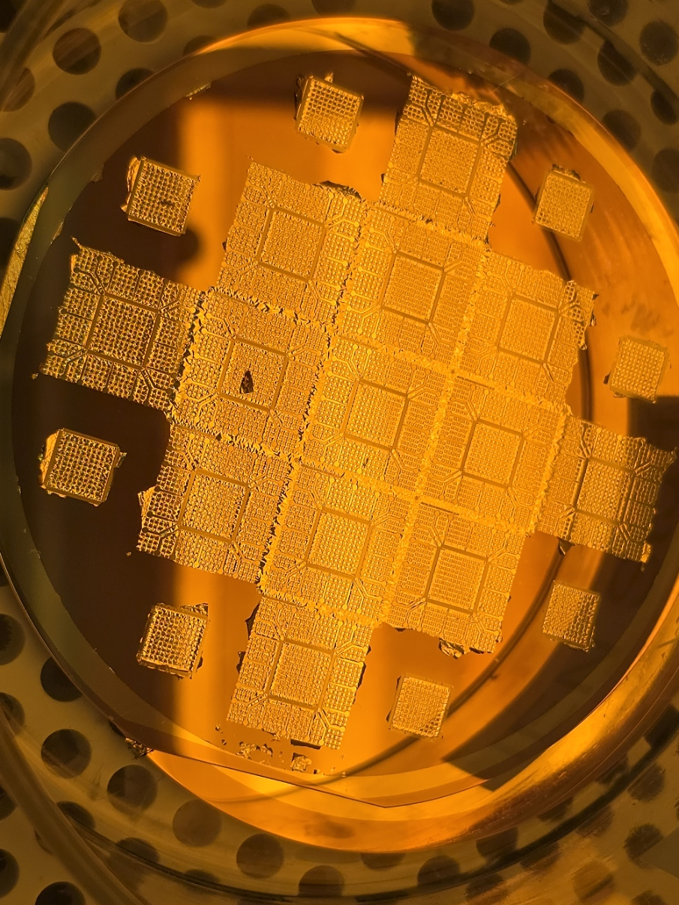
Current Progress
Surface finish tests
Titanium (200A) , and gold (1000A)

Slide 15
Finished Coupon Inspection
1 2
Coupon surface finish inspected
  Attempt to predict defects
  Each coupon measured in 8 sections
8
3
7
4
5 6
Notes:
What is a coupon, how it differs from die

Slide 16
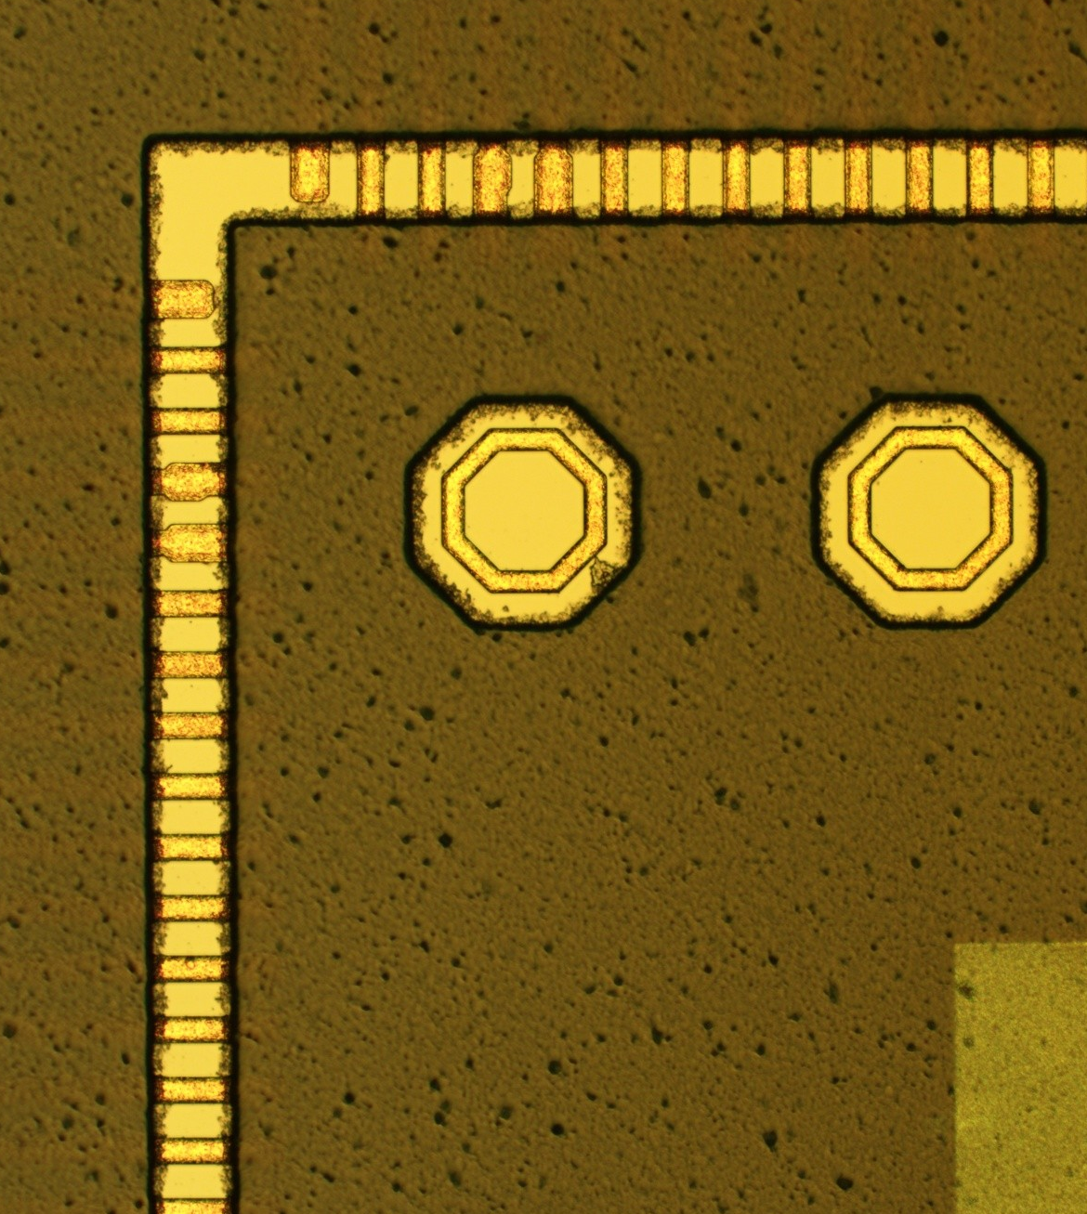
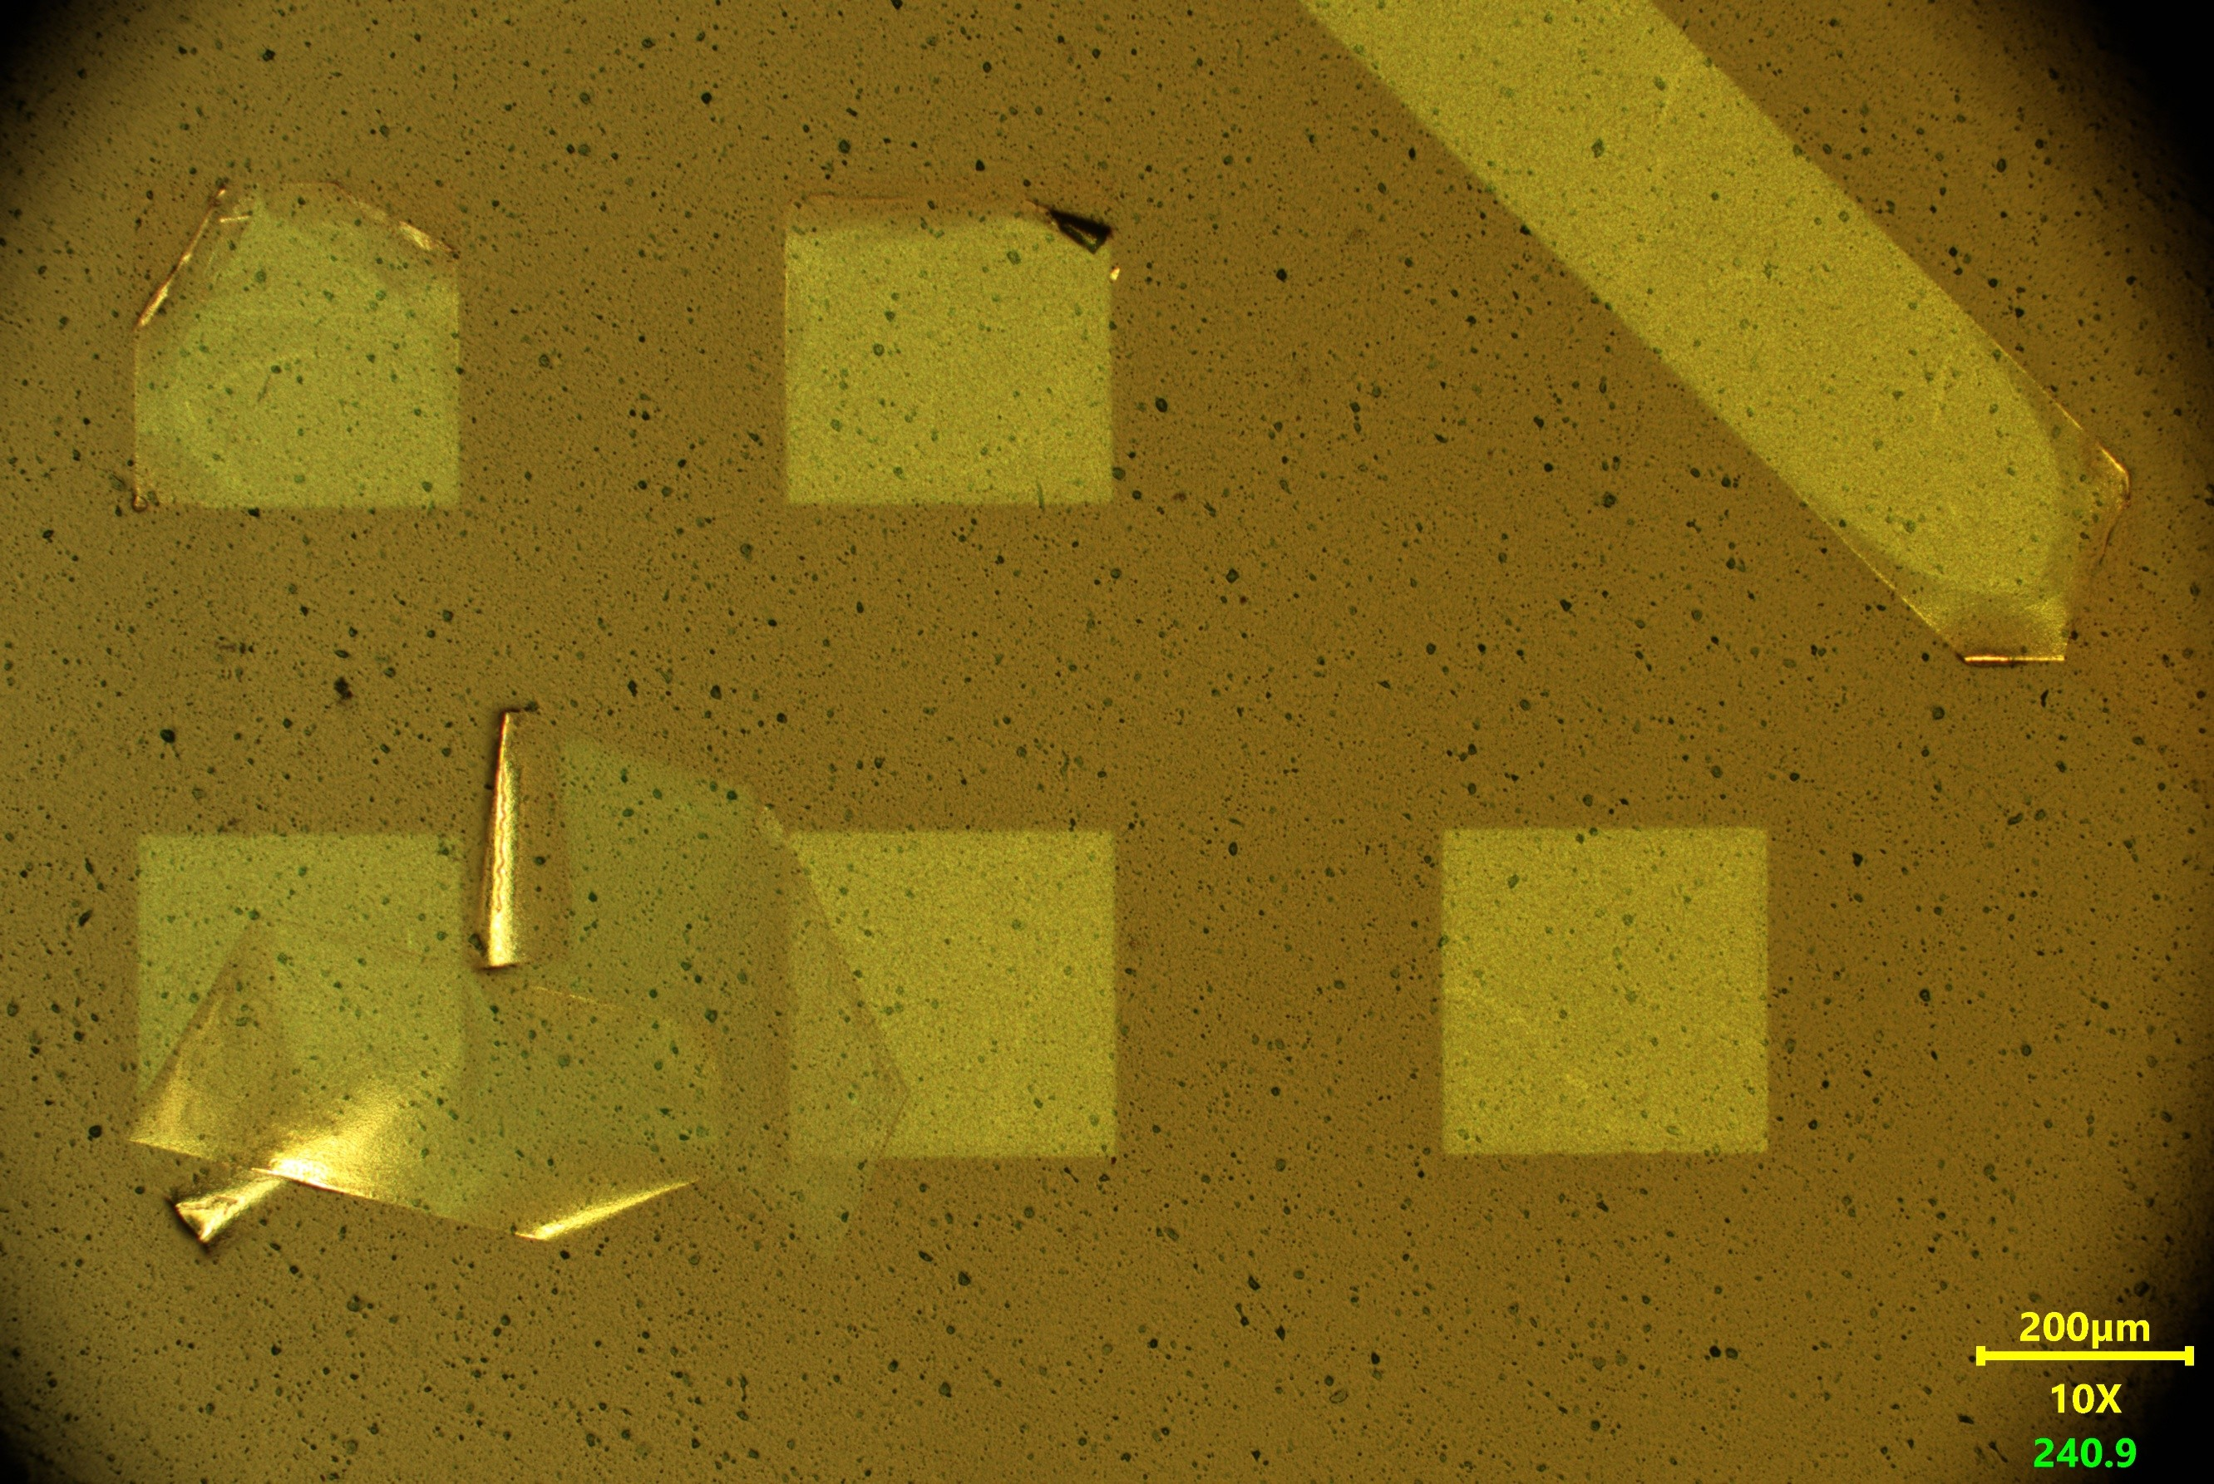
Finished Coupon Inspection
Most recent processed wafer
  No more surface texture issues
  Surface finish peeling issues

Slide 17
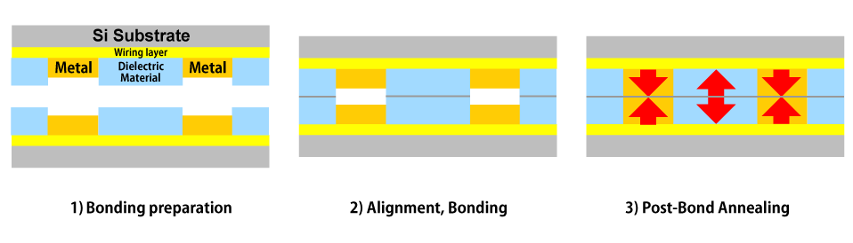
Next Steps
Bonding tests for hybrid bonding
  Skips solder bumps to allow denser connections (<1 um)
  Bonds dielectric material first, then metals
  Next step in packaging research
Notes:
Explain how this connects with the project, the dieletric is the oxide

Slide 18
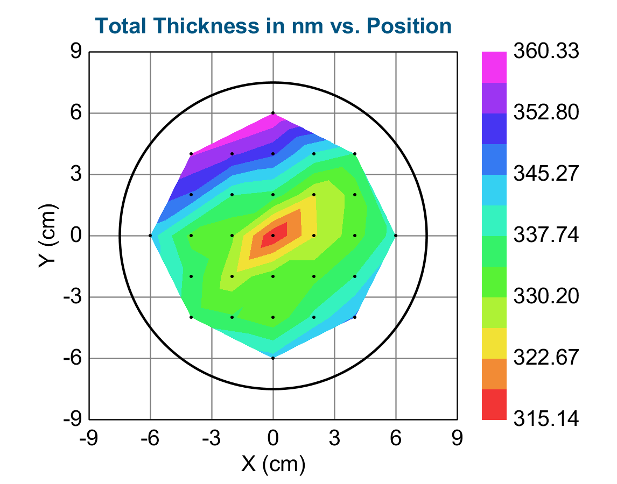
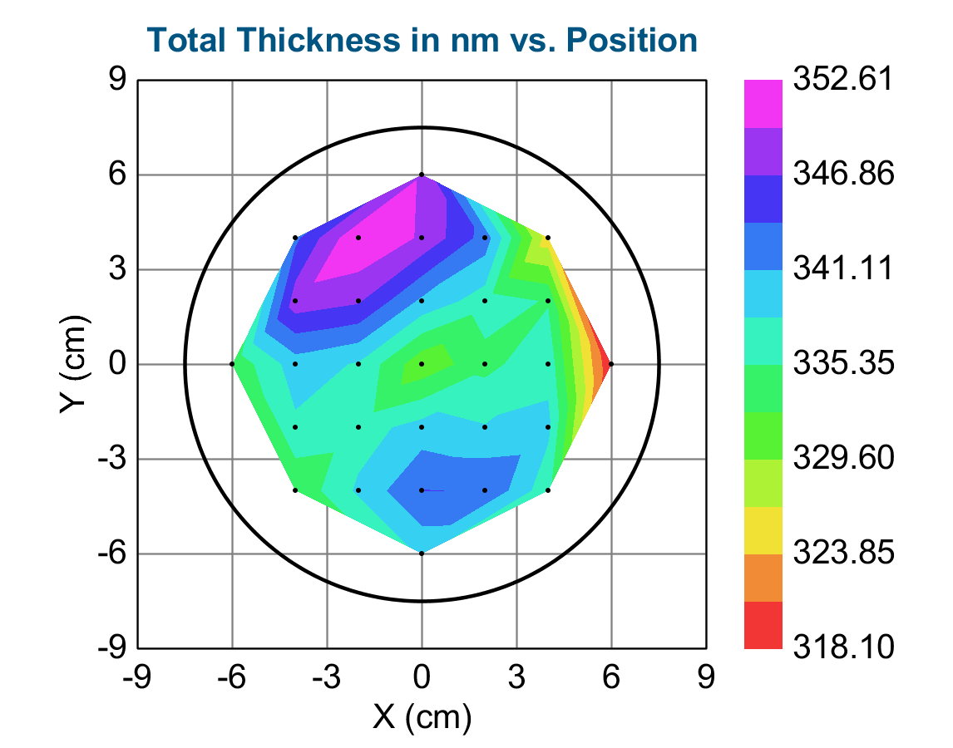
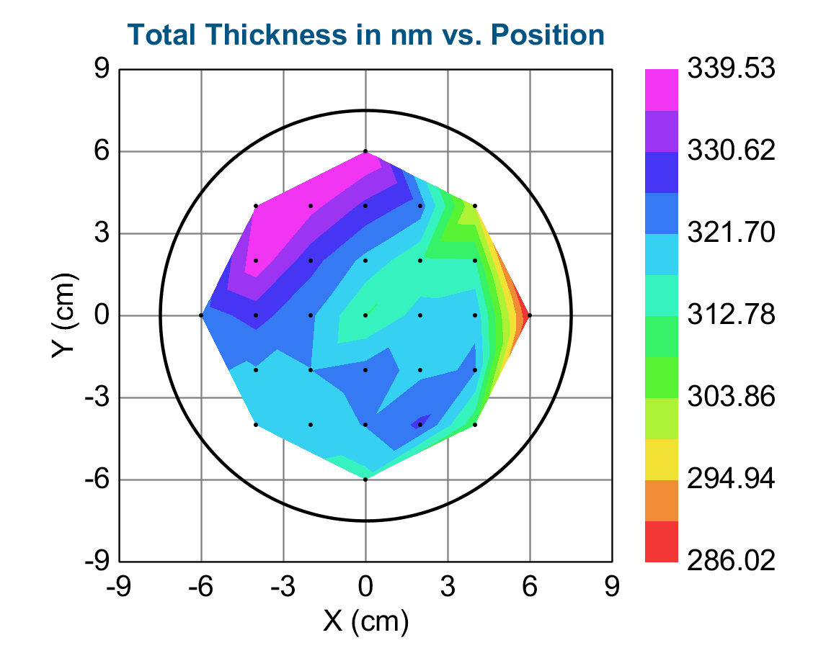
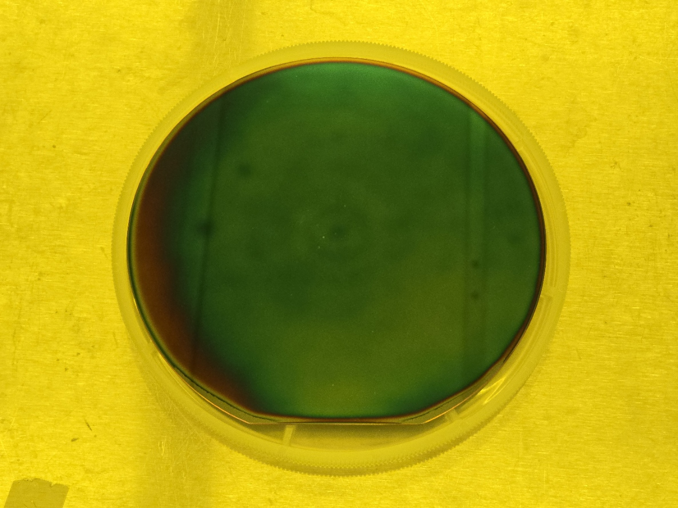
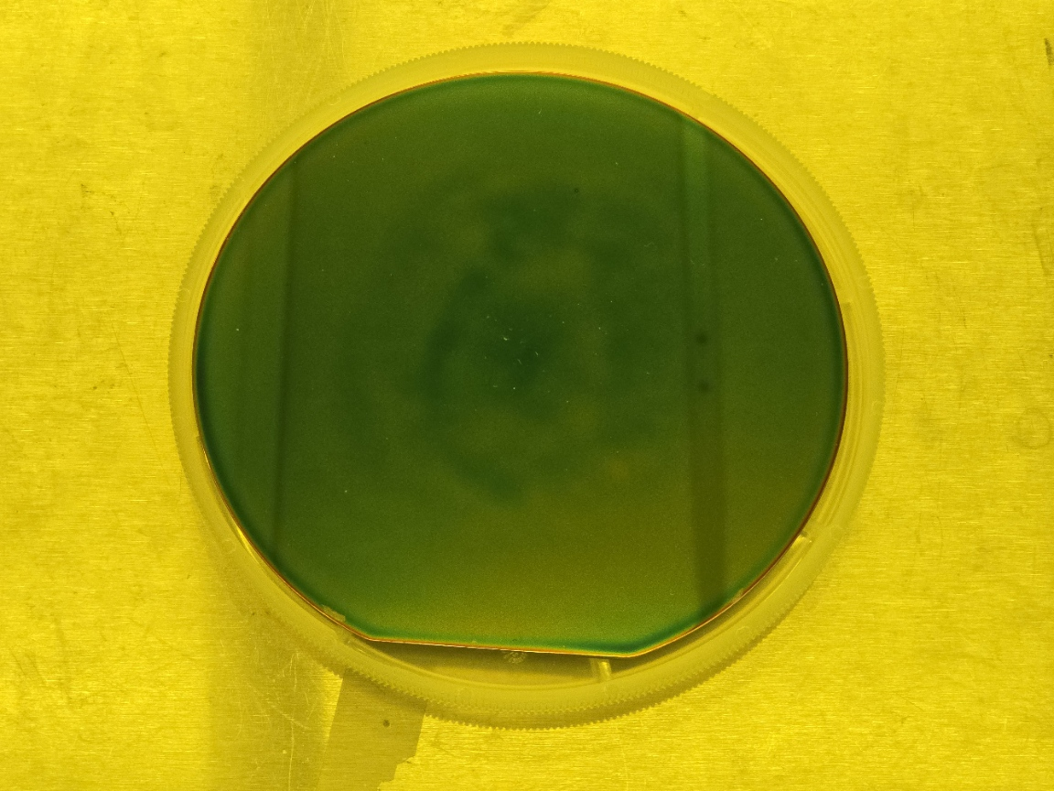
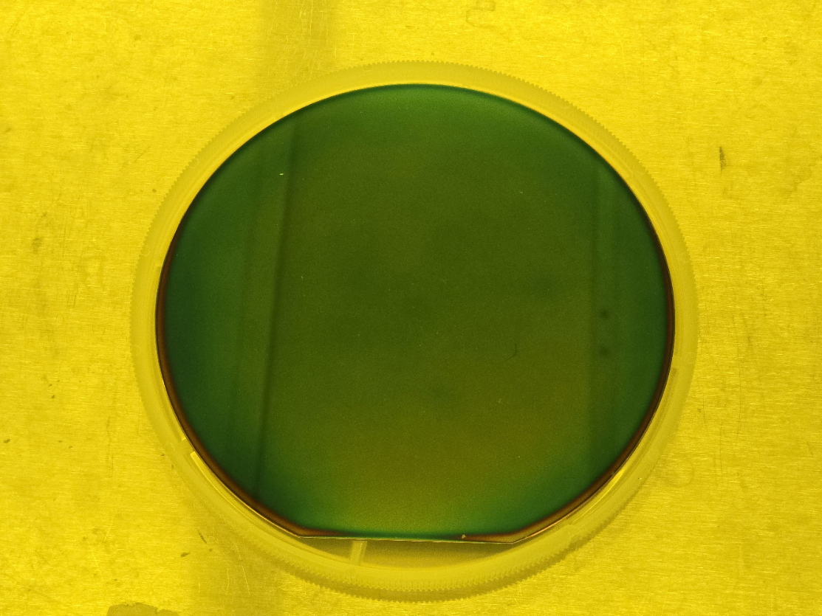
Next Steps
Wafers with oxide and nitride layers for bonding tests
SiO₂ #1
SiO₂ #2
SiO₂ #3

Slide 19
Closing Remarks
Contributions
  Processing back up and experimental wafers
  Surface finish testing and liftoff
Advanced packaging research used for chip manufacturers
  Ensure reliability for every unit
Test vehicles fabricated to experiment with inspection methods
Current fabrication issues
  Surface finish
  Photoresist edge bead

Slide 20
Acknowledgement
Cleanroom Staff
Milette Handley
Vickiana Rosefort
Gary Spinner
Charlie Turgeon
Christopher White
Internship Coordinators
Leslie O’Neill
Dr. Mikkel Thomas
Research Project Members
Dr. Seung Joon Paik
Dr. Yogendra Joshi
Dr. Kyoung-Sik Moon
Junyoung Kim
Matthew Kim

Slide 21
Questions?
Notes:
Longer, don’t rush

