Slide 1








Suborbital Flight Assessment of dRBC in Reduced Gravity:
Advancing of Automated Control System with
Dual-Wavelength Spectrophotometer
Adam Bowman, Centre College
Dr. Thomas Roussel, University of Louisville
Dr. George Pantalos, University of Louisville & Cardiovascular Innovation Institute
NSF REU Award ID # 2348869
NSF NNCI Award ID # 2025075

Slide 2
Challenges of Blood Preservation for Space Travel
Blood Shelf Life on Earth
  Standard red blood cells (RBCs) last about 42 days at 4 degrees C
A mission to Mars takes roughly 7–9 months one way
Traditional liquid storage is useless
    Heavy refrigeration units are "costly" in terms of fuel & energy
    More mass = More propellent
Why is Blood even needed for Space Travel?
  Radiation induced “Space Anemia”
    High-energy cosmic rays can damage the cellular membranes of stored blood, leading to hemolysis (rupturing)
    Astronauts lose approximately 50% more blood / second than a human on Earth
    Astronauts will need regular transfusions

Slide 3

Dehydrated Red Blood Cells for Space Flight
Dehydrated Red Blood Cells (dRBCs) are currently
the "holy grail" of space hematology
By removing water from the cells, blood can
be stored as a lightweight powder at room
temperature
Benefit: It reduces mass by over 70% and eliminates the need for constant refrigeration
UofL researchers have a NASA-funded
experiment planned in Fa ‘26/Sp ’27
to rehydrate RBCs on an unmanned
suborbital flight (Virgin Galactic’s SpaceShip 2)

Slide 4
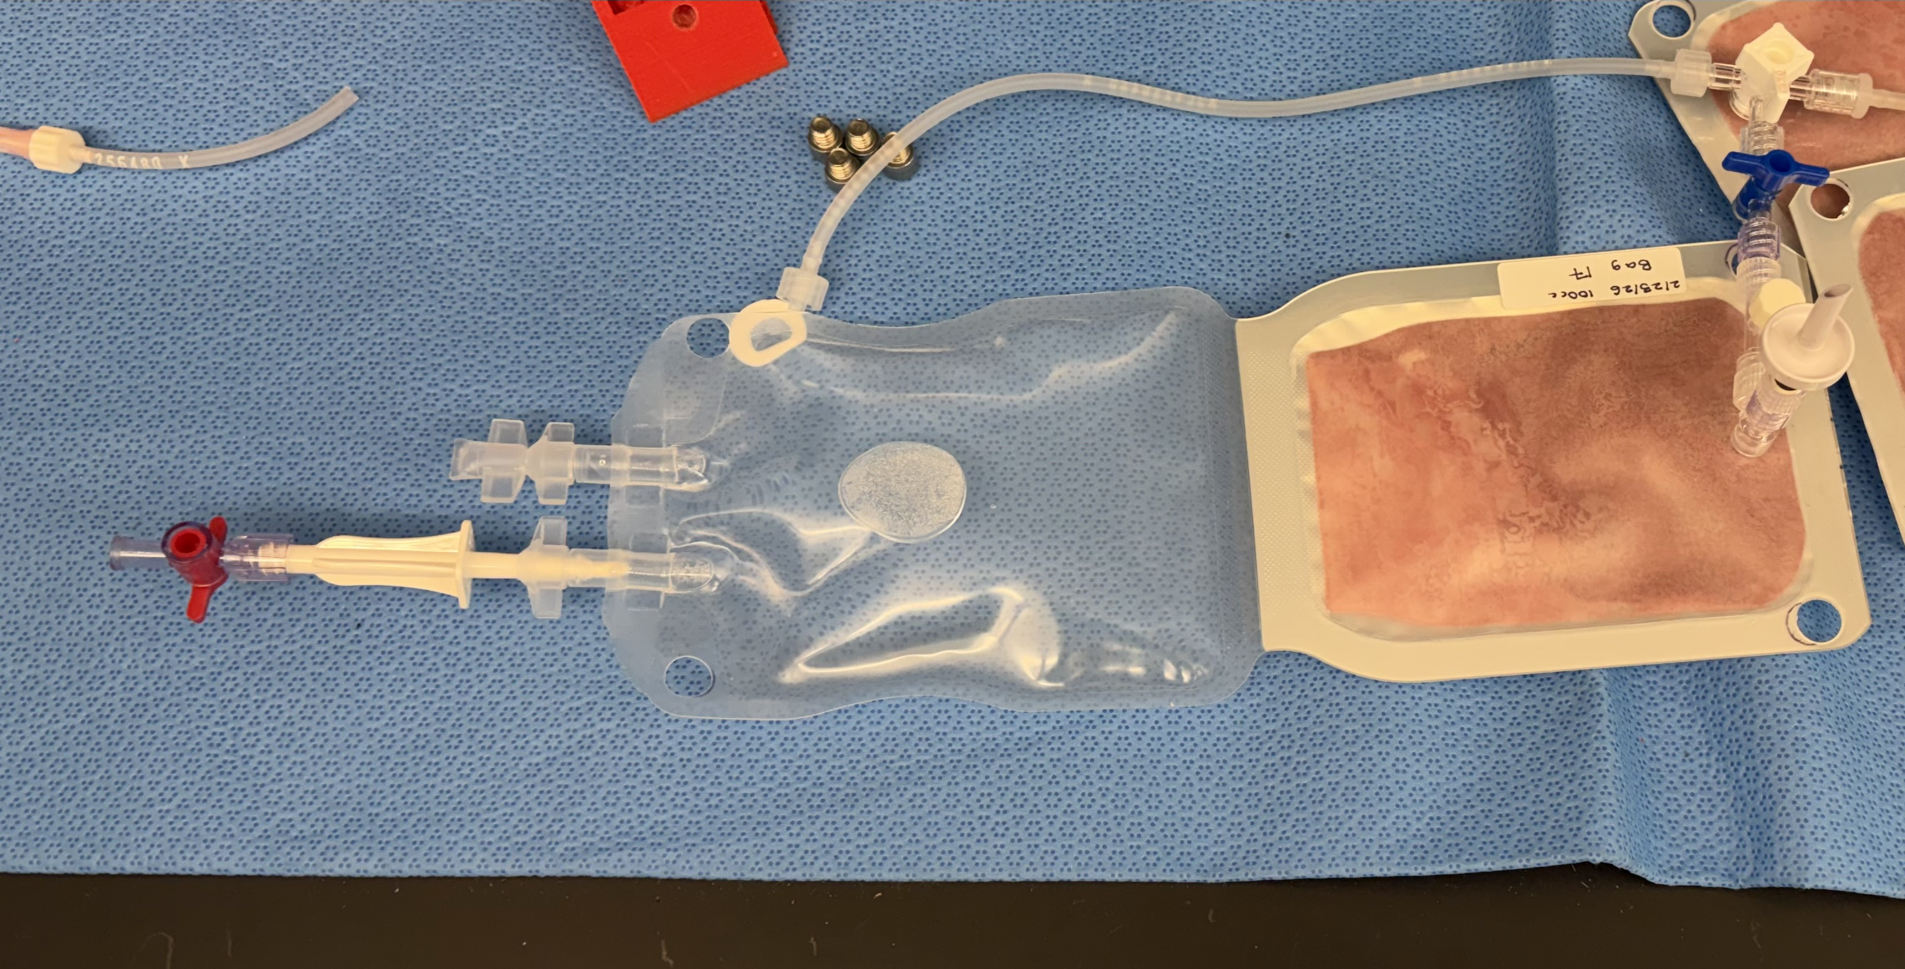
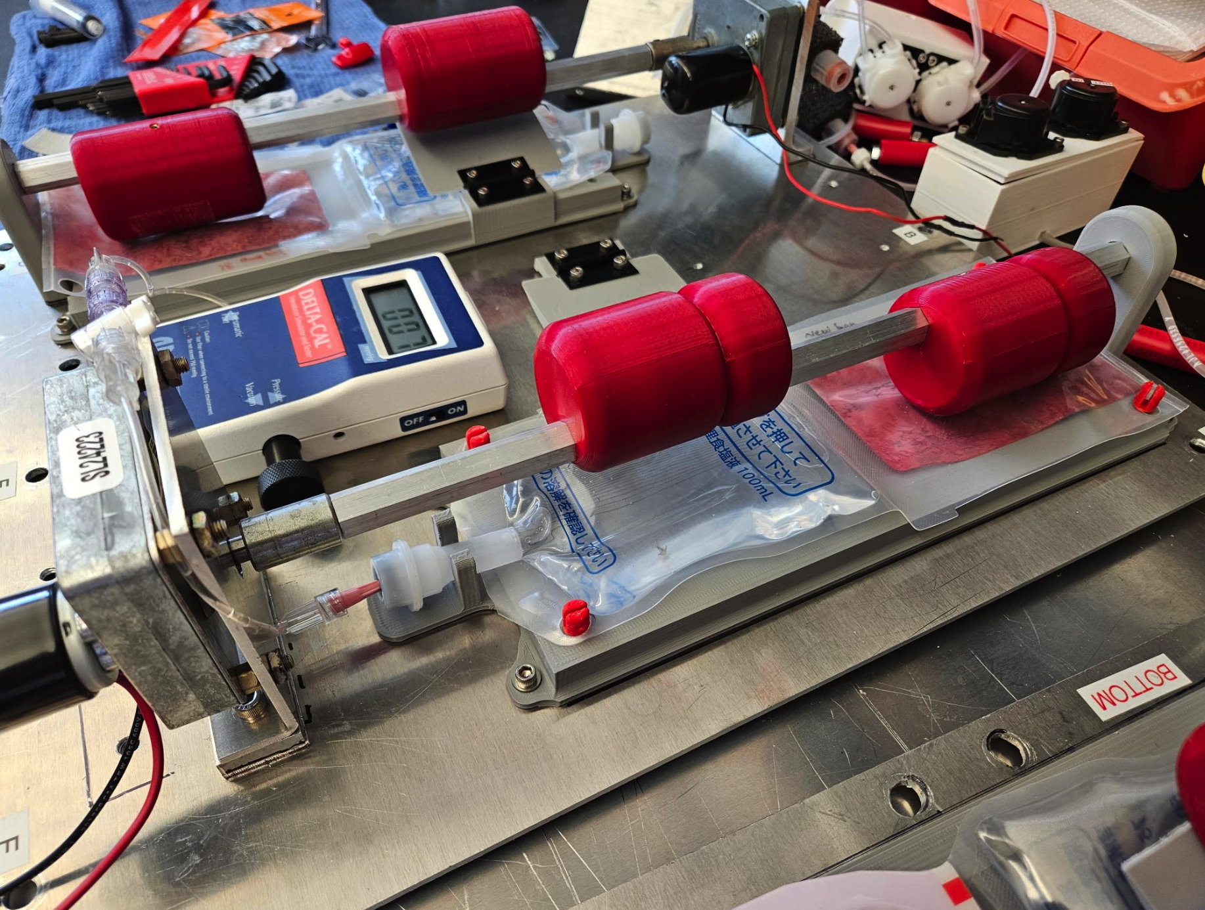
Suborbital Experiment:
Automated dRBC Rehydration (Rupturing a Dual Chamber Blood Bag)
Dehydrated RBCs
IV Spike Port
Rehydration
Solution
Pressure Seal

Slide 5
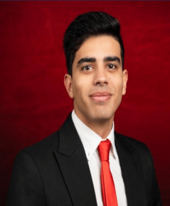
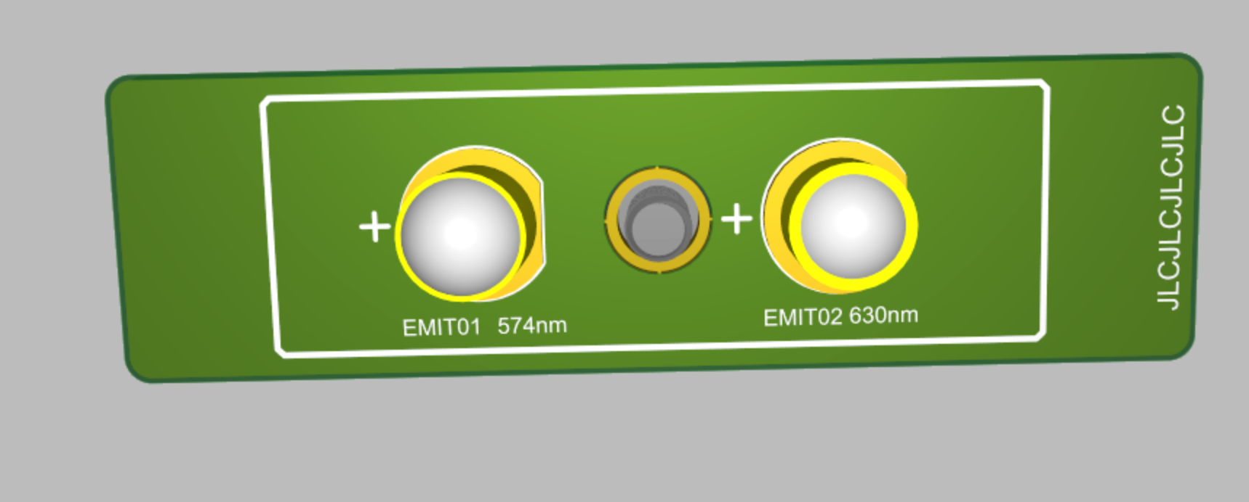
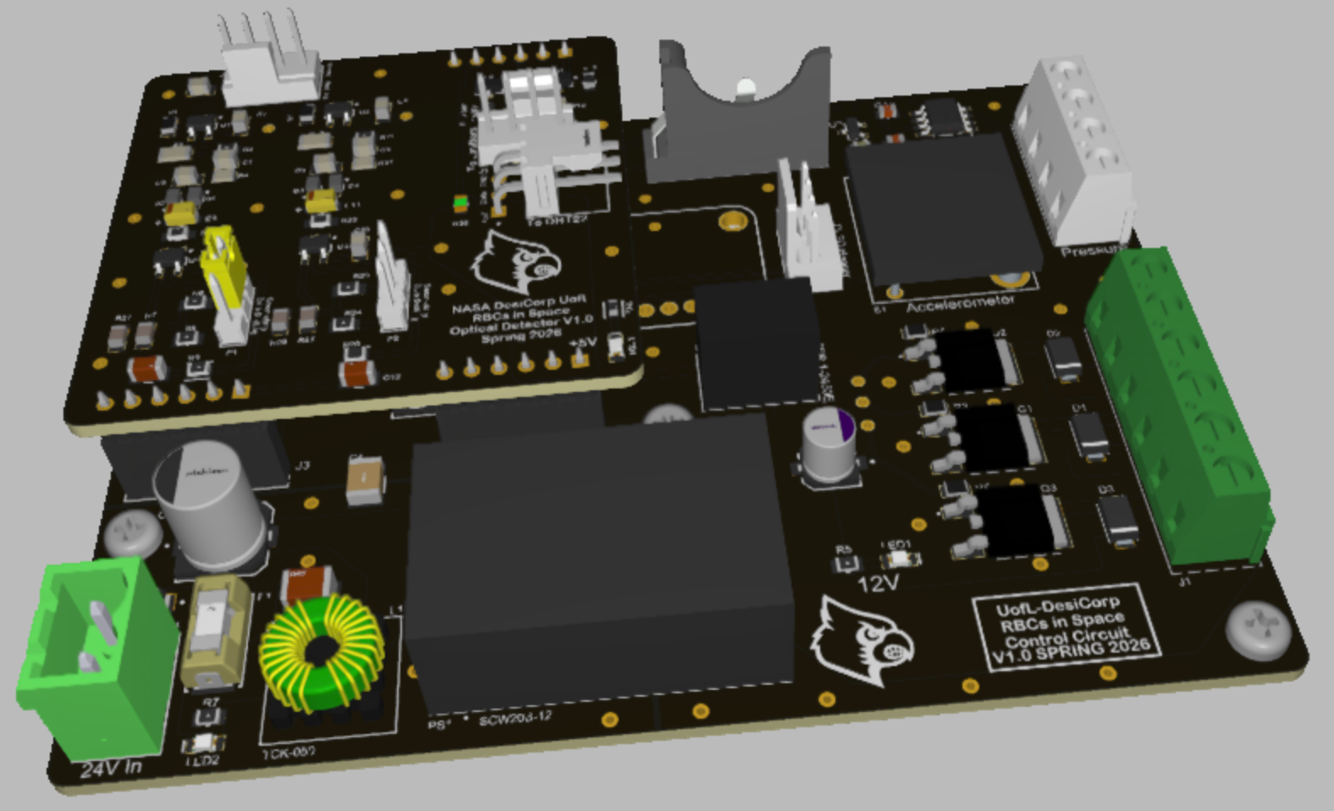
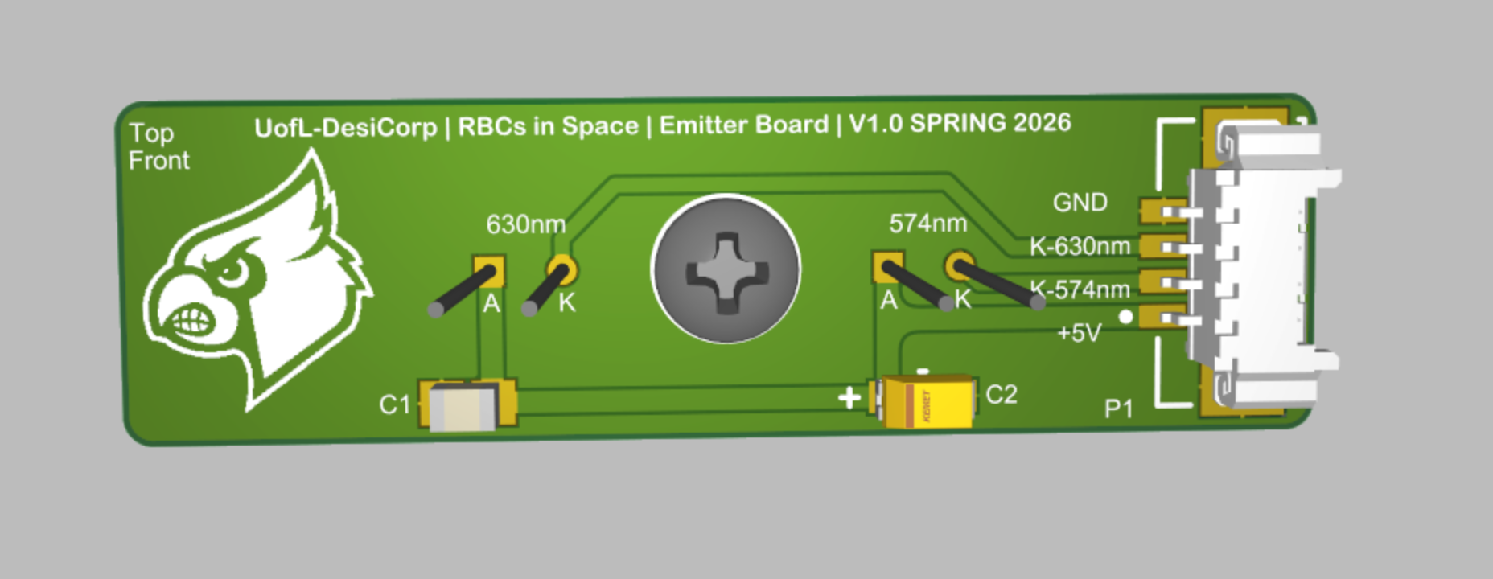
Future Suborbital Flight Experiment (Fa’26/Sp’27)
Project Control PCB design
  Microgravity trigger (used in ‘21 suborbital experiment)
  Experiment automation via tight sequence timing
  Custom analog spectrophotometer circuit
    Dual wavelength (574 nm | 630 nm)
    Quantify O₂ binding capacity of rehydrated RBCs
Samuel Ibrahim
(BE M.S.)
Optical Sensor PCBs

Slide 6
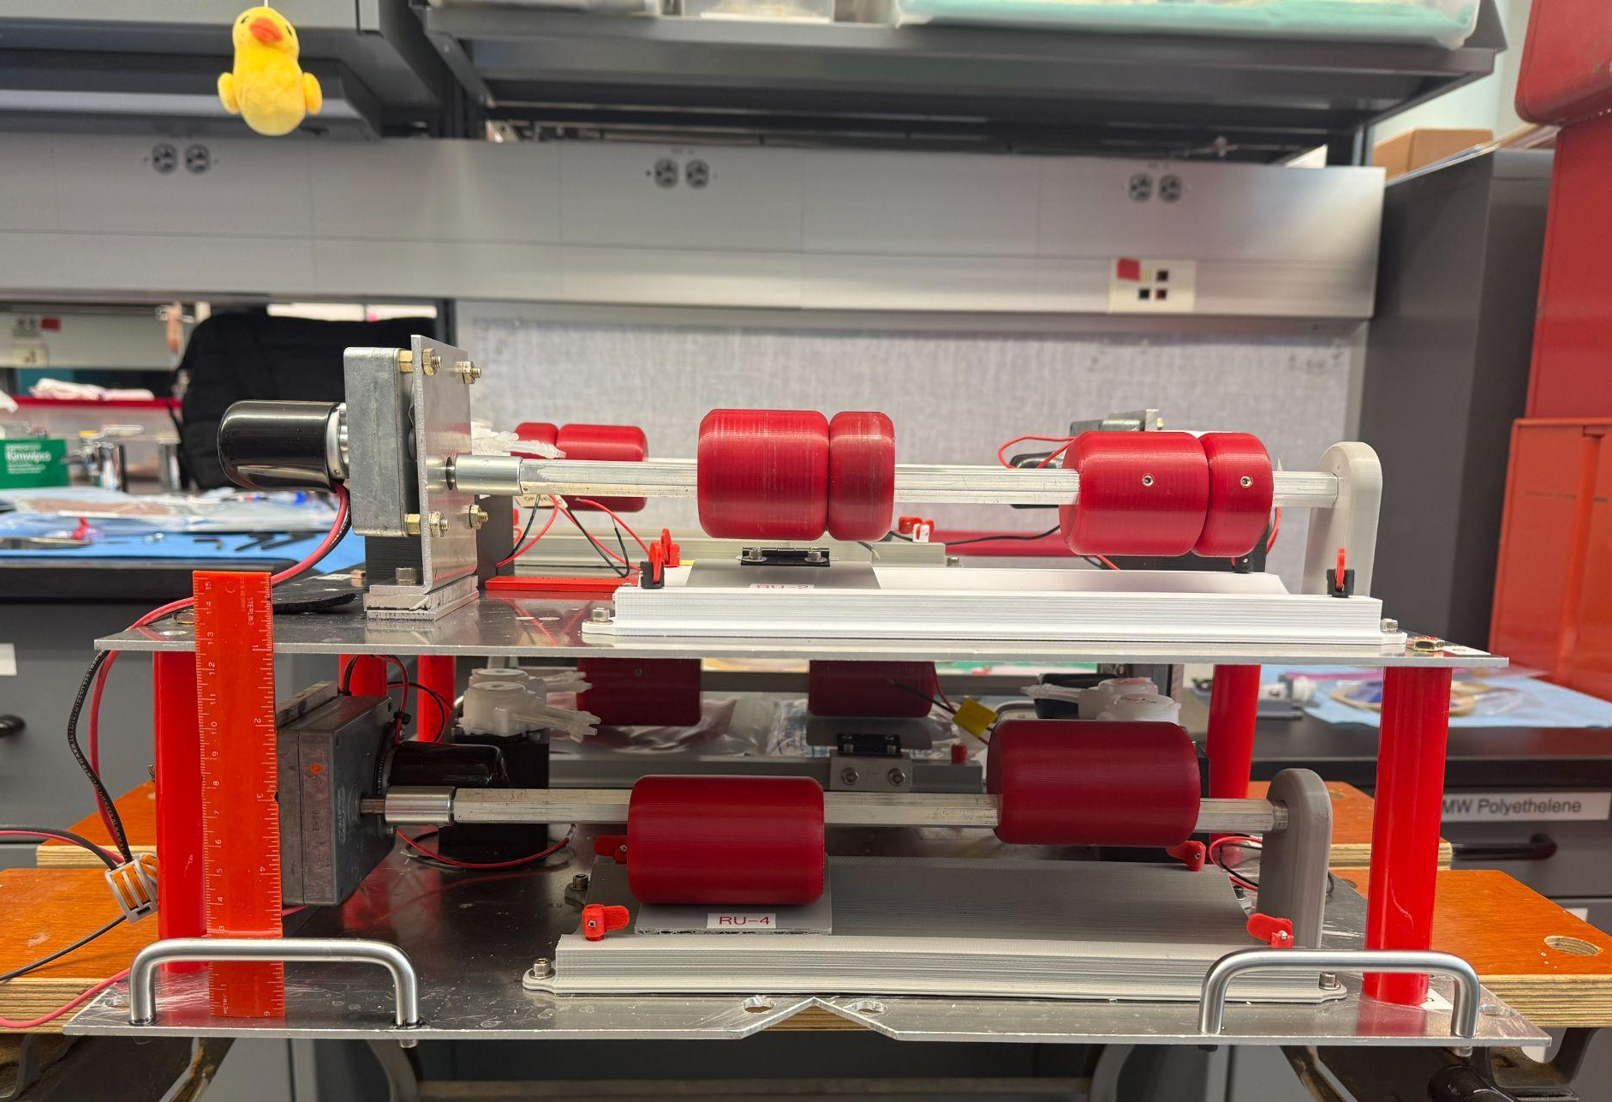
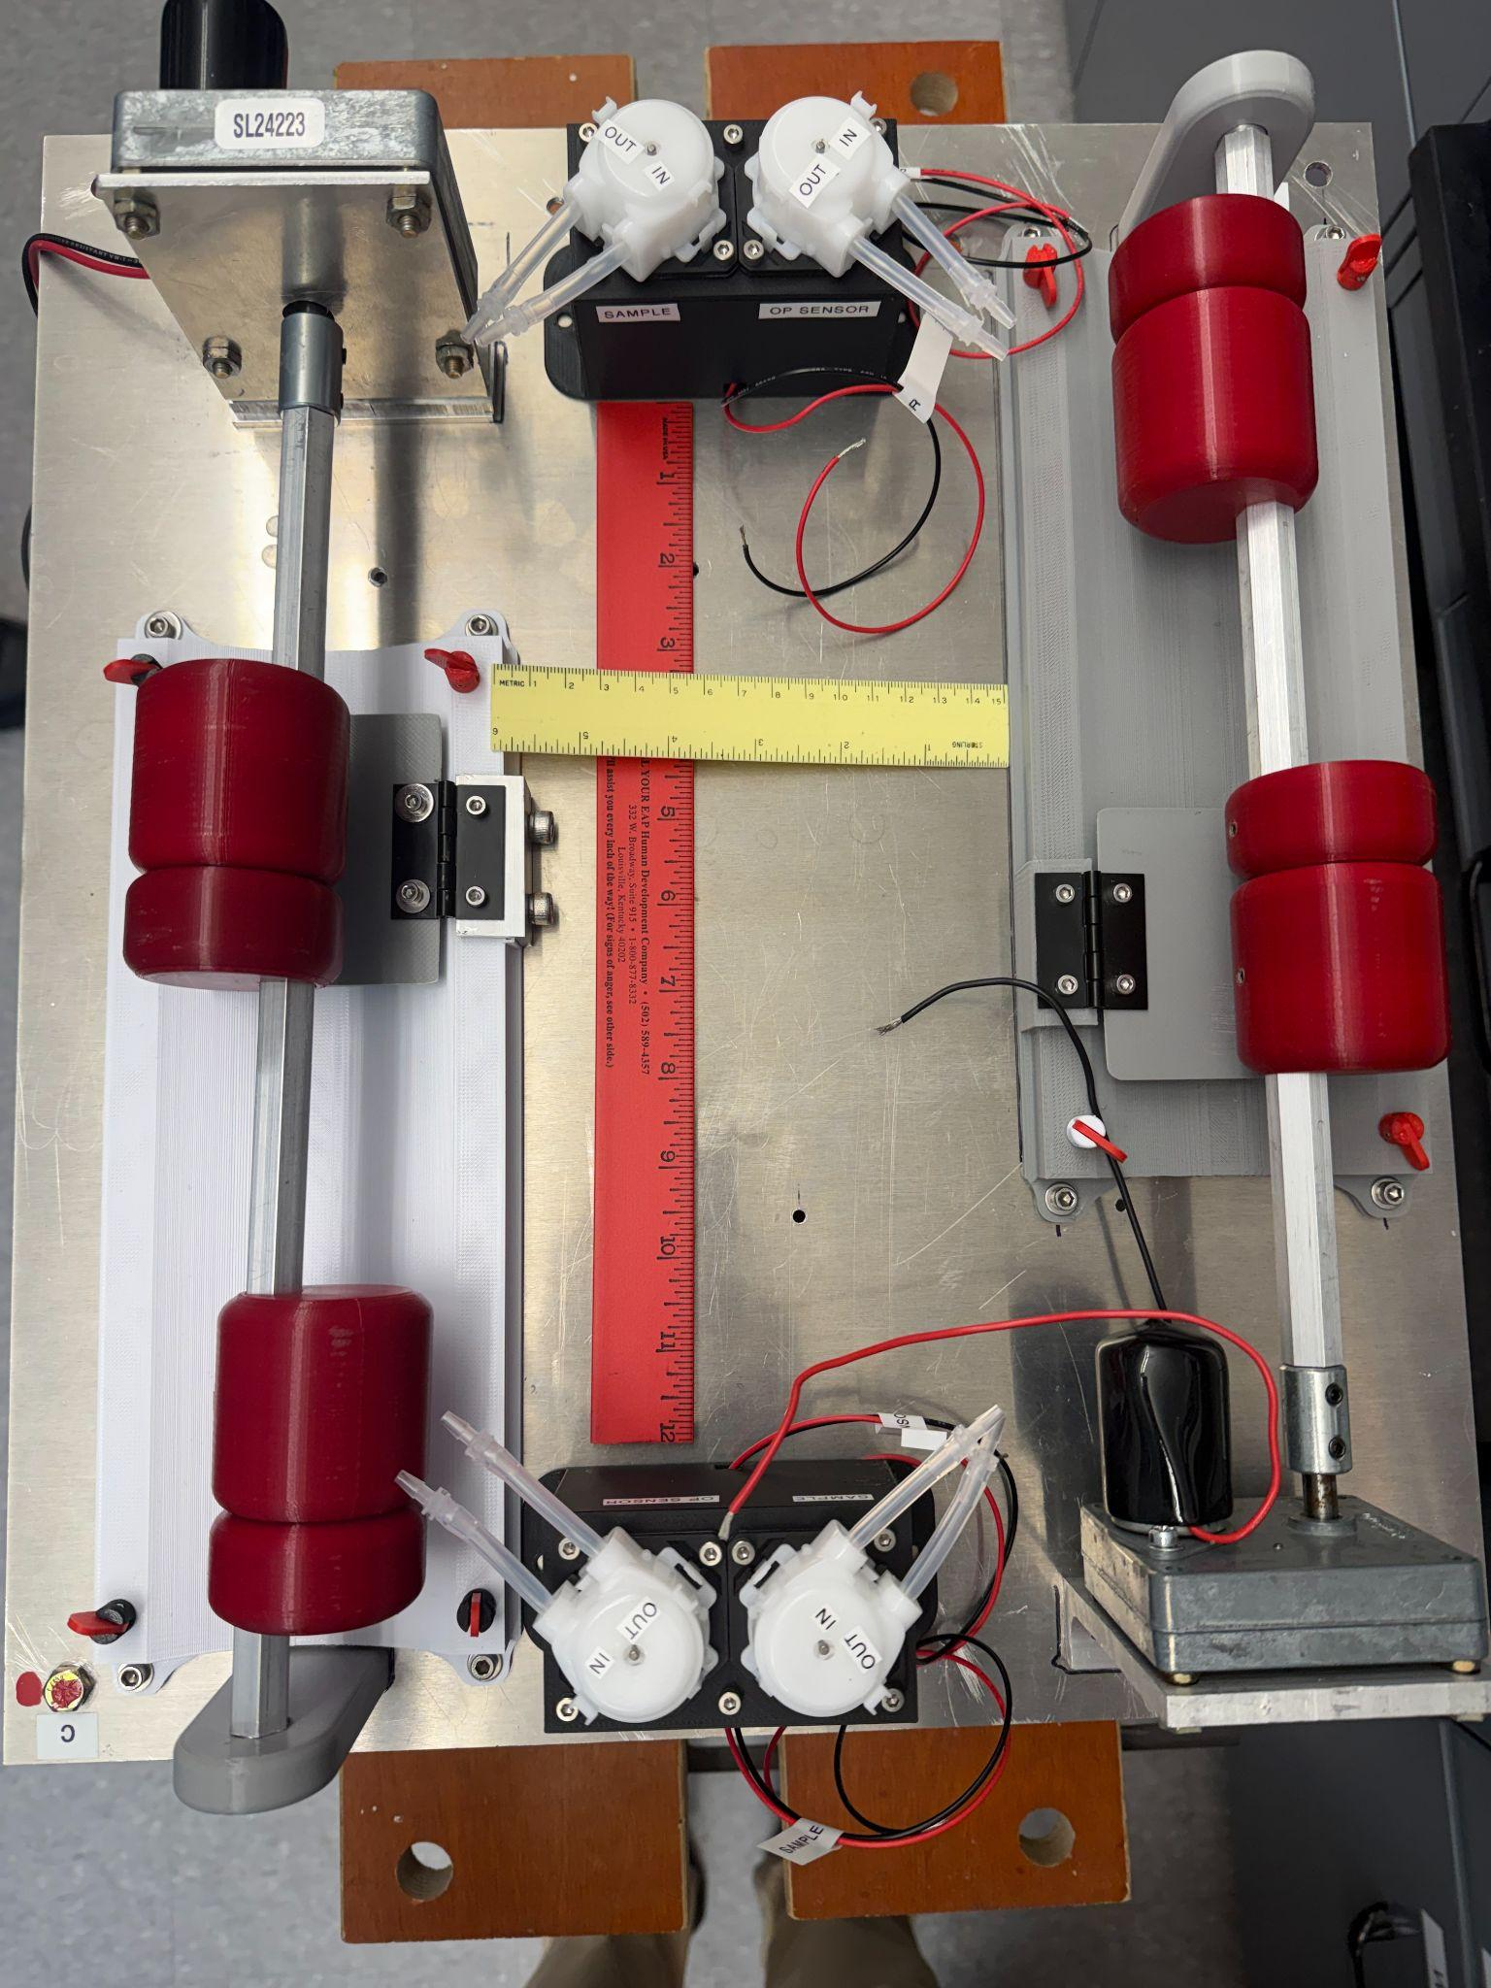
Summer Goal: Complete Development of Control System
Custom Enclosure Design
  Payload restricted volume requirements
  Feedthroughs for fluid and electrical circuits
  Blackout conditions for optical components
Experiment Design and Layout
  Wiring (Layout and installation)
  Fluid Compnents (Layout and installation)
  Optical flow cell evaluation
  Post-Experiment data access
System Validation
  Control circuit assembly and testing
  Software evaluation and refactoring
  Experiment Sequence
  Strict Timing Requirement (< 190 seconds)
  Data format and access
  Spectrophotometer calibration
    574nm
    630nm
Experiment Side View
Experiment Top View

Slide 7
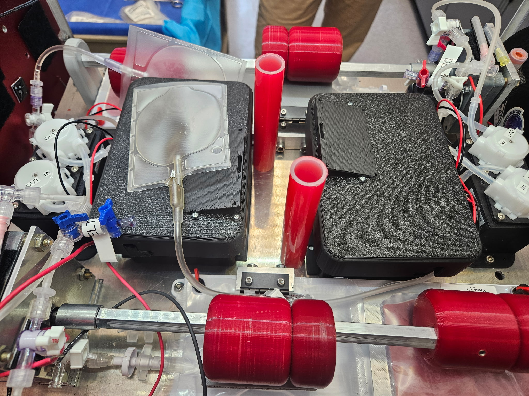
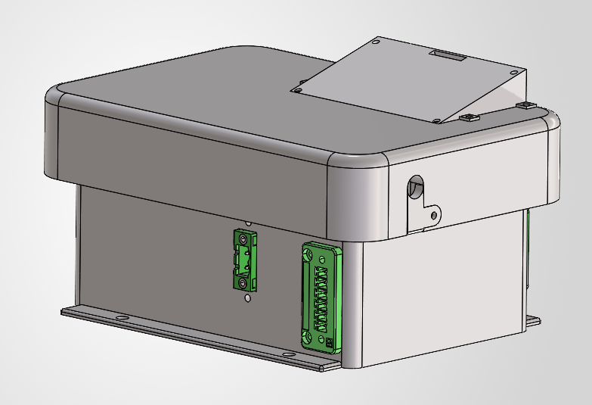
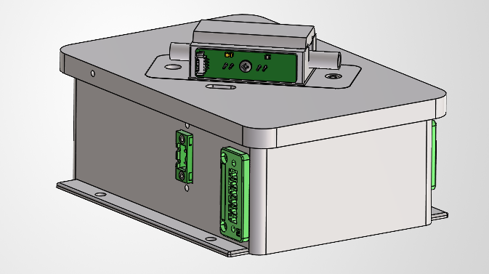
Custom Enclosure Design Progress
Nested design
  Housing for the PCB within the housing for optical sensor
Size constraints dictated by footprint of the experiment board
Various fit-trials have led to the following design and experiment layout (including LCD Display mount)
Fit Trial
Full Assembled Enclosure
Lid Removed to reveal flow components

Slide 8
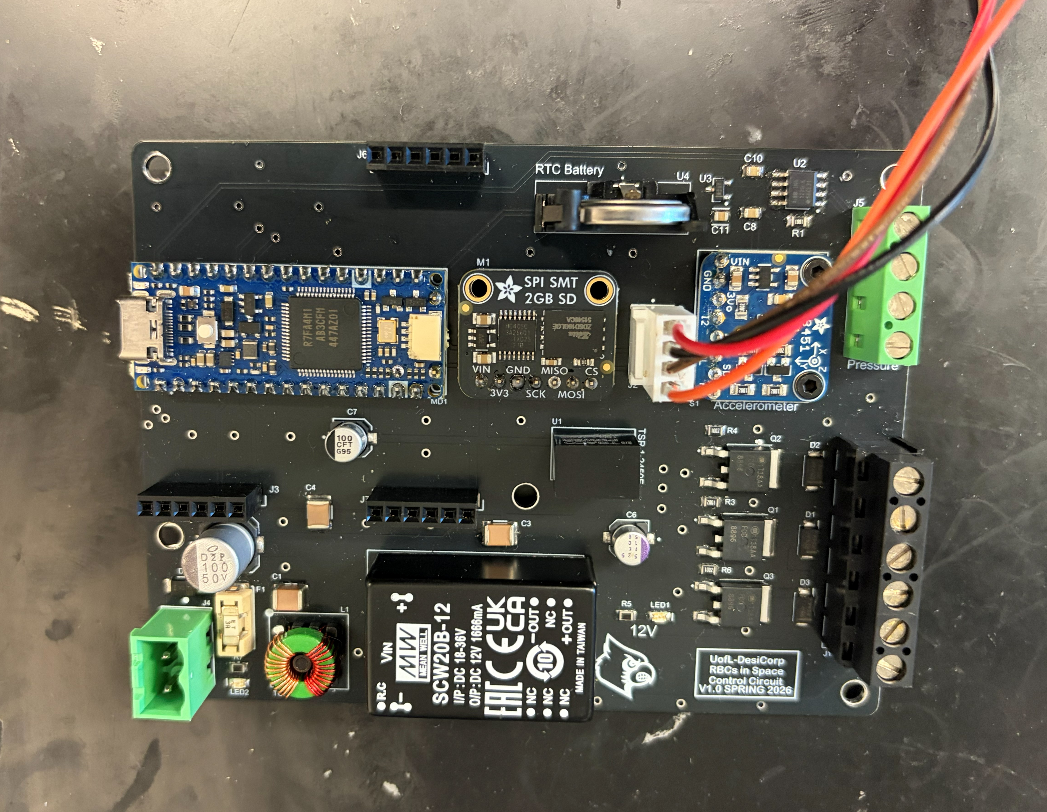
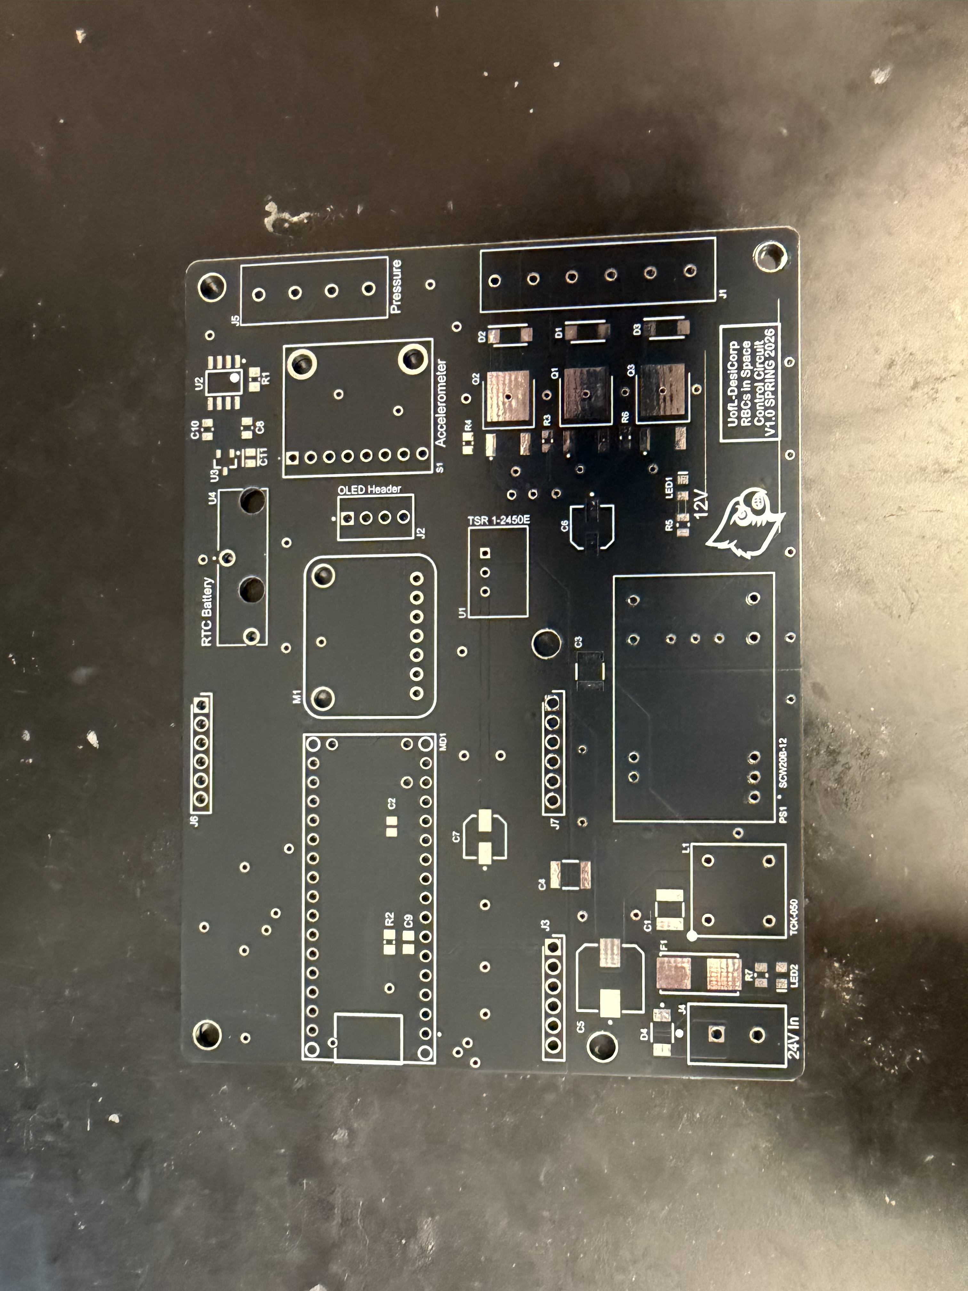
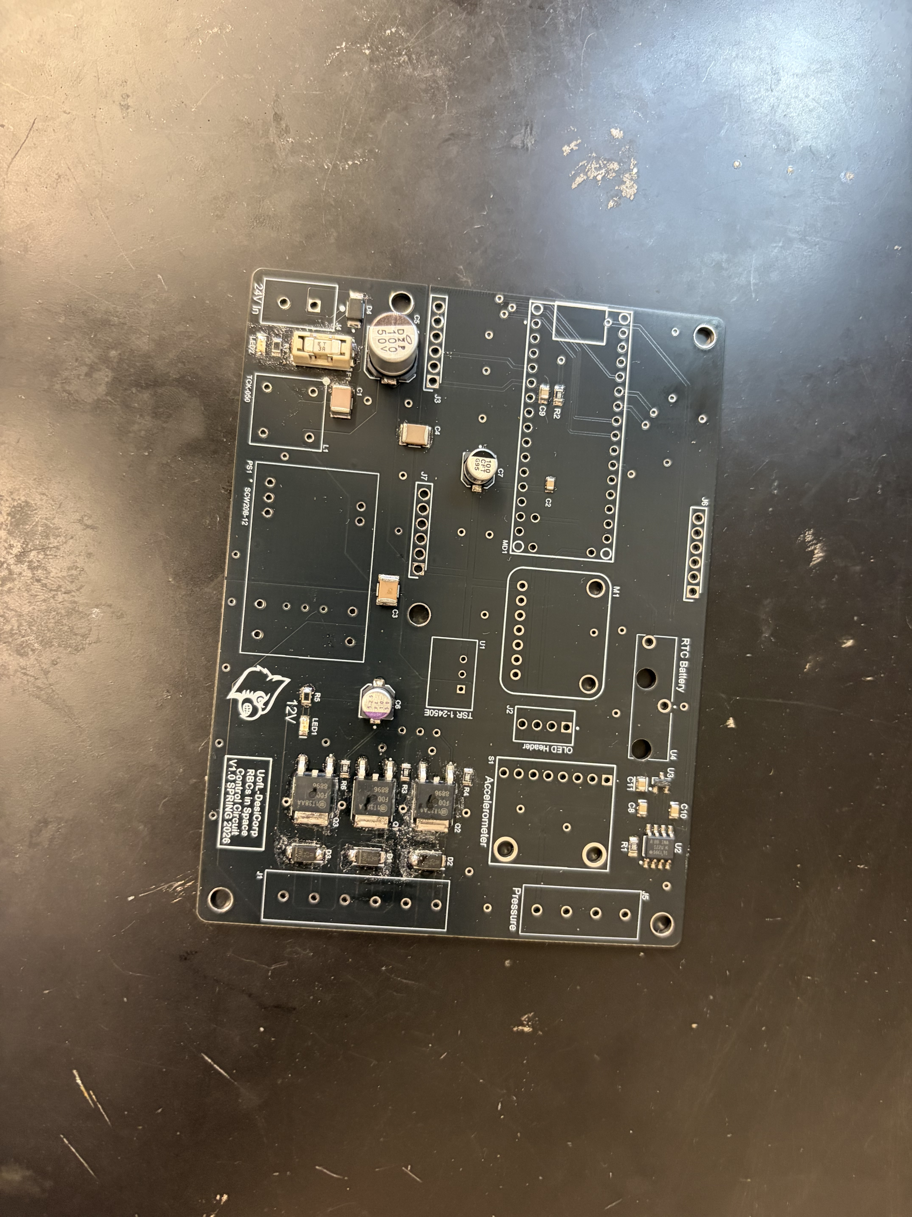
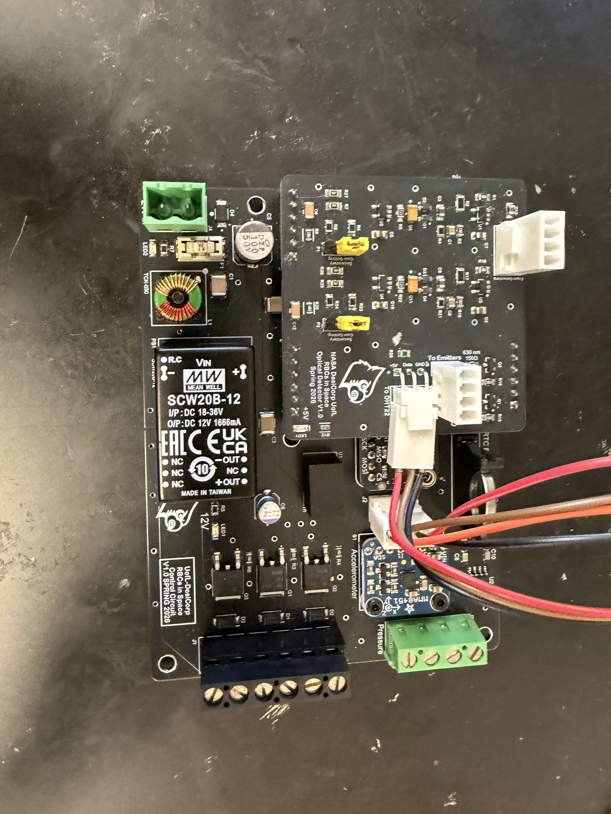
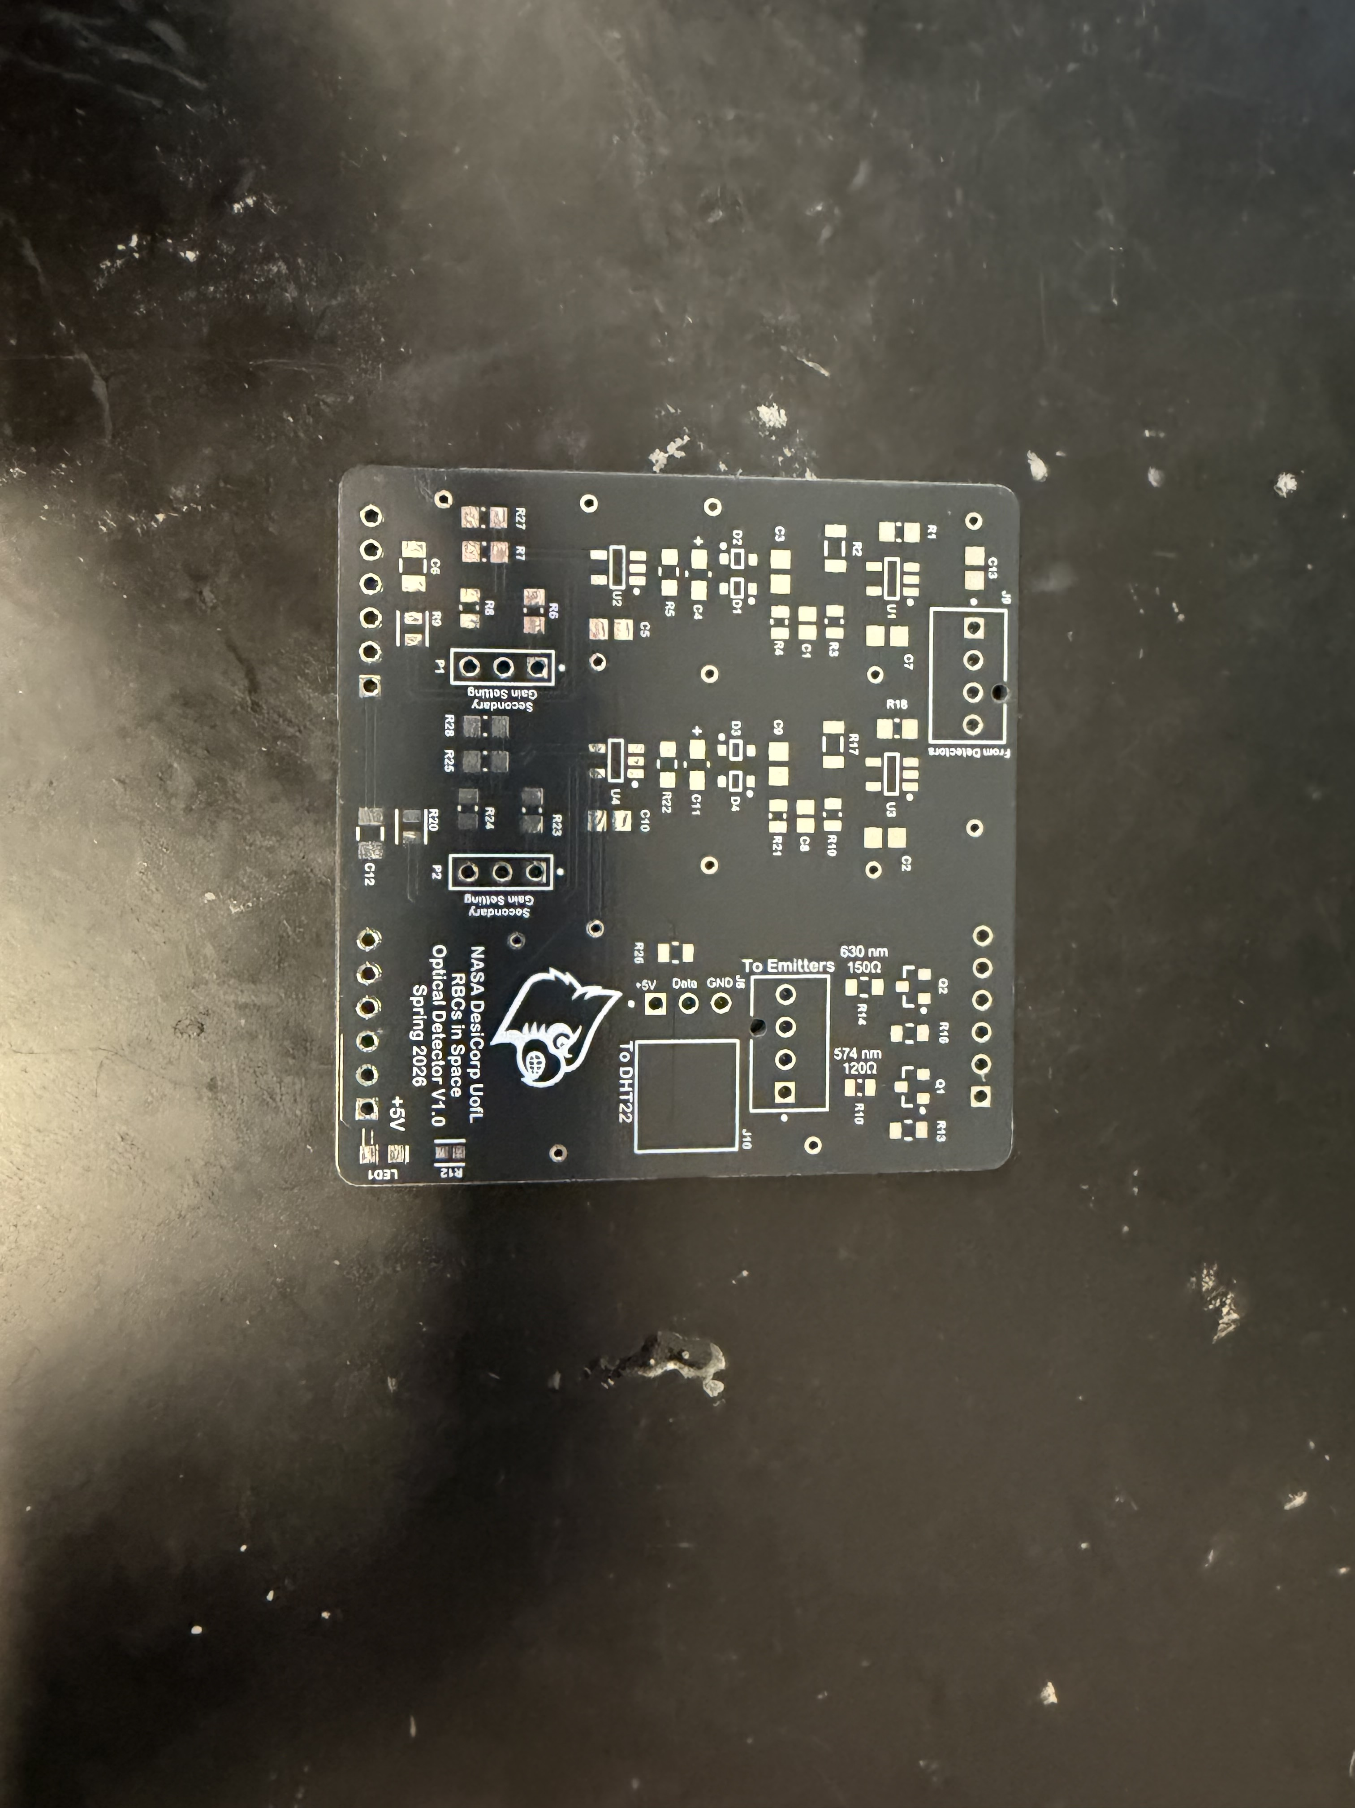
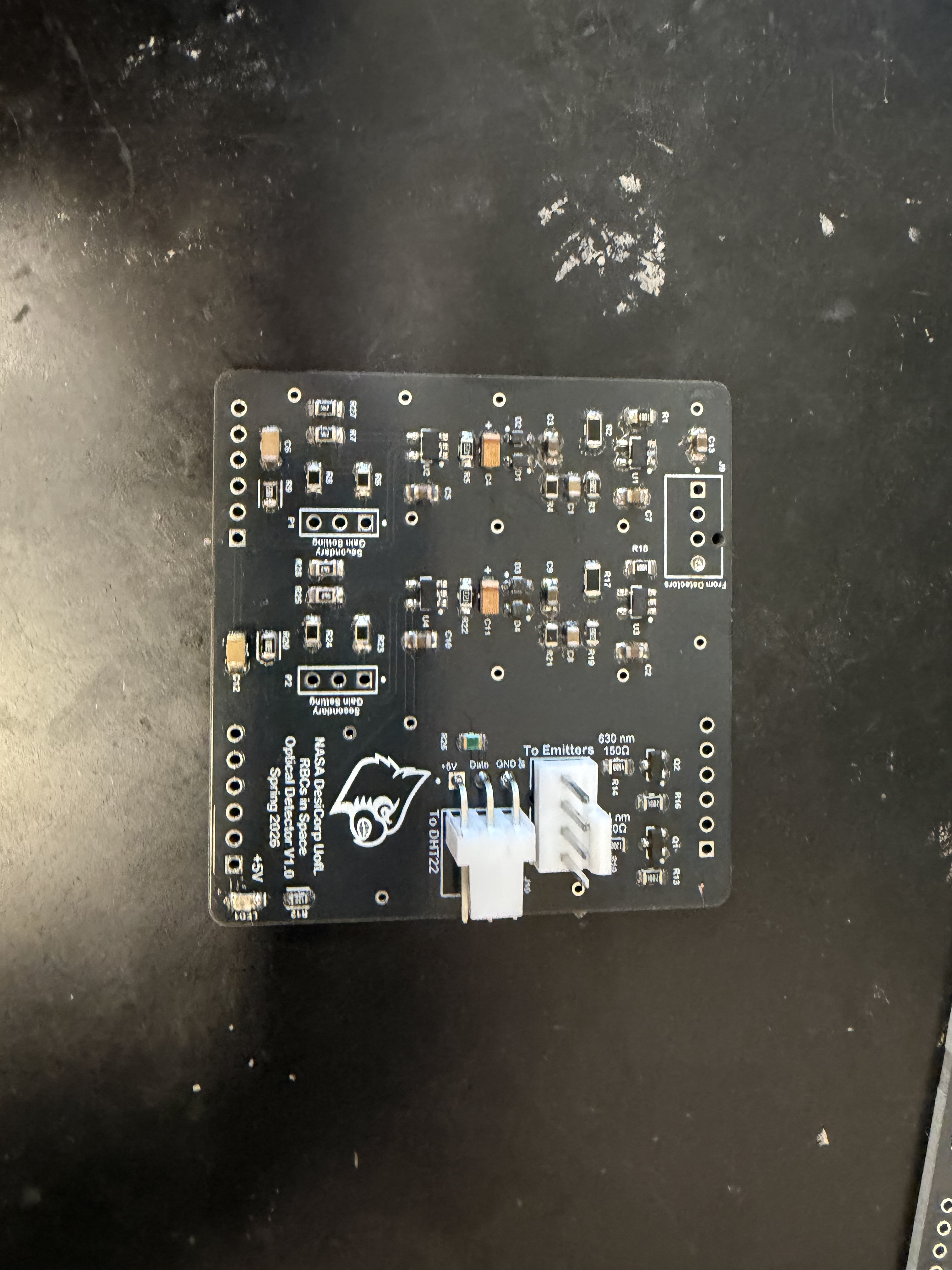
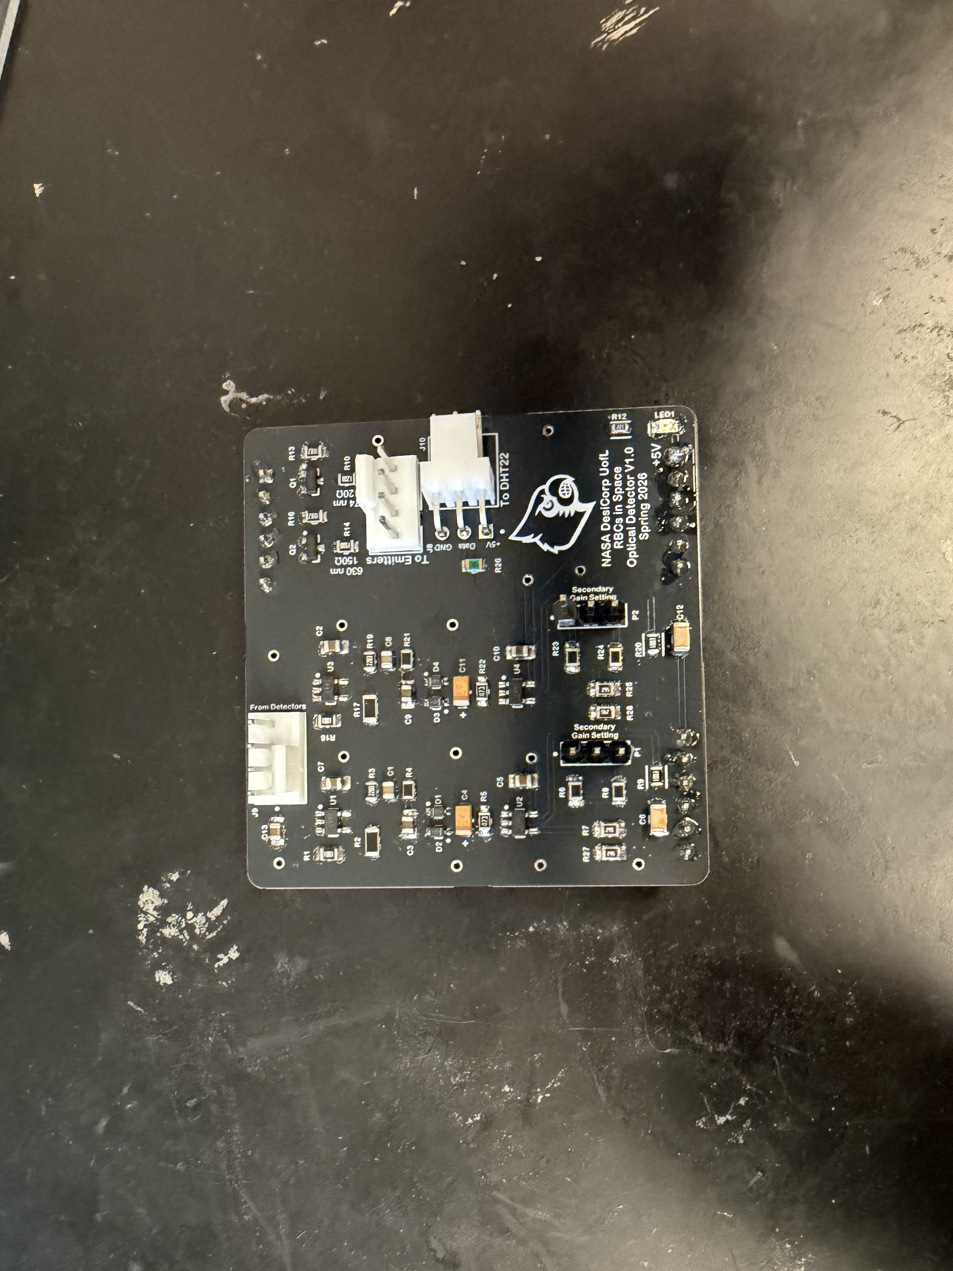
PCB Production
Final Constructed PCB
Final Through-hole Components
Empty Boards
Parts Installation

Slide 9
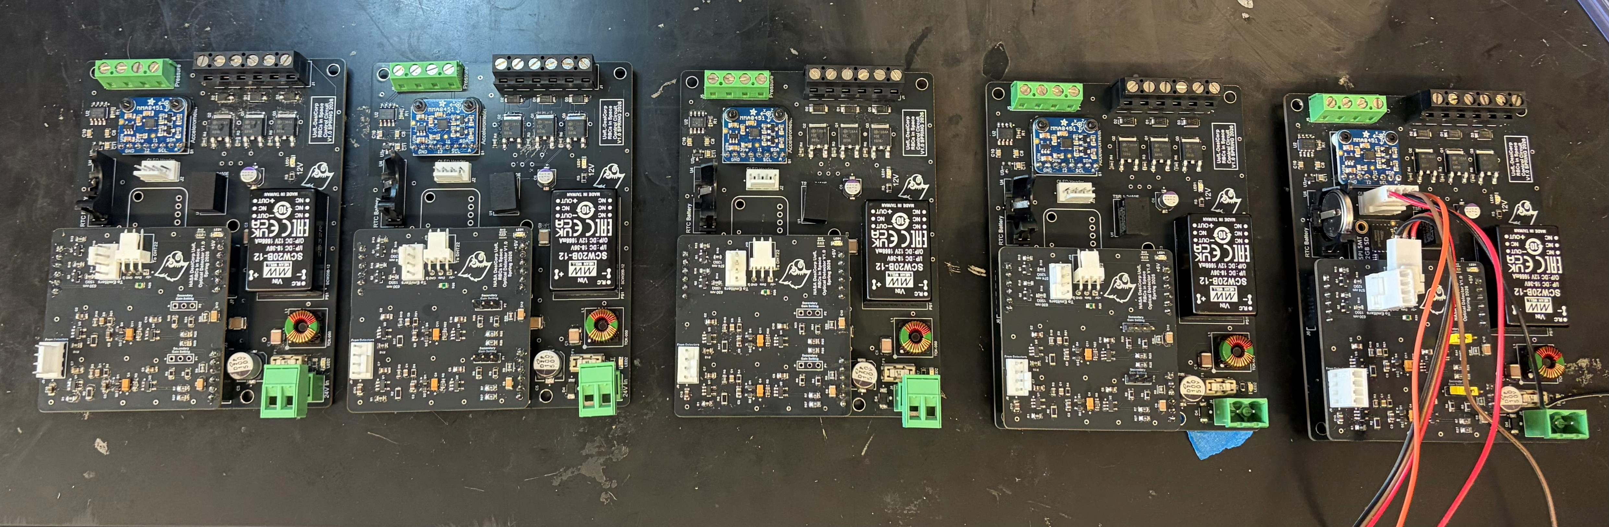
PCB Production
All PCBs have been assembled and are ready for testing
  Flash memory is not attached yet but can test without it

Slide 10
Experiment Block Diagram:
CONTROL
NAND FLASH Storage
XTX Technology Limited
XTSD02GLGEAG
2 GB
NAND FLASH Storage
XTX Technology Limited
XTSD02GLGEAG
2 GB
NAND FLASH Storage
XTX Technology Limited
XTSD02GLGEAG
2 GB
Accelerometer
MMA8451 (I2C)
Accelerometer
MMA8451 (I2C)
24V DC
(From Vehicle)
24V DC
(From Vehicle)
24V DC
(From Vehicle)
POWER
POWER
POWER
Switching Converter
(12V)
Switching Converter
(12V)
Switching Converter
(12V)
Microcontroller
Arduino Nano R4
Renesas RA4M1
Arm® Cortex®-M4
(Includes RTC)
Microcontroller
Arduino Nano R4
Renesas RA4M1
Arm® Cortex®-M4
(Includes RTC)
Microcontroller
Arduino Nano R4
Renesas RA4M1
Arm® Cortex®-M4
(Includes RTC)
TEMPERATURE
DHT22
TEMPERATURE
DHT22
Switching Converter
(5V)
TEMPERATURE
DHT22
Switching Converter
(5V)
Switching Converter
(5V)
PUMP/MOTOR CONTROL
5V N-Channel
POWER MOSFET (3)
PUMP/MOTOR CONTROL
5V N-Channel
POWER MOSFET (3)
PUMP/MOTOR CONTROL
5V N-Channel
POWER MOSFET (3)
SPECTROPHOTOMETER
574nm 630nm
(Custom Analog Circuit)
SPECTROPHOTOMETER
574nm 630nm
(Custom Analog Circuit)
SPECTROPHOTOMETER
574nm 630nm
(Custom Analog Circuit)
10

Slide 11
MOSFET
5V N-Channel
EMITTER
574nm/630nm
Tone Generator (1.5kHz Sq. Wave)
EMITTER STAGE
Light Output
PHOTOTRANSISTOR
Vishay TEPT5600
Peak Sensitivity 570nm
Spectral BW440 to 800nm
Voltage Output
DETECTOR STAGE
GAIN A
High Pass Filter
Voltage Clamp
Low Pass Filter
GAIN B
(Adjustable)
Analog Input
(0-5V) 14-bit
Spectrophotometer Circuit Block Diagram

Slide 12
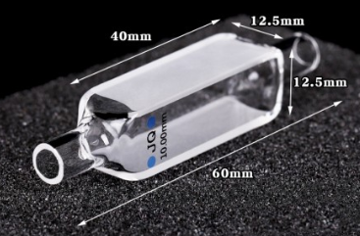
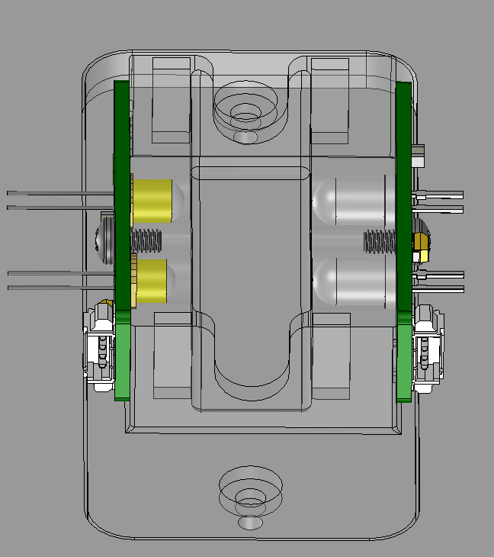
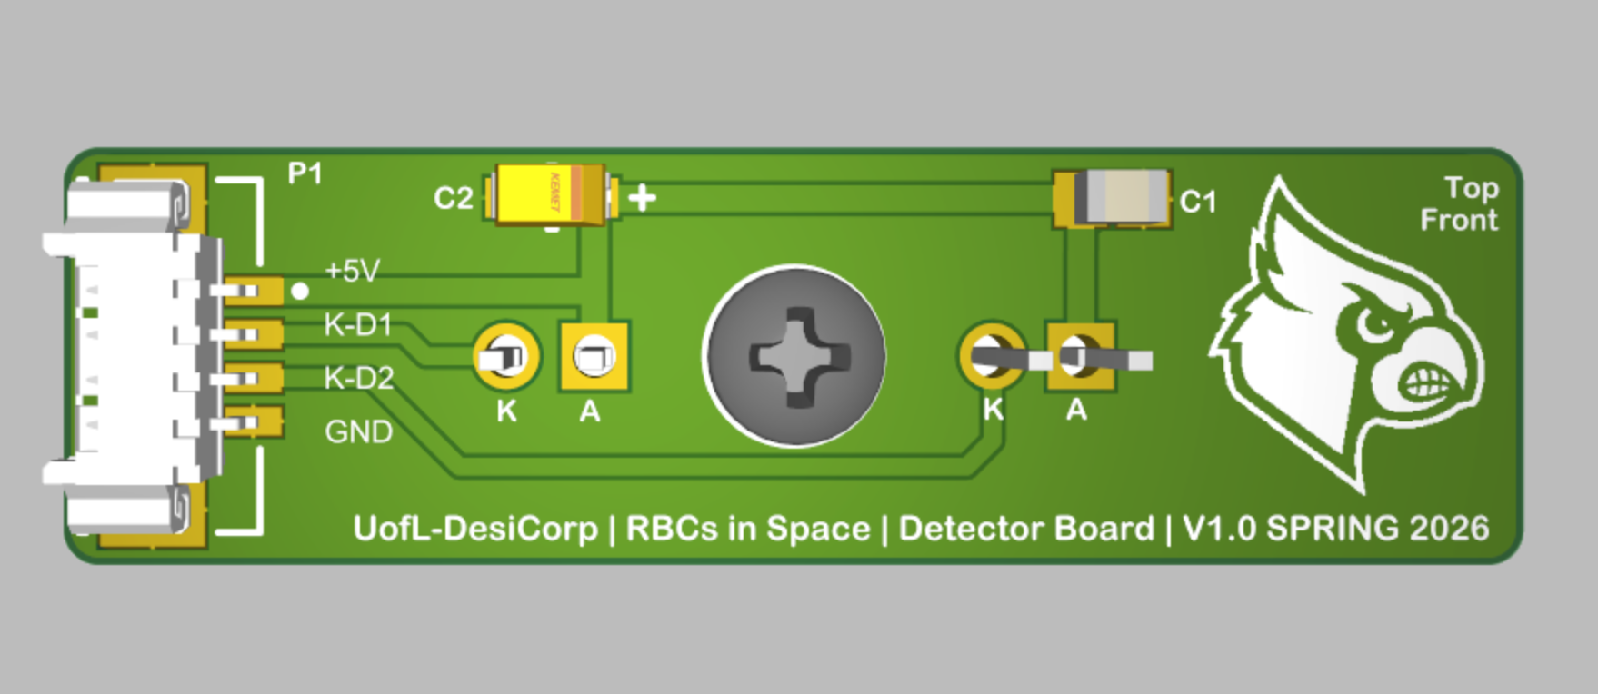
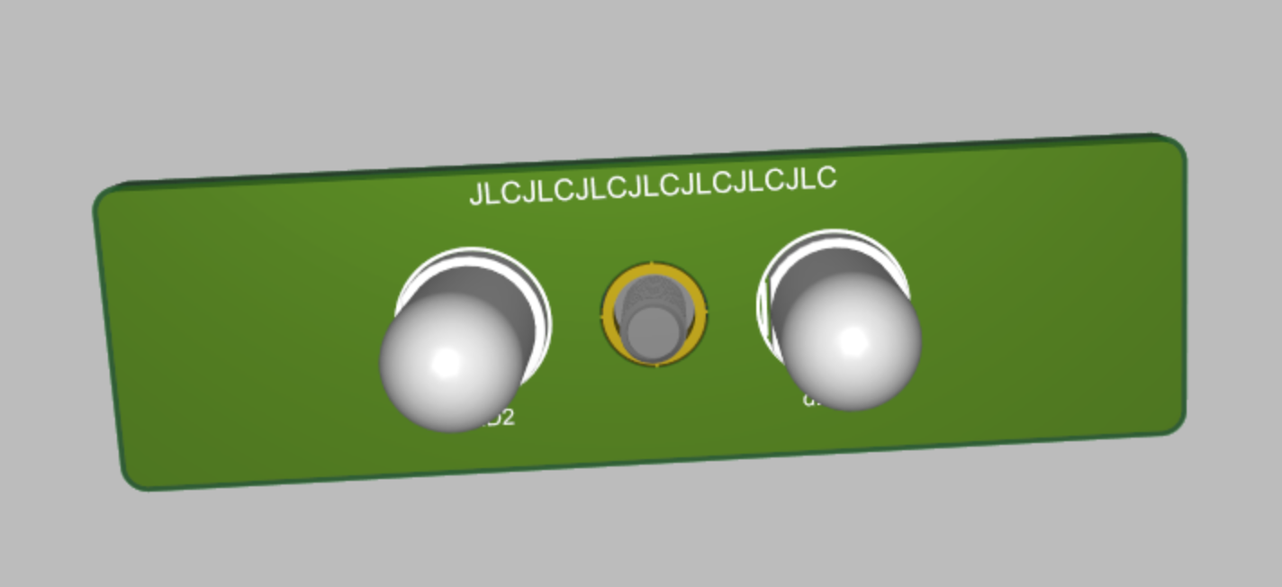
Optical Detection Functionality
Tubing from rehydration stage feeds into a flow cuvette
Optical circuit designed to quantify oxyhemoglobin and methemoglobin
2 LED Emitters
  Narrow wavelength
  Oxyhemoglobin at ~574 nm
  Methemoglobin at ~630 nm
"Quality” rehydration
  ≥ 90% oxyhemoglobin
  ≤ 10% methemoglobin
  1% tolerance for hemolysis
Calibration Steps
  Serial dilution of rehydrated RBC to
  create calibration curve
  Transmittance Vs. Concentration
  curve

Slide 13
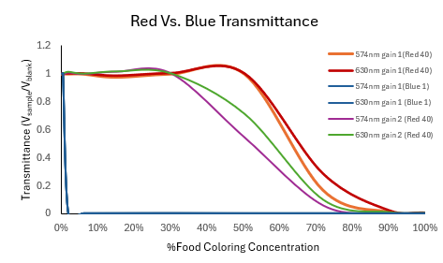

Procedural Calibration of Spectrophotometer
Serial Dilution of two food colorings
  Red 40
  Blue 1
Two measurements for each concentration to evaluate the gain settings
Transmittance was analyzed
  Lower gain setting potentially unusable
Provides an example procedure for future calibration with rehydrated RBCs
Transmittance Equation:

Slide 14
Conclusion
Accomplished Work
  Custom enclosure design, fabrication, and fit testing
  Confirmed Experiment Layout (electrical and fluidic circuits)
  PCBs populated and flashed with current control software version
  Validation of analog spectrophotometer circuit
Future Work
  Minor refinements to enclosure for optimal fit
  Validation of experimental with each control PCB
  Calibration with rehydrated RBCs
    Potential adjustment to fixed analog signal gain settings

Slide 15
References
Elgengehy, I. Design, Calibration, and Validation of a Single‑Wavelength Spectrophotometer Circuit for Reconstituted Dehydrated Red Blood Cells in Zero Gravity. BE‑691 Non‑Thesis Project Report, University of Louisville (2025).
Ibrahim, S. Design and Validation of an Automated Control System for Rehydrated RBC Analysis in Suborbital Flight. Master’s Project Report, University of Louisville, Department of Bioengineering (2026).
Trudel, G., Shahin, N., Ramsay, T. et al. Hemolysis contributes to anemia during long-duration space flight. Nat Med 28, 59–62 (2022). https://doi.org/10.1038/s41591-021-01637-7
G. Pantalos et al., "Preserved Red Blood Cells for Transfusion Therapy in Reduced Gravity," NASA HRP Investigators' Workshop, 2024

Slide 16
Thank you!
Acknowledgements:
Thomas Roussel, Ph.D.
George Pantalos, Ph.D.
Samuel Ibrahim (BE M.S.)
Islam Elgaengehy (BE M.S.)
Brett Janis, Ph.D.
Jonathan Kopechek, Ph.D.
Michael Menze, Ph.D.
Questions?
NSF REU Award ID # 2348869
NSF NNCI Award ID # 2025075

Slide 17
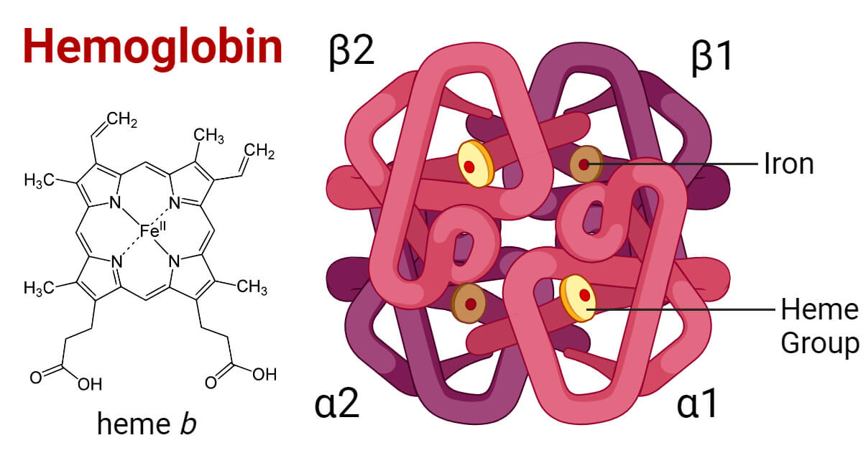
Hemoglobin Structure
https://microbenotes.com/hemoglobin/

Slide 18

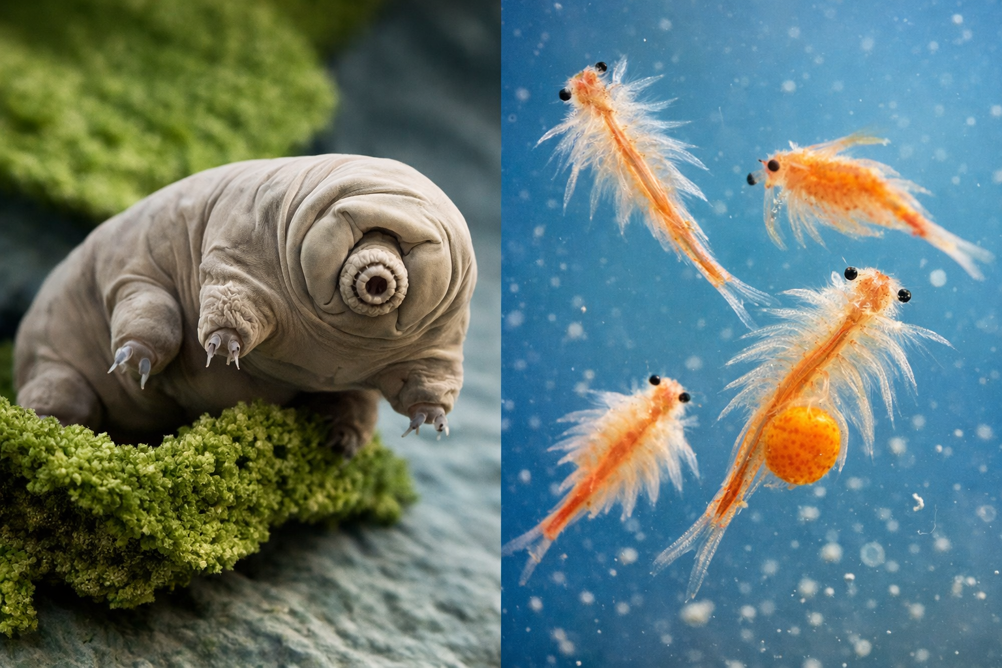
Emerging Preservation Strategies: How it is Done
Lyophilization (Freeze-Drying) is the current mechanism to dehydrate RBCs.
Mechanism: Cells treated with a cryoprotectant (like trehalose, a sugar used by water bears and sea monkeys) to prevent the cell membrane from shattering during drying
Brett Janis, Ph.D.
Jonathan Kopechek, Ph.D.
Michael Menze, Ph.D.

Slide 19
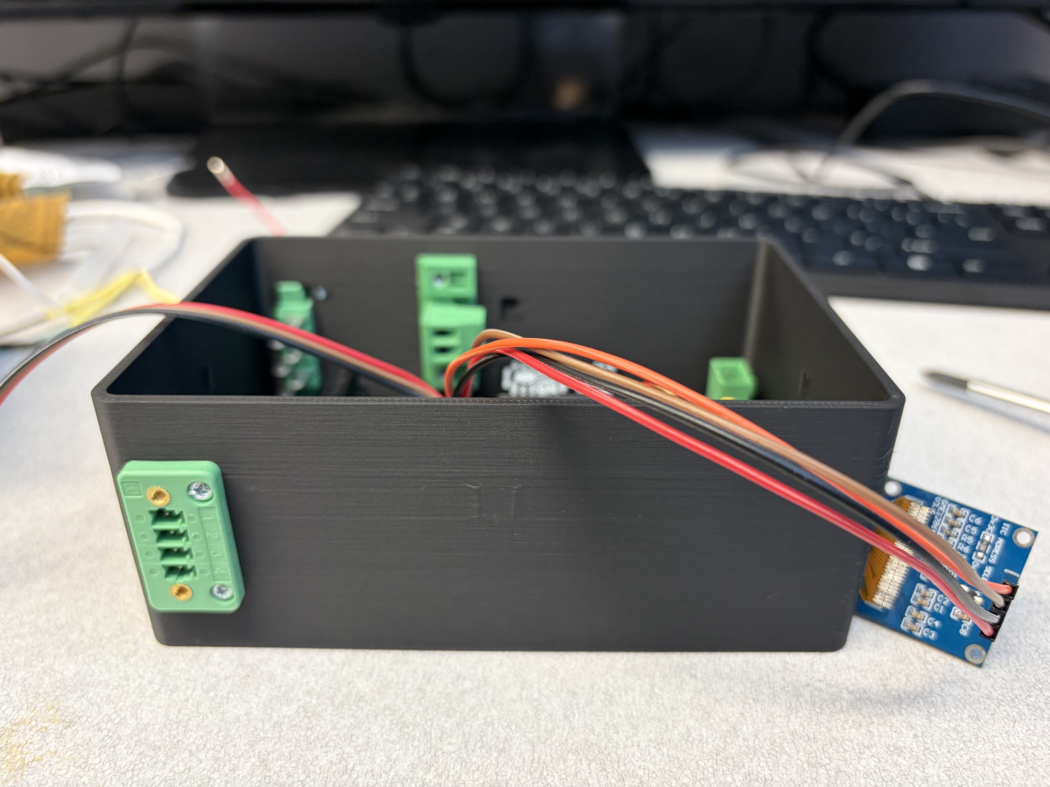
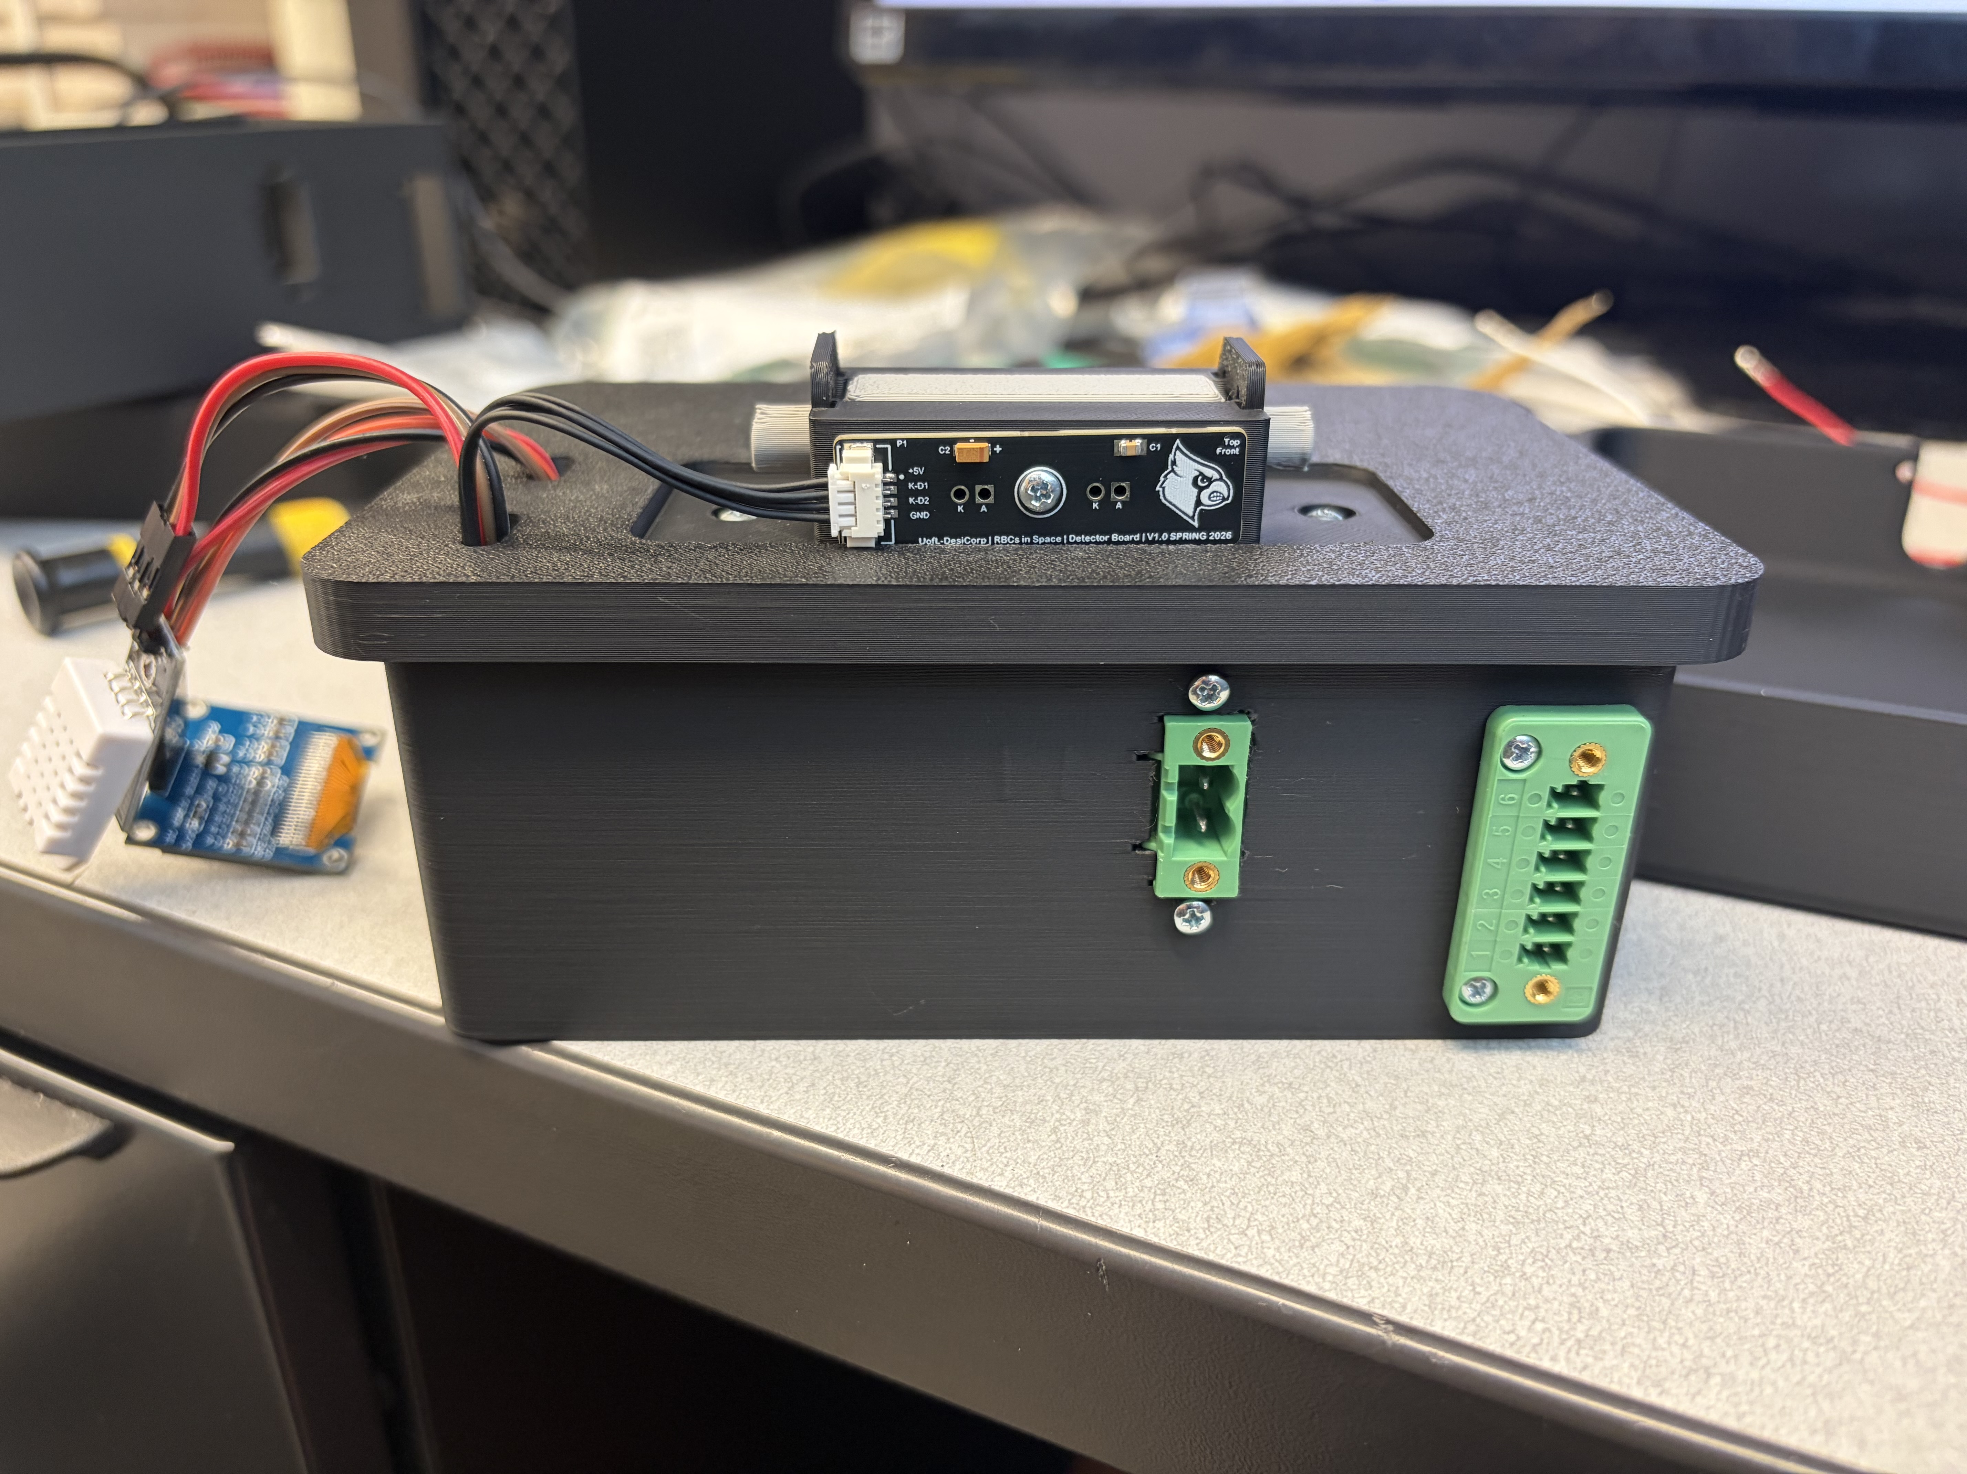
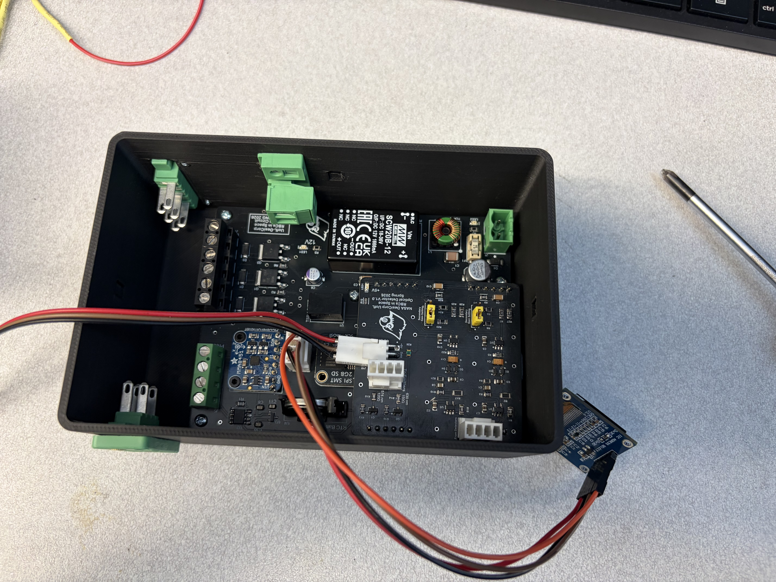
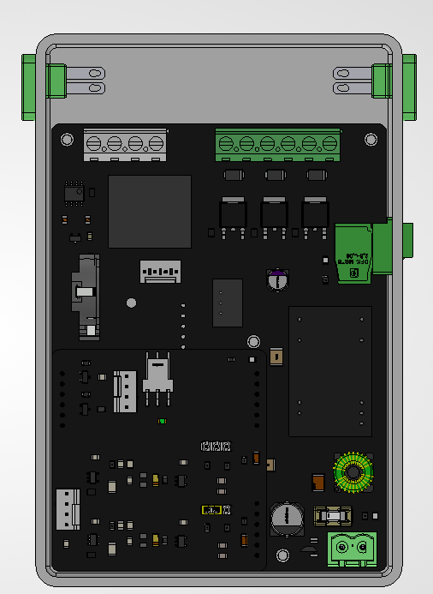
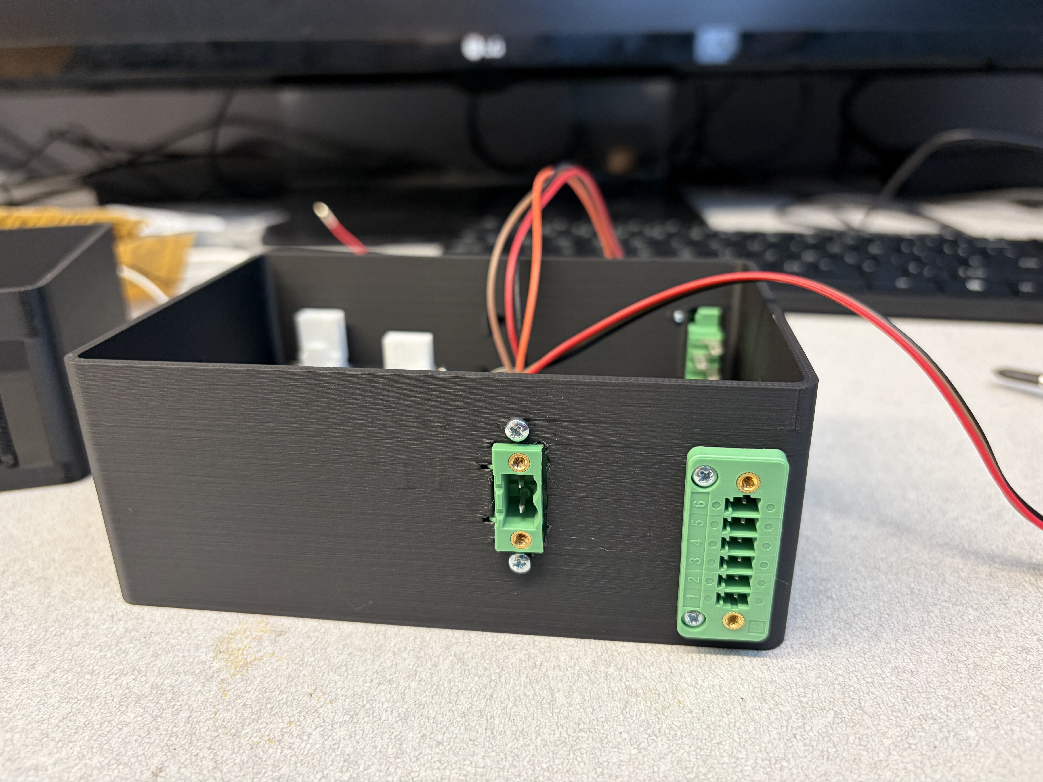
PCB & Enclosure Integration

Slide 20
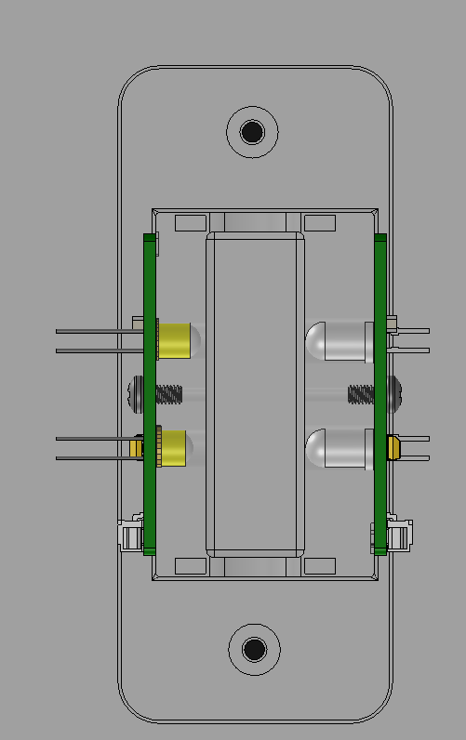
Optical Sensor Integration

Slide 21
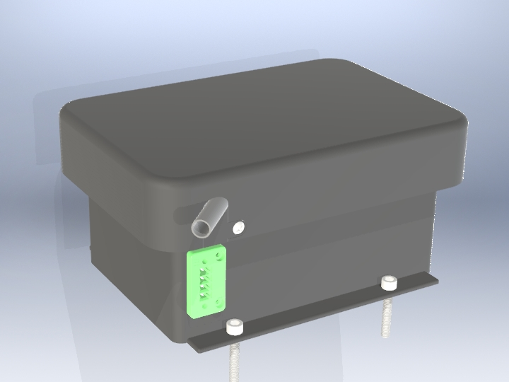
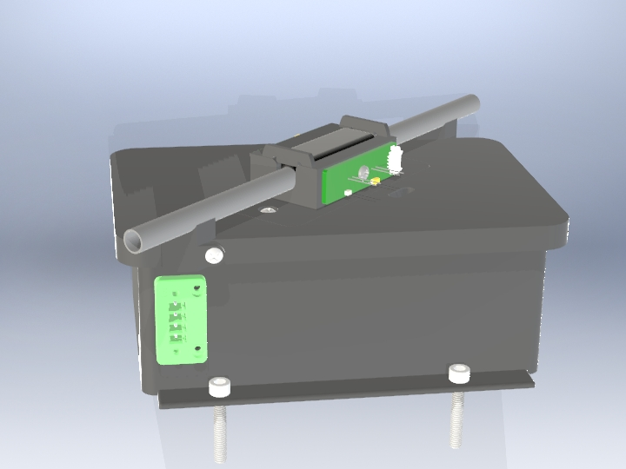
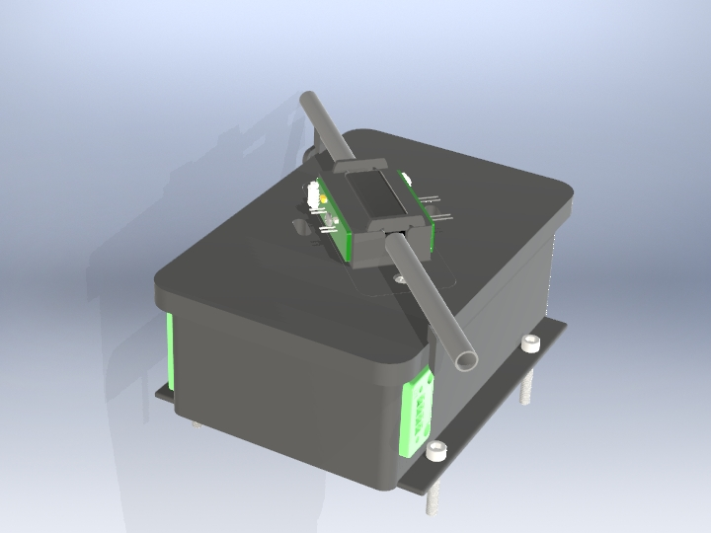
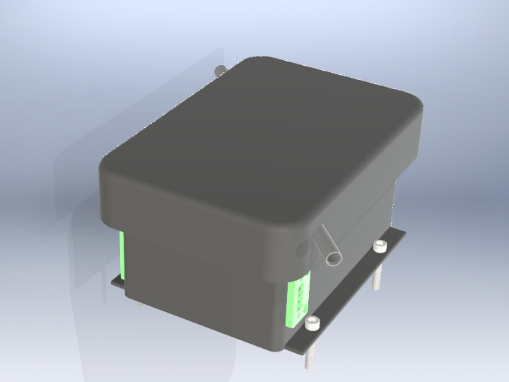
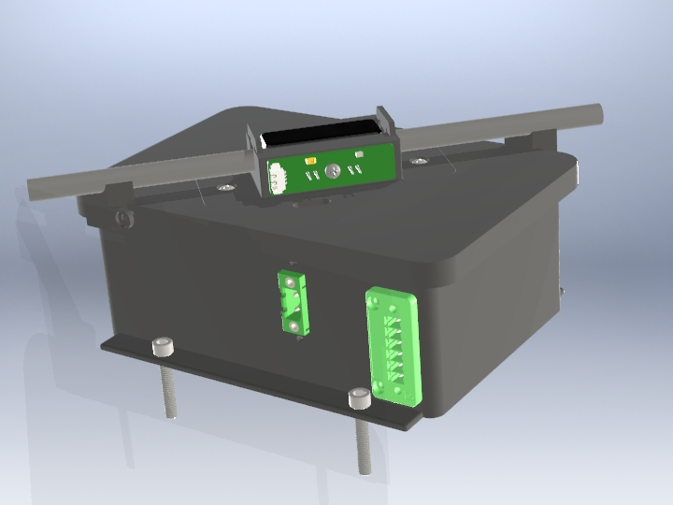
Renders

Slide 22
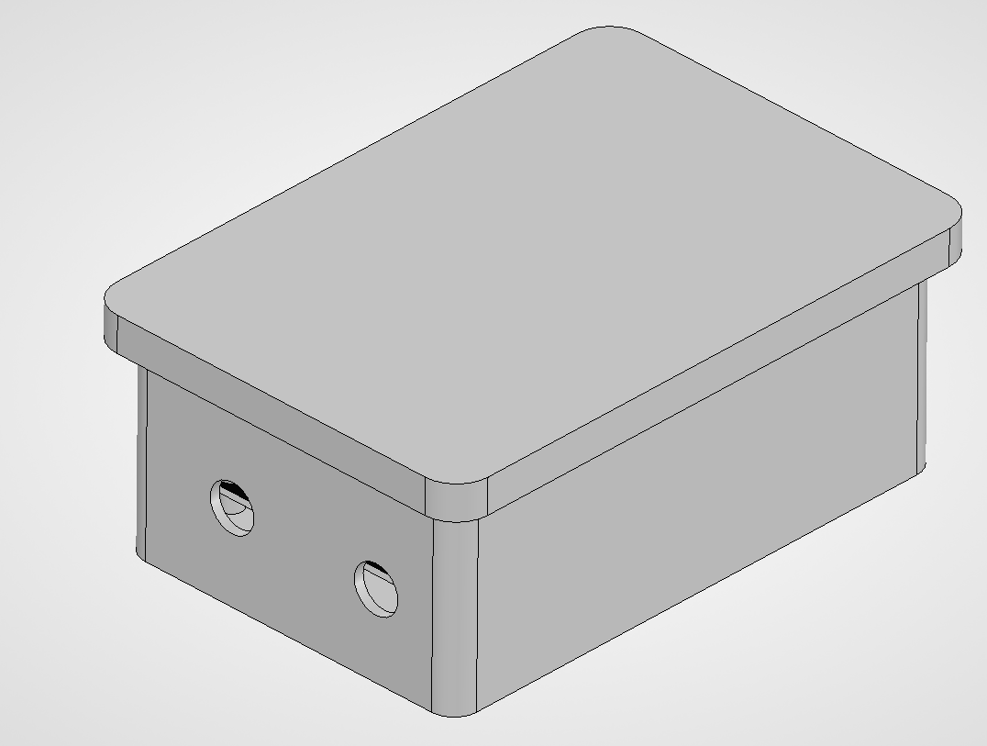
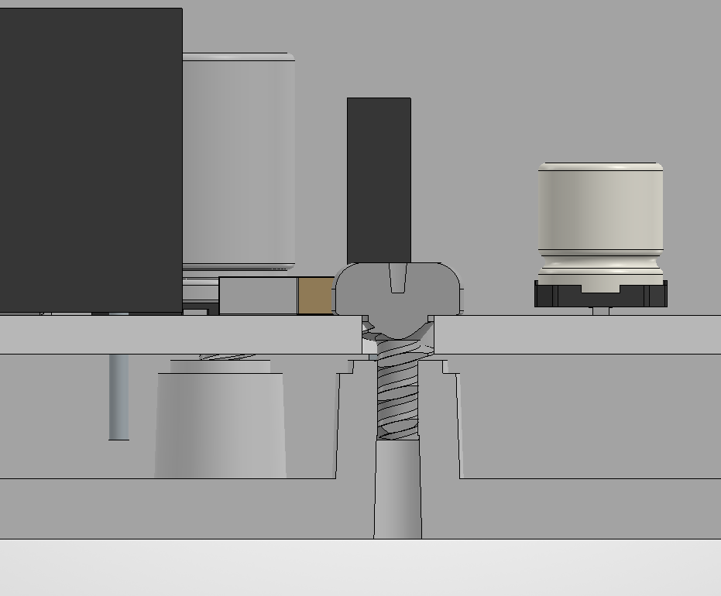
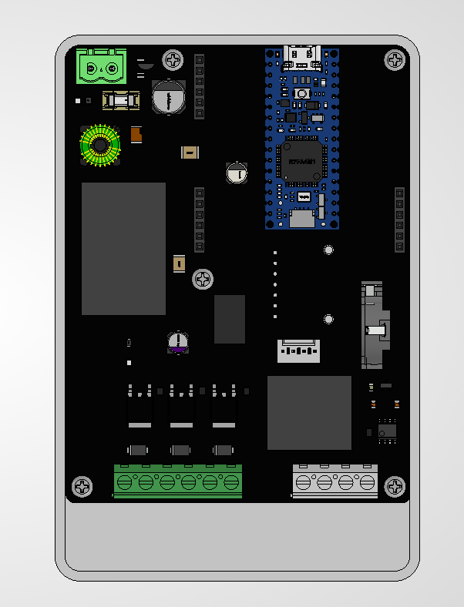
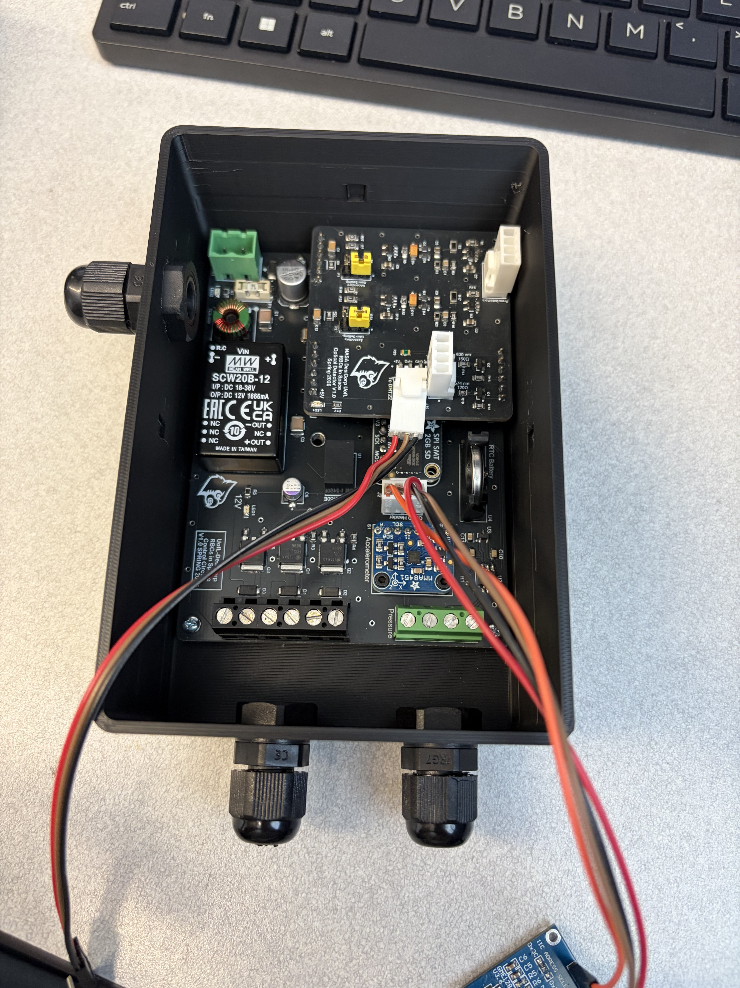
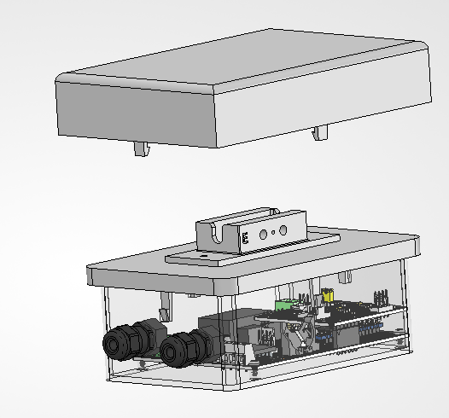
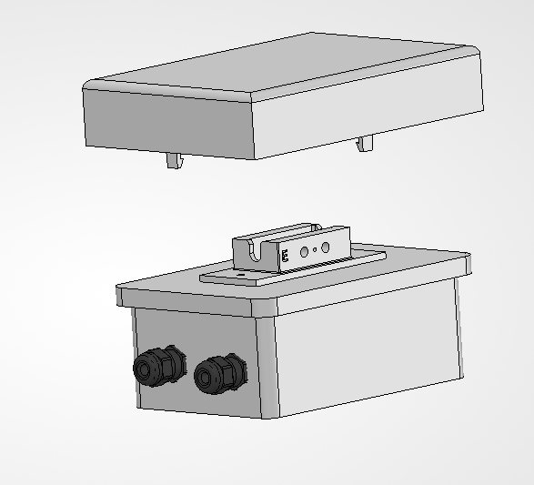
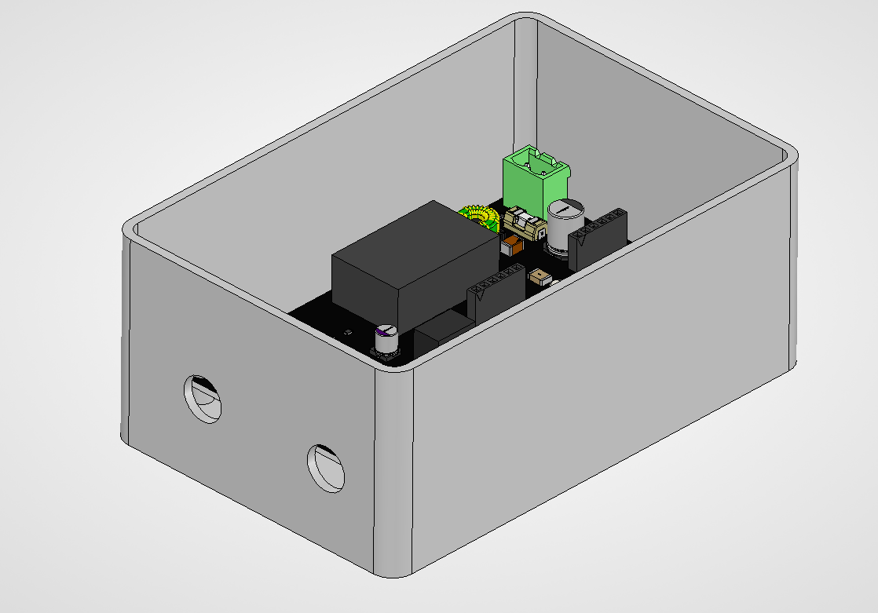
Extra Photos

