Slide 1
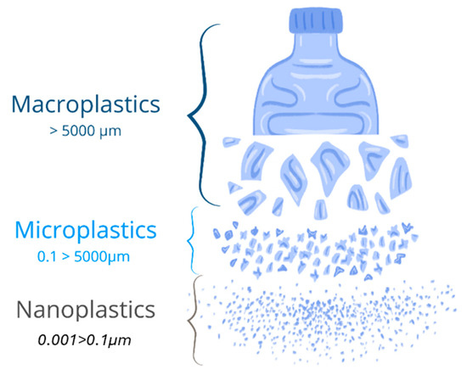
Understanding Micro- and Nanoplastics Formation Through Polymer Structure-Property Relationships
Lirio Delgado Diaz, Boston University
Kelly Nguyen, Arizona State University
Timothy Long, Arizona State University

Slide 2
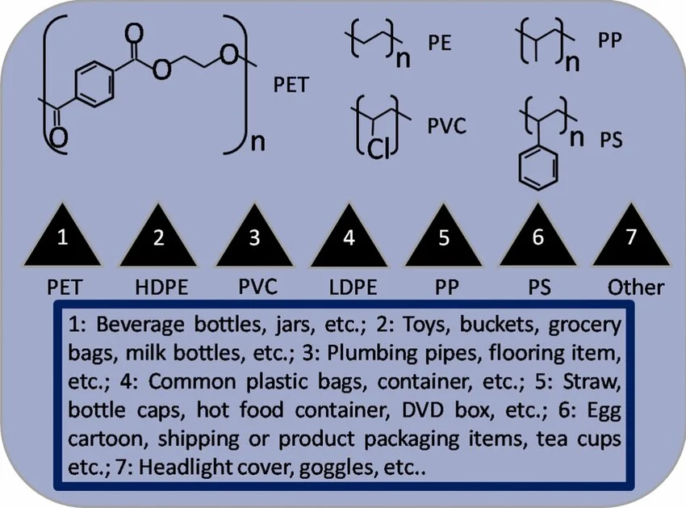
What are Micro and Nanoplastics?
Microplastics – tiny plastic pieces smaller than 5 mm
Nanoplastics – even smaller plastic particles, ranging from 1 nm to 1 μm
How they enter the body – through food and water, breathing them in, or skin contact
Common polymers used in our environment.¹
Notes:
To start, what even are micro and nano plastics?

Slide 3
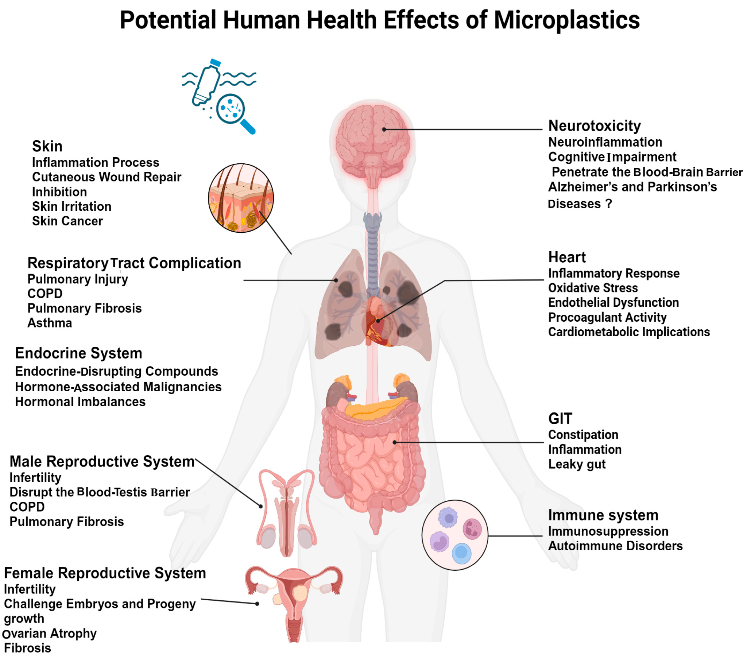
Why Do Micro/Nanoplastics Matter?
Microplastics have been found in²
  Blood
  Lungs
  Placenta
  Heart
  Breast milk
Current Challenge
  Scientists still don't fully understand Micro/Nanoplastics (MNPS)
Research Goal
  Understand how a polymer's composition affects its friction, wear, and durability because scientists still don't fully understand how plastic properties influence wear, degradation, and the formation of MNPS
potential health effects caused by mnps.²

Slide 4
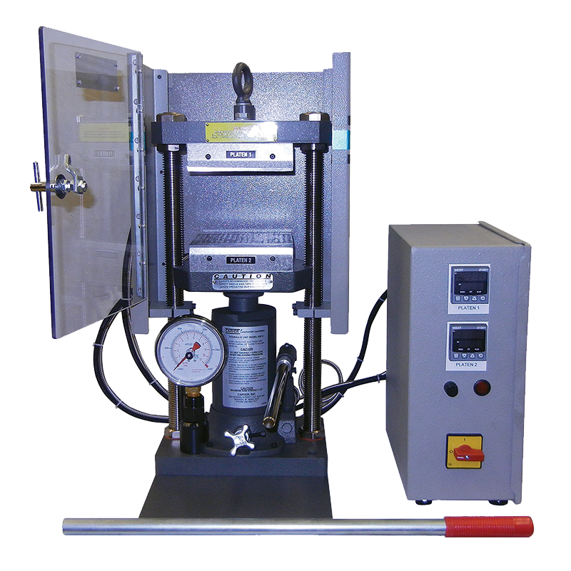
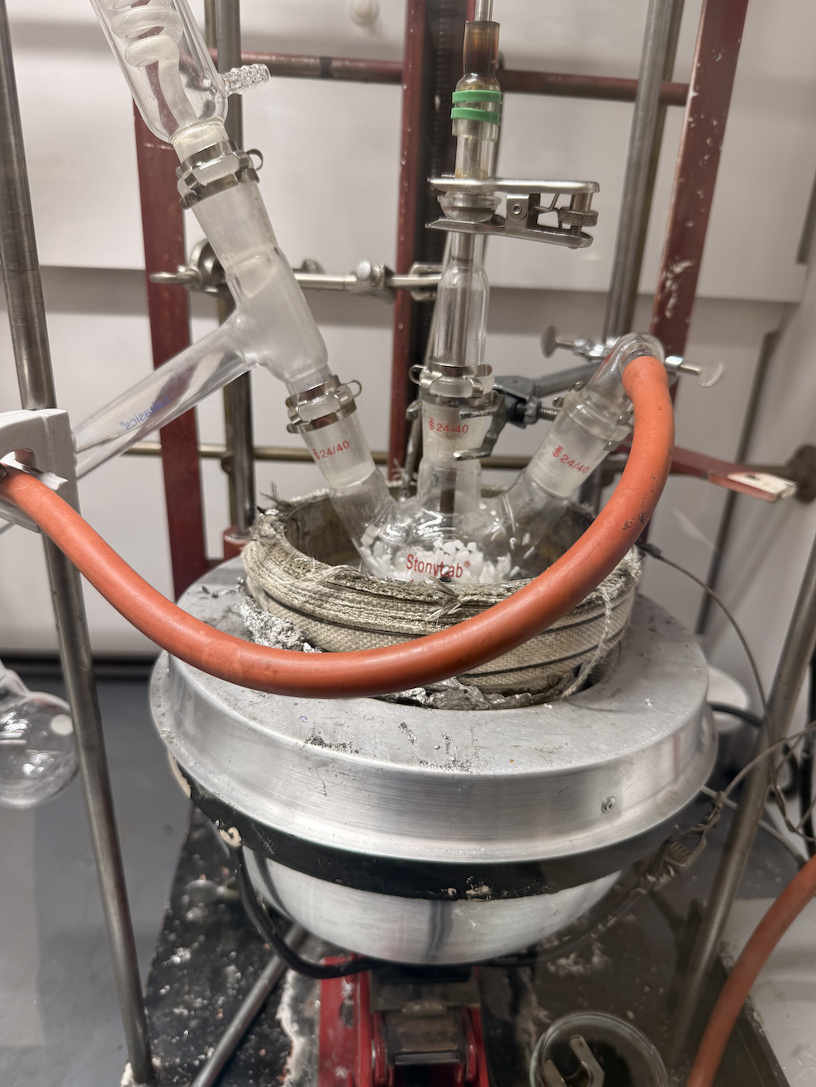
Using Technology to
Better Microplastics
To understand micro/nanoplastics, we must first understand how plastics are made and how their properties change.
Melt Pressing
Melt Reactor

Slide 5
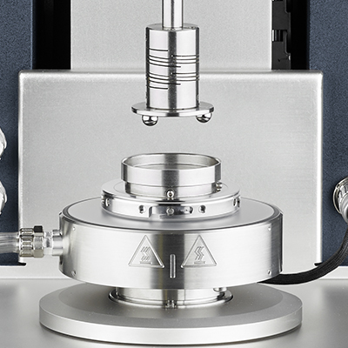
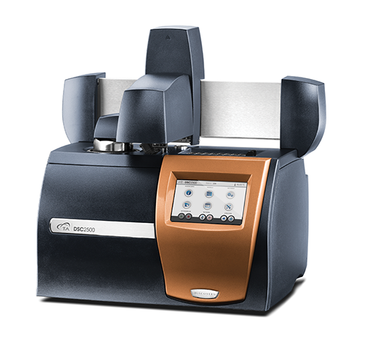
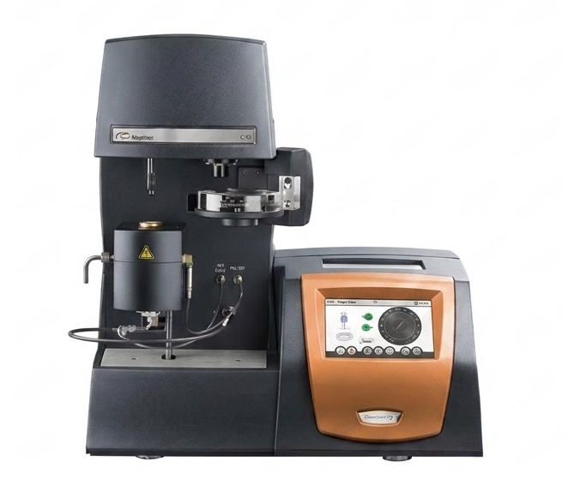
Using Technology to
Better the Use of Microplastics
To understand micro/nanoplastics, we must first understand how plastics are made and how their properties change.
Differential -> Scanning Calorimetry
Thermogravimetric -> Analysis
Rheometer- with Tribology Accessories
Notes:
Next, Thermogravimetric Analysis, or TGA, measures the weight of the sample as it is heated. This shows us when the polymer starts to degrade and lose mass, which is important for understanding its thermal stability and when it might begin to generate micro‑ and nanoplastics.
Finally, we use a rheometer with tribology accessories to study friction and wear. It lets us measure how the polymer surface behaves under sliding contact, so we can connect the crystallinity and thermal behavior to real tribological performance.

Slide 6
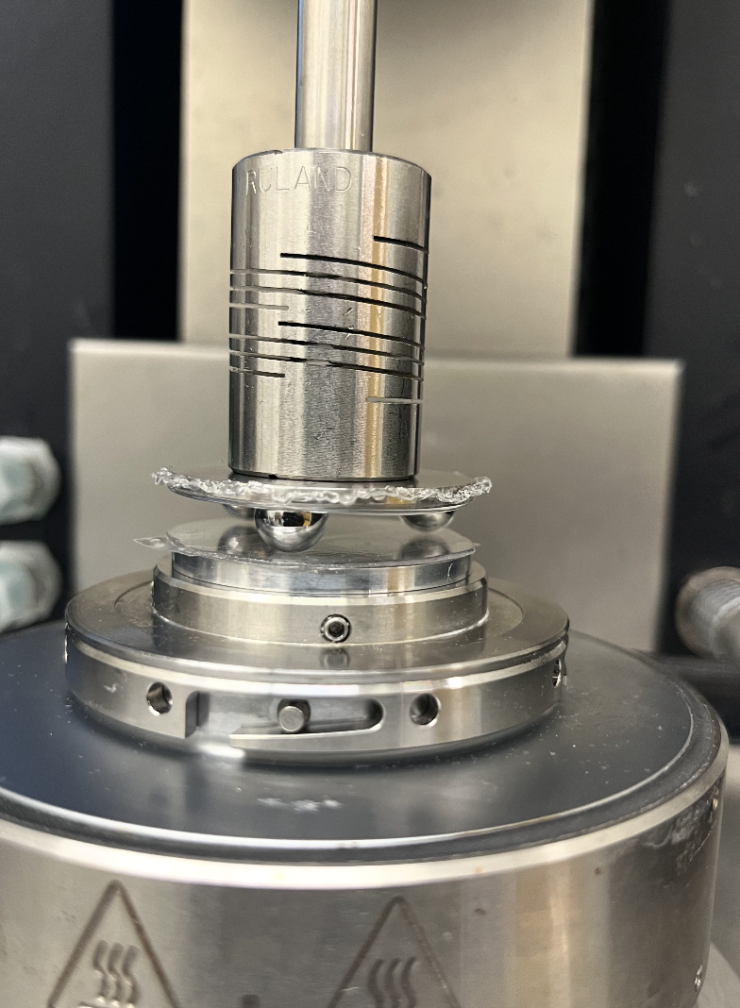
Why is Tribology Important?
Study of friction, wear, and lubrication.
Examines how surfaces move and contact each other.
In plastics, shows how materials slide and wear over time. -> We can test the durability of the plastic

Slide 7
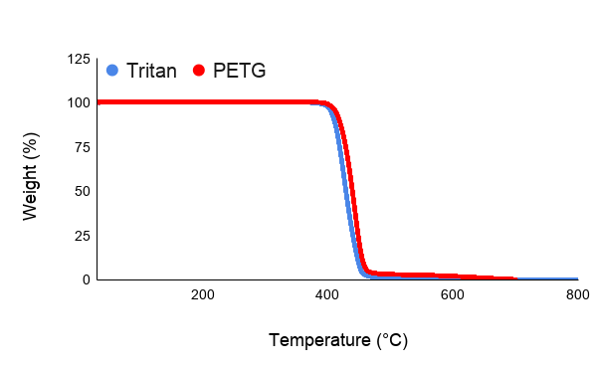
TGA of Tritan MP100 & PETG
TGA results show that Tritan MP100 and PETG. Both materials show thermal stability up to 400 °C.

Slide 8
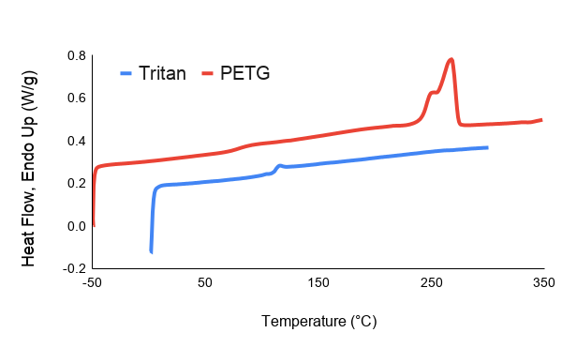
DSC of Tritan MP100 & PETG
DSC results of Tritan MP100 and PETG shows that PETG has some crystallinity while Tritan is fully amorphous.

Slide 9
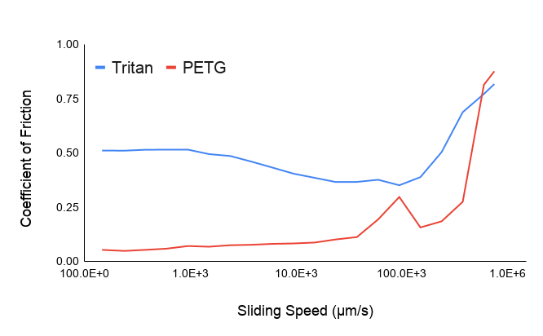
Tribology of Tritan MP100 & PETG
Tribology results show that tritan has a higher coefficient of friction (COF). This indicates that crystalline domains in PETG affect the COF which causes it to decrease.

Slide 10
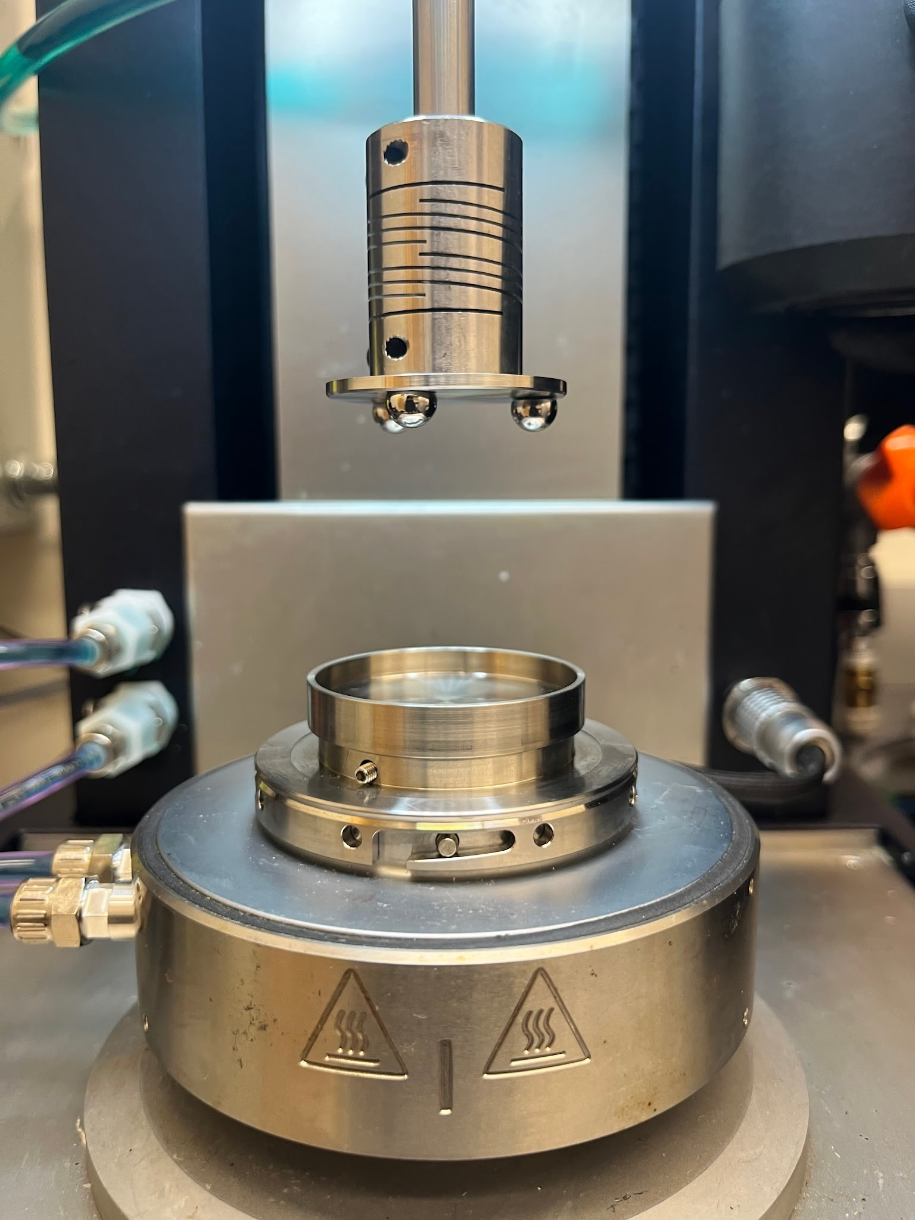
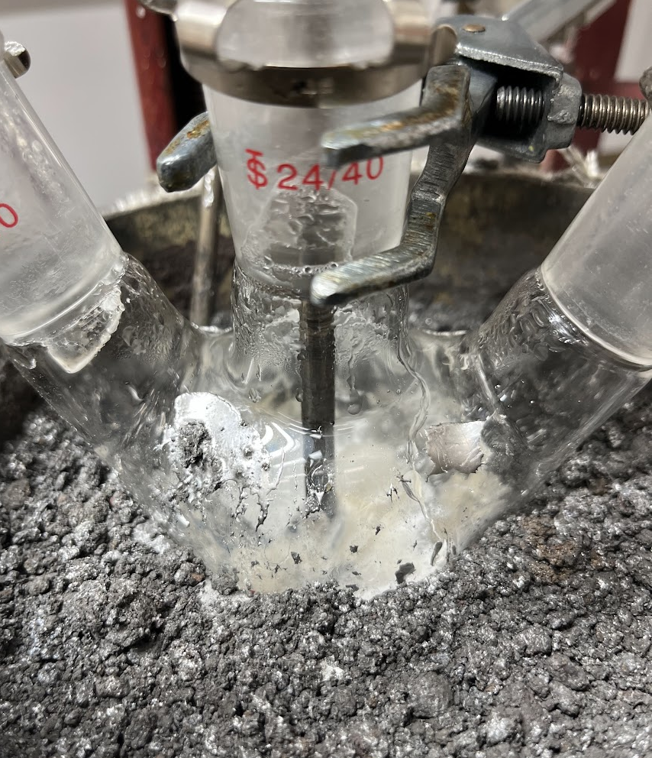
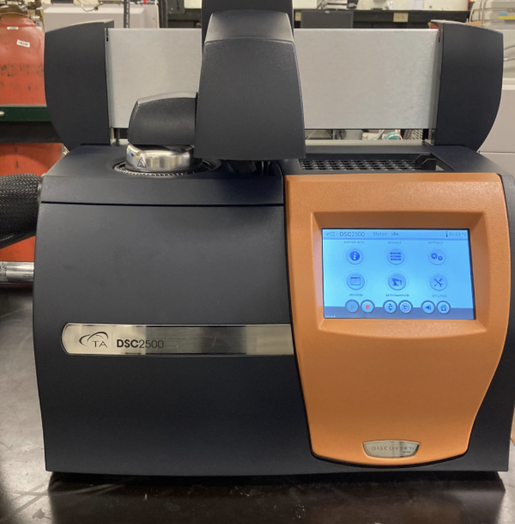
How are you going to solve your problem using nanotechnology?
Melt reactor: Enables synthesis of different ratios of material
DSC: Measure and confirm the degree of crystallinity.
Tribology: Measure friction and wear of the polymer.
Notes:
Crystallinity

Slide 11
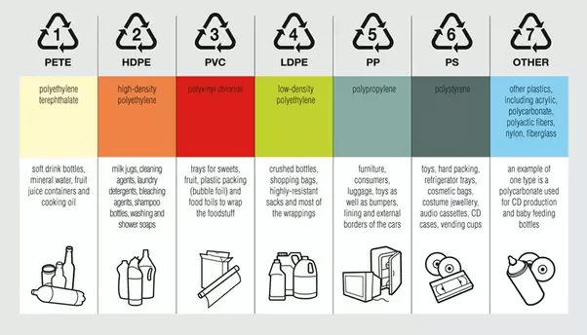
Conclusions & Future Work
Introduction of crystalline domains decreases coefficient of friction because the loading force is distributed across the crystalline domains instead of amorphous regimes.
Expand testing of different polymer properties (ex. molecular weight) and tribological conditions
Common polymers used in our environment.⁵

Slide 12



Acknowledgements
Kelly Nguyen - Mentor
Timothy Long - Professor
Jessica - REU Advisor

Slide 13
Resources
[1] Dubey, Prashant. (2025). From Waste Plastics to Carbon/Graphene Quantum Dots: A Journey Towards Value-Added Carbon Nanostructures for Various Applications. Waste and Biomass Valorization. 16. 6373-6431. 10.1007/s12649-025-03118-1.
[2]Abbas, Ghulam & Ahmed, Usama & Ahmad, Muhammad. (2025). Impact of Microplastics on Human Health: Risks, Diseases, and Affected Body Systems. Microplastics. 4. 10.3390/microplastics4020023.
[3] Ragusa, A., Notarstefano, V., Svelato, A., Belloni, A., Gioacchini, G., Blondeel, C., Zucchelli, E., De Luca, C., D’Avino, S., Gulotta, A., Carnevali, O., & Giorgini, E. (2022). Raman Microspectroscopy Detection and Characterisation of Microplastics in Human Breastmilk. Polymers, 14(13), 2700. https://doi.org/10.3390/polym14132700
[4] Yee, M. S., Hii, L. W., Looi, C. K., Lim, W. M., Wong, S. F., Kok, Y. Y., Tan, B. K., Wong, C. Y., & Leong, C. O. (2021). Impact of Microplastics and Nanoplastics on Human Health. Nanomaterials (Basel, Switzerland), 11(2), 496. https://doi.org/10.3390/nano11020496
[5] team prakati. (2019, September 13). Types of Plastic. Prakati India. https://prakati.in/types-of-plastic/

