Slide 1

Fabrication and Characterization of Isotropic Liquid Metal Composites for Thermal Interface Materials
Amanda Gutierrez, Andrea Mikulasova, Dr. Ravi Tutika, Dr. Eric Markvicka
Department of Mechanical and Materials Engineering University of Nebraska – Lincoln

Slide 2
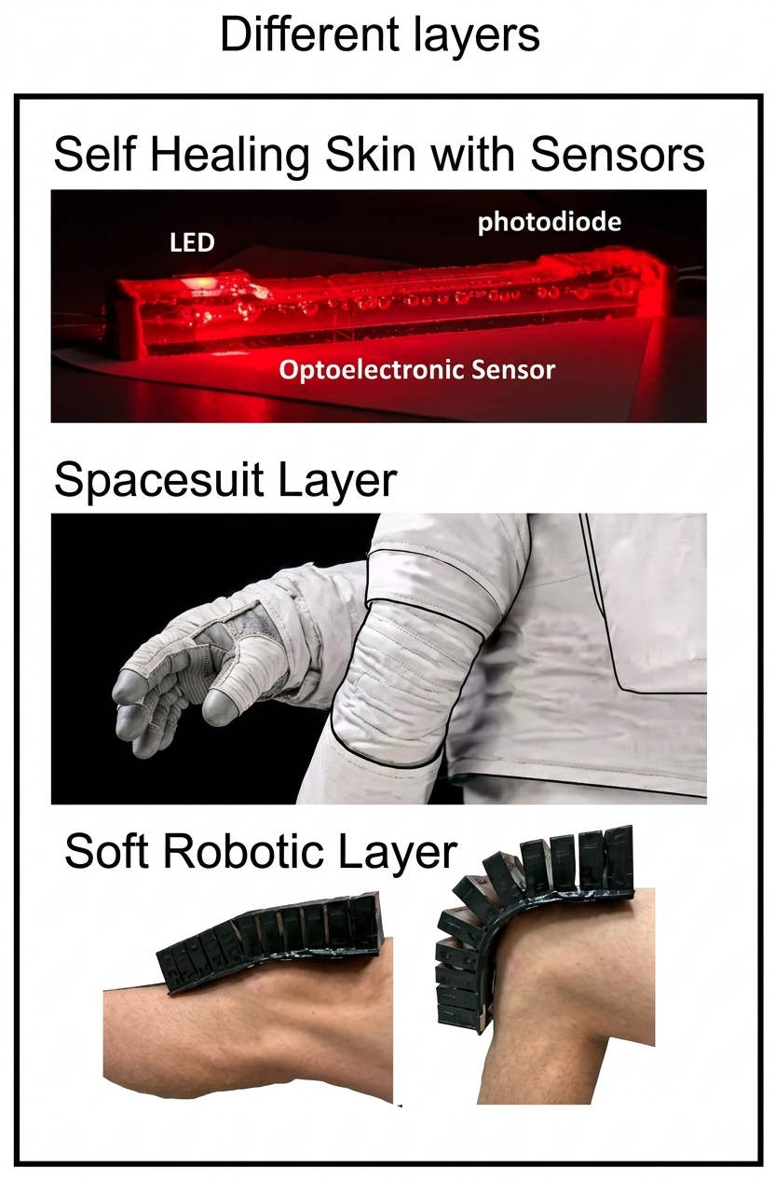
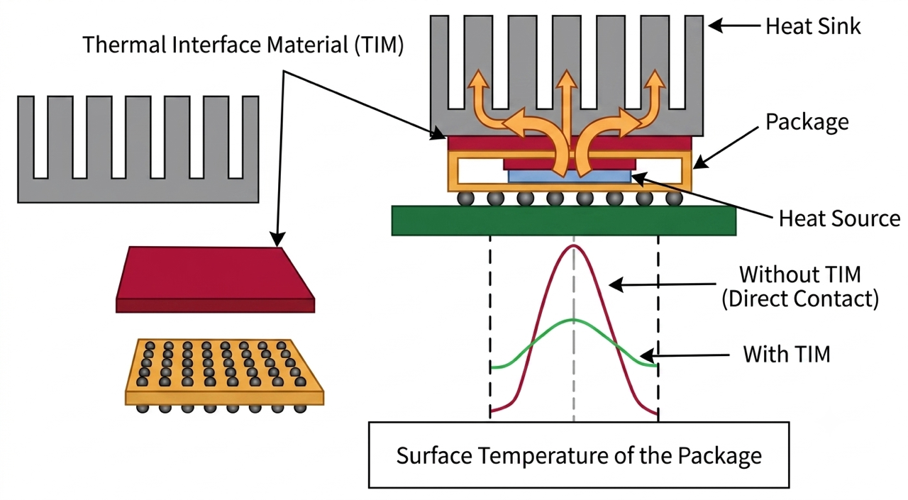
Motivation
https://bhp.engr.tamu.edu/research/smartsuit/

Slide 3
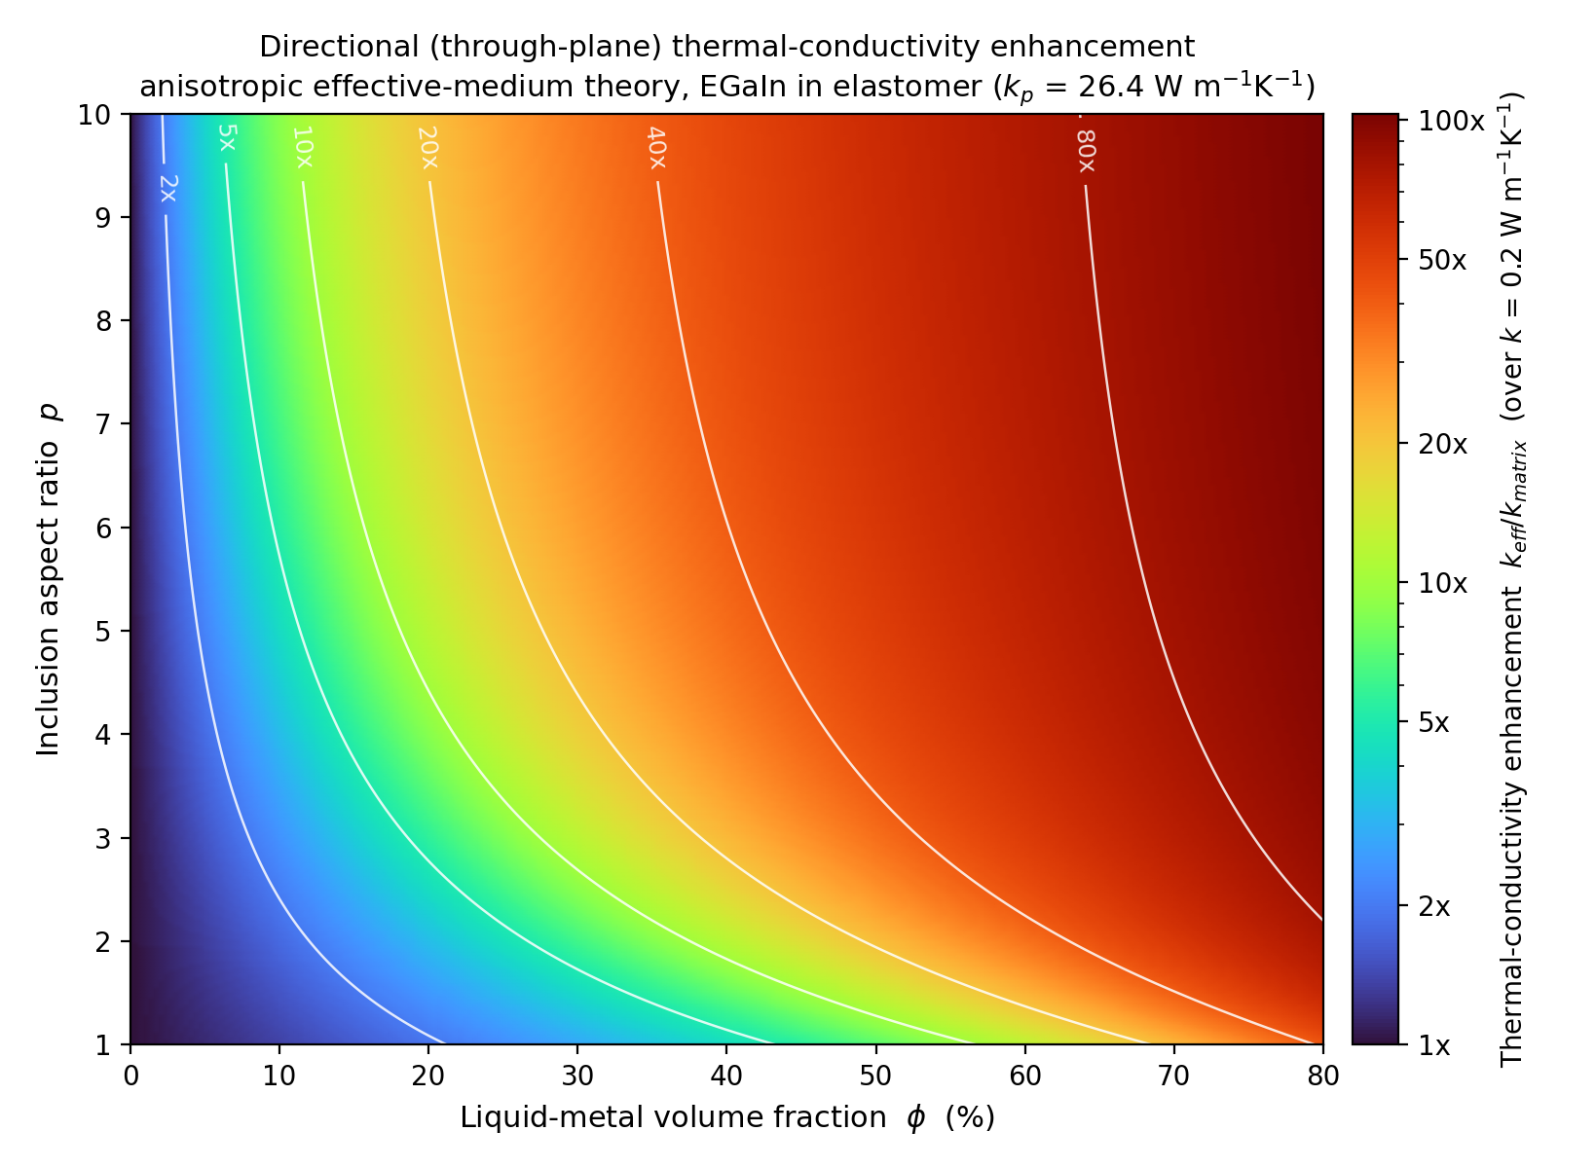
Create Elongated Liquid Metal Droplets
Hur et al., Addit. Manuf., 2024, Schloer et al., Adv. Mater., 2026, Malakooti et al., Adv. Funct. Mater., 2019

Slide 4
Objectives
Optimize droplet elongation and perform
image analysis
Evaluate its direct impact on thermal
Conductivity
Extrude into irregular shapes to observe
structural, flexible, and textured qualities

Slide 5
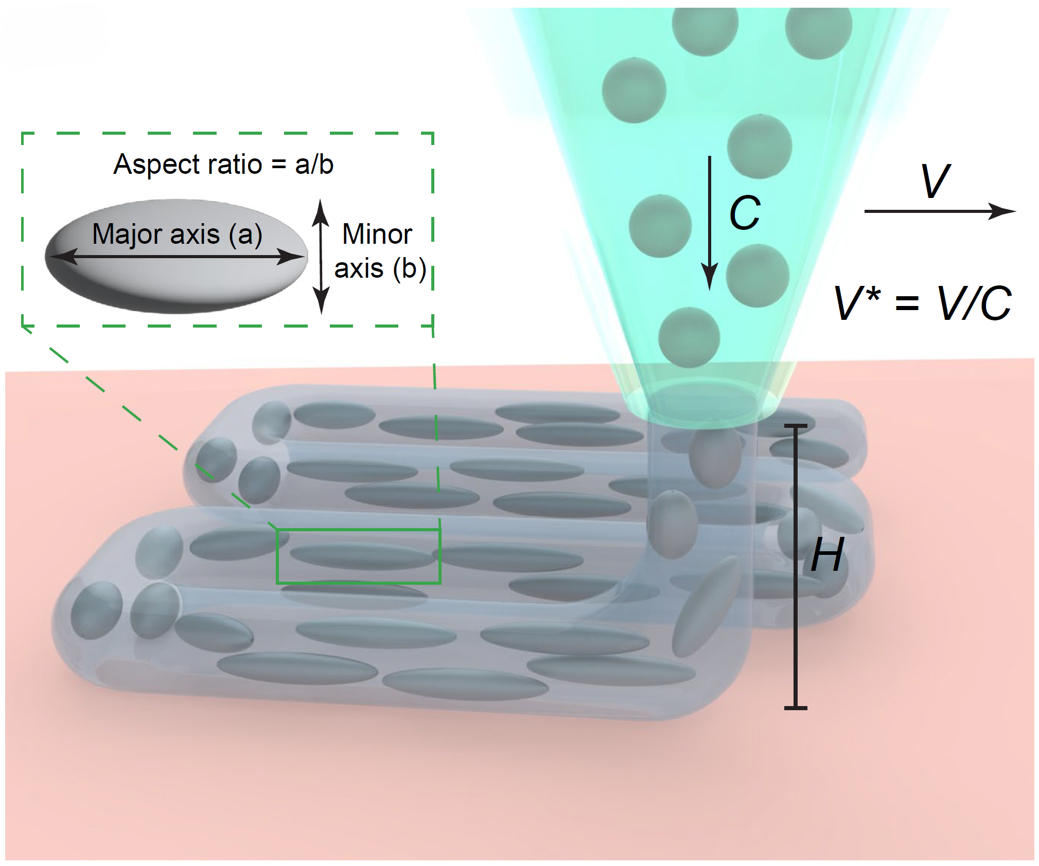
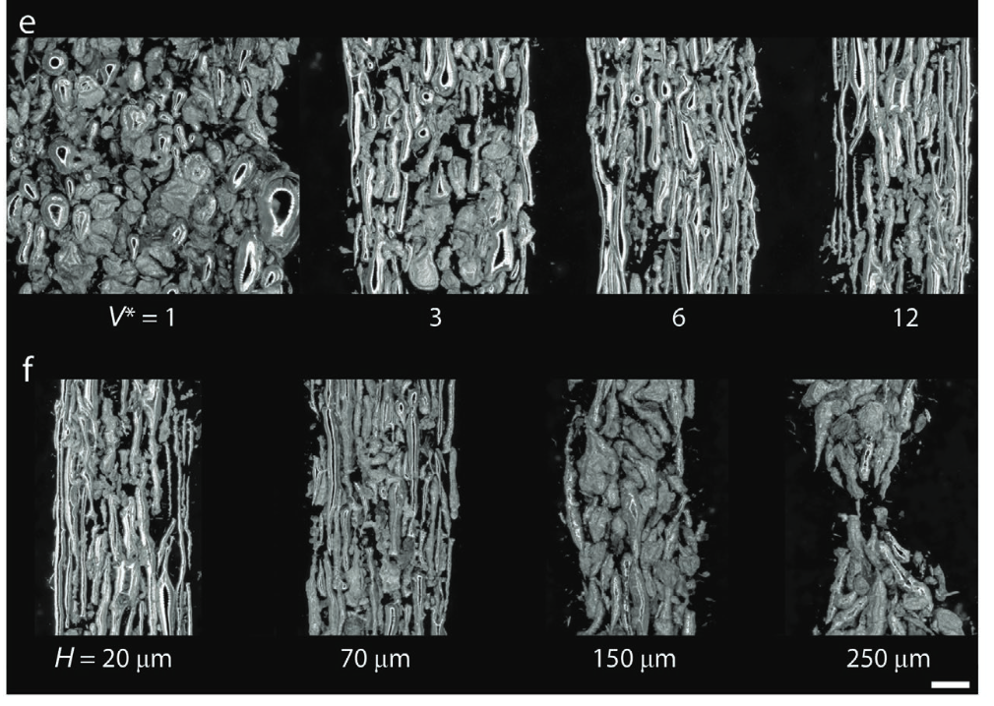
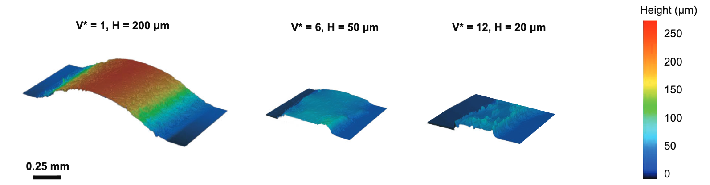
3D Printing to Control Droplet Shape
Hur et al., Addit. Manuf., 2024

Slide 6
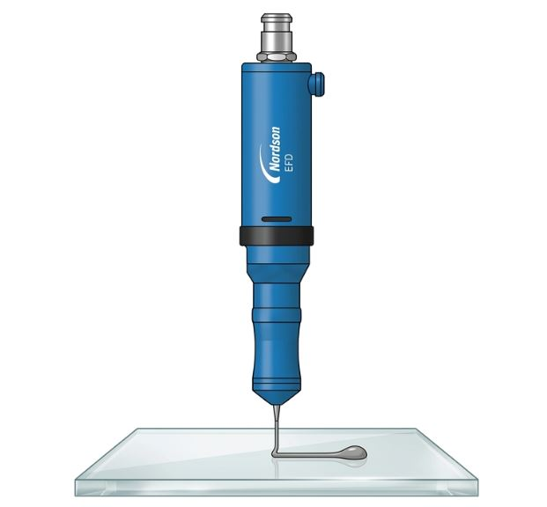
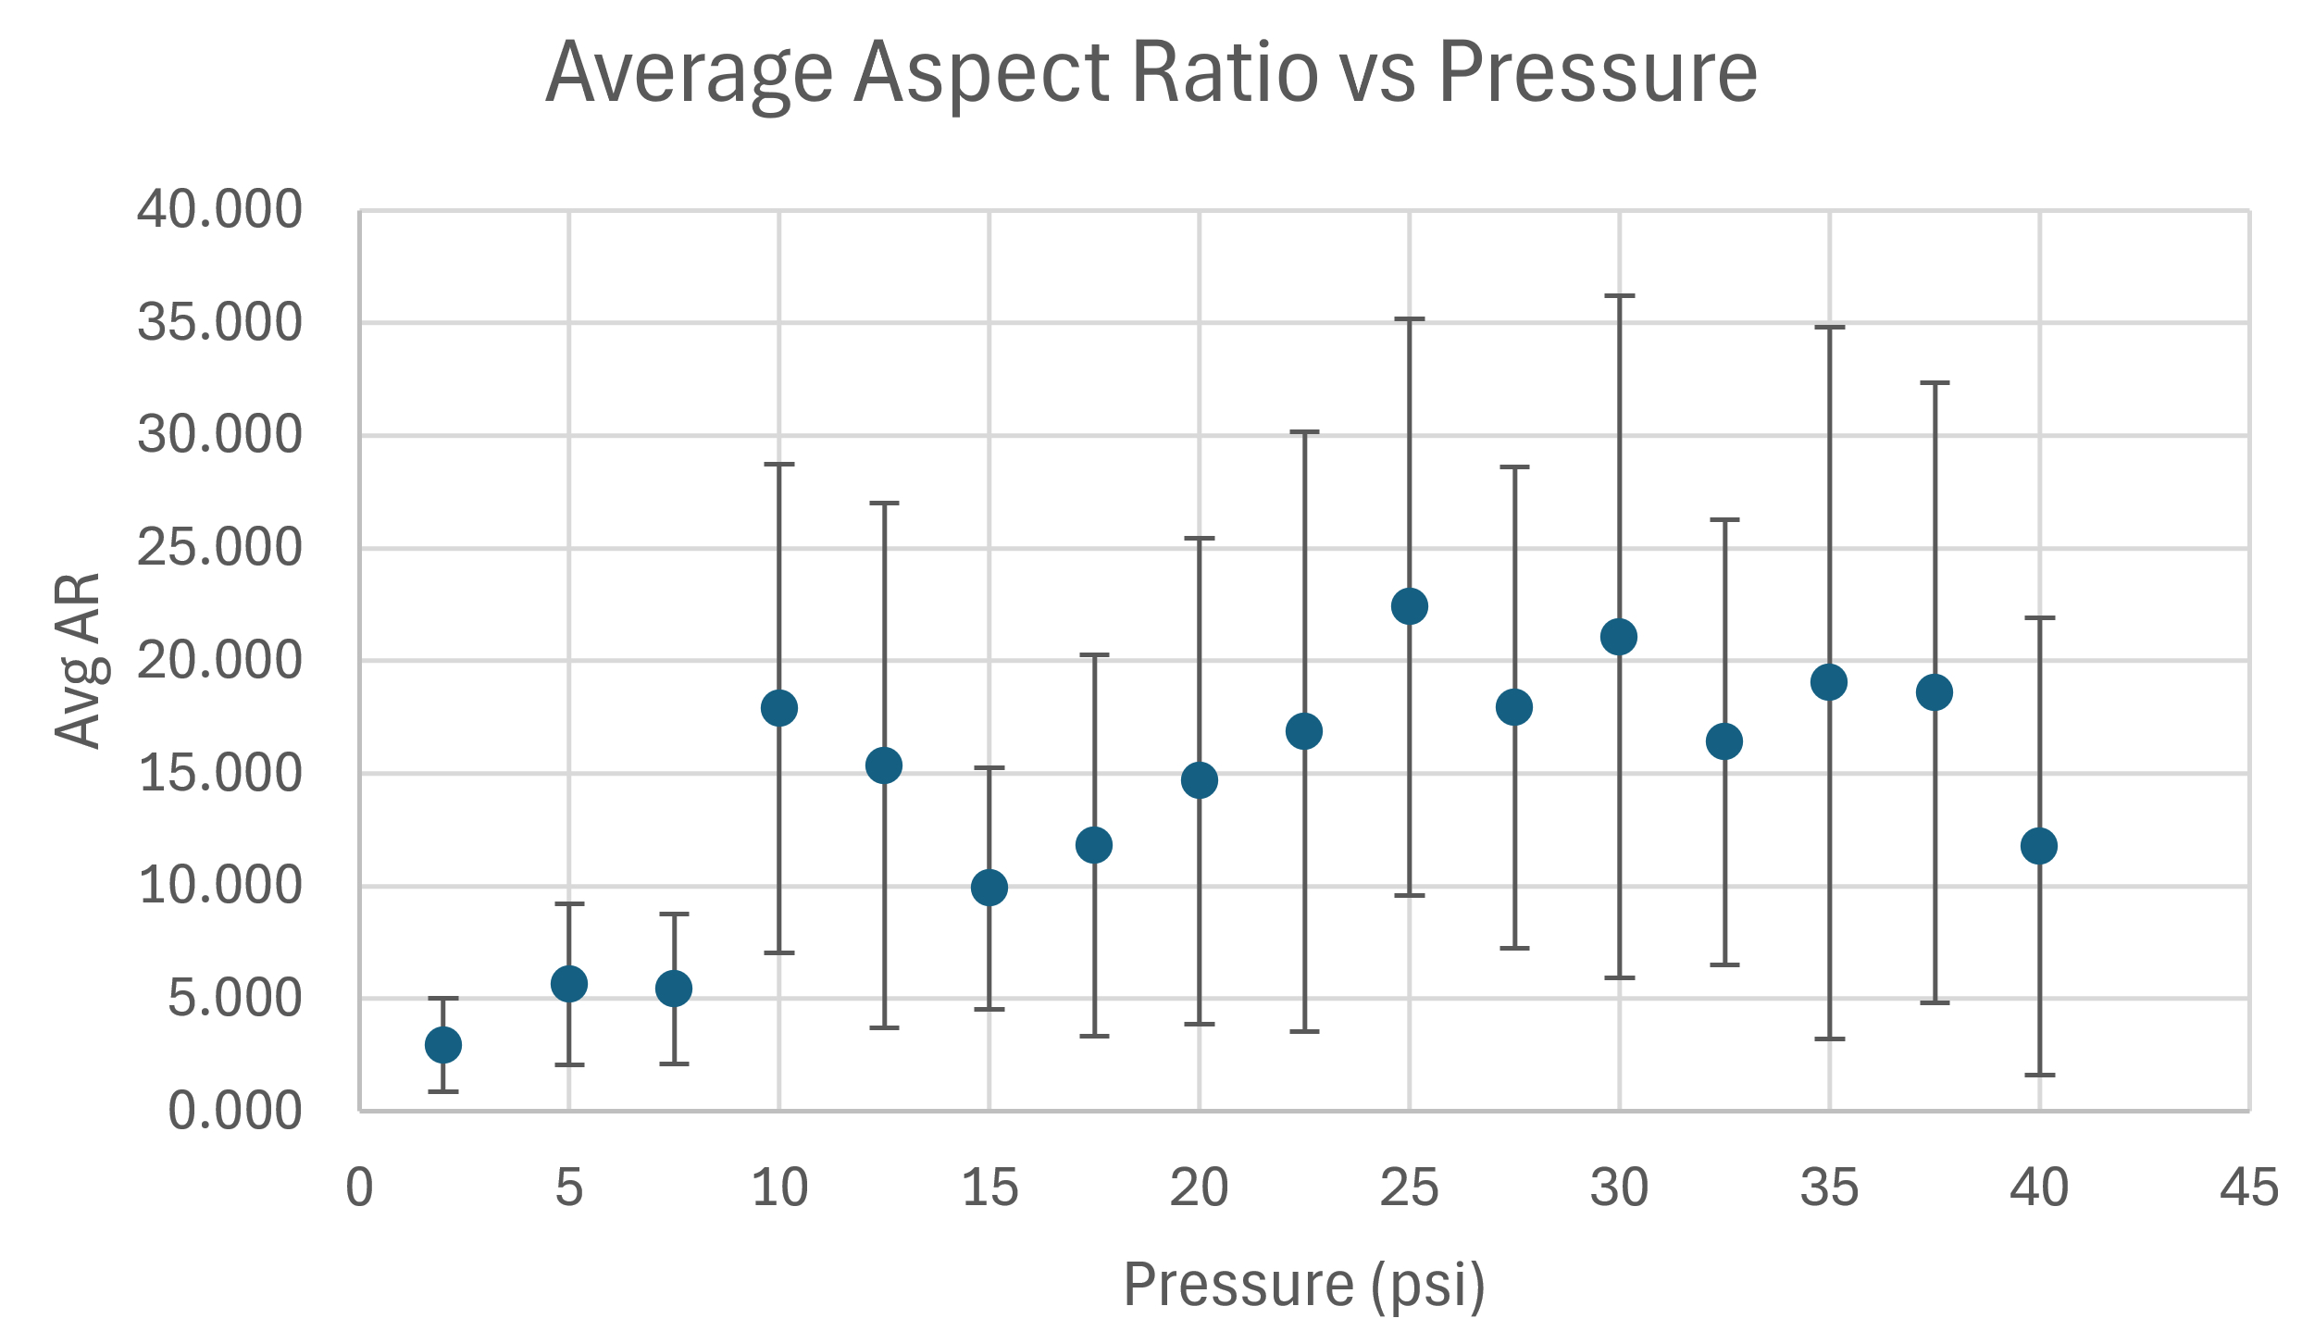
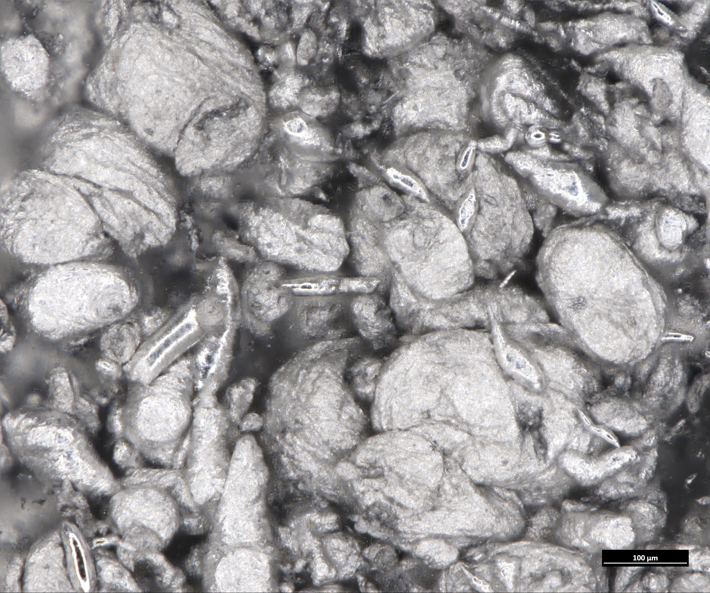
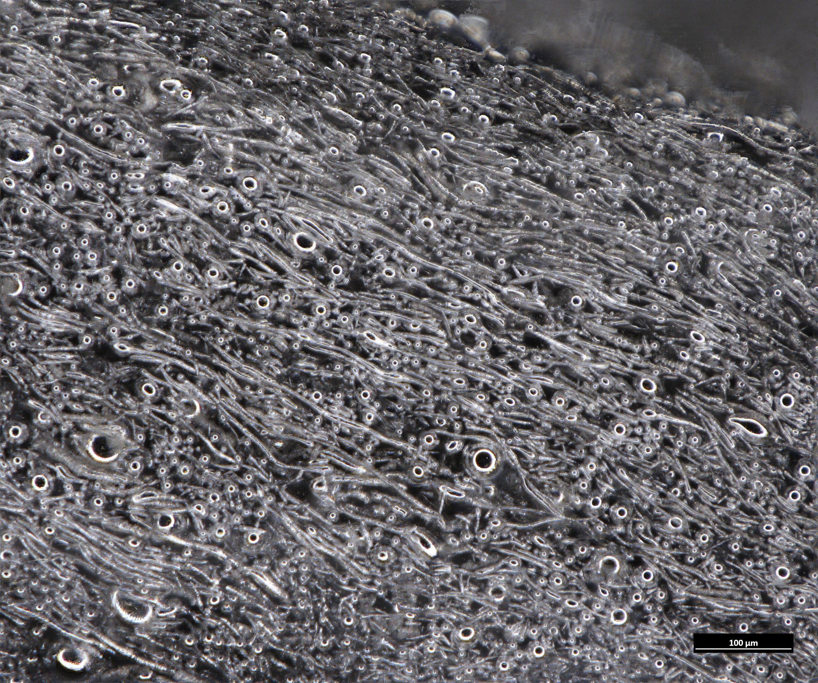
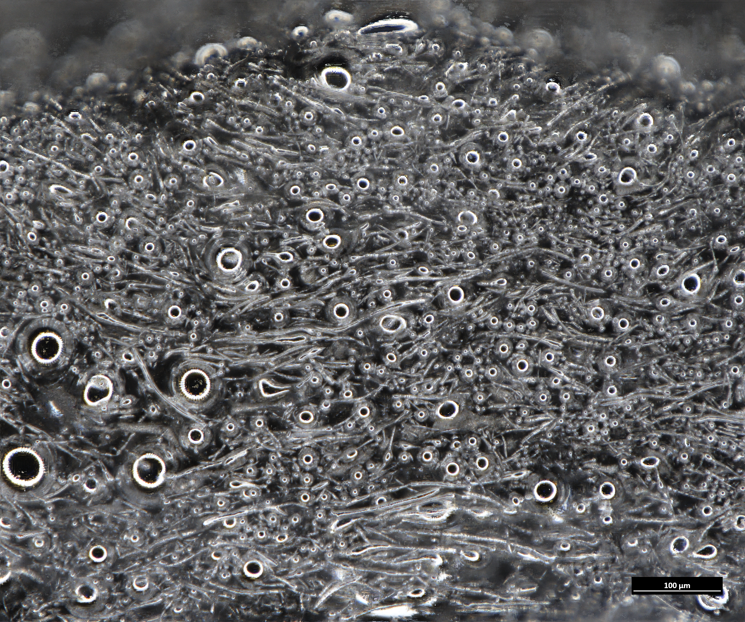
Extrusion to Control Droplet Shape

Slide 7
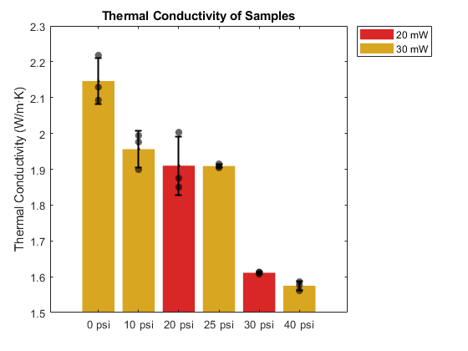
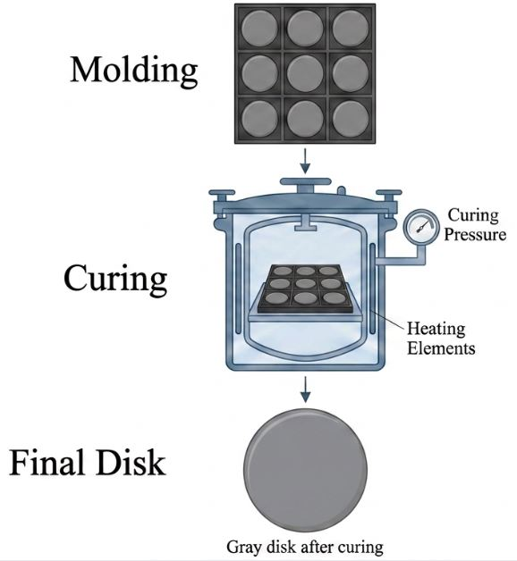
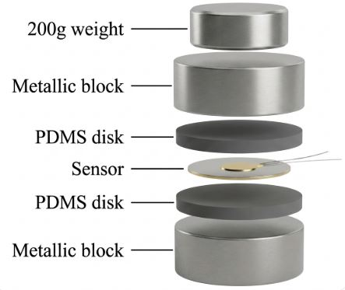
Thermal Conductivity Measurement
Sample Fabrication
Thermal Conductivity Measurement Setup
Results

Slide 8
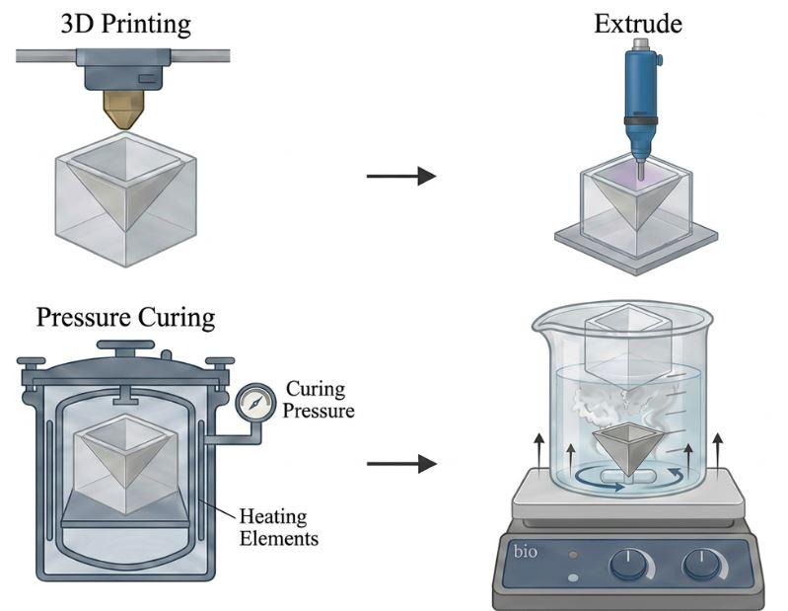
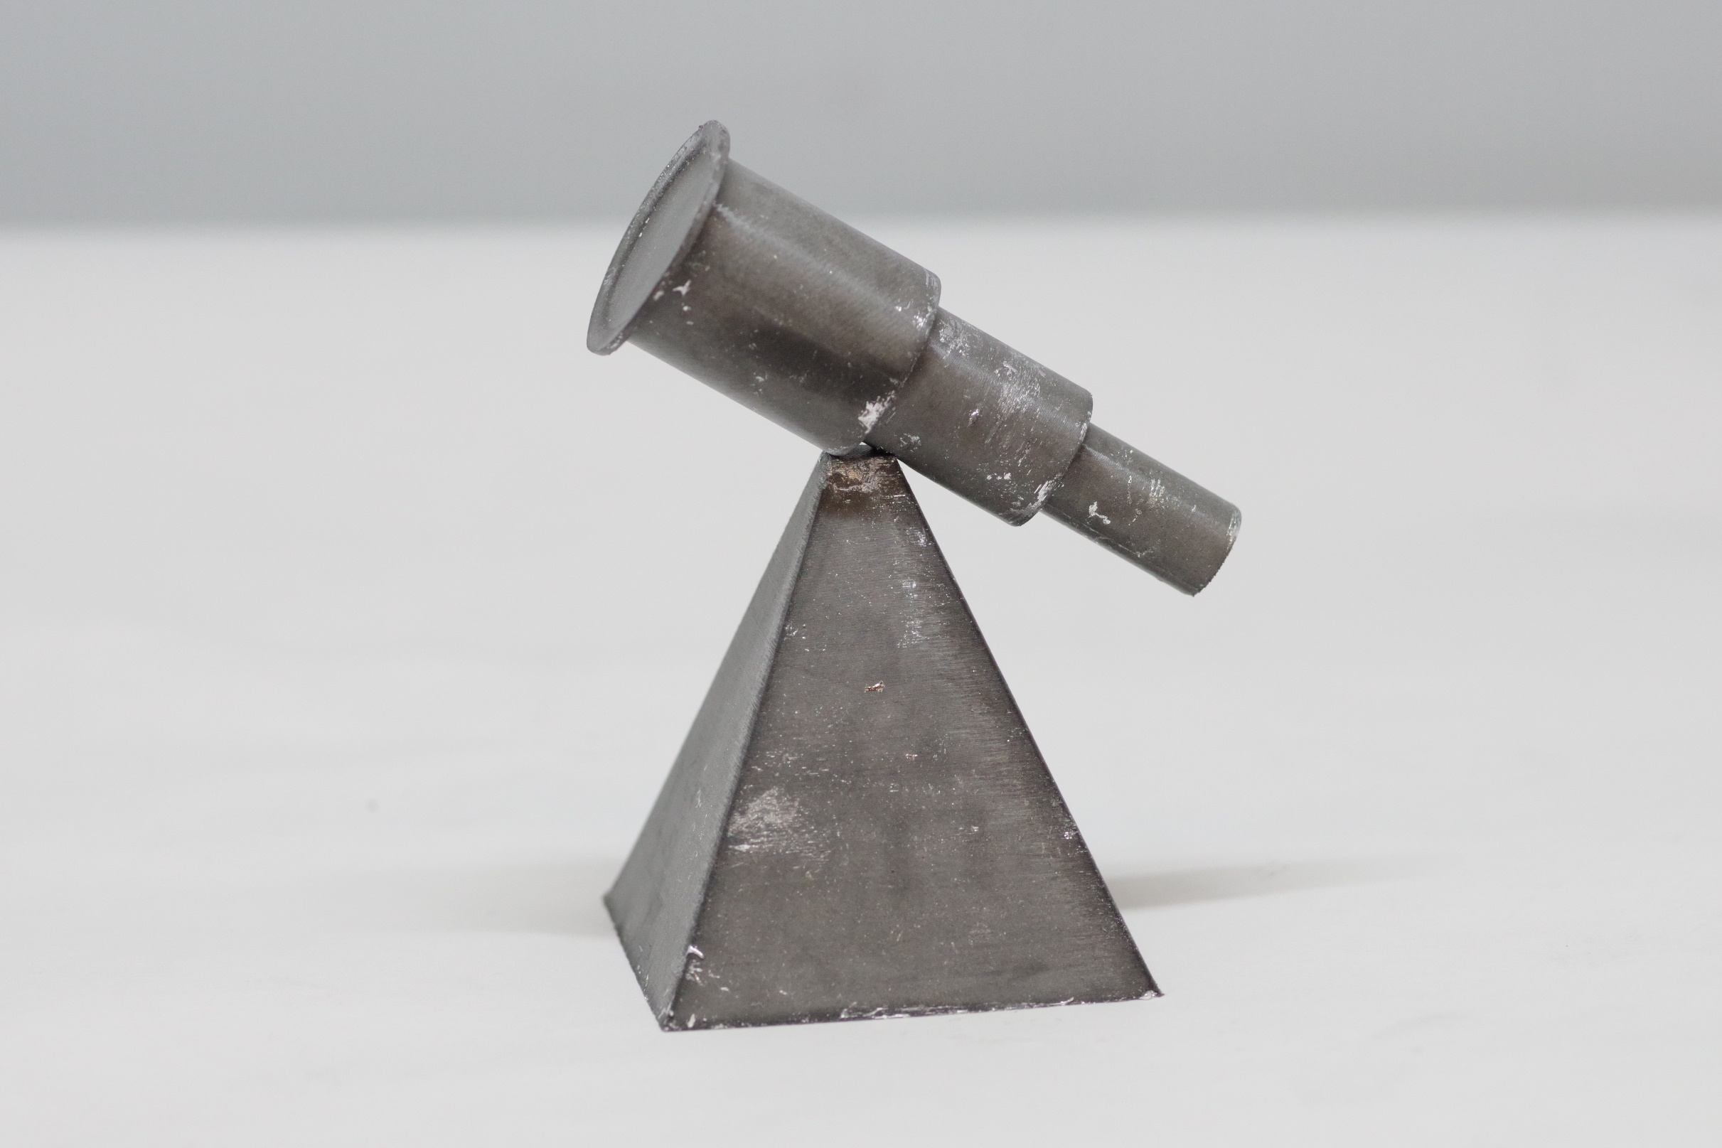
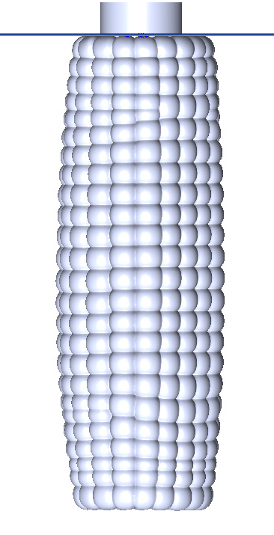
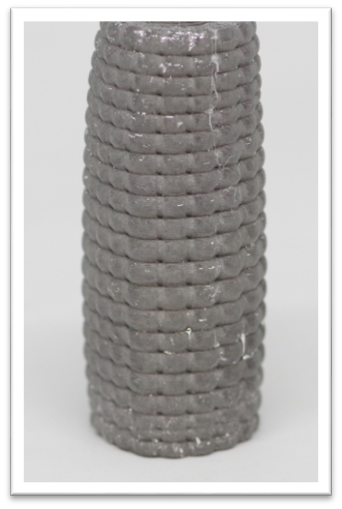
3D Printing Process
• Isotropic LM composite can be
shaped by injection molding

Slide 9
Summary
Developed a method to create isotropic LM composite with elongated LM droplets
Droplet shape can be tuned by changing the droplet size and applied pressure
Textured surfaces and overhangs can be created with LM composites consisting of isotropic distribution of elongated LM droplets.

Slide 10






Acknowledgements
Dr. Eric Markvicka
Andrea Mikulasova
Dr. Ravi Tutika
This work was supported by Nebraska Center for Energy Sciences Research and National Science Foundation (No. EEC-1950137)

