Slide 1






Nonvolatile Computer Memory Using MEMS Technology
Romindra Gokhul, The City College of New York
Dr. Shamus McNamara, University of Louisville
NSF REU Award ID #2348869

Slide 2
Current Limitations of Existing Semiconductor Memories
Main Memory(DRAM) | Storage Memory(Flash)
Needs constant Refreshing Wastes power Volatile memory Susceptible to Radiation Approaching physical scaling limits | Limited Write Cycles Fails over time Susceptible to Radiation Approaching physical scaling limits
What if the bit didn’t rely on stored charge at all?
2

Slide 3
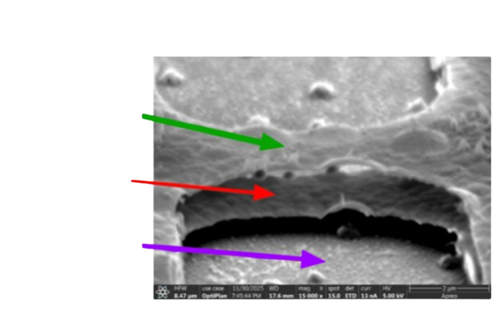
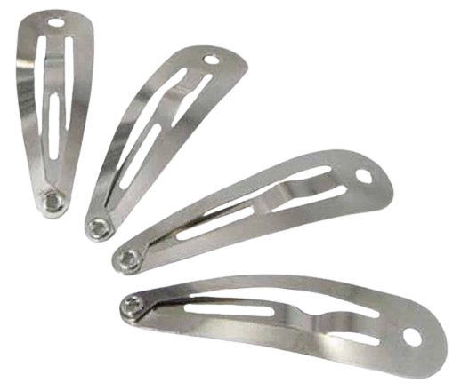
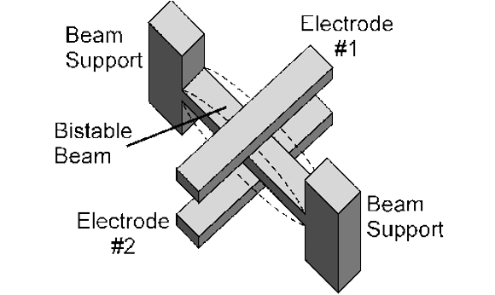

Bistable Structures
Snap Clips
Schematic
SEM image
$$5\text{μ}\text{m} \text{Memory} \text{Bit}$$
Top Electrode
Buckled Beam
(Ti-W)
Bottom Electrode
(Ti-W)
The beam is buckled such that it rests in a bistable position.
3

Slide 4
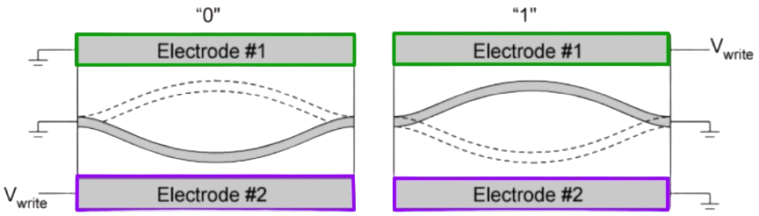
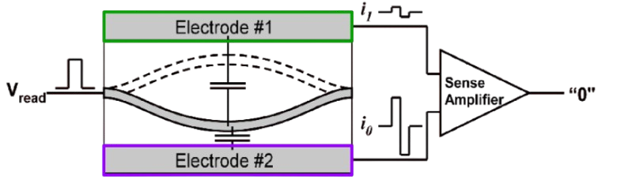
Writing & Reading a bit with our Beam
Writing a bit
Apply a voltage to pull the beam up or down
It stays there with no power — that's the bit
Our bistable beam
Reading the bit
Beam position changes the capacitance
A sense amplifier detects which way it's bent → 0 or 1
4

Slide 5
What are the benefits to MEMS computer memory?
1. Competitive with Flash memory
  Lower write voltage
  Lower energy / power consumption
  Faster writing
  More Reliable
2. Not limited by the charge-leakage wall. As DRAM/Flash cells shrink, leakage and tunneling worsen; a position-based bit avoids that failure mode.
3. Radiation hard. Because the bit is mechanical position, not stored charge, stray charge from ionizing particles can't flip it. (DRAM and Flash are both vulnerable.)
5

Slide 6
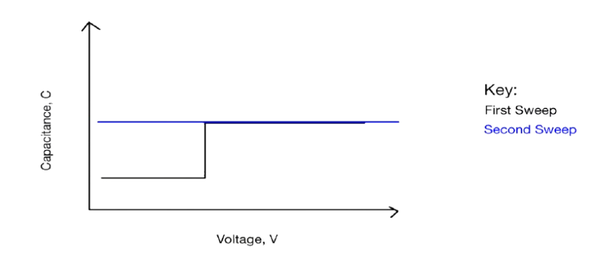
Goal: Read capacitance to verify that the beam switches
The bit is a tiny capacitance change that noise can bury — readable only when the signal clears the noise.
We sweep the voltage and look for the capacitance to jump between two states, on both electrode pairs. Measurements need to be repeatable when coming to a consensus on beam position.
Expectation of a Beam Switching States
Switching
Voltage

Slide 7
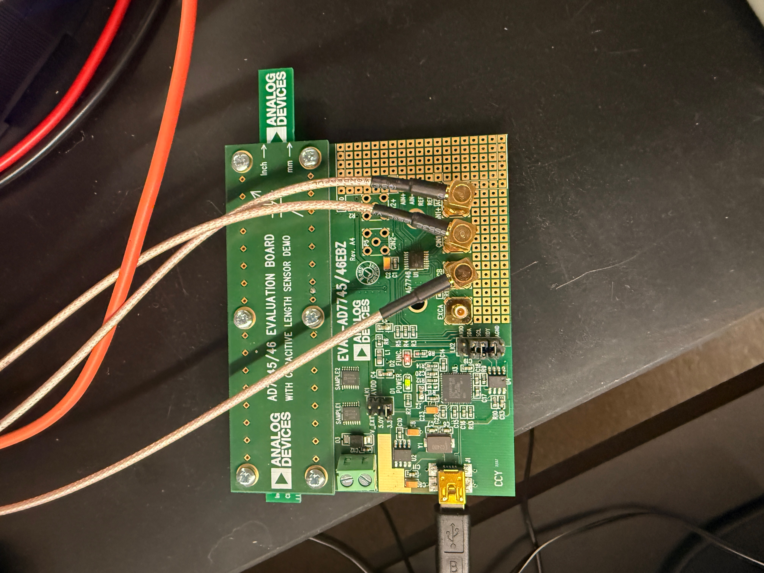
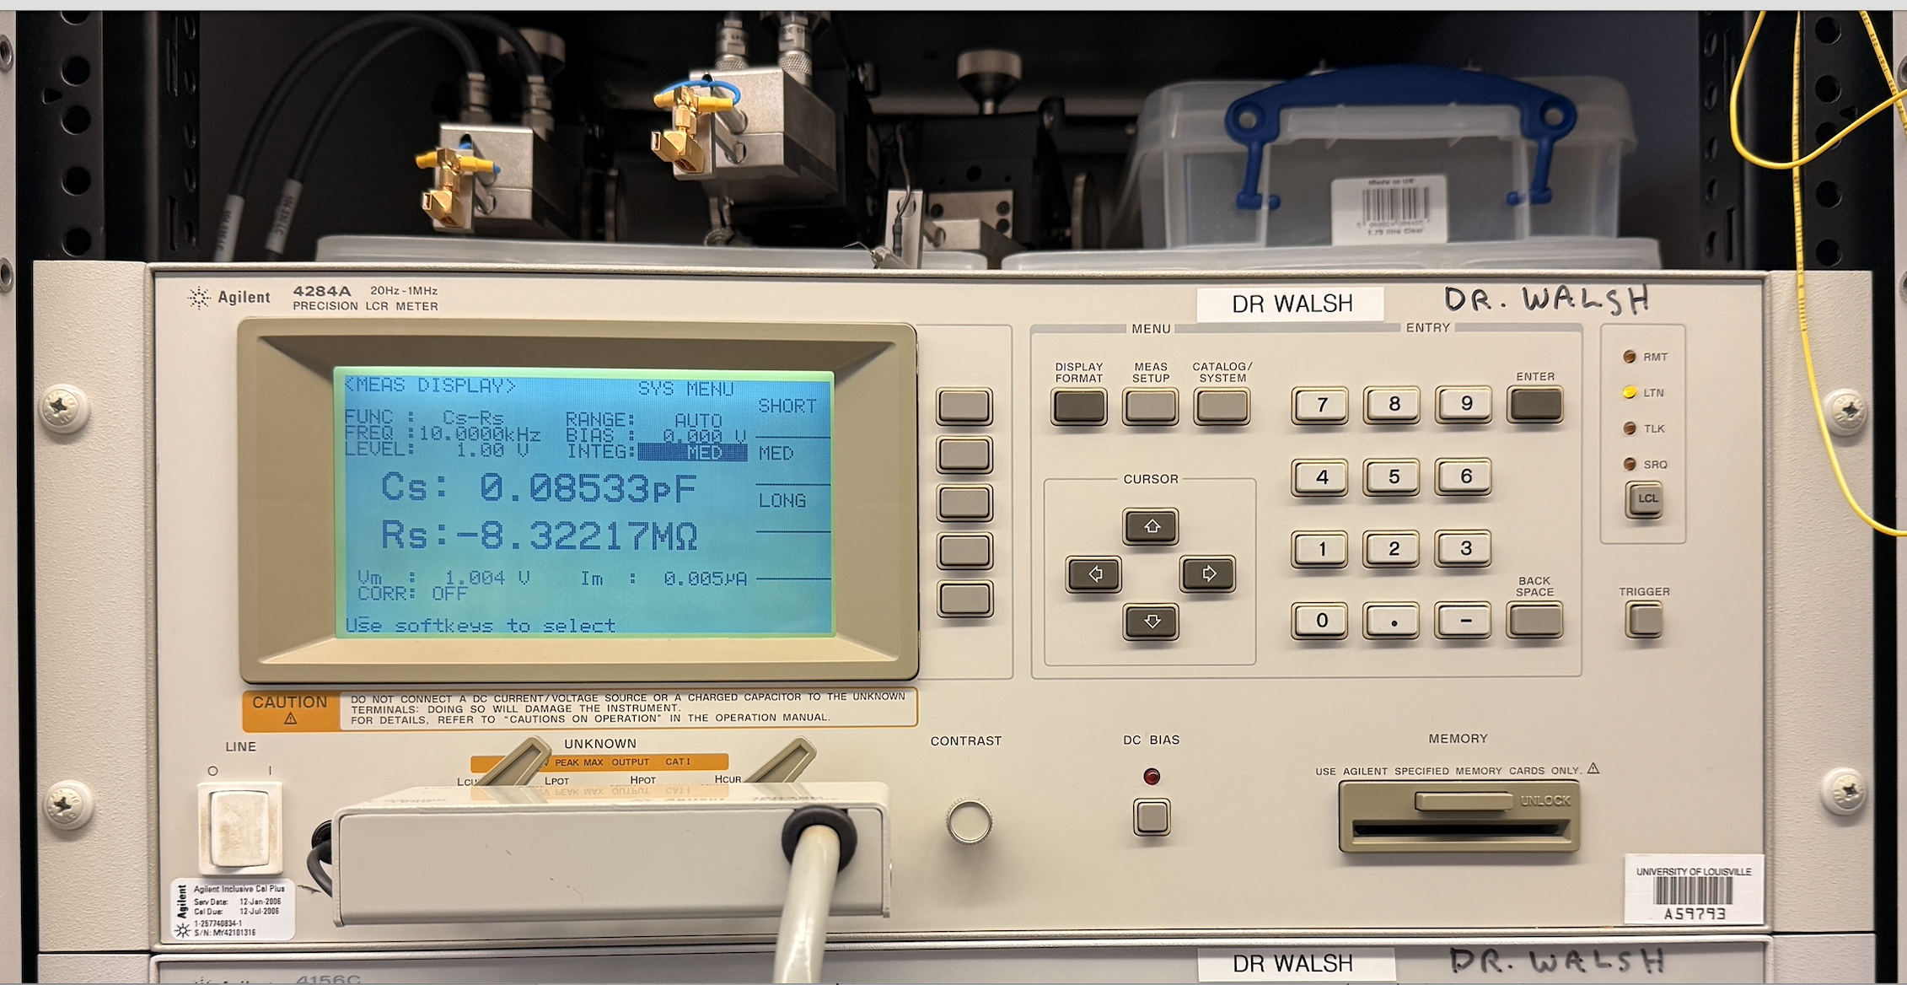
Methods of Measuring the Capacitance:
1. Agilent 4284A, LCR Meter
2. Using a AD7746 capacitance evaluation board and testing via. LabVIEW:
Q = CV
7

Slide 8
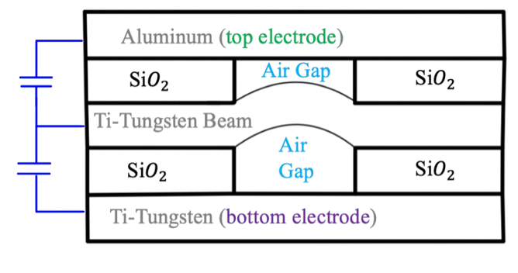
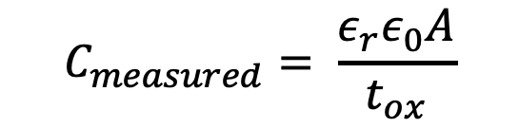


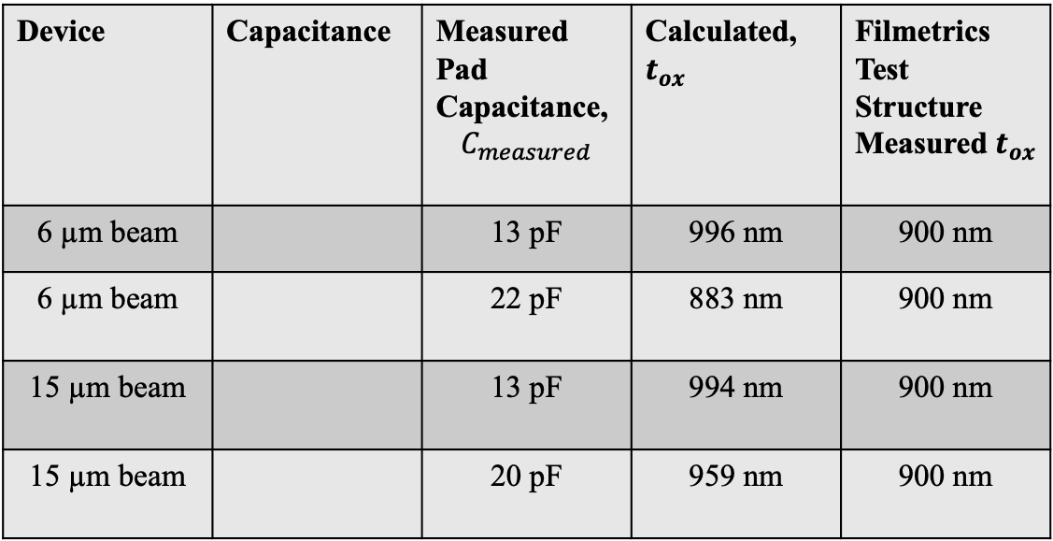



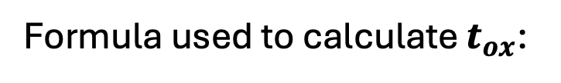

Confirm oxide thickness
Cross-section of the device:
Device | Capacitance | Measured Pad Capacitance, $$C_{measured}$$ | Calculated, $t_{ox}$ | Filmetrics Test Structure Measured $t_{ox}$
6 µm beam |  | 13 pF | 996 nm | 900 nm
6 µm beam |  | 22 pF | 883 nm | 900 nm
15 µm beam |  | 13 pF | 994 nm | 900 nm
15 µm beam |  | 20 pF | 959 nm | 900 nm
$$C_{1}$$
$$C_{1}$$
$$C_{2}$$
$$C_{2}$$
$$C_{1}$$
$$C_{2}$$
Formula used to calculate $t_{ox}$:
$$C_{measured}= \frac{ε_{r}ε_{0}A}{t_{ox}}$$
Similar results between electrical and optical testing — confirms device geometry.

Slide 9
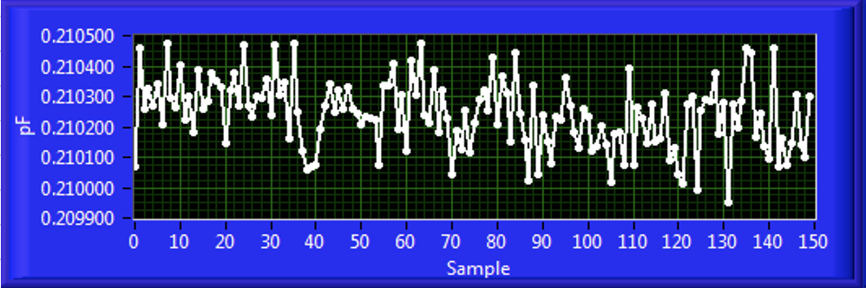
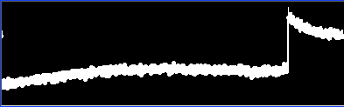
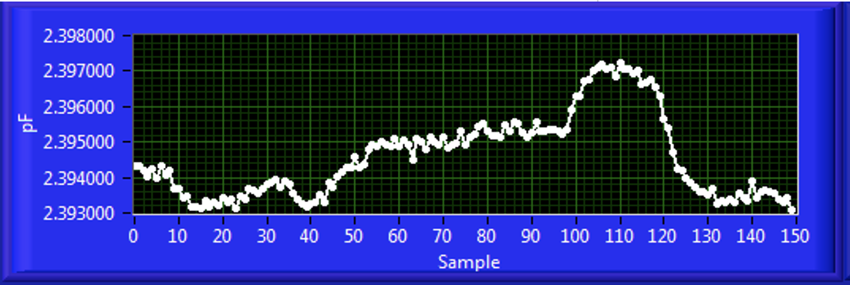
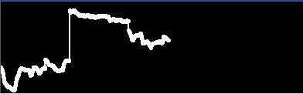
Characterizing Noise Within Our System
Agilent 4284A, LCR Meter: Chuck Vs. Lens
AD7746 Chip: 8 µm beam device
Top Electrode to Middle Beam:
Noise: 116 aF RMS
Realtime Analysis:
Chuck: Floating is quieter
Middle Beam to Bottom Electrode:
Noise: 1166 aF RMS
Realtime Analysis:
Lens: no difference
Middle-to-bottom is 10× noisier than top-to-middle — consistent with the bottom electrode's larger, substrate-contacting area coupling more environmental pickup.
9

Slide 10
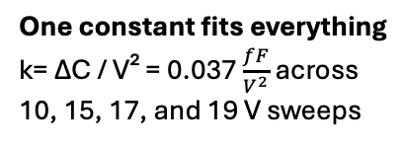
Looking for a snap, finding a quadratic response
Guided by our previous noise characterization, all following measurements use the Agilent 4284A with the chuck floating — our
lowest noise configuration.
10V
15V
C grows as V²
Electrostatic Force ∝ V²,
Deflection ∝ Electrostatic Force
One constant fits everything
k= ΔC / V² = 0.037 $\frac{fF}{V^{2}}$ across
10, 15, 17, and 19 V sweeps
Fully reversible
10 V response reproduces even after 19 V stress.
The capacitance grows as V² and fully recovers after every sweep, ~ -7.80pF. It is not the step function beam switching we were expecting.
Why is this happening?
10
Notes:
Here we have our measured data
- we see the capacitance grows as a function of voltage squared and after the voltage is applied, it rests at the same value it starts at. Something is bending and its not just the beam, the capacitance is rising too quick

Slide 11
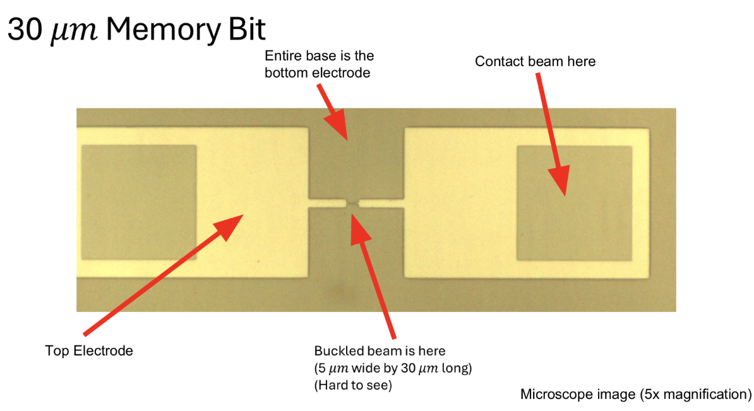
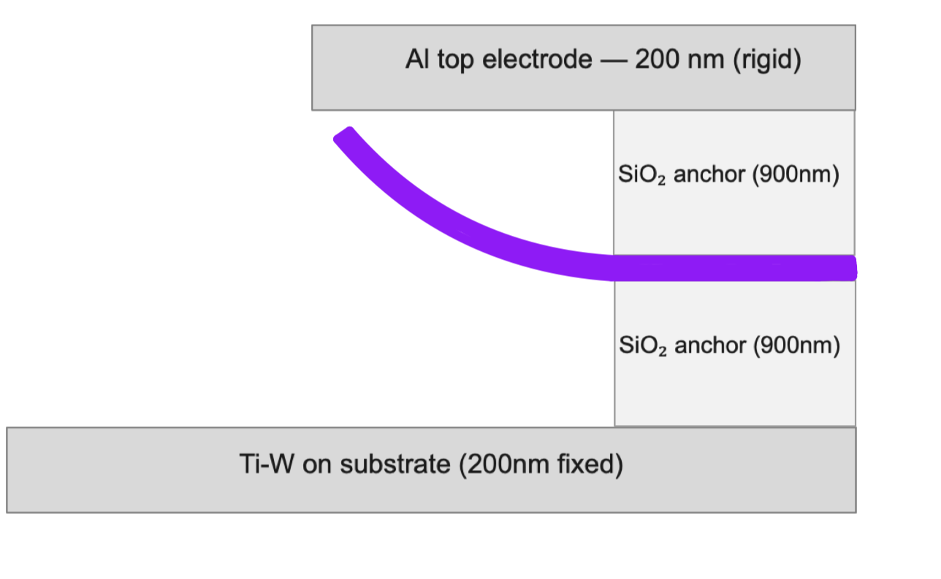
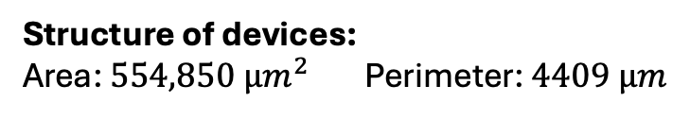
Cross-section of What’s happening:
Structure of devices:
Area: $554,850 {µm}^{2}$Perimeter: $4409 µm$
Edge of the Device:
electrostatic pull ∝ V²
20 nm Ti-W Beam
red outline: undercut rim — thousands of µm of released edge
undercut cavity (Anhydrous HF removes SiO₂)
beam: ~5 µm of released edge
The etch that frees the beam frees the entire perimeter. About 4,409 µm of released edge vs ~5 µm of beam — nearly 900× more moving metal. This extra Ti-W beam that is released from the etch dominates our capacitance readings.
11

Slide 12
Conclusions: What We Found
1. Device geometry Confirmed
Oxide thickness from pad capacitance: ~900 nm — matches the Filmetrics optical measurement. Both electrical and optical agree.
2. Our noise reduction system
Agilent 4284A LCR meter: floating chuck is quieter; lens grounding makes no difference. Led us to to a best noise calculation within a measurement of 82.5 aF RMS in our 0-15V sweep.
AD7746 Capacitance Evaluation Board: the bottom electrode is the dominant noise source — consistent with its larger area.
3. A Spring Response
One constant found from the slope of the graph — $k=\frac{ΔC}{V^{2}}$ = 0.037 $\frac{fF}{V^{2}}$ — across 10, 15, 17, 19 V sweeps; fully reversible.
4. The mechanism: the released perimeter
The anhydrous HF release undercut the whole perimeter: ~4,409 µm of released edge vs ~5 µm of beam (~900×). The beams perimeter capacitance dominates our measured capacitance response.
Next steps:
1. Design and develop a new generation of devices that confine the undercut to the beam and not the perimeter — and fully test them. Without the outer perimeter exposed, the beam’s switching signal is much easier to measure.
2. Redesign the bottom electrode to cut its environmental coupling. Having a smaller pad area — so the middle-to-bottom path so we ideally yield better measurements as a result.
12
Notes:
Clearly state what we found with the noise characterization of our systems.

Slide 13
Thanks for listening!
Questions?
Acknowledgements:
1. Dr. Shamus McNamara, Research Advisor
2. Dr. Kevin Walsh, Instrumentation devices
3. Ana Sanchez Galiano, Program Coordinator
NSF REU Award ID #2348869

Slide 14


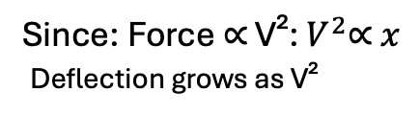
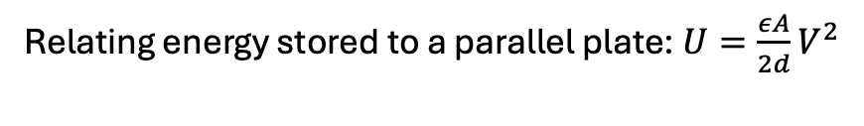
The physics behind the Spring Model: Electrostatic Force ∝ V²
Energy stored in a capacitor formula: $U=\frac{1}{2}CV^{2}$
Hooke’s Law: F = kx
Parallel-Plate Formula: $C=\frac{εA}{d}$
Since: Force ∝ V²: $V^{2}\text{∝} x$
Deflection grows as V²
Relating energy stored to a parallel plate: $U=\frac{εA}{2d}V^{2}$
Relationship between Force & energy: $F=−\frac{dU}{dx}=\frac{εA}{2x^{2}}V^{2}$

Slide 15
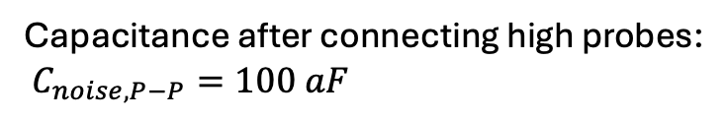
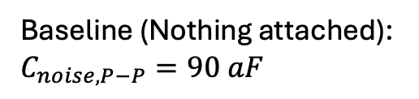
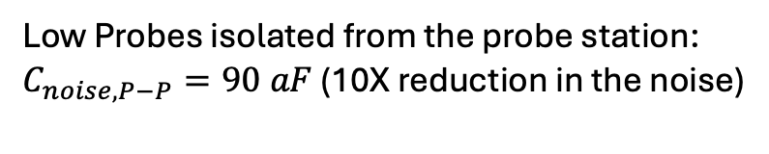
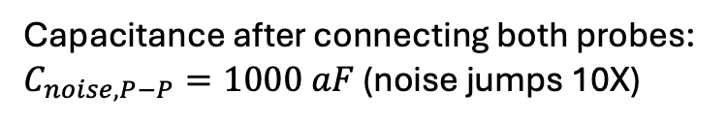
Characterizing Noise at the Probe Station
We characterize the system without the chip first, building up one piece at a time — instrument alone, then each probe/cable — so every component’s noise contribution is isolated.
If noise jumps at a step, that step is the target for reduction.
LCR Meter
Baseline (Nothing attached):
$$C_{noise, P−P}=90 aF$$
Low Probes isolated from the probe station:
$C_{noise,P−P}=90 aF$ (10X reduction in the noise)
Capacitance after connecting high probes:
$C_{noise, P−P}=100 aF$
The floating structure acts as a single capacitively-coupled node whose potential fluctuates with 60 Hz fields, contributing to more stray noise in the measurements.
Capacitance after connecting both probes:
$C_{noise,P−P}=1000 aF$ (noise jumps 10X)

Slide 16
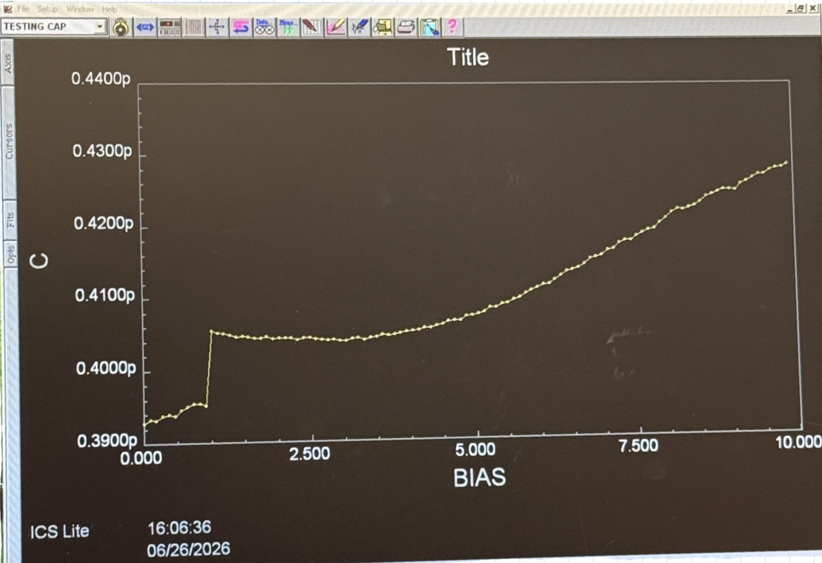
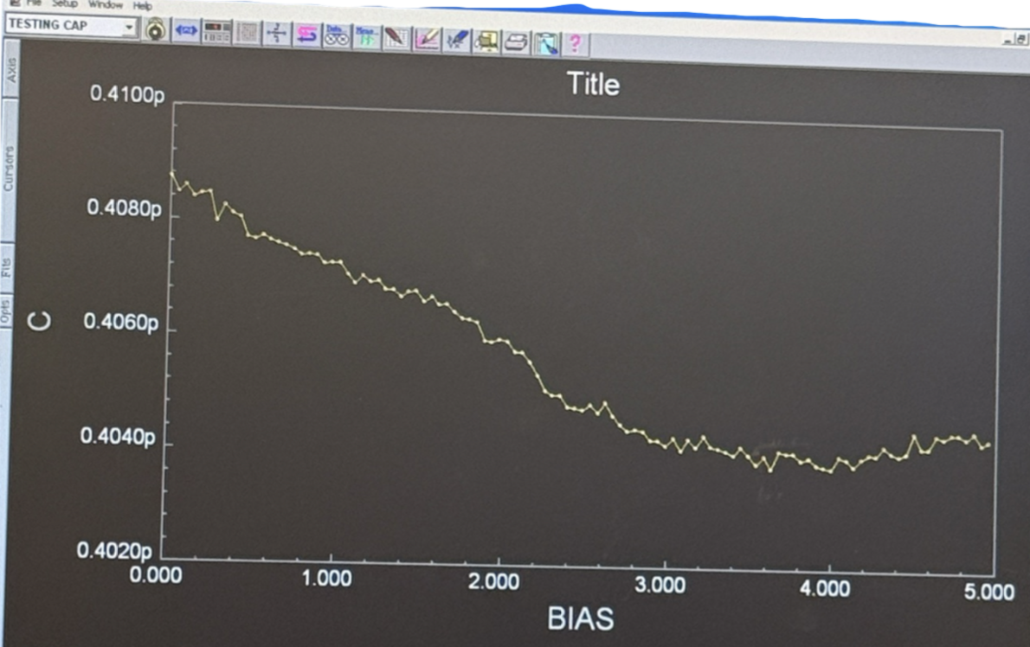
Sample Measurement from the Middle beam to Bottom Electrode
First Sweep
Second Sweep
Expectation of a Beam Switching States
Capacitance should
not be decreasing, it should
be stable
Possible explanations: The probe could’ve
moved causing the jump in capacitance

Slide 17
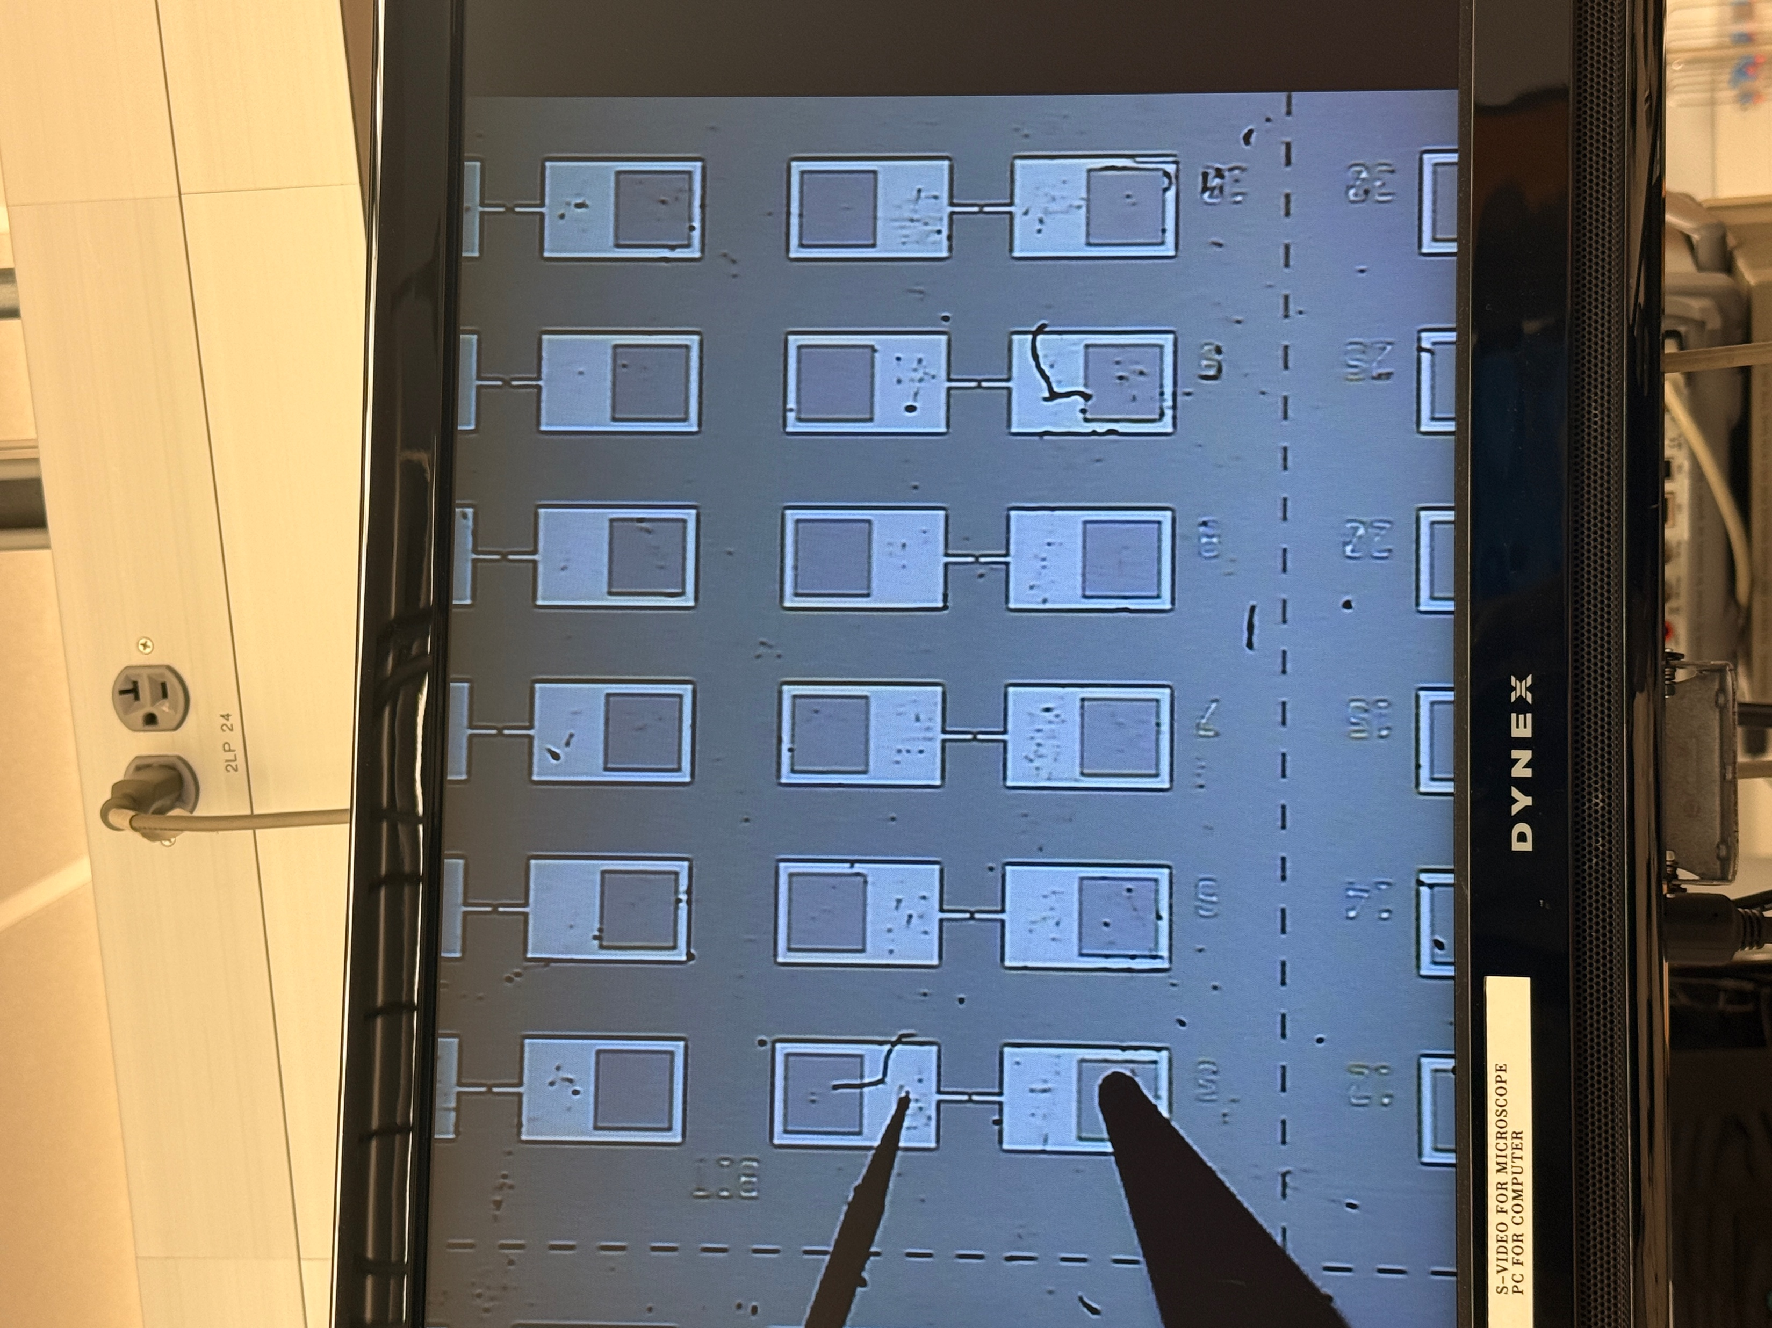
What’s Next ?
Reducing noise systematically
Use the noise ladder to target the dominant source — probes and cabling. We want to reduce the two-probe noise floor.
Testing the two-layer devices (already fabricated)
Measure middle beam ↔ bottom electrode noise
Compare noise: 2-layer vs. 3-layer structures
Verifying the switch
Voltage sweeps in progress — separating true mechanical switching from any stray capacitance effects
Testing via the Probe Station

Slide 18
What’s Next ?
By being able to characterize the noise, we’re able to systematically target each step of the measurement to potentially reduce noise and produce the most accurate measurements.
Continuing to test the devices as accurately as possible.
Testing via the Probe Station

Slide 19
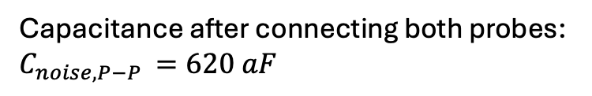
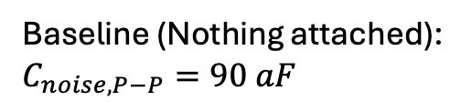
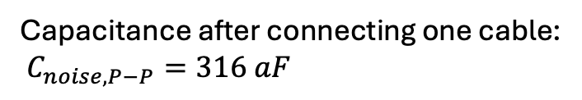
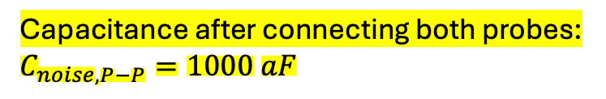
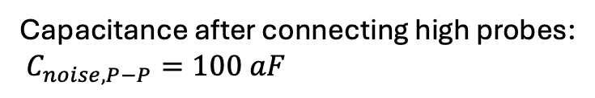
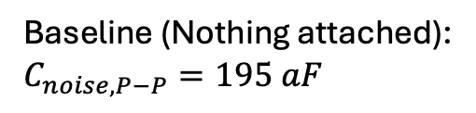
Step 2: Characterizing Noise Without Devices
We characterize the system without the chip first, building up one piece at a time — instrument alone, then each probe/cable — so every component’s noise contribution is isolated.
If noise jumps at a step, that step is the target for reduction.
LCR Meter
Capacitance Evaluation Board
Baseline (Nothing attached):
$$C_{noise, P−P}=90 aF$$
Baseline (Nothing attached):
$C_{noise,P−P}=195 aF$
Capacitance after connecting high probes:
$C_{noise, P−P}=100 aF$
Capacitance after connecting one cable:
$C_{noise,P−P}=316 aF$
Capacitance after connecting both probes:
$C_{noise,P−P}=1000 aF$
Capacitance after connecting both probes:
$$C_{noise,P−P }=620 aF$$

Slide 20
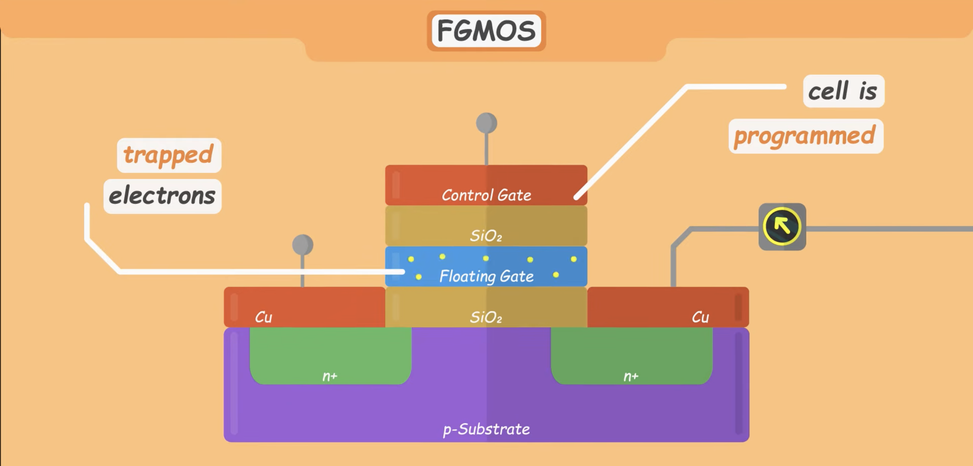
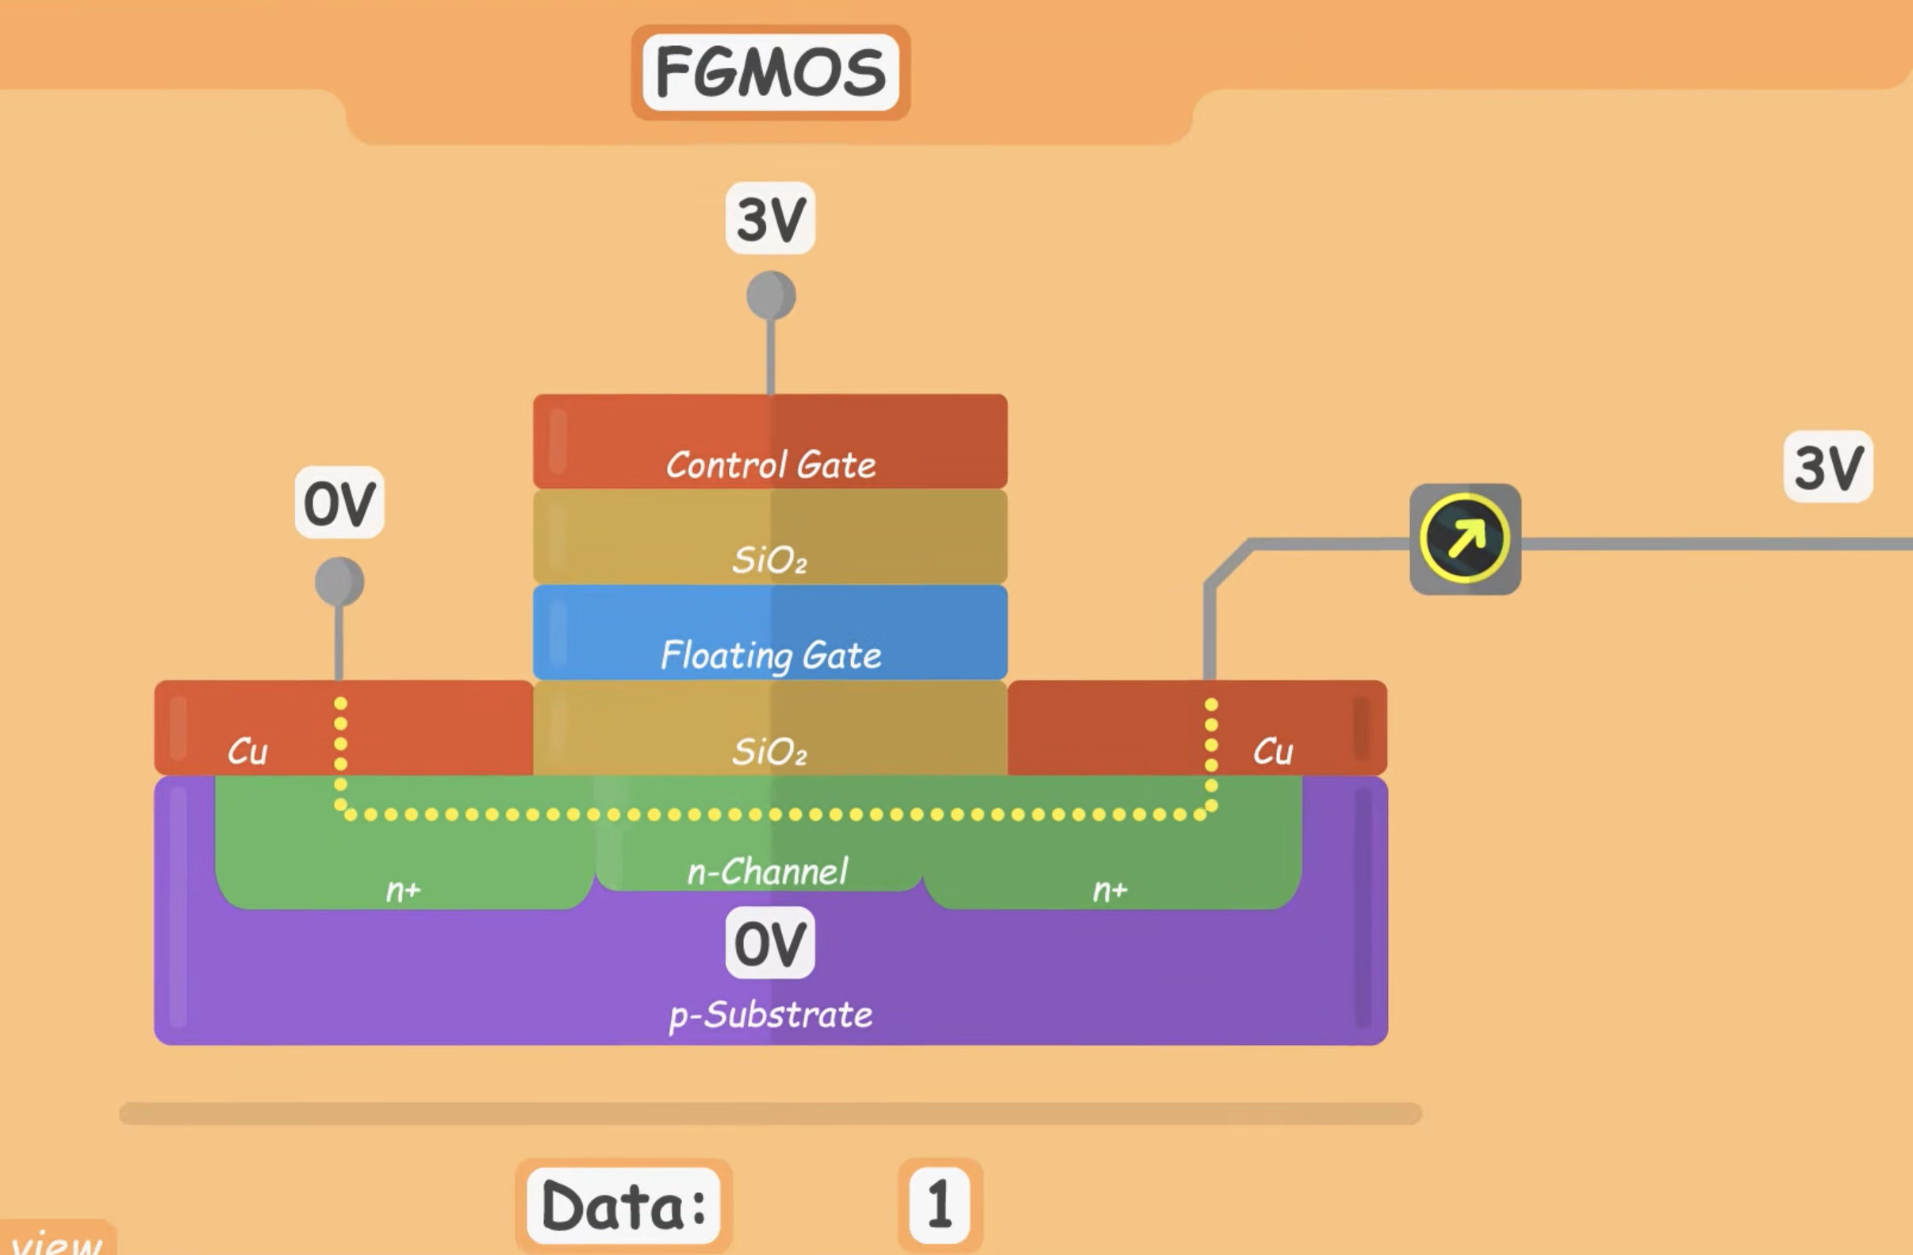
Trapped electrons in the floating gate raises threshold V
so no current flows across channel, reads 0
Flash Memory Cell (reading)
Current flows directly through channels,
reads 1

Slide 21
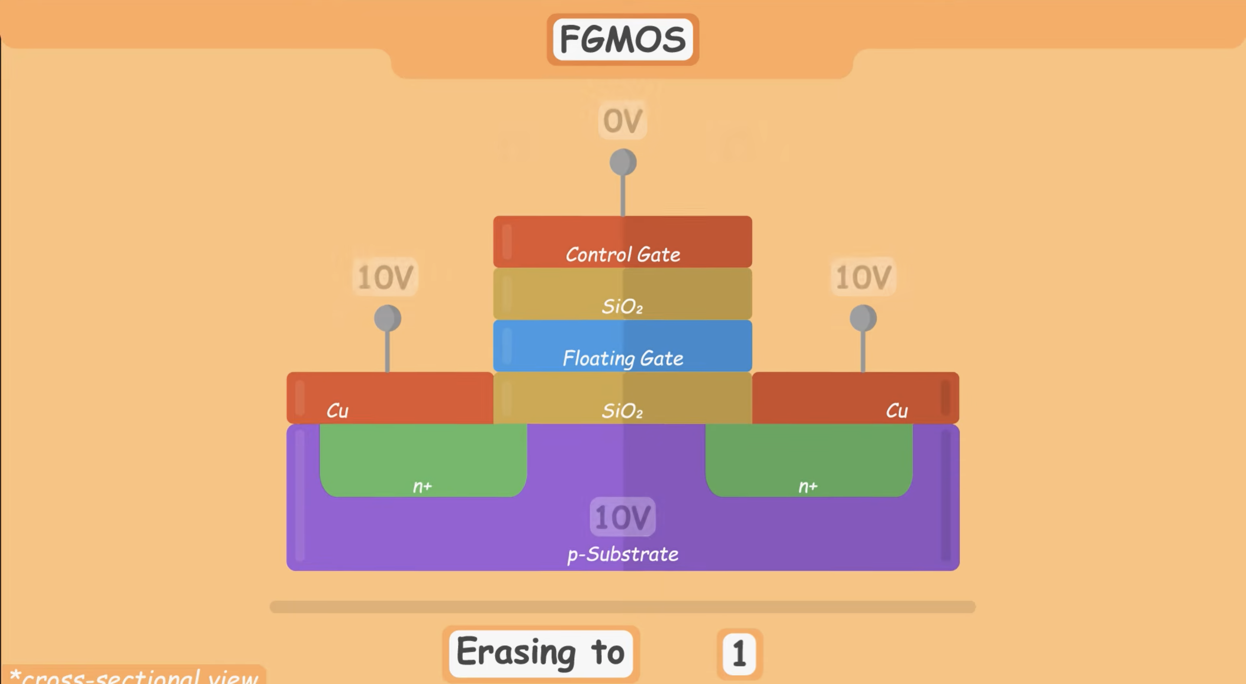
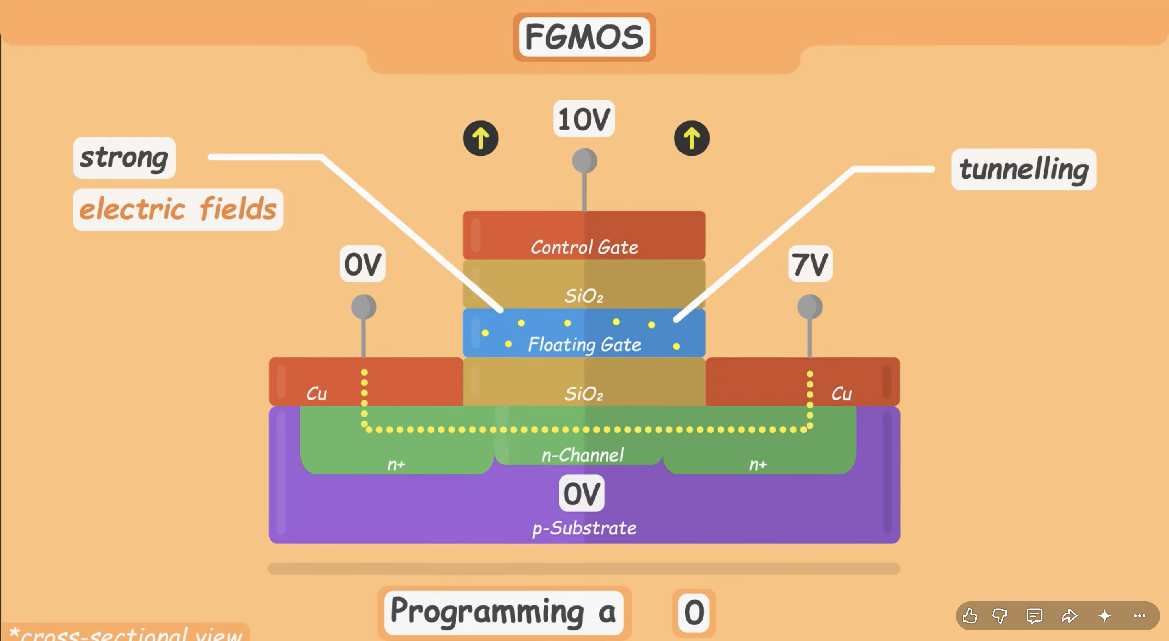
Flash Memory Cell
(writing)
Constant reading and writing has a distructive
effect on oxide layer that causes it to wear out,
fails over time.
https://www.youtube.com/watch?v=r2KaVfSH884

Slide 22
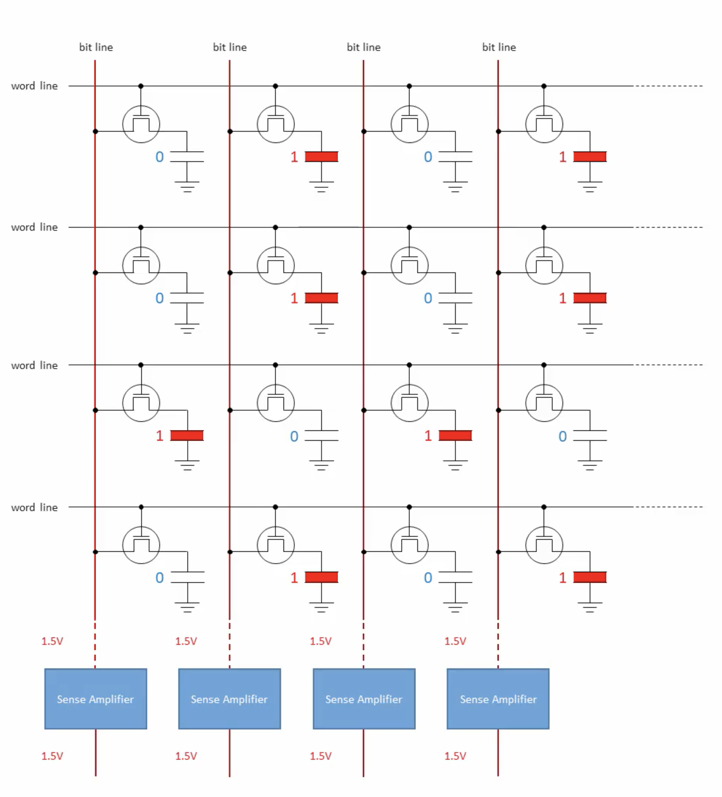
DRAM Memory Cells
https://semiengineering.com/dram-scaling-challenges-grow/

Slide 23

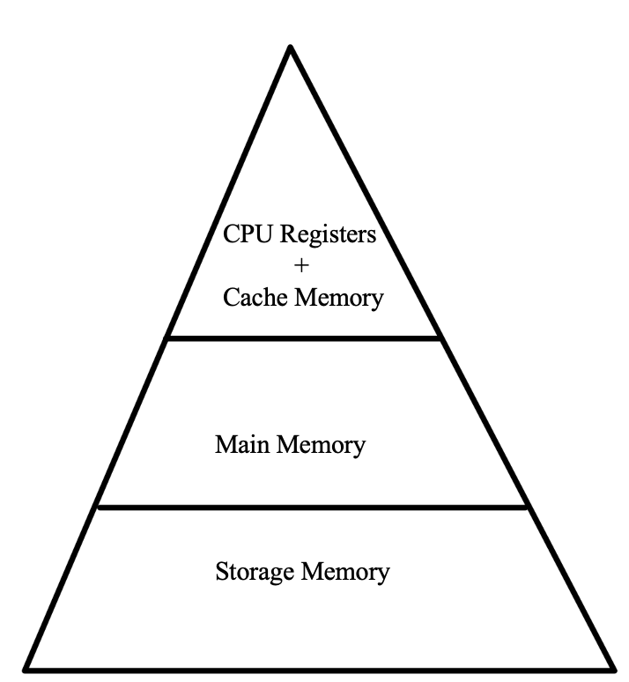
Motivation: Improving Computer Processing
Unifying
memory
Speed and Cost per Bit increases
Storage Capacity decreases
Have reaches scaling limits, flash has limited write cycles, dram needs constant refresh, both susceptible to radiation.

Slide 24
What does our MEMS computer memory buy us?
1. Non-Volatility + no standby power. The bit is stored as a physical position of the beam so once written,
it persists with negligible power and costs nothing to hold. The beam is buckled so its stable in one of 2
positions once written.
2. Lower write voltage + faster write times vs. Flash. While Flash is also non-volatile, it
requires much more energy to write and much slower. MEMS writes using electrostatically — lower voltage, faster
writing. Oxide layer in flash cells degrade due to constant writing/erasing of the data within cells,
they fail and cannot be used as main memory.
3. Can potentially scale smaller than Flash and DRAM. As Flash and DRAM cells continue to shrink, the walls
used to house these charges also shrink leaving open to issues such as quantum tunneling that causing charge to leak
from the cells themselves. Devices are currently about 20nm thick but can be scaled down to 1 atom thick.
4. Radiation Hard. Stray charges due to impact ionization from charged particles that can impact memory cells in
DRAM and Flash memory will have no affect on the MEMS beam as its not charge based.

Slide 25
Goal: Read capacitance to verify that the beam switches
The bit we're reading is very small, in the attofarad range — so tiny that random noise can bury it. We can only tell a 0 from a 1 if the signal stands above the noise.
Our Two Methods of Measuring the Capacitance:

Slide 26
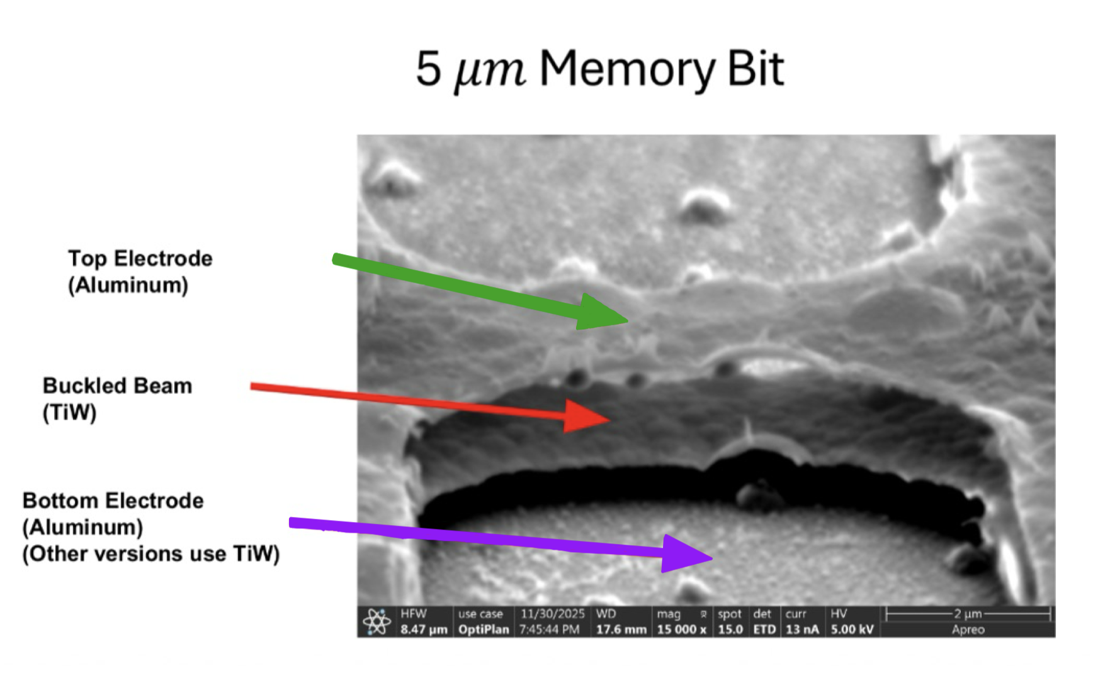
The MEMS device
Up until this point, we’ve only talked about the beam. Here we see the full device itself.
Testing on the Probe Station

Slide 27
