Slide 1







Genetically Encoded Amphiphilic Polymers for Membrane Based Nanotechnologies
Adam Vanluvanee
Department of Engineering, Harvey Mudd College
Ashley Martinez, BS & Gabriel Montaño, PHD
Center for Materials Interfaces in Research and Access (¡MIRA!), Northern Arizona University
NSF award No.ECCS-2025490
1
Notes:
Hello, my name is Adam Vanluvanee and I'm a fourth-year undergrad at Havey Mudd College. Today, I’ll be presenting on my research project titled…

Slide 2
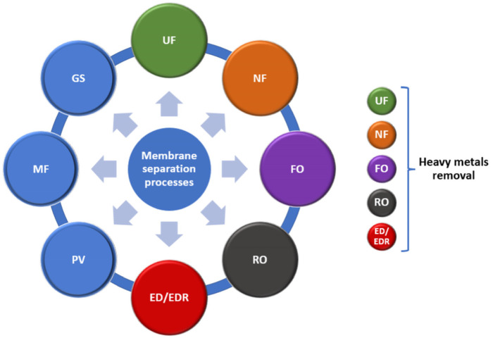
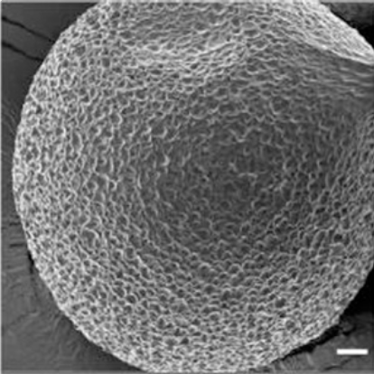
Applications of Membrane-Based Nanotechnology
Biomimetic membrane-based nanotechnology has broad reach across medicine, environmental remediation, and energy-based applications
Nanofiltration membranes ¹
Specialized polymers ²
Fig 1: Membrane separation process & ELP microparticle
¹ Sandu T, Sârbu A, Căprărescu S, Stoica EB, Iordache TV, Chiriac AL. Polymer Membranes as Innovative Means of Quality Restoring for Wastewater Bearing Heavy Metals. Membranes (Basel). 2022 Nov 23;12(12):1179. doi: 10.3390/membranes12121179. PMID: 36557086; PMCID: PMC9783154.
² MacEwan SR, Chilkoti A. Applications of elastin-like polypeptides in drug delivery. J Control Release. 2014 Sep 28;190:314–330. doi: 10.1016/j.jconrel.2014.06.028. PMID: 24954283; PMCID: PMC4163487.
2
NSF award No.ECCS-2025490
Notes:
Nanofiltration membranes effectively remove heavy metals for water quality restoration¹
Specialized polymers deliver therapeutics and small molecule drugs to target sites for disease treatment ²

Slide 3
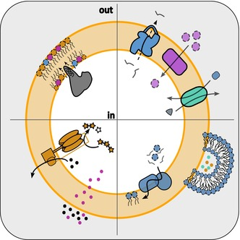
Challenges of Synthetic Membrane-Based Nanotechnology
Synthetic lipid membranes ¹
Labile
High cost
Complexity driven by composition
Amphiphilic block copolymers ²
Caustic synthesis
High cost
Low throughput and yield
Fig 2: Schematic representation of key functions required for a synthetic minimal cell membrane
¹ Gan S, Scarpelli V, Exterkate M. Exploring lipid diversity and minimalism to define membrane requirements for synthetic cells. FEBS Lett. 2025 Dec;599(24):3569-3590. doi: 10.1002/1873-3468.70131. Epub 2025 Aug 11. PMID: 40787853; PMCID: PMC12720230.
² Polymer Source Inc. Product Categories. Polymer Source Inc.; 2026 [cited 2026 Jun 18]. Available from: https://www.polymersource.ca/index.php?route=product/maincategory
3
NSF award No.ECCS-2025490
Notes:
Potential time saver: current materials used in the field are lipid and ABC based, having their own disadvantages such as being costly, caustic, labile, complex, among other reasons shown here
PEO ABC 2.5 kD, GEP 13 kD,

Slide 4
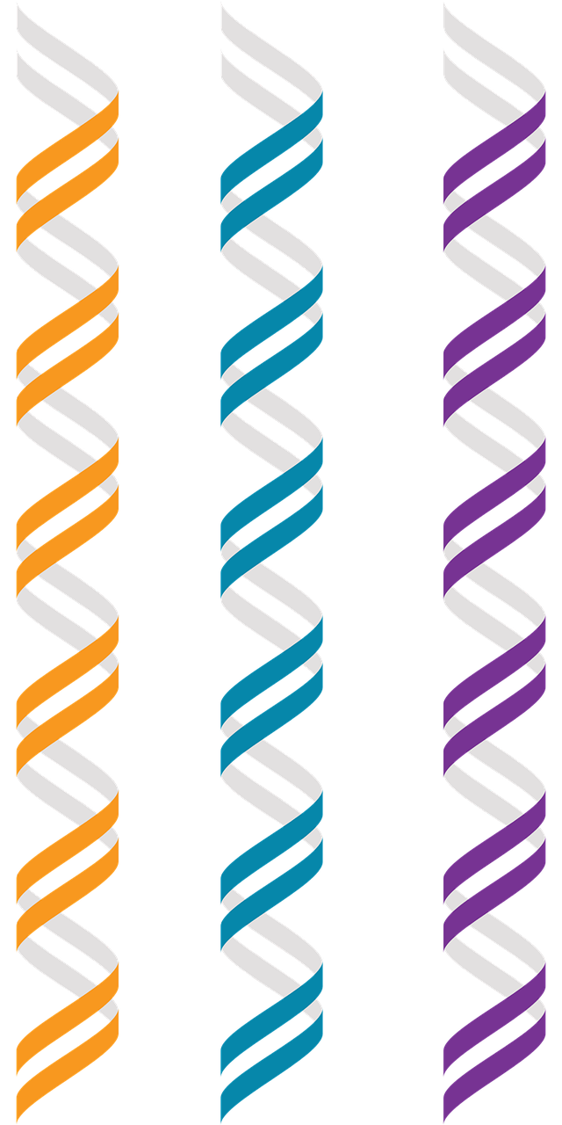
Overcoming Challenges Faced in Synthetic Membrane Technology
Genetically encoded polymers (GEP’s) have the potential to overcome the challenges faced in the development of synthetic membrane-based nanotechnology
NSF award No.ECCS-2025490
4

Slide 5
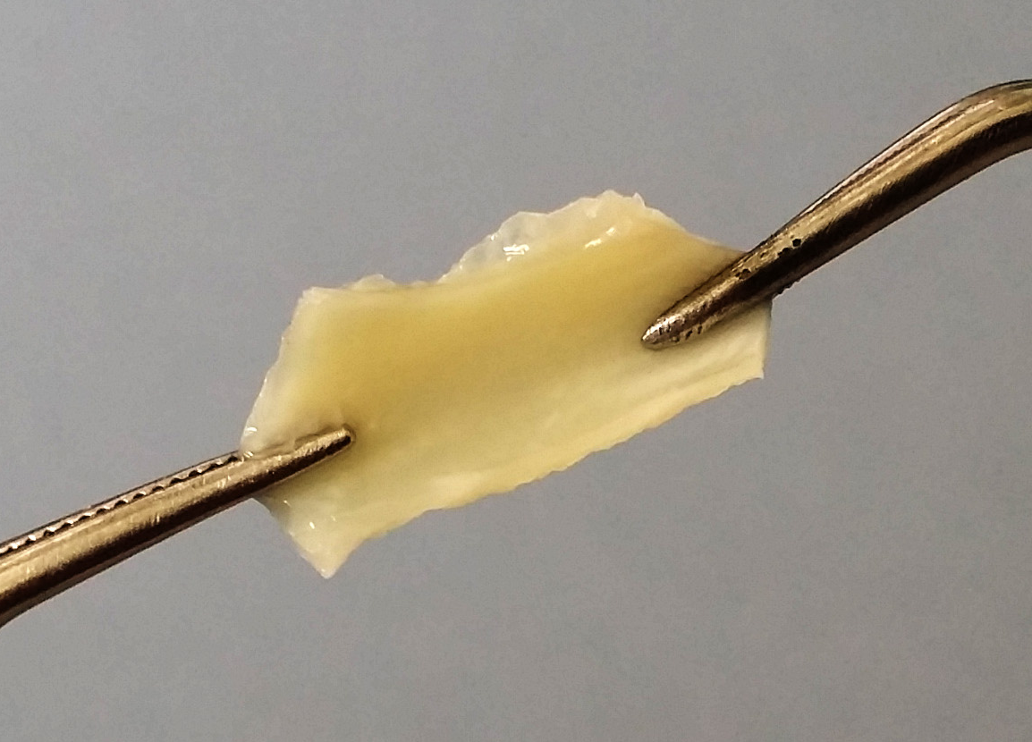
Elastin as a Template for Producing GEP’s
Elastin is one of the most abundant proteins in the human body
Provides elasticity to tissues
Consists primarily of glycine, valine, alanine, and proline
Fig 3: Bovine aorta elastin ¹
¹ Knapp S. Connective Tissue. Biology Dictionary; 2020 Oct 11 [cited 2026 Jul 27]. Available from: https://biologydictionary.net/connective-tissue/
5
NSF award No.ECCS-2025490
Notes:
Fraunhofer Institute for Microstructure of Materials and Systems IMWS. Elastin- and Collagen-based Skin Products [flyer]. Fraunhofer-Gesellschaft; 2020 [cited 2026 Jul 27]. Available from: https://www.imws.fraunhofer.de/content/dam/imws/en/documents/Kontakt/Infomaterial/Infomaterial_EN/200219_Flyer%20SkinNext.pdf

Slide 6
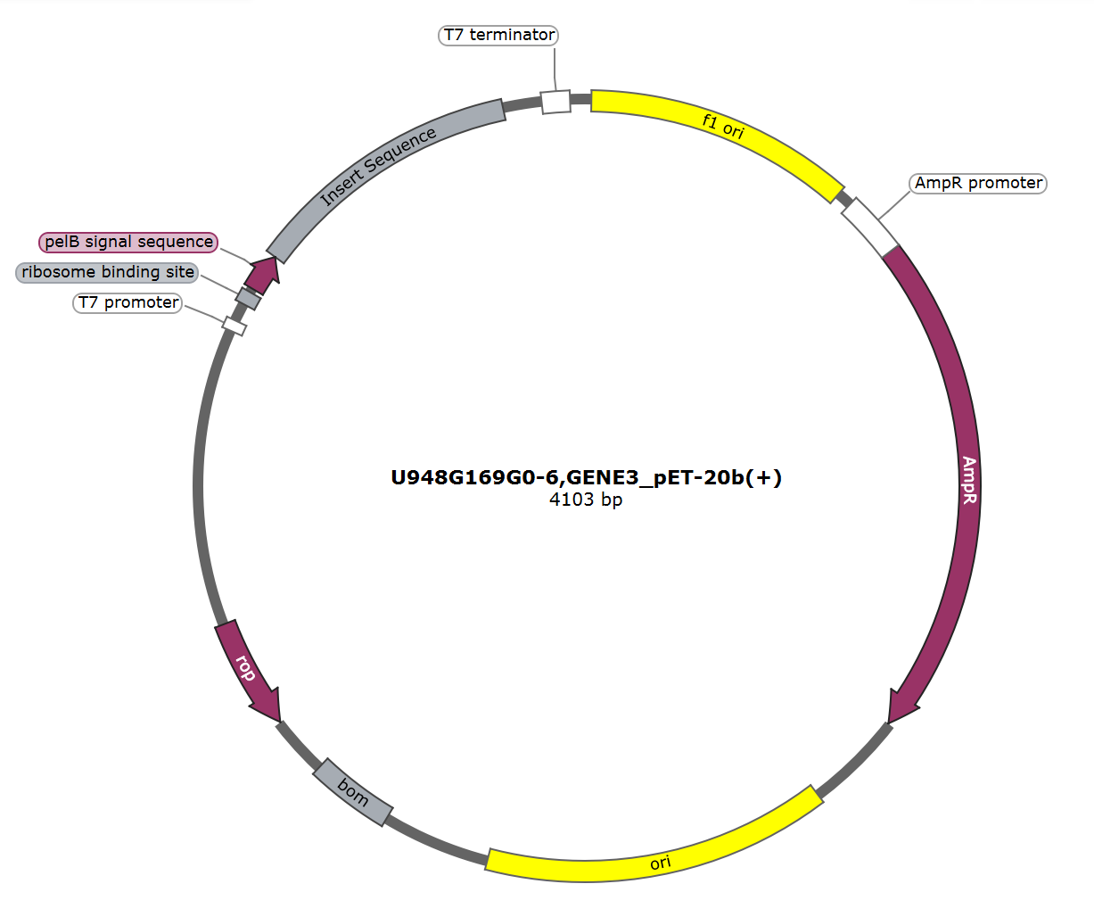
Primary Research Goal
Design, synthesize, and characterize amphiphilic small chain GEP’s for membrane technology applications
Fig. 4: GEP sequence used in this project for bacterial transformation
6
NSF award No.ECCS-2025490

Slide 7
GEP Sequence (“20:10”)
Designed a vector (as shown in previous slide) that encodes for a 20:10 ratio of hydrophobic to hydrophilic regions of amino acids
Histidine group provides tagging capability
Yields desired properties of elastin
  Amphiphilic nature
  Formation of nanocomposites with dimensions similar to biomembranes
G(VPGXG)₂₀ (VPGSG)₁₀ H₆
where X = 1:4 ratio of W:V
Fig. 5: 20:10 GEP sequence
6
7
NSF award No.ECCS-2025490
Notes:
First, I want to discuss our GEP design. We start with a synthetic version of bacteria DNA that has our desired GEP sequence within it, shown at right. The first half consists of 20 repeat units of a hydrophobic sequence of amino acids, followed by 10 repeat units of a hydrophilic sequence. This 20:10 ratio has led us to nickname the sequence the "20:10" sequence, which is how I will refer to it from now on. There is also a histidine group on the end that provides tagging capability. These specific amino acids and design decisions allow us to impart specific elastin like properties such as being amphiphilic in nature and having the ability to form nanocomposites with dimensions similar to biomembranes.

Slide 8
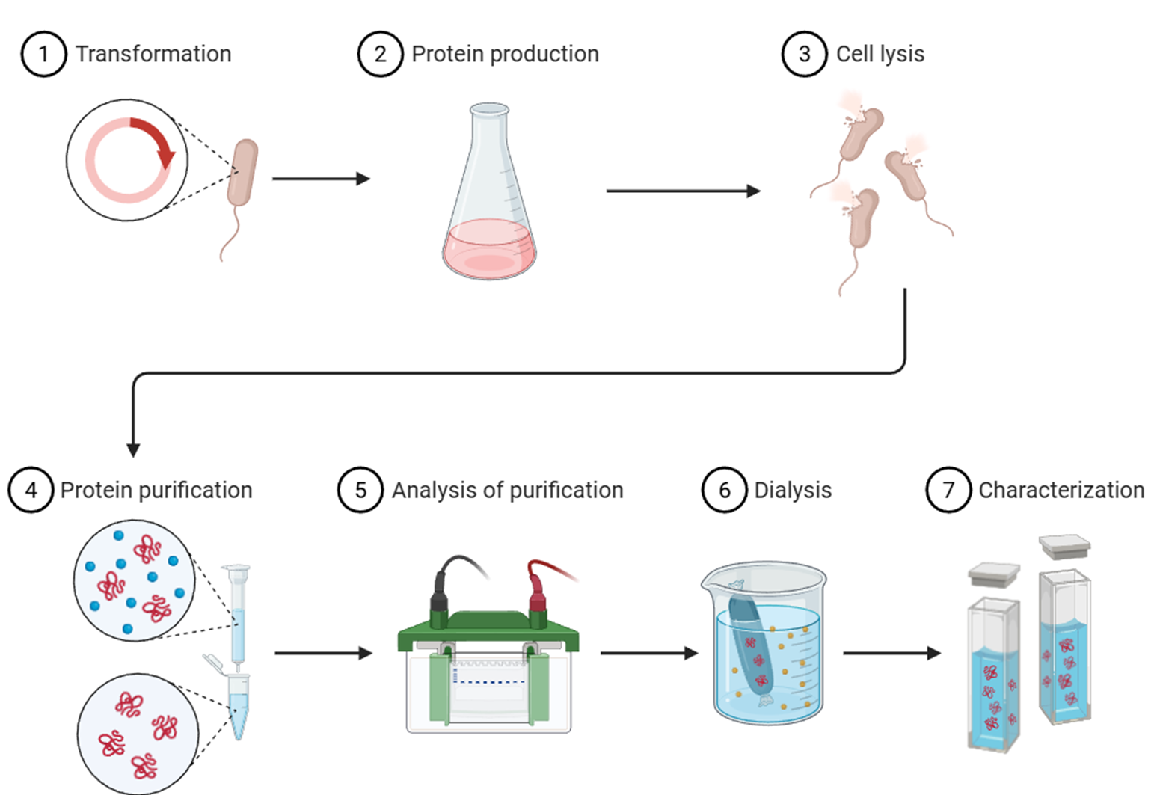
GEP Production
Transformation of bacteria for DNA uptake
Protein production and purification
Detailed analysis for characterization
Fig. 6: Schematic showing the process used to produce, purify, and analyze the desired protein
8
NSF award No.ECCS-2025490
Notes:
Maybe enlarge image

Slide 9
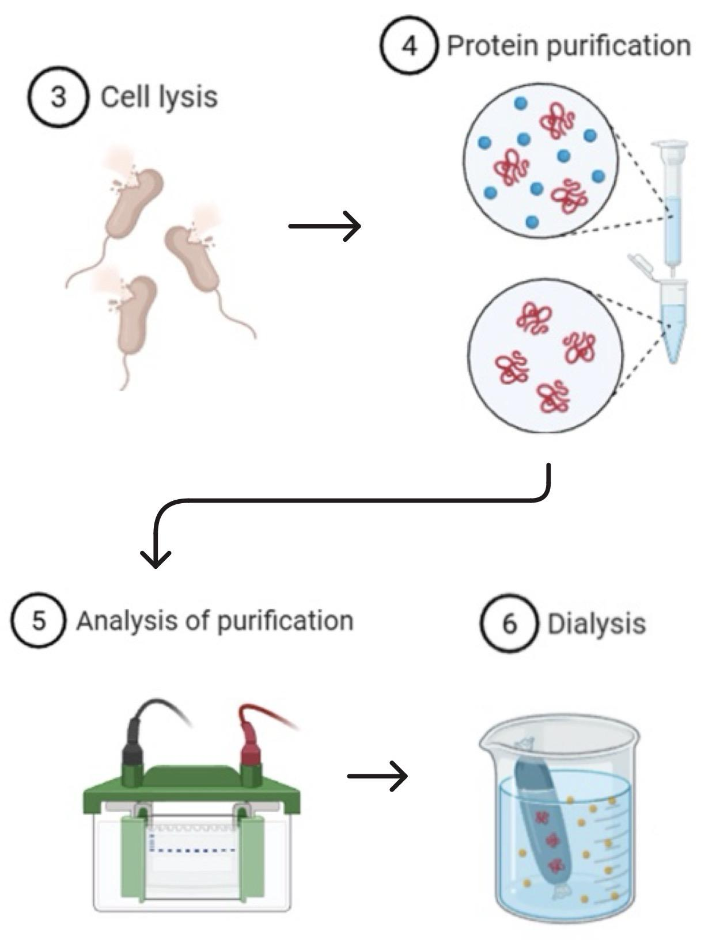
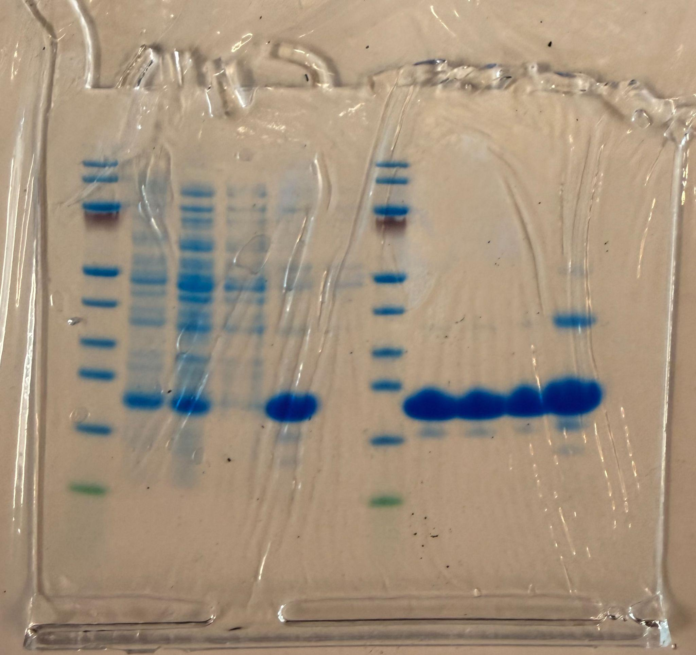
Results: SDS Gel
1 - Ladder
2 - PPF 1
3 - PPF 2
4 - PPF 3
5 - CC1
6 - WC1
7 - Ladder
8 - CC3
9 - CC4
10 - Dialysis
11 - Pos Control
1 2 3 4 5 6 7 8 9 10 11
Fig. 7: SDS-PAGE Gel displaying protein purification process
NSF award No.ECCS-2025490
9
Notes:
This SDS gel shows our purification process from cell lysis through dialysis. It works by running current through the sample to pull proteins through by size, so we can see purity: more bands means more contaminants, fewer means cleaner. Lanes 1 and 7 are our ladders, giving us a weight reference and confirming the gel ran properly. Lanes 2 through 4 show the process by which we break open the bacterias periplasmic membrane to access our protein. In lanes 5 through 9, where we use inverse temperature cycling to remove contaminants from the protein. Lane 10 is dialysis, our final step before characterization, and the purest sample of the set. Lane 11 is a positive control, a different vector from the same series, confirming the gel ran correctly. Overall, this shows the purification working as intended, and gives us a clean, correctly sized protein ready for characterization.

Slide 10
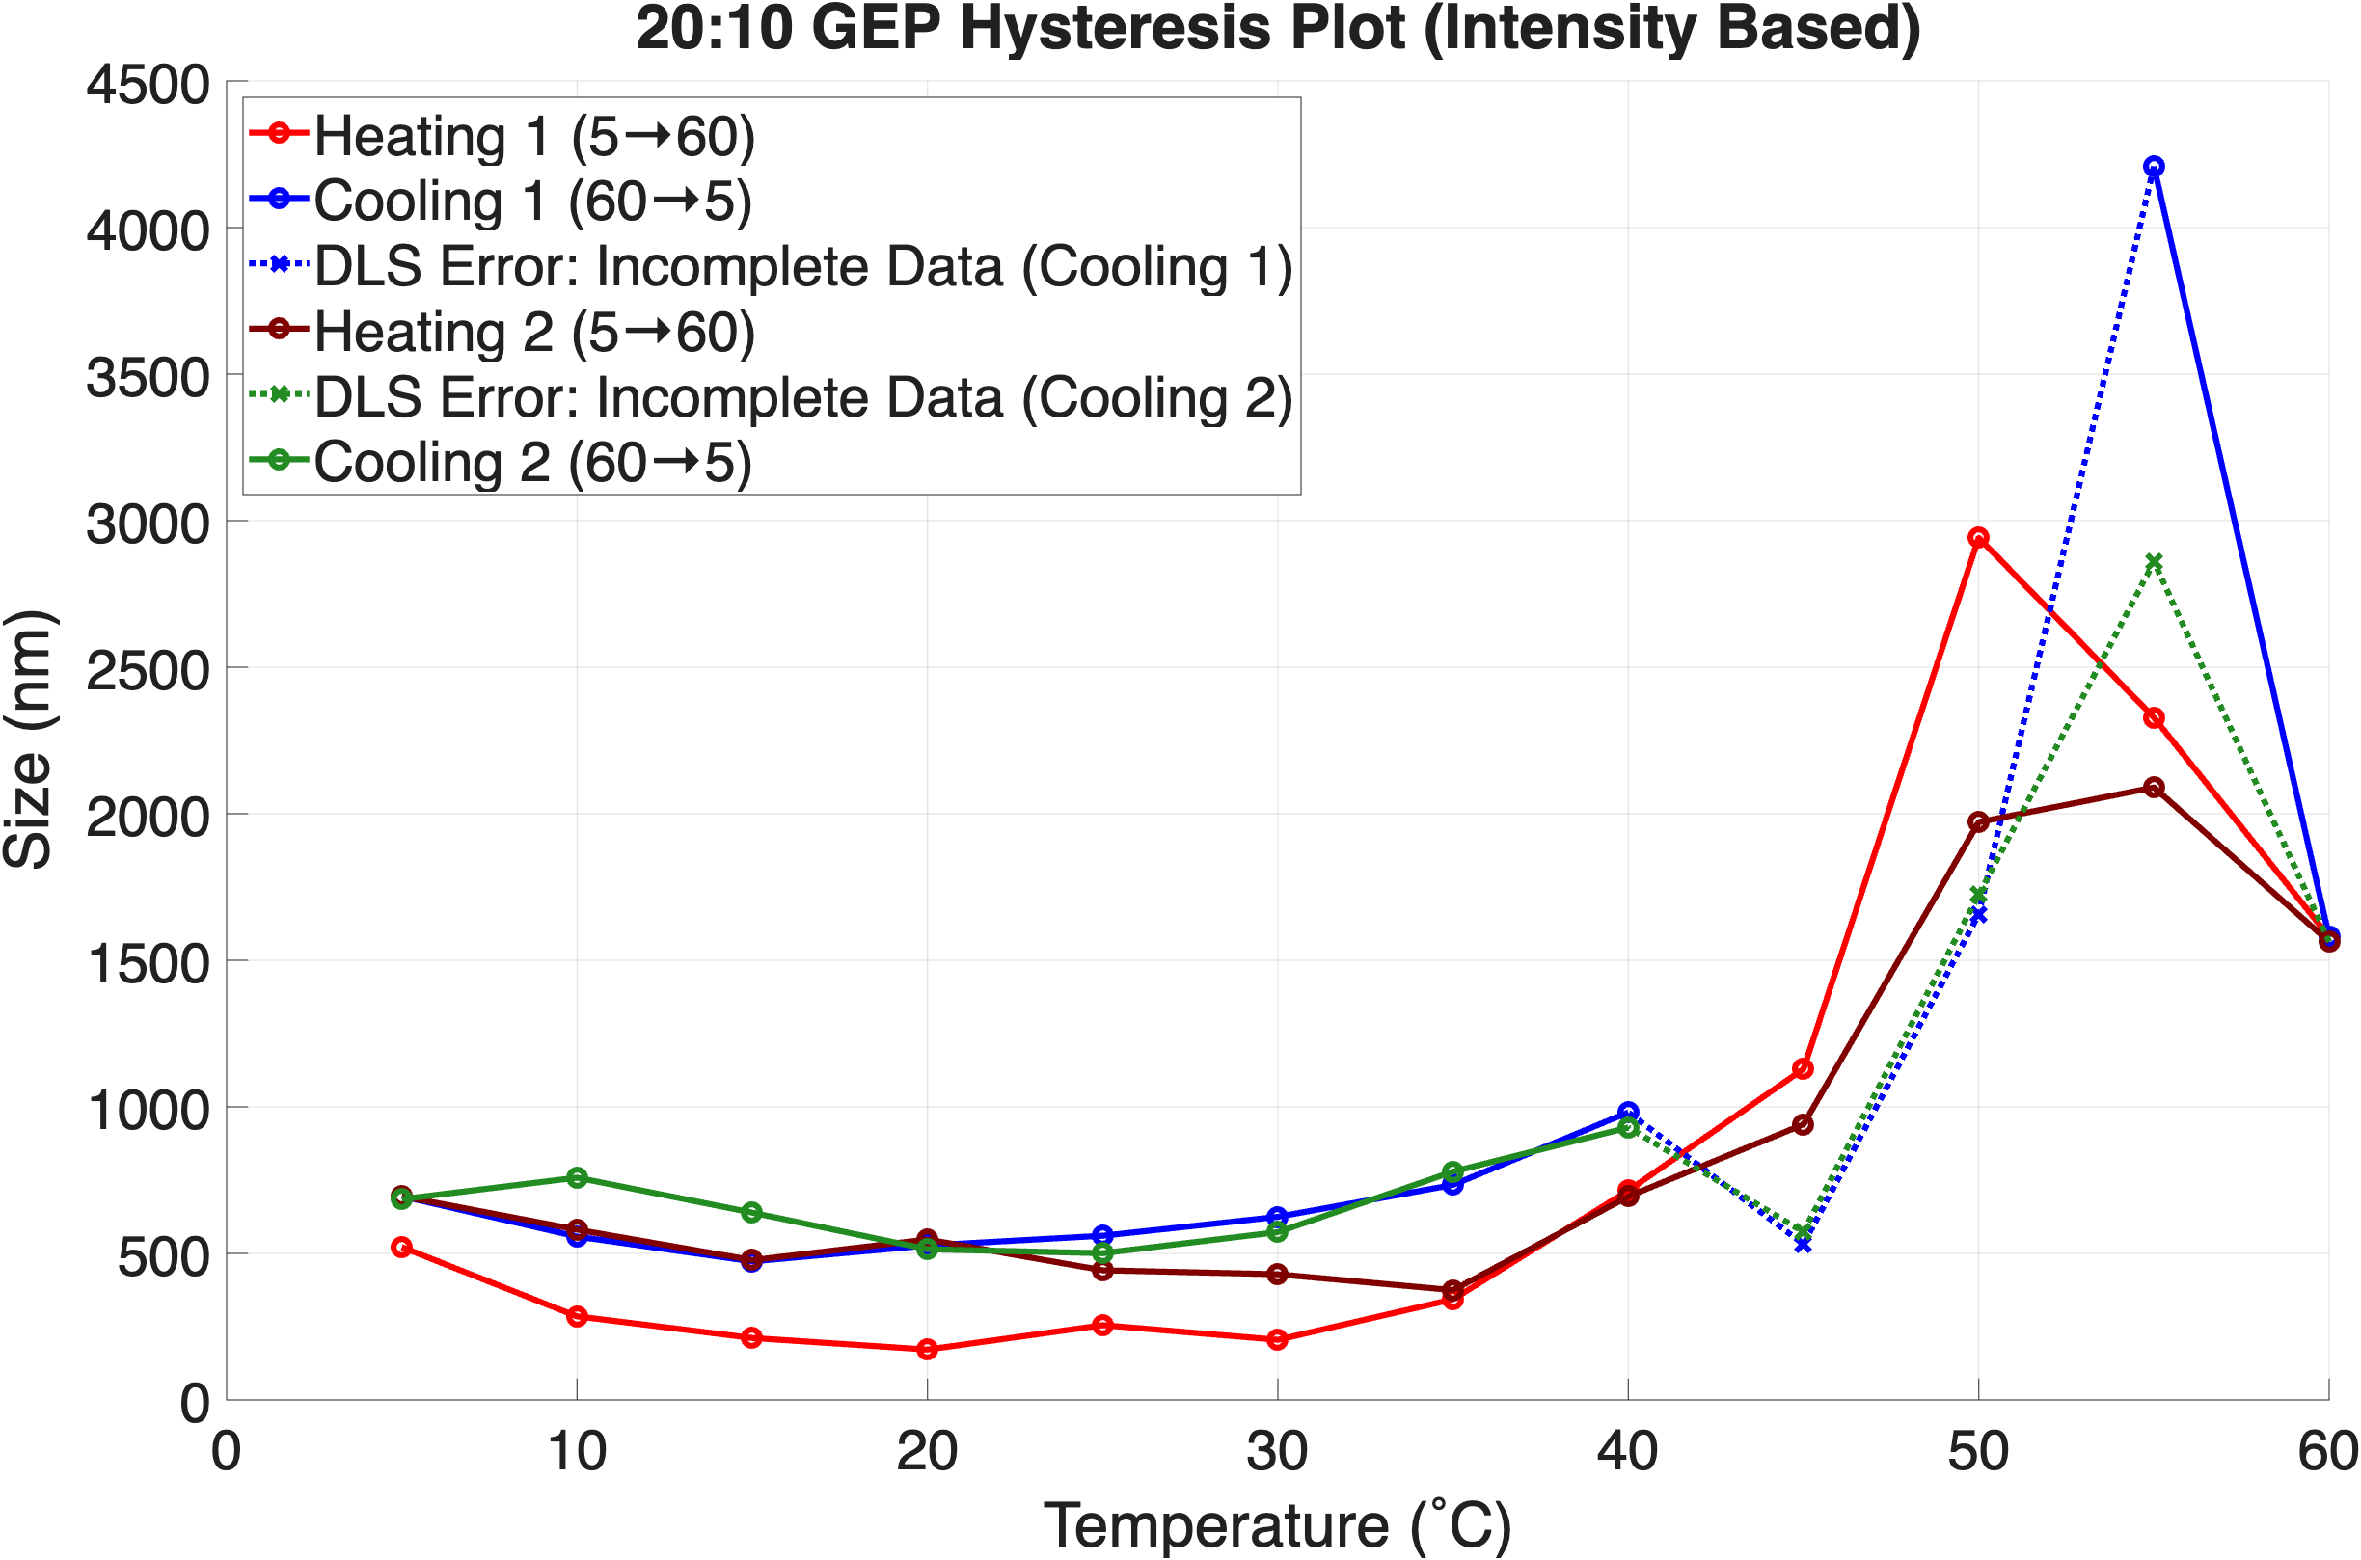
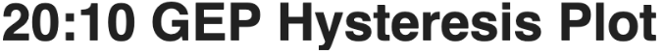
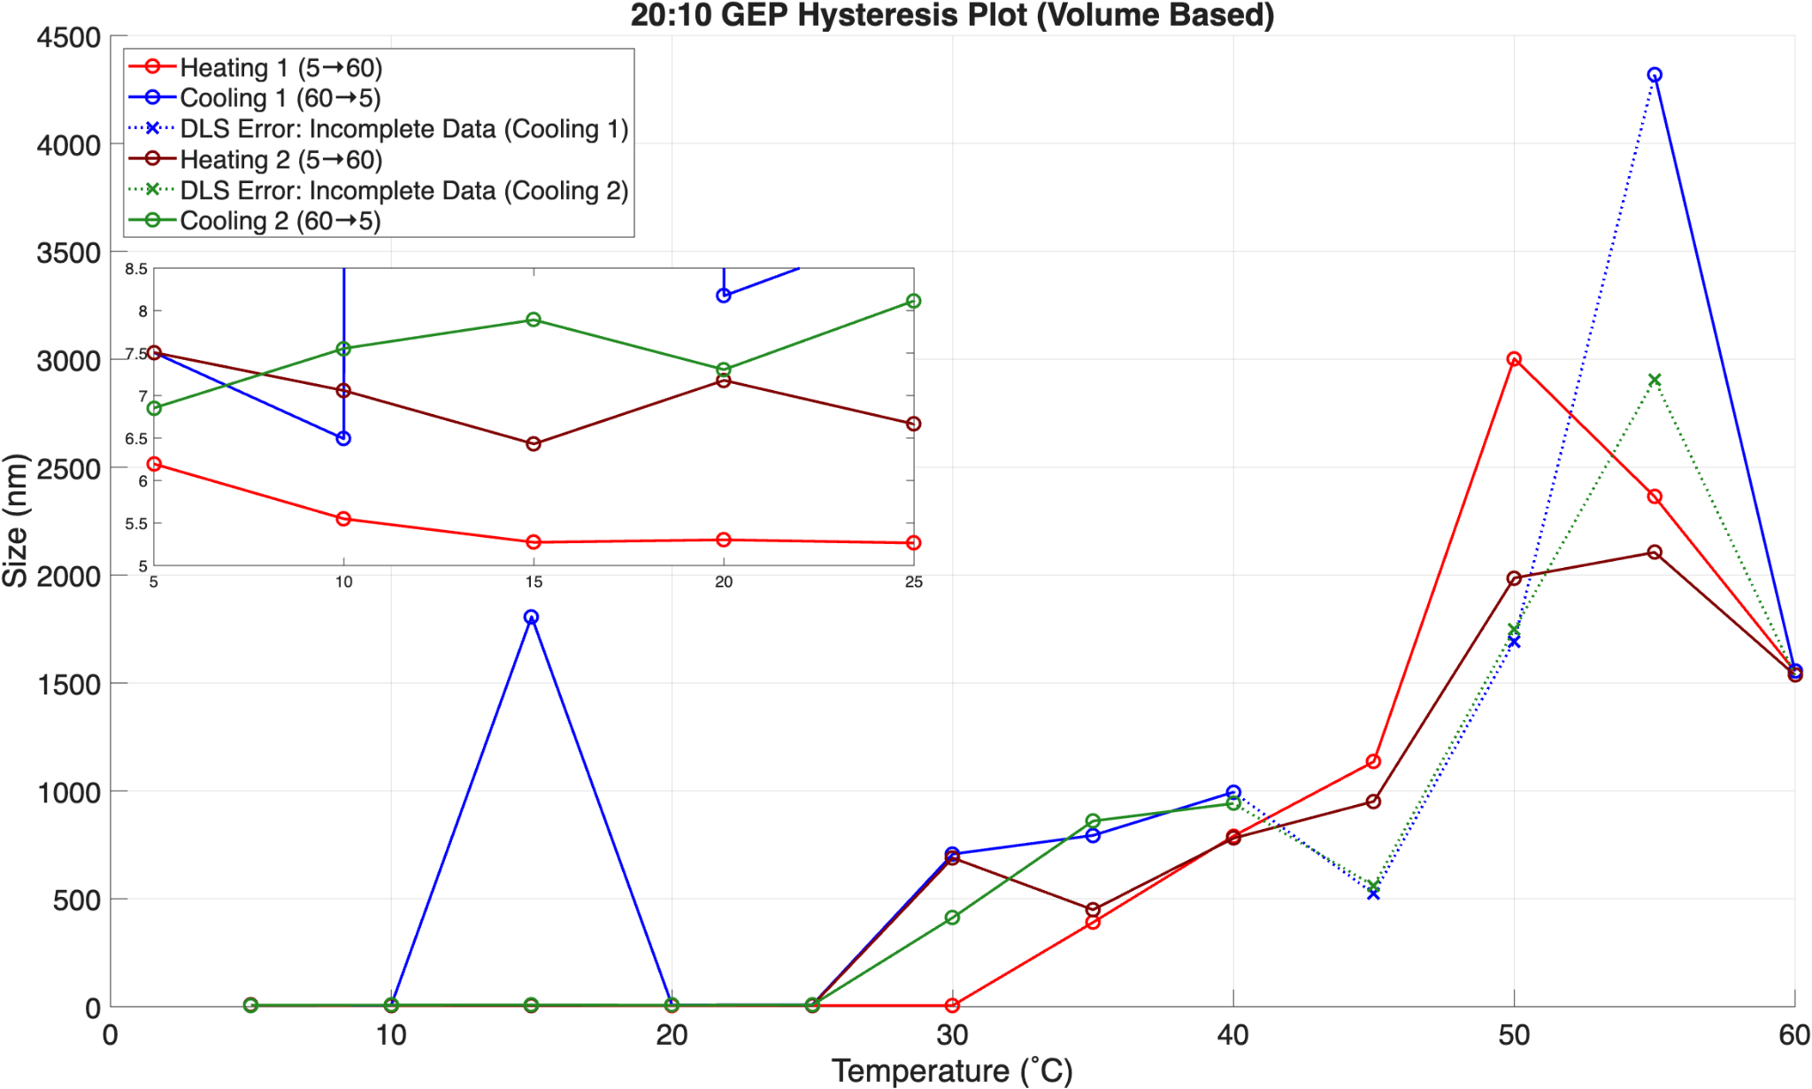
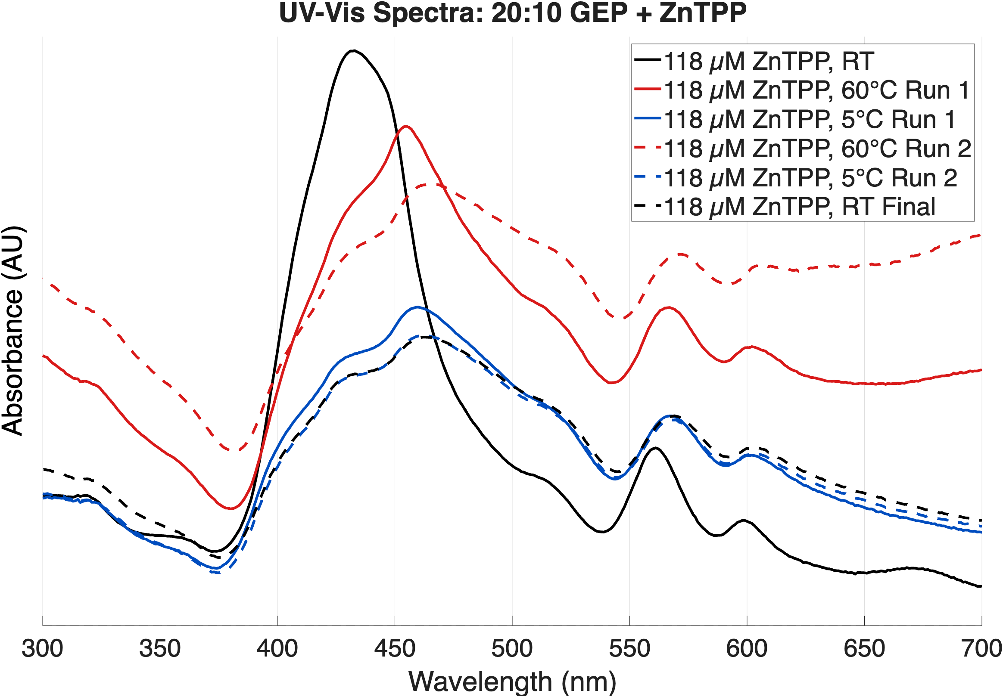
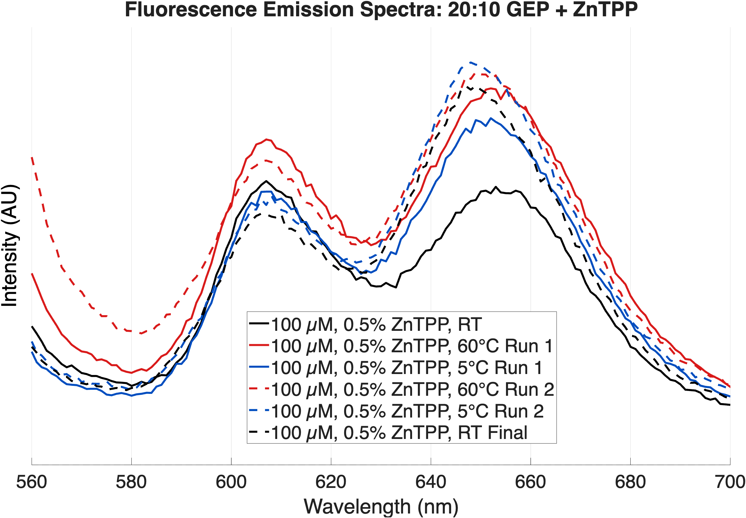
Results: 20:10 Hysteresis via DLS
Fig 8: 20:10 GEP hysteresis plot displaying a reversible phase transition in particle size
10
NSF award No.ECCS-2025490
Notes:
Here I’m showing what the 20:10 GEP looks like in terms of size over varying temperature, measured via dynamic light scattering, where size in nm is on the y-axis as a function of temperature. The proteins amphiphilic nature allows it to self assemble into nano size particles, and we wanted to see what the assembly would look like if we ran multiple temperature cycles from 5˚ C to 60˚ C in 5˚ C increments.
*Click*
This plot demonstrate the ability of the polymer to achieve a reversible phase transition in particle size across multiple cycles.
Dashed lines show that there was incomplete data but there were enough data points
Can only read things if they're a sphere or of appropriate size so more than likely they formed these large aggregates it couldn't read

Slide 11
Results: 20:10 Hysteresis via DLS
Main takeaway: Created temperature dependent reversible nanocomposites
Fig 8: 20:10 GEP hysteresis plot displaying a reversible phase transition in particle size
10
NSF award No.ECCS-2025490
Notes:
Here I’m showing what the 20:10 GEP looks like in terms of size over varying temperature, measured via dynamic light scattering, where size in nm is on the y-axis as a function of temperature. The proteins amphiphilic nature allows it to self assemble into nano size particles, and we wanted to see what the assembly would look like if we ran multiple temperature cycles from 5˚ C to 60˚ C in 5˚ C increments.
*Click*
This plot demonstrate the ability of the polymer to achieve a reversible phase transition in particle size across multiple cycles.

Slide 12
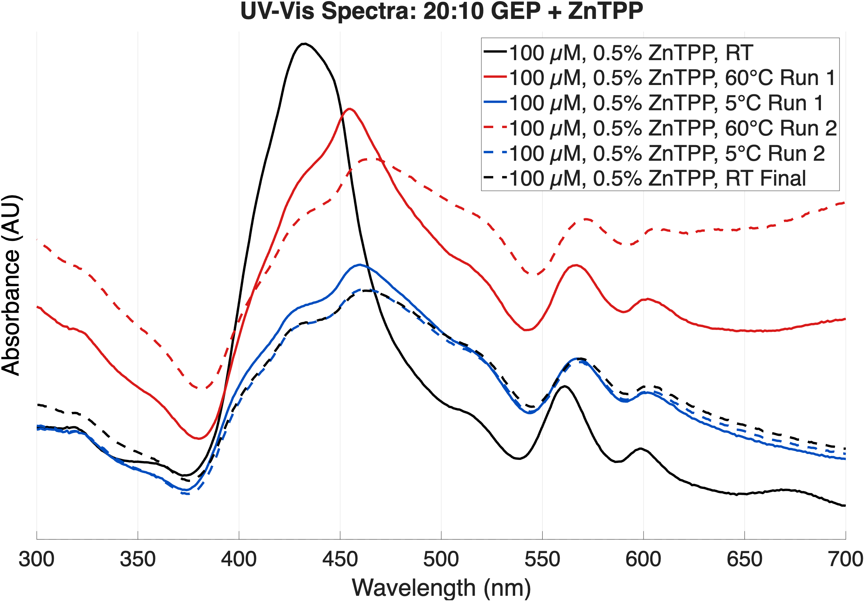
Results: 20:10 ZnTPP Encapsulation UV-Vis
Fig 9: UV-VIS Spectra of 20:10 GEP & ZnTPP indicative of J-aggregate formation
11
NSF award No.ECCS-2025490
Notes:
Next, we have a UV-Vis spectra of our 20:10 GEP with a hydrophobic dye called Zinc TPP. The y-axis is measured in arbitrary units and serves as a relative measurement between peaks as a function of wavelength. Each line displays a similar temperature cycling process to that of the DLS measurements. The large black peak displays the characteristic Soret band associated with Zinc TPP, which red-shifts after the initial room-temperature scan.
*Click*
This shift suggests the dye is stacking with itself, forming what is called a J-aggregate. Since the shift doesn't reverse through subsequent cycling, this aggregation appears to get locked into place by the GEP.

Slide 13
Results: 20:10 ZnTPP Encapsulation UV-Vis
Main Takeaways:
Zn-TPP aggregates form in GEP nanocomposites
Aggregates appear to form during first temperature ramp and remain through subsequent cycling
Fig 9: UV-VIS Spectra of 20:10 GEP & ZnTPP indicative of J-aggregate formation
11
NSF award No.ECCS-2025490
Notes:
Next, we have a UV-Vis spectra of our 20:10 GEP with a hydrophobic dye called Zinc TPP. The y-axis is measured in arbitrary units and serves as a relative measurement between peaks as a function of wavelength. Each line displays a similar temperature cycling process to that of the DLS measurements. The large black peak displays the characteristic Soret band associated with Zinc TPP, which red-shifts after the initial room-temperature scan.
*Click*
This shift suggests the dye is stacking with itself, forming what is called a J-aggregate. Since the shift doesn't reverse through subsequent cycling, this aggregation appears to get locked into place by the GEP.

Slide 14
Results: 20:10 ZnTPP Encapsulation Fluorescence
Fig 10: Fluorescence emission spectra supportive of an irreversible J-aggregate formation
12
NSF award No.ECCS-2025490
Notes:
Finally, we have a fluorescence emission spectra of the 20:10 GEP with Zinc TPP, where the axes are the same as the previous figure. We see characteristic emission peaks near 605 and 650 nanometers...
*Click*
...and the relative intensity and ratios between peaks across thermal cycling supports irreversible J-aggregate formation, consistent with what we saw in the absorbance data. What's still unknown is whether ZnTPP incorporation and this aggregation also affect the GEP's own thermal cycling behavior, something we're still working to determine.
get rid of µM

Slide 15
Results: 20:10 ZnTPP Encapsulation Fluorescence
Main Takeaways:
Fluorescence indicative of Zn-TPP aggregate formation
Change in ratios of peaks occurs during first ramp consistent with aggregate formation and locking
Fig 10: Fluorescence emission spectra supportive of an irreversible J-aggregate formation
12
NSF award No.ECCS-2025490
Notes:
Finally, we have a fluorescence emission spectra of the 20:10 GEP with Zinc TPP, where the axes are the same as the previous figure. We see characteristic emission peaks near 605 and 650 nanometers...
*Click*
...and the relative intensity and ratios between peaks across thermal cycling supports irreversible J-aggregate formation, consistent with what we saw in the absorbance data. What's still unknown is whether ZnTPP incorporation and this aggregation also affect the GEP's own thermal cycling behavior, something we're still working to determine.

Slide 16
Summary
Successfully designed and generated short chain membrane nanocomposites based upon amphiphilic GEPs
20:10 GEP demonstrated:
  Reversible phase transitions via DLS temperature cycling indicates reversible nanocomposite formation presumably between coacervates and micelles (TBD)
ZnTPP incorporation results in aggregates that form during first cycling and remain upon subsequent cycling's
Future studies will investigate: 1) GEP:ZnTPP nanocomposites organization, and; 2) utility of GEP:ZnTPP for applications such as PhotoDynamic Therapy and Sensing
13
NSF award No.ECCS-2025490
Notes:
To summarize, we successfully designed and produced short-chain membrane nanocomposites from amphiphilic GEPs. Our 20:10 GEP shows a reversible phase transition under DLS thermal cycling, likely switching between coacervates and micelles, although this is still to be confirmed. Adding ZnTPP causes aggregates to form during the first cycle and persist through later ones. Going forward, we'll investigate how these GEP:ZnTPP nanocomposites are organized and explore applications such as photodynamic therapy and sensing.
varying microscopy techniques, AFM, SEM

Slide 17
Acknowledgments
Gabriel Montaño, Northern Arizona University
Ashley Martinez, Northern Arizona University
Celedonio Rodríguez, Northern Arizona University
Jessica Hauer, Arizona State University
14
NSF award No.ECCS-2025490
Notes:
I’d like to thank my PI Dr. Gabe Montano, my mentor Ashely Martinez, and Cele Rodriguez, all from Northern Arizona University, as well as Jessica Haur of Arizona State University and the organizations shown. Now I’d like to open the floor for any questions, thank you!

Slide 18
Genetically Encoded Amphiphilic Polymers for Membrane Based Nanotechnologies
Adam Vanluvanee
Department of Engineering, Harvey Mudd College
Ashley Martinez, BS & Gabriel Montaño, PHD
Center for Materials Interfaces in Research and Access (¡MIRA!), Northern Arizona University
NSF award No.ECCS-2025490
1

Slide 30
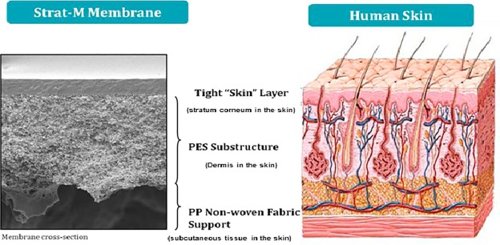
Biomimicry Introduction 😀
Biomimicry is copying natures designs, which evolution has refined over millions of years
¹
Example:
Real human and animal skin is difficult to source and raises ethical concerns
Fig x:
Bio-inspired membranes have emerged as a reproducible and cost-effective tool
¹ Neupane, Rabin & Boddu, Sai HS & Renukuntla, Jwala & Babu, R. Jayachandra & Tiwari, Amit. (2020). Alternatives to Biological Skin in Permeation Studies: Current Trends and Possibilities. Pharmaceutics. 12. 152. 10.3390/pharmaceutics12020152.
2
NSF award No.ECCS-2025490
Insert Image of Biomimicry Tech (Some sort of membrane)

Slide 31
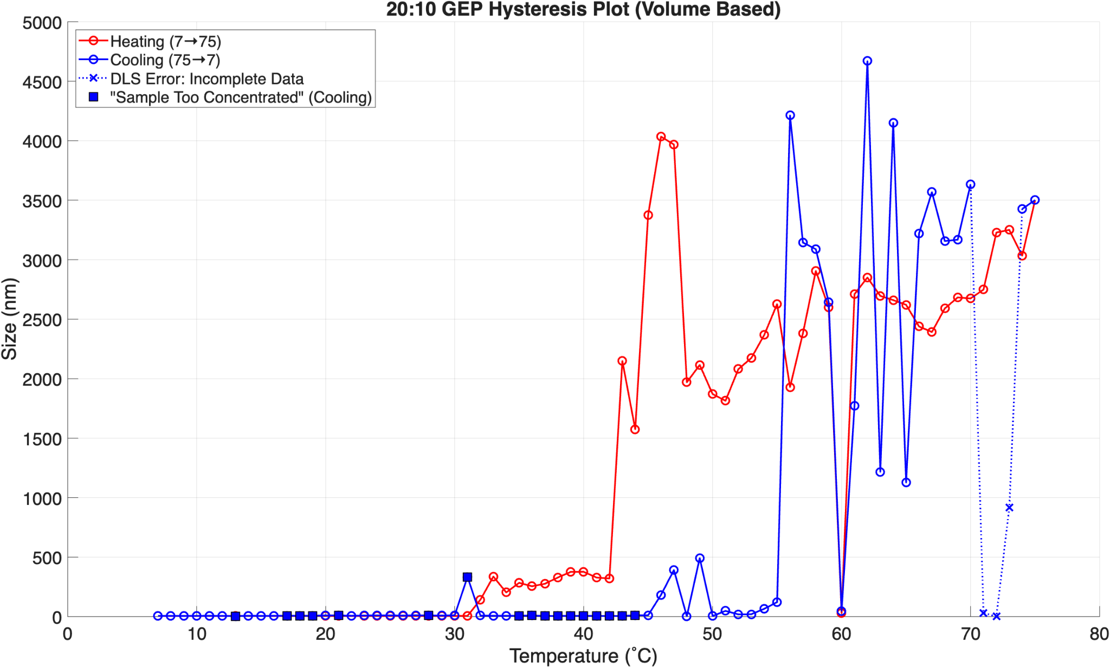
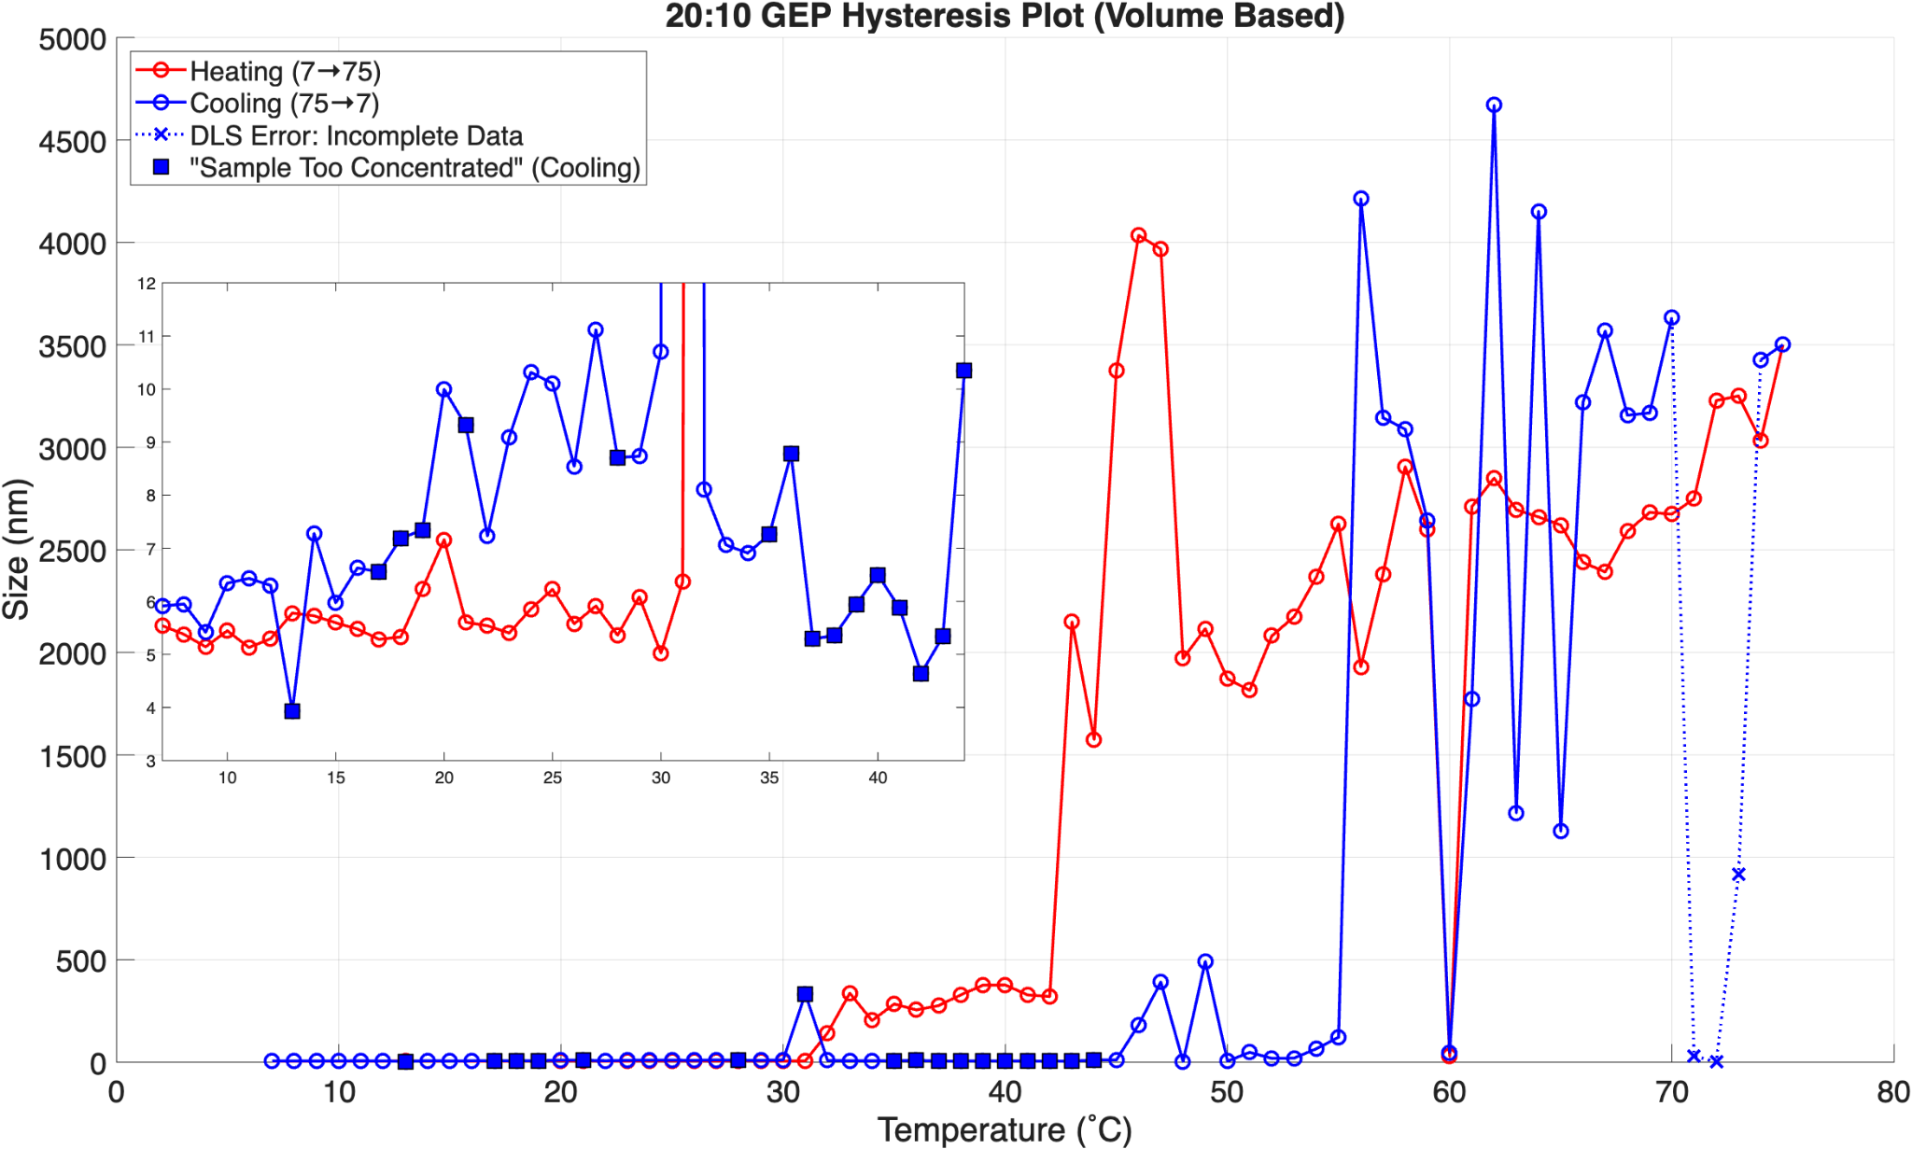
75.7 µM 20:10 Hysteresis DLS Results
10
NSF award No.ECCS-2025490
Notes:
Here I’m showing what the 20:10 GEP looks like in terms of size over varying temperature. I have size in nm on the y-axis as a function of temp. The red line is me heating from 7 up to 75 whereas the blue is tracking the cooling from 75 back down to 7. We can see it is pretty steady from 7 to 42 when heating before having a major fluctuation in size.
The same phenomenon is happening on the cooling side before a fluctuation at 43 (size is this at 56 a
30˚C instead of 35˚C, only one peak because entire sample set at the same temperature
22000

Slide 32
75.7 µM 20:10 Hysteresis DLS Results
11
NSF award No.ECCS-2025490
Notes:
We can see it is pretty steady from 7 to 42 when heating before having a major fluctuation in size as highlighted with the red box where it goes from 300 nm to 2200 nm. The same phenomenon is happening on the cooling side before a fluctuation at 56 where it goes from 4200 nm to 10 nm as shown in the blue box.
30˚C instead of 35˚C, only one peak because entire sample set at the same temperature
22000

Slide 33
75.7 µM 20:10 Hysteresis DLS Results
12
NSF award No.ECCS-2025490
Notes:
The orange box highlights a stable size of assembly from 7 to around 40˚C. We gonna zoom in…
30˚C instead of 35˚C, only one peak because entire sample set at the same temperature
22000

Slide 34
75.7 µM 20:10 Hysteresis DLS Results
13
NSF award No.ECCS-2025490
Notes:
Mention new y-axes and temp range. Emphasize between 3 and 12 nm, yes 8 nm fluctuation but relatively the same size but a lot smaller than these major fluctuations after that. Overall this region looks similar to our positive control which forms notable assemblies in this nm range.
30˚C instead of 35˚C, only one peak because entire sample set at the same temperature
22000

Slide 35
AFM
…
15
NSF award No.ECCS-2025490
Notes:
Describe what you plan to do / are doing / have done in this project to solve the problem

Slide 36
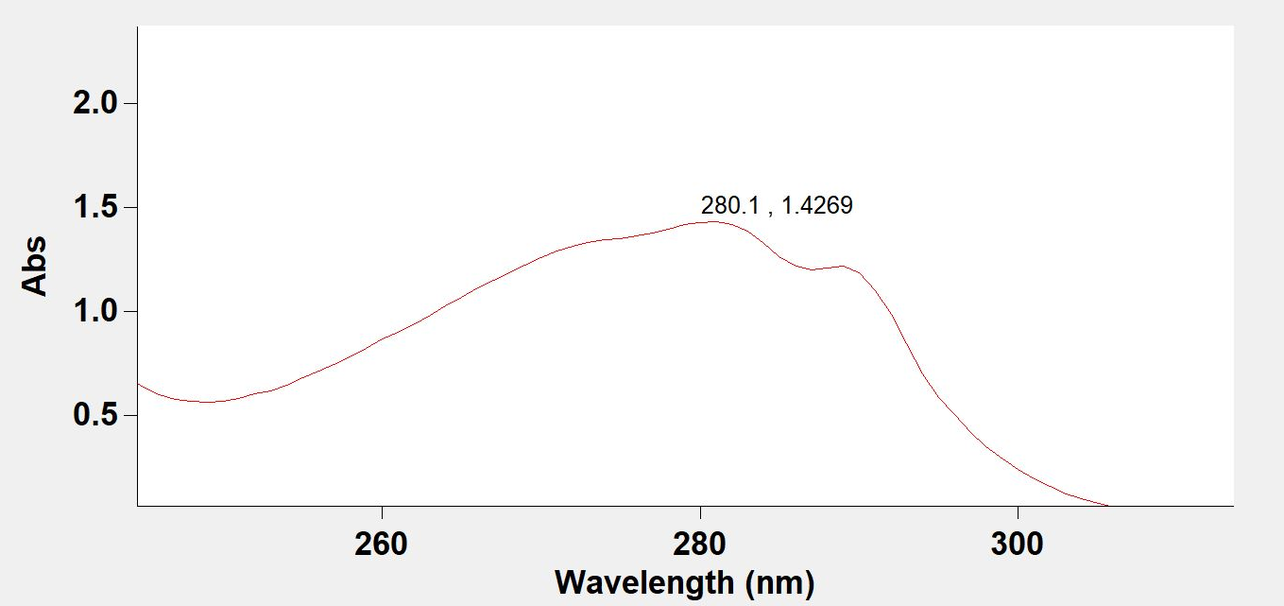
Determining Protein Concentration
😀*
259.0 µM (30˚C)
(VPGXG)₂₀ (VPGSG)₁₀ 6H
where X = 1:4 ratio of W:V
9
NSF award No.ECCS-2025490
Notes:
30˚C instead of 35˚C, only one peak because entire sample set at the same temperature
22000

Slide 37
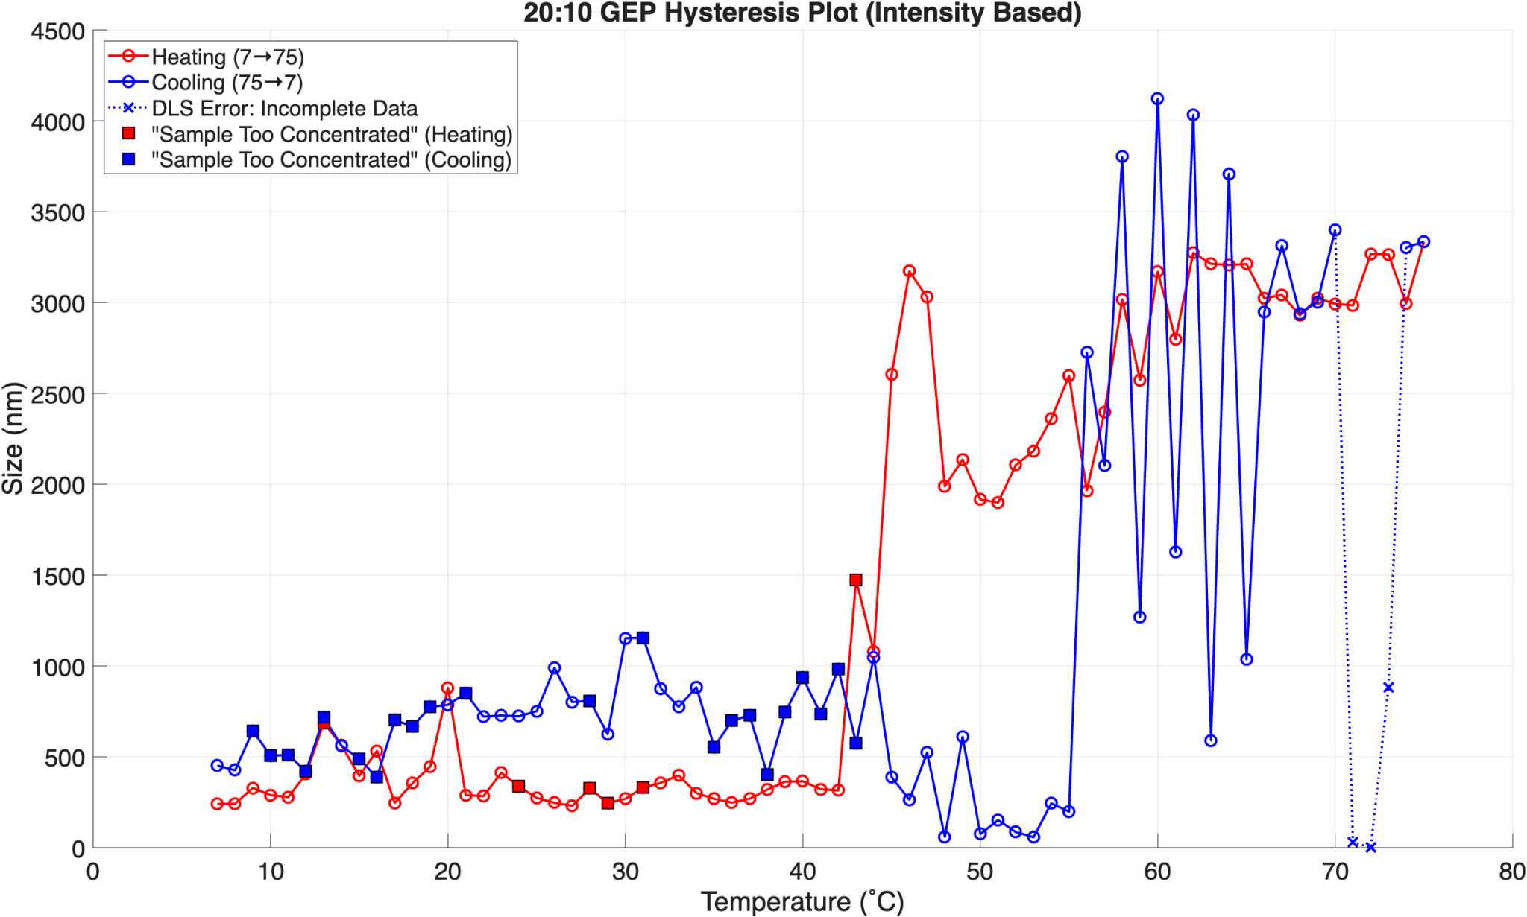
DLS: Intensity Based
10
NSF award No.ECCS-2025490
Notes:
Fig 4: DLS measures particle and size distribution of a sample by analyzing fluctuations in scattered light due to Brownian motion ⁴
30˚C instead of 35˚C, only one peak because entire sample set at the same temperature
22000

Slide 38
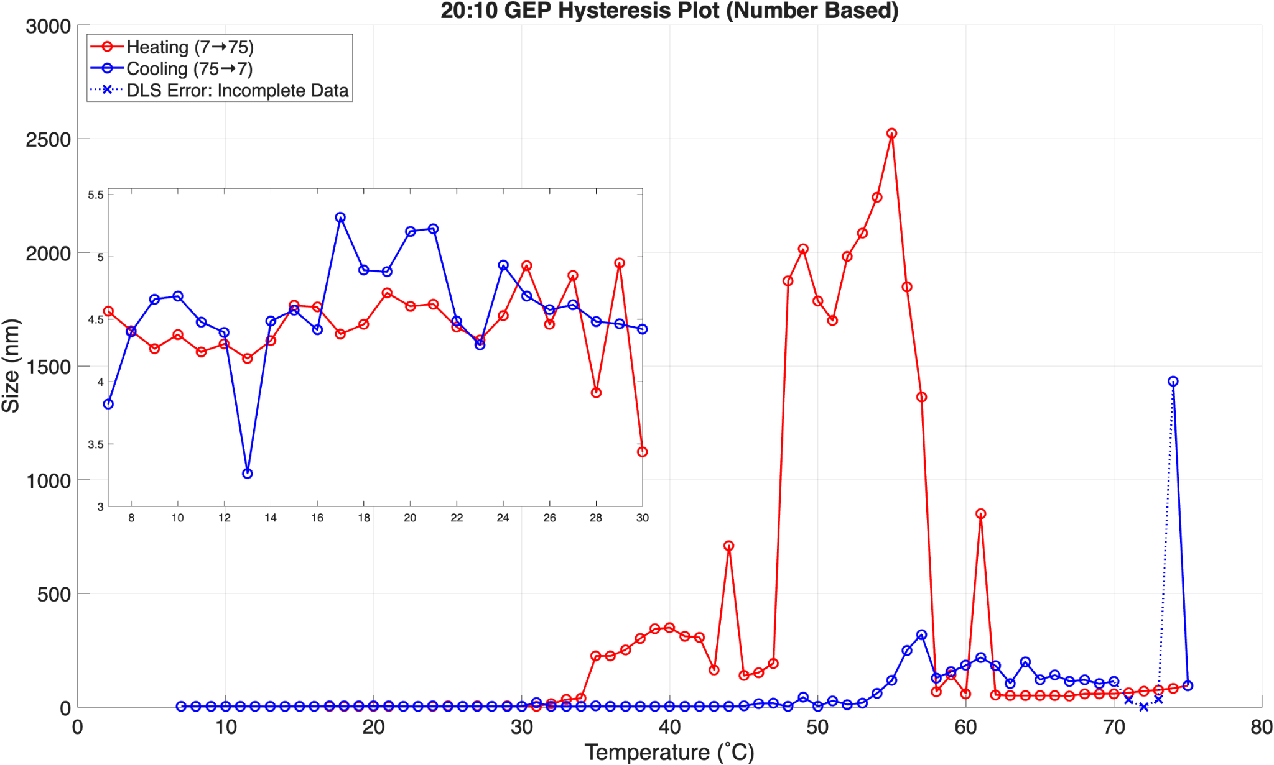
DLS: Number Based
12
NSF award No.ECCS-2025490
Notes:
30˚C instead of 35˚C, only one peak because entire sample set at the same temperature
22000

Slide 39
Future Work
Measure pH
Decrease in concentration
Ionic strength
?
14
NSF award No.ECCS-2025490
Notes:
Describe what you plan to do / are doing / have done in this project to solve the problem

Slide 43
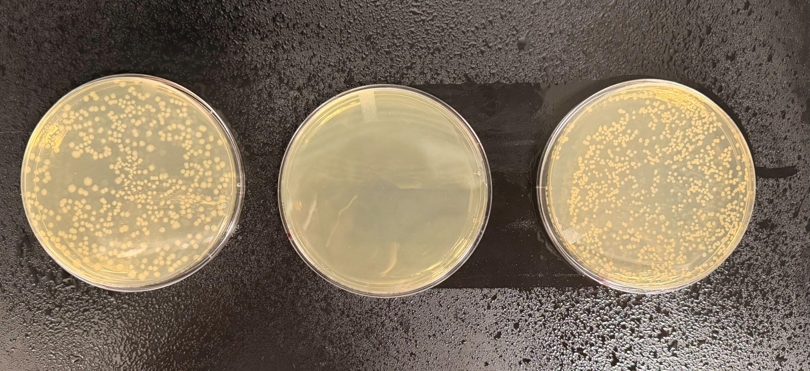
Growing up Bacteria with the 20:10 Vector
+
-
Sample
NSF award No.ECCS-2025490
9
Notes:
plates have antibiotic resistance in them to ensure we only grow the bacteria we want
pos cntrl has e coli bacteria and a vector called puc19 inserted into it - commonly used vector across bioengineering labs and it allows bacteria to grow in lots of environments
neg cntrl - e. coli bacteria as is meaning no antibiotic resistant gene so it shouldn’t grow on the plate
sample - e. coli with our 20:10 vector - grew well :)
Then started step two which is the protein production followed by purification steps to finally analyze the protein
Describe what you plan to do / are doing / have done in this project to solve the problem

Slide 44
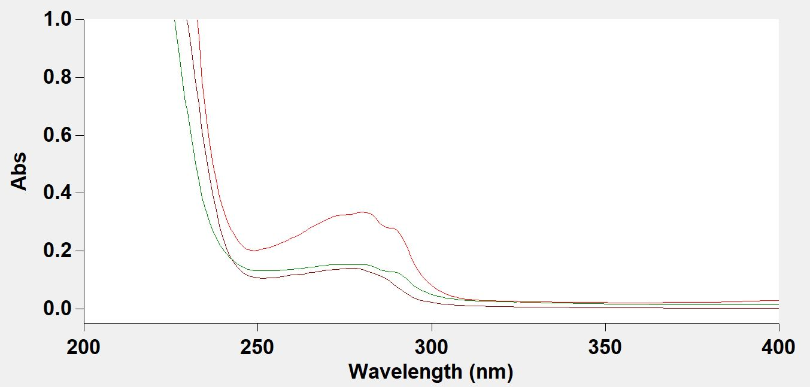
20:10 Protein Concentration
73.67 µM (35˚C)
34.97 µM (RT)
NSF award No.ECCS-2025490
9
Notes:
With characterization we are finding the protein concentration of our dialysis sample using UV-Vis (absorbance on y-axis vs. wavelength). In our sequence, we have an amino acid called tryptophan (W), which notably absorbs light at 280 nm, allowing us to see a peak and obtain an absorbance value that can be plugged into Beer’s law equation to determine protein concentration. Here we are showing two peaks, the 73.67 µM peak had slightly different purification steps than the 34.97 µM. We are looking for a concentration of at least 100 µM, so we redid the process using… next slide, glycerol stock to see if we could get the 100 µM.
(temperature 35˚C during warm cycle, room temp, respectively - transition temp with protein (why we do CC and WC, 4˚C vs RT), didn’t feel like RT was pulling down as much protein as it should, so we upped it to try and improve yield) with 35˚C we saw some protein come out in dialysis as white flakes)
We wanted to try a temperature difference during the warm cycle to see if there would be less loss of protein
Looking at the peak at 280 bc the amino acid tryptophan absorbs light strongly at 280 nm
Use Beer’s law to calculate the protein concentration in solution after dialysis - (we got 73.67 µM & 34.97 µM)
Put box around well 11 (it’s in the weight range we want and juicy)
Describe what you plan to do / are doing / have done in this project to solve the problem

Slide 45
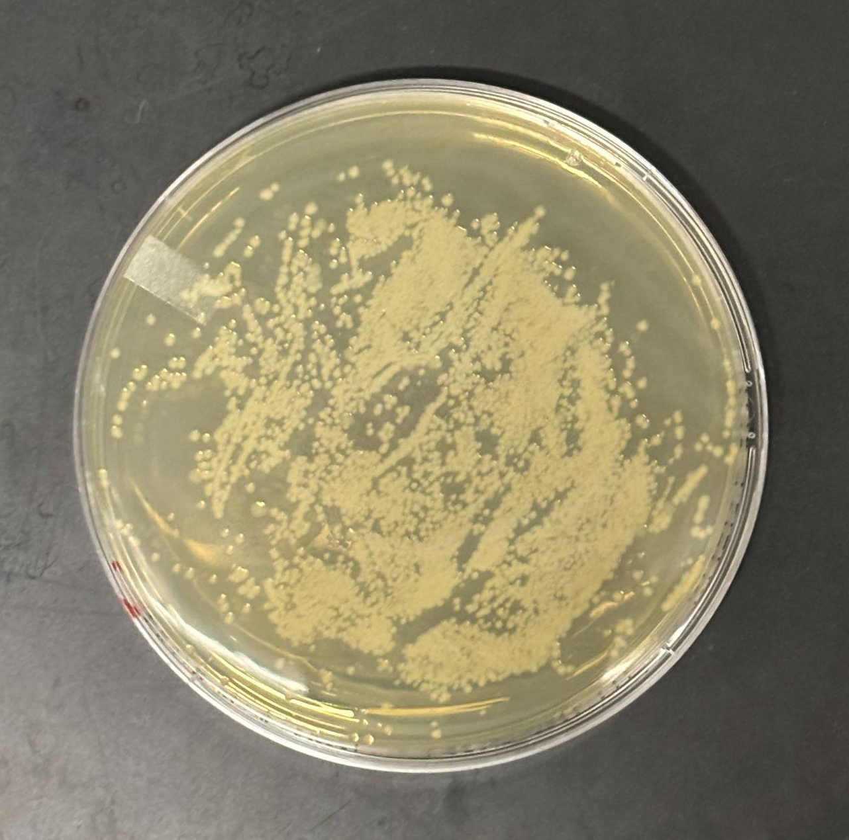
Glycerol Stock
NSF award No.ECCS-2025490
9
Notes:
Once the bacteria is produced, we can mix it with some glycerol and store it in a -80˚C freezer so that when we need to make another batch of bacteria, we don’t need to do the entire transformation process again, we just put it on a plate and start the process from there.

Slide 46
Next Steps
Cell lysis via sonication
  Check for leftover protein in the bacteria's cytoplasm
Environmental response experiments
😀
NSF award No.ECCS-2025490
9

Slide 47
Overcoming Challenges Faced in Synthetic Membrane Technology
GEP’s offer the simplicity and diversity needed to overcome the challenges faced in the development of synthetic membrane-based nanotechnology
Elastin is one of the most abundant proteins in the human body
  Provides elasticity to tissues
  Over 75% of the amino acid sequence consists of glycine, valine, alanine, and proline
¹ Gan S, Scarpelli V, Exterkate M. Exploring lipid diversity and minimalism to define membrane requirements for synthetic cells. FEBS Lett. 2025 Dec;599(24):3569-3590. doi: 10.1002/1873-3468.70131. Epub 2025 Aug 11. PMID: 40787853; PMCID: PMC12720230.
² Polymer Source Inc. Product Categories. Polymer Source Inc.; 2026 [cited 2026 Jun 18]. Available from: https://www.polymersource.ca/index.php?route=product/maincategory
NSF award No.ECCS-2025490
5
Notes:
Condense, maybe split into two slides
membrane tech nothing new…traditionally based on lipids bc foundation of cell…inherent issues (as a material): static in nature (induces flexibility by composition as opposed to a dynamic material), very labile, fall apart easily (not very robust), not very dynamic (can’t do a lot of different things with them) good ex: take popc (18:1 (1 saturated carbon), 18:0 (no sat carbon), self assembly process will always create the same thing, a 3D liposome or 2D membrane). Polymers like peopbd can form a mycell, but if u put it on a substrate it turns into a bilayer - can’t be done with lipids - these chains are much less static and respond to environmental stimuli. Limitation to a polymer - synthetically make - costic (harmful - bad chemicals), costly, low yields, low throughput (to change anything about them is really hard - PhD project two make a couple and analyze them) - elp’s give us the advantage of polymers, definitely not as costly, caustic, and high throughput. Go back to our own published research on polymers. Cite our research polymers, membranes, mix in ELPs - that’s where the novelty comes in.
Saturated makes tighter packing, double bonds add in kinks that make them more fluid and chaotic
Amino acids - add a histodine - can bind metals, or other things you want
popc:1 pomotil, octodecil or smtg phosphocital coline & dopc: di octoneal phophotital coline
lipids blah blah…alt is abc…blah blah…so goal is blah blah
Define biomimicry, use membranes as an example, give an example of membrane, where we see it in everyday life, what it’s naturally made of (lipids), lipids work great for a natural membrane, but they don’t work well synthetically, current alternative on market for making synthetic membranes are very costly, time consuming, limited in variation in what you can buy - leads into my goals - I want to do this using this polymer (protein)
To overcome disadvantages over the summer I worked on producing at GEAP and see what its optimal conditions are in an effort to
Still working through beginning, but I can explain material I’m using - start at goal slide and go from there
Broad picture of whole project - create polymer library to overcome the disadvantages. I’m specifically focused on one kind of polymer and its properties, looking at where that can fit into the library
Problem I am trying to solve: Making a synthetic polymer is expensive and time consuming,
Want to make membranes, those are naturally made with lipids, but lipids are limited in functionality such as structural, self-assembly
Can use an amphiphilic block polymer but making them is expensive and time consuming
Genetic encoded polymers
Lipids bad in terms of limits, amphiphilic also limited
genetically encoded polymers reproducible, don't take as time to make, structural properties…can be used for varying membrane based nanotech
Accessibility of amphiphilic polymer for membrane based technology
Big problem: lipids and abc’s are limiting themselves, limit of material to use - limitation of material, need for expansion of material for polymer membrane
Different tech beyond drug deliver - heavy metal waste pickup, photonics, photovoltaic cells
Goal: produce GEP (genetically encoded polymer), GEAP (genetically encoded amphiphilic polymer) and investigate response for varying temperatures for membrane based nanotech
Specifics, what is GEP, explain specifics after goal slide
Talk about biomimicry and why membranes are important
Membranes are made of lipids and do all this cool stuff
When talking about membranes can talk about applications
Next: but lipids not so good when synthetically making them
Alt to lipids are so expensive and there are limits to what you can by and limits to what you can choose from
Next: Goal slide - what I’m doing using GEAP
Next: so what are GEAP’s? pictures shown vs what I pulled from lecture slide
Biomimic elastin which is naturally occurring in body (name organs), ability to contract and expand millions of times throughout lifetime
Next: How to make them - bacteria transformation, expression, purification
Show final product of protein
Move into results: When introducing GEAP’s can talk about weight and why that matters too
after going through how to make - UV vis results of how to calculate protein calculation per vial - tryptophan in there can be ID’d with UV vis
Then move into DLS - explain what that does/its background and how I’m using it - using to monitor how GEAP changes size over temperature and over ionic strength (max: 140 mM)
DLS results and what they mean - show graph
Next: next steps or future directions
Next: overview of what I talked about
Next: Acknowledgments
Summary slide good at very end - might move acknowledgments after title slide

Slide 48
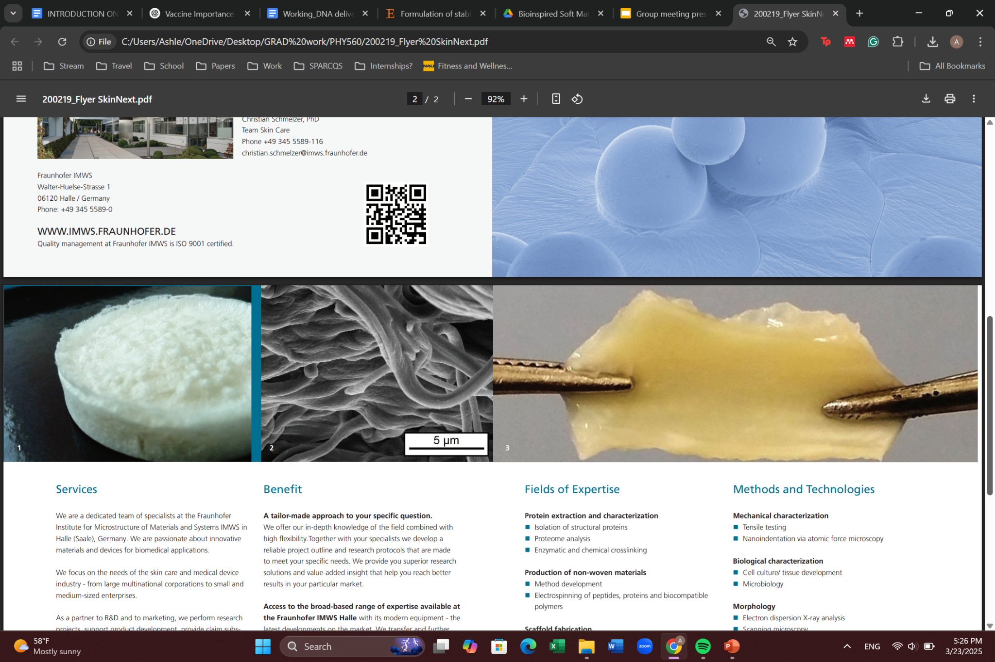
Primary Research Goal
Produce genetically encoded elastin like polymers (ELP’s) and investigate their response to varying environmental conditions such as temperature and ionic strength to contribute to a library of materials with various applications
Advantages of ELP’s
ELP’s offer the simplicity and diversity needed to overcome the challenges faced in the development of synthetic membrane-based nanotechnology
Insert Image of ELP (or something else)
¹ Fraunhofer IMWS - Fraunhofer-Gesellschaft
Gan S, Scarpelli V, Exterkate M. Exploring lipid diversity and minimalism to define membrane requirements for synthetic cells. FEBS Lett. 2025 Dec;599(24):3569-3590. doi: 10.1002/1873-3468.70131. Epub 2025 Aug 11. PMID: 40787853; PMCID: PMC12720230.
https://www.polymersource.ca/
3
Notes:
Too text heavy…condense…what and why are we creating…be more direct about advantages
Define biomimicry, use membranes as an example, give an example of membrane, where we see it in everyday life, what it’s naturally made of (lipids), lipids work great for a natural membrane, but they don’t work well synthetically, current alternative on market for making synthetic membranes are very costly, time consuming, limited in variation in what you can buy - leads into my goals - I want to do this using this polymer (protein)
To overcome disadvantages over the summer I worked on producing at GEAP and see what its optimal conditions are in an effort to
Still working through beginning, but I can explain material I’m using - start at goal slide and go from there
Broad picture of whole project - create polymer library to overcome the disadvantages. I’m specifically focused on one kind of polymer and its properties, looking at where that can fit into the library
Problem I am trying to solve: Making a synthetic polymer is expensive and time consuming,
Want to make membranes, those are naturally made with lipids, but lipids are limited in functionality such as structural, self-assembly
Can use an amphiphilic block polymer but making them is expensive and time consuming
Genetic encoded polymers
Lipids bad in terms of limits, amphiphilic also limited
genetically encoded polymers reproducible, don't take as time to make, structural properties…can be used for varying membrane based nanotech
Accessibility of amphiphilic polymer for membrane based technology
Big problem: lipids and abc’s are limiting themselves, limit of material to use - limitation of material, need for expansion of material for polymer membrane
Different tech beyond drug deliver - heavy metal waste pickup, photonics, photovoltaic cells
Goal: produce GEP (genetically encoded polymer), GEAP (genetically encoded amphiphilic polymer) and investigate response for varying temperatures for membrane based nanotech
Specifics, what is GEP, explain specifics after goal slide
Talk about biomimicry and why membranes are important
Membranes are made of lipids and do all this cool stuff
When talking about membranes can talk about applications
Next: but lipids not so good when synthetically making them
Alt to lipids are so expensive and there are limits to what you can by and limits to what you can choose from
Next: Goal slide - what I’m doing using GEAP
Next: so what are GEAP’s? pictures shown vs what I pulled from lecture slide
Biomimic elastin which is naturally occurring in body (name organs), ability to contract and expand millions of times throughout lifetime
Next: How to make them - bacteria transformation, expression, purification
Show final product of protein
Move into results: When introducing GEAP’s can talk about weight and why that matters too
after going through how to make - UV vis results of how to calculate protein calculation per vial - tryptophan in there can be ID’d with UV vis
Then move into DLS - explain what that does/its background and how I’m using it - using to monitor how GEAP changes size over temperature and over ionic strength (max: 140 mM)
DLS results and what they mean - show graph
Next: next steps or future directions
Next: overview of what I talked about
Next: Acknowledgments
Summary slide good at very end - might move acknowledgments after title slide

Slide 49
Primary Research Goal
Produce genetically encoded elastin like polymers (ELP’s) and analyze their response to varying environmental conditions such as temperature and ionic strength to contribute to a library of materials with various applications
¹ Fraunhofer IMWS - Fraunhofer-Gesellschaft
ELP’s offer the simplicity and diversity needed to overcome the challenges faced in the development of synthetic membrane-based nanotechnology
3
Notes:
Too text heavy…condense…what and why are we creating…be more direct about advantages
Define biomimicry, use membranes as an example, give an example of membrane, where we see it in everyday life, what it’s naturally made of (lipids), lipids work great for a natural membrane, but they don’t work well synthetically, current alternative on market for making synthetic membranes are very costly, time consuming, limited in variation in what you can buy - leads into my goals - I want to do this using this polymer (protein)
To overcome disadvantages over the summer I worked on producing at GEAP and see what its optimal conditions are in an effort to
Still working through beginning, but I can explain material I’m using - start at goal slide and go from there
Broad picture of whole project - create polymer library to overcome the disadvantages. I’m specifically focused on one kind of polymer and its properties, looking at where that can fit into the library
Problem I am trying to solve: Making a synthetic polymer is expensive and time consuming,
Want to make membranes, those are naturally made with lipids, but lipids are limited in functionality such as structural, self-assembly
Can use an amphiphilic block polymer but making them is expensive and time consuming
Genetic encoded polymers
Lipids bad in terms of limits, amphiphilic also limited
genetically encoded polymers reproducible, don't take as time to make, structural properties…can be used for varying membrane based nanotech
Accessibility of amphiphilic polymer for membrane based technology
Big problem: lipids and abc’s are limiting themselves, limit of material to use - limitation of material, need for expansion of material for polymer membrane
Different tech beyond drug deliver - heavy metal waste pickup, photonics, photovoltaic cells
Goal: produce GEP (genetically encoded polymer), GEAP (genetically encoded amphiphilic polymer) and investigate response for varying temperatures for membrane based nanotech
Specifics, what is GEP, explain specifics after goal slide
Talk about biomimicry and why membranes are important
Membranes are made of lipids and do all this cool stuff
When talking about membranes can talk about applications
Next: but lipids not so good when synthetically making them
Alt to lipids are so expensive and there are limits to what you can by and limits to what you can choose from
Next: Goal slide - what I’m doing using GEAP
Next: so what are GEAP’s? pictures shown vs what I pulled from lecture slide
Biomimic elastin which is naturally occurring in body (name organs), ability to contract and expand millions of times throughout lifetime
Next: How to make them - bacteria transformation, expression, purification
Show final product of protein
Move into results: When introducing GEAP’s can talk about weight and why that matters too
after going through how to make - UV vis results of how to calculate protein calculation per vial - tryptophan in there can be ID’d with UV vis
Then move into DLS - explain what that does/its background and how I’m using it - using to monitor how GEAP changes size over temperature and over ionic strength (max: 140 mM)
DLS results and what they mean - show graph
Next: next steps or future directions
Next: overview of what I talked about
Next: Acknowledgments
Summary slide good at very end - might move acknowledgments after title slide

Slide 50
Primary Research Goal
Understand how genetically encoded polymers (GEPs) can be fine tuned for various applications
Analyze response to environmental conditions
  Ionic strength
  Temperature
contribute to a growing library of materials
¹ Fraunhofer IMWS - Fraunhofer-Gesellschaft
ELP’s offer the simplicity and diversity needed to overcome the challenges faced in the development of synthetic membrane-based nanotechnology
3
Notes:
Too text heavy…condense…what and why are we creating…be more direct about advantages
Define biomimicry, use membranes as an example, give an example of membrane, where we see it in everyday life, what it’s naturally made of (lipids), lipids work great for a natural membrane, but they don’t work well synthetically, current alternative on market for making synthetic membranes are very costly, time consuming, limited in variation in what you can buy - leads into my goals - I want to do this using this polymer (protein)
To overcome disadvantages over the summer I worked on producing at GEAP and see what its optimal conditions are in an effort to
Still working through beginning, but I can explain material I’m using - start at goal slide and go from there
Broad picture of whole project - create polymer library to overcome the disadvantages. I’m specifically focused on one kind of polymer and its properties, looking at where that can fit into the library
Problem I am trying to solve: Making a synthetic polymer is expensive and time consuming,
Want to make membranes, those are naturally made with lipids, but lipids are limited in functionality such as structural, self-assembly
Can use an amphiphilic block polymer but making them is expensive and time consuming
Genetic encoded polymers
Lipids bad in terms of limits, amphiphilic also limited
genetically encoded polymers reproducible, don't take as time to make, structural properties…can be used for varying membrane based nanotech
Accessibility of amphiphilic polymer for membrane based technology
Big problem: lipids and abc’s are limiting themselves, limit of material to use - limitation of material, need for expansion of material for polymer membrane
Different tech beyond drug deliver - heavy metal waste pickup, photonics, photovoltaic cells
Goal: produce GEP (genetically encoded polymer), GEAP (genetically encoded amphiphilic polymer) and investigate response for varying temperatures for membrane based nanotech
Specifics, what is GEP, explain specifics after goal slide
Talk about biomimicry and why membranes are important
Membranes are made of lipids and do all this cool stuff
When talking about membranes can talk about applications
Next: but lipids not so good when synthetically making them
Alt to lipids are so expensive and there are limits to what you can by and limits to what you can choose from
Next: Goal slide - what I’m doing using GEAP
Next: so what are GEAP’s? pictures shown vs what I pulled from lecture slide
Biomimic elastin which is naturally occurring in body (name organs), ability to contract and expand millions of times throughout lifetime
Next: How to make them - bacteria transformation, expression, purification
Show final product of protein
Move into results: When introducing GEAP’s can talk about weight and why that matters too
after going through how to make - UV vis results of how to calculate protein calculation per vial - tryptophan in there can be ID’d with UV vis
Then move into DLS - explain what that does/its background and how I’m using it - using to monitor how GEAP changes size over temperature and over ionic strength (max: 140 mM)
DLS results and what they mean - show graph
Next: next steps or future directions
Next: overview of what I talked about
Next: Acknowledgments
Summary slide good at very end - might move acknowledgments after title slide

Slide 51
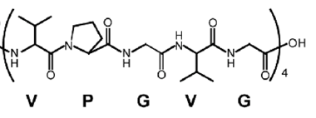
Why Mimic Elastin?
To create highly customizable, biocompatible, and biodegradable materials for advanced biotechnology and medicine
Genetically encodable for precise control over exact sequence and size
Changes in polymer length and composition allow for tunable control in response to environmental factors such as temperature and pH
Self-assembly into nanoparticles
6
Notes:
Describe what you plan to do / are doing / have done in this project to solve the problem

Slide 52
Biomimicry Introduction
Biomimicry is copying natures designs, which evolution has refined over millions of years
¹
Example:
Real human and animal skin is difficult to source and raises ethical concerns
Bio-inspired membranes have emerged as a reproducible and cost-effective tool
Biological templates deliver properties synthetic materials can’t easily match
¹ Neupane, Rabin & Boddu, Sai HS & Renukuntla, Jwala & Babu, R. Jayachandra & Tiwari, Amit. (2020). Alternatives to Biological Skin in Permeation Studies: Current Trends and Possibilities. Pharmaceutics. 12. 152. 10.3390/pharmaceutics12020152.
4
Insert Image of Biomimicry Tech (Some sort of membrane)
Notes:
Describe what you plan to do / are doing / have done in this project to solve the problem
Biological templates deliver properties synthetic materials can’t easily match
See it everywhere…for example…fast skin tech
Nature finds a way…not necessarily the best way (not optimization, more like competition) when does something stop evolving…when it doesn’t need to compete anymore…we use biomimicry as a template, not to meet it, but to make it better
Transition…new slide…

Slide 53
What is the big picture your problem fits into? (background)
Tells us why we should care about your problem! You should need to cite articles you have read to do this.
You can copy graphs and diagrams from other people’s papers to communicate your answer but be sure to cite your source.
3

Slide 54
What is the problem you are trying to solve?
Tell us about the specific problem you are trying to solve. You will probably have to cite different articles here.
You can copy graphs and diagrams from other people’s papers to communicate your answer but be sure to cite your source.
3
Notes:
Define biomimicry, use membranes as an example, give an example of membrane, where we see it in everyday life, what it’s naturally made of (lipids), lipids work great for a natural membrane, but they don’t work well synthetically, current alternative on market for making synthetic membranes are very costly, time consuming, limited in variation in what you can buy - leads into my goals - I want to do this using this polymer (protein)
To overcome disadvantages over the summer I worked on producing at GEAP and see what its optimal conditions are in an effort to
Still working through beginning, but I can explain material I’m using - start at goal slide and go from there
Broad picture of whole project - create polymer library to overcome the disadvantages. I’m specifically focused on one kind of polymer and its properties, looking at where that can fit into the library
Problem I am trying to solve: Making a synthetic polymer is expensive and time consuming,
Want to make membranes, those are naturally made with lipids, but lipids are limited in functionality such as structural, self-assembly
Can use an amphiphilic block polymer but making them is expensive and time consuming
Genetic encoded polymers
Lipids bad in terms of limits, amphiphilic also limited
genetically encoded polymers reproducible, don't take as time to make, structural properties…can be used for varying membrane based nanotech
Accessibility of amphiphilic polymer for membrane based technology
Big problem: lipids and abc’s are limiting themselves, limit of material to use - limitation of material, need for expansion of material for polymer membrane
Different tech beyond drug deliver - heavy metal waste pickup, photonics, photovoltaic cells
Goal: produce GEP (genetically encoded polymer), GEAP (genetically encoded amphiphilic polymer) and investigate response for varying temperatures for membrane based nanotech
Specifics, what is GEP, explain specifics after goal slide
Talk about biomimicry and why membranes are important
Membranes are made of lipids and do all this cool stuff
When talking about membranes can talk about applications
Next: but lipids not so good when synthetically making them
Alt to lipids are so expensive and there are limits to what you can by and limits to what you can choose from
Next: Goal slide - what I’m doing using GEAP
Next: so what are GEAP’s? pictures shown vs what I pulled from lecture slide
Biomimic elastin which is naturally occurring in body (name organs), ability to contract and expand millions of times throughout lifetime
Next: How to make them - bacteria transformation, expression, purification
Show final product of protein
Move into results: When introducing GEAP’s can talk about weight and why that matters too
after going through how to make - UV vis results of how to calculate protein calculation per vial - tryptophan in there can be ID’d with UV vis
Then move into DLS - explain what that does/its background and how I’m using it - using to monitor how GEAP changes size over temperature and over ionic strength (max: 140 mM)
DLS results and what they mean - show graph
Next: next steps or future directions
Next: overview of what I talked about
Next: Acknowledgments
Summary slide good at very end - might move acknowledgments after title slide

Slide 55
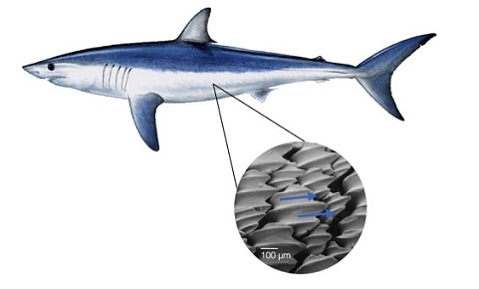
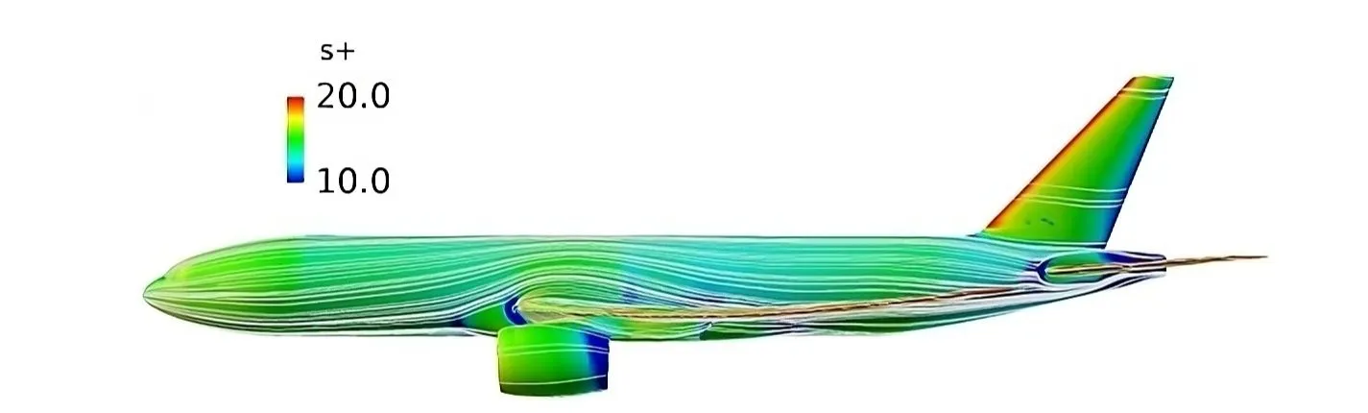
Biomimicry Introduction*
Biomimicry is copying natures designs, which evolution has refined over millions of years
Applications ¹
Shark dermal denticles reduce turbulence by channeling water flow
Researches mimicked this in a shark-skin-inspired airplane paint
This technology could save up to 4.48 million tons of fuel per year all aircraft
²
¹ Li, J. "From Shark Skin to Speed." Illumin Magazine, USC Viterbi School of Engineering, March 21, 2017.
² Depond, C. "More fuel-efficient planes with this 'shark skin' paint." Techno-Science.net, January 29, 2025.
4
Insert Image of Biomimicry Tech (Some sort of membrane)
Notes:
Describe what you plan to do / are doing / have done in this project to solve the problem
Biological templates deliver properties synthetic materials can’t easily match
See it everywhere…for example…fast skin tech

Slide 56
Overcoming Challenges Faced in Synthetic Membrane Technology
GEP’s offer the simplicity and diversity needed to overcome the challenges faced in the development of synthetic membrane-based nanotechnology
¹ Gan S, Scarpelli V, Exterkate M. Exploring lipid diversity and minimalism to define membrane requirements for synthetic cells. FEBS Lett. 2025 Dec;599(24):3569-3590. doi: 10.1002/1873-3468.70131. Epub 2025 Aug 11. PMID: 40787853; PMCID: PMC12720230.
² Polymer Source Inc. Product Categories. Polymer Source Inc.; 2026 [cited 2026 Jun 18]. Available from: https://www.polymersource.ca/index.php?route=product/maincategory
4
Notes:
membrane tech nothing new…traditionally based on lipids bc foundation of cell…inherent issues (as a material): static in nature (induces flexibility by composition as opposed to a dynamic material), very labile, fall apart easily (not very robust), not very dynamic (can’t do a lot of different things with them) good ex: take popc (18:1 (1 saturated carbon), 18:0 (no sat carbon), self assembly process will always create the same thing, a 3D liposome or 2D membrane). Polymers like peopbd can form a mycell, but if u put it on a substrate it turns into a bilayer - can’t be done with lipids - these chains are much less static and respond to environmental stimuli. Limitation to a polymer - synthetically make - costic (harmful - bad chemicals), costly, low yields, low throughput (to change anything about them is really hard - PhD project two make a couple and analyze them) - elp’s give us the advantage of polymers, definitely not as costly, caustic, and high throughput. Go back to our own published research on polymers. Cite our research polymers, membranes, mix in ELPs - that’s where the novelty comes in.
Saturated makes tighter packing, double bonds add in kinks that make them more fluid and chaotic
Amino acids - add a histodine - can bind metals, or other things you want
popc:1 pomotil, octodecil or smtg phosphocital coline & dopc: di octoneal phophotital coline
lipids blah blah…alt is abc…blah blah…so goal is blah blah
Define biomimicry, use membranes as an example, give an example of membrane, where we see it in everyday life, what it’s naturally made of (lipids), lipids work great for a natural membrane, but they don’t work well synthetically, current alternative on market for making synthetic membranes are very costly, time consuming, limited in variation in what you can buy - leads into my goals - I want to do this using this polymer (protein)
To overcome disadvantages over the summer I worked on producing at GEAP and see what its optimal conditions are in an effort to
Still working through beginning, but I can explain material I’m using - start at goal slide and go from there
Broad picture of whole project - create polymer library to overcome the disadvantages. I’m specifically focused on one kind of polymer and its properties, looking at where that can fit into the library
Problem I am trying to solve: Making a synthetic polymer is expensive and time consuming,
Want to make membranes, those are naturally made with lipids, but lipids are limited in functionality such as structural, self-assembly
Can use an amphiphilic block polymer but making them is expensive and time consuming
Genetic encoded polymers
Lipids bad in terms of limits, amphiphilic also limited
genetically encoded polymers reproducible, don't take as time to make, structural properties…can be used for varying membrane based nanotech
Accessibility of amphiphilic polymer for membrane based technology
Big problem: lipids and abc’s are limiting themselves, limit of material to use - limitation of material, need for expansion of material for polymer membrane
Different tech beyond drug deliver - heavy metal waste pickup, photonics, photovoltaic cells
Goal: produce GEP (genetically encoded polymer), GEAP (genetically encoded amphiphilic polymer) and investigate response for varying temperatures for membrane based nanotech
Specifics, what is GEP, explain specifics after goal slide
Talk about biomimicry and why membranes are important
Membranes are made of lipids and do all this cool stuff
When talking about membranes can talk about applications
Next: but lipids not so good when synthetically making them
Alt to lipids are so expensive and there are limits to what you can by and limits to what you can choose from
Next: Goal slide - what I’m doing using GEAP
Next: so what are GEAP’s? pictures shown vs what I pulled from lecture slide
Biomimic elastin which is naturally occurring in body (name organs), ability to contract and expand millions of times throughout lifetime
Next: How to make them - bacteria transformation, expression, purification
Show final product of protein
Move into results: When introducing GEAP’s can talk about weight and why that matters too
after going through how to make - UV vis results of how to calculate protein calculation per vial - tryptophan in there can be ID’d with UV vis
Then move into DLS - explain what that does/its background and how I’m using it - using to monitor how GEAP changes size over temperature and over ionic strength (max: 140 mM)
DLS results and what they mean - show graph
Next: next steps or future directions
Next: overview of what I talked about
Next: Acknowledgments
Summary slide good at very end - might move acknowledgments after title slide

Slide 57
GEPs Inspired by Elastin ¹
Elastin is one of the most abundant proteins in the human body
Allows tissues to stretch and shrink back
  Found in blood vessels, lungs, skin, bladder, and some ligaments
Over 75% of the amino acid sequence consists of glycine, valine, alanine, and proline
¹ Wang K, Meng X, Guo Z. Elastin Structure, Synthesis, Regulatory Mechanism and Relationship With Cardiovascular Diseases. Front Cell Dev Biol. 2021 Nov 30;9:596702. doi: 10.3389/fcell.2021.596702. PMID: 34917605; PMCID: PMC8670233.
6
Notes:
Describe what you plan to do / are doing / have done in this project to solve the problem
couple with goal slide

Slide 58
GEPs Inspired by Elastin ¹
Elastin is one of the most abundant proteins in the human body
Allows tissues to stretch and shrink back
  Found in blood vessels, lungs, skin, bladder, and some ligaments
Over 75% of the amino acid sequence consists of glycine, valine, alanine, and proline
¹ Wang K, Meng X, Guo Z. Elastin Structure, Synthesis, Regulatory Mechanism and Relationship With Cardiovascular Diseases. Front Cell Dev Biol. 2021 Nov 30;9:596702. doi: 10.3389/fcell.2021.596702. PMID: 34917605; PMCID: PMC8670233.
6
Notes:
Describe what you plan to do / are doing / have done in this project to solve the problem
couple with goal slide

Slide 59
Challenges of Synthetic Membrane-Based Nanotechnology
Synthetic lipid membranes are extremely complex, static, and prone to fluctuation ¹
¹ Gan S, Scarpelli V, Exterkate M. Exploring lipid diversity and minimalism to define membrane requirements for synthetic cells. FEBS Lett. 2025 Dec;599(24):3569-3590. doi: 10.1002/1873-3468.70131. Epub 2025 Aug 11. PMID: 40787853; PMCID: PMC12720230.
4
Notes:
membrane tech nothing new…traditionally based on lipids bc foundation of cell…inherent issues (as a material): static in nature (induces flexibility by composition as opposed to a dynamic material), very labile, fall apart easily (not very robust), not very dynamic (can’t do a lot of different things with them) good ex: take popc (18:1 (1 saturated carbon), 18:0 (no sat carbon), self assembly process will always create the same thing, a 3D liposome or 2D membrane). Polymers like peopbd can form a mycell, but if u put it on a substrate it turns into a bilayer - can’t be done with lipids - these chains are much less static and respond to environmental stimuli. Limitation to a polymer - synthetically make - costic (harmful - bad chemicals), costly, low yields, low throughput (to change anything about them is really hard - PhD project two make a couple and analyze them) - elp’s give us the advantage of polymers, definitely not as costly, caustic, and high throughput. Go back to our own published research on polymers. Cite our research polymers, membranes, mix in ELPs - that’s where the novelty comes in.
Saturated makes tighter packing, double bonds add in kinks that make them more fluid and chaotic
Amino acids - add a histodine - can bind metals, or other things you want
popc:1 pomotil, octodecil or smtg phosphocital coline & dopc: di octoneal phophotital coline
lipids blah blah…alt is abc…blah blah…so goal is blah blah
Define biomimicry, use membranes as an example, give an example of membrane, where we see it in everyday life, what it’s naturally made of (lipids), lipids work great for a natural membrane, but they don’t work well synthetically, current alternative on market for making synthetic membranes are very costly, time consuming, limited in variation in what you can buy - leads into my goals - I want to do this using this polymer (protein)
To overcome disadvantages over the summer I worked on producing at GEAP and see what its optimal conditions are in an effort to
Still working through beginning, but I can explain material I’m using - start at goal slide and go from there
Broad picture of whole project - create polymer library to overcome the disadvantages. I’m specifically focused on one kind of polymer and its properties, looking at where that can fit into the library
Problem I am trying to solve: Making a synthetic polymer is expensive and time consuming,
Want to make membranes, those are naturally made with lipids, but lipids are limited in functionality such as structural, self-assembly
Can use an amphiphilic block polymer but making them is expensive and time consuming
Genetic encoded polymers
Lipids bad in terms of limits, amphiphilic also limited
genetically encoded polymers reproducible, don't take as time to make, structural properties…can be used for varying membrane based nanotech
Accessibility of amphiphilic polymer for membrane based technology
Big problem: lipids and abc’s are limiting themselves, limit of material to use - limitation of material, need for expansion of material for polymer membrane
Different tech beyond drug deliver - heavy metal waste pickup, photonics, photovoltaic cells
Goal: produce GEP (genetically encoded polymer), GEAP (genetically encoded amphiphilic polymer) and investigate response for varying temperatures for membrane based nanotech
Specifics, what is GEP, explain specifics after goal slide
Talk about biomimicry and why membranes are important
Membranes are made of lipids and do all this cool stuff
When talking about membranes can talk about applications
Next: but lipids not so good when synthetically making them
Alt to lipids are so expensive and there are limits to what you can by and limits to what you can choose from
Next: Goal slide - what I’m doing using GEAP
Next: so what are GEAP’s? pictures shown vs what I pulled from lecture slide
Biomimic elastin which is naturally occurring in body (name organs), ability to contract and expand millions of times throughout lifetime
Next: How to make them - bacteria transformation, expression, purification
Show final product of protein
Move into results: When introducing GEAP’s can talk about weight and why that matters too
after going through how to make - UV vis results of how to calculate protein calculation per vial - tryptophan in there can be ID’d with UV vis
Then move into DLS - explain what that does/its background and how I’m using it - using to monitor how GEAP changes size over temperature and over ionic strength (max: 140 mM)
DLS results and what they mean - show graph
Next: next steps or future directions
Next: overview of what I talked about
Next: Acknowledgments
Summary slide good at very end - might move acknowledgments after title slide

Slide 60
Synthesizing Genetically Encoded Amphiphilic Polymers for Membrane Based Nanotechnologies
Adam Vanluvanee, Harvey Mudd College
Ashley Martinez, Northern Arizona University
Gabriel Moñtano, Northern Arizona University
NSF award No.ECCS-2025490
1
Notes:
Introduce myself, year I’m going into, worked with Ash and Gabe from NAU on my project titled:
NOTE: You will have 8 minutes to present.
The more slides, the less time on each slide.
Could start with what is elastin, why make the synthetic version of it
Could also talk about sequences, where we got the original sequence from
Next week specifically:
Introduce elastin, why we care, sequences that were chosen,
Best thing to do - this is our projected path/timeline
Creating membrane materials not just
Show pictures, what I’ve done, all that

Slide 61
Biomimicry Introduction 😀
Biomimicry is copying natures designs, which evolution has refined over millions of years
¹
Example:
Real human and animal skin is difficult to source and raises ethical concerns
Fig x:
Bio-inspired membranes have emerged as a reproducible and cost-effective tool
¹ Neupane, Rabin & Boddu, Sai HS & Renukuntla, Jwala & Babu, R. Jayachandra & Tiwari, Amit. (2020). Alternatives to Biological Skin in Permeation Studies: Current Trends and Possibilities. Pharmaceutics. 12. 152. 10.3390/pharmaceutics12020152.
2
NSF award No.ECCS-2025490
Insert Image of Biomimicry Tech (Some sort of membrane)
Notes:
Describe what you plan to do / are doing / have done in this project to solve the problem
Along with these synthetic membranes, here are some apps
Biological templates deliver properties synthetic materials can’t easily match
See it everywhere…for example…fast skin tech
Nature finds a way…not necessarily the best way (not optimization, more like competition) when does something stop evolving…when it doesn’t need to compete anymore…we use biomimicry as a template, not to meet it, but to make it better
Transition…new slide…

Slide 62
Applications of Membrane-Based Nanotechnology
Biomimetic membrane-based nanotechnology has broad reach across medicine, environmental remediation, and energy-based applications
Nanofiltration membranes
Specialized polymers
¹ Sandu T, Sârbu A, Căprărescu S, Stoica EB, Iordache TV, Chiriac AL. Polymer Membranes as Innovative Means of Quality Restoring for Wastewater Bearing Heavy Metals. Membranes (Basel). 2022 Nov 23;12(12):1179. doi: 10.3390/membranes12121179. PMID: 36557086; PMCID: PMC9783154.
² MacEwan SR, Chilkoti A. Applications of elastin-like polypeptides in drug delivery. J Control Release. 2014 Sep 28;190:314–330. doi: 10.1016/j.jconrel.2014.06.028. PMID: 24954283; PMCID: PMC4163487.
3
NSF award No.ECCS-2025490
Notes:
Introduce myself, year I’m going into, worked with Ash and Gabe from NAU on my project titled:
Nanofiltration membranes effectively remove heavy metals for water quality restoration¹
Specialized polymers deliver therapeutics and small molecule drugs to target sites for disease treatment ²
You can copy graphs and diagrams from other people’s papers to communicate your answer but be sure to cite your source.
Tells us why we should care about your problem! You should need to cite articles you have read to do this.
What is the big picture your problem fits into? (background)
Elastin like polymers (ELP’s) can be used to deliver biological therapeutics and small molecule drugs to various anatomical sites for treatment of disease ²
Biological templates deliver properties synthetic materials can’t easily match

Slide 63
Challenges of Synthetic Membrane-Based Nanotechnology 😀
Synthetic lipid membranes ¹
Static
Extremely complex
Prone to fluctuation
Amphiphilic block copolymers ²
Caustic
High costs
Low throughput and yield
Fig x: Schematic representation of key functions required for a synthetic minimal cell membrane
¹ Gan S, Scarpelli V, Exterkate M. Exploring lipid diversity and minimalism to define membrane requirements for synthetic cells. FEBS Lett. 2025 Dec;599(24):3569-3590. doi: 10.1002/1873-3468.70131. Epub 2025 Aug 11. PMID: 40787853; PMCID: PMC12720230.
² Polymer Source Inc. Product Categories. Polymer Source Inc.; 2026 [cited 2026 Jun 18]. Available from: https://www.polymersource.ca/index.php?route=product/maincategory
4
NSF award No.ECCS-2025490
Notes:
Mention micelles somewhere… but where??
Synthetic:
-
-
-
Amp:
-
-
- restrict experimental applications
membrane tech nothing new…traditionally based on lipids bc foundation of cell…inherent issues (as a material): static in nature (induces flexibility by composition as opposed to a dynamic material), very labile, fall apart easily (not very robust), not very dynamic (can’t do a lot of different things with them) good ex: take popc (18:1 (1 saturated carbon), 18:0 (no sat carbon), self assembly process will always create the same thing, a 3D liposome or 2D membrane). Polymers like peopbd can form a mycell, but if u put it on a substrate it turns into a bilayer - can’t be done with lipids - these chains are much less static and respond to environmental stimuli. Limitation to a polymer - synthetically make - costic (harmful - bad chemicals), costly, low yields, low throughput (to change anything about them is really hard - PhD project two make a couple and analyze them) - elp’s give us the advantage of polymers, definitely not as costly, caustic, and high throughput. Go back to our own published research on polymers. Cite our research polymers, membranes, mix in ELPs - that’s where the novelty comes in.
Saturated makes tighter packing, double bonds add in kinks that make them more fluid and chaotic
Amino acids - add a histodine - can bind metals, or other things you want
popc:1 pomotil, octodecil or smtg phosphocital coline & dopc: di octoneal phophotital coline
lipids blah blah…alt is abc…blah blah…so goal is blah blah
Define biomimicry, use membranes as an example, give an example of membrane, where we see it in everyday life, what it’s naturally made of (lipids), lipids work great for a natural membrane, but they don’t work well synthetically, current alternative on market for making synthetic membranes are very costly, time consuming, limited in variation in what you can buy - leads into my goals - I want to do this using this polymer (protein)
To overcome disadvantages over the summer I worked on producing at GEAP and see what its optimal conditions are in an effort to
Still working through beginning, but I can explain material I’m using - start at goal slide and go from there
Broad picture of whole project - create polymer library to overcome the disadvantages. I’m specifically focused on one kind of polymer and its properties, looking at where that can fit into the library
Problem I am trying to solve: Making a synthetic polymer is expensive and time consuming,
Want to make membranes, those are naturally made with lipids, but lipids are limited in functionality such as structural, self-assembly
Can use an amphiphilic block polymer but making them is expensive and time consuming
Genetic encoded polymers
Lipids bad in terms of limits, amphiphilic also limited
genetically encoded polymers reproducible, don't take as time to make, structural properties…can be used for varying membrane based nanotech
Accessibility of amphiphilic polymer for membrane based technology
Big problem: lipids and abc’s are limiting themselves, limit of material to use - limitation of material, need for expansion of material for polymer membrane
Different tech beyond drug deliver - heavy metal waste pickup, photonics, photovoltaic cells
Goal: produce GEP (genetically encoded polymer), GEAP (genetically encoded amphiphilic polymer) and investigate response for varying temperatures for membrane based nanotech
Specifics, what is GEP, explain specifics after goal slide
Talk about biomimicry and why membranes are important
Membranes are made of lipids and do all this cool stuff
When talking about membranes can talk about applications
Next: but lipids not so good when synthetically making them
Alt to lipids are so expensive and there are limits to what you can by and limits to what you can choose from
Next: Goal slide - what I’m doing using GEAP
Next: so what are GEAP’s? pictures shown vs what I pulled from lecture slide
Biomimic elastin which is naturally occurring in body (name organs), ability to contract and expand millions of times throughout lifetime
Next: How to make them - bacteria transformation, expression, purification
Show final product of protein
Move into results: When introducing GEAP’s can talk about weight and why that matters too
after going through how to make - UV vis results of how to calculate protein calculation per vial - tryptophan in there can be ID’d with UV vis
Then move into DLS - explain what that does/its background and how I’m using it - using to monitor how GEAP changes size over temperature and over ionic strength (max: 140 mM)
DLS results and what they mean - show graph
Next: next steps or future directions
Next: overview of what I talked about
Next: Acknowledgments
Summary slide good at very end - might move acknowledgments after title slide

Slide 64
Overcoming Challenges Faced in Synthetic Membrane Technology 😀
Genetically Encoded Polymers (GEP’s) biomimicking elastin offer the simplicity and diversity needed to overcome the challenges faced in the development of synthetic membrane-based nanotechnology
5
NSF award No.ECCS-2025490
Notes:
Just title and main thing no more
Condense, maybe split into two slides
membrane tech nothing new…traditionally based on lipids bc foundation of cell…inherent issues (as a material): static in nature (induces flexibility by composition as opposed to a dynamic material), very labile, fall apart easily (not very robust), not very dynamic (can’t do a lot of different things with them) good ex: take popc (18:1 (1 saturated carbon), 18:0 (no sat carbon), self assembly process will always create the same thing, a 3D liposome or 2D membrane). Polymers like peopbd can form a mycell, but if u put it on a substrate it turns into a bilayer - can’t be done with lipids - these chains are much less static and respond to environmental stimuli. Limitation to a polymer - synthetically make - costic (harmful - bad chemicals), costly, low yields, low throughput (to change anything about them is really hard - PhD project two make a couple and analyze them) - elp’s give us the advantage of polymers, definitely not as costly, caustic, and high throughput. Go back to our own published research on polymers. Cite our research polymers, membranes, mix in ELPs - that’s where the novelty comes in.
Saturated makes tighter packing, double bonds add in kinks that make them more fluid and chaotic
Amino acids - add a histodine - can bind metals, or other things you want
popc:1 pomotil, octodecil or smtg phosphocital coline & dopc: di octoneal phophotital coline
lipids blah blah…alt is abc…blah blah…so goal is blah blah
Define biomimicry, use membranes as an example, give an example of membrane, where we see it in everyday life, what it’s naturally made of (lipids), lipids work great for a natural membrane, but they don’t work well synthetically, current alternative on market for making synthetic membranes are very costly, time consuming, limited in variation in what you can buy - leads into my goals - I want to do this using this polymer (protein)
To overcome disadvantages over the summer I worked on producing at GEAP and see what its optimal conditions are in an effort to
Still working through beginning, but I can explain material I’m using - start at goal slide and go from there
Broad picture of whole project - create polymer library to overcome the disadvantages. I’m specifically focused on one kind of polymer and its properties, looking at where that can fit into the library
Problem I am trying to solve: Making a synthetic polymer is expensive and time consuming,
Want to make membranes, those are naturally made with lipids, but lipids are limited in functionality such as structural, self-assembly
Can use an amphiphilic block polymer but making them is expensive and time consuming
Genetic encoded polymers
Lipids bad in terms of limits, amphiphilic also limited
genetically encoded polymers reproducible, don't take as time to make, structural properties…can be used for varying membrane based nanotech
Accessibility of amphiphilic polymer for membrane based technology
Big problem: lipids and abc’s are limiting themselves, limit of material to use - limitation of material, need for expansion of material for polymer membrane
Different tech beyond drug deliver - heavy metal waste pickup, photonics, photovoltaic cells
Goal: produce GEP (genetically encoded polymer), GEAP (genetically encoded amphiphilic polymer) and investigate response for varying temperatures for membrane based nanotech
Specifics, what is GEP, explain specifics after goal slide
Talk about biomimicry and why membranes are important
Membranes are made of lipids and do all this cool stuff
When talking about membranes can talk about applications
Next: but lipids not so good when synthetically making them
Alt to lipids are so expensive and there are limits to what you can by and limits to what you can choose from
Next: Goal slide - what I’m doing using GEAP
Next: so what are GEAP’s? pictures shown vs what I pulled from lecture slide
Biomimic elastin which is naturally occurring in body (name organs), ability to contract and expand millions of times throughout lifetime
Next: How to make them - bacteria transformation, expression, purification
Show final product of protein
Move into results: When introducing GEAP’s can talk about weight and why that matters too
after going through how to make - UV vis results of how to calculate protein calculation per vial - tryptophan in there can be ID’d with UV vis
Then move into DLS - explain what that does/its background and how I’m using it - using to monitor how GEAP changes size over temperature and over ionic strength (max: 140 mM)
DLS results and what they mean - show graph
Next: next steps or future directions
Next: overview of what I talked about
Next: Acknowledgments
Summary slide good at very end - might move acknowledgments after title slide

Slide 65
Overcoming Challenges Faced in Synthetic Membrane Technology 😀
Elastin is one of the most abundant proteins in the human body
Provides elasticity to tissues
Consists primarily of glycine, valine, alanine, and proline
Fig x: Bovine aorta elastin
¹ Gan S, Scarpelli V, Exterkate M. Exploring lipid diversity and minimalism to define membrane requirements for synthetic cells. FEBS Lett. 2025 Dec;599(24):3569-3590. doi: 10.1002/1873-3468.70131. Epub 2025 Aug 11. PMID: 40787853; PMCID: PMC12720230.
² Polymer Source Inc. Product Categories. Polymer Source Inc.; 2026 [cited 2026 Jun 18]. Available from: https://www.polymersource.ca/index.php?route=product/maincategory
6
NSF award No.ECCS-2025490
Notes:
Picture on right showing elastin from a bovine aorta
Condense, maybe split into two slides
membrane tech nothing new…traditionally based on lipids bc foundation of cell…inherent issues (as a material): static in nature (induces flexibility by composition as opposed to a dynamic material), very labile, fall apart easily (not very robust), not very dynamic (can’t do a lot of different things with them) good ex: take popc (18:1 (1 saturated carbon), 18:0 (no sat carbon), self assembly process will always create the same thing, a 3D liposome or 2D membrane). Polymers like peopbd can form a mycell, but if u put it on a substrate it turns into a bilayer - can’t be done with lipids - these chains are much less static and respond to environmental stimuli. Limitation to a polymer - synthetically make - costic (harmful - bad chemicals), costly, low yields, low throughput (to change anything about them is really hard - PhD project two make a couple and analyze them) - elp’s give us the advantage of polymers, definitely not as costly, caustic, and high throughput. Go back to our own published research on polymers. Cite our research polymers, membranes, mix in ELPs - that’s where the novelty comes in.
Saturated makes tighter packing, double bonds add in kinks that make them more fluid and chaotic
Amino acids - add a histodine - can bind metals, or other things you want
popc:1 pomotil, octodecil or smtg phosphocital coline & dopc: di octoneal phophotital coline
lipids blah blah…alt is abc…blah blah…so goal is blah blah
Define biomimicry, use membranes as an example, give an example of membrane, where we see it in everyday life, what it’s naturally made of (lipids), lipids work great for a natural membrane, but they don’t work well synthetically, current alternative on market for making synthetic membranes are very costly, time consuming, limited in variation in what you can buy - leads into my goals - I want to do this using this polymer (protein)
To overcome disadvantages over the summer I worked on producing at GEAP and see what its optimal conditions are in an effort to
Still working through beginning, but I can explain material I’m using - start at goal slide and go from there
Broad picture of whole project - create polymer library to overcome the disadvantages. I’m specifically focused on one kind of polymer and its properties, looking at where that can fit into the library
Problem I am trying to solve: Making a synthetic polymer is expensive and time consuming,
Want to make membranes, those are naturally made with lipids, but lipids are limited in functionality such as structural, self-assembly
Can use an amphiphilic block polymer but making them is expensive and time consuming
Genetic encoded polymers
Lipids bad in terms of limits, amphiphilic also limited
genetically encoded polymers reproducible, don't take as time to make, structural properties…can be used for varying membrane based nanotech
Accessibility of amphiphilic polymer for membrane based technology
Big problem: lipids and abc’s are limiting themselves, limit of material to use - limitation of material, need for expansion of material for polymer membrane
Different tech beyond drug deliver - heavy metal waste pickup, photonics, photovoltaic cells
Goal: produce GEP (genetically encoded polymer), GEAP (genetically encoded amphiphilic polymer) and investigate response for varying temperatures for membrane based nanotech
Specifics, what is GEP, explain specifics after goal slide
Talk about biomimicry and why membranes are important
Membranes are made of lipids and do all this cool stuff
When talking about membranes can talk about applications
Next: but lipids not so good when synthetically making them
Alt to lipids are so expensive and there are limits to what you can by and limits to what you can choose from
Next: Goal slide - what I’m doing using GEAP
Next: so what are GEAP’s? pictures shown vs what I pulled from lecture slide
Biomimic elastin which is naturally occurring in body (name organs), ability to contract and expand millions of times throughout lifetime
Next: How to make them - bacteria transformation, expression, purification
Show final product of protein
Move into results: When introducing GEAP’s can talk about weight and why that matters too
after going through how to make - UV vis results of how to calculate protein calculation per vial - tryptophan in there can be ID’d with UV vis
Then move into DLS - explain what that does/its background and how I’m using it - using to monitor how GEAP changes size over temperature and over ionic strength (max: 140 mM)
DLS results and what they mean - show graph
Next: next steps or future directions
Next: overview of what I talked about
Next: Acknowledgments
Summary slide good at very end - might move acknowledgments after title slide

Slide 66
Primary Research Goal 😀
Understand how GEP’s behavior responds to environmental changes to contribute to a growing library of materials
Temperature
pH
¹ Fraunhofer IMWS - Fraunhofer-Gesellschaft
7
NSF award No.ECCS-2025490
Notes:
blah blah….smtg abt viewing morphology
Too text heavy…condense…what and why are we creating…be more direct about advantages
Define biomimicry, use membranes as an example, give an example of membrane, where we see it in everyday life, what it’s naturally made of (lipids), lipids work great for a natural membrane, but they don’t work well synthetically, current alternative on market for making synthetic membranes are very costly, time consuming, limited in variation in what you can buy - leads into my goals - I want to do this using this polymer (protein)
To overcome disadvantages over the summer I worked on producing at GEAP and see what its optimal conditions are in an effort to
Still working through beginning, but I can explain material I’m using - start at goal slide and go from there
Broad picture of whole project - create polymer library to overcome the disadvantages. I’m specifically focused on one kind of polymer and its properties, looking at where that can fit into the library
Problem I am trying to solve: Making a synthetic polymer is expensive and time consuming,
Want to make membranes, those are naturally made with lipids, but lipids are limited in functionality such as structural, self-assembly
Can use an amphiphilic block polymer but making them is expensive and time consuming
Genetic encoded polymers
Lipids bad in terms of limits, amphiphilic also limited
genetically encoded polymers reproducible, don't take as time to make, structural properties…can be used for varying membrane based nanotech
Accessibility of amphiphilic polymer for membrane based technology
Big problem: lipids and abc’s are limiting themselves, limit of material to use - limitation of material, need for expansion of material for polymer membrane
Different tech beyond drug deliver - heavy metal waste pickup, photonics, photovoltaic cells
Goal: produce GEP (genetically encoded polymer), GEAP (genetically encoded amphiphilic polymer) and investigate response for varying temperatures for membrane based nanotech
Specifics, what is GEP, explain specifics after goal slide
Talk about biomimicry and why membranes are important
Membranes are made of lipids and do all this cool stuff
When talking about membranes can talk about applications
Next: but lipids not so good when synthetically making them
Alt to lipids are so expensive and there are limits to what you can by and limits to what you can choose from
Next: Goal slide - what I’m doing using GEAP
Next: so what are GEAP’s? pictures shown vs what I pulled from lecture slide
Biomimic elastin which is naturally occurring in body (name organs), ability to contract and expand millions of times throughout lifetime
Next: How to make them - bacteria transformation, expression, purification
Show final product of protein
Move into results: When introducing GEAP’s can talk about weight and why that matters too
after going through how to make - UV vis results of how to calculate protein calculation per vial - tryptophan in there can be ID’d with UV vis
Then move into DLS - explain what that does/its background and how I’m using it - using to monitor how GEAP changes size over temperature and over ionic strength (max: 140 mM)
DLS results and what they mean - show graph
Next: next steps or future directions
Next: overview of what I talked about
Next: Acknowledgments
Summary slide good at very end - might move acknowledgments after title slide

Slide 67
GEP Sequence (“20:10”) 😀
Designed a vector that encodes for a 20:10 ratio of hydrophobic to hydrophilic regions of amino acids
Amphiphilic nature mimics lipid
Hexa-histidine group provides tagging capability
Yields desired properties of elastin
(VPGXG)₂₀ (VPGSG)₁₀ 6H
where X = 1:4 ratio of W:V
6
8
NSF award No.ECCS-2025490
Notes:
synthetic version of bacteria DNA
first we made a synthetic version of bacteria DNA that has a our desired GEP sequence within it. As shown in the right hand side. STartrinhg with the first half with the VPGXG, that’s opur hydrophobic region, followed by our hydrophilic region which is VPGSG and ending in a histag. With the hydrophobic region we were curious to see how the larger hydrophobic region would do compared to the shoerter hydrophilic so in the=is case the hydrophobic is 2x the length of the hydrophilic. we then take this synthetic bacteria DNA … next slide and move into this process where we put it in the bacteria
Describe what you plan to do / are doing / have done in this project to solve the problem

Slide 68
GEP Production 😀
Transformation of bacteria for DNA uptake
Protein production and purification
Detailed analysis for characterization
9
NSF award No.ECCS-2025490
Notes:
Say AFM and DLS, no UV-VIS
protein purification via ITC
Describe what you plan to do / are doing / have done in this project to solve the problem

Slide 69
Results: SDS Gel
1 - Ladder
2 - PPF 1
3 - PPF 2
4 - PPF 3
5 - CC1
6 - WC1
7 - Ladder
8 - CC3
9 - CC4
10 - Dialysis
11 - Pos Control
1 2 3 4 5 6 7 8 9 10 11
NSF award No.ECCS-2025490
9
Notes:
gel showing various steps of the purification process. we used inverse temperature cycling to purify the protein and those steps are shown in lanes 2 through 6 and 8 through 10. This is us double checking that we not only has protein at the appropriate steps but that the protein is also falling at its weight range when comparing it to the ladder seen in lanes 1 and 7. we ran a positive control as shown in lane 12, that is another vector in the series we are working with which came out appropriately as well. Lane 11 shows the dialysis step (protein is very pure) which is the last step before characterization.
SDS gel uses current to pull down protein so we can view purity
Left side I will have my ladder (for weight estimates, how well gel is running and another in the middle to make sure its still working well)…
Way to see how pure the sample is becoming as we go from cell lysis to dialysis (steps 3 thru 6). Judging purity based on how many bands are in the lane. (more bands = less pure)
During cell lysis we break open periplasmic portion of bacteria because that’s where out protein is. So lanes 2 - 4 are showing how well we broke them out while not being worried about purity (in these steps we break open membrane parts to access periplasm - will have bacteria chunks lingering around, so even though it’s meant to give a clearer purification, you’ll have things like natural bacteria protein, membrane, various parts of the bacteria itself)
Not until we start doing the salting back and forth that we worry about purity which can be shown in lanes 5 through 10
Pos control for consistency - a check per se to make sure everything ran through
Lane 11 is dialysis - the purest sample of the set - 1 to 2 bands is fine (might have smtg sticking to it)
Describe what you plan to do / are doing / have done in this project to solve the problem

Slide 70
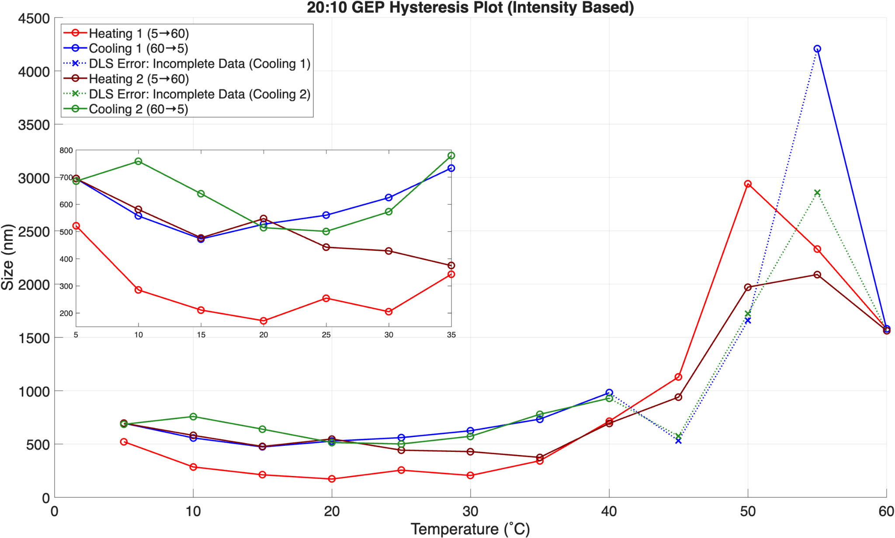
Results: 20:10 Hysteresis via DLS
14
NSF award No.ECCS-2025490
Notes:
Here I’m showing what the 20:10 GEP looks like in terms of size over varying temperature, where size in nm is on the y-axis as a function of temp. The proteins amphiphilic nature allows it to self assemble into nano size particles, and we wanted to see what the assembly would look like if we ran multiple temp cycles from 5˚ C to 60˚ C in 5˚ C increments. This plot demonstrate the ability of the polymer to achieve a reversible phase transition within a wide temperature range.

Slide 71
Results: 20:10 ZnTPP Encapsulation UV-Vis
14
NSF award No.ECCS-2025490

Slide 72
Results: 20:10 ZnTPP Encapsulation Fluorescence
14
NSF award No.ECCS-2025490

Slide 73
Summary
Biomimetic membrane-based nanotechnologies have broad potential across varying applications
Current technologies face significant limitations
20:10 GEP demonstrated:
  Reversible phase transitions via DLS temperature cycling
  Generation of membrane architectures
Next we should…
16
NSF award No.ECCS-2025490

Slide 74
Acknowledgments
Gabriel Moñtano, Northern Arizona University
Ashley Martinez, Northern Arizona University
Jessica Hauer, Arizona State University
Celedonio Rodriguez, Northern Arizona University
17
NSF award No.ECCS-2025490

Slide 75
Synthesizing Genetically Encoded Amphiphilic Polymers for Membrane Based Nanotechnologies
Adam Vanluvanee, Harvey Mudd College
Ashley Martinez, Northern Arizona University
Gabriel Moñtano, Northern Arizona University
NSF award No.ECCS-2025490
1

