Slide 1
Nanofabrication of a
Wire Grid Polarizer
MSU ECE REU Site Summer 2026 Project Presentation
Presenter: Sean Freeland
Co-authors: Dr. Andrew Lingley, PhD
Mentors: Dr. Wataru Nakagawa, PhD and Dr. David Dickensheets, PhD

Slide 2
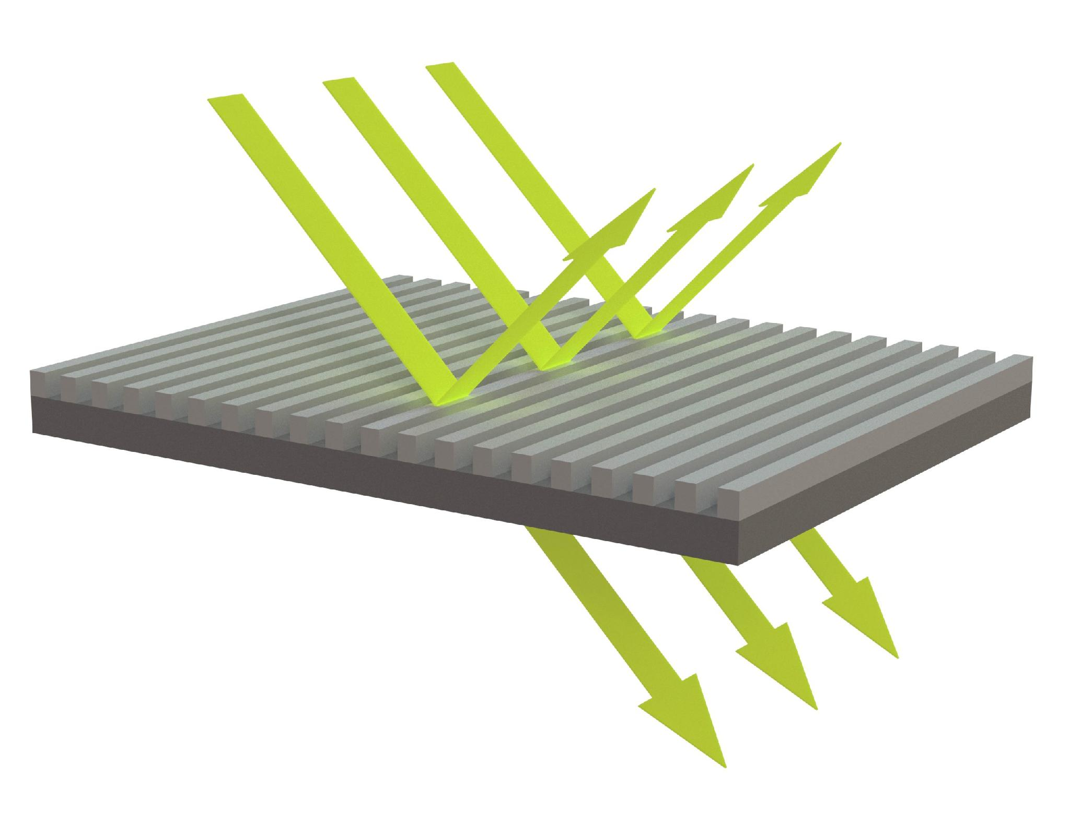
Introduction
Incoming Light
s-Polarized Light
Wire grid polarizing beamsplitter¹
  Electric field is parallel, excites electrons reflects
  Electric field is perpendicular, doesn’t excite
electrons transmits
MSU to establish Montana Microfabrication Facility (MMF) capability
  Requires very small (<1um) feature size and period³
  Proof-of-concept of the lithography and characterization process using the MMF
Substrate
p-Polarized Light
Metal Wires
Light is converted into two polarization states from a wire grid polarizer²
Notes:
What actually is a wire grid polarizer? Well, it is a grid of long, thin, and close metal wires on top of a substrate, and is a type of beamsplitter that splits incoming light into two different polarization states. As we know, light is an electromagnetic wave, and that electric field is what is affected by the wire grid polarizer. The electric field is made up of two parts, one parallel to the wire grid and one perpendicular. The electric field section that is parallel to the metal wires causes the electrons in the metal to excite along those wires, which then causes the grid to act as a mirror, and then the parallel electric field is reflected and called s-polarized. The opposite is true for the perpendicular section of electric field, where the electrons are not excited, so the electric field is just transmitted through the grid and is called p-polarized.
This project will help to establish the MMF capability of creating a grid like this. Although this has been done elsewhere, no one at MSU has created a wire grid polarizer like this because it requires extremely small feature sizes, and all the corners and lines must be precise. What I will be doing is creating a slightly larger version as a proof-of-concept of the real thing and making sure that there is a reliable and reproducible start. Despite this, I will still try to get these wires as close to the original in size as I can while still be repeatable.
Talk more about the largeness of my project for the second bullet point. I am doing this, however it is more a proof-of-concept for the real thing which will be much smaller. How small can the current clean room get and make a modern recipe that later processes can be based off of. It needs to be reliable and reproducible.

Slide 3
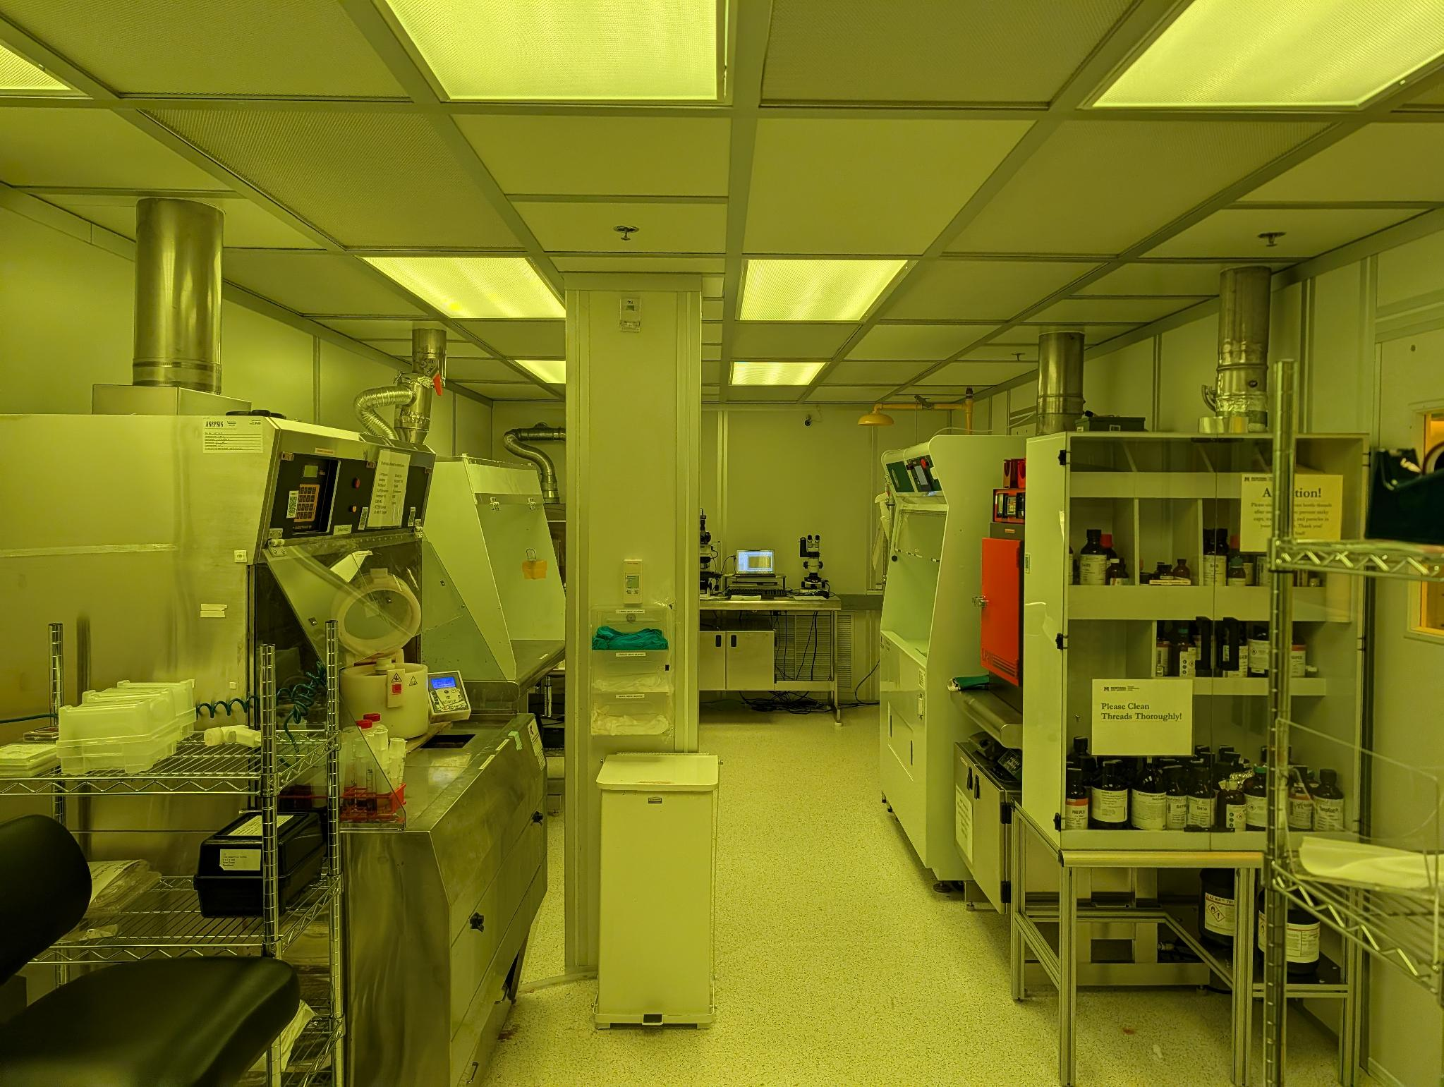
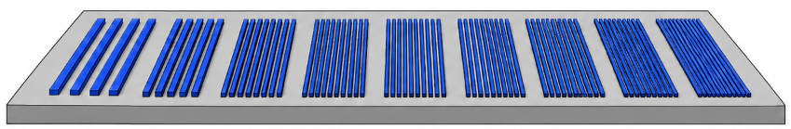
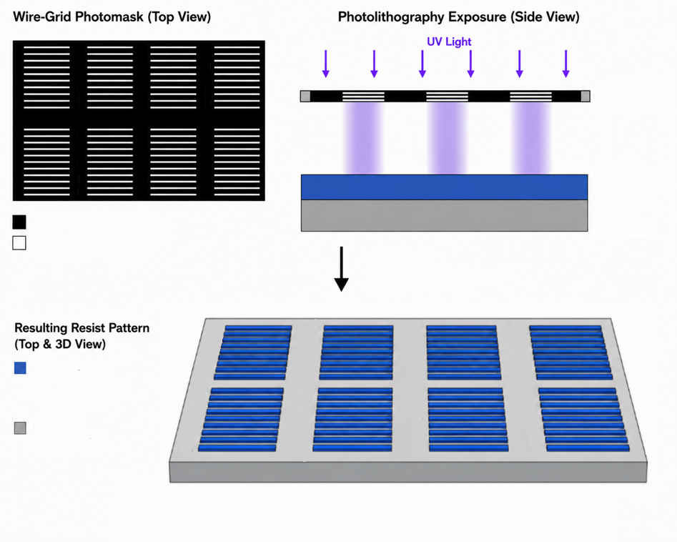
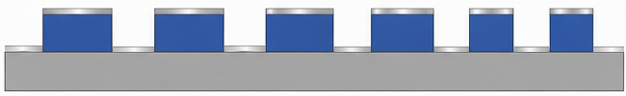
Introduction
70um
5190um
Substrate
Resist
Metal
Evaporated metal on patterned resist. Generated by ChatGPT
40nm aluminum
thickness⁴
MMF Cleanroom
Notes:
Using photolithography in the MSU clean-room, I will be fabricating a wire grid pattern as small as I can make it, meaning as thin as I can and with minimal feature size. Then, metal evaporation will deposit a metal nonconformally onto the checkerboard pattern, meaning only on the horizontal surfaces.

Slide 4
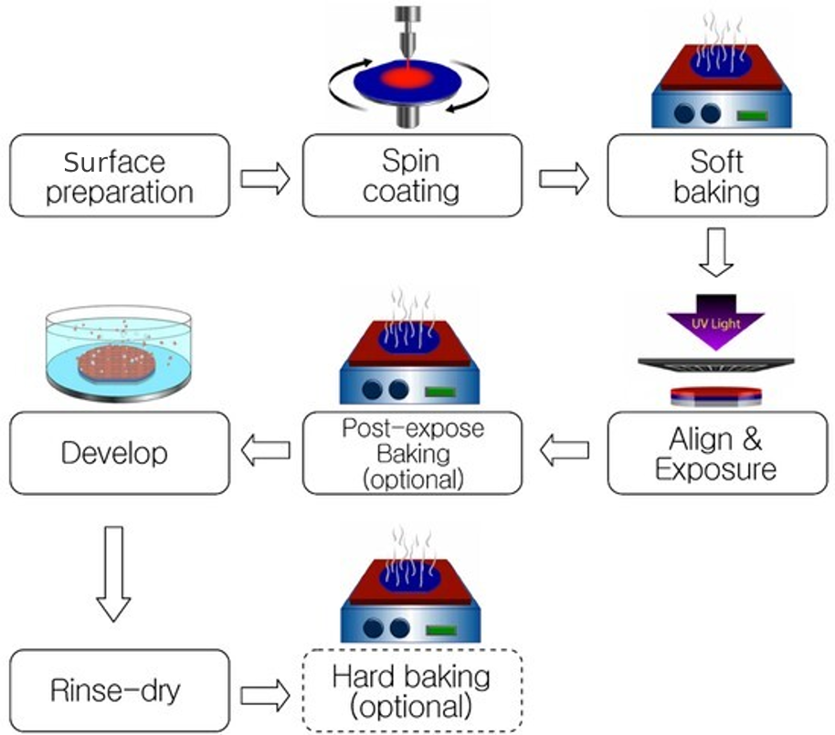
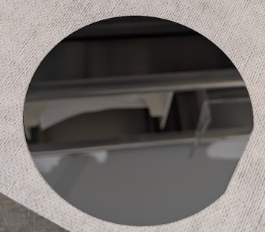
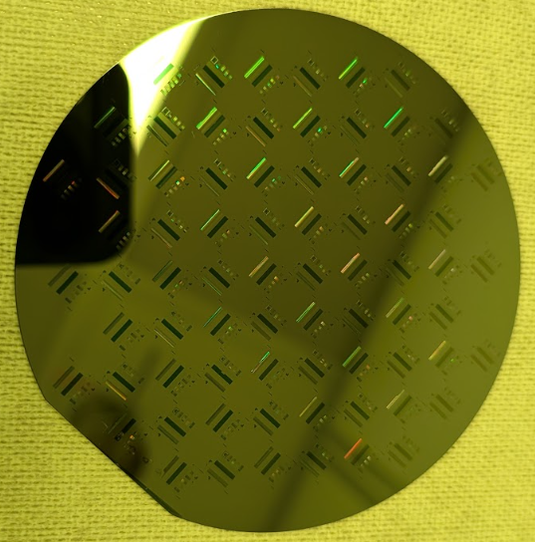
Background: Photolithography⁵
Start: clean wafer
End: patterned wafer
6
Notes:
Surface preparation: clean wafer, apply adhesion for resist if needed, HDMS
Spin coating: uniformly adds resist to the substrate, with resist thickness depending on spin speed and time
Soft baking: evaporates excess solvents, solidifies the resist and improves adhesion to the substrate in preparation for exposure
Exposure: UV light passes through the mask and “exposes” certain areas of the resist in the mask’s pattern
PEB: completes the chemical reaction started in the exposure step. Cross-links the exposes regions so that they persist after development
Development: “develops” away the unexposed areas leaving only the exposed, cross-linked regions in negative resists.
Hard bake: solidifies remaining resist and makes it more durable. Useful if you plan on further steps (etching, deposition)

Slide 5
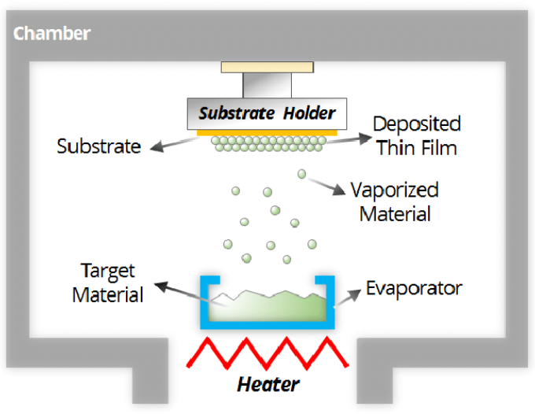
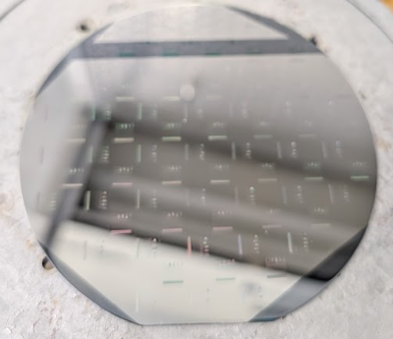
Background: Metal Evaporation⁷
Start: patterned wafer
End: metal on wafer
Notes:
The substrate is placed above the material (in this case a metal) that is about to be vaporized.
Air and everything else in the chamber is pumped out to create a vacuum. This ensures the vaporized metal doesn’t collide with anything on its way to the substrate.
The metal is then heated to its vaporization temperature, and vaporized atoms have enough energy to escape their condensed material in straight lines.
The vaporized atoms then reach the substrate’s colder surface, causing the atom to condense and create a thin, uniform layer on the substrate.

Slide 6
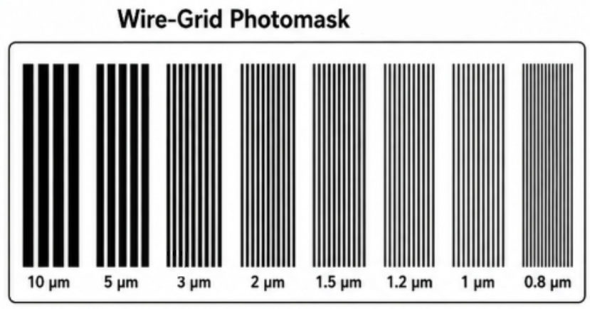
Research Question
Mask
Resist
Substrate
How close to the optical resolution limit can a two-level metal wire grid polarizer be fabricated when using MSU cleanroom processes?
Transmits UV
Blocks UV
After Exposure
Resist
Substrate
After Aluminum Deposition
Side View
Substrate
Resist
Metal
Notes:
Read research question, visual show what I am trying to do

Slide 7
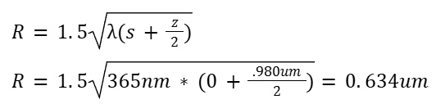
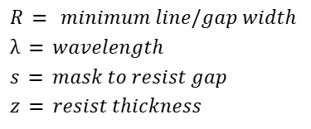
Optical Resolution Limit
Physical diffraction limit⁸
  Resist cannot distinguish between exposed and unexposed regions
  Limits of wavelength
Practical limit in MMF cleanroom
  Air quality
  Humidity/Temperature
  Process Optimizations
9

Slide 8
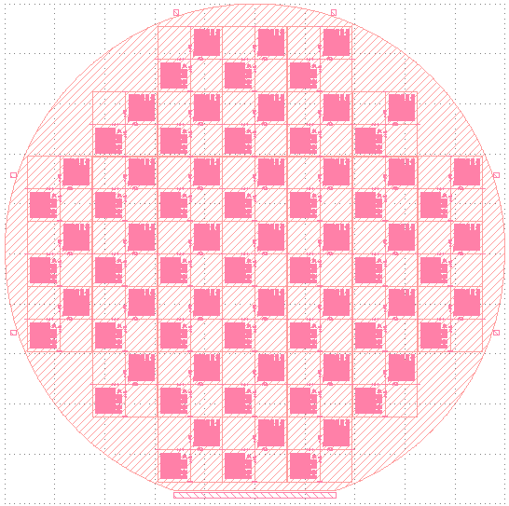
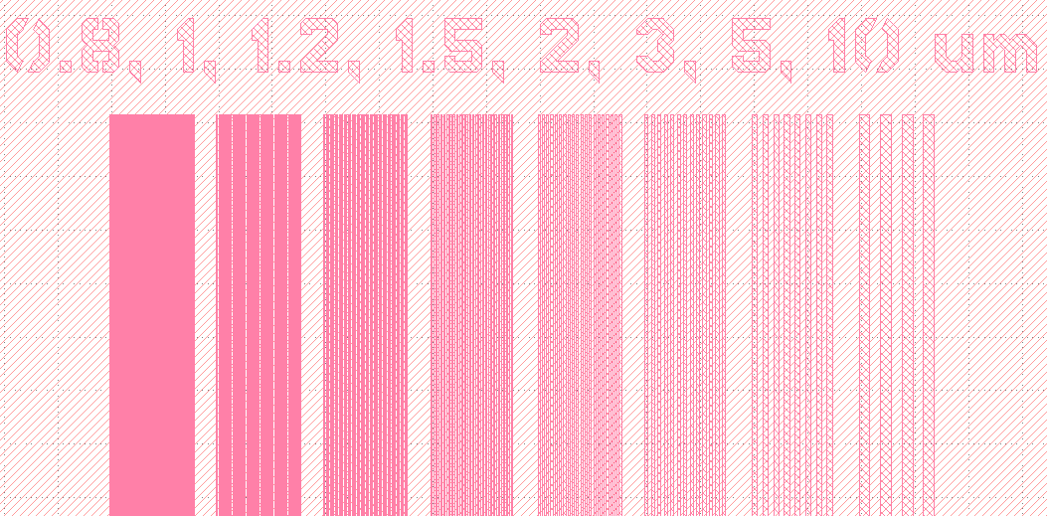
Photomask: MMF Resolution Mask 1
5180um
770um
70um

Slide 9
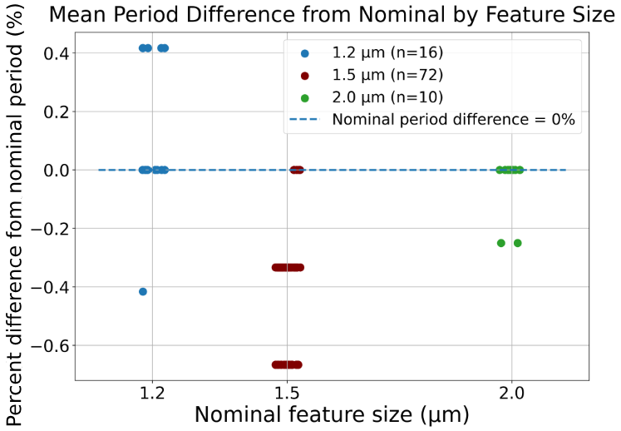
Wire-Grid Periods
Nominal periods come from the mask
Nominal period size is twice the feature size due to a 50% nominal fill factor
Each feature size had a very similar period to the nominal period
  Shows the process is accurate

Slide 10


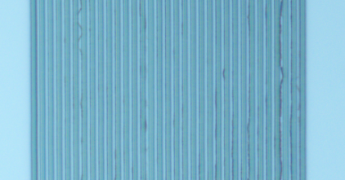

Comparing Wire-Grids
This is an example of a “good” wire-grid region because:
  Evenly spaced wires
  Approximately 50% fill factor
  Minimal contamination
This is an example of a “bad” wire-grid region because:
  Missing/merged lines
  Far from the nominal 50% fill factor
  Visible scum/dirt

Slide 11
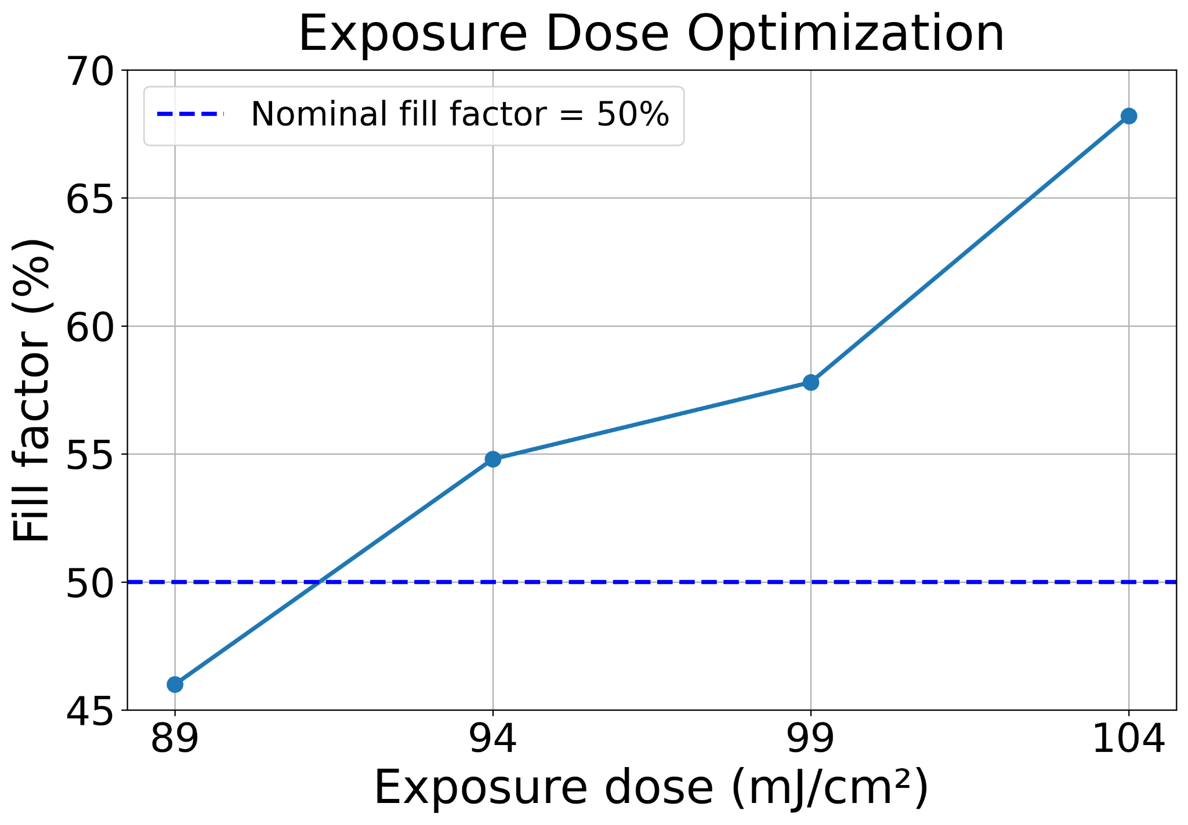
Optimizing Exposure Dose
Fill factor of 1.5um feature sizes
91mJ/cm² of UV exposure dose produced the clearest and most uniform wire-grid patterns

Slide 12
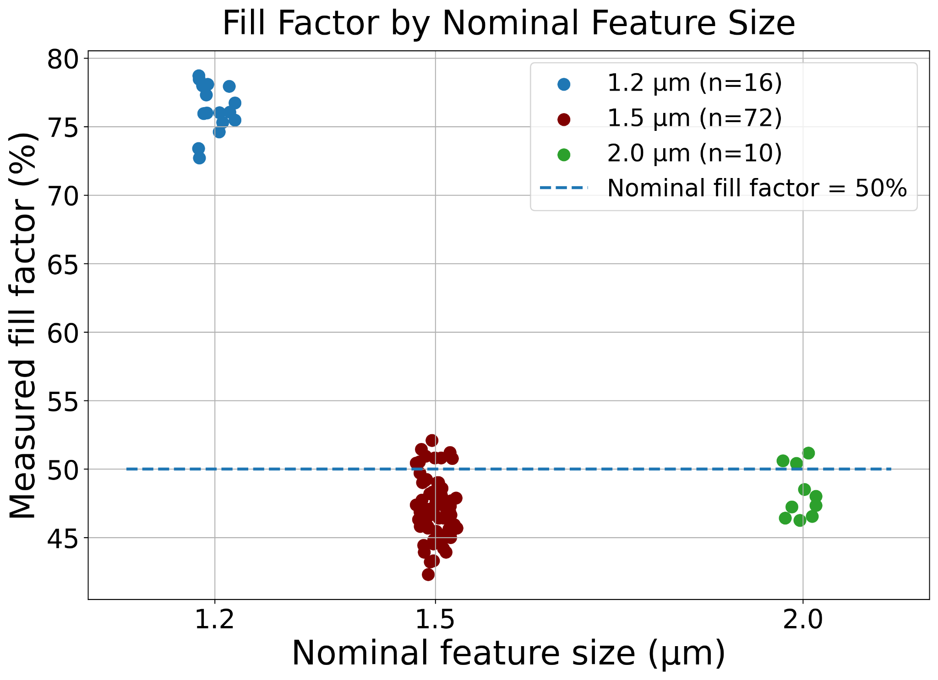
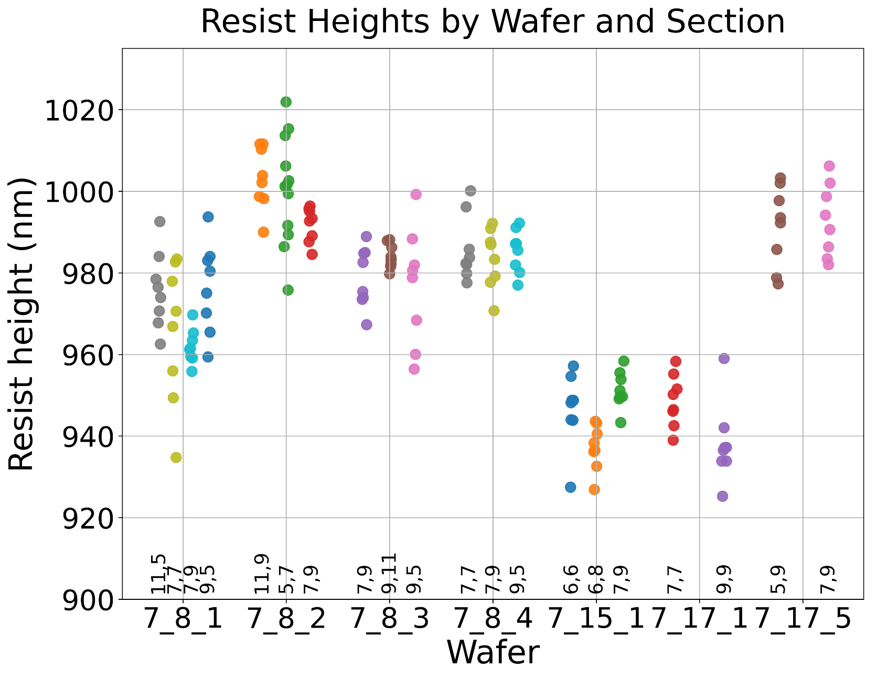
Wire Grid Comparison Results
The 2um and 1.5um grids were close to the nominal 50% fill factor
The 1.2um grids were much farther away, so its wires were wider than they were supposed to be

Slide 13
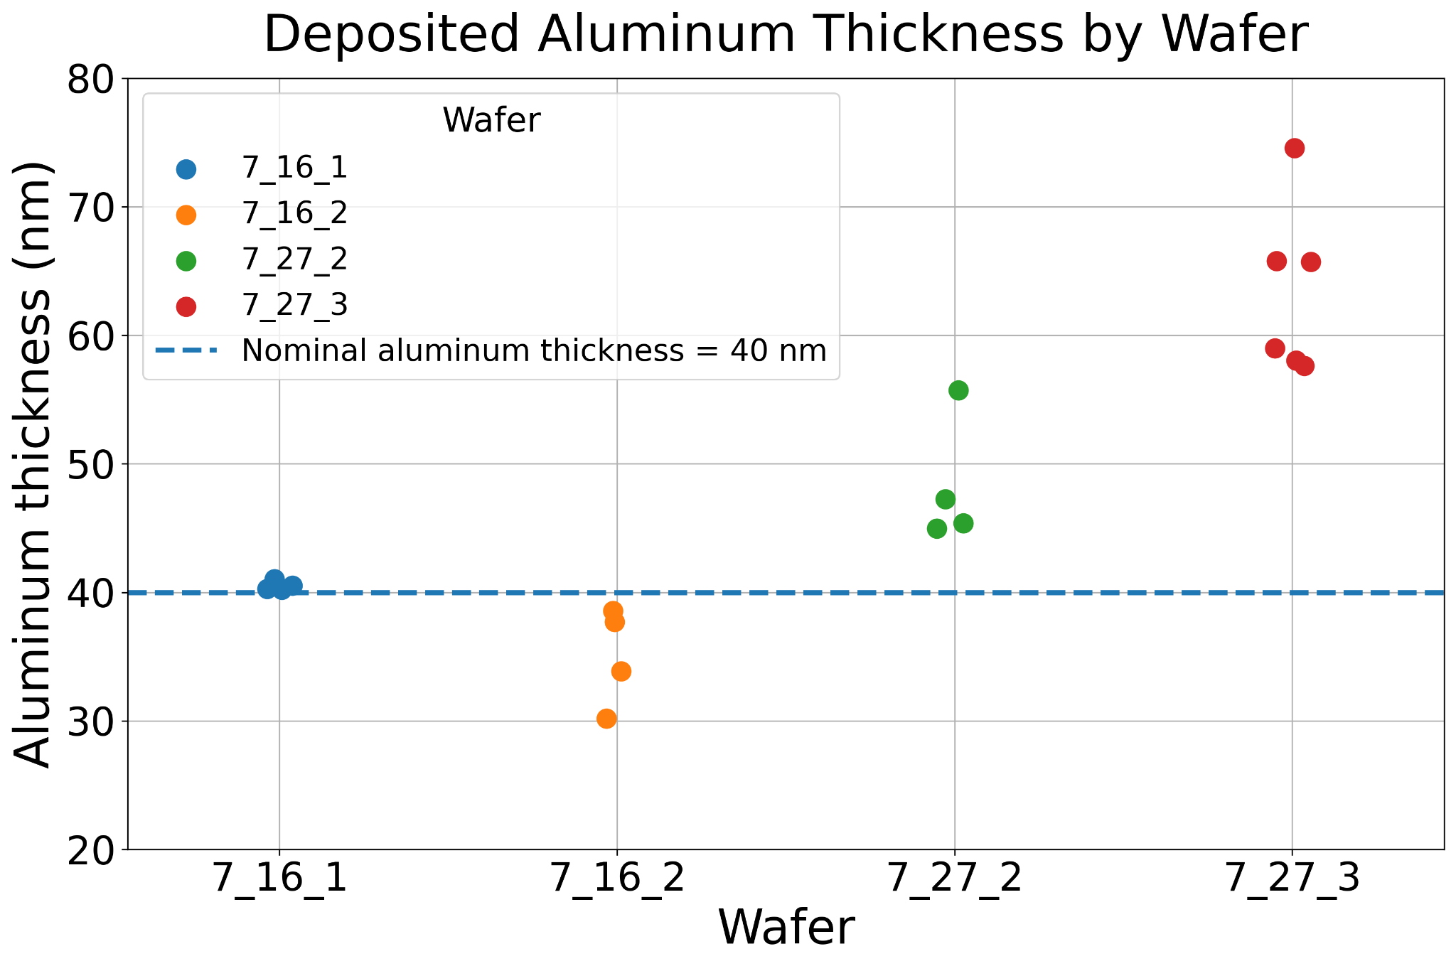
Photoresist and Aluminum Heights

Slide 14


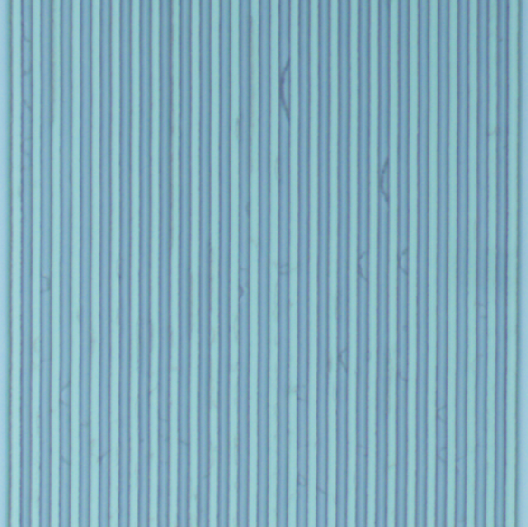


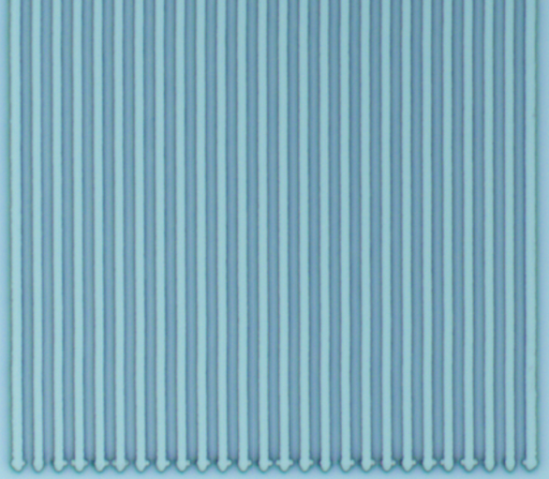
Images of an entire wire-grid after aluminum deposition

Slide 15
Red shows “bad” regions with contamin-ation or pattern failure
<1% of total area is red

Slide 16
Conclusions
The current MSU process can reliably fabricate 1.5um wire grids with approximately 50% fill factor and >98% nominal pattern retention.
This was accomplished using an exposure dose of 91mJ/cm².
Pattern uniformity and reliability decreased as feature size approached the process’ resolution limit.
Future Directions:
Use equipment such as the scanning electron microscope for more precise characterization.
Repeat the optimized process on additional wafers to determine reproducibility and statistical uncertainty.
Further optimize lithography, such as using thinner resist or an electron-beam lithography.

Slide 17
Acknowledgments
This material is based upon work supported by the National Science Foundation under Grant No. 2349091.
Work was performed at the Montana Nanotechnology Facility, a member of the National Nanotechnology Coordinated Infrastructure (NNCI), which is supported by the National Science Foundation (Grant No. ECCS-2025391).
Thank you to the MMF staff for safety and equipment training required for my project and entering the MMF cleanroom.
Notes:
Just say thanks to NSF for sponsoring me and the MMF, as well as all of the help from the MMF staff

Slide 18
References
¹ Omega Optical, “Understanding Polarization & Wire Grid Polarizers,” 2019, <https://omega-optical.com/blog/understanding-wire-grid-polarizers/> (18 June 2026).
² Moxtek, “Wire-Grid Polarizing Beamsplitters,” <https://moxtek.com/optics-product/polarizing-beamsplitter/> (18 June 2026).
³ Z. Y. Yang and Y. F. Lu, “Broadband nanowire-grid polarizers in ultraviolet-visible-near-infrared regions,” Opt. Express 15(15), 9510–9519 (2007), https://doi.org/10.1364/OE.15.009510.
⁴ N. G. Semaltianos, “Thermally evaporated aluminium thin films,” Appl. Surf. Sci. 183(3–4), 223–229 (2001), https://doi.org/10.1016/S0169-4332(01)00565-7.
⁵ Micron Technology, Inc., “Intro to Photolithography,” Micron Educator Hub, reviewed 2026, https://www.micron.com/content/dam/micron/educatorhub/fabrication/photolithography/micron-fabrication-intro-to-photolithography-presentation.pdf (18 June 2026).
⁶ MicroChemicals GmbH, “Hardbake, Reflow and DUV Hardening,” MicroChemicals — Fundamentals of Microstructuring, Basics of Microstructuring, https://www.microchemicals.com/dokumente/application_notes/photoresist_hardbake_reflow_uv_hardening.pdf (18 June 2026).
⁷ AEM Deposition, “Evaporation Deposition Guide: Processes, Types, and Materials,” updated 20 June 2025, https://www.aemdeposition.com/blog/evaporation-deposition-guide.html (18 June 2026).
⁸ ASML, “The Rayleigh criterion,” Lithography Principles, https://www.asml.com/en/technology/lithography-principles/rayleigh-criterion (18 June 2026).
⁹ Cornell NanoScale Science and Technology Facility, “Photolithography,” training and process notes, Cornell University, https://www.cnfusers.cornell.edu/sites/default/files/Area-Resources/CNF%20Photolithography20.pdf (30 July 2026).

Slide 19
References
¹⁰ Kavli Nanoscience Institute, “Quick Start for MMRC DektakXT Stylus Profilometer,” California Institute of Technology, updated 16 December 2016, https://mmrc.caltech.edu/DektakXT/Manuals/DektakXT%20User%20Manual.pdf (30 July 2026).
¹¹ T. Ferreira and W. Rasband, “Analyze Menu,” ImageJ User Guide, IJ 1.46r, National Institutes of Health, https://imagej.net/ij/docs/guide/146-30.html (30 July 2026).
¹² I. Kostic, K. Vutova, E. Koleva, R. Andok, A. Bencurova, A. Konecnikova, and G. Mladenov, “Study on polymers with implementation in electron beam lithography,” in Polymer Science: Research Advances, Practical Applications and Educational Aspects, A. Méndez-Vilas and A. Solano-Martín, Eds., Formatex Research Center, 488–497 (2016).
¹³ Futurrex, Inc., “Safety Data Sheet – Negative Resist NR9-1500PY,” Safety Data Sheet, last updated 25 February 2014, https://nrf.aux.eng.ufl.edu/_files/msds/2/Negative%20resist%20NR9-1500P.pdf (18 June 2026).
¹⁴ Georgia Institute of Technology, “Photolithography,” teaching handout, 24 May 2011, https://www.ipfdd.de/fileadmin/user_upload/nm/stamm/Praktikum/5_Photolithography.pdf (18 June 2026).
¹⁵ Allresist GmbH, “How are photo resists exposed, and how can the optimum exposure dose be determined?,” Resist Wiki, 21 August 2008, https://www.allresist.com/resist-wiki-how-are-photo-resists-exposed-and-how-can-the-optimum-exposure-dose-be-determined/ (18 June 2026).
¹⁶ S.-H. Lim and H.-K. Kim, “Deposition rate effect on optical and electrical properties of thermally evaporated WO3−x/Ag/WO3−x multilayer electrode for transparent and flexible thin film heaters,” Sci. Rep. 10, 8357 (2020), https://doi.org/10.1038/s41598-020-65260-1
¹⁷ Moorfield Nanotechnology, “Thin Film Deposition Using Thermal Evaporation,” application note, https://moorfield.co.uk/applications/thermal-evaporation-thin-film-deposition/ (18 June 2026).

Slide 20
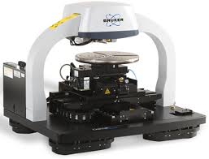
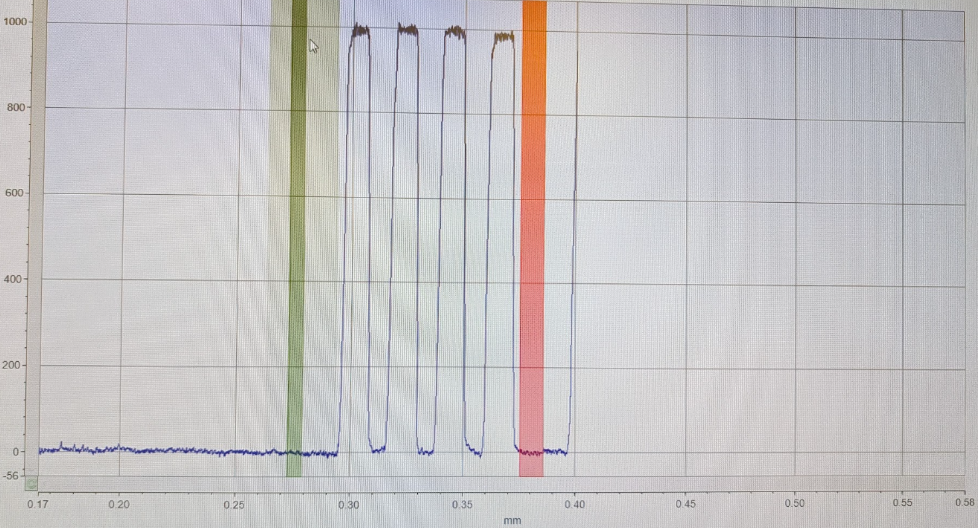
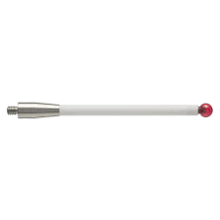
Dektak Stylus Explanation¹⁰
2um

Slide 21
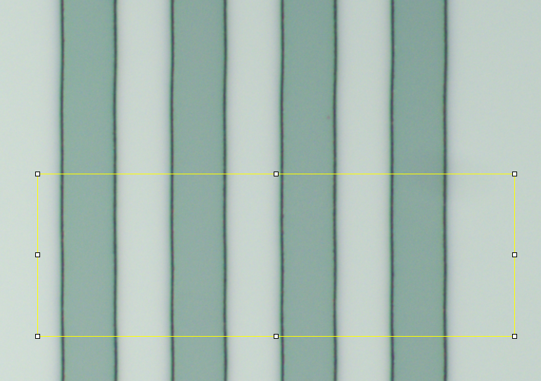
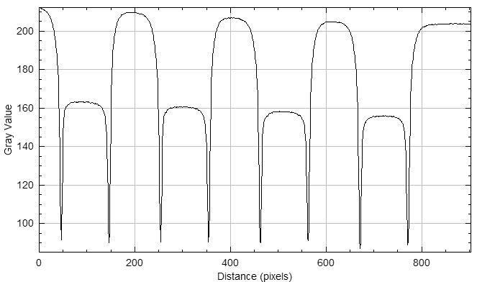
FIJI Imaging Explanation¹¹
10.46pixels/um

Slide 22
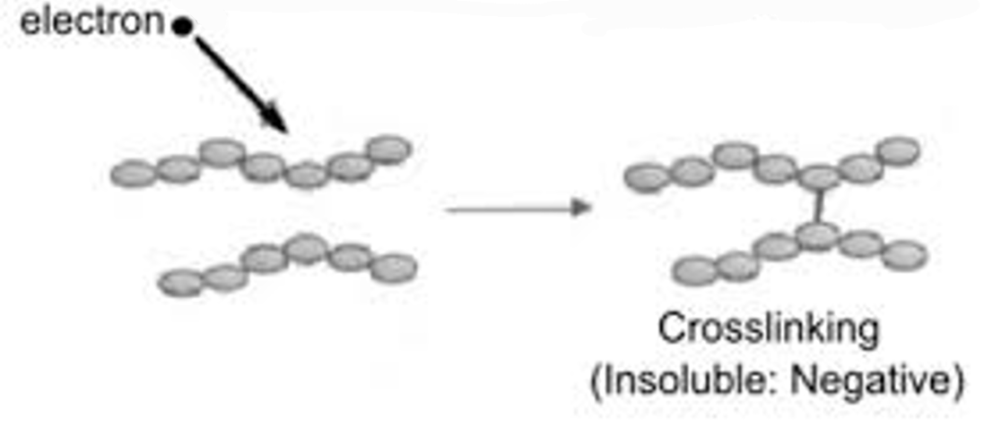
Cross-linking of Negative Resist¹²
photon
During exposure:
resist polymer
An electron causes the crosslinking of two polymers in negative resist

