Slide 1
Spectroscopic Studies of Superfluorescence
Alexander Gaines
Princeton University
North Carolina State University
Kenan Gundogdu, Myrat Kotyrov, Murat Onem

Slide 2
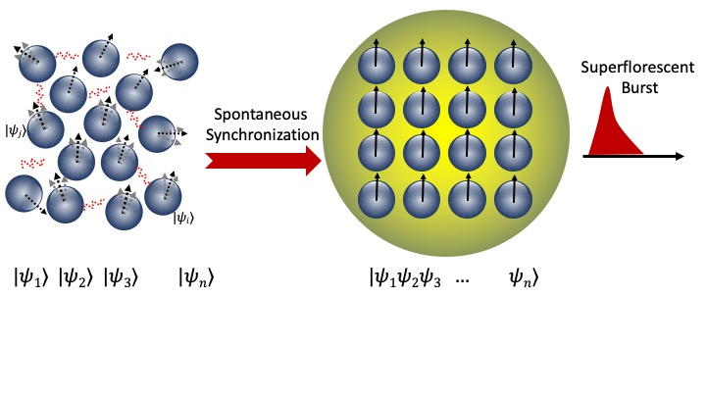
What is Superfluorescence?
SF is a quantum optical phenomenon where a group of excited atoms or particles synchronize and emit a collective intense burst of coherent light
Photoluminescence (PL) is a stochastic process in which a material absorbs light energy and then emits said energy as light
Incoherent light emission
Incoherent dipoles

Slide 3
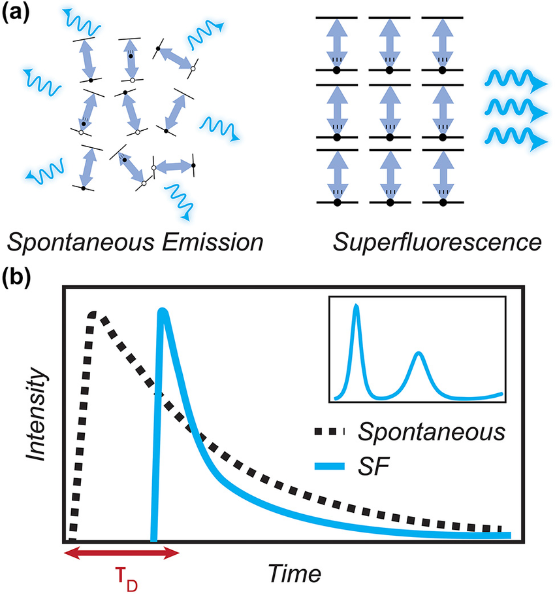
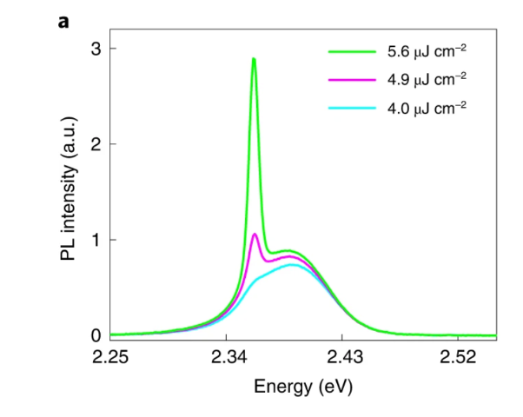
Signatures of Superfluorescence
Superlinear intensity scaling - peak intensity scales faster than linearly with the number of emitters/excitation density (ideally ~N², vs. N for ordinary spontaneous emission)
Shot-to-shot delay fluctuations – decay time varies from shot to shot because SF builds from quantum vacuum/spontaneous-emission noise, giving delay-time statistics that are themselves a signature
https://www.researchgate.net/figure/Characteristic-properties-of-superfluorescent-emission-a-Schematic-of-spontaneous_fig1_380535450
https://www.nature.com/articles/s41586-025-09030-x
Characteristic Time Delay: Unlike regular fluorescence which spikes instantly, this line stays flat initially while the dipoles build coherence, then fires a delayed burst.
Spectral Redshift: A sudden shift in the emission peak to lower energies (longer wavelengths) compared to individual excitons.

Slide 4
Potential SF Applications
Superfluorescence has potential applications in quantum computing and information processing Generating large batches of entangled photons for quantum computing is traditionally difficult. Because superfluorescence forces thousands of dipoles to interact collectively, it acts as a scalable, highly efficient factory for creating multi-particle quantum entanglement and traveling qubits
In optoelectronics, SF allows for the creation and use of cavity free lasers. Standard lasers require precise micro-mirrors (cavities) to bounce light back and forth to make it coherent. Superfluorescence generates perfectly coherent, directional light entirely on its own through quantum noise.
Further, SF has applications in Biomedical imaging, by providing super-brights optical tags. Lanthanide-doped upconversion nanoparticles (UCNPs) utilizing superfluorescence emit light that is thousands of times brighter and faster than normal bioluminescent tags. Because these nanoparticles are smaller than 500 nanometers and do not require heavy laser equipment, they can be injected into tissue as non-destructive, ultra-bright contrast agents for deep-tissue medical imaging

Slide 5
Photon Statistics
To understand the nature of the light emitted via SF, and to more easily differentiate the phenomenon from Amplified Sponaneous Emission, we need to understand the photon statistics of the emitted light
We do this via Homodyne Detection. Homodyne detection gives us a graph of the quadrature probability distribution, which we can convert to photon distribution. In our case we are phase randomized, so we get to know everything about our photon distribution while lacking all phase information
From these reading we also get our second-order coherence function (g²), which also directly tells us nature of the light.
g² < 1 → Photons are antibunched, and avoid arriving together. A perfect single photon source has g² = 0, which is Fock light
g² = 1 → Coherent (poissonian) light, photon arrivals are uncorrelated
g² > 1 → Photons are bunched and prefer to arrive in clusters, think thermal light, which is about g² = 2.

Slide 6
Homodyne Detection + Kerr Gating
standard electronic detectors are too slow to capture events that happen in picoseconds. To solve this, we add an Optical Kerr Gate. This acts as an ultra-fast camera shutter. We use an intense laser pulse to temporarily change the crystal structure of a material effectively opening and closing a window of light in under a single picosecond. By sliding this window across our emission timeline, we can capture snapshot images of the process as it evolves.
LO
Signal
Polarizing Beam Combiner
λ\2
Wollaston Prism
Balanced Photodiode
Kerr Gate setup
Homodyne detection
CCD
To measure the weak emission of Superfluorescence, we use Homodyne Detection. Think of this as a quantum amplifier. Instead of trying to measure a faint, noisy signal directly, we mix it with a very strong, stable reference laser called a Local Oscillator. This amplifies our signal well above any background noise, allowing us to extract not just the intensity of the light, but its exact phase and quantum state.
Gate
Flip Mirror
Signal
Polarizer 1
CS₂
Polarizer 2
PMT
LIA

Slide 7
Verification of Homodyne Detection Setup

Slide 8
Consolidated Temperature Dependence Results
1.6K
VS.
180K

Slide 9
Next Steps
We are now working on improving on our Homodyne detection setup. Our Mean Photon number was not the greatest, so we want to make the system more efficient to resolve finer details. So we have begun the process of adding pinholes to really focus light and make sure we do not lose an unnecessarily large amount of information
We are also continuing to understand the temperature dependence of Superfluorescence’s g² specifically why there is a superthermal photon statistics (g² > 2) at low temperatures and then a crossover into a Bose-Einstein Distribution at higher temperatures

Slide 10
Thank You!
Thank you so much to Myrat Kotyrov, Murat Onem, Kenan Gundogdu, and all the other members of the Gundogdu Lab. I would also like to thank NC state for hosting me, and the Research Triangle Nanotechnology Network for the opportunity
If you have any questions, please email me at ag0207@princeton.edu
This material is based upon work which is supported by the National Science Foundation (award numbers 2447827, 2447828, 2447829 and ECCS-2025064). Any opinions, findings, and conclusions or recommendations expressed in this material are those of the author(s) and do not necessarily reflect the views of the National Science Foundation.

