Slide 1





Electrical Discharge Machining of Ultra High Temperature Ceramics
Tara Martindale, University of Maryland – College Park
Mentor: Luke Wadle, University of Nebraska – Lincoln
PI: Dr. Bai Cui, University of Nebraska – Lincoln
Acknowledgements: NSF Award #1950137
Notes:
Hi, thank you for coming, I'm Tara Martindale, an aerospace engineering student from UMD. I participated in the REU program at UNL and studied electrical discharge machining of ultra-high temperature ceramics.

Slide 2
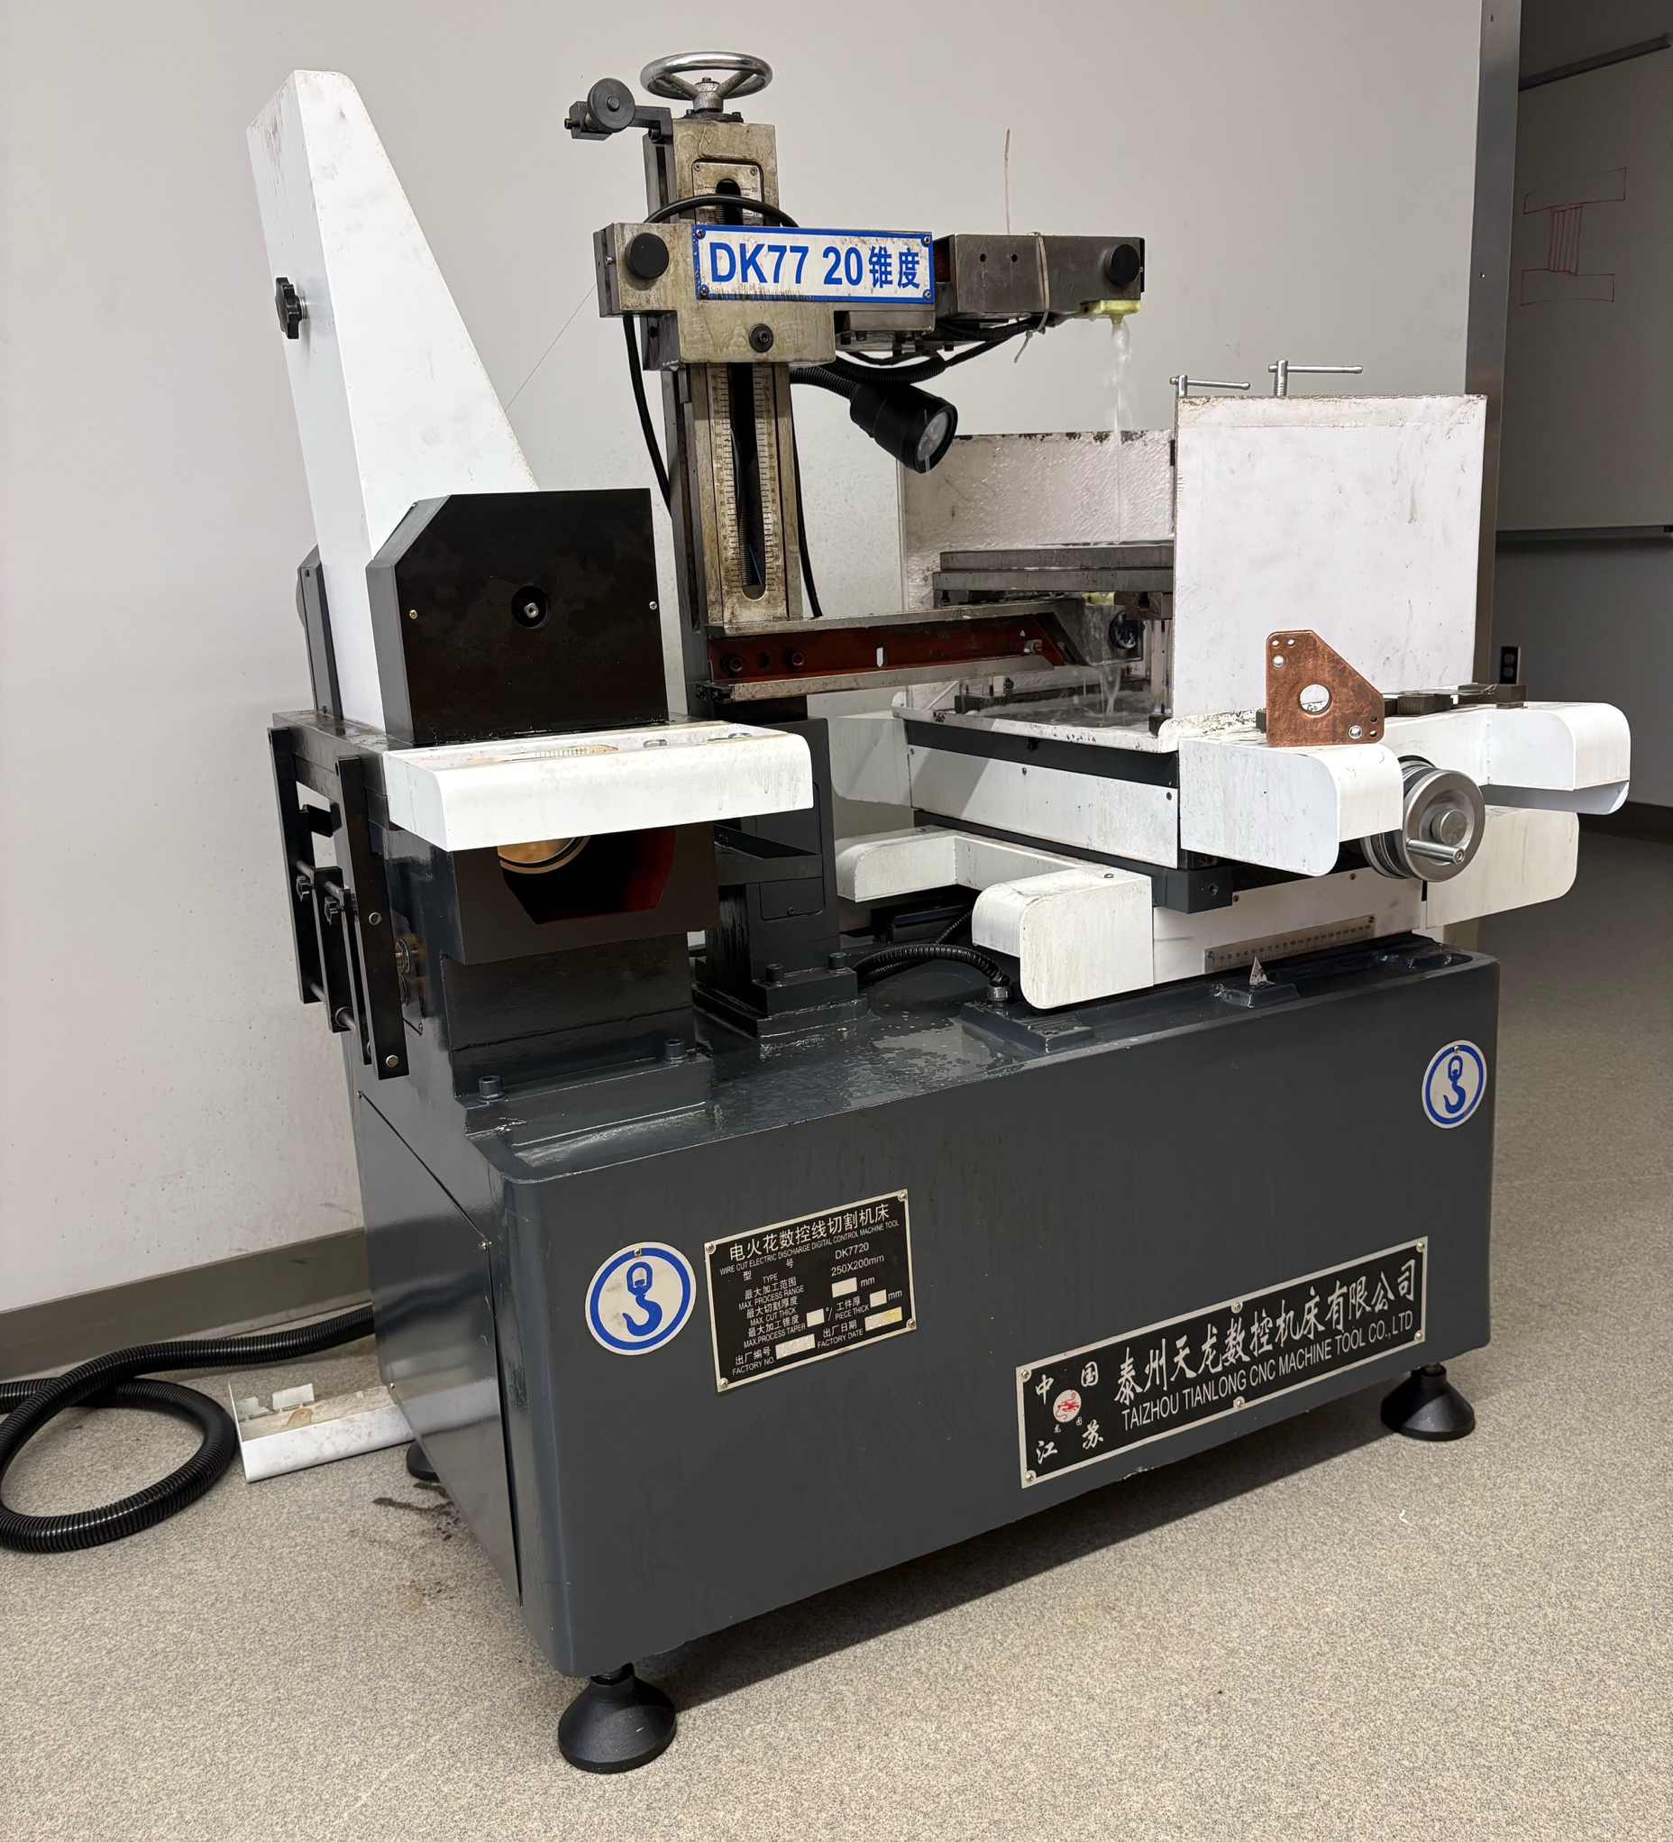
Overview
Background information on UHTCs and WEDM
Material properties before cutting
Tool path and Efficiency
Chemical and physical characterization
Conclusion / Future work
Image of WEDM.
Notes:
In this presentation, I will give you background information on UHTCs and WEDM, how we utilized the machining technique, and how the machine effected the materials we cut, chemically and physically.

Slide 3
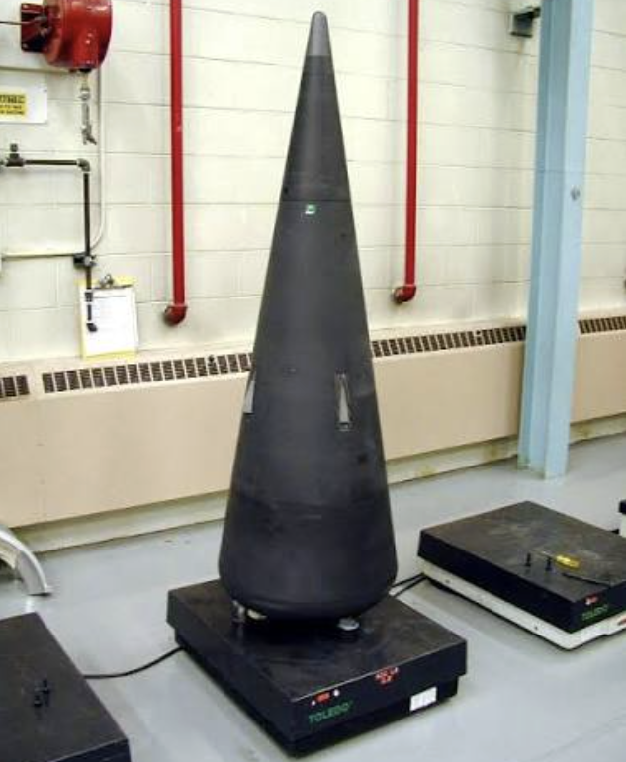
Ultra-High Temperature Ceramics (UHTCs)
UHTCs: a class of refractory ceramics, primarily transition-metal diborides, carbides, and nitrides, that exhibit melting temperatures above 3000°C [1].
Zirconium carbide (ZrC) is among the most promising UHTCs for next-generation aerospace and nuclear-energy applications [4,6].
  Key properties:
    Exceptionally high melting temperature
    Excellent thermal stability
    Outstanding resistance to harsh environments
ZrC can be combined with silicon carbide (SiC) to
form composites (ZrC-30vol%SiC) that offer improved
oxidation resistance while retaining the excellent high-
temperature properties of ZrC [7].
  Applications for ZrC-30vol%SiC [5,6]:
    Engine components
    Filament winding
    Fuel cladding
SHARP-B2 flight experiment Sept. 28, 2000 [11].
Notes:
Ultra-high temperature ceramics, or UHTCs, are transition-metal diborides, carbides, and nitrides that have melting points above 3k Celsius. We are interested in zirconium carbide due to its high melting temp, thermal stability, and resistance to harsh environments. However, pure ZrC oxidizes quickly. Therefore, combining it with silicon carbide to make the composite, ZrC-SiC, is more favorable as it has improved oxidation resistance while maintaining its high melting temperature.
SHARP = Slender Hypervelocity Aerothermodynamic Research Probes

Slide 4
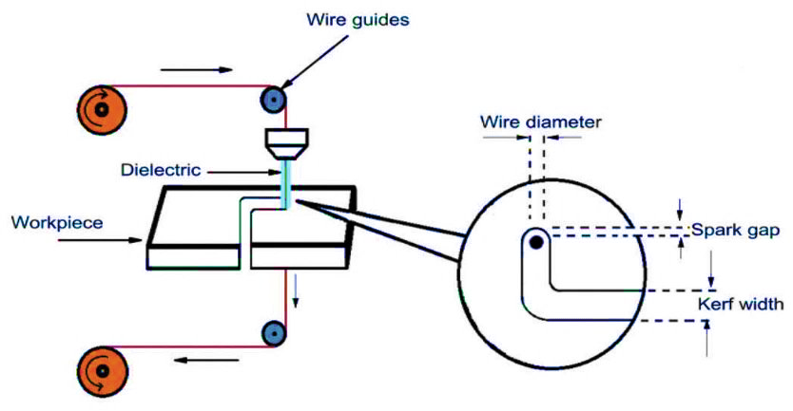
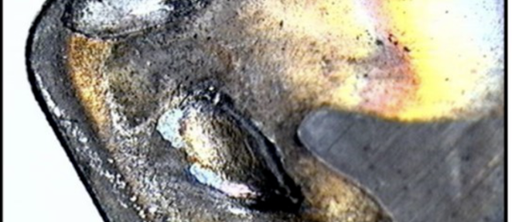
Wire Electrical Discharge Machining (WEDM)
UHTCs are difficult to machine using conventional methods due to extreme hardness and brittleness.
WEDM involves a conductive wire that creates an electric spark to cut various shapes with extreme precision rather than traditional mechanical means.
Tool wear from milling tungsten carbide (WC) [10]. Proves UHTCs are difficult to machine using traditional machining techniques.
Schematic diagram of WEDM [8].
Objective: to characterize the effects of WEDM on the chemical and physical properties of ZrC, SiC, and ZrC–SiC composites fabricated by spark plasma sintering (SPS).
Fig. 1 Schematic diagram of WEDM [8]
Fig. 1 Schematic diagram of WEDM [8]
Fig. 1 Schematic diagram of WEDM [8]
Fig. 1 Schematic diagram of WEDM [8]
Fig. 1 Schematic diagram of WEDM [8]
Notes:
Since UHTCs are extremely hard and brittle, it makes them difficult to machine using conventional methods. As seen in the left picture, it is common to experience tool wear when milling UHTCs. Even though wire electrical discharge machining, or WEDM, is a thermal machining process that has difficulty with heat affected zones; however, since the machine never comes in contact with the material, it poses a solution to having tool wear. For this machine, a conductive wire comes in close to contact with an electrically conductive material which creates an electric spark that melts and/or chips away at the material. As the machine is running, there is dielectric fluid which is non-conductive water that flows down the wire and pass the material to clear out any debris cause from the spark. This allows the wire to move through the material efficiently. For this project, our objective was to ...
Point to which image you are talking about

Slide 5
Spark Plasma Sintering (SPS) Parameters and Statistical Data Before WEDM
SPS Parameters:
Material | Powder Amount (g) | Temperature (°C) | Pressure (MPa) | Holding Time (min.)
ZrC | 13.955 | 1900 | 50 | 10
SiC | 6.532 | 1900 | 50 | Trial 1: 10 Trial 2: 5
ZrC-30vol%SiC | 11.728 | 2000 | 50 | 10
Material Properties:
Material | Relative Density (%) | Volume (cm³) | Sample Thickness (mm)
ZrC | 85.8 (±0.1) | 2.244 | 7.203
SiC | 79.8 (±0.6) | 2.552 | 8.167
ZrC-SiC | 91.1 (±2.9) | 2.154 | 6.913
Notes:
We followed these parameters when spark plasma sintering the commercial powders. The composite densified the easiest as shown by the 91% relative density; whereas ZrC and SiC had low relative densities, 85.8% and 79.8% respectively.

Slide 6
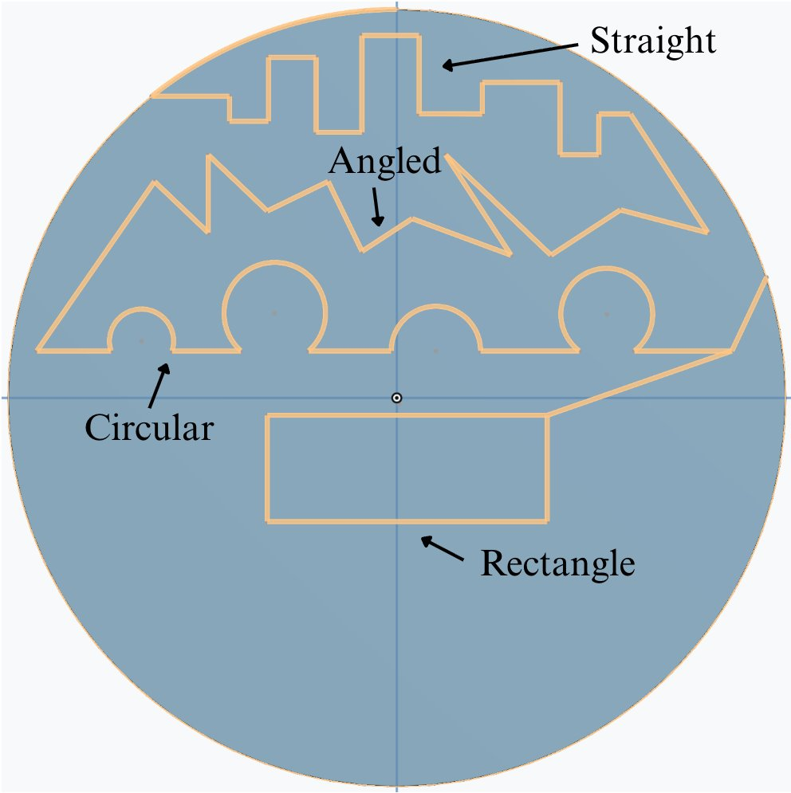
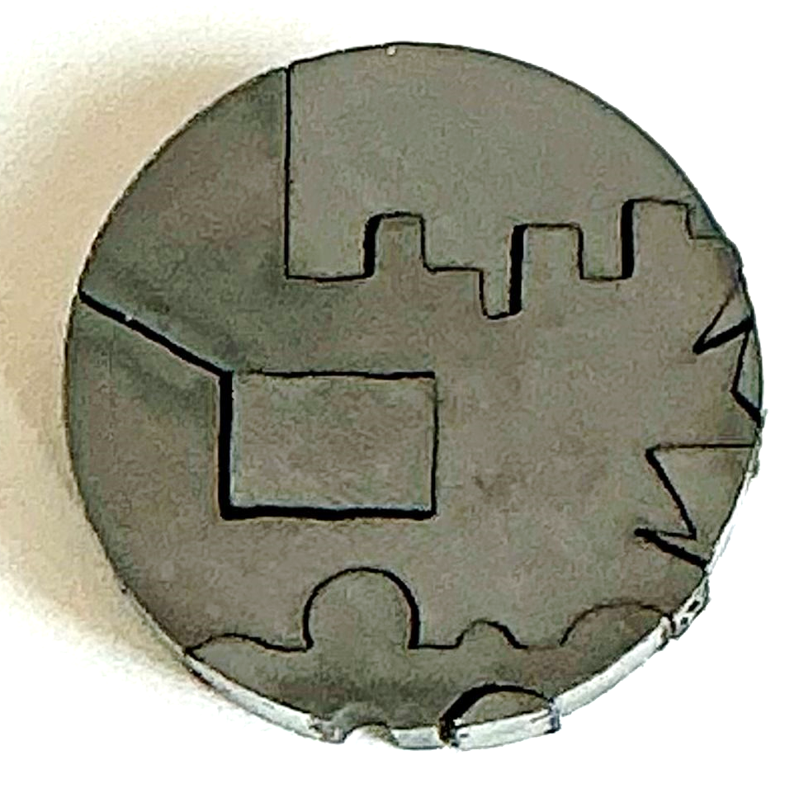
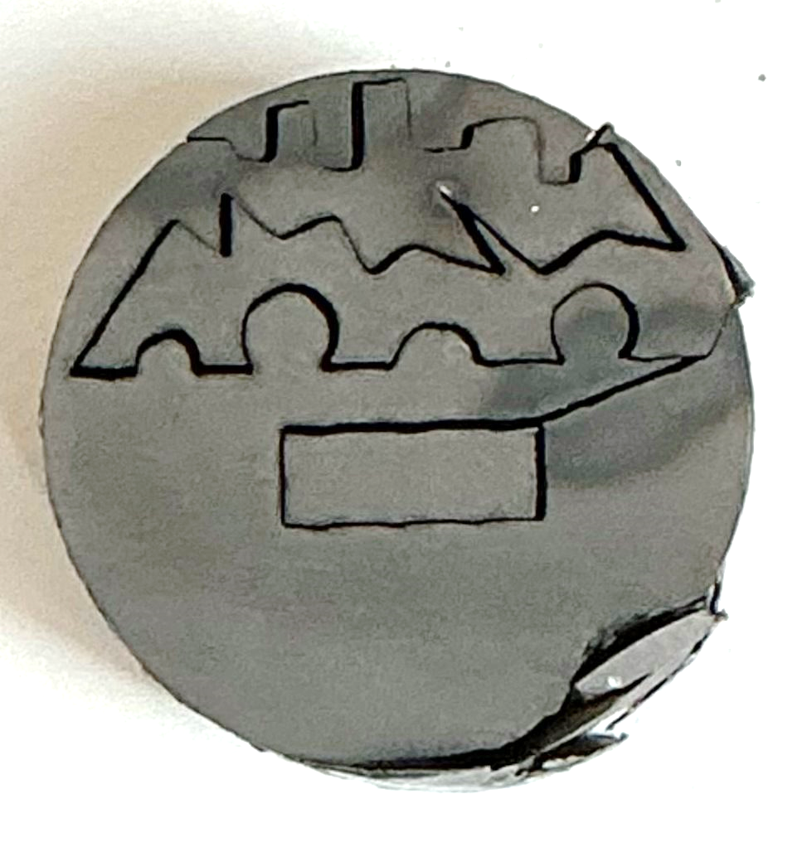
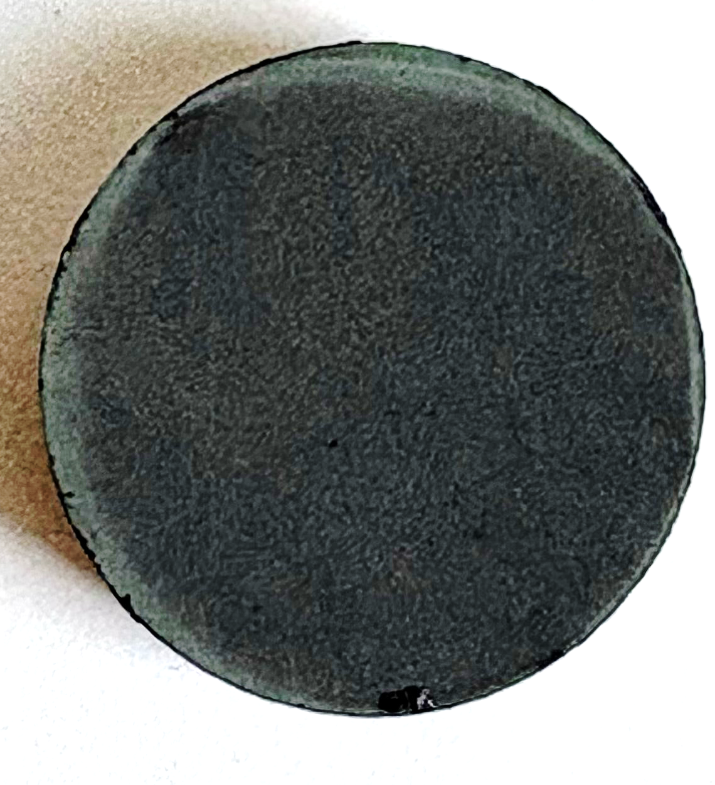
Tool Path
Polished samples with SiC sheets up to 1200 grit.
(A)
(B)
(C)
(D)
(A) Tool path with labeled cut types for (B) ZrC-SiC, (C) ZrC, and (D)SiC. Note that the SiC specimen was not machined because of its nonconductive nature.
The tool path was made using OnShape for a disk size of 20 mm for diameter and 6 mm for height.
Notes:
Right after SPS, we polished each sample with 1200 grit SiC sheets; this helps smooth out the surface so we can get the most accurate results. We labeled the top cut "straight" to test how the machine would handle several short, straight lines mixed with 90-degree angles. Then, "angled" to test for sharp corners, "circular" for arcs cuts, and "rectangle" for surface analysis. The tool path for ZrC-SiC is different than ZrC since the first path (ZrC-SiC) did not work due to difficulty finding correct start and end points on the sample.

Slide 7
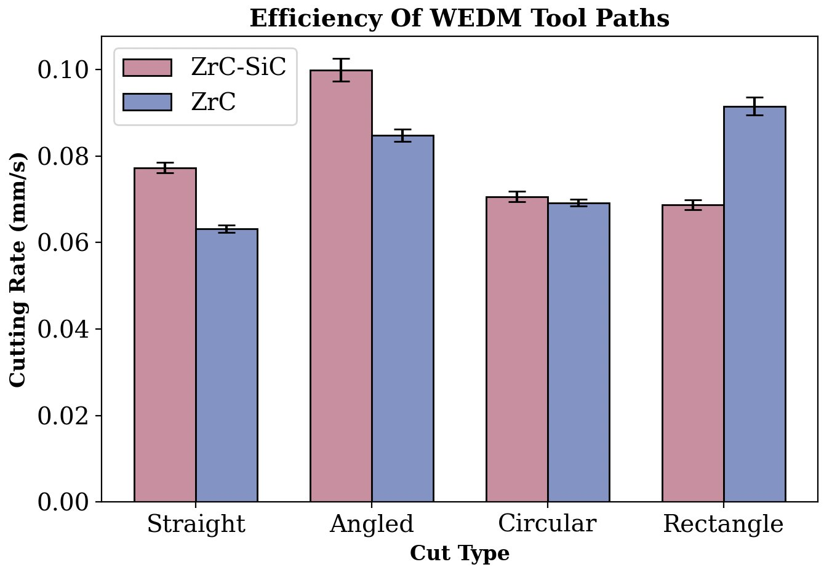
Efficiency
Both ZrC and ZrC–SiC can be readily machined by WEDM. SiC cannot be machined by WEDM.
  Electrical conductivity:
    ZrC: 2.3 x 10⁴ S·cm⁻¹
    SiC: 3 x 10² S·cm⁻¹
    ZrC-SiC: 0.89 x 10³ S·cm⁻¹
WEDM cuts long, straight lines faster than lines with angles and/or curves for ZrC since it is extremely conductive and ZrC-SiC has more electrical resistance. However, WEDM cuts angles and curves quicker for ZrC-SiC due to ZrC being more prone to chipping so the machine must slow down more when changing directions. The addition of SiC allows for more stable electrical discharges throughout the material.
Speed of each cut type (Fig. 2A) for both materials.
Notes:
This data was collected during the machining process. Both ZrC and ZrC-SiC were easily machined by WEDM. Due to SiC being non-conductive, there would be no spark with the machine which means that no material would get melted or chipped away. For all the cuts except the rectangle cut, ZrC-SiC was able to cut at a faster rate than ZrC, predominantly for the angled cut. This is because SiC allowed for more stable electrical discharge throughout the material (sparks pass through evenly) and because pure ZrC is more prone to chipping so the machine must slow down more when making tight corners. If the machine doesn't slow down enough, the machine arcs which could also slow down the cutting rate. However, ZrC was able to be cut faster for the rectangle cut than the composite since ZrC is more conductive and the machine did not have to slow down for turns.

Slide 8
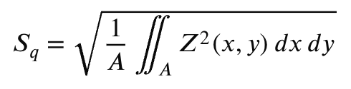
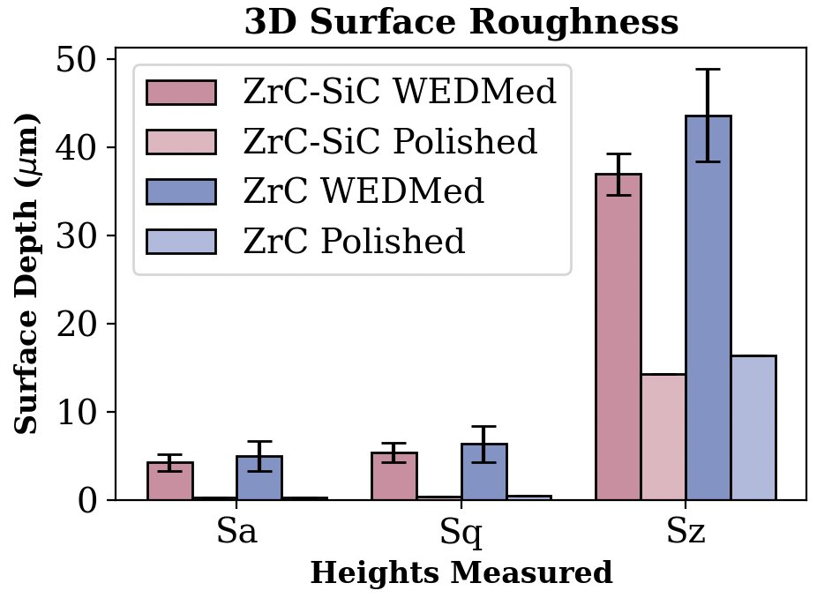
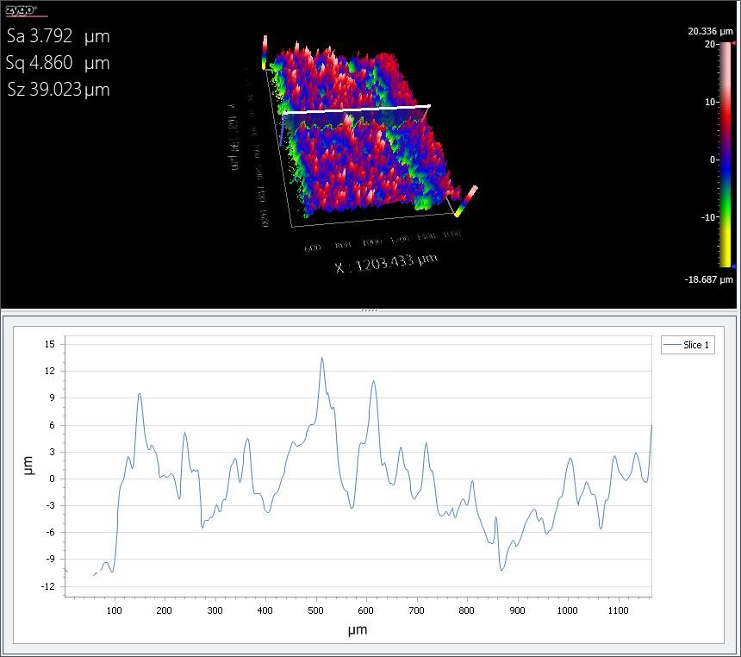
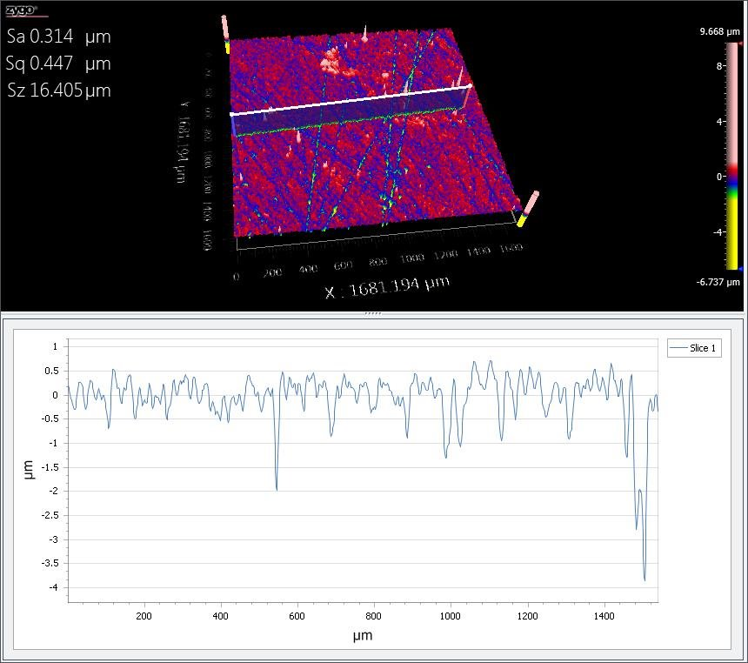
Surface Roughness
The WEDM-machined surfaces of both materials were significantly rougher and had more impurities than their polished surfaces.
The root mean squared height (Sq) value is greater than the average height (Sa) value, indicating greater variation in surface height and the presence of pronounced peaks and valleys. This is also supported with the maximum height of the surface values (Sz).
A: Defined evaluation area
Z(x,y): Height deviation of the surface from the mean plane at coordinates and y
(A)
(B)
(A) WEDM-machined surface of ZrC and (B) polished surface of ZrC.
Surface roughness results obtained from 3-D surface topography analysis.
Fig. 4 Surface roughness results obtained from 3-D surface topography analysis.
Notes:
We utilized the Zygo surface roughness machine to test for coarseness on each rectangle cut out. We repolished one side of the rectangle and left the other side alone to see roughness from WEDM. We expect the polished surface to be smoother than the WEDMed surface. The WEDM-machined surface for both materials were significantly rougher and had more impurities than their polished surface. The root mean squared value squares each height deviation first which means that tall peaks and deep valleys have a much bigger impact on the RMS value than on the average, which is the Sa value. Also, supported by the Sz value, which is the max height on the surface, we can conclude that ZrC had a rougher surface than ZrC-SiC, even after polishing. This makes sense as SiC acts as a grain filling sintering aid which helps smooth out the overall surface.

Slide 9
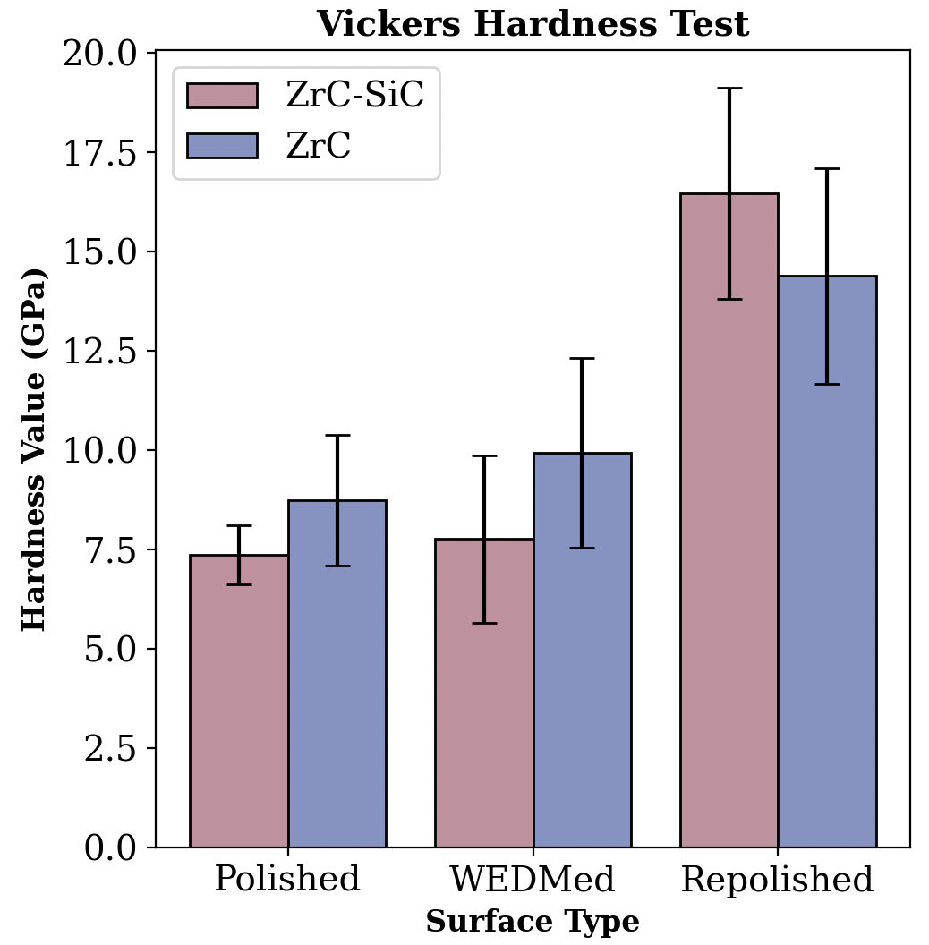
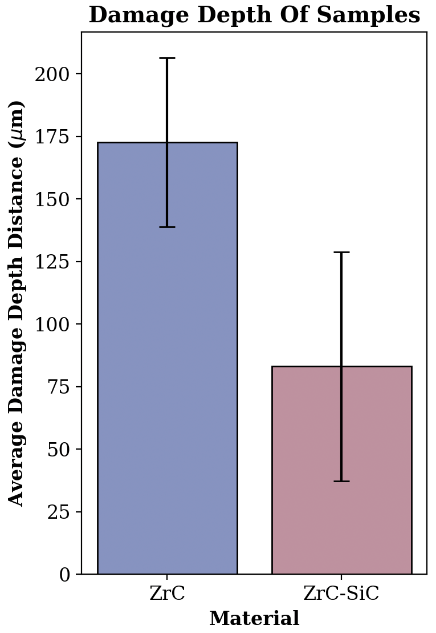
Damage Depth and Vickers Hardness Testing
There is more damage depth for ZrC than ZrC-SiC since SiC helps improve oxidation resistance.
  The damaged layer caused by WEDM is readily removable due to a lower hardness when compared with the bulk material.
The ZrC-SiC sample is weaker than the ZrC sample on the surface after WEDM but stronger without the recast layer.
Both samples increase in hardness when repolished after WEDM. This is due to the heat affected zone (HAZ).
Vickers hardness and damage depth are inversely proportional; when the samples are polished, their hardness increases, but damage depth decreases.
Vickers hardness test (1kg. test force) and damage depth of each sample's WEDMed side. "Polished" is before WEDM and "repolished" is after WEDM.
Notes:
Additionally, we preformed damage depth and vickers hardness testing to further analyze the physical characteristics after WEDM. We saw that the damage depth for ZrC-SiC was greater than that of ZrC. The damaged layer cause by WEDM was still readily removable due to a lower hardness when compared with the bulk material. We also saw that ZrC-SiC had a weaker WEDMed surface than ZrC, but stronger repolished surface. This is due to thermal expansion mismatch between ZrC and SiC on the recast layer, however without that layer, the intrinsic fine-grained surface due to the addition of SiC caused the bulk composition to be stronger. We can conclude that Vickers hardness and damage depth are inversely proportional.

Slide 10
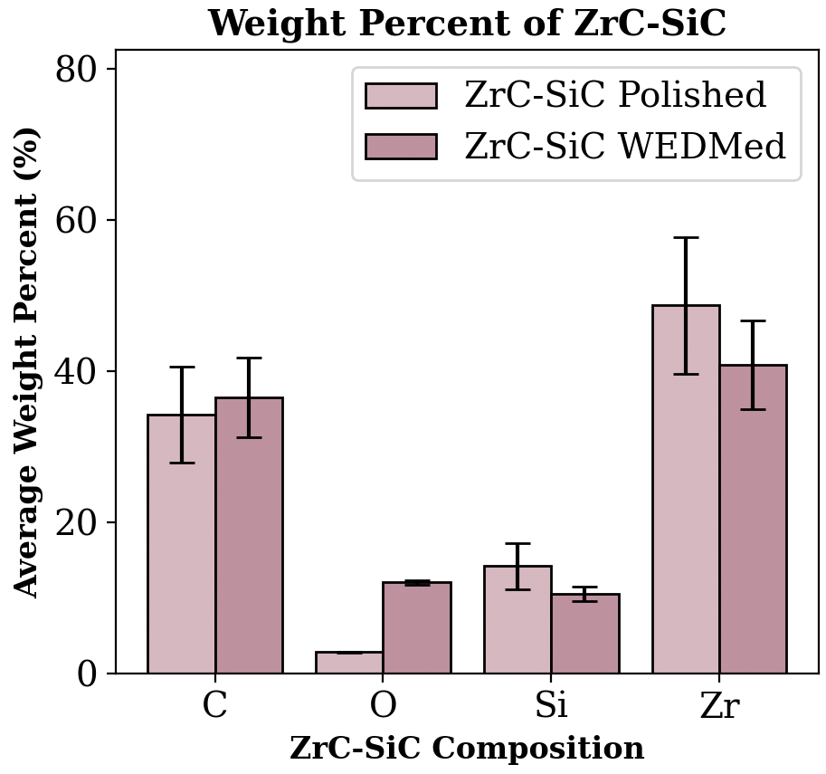
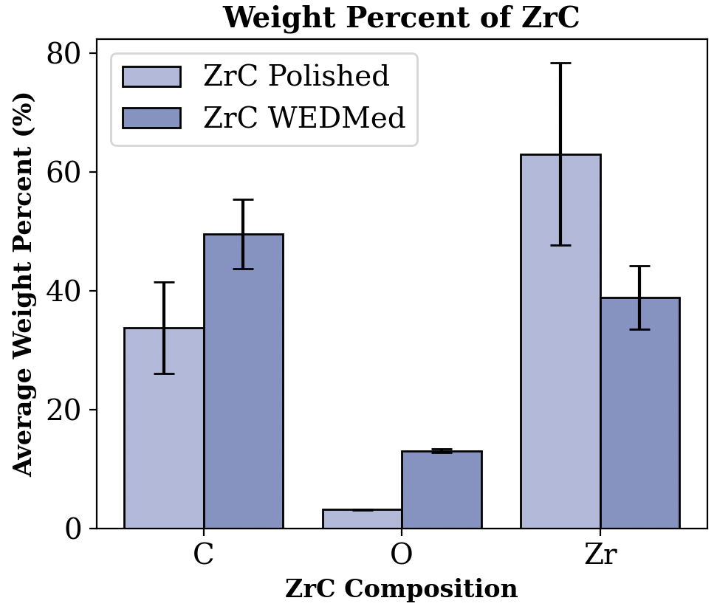
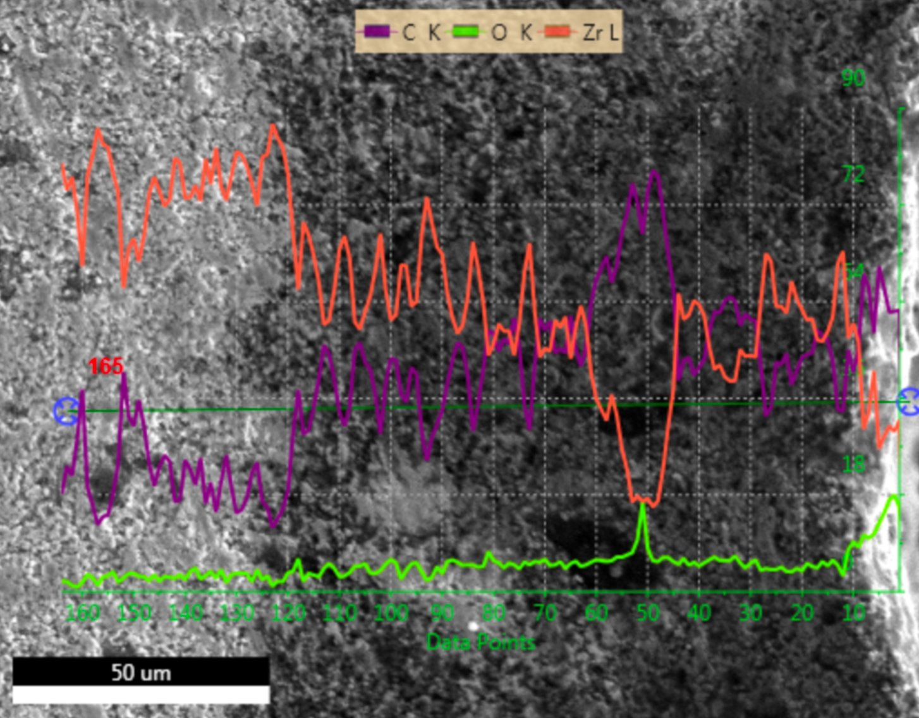
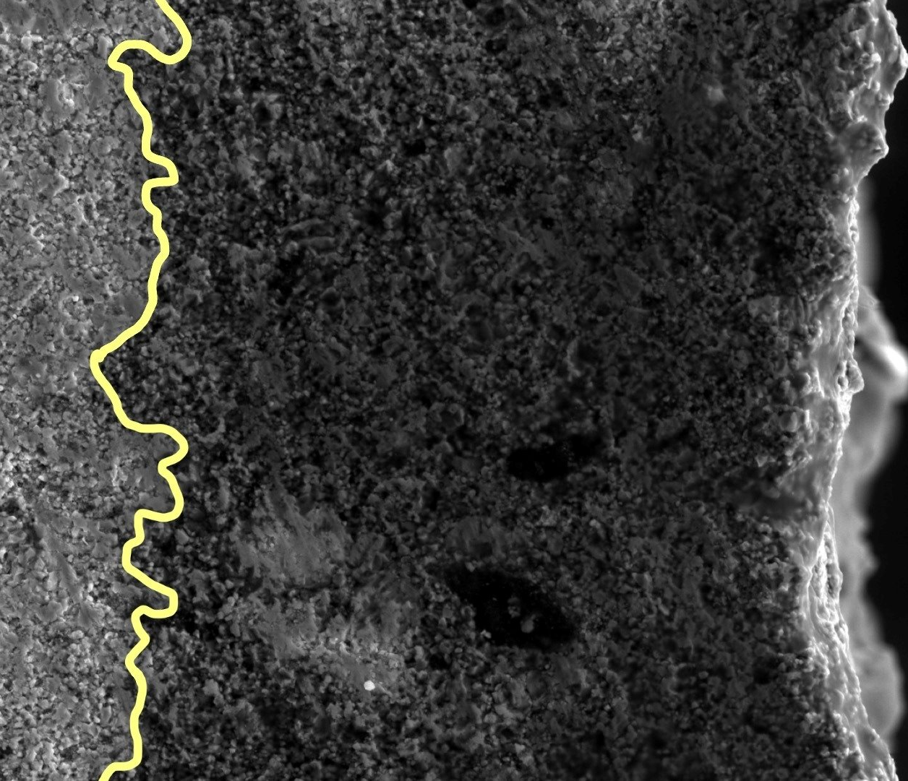
WEDM Damage
WEDM changes the measured surface composition for both ZrC-SiC and ZrC.
WEDM resulted in less silicon and zirconium in ZrC-SiC, and less zirconium in ZrC.
WEDM resulted in a greater amount of carbon and oxygen in ZrC-SiC and ZrC.
  This machining method left behind highly contaminated recast layer.
Heat Affected Zone (HAZ)
(A)
(B)
Weight percent of each element in both samples.
(A) Chemical composition of WEDMed ZrC and (B) emphasized heat-affected zone (HAZ) of WEDMed ZrC.
Notes:
We also completed a chemical analysis of each sample to confirm the chemical composition was correct. From this test, we can see that WEDM changed the measured surface composition for both ZrC-SiC and ZrC. There was less Si and Zr in ZrC-SiC, and less Zr in ZrC. This could be from oxidation from the dielectric fluid or air. To support this further, we can see that there was more carbon and oxygen in both samples which means that this machining method also left behind a highly contaminated recast layer.

Slide 11
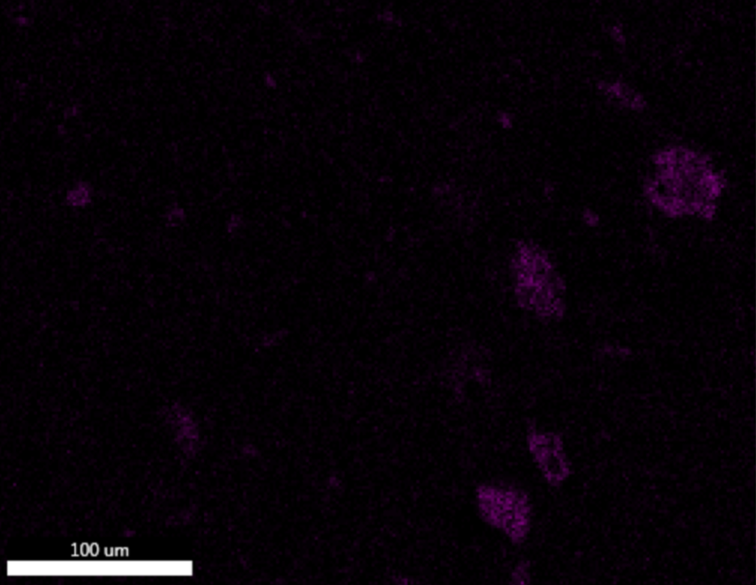
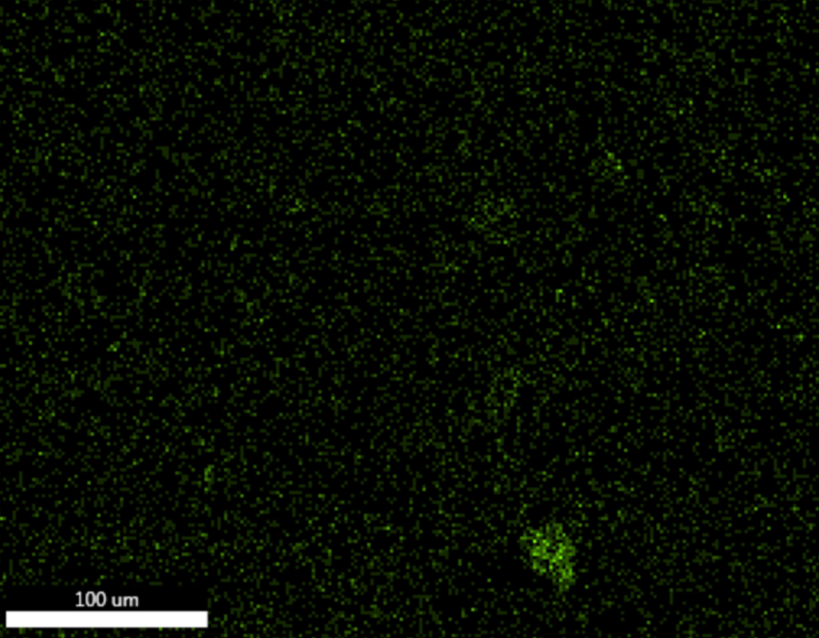
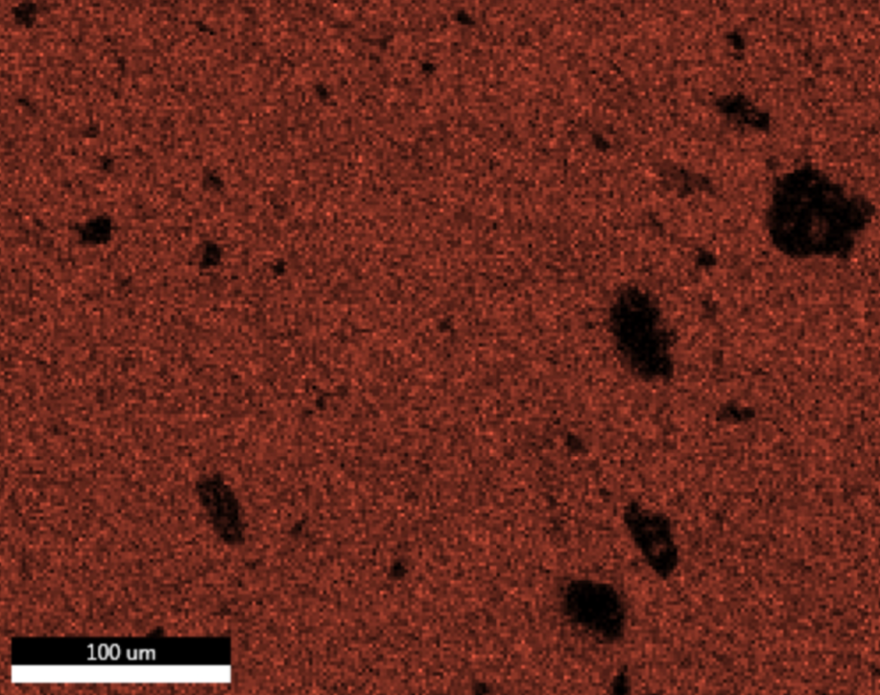
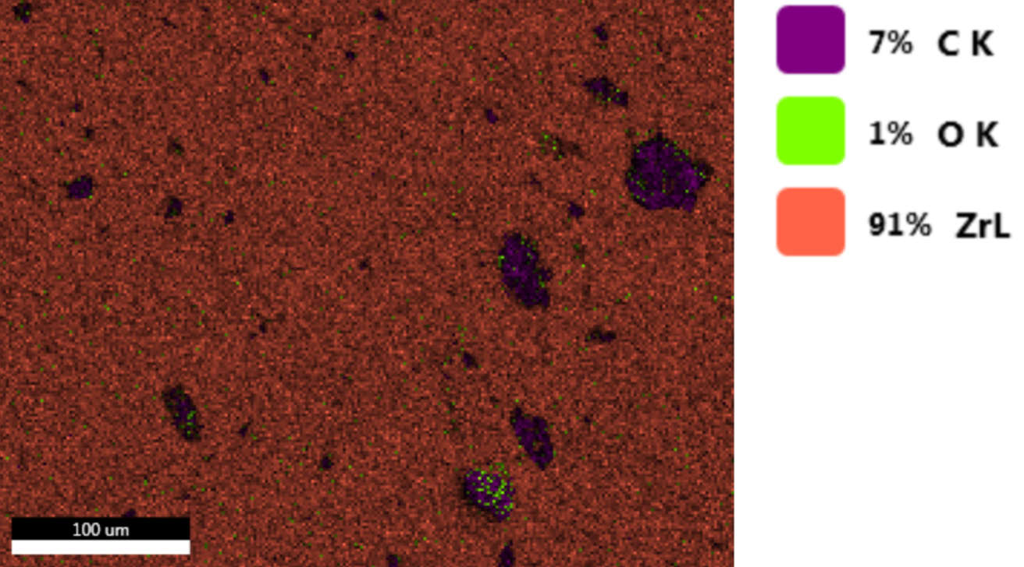
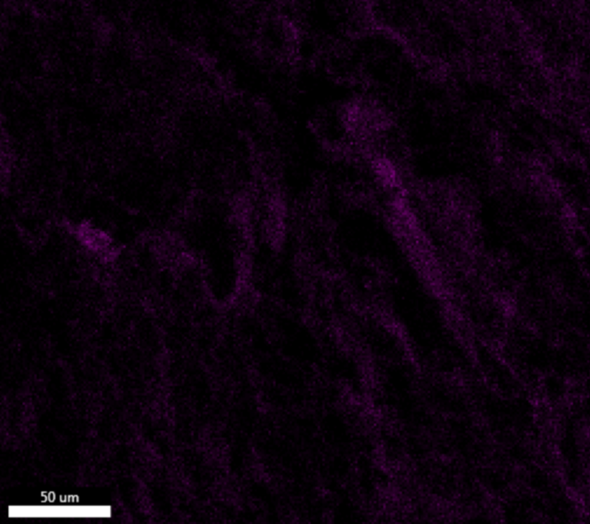
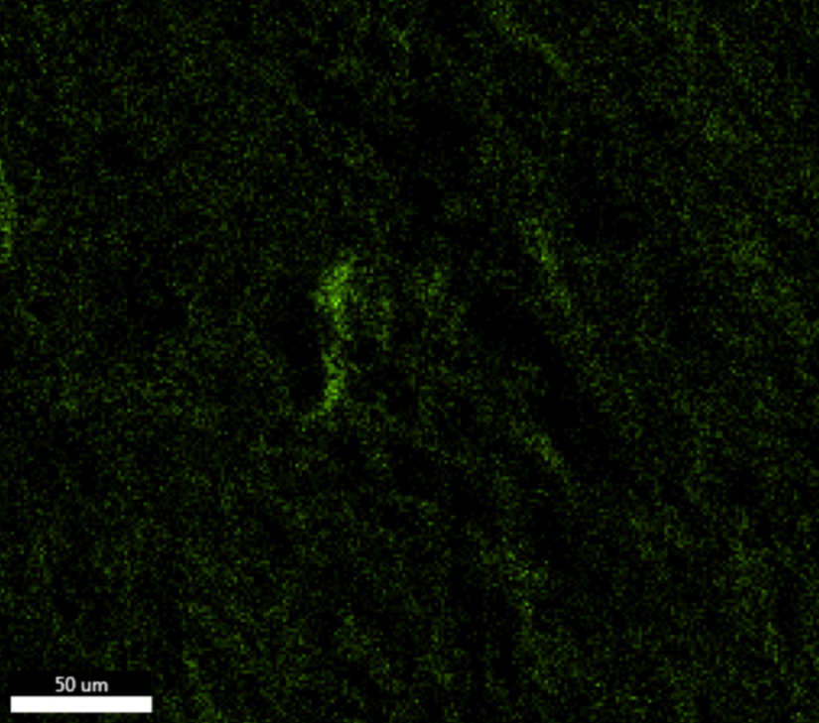
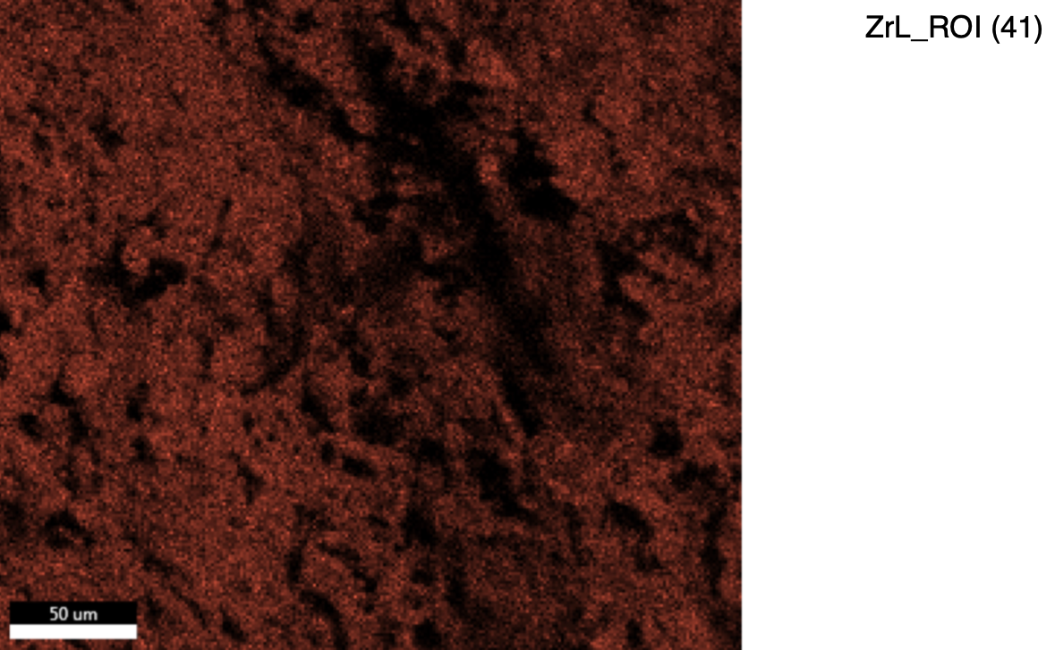
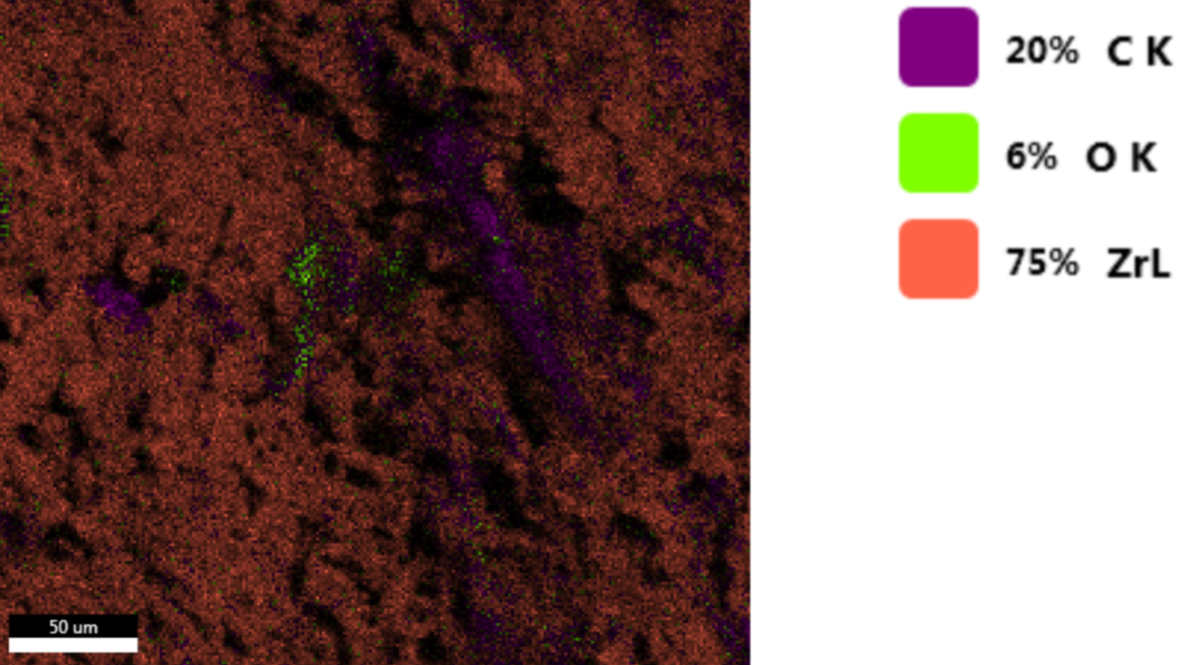
Oxygen Element Mapping (EDS – Electron Dispersive Spectroscopy)
ZrC Polished
Carbon
Oxygen
Zirconium
ZrC WEDMed
Carbon
Oxygen
Zirconium
Notes:
ZrC polished: CO
ZrC WEDMed: CO
We used EDS to analyze the oxygen amount in each sample. There are more Zr signals since more electrons get bounced off from that material when shot at with an electron, compared to carbon (only has 2 shells compare to 5).

Slide 12
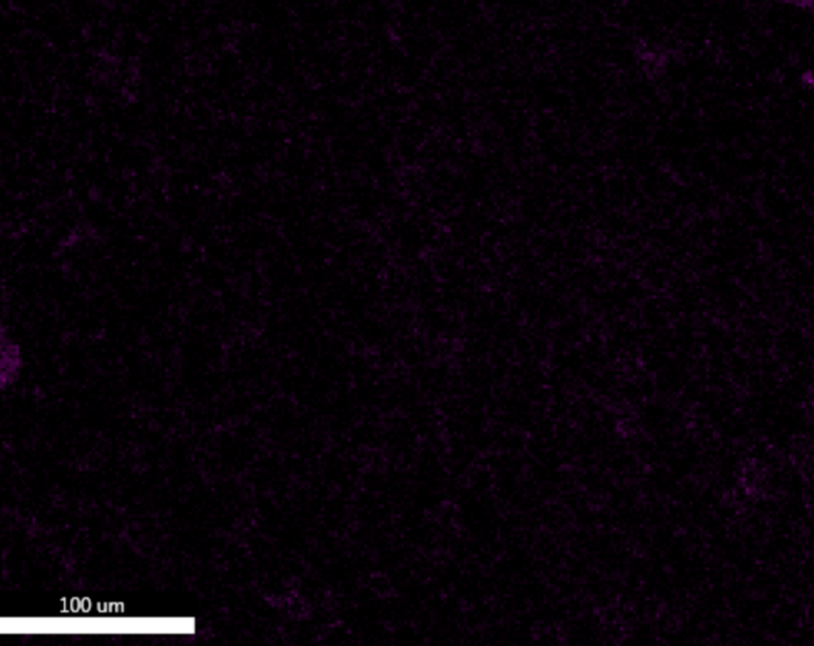
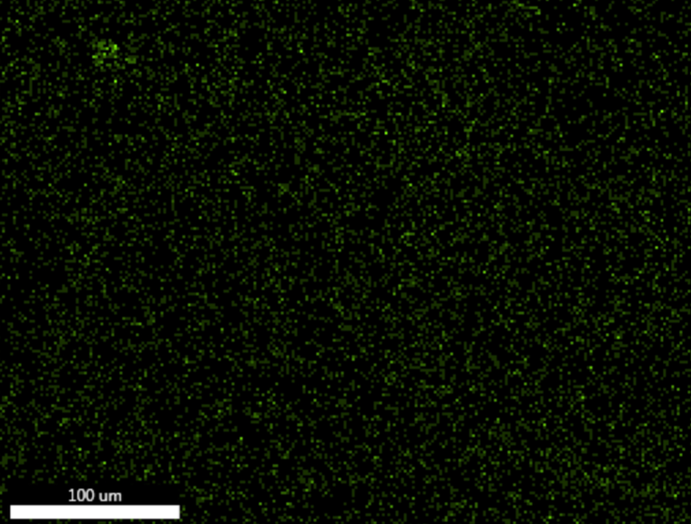
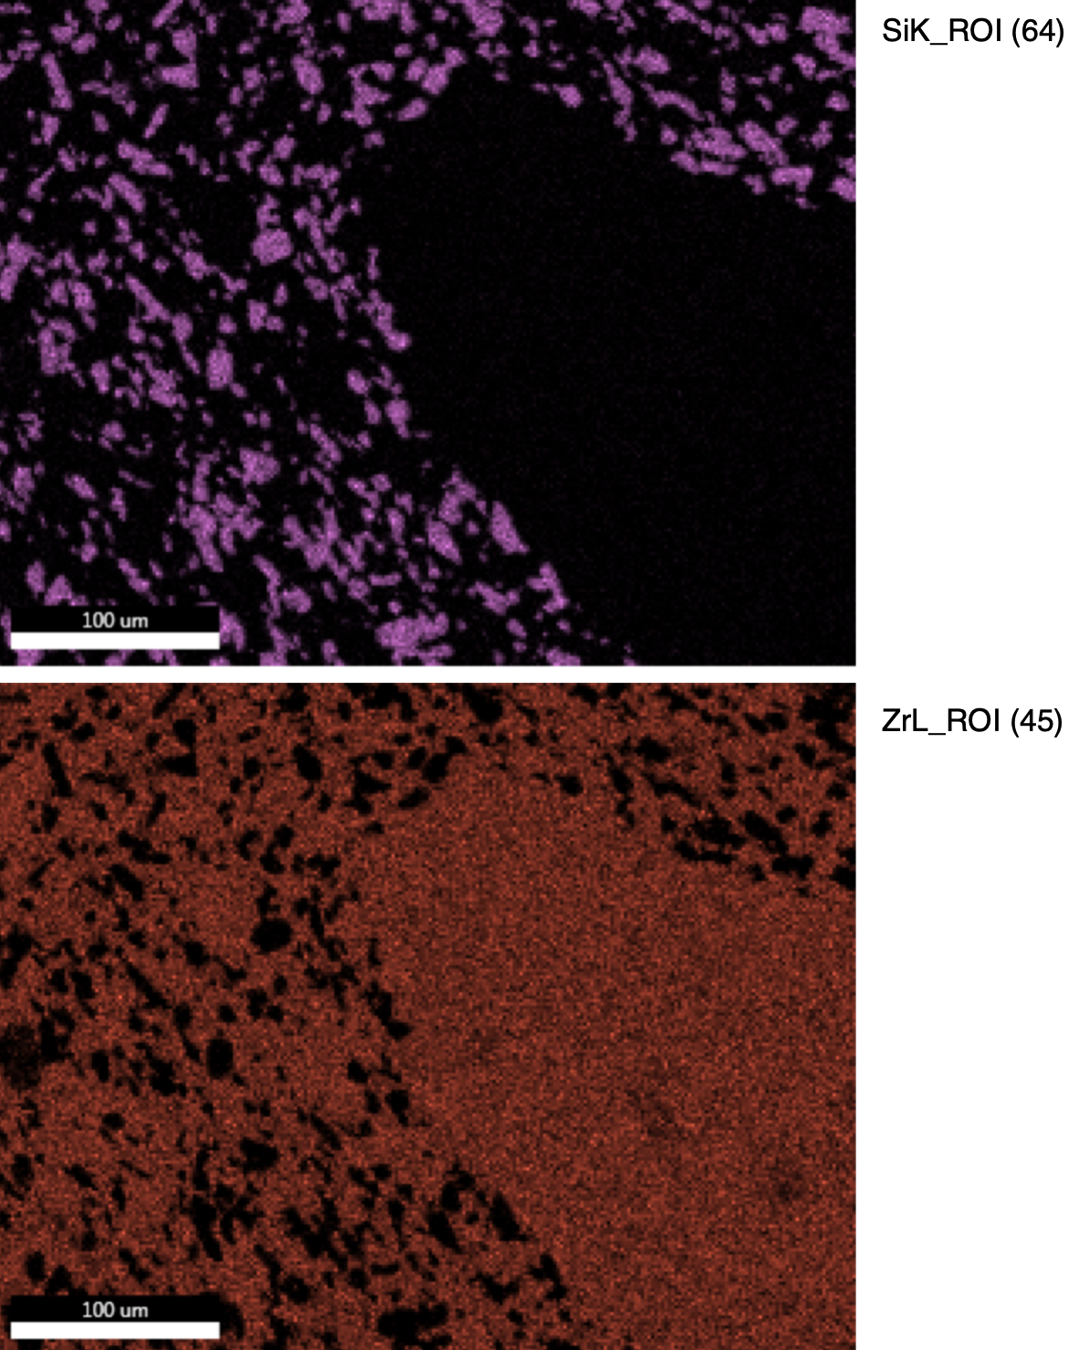
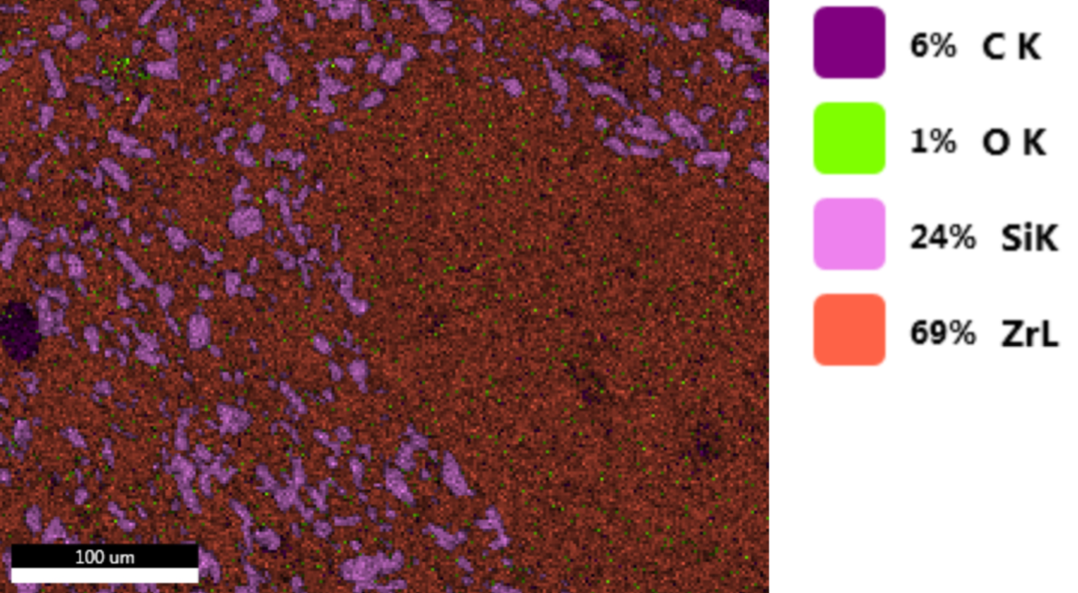
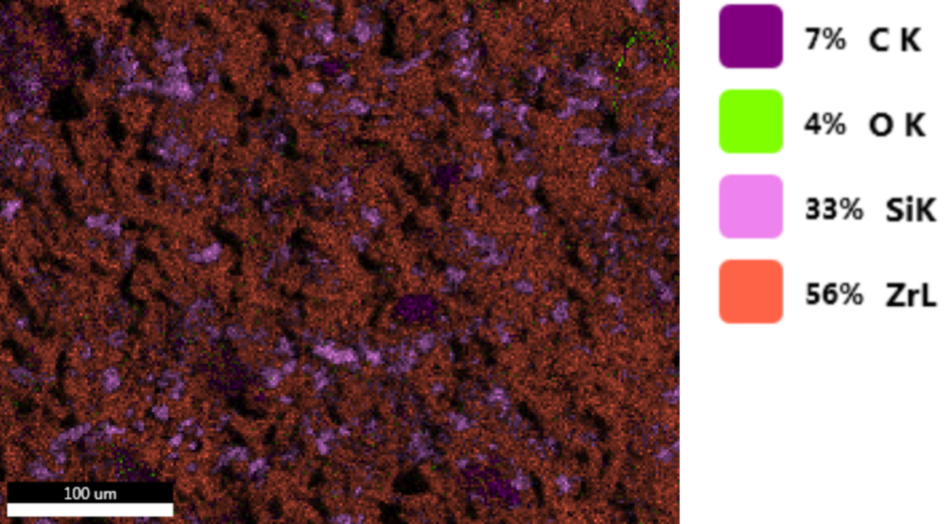
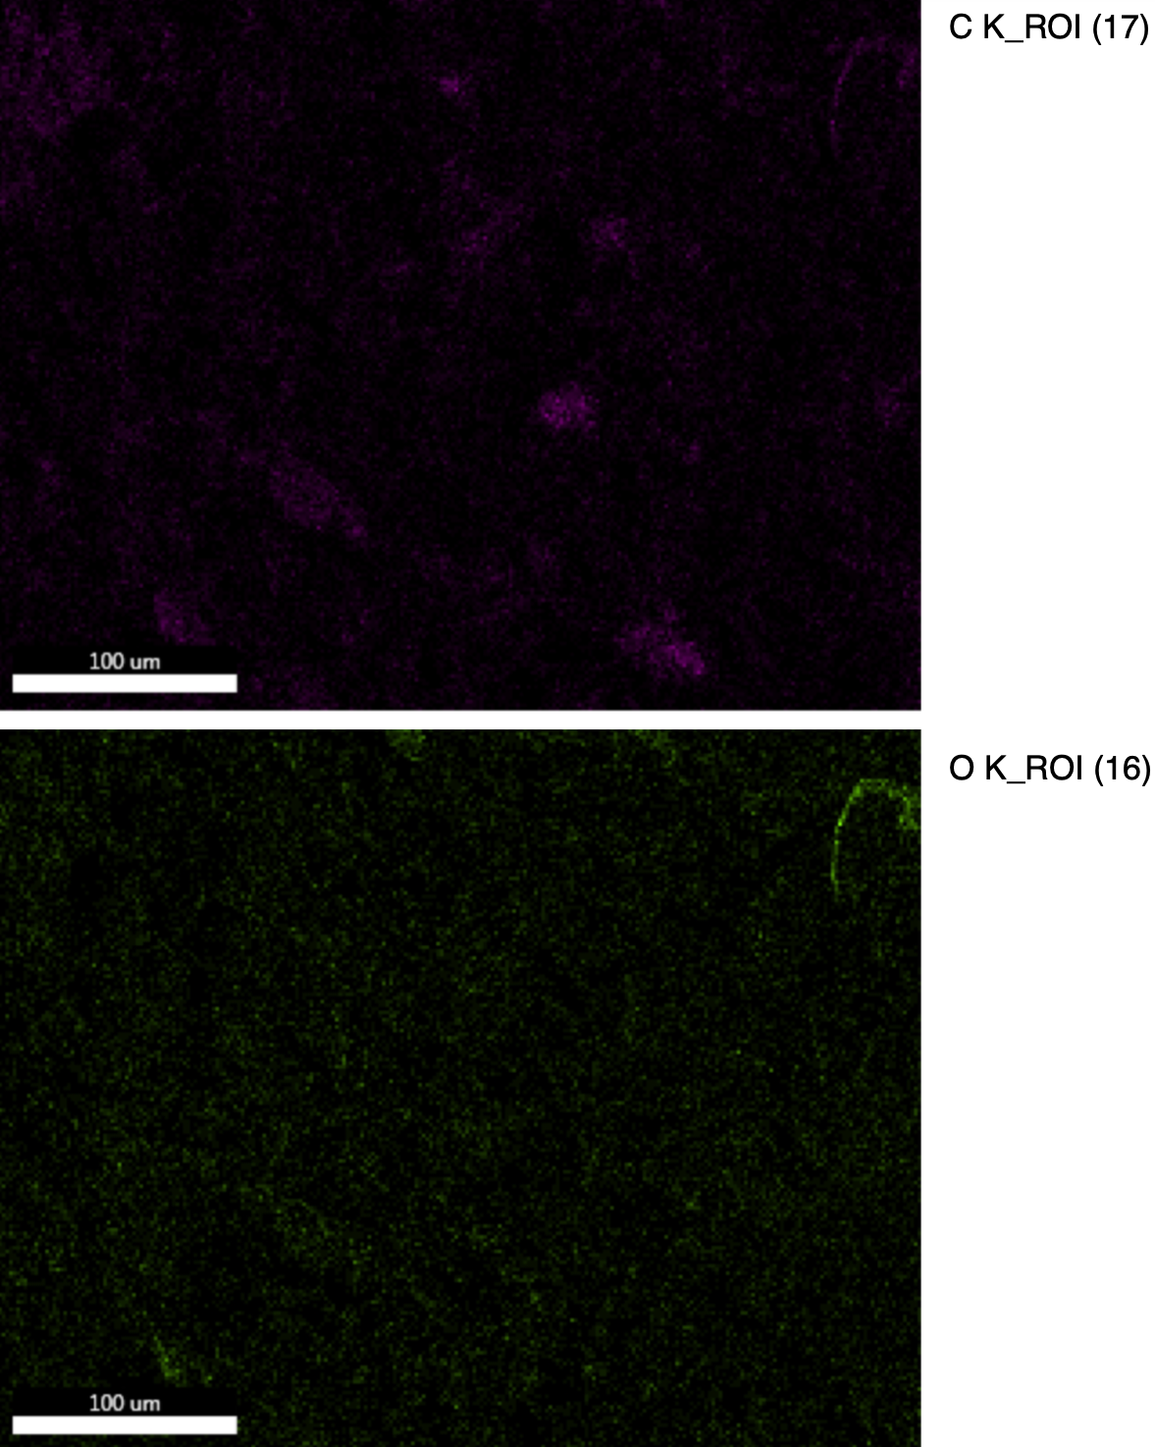
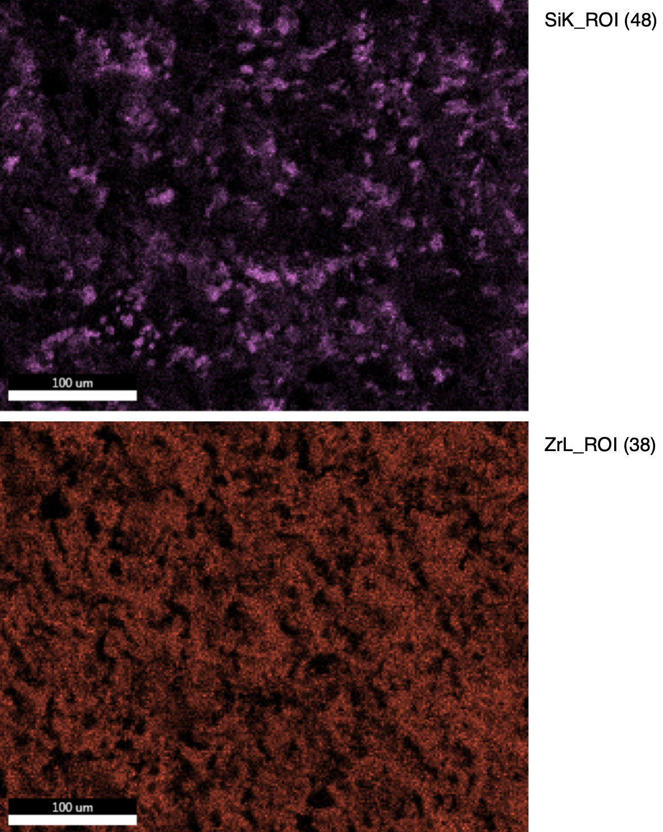
Oxygen Element Mapping (EDS – Electron Dispersive Spectroscopy)
ZrC-SiC Polished
Carbon
Oxygen
Silicon
Zirconium
ZrC-SiC WEDMed
Carbon
Oxygen
Silicon
Zirconium
Notes:
ZrC-SiC polished: CO?
ZrC-SiC WEDMed: CO
In both samples, the silicon helps prevent oxidation. However, SiC and ZrC powder mixed poorly which is why there is a giant piece of zirconium.

Slide 13
Conclusion / Future Work
Evaluate the effect of performing 2–3 skimming passes after the initial WEDM cut on reducing the surface roughness.
Prepare samples of the same material with different relative densities using SPS and investigate the influence of density on the cutting rate and surface roughness.
Compare ZrC with other UHTCs (HfC and ZrB₂) to compare HAZ depth and eventually laser polish the surface to remove that HAZ.
Notes:
Some future work that could be done to support this project is performing several skimming passes after the initial WEDM cut to further analyze surface roughness. Preparing samples of the same material but with different relative densities using SPS would be a good idea to investigate the influence of density on cutting rate and surface roughness. Lastly, there could be comparisons made about ZrC with HfC and ZrB₂ to see their HAZ and to see if that zone could be removed using laser polishing.

Slide 14


Acknowledgements / References
Acknowledgements: The REU internship of Tara Martindale is supported by NSF Award #1950137. The research was performed in part in the Nebraska Nanoscale Facility: National Nanotechnology Coordinated Infrastructure and the Nebraska Center for Materials and Nanoscience (and/or NERCF), which are supported by the National Science Foundation under Award ECCS: 2025298, and the Nebraska Research Initiative.
References:
Notes:
Read off acknowledgements
Thank you for your time and attention. Are there any questions?

