Slide 1





Determining Operating Sensitivities and Tolerances of a Rubidium-85 Magneto-Optical Trap
Elaine Ngo, Pasadena City College
Jaime Diaz, Northern Arizona University
Michael Jaden Brewer, Northern Arizona University
Ines Montano, Northern Arizona University
We acknowledge funding from OSI 2427169 (Expand QISE) and EECS 2025490 (NCI-SW).
1
Notes:
talking about how I (title)

Slide 2
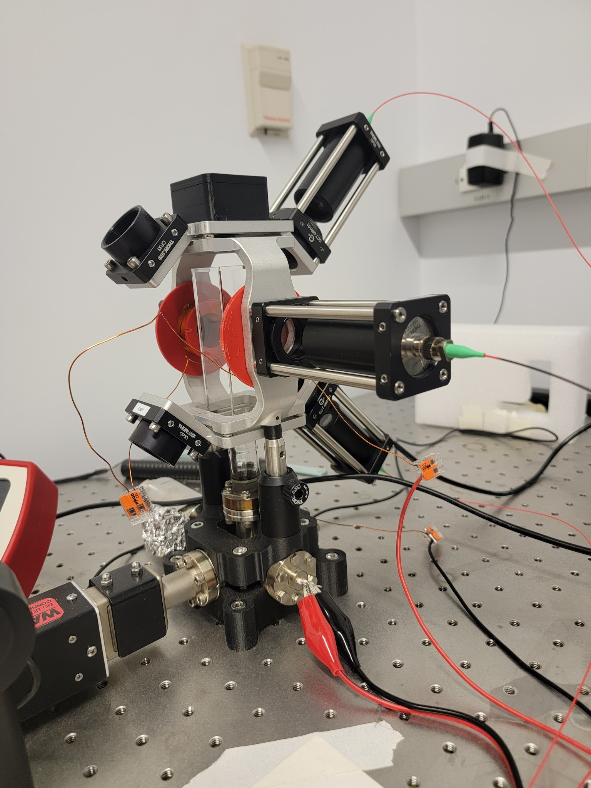
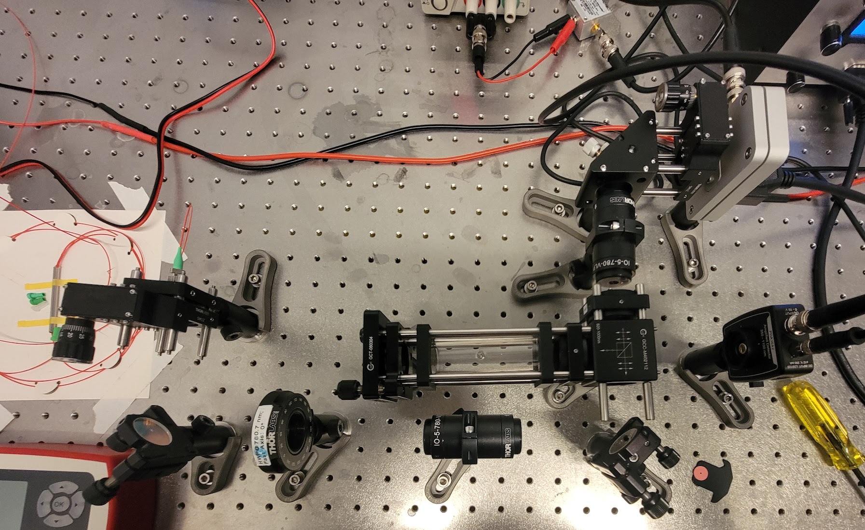
Introducing A MOT
We acknowledge funding from OSI 2427169 (Expand QISE) and EECS 2025490 (NCI-SW).
2
Notes:
so just before me and Lab partner arrived our LAB just got a MOT like almost right out the box

Slide 3
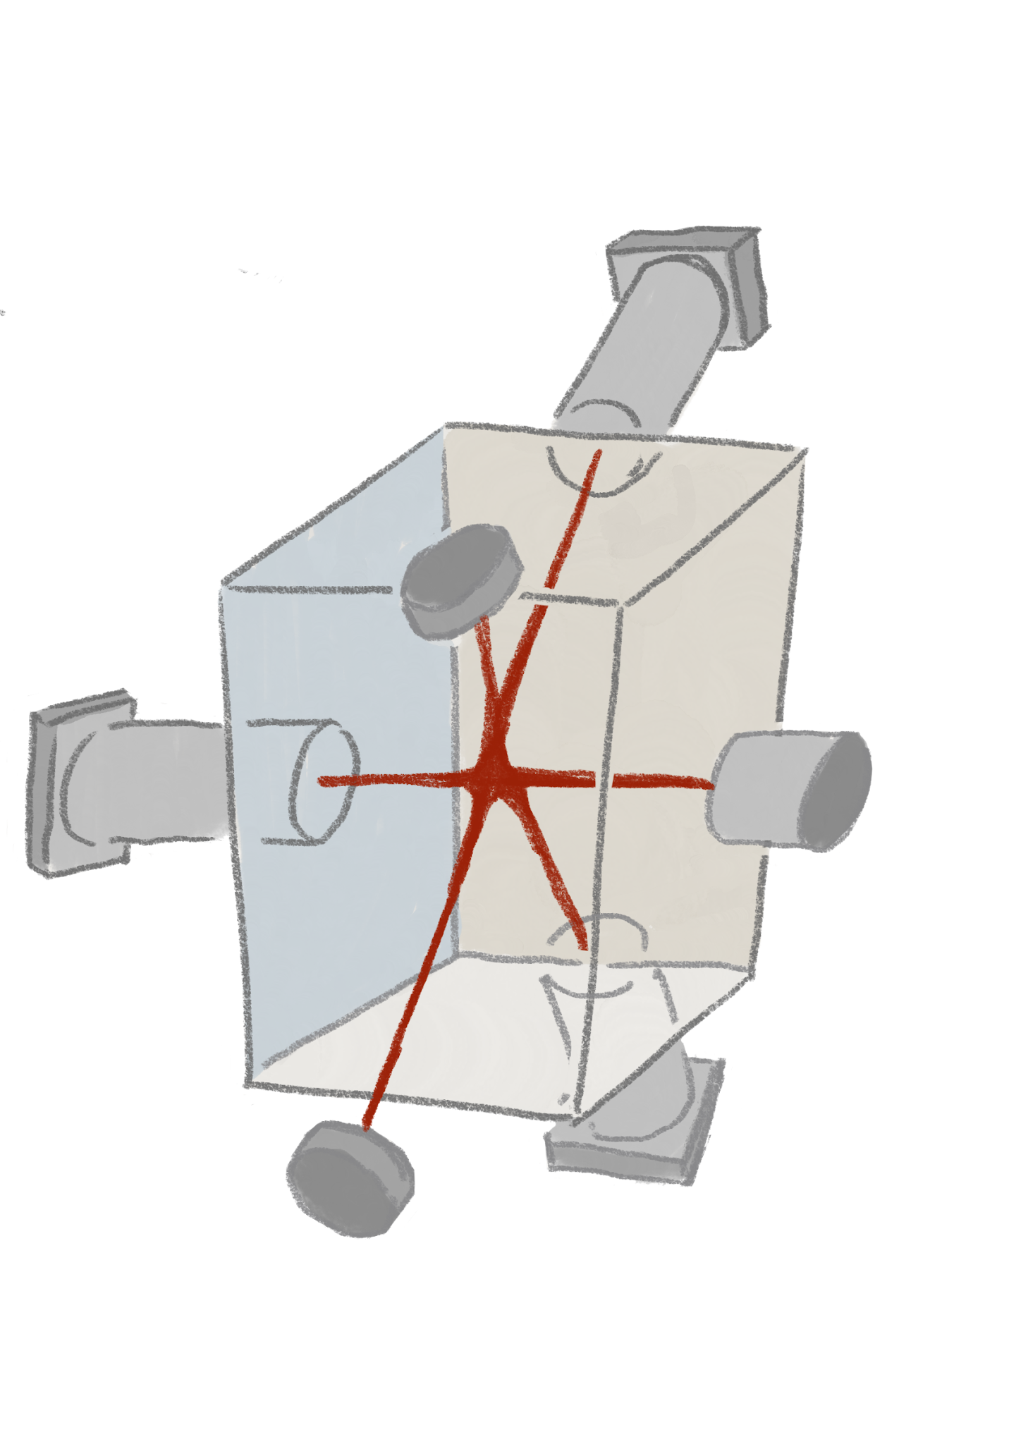
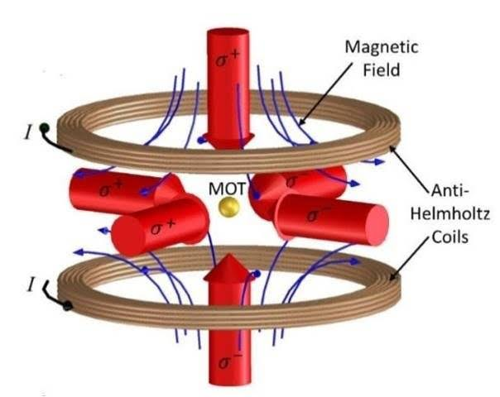
Magneto-Optical Trap
We acknowledge funding from OSI 2427169 (Expand QISE) and EECS 2025490 (NCI-SW).
3
Notes:
mot stands for magneto optical trap

Slide 4
Why should anyone care?
We acknowledge funding from OSI 2427169 (Expand QISE) and EECS 2025490 (NCI-SW).
4
Notes:
image link
so we got a mot who cares

Slide 5
Why should anyone care?
MOT Applications
quantum sensing
quantum sensing/computing
  gravimeter
  atomic clocks
  etc
materials science/nanotech research
We acknowledge funding from OSI 2427169 (Expand QISE) and EECS 2025490 (NCI-SW).
4
Notes:
image link
but addition to scale
we know that atoms are pretty small we intuitively know that the trapping atoms is pretty hard and the MOT is pretty sensitive
and because it sensitive we are able to use the MOT in quantum sensing (graviometers, quantum clocks, detecting polaization drifit and what not)
but also as quantum tweezers and nuclear/particle physics

Slide 6
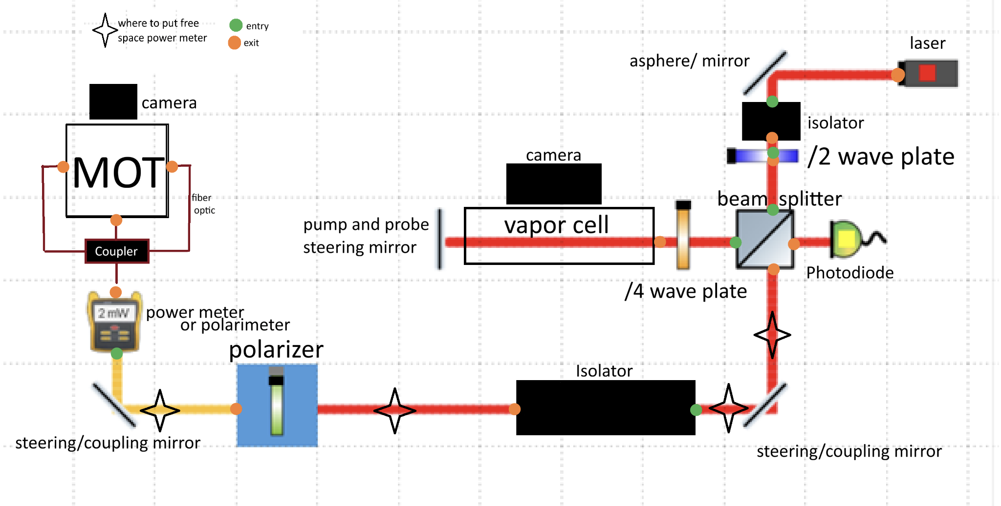
Everything Before the MOT
We acknowledge funding from OSI 2427169 (Expand QISE) and EECS 2025490 (NCI-SW).
6
Notes:
so theres a lot going even before the MOT and we’re gonna brief go over everything
so the laser starts in the top right before

Slide 7
Everything Before the MOT
We acknowledge funding from OSI 2427169 (Expand QISE) and EECS 2025490 (NCI-SW).
7
Notes:
hitting this beam splitter
which brings us to the saturated absorption set up
some of the laser will pass through the beam splitter to reach the MOT but some of laser is splitter here keep this section in mind

Slide 8
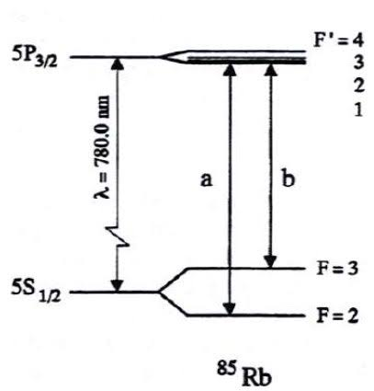
Spectroscopy
Rb-85 Hyperfine Structure
laser locks on
  F=3 to F’=4
  F=2 to F’=3
We acknowledge funding from OSI 2427169 (Expand QISE) and EECS 2025490 (NCI-SW).
8
Notes:
so remember when I talked about our spectroscopy set up
the what the saturated spectroscopy is for is to use Rb’s hyperfine structure and lock on to the frequency and energy that corresponds to F=3 to F’=4
and just in case the atom get excited to F’=3 and falls to a F=2 theres another laser for that

Slide 9
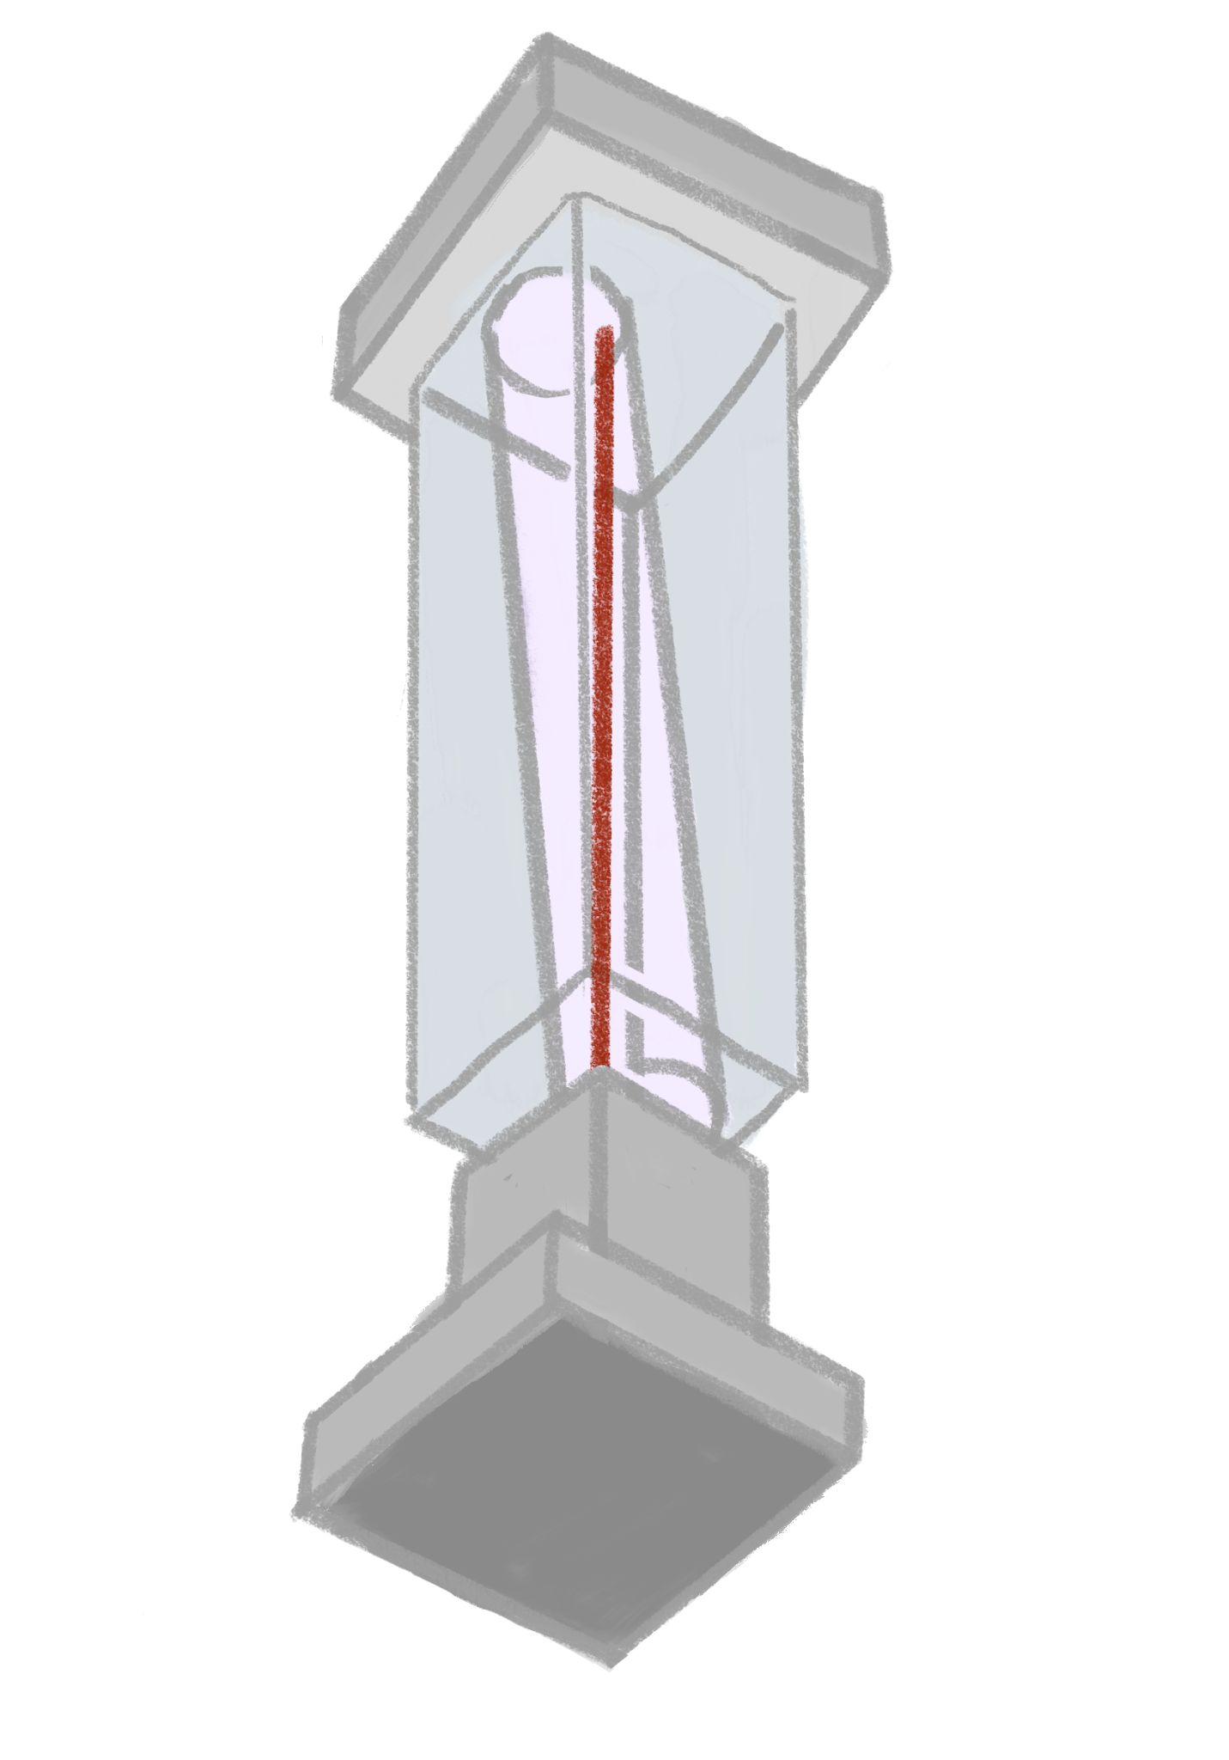
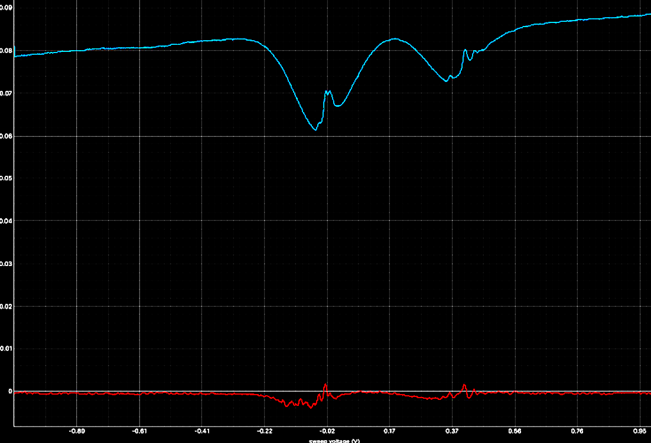
Spectroscopy
We acknowledge funding from OSI 2427169 (Expand QISE) and EECS 2025490 (NCI-SW).
9
Notes:
atom would go into the vapor chamber exciting atom and then coming back on the same perfectly aligned beam path in to a photodiode
which would give us this spectroscopy
this broad dip is from doppler broadening
these small dips are our atoms that are are already excited and which are also in frequency with the laser

Slide 10
So what frequency
F=3 - F’=4
F=2 - F’=3
E
we wanna be here cause of doppler cooling
We acknowledge funding from OSI 2427169 (Expand QISE) and EECS 2025490 (NCI-SW).
10
Notes:
we want our frequency to be somewhere here, because the atoms moving slight below frequency to the laser because of the doppler effect
atoms moving exact the 3-4 transition to the laser would look still
we want atoms that have moment to slow them down
this value that we are setting our laser to is called the detuning frequency

Slide 11
Everything Before the MOT
We acknowledge funding from OSI 2427169 (Expand QISE) and EECS 2025490 (NCI-SW).
11
Notes:
the laser that passes through the beam splitter is the directed towards an isolator which prevent any back power too mess up the beam

Slide 12
Everything Before the MOT
We acknowledge funding from OSI 2427169 (Expand QISE) and EECS 2025490 (NCI-SW).
12
Notes:
then before it the Laser get coupled into the fiber optic cable it goes through this polarizor which is also important

Slide 13
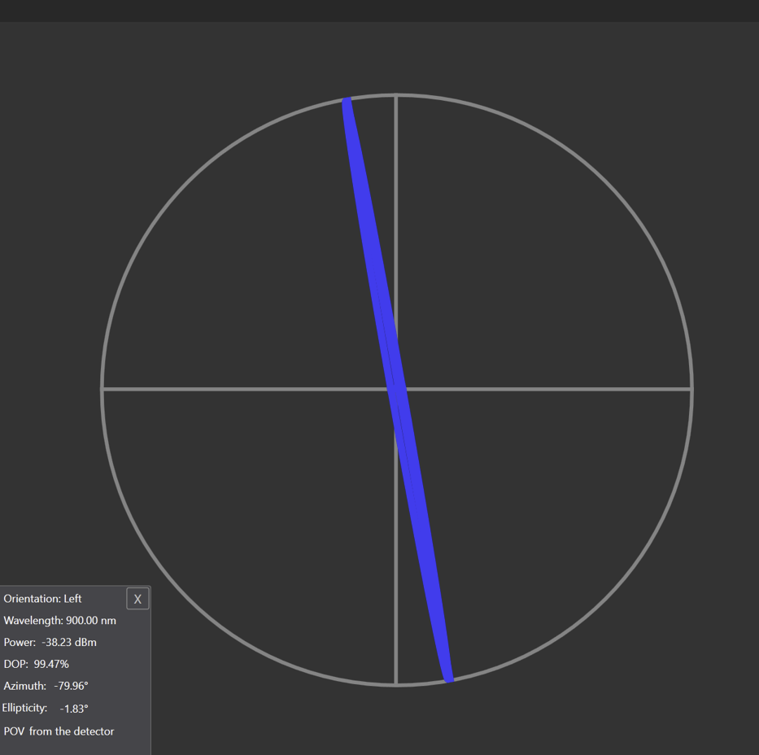
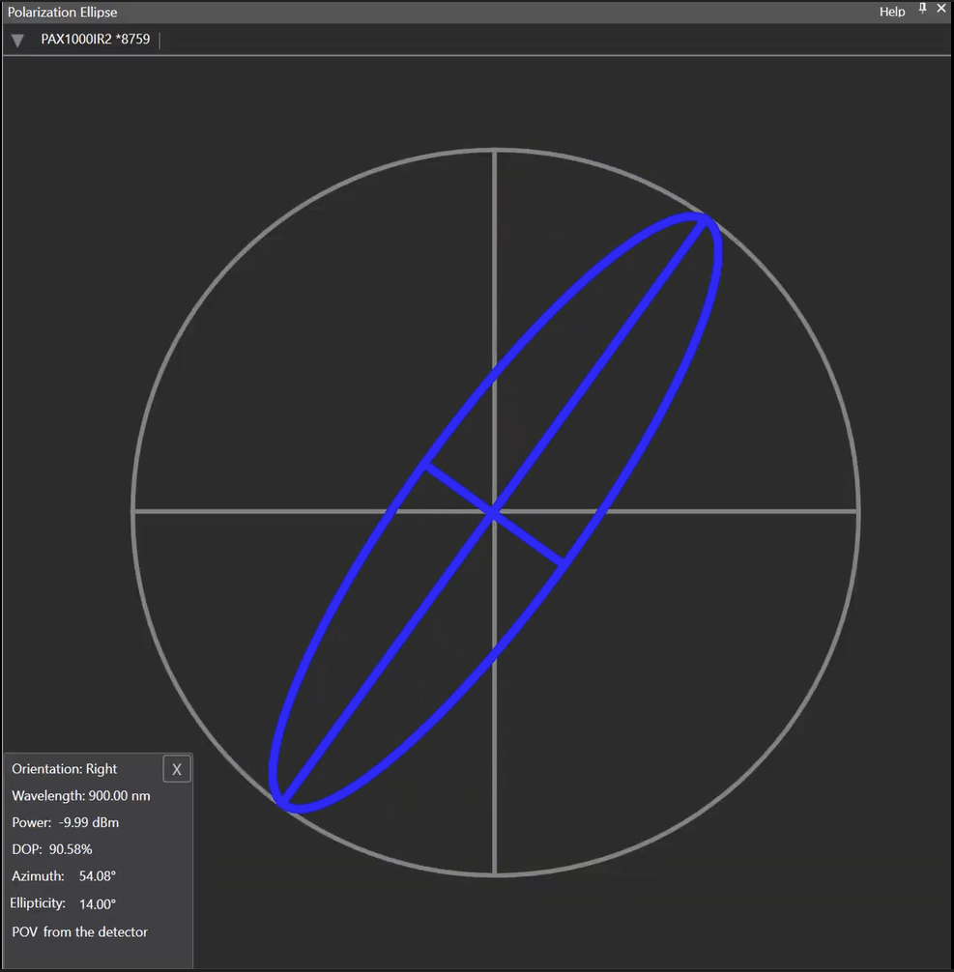
Polarization
view from Thorlab polarimeter
pretty linear
not very linear
We acknowledge funding from OSI 2427169 (Expand QISE) and EECS 2025490 (NCI-SW).
13
Notes:
remember the polarizor, so we’re also going to test its sensitivities
As I mentioned earlier, the MOT has quarter wave plates attached to it, the purpose of which is to turn vertically polarized light into circularly polarized light, so the wave plates are already optimized all we have to do is to ensure that the laser that’s being coupled into the fiber optics are as vertical as possible
so the variable that we are measuring is whether how non linearly polarized the light can be
this is is the view from a poolarimeter from thor labs, the one on the left is pretty linearly polarized the one on the right is not so much

Slide 14
Polarization = ellipticity
view from Thorlab polarimeter
pretty linear
not very linear
We acknowledge funding from OSI 2427169 (Expand QISE) and EECS 2025490 (NCI-SW).
14
Notes:
so the shape of the diagram is pretty useful and intuitive to look at
however what we’re actually measuring is on the bottom left: ellipticity
uses a rotate quarter wave plate and the stokes parameters to extract the ellipticity

Slide 15
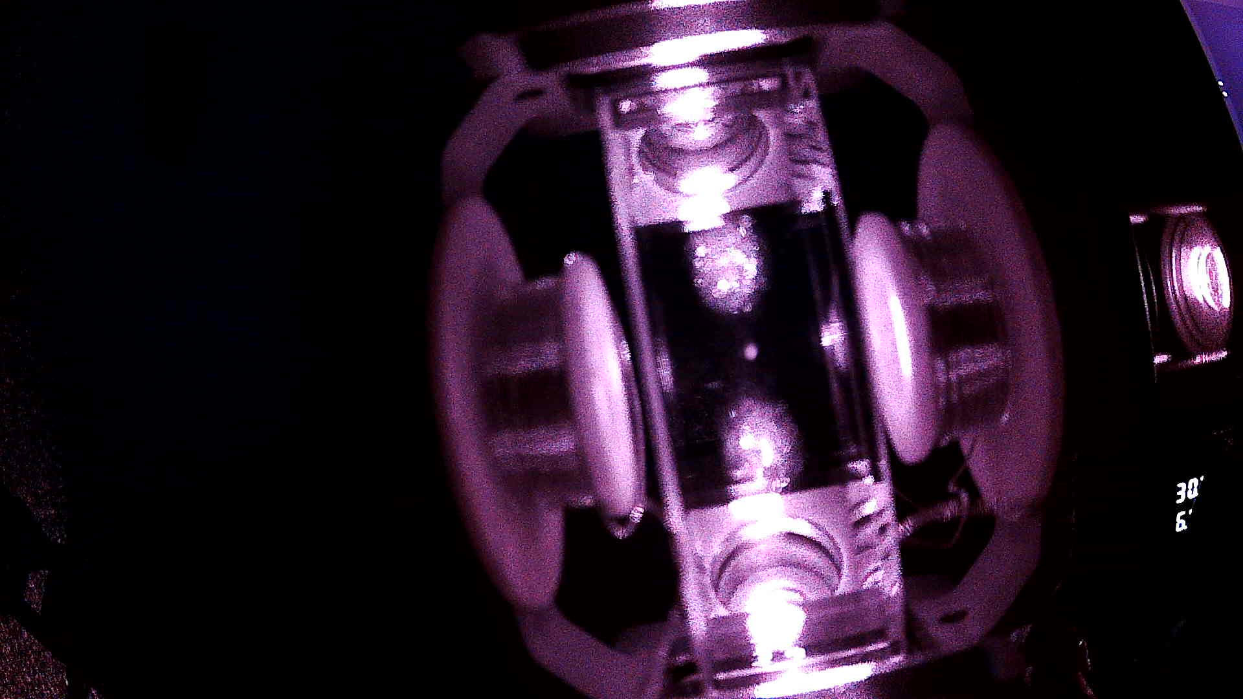
The Result of Trapping:
We acknowledge funding from OSI 2427169 (Expand QISE) and EECS 2025490 (NCI-SW).
15
Notes:
image link
and if everything goes right this is what we get a nice and bright fluorescent dot in the middle of the MOT

Slide 16
The Goals of MOT Research
We acknowledge funding from OSI 2427169 (Expand QISE) and EECS 2025490 (NCI-SW).
16
Notes:
image link
eventually we got the MOT to trap consistently
once we got the MOT to work this this is what I sought out to do

Slide 17
Frequency Detuning and Polarization Dependence
white = 255
black = 0
polarizer
We acknowledge funding from OSI 2427169 (Expand QISE) and EECS 2025490 (NCI-SW).
17
Notes:
correlate the fluorescent the trapped atoms with the the detuning frequency and the distance between ideal polarization, to see how far away from ideal conditions would be acceptable to trap under
how we did that was individually detune both variables from idea conditions and the took a snapshot of the trap, by then grayscaling the picture and giving gray scale arbitrary number values we are able to quantify the difference ideal conditions and non ideal conditions

Slide 18
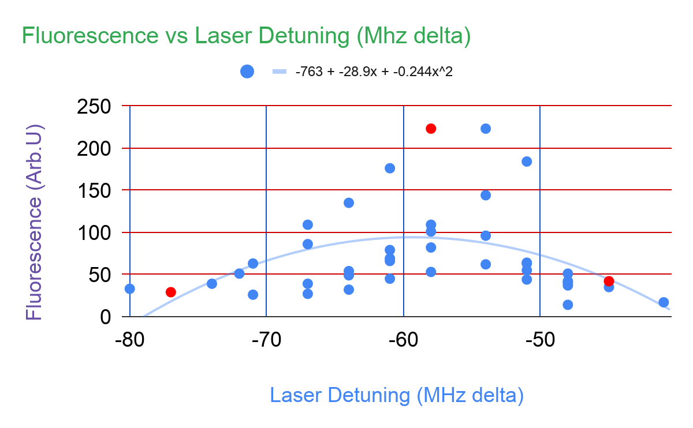
Frequency Detuning Vs Fluorescence
Optimal laser detuning is at Δ= 59.221
Speed of atoms while trapping ideally are moving at 46.192 m/s
We acknowledge funding from OSI 2427169 (Expand QISE) and EECS 2025490 (NCI-SW).
18
Notes:
so for frequency detuning
well ideally the detuning frequency should be around 59.221 MHz away from the 3-4 transition
and in correlation the speed of the atoms that ideal for trapped are about 46.192 m/s slower than the atoms that are moving at the same frequency as the laser

Slide 19
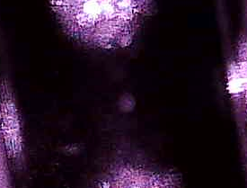
Frequency Detuning Vs Fluorescence
A
B
A
C
We acknowledge funding from OSI 2427169 (Expand QISE) and EECS 2025490 (NCI-SW).
19
Notes:
lets demonstrate visually
here we have A which is about 77 MHz away from the 3-4 transition frequency, dot is still there but its kinda dim

Slide 20

Frequency Detuning Vs Fluorescence
A
B
B
A
C
We acknowledge funding from OSI 2427169 (Expand QISE) and EECS 2025490 (NCI-SW).
19
Notes:
compare that to B which is about 57Mhz aways, the dot is nice and bright

Slide 21

Frequency Detuning Vs Fluorescence
A
B
B
A
C
C
We acknowledge funding from OSI 2427169 (Expand QISE) and EECS 2025490 (NCI-SW).
19
Notes:
compare B to C which also quite a distance from the IDEAL detuning frequency, the dot is barely there

Slide 22
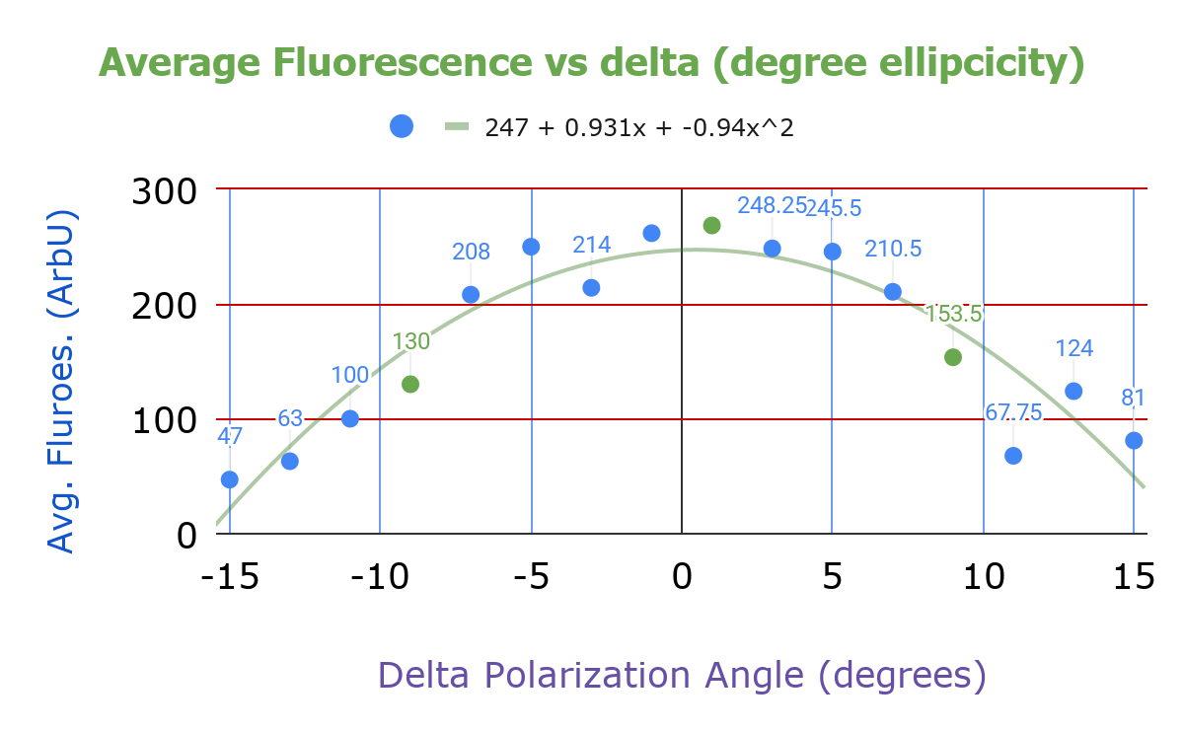
Polarization Vs Fluorescence
On average:
fluorescence is strong visible between +/- 5 degrees from ideal polarization
We acknowledge funding from OSI 2427169 (Expand QISE) and EECS 2025490 (NCI-SW).
20
Notes:
as for polarization on average polariation fluroesce is strongest obviously around 0 degrees of elliptcicity
but there are still strong result with +/- 5 degrees

Slide 23
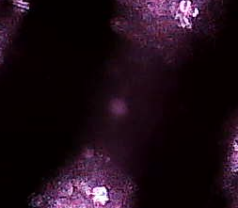
Polarization Vs Fluorescence
A
A
B
C
We acknowledge funding from OSI 2427169 (Expand QISE) and EECS 2025490 (NCI-SW).
21
Notes:
once again lets compare visually this is A which is out side that 5 degrees

Slide 24

Polarization Vs Fluorescence
A
B
A
C
B
C
We acknowledge funding from OSI 2427169 (Expand QISE) and EECS 2025490 (NCI-SW).
21
Notes:
compare that to B

Slide 25
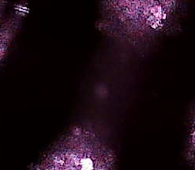
Polarization Vs Fluorescence
A
B
A
C
B
C
We acknowledge funding from OSI 2427169 (Expand QISE) and EECS 2025490 (NCI-SW).
21
Notes:
and finally C

Slide 26
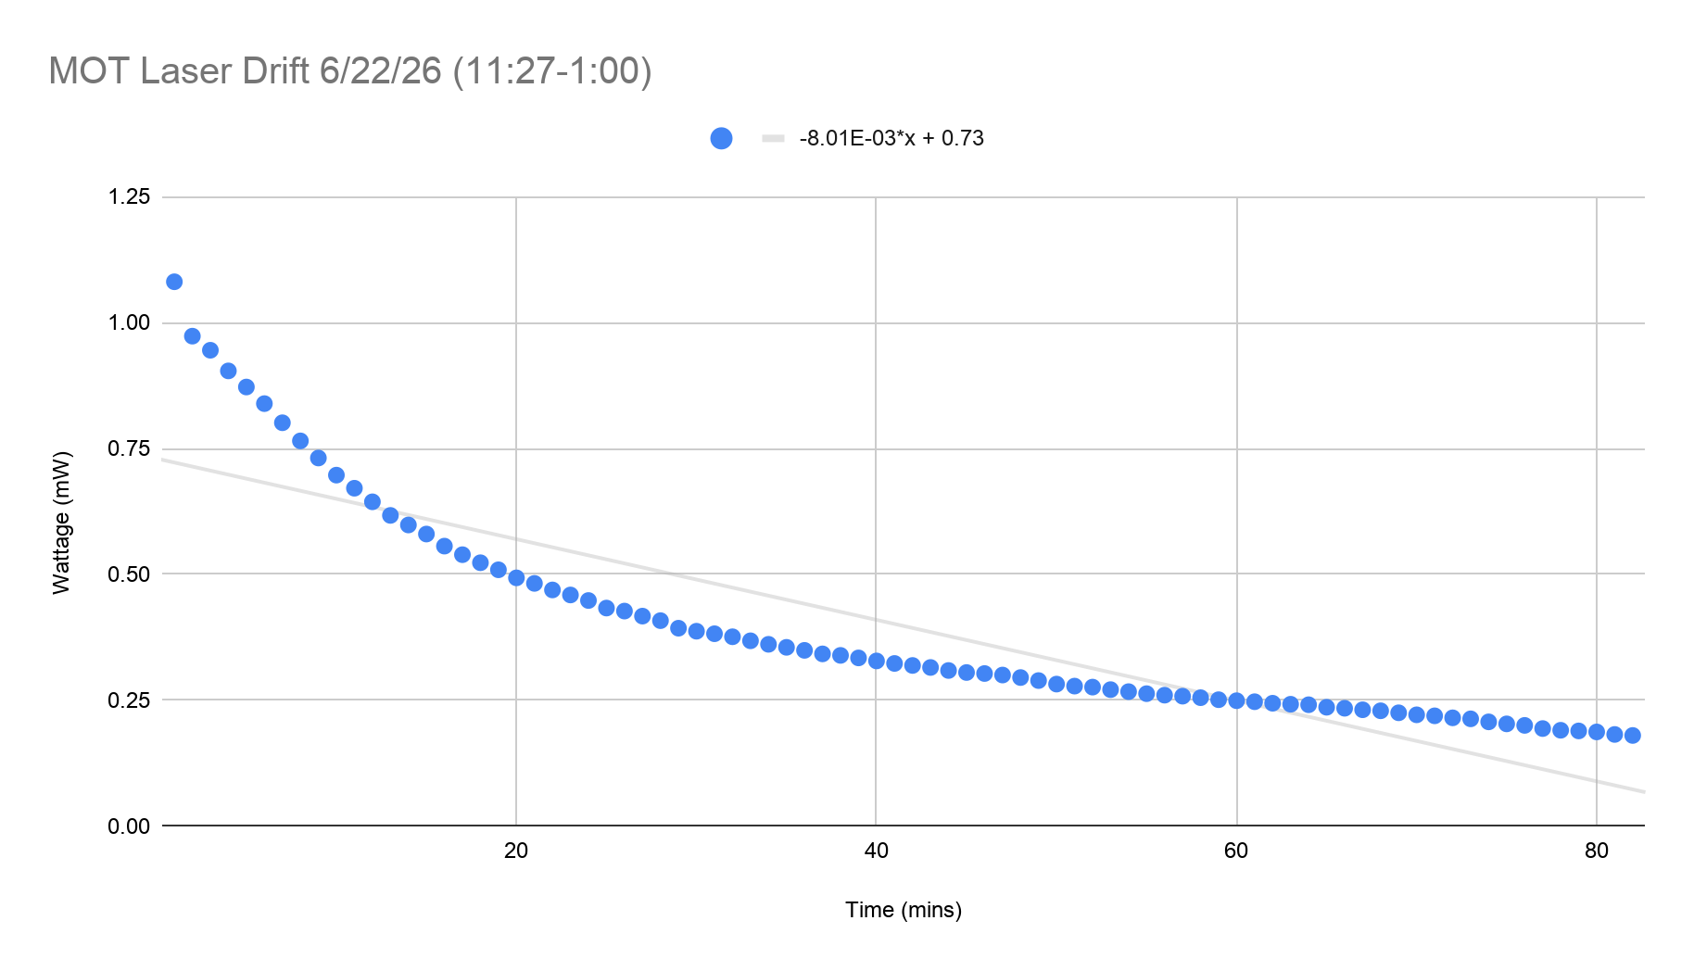
Uncertainty in Polarization
Detuning
We acknowledge funding from OSI 2427169 (Expand QISE) and EECS 2025490 (NCI-SW).
22
Notes:
but as an uncertainty lets bring back that laser drift plot because we found that power does affect polarization tolerance

Slide 27
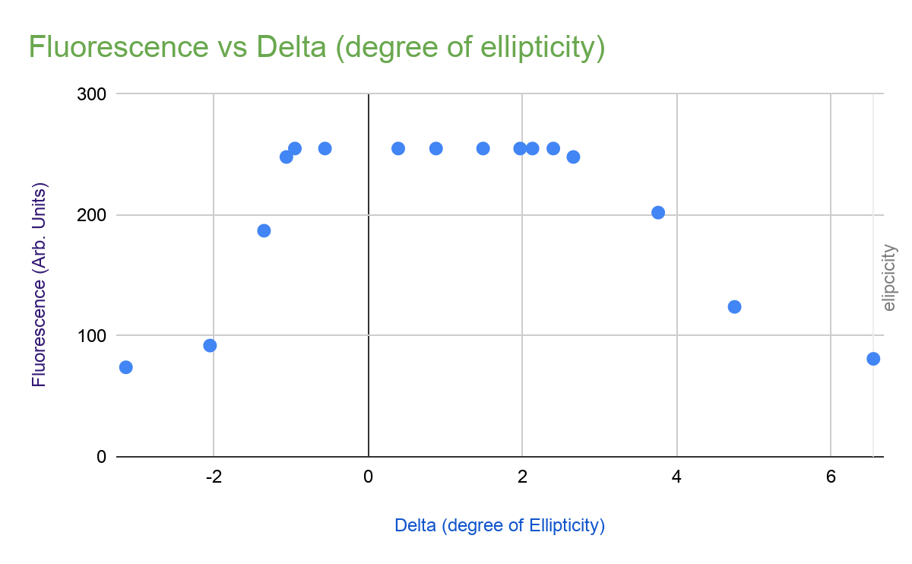
Uncertainty in Polarization
Detuning
Laser power: 2.73 mW
vs
Avg Laser Power: 2.54 mW
We acknowledge funding from OSI 2427169 (Expand QISE) and EECS 2025490 (NCI-SW).
23
Notes:
higher power does allow the desensitize polarization tolerance, as you can see in this plot where the wattage of the laser is higher than usual this allows the maximum fluorescence that we were able to measure to be to consistent out side of an ideal polarization

Slide 28
Future Work
Finding optimal velocity at which atoms are moving to trap.
Calibrate the laser frequency to determine exact detuning value from cooling transition
Foundational work in quantum sensing
We acknowledge funding from OSI 2427169 (Expand QISE) and EECS 2025490 (NCI-SW).
24
Notes:
higher power does allow the desensitize polarization tolerance, as you can see in this plot where the wattage of the laser is higher than usual this allows the maximum fluorescence that we were able to measure to be to consistent out side of an ideal polarization

Slide 29
References
References:
[1] Aalto, M. (n.d.). Open Quantum qMOT v4: Technical Manual. Open Quantum.
[2] Leykauf, B. (2024, August 15). LinienVersion (v2.1.0). GitHub. Retrieved June 1, 2026, from https://github.com/linien-org/linien.
[3] Magneto-optical trap - wikipedia. (n.d.). https://en.wikipedia.org/wiki/Magneto-optical_trap
[4] Thorlabs. (n.d.). https://www.thorlabs.com/
[5] University of New Mexico. (n.d.). Zeeman writeup: Study of the Zeeman effect in rubidium using saturated absorption spectroscopy. Albuquerque.
We acknowledge funding from OSI 2427169 (Expand QISE) and EECS 2025490 (NCI-SW).
25
Notes:
https://www.mckinsey.com/capabilities/mckinsey-technology/our-insights/mckinsey-quantum-technology-monitor-2026-a-commercial-tipping-point

Slide 30

Acknowledgements
NNCI - The National Nanotechnology Coordinated Infrastructure (NNCI)
NCI-Southwest- Nanotechnology Collaborative Infrastructure Southwest
NSF - National Science Foundation
Jaden Brewer, Northern Arizona University
Jaime Diaz, Northern Arizona University
Ines montano, Northern Arizona University
Cele Rodriguez, Northern Arizona University
Jessica Hauer, Arizona State University
We acknowledge funding from OSI 2427169 (Expand QISE) and EECS 2025490 (NCI-SW).
26
Notes:
https://www.mckinsey.com/capabilities/mckinsey-technology/our-insights/mckinsey-quantum-technology-monitor-2026-a-commercial-tipping-point

Slide 31
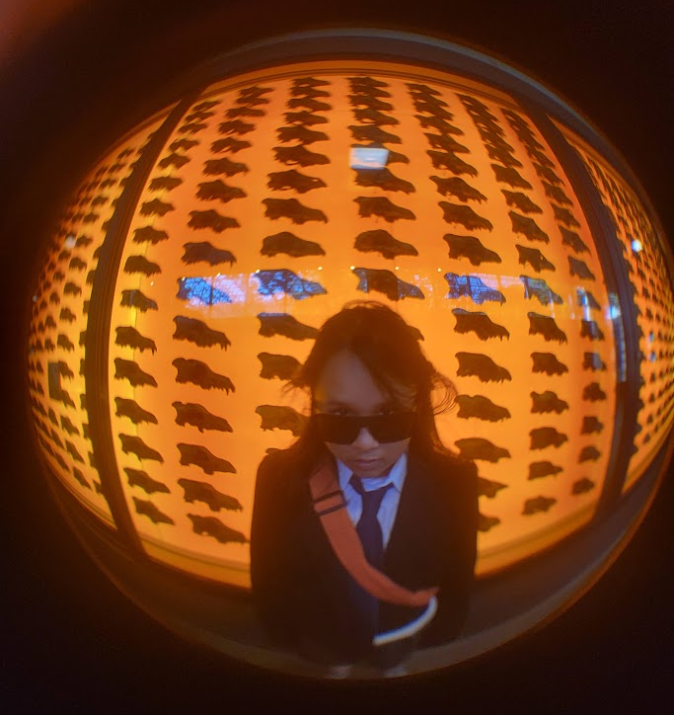
That’s All Folks
Thanks for Listening
Elaine Ngo
Pasadena City College
ngo.a.elaine@gmail.com
27
Notes:
https://www.mckinsey.com/capabilities/mckinsey-technology/our-insights/mckinsey-quantum-technology-monitor-2026-a-commercial-tipping-point

