Slide 1



Extracellular Vesicles as Drug Carriers:
Establishing a Loading Protocol and Prototyping a Microfluidic Chip
Simon Ignjatovic – University of Georgia
Mentor: Jessica Ayivi
Principal Investigator: Dr. Kristen Dellinger

Slide 2
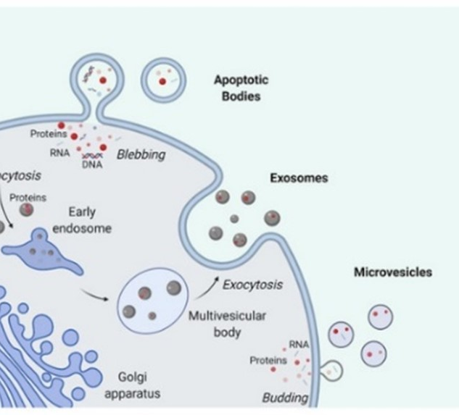
Extracellular Vesicles (EVs)
1
Lipid bilayer-delimited nanoparticles
Range from 10-20 nm to 10 micron in diameter [1]
Naturally produced by cells containing source cell biomarkers
Vital to cell-to-cell communication
Research interests:
  Tumor targeting
  Disease identification
  Drug delivery
Stago.com [1]
Notes:
Highlight drug delivery

Slide 3
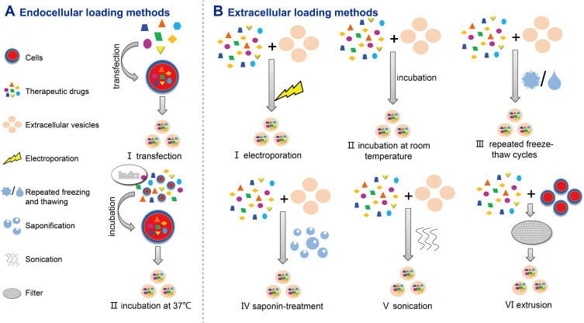
Loading Methods
2
Int J Nanomedicine, 2020, 15, 6485-6502 [2]
Notes:
Call attention to endogenous (pre-isolation) vs exogeneous (post-isolation) and active vs passive loading → focus passive

Slide 4
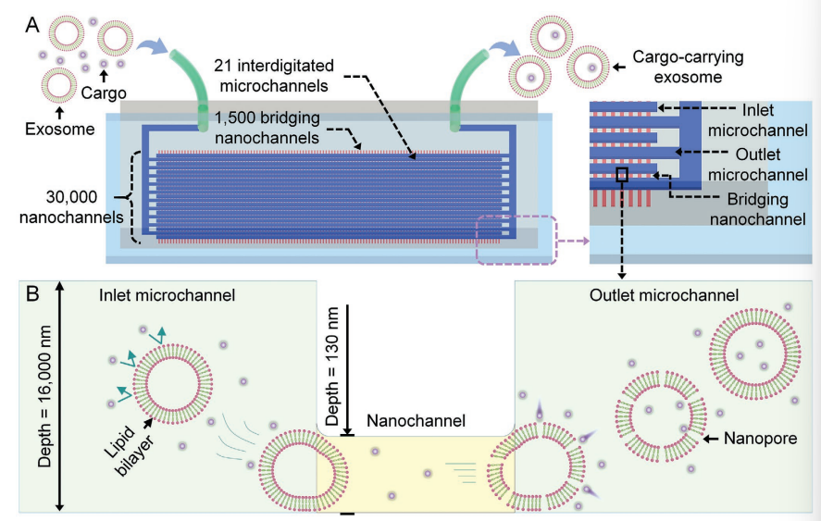
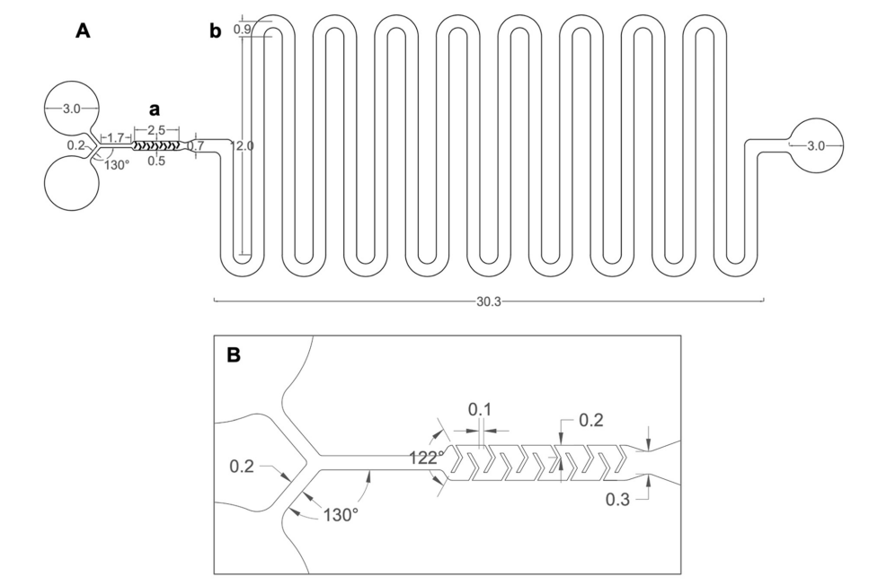
Microfluidic Loading
3
Lab Chip, 2025, 25, 1718-1727. [4]
Small, 2021, 17, 2102150. [3]
Notes:
Mention Need for standardized studies to segway into next slide

Slide 5
4
My aims:
Aim 1: Develop a Protocol for Passive Loading of Fluorescent Cargo in EVs
Aim 2: Develop a Microfluidic Chip for Fluorescent Cargo Loading of EVs
Mentor’s aim:
Aim 1: Establish a Reproducible Workflow for Fluorescent Cargo Loading and Baseline Release Characterization Across EV Subpopulations

Slide 6
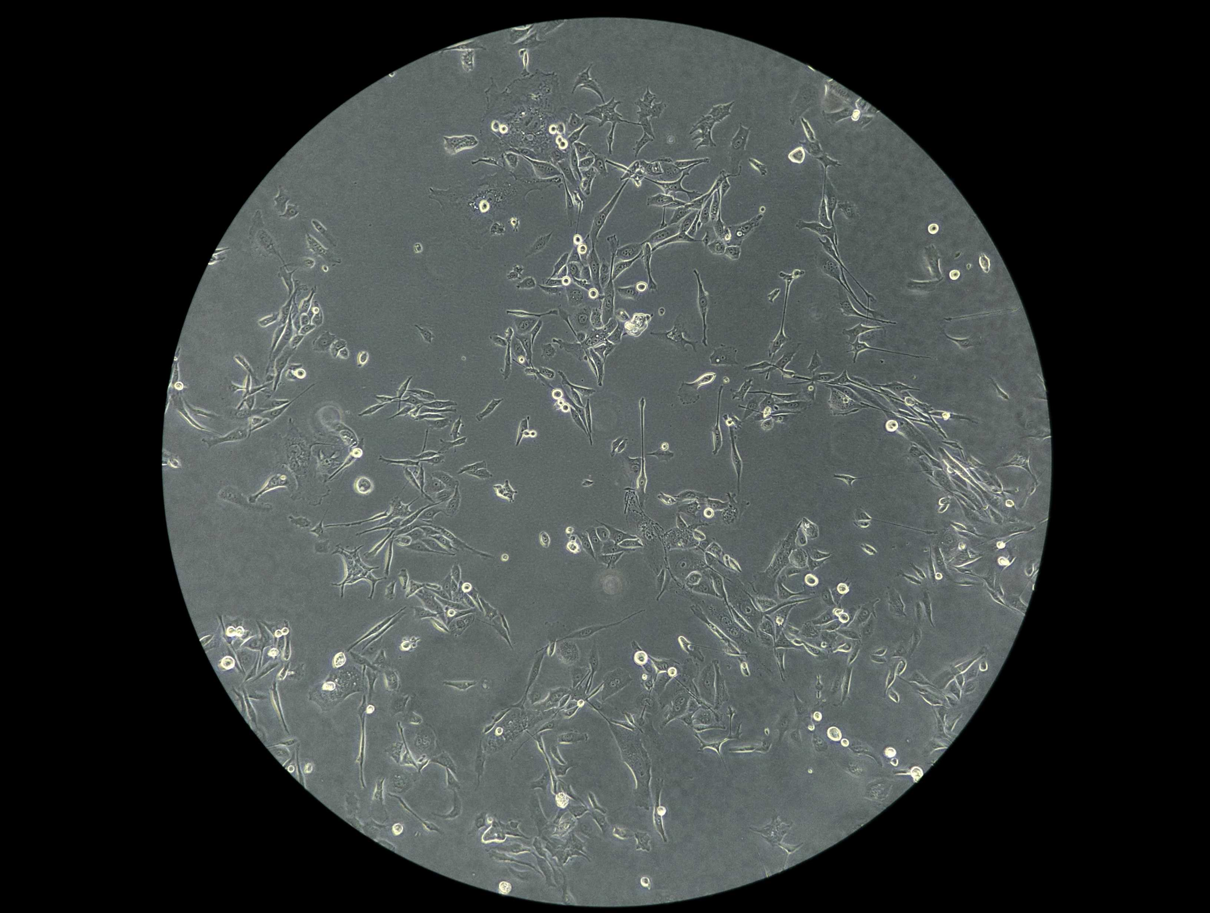
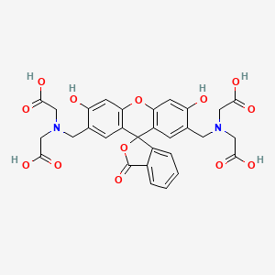
Aim 1: Passive Loading
5
Passive loading with Calcein
  Hydrophilic fluorescent dye
  Capable of self-quenching above 70 mM
EVs isolated from human prostate cancer (PC-3) and human embryonic kidney (HEK) cell lines
EV isolation using size exclusion chromatography (SEC) with Izon qEVoriginal 500 µL column
Figure 1: PC-3 cells.
Pubchem [5]

Slide 7
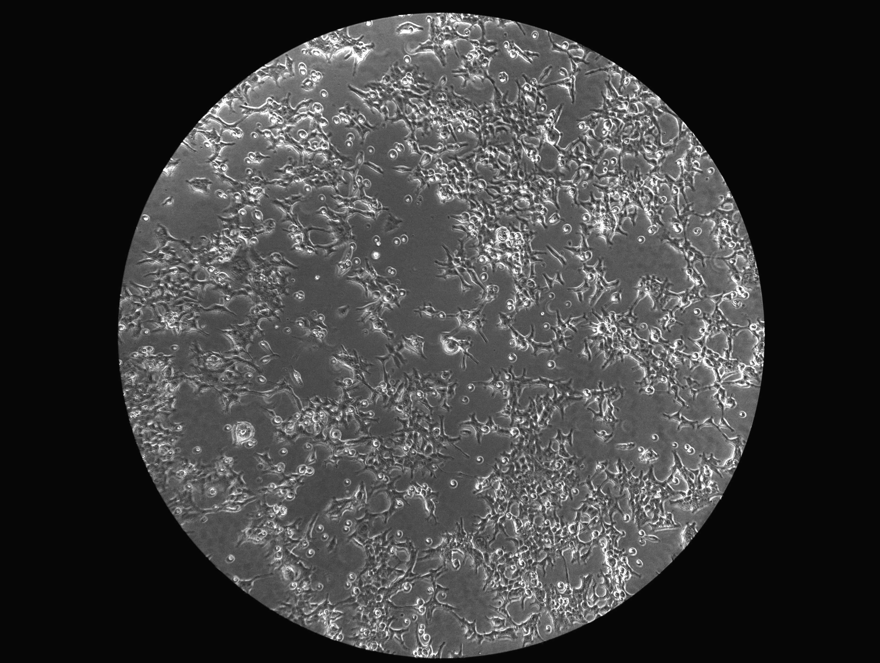
Aim 1: Passive Loading
6
Incubation at 37°C for 24 hours
3 test trials:
  Trial 1: 200 µL 3.06 x 10⁸ EVs + 300 µL 4 mM calcein
  Trial 2: 200 µL 3.06 x 10⁸ EVs + 300 µL 5 mM calcein
  Trial 3: 200 µL 3.06 x 10⁸ EVs + 300 µL 2.5 mM calcein
Wash solution of free calcein via SEC
Measure fluorescence before and after lysing with Triton X-100 (Biotek Cytation5 image reader)
Measure size distribution and concentration before and after loading (Malvern NanoSight Pro)
Pubchem [5]
Figure 2: HEK cells.

Slide 8
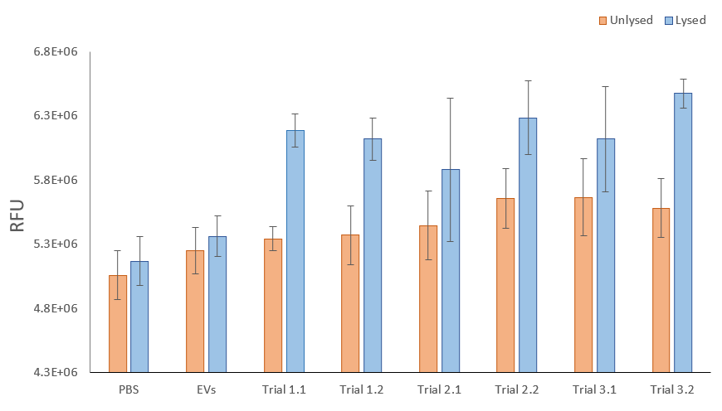
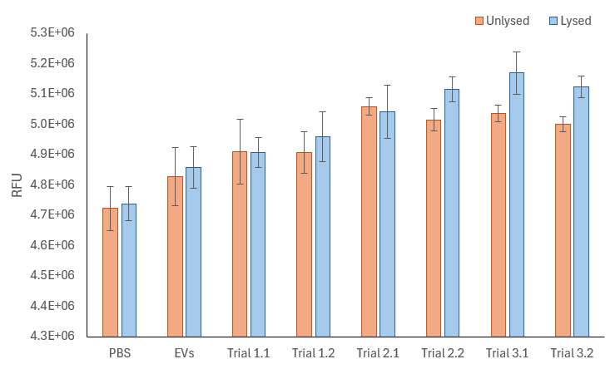
7
Aim 1: Results
Figure 3: Fluorescence results of Loading Test 1 with PC-3 cells
Figure 4: Fluorescence results of Loading Test 2 with HEK cells

Slide 9
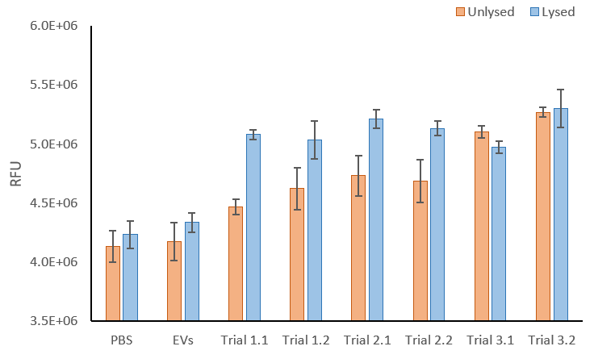
8
Aim 1: Results
Table 1: Results of two-way ANOVA tests across EVs and Trials.
 | P-values
Loading Test 1 | 5.3 x 10⁻¹³
Loading Test 2 | 2.77 x 10⁻⁰⁷
Loading Test 3 | 1.46 x 10⁻¹⁶
Figure 5: Fluorescence results of Loading Test 3 with HEK cells

Slide 10
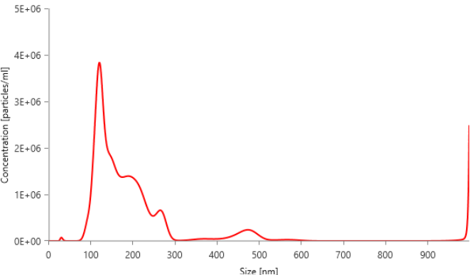
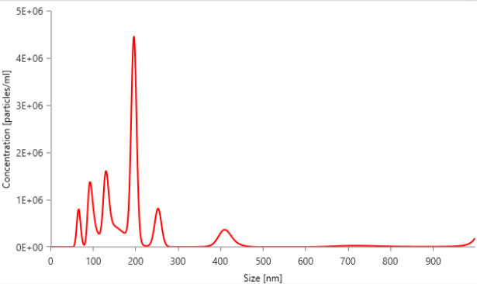
Aim 1: Results
9
Figure 6: Size distribution and concentration of PC-3 EVs before loading.
Figure 7: Size distribution and concentration of PC-3 EVs after loading.

Slide 11
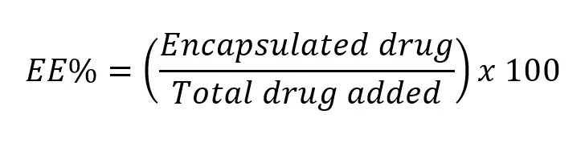
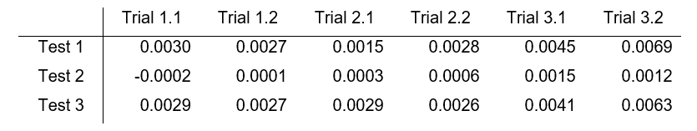
Aim 1: Results
10
Table 2: Post-lysing EE%. All values are percents.

Slide 12
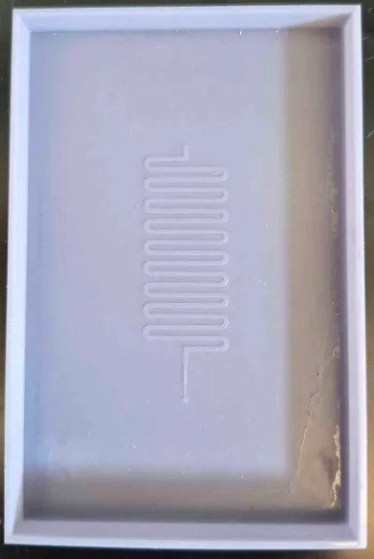
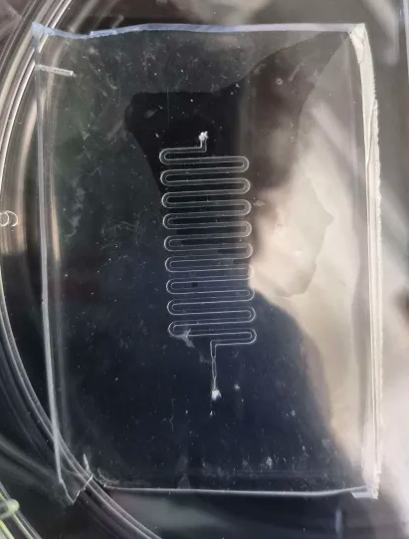
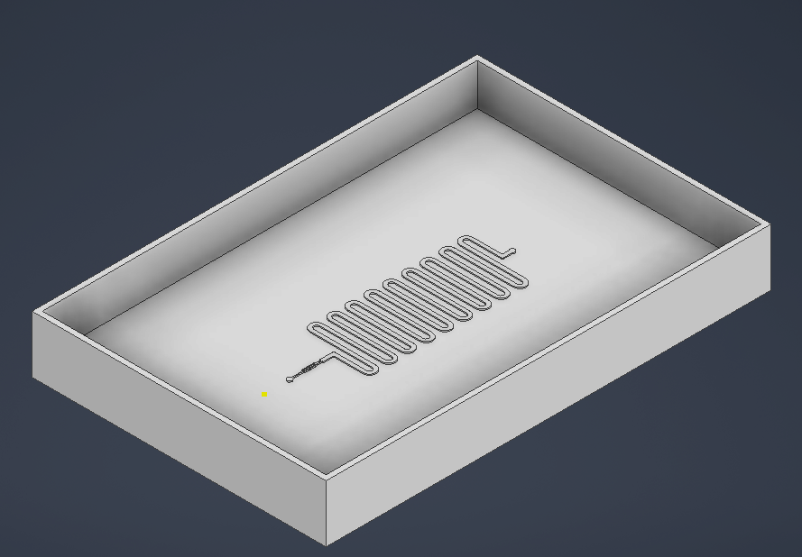
Aim 2: Microfluidic Device
11
1. 3D model mold
2. 3D print mold
3. Cast mold with PDMS

Slide 13
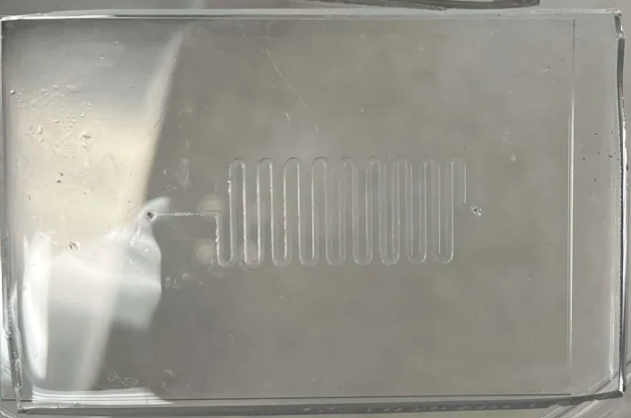
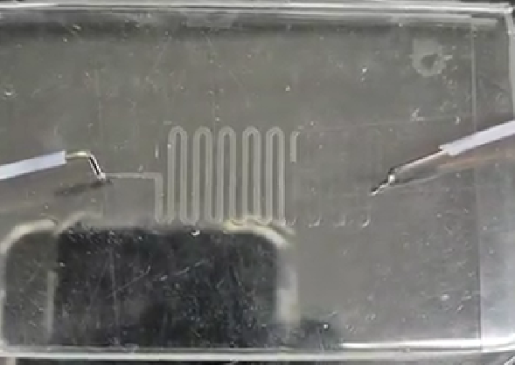
Aim 2: Microfluidic Device
12
4. Punch holes and plasma bond PDMS to glass slide
5. Leakage test of finished device.

Slide 14
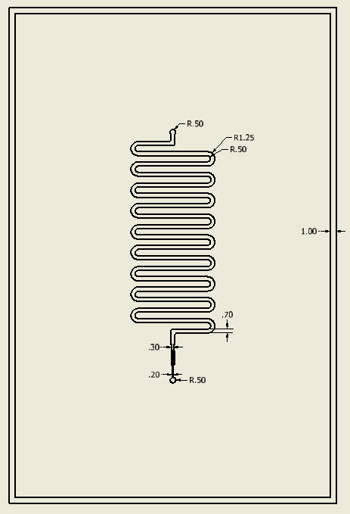
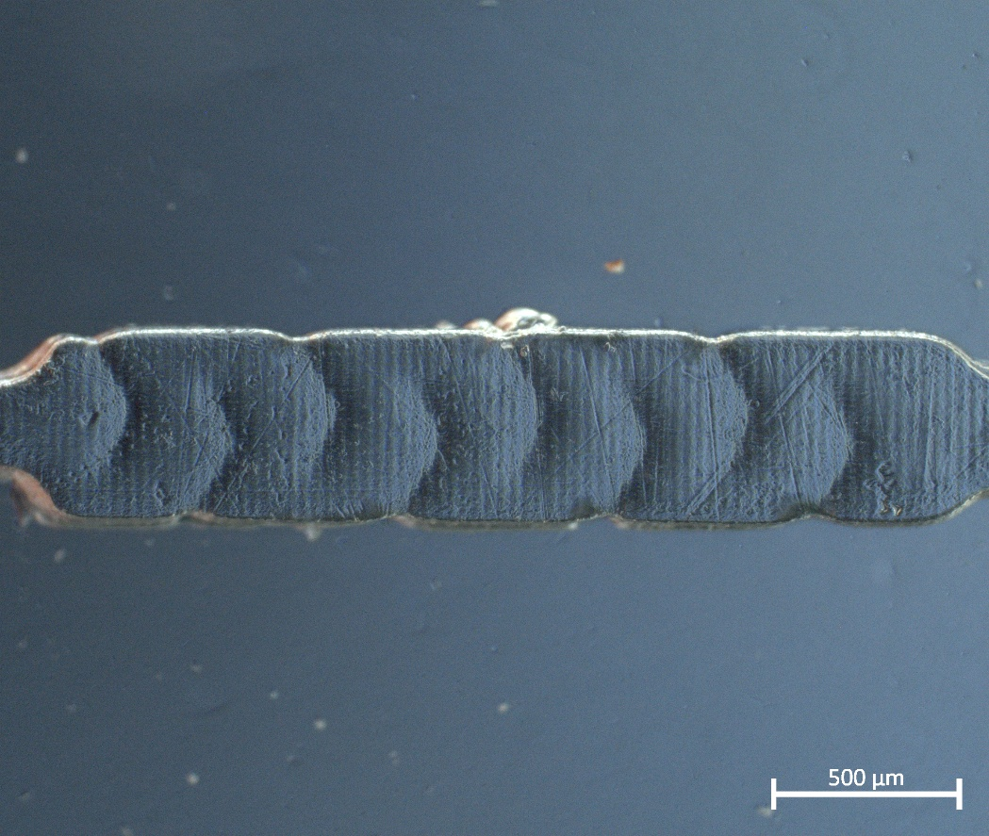
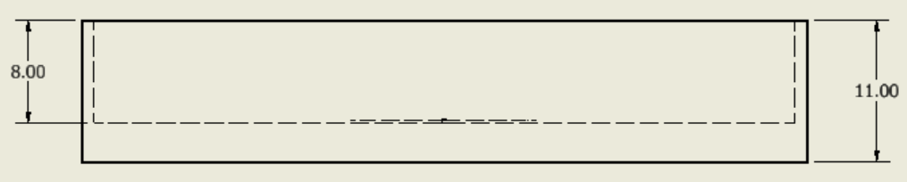
Aim 2: Design
13
Figure 8: Microscope image of herringbone.
Figure 9: Dimensioned 3D print model. All units in mm.

Slide 15
Conclusions
14
Aim 1:
Successfully loaded EVs with fluorescent calcein by passive incubation
Moving forward:
  Use standardized EV : calcein molar ratios
  Explore calcein self-quenching concentrations
Aim 2:
Successfully developed a microfluidic device
Moving forward:
  Test device with EV & calcein solution

Slide 16
Acknowledgements
15
Thank you to Dr. Kristen Dellinger, Jessica Ayivi, and Gregory Roberts for their continuous support and guidance
Work funded by NSF REU Award No. 2349519 and NSF Award No. 2302452
Thank you to the Nanobio Innovations Lab, the Joint School of Nanoscience and Nanoengineering, North Carolina A&T University, and the University of North Carolina Greensboro

Slide 17
References
16
[1] “Extracellular Vesicles (EVs) – Microvesicles (MVs) | Stago.com,” 2024. Accessed: July 23, 2026. [Online]. Available: https://www.stago.com/haemostasis/tests-clinical- applications/extracellular-vesicles-evs-microvesicles-mvs/
[2] T. Huyan et al., “Extracellular Vesicles – Advanced Nanocarriers in Cancer Therapy: Progress and Achievements,” International Journal of Nanomedicine, vol. Volume 15, pp. 6485–6502, Aug. 2020, doi: 10.2147/ijn.s238099.
[3] R. Hao, Z. Yu, J. Du, S. Hu, C. Yuan, H. Guo, Y. Zhang, H. Yang 2102150, A High -Throughput Nanofluidic Device for Exosome Nanoporation to Develop Cargo Delivery Vehicles. Small 2021, 17, 2102150. https://doi.org/10.1002/smll.202102150
[4] C. Piunti, S. Micheli, S. Giancaterino, P. Fusco, C. Boi, and E. Cimetta, “Microfluidic loading of verteporfin into extracellular vesicles for neuroblastoma therapy,” Lab on a Chip, vol. 25, no. 7, pp. 1718–1727, 2025, doi: https://doi.org/10.1039/d4lc01103a.
[5] PubChem, “Calcein,” PubChem, 2026. Accessed: July 23, 2026.[Online]. Available: https://pubchem.ncbi.nlm.nih.gov/compound/Calcein

