Slide 1
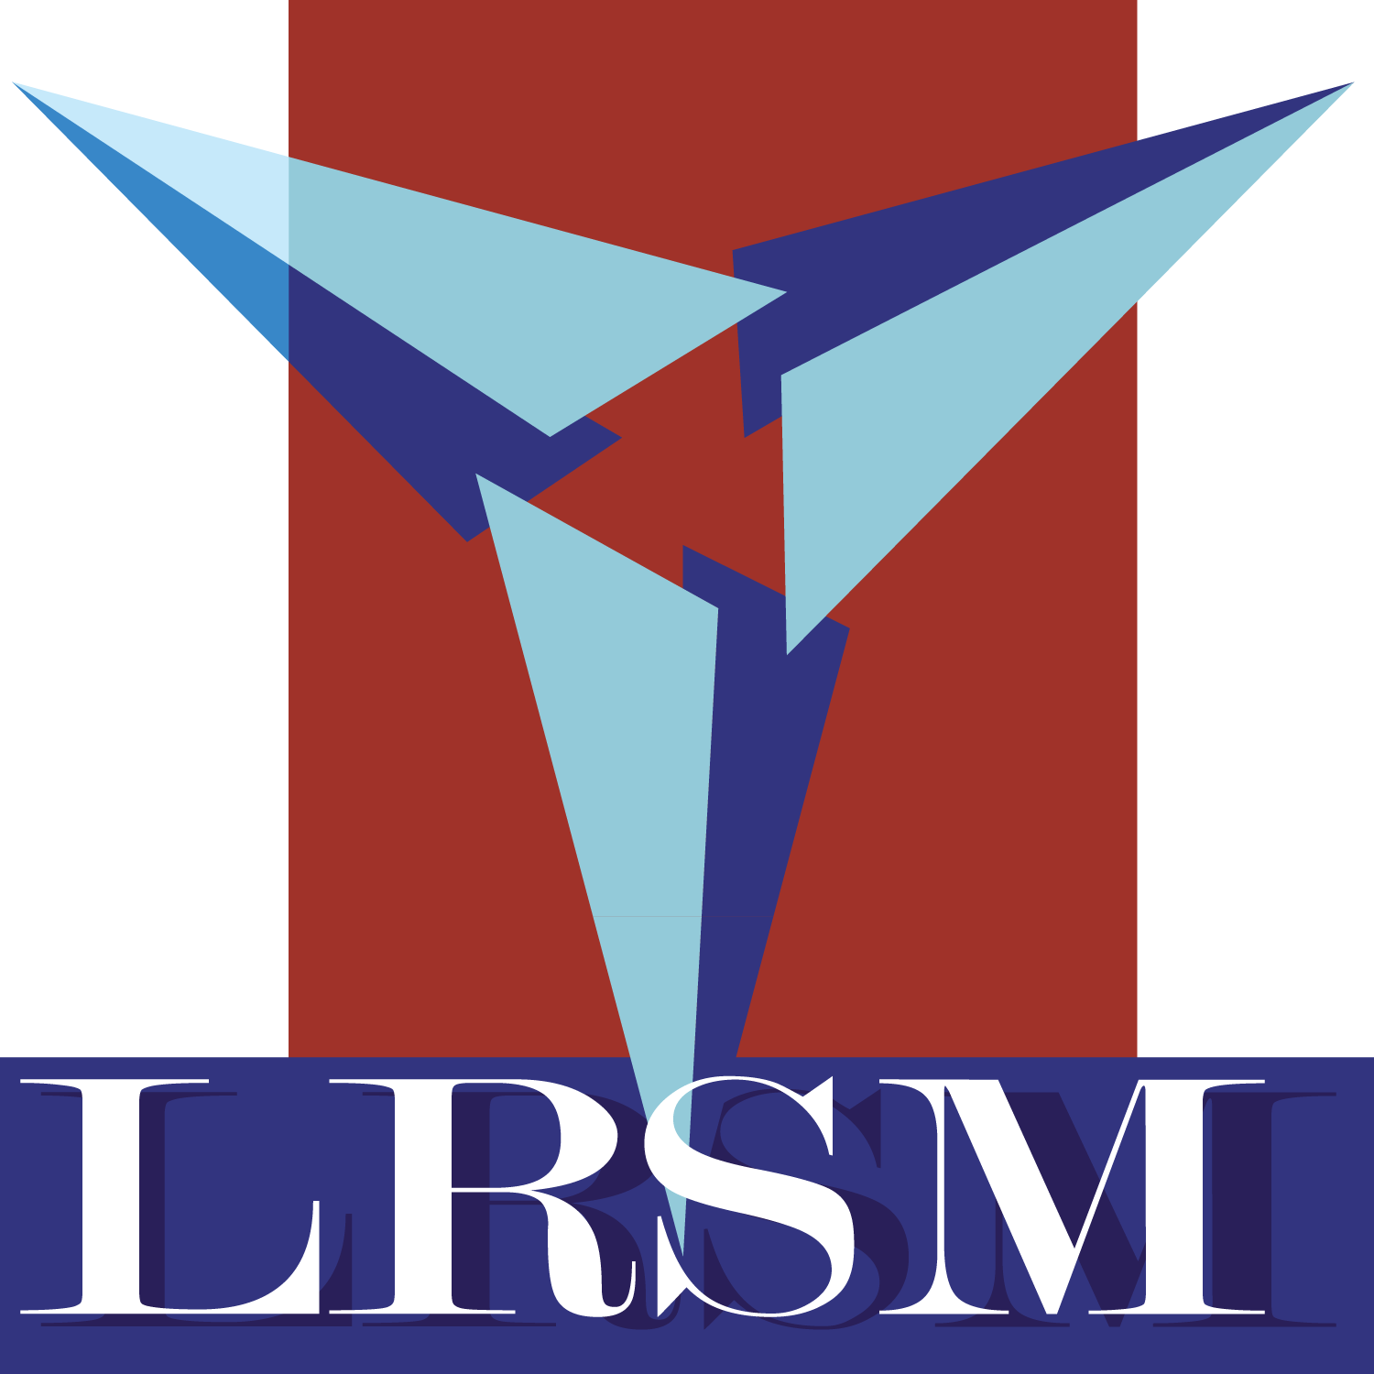

Fabrication and Scale-Up of Honeycomb-Structured Ultrathin Films
Presenter: Enmanuel Rijo
Research Mentors: Gulzhan Aldan, Matthew F. Campbell, Ph.D.
Principal Investigator: Igor Bargatin, Ph.D.
July 27, 2026

Slide 2

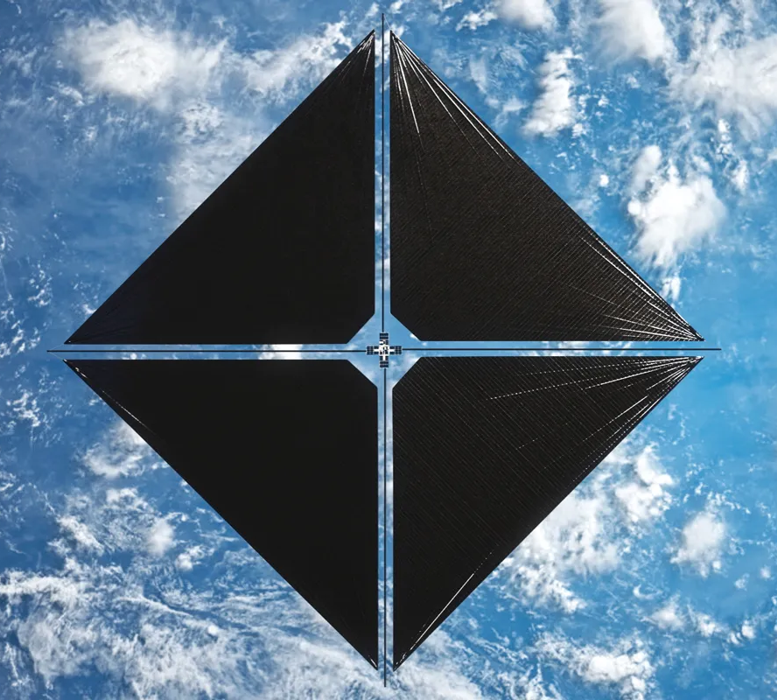

The Challenge of Space Propulsion
Carrying fuel increases spacecraft mass, launch cost, and limits range
Can we move spacecrafts without carrying so much fuel?
Solar sails reduce dependence on onboard fuel by using light for propulsion

Slide 3
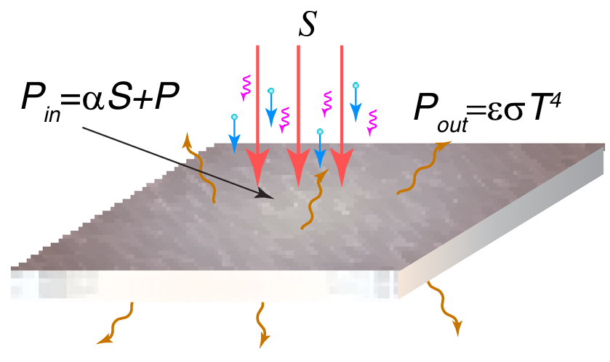
Why Ceramic Ultrathin Films?
Ceramic oxides are useful for ultrathin films because they provide:
High thermal stability
Low optical absorption
Mechanical stiffness
Davoyan, A. R. et al. Optica 8, 722–734 (2021).
For solar sails, the goal is to limit $P_{in}$ and increase $P_{out}$,
keeping the ultrathin film thermally stable.

Slide 4
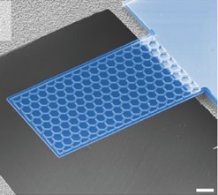
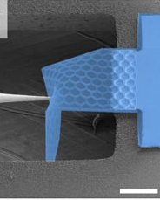
Modifying a material's structure to tune its properties
100 μm
Davami, K. et al. Nat. Commun., 6, 10019 (2015)
Honeycomb structure improves lightweight material stiffness and shape recovery

Slide 5
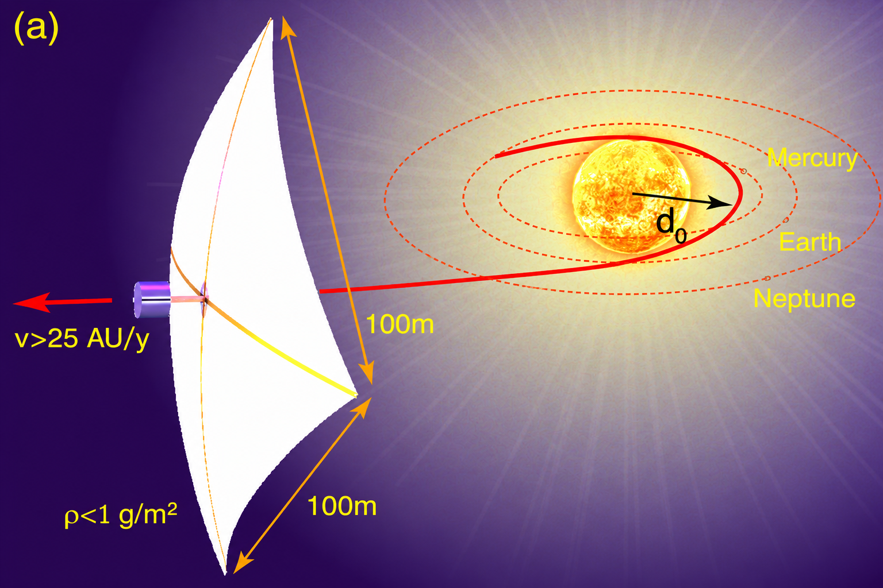
Solar sails need to be big.
Davoyan, A.R. et al. Optica, 8(5), 722-734 (2021)

Slide 6
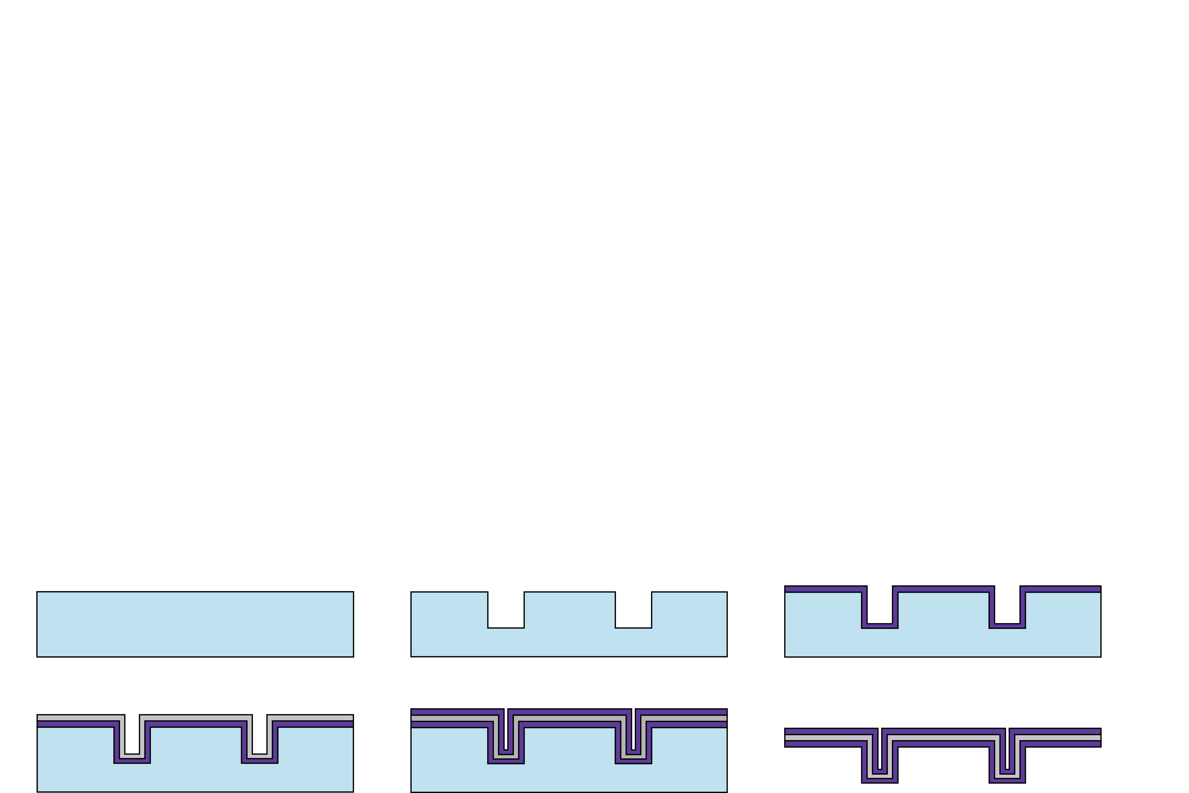
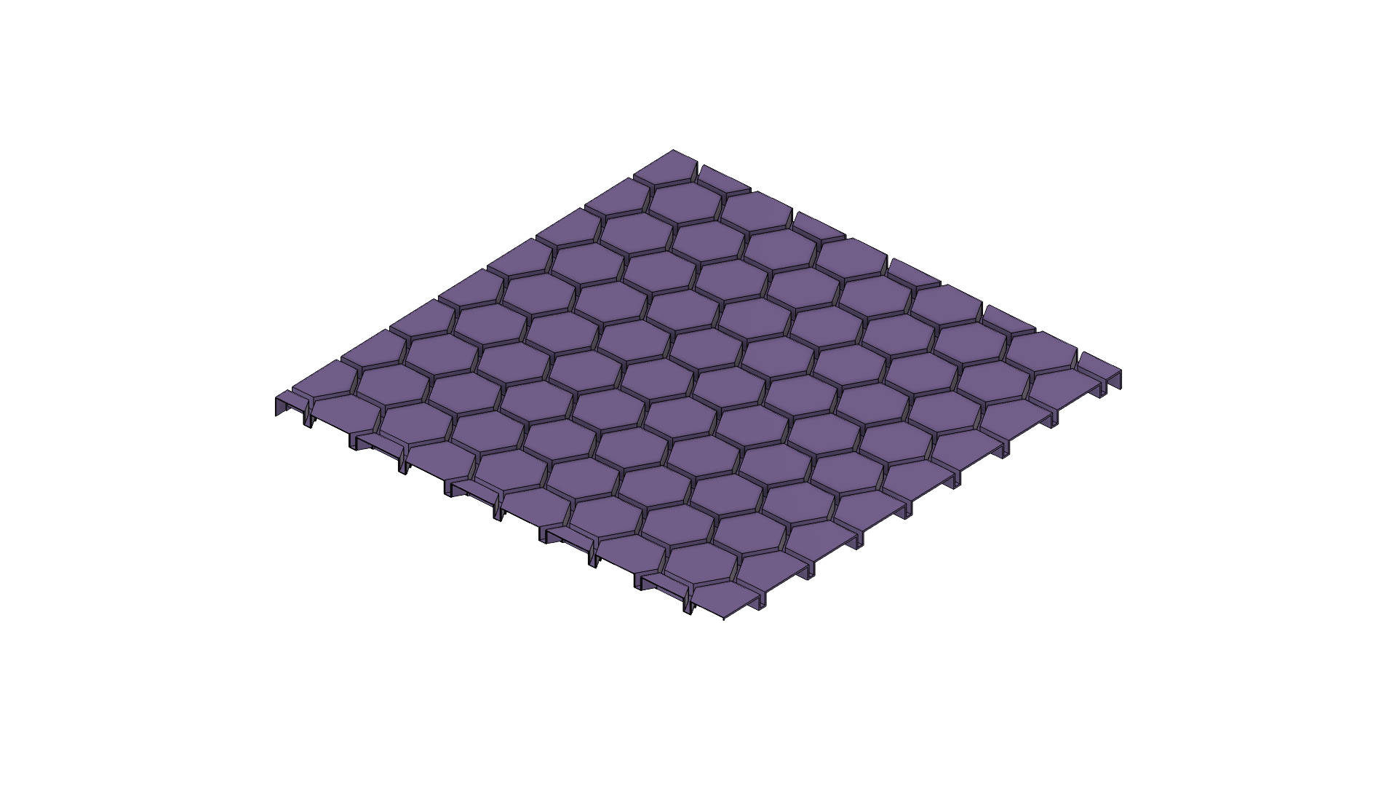
How do we scale up corrugated plates?
Our goal: fabricate films ~6 cm wide with a more scalable process
(1) Ceramic with increased thermal stability
(2) Reflective metallic core
(3) Laser-engraved plastic substrate
100 μm
cross section view
Not to scale. Hexagon size exaggerated for visibility.

Slide 7

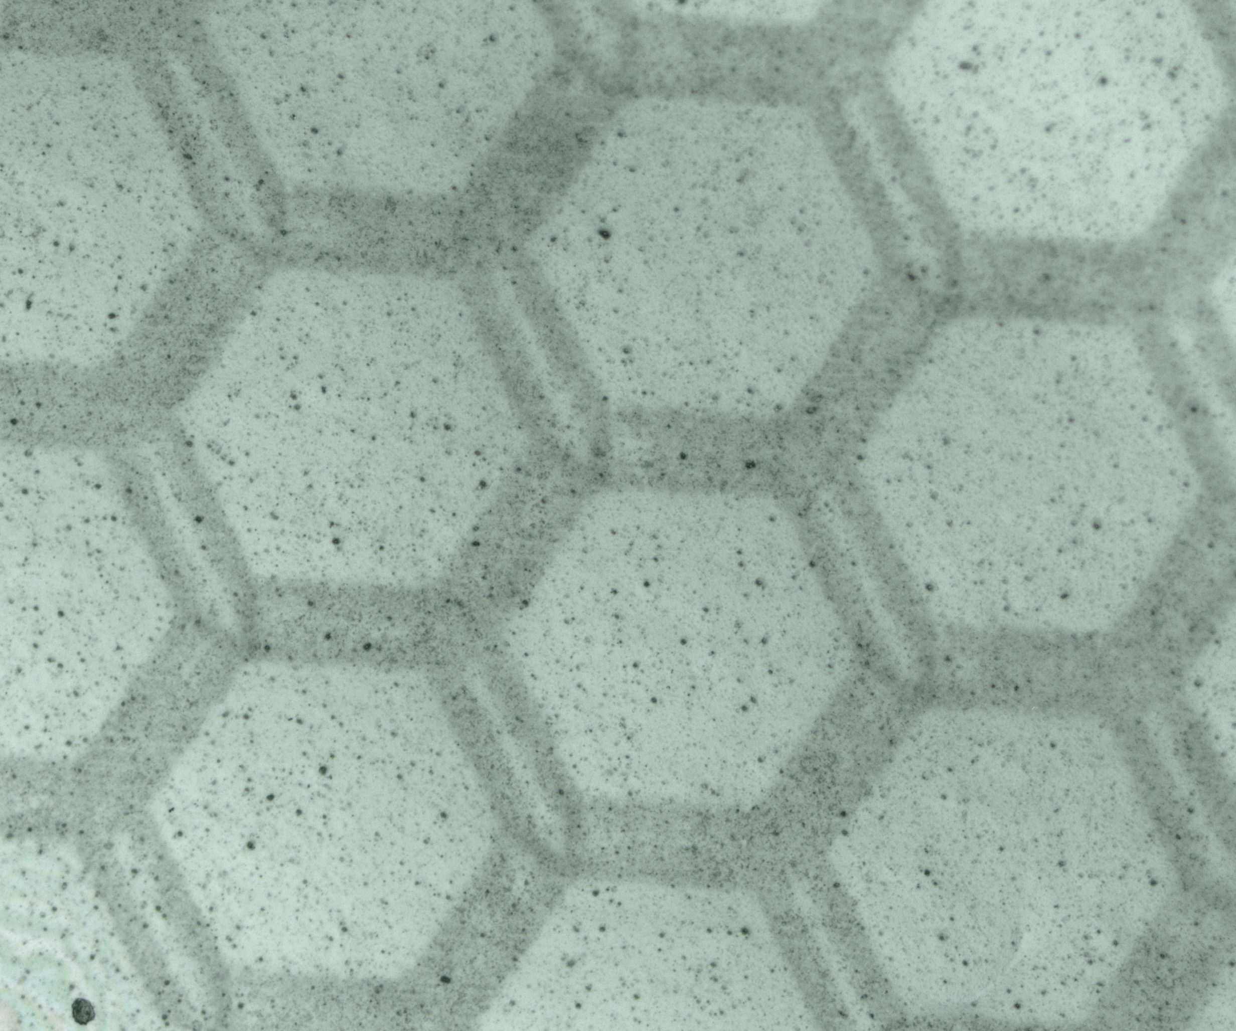
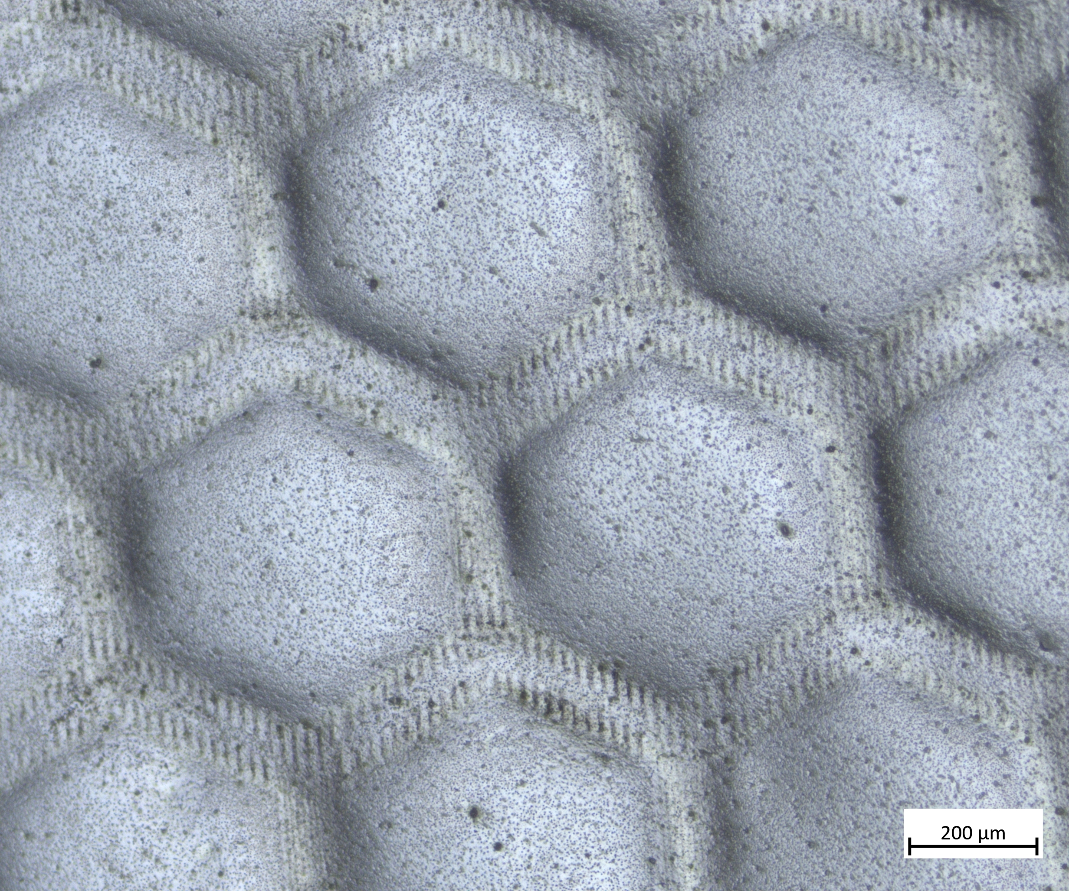
Fabricating Films with a Mylar Mold
1
2
3
3.5 μm
Fabrication starts with Mylar, a thin plastic
Engrave honeycomb pattern with a laser
Deposit hafnia layer by ALD (30 nm)
Scale bars are 500 μm

Slide 8

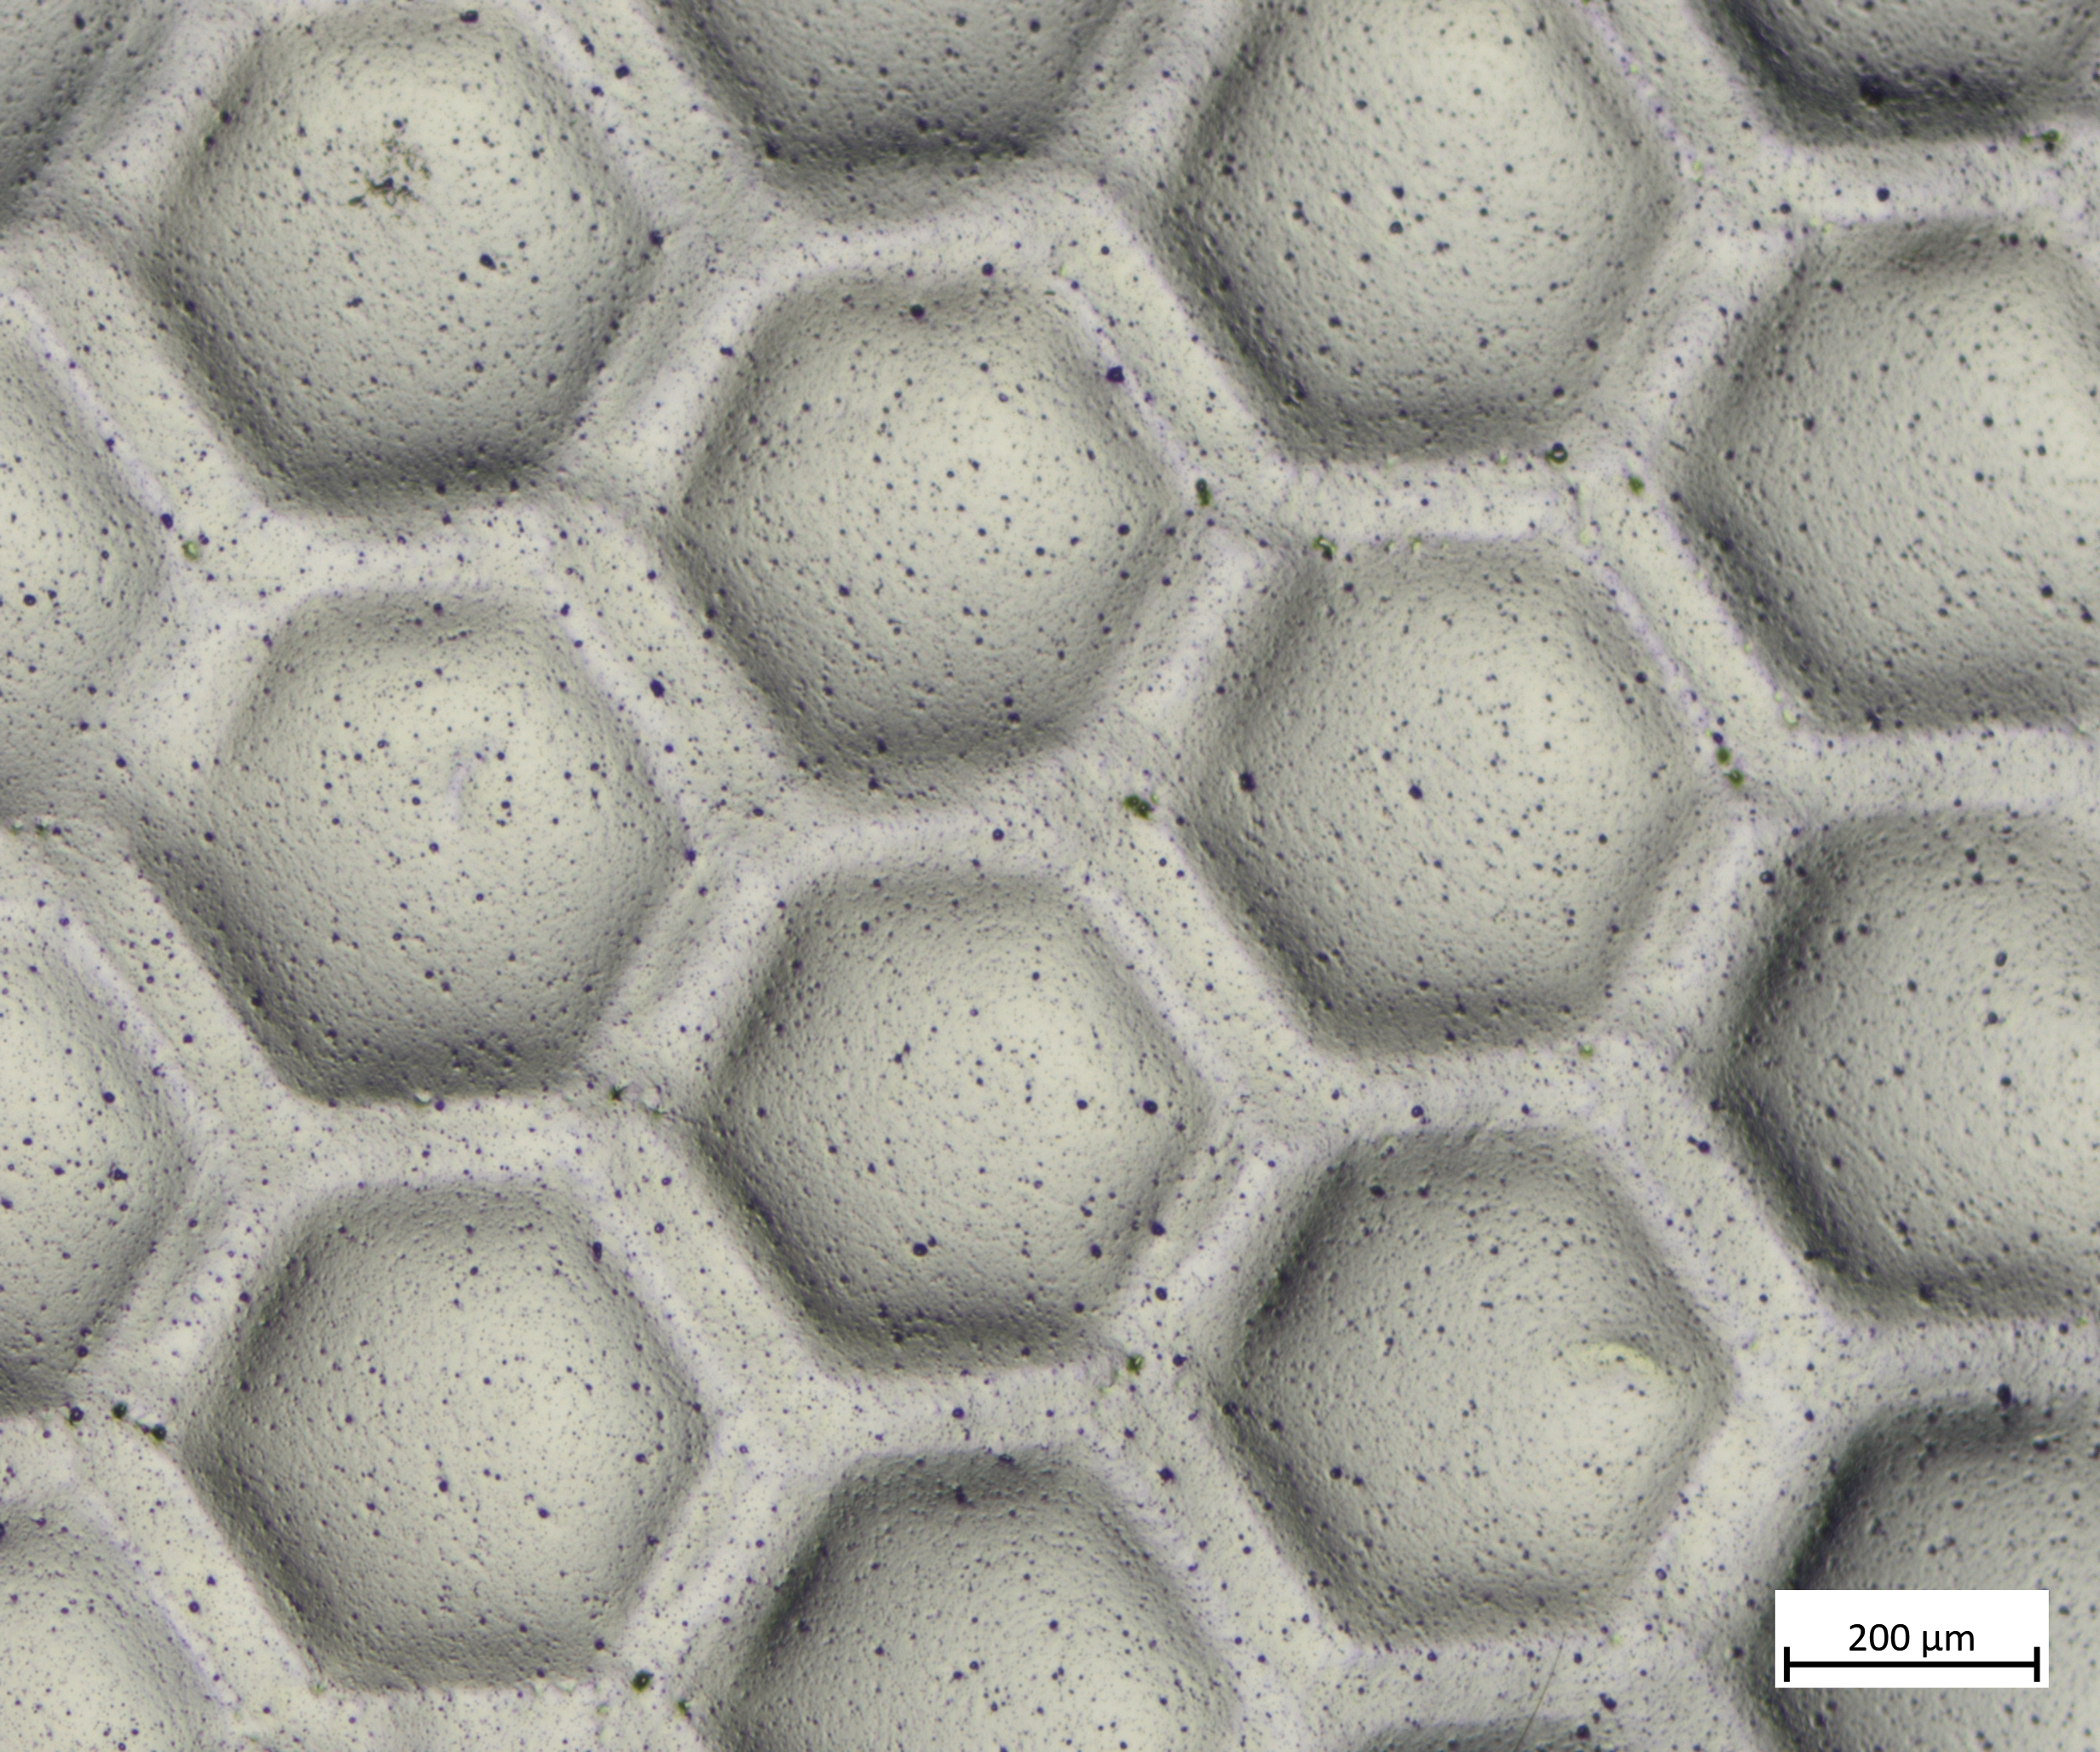
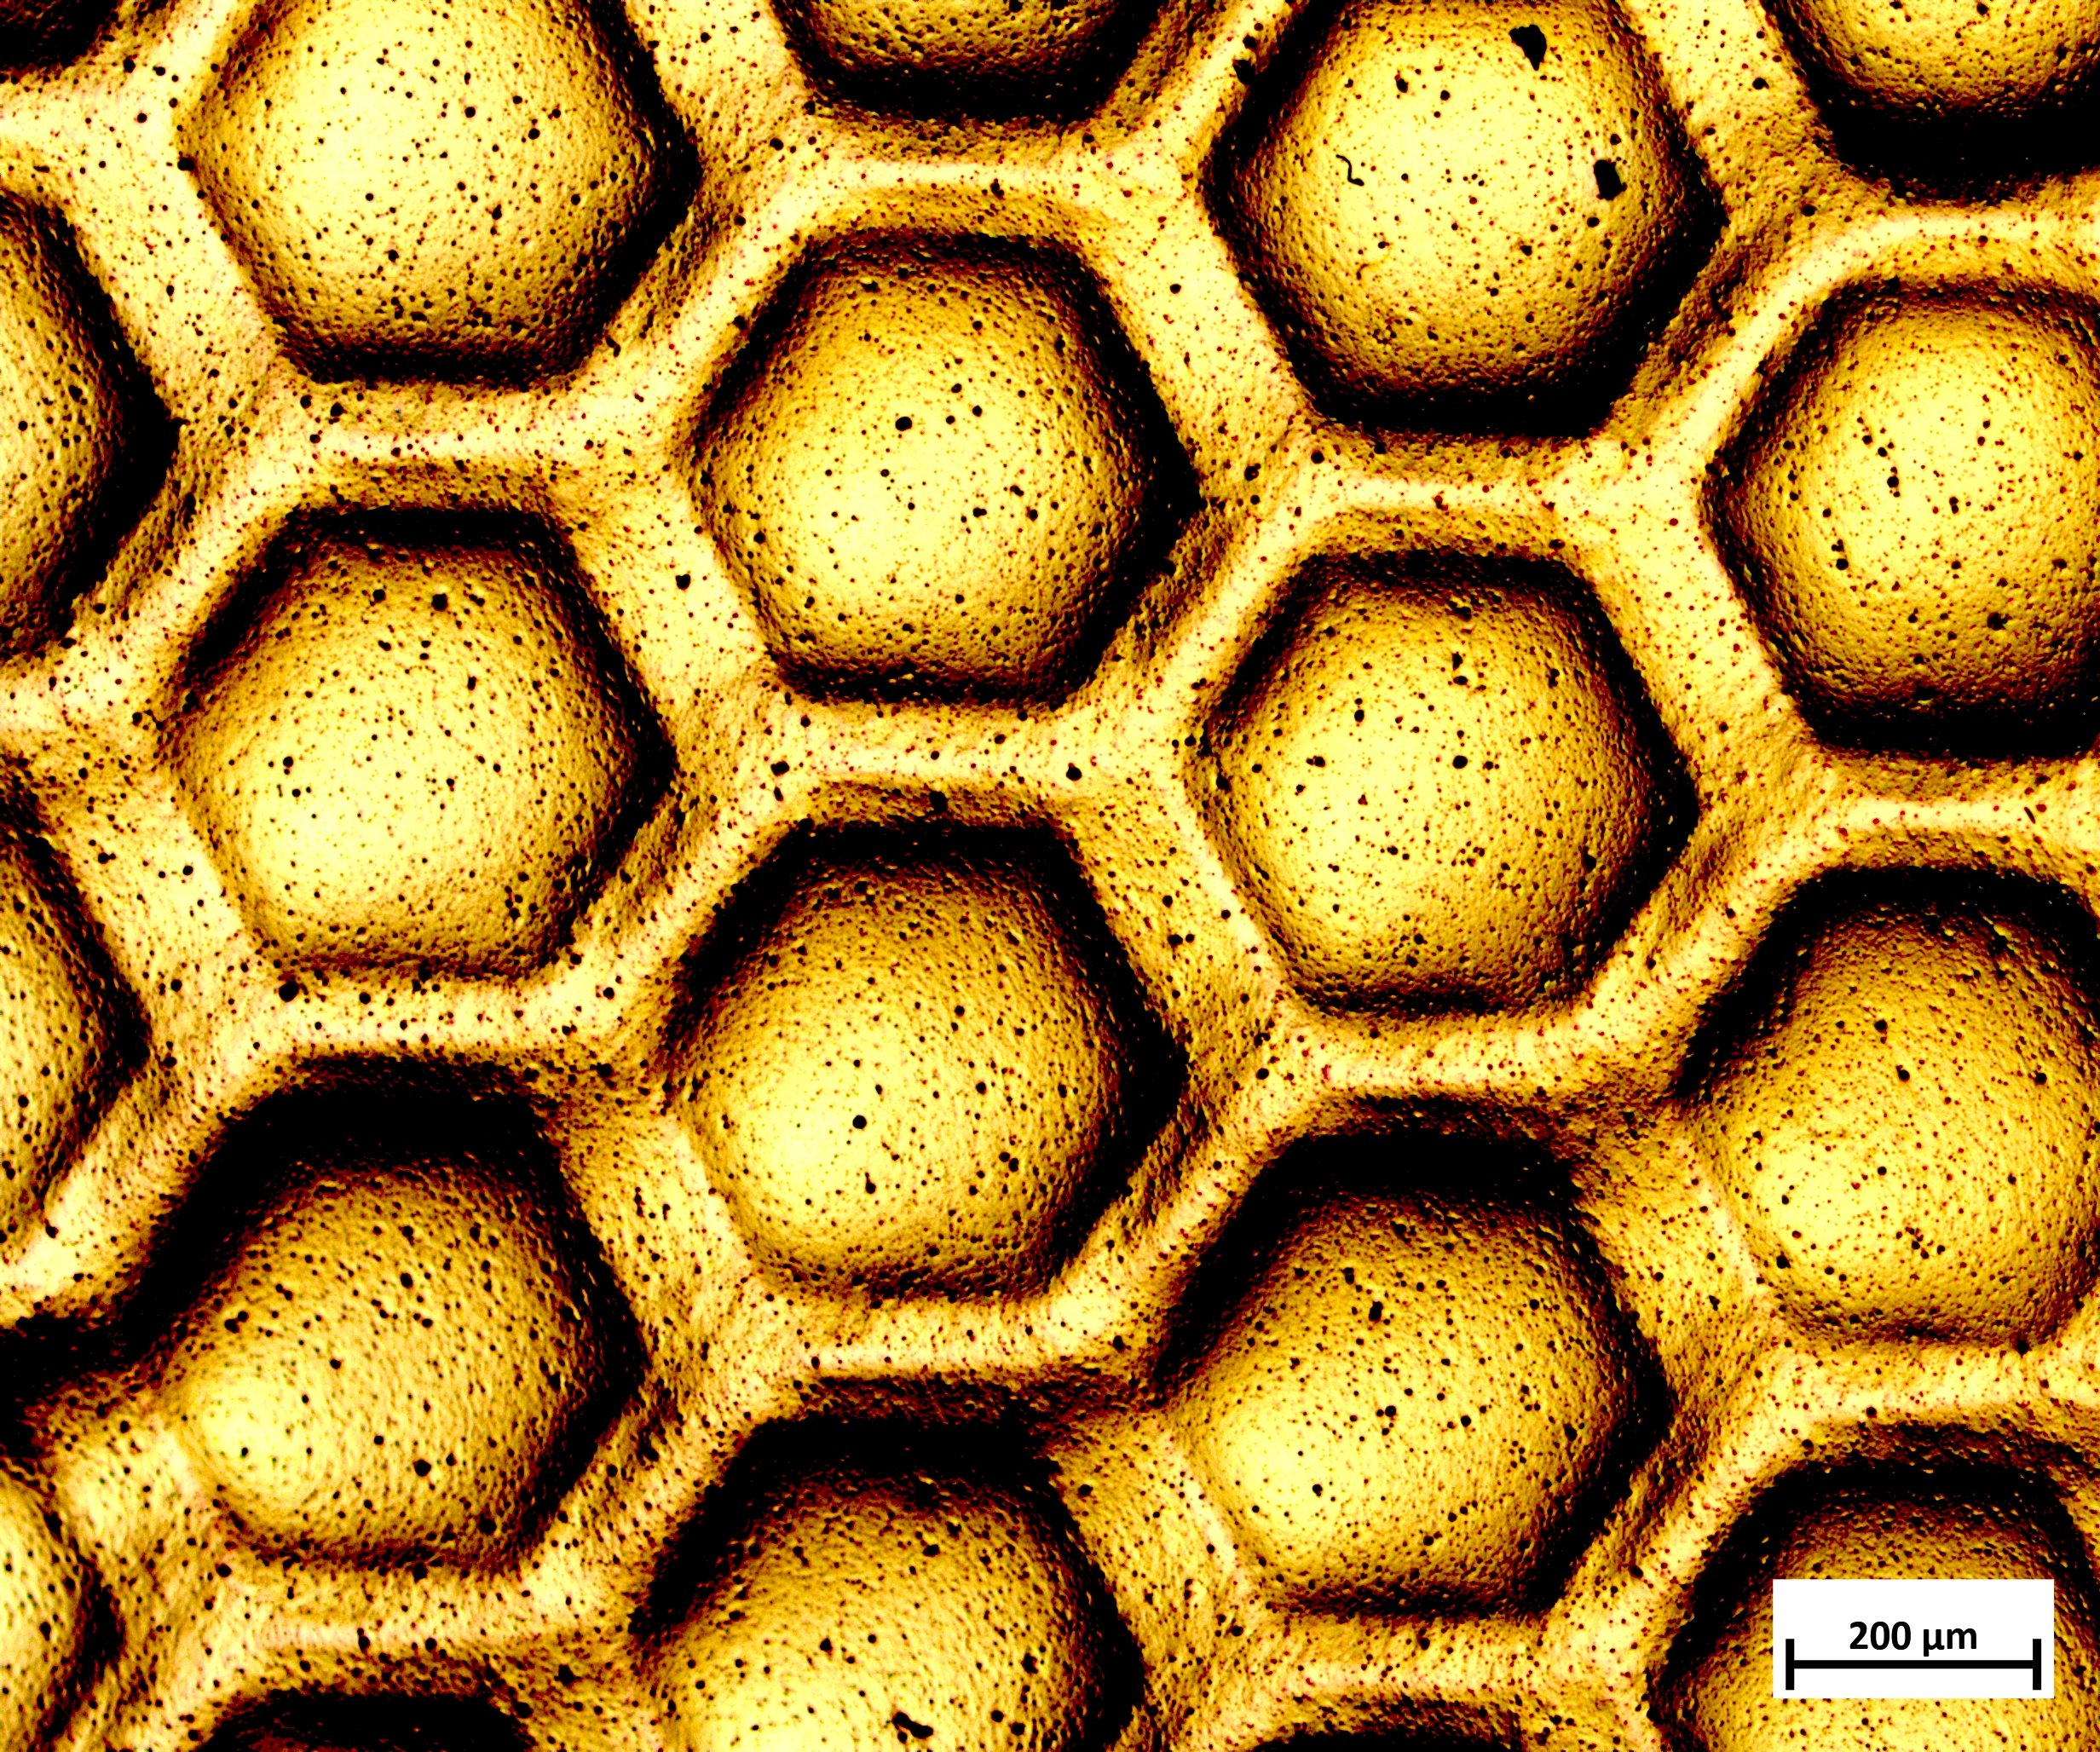
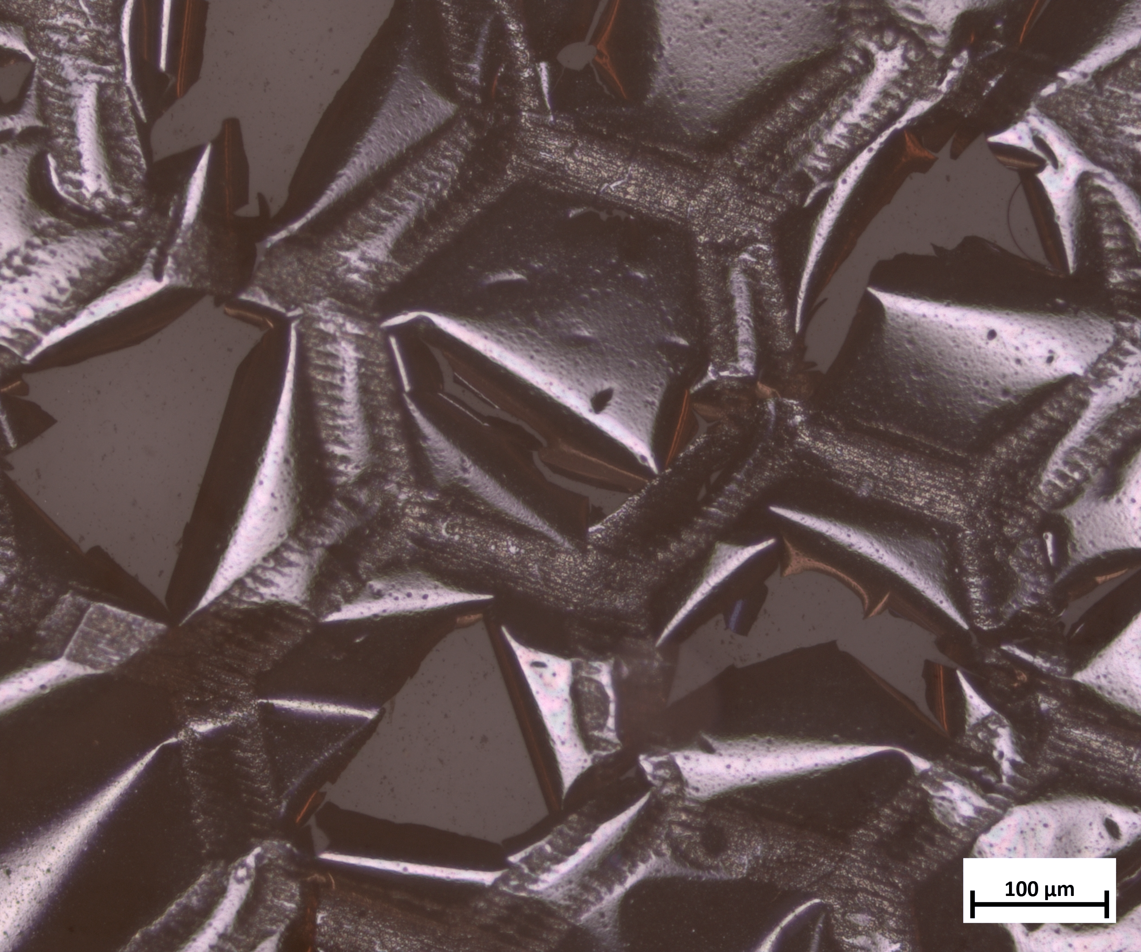
Fabricating Films with a Plastic Mold
4
5
6
Deposit aluminum by sputtering (60 nm)
Deposit 2nd hafnia layer by ALD (30 nm)
Remove substrate by plasma ashing
→ final product!
Scale bars are 500 μm

Slide 9
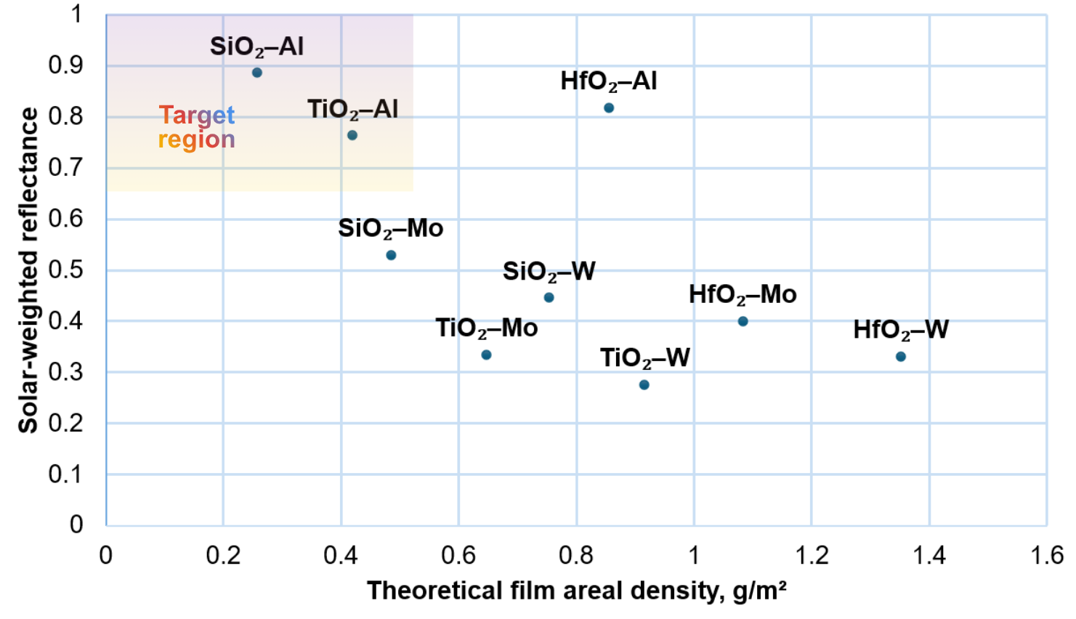
How can we predict the optical behavior of thin films?
SiO₂–Al and TiO₂–Al seem to provide the best balance.
Thermal behavior, mechanical stability, and experimental validation must also be considered.

Slide 10
Scaling up corrugated plates
Laser-patterned plastic molds provide a scalable fabrication pathway
Simulations give insight on optimal parameters before full fabrication.
Future directions
Optimize the plasma process to reduce thermal stress
SEM or profilometry to better understand surface topography and release quality
Davoyan, A.R. et al. Optica, 8(5), 722-734 (2021)

Slide 11
Thank you!
Acknowledgements
A huge thank-you to:
Gulzhan Aldan and Matthew F. Campbell, Ph.D.
Principal Investigator: Igor Bargatin, Ph.D.
This work was carried out in part at the Singh Center for Nanotechnology, which is supported by the NSF National Nanotechnology Coordinated Infrastructure Program under grant NNCI-2025608, and through the use of facilities supported by the University of Pennsylvania Materials Research Science and Engineering Center (MRSEC) DMR-2309043.

