Slide 1
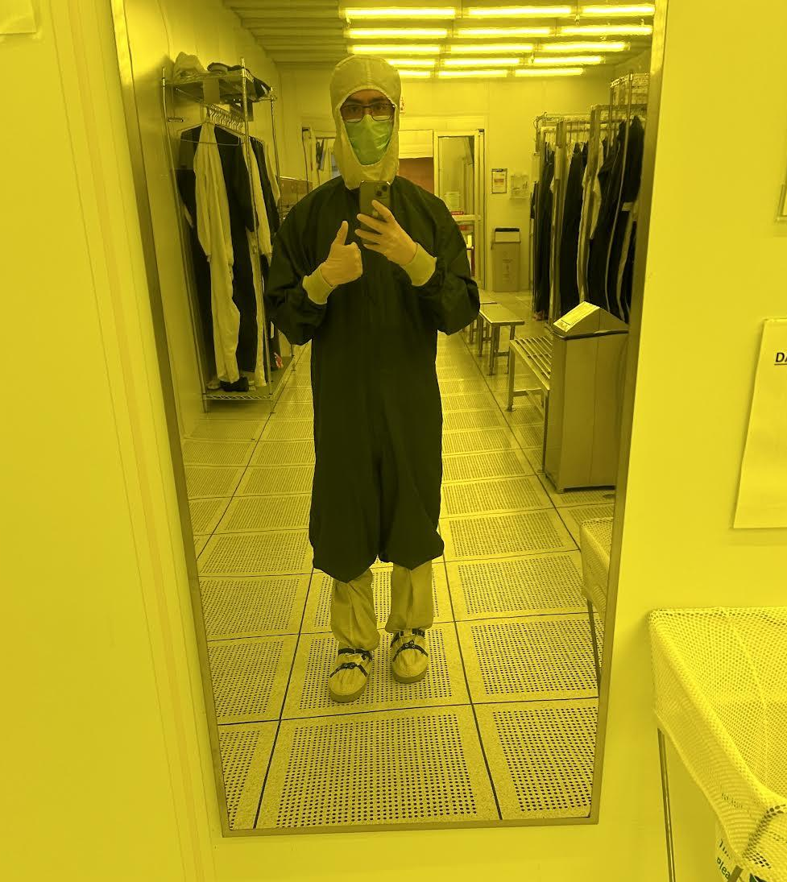
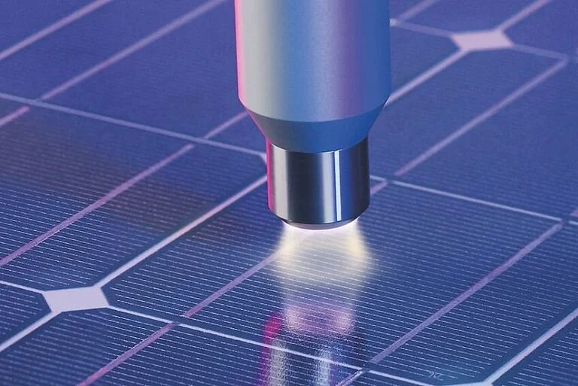
Open-Air Processing and Synthesis for ZnO Thin Film Transistors
Mateo Aleksov, Arizona State University
Nicholas Rolston, Arizona State University
Notes:
10 minutes total to present

Slide 2

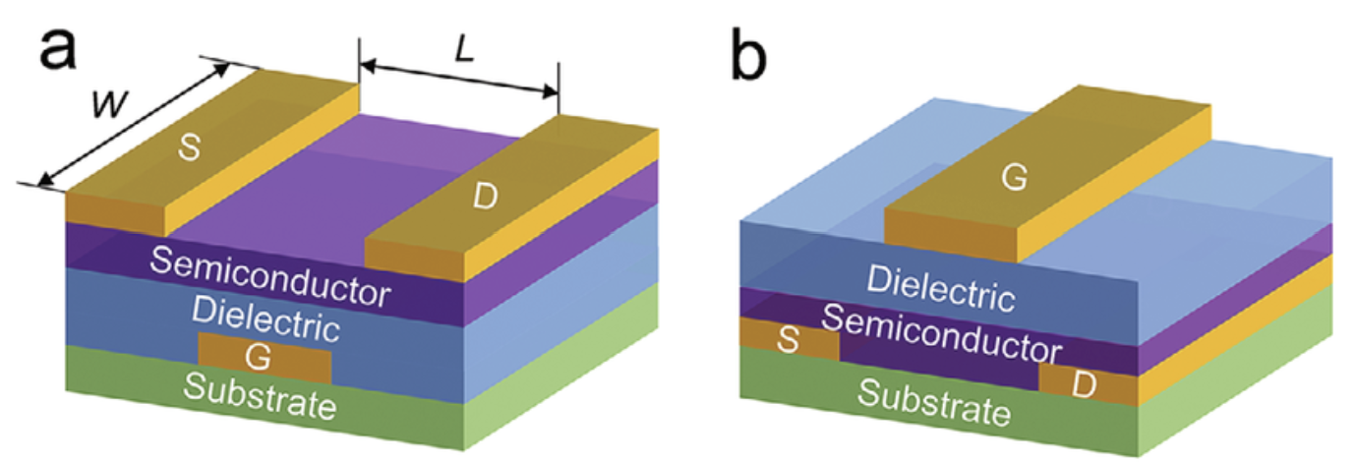
What are Thin Film Transistors?
Transistors are a fundamental component of electronics that serve as on/off switches
Field-Effect Transistors (FETs) are made up of a source, drain, and gate electrode, a dielectric insulator, and a semiconducting active layer [E]
  Operate by using a voltage source between the gate and drain electrodes to control whether current can pass through the semiconducting channel
Thin Film Transistors (TFTs) are FETs that are made by depositing thin layers
  Effective for flexible displays and are relatively cheap to manufacture
a) Bottom-gate TFT b) Top-gate TFT [A]
Notes:
Tells us why we should care about your problem! You should need to cite articles you have read to do this.

Slide 3
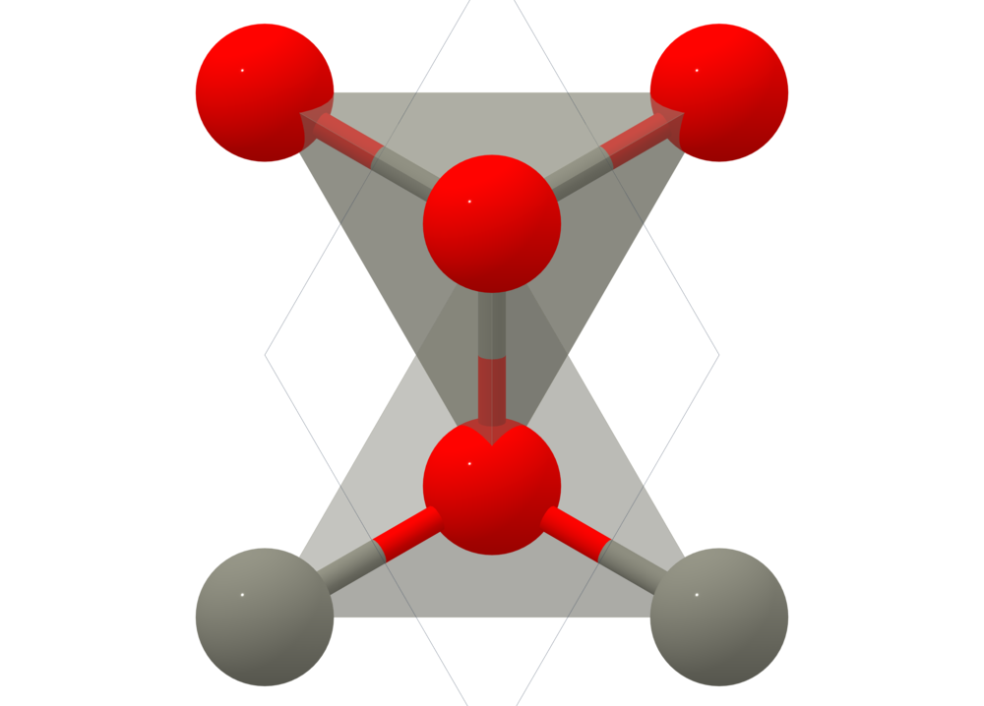
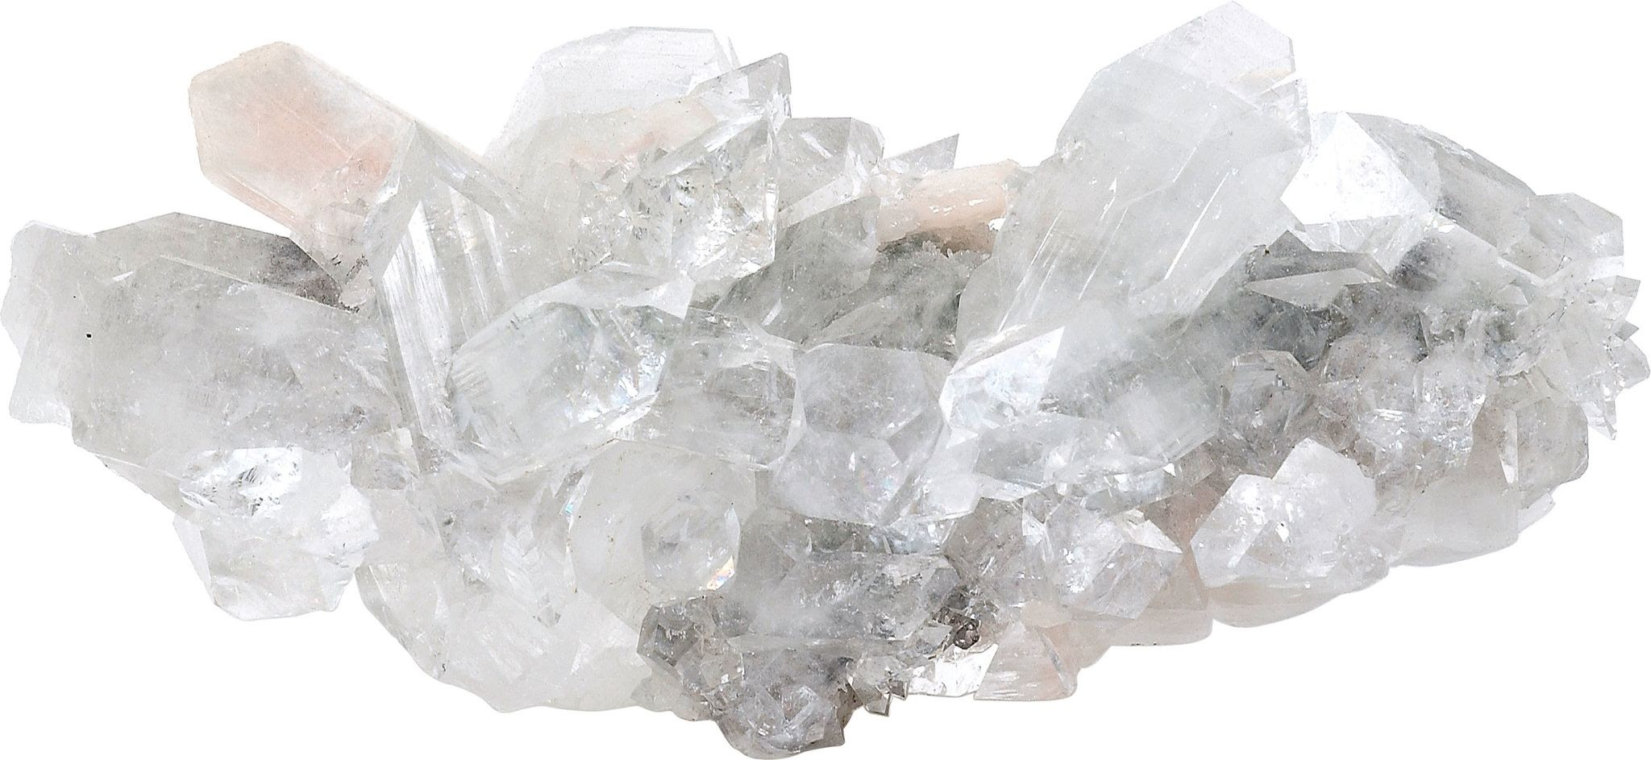
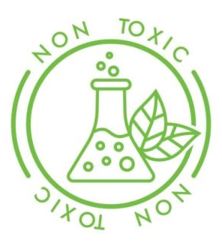
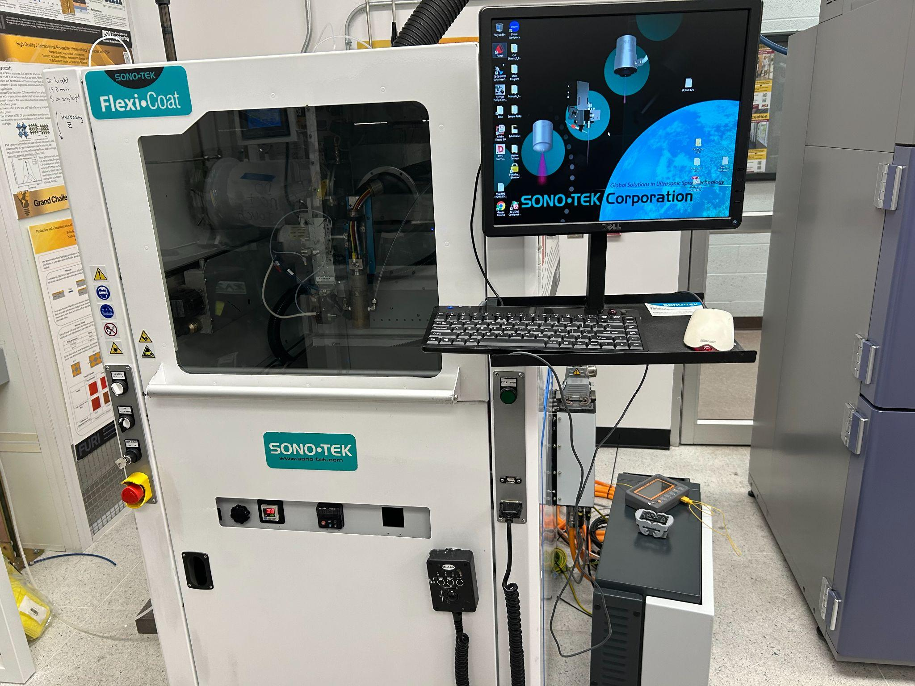

Why ZnO and Open-Air Processing?
ZnO has shown promising electrical and optical properties [D]
  Cheaper, abundant, and non-toxic
ZnO unit structure
SonoTek Plasmatreat System
Open-air processing can enable low-cost module manufacturing [B]
Plasmatreating is an environmentally safe and effective alternative to traditional cleaning and annealing methods [C]
Notes:
Tells us why we should care about your problem! You should need to cite articles you have read to do this.
Enables low-cost manufacturing through methods such as spin coating, spray coating, plasma treatments, and so on

Slide 4
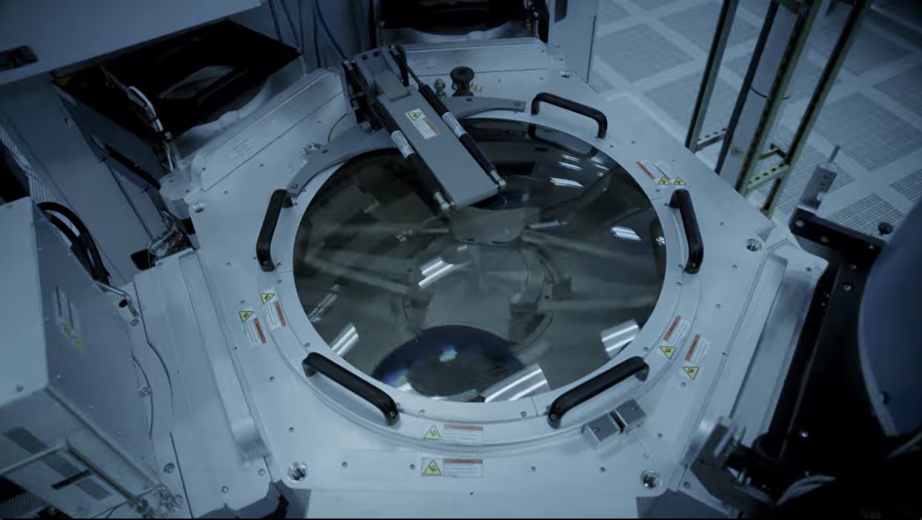
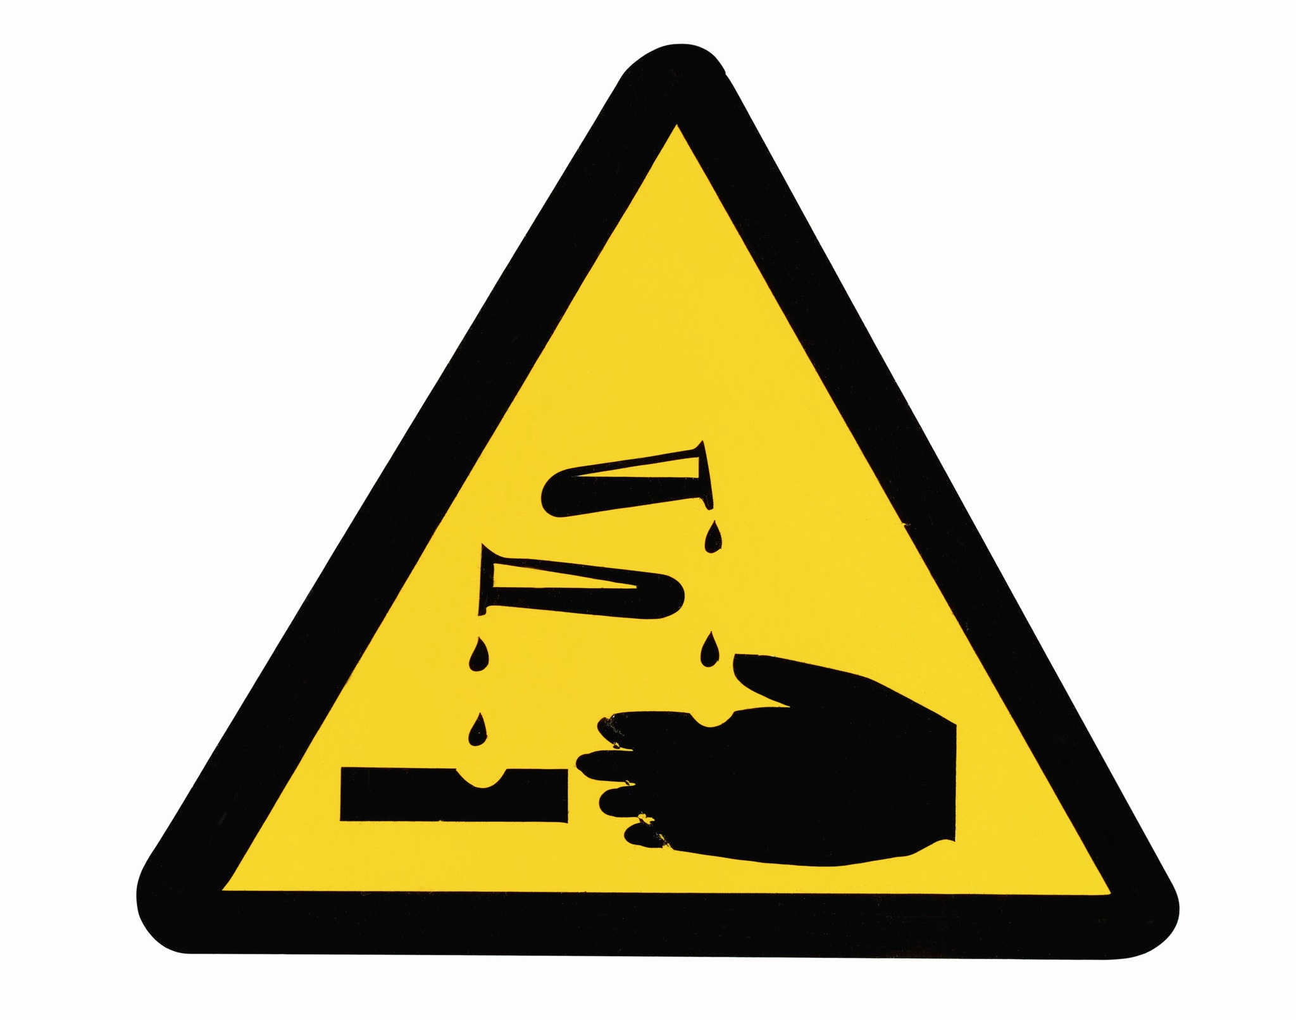


Reducing Manufacturing Costs and Impacts
Transistors traditionally require expensive and very clean manufacturing
Cleaning transistors can especially use many toxic chemicals, such as hydrofluoric acid
Wafer Fabrication Equipment
Open-air processing:
Circumvents the need for high cleanliness
Allows for quicker transistor production
Overall simplifies manufacturing
Is cheaper and more sustainable
Notes:
Tell us about the specific problem you are trying to solve. You will probably have to cite different articles here.
Open-air processing can circumvent the need for high cleanliness (and cost)
Open-air processing allows for quicker transistor production
Overall simplifies manufacturing, and makes it cheaper and more sustainable

Slide 5
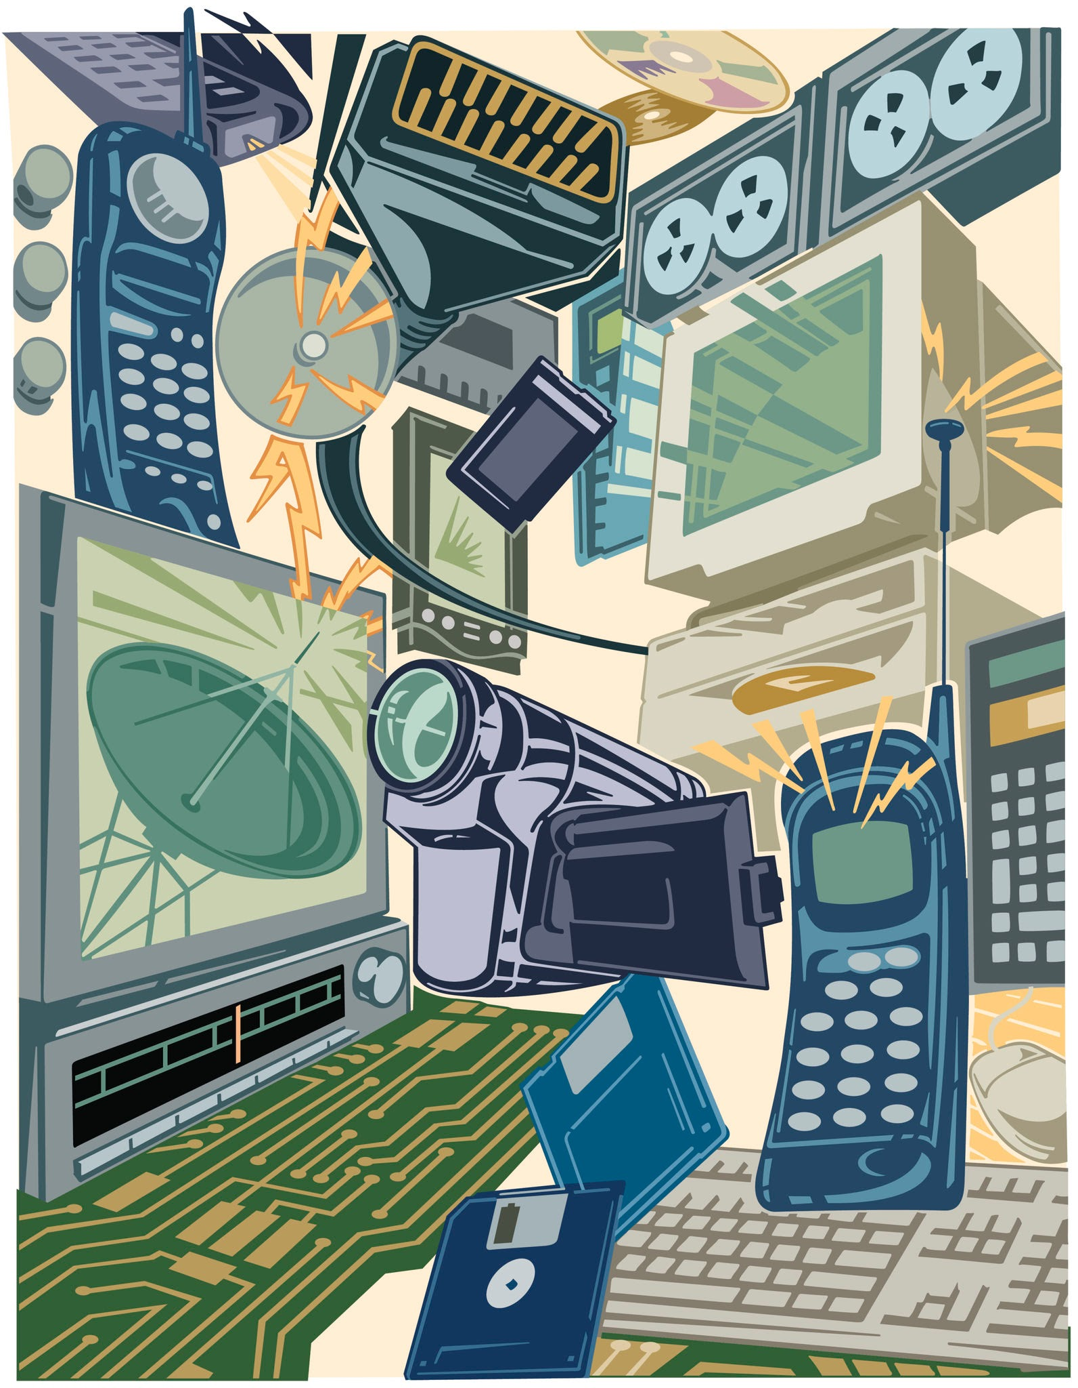
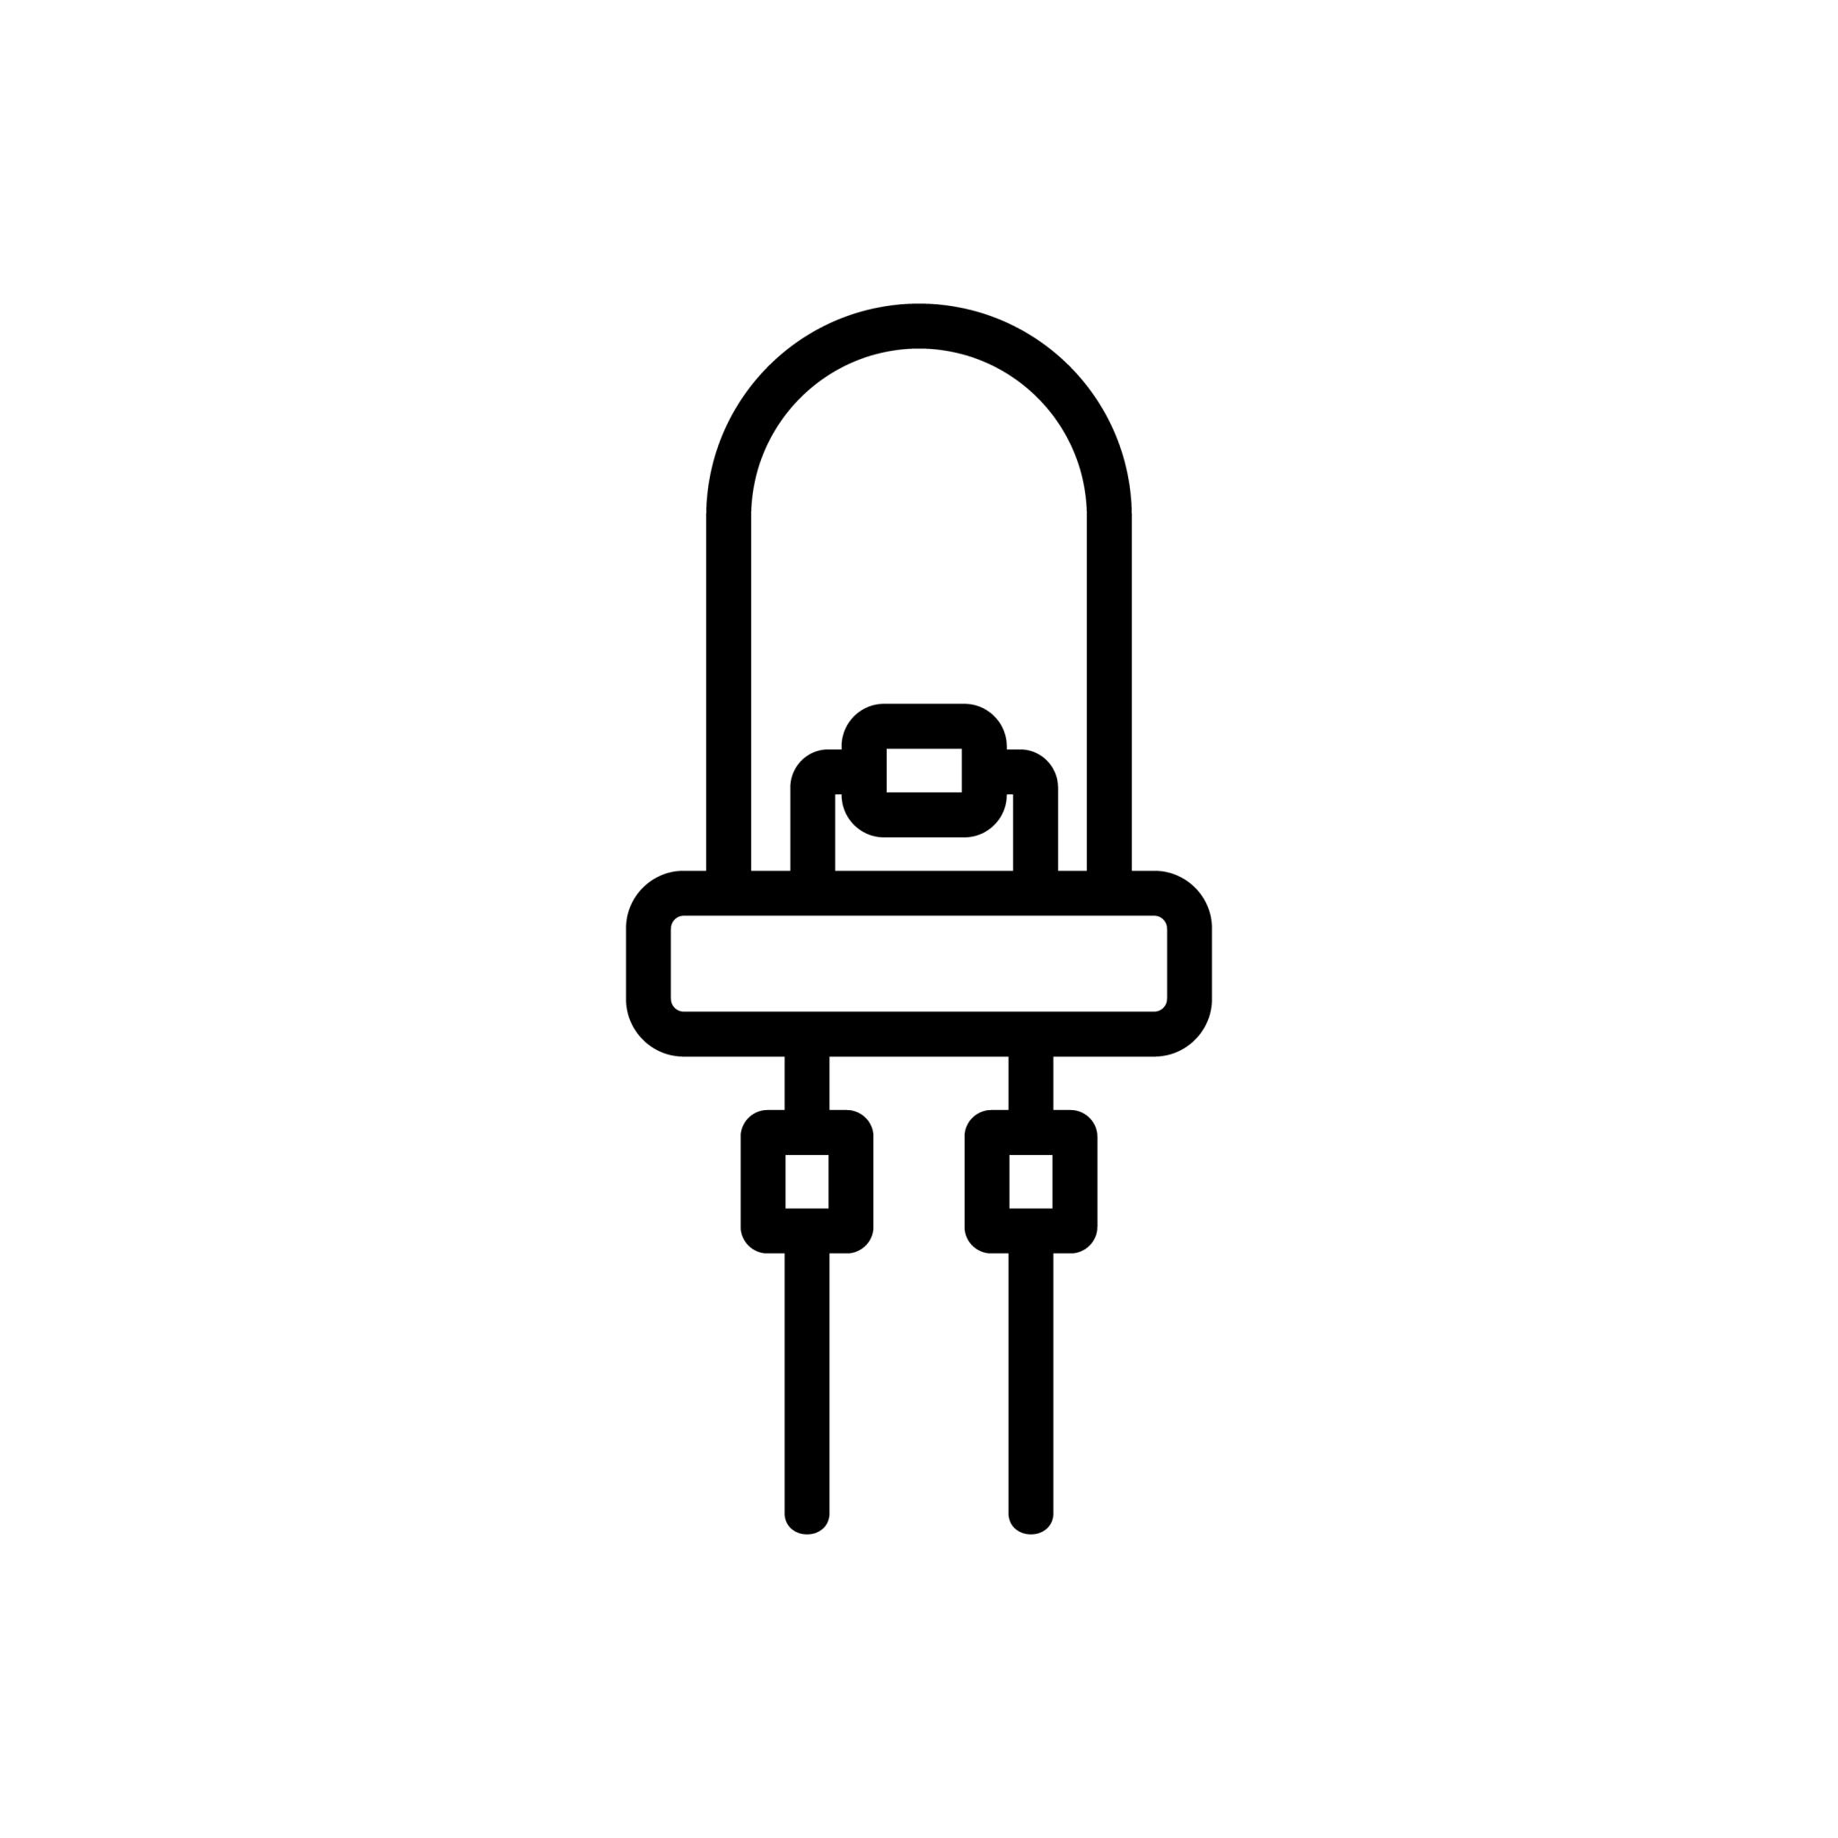
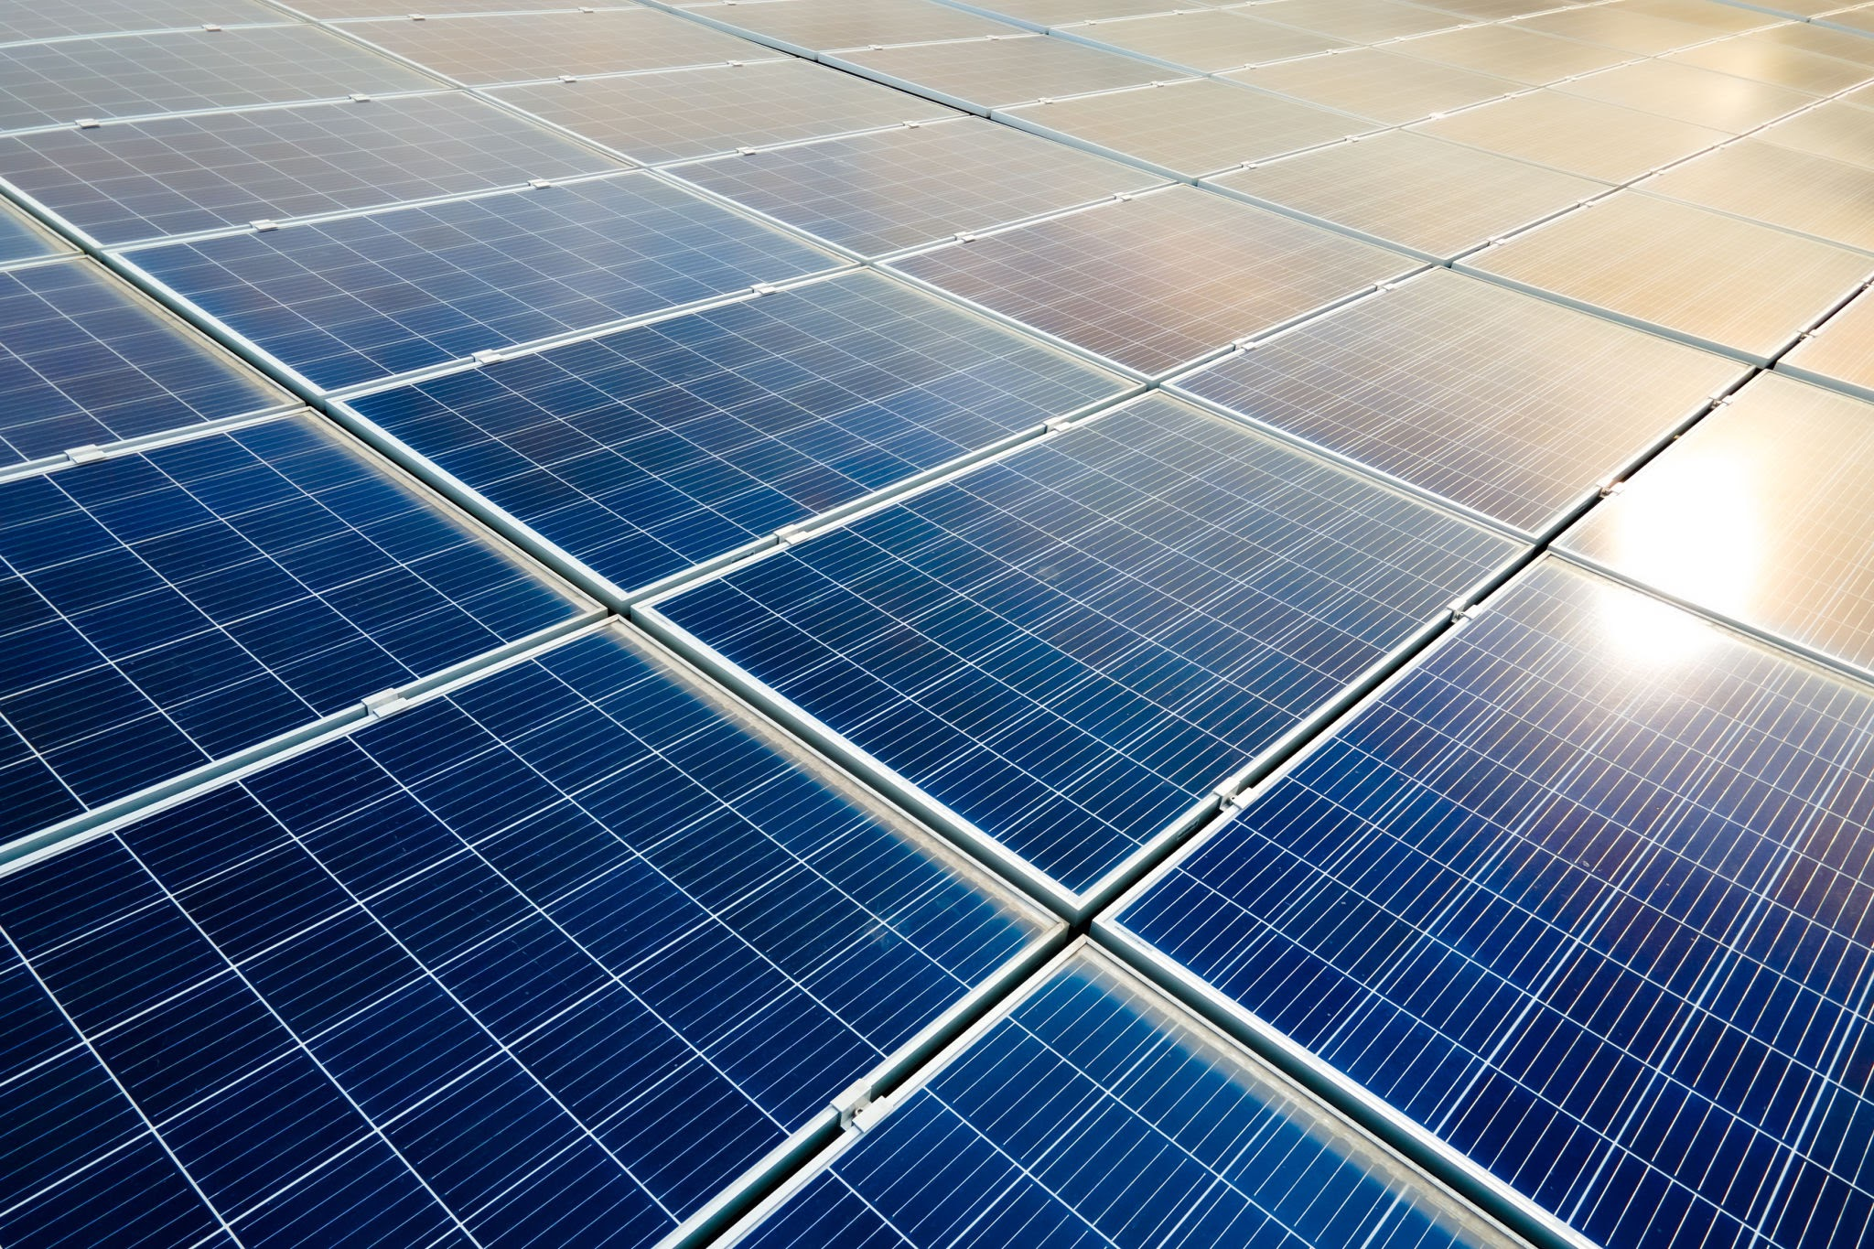
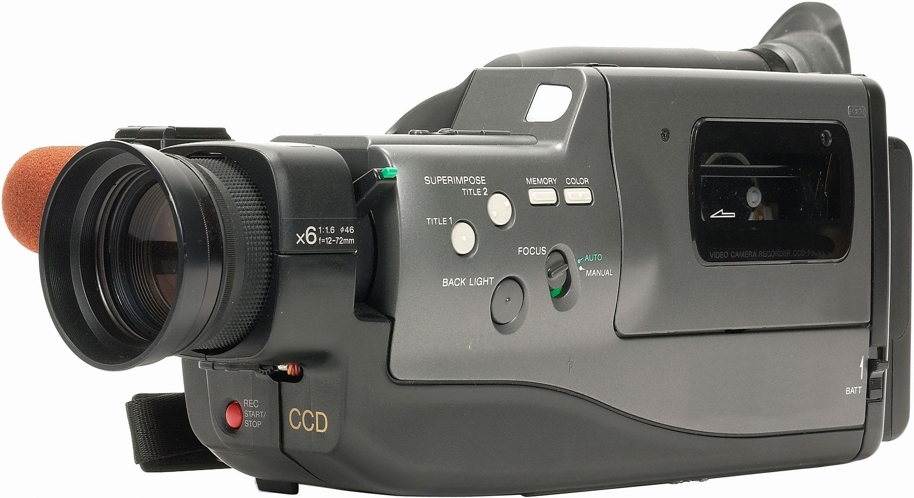

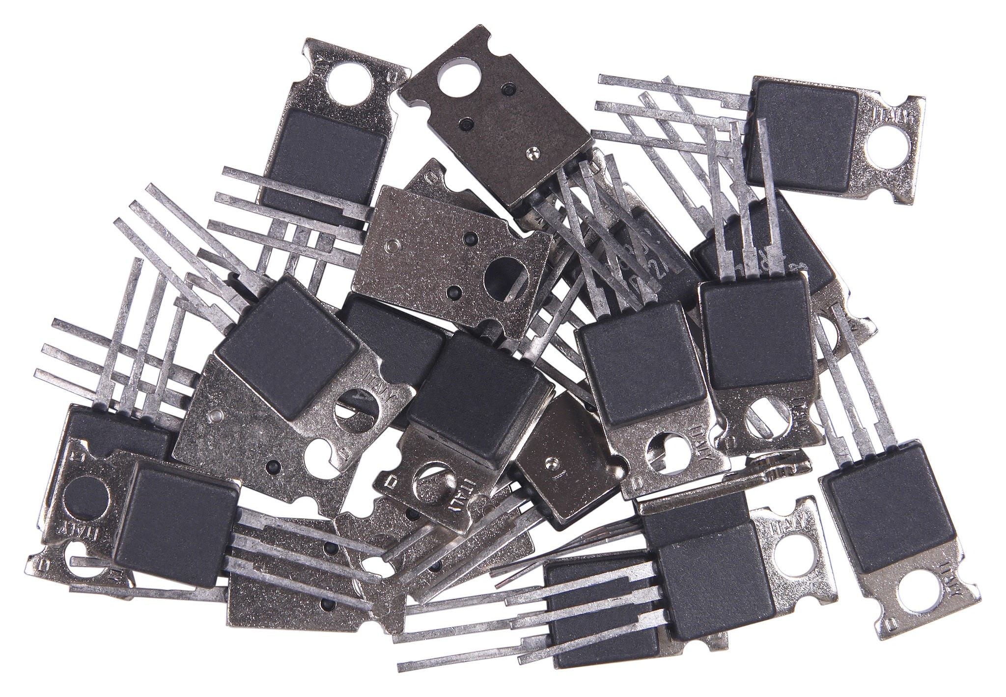



Why is this Relevant?
Transistors are used in nearly ALL electronics
ZnO TFTs have already shown promise in areas such as consumer electronics, LEDs, solar cells, and photodetectors [D]
=
=
Cheaper transistors = cheaper electronics = less resources needed = wider availability
Notes:
Tell us about the specific problem you are trying to solve. You will probably have to cite different articles here.

Slide 6
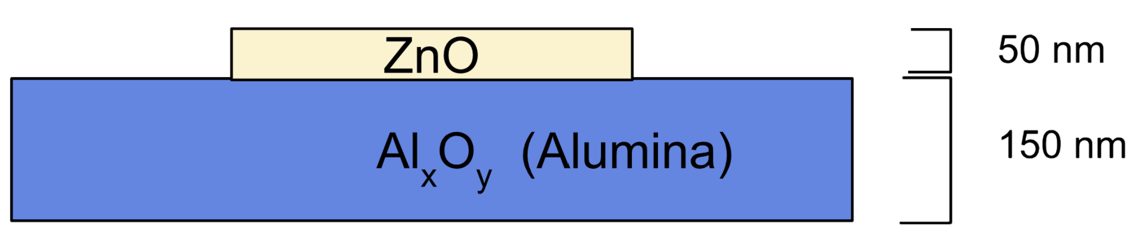
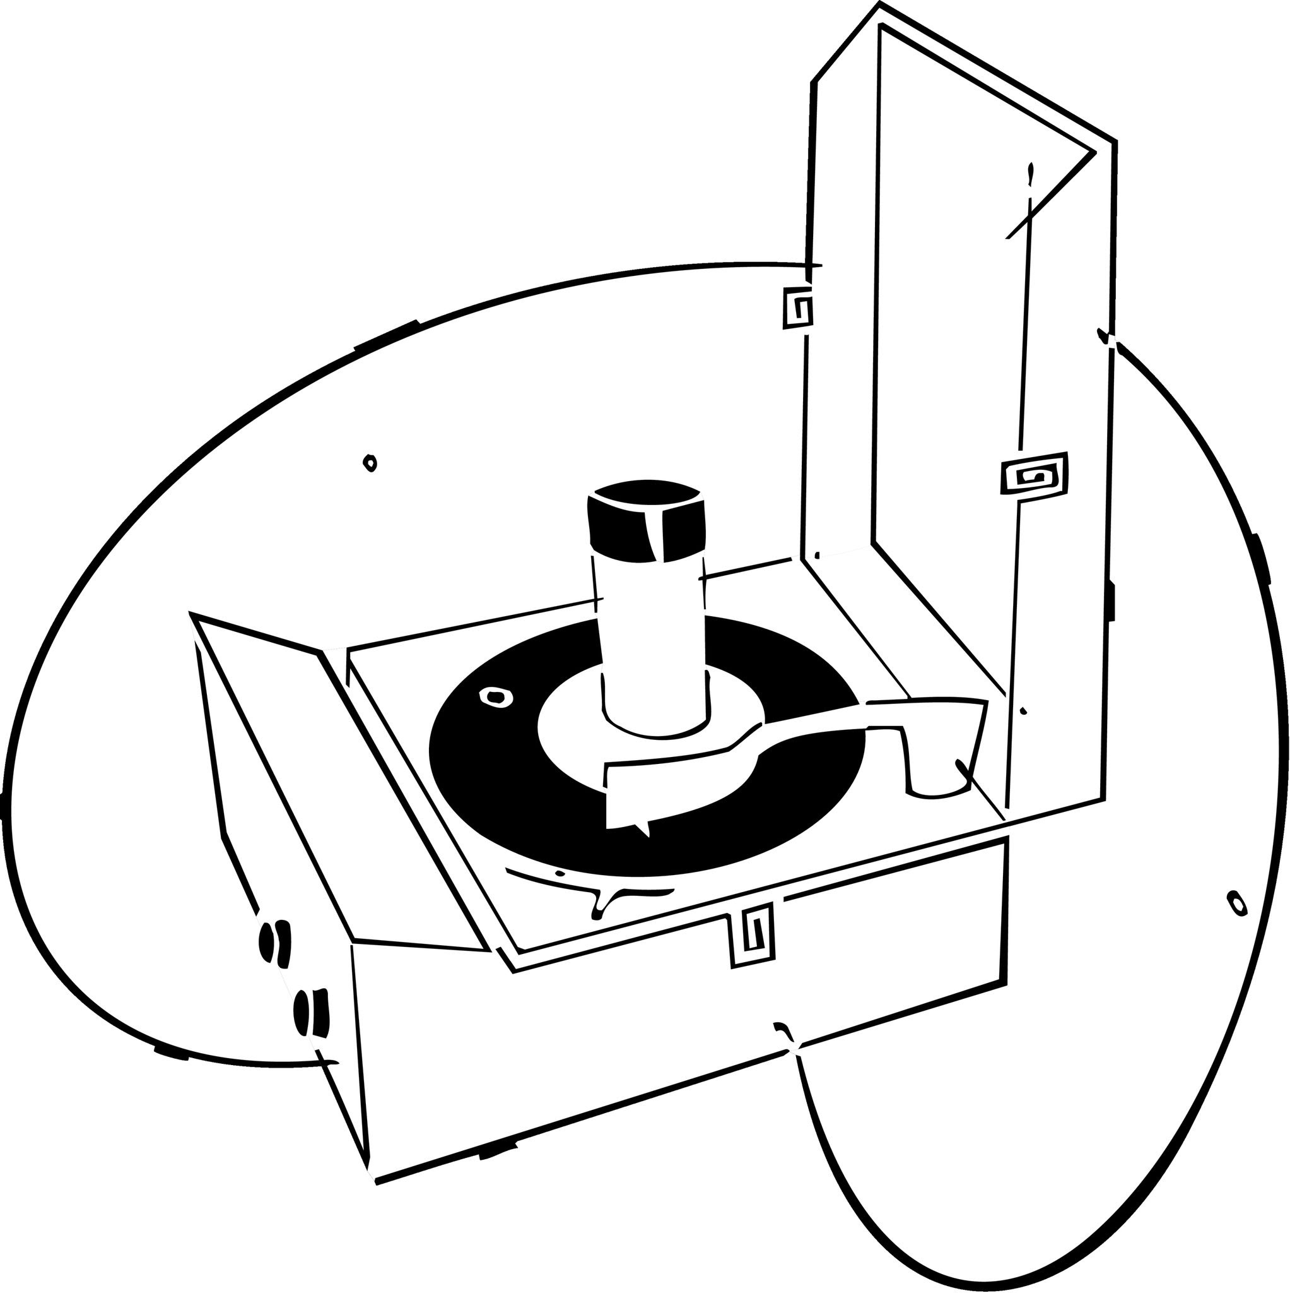
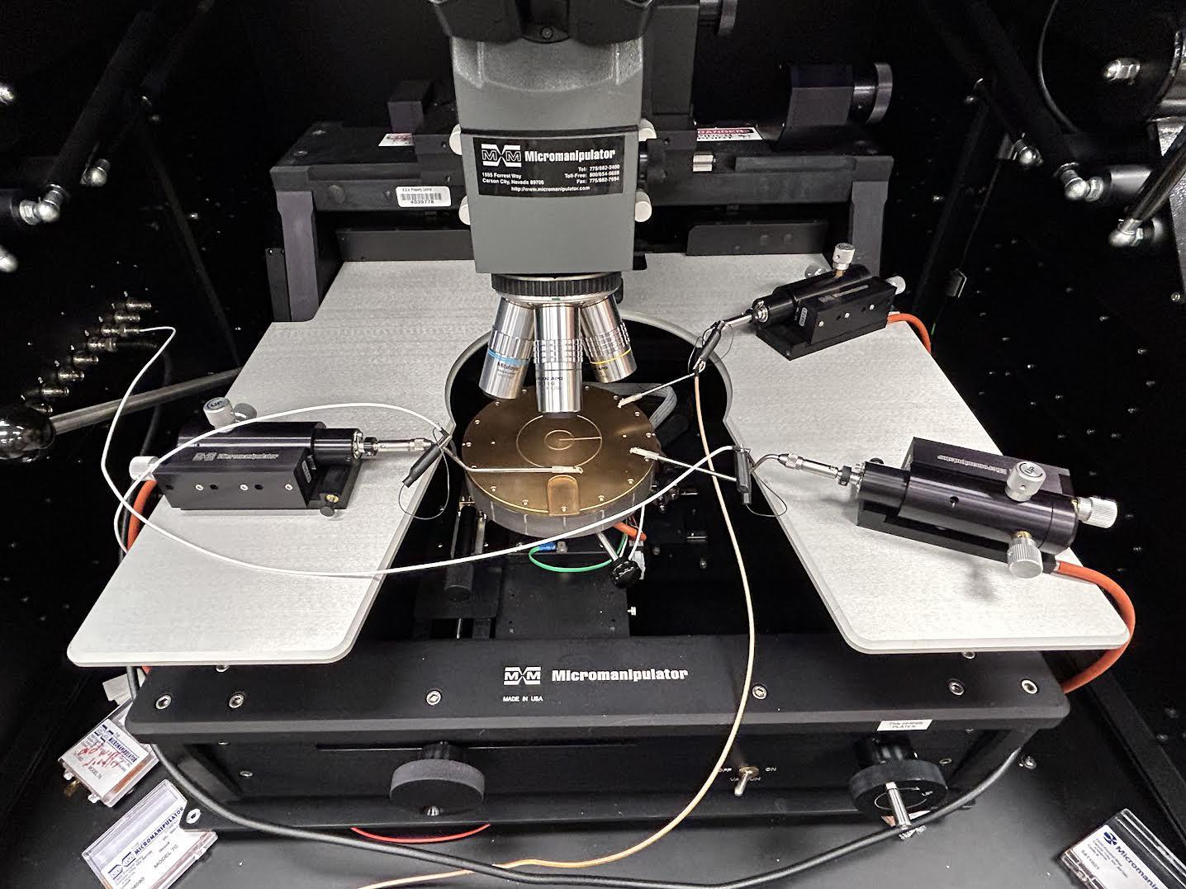
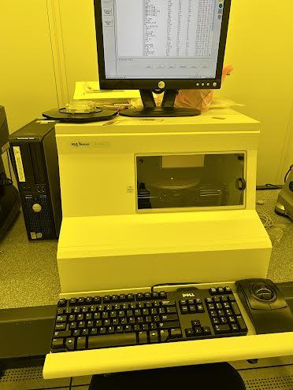
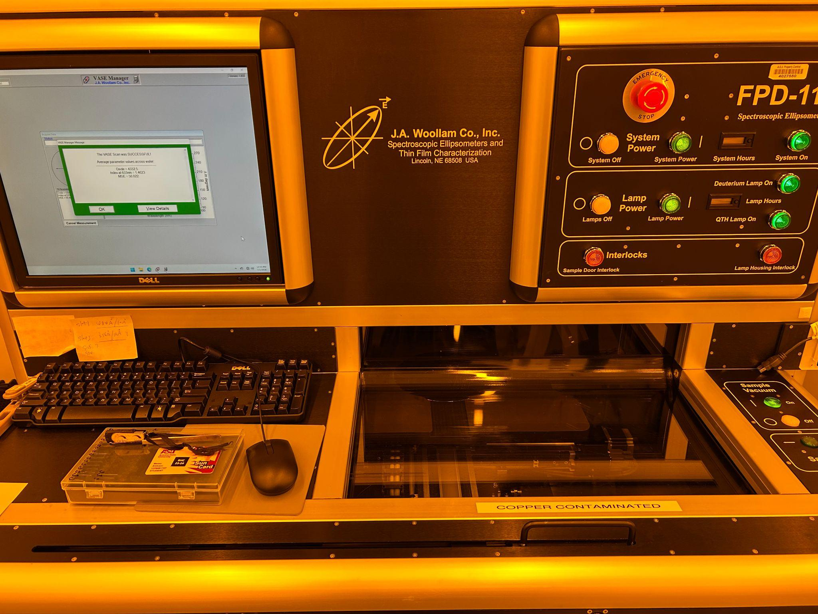
The Role of Nanotechnology
Nanometer scale materials have different properties from their bulk counterparts
Dielectric and semiconducting layers are in the nanometer range (around 150 and 50 nm respectively)
The Goal: Creating an open-air process for depositing usable dielectric and semiconducting layers
The Plan:
Spin coating and spray coating for creating these nanometer-scale films
Testing:
Micromanipulator for electrical properties and profilometer and ellipsometer for thickness measurements
Notes:
Describe what you plan to do / are doing / have done in this project to solve the problem

Slide 7
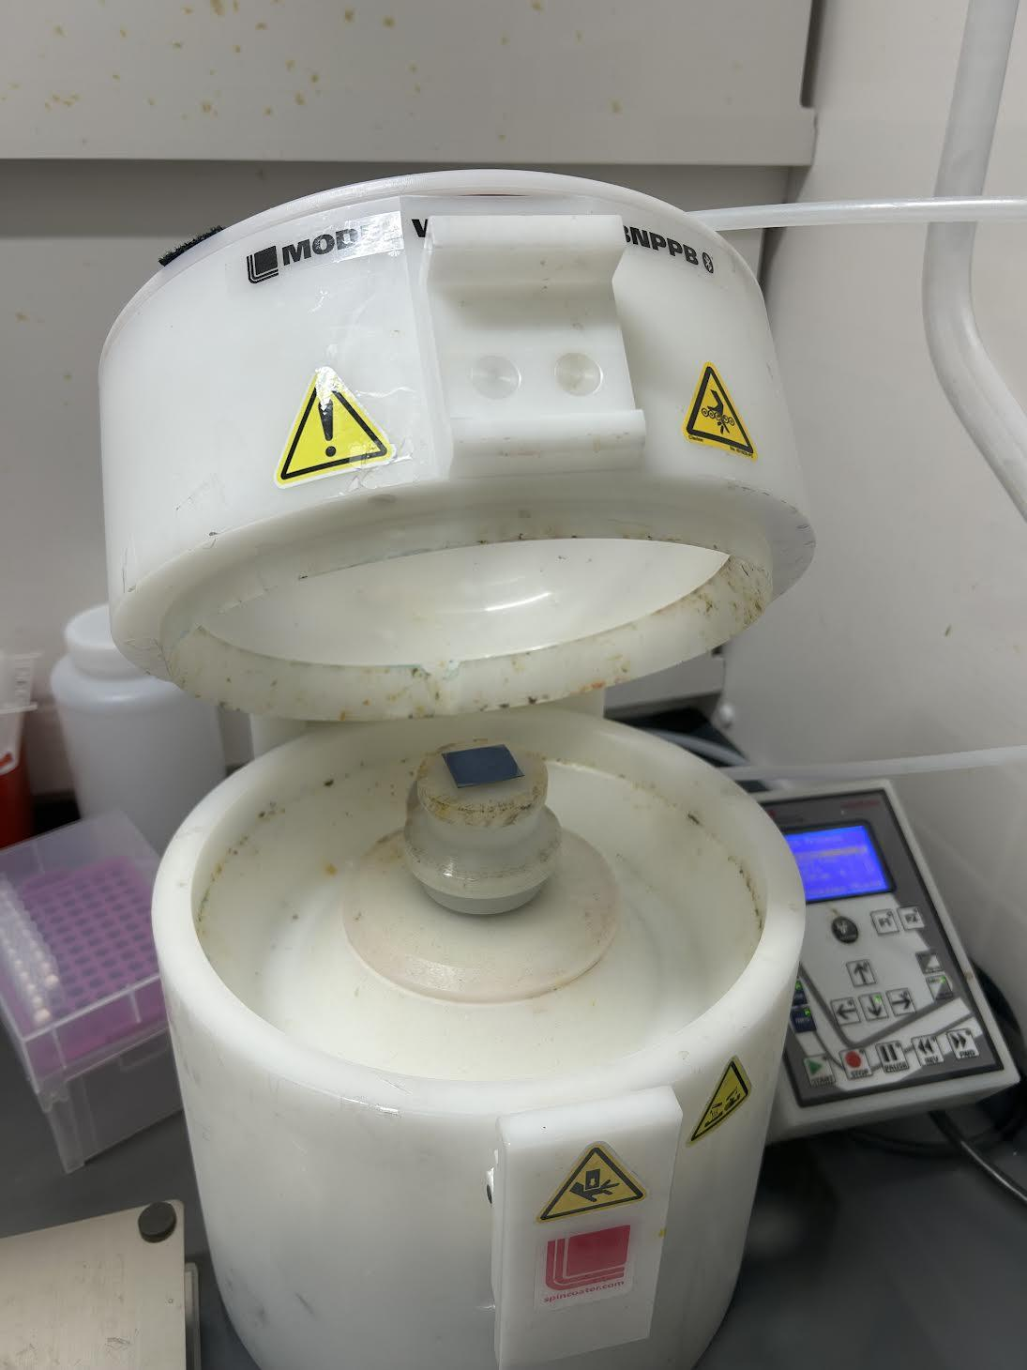
Making the Layers
Spin coating has been used to deposit dielectric and semiconducting layers
Profilometer and ellipsometer both are used to determine film thicknesses
Wafer Cleaning
Full area alumina spin coat
Profilometer
Soft-bake, annealing
Masked ZnO spin coat
Spin Coater
Soft-bake, annealing
Ellipsometer
Notes:
Explain some experimentation steps that have led to results.

Slide 8
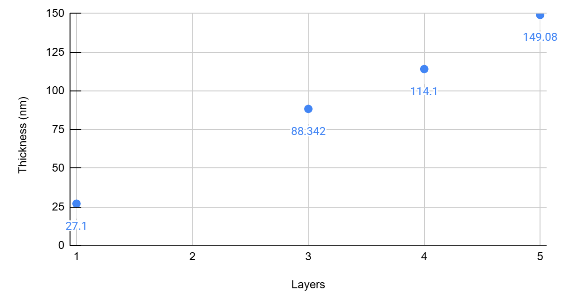
Determining Layer Thicknesses
0.1 M, 40μL, 3000 rpm Alumina (Multi-Layer)

Slide 9
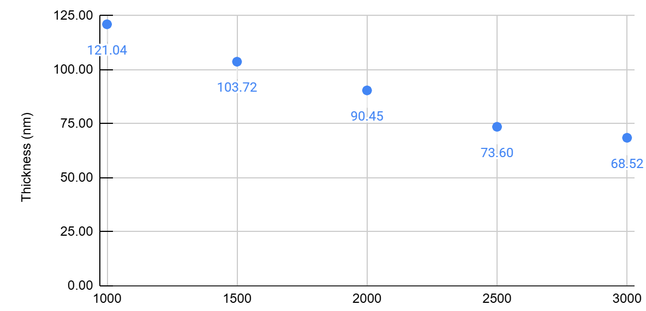
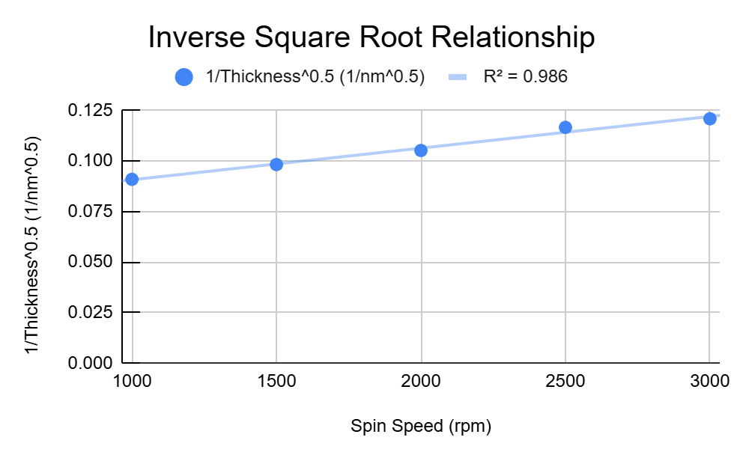
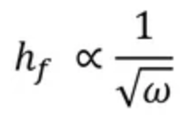
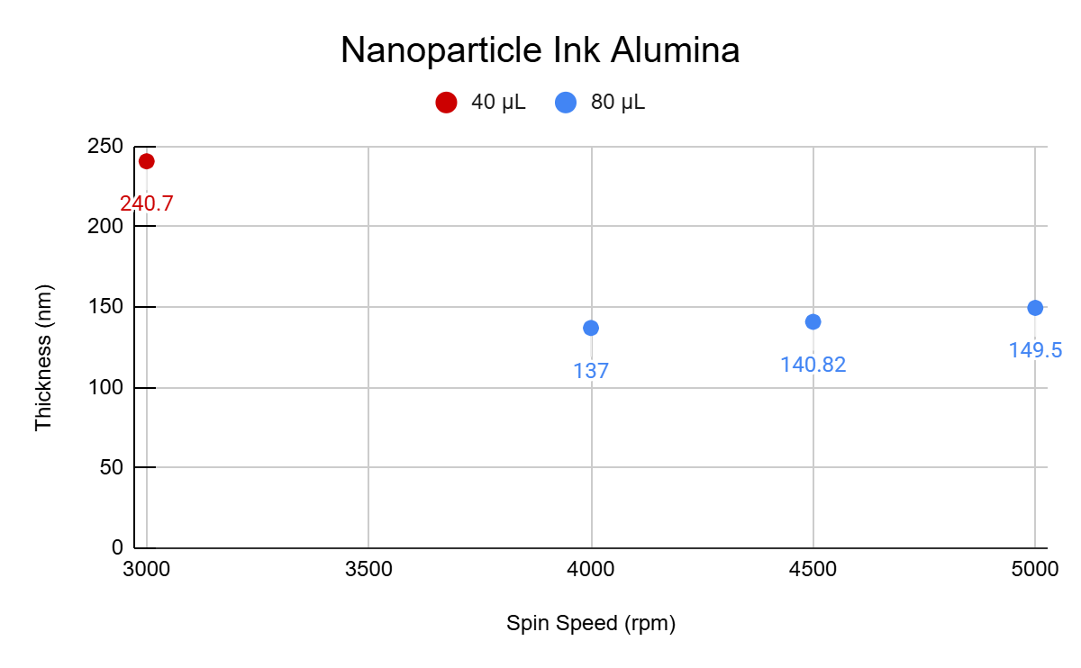
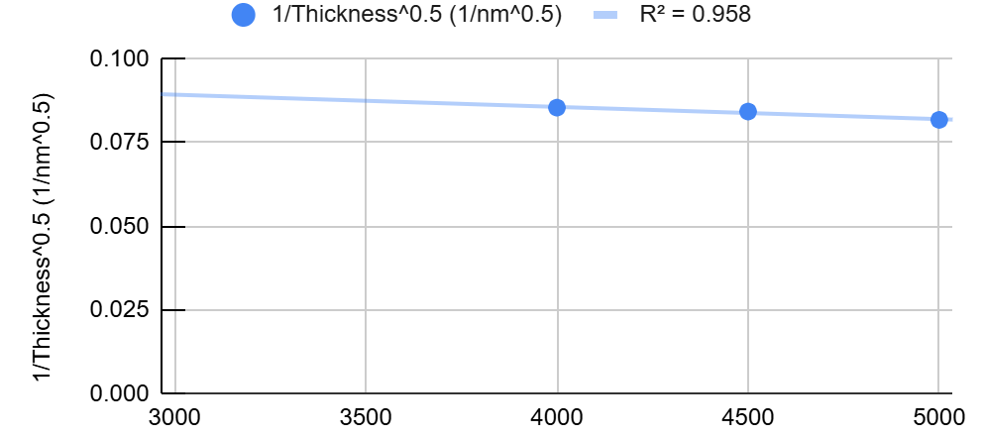
Determining Layer Thicknesses
(1) 0.2 M, 40µL, Alumina (Single Layer)
(3) Inverse Square Root Relationship
Spin-Coating Theory^{[F]}:
(2) Nanoparticle Ink Alumina
(4) Inverse Square Root Relationship

Slide 10
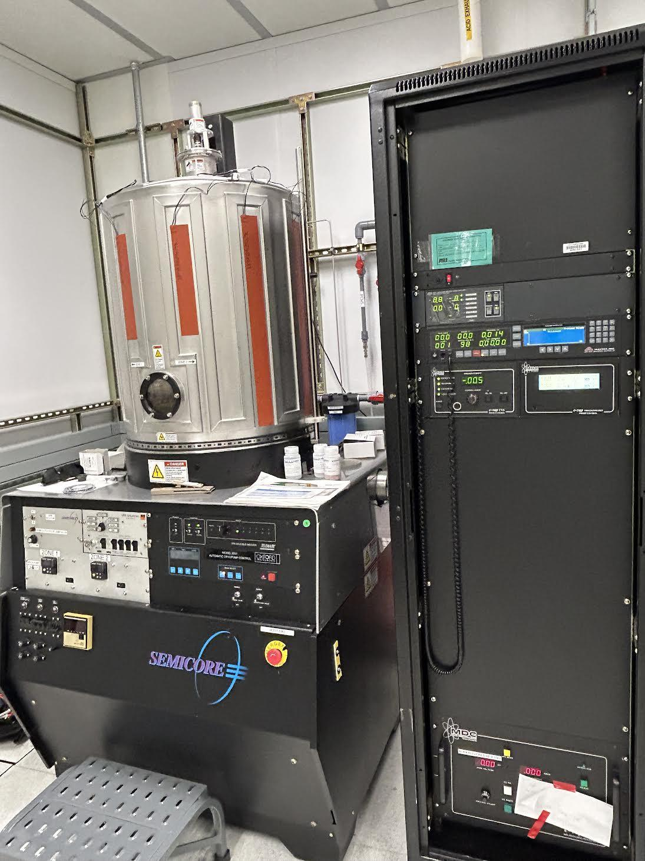
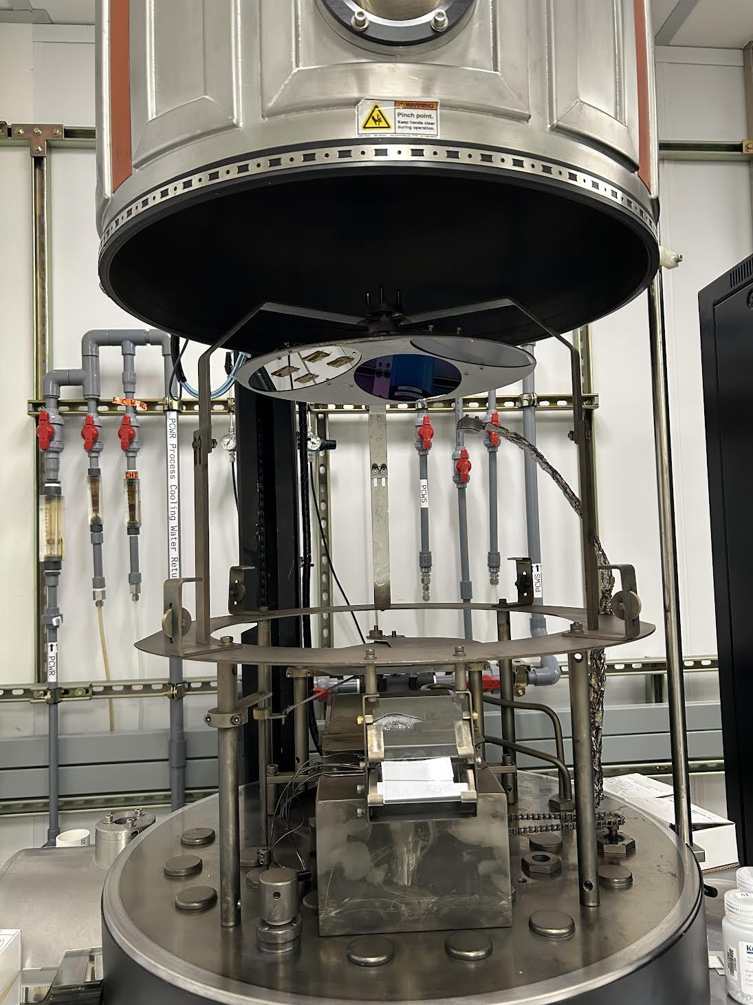
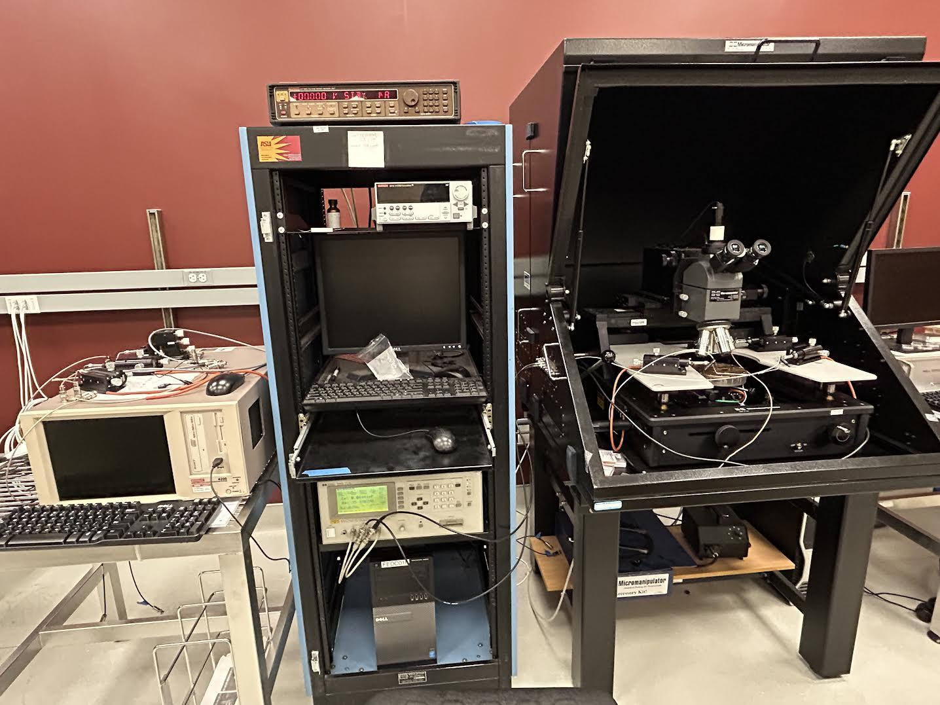
Making the Layers
CHA Metal Evaporator was used to deposit aluminum top contacts
Micromanipulator is used to determine electrical properties of the transistor and individual layers
Micromanipulator
Micromanipulator stage and probes
CHA Metal Evaporator
Inside the evaporator chamber with samples loaded

Slide 11
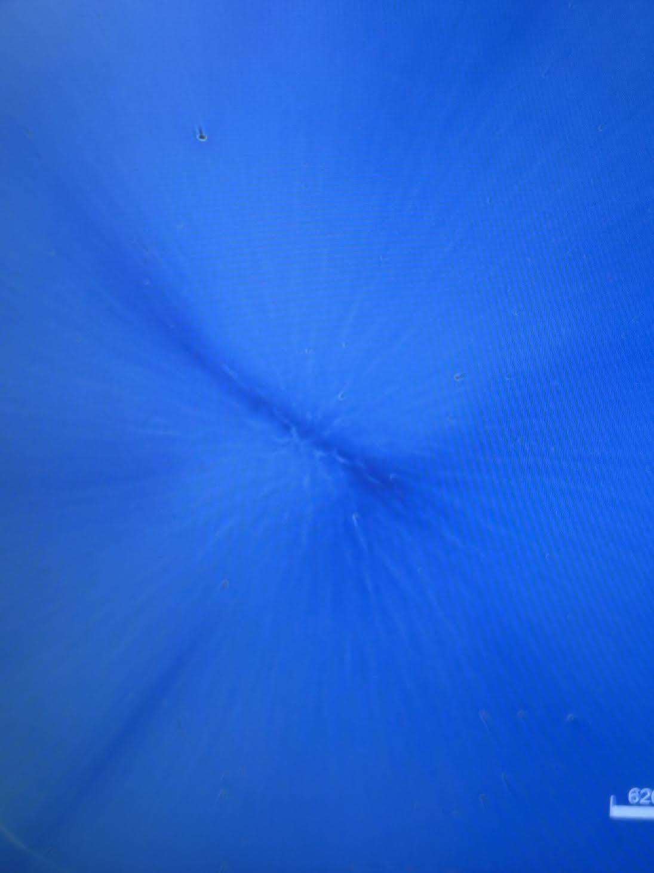
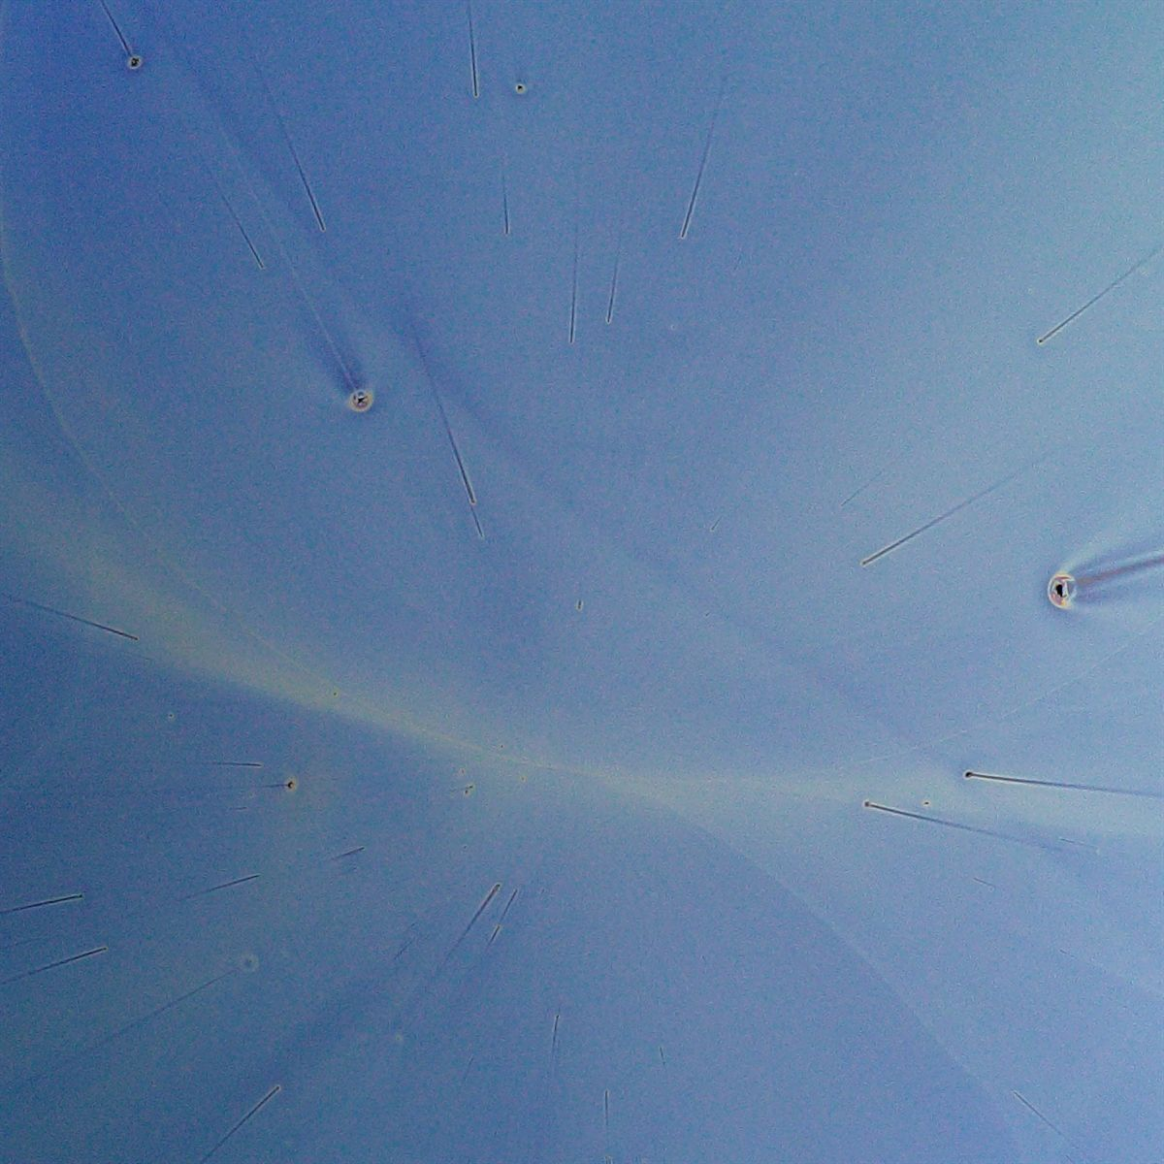
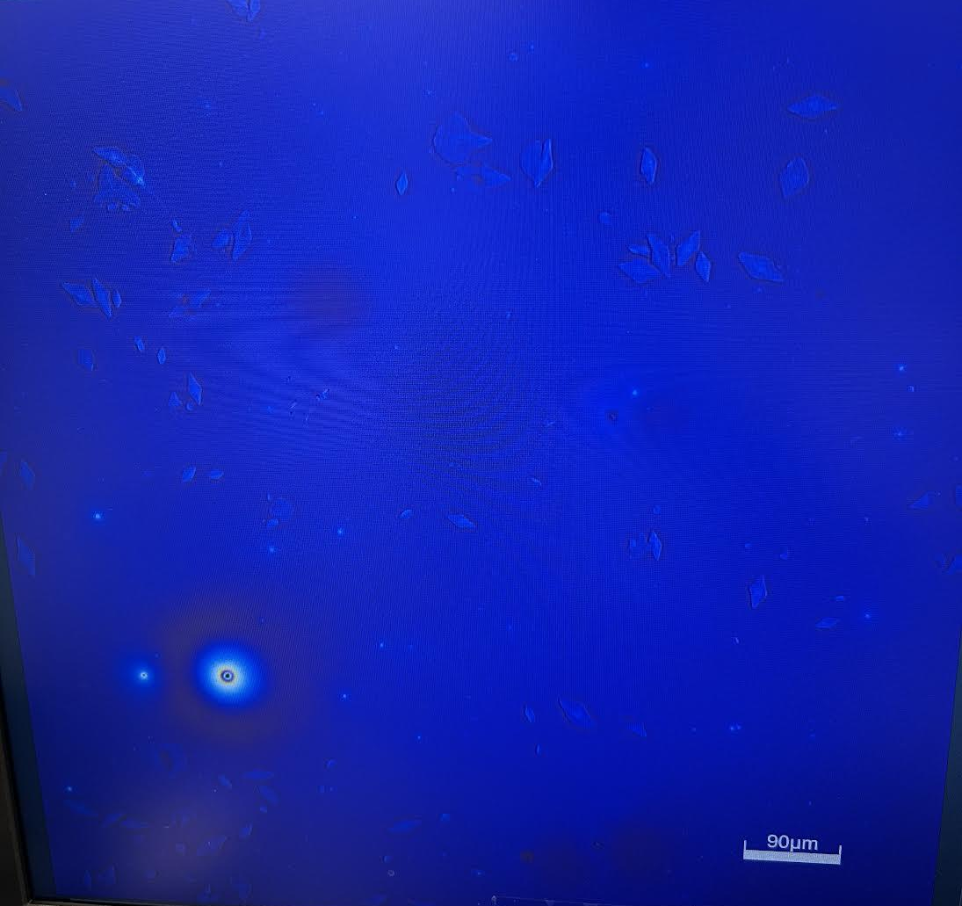
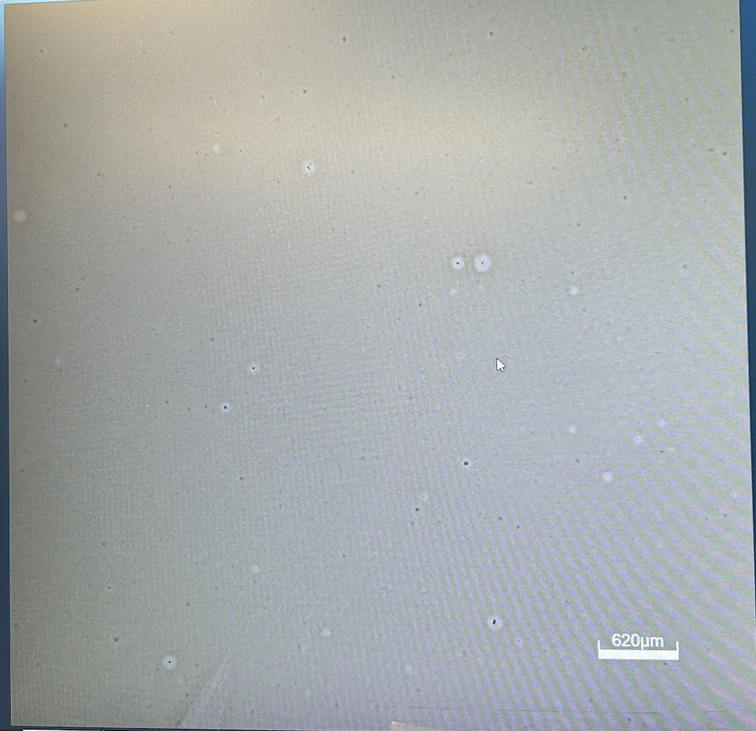
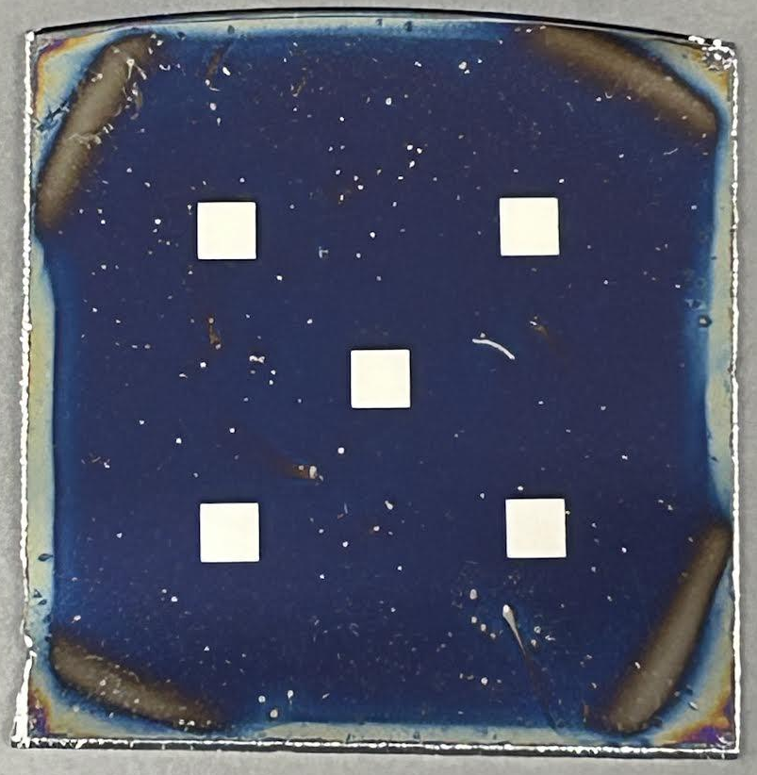
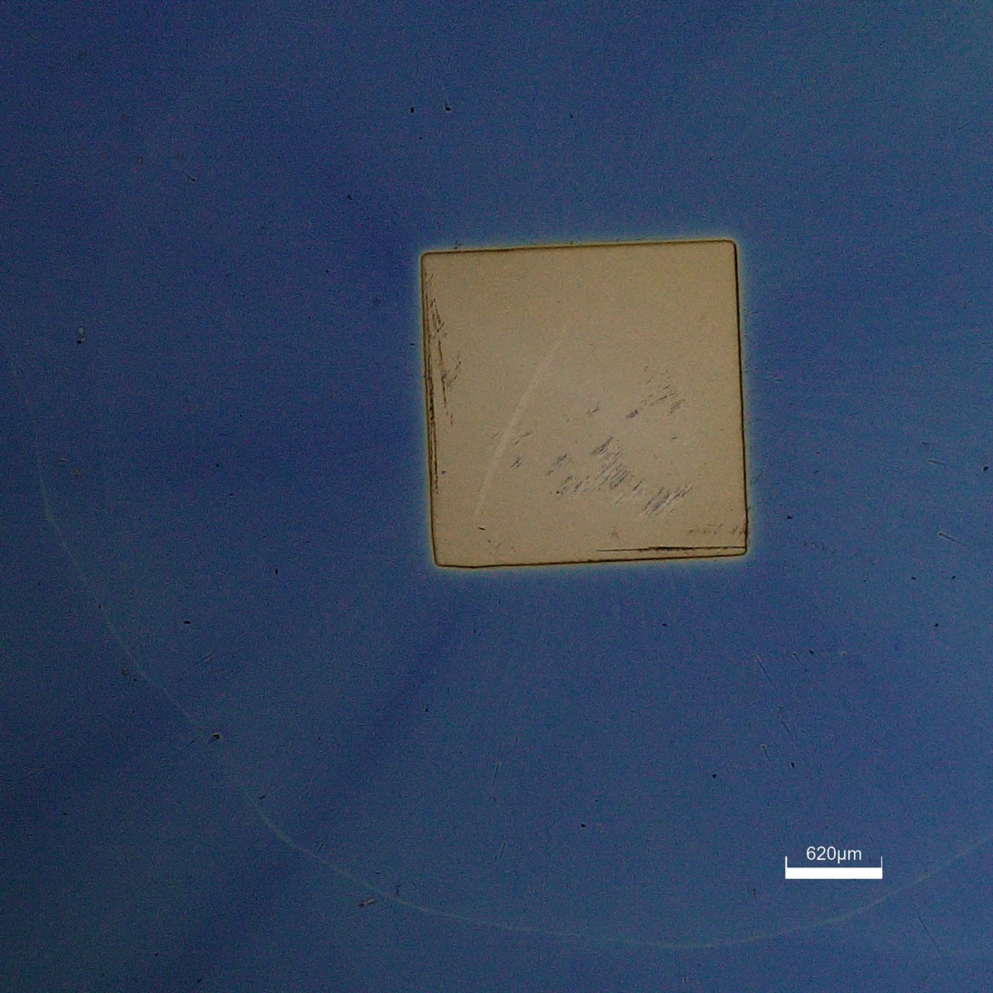
Alumina Dielectric Layer
Alumina nanoparticle ink solutions
(3000 and 5000 rpm)
0.2 M Alumina
(1000 rpm)
0.1 M Alumina
(3000 rpm)
Capacitor setup for testing dielectric properties,
zoomed out (left) and on a single Al contact (right)
Notes:
Present your data – modelled and measured (if applicable)
Tell us what you think it means
What do you think it means for the next step?
Include more images of the alumina dielectric and failed iterations here… possibly on this slide or the next slide show (hopefully) capacitance results of successful dielectric capacitors

Slide 12
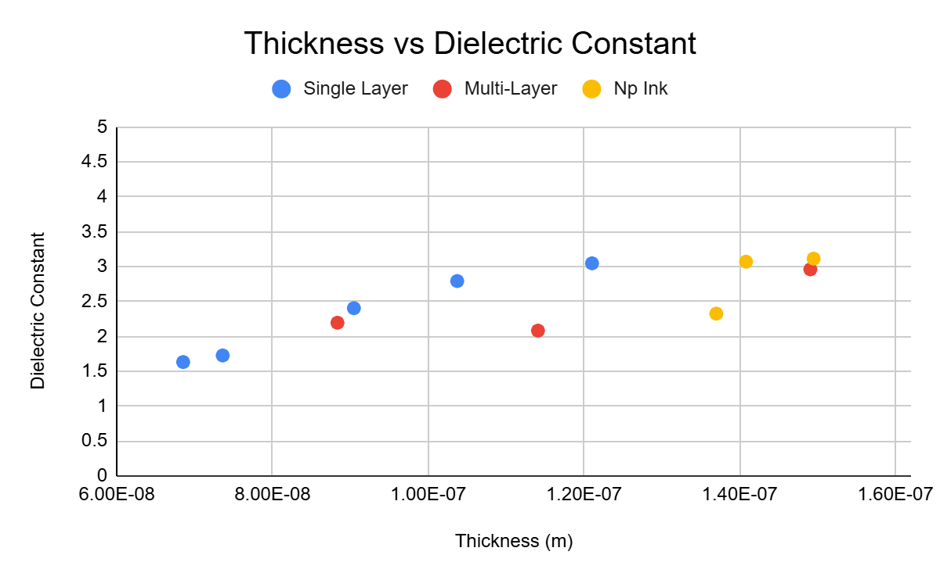
Capacitor Dielectric Results
Initial capacitance measurements resulted in a dielectric constant of 0.11 (below 1 which is air), indicative of a leaky (shorting) dielectric
Found out that this was partially due to the dielectric being 27 nm thick
So new thicknesses were made…
Notes:
Present your data – modelled and measured (if applicable)
Tell us what you think it means
What do you think it means for the next step?

Slide 13
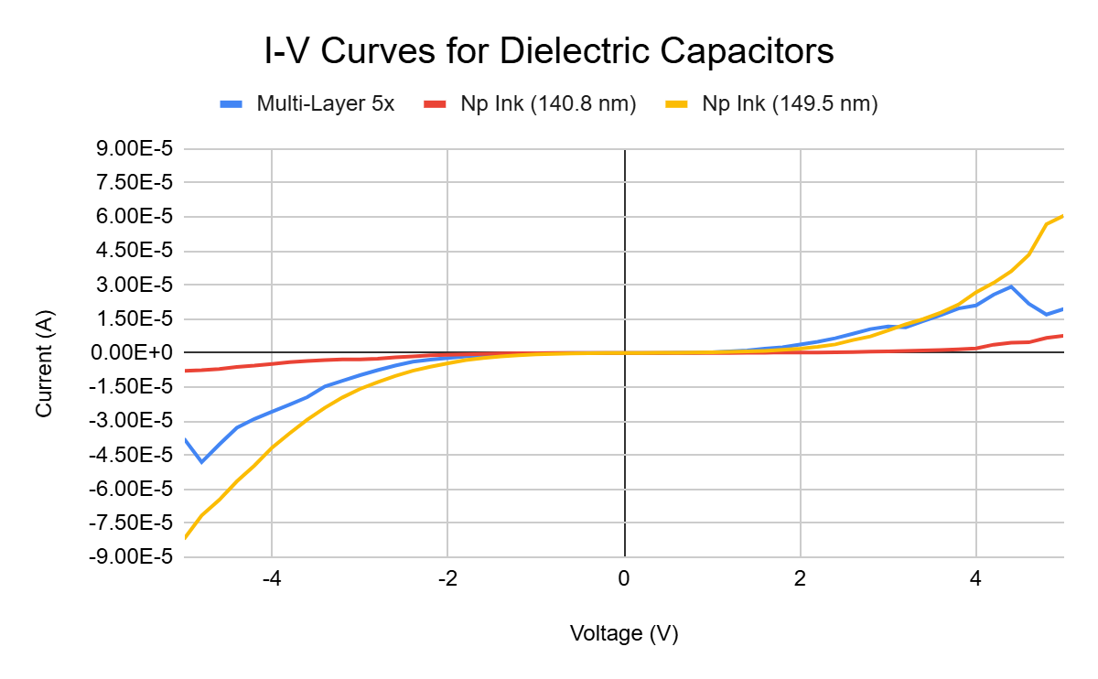
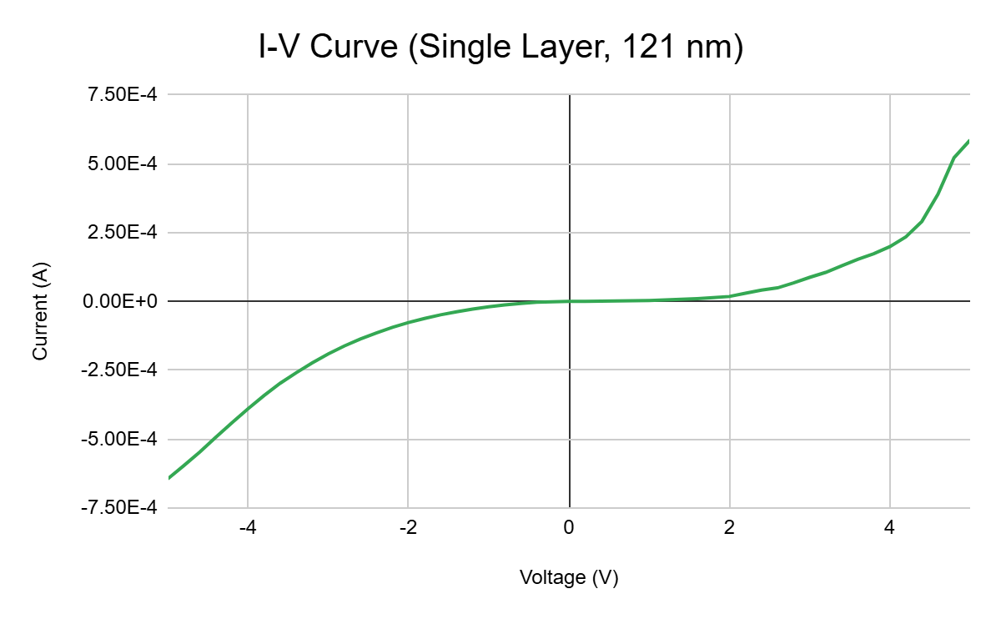
Capacitor I-V Results
Have asymmetrical plots, indicative of a non-ohmic contact or other issue (nonuniformity)
Has 10 times the leakage current compared to other samples
Notes:
Present your data – modelled and measured (if applicable)
Tell us what you think it means
What do you think it means for the next step?

Slide 14
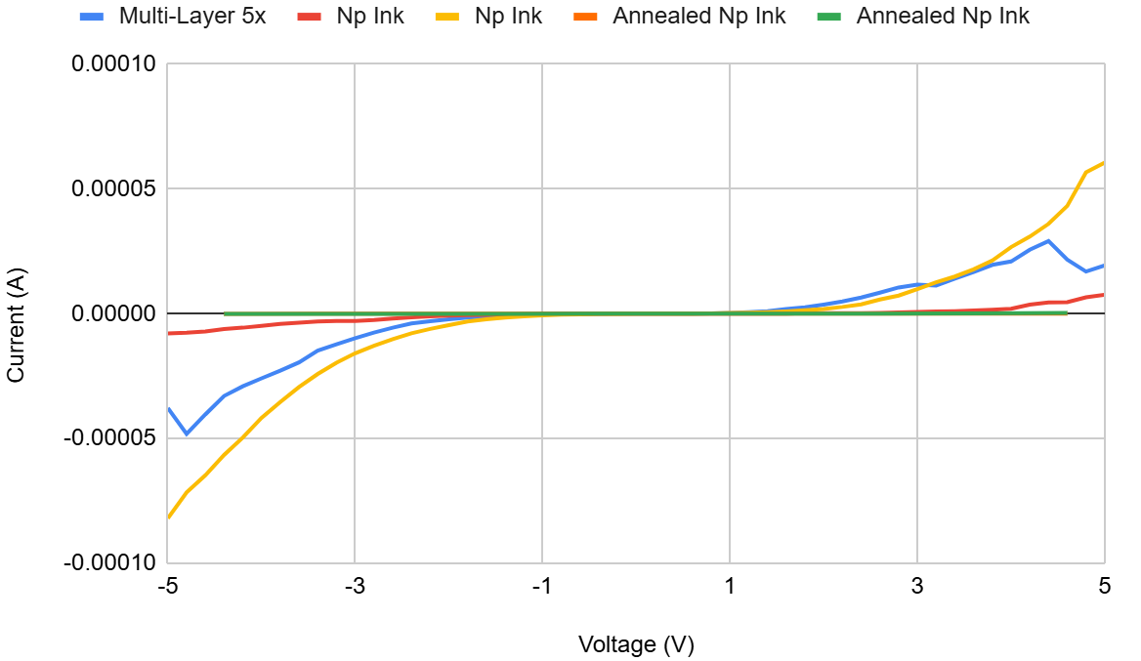
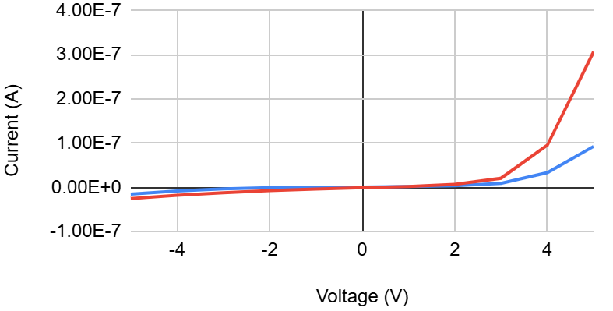
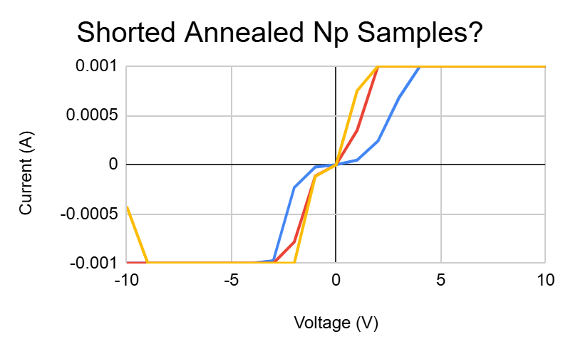
Capacitor I-V Results
(1) I-V Curves for Dielectric Capacitors
(2) Annealed Np Zoomed-In I-V Curve
(3) Shorted Annealed Np Samples?
Less symmetry, some samples were still leaky
Even lower leakage current, but lower dielectric constants
Notes:
Improvements in dielectric performance will increase the viability of these transistors, improving the effectiveness of these cheaper processing methods
Present your data – modelled and measured (if applicable)
Tell us what you think it means
What do you think it means for the next step?
Include a bit about what this means for the dielectric layer... Overall, still needs work to improve consistency and reduce leakage

Slide 15
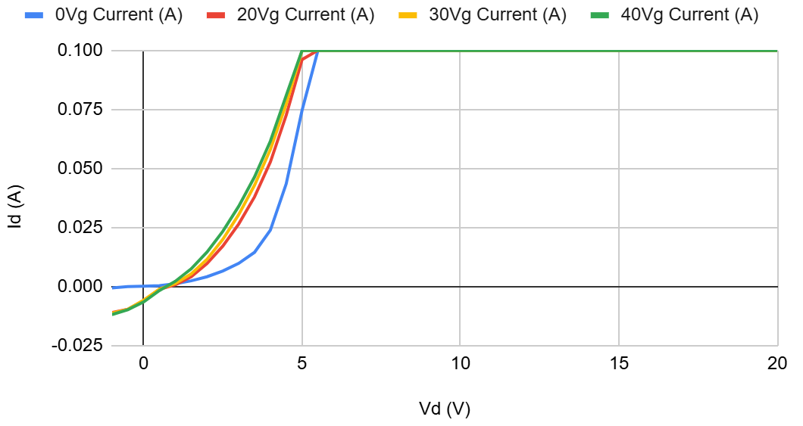
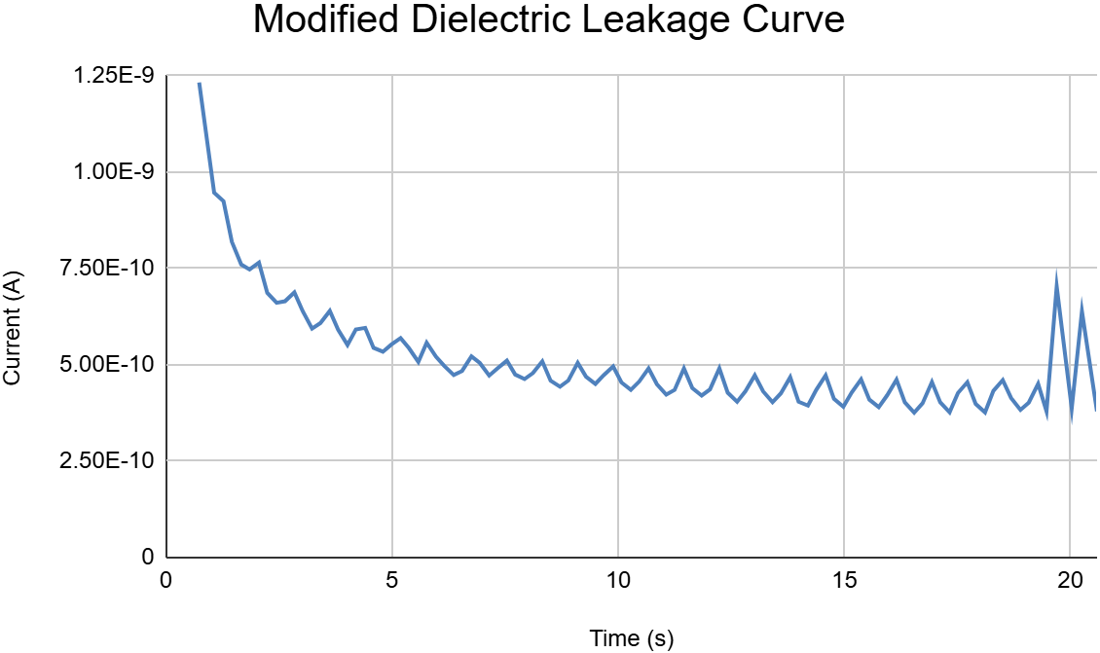
Future and Ongoing Work
Transistor Top View
Preliminary transistor results show some gate control, but mostly high current leakage
Ongoing research into improving alumina dielectric and characterizing ZnO
Alumina
ZnO
Representative Transistor Sample
Id: Drain Current
Vd: Drain Voltage
Vg: Gate Voltage
Aluminum
New dielectrics yield much better results!
Transistor measurements are still poor, so further improvements are needed

Slide 16



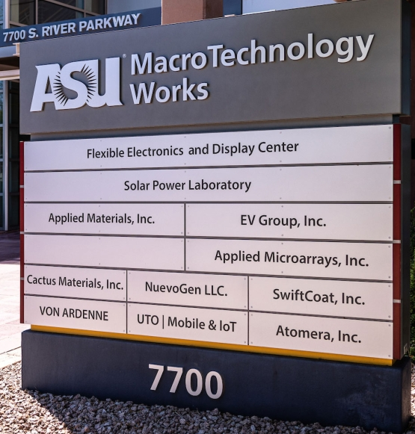


Acknowledgements
Many thanks to Nicholas Rolston
and Jessica Hauer
🎉 🔬
Questions? Reach out to me at maleksov@asu.edu

Slide 17
References
[A] Shen, Chengxu, et al. Atomic Layer Deposition of Metal Oxides and Chalcogenides for High Performance Transistors. Humboldt-Universität zu Berlin, 16 June 2022. ResearchGate, https://doi.org/10.18452/25753.
[B] Flick, Austin C., et al. "Accelerating Low-Cost Perovskite Module Manufacturing with High-Throughput Open-Air Techniques." 2025 IEEE 53rd Photovoltaic Specialists Conference, 2025, https://doi.org/10.1109/PVSC59419.2025.11132675.
[C] Plasmatreat. "Plasmatreat GmbH: Plasma Technology Supports the Automotive Industry in Terms of Quality and Sustainability." PR Newswire, 29 Sept. 2025, www.prnewswire.com/news-releases/plasmatreat-gmbh-plasma-technology-supports-the-automotive-industry-in-terms-of-quality-and-sustainability-302569361.html. Accessed 20 Oct. 2025.
[D] Chai, Zhimin, et al. "Additively Manufactured Zinc Oxide Thin-Film Transistors Using Directed Assembly." ACS Applied Electronic Materials, vol. 5, no. 4, 14 Apr. 2023, pp. 2328-37. ACS Publications, https://doi.org/10.1021/acsaelm.3c00143.
[E] Elli, Giulia, et al. "Field-Effect Transistor-Based Biosensors for Environmental and Agricultural Monitoring." Sensors, vol. 22, no. 11, 31 May 2022, p. 4178, https://doi.org/10.3390/s22114178.
[F] Griffin, Jon, et al. "Spin Coating: Complete Guide to Theory and Techniques." Ossila, www.ossila.com/pages/spin-coating. Accessed 29 June 2026.

