Slide 1
Surface Functionalization for Hybrid Perovskite Growth
Mason Kempf
North Carolina State University
University of North Carolina Chapel Hill
Zachary Krajnak and Jim Cahoon

Slide 2
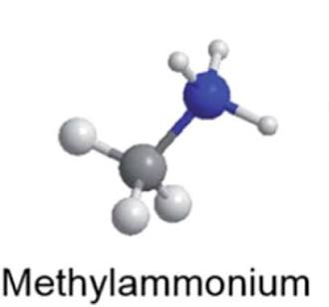
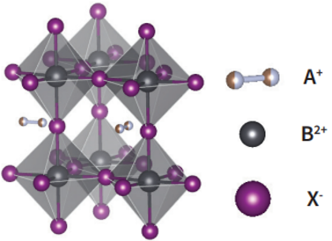
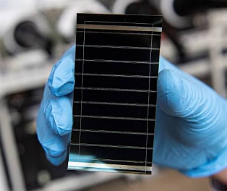
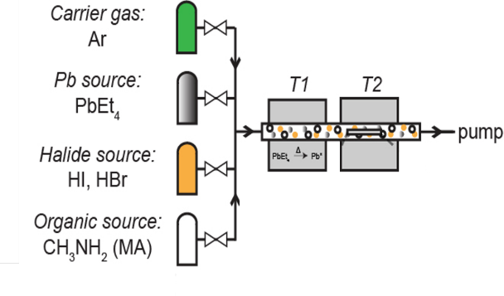
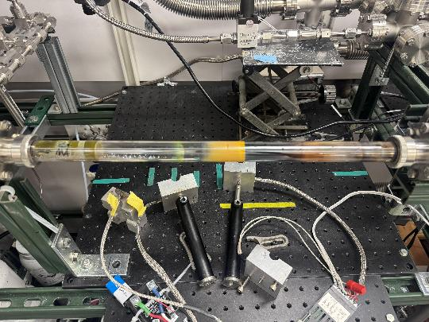
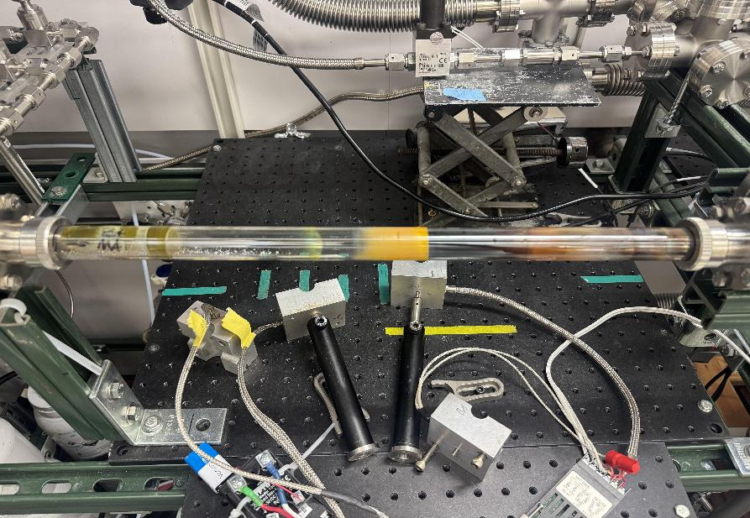
Project Background
Hybrid Perovskites
ABX₃
Energy.gov, “Perovskite Solar Cells”
Brenner et al. 2016
Metal-Organic Chemical Vapor Deposition (MOCVD)
Bryan et al. 2025

Slide 3
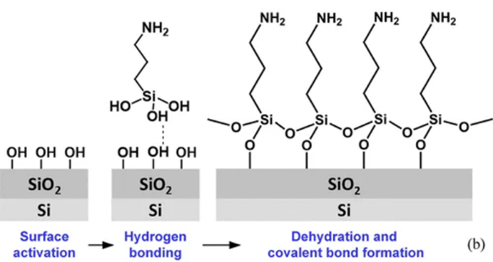
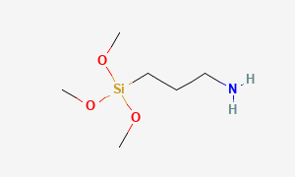
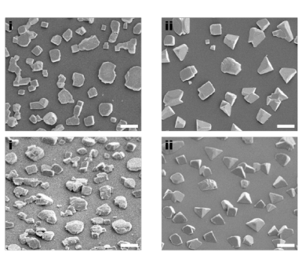
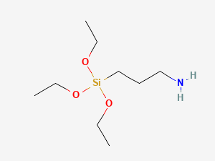
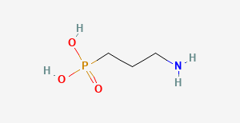
Surface Functionalization
Precursors
3-aminopropyl
trimethoxysilane
APTMS
Chen et al. 2024
3-aminopropyl
triethoxysilane
APTES
Bryan et al. 2025
3-aminopropyl
phosphonic acid
APPA
Unfunctionalized Si/SiO₂
Functionalized
Si/SiO₂

Slide 4
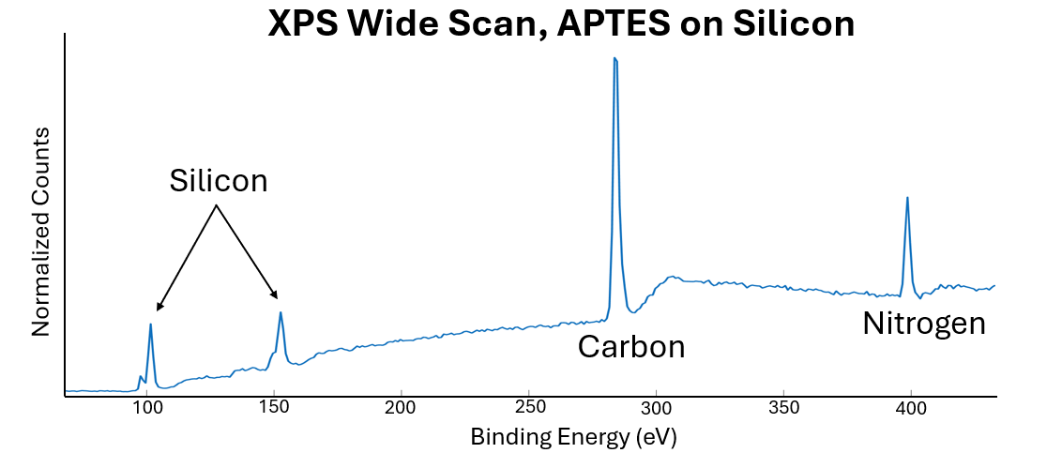
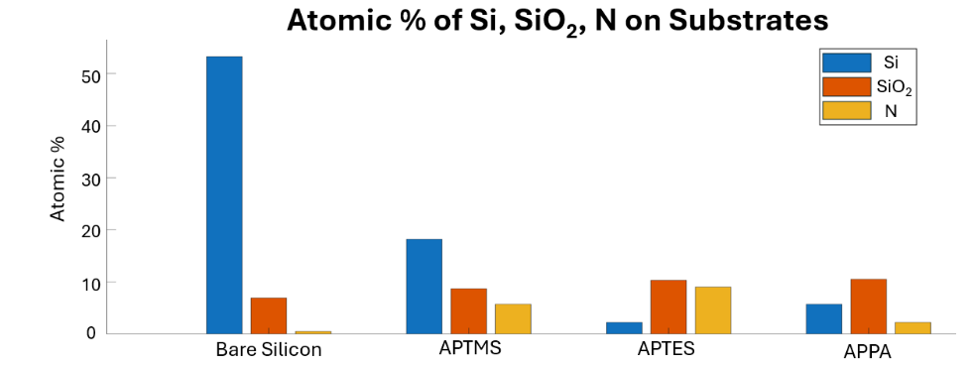
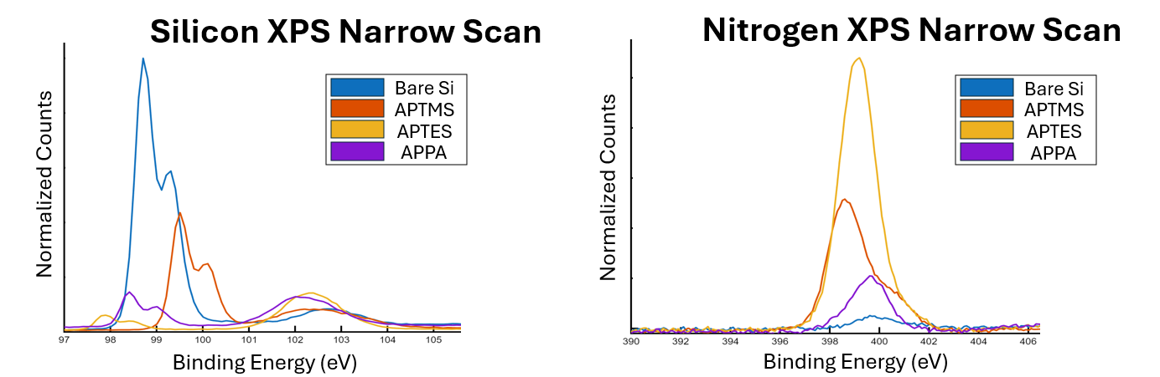
Surface Characterization
All three functionalization precursors were successful, with APTES showing the highest degree of amine adhesion

Slide 5
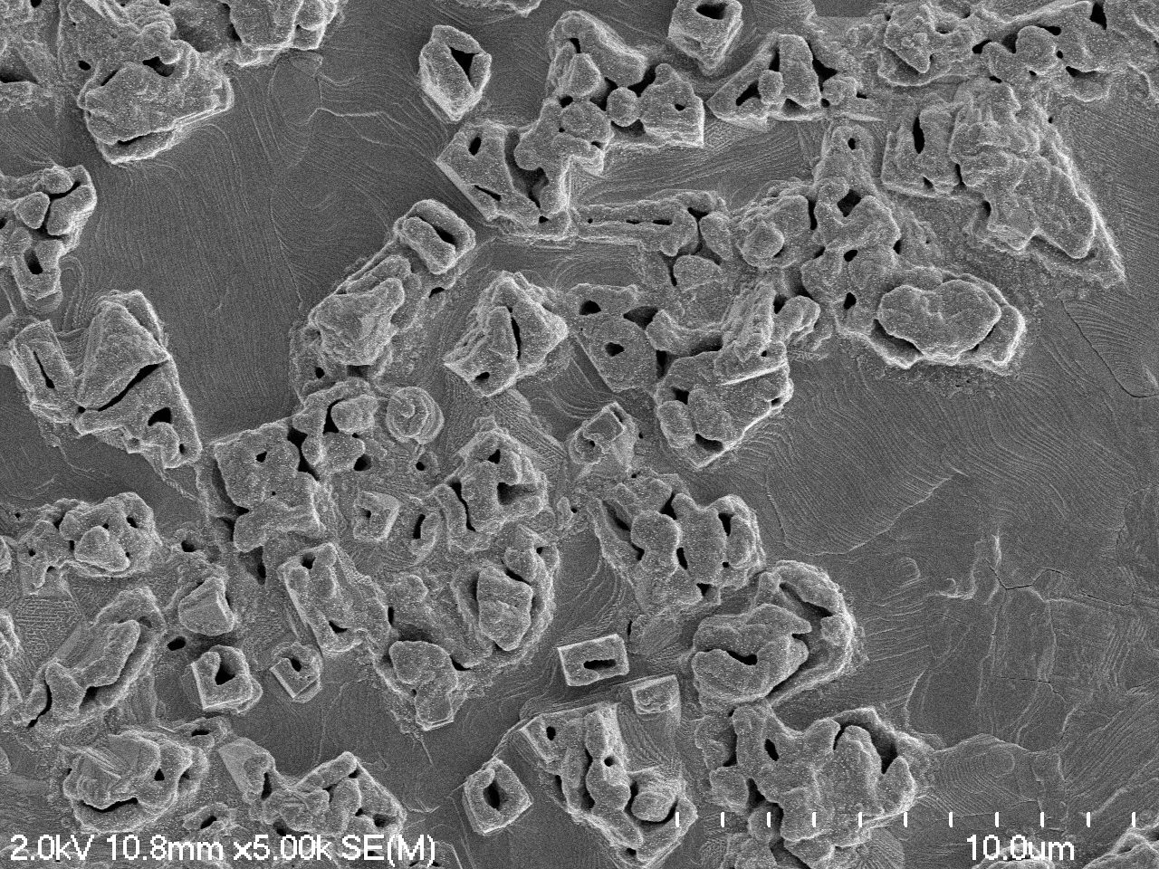
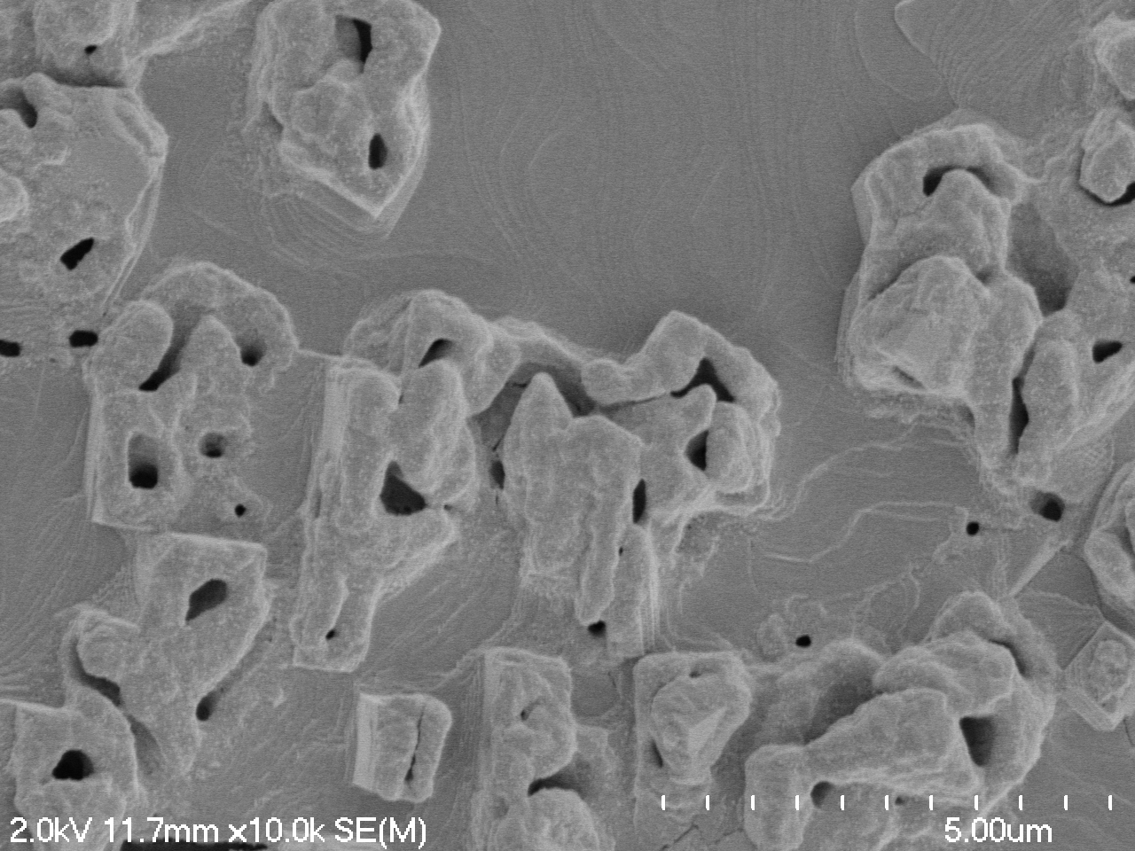
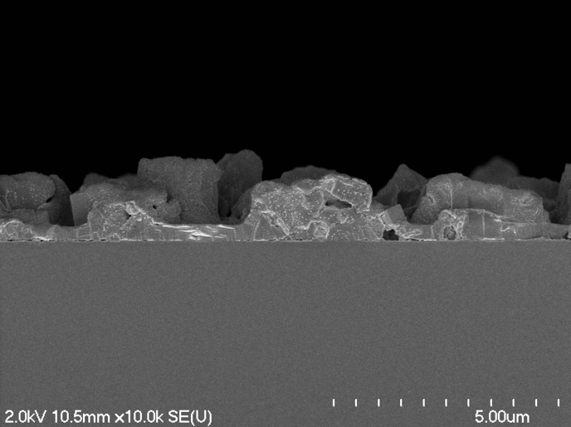
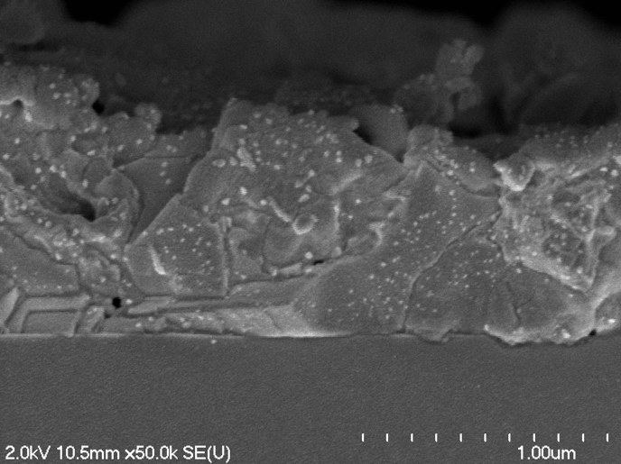
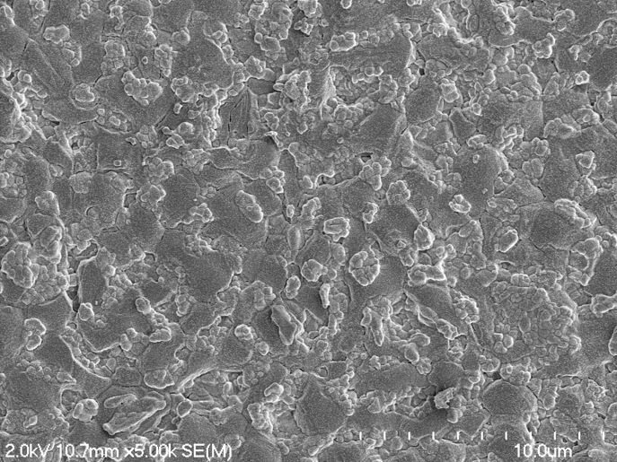
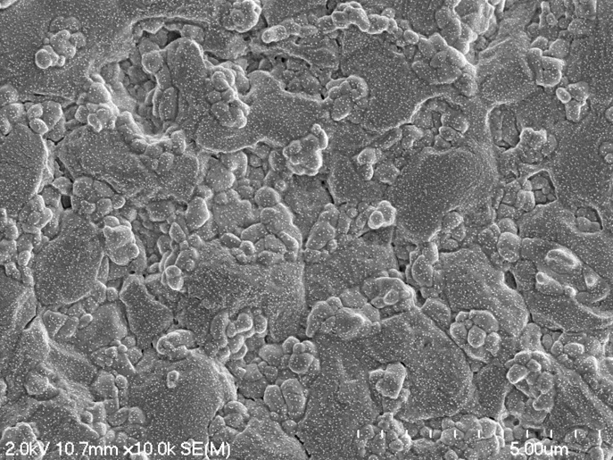
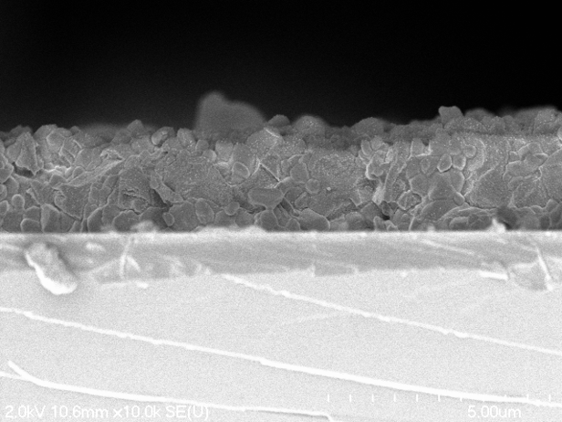
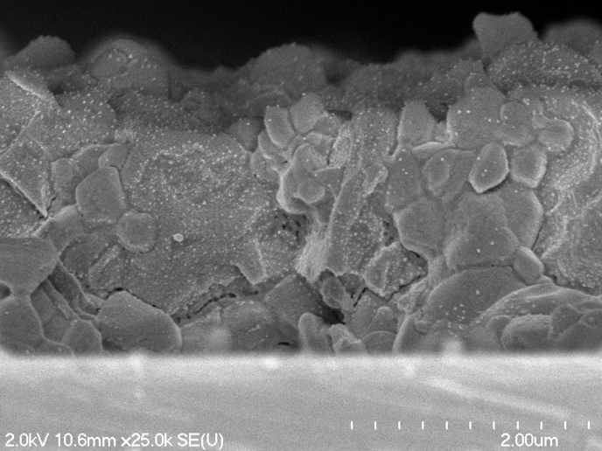
Perovskite Characterization
Untreated Si/SiO₂
Non-uniform, large grains with deep pinholes
Uniform layer with small grains
APTMS
Full coverage with large, round grains
APTES
Dense interfacial layer with rounded grains on top
APPA
All scale bars are 1 μm

Slide 6
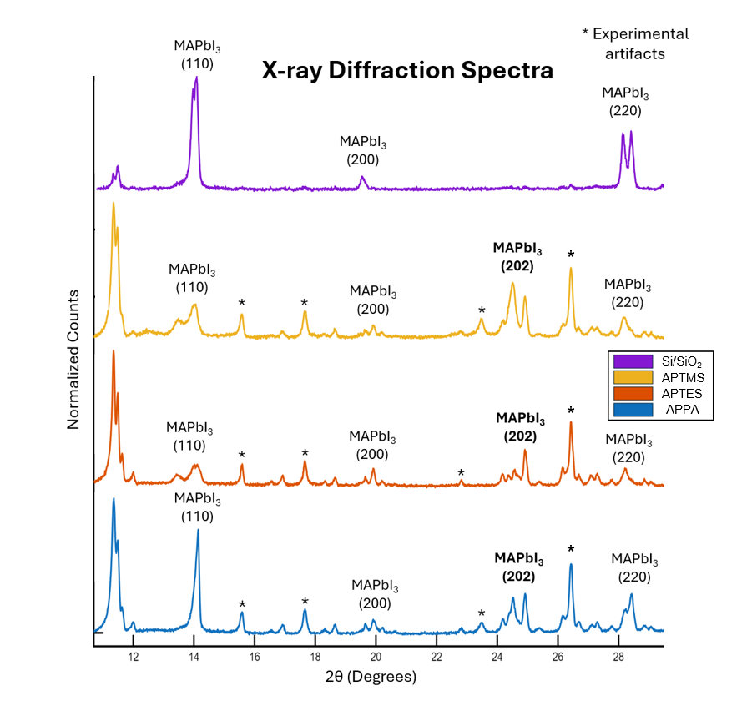
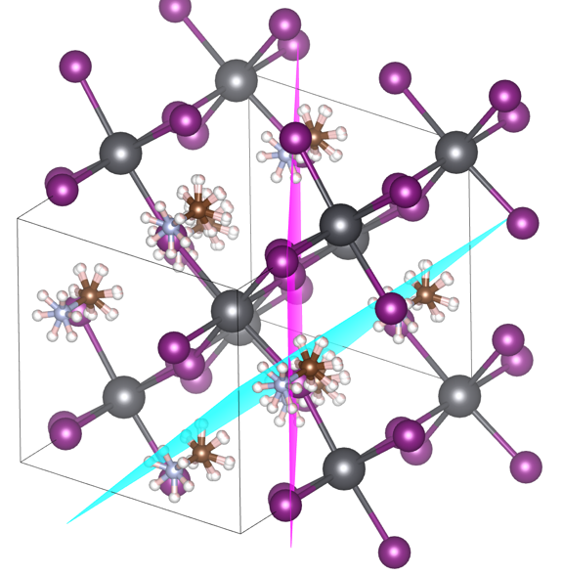
Perovskite Characterization Continued
*
Si/SiO₂
APTMS
*
APTES
APPA
*
MAPbI₃ crystal structure, (110) plane in cyan, (202) plane in magenta

Slide 7
Future Directions
Test surface functionalization with other perovskite formulations
Refine and better quantify functionalization to determine exact trends in film behaviors
Test functionalization on other substrate materials
Examine the role of surface functionalization to improve perovskite-transport layer interfaces in photovoltaic cells
Xiao et al. 2024

Slide 8


Thank You!
This material is based upon work which is supported by the National Science Foundation (award numbers 2447827, 2447828, 2447829 and ECCS-2025064). Any opinions, findings, and conclusions or recommendations expressed in this material are those of the author(s) and do not necessarily reflect the views of the National Science Foundation. This work was performed in part at the Chapel Hill Analytical and Nanofabrication Laboratory, CHANL, a member of the North Carolina Research Triangle Nanotechnology Network, RTNN, which is supported by the National Science Foundation, Grant ECCS-2025064, as part of the National Nanotechnology Coordinated Infrastructure, NNCI. A portion of this work was performed using XPS/UPS instrumentation supported by the Center for Hybrid Approaches in Solar Energy to Liquid Fuels (CHASE), an Energy Innovation Hub funded by the U.S. Department of Energy, Office of Science, Office of Basic Energy Sciences under Award Number DE-SC0021173. The author would also like to thank Ryan Gentile and Alicia Bryan for their contributions to this project.

Slide 9
References
Brenner, T. M., Rakita, Y., Orr, Y., Klein, E., Feldman, I., Elbaum, M., Cahen, D., & Hodes, G. (2016). Conversion of single crystalline PBI2 to CH3NH3PBI3: Structural relations and transformation dynamics. Chemistry of Materials, 28(18), 6501–6510. https://doi.org/10.1021/acs.chemmater.6b01747
Bryan, A. C., Meyers, J. K., Serafin, L. Y., Krajnak, Z. A., Gentile, R. J., & Cahoon, J. F. (2025). Metal organic chemical vapor deposition of hybrid perovskites. Journal of the American Chemical Society, 147(12), 10212–10218. https://doi.org/10.1021/jacs.4c15822
Chen, T., Yu, T., Vu, V. T., Huang, C., & Chen, C. (2024). Silatrane-Based Molecular nanolayers as efficient diffusion barriers for CU/SIO2/SI Heterojunctions: Implications for Integrated Circuit Manufacturing. ACS Applied Nano Materials, 7(5), 4874–4885. https://doi.org/10.1021/acsanm.3c05604
X. Sun et al., "Short-Wavelength Light Beam In Situ Monitoring Growth of InGaN/GaN Green LEDs by MOCVD," Nanoscale Res. Lett. 7, 1 (2012).
Xiao, Y., Yang, X., Zhu, R., & Snaith, H. J. (2024). Unlocking interfaces in photovoltaics. Science, 384(6698), 846–848. https://doi.org/10.1126/science.adh8086

