Slide 1
Design and Optimization of a Self-Monitored Photonic Wire Bond
MSU ECE REU Site Summer 2026
Final Project Presentation
Presenter: Audrey Cseh
Mentor: Dr. Parvinder Gill
Notes:
…

Slide 2
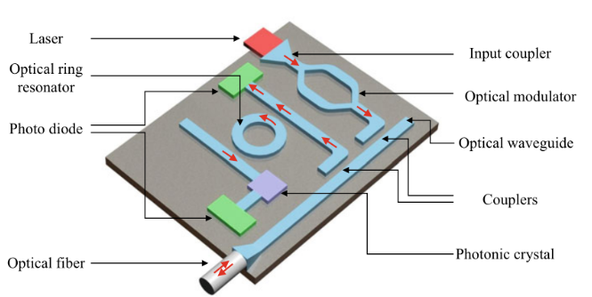

Introduction & Background
Photonics: The science of generating, controlling, and detecting photons. Manipulation of light on a chip scale.
Integrated photonics: Subfield of photonics in which waveguides and devices are fabricated onto microchips: Photonic Integrated Circuits (PICs).
Fiber integrated photonics: Optical components built directly inside or onto an optical fiber itself
[1]
[2]
Notes:
First, some background information… Photonics is the science of generating, controlling, and detecting photons. Two subfields of photonics that are relevant to my project are integrated photonics and fiber integrated photonics. Integrated photonics refers to the fabrication of waveguides and devices onto a microchip, referred to as a Photonic Integrated Circuit. In this diagram you can see an example of a photonic integrated circuit with some common components such as lasers, modulators, and waveguides connecting the structures. Fiber integrated photonics refers to the fabrication of optical components directly inside or onto an optical fiber. This figure shows an example of a fiber integrated photonic device, a ring resonator designed on the tip of an optical fiber.

Slide 3
Introduction & Background
Uses:
Next-generation computing & AI
Communication
Metrology
Biosensing & medicine
Advantages:
Increased bandwidth
No resistance = no heat
No interference between photons
Sensitivity and precision
Key Challenges:
Packaging, assembly, and testing makes up ~70–80% of a PIC’s manufacturing cost, vs 20% for an electronic chip. [3]
Active alignment of optical fibers and chips required for mode matching → Inefficient packaging process
Notes:
Photonics is relevant and applicable in many fields, including computing, communication, metrology, and biomedical devices. This is because of certain advantages that photonic devices have over traditional electronics, including increased bandwidth, lack of electrical resistivity which results in no resistive heat generation during transfer, no interference between individual photons which enables capabilities like transmitting multiple data streams at once in the same guide, and high sensitivity and precision.
However, the implementation of photonics technology still faces many challenges. One such challenge is the packaging process. Packaging, assembly, and testing accounts for 70-80% of a PIC’s manufacturing cost, as opposed to just 20% for a traditional electronic chip. This is because optical components must be precisely aligned for mode matching, with the slow alignment process resulting in inefficiency during packaging.

Slide 4
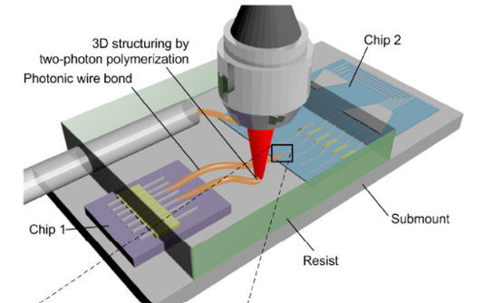
Introduction & Background
Photonic Wire Bonds
Photonic wire bond is fabricated via nanoscale 3D printing AFTER components are placed → No inefficient alignment process
Misalignment tolerance up to >30 μm, compared to 0.5–2 μm tolerance of other coupling methods (grating couplers, edge couplers, etc.) [4]
[5]
Notes:
The main advantage of a photonic wire bond is that it’s fabricated with nanoscale 3D printing after components are placed. That is, instead of having to precisely align the components, you can place them with relaxed tolerances, scan them with machine vision, and adaptively fabricate the connection based on their observed locations. This method can offer misalignment tolerance of greater than 30 micron, compared to the 0.5-2 micron tolerance of other coupling methods like grating couplers and edge couplers.
Here you can see a diagram of the fabrication of a photonic wire bond using two-photon polymerization. As you can see, the connection is created between the components after they are placed.

Slide 5
Research Question
In the design of a self-monitoring photonic wire bond (PWB), what Bragg grating corrugation depth and grating length balance strength and insertion loss, and what is the resultant temperature sensitivity?
Proposed device: Self-monitoring PWB that serves as an interconnect and temperature sensor
Bragg grating supports temperature sensing as temperature shifts λ_{B} by change in polymer index (thermo-optic effect) and expansion of grating period (thermal expansion) → Shifts in λ_{B} can be recorded to track temperature variation
Self-monitoring optical fibers using fiber Bragg gratings are an established technology, but self-monitoring PWBs are a new concept
Saves valuable chip space that would be taken up by introduction of a separate sensor
Objectives:
Design of a tapered PWB for edge coupling between an optical fiber and waveguide
Design of a Bragg grating on the PWB surface for sensing
Characterization of grating’s temperature sensitivity
Notes:
My research project has to do with the design of a new type of photonic wire bond with self-monitoring capabilities, serving as both an interconnect and a temperature sensor. Self-monitoring optical fibers that use fiber Bragg gratings are an established technology, but self-monitoring PWBs are a new concept.
The research question that I aim to answer is “In the design of a self-monitoring photonic wire bond (PWB), what Bragg grating corrugation depth and grating length balance strength and minimized insertion loss, and what is the resultant temperature sensitivity?”
The means by which a Bragg grating can enable temperature sensing is that temperature shifts the wavelength of light reflected by the grating, called the Bragg wavelength, via change in the index of the wire bond’s core and the mechanical expansion of the grating period. These shifts in wavelength serve as indicators of temperature variation.
The three main objectives of my project are to design a tapered wire bond for coupling between an optical fiber and waveguide, to design and incorporate a Bragg grating on the wire bond’s surface for sensing, and to characterize the grating’s temperature sensitivity.

Slide 6
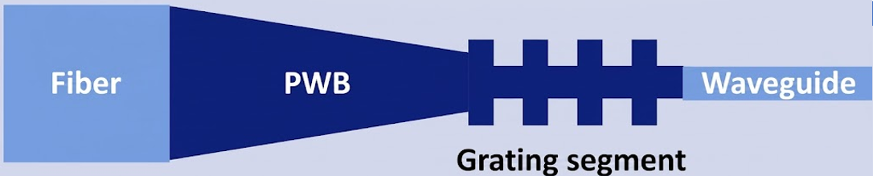
Methodology
Air-clad polymer PWB (n = 1.52) modeled as interconnect between SMF-28 optical fiber and Si₃N₄ strip waveguide.
Grating incorporated on uniform-diameter segment to avoid spatial variation of neff along the taper, which would broaden the reflection peak.
PWB Taper
Taper Design
FDE mode-overlap sweeps used to select PWB cross-sections for coupling with either device.
EME sweep used to set taper length (|S₂₁|² plateau = adiabatic transmission).
Grating Design
Grating modeled in EME as radial corrugation → spectral response simulations used to select corrugation depth and grating length based on reflection strength, reflection bandwidth, and insertion loss.
λ_{B} = 2·n_{eff,avg}·Λ
Thermo-optic effect: Coefficient dn/dT = -2.6·10⁻⁴ K⁻¹ [6]
Thermal expansion: r, Λ scaled by 1 + αΔT (α = 8·10⁻⁵ [7])
Temperature sensitivity prediction: FDE analysis of grating segment cross-sections
Validation: EME simulation of full grating structure
PWB Architecture
Design
Temperature Sensitivity Characterization
Notes:
Here's an overview of my methodology, including the overall architecture of my photonic wire bond, design to meet performance goals, and measurement of the device’s temperature sensitivity.
I modeled the wire bond as an air-clad polymer interconnect between an SMF-28 fiber and a silicon nitride waveguide. The grating sits on a uniform-diameter segment so the effective index stays constant along it, otherwise the reflection peak would broaden as the Bragg wavelength is dependent on effective index.
For the design of the taper, I used Ansys Lumerical FDE (finite difference eigenmode) mode-overlap analysis to choose the preferred wire bond cross-sections for coupling with each device, and an EME sweep to set the taper length for smooth transmission.
For the grating, I modeled a radial corrugation in EME and swept corrugation depth and grating length to choose their values based on the resulting reflection strength, reflection bandwidth, and insertion loss.
For temperature sensitivity, I accounted for the thermo-optic effect via change in the wire bond’s refractive index and the thermal expansion of the grating period. I simulated the resulting shift in the Bragg wavelength with FDE and further validated these results with a full EME simulation of the grating.

Slide 7
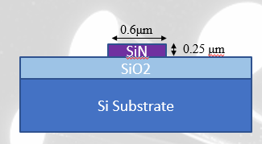
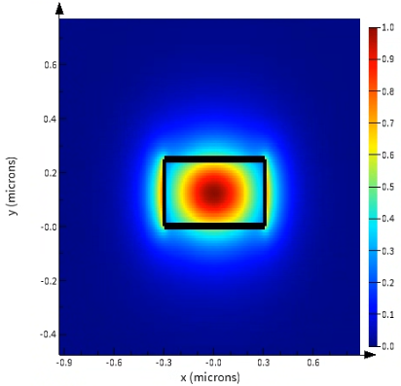
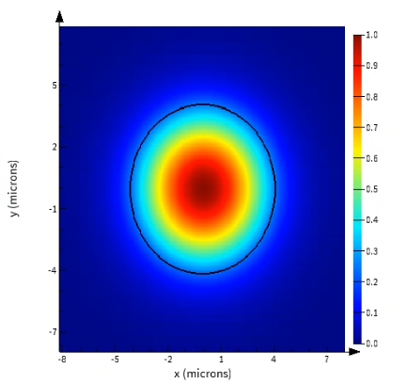
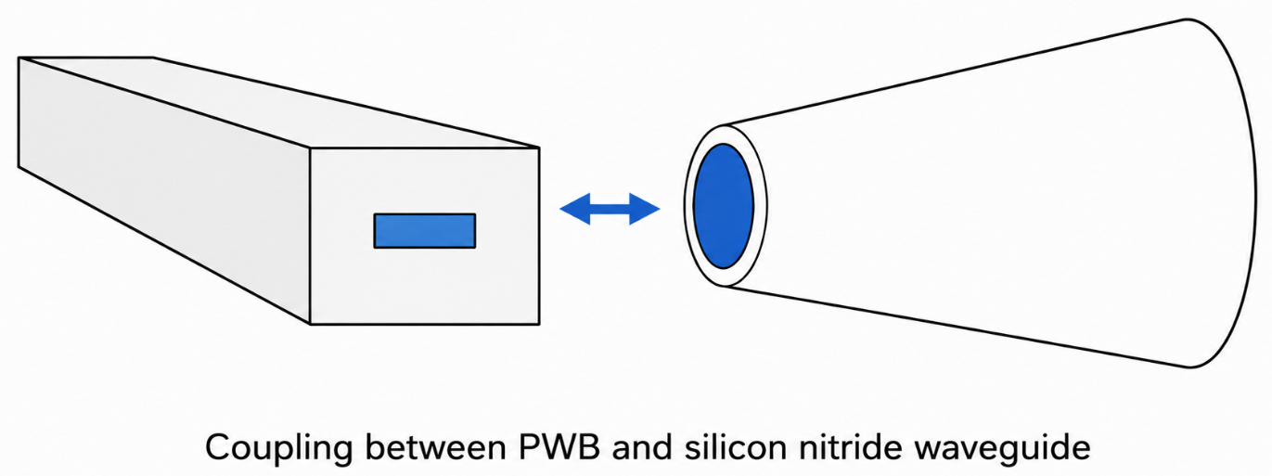
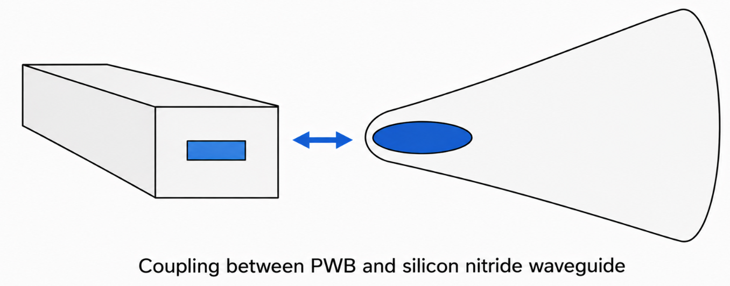
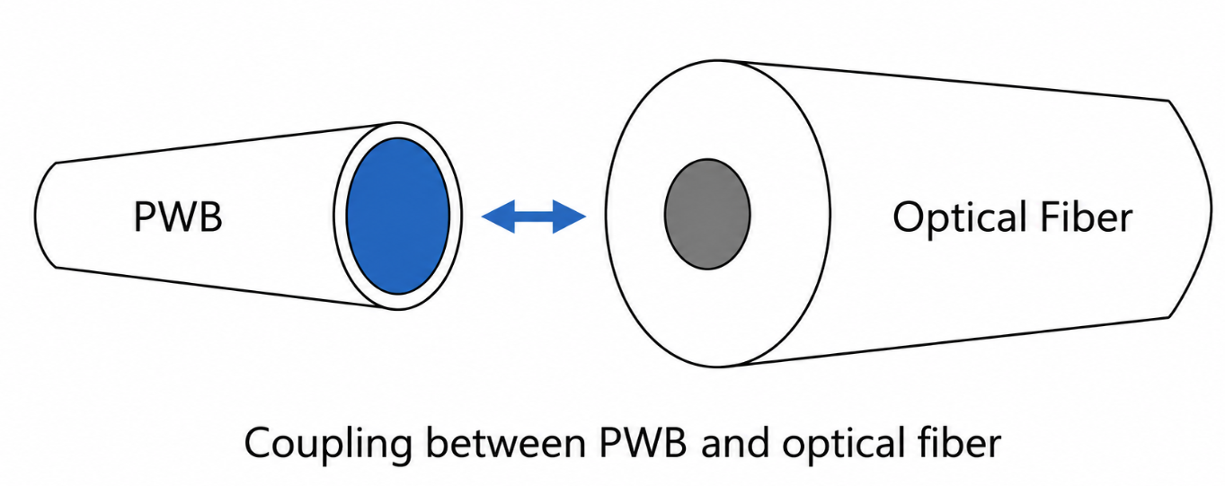
Results: Taper Design
Silicon Nitride Waveguide
Optical Fiber
Waveguide topology
Waveguide mode plot
Fiber mode plot
Coupling between PWB (circular cross-section) and silicon nitride waveguide
Coupling between PWB (elliptical cross-section) and silicon nitride waveguide
Coupling between PWB and optical fiber
Notes:
(NOTE: A fundamental mode is the lowest-order electromagnetic wave pattern that can travel through a waveguide: the most stable, most tightly confined state of light in the structure
Lowest-order refers to the simplest spatial pattern of the electric and magnetic fields that can exist in a specific environment: The wave has the fewest possible field variations across its cross-section (e.g., a single, solid beam of light with no dark spots or rings))
First, I’ll go over the results for the taper design. Here are my models of the fiber and waveguide cross-sections that I used to select PWB cross-sections for coupling with each device.
You can see here the topology of the waveguide, which consists of a silicon nitride core surrounded by silicon oxide cladding on a silicon substrate. Here is the mode plot of the waveguide. A mode is a specific, stable pattern of an EM wave as it travels through space or a guide, and this plot shows the fundamental mode of the waveguide. As you can see, it’s strongly concentrated within the core, that is, it’s confined and it’s being guided. This is what we want to see.
Here is the mode plot of the optical fiber. Similarly, you can see the mode is well-confined within the core, which is good.
These are diagrams showing coupling….

Slide 8
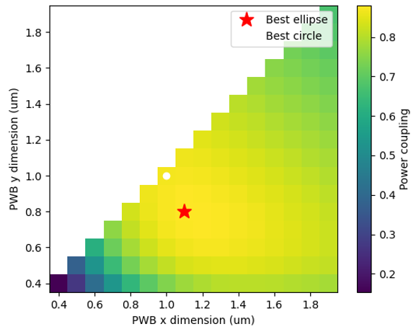
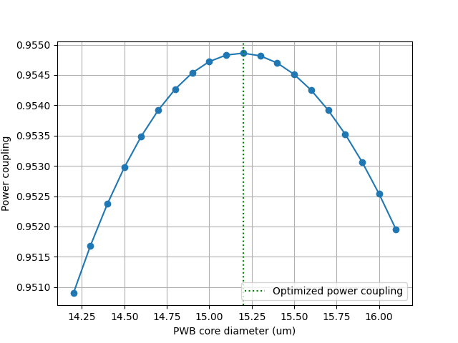
Results: Taper Cross-Sections
Waveguide Coupling
Fiber Coupling
Optimal elliptical cross-section
Width = 1.10 μm, Height = 0.80 μm
Power coupling = 0.8809
~0.55 dB loss
Optimal circular cross-section
Diameter = 1.00 μm
Power coupling = 0.8691
~0.61 dB loss
Optimal diameter: 15.2 μm, Power coupling = 0.9549
Loss (dB): −10·log₁₀(0.9549) ≈ 0.2 dB loss
Difference: ~0.06 dB (negligible). Circular cross-section used for geometric simplicity.
Notes:
These are my results for identifying the optimal photonic wire bond diameters for coupling.
Here, I swept different diameters of the photonic wire bond’s circular cross-section and took the overlap integral between the wire bond’s mode and the fiber’s mode for each diameter, which let me identify the dimensions at which the power coupling between the components was maximized. I found the optimal diameter of the wire bond to be 15.2 micron, with a loss of approximately 0.2 decibel.
…
Here’s a heatmap showing my results for coupling between the wire bond and waveguide. This circle here indicates the optimal circular wire bond cross-section, with a diameter of 1 micron, and the star indicates the optimal elliptical wire bond cross-section, with a width of 1.1 micron and a height of 0.8 micron. The loss for the elliptical cross-section was approximately 0.55 dB, compared to the circular cross-section loss of about 0.61 dB. This is about 0.06 decibels difference, which is fairly negligible, so going forward I plan to use the circular cross-section for geometric simplicity.

Slide 9
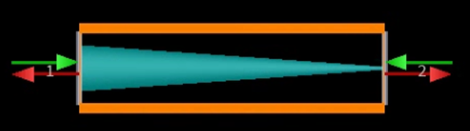
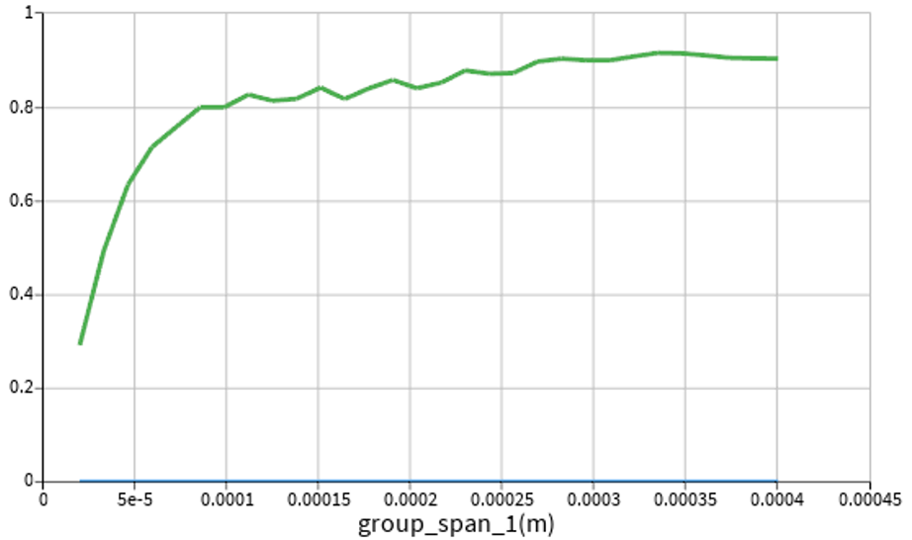
Results: PWB Taper Model
Interpretation:
|S₁₁|²: reflection at the input (want ≈ 0)
|S₂₁|²: forward transmission through the taper (want ≈ 1)
Transmission rises with length and plateaus: Taper behaves adiabatically at ~350 μm length
PWB model
EME Sweep Visualization
Notes:
I modeled the tapered wire bond to connect those two selected cross-sections. Here is my model of the wire bond in Lumerical’s EME solver, and this is the visualization of an EME sweep that I performed.
The blue plot represents the reflection at the input. We want that to be approximately 0, which it is.
The green plot represents the forward transmission through the taper. We want that to be close to 1. (A finite-length taper is never perfectly adiabatic)
The x axis of this graph is the length of the taper, which I swept to identify the optimal dimensions. As you can see, transmission rises with length and plateaus. This indicates that the taper behaves adiabatically at approximately 350 micron in length. Adiabaticity means that the light can smoothly propagate through the taper and stay in its original mode without scattering or converting into higher-order modes.

Slide 10
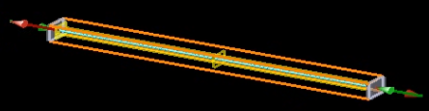
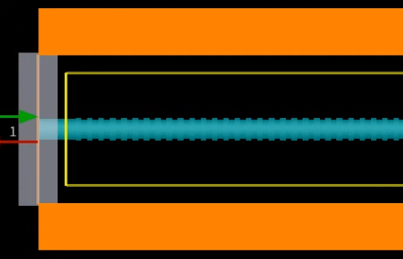
Results: Grating Model
Grating modeled as a radial corrugation with 50% duty cycle.
Parameters varied:
Corrugation depth
Grating length
Period for each corrugation depth determined via λ_{B} = 2·n_{eff,avg}·Λ
(λ_{B} = 1540 nm, FDE analysis to find n_{eff,avg})
Desired effects:
High reflection strength / transmission attenuation at λ_{B}
Narrow -3 dB reflection bandwidth
Low insertion loss
Grating model
Notes:
Now to the design of the grating. I modeled the grating in EME as a radial corrugation with a 50 percent duty cycle. The parameters that I evaluated were the corrugation depth and the grating length; the period was set by each corrugation depth based on the Bragg condition, using a target Bragg wavelength of 1540 nanometers and average effective index attained from FDE analysis of the grating cross-sections. What I'm looking for is strong reflection, that is, strong transmission attenuation, at the Bragg wavelength; a narrow reflection bandwidth; and low insertion loss.

Slide 11
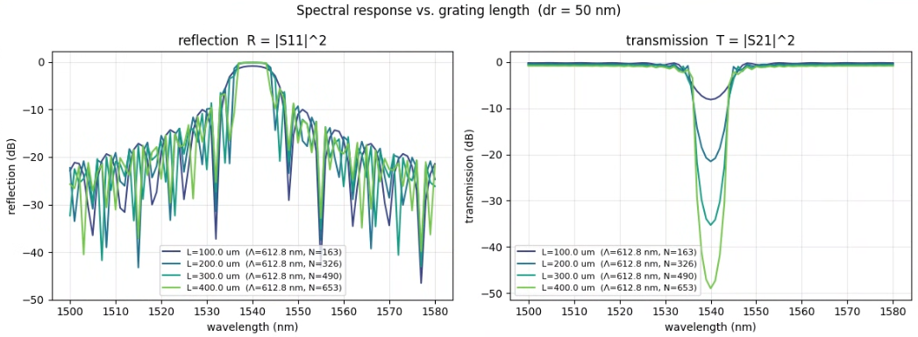
Results: Spectral Response, 50 nm corrugation depth
50 nm corrugation depth, Λ = 612.8 nm
N (number of periods) | Grating length (μm) | Minimum loss (dB)
163 | 99.9 | 0.21
326 | 199.8 | 0.42
490 | 300.3 | 0.64
653 | 400.2 | 0.85
Notes:
These are the spectral responses for a 50-nanometer corrugation depth at four grating lengths. As you can see, as the grating gets longer, the transmission dip at the Bragg wavelength deepens, meaning stronger reflection, but the insertion loss also climbs, from about 0.2 dB at 100 microns up to 0.85 dB at 400 microns. So there’s a tradeoff between reflection strength and loss.

Slide 12
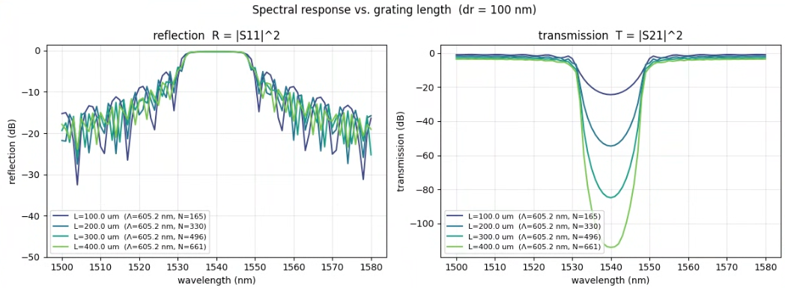
Results: Spectral Response, 100 nm corrugation depth
50 nm corrugation depth, Λ = 612.8 nm
N (number of periods) | Grating length (μm) | Minimum loss (dB)
163 | 99.9 | 0.21
326 | 199.8 | 0.42
490 | 300.3 | 0.64
653 | 400.2 | 0.85
100 nm corrugation depth, Λ = 605.2 nm
N (number of periods) | Grating length (μm) | Minimum loss (dB)
165 | 99.9 | 0.88
330 | 199.7 | 1.75
496 | 300.2 | 2.63
661 | 400.0 | 3.49
Notes:
Here are the spectral responses for a 100-nanometer corrugation depth with the same range of tested grating lengths. The deeper corrugation produces a deeper transmission dip, that is, stronger reflection at each grating length, but it also has a broader reflection band and the insertion loss is substantially higher at every length, roughly four times the 50-nanometer values.

Slide 13
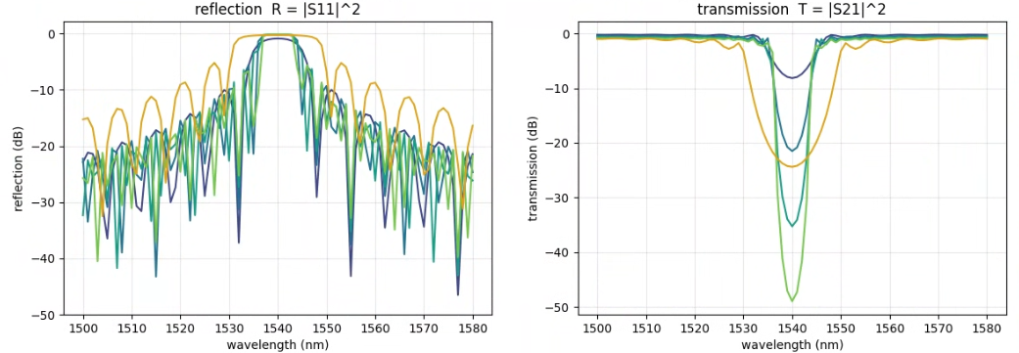
Results: Grating Parameter Selection
50 nm corrugation depth selected for narrower reflection bandwidth
200 µm grating length selected to balance sufficiently strong transmission attenuation (~-20 dB) with sufficiently low insertion loss (0.42 dB)
Notes:
Here’s an overlay of the 100 nm corrugation and 100 um grating length spectrum overlaid with the full 50 nm corrugation spectral sweep, showing the deeper transmission dip and broader reflection peak.
I did test corrugation depths beyond this range, but I ultimately didn’t consider values greater than 100 nm because of the effects you can see here, nor did I consider values less than 50 nm because of fabricability concerns.
I selected the 50-nanometer corrugation depth because it gives a narrower reflection bandwidth, which is better for sensing resolution, and I chose a 200-micron grating length as a balance point that gives strong enough transmission attenuation, around minus 20 dB, while keeping insertion loss low at about 0.42 dB.

Slide 14
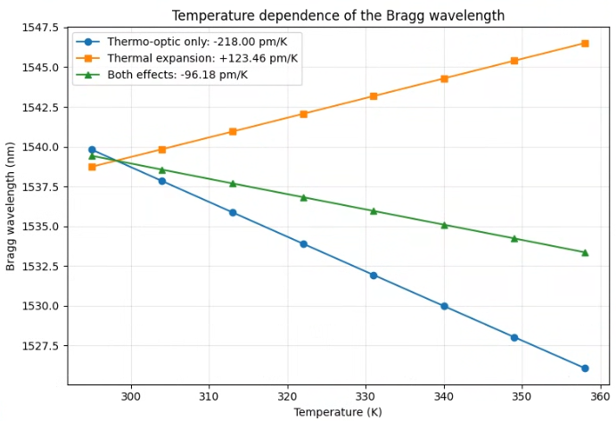
Results: Temperature Sensitivity (FDE)
Note: The two contributions do not additively combine.
This is due to λ_{B} being proportional to the product of the two temperature-dependent parameters, n_{eff,avg} and Λ, rather than their sum, introducing a term of Δn_{eff,avg}·ΔΛ.
Notes:
After selecting my grating parameters, I characterized the structure’s temperature sensitivity. Using FDE analysis of the grating structure’s cross sections, I computed how the Bragg wavelength shifts with temperature from each of the two contributions — the thermo-optic effect and thermal expansion — and then the net response.
[list values]
Add if necessary: Note that the combined shift as recorded in this figure is not the sum of the individual shifts as they don’t combine additively. The Bragg wavelength depends on the product of the effective index and the period, not their sum.

Slide 15
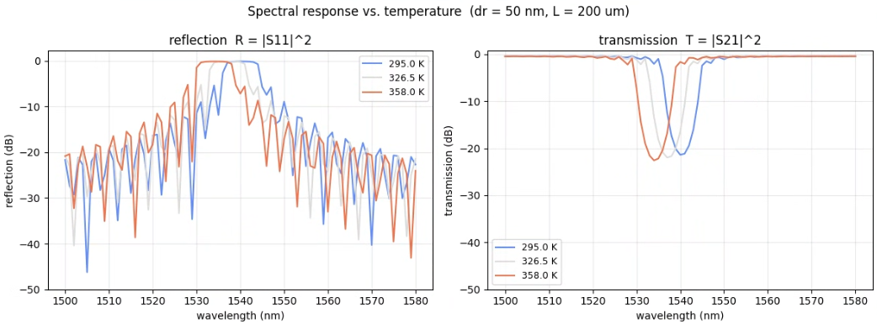
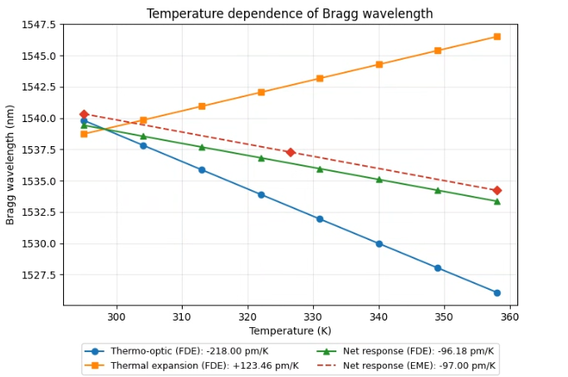
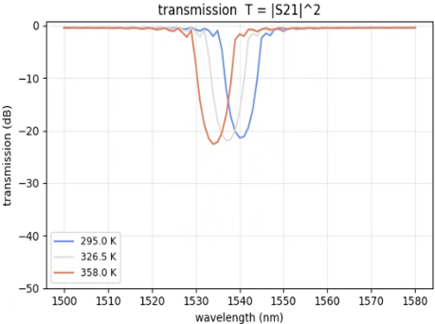
Results: Temperature Sensitivity (EME)
Notes:
To validate results attained using FDE, I ran EME simulations of the full grating structure at a range of temperatures and tracked how the reflection dip shifts. These spectra show the dip moving with temperature, and the slope of that shift gives me the temperature sensitivity recorded from the full structure.

Slide 16
Analysis
FDE and EME –derived values agree closely: -96.18 pm/K vs. -97.00 pm/K (0.85% difference), supports reliability of results.
Very high temperature sensitivity in comparison to temperature sensitivity of traditional silica FBGs: ~13.7 pm/K [8]. This can be attributed to the high thermo-optic coefficient of polymer materials [9].
-3 dB reflection bandwidth is ~10 nm, significantly larger than 0.2-0.5 nm standard for FBG temperature sensors [10].
  This is balanced by high temperature sensitivity: Temperature change of 1 K would produce a λ_{B} shift of approximately 0.093-0.097 nm. With the resolution of commercially available interrogators ranging 0.3-5 pm [11], this could support sub-1 K temperature resolution.
Notes:
Now, discussing the takeaways from my results. First, the FDE and EME sensitivities agree closely — minus 96.2 versus minus 97.0 picometers per Kelvin, less than a percent apart — which supports the reliability of the result. Second, this sensitivity is far higher than a traditional silica fiber Bragg grating, which is around 13.7 picometers per Kelvin, with the difference due to the large thermo-optic coefficient of the polymer. The reflection bandwidth here is about 10 nanometers, which is significantly wider than the 0.2 to 0.5 nanometers typical of FBG sensors. However, this is offset by the high sensitivity: a one-Kelvin change shifts the Bragg wavelength by nearly 0.1 nanometer, and with commercial interrogators exhibiting resolution down to the picometer scale, this will still likely support sub-one-Kelvin temperature resolution.

Slide 17
Conclusions
Bragg grating parameters of 50 nm corrugation depth and 200 µm grating length were selected to meet targets for reflection strength, reflection bandwidth, and insertion loss.
Observed high temperature sensitivity and low insertion loss supports potential viability of PWBs as multifunctional temperature sensors and optical interconnects.
Future Directions:
Further characterization of coupling between taper and grating: work thus far has mainly evaluated the structures separately.
Design of a fin for mechanical support.
Validation though experimental fabrication.
Notes:
In conclusion, I selected grating parameters of a 50-nanometer corrugation depth and a 200-micron length to meet my targets for reflection strength, bandwidth, and insertion loss. The high temperature sensitivity together with low insertion loss supports the potential viability of photonic wire bonds as multifunctional temperature sensors and optical interconnects. Going forward, I'd like to further characterize the coupling between the taper and grating structures, since I've mostly evaluated them separately, design a structural fin for mechanical support of the wire bond, and ultimately validate the design through fabrication.

Slide 18
Acknowledgments
This material is based upon work supported by the National Science Foundation under Grant No. 2349091.
Thank you to my mentor, Dr. Parvinder Gill, for her guidance and support.
Thank you to my REU coordinators, Dr. Brad Whitaker and Dr. Wataru Nakagawa, for organizing this research program.
Notes:
…

Slide 19
References
[1] S. Brinkley, "Photonic integrated circuit: Definition, disadvantage, fabrication, application," Ovaga Technologies, Nov. 22, 2023. [Online]. Available: https://www.ovaga.com/blog/transistor/photonic-integrated-circuit-definition-disadvantage-fabrication-application (accessed Jun. 17, 2026).
[2] P. K. Gill, A. Kukin, and D. M. Marom, "Direct 3D-printed ring-resonator photonic circuit on a dual core fiber tip for remote sensing applications," Opt. Lett., vol. 49, no. 14, pp. 3946–3949, 2024, doi: 10.1364/OL.529001.
[3] D. Weninger, S. Serna, L. Ranno, L. Kimerling, and A. Agarwal, "Advances in waveguide to waveguide couplers for 3D integrated photonic packaging," Light Sci. Appl., vol. 15, no. 1, art. no. 17, 2026, doi: 10.1038/s41377-025-02048-w.
[4] B. Lin, D. Witt, J. F. Young, and L. Chrostowski, "Cryogenic optical packaging using photonic wire bonds," APL Photon., vol. 8, no. 12, art. no. 126109, 2023, doi: 10.1063/5.0170974.
[5] N. Lindenmann, G. Balthasar, D. Hillerkuss, R. Schmogrow, M. Jordan, J. Leuthold, W. Freude, and C. Koos, "Photonic wire bonding: a novel concept for chip-scale interconnects," Opt. Express, vol. 20, no. 16, pp. 17667–17677, 2012, doi: 10.1364/OE.20.017667.
[6] J. W. Smith et al., “Three-dimensional Fabry–Pérot cavities sculpted on fiber tips using a multiphoton polymerization process,” J. Micromech. Microeng., vol. 30, no. 12, Art. no. 125007, 2020.
[7] Y. Qu, D. Kadic, M. Naber, and M. Wegener, “Micro-structured two-component 3D metamaterials with negative thermal-expansion coefficient from positive constituents,” Sci. Rep., vol. 7, Art. no. 40643, 2017.
[8] C. V. N. Bhaskar, S. Pal, and P. K. Pattnaik, “Recent advancements in fiber Bragg gratings based temperature and strain measurement,” Results in Optics, vol. 5, Art. no. 100130, 2021, doi: 10.1016/j.rio.2021.100130.
[9] N. T. Beneitez, J. Missinne, Y. Shi, et al., "Highly sensitive waveguide Bragg grating temperature sensor using hybrid polymers," IEEE Photon. Technol. Lett., vol. 28, no. 10, pp. 1150–1153, 2016.
[10] D. Srivastava and B. Das, “Interrogation techniques for π-phase-shifted fiber Bragg grating sensor: A review,” Sensors and Actuators A: Physical, vol. 315, Art. no. 112215, Nov. 2020, doi: 10.1016/j.sna.2020.112215.
[11] S. Xu, A. Fernandez Lopez, and I. Olivares, “Fiber Bragg Grating Interrogators Based on Photonic Integrated Circuit Platforms,” Photonics, vol. 13, no. 6, Art. no. 517, 2026, doi: 10.3390/photonics13060517.

Slide 20
Questions?

