Slide 1
Understanding Phase Transitions and Lattice Dynamics of Antimony-Doped Double Perovskites via Temperature Dependence
Dorothy Wong
Home Institution: Cornell University
Host Institution: Duke University
Patrick Postec, Wenda Si, Olivier Delaire

Slide 2
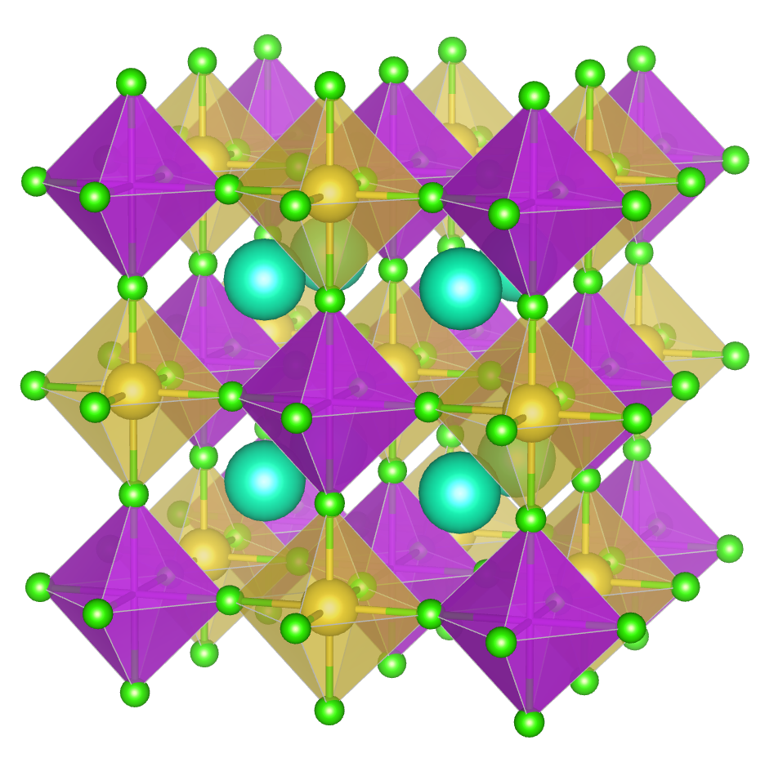
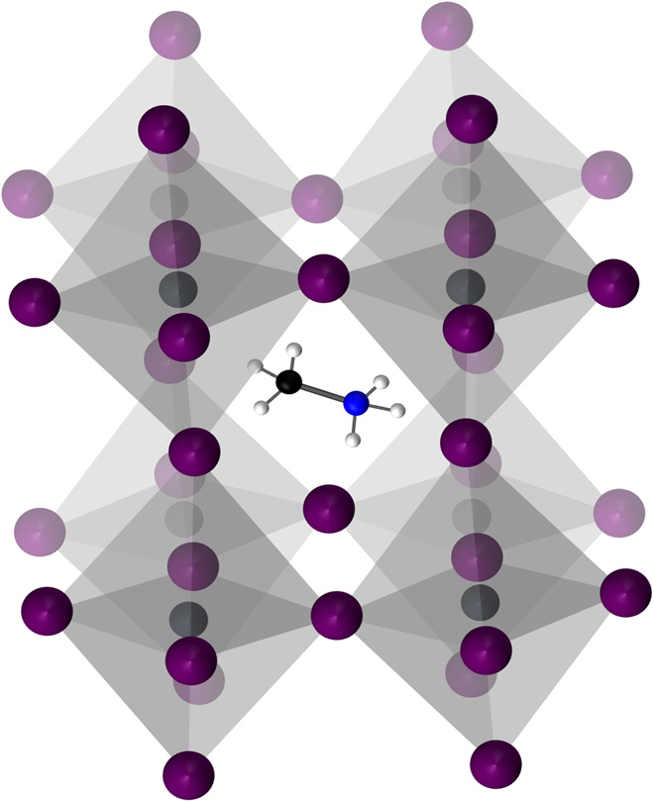
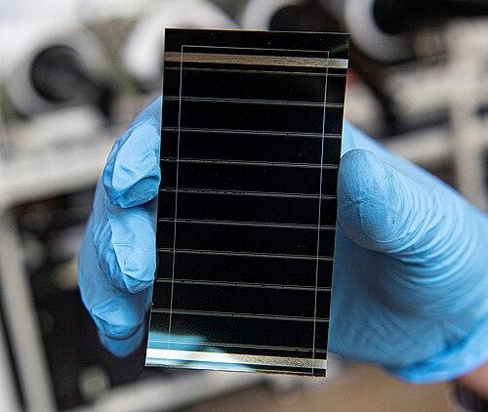
Project Background: Lead Halide & Double Perovskites
Lead halide perovskites (APbX₃):
High photovoltaic power conversion efficiencies
Pb content → toxic
Double perovskite crystal structure, cubic phase
Motivation:
Getting the true structure is key to correctly predicting the bulk properties
Understanding of phase shifts and dynamics of the crystal → effective improvement of their performance^{[3]}
Alternatives:
Replacing Pb with other 2+ transition metals → unstable (atomic radii variation)
Solution - Mix transition metals with average 2+ (Cs₂B’B’’Cl₆)^{[2]}
Methylammonium lead halide crystal structure, cubic phase^{[1]}
Perovskites usage in a solar cell
Notes:
“Lead halide perovskites, with the form APbX₃, have been extensively studied and are highly valued for their excellent optoelectronic properties.”
→ optoelectronic properties largely due to symmetry of the crystal structure (point out a symmetric crystal structure figure of APbX₃ form)
→ lead is toxic (well known), so alternative Pb-free perovskites are finding greater use
“These alternatives include a family of perovskites called ‘double perovskites’.”
→
-------------------------------------------------------------------------------------------------------------------------------------------------------------------------------------------------------------------------------------------------------
Perovskite- “a specific crystal structure that typically has the structure ABX₃”

Slide 3
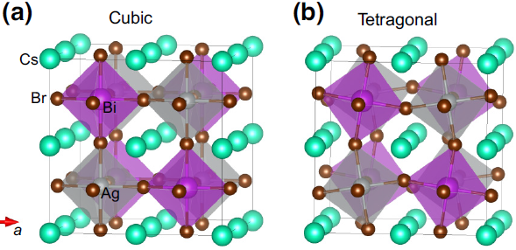
Project Objectives
Accessing the influence of Sb-doping at the Bi-site on structure, phase transition, temperature, and lattice dynamics
Synthesis of 3D single crystals of Cs₂NaBiCl₆ and its antimony-doped counterparts Cs₂NaBi_{1-x}Sb_{x}Cl₆
Perform powder x-ray diffraction and Raman spectra measurements on crystals and analyze data for phase transitions
Consider effects of low temperature on crystal structure and lattice dynamics
Cs₂AgBiBr₆ Structure Distortions from cubic to tetragonal^{[4]}
Notes:
Work on the motivation (previous slide??)
*ask Patrick why we are studying lattice dynamics*

Slide 4
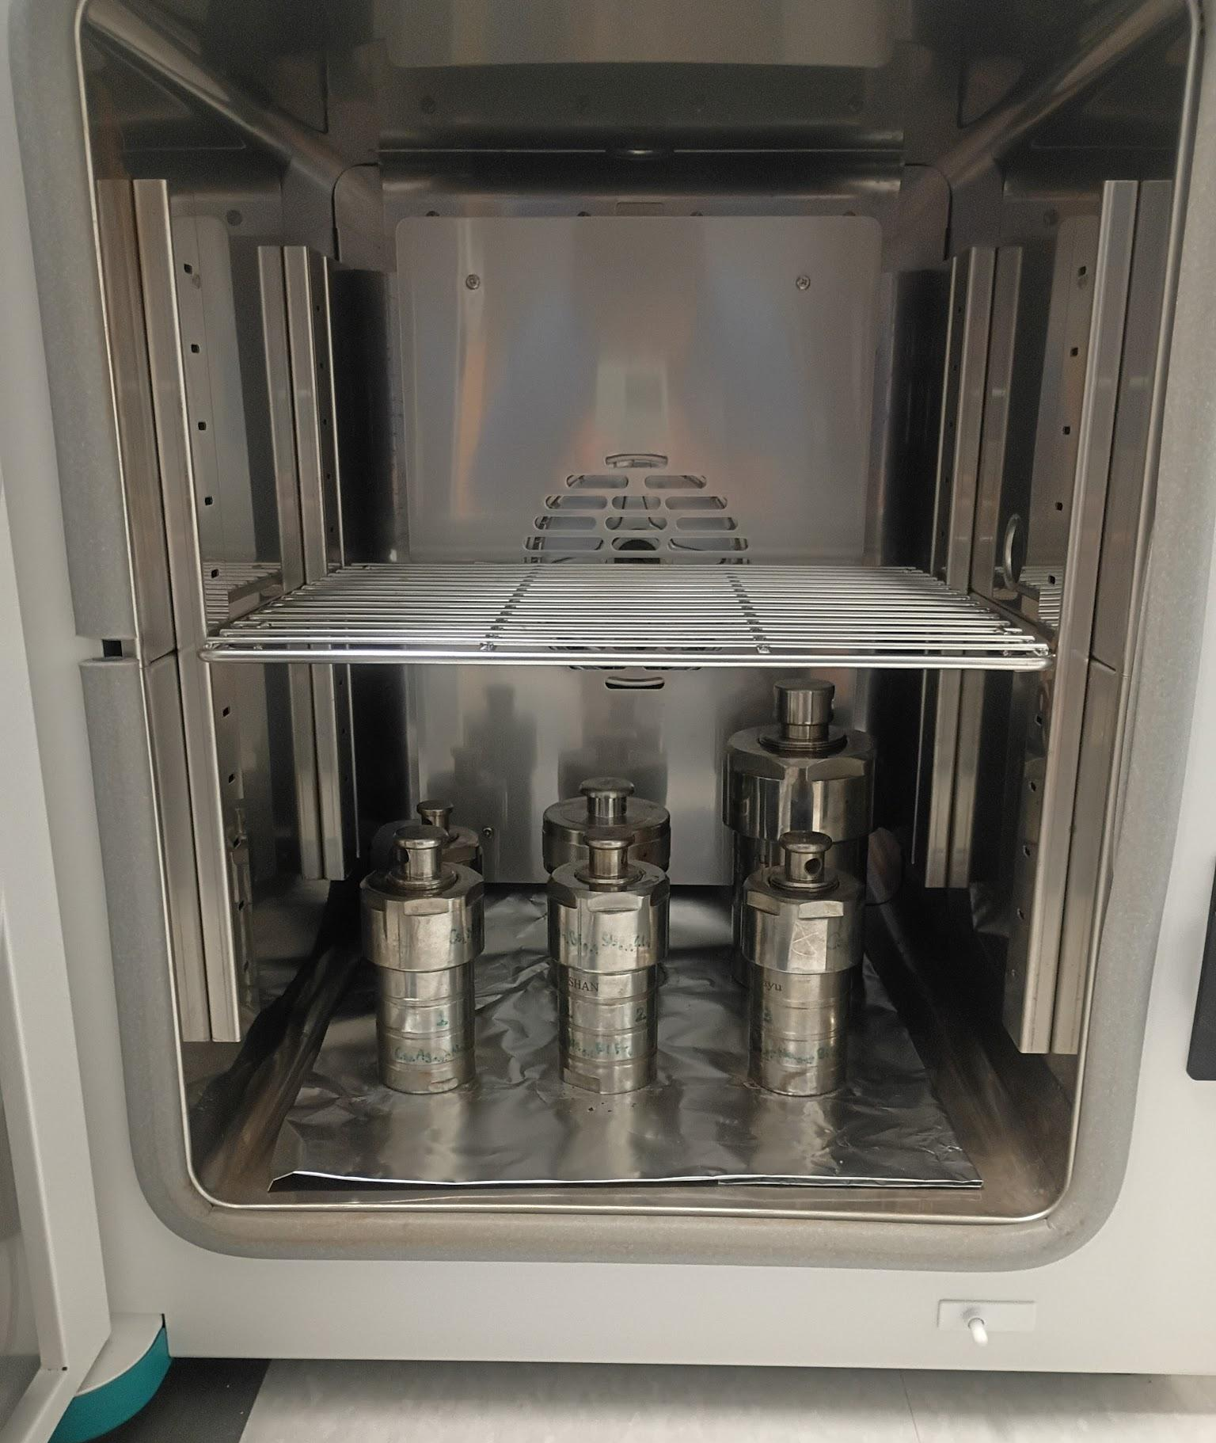
Hydrothermal Synthesis
Mix powder reactants in acidic solution
Heat mixture under high pressure
Slowly cool down for optimal crystal formation
Reaction: 2CsCl + NaCl + (1-x)BiCl₃ + (x/2)Sb₂O₃ + (3x)HCl→ Cs₂NaBi_{1-x}Sb_{x}Cl₆ + (3x/2)H₂O
Reactants are in powder form
Dissolved in 37% HCl
Concentration 50 mM
Ratios of BiCl₃ and Sb₂O₃ for different Sb-doping ratios

Slide 5
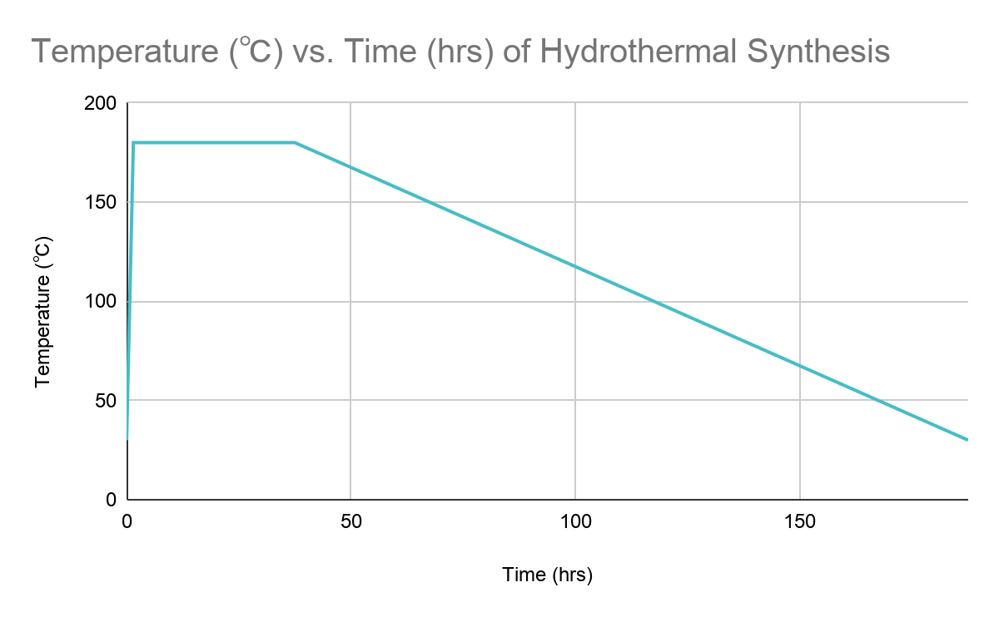
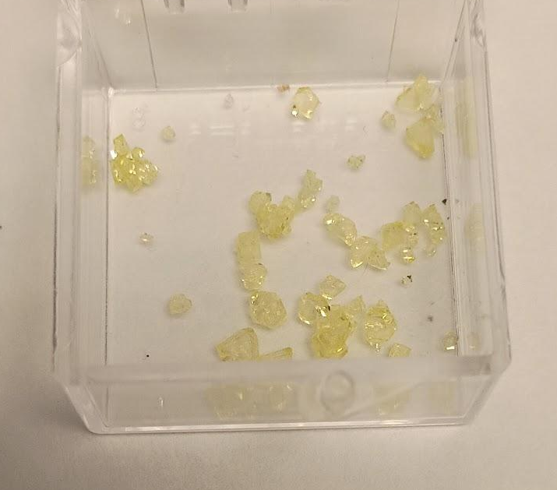
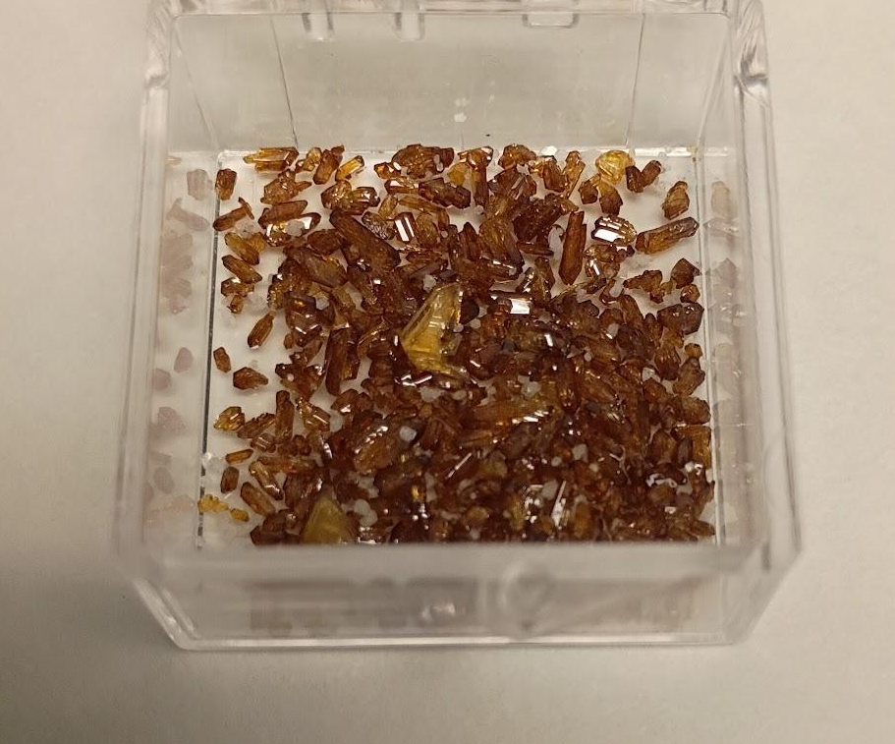
Hydrothermal Synthesis: Cs₂NaBiCl₆ and Cs₂NaSbCl₆
Maintained at 180℃ for 36 hrs
Cooled down to 30℃ at 1℃/hr
Critical for continuous single crystals
Cs₂NaBiCl₆ 0.05 M
Cs₂NaSbCl₆ 0.65 M

Slide 6
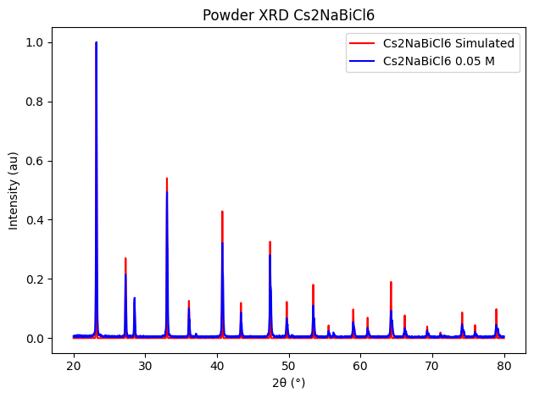
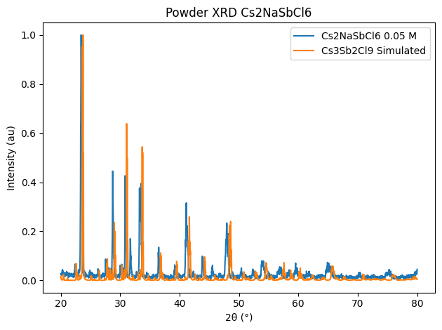
Results
Learned from Powder X-Ray Diffraction (PXRD) that…
Synthesis of Cs₂NaBiCl₆ was a success
Synthesis of Cs₂NaSbCl₆ was not successful; Cs₃Sb₂Cl₉ formed instead

Slide 7
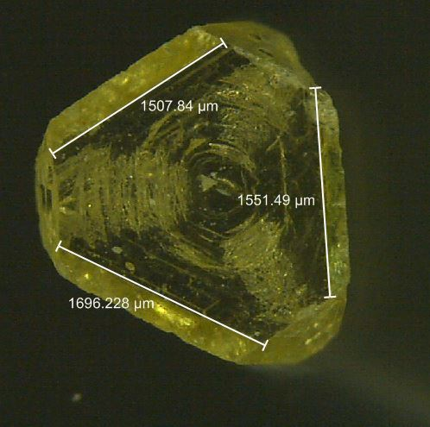
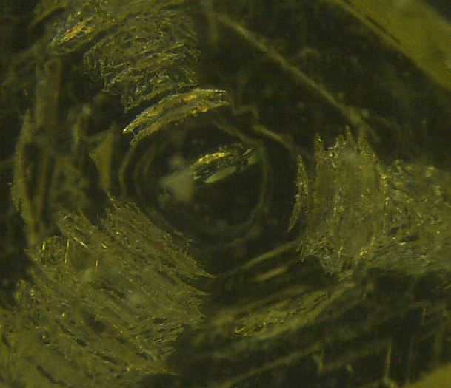
Cs₂NaBiCl₆ and Cs₂NaSbCl₆ Microscope Pictures
Visible octahedral structure formed during crystal growth
Cs₂NaBiCl₆ 0.05 M, 5X
Cs₂NaBiCl₆ 0.05 M, 2X

Slide 8
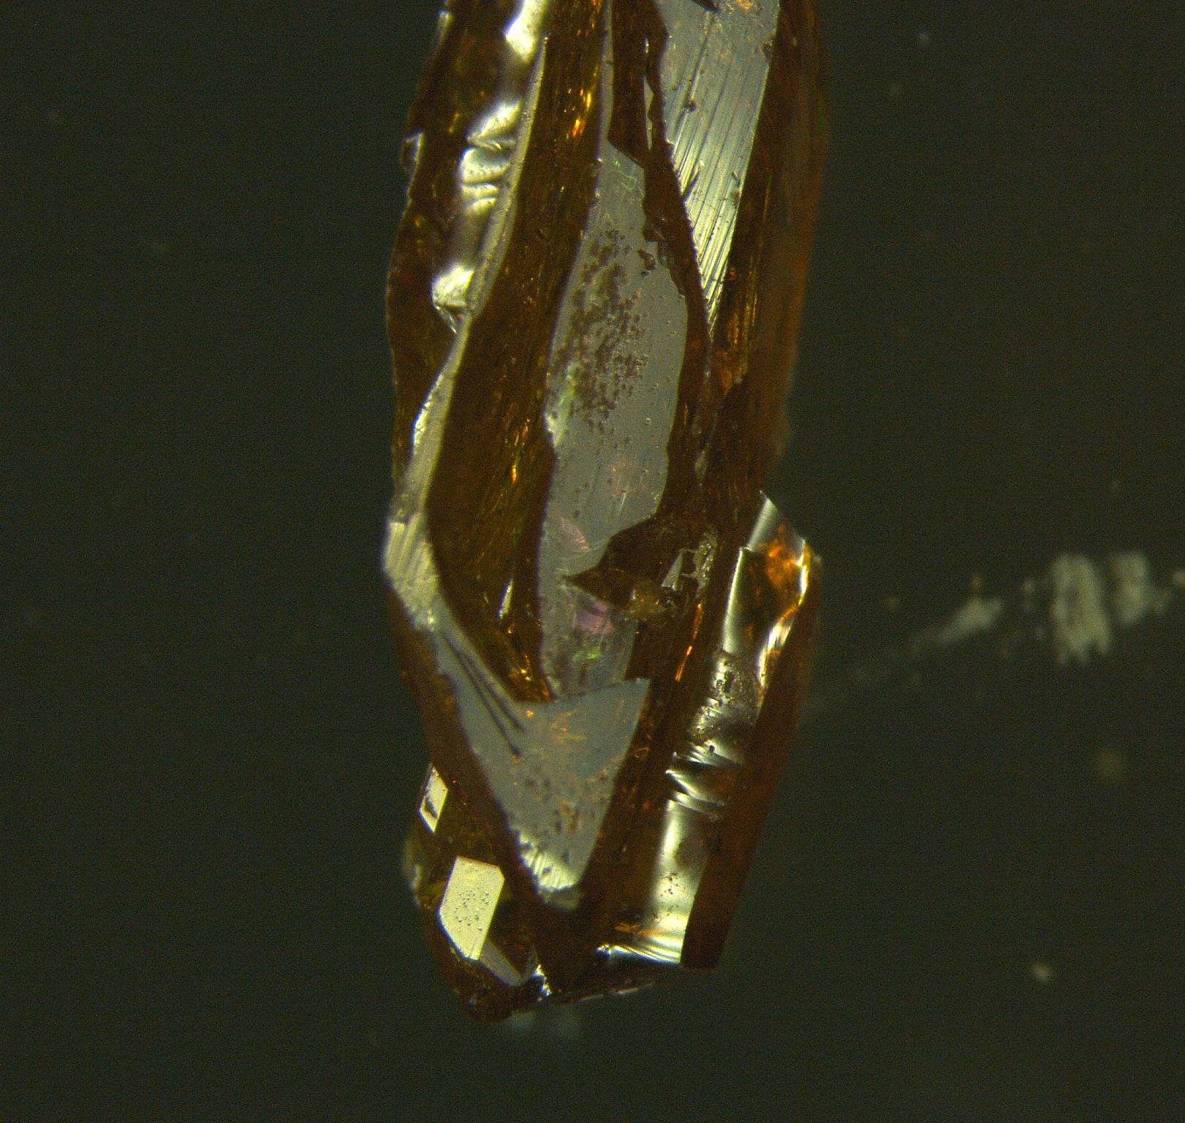
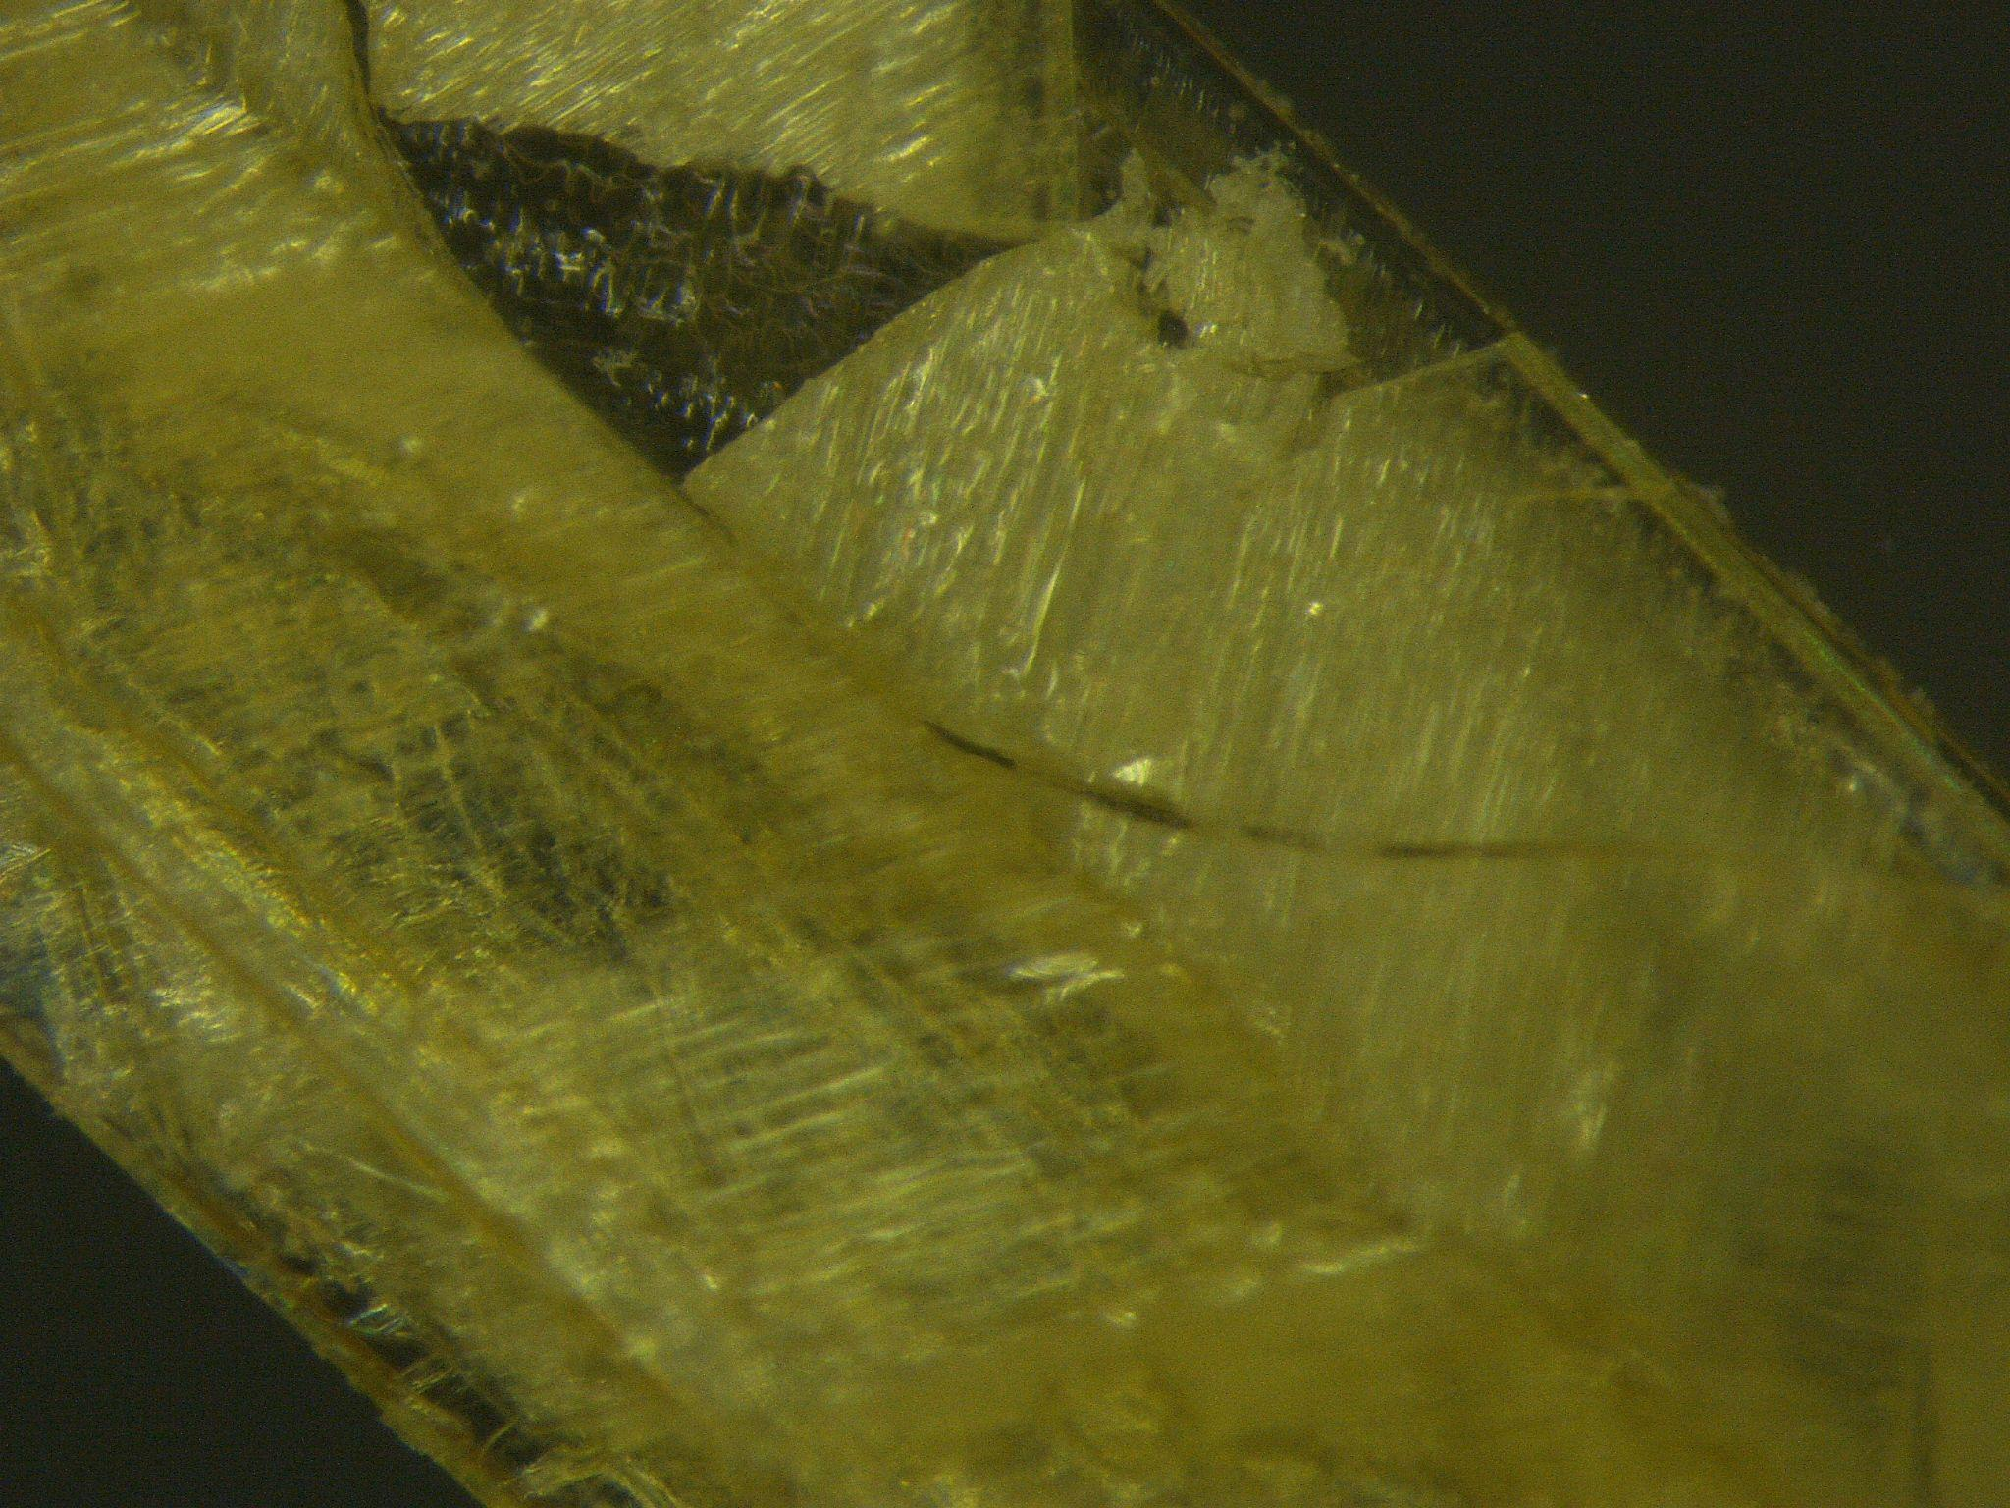
Cs₂NaBiCl₆ and Cs₂NaSbCl₆ Microscope Pictures
Visible octahedral structure formed during crystal growth
No octahedral structure
Flaky layers imply 2D growth
Cs₂NaBiCl₆ 0.05 M, 5X
Cs₂NaSbCl₆ 0.35 M, 5X
Cs₂NaBiCl₆ 0.05 M, 2X
Cs₂NaSbCl₆ 0.65 M, 2X

Slide 9
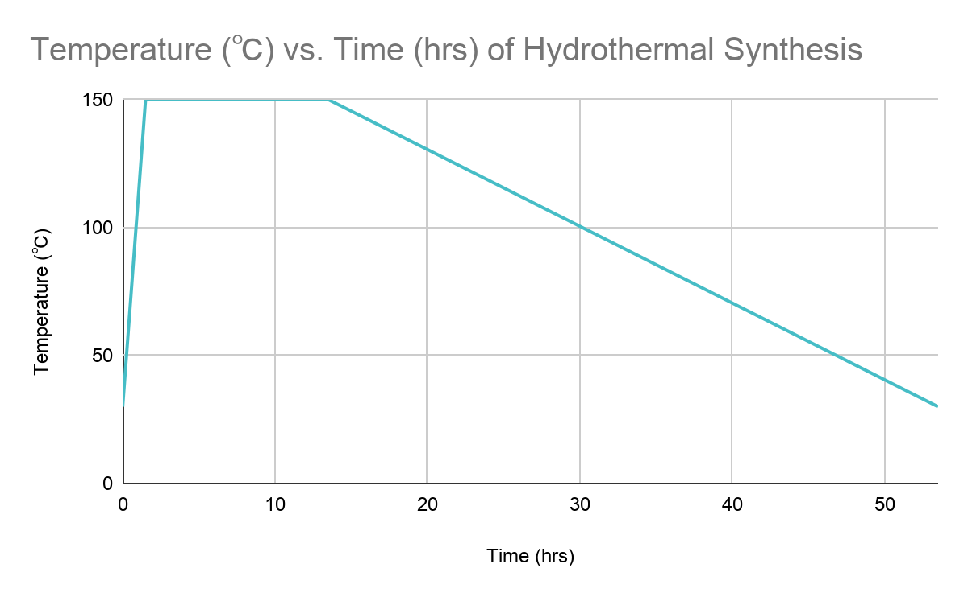
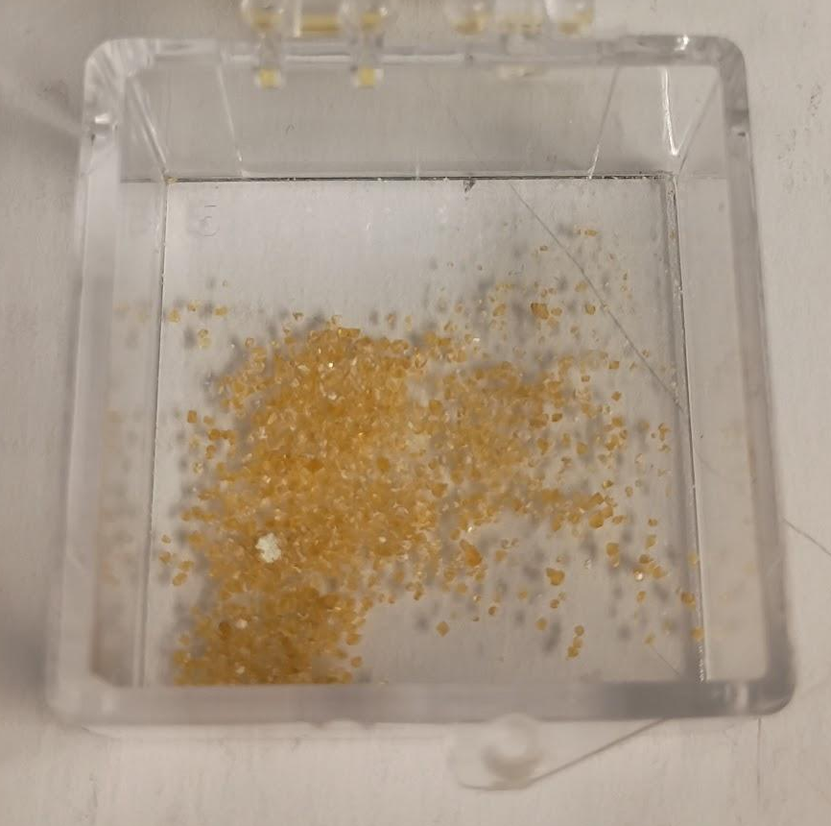
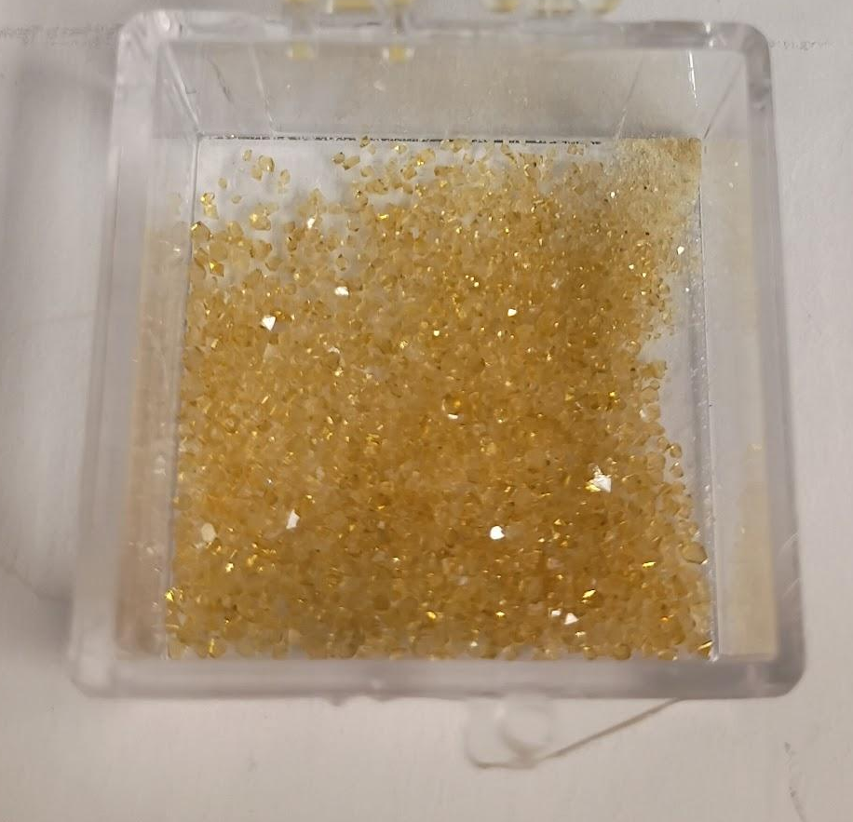
Hydrothermal Synthesis (Round 2): Cs₂NaBi_{(1-x)}Sb_{(x)}Cl₆
Maintained at 150℃ for 12 hrs
Cooled down to 30℃ at 3℃/hr
Cs₂NaBi_{0.85}Sb_{0.15}Cl₆ 0.05 M
Cs₂NaBi_{0.75}Sb_{0.25}Cl₆ 0.05 M
Notes:
*remember to be clear about why 30% doping (literature reference)*

Slide 10
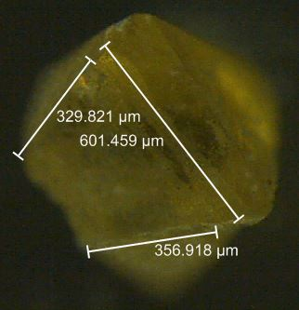
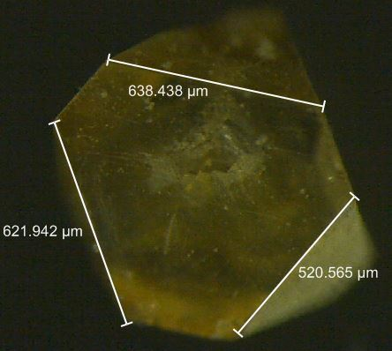
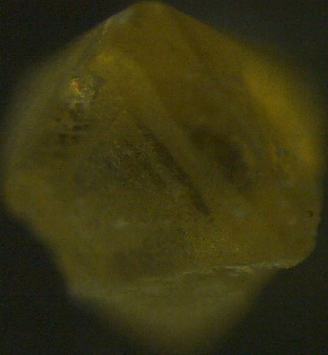
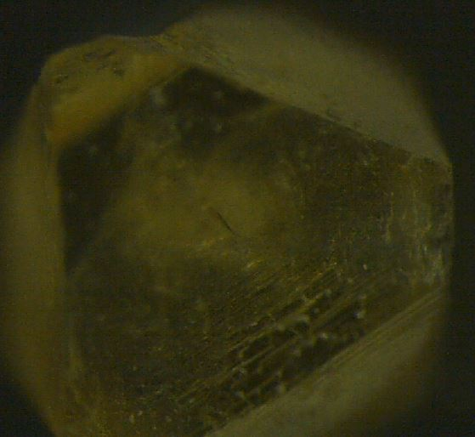
Cs₂NaBi_{1-x}Sb_{x}Cl₆ Microscope Pictures
Cs₂NaBi_{0.9}Sb_{0.1}Cl₆ 0.05 M, 8X
Cs₂NaBi_{0.75}Sb_{0.25}Cl₆ 0.05 M, 8X
Cs₂NaBi_{0.9}Sb_{0.1}Cl₆ 0.05 M, 5X
Cs₂NaBi_{0.75}Sb_{0.25}Cl₆ 0.05 M, 5X
Octahedral structure still present
Assume successful synthesis

Slide 11
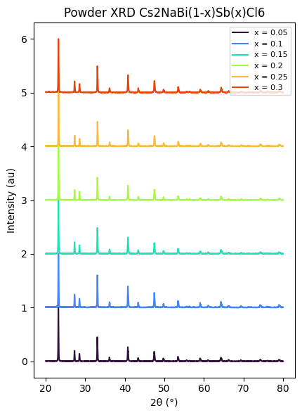
Synthesis with doping successful
Previous work demonstrated that substituting Bi in Cs₂NaBiCl₆ with Sb was possible up to 7:3 ratio^{[5]}
Experimentally reproduced results successfully
All dopings match with pure Cs₂NaBiCl₆ PXRD
*Consider doing SEM-EDS in the future to verify correct stoichiometric composition of Sb-doping*

Slide 12
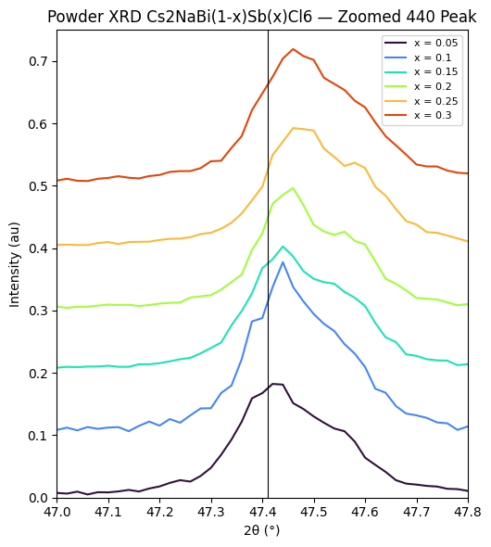
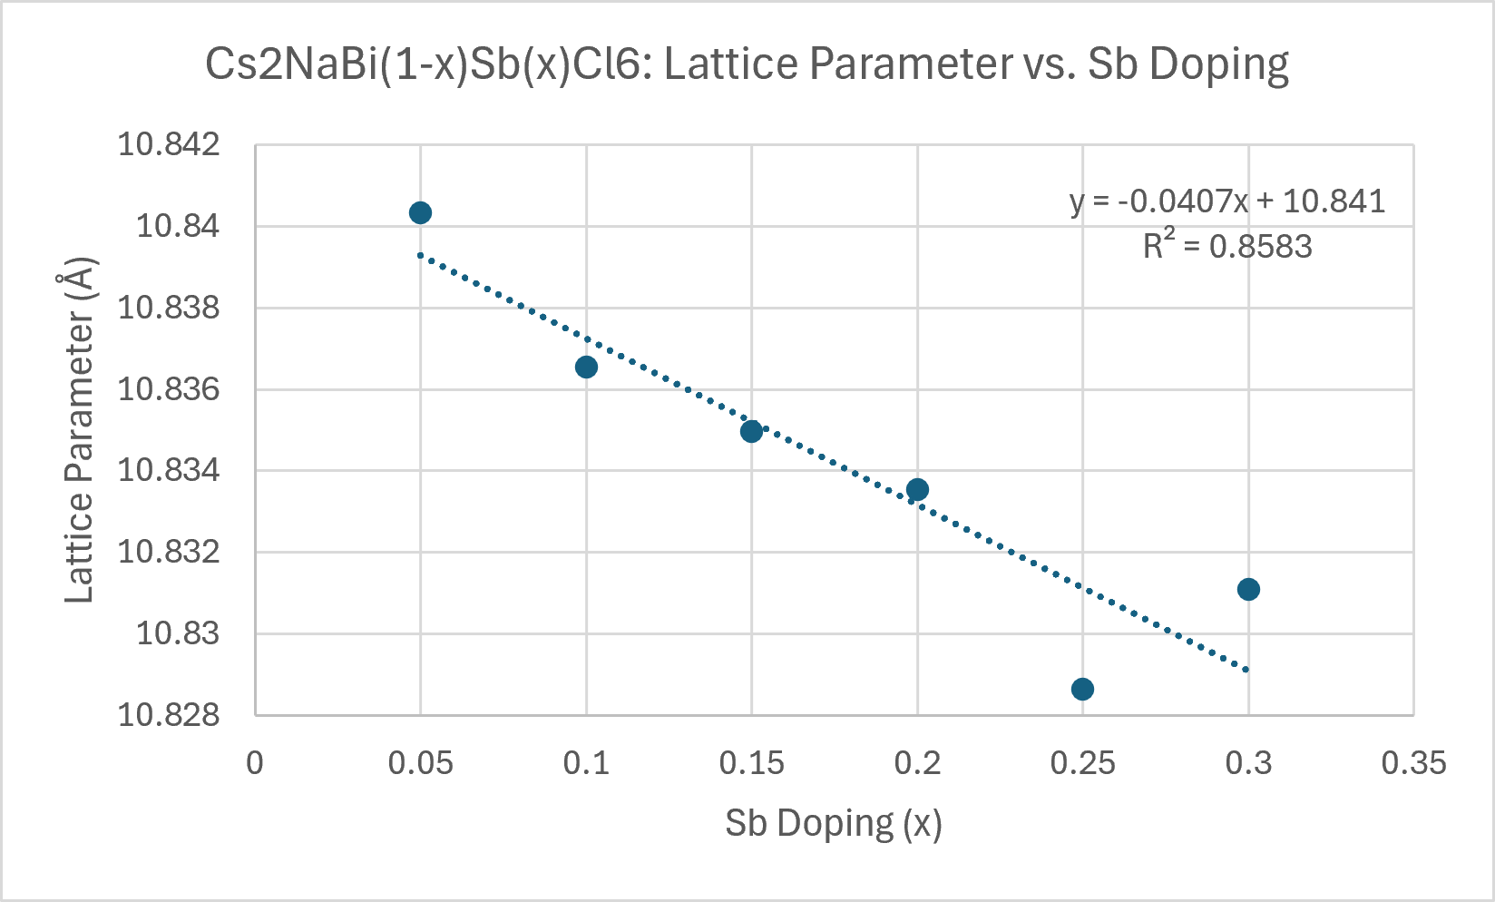
Cs₂NaBi_{1-x}Sb_{x}Cl₆ PXRD Analysis
Lattice Parameter Trends
Increase in Sb-doping → Decrease in cubic lattice parameter

Slide 13
Expectations
Increase in Sb-doping should decrease lattice parameter
Sb ionic radius ≤ Bi ionic radius (Shannon Radii)
  Sb ionic radius ≈ 0.76 Å
  Bi ionic radius ≈ 1.03 Å
Replacing Bi ions with Sb ions causes structure to shrink in size

Slide 14
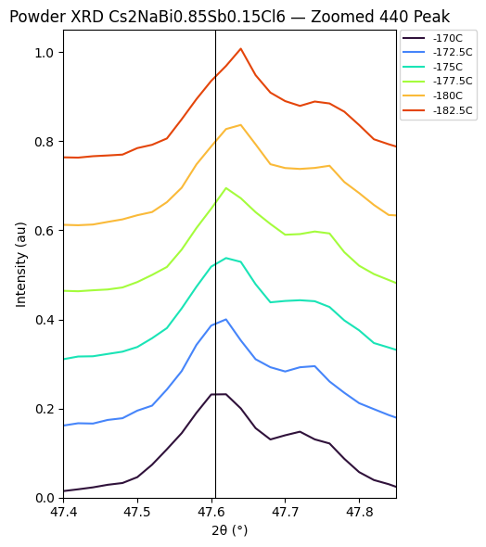
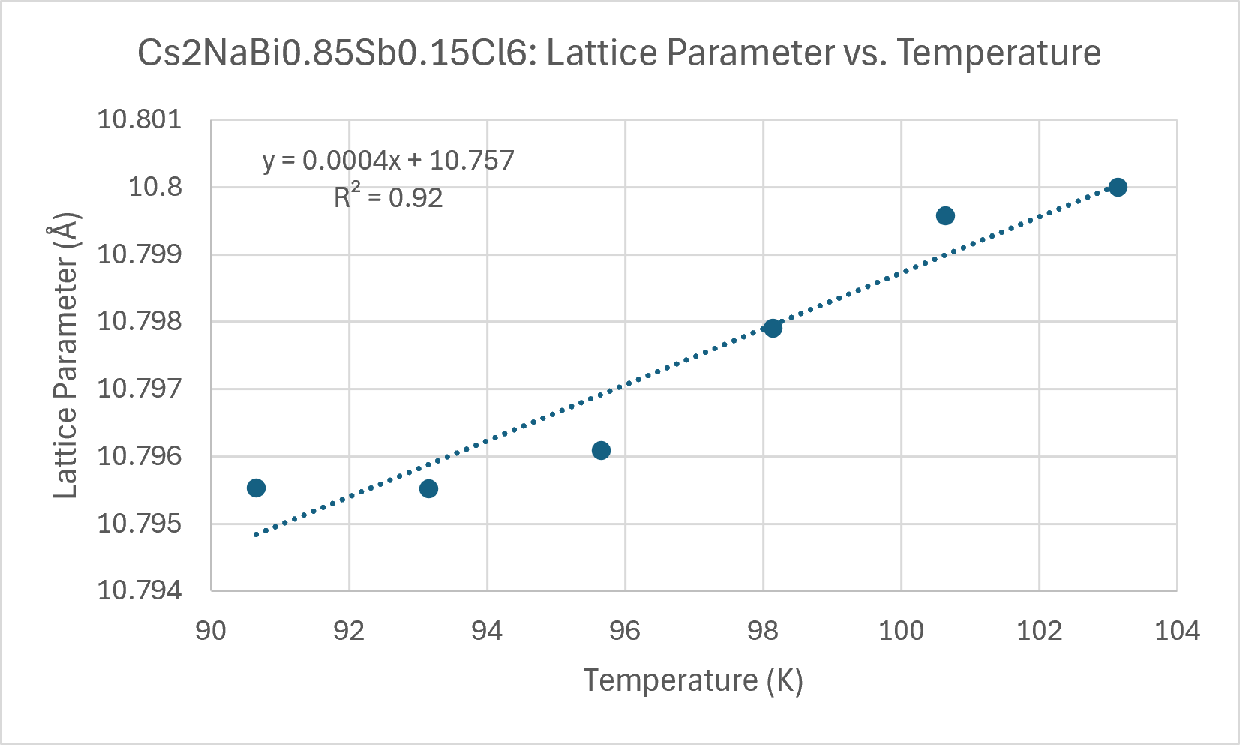
Cs₂NaBi_{1-x}Sb_{x}Cl₆ PXRD Analysis (cont.)
Lattice Parameter Trends (cont.)
Decrease in crystal temperature → decrease in lattice parameter

Slide 15
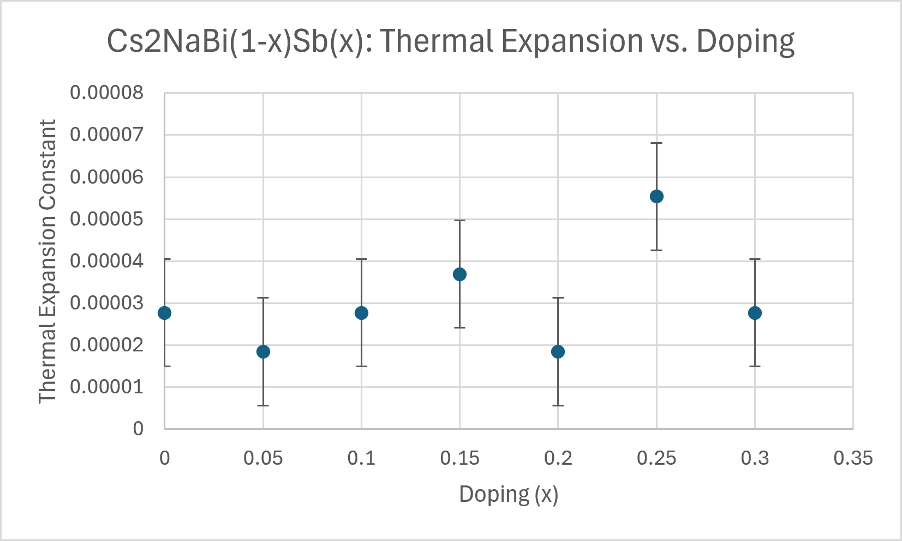
Cs₂NaBi_{1-x}Sb_{x}Cl₆ PXRD Analysis (cont.)
Lattice Parameter Trends (cont.)
Increase in Sb-doping → Seemingly no effect on thermal expansion

Slide 16
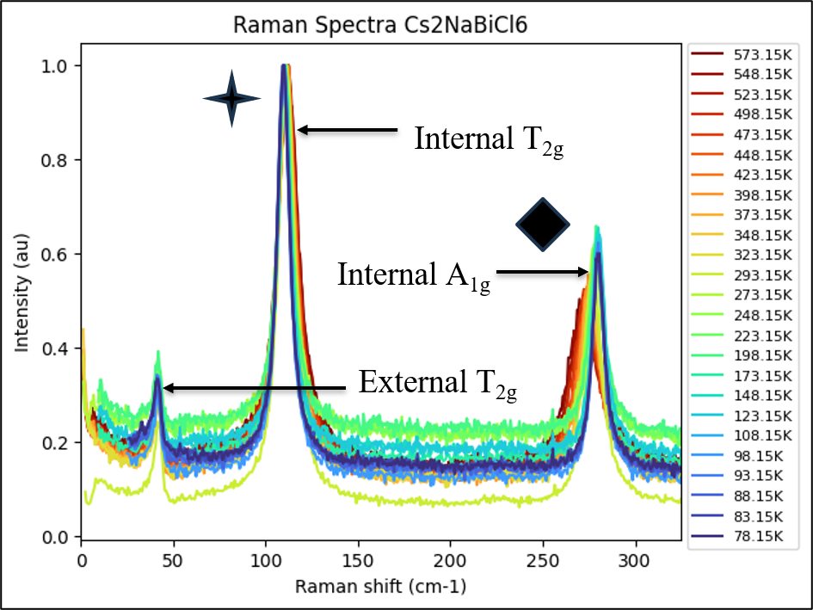
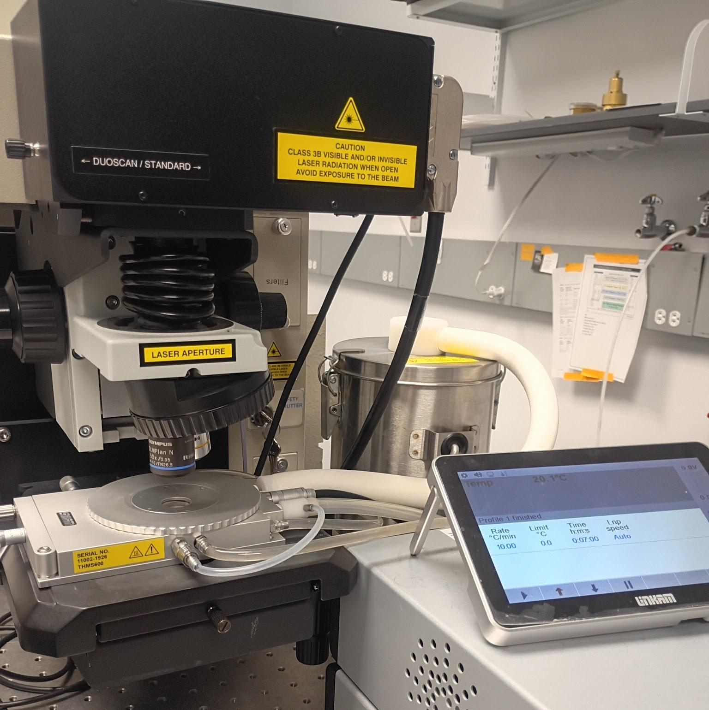
Cs₂NaBi_{1-x}Sb_{x}Cl₆ Raman Spectra
Raman Spectra and Vibrational Modes
Cs₂NaBi_{1-x}Sb_{x}Cl₆ has 3 distinctive modes^{[6]}
External T_{2g} for Cs⁺ ions ̴50 cm⁻¹
Internal T_{2g} forBiCl₆⁻ octahedra ̴110 cm⁻¹
Internal A_{1g} for BiCl₆⁻ octahedra ̴270 cm⁻¹

Slide 17
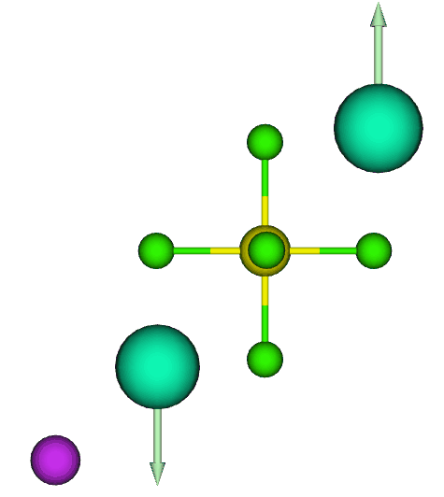
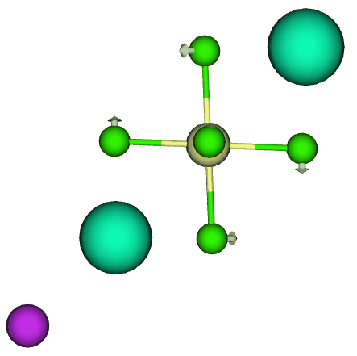
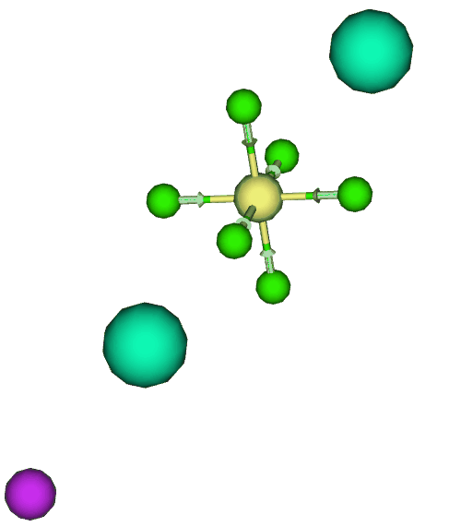
Vibrational Mode Visualization
External T_{2g} Mode
Internal T_{2g} Mode
Internal A_{1g} Mode

Slide 18
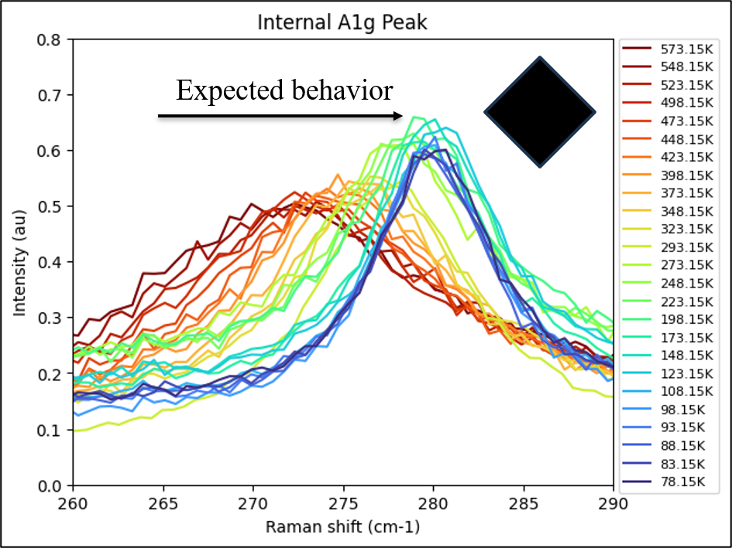
Cs₂NaBi_{1-x}Sb_{x}Cl₆ Expect Peak Shift
Decreasing temperature causes peak shift to higher frequencies for A1g mode peak
→ energy gain and phonon hardening

Slide 19
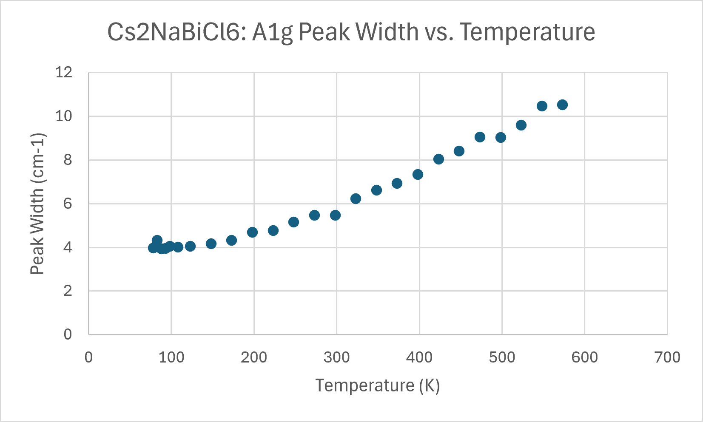
Cs₂NaBi_{1-x}Sb_{x}Cl₆ Expect Peak Narrowing
Decreasing temperature causes peak to narrow
→ Vibrations become more underdamped
Less energy → Less vibrations through molecule → Less interfering vibrations→ Vibrations have a longer lifetime

Slide 20
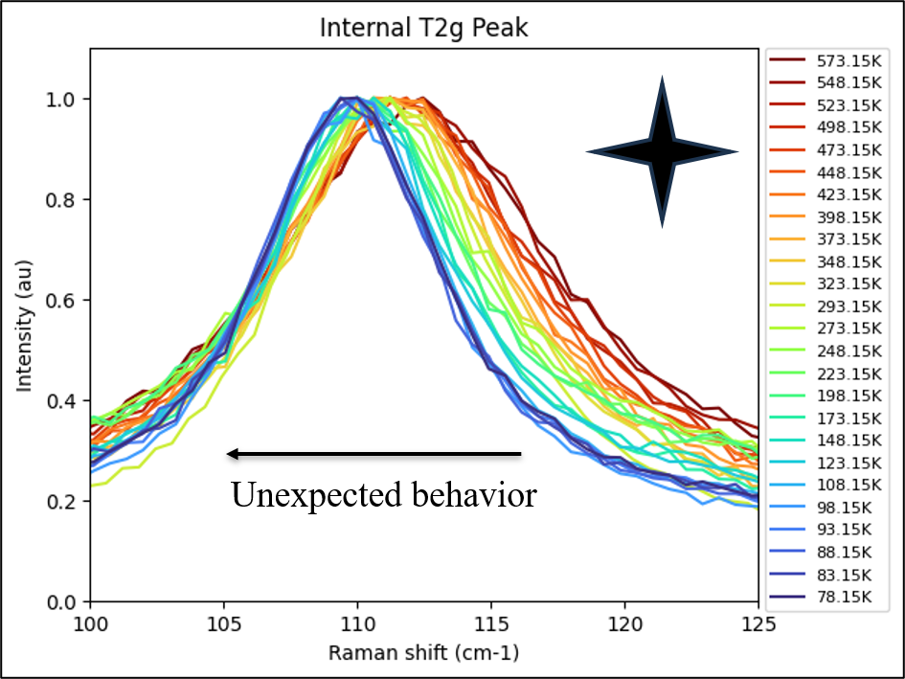
Cs₂NaBi_{1-x}Sb_{x}Cl₆ Unexpected Peak Shift
Decreasing temperature causes peak shifts to lower frequencies for T2g mode peak
→ energy loss and phonon softening
→ does not match expected trend

Slide 21
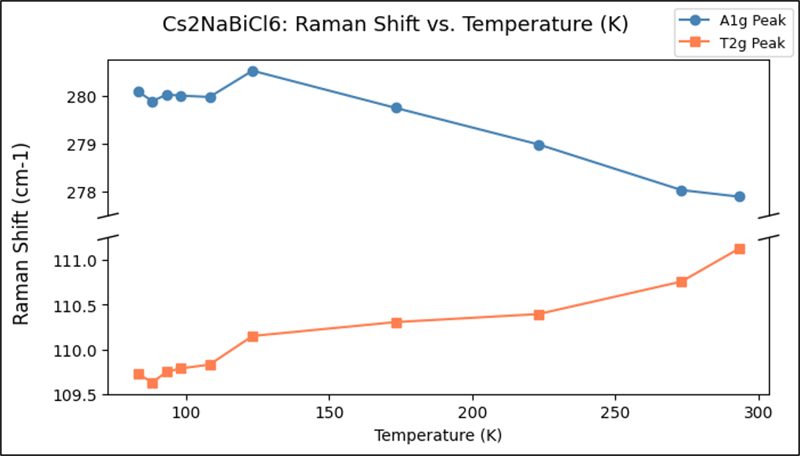
Erratic Raman peak behavior near phase transition
Dip in Raman shift of modes at low temperature indicates phase transition

Slide 22
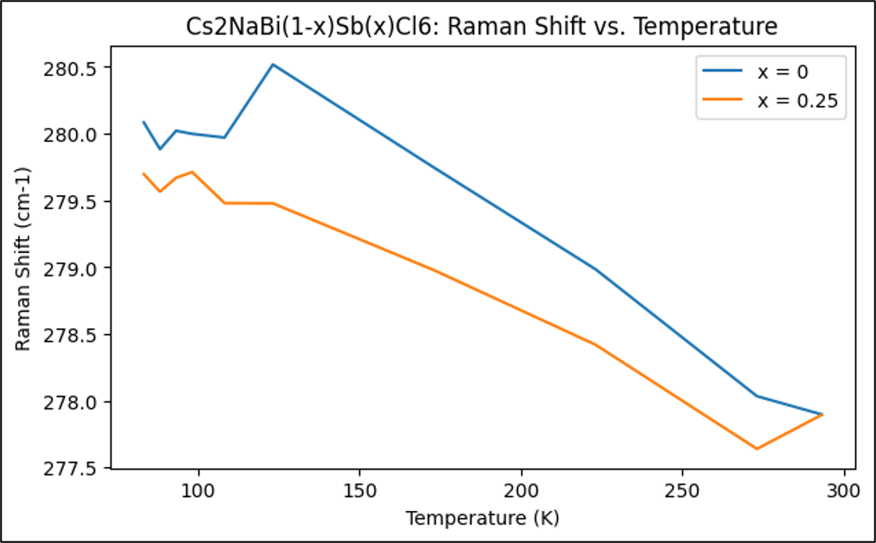
Inconclusive phase transition temperature change from Raman
Sb doping has little to no effect on location of dip → no effect on phase transition

Slide 23
Conclusions & Future Work
Conclusions
Successful synthesis of Cs2NaBiCl6 and Cs2NaBi1-xSbxCl6 single crystals
Lattice parameters change with Sb-doping and temperature as expected
Raman spectra vibrational modes match with literature
Simultaneous softening and stiffening vibrations at low temperatures
Sb-doping has no effect on thermal expansion or phase transition
Future work
Test vibrational activity at even lower temperatures
Increase Sb-doping and understand effects

Slide 24
Sources
[1] Miyata, K., et al. (2017). Lead halide perovskites: Crystal-liquid duality, phonon glass electron crystals, and large polaron formation. Science Advances, 3(10). https://doi.org/10.1126/sciadv.1701469.
[2] Dakshinamurthy, A. C., & Sudakar, C. (2023). Influence of the octahedral cation on the evolution of lattice phonons in metal halide double perovskites: Raman spectroscopic investigation of Cs₂B’B’’Cl₆ (B’ = Ag_{1-x}Na_{x}; B’’ = Bi_{1-x}In_{x}). Physical Review Materials, 7(6). https://doi.org/10.1103/PhysRevMaterials.7.065401.
[3] Martin-Garcia, B., et al. (2020). Phase Transitions in Low-Dimensional Layered Double Perovskites: The Role of the Organic Moieties. The Journal of Physical Chemistry, 12(1), 280-286. https://doi.org/10.1021/acs.jpclett.0c03275.
[4] He, X., Krogstad, M.J., Gupta, M.K., et al. (2024). Multiple Lattice Instabilities and Complex Ground State in Cs₂AgBiBr₆. PRX Energy, 3(1). https://doi.org/10.1103/PRXEnergy.3.013014.
[5] Wu, S., Li, W., et al. (2020). Antimony doped lead-free double perovskites (Cs₂NaBi_{1-x}Sb_{x}Cl₆) with enhanced light absorption and tunable emission. Journal of Materials Chemistry, 8(39). https://doi.org/10.1039/d0tc03003a.
[6] Pelle, F., et al. (1983). Low temperature phase transition in cubic elpasolithe crystal Cs₂NaBiCl₆. Solid State Communications, 49(11), 1089-1093. https://doi.org/10.1016/0038-1098(84)90430-7.

Slide 26
Thank You!
Thank you to my mentors Patrick Postec and Wenda Si, and PI, Olivier Delaire.
Please reach out to me: dorothywongdw@gmail.com
Acknowledgements: Thank you to the Shared Materials Instrumentation Facility (SMIF) for the use of the powder x-ray diffractometer. Thank you to Emily Snell for help with its operation.
This work was in part supported by the DOE Office of Science under award number SC0019978.
This material is based upon work which is supported by the National Science Foundation (award numbers 2447827, 2447828, 2447829 and ECCS-2025064). Any opinions, findings, and conclusions or recommendations expressed in this material are those of the author(s) and do not necessarily reflect the views of the National Science Foundation.

