Slide 1



Degradation of Hydrogels for Lymphatic Drug Delivery
Heidi Thompson SUIN 2026
Mentor: Marianne Esnaurrizar
PI: Dr. Susan Thomas

Slide 2
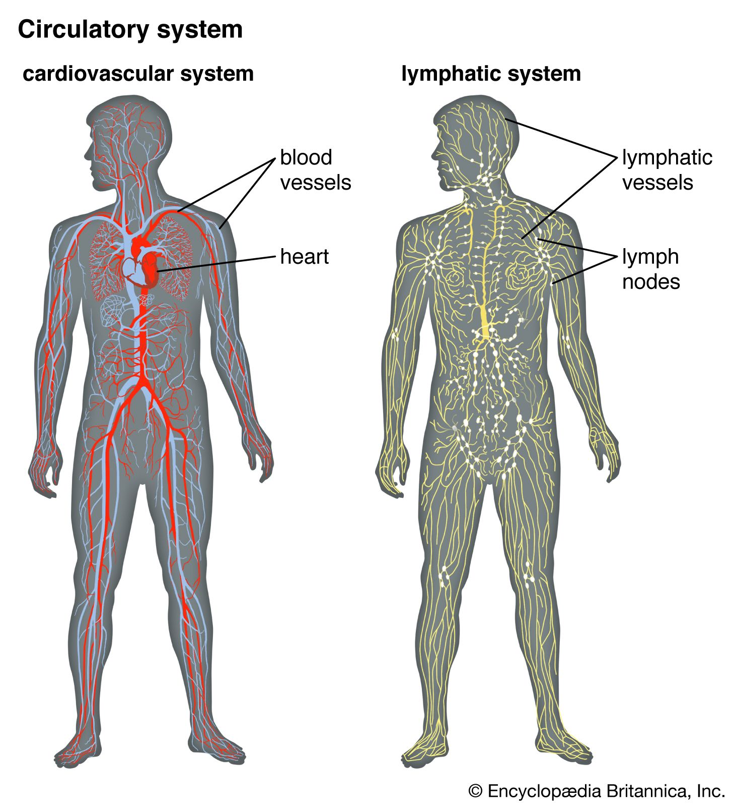
Introduction
  What is a hydrogel?
  Network of cross-linked polymers
  Retain large amounts of water
  What is the lymphatic system?
  Second circulatory system
  Acts as a drainage system
  Surveillance of the immune environment
(Ho, Tzu-Chuan et al., 2023, MDPI Molecules)
1

Slide 3
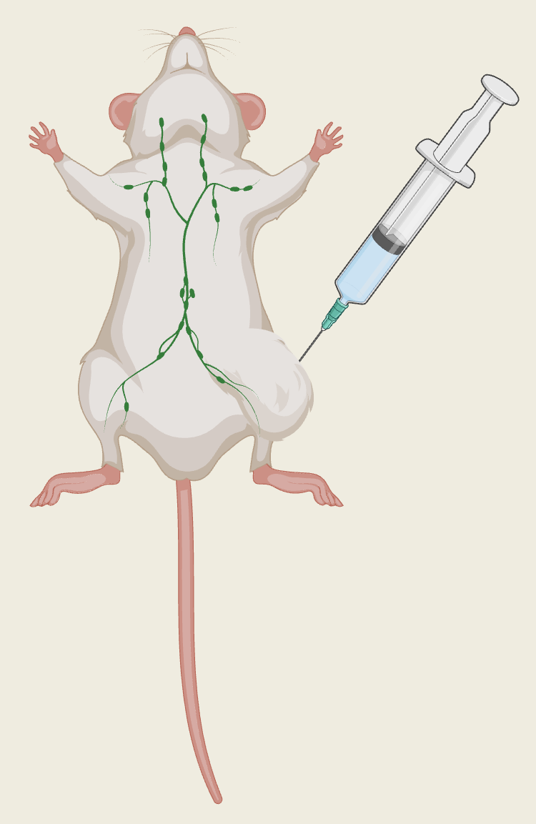
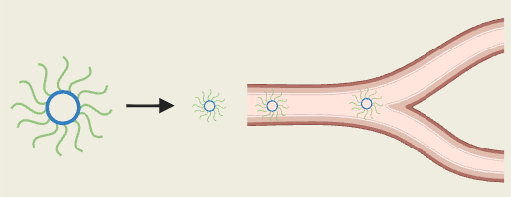
Purpose of Hydrogel
  Drug delivery system capable of enabling sustained drug release of small molecules into the lymphatic system
  Treat lymphatic diseases
(Lucas et al., 2025, ACS Nano)
(Kim et al., 2022, Nature Communications)
Created in https://BioRender.com
2
Notes:
size range appropriate for efficient lymphatic uptake (10–100 nm)
Simple loading of diverse drug types, administration without surgery
Lymphedema – lymphatic vessels stop pumping fluid
in situ - in the original place (place where treated)

Slide 4
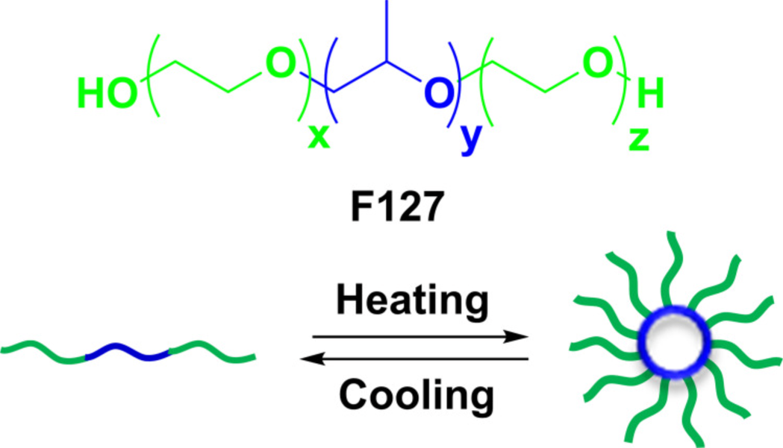
Polymer A
Protein B
  Triblock copolymer
  Has hydrophilic and hydrophobic regions
  Forms micelles above specific concentration and temperature
  Has acidic (carboxyl) and basic (amine) functional groups
  Very reactive, allows for chemical cross-linking
(Li, Shanshan et al., 2023, International Journal of Nanomedicine)
3
Notes:
two FDA-approved polymers
amphiphilic - possesses both hydrophilic and hydrophobic regions/properties
amphoteric - acidic (carboxyl) and basic (amine) functional groups

Slide 5
Material Properties
 | Polymer A | Protein B | Hydrogel
Biocompatible
Forms micelles
Stable
Gelation Temperature | High | Low | Above room temperature
4
Notes:
Thermosensitive - liquid at low temperatures and gels above room temperature
Weight percent for cmc??

Slide 6
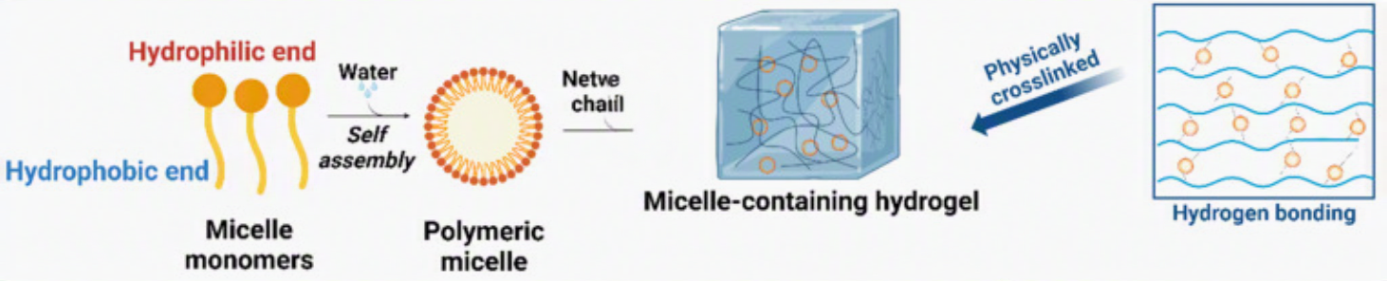
Degradation of Hydrogel
  Degradation forms micelles that carry drugs to the lymphatic system
  Does varied temperature change the stability of the hydrogel?
  Where are components A and B in the degraded samples
5
(Wu, Jinghua et al., 2024, MDPI Gels)
Notes:
(Sodium Dodecyl Sulfate-Polyacrylamide Gel Electrophoresis)

Slide 7
Objectives
  Simulate degradation of hydrogel in physiological conditions
  Determine effects of different temperature storage conditions on degradation time and composition
  Characterize components of hydrogel degradation in supernatant using SDS-PAGE, iodine assay, and BCA assay
6
Notes:
(Sodium Dodecyl Sulfate-Polyacrylamide Gel Electrophoresis)

Slide 8
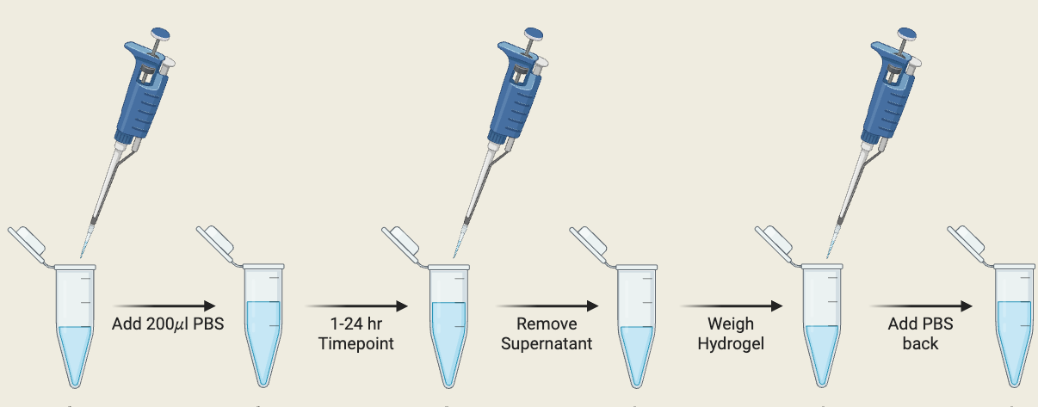
Methods
  A heat-cool cycle was performed: solubilized hydrogel was placed in the fridge and then warmed to room temperature three times
  Collected samples at hour 1, 2, 4, 7 (Day 0), and then once per day until fully degraded
Created in https://BioRender.com
7
Notes:
Supernatant is the liquid above the hydrogel – PBS plus micelles that come off hydrogel

Slide 9
Effects of Thermocycling on Degradation Times
  Hydrogel used immediately after solubilizing had 7-day degradation time
  Hydrogel that underwent heat/cool cycle had a 5-day degradation time
Control data collected by Dr. Megan Elliott
8

Slide 10
Characterization of Degraded Samples
  SDS-Polyacrylamide Gel Electrophoresis (SDS-PAGE)
    Iodine stains for polyethylene glycol (PEG) (Polymer A)
    Coomassie blue stains for proteins (Protein B)
Iodine assay to detect PEG (Polymer A)
Bicinchoninic acid (BCA) to detect proteins (Protein B)
9
Notes:
used to separate proteins based on their molecular weight
SDS page is for proteins
agarose is for DNA RNA

Slide 11
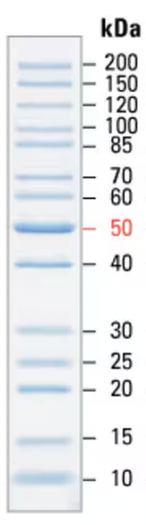
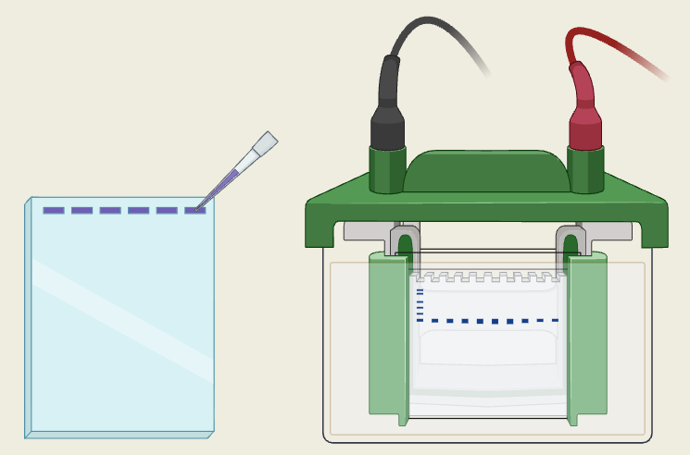
SDS-PAGE
  Separates proteins based on size
  Smaller proteins migrate faster due to less resistance from the gel matrix
  4-20% Tris HCl protein gels were run at 180 V for 25 minutes
(PageRulerTM Unstained Protein Ladder 2 X 250 μL | Thermo ScientificTM.)
Created in https://BioRender.com
10
Notes:
(Sodium Dodecyl Sulfate-Polyacrylamide Gel Electrophoresis)
- heat to denature
- detergent (SDS) to unfold proteins and give them a uniform negative charge
- electricity to push them through a gel mesh
- separation by size

Slide 12
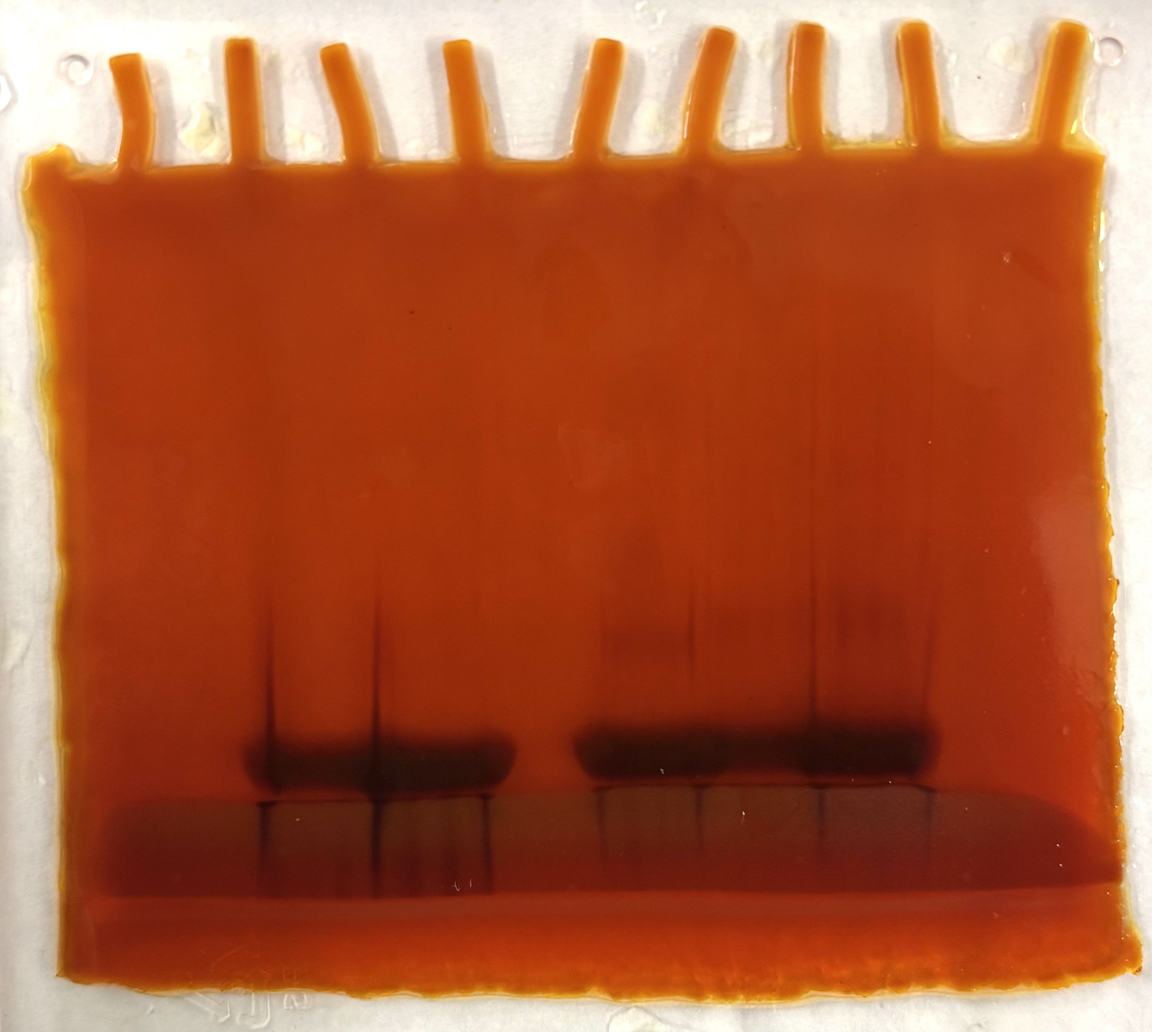
Iodine Stain: 24-Hour Timepoint
Polymer A is present in both controls and all three supernatant samples
Blank control lane (Protein B) is empty
Sample 1
Sample 2
50/50 A:B
Sample 3
Polymer A
Polymer B
11
Notes:
Talk about controls!!
10 mg/ml polymer A
2.5 mg/ml polymer B

Slide 13
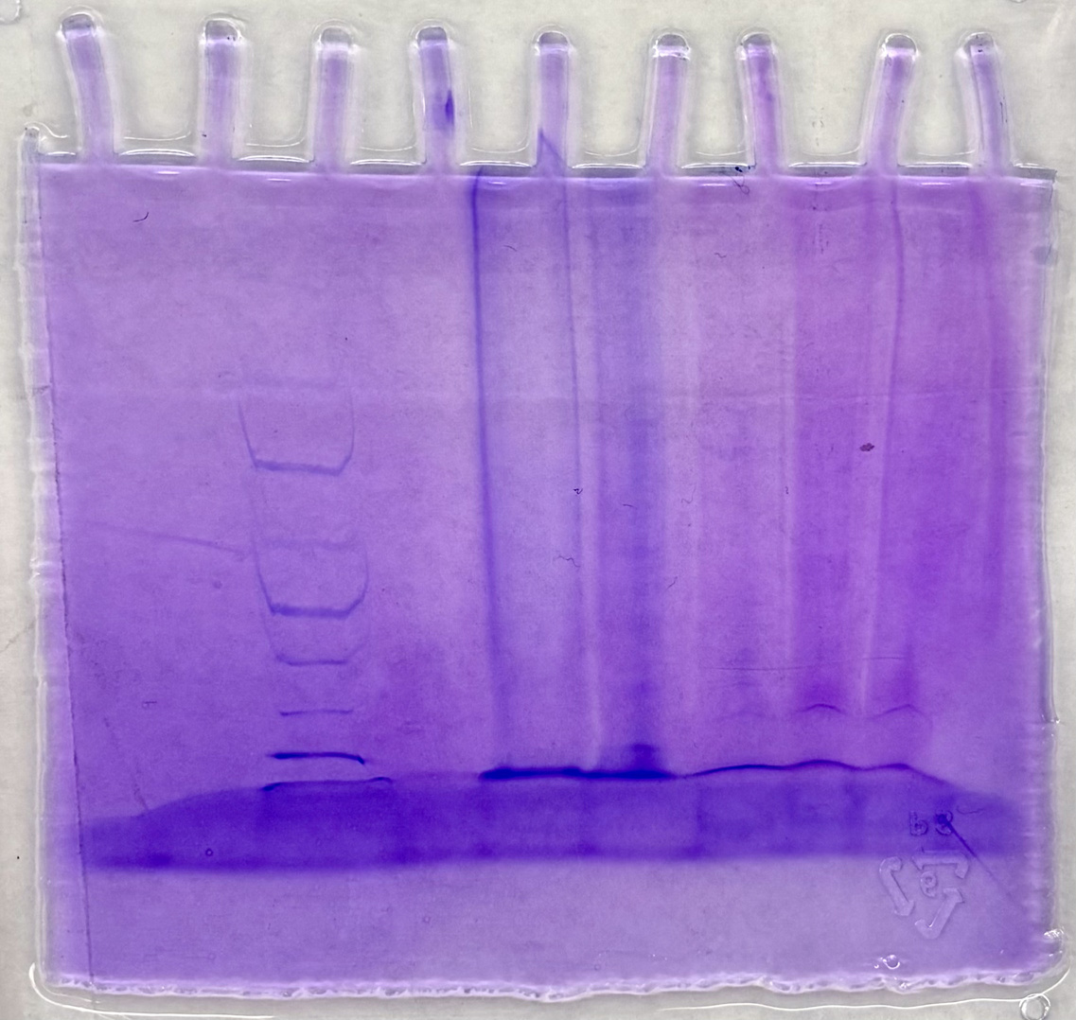
Coomassie Blue Stain: 24-Hour Timepoint
  Protein B is 75 kDa
  Smearing indicates Protein B is present in samples
  Control reads ~60 kDa
  Supernatant lines ~65 kDa
kDa
200
150
120
100
85
70
60
50
Protein Ladder
Sample 3
Sample 1
50/50 A:B
Sample 2
Polymer A
Polymer B
12
Notes:
Potentially smaller fragments?
Presence of gelatin causes smearing

Slide 14
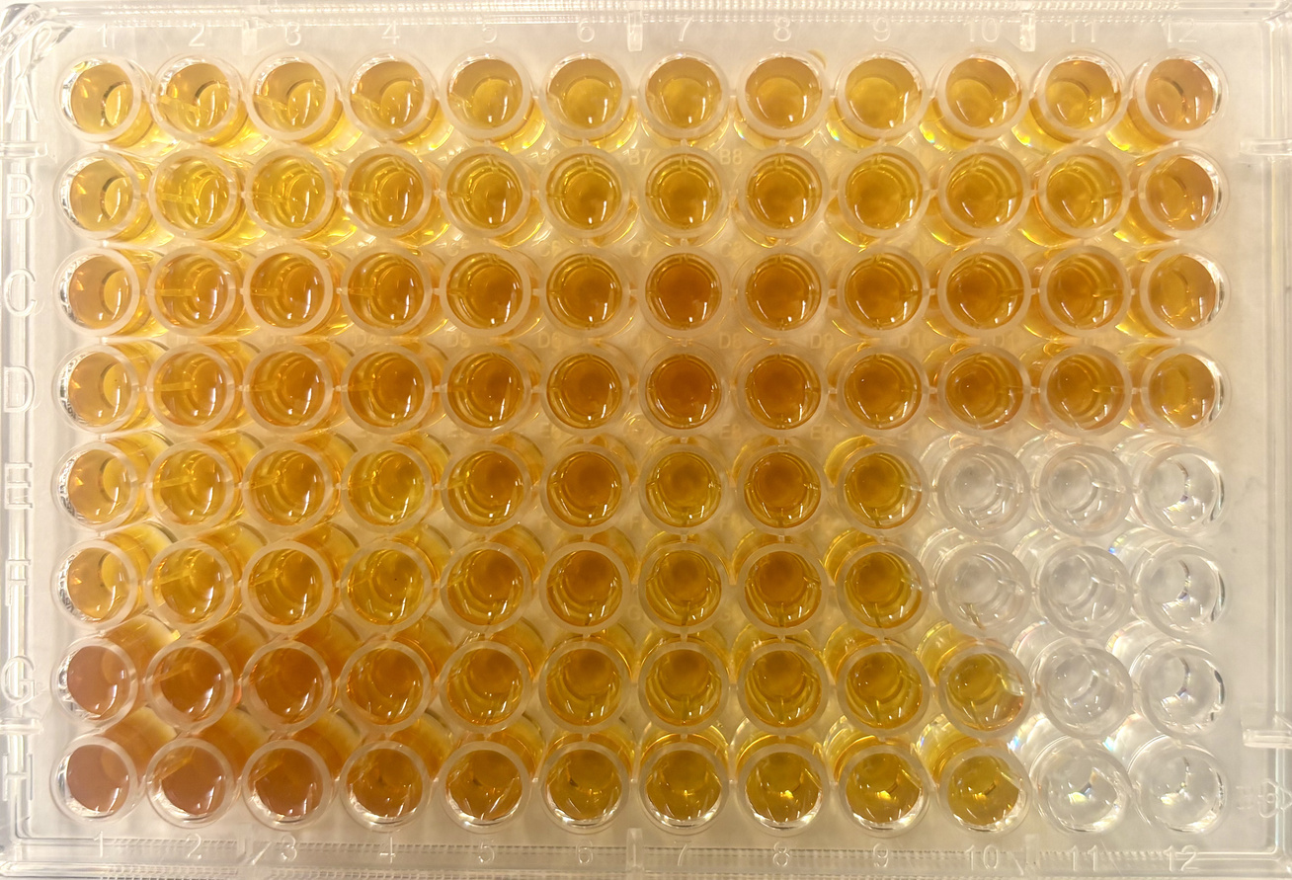
Iodine Assay
  PEG reacts with BaCl₂ and Iodine to form color
  Measured absorbance at 535 nm
Standard Curve
13
Notes:
Pluronic started at 45mg/ml
days 1, 2, 3 had highest amounts of degradation

Slide 15
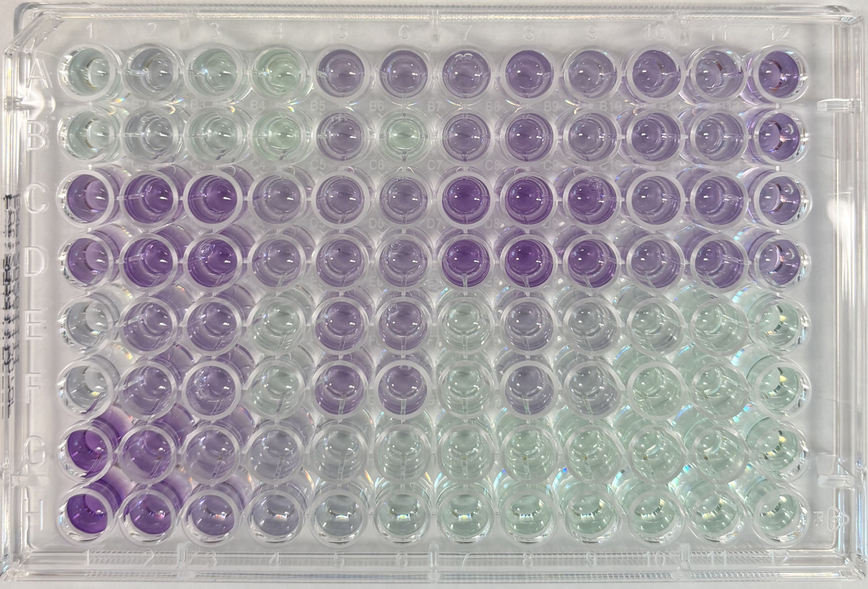
BCA Assay
  Colorimetric detection of total protein
  Measured absorbance at 562 nm
Standard Curve
14
Notes:
peptide bonds reduce cupric ions to cuprous ions,
Bicinchoninic acid binds to cuprous ions
conc started at 15mg/ml

Slide 16
Degradation Totals
Cumulative Percent Release during Degradation
  Polymer A and Protein B degrade simultaneously
  Decrease in rate of degradation over time
  Covalently linked components
15
Notes:
a - started at 45mg/ml
b - conc started at 15mg/ml

Slide 17
Conclusions
  Varying temperature for hydrogel storage resulted in faster degradation time: 5 days with a heat cool cycle compared to 7 days without
  SDS-PAGE confirmed the presence of components A and B in supernatant as expected
  Polymer A and Protein B had similar degradation patterns and reached 50% release at 24 hours, compared to 30% for control groups
16

Slide 18
Future Considerations
  Confirm composition of degradation
    Test for micelles in the supernatants throughout the study using Dynamic Light Scattering (DLS)
  See if thermocycling affects degradation and efficacy of drug-loaded hydrogel
17

Slide 19
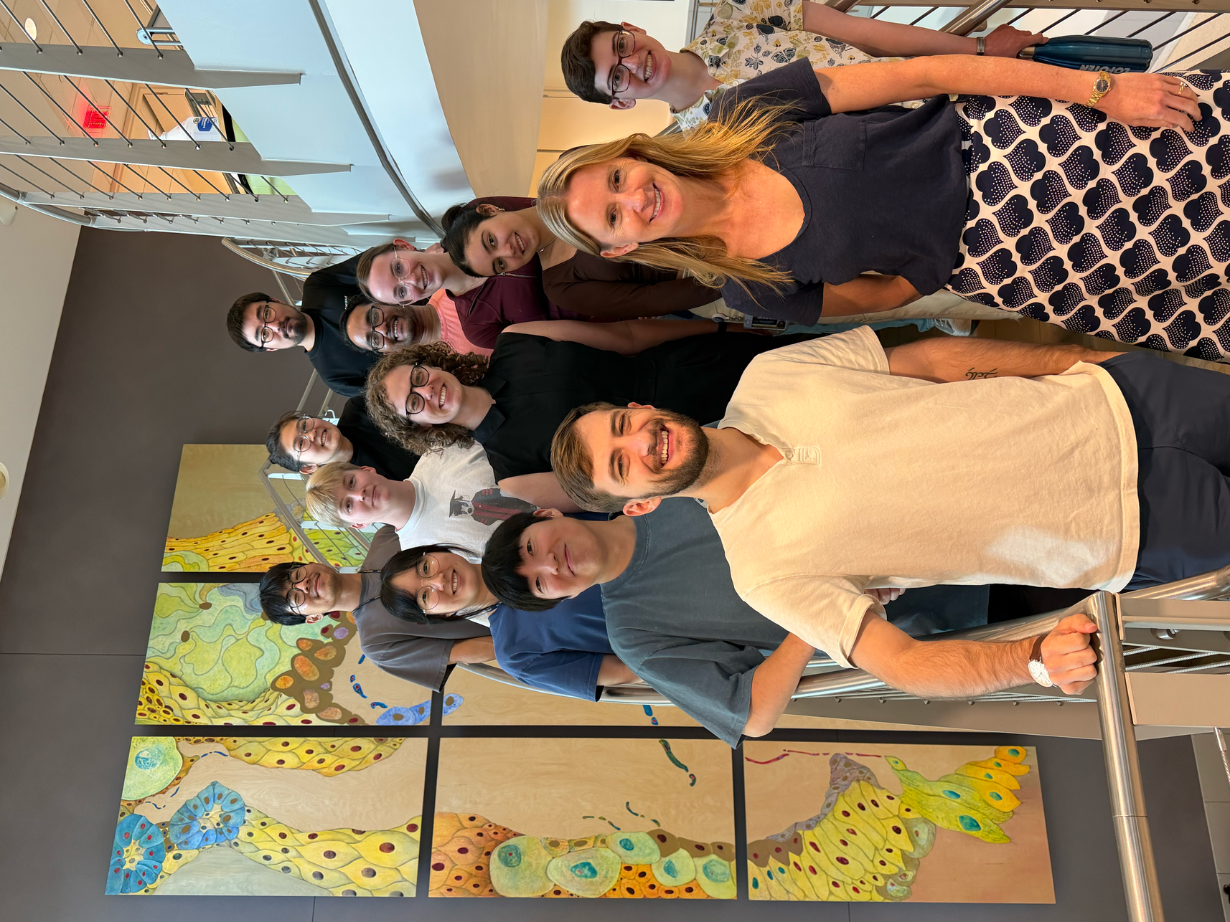

Acknowledgements
  Thomas Lab
  Marianne Esnaurrizar
  Dr. Emily Roe
  Dr. Megan Elliott
  Maya Levitan
  Nathan Holland
  SUIN Program Directors
  Dr. Mikkel Thomas
  Leslie O’Neill
This research was funded by NSF Award #2349519 and ARPA-H agreement #AY2AX000135
18

