Slide 1
Ferroelectric Field-Effect Transistors with Ultrathin AlScN Gates and 2D MoS₂ Channels
By Alexis Argueta and Michael Connolly

Slide 2
Why FeFETs?
von Neumann Bottleneck
Matrix-vector multiplication for ML/AI applications
Compute-in-memory
  Stack memory and compute
  CPU
  Memory
Two key goals:
  Demonstrate ferroelectric switching
  Fabricate a full device

Slide 3
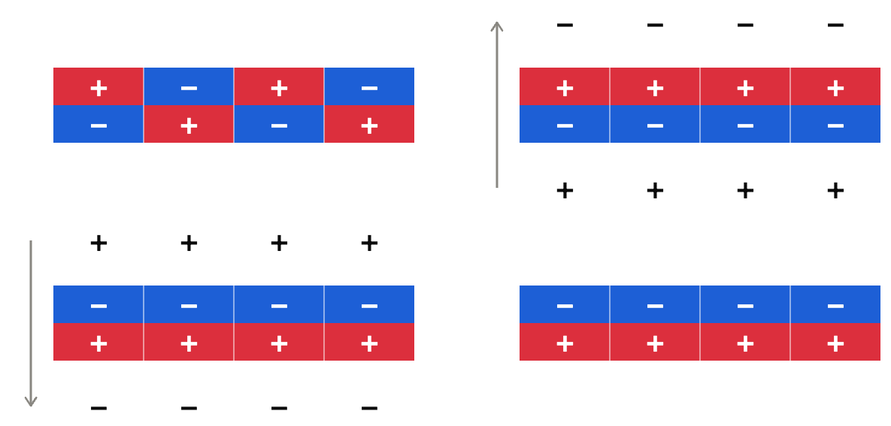

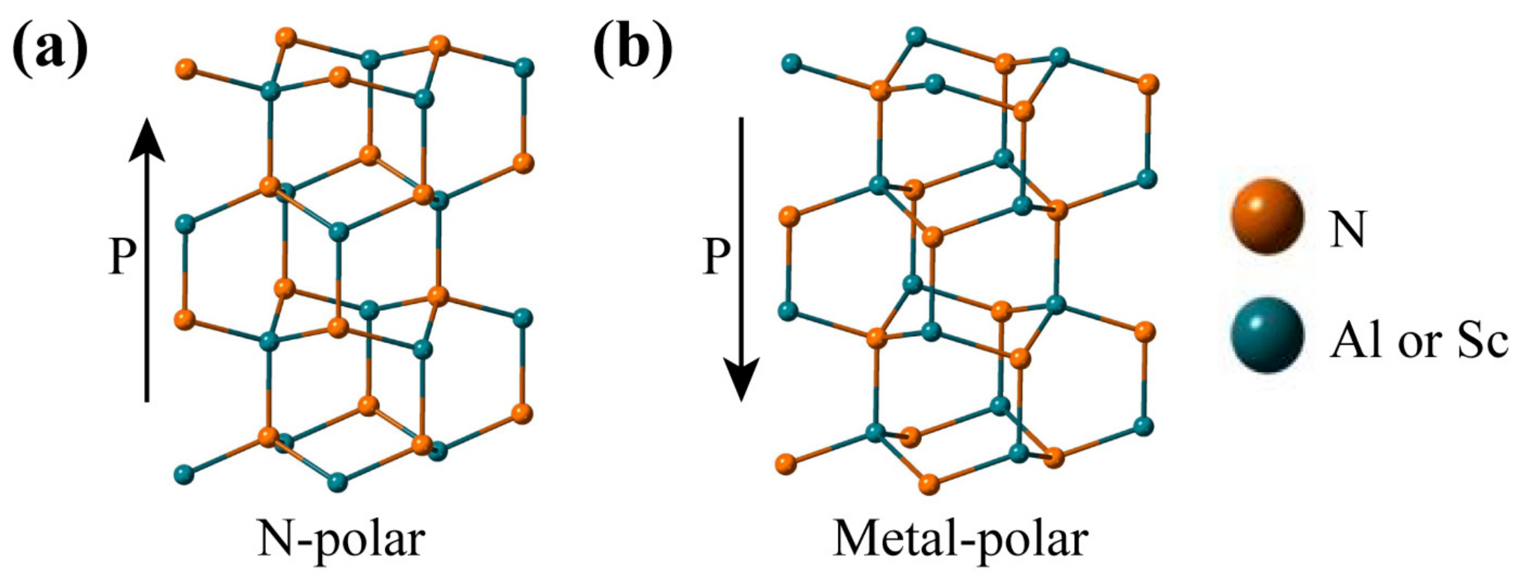
Ferroelectric Material as Memory Devices
What are Ferroelectric Materials?
Why Aluminum Scandium Nitride (AlScN)?
Nie, R.; Shao, S.; Luo, Z.; Kang, X.; Wu, T. Characterization of Ferroelectric Al0.7Sc0.3N Thin Film on Pt and Mo Electrodes. Micromachines 2022, 13 (10), 1629. https://doi.org/10.3390/mi13101629.
High remanent polarization
BEOL compatibility
Role of Scandium - Switching
Notes:
Contains dipoles - little bits of
Switchable with field
Maintained after the field is removed
Acts as a switch, with polarization one way representing a 0 and the other way representing a 1

Slide 4
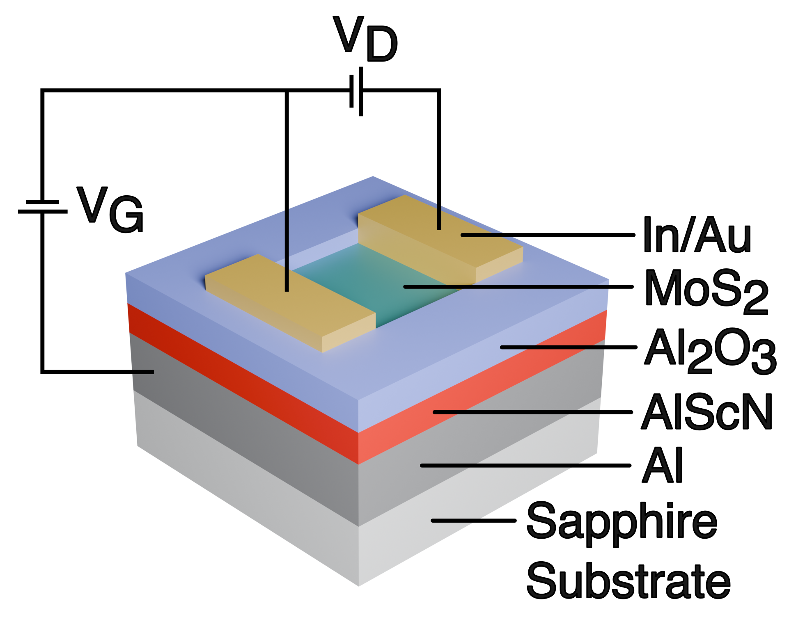
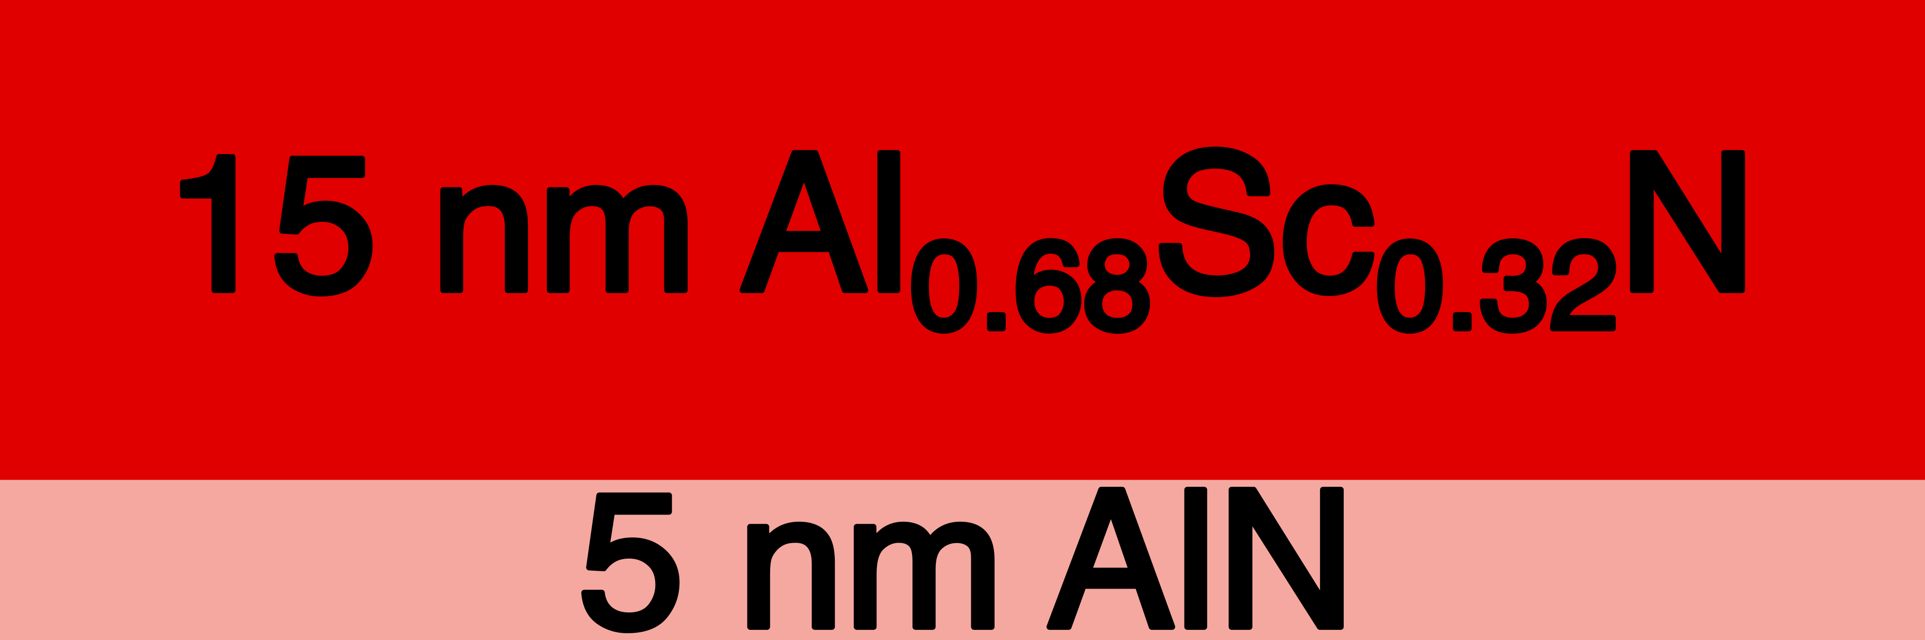
FeFET Device Structure

Slide 5
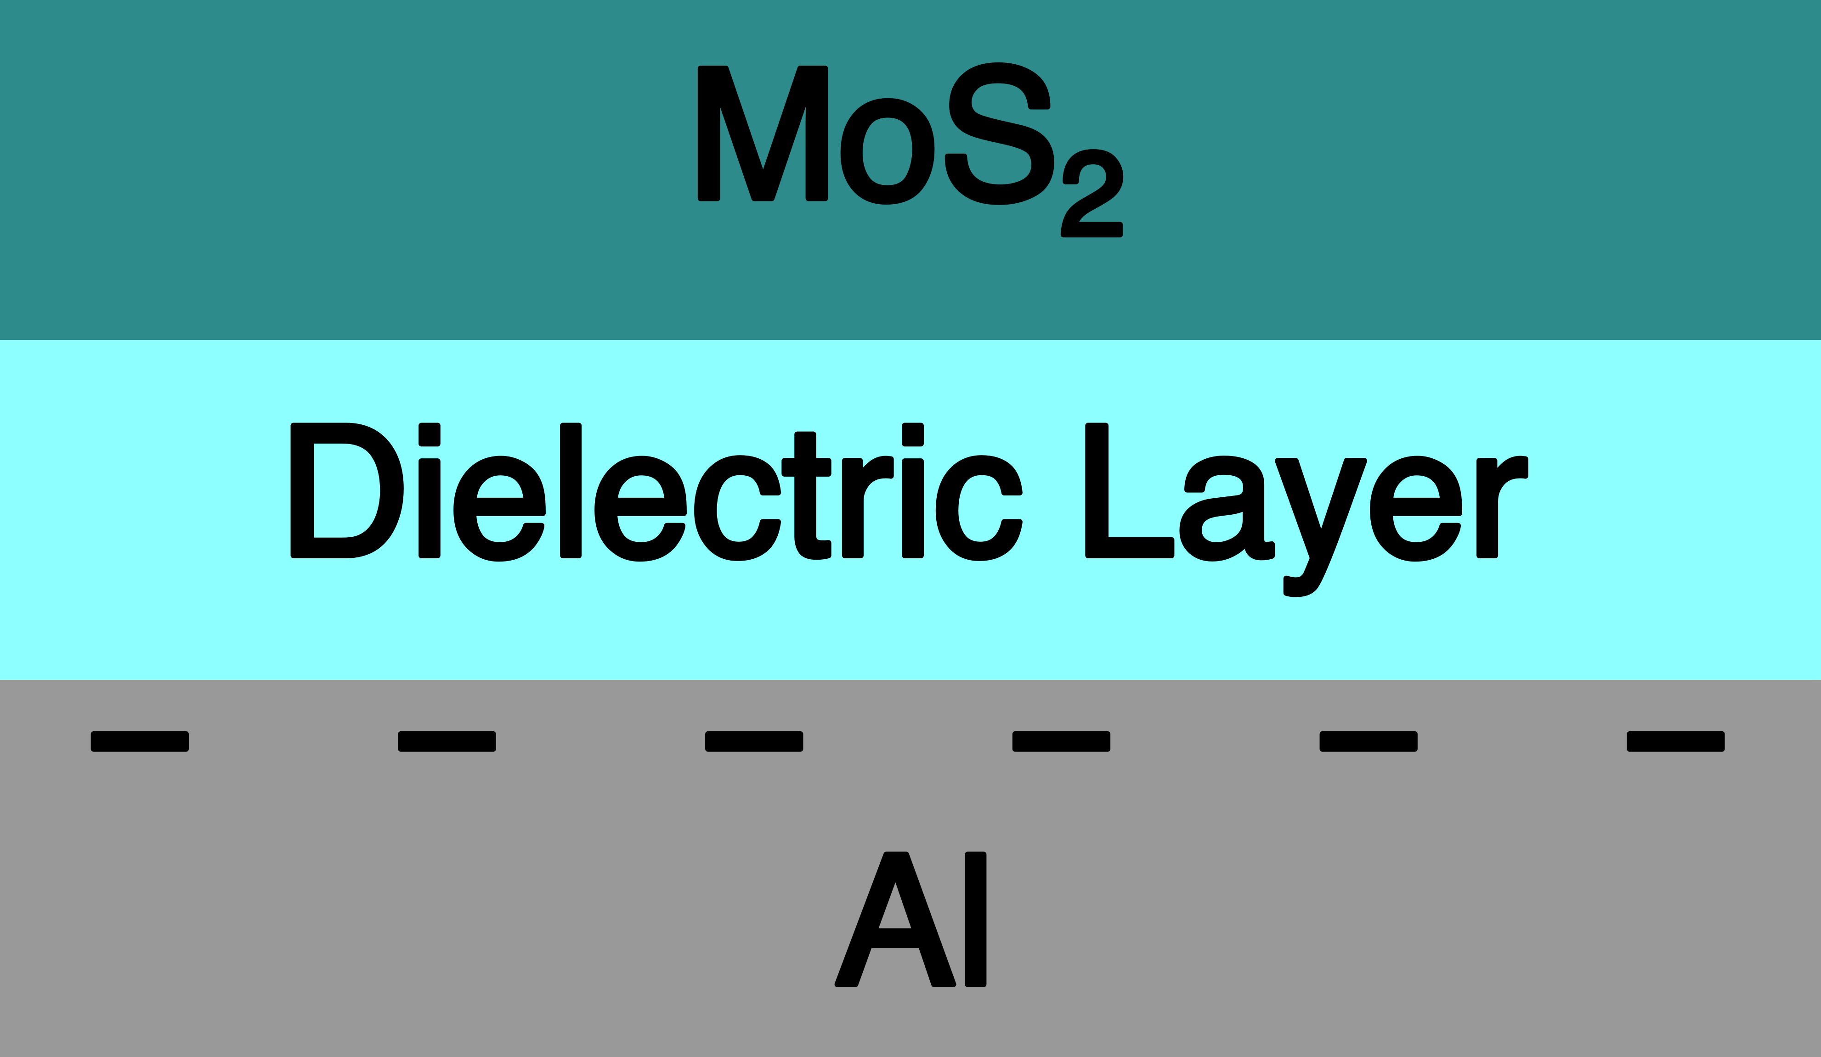
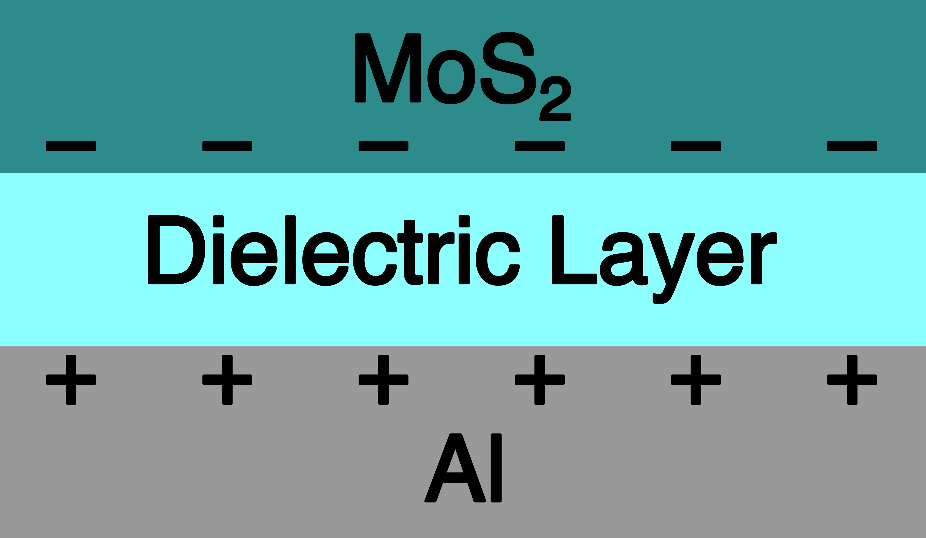
Field-Effect Transistors (FETs) with Monolayer MoS₂
OFF State
ON State

Slide 6
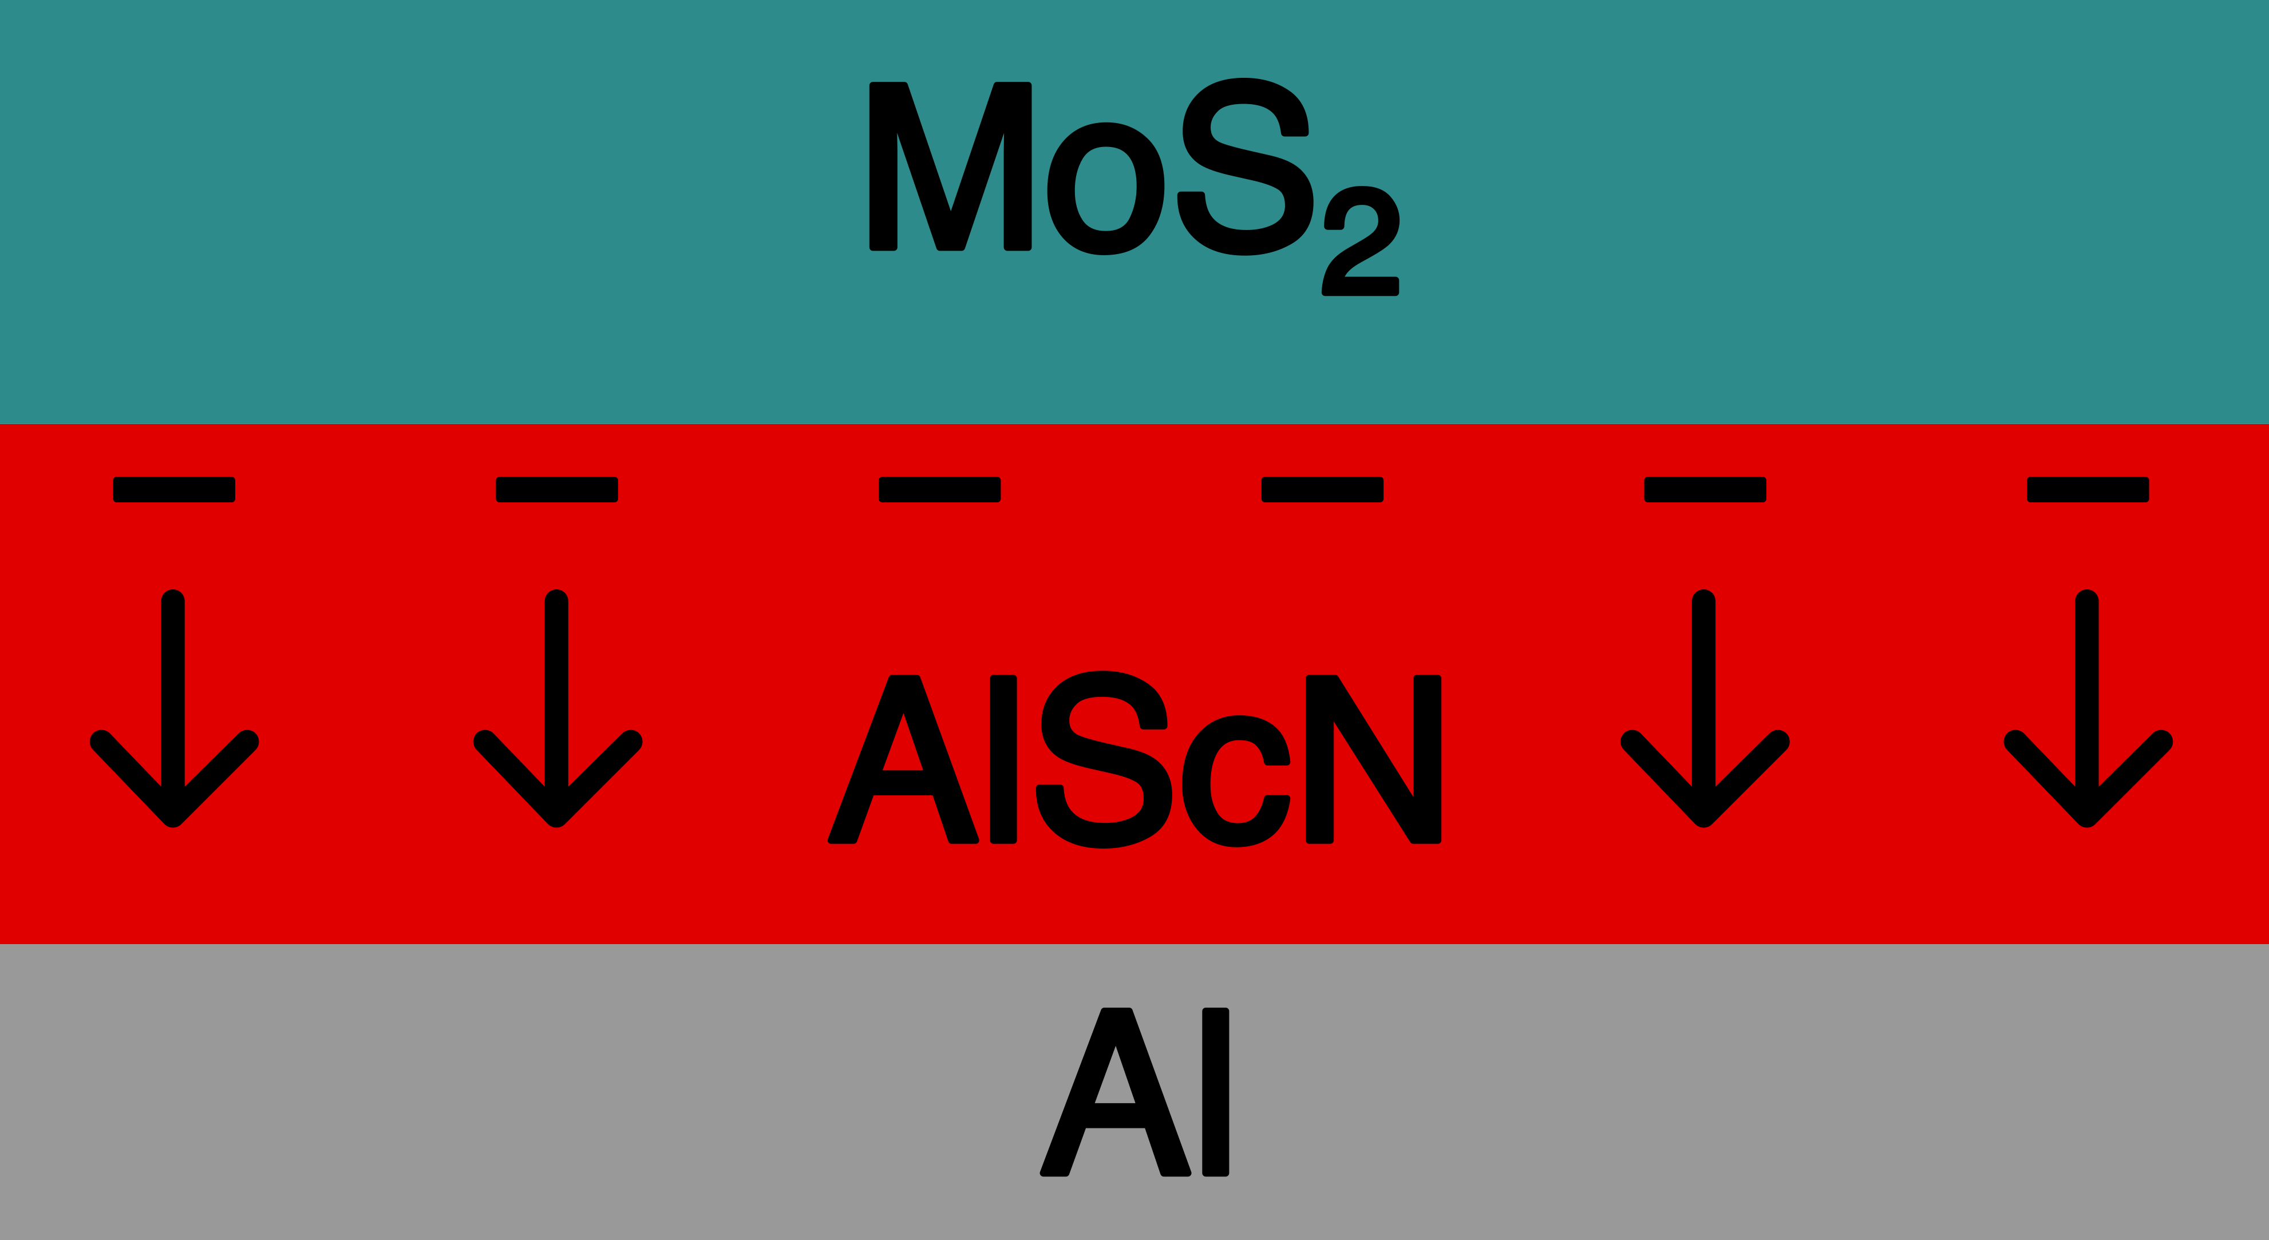
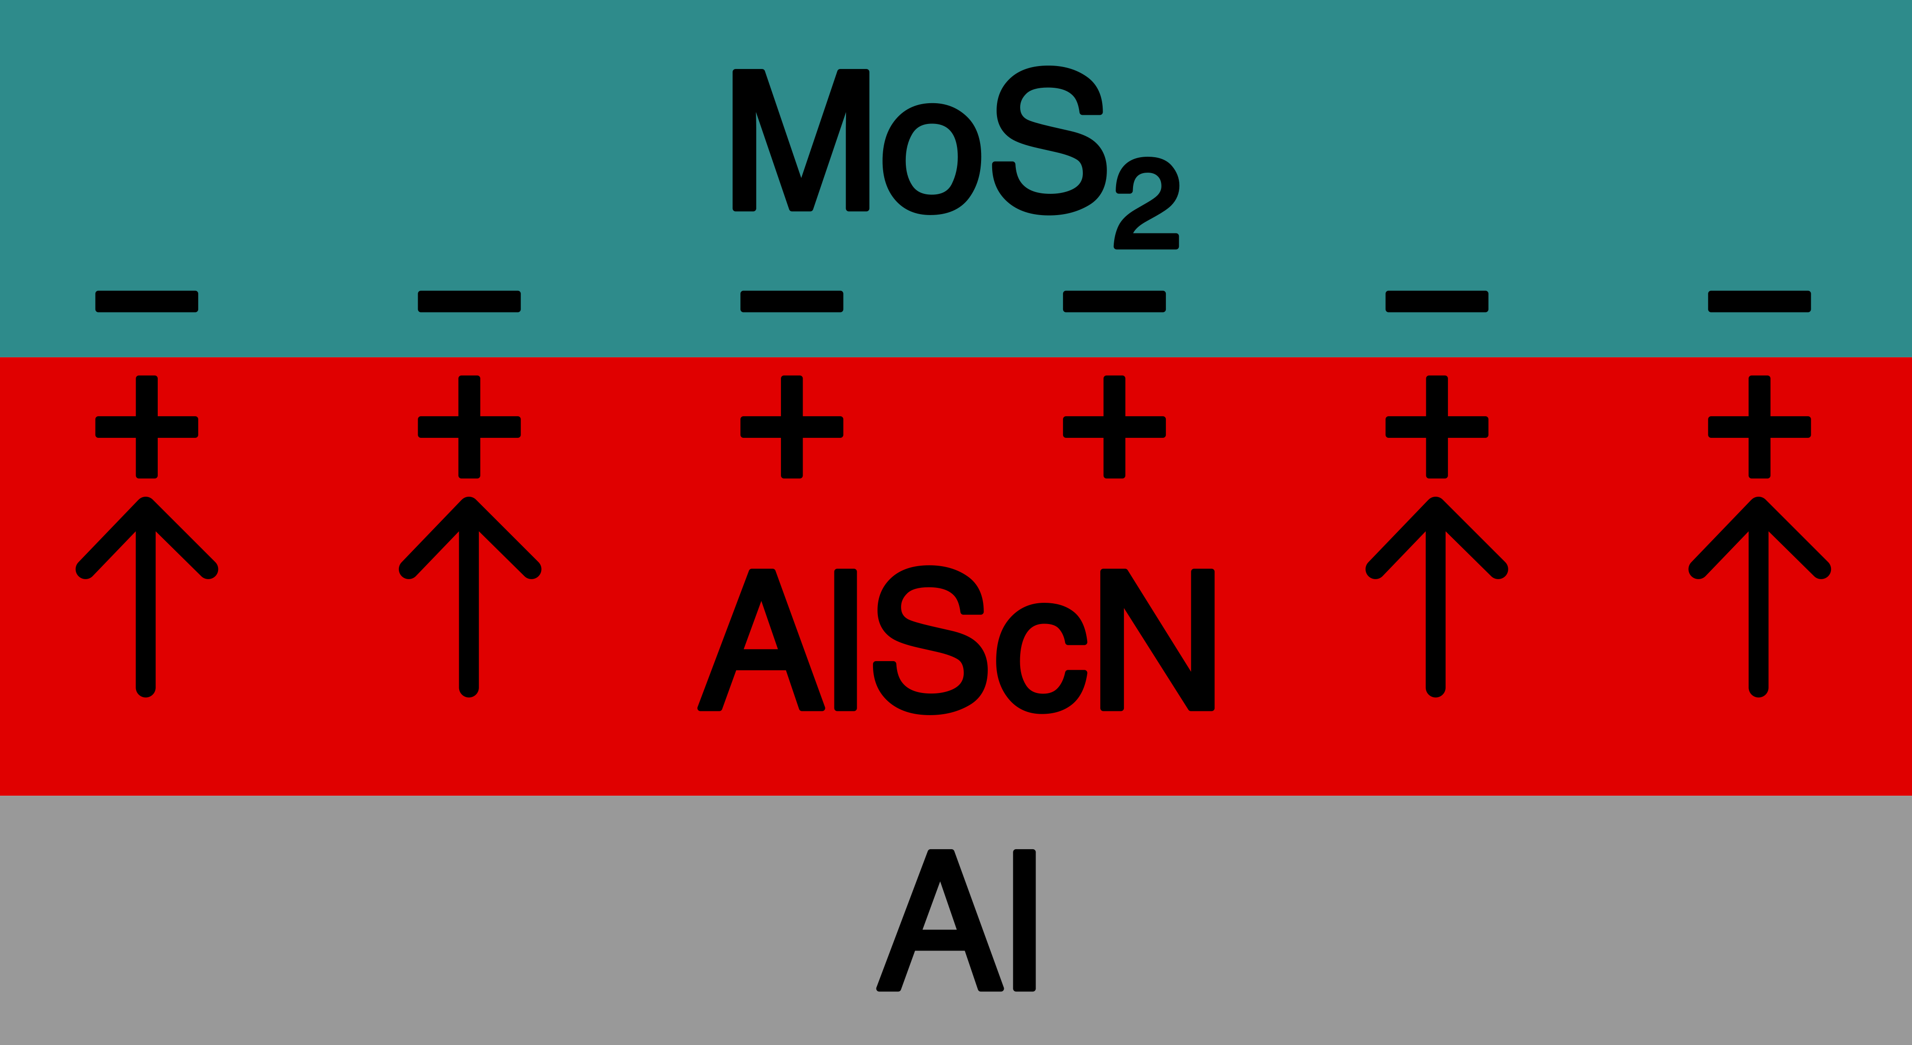
Ferroelectric Field-Effect Transistors (FeFETs)
OFF State
ON State

Slide 7
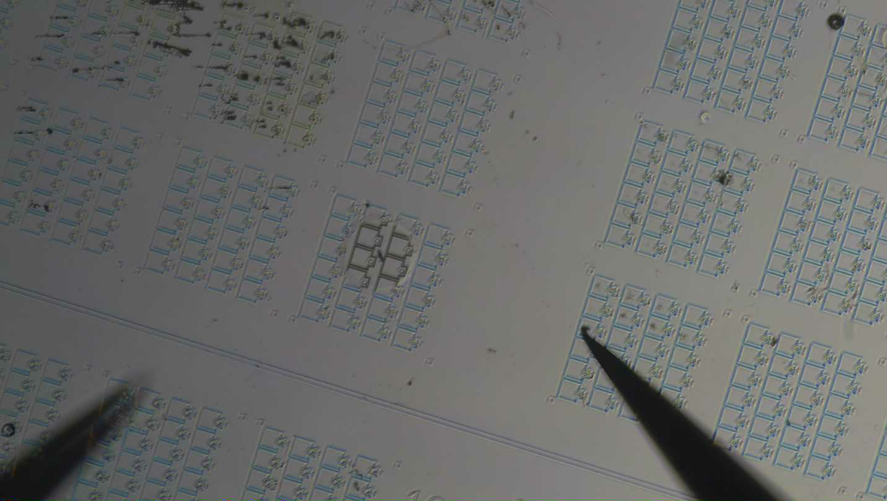
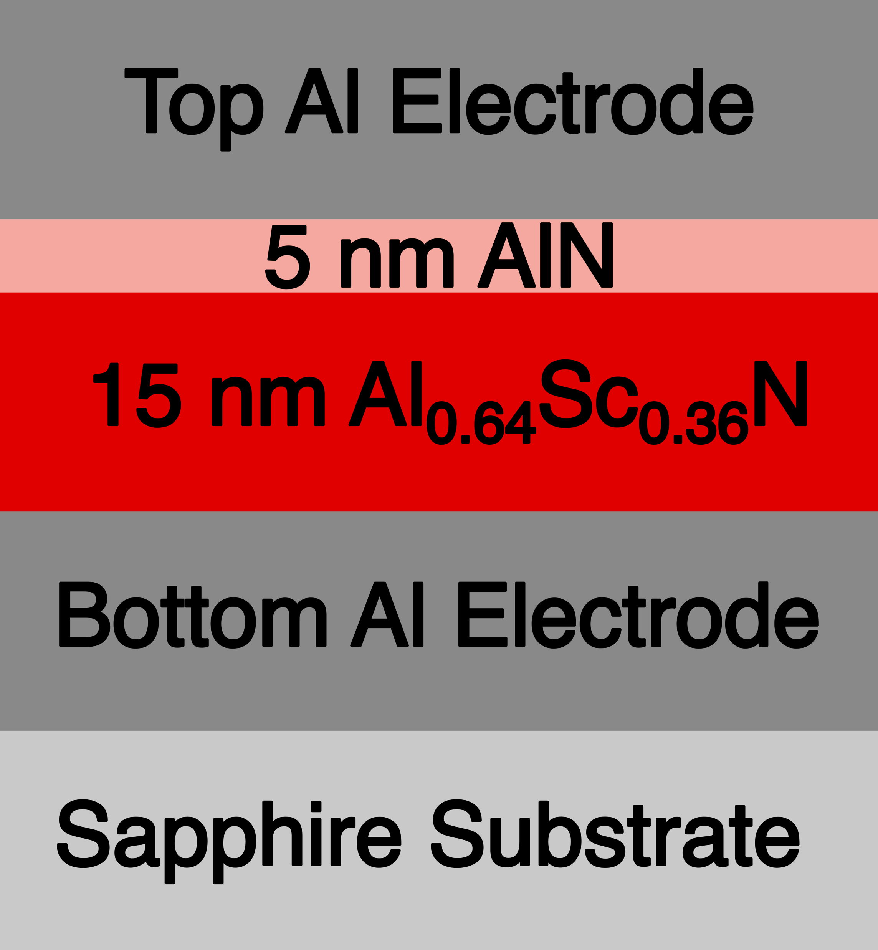
Ultrathin AlScN Ferroelectric Devices
Will this ultrathin device show ferroelectric switching?
FeDiode Device
Optical micrograph of the ferroelectric device array. Probe tips are used to contact individual devices for electrical characterization.

Slide 8
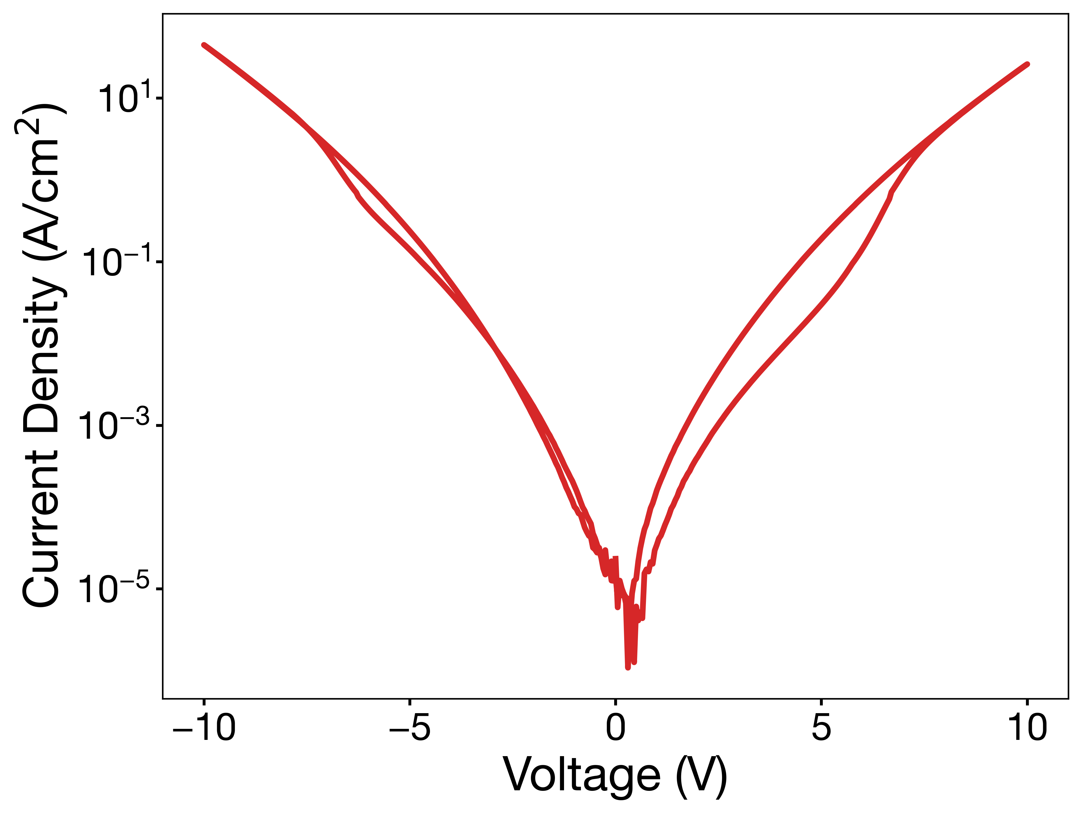
Ferroelectric Switching– DC J-V Data
Forward vs. reverse currents are different
Polarization affects the resistances of the device
Quantum tunneling behavior change depending on polarization

Slide 9
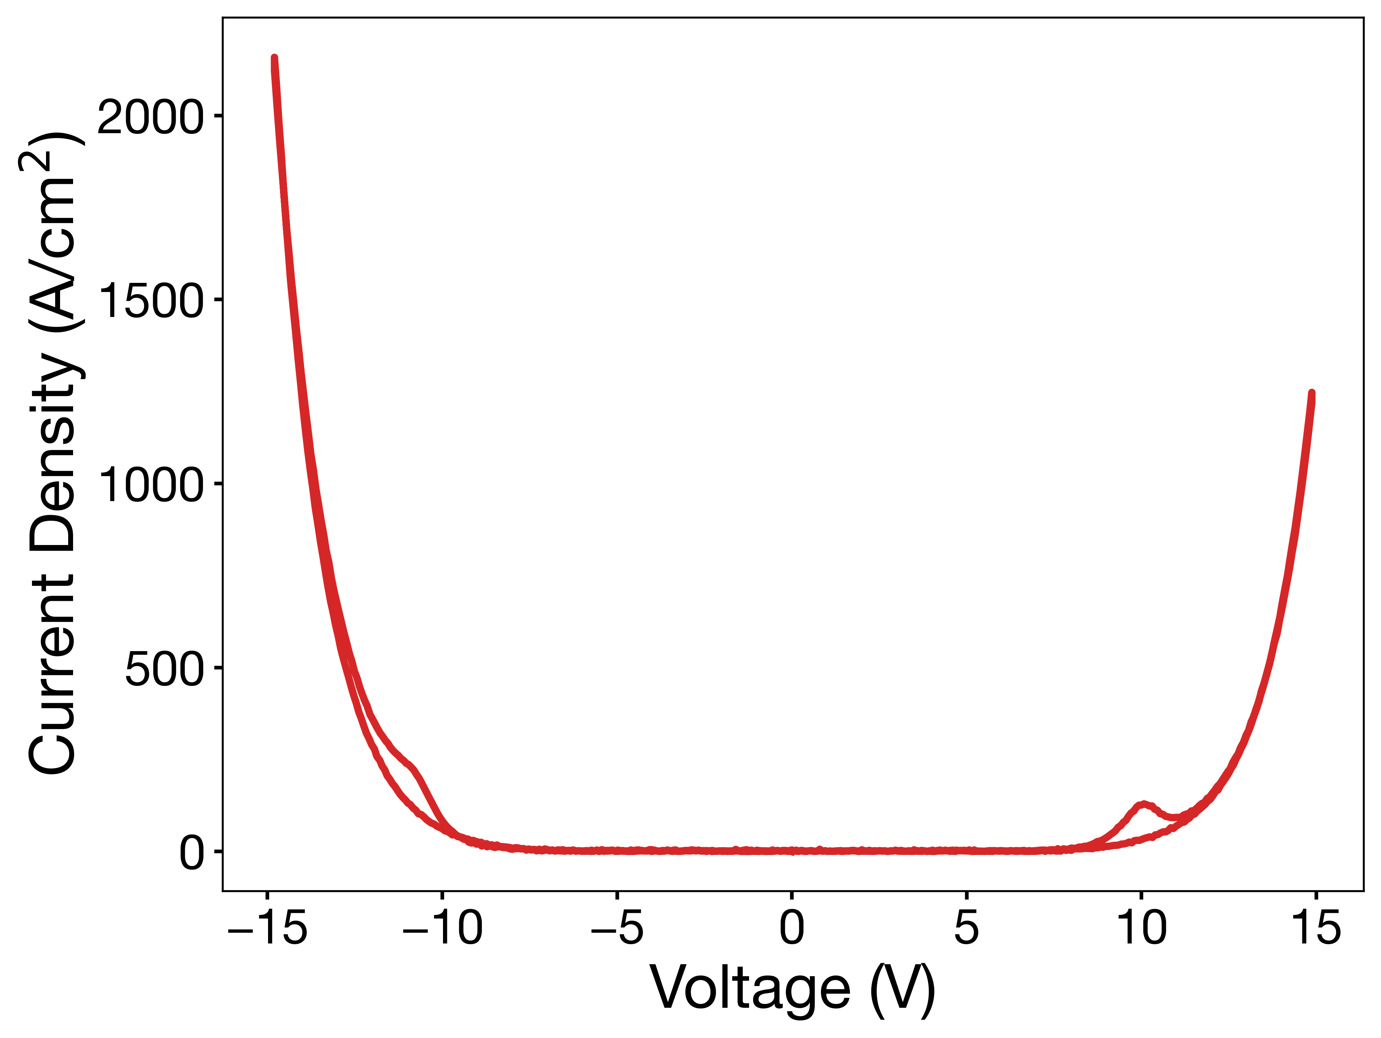
Ferroelectric Switching– AC J-V Data
Charging vs. leakage vs. switching
AC gives a quick pulse that amplifies switching
Peaks are the switching current of the device

Slide 10
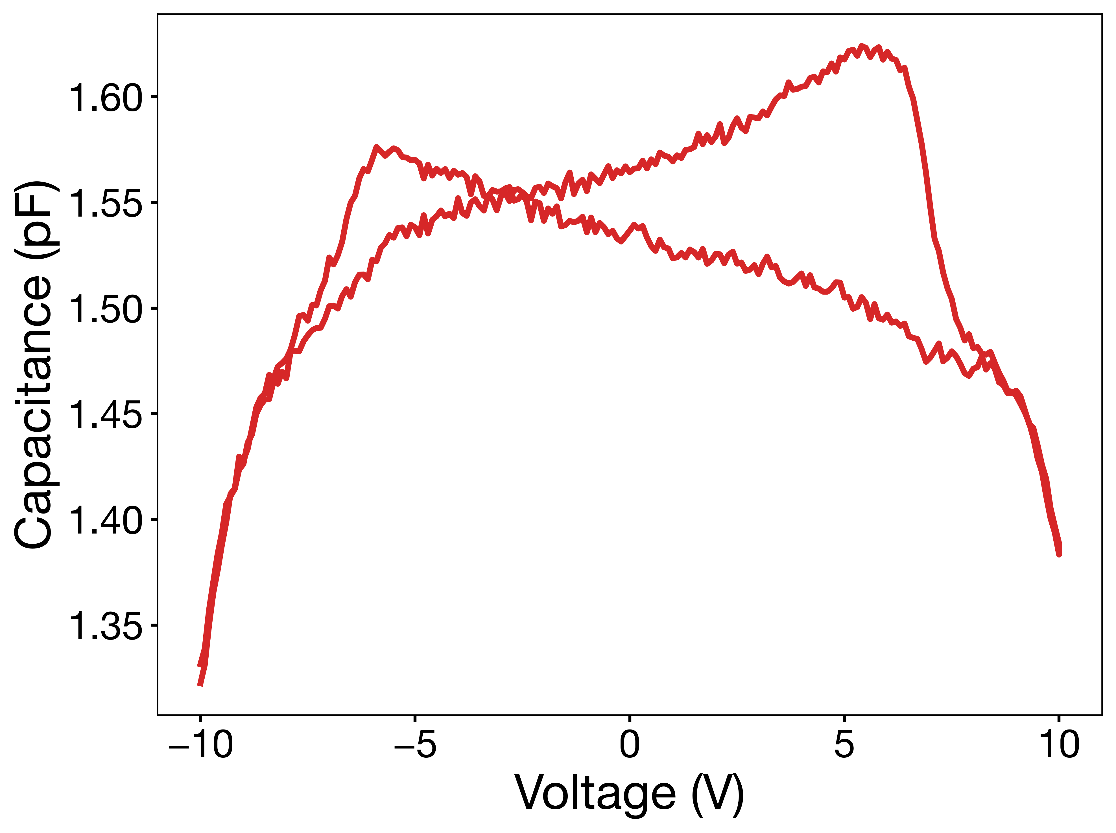
Ferroelectric Switching– C-V Data
Characteristic “butterfly loops”
One-way peaks indicate ferroelectric switching
Combined data confirms observations

Slide 11
FeFET Fabrication Results
Fabrication attempts did not yield a device that showed switching
Suspect that the device is too thin – cannot distinguish states

Slide 12
Future Work
More attempts at building devices with different properties – i.e. AlScN thickness
A control MoS₂ FET on a standard dielectric
Retention and endurance testing of FeFET
Interface engineering of AlScN and MoS₂

Slide 13




Collaborators/Acknowledgements
Mentorship
Zekun Hu, Chao-Chuan Chen, Prof. Deep Jariwala, Dr. Ashley Wallace, Dr. Adriana Santiago-Ruiz
Research Support
Alexis Argueta, Panagiotis Dimtsoudis, Nancy Pham
This work was carried out in part at the Singh Center for Nanotechnology, which is supported by the NSF National Nanotechnology Coordinated Infrastructure Program under grant NNCI-2025608, and through the use of facilities supported by the University of Pennsylvania Materials Research Science and Engineering Center (MRSEC) DMR-2309043.

