Slide 1
Nanoimprinted Laser Cavities on Silicon
April McLane
Home institution: Georgia Institute of Technology
Host institution: North Carolina State University
Mentor: Md Ayenul Azim, North Carolina State University
PI: Qing Gu, North Carolina State University

Slide 2
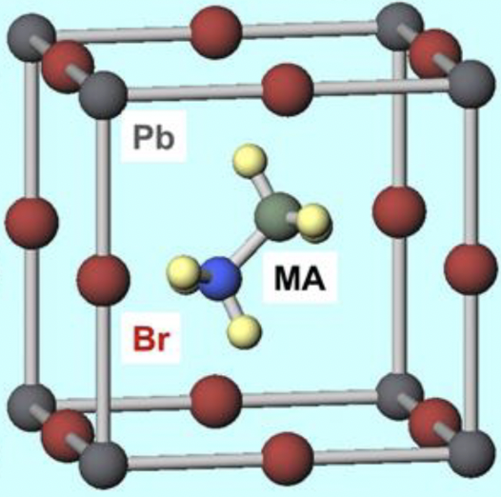
Hybrid Organic-Inorganic Metal Halide Perovskites as Laser Gain Medium
Perovskites have properties such as long charge carrier lifetimes, high charge carrier mobilities, high quantum yields, tunable bandgaps, and high absorption coefficients¹
Promising for use as gain media in lasers
¹Moon, J. et. al. ACS applied materials & interfaces 2021, 13 (4), 5368-5378.
Okumura, R. et. al. Chemistry Proceedings 2022, 9 (1), 11.

Slide 3
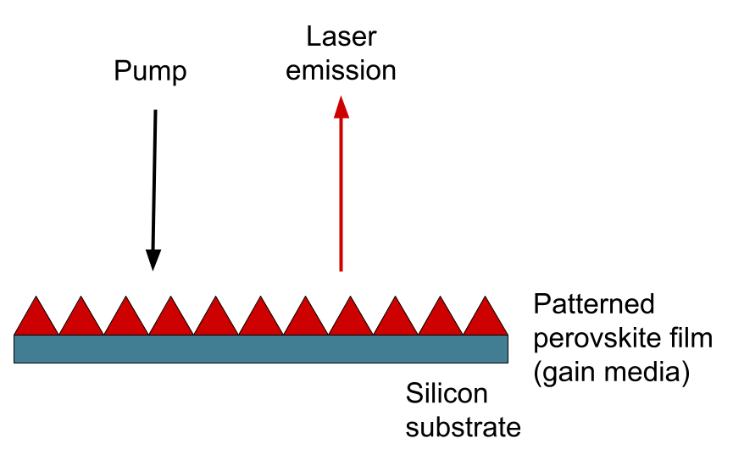
Motivation: Patterning Perovskites into Laser Cavities
The patterned perovskite film functions as the gain medium and the optical cavity
Optical cavities: confine light within the laser structure
  Patterned perovskite can be used as optical cavities to provide feedback and stimulated emission

Slide 4
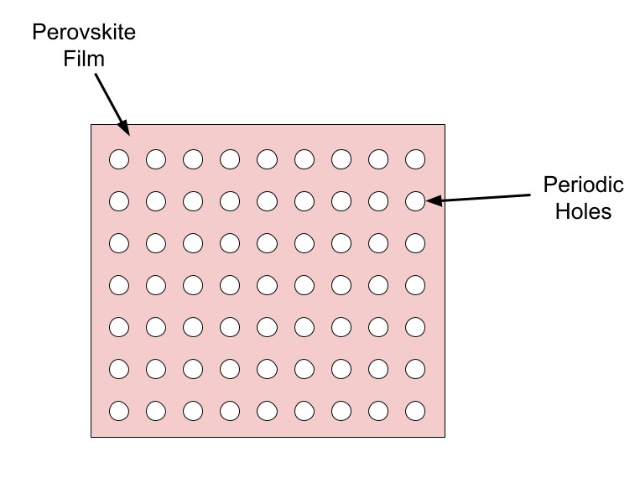
Nanoimprint Lithography (NIL) for Patterning Perovskite Films
Conventional patterning techniques (e.g. photolithography & e-beam lithography) use polar solvents that degrade perovskites²
NIL uses heat and pressure to pattern the perovskites
REU project goal: verify imprinting on glass and silicon with a flat stamp before moving to a patterned grating stamp
Long-term goal: create photonic crystal cavity structures on perovskite thin films
²Moon, J. et. al. ACS Photonics 2022, 9 (6), 1984-1991.

Slide 5
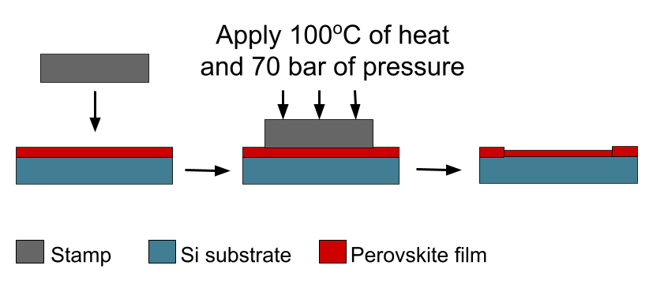
NIL Method

Slide 6
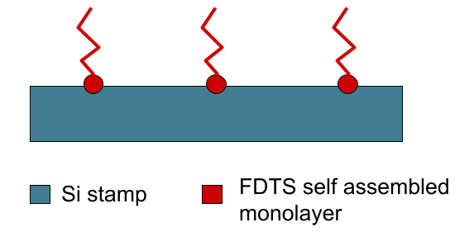
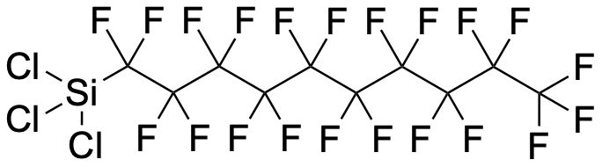
Stamp Preparation
Flat Si stamp coated with FDTS (an anti-adhesion layer)
  Needed for clean stamp release after imprinting
Contact angle measured to confirm hydrophobicity (>100º needed for clean release)

Slide 7
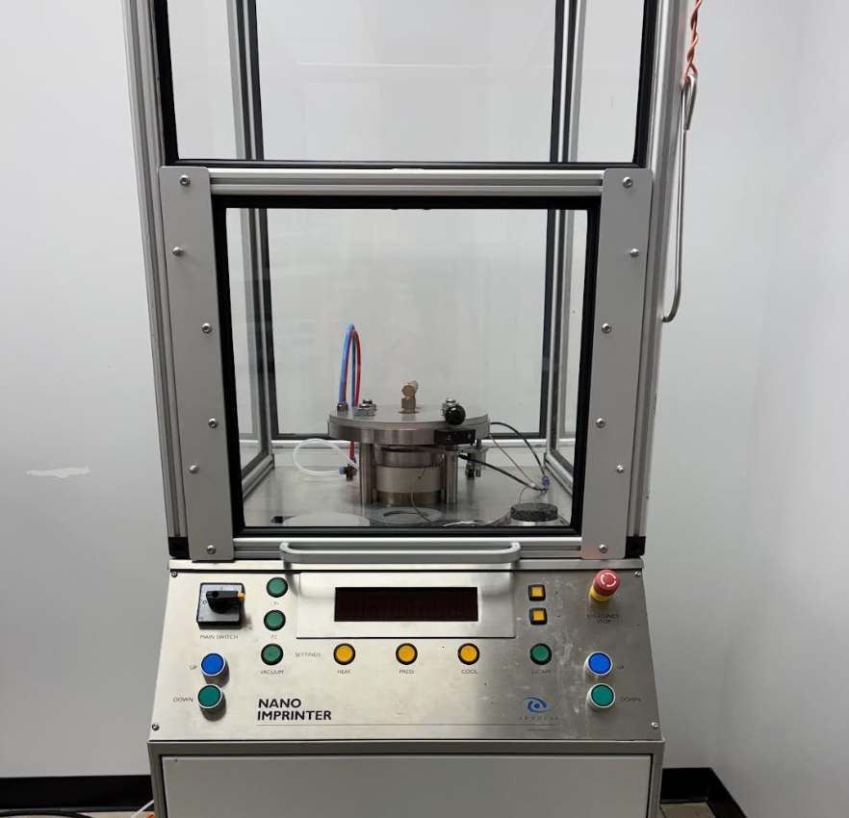
NIL Procedure
MAPbBr₃ thin films prepared on glass and Si substrates by Dr. Xiaotong Li’s group
Imprinted with flat stamp at 100ºC, 70 bar for 20 minutes

Slide 8
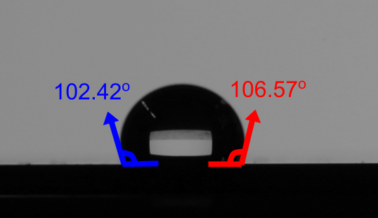
Results: Contact Angle
Average contact angle 104.49º (left: 102.42º, right: 106.57º)
Meets the >100º hydrophobicity criterion for clean stamp release

Slide 9
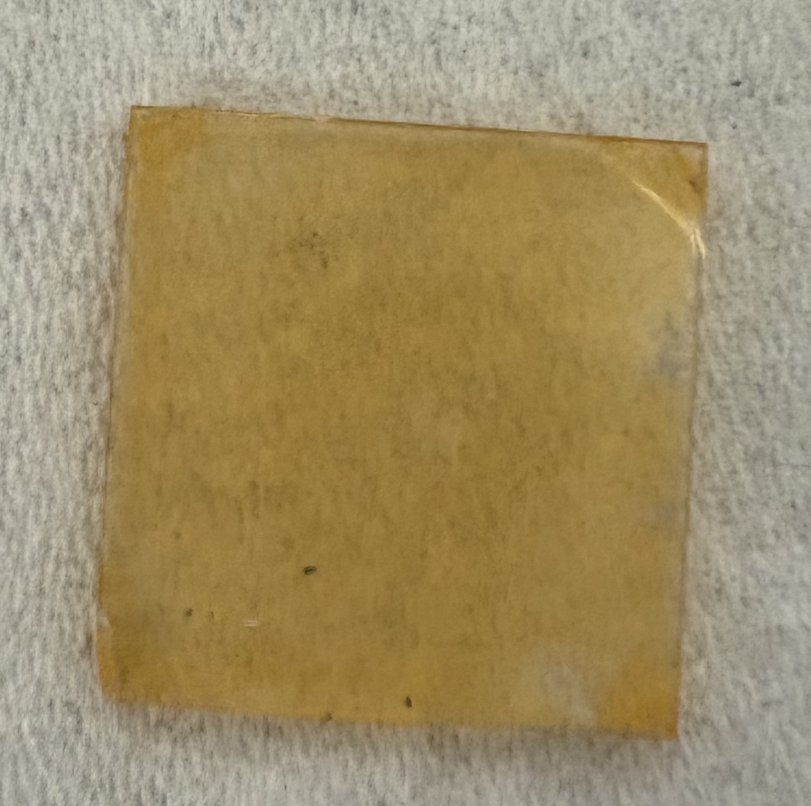
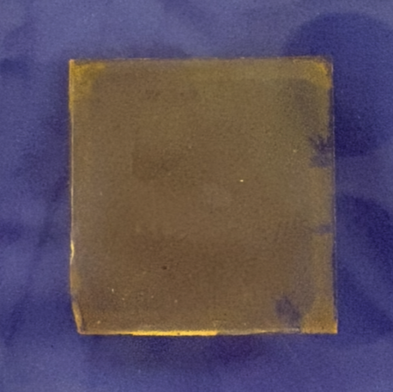
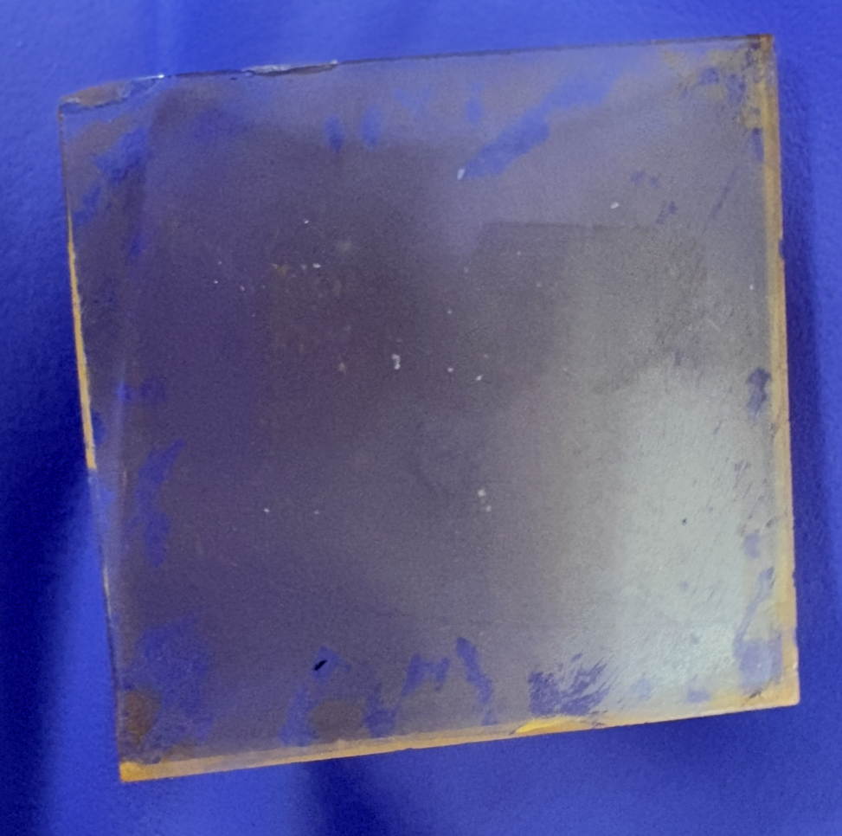
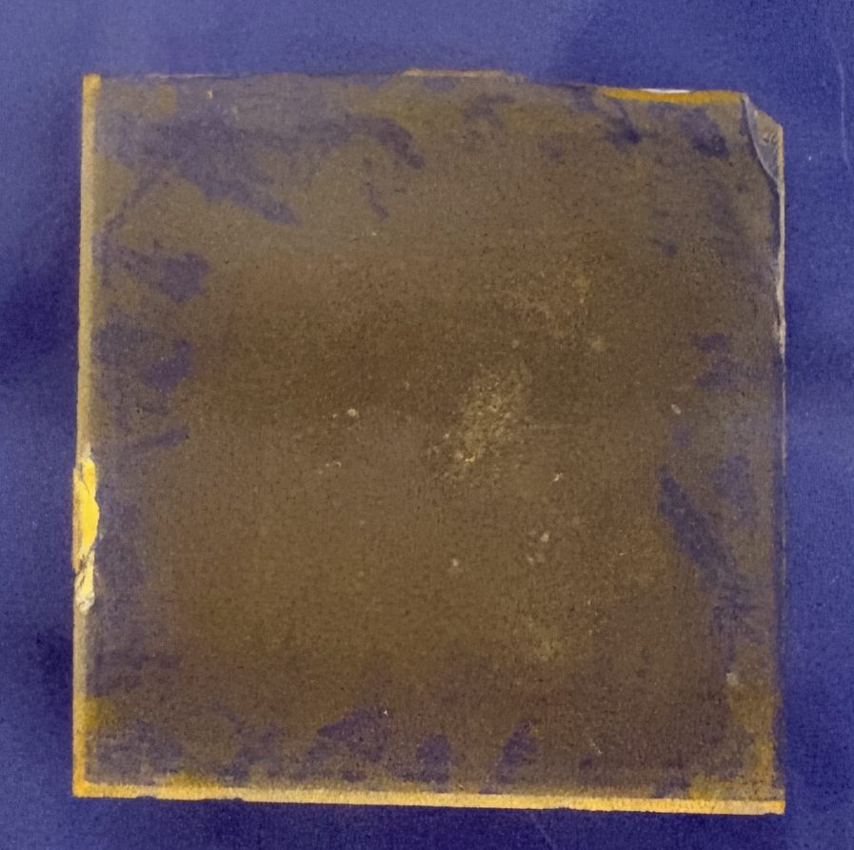
Results: Imprinting on Glass Substrates
Before
After
Sample #1
Sample #2

Slide 10
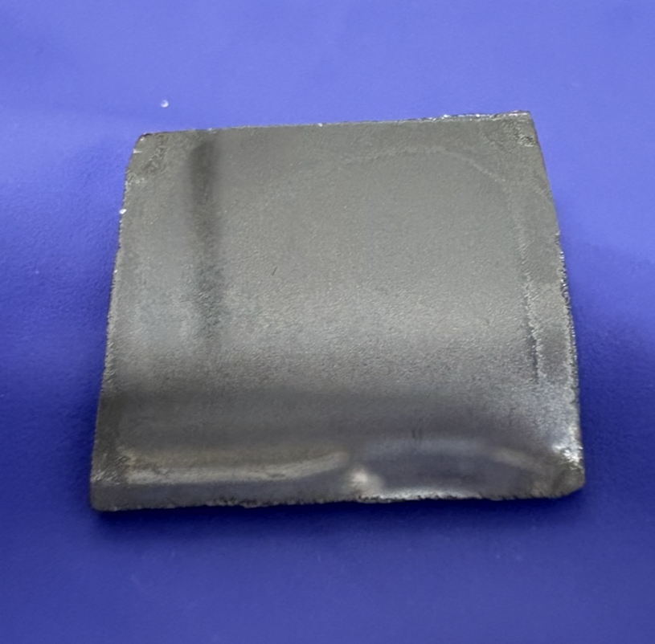
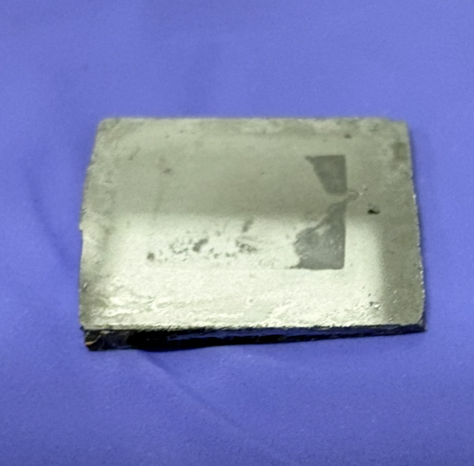
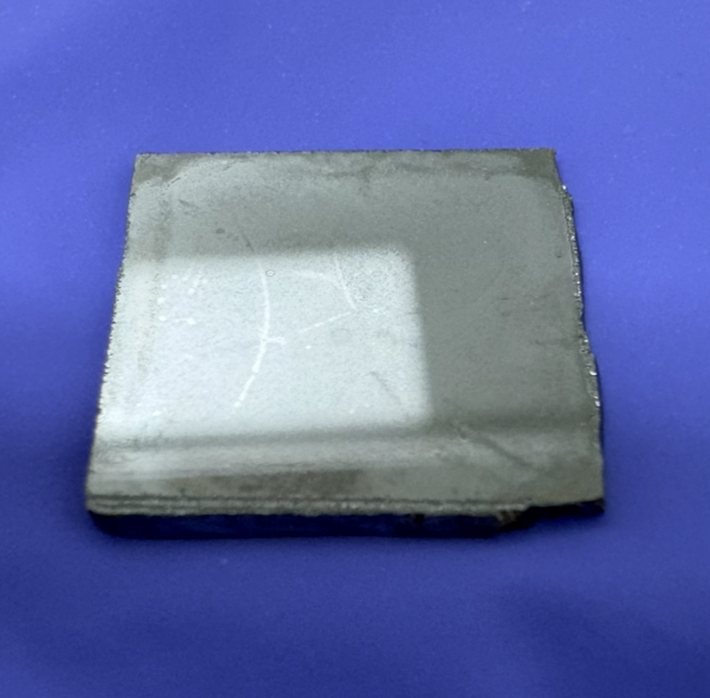
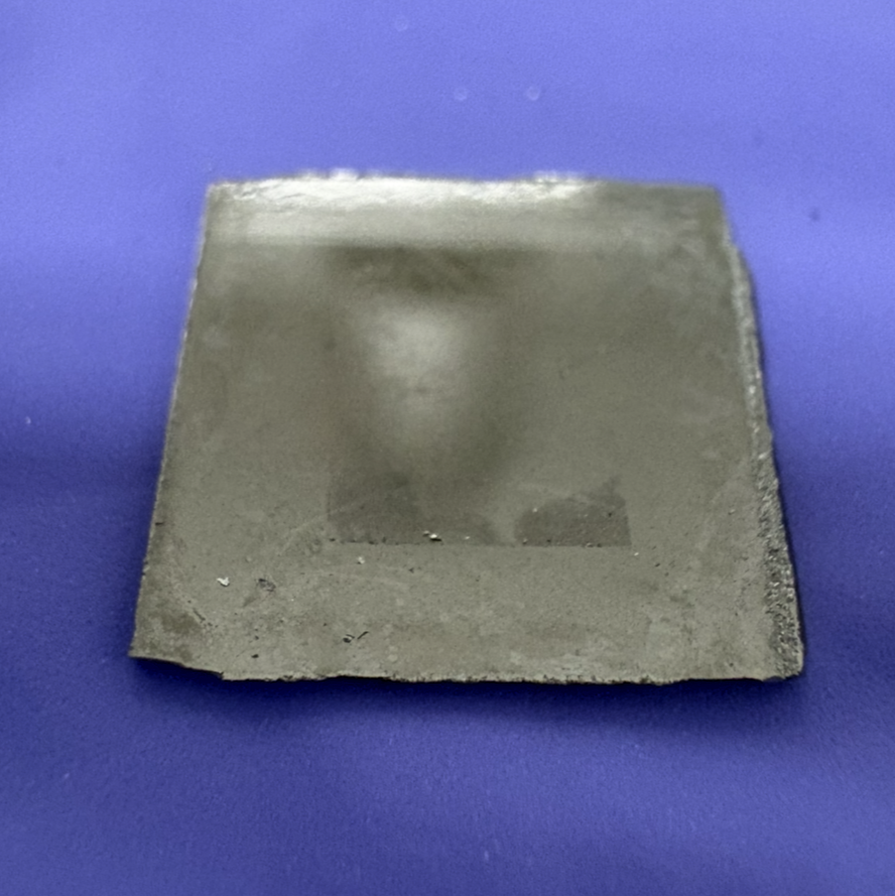
Results: Imprinting on Silicon Substrates
Before
After
Sample #1
Sample #2

Slide 11
Conclusion & Future Work
Nanoimprinter reliably reaches target processing conditions (100ºC, 70 bar) with MAPbBr₃ on Si
FDTS-coated flat stamp met hydrophobicity requirement for clean release
Films on glass substrates showed no visible changes after imprinting
Films on silicon substrates had a visible outline after imprinting
  Some FDTS transfer from stamp to film
Future work: characterization (e.g., photoluminescence and SEM) of films before and after imprinting to evaluate imprint success

Slide 12
Thank You!
Thank you to my mentors, Md Ayenul Azim and Prof. Qing Gu, for their guidance throughout this project as well as Dr. Xiang-Bin Han, Dr. Boyu Guo, and Prof. Xiaotong Li. Thank you to the RTNN REU program for the opportunity.
Contact email: amclane6@gatech.edu
This material is based upon work which is supported by the National Science Foundation (award numbers 2447827, 2447828, 2447829 and ECCS-2025064). Any opinions, findings, and conclusions or recommendations expressed in this material are those of the author(s) and do not necessarily reflect the views of the National Science Foundation.

