Slide 1
ML Analysis of Real Time Spectral Data During Perovskite Fabrication
Kathy Guo
Cornell University
North Carolina State University
Boyu Guo, Ali Shashaani, Aram Amassian
Department of Materials Science and Engineering and Industrial and Systems Engineering and Carbon Electronics Laboratories (ORaCEL)

Slide 2
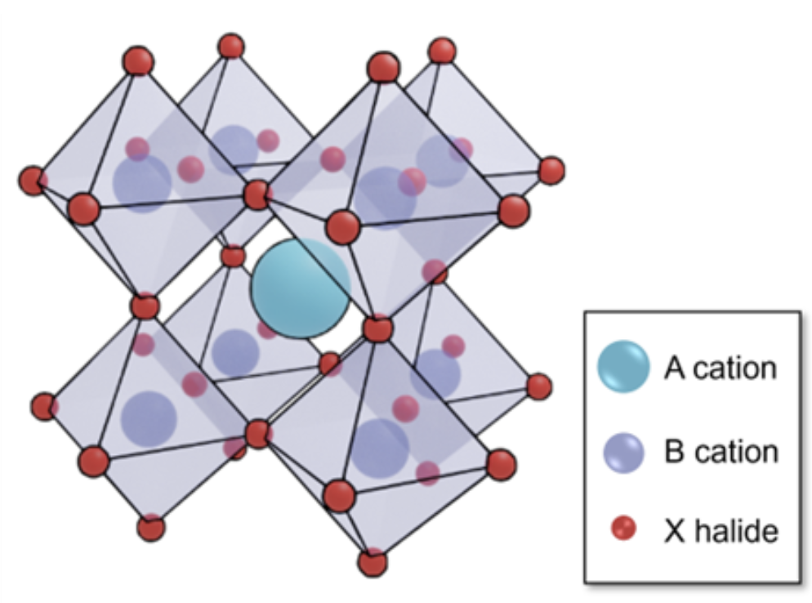
Hybrid Metal Halide Perovskite Background
ABX₃ structure
  Organic and inorganic A site cation
  Metal B site cation
  X site halide
Antisolvent spin coating fabrication
Layered perovskites unique formation
Efficient, tunable, and inexpensive
FA_{0.83}Cs_{0.17}Pb(I_{0.83}Br_{0.17})₃ (17-17)
A cation: Cs⁺, CH₅N₂⁺ (FA⁺)
B cation: Pb²⁺
X halide: I⁻, Br⁻

Slide 3
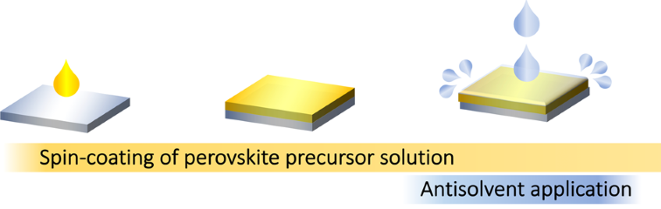
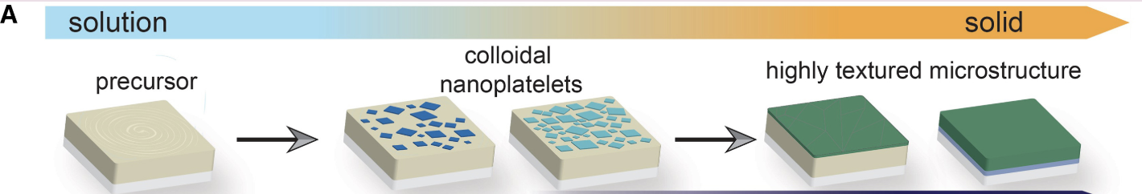
Fabrication: Antisolvent Drip Process

Slide 4
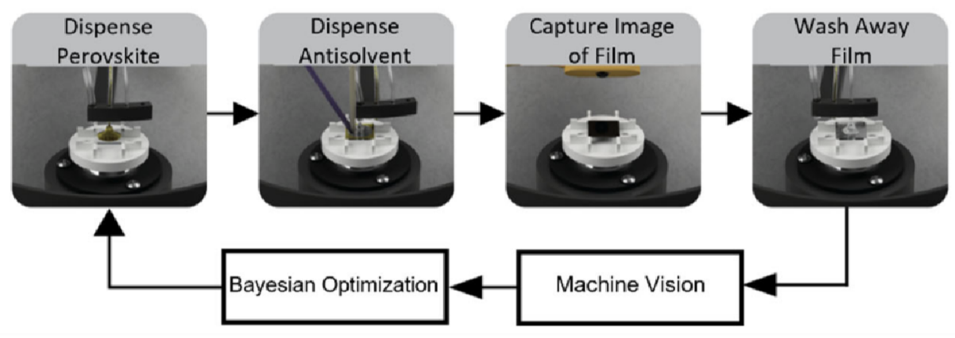
Automated Process
RoboCoater
17-17 in DMF/DMSO
Analyze along with in-situ data
2x wash cycle with DMF
Chlorobenzene

Slide 5
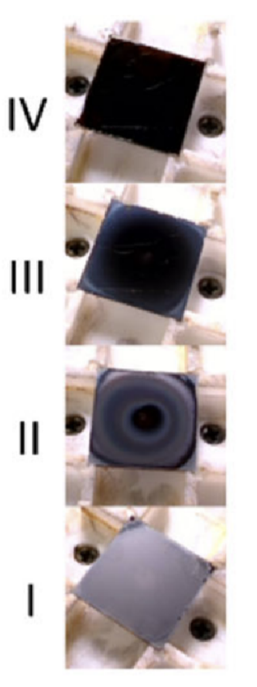
Film Classification
Current film classification depends on visual inspection into four discrete ranks
  IV (4): Uniform, black
  III (3): Black with unclear edges
  II (2): Not uniform
  I (1): Uniform, hazy, not black
Visual inspection -> Random forest model
No physical (instrumentation) properties
1.0
0.66
0.33
0.0

Slide 6
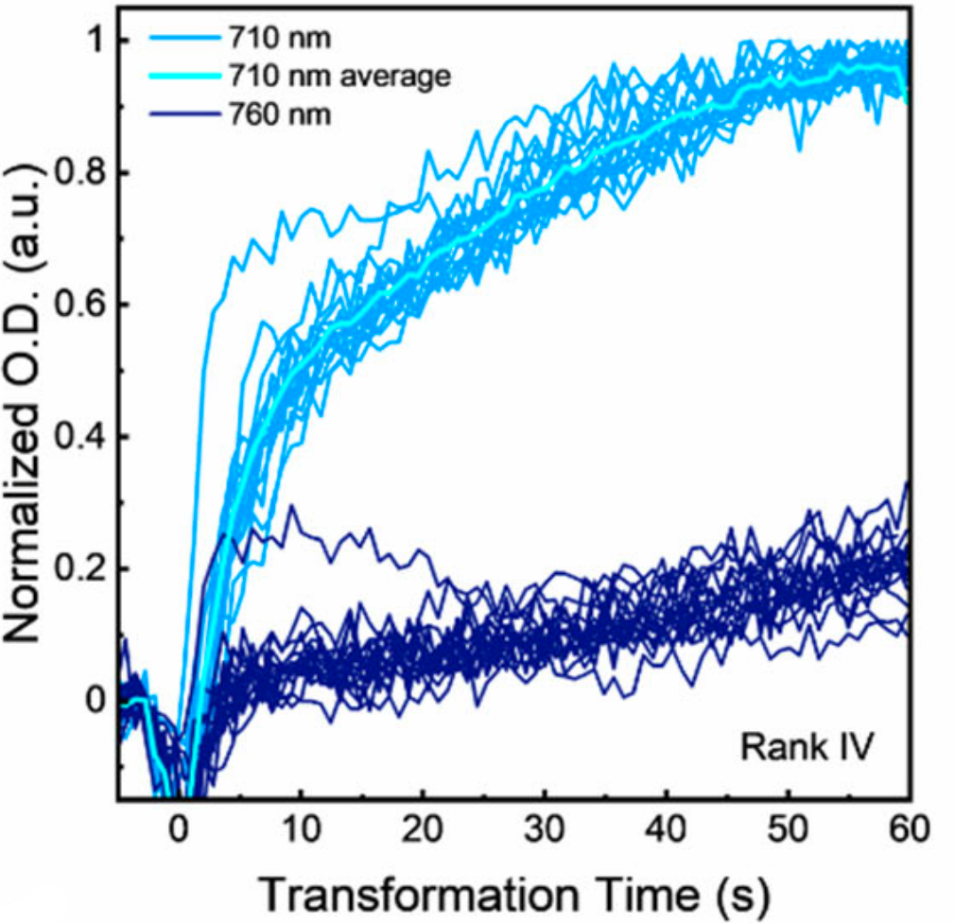
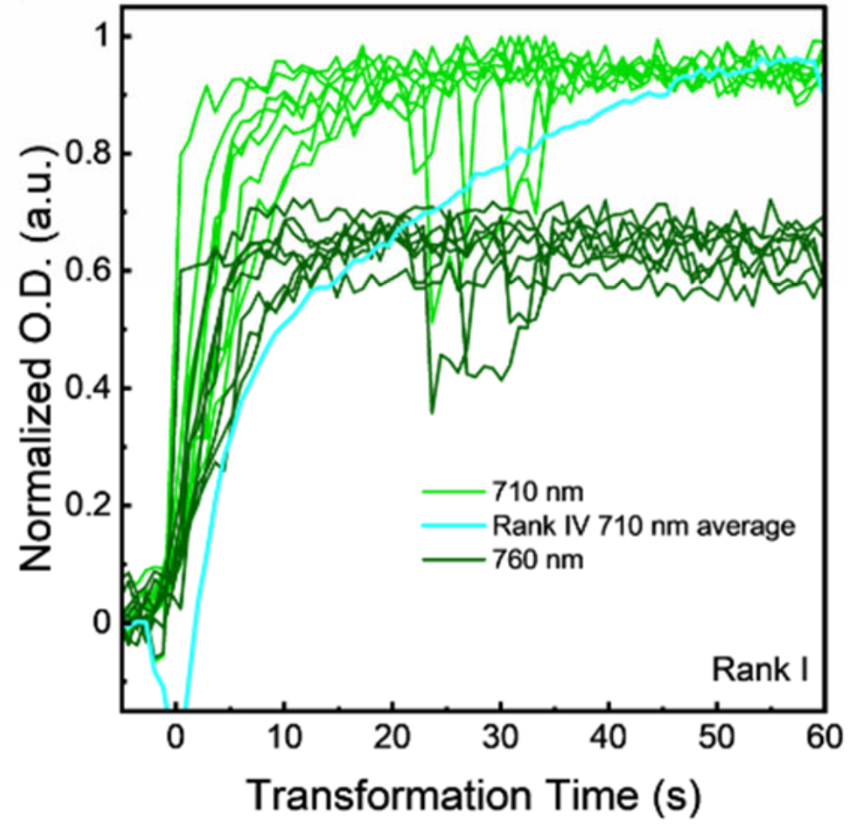
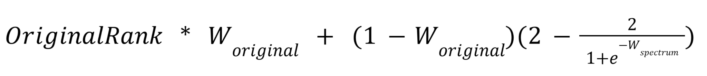
Film Classification with Spectral Data
760 nm absorbance difference from zero vector
Second derivative of absorbance at 710 nm
Ratio of 760/710 nm abs
Weighted number representing spectral classification (W_{spectrum})
Weighted portion of visual ranking (W_{original)})
Final Rank:

Slide 7
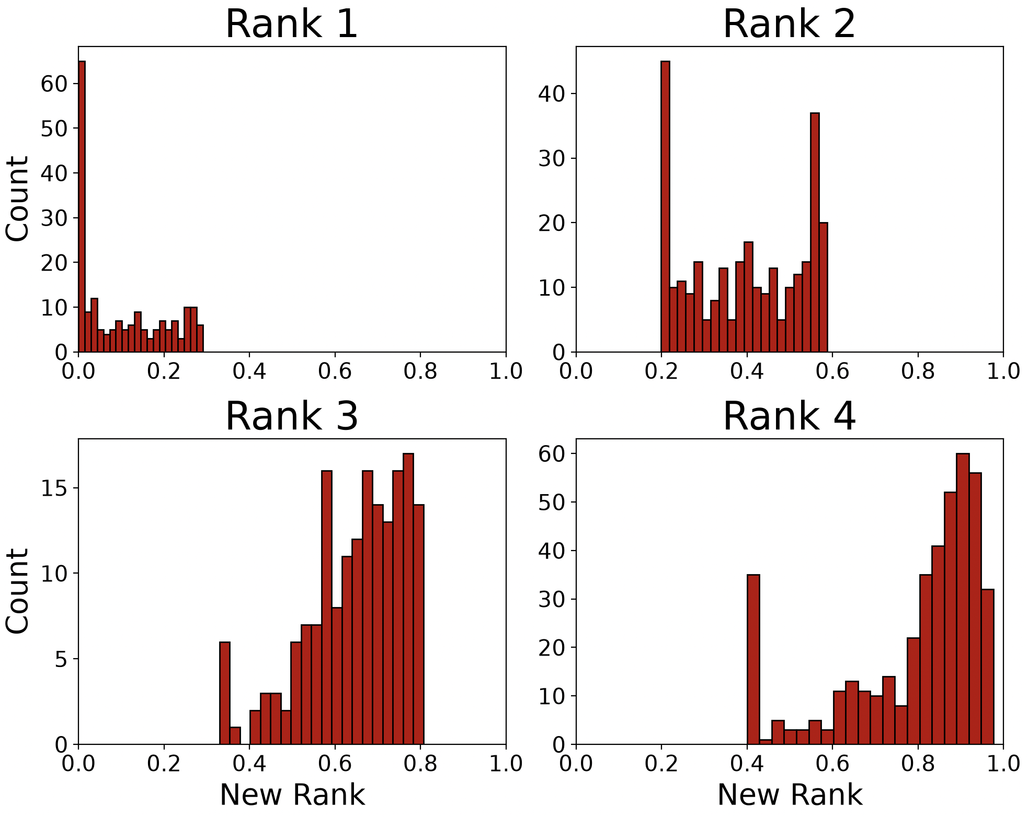
Results for New Classification
Consistent boundaries between films
Provides continuum of film qualities in one rank
Weighting of visual and spectral need further study

Slide 8
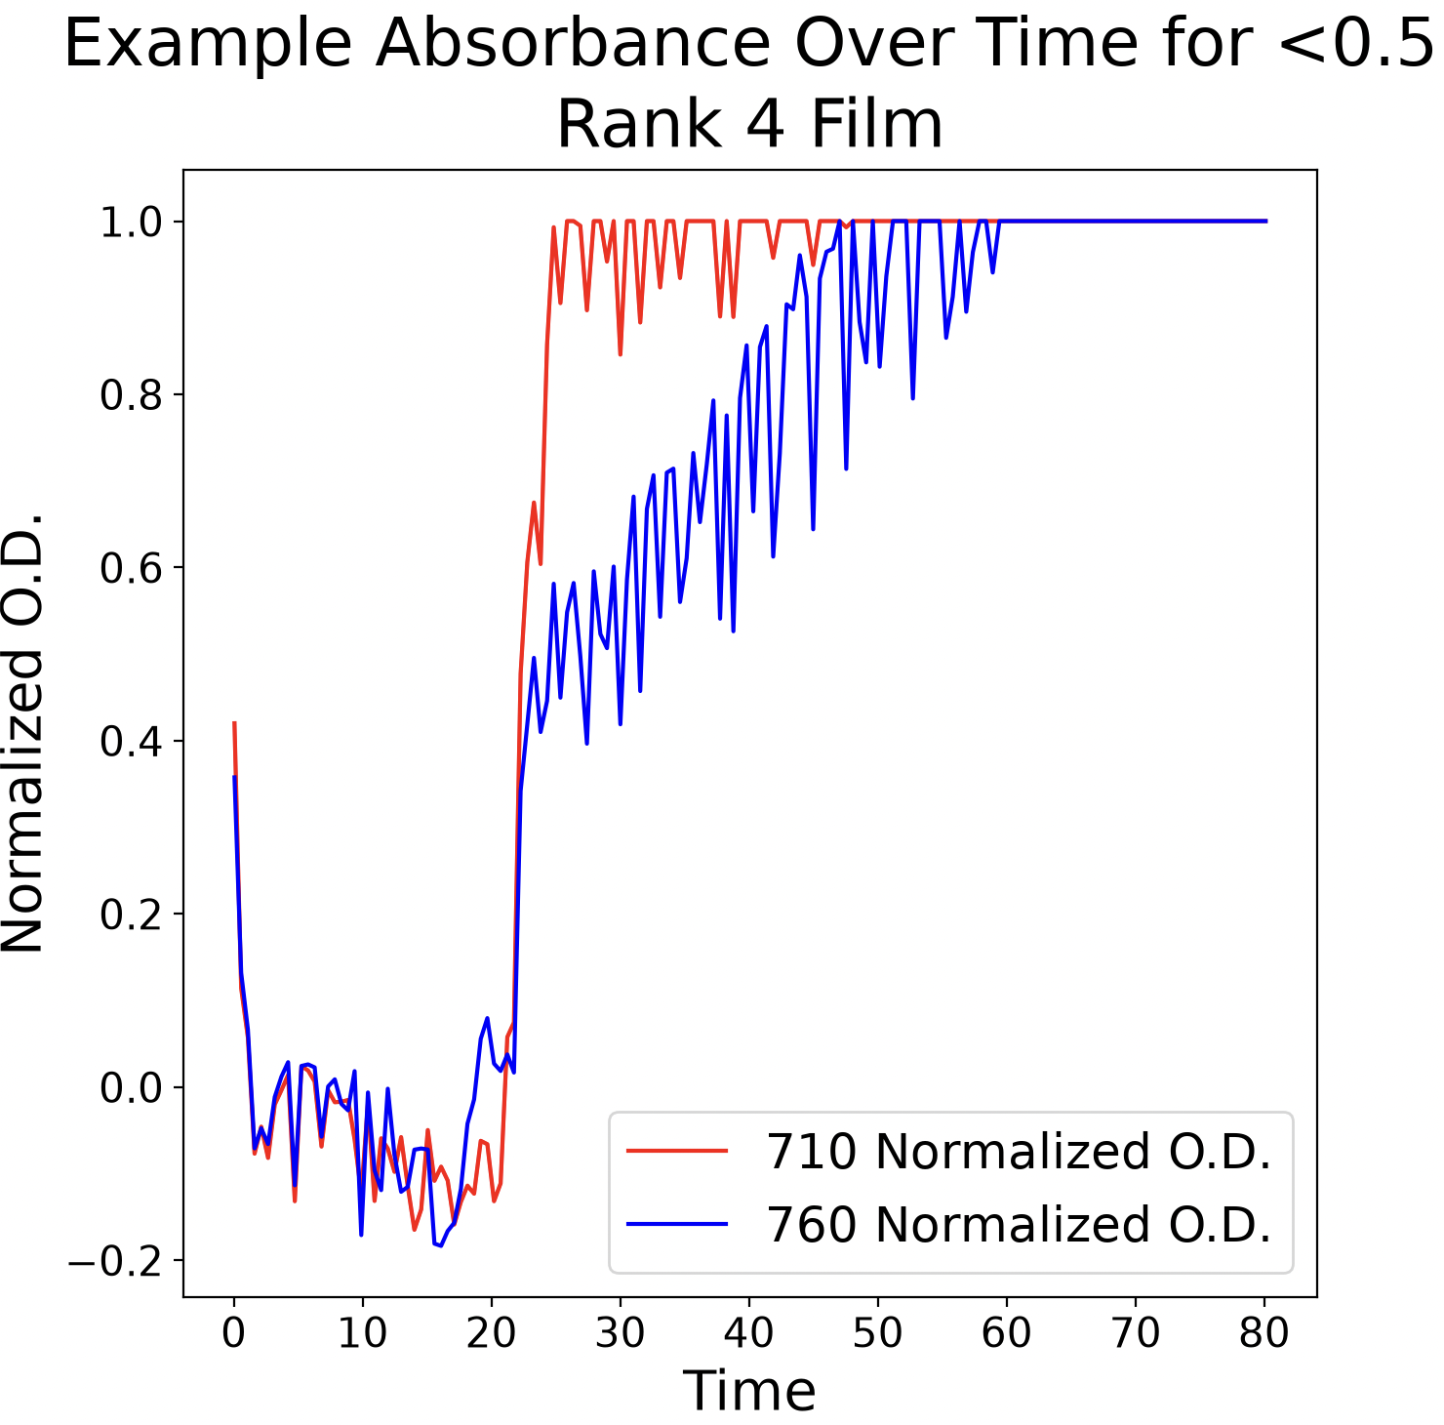
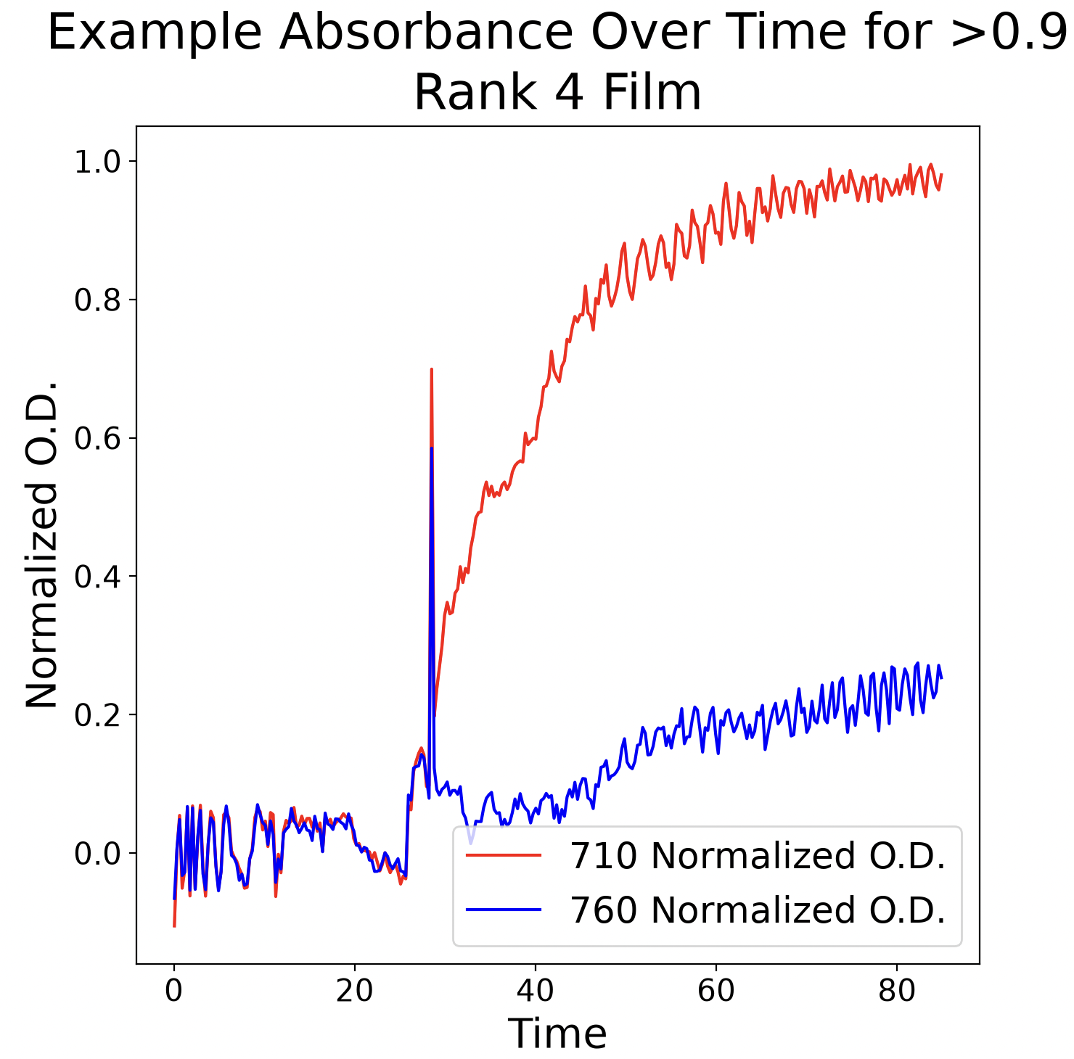
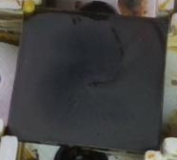
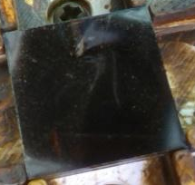
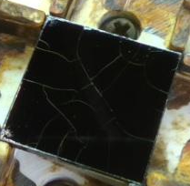
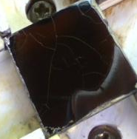
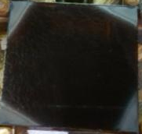
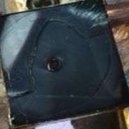
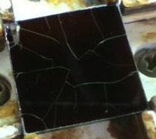
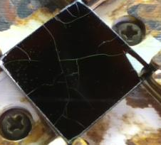
Score Range of Rank 4
Score <0.50
Score >0.90

Slide 9
Predictive Model Before Completion
Film formation requires a controlled environment and is very sensitive to small changes (humidity, hydrocarbon air density, etc.)
Antisolvent drip timing, rate, and volume may be different as a result…

Slide 10
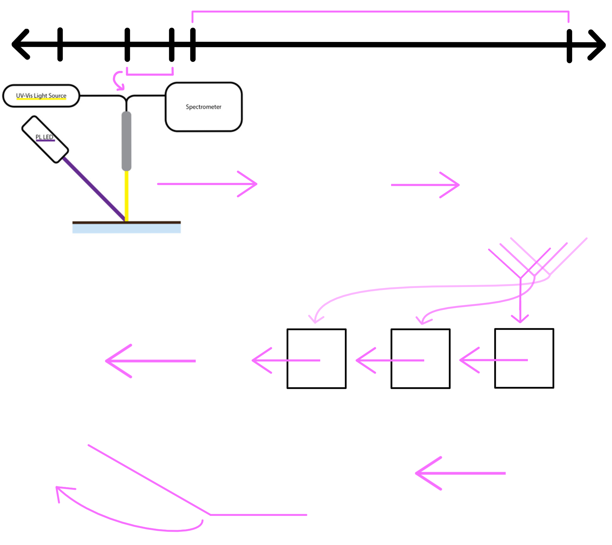
Proposed Solution: ML Neural Network
Dispense Perovskite
Start spinner
Antisolvent dispense drip window
18.5s
82s
Extract key information from in-situ data about the current environment
Combine with drip parameters (time, rate, volume)
Predict the final film quality
12s
19s
0s
In-situ data from 500 - 900 nm during 6.5s, giving 8 pairs of spectral data with 1123 measurements per instrument
Convolutional Neural Network (CNN)
Compressed UV-Vis
Compressed PL
UV-Vis Data
PL Data
32 x 1
8 times
1123 x 1
8 times
Concatenate
UV-Vis + PL
64 x 1
64 x 1 condensed spectral vector
Gated Recurrent Unit (GRU)
Temporal Spectral
. . .
16 x 1
expanded parameters for more weight
Predicted film quality between 0 -1
Concatenate
Spectral + Drip
80 x 1
Drip Time
Drip Parameters
Drip Rate
Last MLP layer
Multilayer Perceptron (MLP)
Drip Volume

Slide 11
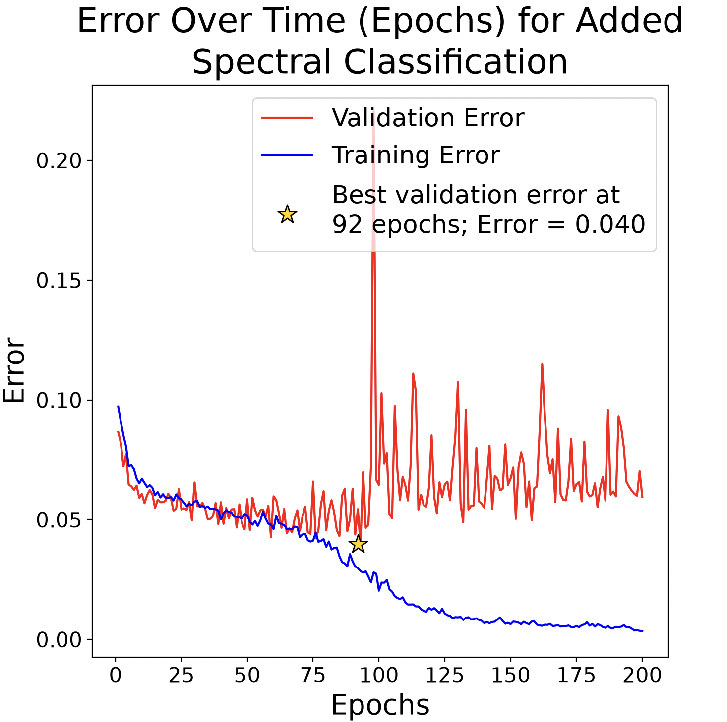
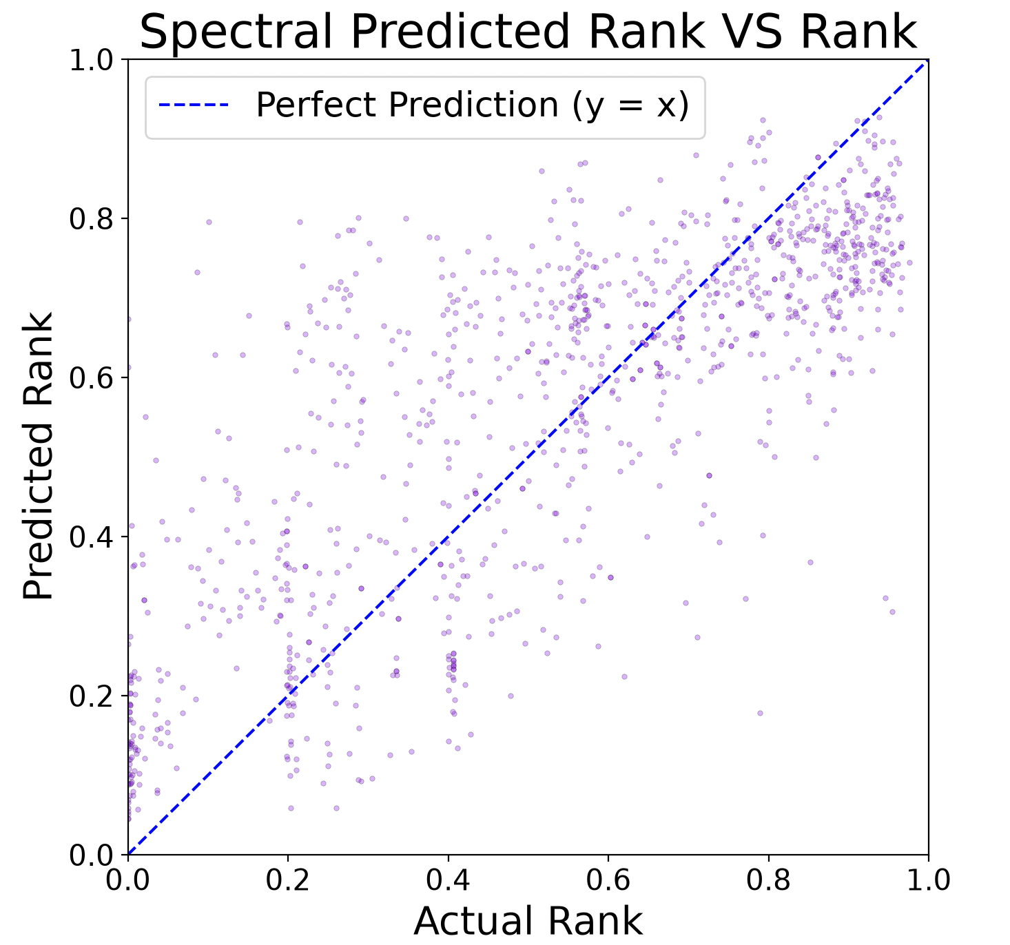
Results for Predictive Model (Spectral Added Rank)
Somewhat accurate prediction of quality before completed fabrication
Error ~20%

Slide 12
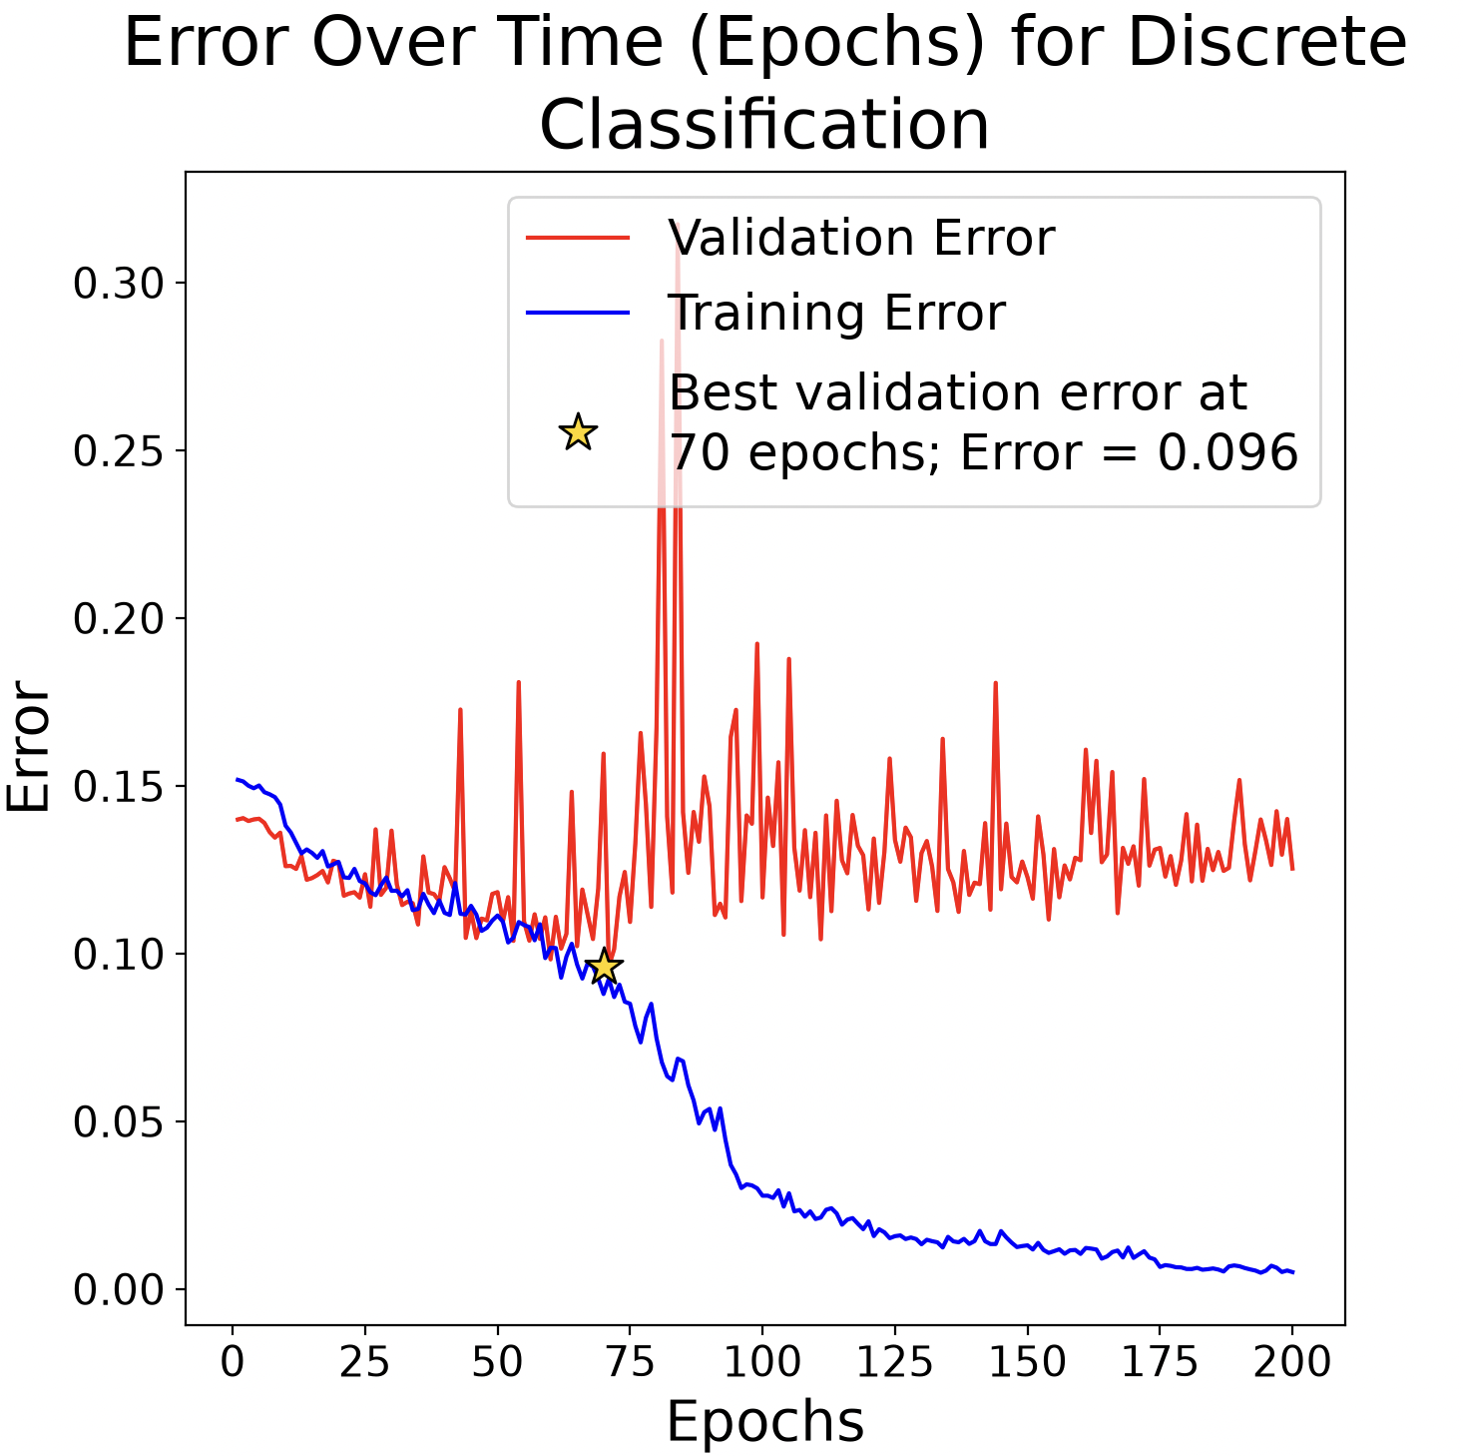
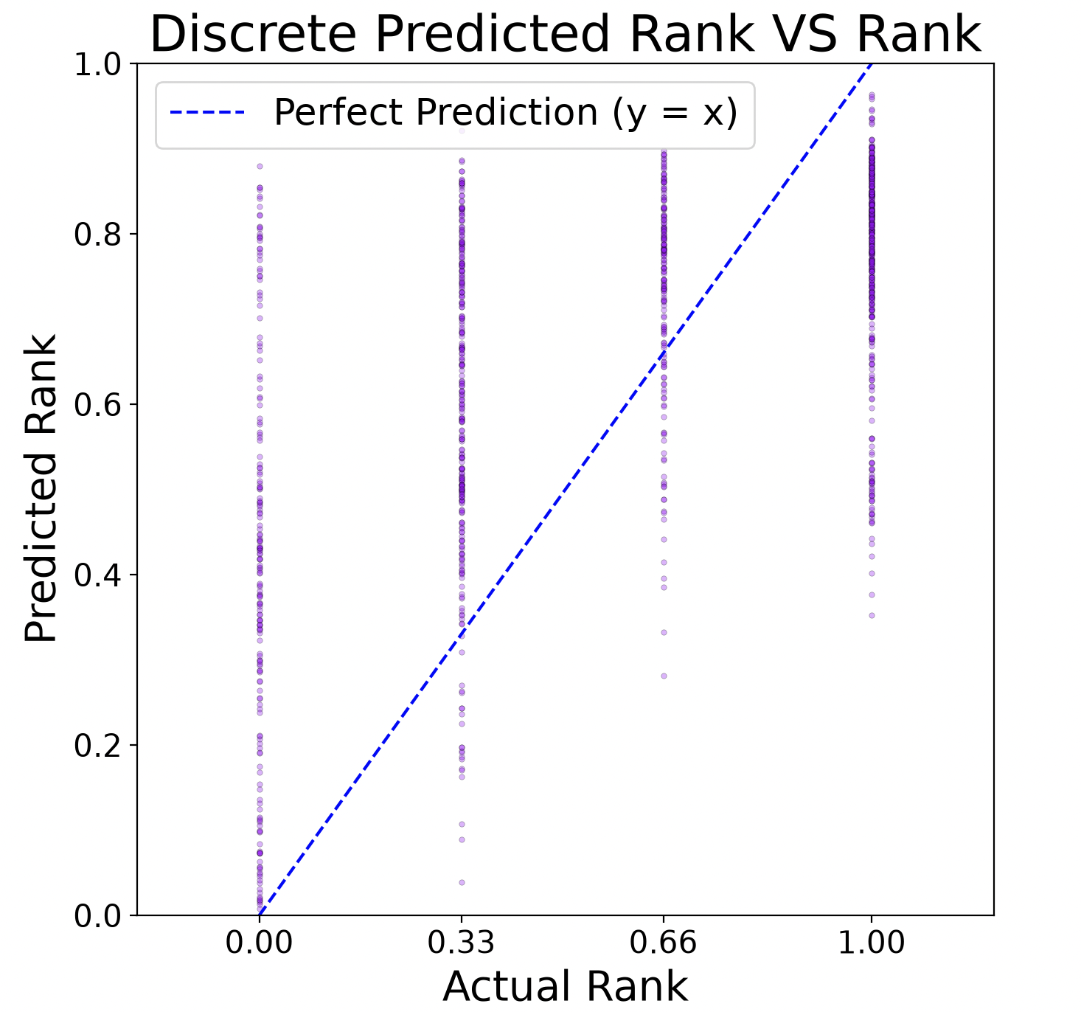
Results for Predictive Model (Discrete Rank)
Not as accurate prediction
Discrete data is hard to train for neural networks
Error ~32%

Slide 13
Future Work
Validate new classification with further research and collaborate with others to develop more robust system
Validate ML model predictions in lab, changing environment to see results for same drip parameters
Combine ML model with existing automated framework—work out a pathway for Bayesian Optimization
  Include uncertainty in model

Slide 14
Thank You!
Thank you to the Carbon Electronics Laboratories (ORaCEL) and the Amassian Group for sponsoring and supporting this project!
Special thanks to Boyu Guo, Ali Shashaani, Michael Hopfinger, and Aram Amassian for helping this project
Contact: kzg7@cornell.edu
This material is based upon work which is supported by the National Science Foundation (award numbers 2447827, 2447828, 2447829 and ECCS-2025064). Any opinions, findings, and conclusions or recommendations expressed in this material are those of the author(s) and do not necessarily reflect the views of the National Science Foundation.

Slide 15
Citation Links
https://www.nature.com/articles/s41467-021-22049-8
https://www.cell.com/matter/fulltext/S2590-2385(24)00489-2

