Slide 1



Stretchable Vertical Organic Electrochemical Transistors
Joohwan Choe
Mentor: Ayush Dhande
PI: Dr. Antonio Facchetti
NSF Award: 2349519

Slide 2





Introduction – What is an OECT?
Organic Electrochemical Transistor
Low Driving Voltage
Mixed Ionic-Electronic Conduction
High Transconductance
Polymer Flexibility
Notes:
Make slide 2 and 3 same.
What oect is, how it works, its properties and reasons for its properties,

Slide 3
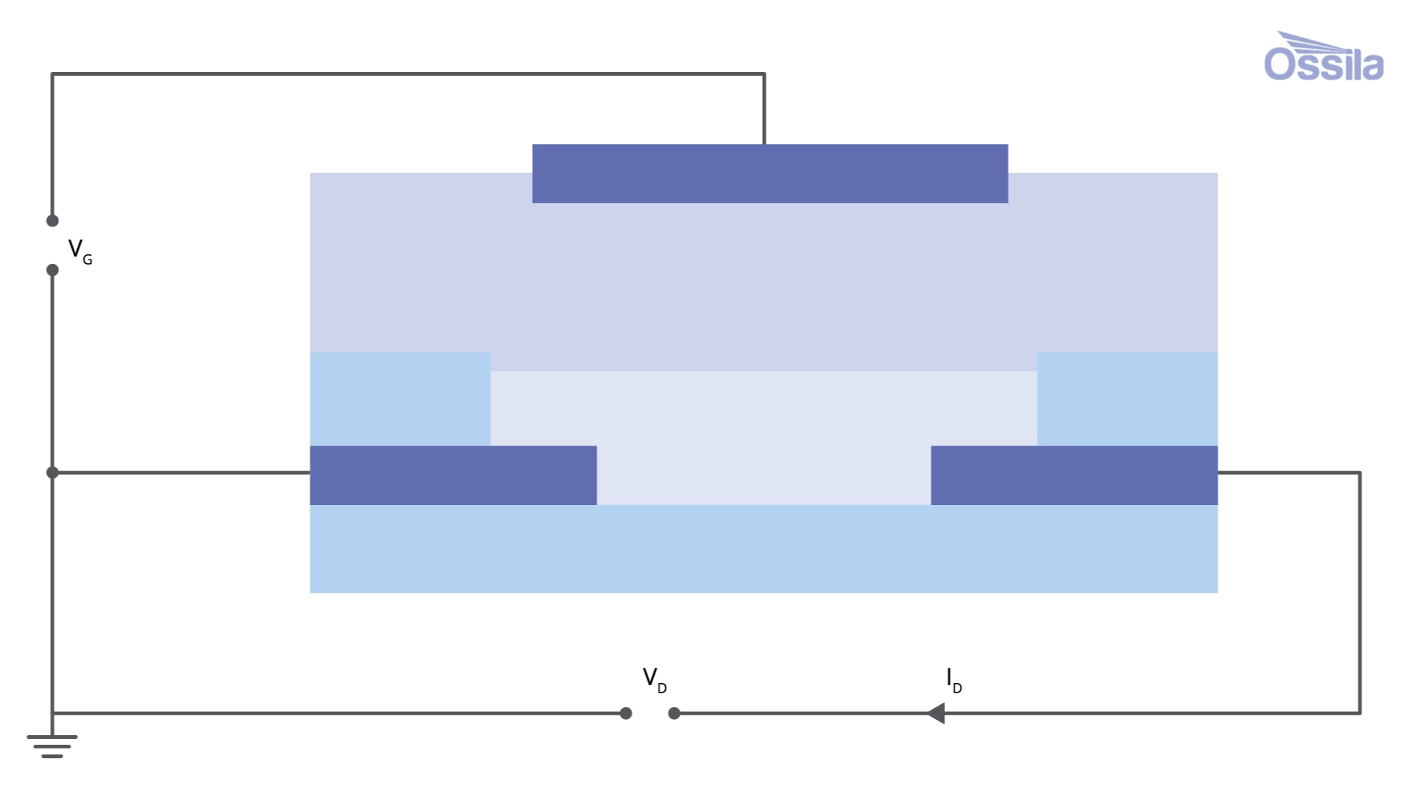
OECT Device Mechanics
Device Mechanic
Gate Voltage drives ions from electrolyte into the organic semiconductor
Causes a change in the semiconductor doping state
Allows the electrons to flow from Source to Drain for transistor to function
https://www.ossila.com/pages/organic-electrochemical-transistors-oects

Slide 4
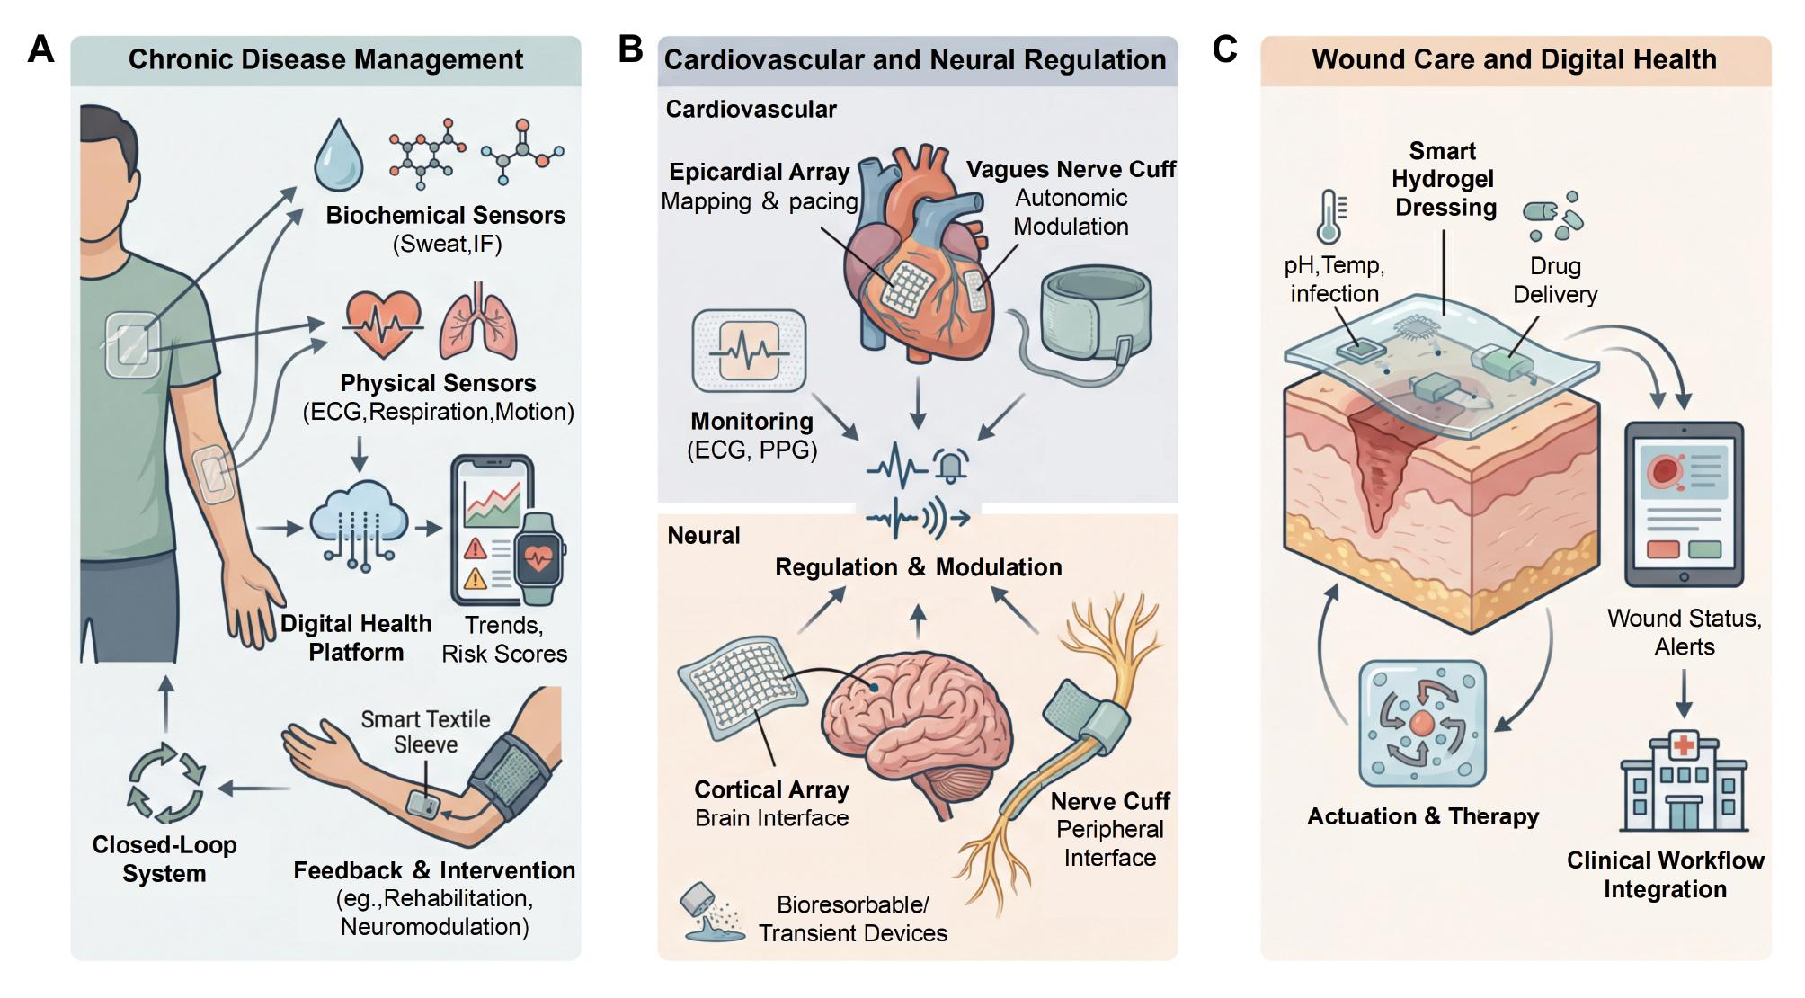
Why are OECTs important?
Li B, Wang Y, Mei J et al. Wearable Bioelectronics: Toward Future Personal Health Monitoring. BIO Integration 2026; 7: 1–10.

Slide 5
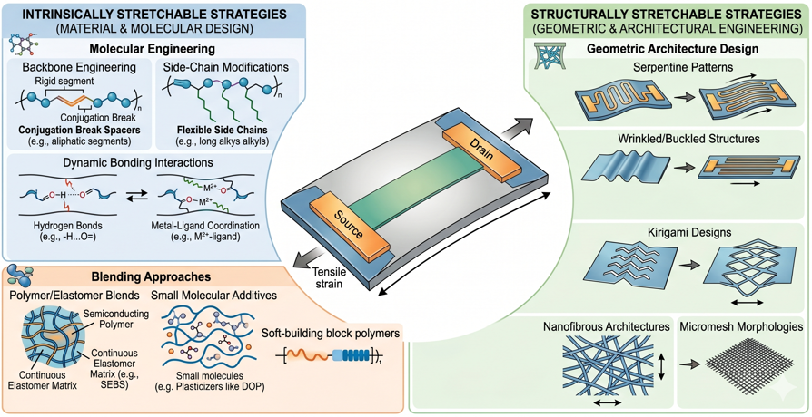
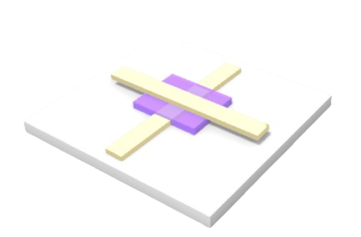


Why is it Stretchable and Vertical?
Bottom electrode
Semiconductor channel
Top electrode
Substrate
Stretchability for wearable electronics as human strain experiences strain of 30%
Vertical OECT overcomes the fabrication limit and reduces source & drain distance
Notes:
Stretchability part, to incorporate it onto human skin must be able to stretch while functioning. Diff methods to make these devices stretchable. You can intrinsically or extrinsically modify them to be more stretchable by using more stretchable materials or changing the overall geometry of the OECT.
Planar limited by the fabrication limitations.

Slide 6
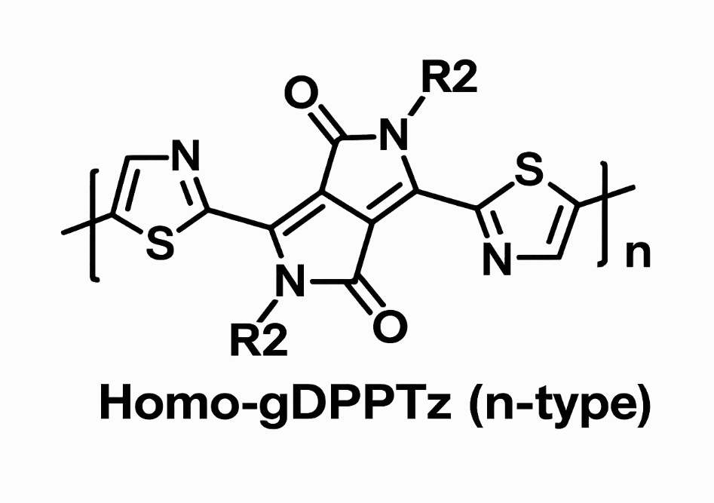
Research Project: Optimization of N-type OECT
PEDOT:PSS
Top Au
Micro-cracked Au
HOMO-gDPPTz
PEDOT:PSS
Bottom Au
O-S=O
O-S=O
SEBS
SEBS
O-H
O-H
O-H
O-H
Molecular Bridge
S
S
S
S
Au supporting layer
Reference gate
Electrolyte
PEDOT:PSS electrode
Supporting Layer
Active Channel
Micro-crack Electrode
Organic Semiconductor
Stretchable Substrate
Notes:
This is the cross-section of the OECT. Explain the structure of the device.
Gold is the major issue (least stretchable) explain it: delamination between layer …

Slide 7
OECT Fabrication Process
SEBS
Dextran
Dextran
Glass
Glass
Glass
Clean Glass Slide
Spin-Coat Dextran
Drop-Cast SEBS
Au
HOMO-gDPPTz
HOMO-gDPPTz
Au
Au
Au
SEBS
SEBS
SEBS
Dextran
Dextran
Dextran
Glass
Glass
Glass
Evaporate Au supporting layer
Spin-Coat semiconductor
Evaporate micro-cracked Au
PEDOT:PSS
PEDOT:PSS
Au
Au
Au
HOMO-gDPPTz
HOMO-gDPPTz
HOMO-gDPPTz
Au
Au
Au
SEBS
SEBS
SEBS
Dextran
Dextran
Dextran
Glass
Glass
Glass
SAM on Au
Spin-coat PEDOT:PSS
Whole Device

Slide 8
Roadmap of my data
Bottom Electrode
Resistance vs strain on microcracked Au
Top Electrode
Bonding between self-assembled monolayer and Au
Organic Semiconductor
N-type polymer photo crosslinked for improved stretchability
Ion Selectivity
K⁺ and pH testing to indicate the selectivity of our devices
03
8
Notes:
My contributions: Resistance vs strain graph of bottom electrode, SAM test using XPS, rigid N and P-type performances, rigid N type OECT with PEGDMA, K and pH testing for the rigid PEGDMA devices.

Slide 9
Bottom Electrode

Slide 10
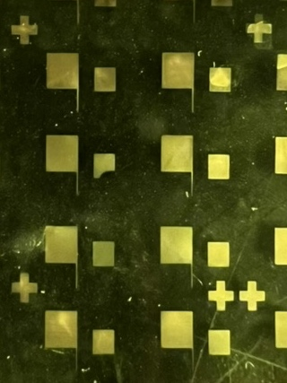

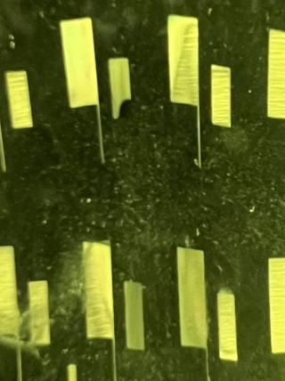
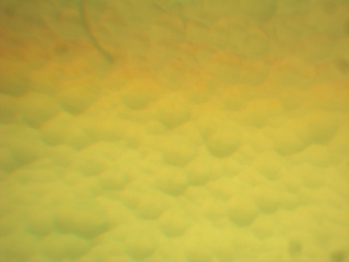
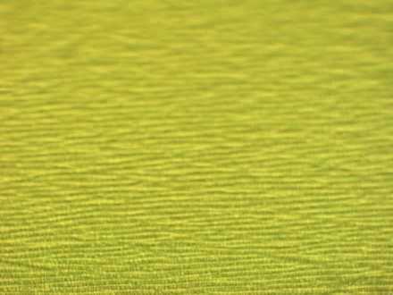
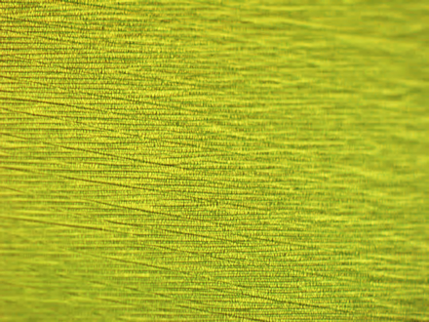
Bottom Electrode – Microcracked Au
Optical images taken by Ayush Dhande
3 cm
100 µm
0%
50%
100%
Embedded gold into the SEBS substrate (stretchable base)
Formation of microcracked Au enabling conductivity
10

Slide 11
Top Electrode

Slide 12
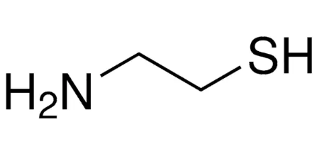
Top Electrode – XPS
PEDOT:PSS
O-S=O
O-S=O
H₂N
H₂N
H₂N
H₂N
Molecular Bridge
S
S
S
S
Au supporting layer
Cysteamine and Au bond
Cysteamine and Au (S-Au) bond formation in the range of 161.9 – 162.2 eV
XPS confirmed that the bond was present
12

Slide 13
Organic Semiconductor

Slide 14
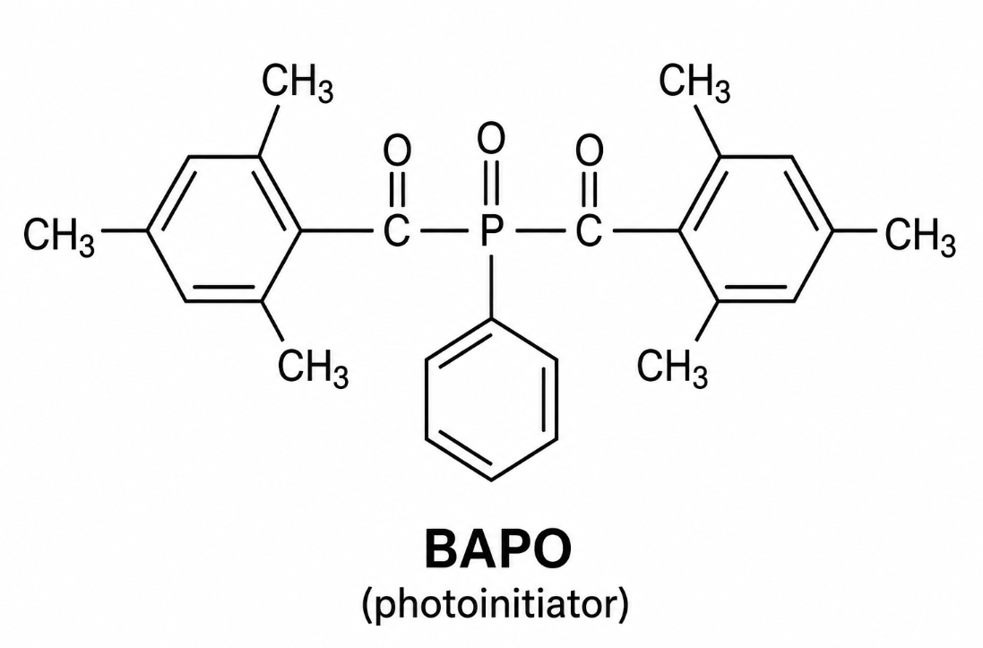
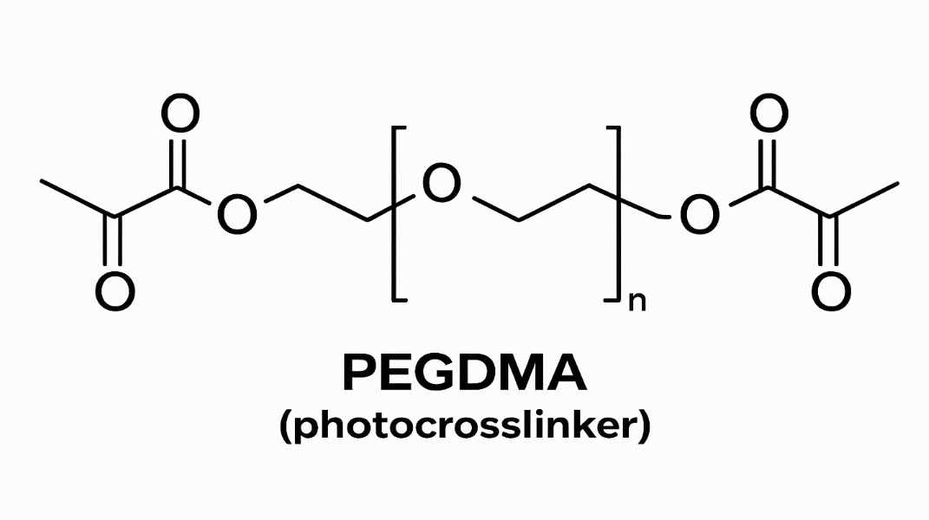
Organic Semiconductor
Homo-gDPPTz crosslinked to PEGDMA at varying concentrations for improved ductility without electrical performance degradation
14

Slide 15
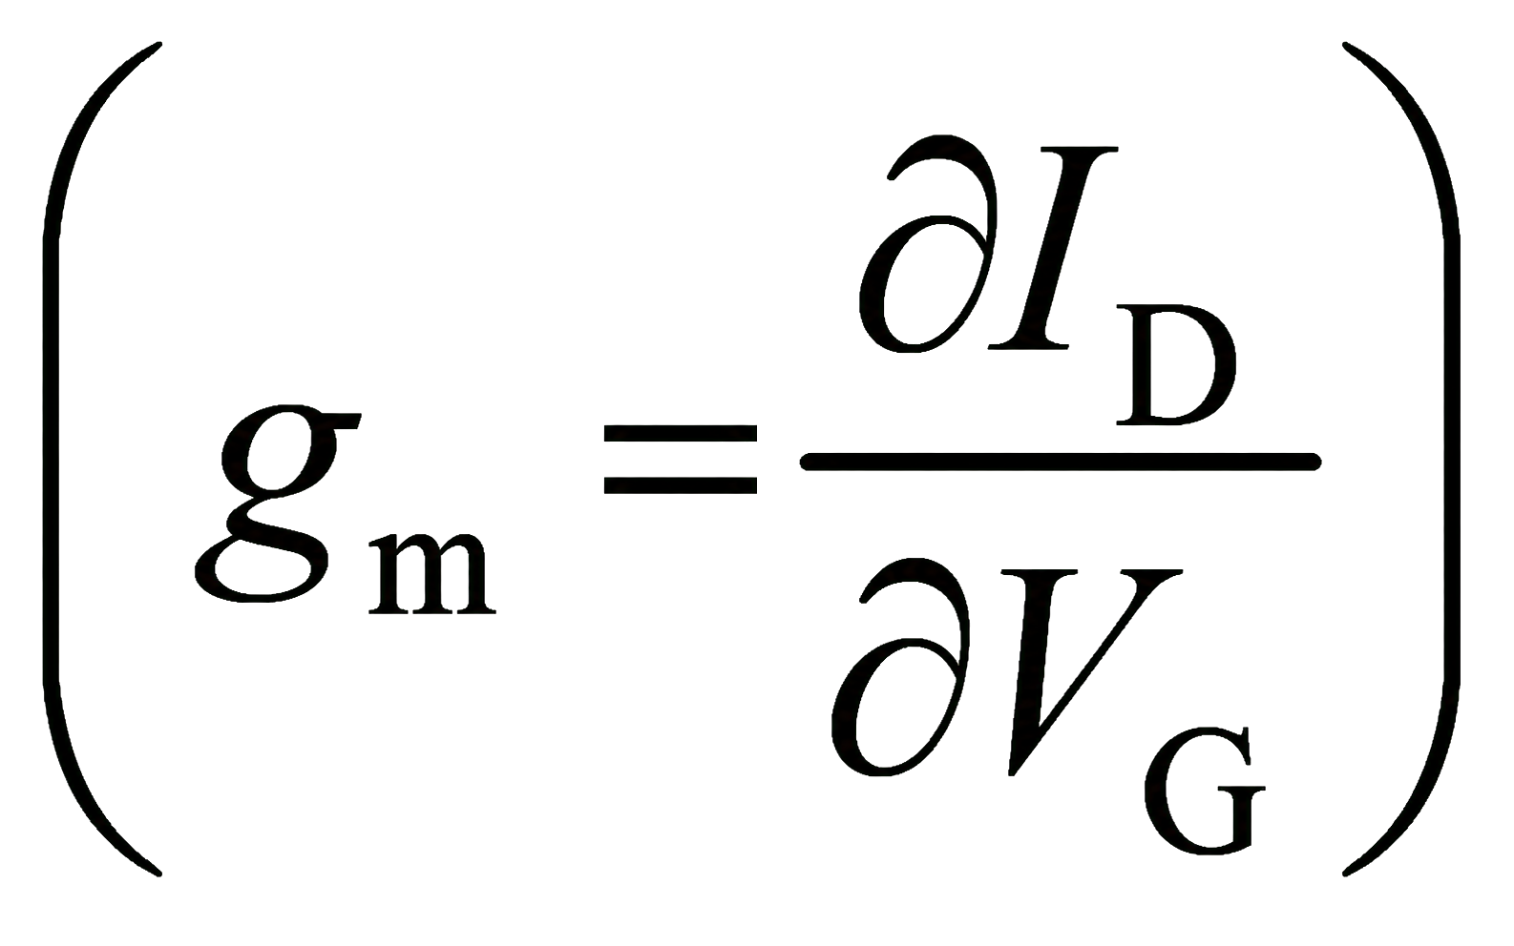
I-V plot of an OECT
I-V plot of an OECT
Transconductance (g_{m})
performance metrics of OECT that measures the amplification ability
15

Slide 16
Photo crosslinked N-type Semiconductor
95 N-type semiconductor to 5 PEGDMA does not cause performance degradation
60 x 60 µm devices
100/0 PEGDMA
95/5 PEGDMA
90/10 PEGDMA
16
Notes:
Concluded that 95/5 ideal volume ratio for n-type OECT

Slide 17
Ion Selectivity

Slide 18
Potassium (K⁺) Ion Selectivity
Potassium Ion Selectivity
Ion selective membrane was adsorbed onto the 95/5 PEGDMA device
Test was conducted to measure the OECT’s performance to detect K⁺ ions selectively
Maintained consistent high transconductance value
95/5 PEGDMA
18

Slide 19
Potassium (K⁺) Ion Selectivity
95/5 PEGDMA
100/0 PEGDMA
19

Slide 20
pH Selectivity
pH Selectivity
pH selectivity measured at pH ranging from 4.5 – 10
Decrease in pH led to more H⁺, allowing the transfer curve to peak higher
Confirmed its ability to selectively detect different pH values
100/0 PEGDMA
20

Slide 21
Conclusion and Future Work
Successfully processed N-type HOMO-gDPPTz OECT device with high transconductance, stretchability, and selectivity
The 95:5 (HOMO-gDPPTz:PEGDMA) ratio showed minimal degradation while 90:10 ratio still showed high transconductance value (~60 g_{m})
Future work, plan to fabricate a full electrical device capable of sensing K⁺, NH₃, pH, glucose, electrical signal
21

Slide 22

Acknowledgements
Dr. Antonio Facchetti
Ayush Dhande
Dr. Mengge Wu
Facchetti Lab
Dr. Mikkel Thomas
Leslie O’Neill
NSF (Award Number: 2349519)

Slide 23
Questions?

