Slide 1
Synthesis of 2D Multilayer Chiral Perovskites
Katherine Kendrick^{1,2}
¹Department of Chemistry, Meredith College
²Department of Chemistry, North Carolina State University
Carson Campbell², Violeta Spanou², Dr. Xiaotong Li²

Slide 2
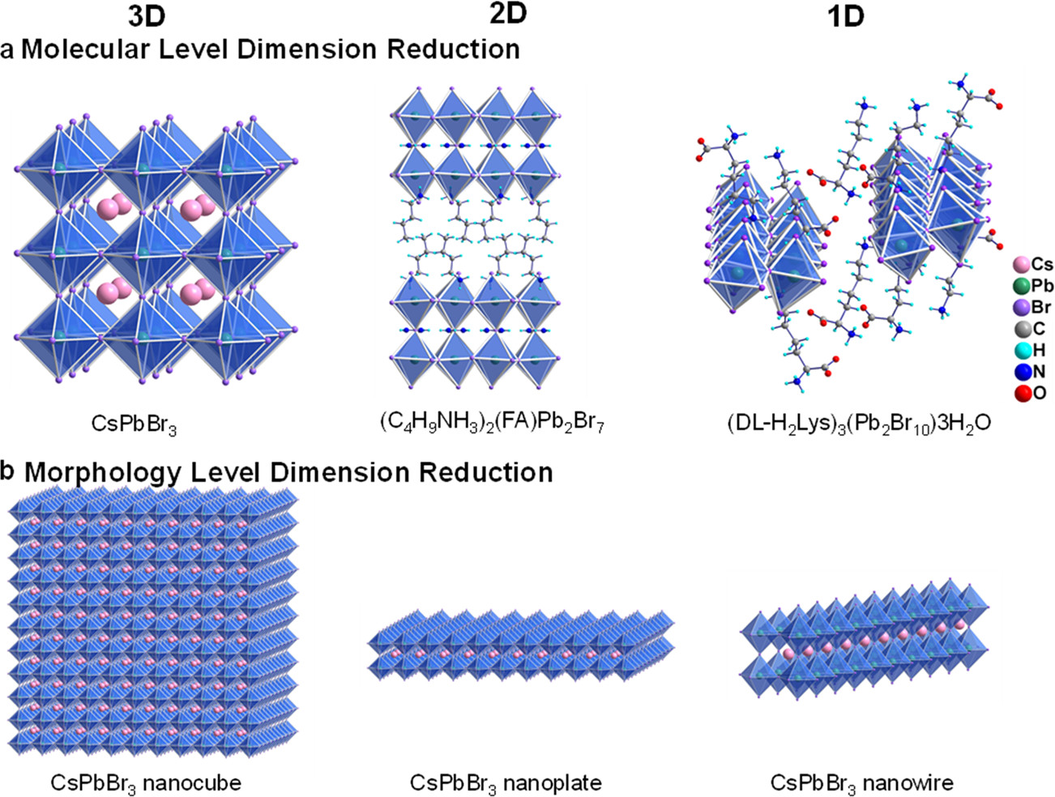
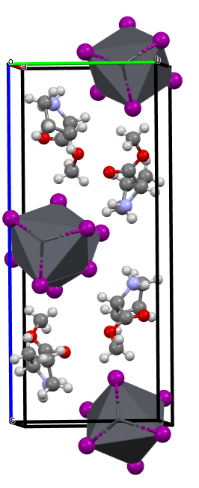
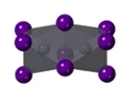
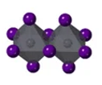
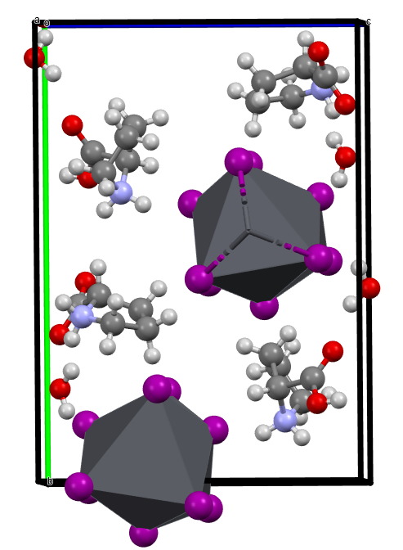
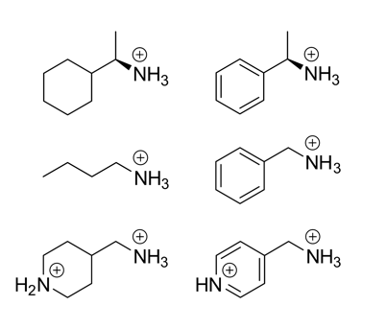
Project Background
Hybrid Perovskitoids
Amino Acid Esters
Amino acids are
Natural
Abundant
Chiral
Ideal spacer candidates!
Esters of amino acids are used to avoid having water in the structure.
Inorganic components
ABX₃
A = Cs⁺, CH₃NH₃⁺(MA), HC(NH₂)₂⁺(FA)
B = Pb²⁺, Sn²⁺, Ge²⁺
X = I⁻, Br⁻, Cl⁻
Organic components

Slide 3
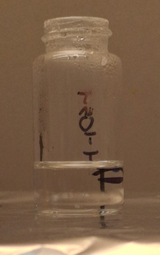
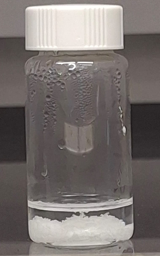
Synthesis and Characterization
Chiral organic cation
+
Metal source
HI
Cool down
Amino acid ester and HI
Heat
Clear
solution
Chiral crystals
HI layer
2 main methods for synthesis:
  Slow cooling (above) is the default method for this synthesis.
  Layer diffusion (right) is used when the amino acid reacts too quickly with lead iodide. It allows for the reaction rate to be controlled.
Characterization methods include powder x-ray diffraction (PXRD), optical microscopy (OM), and UV-Vis spectroscopy (UV-Vis).
Lead iodide and HI

Slide 4
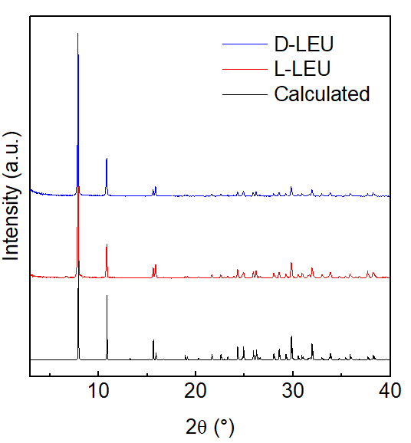
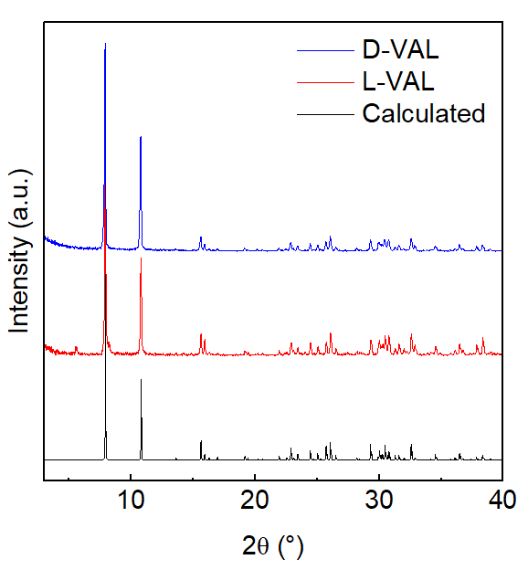
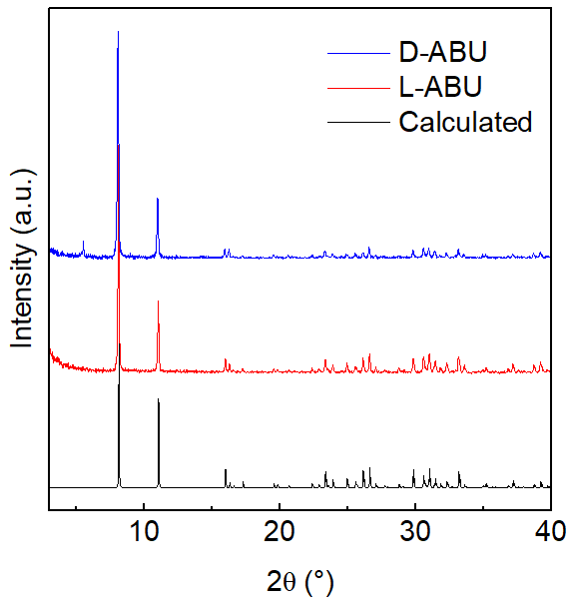
Synthesizing D-Enantiomers
L-LEU
D-LEU
D-VAL
L-VAL
L-ABU
D-ABU
methyl (L)-2-aminobutanoate
methyl (D)-2-aminobutanoate
The L-enantiomer crystals were made previously. D-enantiomers were synthesized to complete the data set.
Crystals were characterized using PXRD.
PXRD data indicate that hybrid materials were successfully made.

Slide 5
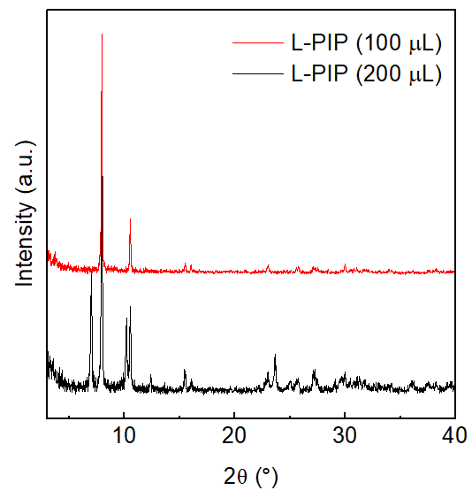
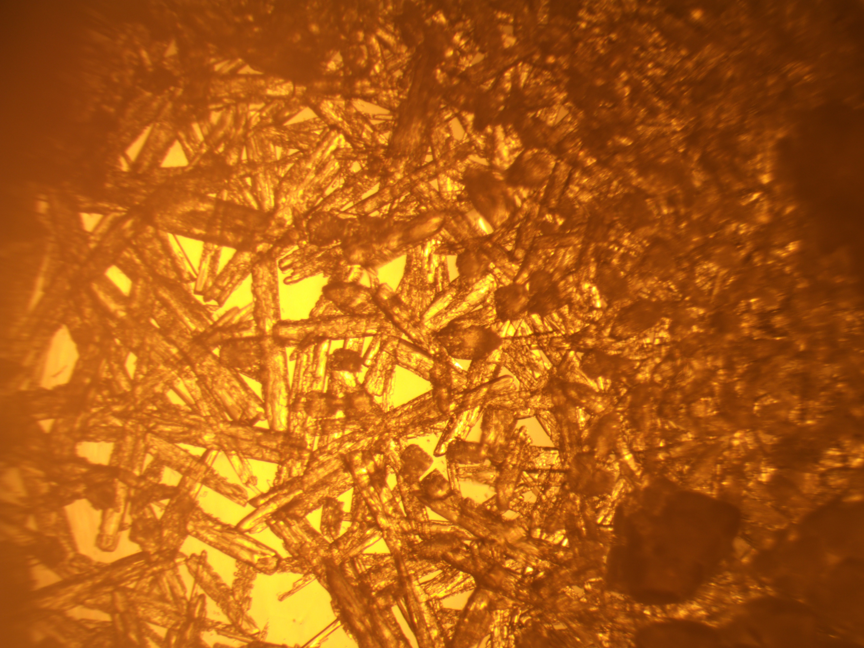
Piperidine Crystal Synthesis
Layering method was used to control the rate of reaction (piperidine reacts too quickly with lead iodide).
3 batches of piperidine crystals were synthesized, with varying volumes of HI in the middle.
100 µL was the optimal middle layer volume, as 200 µL caused a secondary phase to form.
L-PIP

Slide 6
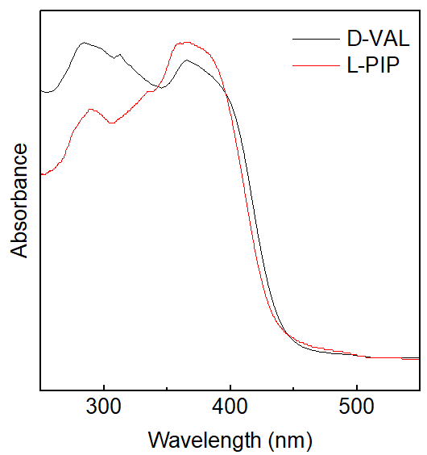
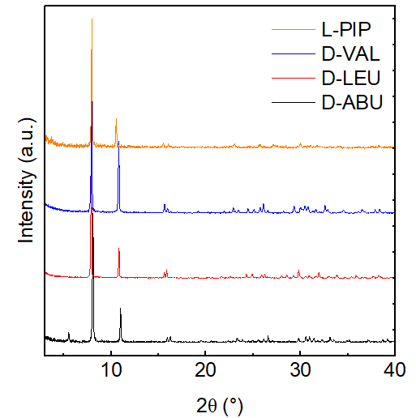
UV-Vis and PXRD Comparison
D-VAL and L-PIP crystals share highly similar structural features.
L-PIP band gap is very close to D-VAL. Both band gaps fall within the range for semiconductors.
PXRD peaks for L-PIP crystals match closely with peaks of other amino acid ester perovskitoids whose structures have been solved.
The data provide strong evidence that the piperidine-based crystals are hybrid perovskitoids.

Slide 7
Conclusions and Future Work
Conclusions
D-enantiomer perovskitoids of LEU, VAL, and ABU esters were successfully synthesized and characterized.
Piperidine-based perovskitoid crystal synthesis was optimized, and the crystals were characterized using PXRD and UV-Vis. There is strong evidence to suggest that a hybrid material with a similar structure to other amino acid ester perovskitoids was formed.
Future Work
Solve single crystal stricture for L-PIP, confirm that the structure is similar to others.
Synthesize D-PIP and take CD measurements of both enantiomers.

Slide 8
Thank You!
I would like to thank everyone in the Li group for their guidance. I had the most supportive and welcoming mentors, thank you for making this research experience even better! I would also like to thank RTNN, SRC, NNCI, and NSF for their support.
Email me if you have any questions! My email address is kakendrick@email.meredith.edu.
Special thanks to NC State University for providing laboratory space and instrumentation that made this research possible.
This material is based upon work which is supported by the National Science Foundation (award numbers 2447827, 2447828, 2447829 and ECCS-2025064). Any opinions, findings, and conclusions or recommendations expressed in this material are those of the author(s) and do not necessarily reflect the views of the National Science Foundation.

