Slide 1

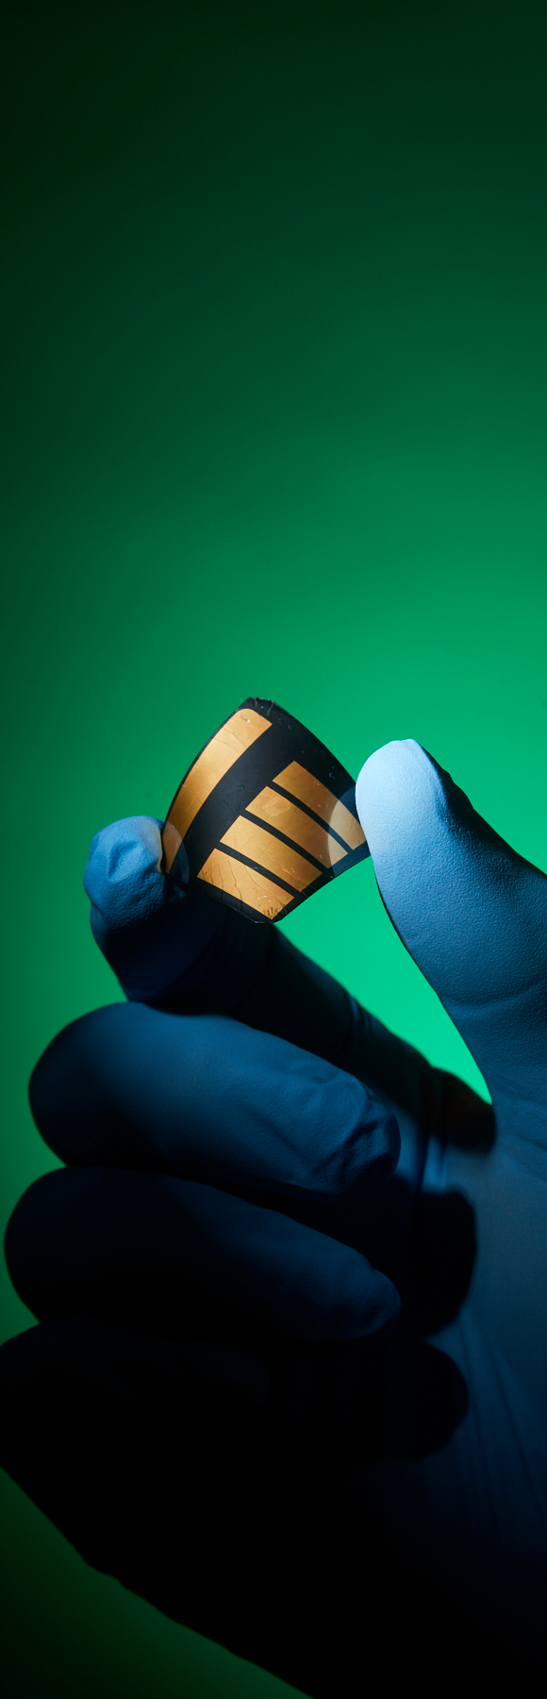

Polymerization of Spacer Cations to Stabilize Perovskite Solar Cell Interfaces
Energy Materials
Laboratories
Molly Auer
August 4, 2025
Mentor: Ahmed Nabeeh
PI: Dr. Juan-Pablo Correa-Baena

Slide 2
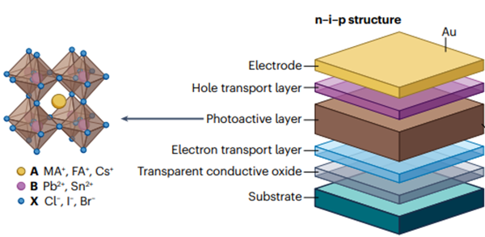
Introduction
Lead Halide Perovskites are an exciting new optoelectronic, semiconducting family of crystalline materials following the chemical formula ABX3
A and B are cations
X is an anion
Gold
Spiro-OMeTAD
Cesium Formamidinium Lead Iodide Perovskite
Titanium Dioxide
Fluoride Tin Oxide
Glass
(Han et al., 2025)

Slide 3
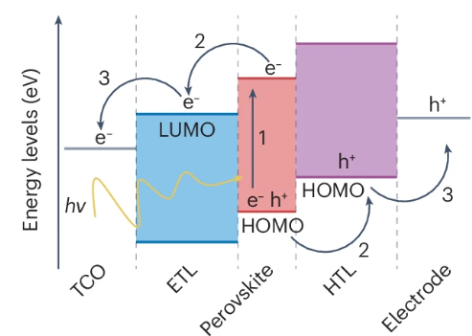
Introduction
Lead Halide Perovskites are an exciting new optoelectronic, semiconducting family of crystalline materials following the chemical formula ABX3
A and B are cations
X is an anion
(Han et al., 2025)

Slide 4
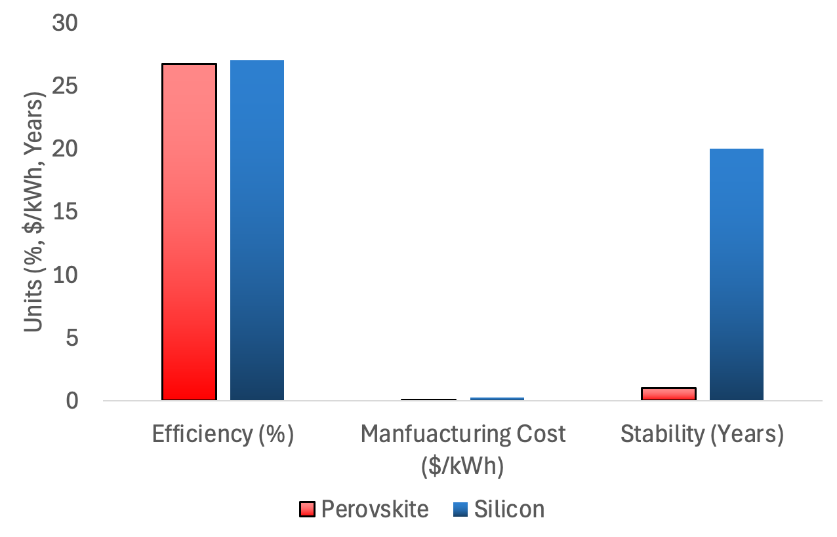
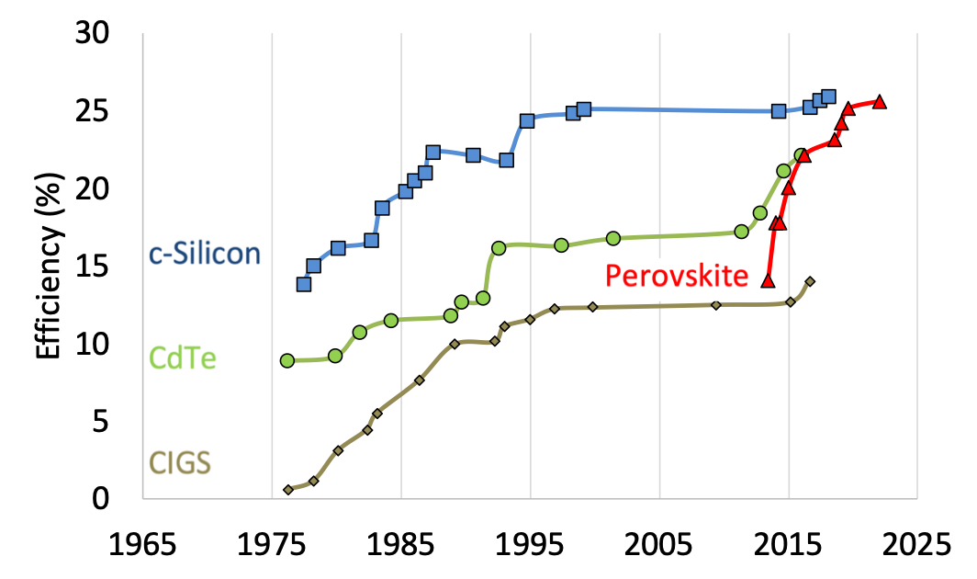
Perovskite vs Silicon
(NREL, 2025)

Slide 5
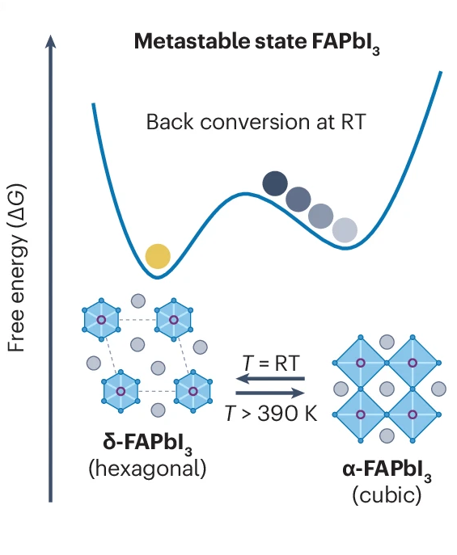
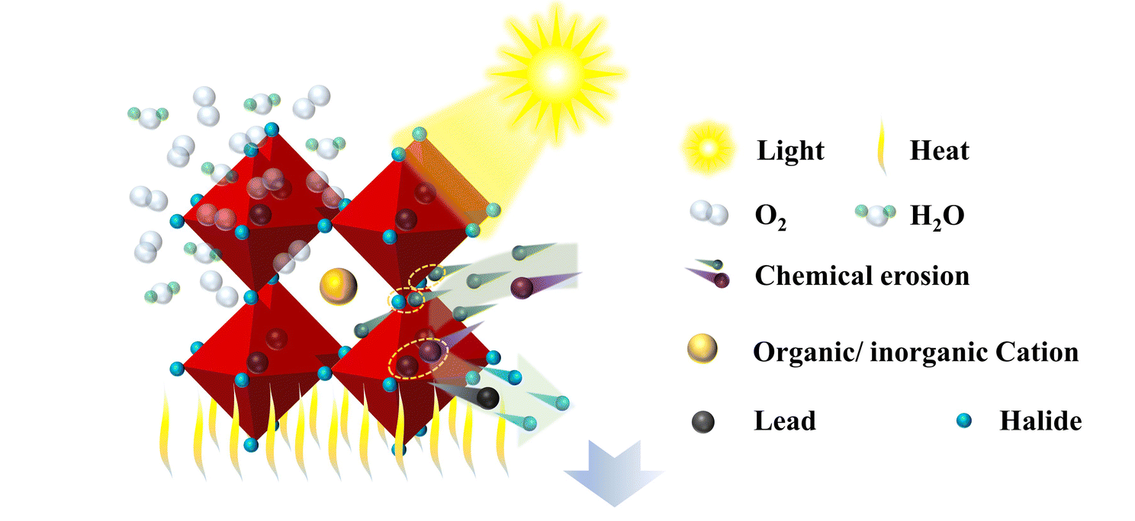
Stability Issues
Lead Halide perovskites degrade into non-perovskite and inactive phases under ambient and operational conditions due to:
Ion migration
Phase instability
Moisture and oxygen ingress
(Han et al., 2025)
(Wang et al., 2025)

Slide 6
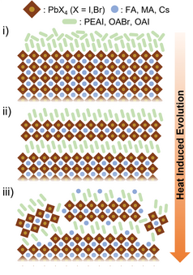
Current Approaches
Surface passivation with organic cations can passivate defects and increase stability. However,
Cations can migrate into the bulk and cause reconstruction, lowering performance
(Perini et al., 2022)

Slide 7
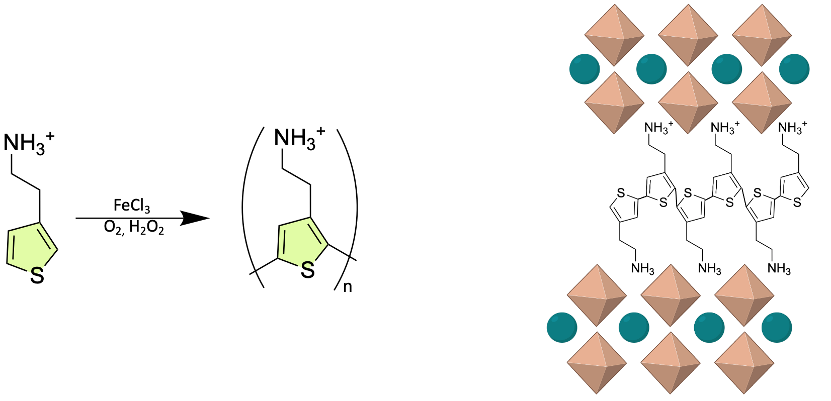
Our Hypothesis
Our Solution: Polymerize spacer cations to form a robust cross-linked interface at the perovskite and hole transport layer
Increase stability
Increase power conversion efficiency

Slide 8
Experimental Plan
Fabricate perovskite solar cell variations
  Passivation layer
    Thiophene ethyl ammonium iodide (TEAI) in Isopropanol (IPA)
    Phenyl ethyl ammonium iodide (PEAI) in Isopropanol
  Initiate polymerization with oxidizing agents
    Iron Chloride (FeCl3) in Chlorobenzene (CB) or Isopropanol
    Hydrogen Peroxide (H2O2) in Chlorobenzene or Isopropanol
    Atmospheric Oxygen (O2)
Characterize efficiency and stability
  Electrical (Dark JV, Light JV, and stabilized MPP)
  Photoluminescence
  XPS
  FT-IR
  UV-Vis
  Raman spectroscopy

Slide 9
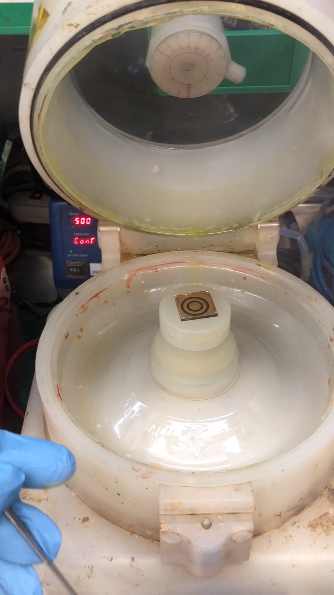
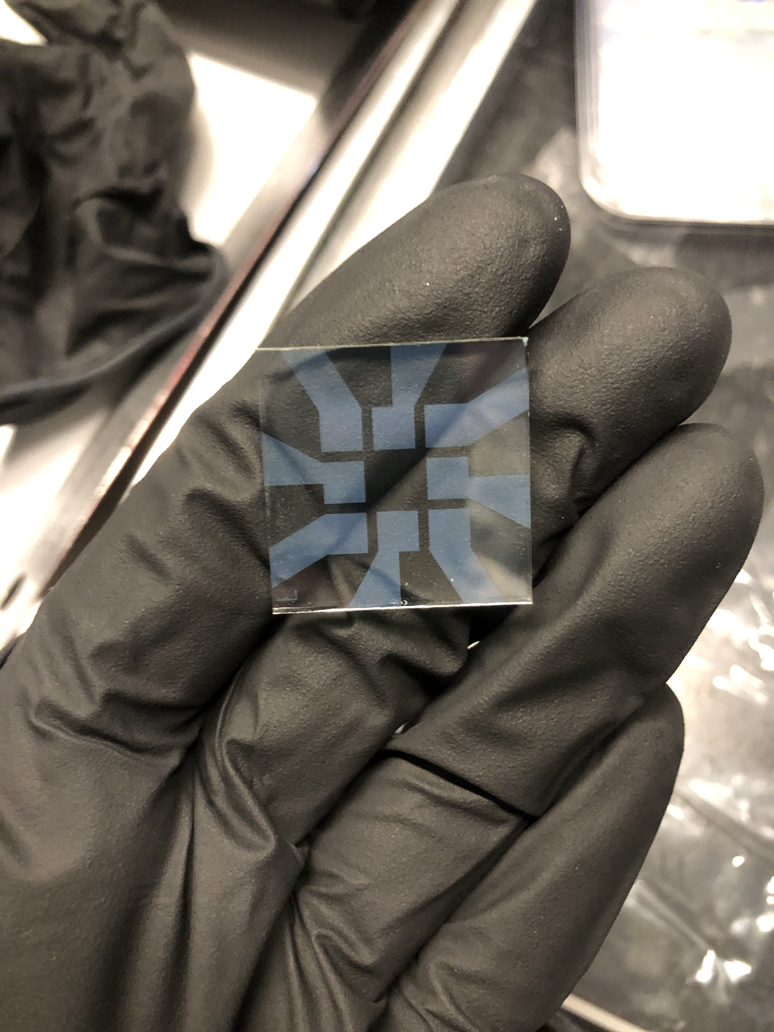
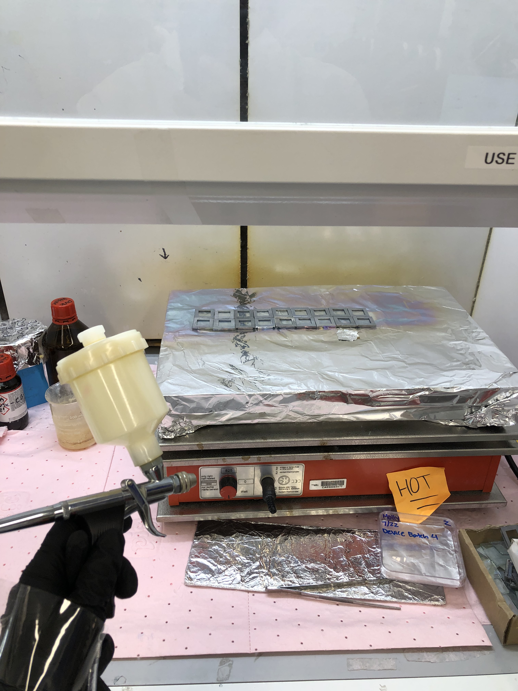
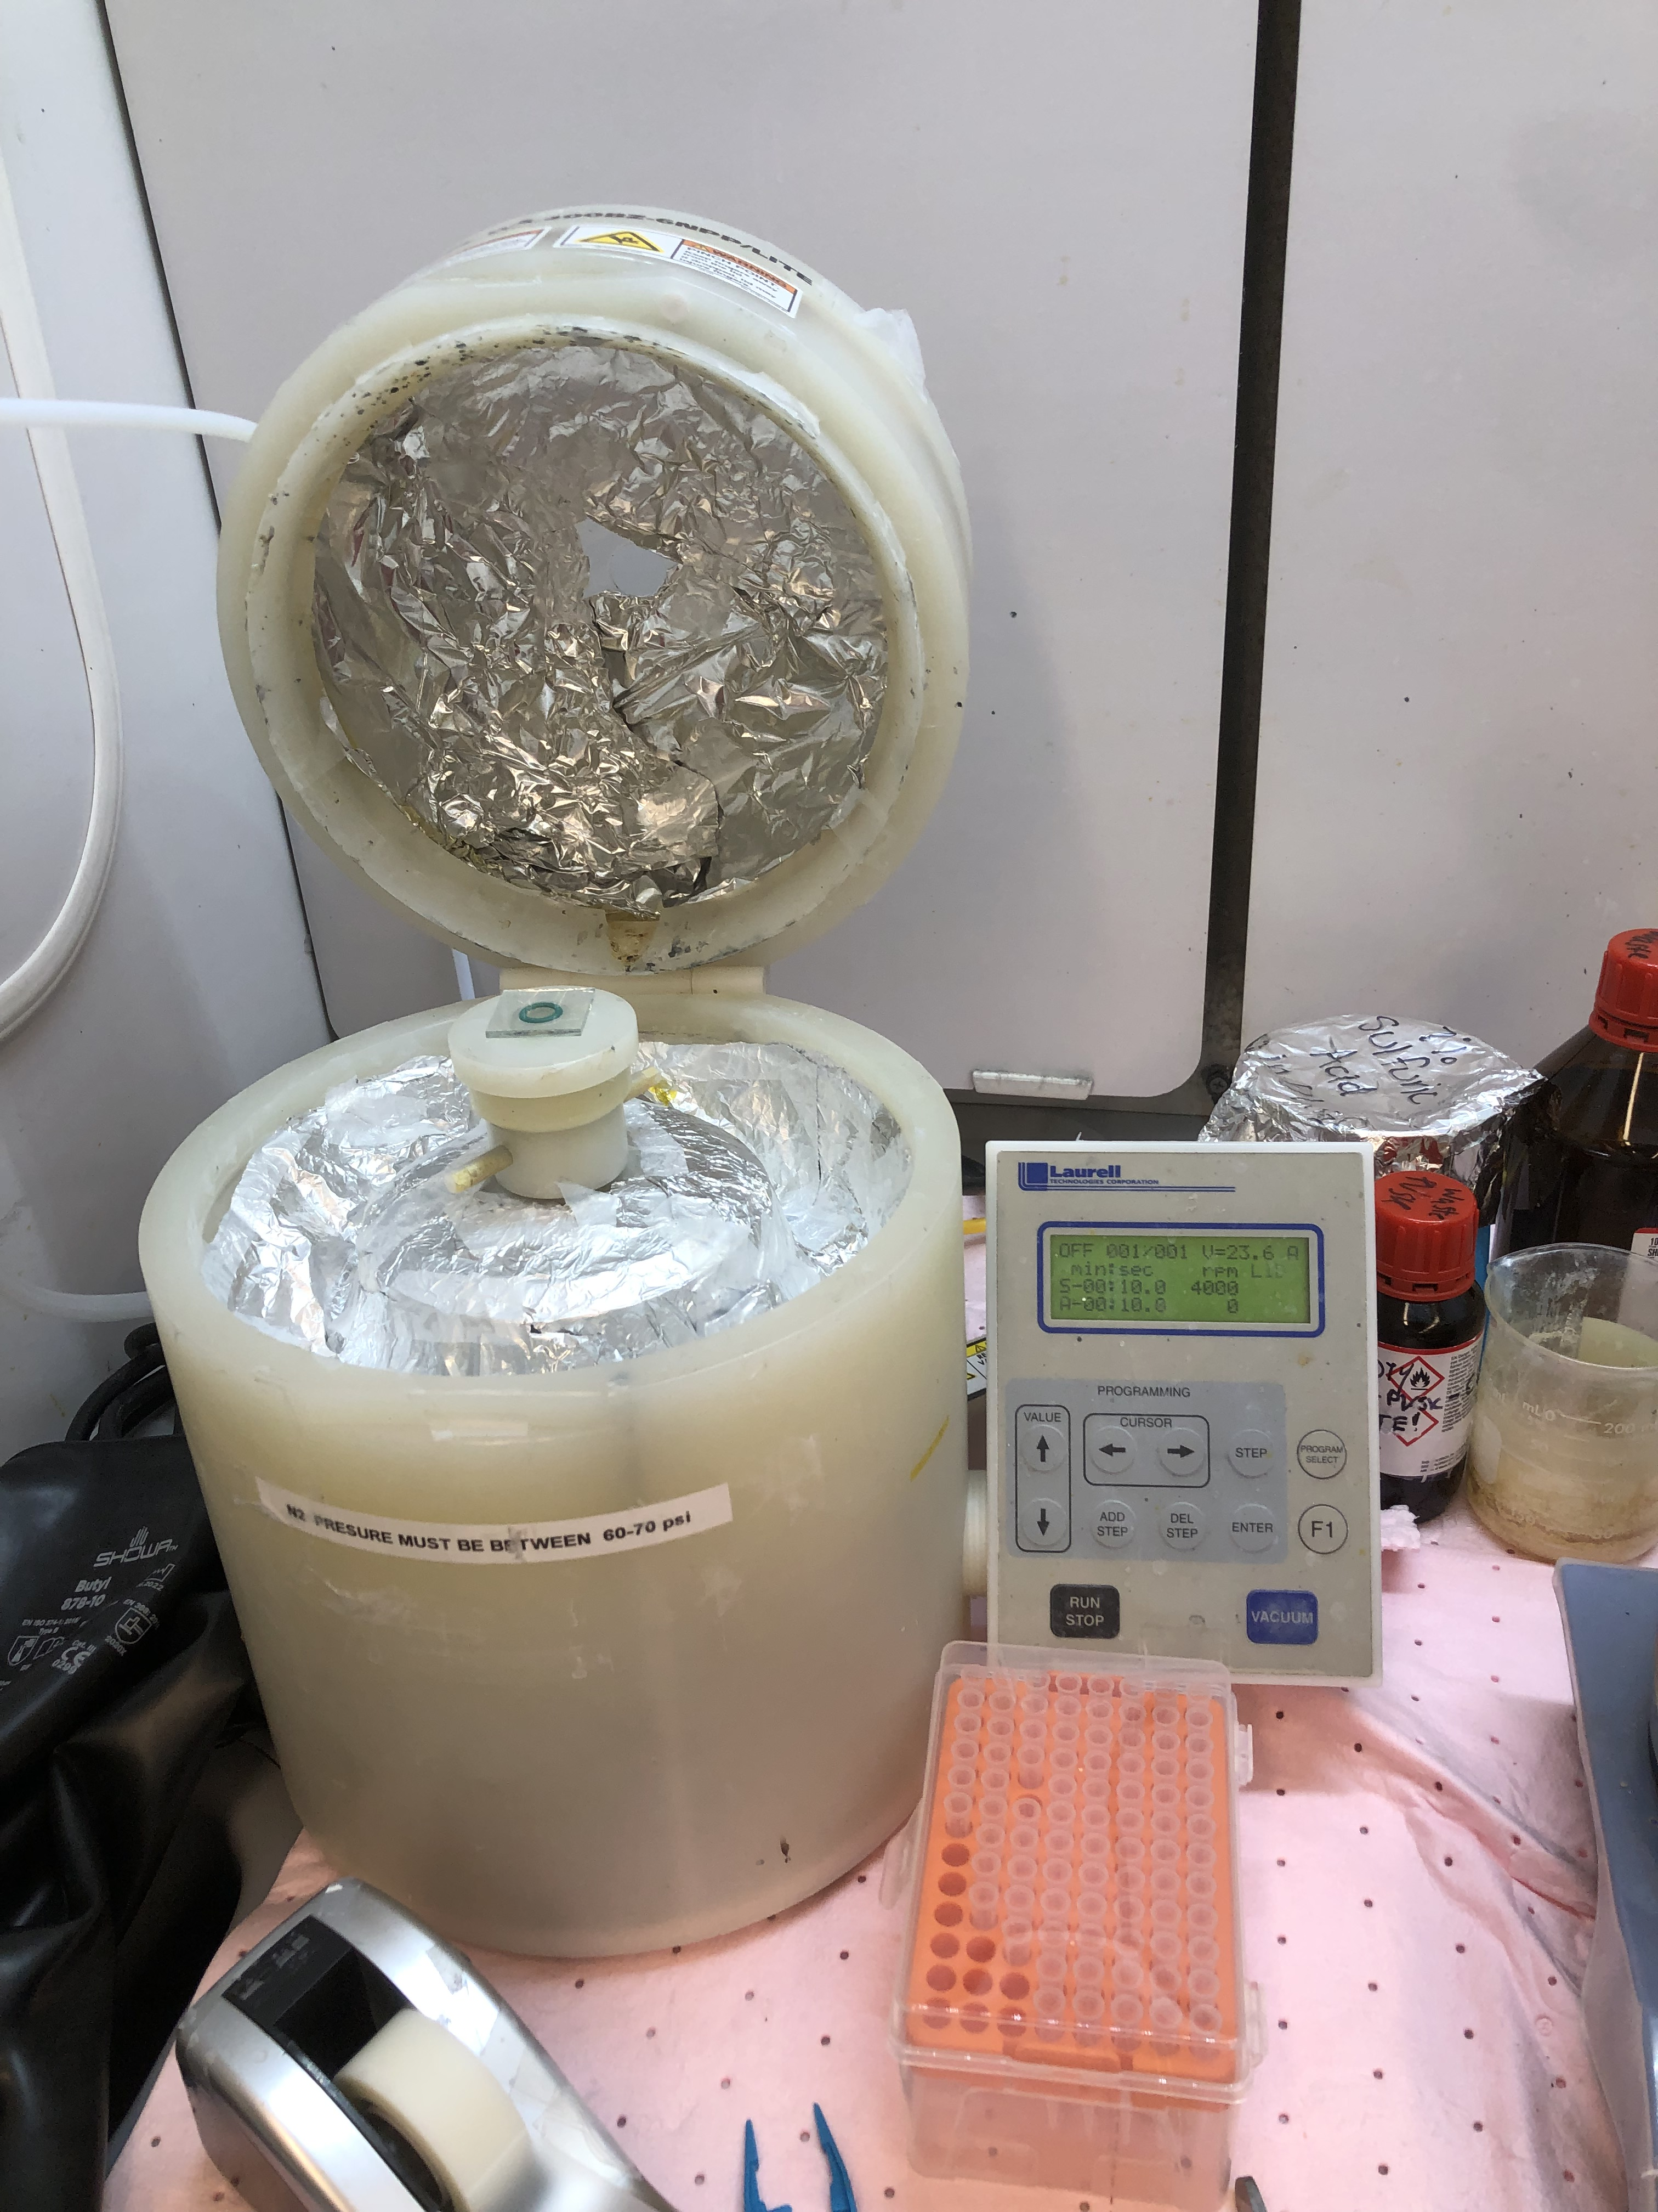
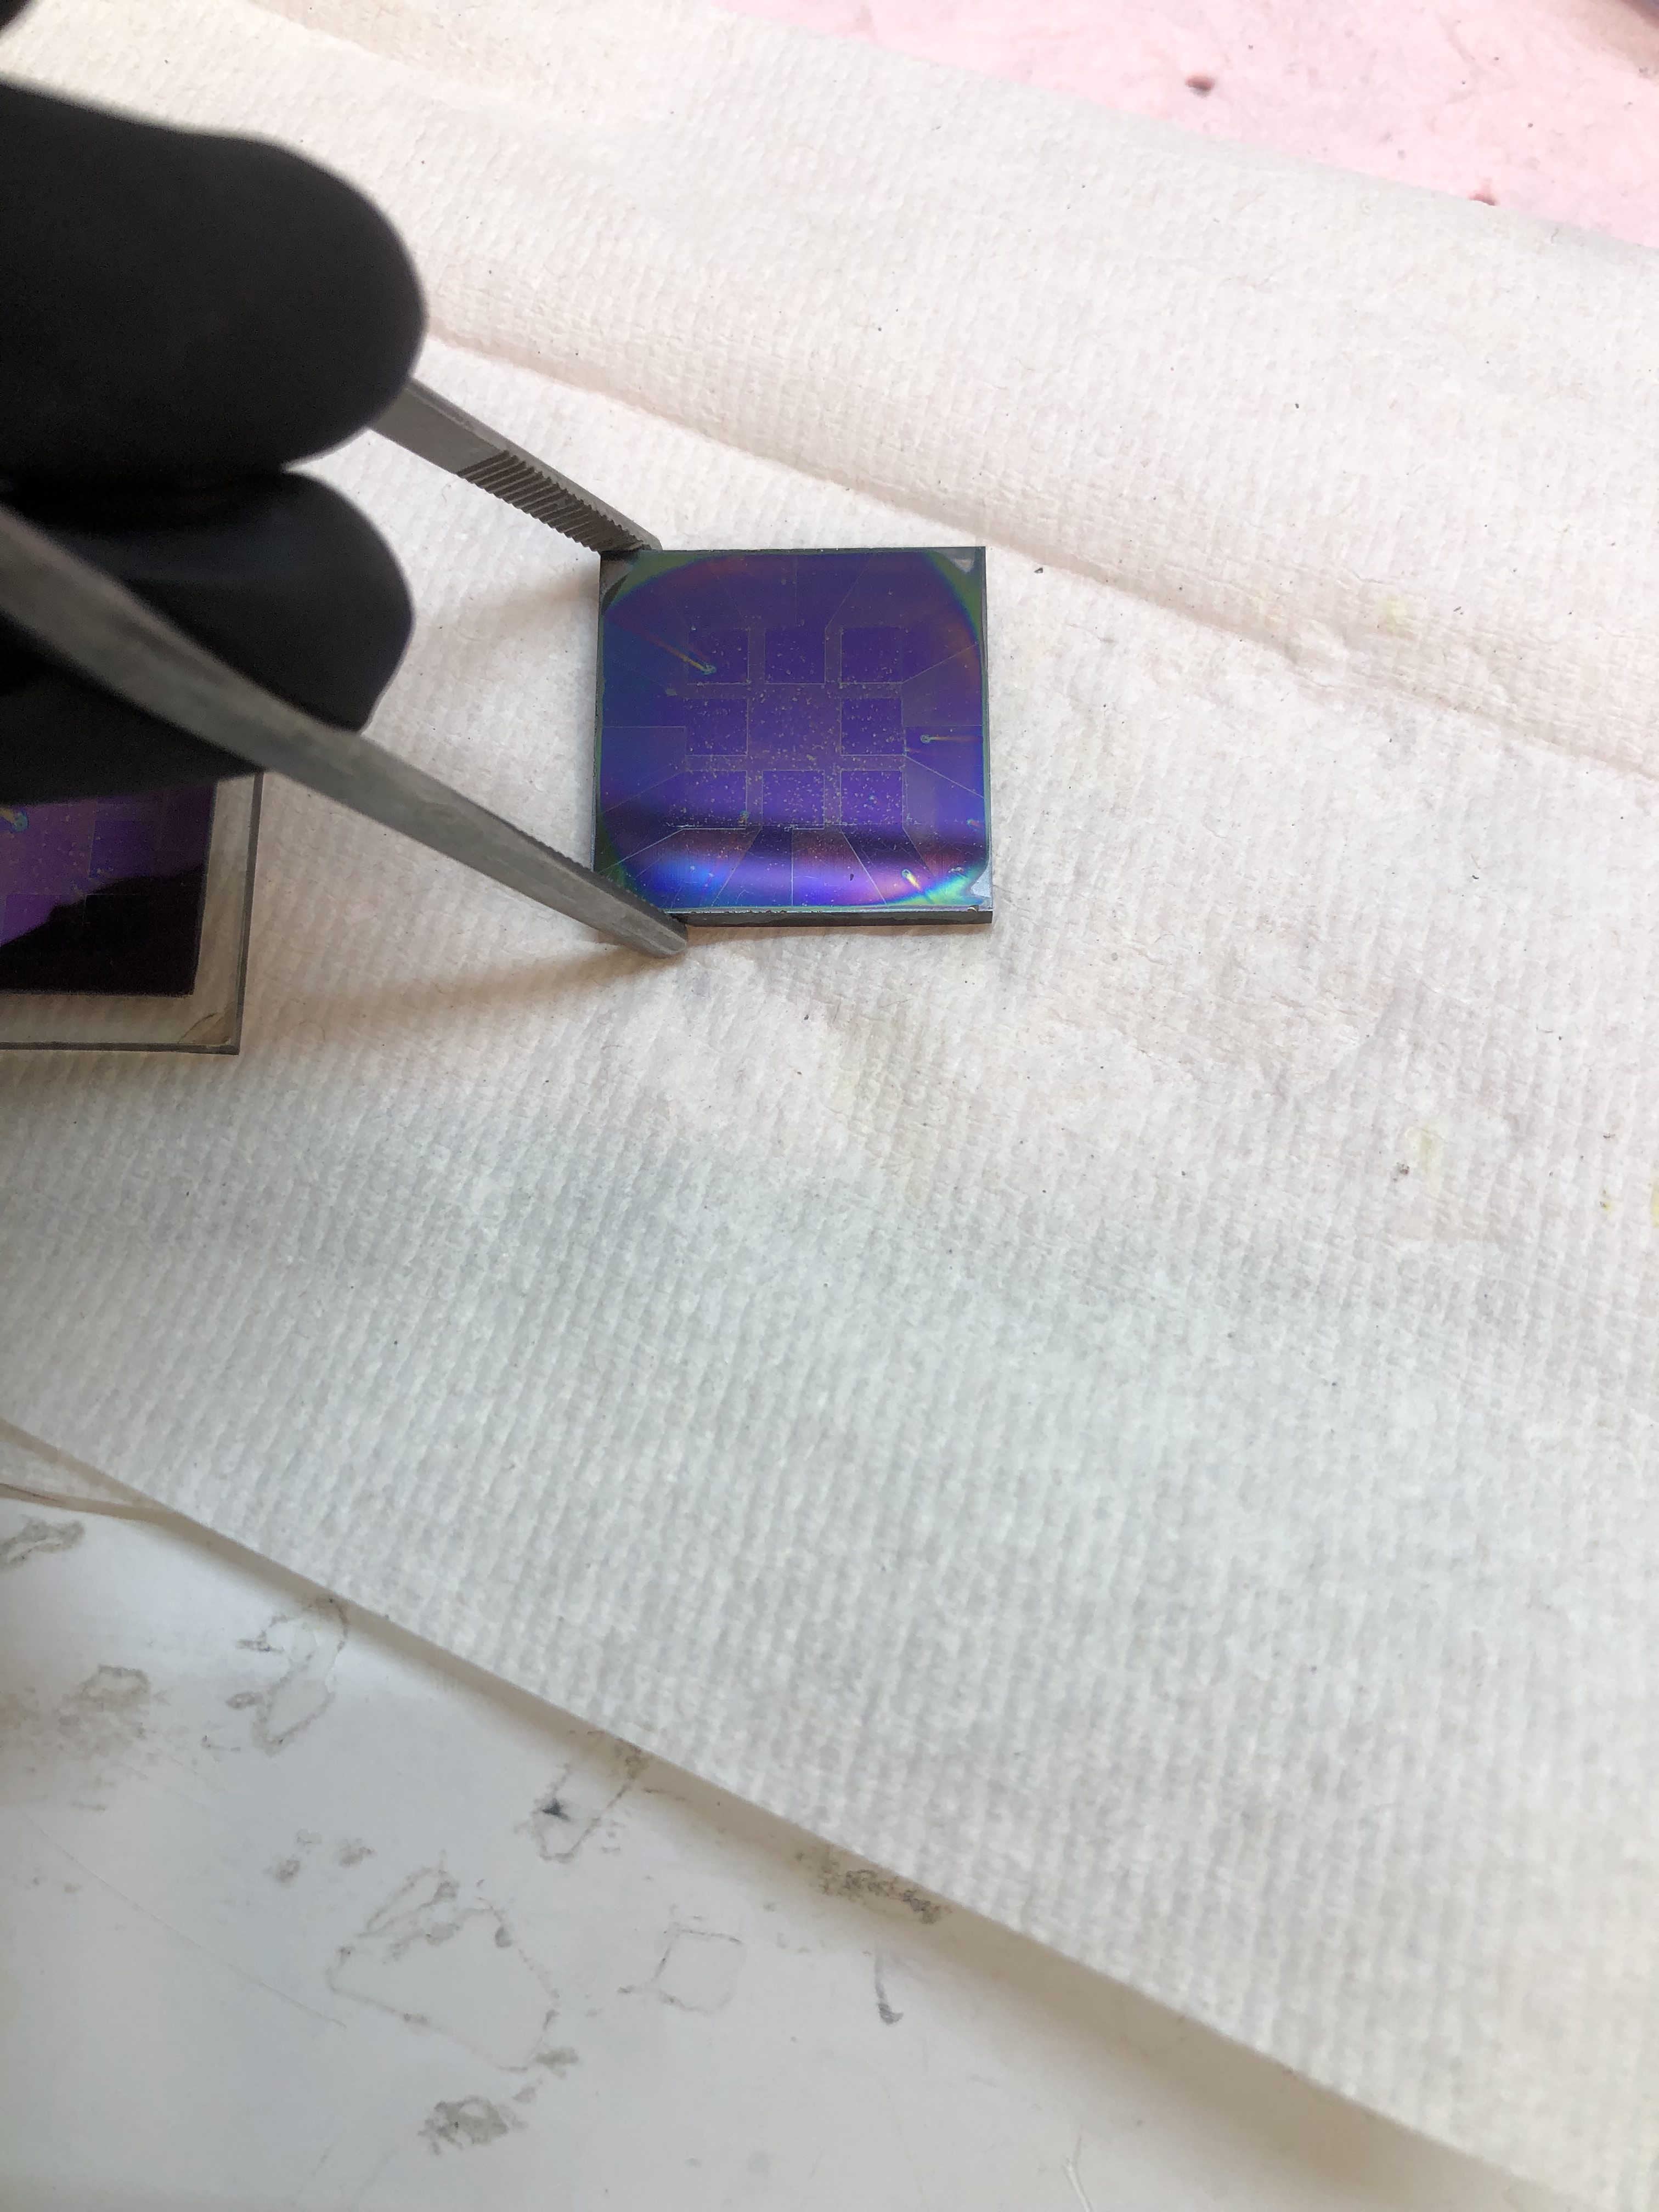
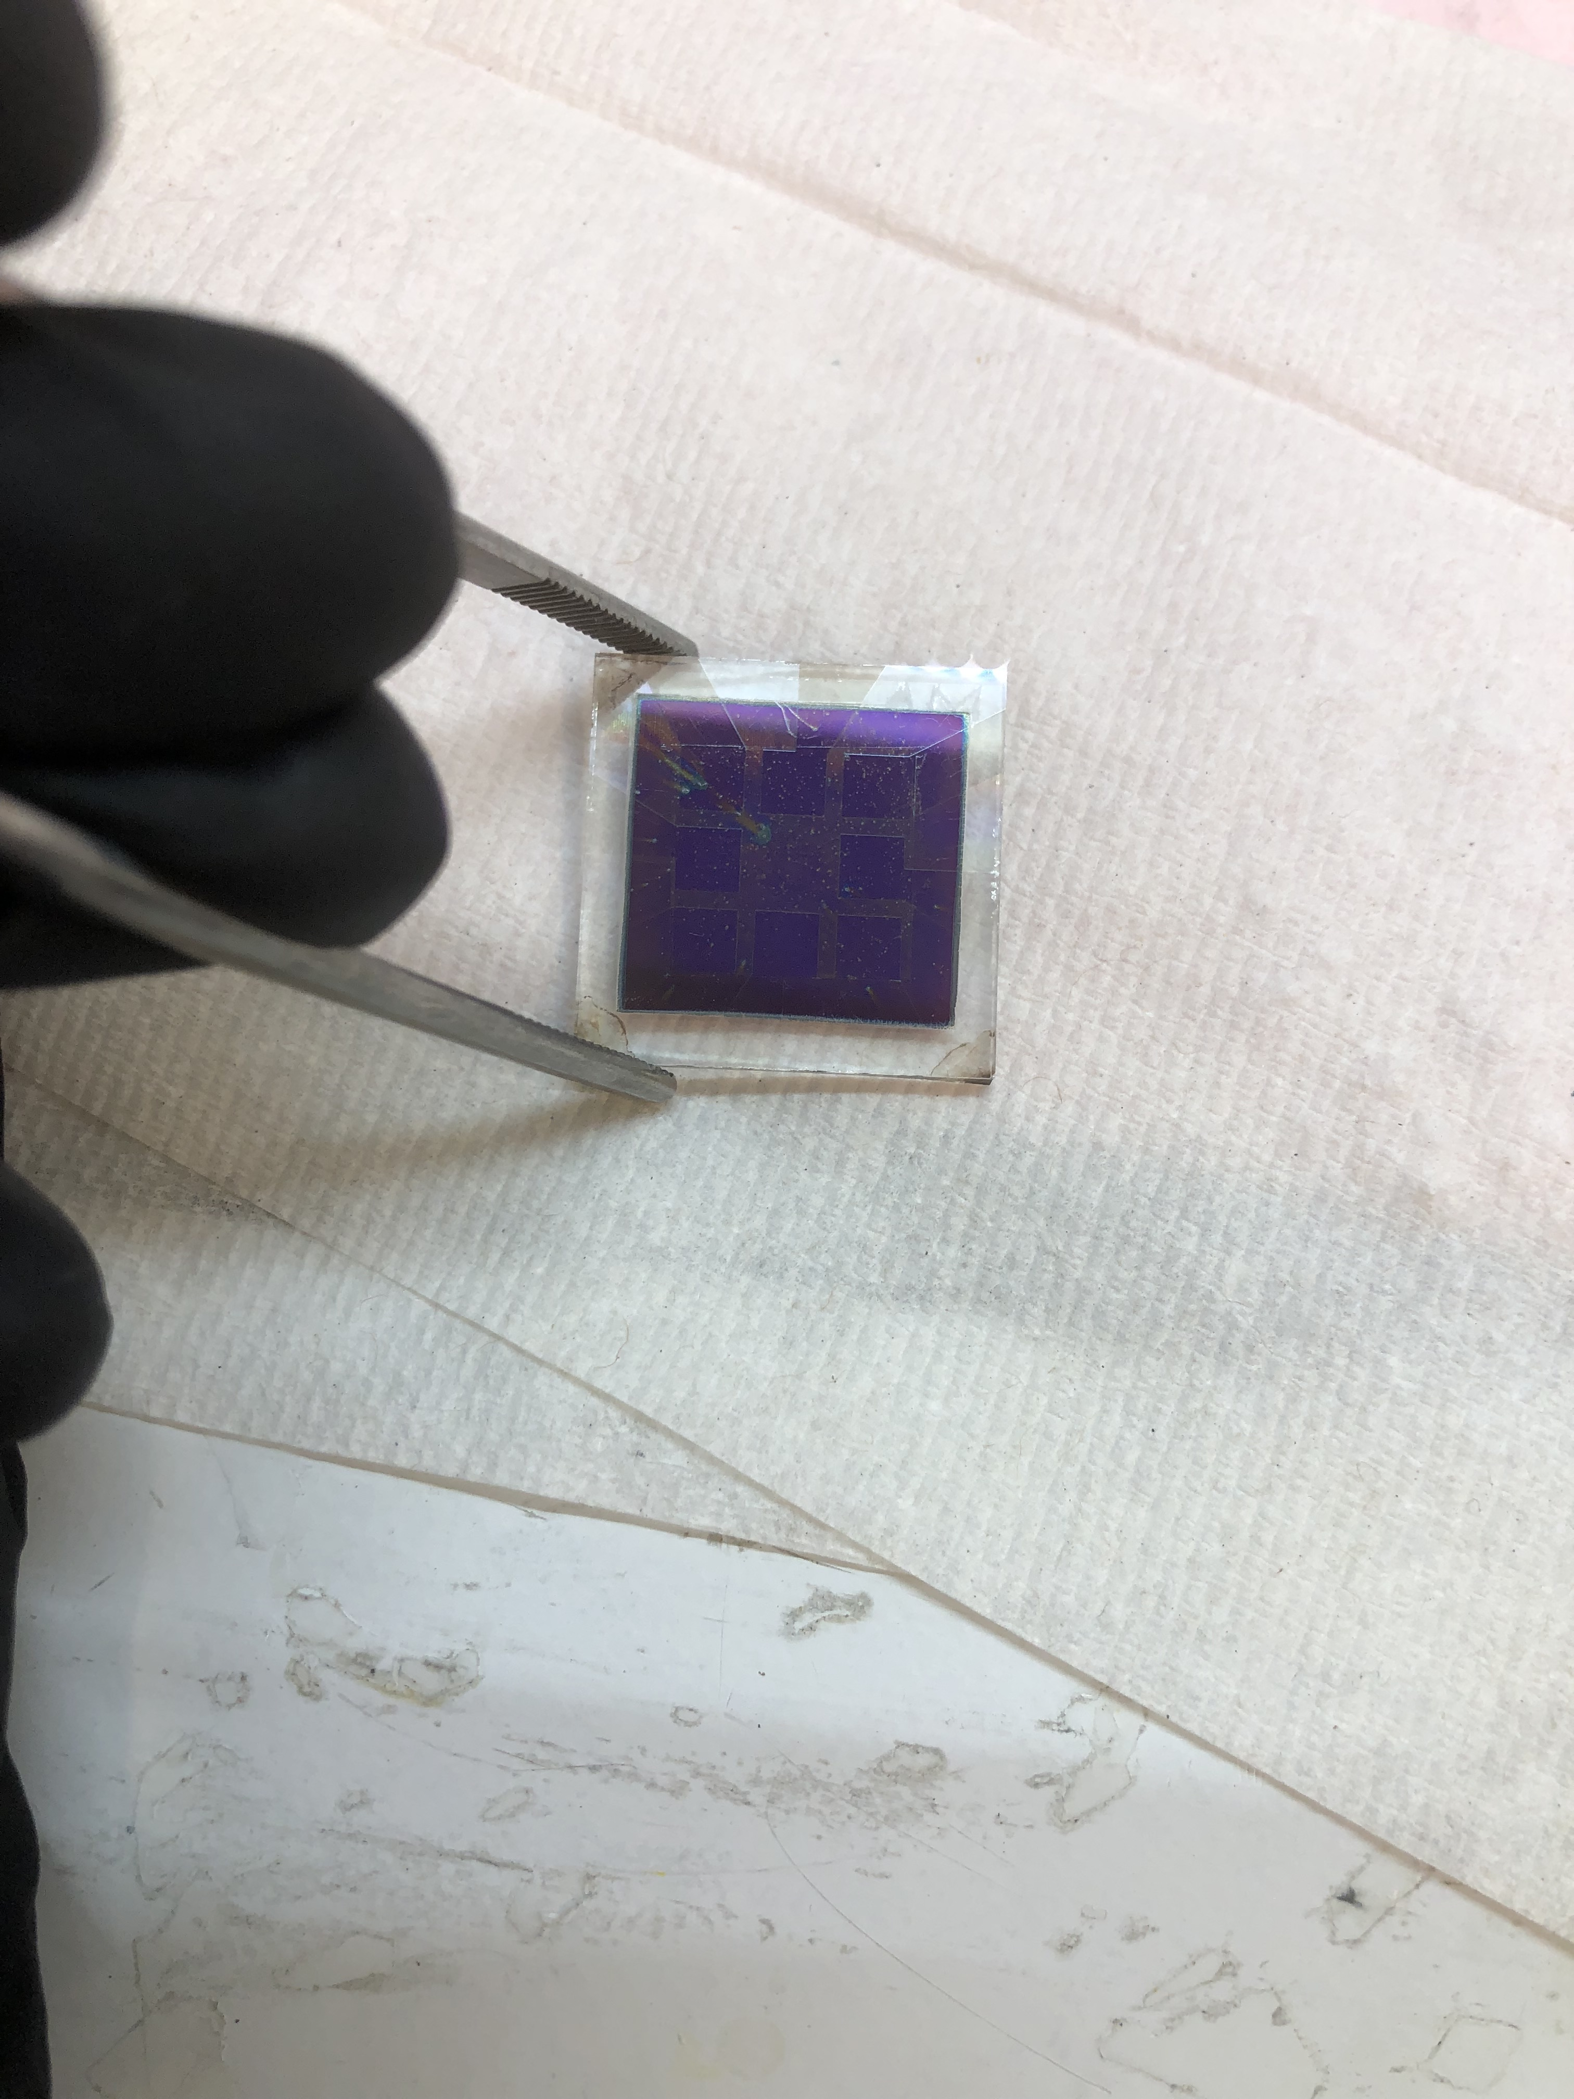
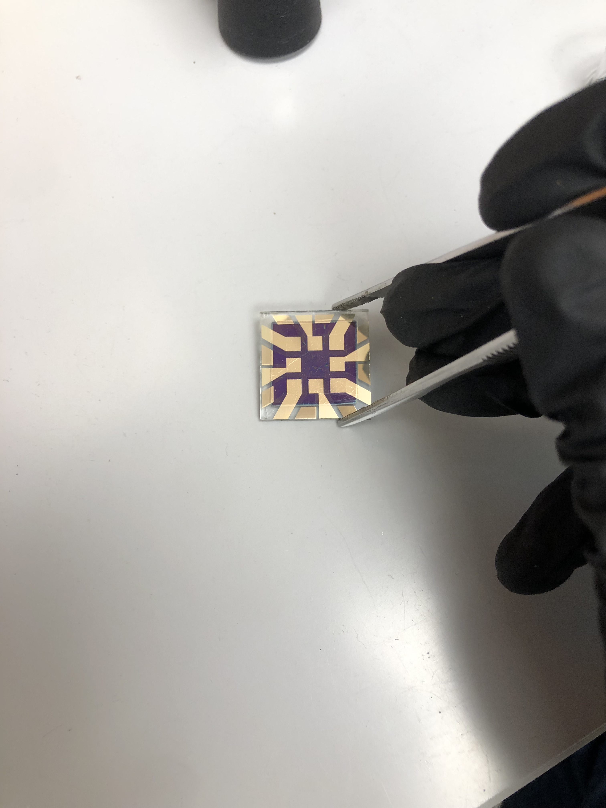
Methods
Clean FTO-coated glass substrates
Spray-coat electron transport layer
Spin-coat perovskite, passivation, and hole transport layers
Anneal
Edge clean
Evaporate gold electrode

Slide 10
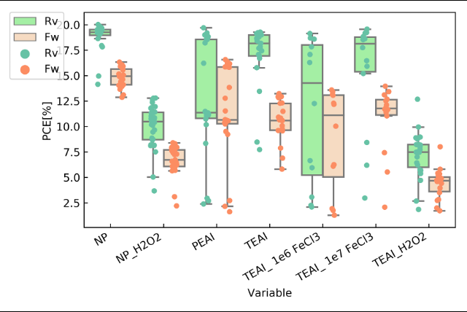
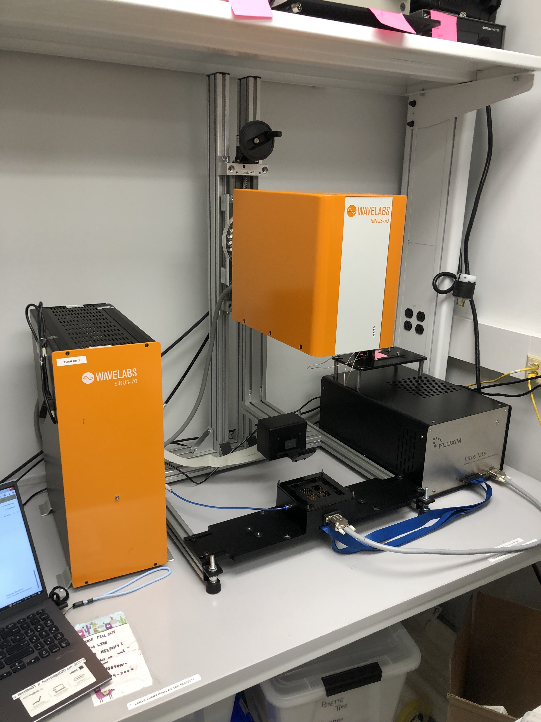
Characterization Results for Iron Chloride
Litos Lite Sun Simulator
TEAI is preferable
Iron Chloride is not preferable

Slide 11
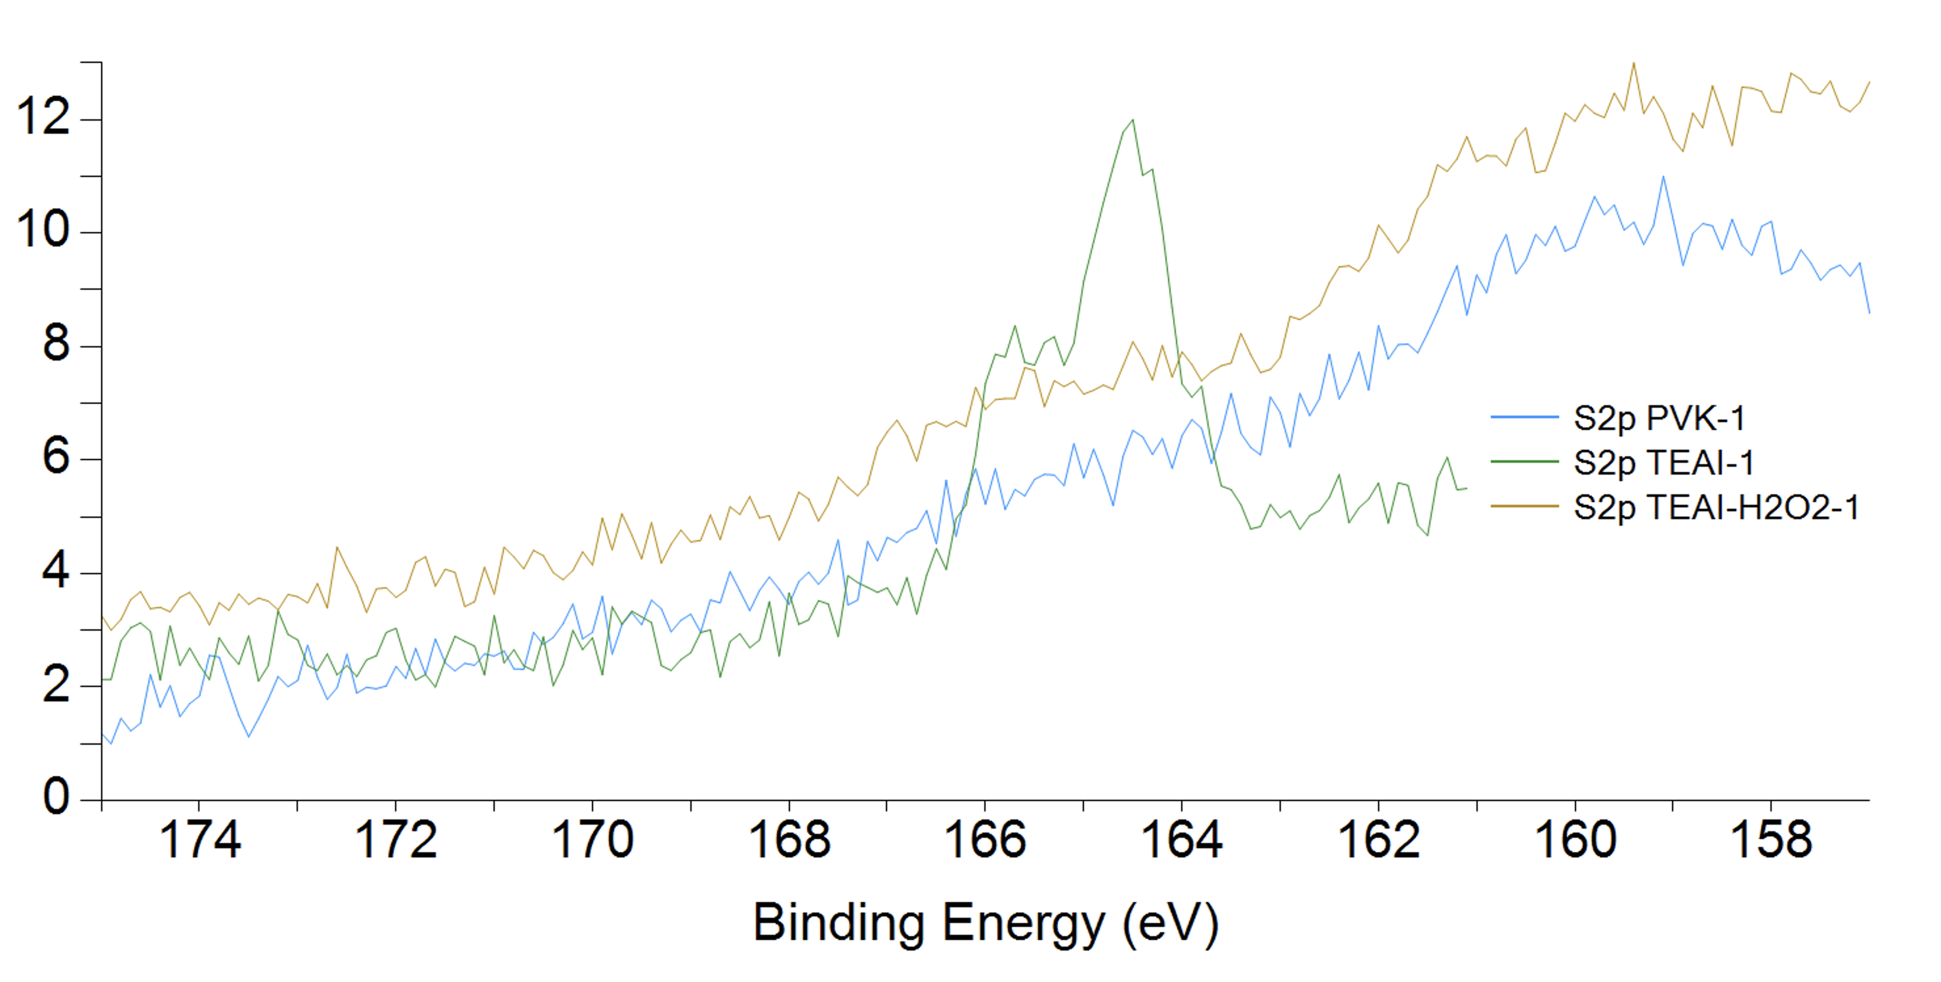
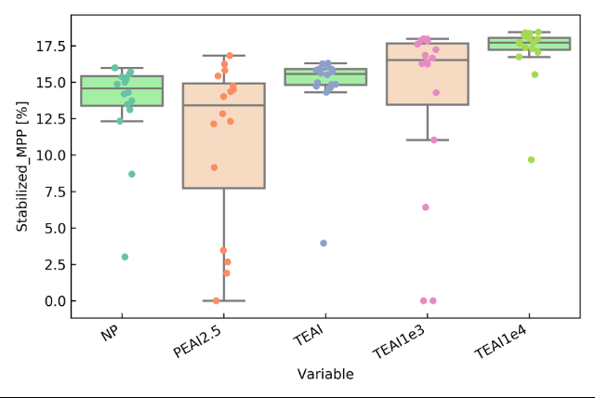
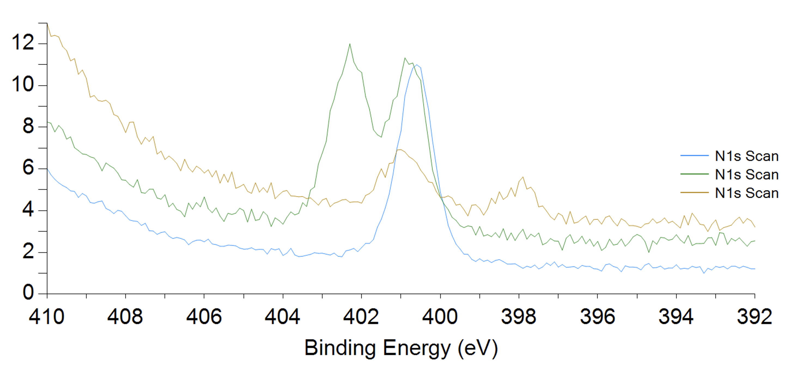
Characterization Results for Polymerization of H2O2 in IPA
X-ray Photoelectron Spectroscopy (XPS):
Litos Lite Sun Simulator:
TEAI is preferable
Chlorobenzene is preferable
H2O2 is preferable

Slide 12
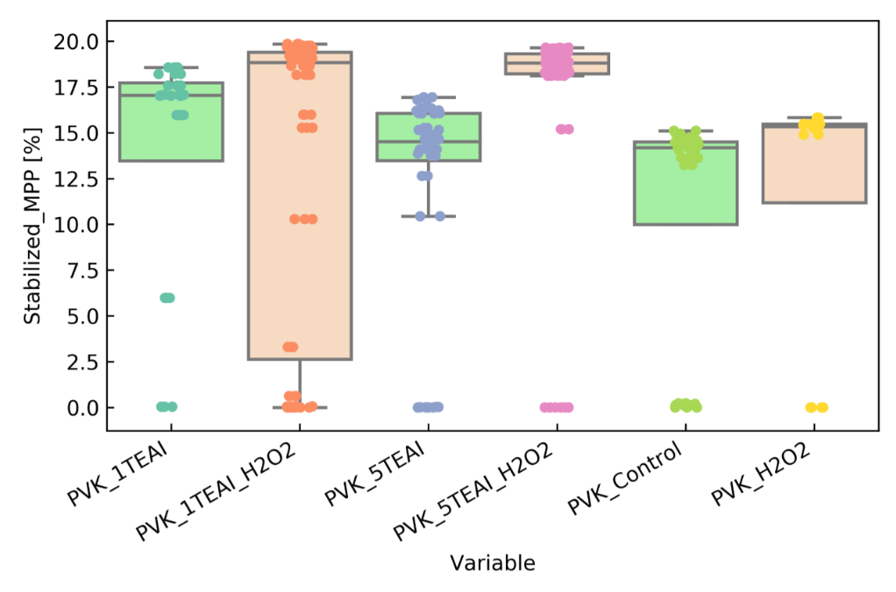
Characterization Results for Polymerization of H2O2 in CB
Litos Lite Sun Simulator:
Passivation and Polymerization enhance performance
Lower concentrations of TEAI are preferable

Slide 13
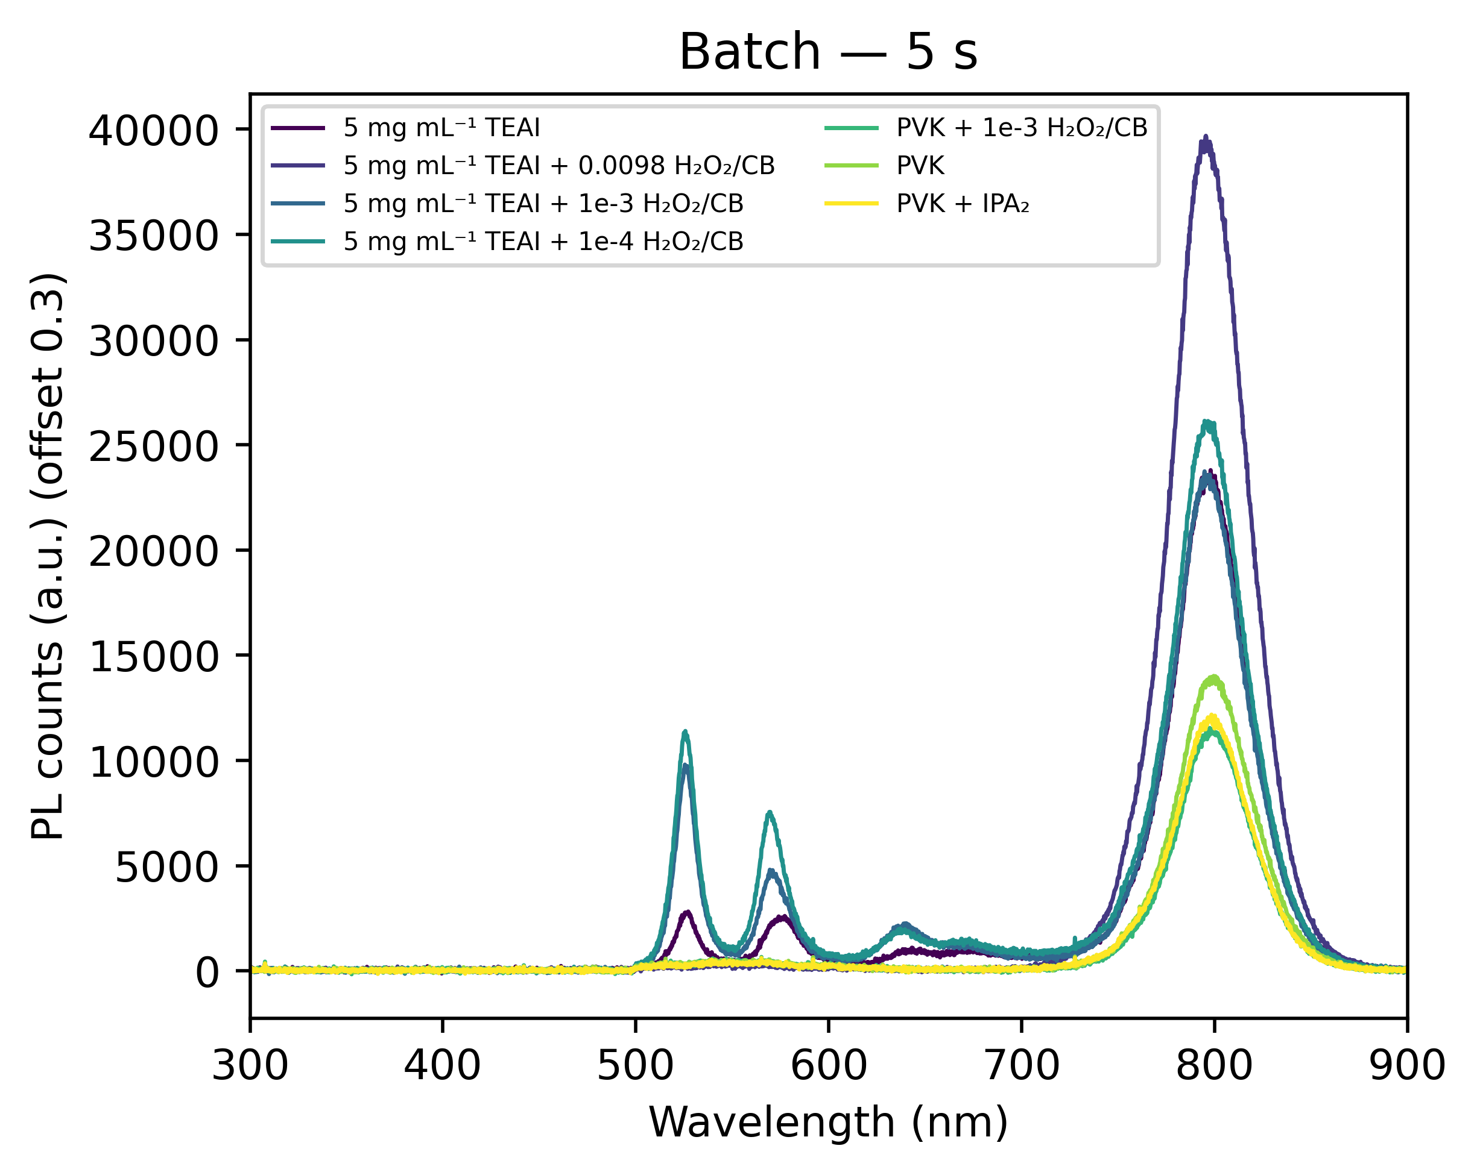
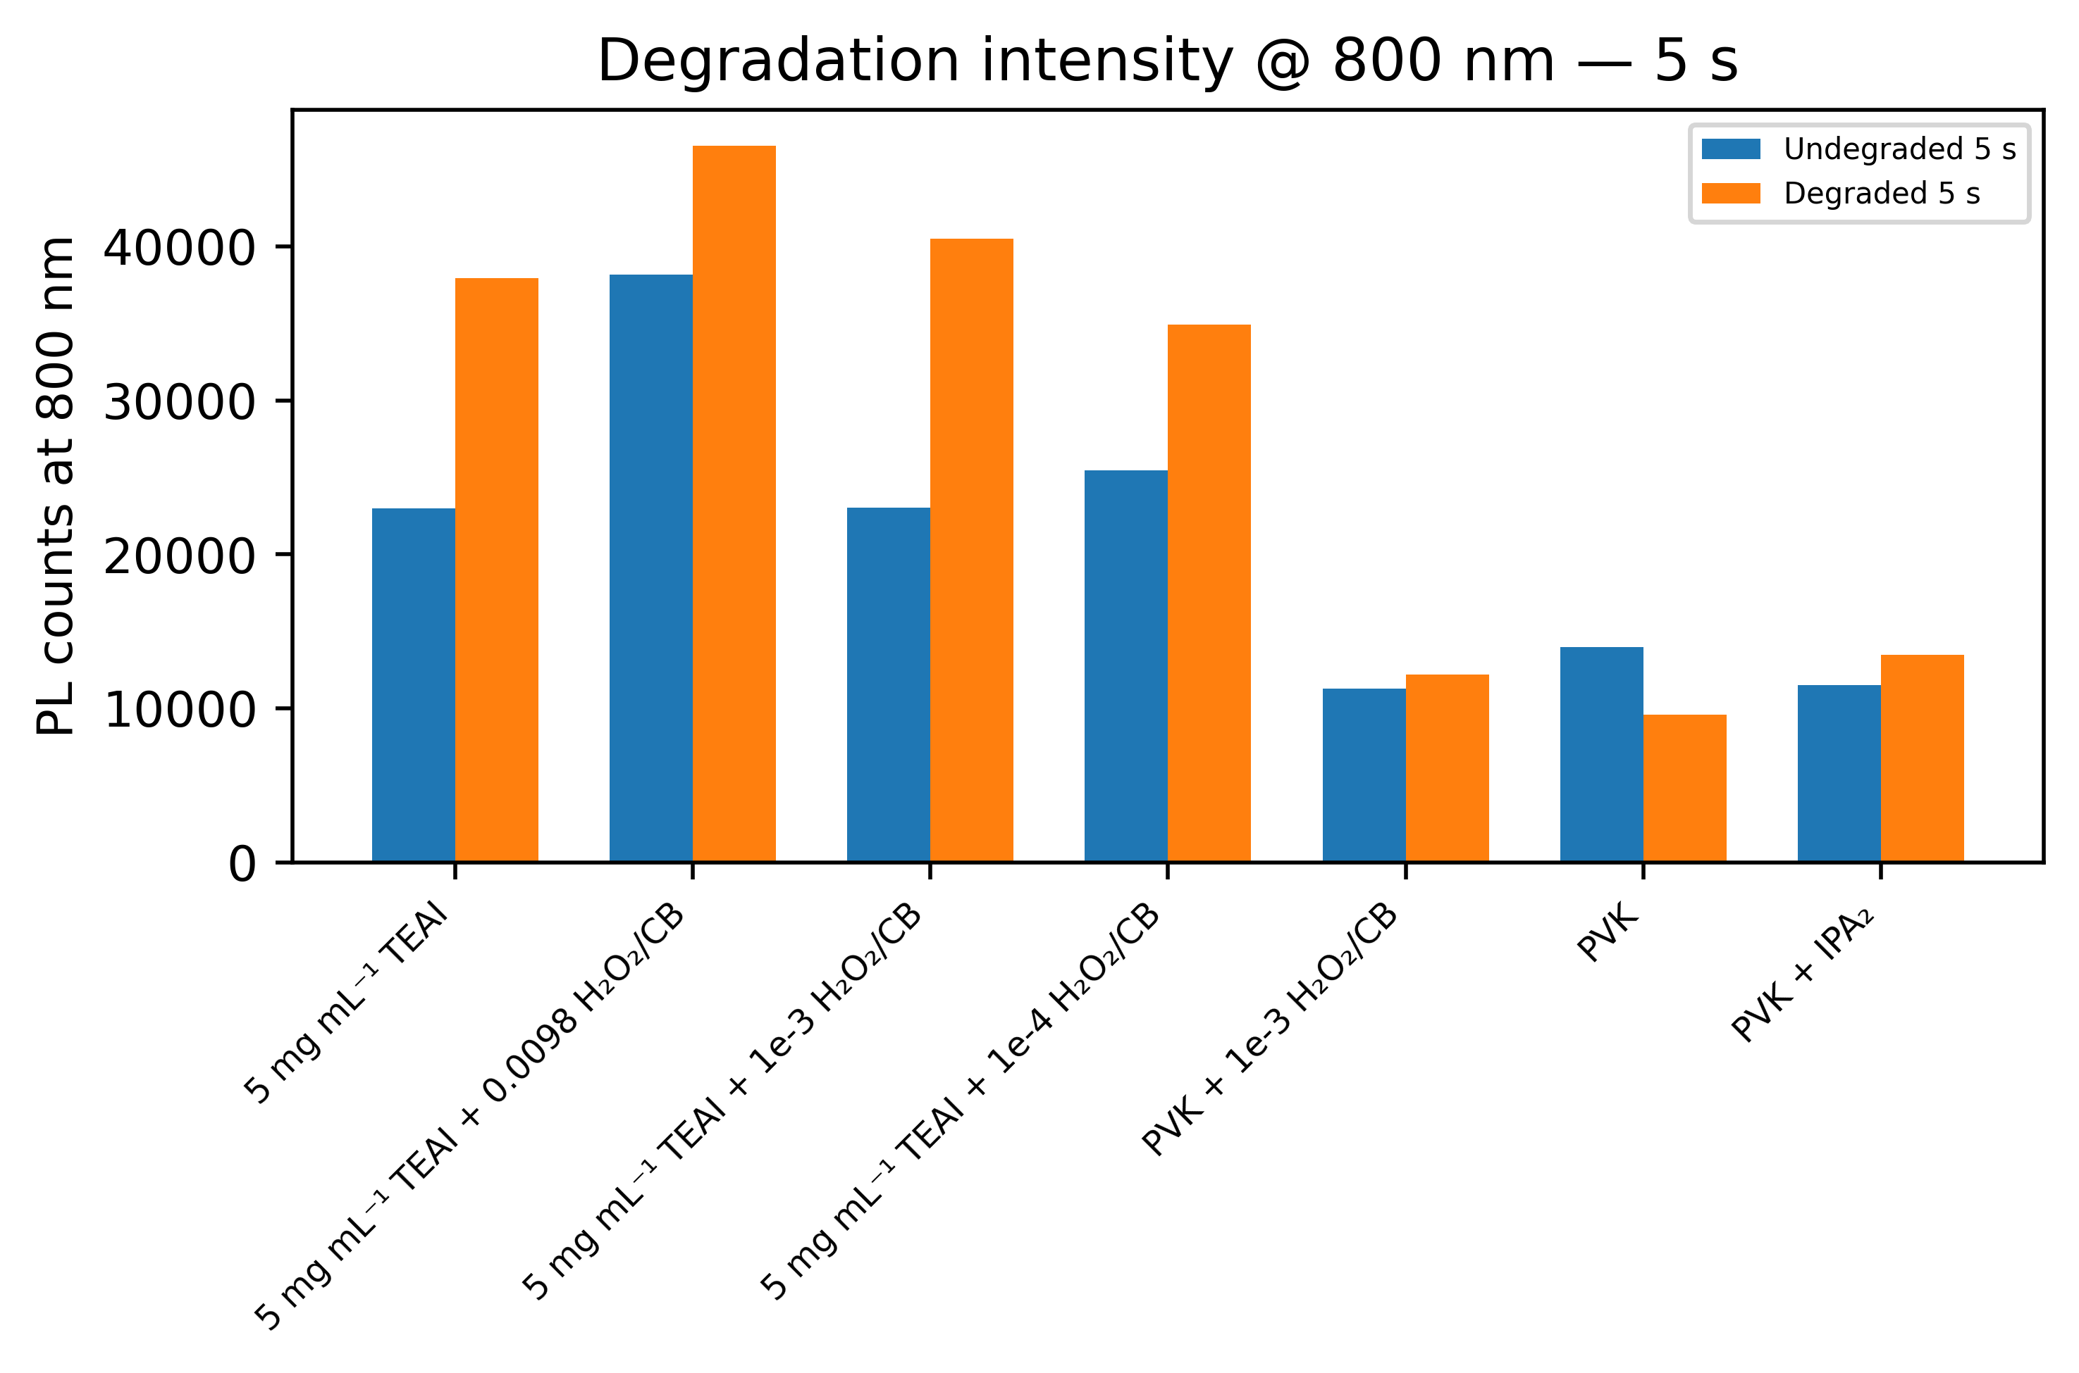
Characterization Results
Photoluminescence Spectra:
Chlorobenzene is preferable
Polymerizing with hydrogen peroxide enhances stability and performance
Passivation enhances performance
Low concentration of TEAI is preferable

Slide 14
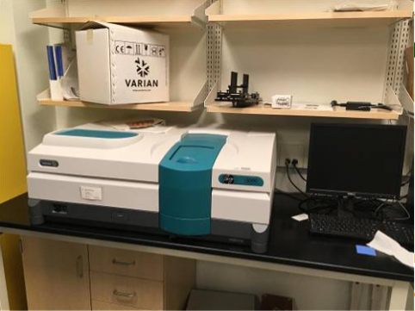
Proof of Polymerization
Ultraviolet-Visible Spectroscopy (UV-Vis)
TEAI PL peak
(Georgia Tech, 2025)

Slide 15
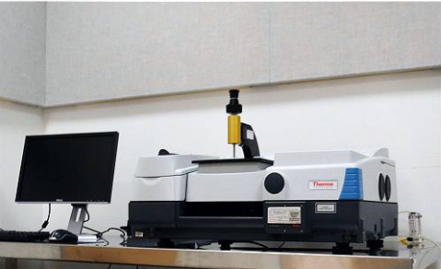
Proof of Polymerization
Fourier-Transform Infrared Spectroscopy (FTIR)
(Georgia Tech, 2025)
Passivation and polymerization increase absorbance

Slide 16
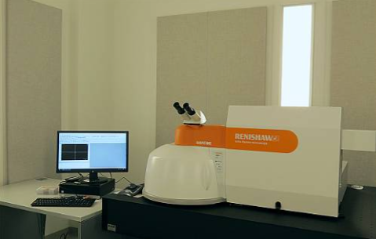
Proof of Polymerization
Raman Spectroscopy
(Georgia Tech, 2025)

Slide 17
Conclusions
TEAI polymerized with H2O2 in CB proved to be the most stable and efficient
Ideal variations:
Passivate with TEAI at low concentrations
Polymerize with Hydrogen Peroxide at middle concentrations
Dissolve in Chlorobenzene

Slide 18
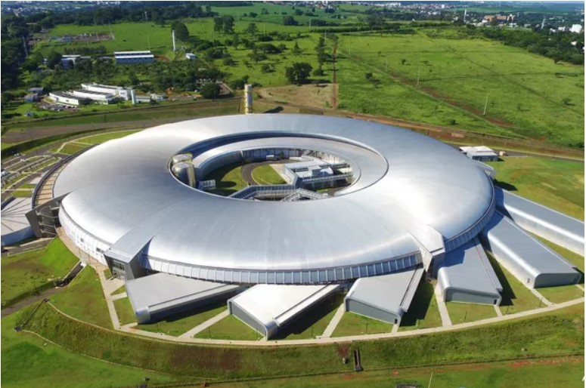
Future Works
Further prove polymerization and study the effects of passivation and polymerization
Grazing Incidence Wide Angle X-Ray Scattering (GIWAXS)
Ongoing Research Efforts
Fabrication
Characterization
Industrialization
Recycling
(Soldera, 2021)

Slide 19
References and Acknowledgements
Han, J., Park, K., Tan, S. et al. (2025). Perovskite solar cells. Nat Rev Methods Primers 5, 3. https://doi.org/10.1038/s43586-024-00373-9
NREL. (2025). Best Research-Cell Efficiency Chart | Photovoltaic Research | NREL. https://www.nrel.gov/pv/cell-efficiency
Perini, C. A. R., & Rojas-Gatjens, E., & Ravello, M., et al. (2022). Interface Reconstruction from Ruddlesden–Popper Structures Impacts Stability in Lead Halide Perovskite Solar Cells. Advanced Materials. 34, 2204726. https://doi.org/10.1002/adma.202204726
Soldera, B. (2021). SIRIUS: The Brightest Star in Brazil. Mind the Graph Blog. https://mindthegraph.com/blog/sirius-world-brightest-synchrotron-light/
Wang, X., Ding, Z., Huang, X., et al. (2024). Cross-linking strategies for efficient and highly stable perovskite solar cells. Journal of Materials Chemistry C, 12(2), 351–387. https://doi.org/10.1039/d3tc03183g
Special thanks to Ahmed, Miles, Dr. Juan-Pablo, Leslie, Mikkel, and everyone in the Energy Materials Lab!
This material is based upon work supported by the National Science Foundation Science and Technology Center (STC) for Integration of Modern Optoelectronic Materials on Demand (IMOD) under Award No. DMR-2019444. Any opinions, findings and conclusions or recommendations expressed in this material are those of the author(s) and do not necessarily reflect the views of the National Science Foundation.

Slide 20



Thank You!
Molly Auer
linkedin.com/in/molly-auer

