Slide 1
Coarsening Kinetics of Nanoporous, Tantalum-Based UHTCs
Noah Zheng, Washington University in St. Louis
Catherine Ott, Northwestern University
PI: Dr. Ian McCue, Northwestern University

Slide 2
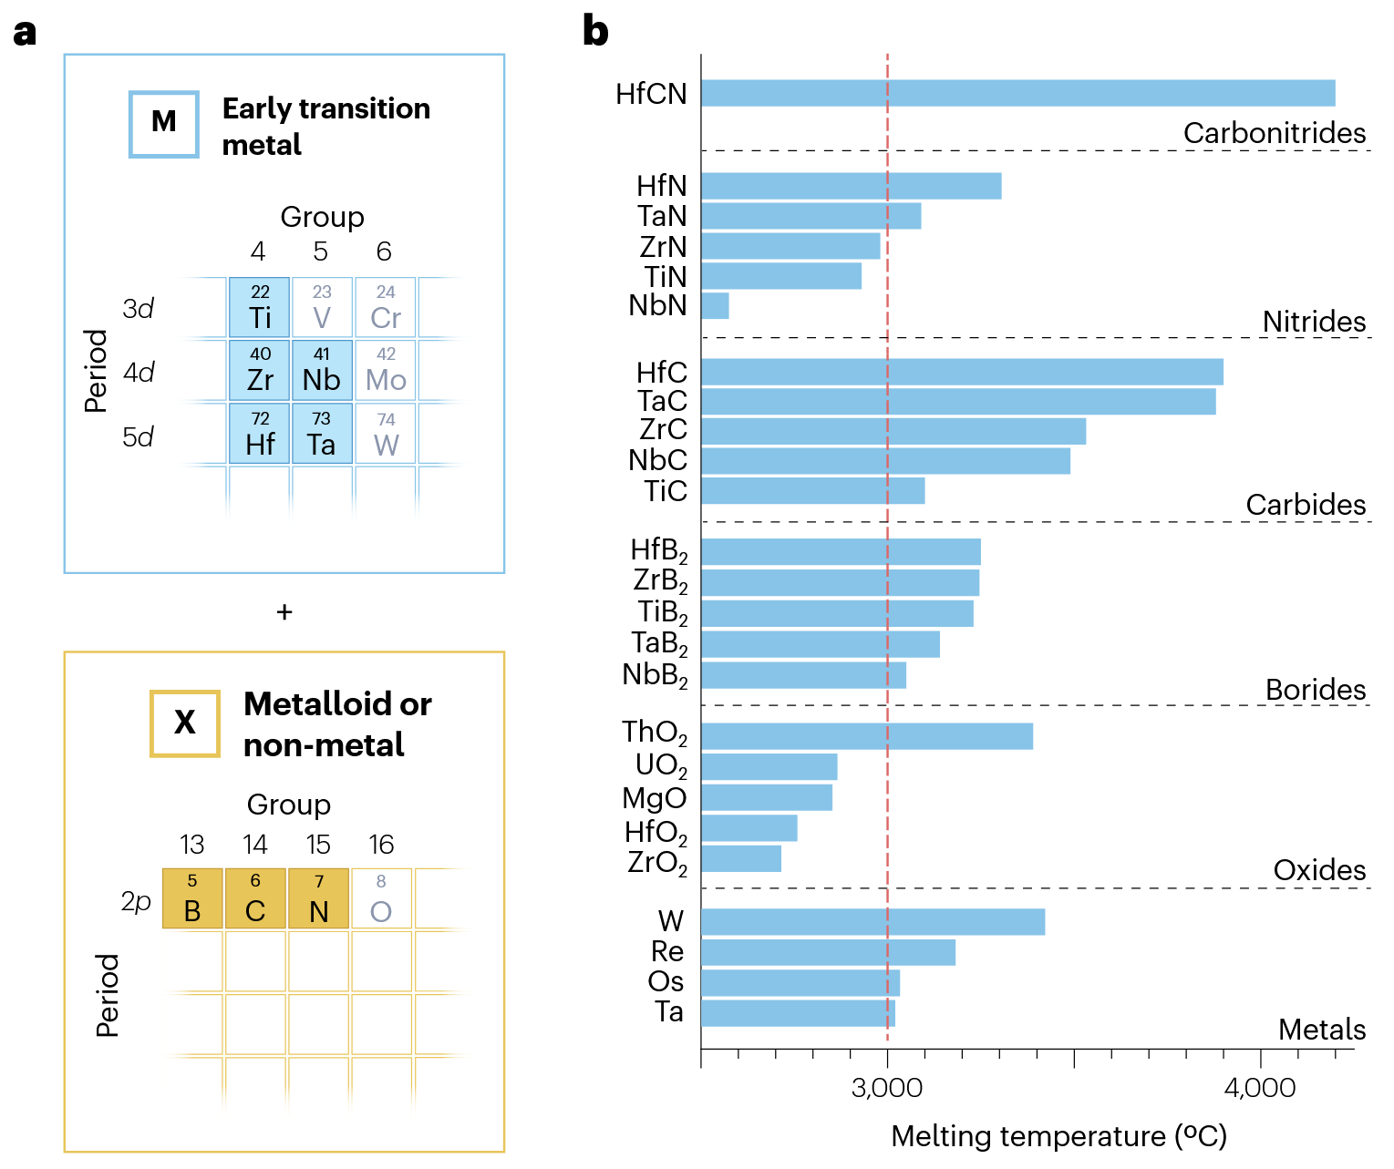
Overview: Ultra-High Temperature Ceramics
3090
Nitrides, carbides, and borides of a refractory metal (e.g., Ta, Nb, Mo, W)
Favorable characteristics:
  High melting point
  High thermal conductivity
  High mechanical stiffness
> 3700
3017
Wyatt et al, Nat. Rev. Mater., 2024

Slide 3
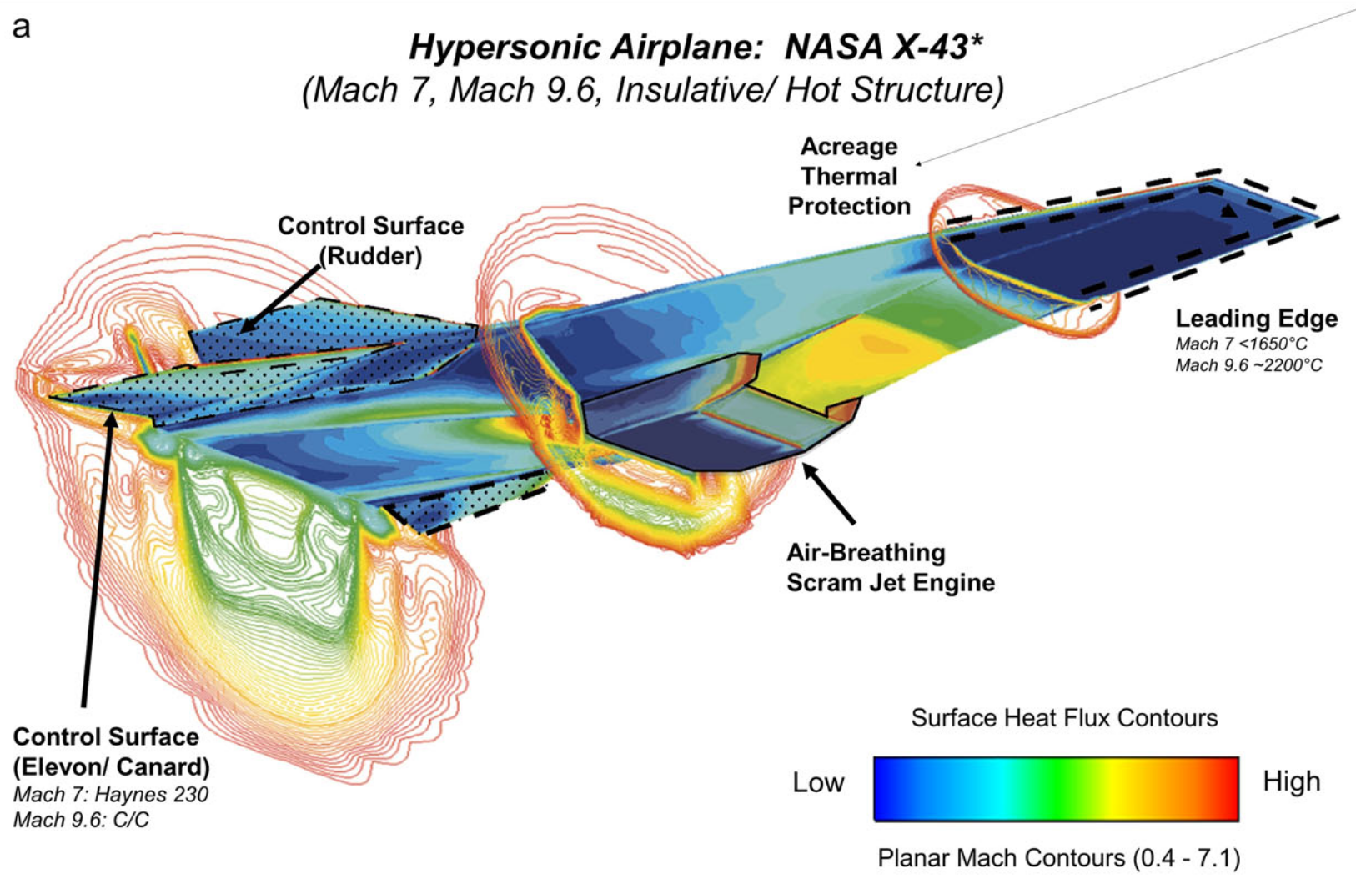
Overview: Ultra-High Temperature Ceramics
Suitable for hypersonic applications
  Vehicles that travel > 5x speed of sound
  Extreme heat flux and oxidation conditions
Peters et al, Nat. Comm., 2024

Slide 4
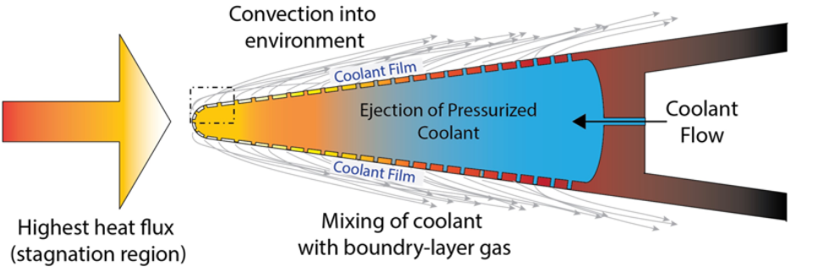
Nanoporous UHTCs Enable Novel Functionality
Active Cooling
  e.g. Transpiration cooling: forced fluid through porous structure
Peters et al, Nat. Comm., 2024

Slide 5
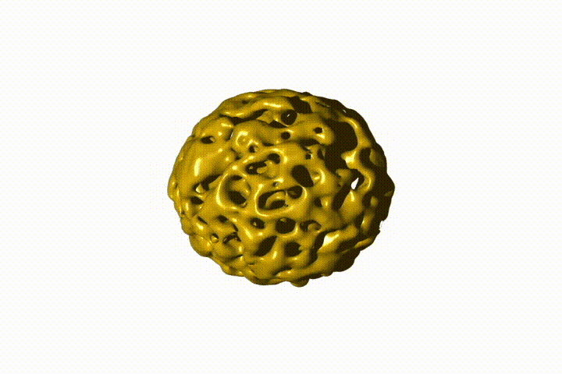
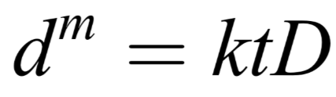
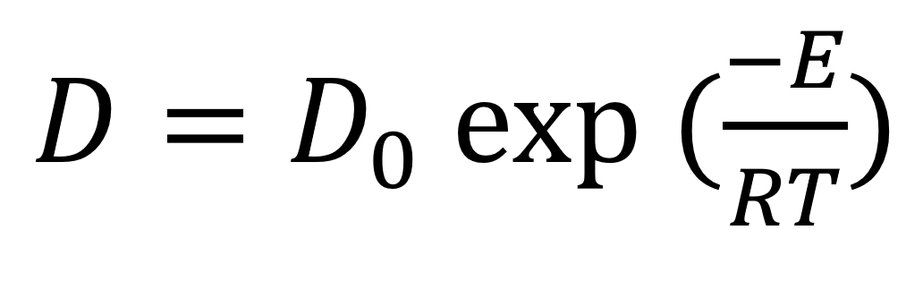
How Do Nanoporous UHTCs Hold Up?
Nanoporous structures "coarsen" at high temps due to surface diffusion
Obtain kinetic constants D₀, E, and m
Courtesy of Ian McCue and Catherine Ott

Slide 6
Project Approach
Nanoporous Source Powder
Ta (Metal)
TaC (Ceramic)
Coarsening
Induction Heating:
1400, 1550, 1700, 1850 °C
5, 10, 30, 60 minutes
X-Ray Diffraction (XRD)
Phase Stability
Scanning Electron Microscopy (SEM)
Feature Size Measurements

Slide 7
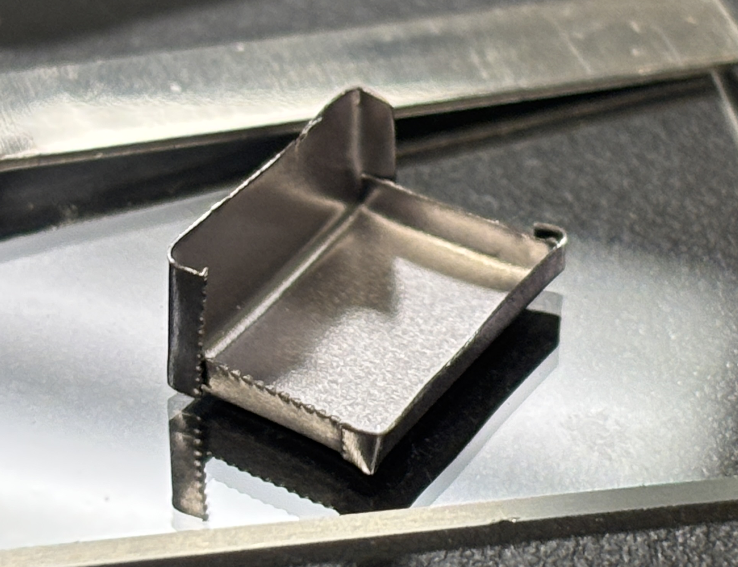
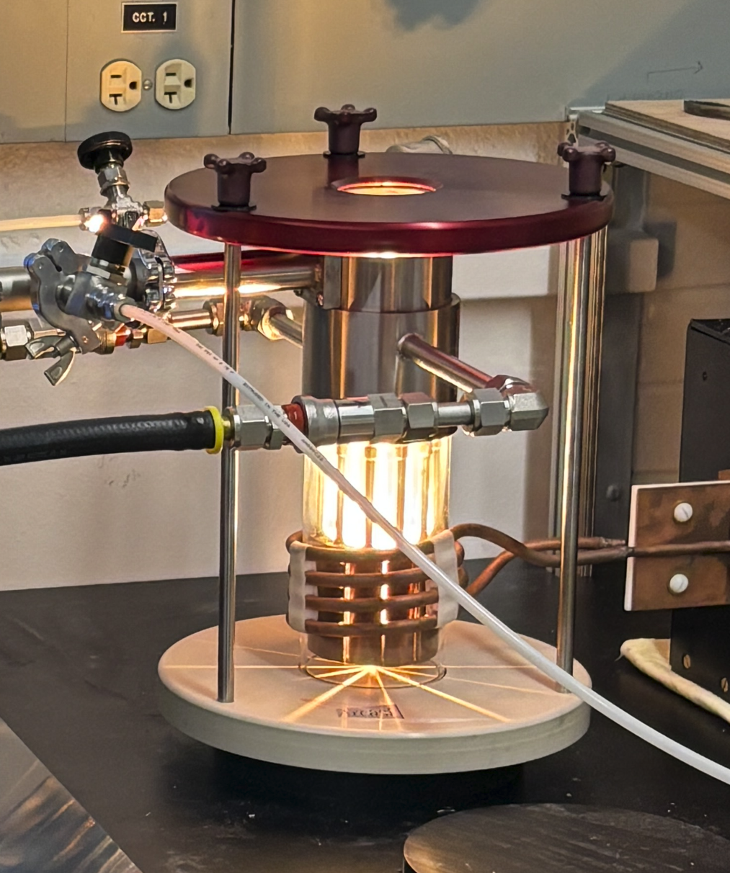
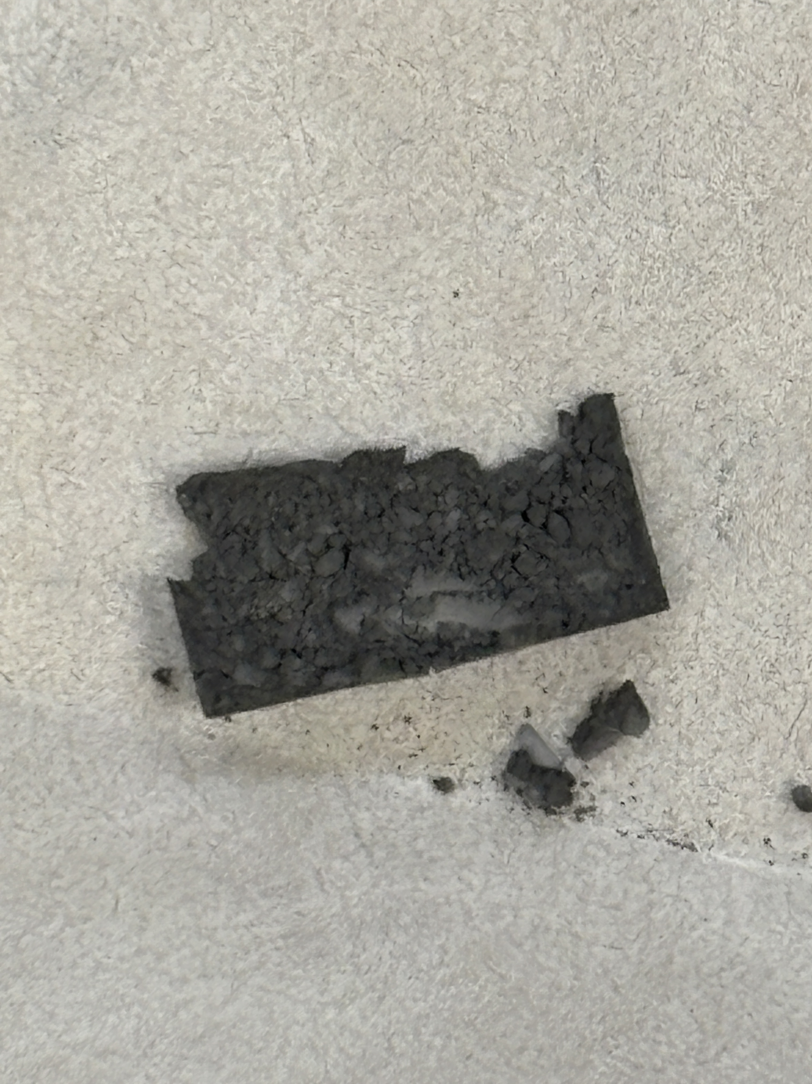
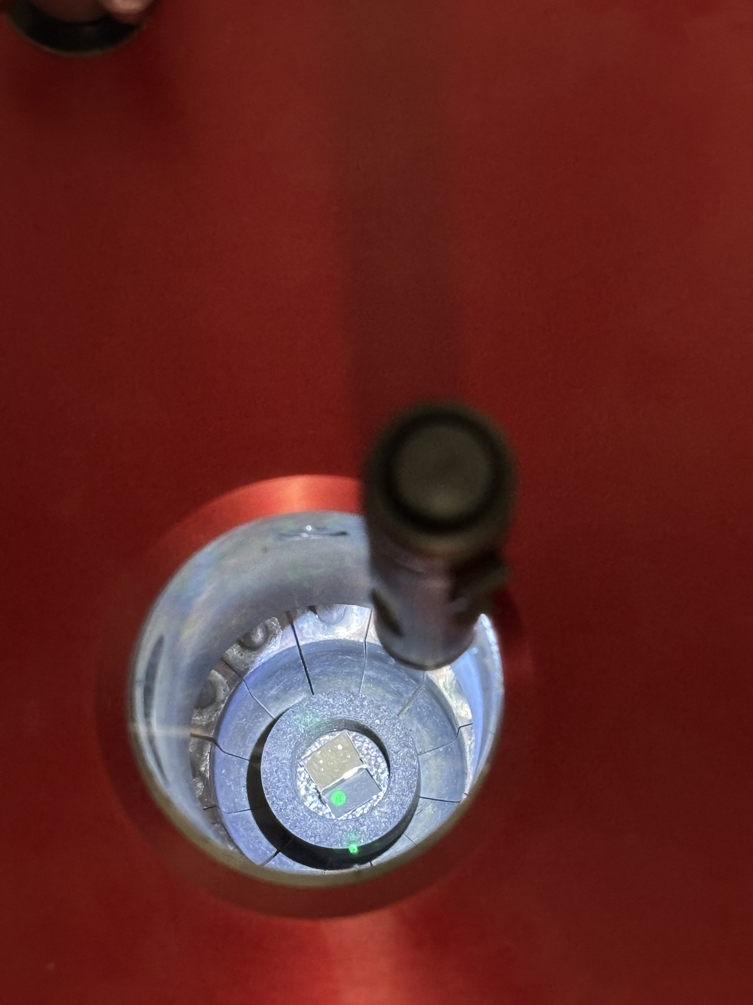
Induction Heating Allows For Precise Coarsening
TaC
Ta

Slide 8
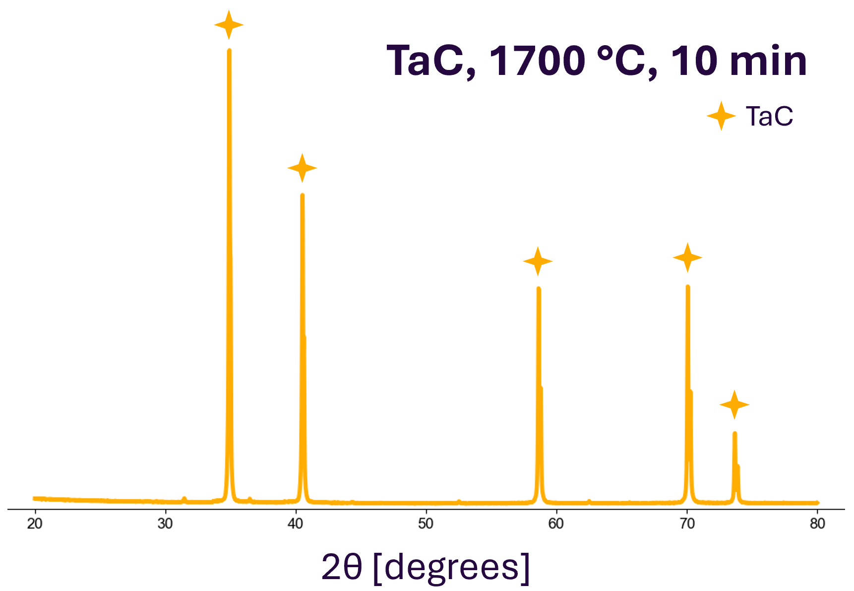
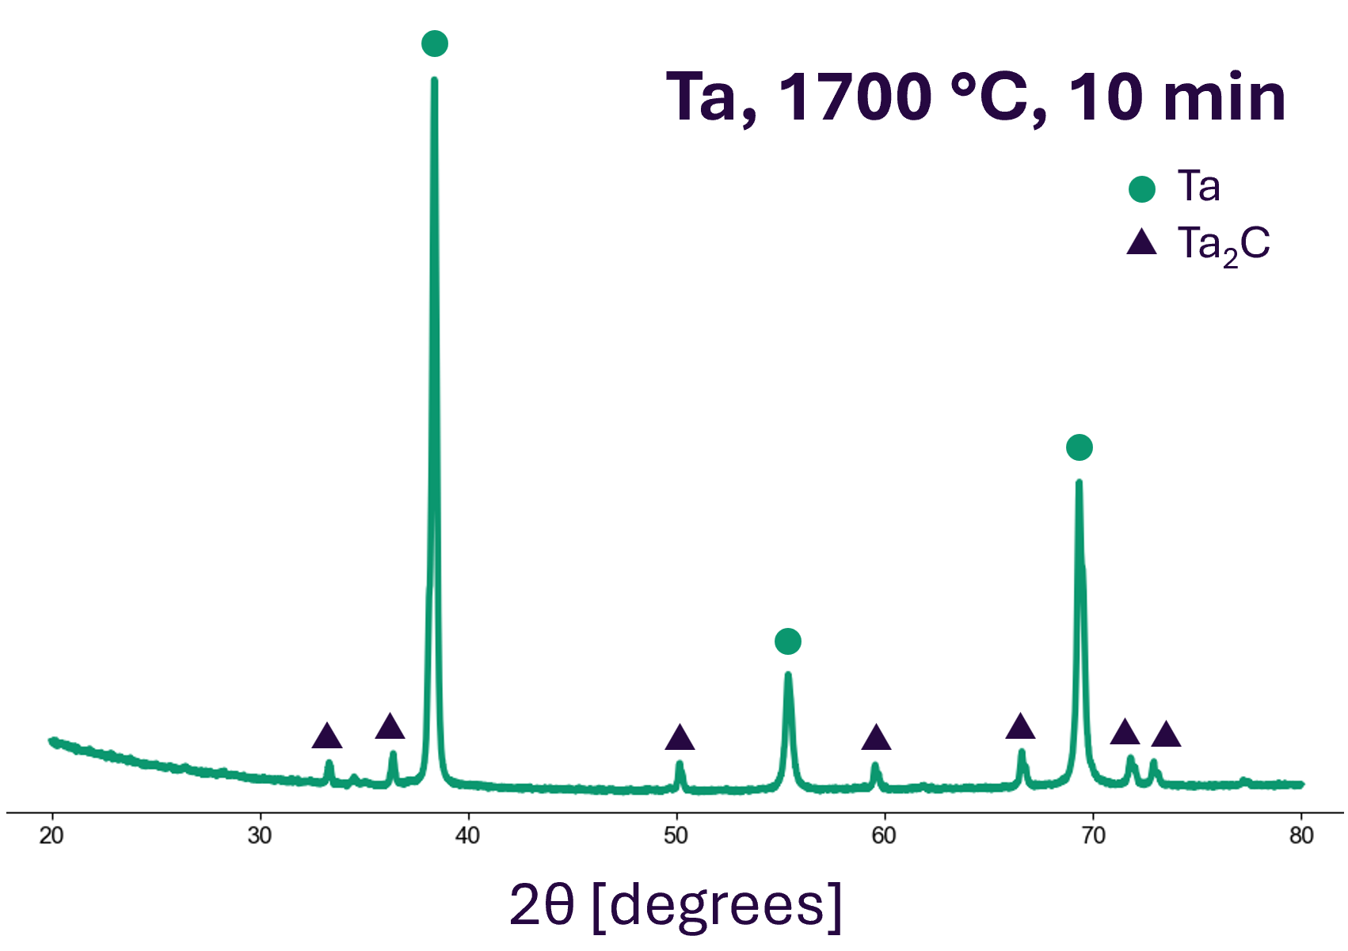
Compositional Stability of TaC

Slide 9
Compositional Stability of Ta

Slide 10
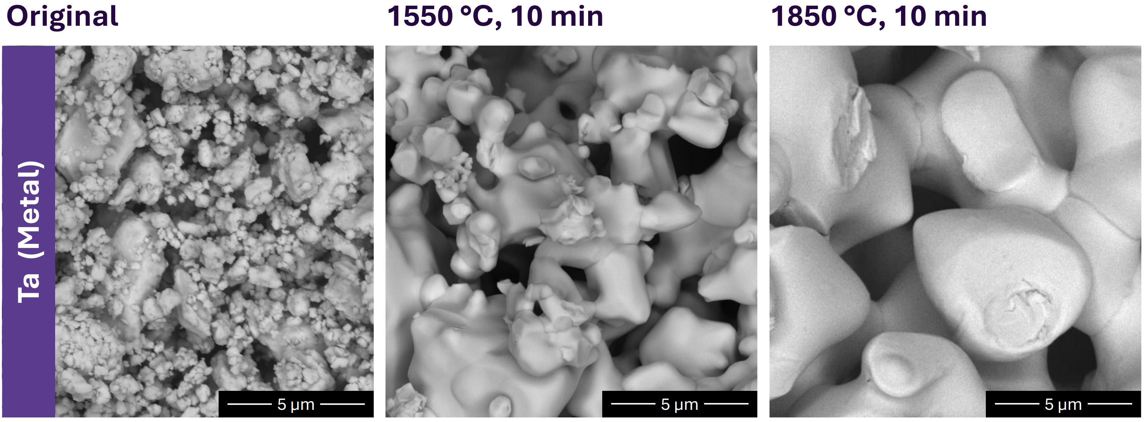
Coarsening: Visual Progression

Slide 11
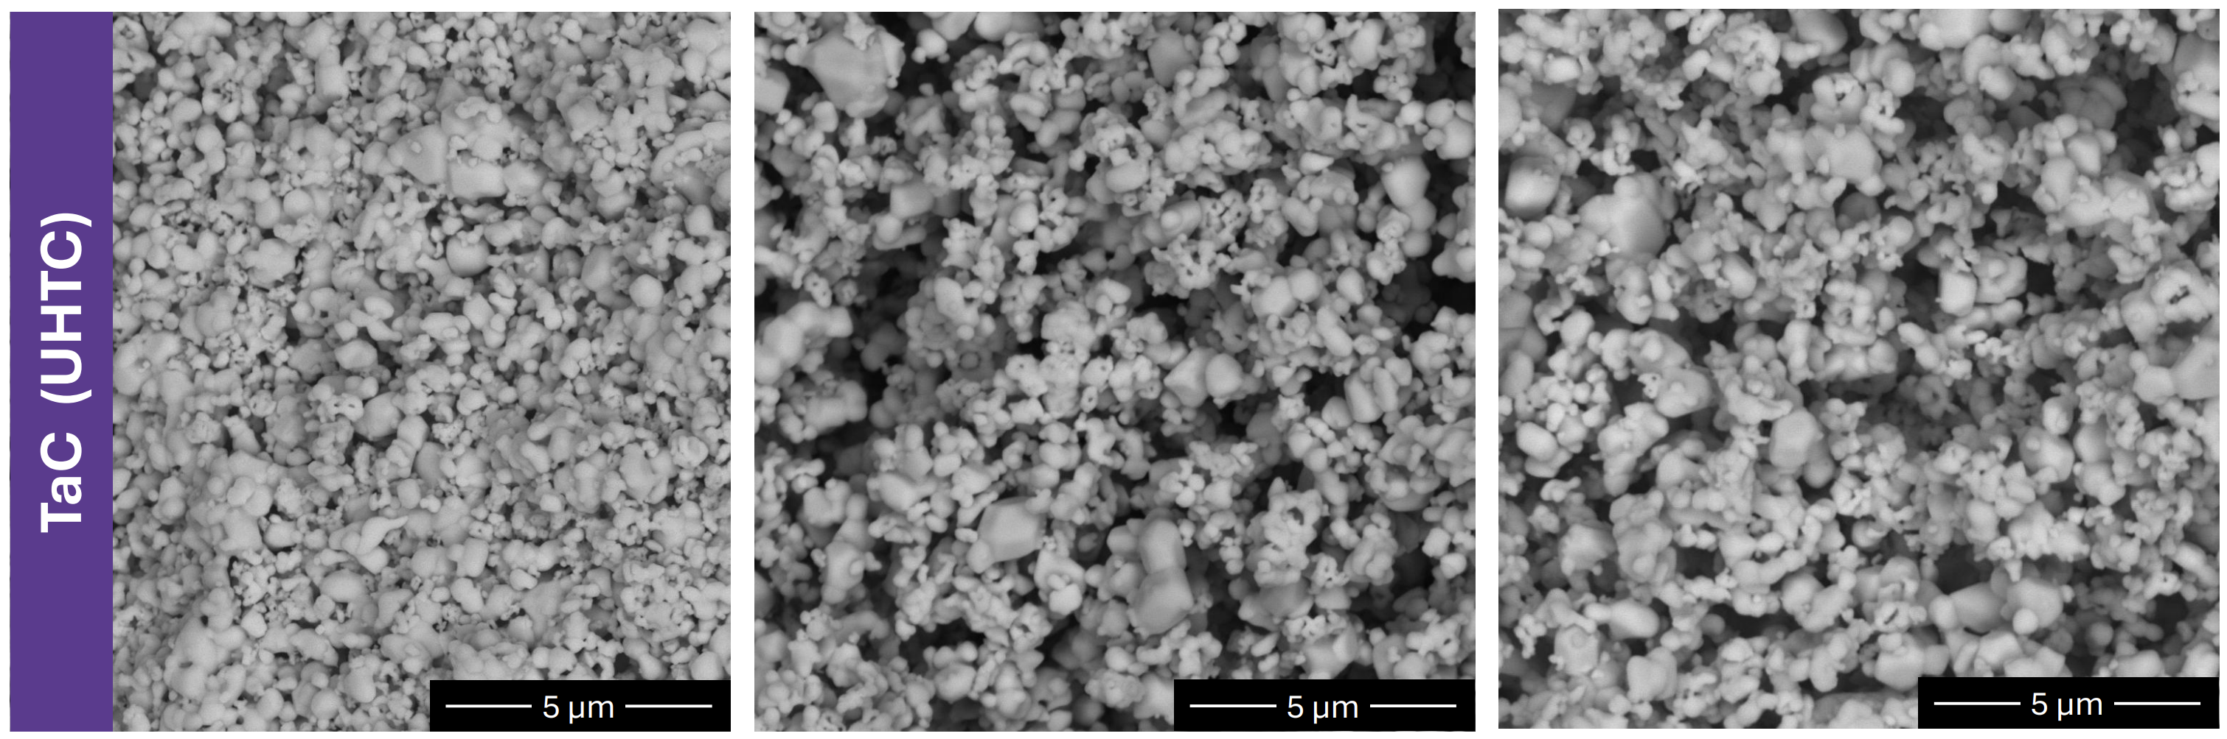
Coarsening: Visual Progression

Slide 12
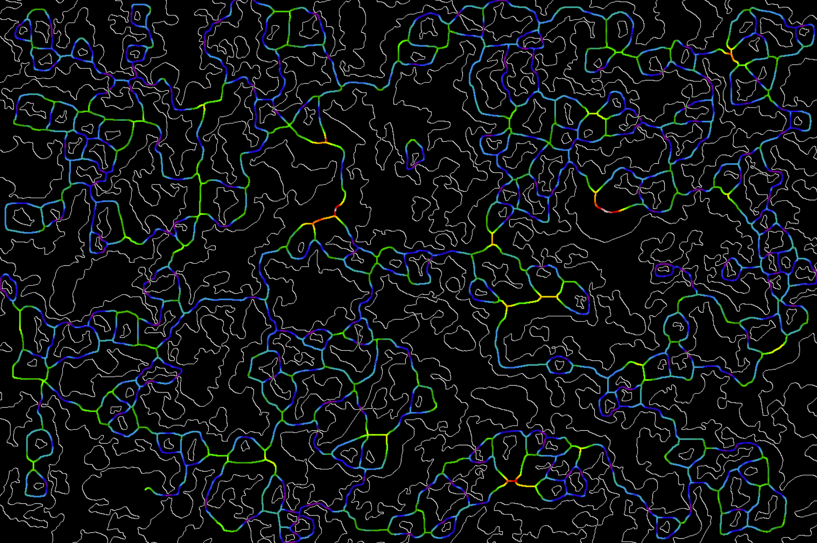

Feature Size Quantification with AQUAMI
TaC, 1550 °C, 5 minutes
4 μm.

Slide 13
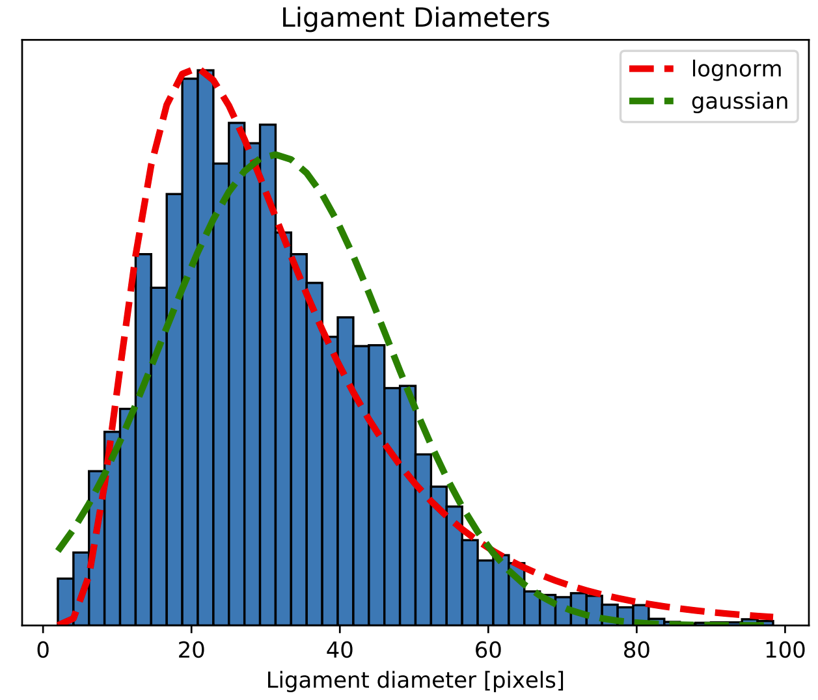
Feature Size Quantification with AQUAMI
4 μm.

Slide 14
Challenges with Feature Size Measurement in Ta
Ta, 1550 C, 60 minutes
3 μm
3 μm

Slide 15
Ta Source Powder Inconsistency
4 μm.

Slide 16
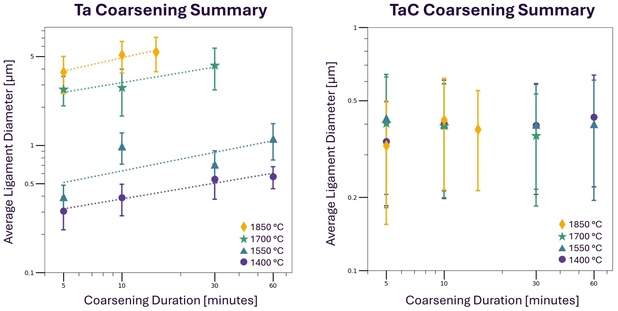
Kinetic Analysis

Slide 17
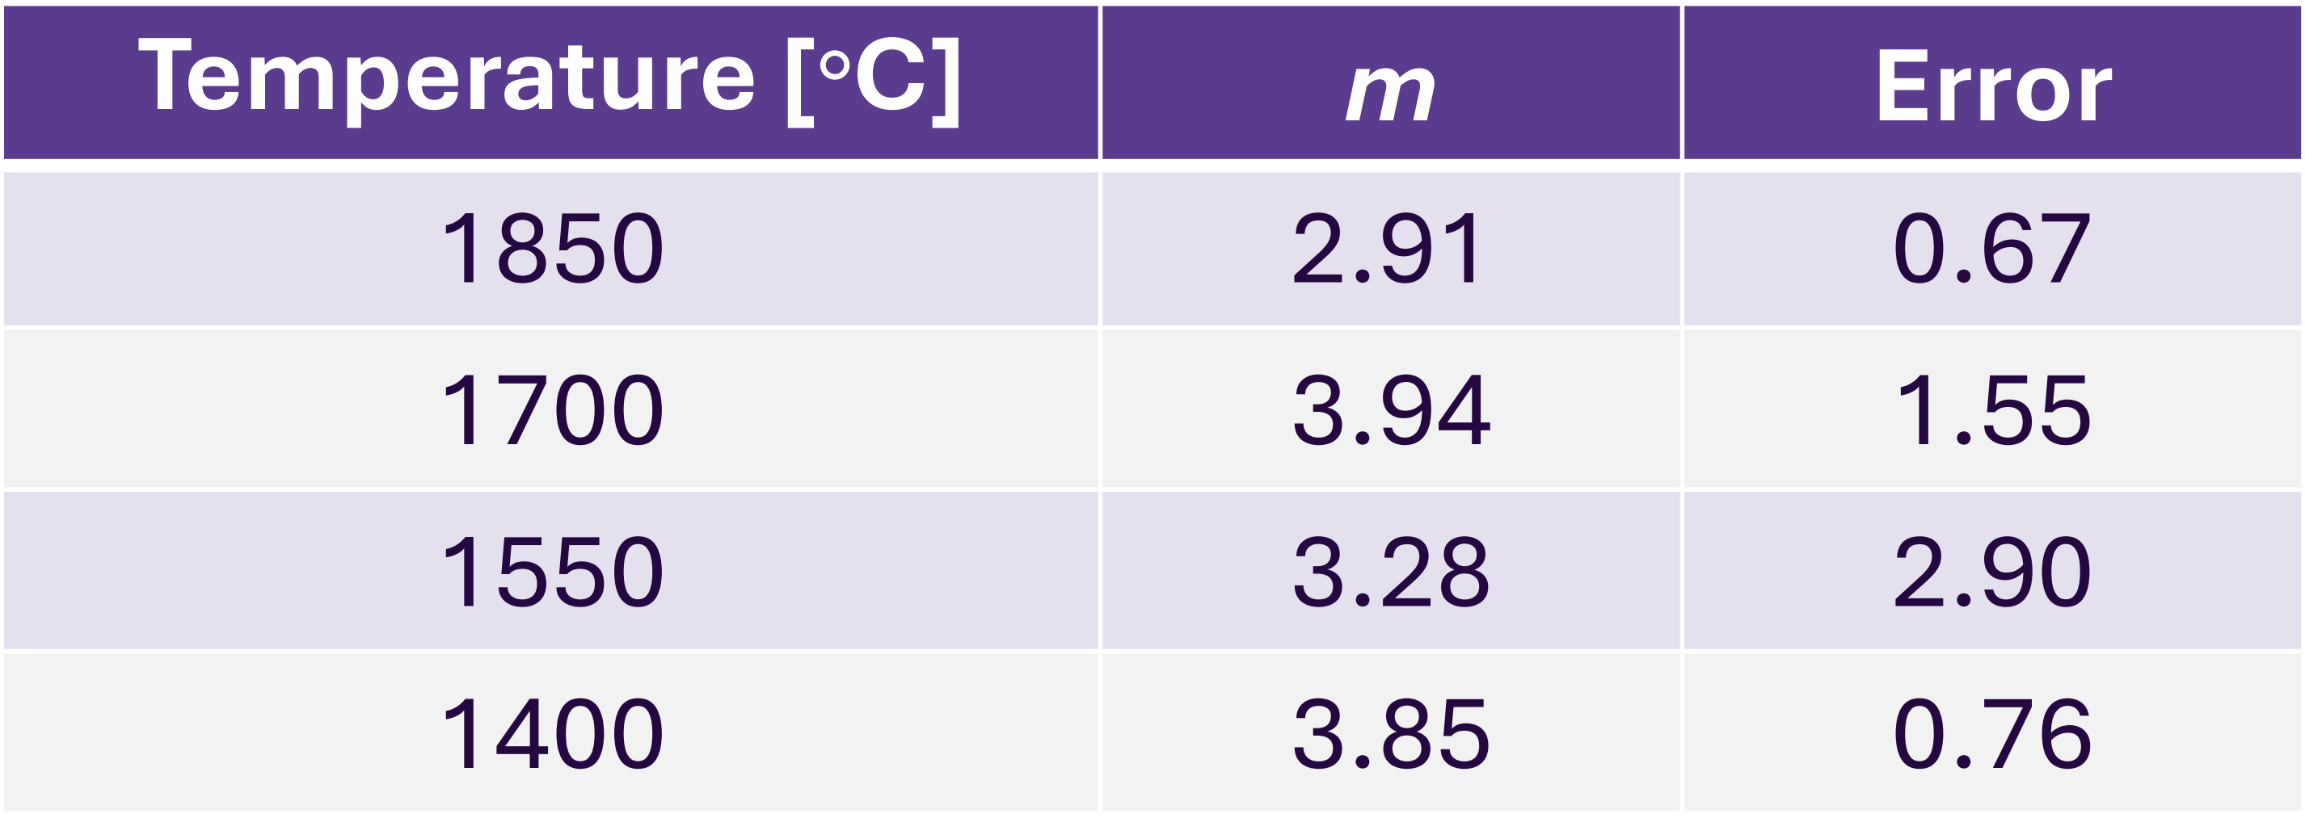
Kinetic Analysis
m = 3 suggests bulk crystal diffusion
m = 4 suggests surface diffusion
(Balluffi et al, 2005)

Slide 18
Conclusions
TaC coarsens at a significantly slower rate than Ta
log(diameter) vs. log(duration) seems linear for Ta coarsening
Preliminary m-values suggest bulk crystal diffusion and surface diffusion

Slide 19
Moving Forward
Improving Ta sample consistency:
Commercial Source Powder (Dehydriding)
Dealloyed Source Powder
2 μm
2 μm

Slide 20
Moving Forward
Improving Ta sample consistency:
Commercial Source Powder (Dehydriding)
Dealloyed Source Powder
Graphite Susceptor
Molybdenum Susceptor
Kinetic Analysis for TaC:
New materials:
Lengthened Coarsening Durations
TaN

Slide 21

Acknowledgments
This work made use of the Northwestern University Jerome B. Cohen X-ray Diffraction Core Facility (RRID:SCR_017866) supported by the MRSEC program of the National Science Foundation (DMR-2308691) at the Materials Research Center of Northwestern University and the Soft and Hybrid Nanotechnology Experimental (SHyNE) Resource (NSF ECCS-2025633).
This work made use of the EPIC facility (RRID: SCR_026361) of Northwestern University’s NUANCE Center, which has received support from the SHyNE Resource (NSF ECCS-2025633), the IIN, and Northwestern's MRSEC program (NSF DMR-2308691).

