Slide 1
Investigating Different Electrode Materials to Pair With CsH₂PO₄
Presenter: Richard Kariuki, University of Wisconsin-Madison
Mentor: Elizabeth Griffin
Principal Investigator: Vinayak P. Dravid
Northwestern University SHyNE REU

Slide 2
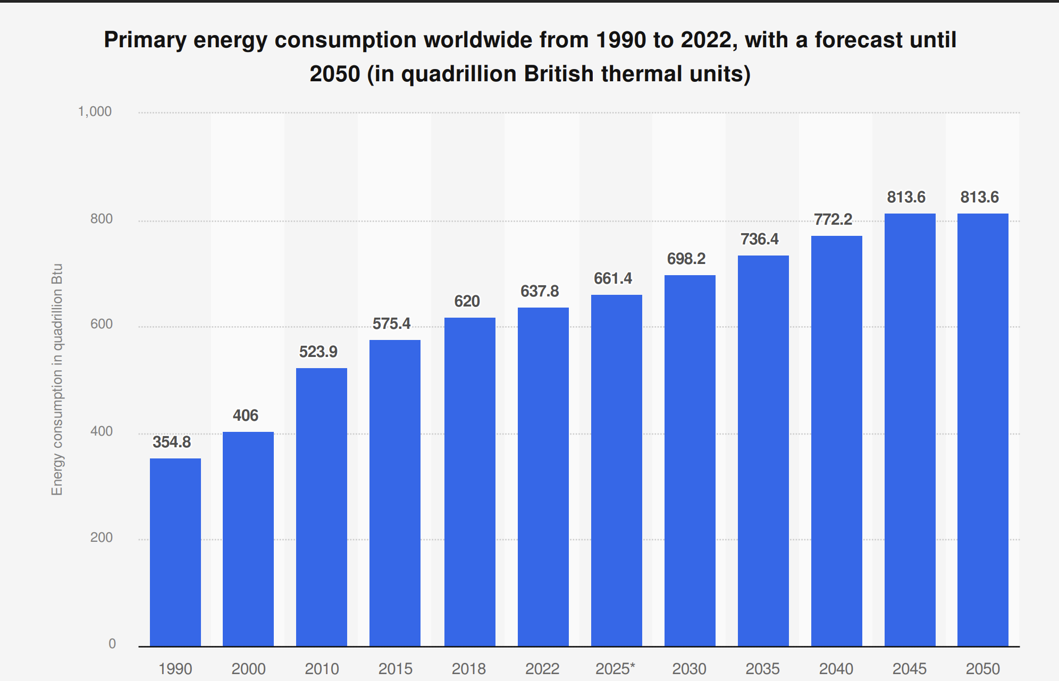
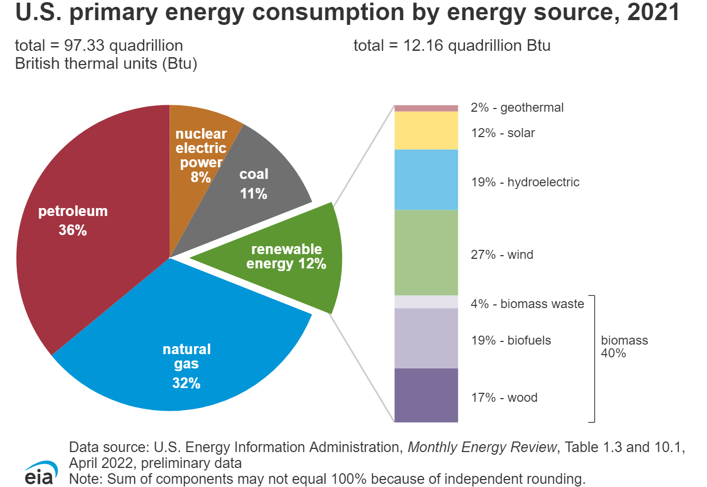
Introduction
50% Increase in Energy
Increase in World Population
Alternative Energy Need
Statista. 2023. “Worldwide Energy Consumption Forecast between 1980 and 2030.” October 2023. Statista.
CLEAN. "Energy Consumption Worldwide Is Increasing." Climate Literacy & Energy Awareness Network. Accessed July 28, 2025. https://cleanet.org/clean/literacy/energy4.html.
Notes:
(Click) Global Energy Consumption is expected to increase by 50% (click) in the year 2050 compared to the year 2020.
And this is due to the increase in world population which will be nearly 9.7 billion in 2050
It is a well-known fact that fossil fuels and natural gas are known to be harmful to the environment and specifically in the United States (click) about 12% of energy produced is renewable.
To keep up with the energy demand and be sustainable in the long run we need to look to alternative energies (click) and one of these alternative energies is hydrogen fuel cells.

Slide 3
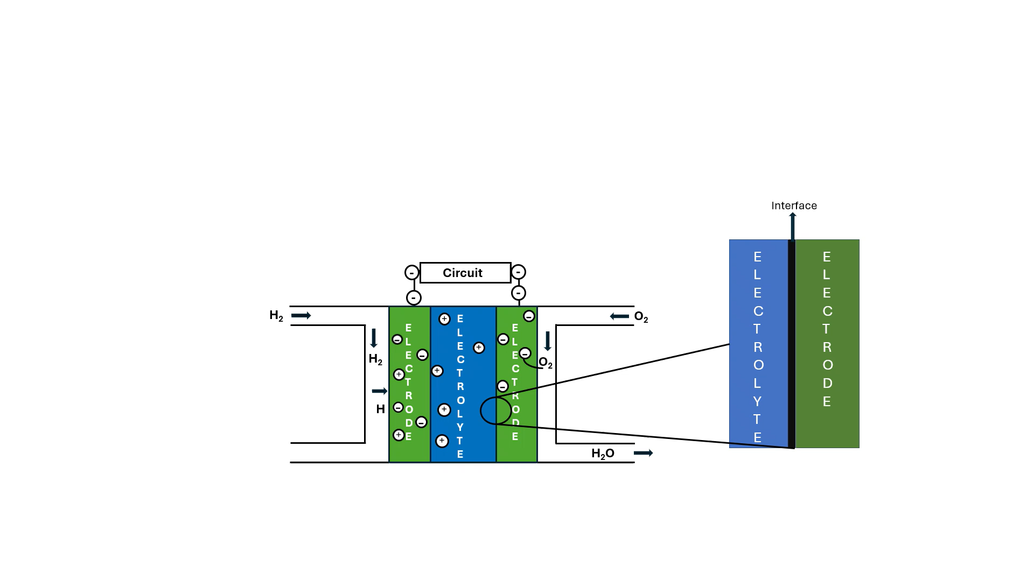
Hydrogen Fuel Cells
Notes:
Talk about how the fuel cell works.
How it works is that hydrogen is fed into the anode which splits the H2 into protons and electrons.
The Protons pass through the electrolyte (or sometimes the membrane), while the electrons go up through the anode through the circuit to the cathode.
At the cathode, the oxygen from the air combine with the electrons and protons to form water.
What this project is interested in figuring out is how the electrolyte and the electrode interact with each other and I will take more about that in a couple slides.
Potential Applications –
Transportation - Uses in semi-trucks, buses and cars.
Renewable Energy Storage – Can store excess energy from solar, wind etc. from peak production and releasing it when needed.
Problems –
Needs expensive catalysts such as platinum to operate.
Can degrade significantly due to electrolyte degradation
One solution to this is CsH₂PO_{4.}
We do not understand completely how hydrogen moves through different layers of the cell, nor do we understand completely what materials are best suited for hydrogen transport.

Slide 4
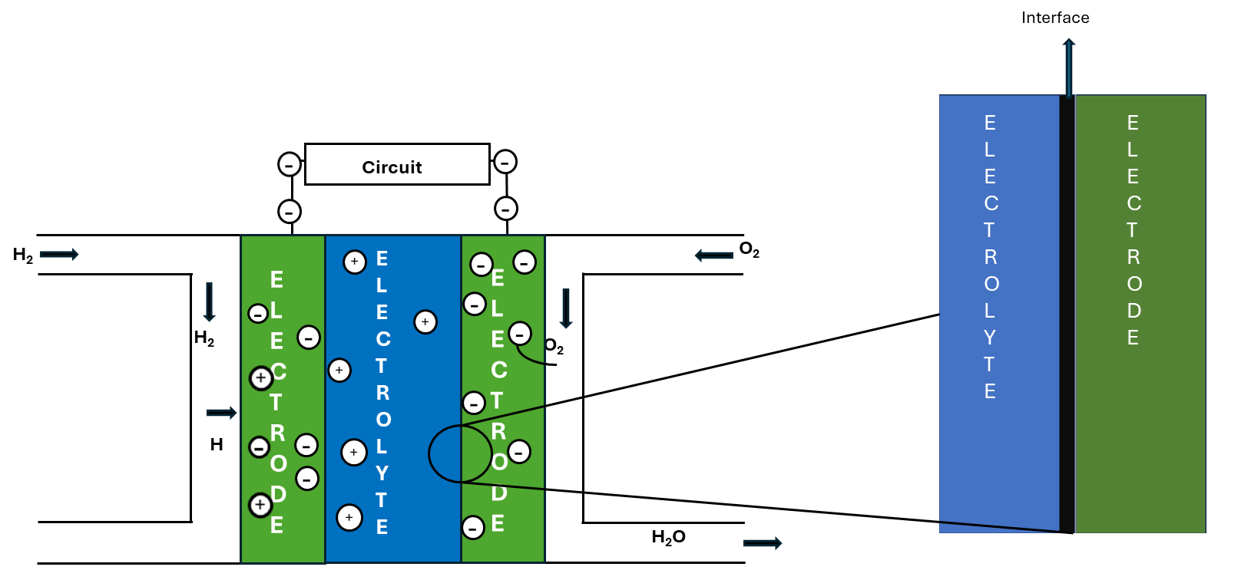
Hydrogen Fuel Cells
Notes:
Talk about how the fuel cell works.
How it works is that hydrogen is fed into the anode which splits the H2 into protons and electrons.
The Protons pass through the electrolyte (or sometimes the membrane), while the electrons go up through the anode through the circuit to the cathode.
At the cathode, the oxygen from the air combine with the electrons and protons to form water.
What this project is interested in figuring out is how the electrolyte and the electrode interact with each other and I will take more about that in a couple slides.
Potential Applications –
Transportation - Uses in semi-trucks, buses and cars.
Renewable Energy Storage – Can store excess energy from solar, wind etc. from peak production and releasing it when needed.
Problems –
Needs expensive catalysts such as platinum to operate.
Can degrade significantly due to electrolyte degradation
One solution to this is CsH₂PO_{4.}
We do not understand completely how hydrogen moves through different layers of the cell, nor do we understand completely what materials are best suited for hydrogen transport.

Slide 5




Hydrogen Fuel Cells
Pros
Cons
Notes:
Talk about how the fuel cell works.
How it works is that hydrogen is fed into the anode which splits the H2 into protons and electrons.
The Protons pass through the electrolyte (or sometimes the membrane), while the electrons go up through the anode through the circuit to the cathode.
At the cathode, the oxygen from the air combine with the electrons and protons to form water.
What this project is interested in figuring out is how the electrolyte and the electrode interact with each other and I will take more about that in a couple slides.
Potential Applications –
Transportation - Uses in semi-trucks, buses and cars.
Renewable Energy Storage – Can store excess energy from solar, wind etc. from peak production and releasing it when needed.
Problems –
Needs expensive catalysts such as platinum to operate.
Can degrade significantly due to electrolyte degradation
One solution to this is CsH₂PO_{4.}
We do not understand completely how hydrogen moves through different layers of the cell, nor do we understand completely what materials are best suited for hydrogen transport.

Slide 6
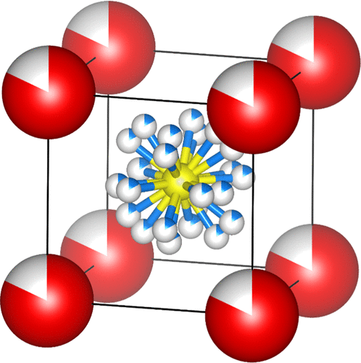
Solid Electrolyte: CsH₂PO₄ (CDP)
10
10µm
Polymorphic Phase Transition
Stability
Expensive Catalyst Not Needed
Notes:
CDP – Is a very important solid acid electrolyte because (click):
At 230 C, polymorphic phase transition where it hits this super protonic phase, making it an excellent solid-state conductor.
Reversible change in solid crystalline structure where crystal structure to another while maintaining same chemical composition.
It is thermally and chemically stable and does not degrade.
Operates without expensive catalysts(click) like Platinum which is what is used in a typical fuel cell.
Due to these reasons, CsH₂PO₄ could unlock more stable, efficient and lower cost fuel cells.

Slide 7

The Project
Electrode Materials
Electrode
Palladium
Palladium + Tin
Platinum
Electrolyte
x2 conditions
6 samples
Interface
Notes:
Specifically, my project is to investigate the different types of electrode materials under a Scanning Electron Microscope (SEM) to see what is best to pair with our solid electrolyte – CDP.
The different types of electrode materials we are looking at are
Palladium
Palladium + Tin
Platinum
All samples with the respective electrode material were deposited on a sample of CDP.
Palladium has shown promising results as an electrode, however it is very unstable which is why it was decided to pair it with Tin to help make it more stable.
Platinum has historically been known to be a good electrode material but is very expensive, but we still believe is worth observing.
We also had another separate set of 3 of the exact same samples except these ones were annealed.
Annealing: When you heat something and allow it to cool slowly.
With two different conditions in total we have 6 samples.
Meaning we had two conditions
For a total of 6 samples
The reason behind annealing them is because temperature often drives diffusion in materials and this could further cause formation of interfaces between the CDP and our electrode.
We are observing whether an interface forms and identify the activity going on between the respective electrode material and the CDP.
For example, it could be likely that some CDP was shown to diffuse into the respective electrode material or vice versa.
CsH₂PO₄

Slide 8
Before Annealing SEM Top-Down Results
Bare CsH₂PO₄
3 µm
Platinum | CDP
5 µm
Notes:
These are our before annealing SEM results for Bare CDP and Platinum | CDP top-down look.
The first photo you see is the bare CDP and we took note of how the surface around the area looks.
We are not completely sure what this middle part is but the microstructure surface was consistent throughout this structure and we took note of that.
The second image on the right is from the Platinum | CDP and we can see that the microstructure is what we expect from a metal and it looks very uniform throughout the photo except of course for these, which we are not too sure what it is but we found them throughout the sample and we believe it is just from sample prep.

Slide 9
Before Annealing SEM Top-Down Results (Continued)
300 µm
20 µm
Palladium + Tin | CsH₂PO₄
Palladium | CsH₂PO₄
Notes:
These are just more SEM images from the top down.
The Pd + Sn we took is from the edge of the sample and this is what we expected to see from a metal. when you look at Palladium if you can see something we also noticed is that there are scratches, which just came from sample prep.
The second image is our palladium sample and this microstructure is again consistent throughout the entire sample.

Slide 10
Before Annealing Palladium | CsH₂PO₄ SEM 90°
10 µm
100 µm
Platinum | CsH₂PO₄
Palladium | CsH₂PO₄
Notes:
Instead of imaging from the top down as before we decided to image from an angle in order to better observe the interaction between the CsH₂PO₄ and the
respective electrode material
As you can see in the first photo on the far left is the Platinum and CDP sample and what we can see is really interesting which is what seems like some of the CsH₂PO₄ has made its way into the Platinum and maybe formed an interface.
We have yet to confirm what is actually happening with Energy Dispersive Spectroscopy Analysis or EDS to identify what specific species are where, but this is very interesting.
And on the right, you can see that there is the Palladium and CDP sample and we are not too sure what is happening with the black area, we again would need Energy Dispersive Spectroscopy to really see what is happening here.

Slide 11
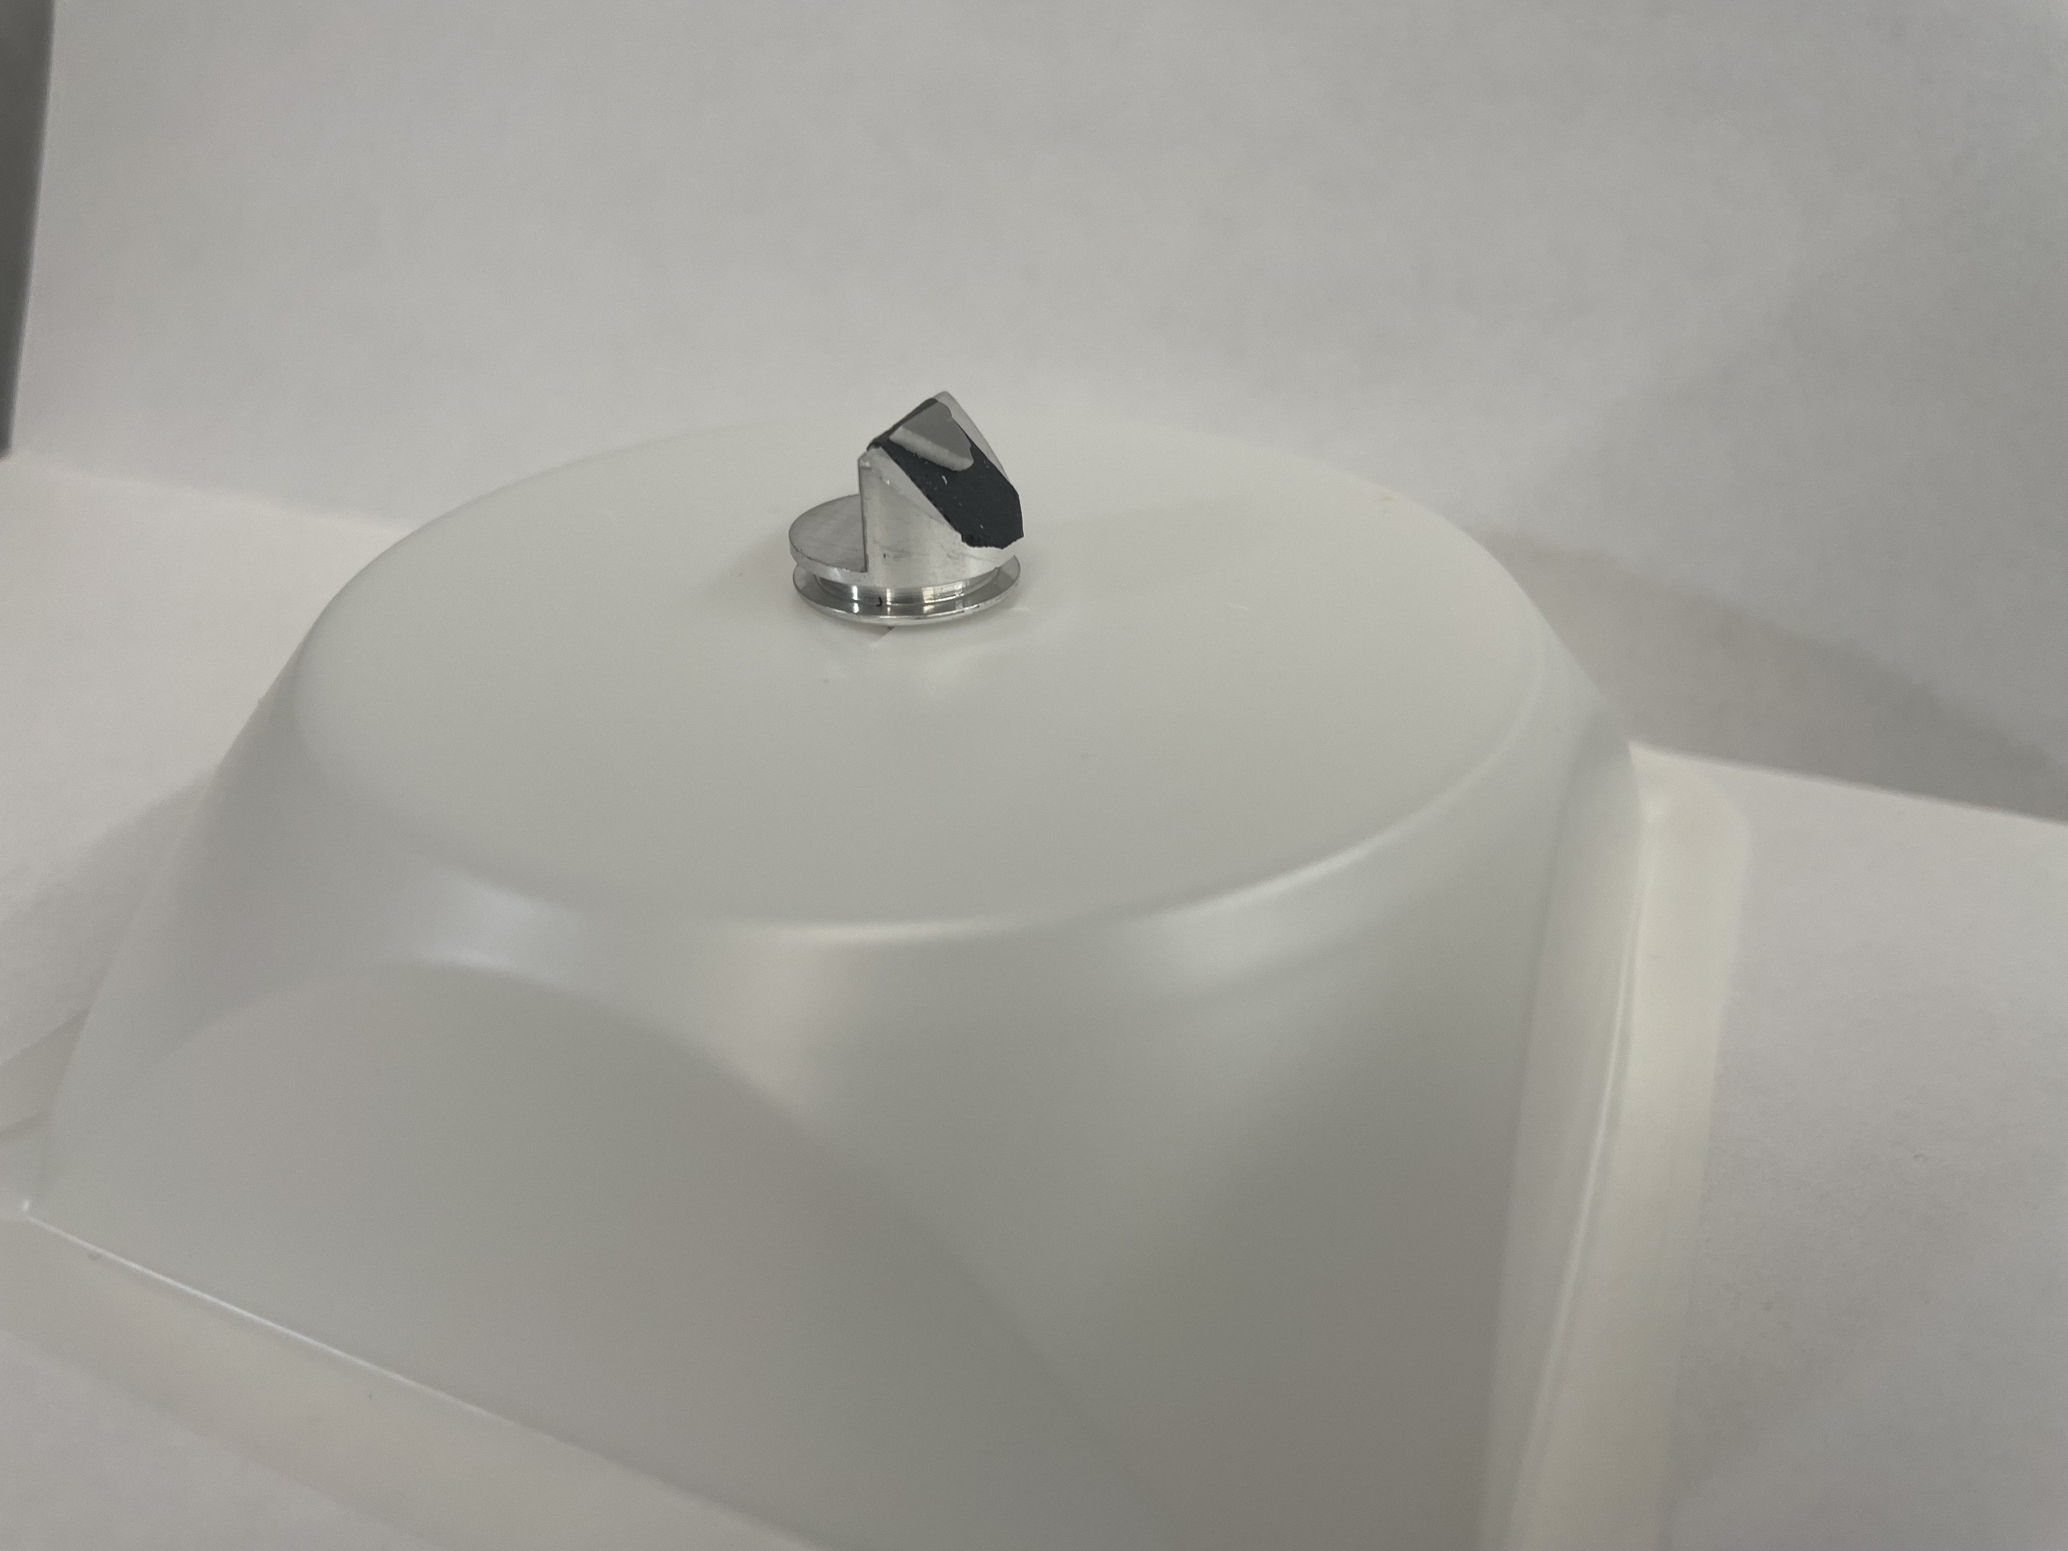

Before Annealing Palladium and CsH₂PO₄ 45° View SEM Image
50 µm
Notes:
Another angle we tried is 45 degrees and it was to again observe and interface and the interaction between our respective electrode material and the electrolyte.
This is how our stub looked like when we put it in the microscope at a 45-degree angle
The image on the far right is an SEM photo of this sample and we can see the stark difference between the two materials with Palladium and CDP on the right.
After imaging, we did some Energy Dispersive Spectroscopy Analysis or EDS to help us identify any interactions between the two materials

Slide 12
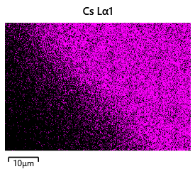
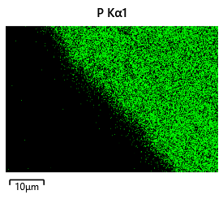
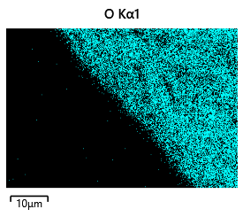
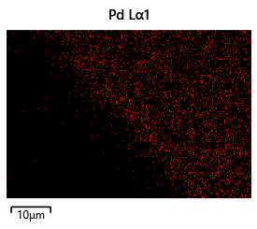
Preliminary Results – Energy Dispersive Spectroscopy (EDS)
50 µm
Notes:
We noticed that all the elements were in the correct place, and they match.
The Cs is on the correct side, same with the Phosphorous and the Oxygen.
However, the Palladium is on the complete opposite side and we concluded that when we positioned our sample in the SEM part of the sample was not facing the detector causing the Palladium to appear in the data on the opposite side.

Slide 13
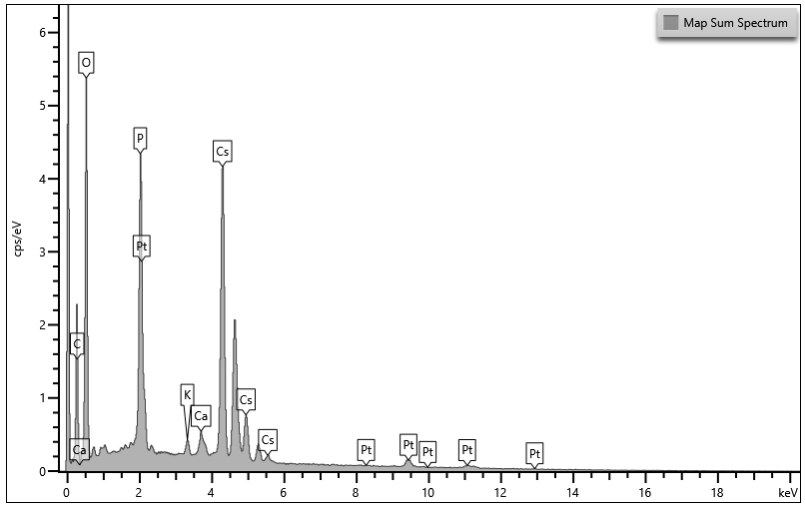
Preliminary Results – Energy Dispersive Spectroscopy (EDS)
Notes:
Here is our EDS map and we can clearly see our elements are showing signal, which is exactly what we wanted

Slide 14
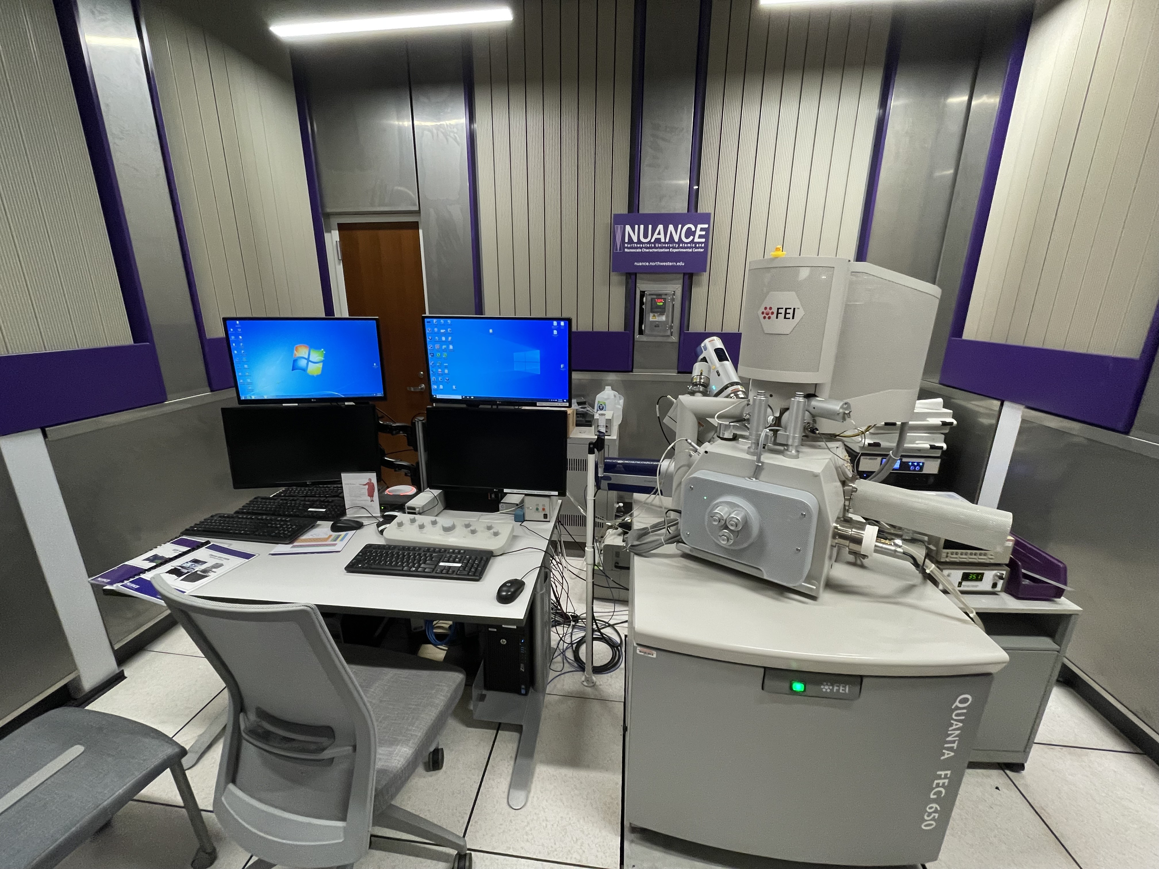
Next Steps
Image More Angled Samples
Analyzing EDS
Notes:
The next steps in the project are to image more of the after annealed angled samples at 90 degrees such as the Pd, Pd+Sn and Pt.
To help better observe the interaction between the CsH₂PO₄ and our respective electrode material.
And then to analyze the interactions of the elements within the electrode and electrolyte through Energy Dispersive Spectroscopy (EDS)

Slide 15


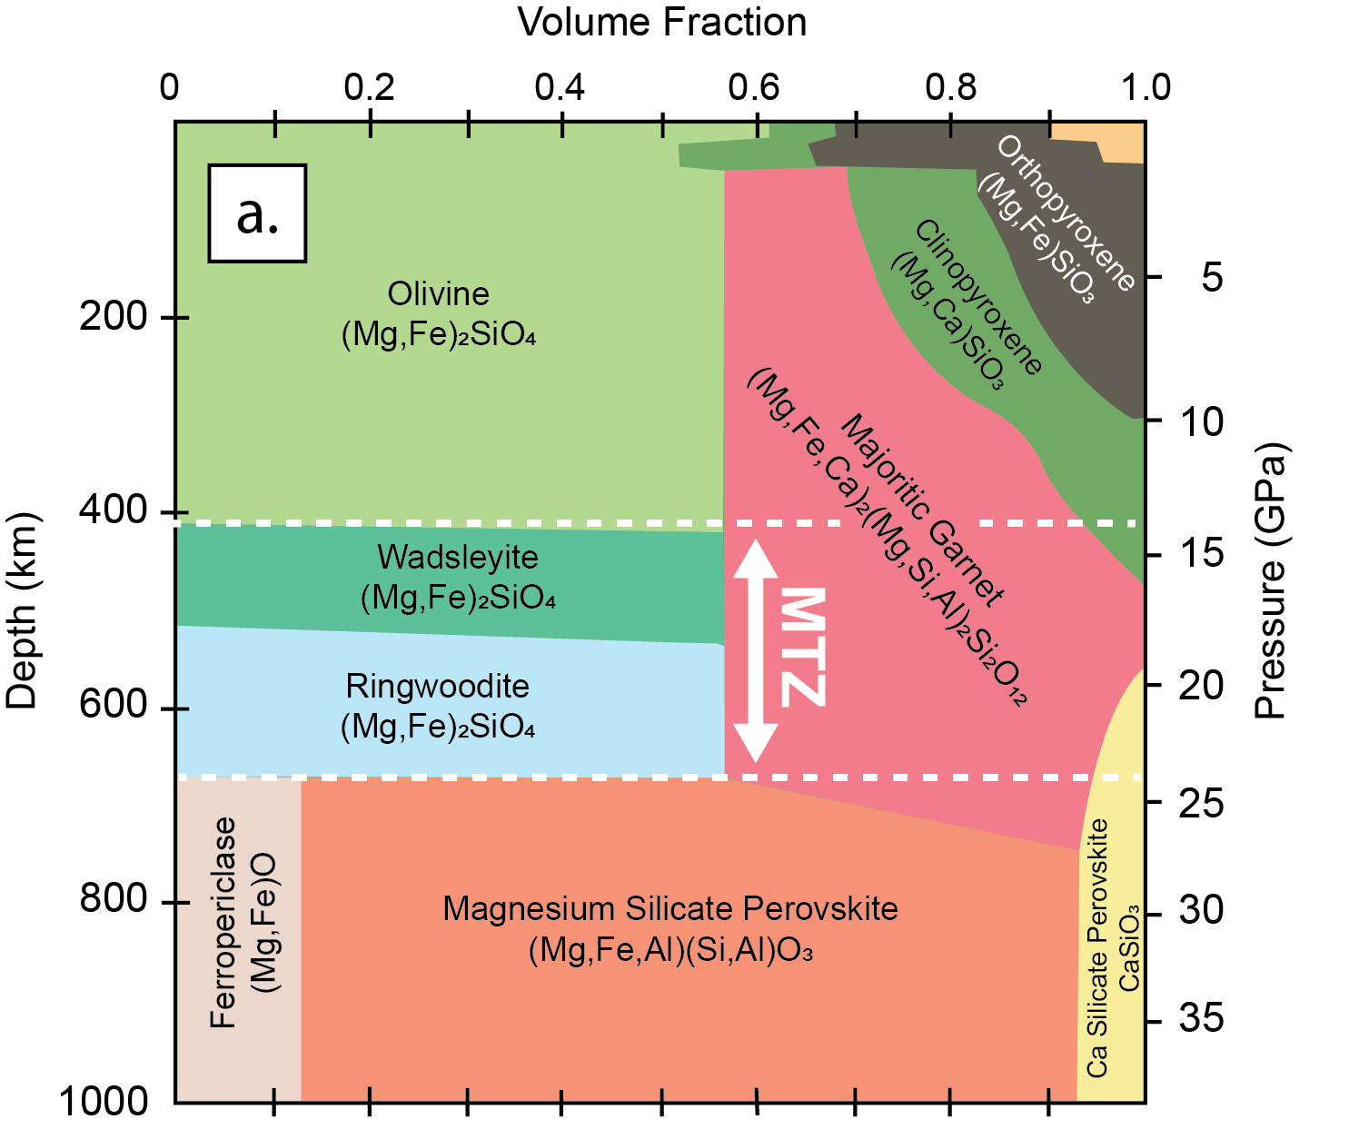


Notes:
Thanks

