Slide 1

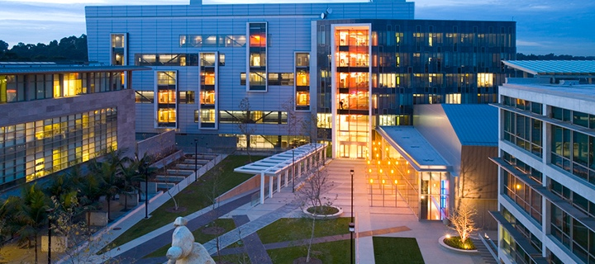




Optimization of a UV-Curable Tough Adhesive Hydrogel and Delivery Device for Minimally Invasive Rotator Cuff Repair
By
Krish Narotam
University of California San Diego &
San Diego Nanotechnology Infrastructure (SDNI)
Faculty PI: Shaochen Chen, Department of Nanoengineering, UC San Diego
Mentor:
David Berry, , Department of Orthopedics , UC San Diego Medical School
Yazhi Sun, Department of Nanoengineering , UC San Diego
Presented at the 2025 NNCI REU Convocation, University of California San Diego, CA
August 4-5, 2025

Slide 2
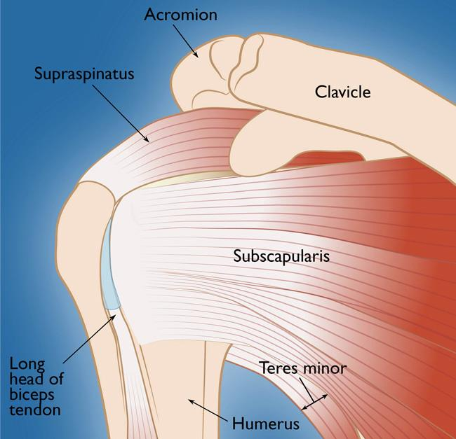
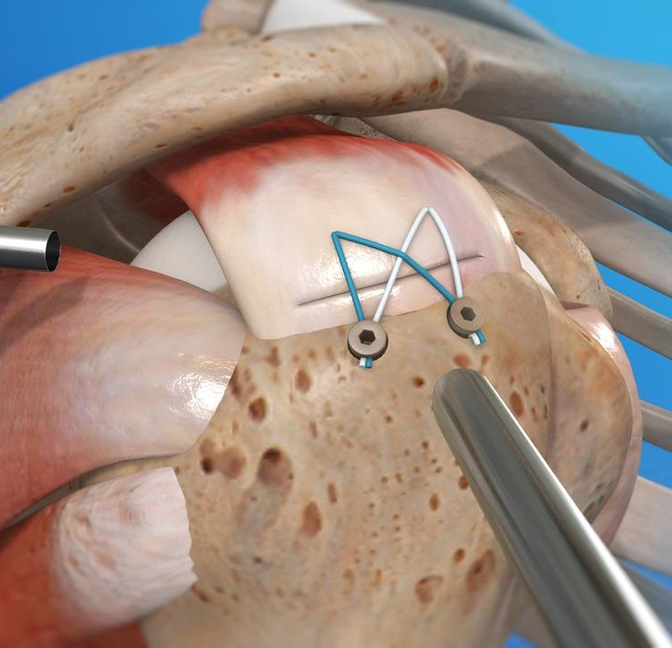
Clinical Need:
Rotator cuffs:
4 main muscles ₍₁₎
Injury Population:
- Labor intensive workers, older members of population, athletes₍₁₎
Re-tear rates:
10% - 34% failure rates (depending on age and activity level) ₍₂₎
Current Solution:
Reattach by tying down with various suture techniques ₍₂₎
  i.e. suture anchors

Slide 3
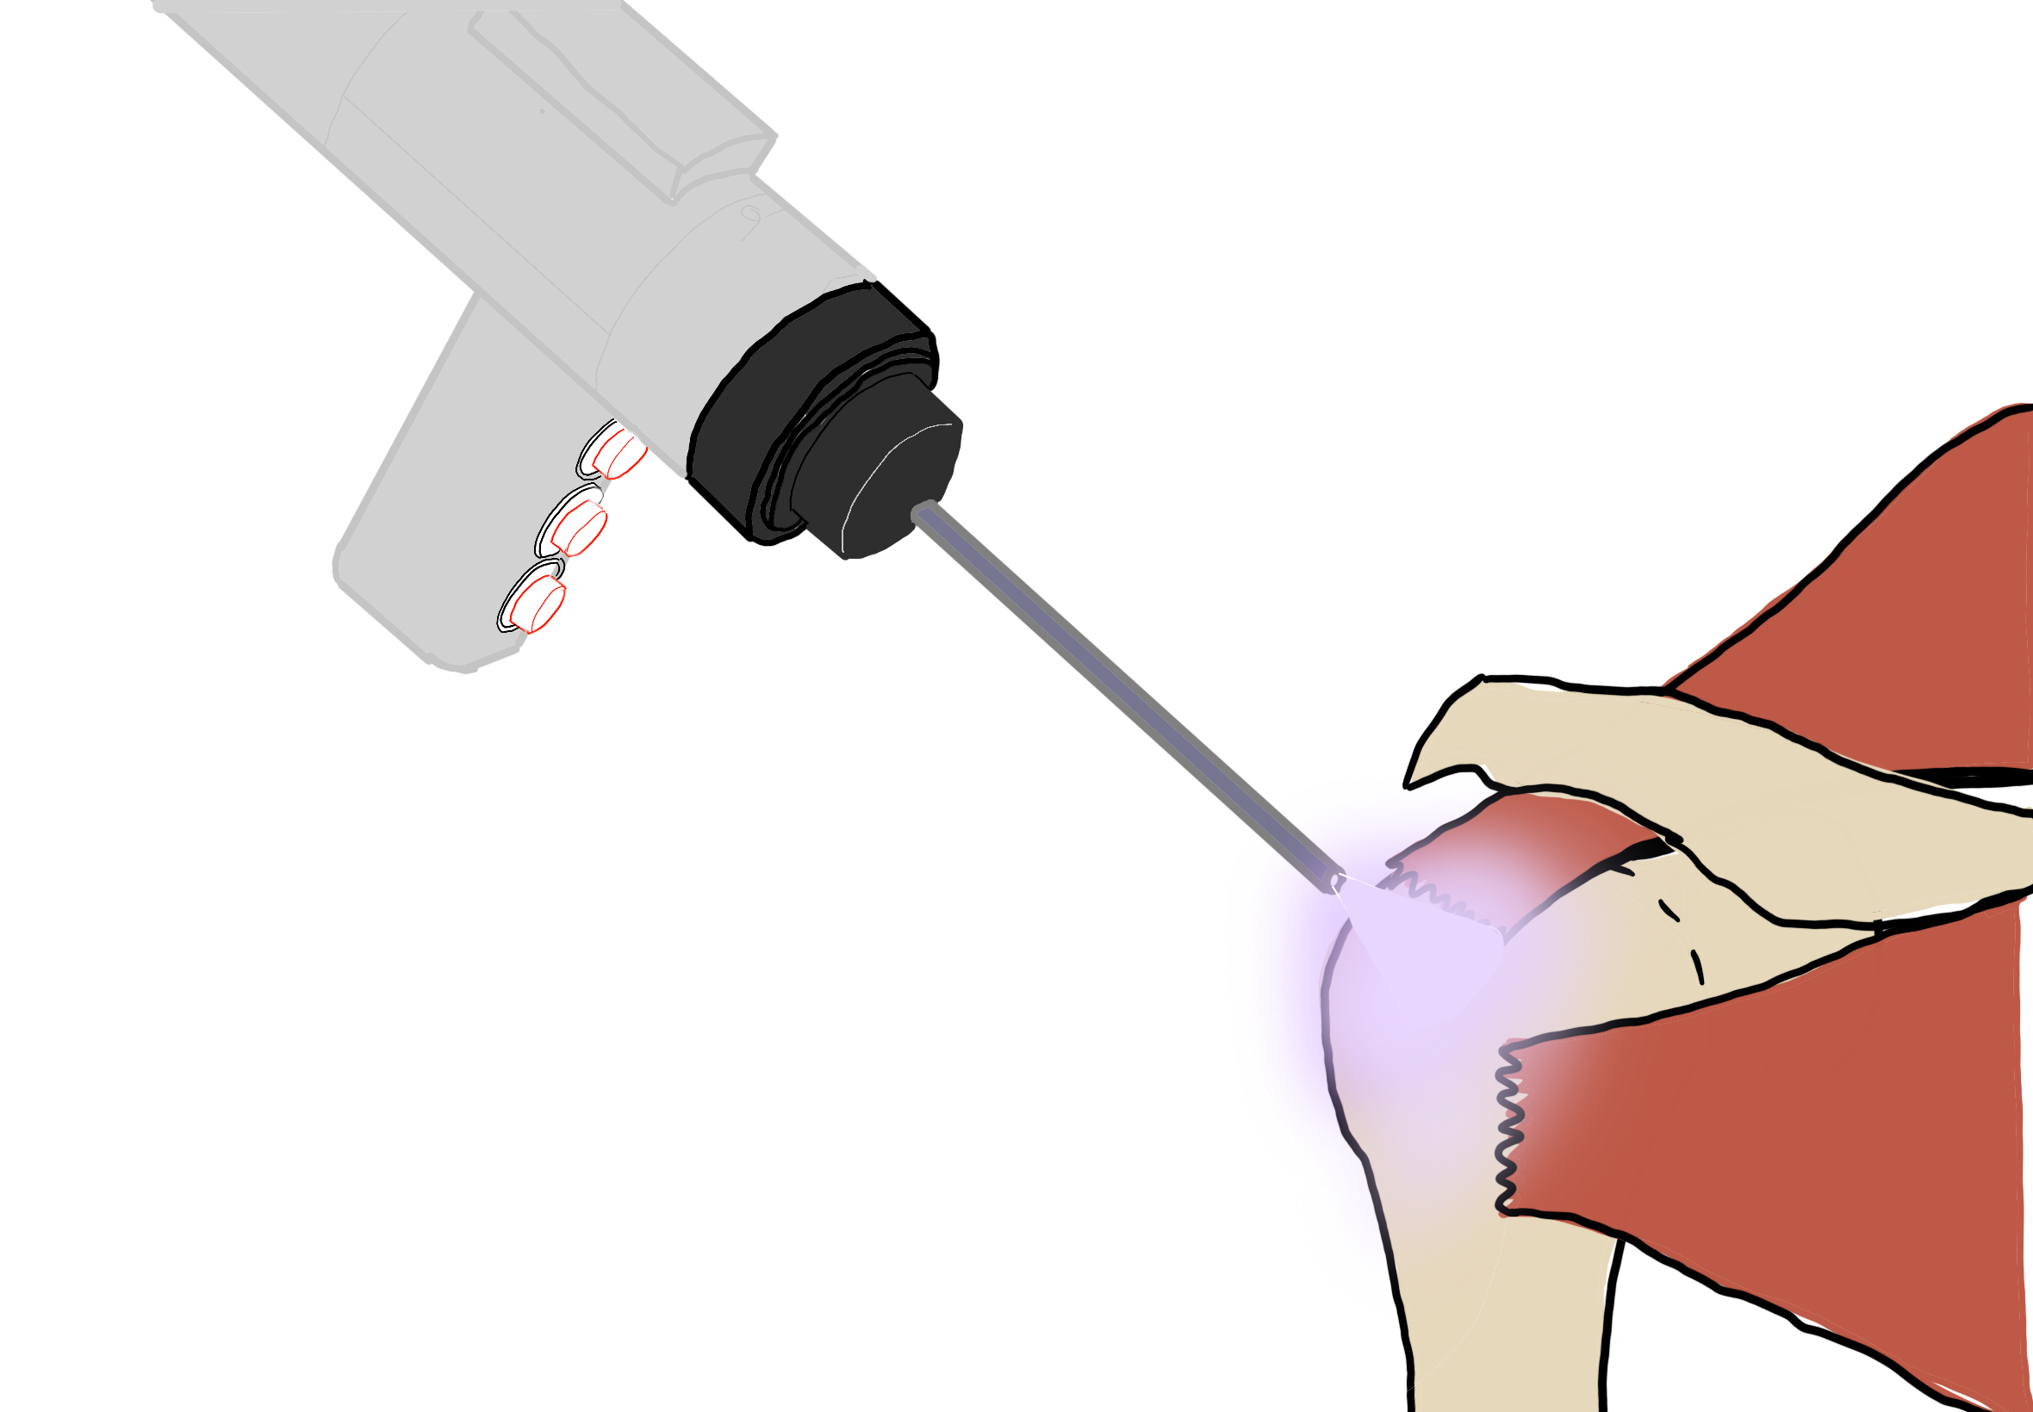
New Adhesive Strategy: 3D printer
Insert diagram of injected adhesive and then curing the TBB with UV light on tendon

Slide 4
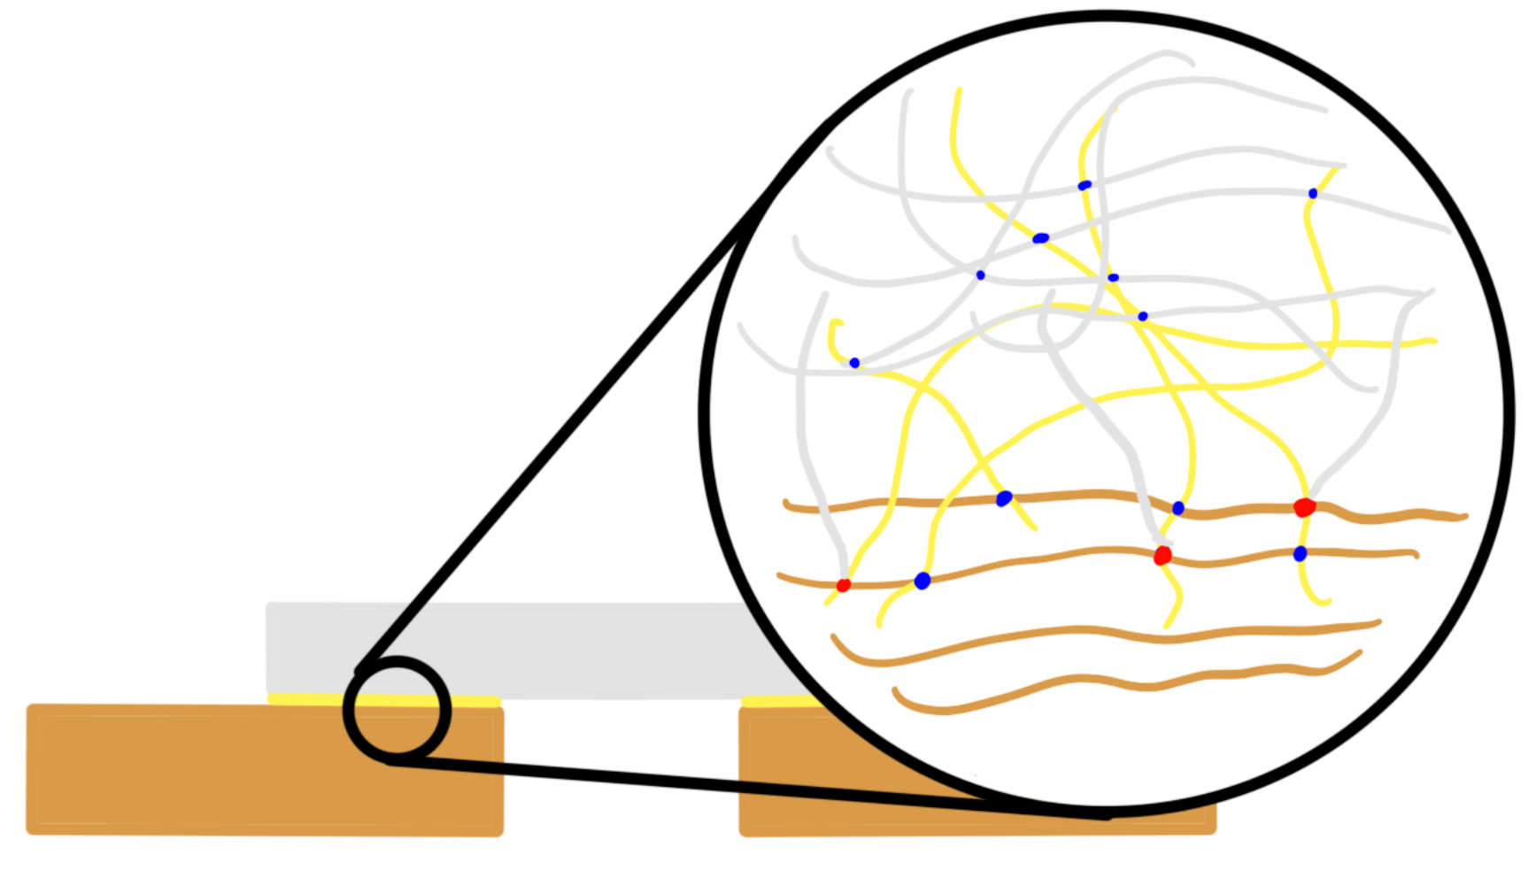
Adhesive Chemistry
Two parts:
1. Adhesive:
Formula: Chitosan + EDC/NHS + MES Buffer
Chitosan diffuses into tissue and tough back bone and then participates in nucleophilic reactions with carboxylic acid
2. Tough Back Bone
Formula: Polyacrylamide + Alginate + BIS + PEGDA + MES Buffer + CaSO4
Polyacrylamide holds everything together while alginate ionic bonds break and reform to absorb the load as the polyacrylamide is held together with covalent bonds that cannot reform after being broken
Tough Hydrogel
Polyacrylamide + Alginate
Adhesive
Chitosan
Tendon
Collagen + glycosaminoglycan

Slide 5
Goal of the project
This project has two main goals:
Aim 1: Design an in-vivo 3D printer that allows the deposition and crosslinking for a nonspecific biomaterial
Aim 2: Characterize the UV cured hydrogel of the new biomaterial for the repair of a rotator cuff injury based on previously reported tough adhesive platform [4]
This project seeks to lay the foundation for a system that can improve the surgical outcomes for patients with rotator cuff repair.

Slide 6
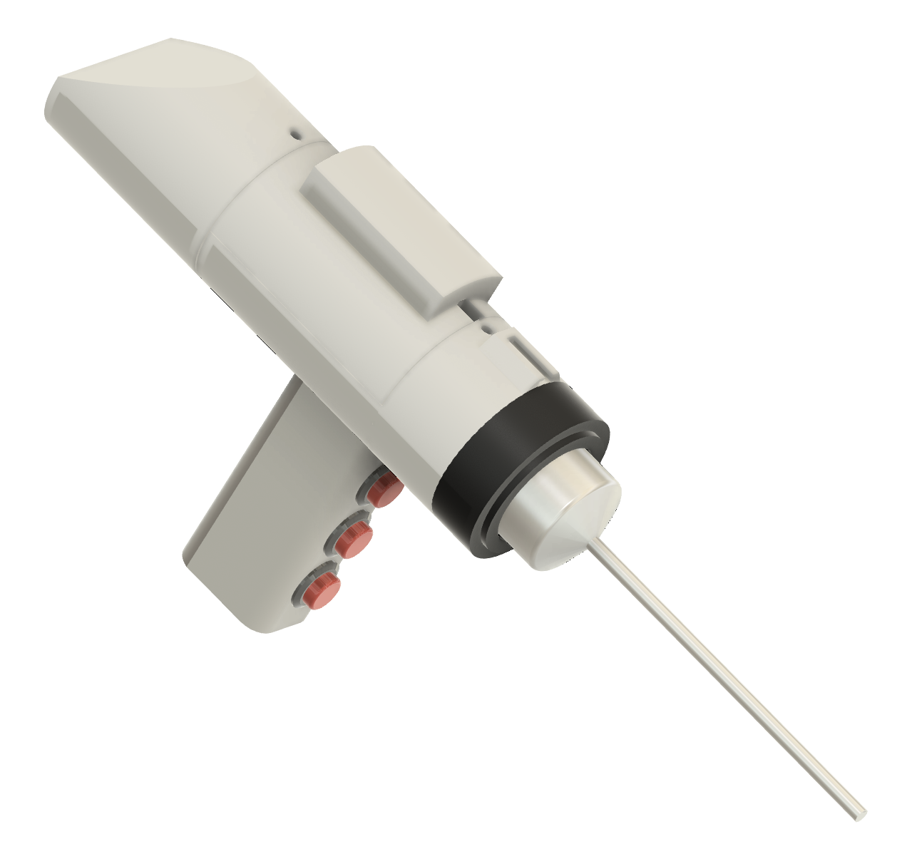
Aim 1: In-vivo 3D printer
Features:
10 mL bioink capacity
3D end tip for curing
Servo controlled deposition
5 mm diameter end tip
Underwater printing

Slide 7
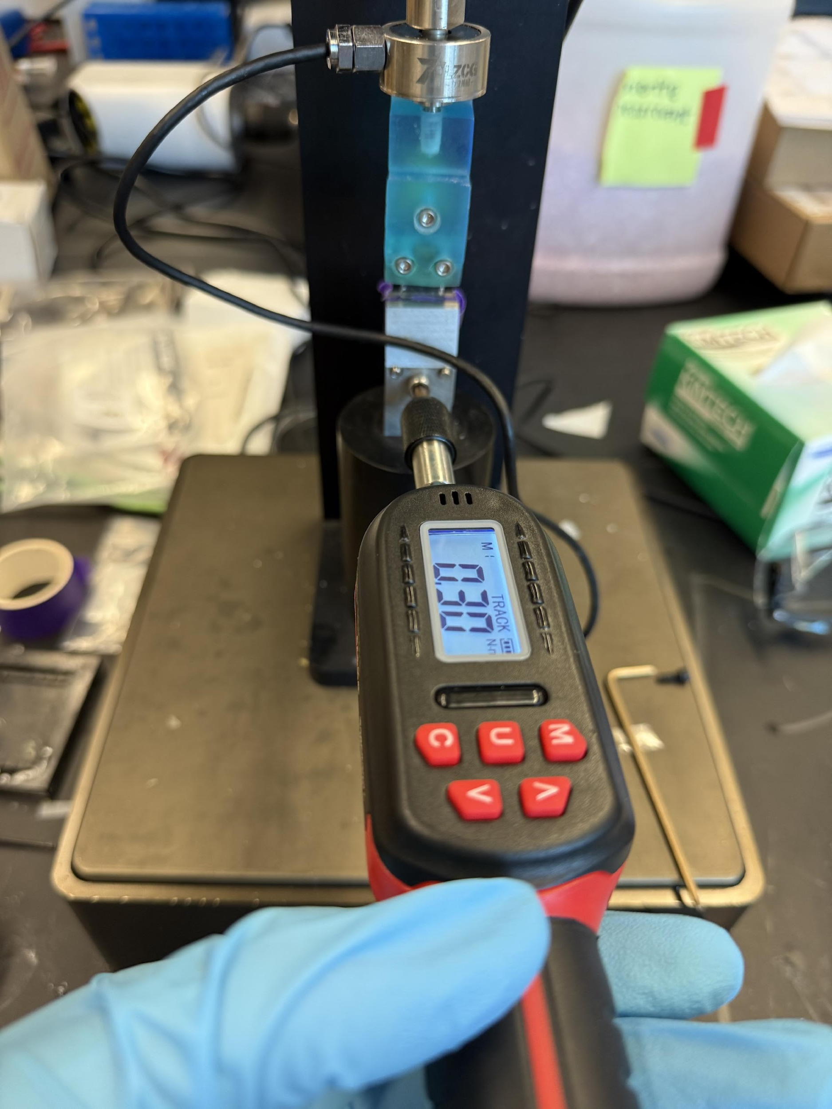
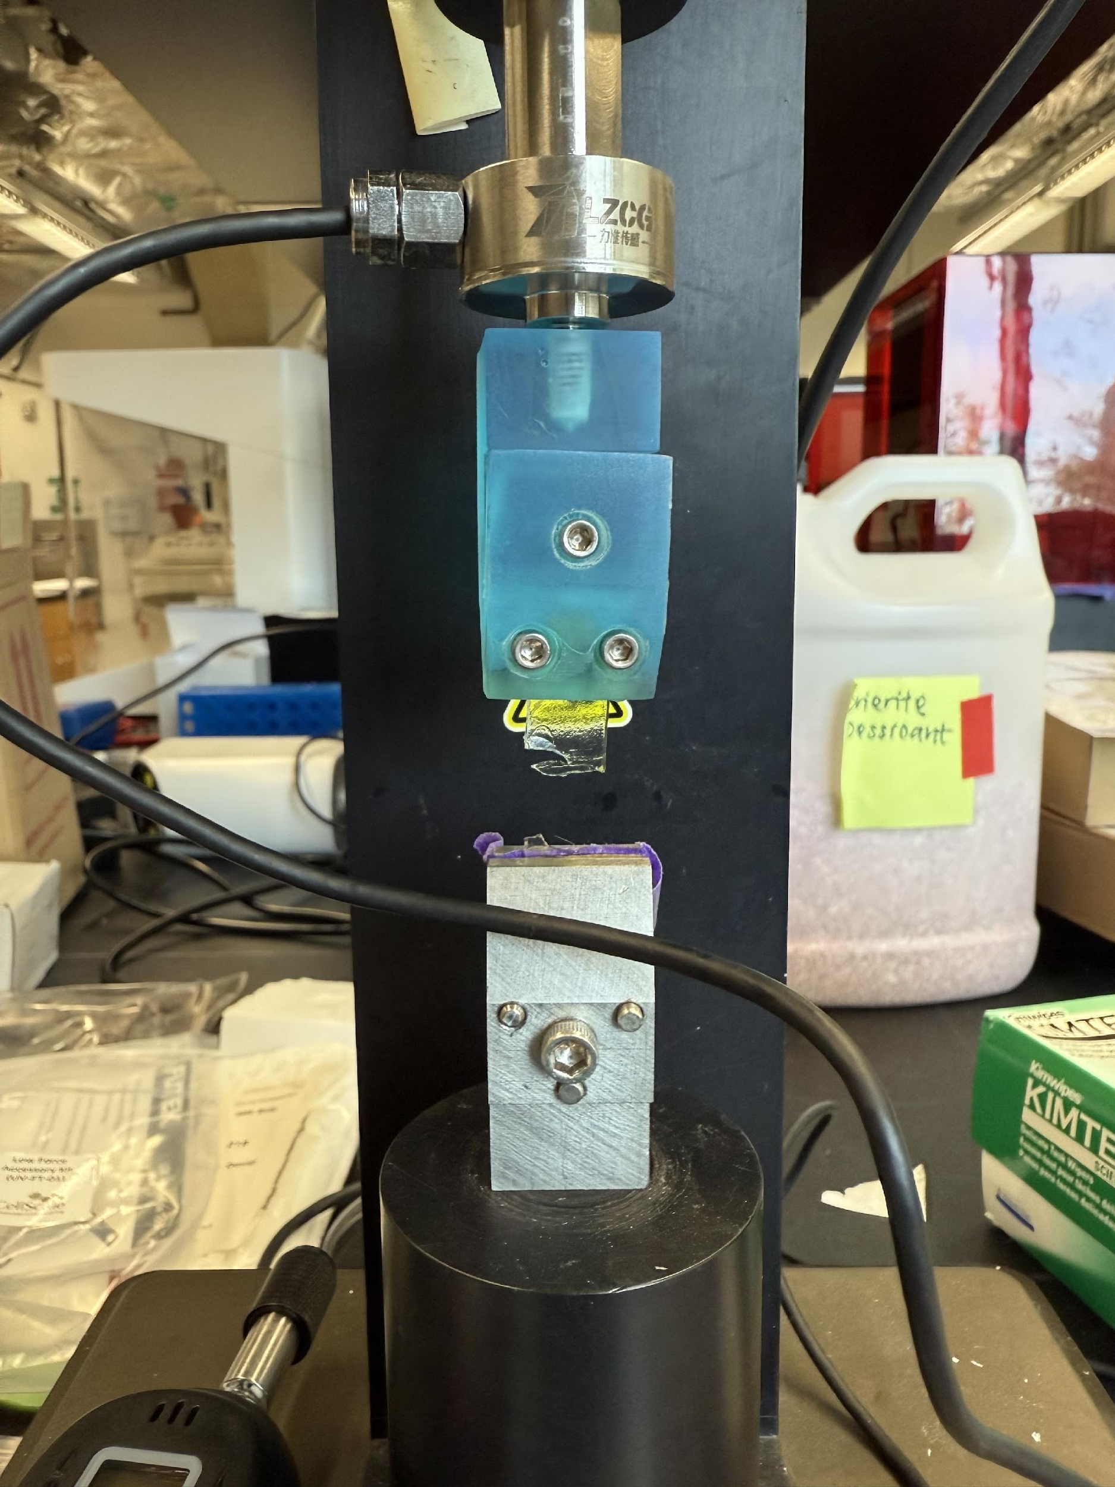
Aim 2: Characterize the Hydrogel
Optimized Testing procedure
Tested 3 different parameters to see their influence on maximum strain and maximum before fracture

Slide 8
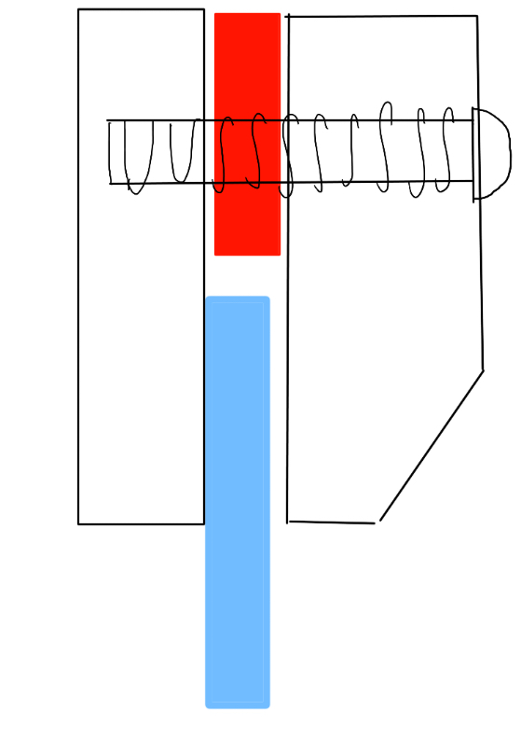
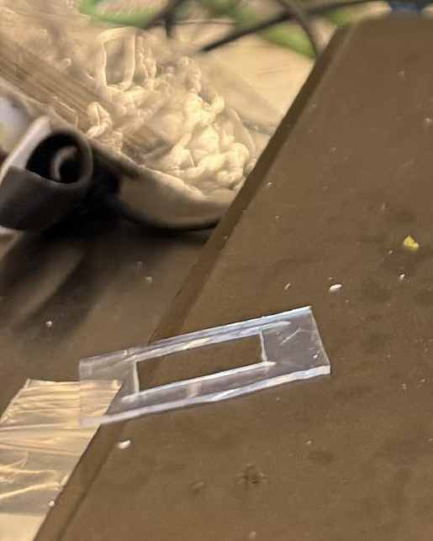
Methods:
1.25 mm
Tensile testing Hydrogels
1. Mix hydrogel ink and cure inside PDMS mold (left)
2. Place 1.25 mm PDMS spacer inbetween clamp
3. grab onto one side of the hydrogel with one clamp
4. Use the torque wrench to apply exactly .3 Nm to the screw
5. Screw the clamp onto the load cell
6. Repeat the same for the other side
7. Run 40 mm displacement test
PDMS sheet
.5 Nm torque
hydrogel
Sandpaper
1 mm

Slide 9
Results

Slide 10
Conclusion
Hydrogel Results Analysis
Concentration Affects:
Total Concentration
- Increasing the length of polyacrylamide, made less brittle (higher maximum strain)
Alginate Concentration
- Though more alginate increased the strength, it became more brittle as the alginate interfered with the polyacrylamide bonds
PEGDA Concentration
- Seemed to have no meaningful effect except changing manufacturability
Broader Context
This UV-curable tendon adhesive platform represents a promising strategy to improve surgical outcomes by reducing retear rates, and may serve as a foundation for minimally invasive tendon repair techniques that enhance long-term healing and patient mobility.

Slide 11
Acknowledgements
I would like to sincerely thank:
The National Science Foundation
Our host, University of California San Diego
San Diego Nanotechnology Infrastructure (SDNI)
Dr. Shaochen Chen, Faculty PI
Yazhi Sun, Mentor
Dr. David Berry
Yves Theriault, SDNI Executive Director, Education and Outreach
Yuhwa Lo, SDNI Faculty Director
The audience for listening and for their time!
This program was supported by NSF grant ECCS 2025752

Slide 12
References
1 - https://orthoinfo.aaos.org/en/diseases--conditions/rotator-cuff-tears/
2 - https://pmc.ncbi.nlm.nih.gov/articles/PMC8170498/

