Slide 2




Powering the Future with Natural Polymers
This work was supported by NSF Award #1950137
Ian Moran
University of California – San Diego
08/04/25
Notes:
Name, University, Who I worked with

Slide 3
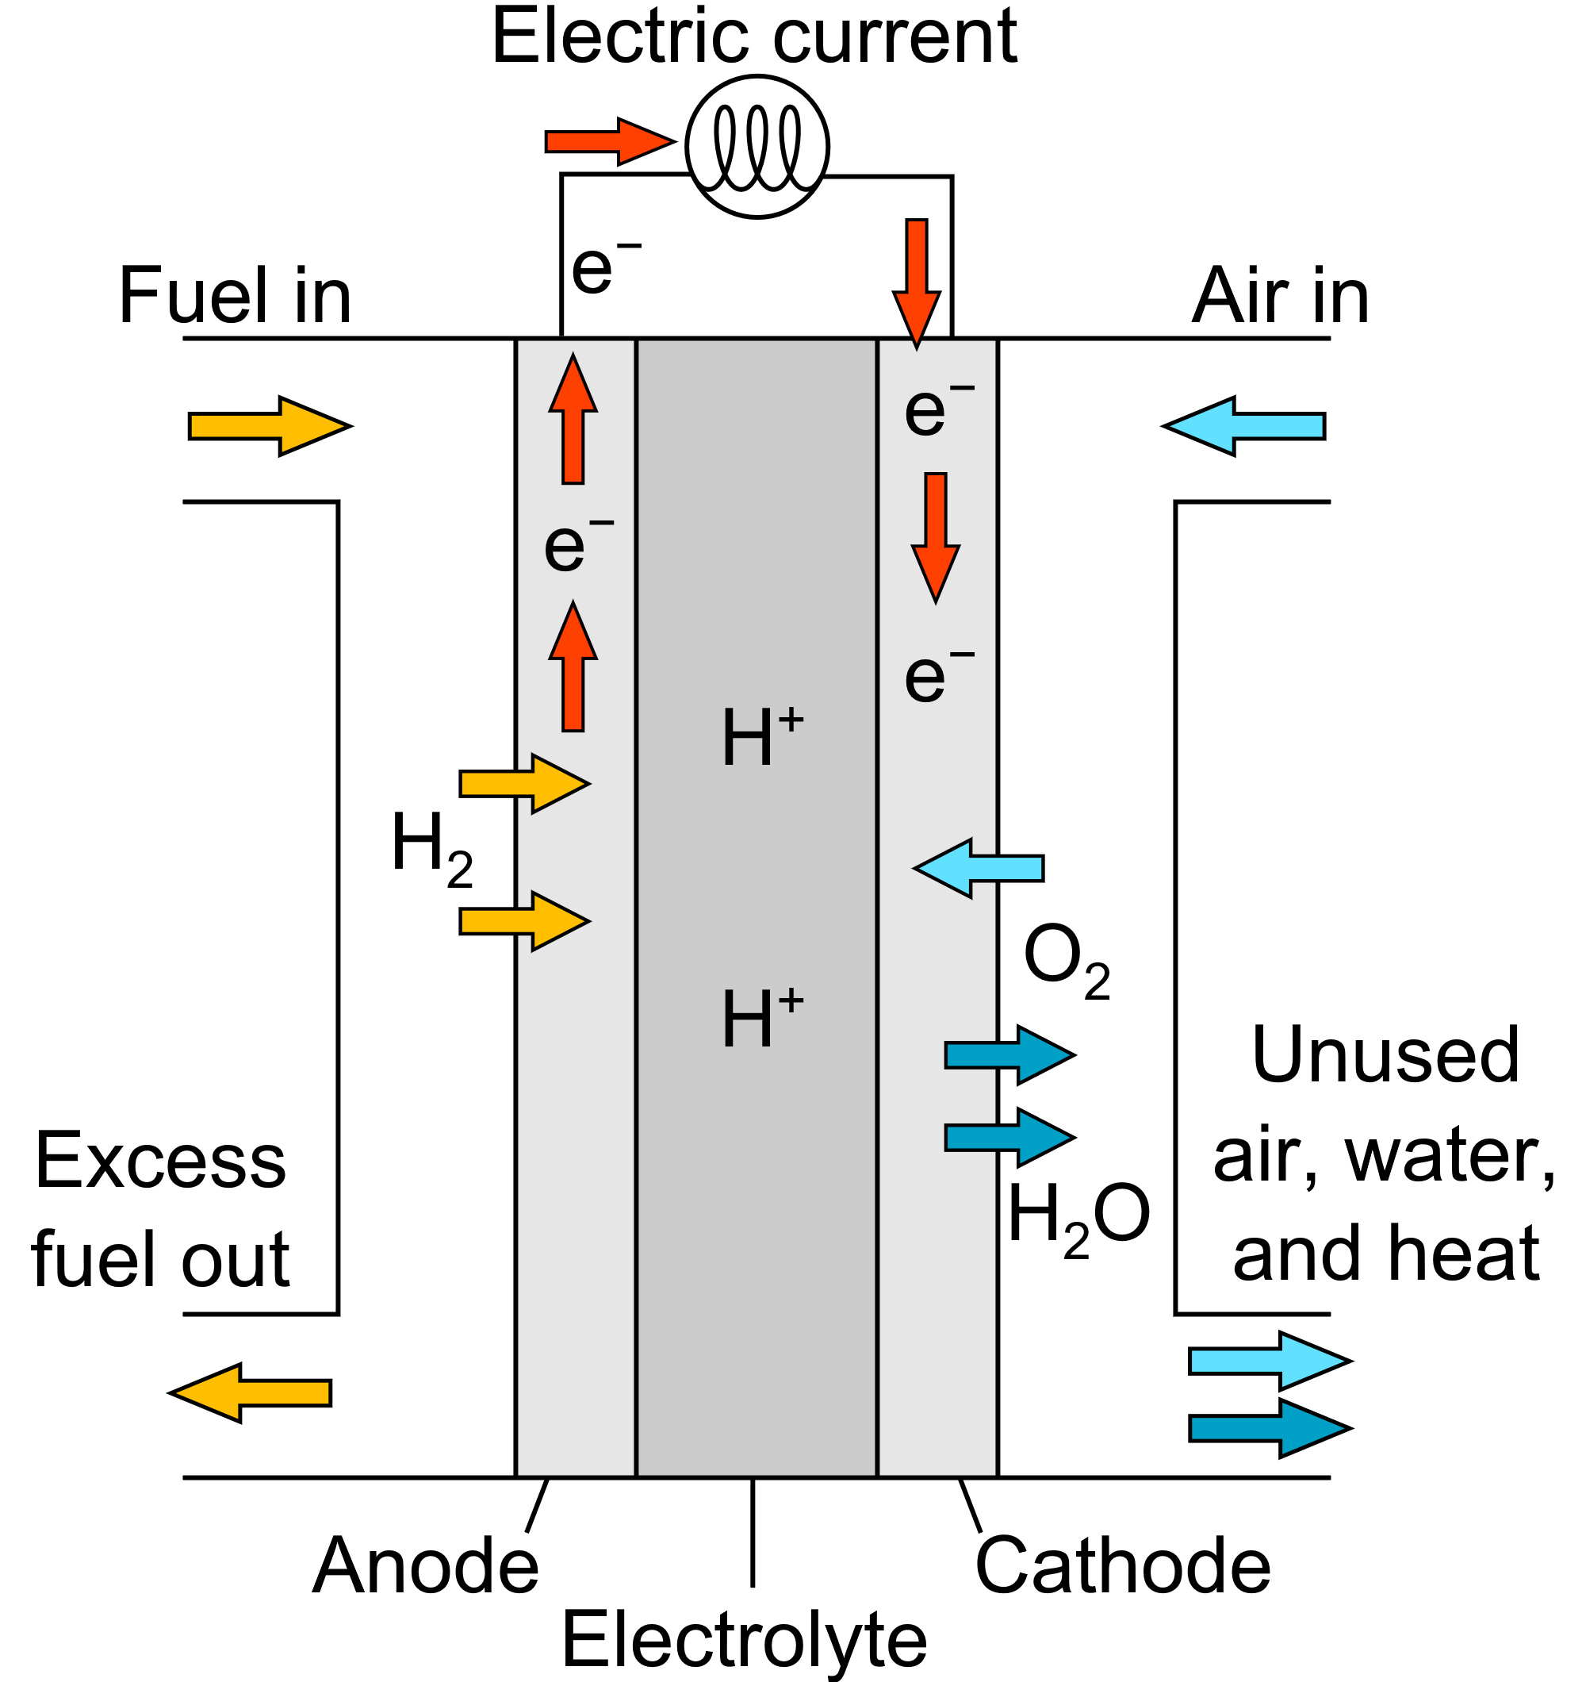
Proton-Exchange Membrane Fuel Cell
Hydrogen Fuel Cells – A promising clean energy source
  Produces only water, heat, and electricity
Prioritizing Proton Transport
  Need for well-connected pathways and water-uptake capability
Anode: 2H₂ → 4H⁺ + 4e⁻
Cathode: 4H⁺ + 4e⁻ + O₂ → 2H₂O (ORR)
Image from Mattuci
Notes:
Good source of clean energy
Hydrogen fuel, only produces water
Oxidizes/Ionizes in Anode, travels across membrane, turns back into water in cathode
Discuss role of ionomer
Binds catalyst to cathode layer to speed up reaction
For protons to travel across, need long-range hydrophilic paths

Slide 4
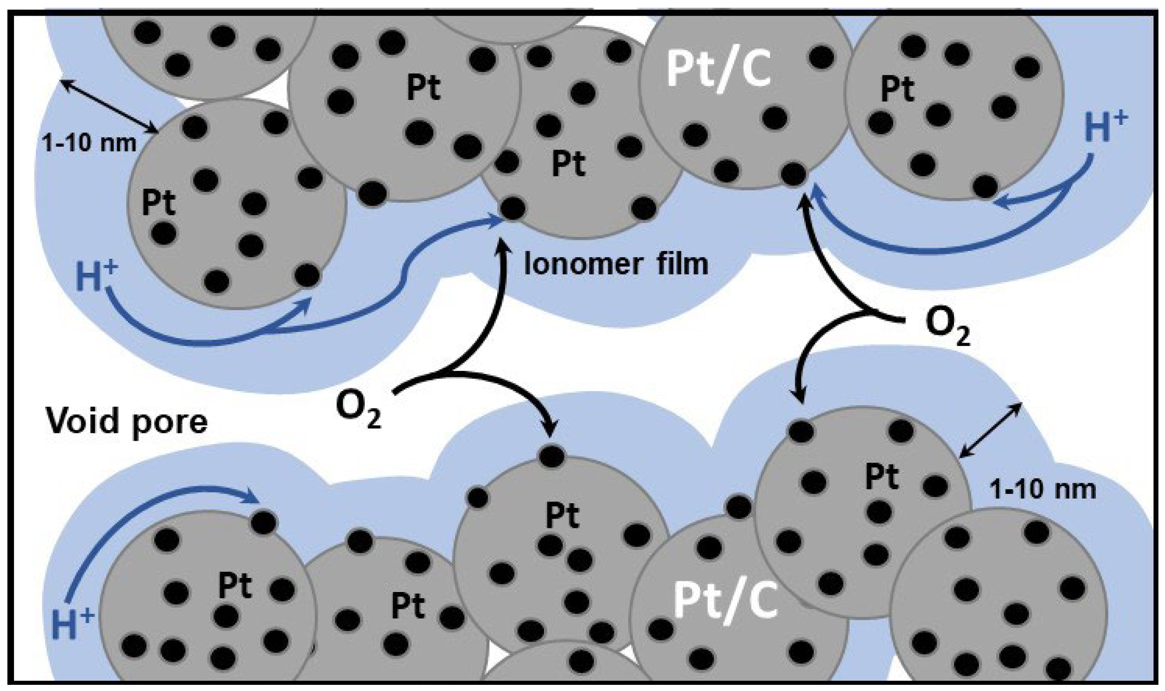
Technical Challenges of
Hydrogen Fuel Cells
Nafion: The Industry Standard
  A fluorocarbon that has excellent film proton conductivity properties as a bulk membrane, but falls short in ionomer form
  Expensive and harmful to the environment
Bulk Membranes vs Thin Films
  Significant differences in behavior even between the same material
  High ion film transport resistance at nanothin polymer-catalyst interface 1. Makes ORR sluggish and 2. negatively impacts fuel cell performance
Dishari , S. K. et al. Chem. Comm. 2024
Dishari , S. K. et al. ACS Appl. Polym. Mater. 2024
Dishari , S. K. et al. Cell Rep. Phys. Sci. 2023
Dishari , S. K. et al. ACS Macro Lett. 2020
Dishari , S. K. et al. J .Phys. Chem. C 2019
Dishari , S. K. et al. J .Phys. Chem. C 2018
Dishari , S. K. et al. Macromolecules 2013
Reshetenko, T.V. et al. Membranes 2021
Notes:
Nafion is used the most, but it is expensive and bad for the environment
It also doesn’t perform as well in a thin film form due to geometric confinement – less space for chains to move/gyrate
Substrate-film interactions also hamper performance

Slide 5
Thin Film Performance
Current fluorocarbon and hydrocarbon ionomers conduct protons poorly in thin films
As films become thinner, there is weaker phase separation
How can we improve performance? What other materials can we use?
Nafion film
thickness
4 nm
10 nm
50 nm
160 nm
Modestino et al. Macromolecules (2013)
Obewhere, O.A. et al. Chem Comm. 2024
Simari, C. et al. Polymers 2021
Notes:
Compare current data and performance
Good in bulk membrane, but not in thin films
Nafion chart illustrates less scattering because of more confinement. Weaker phase separation in thin films
Phase separation is how hydrophilic sulfonic acid chains clump together away from the hydrophobic backbone
Want to answer this question

Slide 6
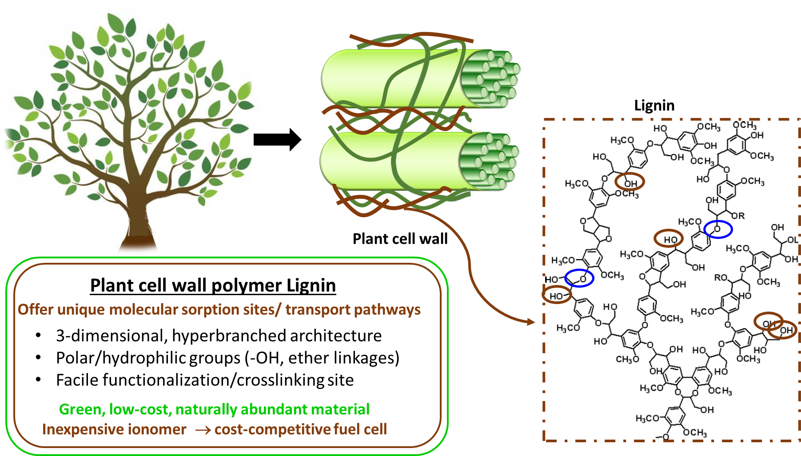
Exploring Lignin-Based Ionomers
Avci, A.H. et al. Molecules 2021
Minke C. et al. Journal of Power Sources 2015
Aftab, S. et al. Energy & Fuels 2020
Notes:
OMG Lignin such wow
From plants, commonly a byproduct of pulp and paper industry
Much cheaper than nafion
Works well as an ionomer/thin film because lots of hydrophilic groups that help make long-range hydrophilic domains
Crosslinking sites mean its adaptable
3D structure provides space for water to collect and transport protons

Slide 7

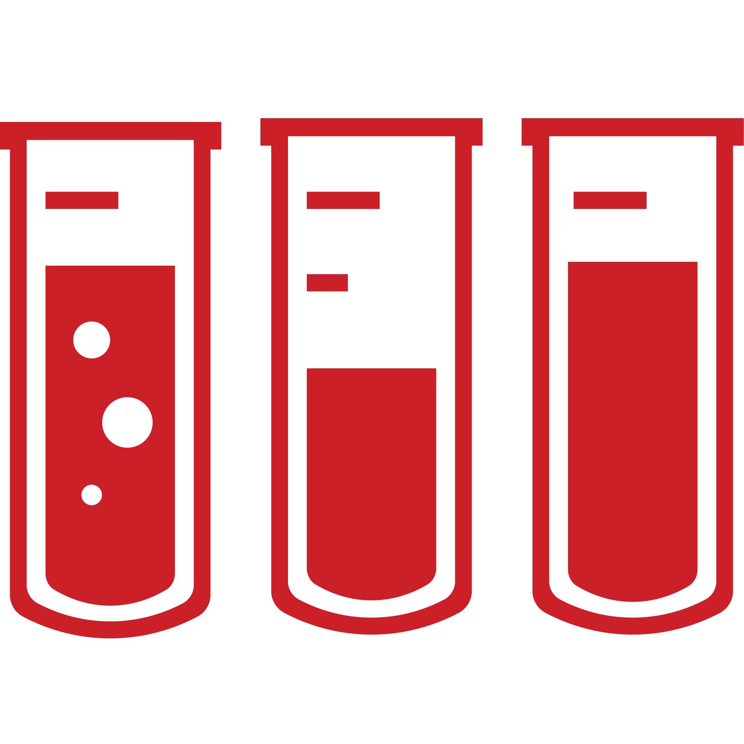





Our Approach: SPSf-LS Composite Thin Films to Improve Thin-Film Proton Conductivity
Prepare silicon and IDE wafers
Prep SPSf and Lignosulfonate solutions
Spin-cast at 3000 rpm
Anneal at 42° C for 3 hrs and 100° C for 7 hrs
Birefringence measurements using VASE
Conductivity measurements using EIS
Notes:
Variable-Angle Spectroscopic Ellipsometry: Shines a beam of light at the wafer and measures the characteristics/differences of the reflected beam
Birefringence: Change in refractive index. Tells us molecular orientation
Electrochemical Impedance Spectroscopy: a common practice. In a circuit, a disruption, or impedance is applied, and the response is measured to gather information

Slide 8
Results

Slide 9

Conductivity and Nyquist Plots
Raw EIS data was analyzed using Z-View
  Must be fit using an equivalent circuit (above)
  Mirrors IDE-film structure
Contact Pad
Film layer
Nyquist plots of SPSf-LS show that semicircle diameter of SPSf-LS composite was significantly smaller than that of pure SPSf, indicating lower film resistance and leading to increased proton conductivity.
Active Area
Notes:
Raw data from EIS analyzed using Z-View and fit using an equivalent circuit that mirrors the properties and setup of our samples
L1: Inductal element accounts for electric field
Rs: Resistor accounts for natural resistance in wires/connections/probe
CPEdl: Constant Phase Element (double layer) accounts for double layer capacitance effect aka false charge storage in the wafer-coating interface. Like a charge is trapped between 2 layers
Rf and CPEf: resistance and Constant Phase Element from film, respectively
Diameter shows resistance, SPSf-LS composite is really really tiny

Slide 10
Conductivity and Nyquist Plots
Performance of SPSf-LS Composite Compared to Nafion
Notes:
From resistance, calculate conductivity
Got some amazingly insane results! Really good performance in 1:1
SPSf-LS in a 1:1 ratio has a significantly higher conductivity by three orders of magnitude, from 0.0203 - 33.98 mS/cm, surpassing that of Nafion.

Slide 11
















LS Changes the Ionomer Chain Orientation in Thin Films
SPSf chains without LS
SPSf chains with LS
Substrate Layer
Substrate Layer
SO₃H-
Birefringence:
<0: Parallel to substrate
~0: Random orientation
>0: Perpendicular to substrate
Hydrophilic ionic domains
Hydrophilic Ionic Domain
LS facilitates long-range, connected ionic domains
SPSf
Lignin
Notes:
Conductivity results explained by birefringence (molecular orientation)
0 and above are good! Picture is a rough approximation of how LS affects it. There is less interaction of SPSf-LS chains with the substrate, so less confinement, making it easier for protons to go through
Proton transport is the name of the game
*next image*
This shows an illustration of the hydrophilic domains that lignin allows for. Clumped SO3H groups attract water, making long-range paths for protons to travel through from mebrane to cathode
LS causes disruption in surface parallel organization of SPSf chains. This reduces thin film confinement because when the ionomer chains are parallel to substrate, they interact with substrate with their –SO3H groups. This induces chain confinement. But when you do not let the SPSf chains sit like that (i.e. parallel to substrate), chain become less confined.
In addition to reducing confinement, LS brings its own benefit, like spider web like, hydrophilic structure that facilitates creating long-range, connected and larger ionic domains.

Slide 12
Conclusion
LS causes disruption in parallel organization of SPSf chains
  Reduces thin film confinement due to less sulfonic acid interaction with the substrate
The spider-web-like hydrophilic structure of LS facilitates the creation of long-range large and connected ionic domains
  Improves proton transport capabilities
More research can be pursued on the interaction of other hydrocarbons with LS as well as durability testing
Notes:
LS causes disruption in surface parallel organization of SPSf chains. This reduces thin film confinement because when the ionomer chains are parallel to substrate, they interact with substrate with their –SO3H groups. This induces chain confinement. But when you do not let the SPSf chains sit like that (i.e. parallel to substrate), chain become less confined.
In addition to reducing confinement, LS brings its own benefit, like spider web like, hydrophilic structure that facilitates creating long-range, connected and larger ionic domains.

Slide 13
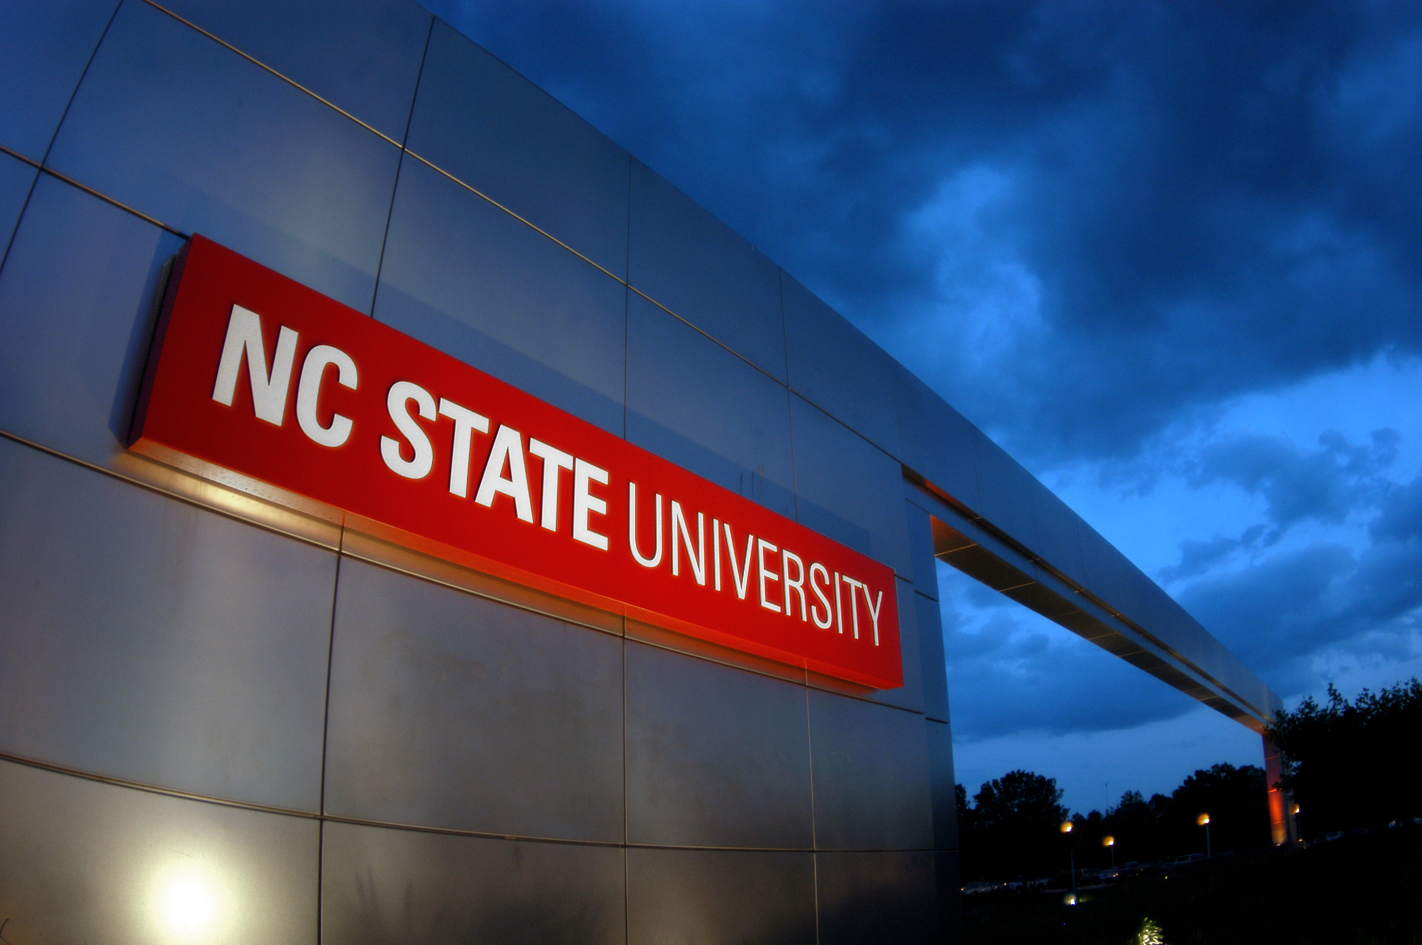
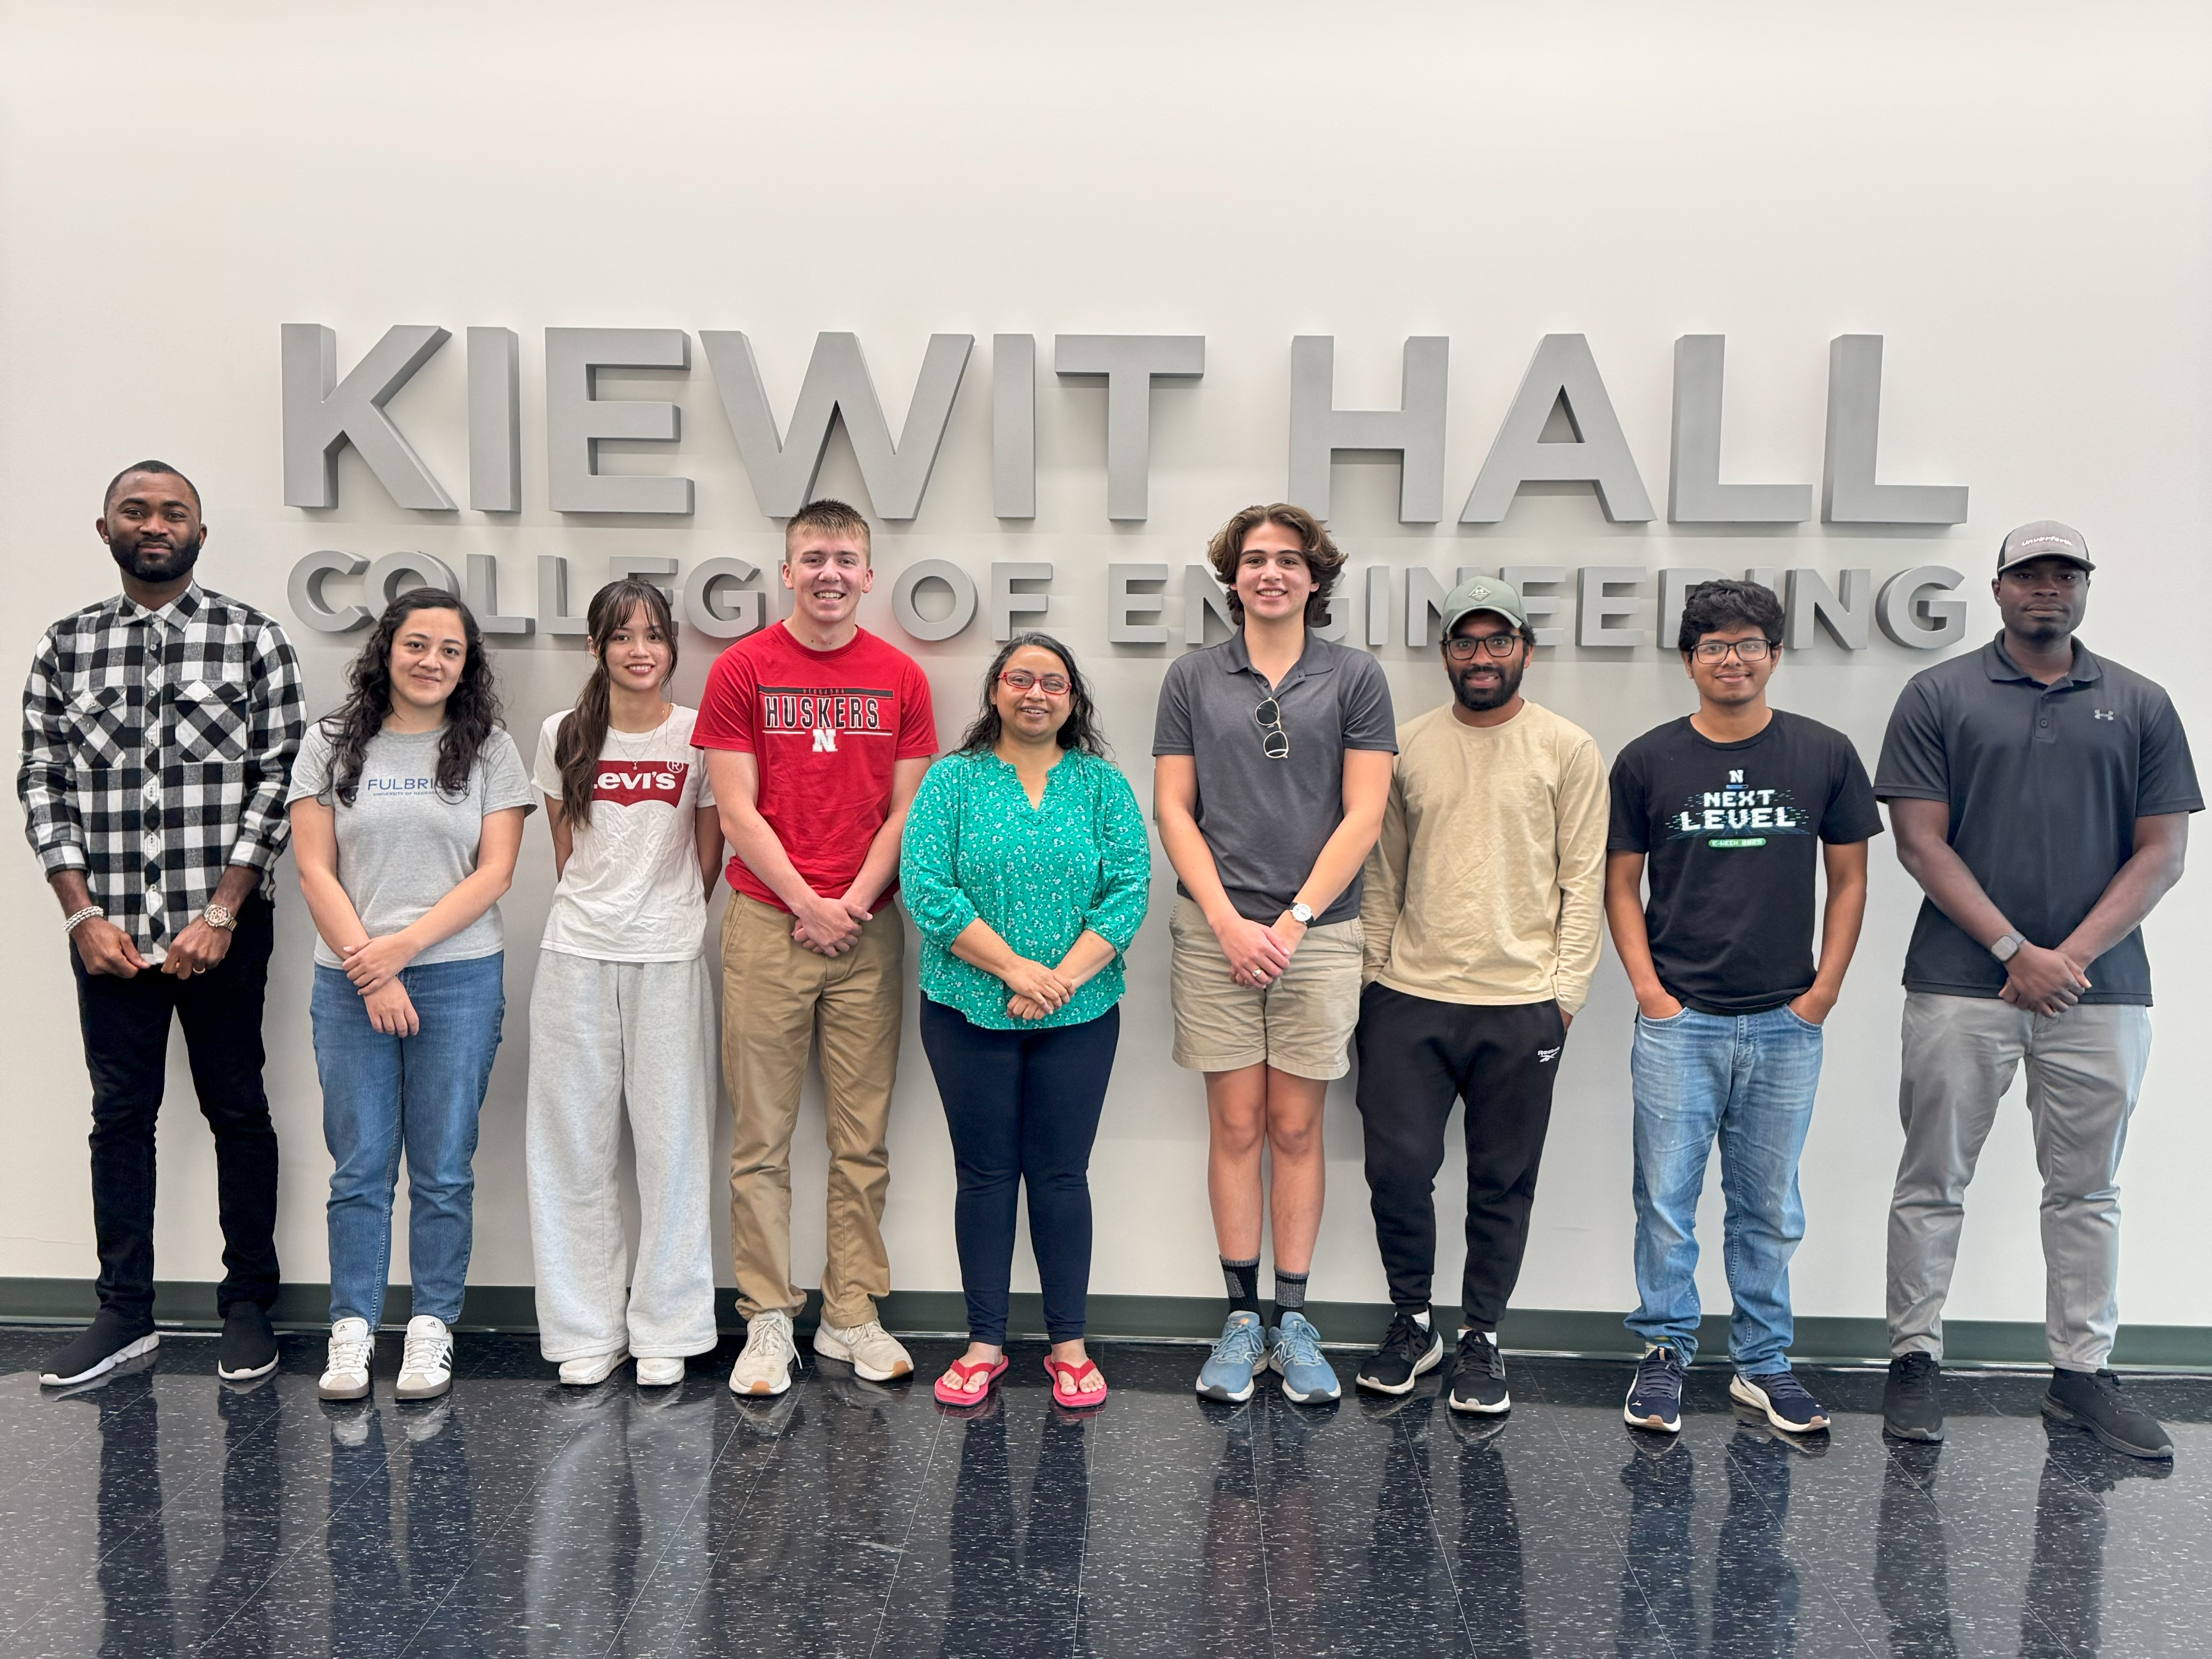
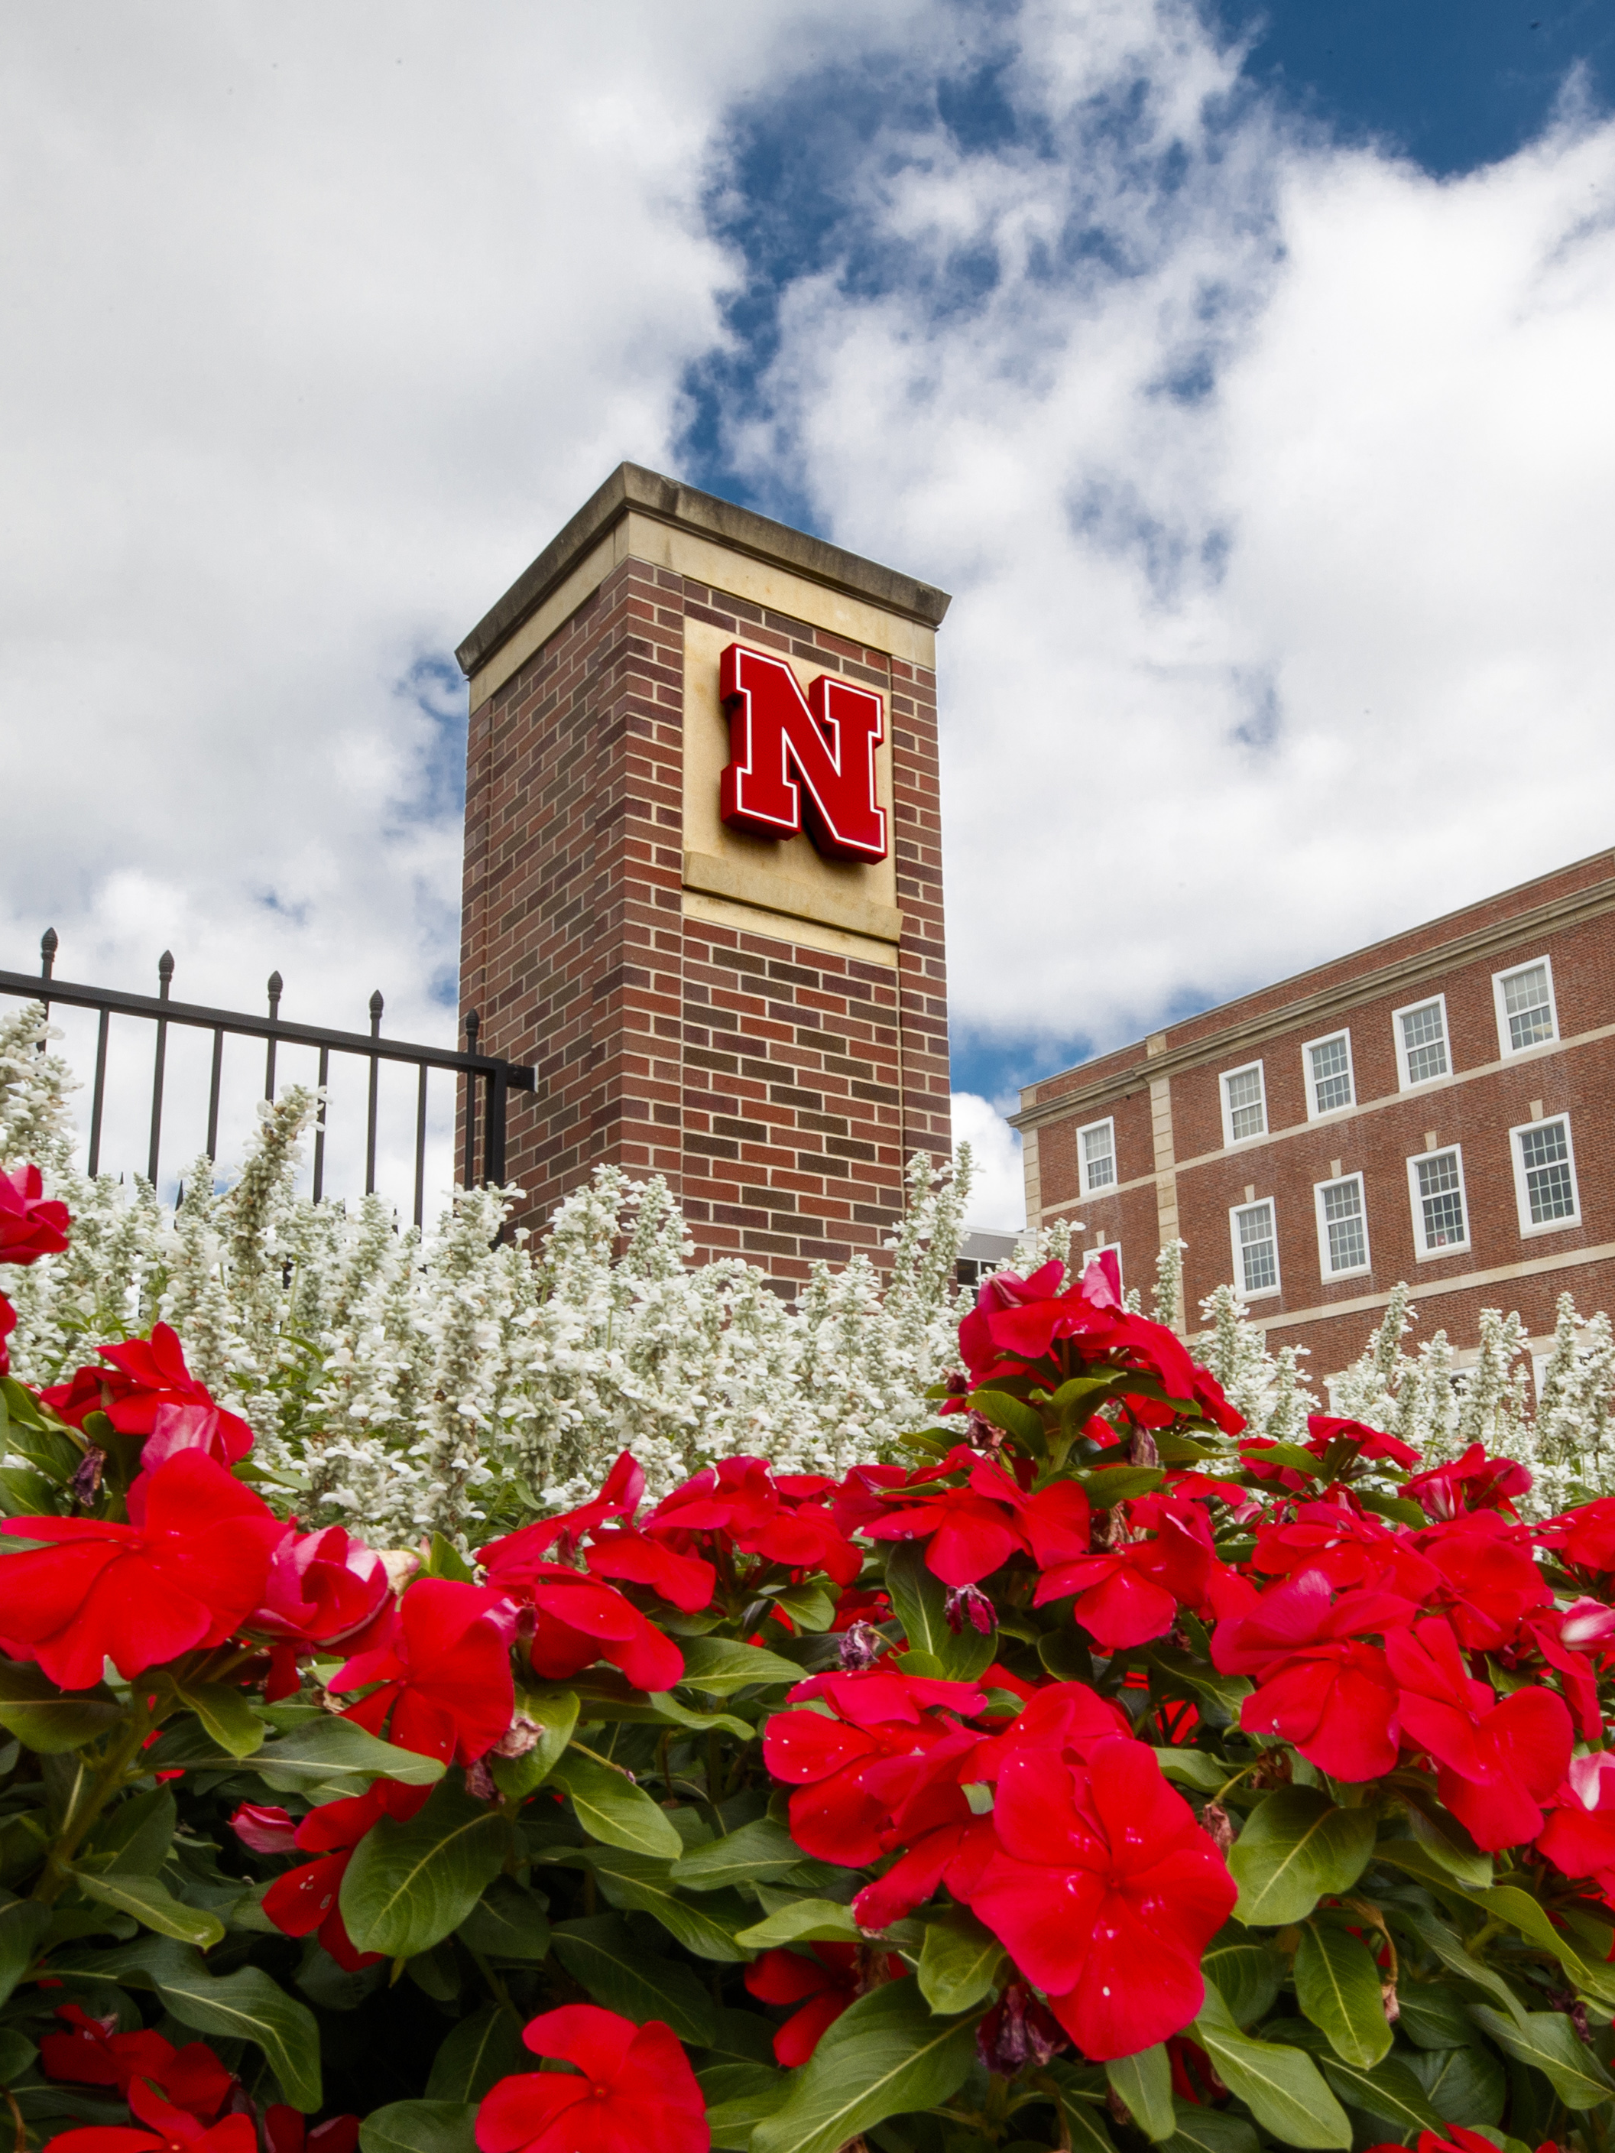
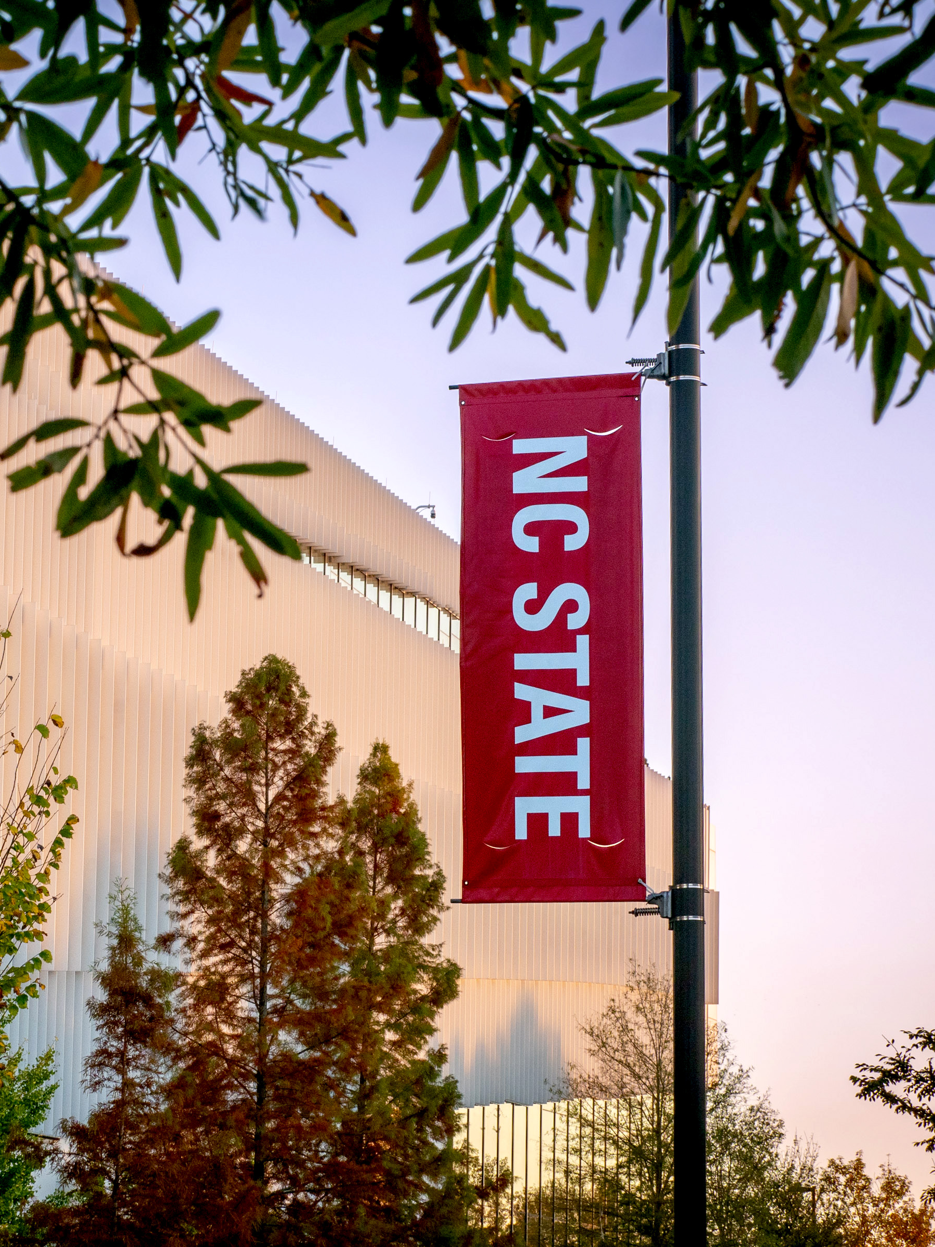
Acknowledgements
Thank you to the following individuals and groups for their support:
Dr. Shudipto Dishari, for her support and feedback
Moses Dike, for answering all my questions and helping design my research project
Graduate students Tega Obewhere, Karen Acurio-Cerda, Sourav Sutradhar, and Rajesh Keloth
Casey Coleman, Hamza Rfissa, and the Nebraska Summer Research Program
Nebraska Center for Materials and Nanoscience Research
NC State Department of Chemical and Biomolecular Engineering
University of Nebraska-Lincoln Department of Chemical and Biomolecular Engineering

Slide 14











LS Changes the Ionomer Chain Orientation in Thin Films
SPSf chains without LS
SPSf chains with LS
Substrate Layer
Substrate Layer
Molecular orientation is perpendicular/random
SO₃H-
Hydrophilic Domain
Molecules are parallel to substrate (flat)
Notes:
LS causes disruption in surface parallel organization of SPSf chains. This reduces thin film confinement because when the ionomer chains are parallel to substrate, they interact with substrate with their –SO3H groups. This induces chain confinement. But when you do not let the SPSf chains sit like that (i.e. parallel to substrate), chain become less confined.
In addition to reducing confinement, LS brings its own benefit, like spider web like, hydrophilic structure that facilitates creating long-range, connected and larger ionic domains.

Slide 15
Birefringence
LS changes the ionomer chain orientation in thin films
Add pictures of spsf base (flat), with lignin, and lignin structure
Notes:
LS causes disruption in surface parallel organization of SPSf chains. This reduces thin film confinement because when the ionomer chains are parallel to substrate, they interact with substrate with their –SO3H groups. This induces chain confinement. But when you do not let the SPSf chains sit like that (i.e. parallel to substrate), chain become less confined.
In addition to reducing confinement, LS brings its own benefit, like spider web like, hydrophilic structure that facilitates creating long-range, connected and larger ionic domains.

Slide 16

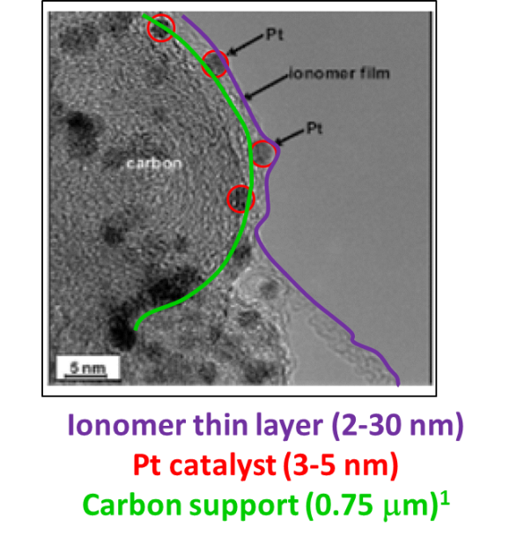
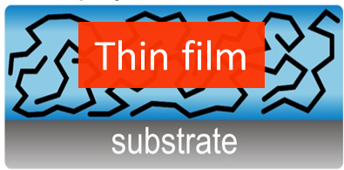
Technical Challenges of H-Fuel Cells
Dishari , S. K. et al. Chem. Comm. 2024
Dishari , S. K. et al. ACS Appl. Polym. Mater. 2024
Dishari , S. K. et al. Cell Rep. Phys. Sci. 2023
Dishari , S. K. et al. ACS Macro Lett. 2020
Dishari , S. K. et al. J .Phys. Chem. C 2019
Dishari , S. K. et al. J .Phys. Chem. C 2018
Dishari , S. K. et al. Macromolecules 2013
Proton exchange membrane fuel cell
(PEMFC)
Ionomer-catalyst interface
Anode: 2H₂ → 4H⁺ + 4e⁻
Cathode: 4H⁺ + 4e⁻ + O₂ → 2H₂O (ORR)
Issues with current state-of-the-art ionomer Nafion:
High ion transport resistance at nanothin polymer-catalyst interface
- makes ORR sluggish
- negatively impacts power performance of fuel cells
Nafion is very expensive ($500/kg, DOE cost projection report)
Nafion is fluorocarbon-based - not environment friendly.
Ionomer thin film & interfacial behavior are neither well-understood
nor attempted to improve significantly
We need low-cost, efficient, and environment friendly ionomers.
Gittleman, C. et al. Curr. Opinion Electrochem. 2019

Slide 17
Current fluorocarbon and hydrocarbon ionomers conduct protons poorly in thin films
Nafion film
thickness
4 nm
10 nm
50 nm
160 nm
Modestino et al. Macromolecules (2013)

Slide 18
LS Changes the Ionomer Chain Orientation in Thin Films
Notes:
LS causes disruption in surface parallel organization of SPSf chains. This reduces thin film confinement because when the ionomer chains are parallel to substrate, they interact with substrate with their –SO3H groups. This induces chain confinement. But when you do not let the SPSf chains sit like that (i.e. parallel to substrate), chain become less confined.
In addition to reducing confinement, LS brings its own benefit, like spider web like, hydrophilic structure that facilitates creating long-range, connected and larger ionic domains.

Slide 19
SO₃H-
Hydrophilic Domain

Slide 20
Conductivity and Nyquist Plots
SPSf-LS in a 1:1 ratio has a significantly higher conductivity by three orders of magnitude, from 0.0203 - 33.98 mS/cm, surpassing that of Nafion.

Slide 21
What is a Proton-Exchange Membrane Fuel Cell?
Hydrogen Fuel Cells – A promising clean energy source
Prioritizing Proton Transport
  Need for well-connected pathways and water-uptake capability

Slide 22
Why lignin-based ionomers?
Dishari, S.K. et al, Frontiers in Chemistry 2020

Slide 23
Identifying Knowledge Gaps
Nafion: The Industry Standard
  A fluorocarbon that has excellent conductivity properties as a bulk membrane, but falls short in ionomer form
Bulk Membranes vs Thin Films
  Significant differences in behavior even between the same material
  Substrate Interface, Geometric Confinement, Heterogeneous Microenvironment
The Best of Both Worlds?
  Lignin: Excellent Water Uptake and Conductivity properties
  SPSf: Poor conductor, but much more rigid and durable

Slide 24
Conductivity and Nyquist Plots
Notes:
Go in-depth about the equilibrium

Slide 25


Challenges
Time management and
sample consistency
Working with relative humidity
Notes:
Trouble reaching target relative humidity

Slide 26
Where to next?
SPSf-LS ionomers appear to be a viable and improved substitute to Nafion in PEMFC applications. Cost comparisons strengthen the argument for more research to be done in this field.
Combining other hydrocarbons with LS is something that can be explored.

