Slide 1


Upcycling of Multi-layer Plastics Through Delamination
Tabitha Tabb
PI: Dr. Natalie Stingelin
Mentor: Matteo Palesati
School of Materials Science and Engineering

Slide 2
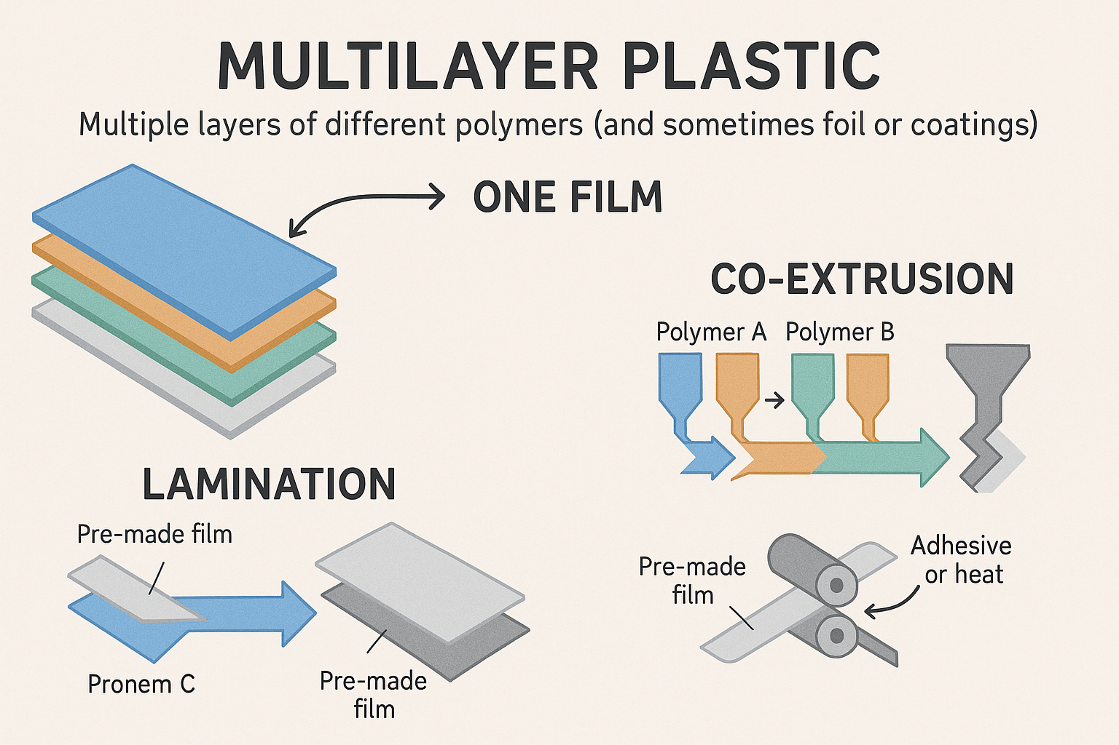
What are multilayer plastics? Intro
Notes:
Multilayer plastic is a material made by stacking multiple layers of different polymers (and sometimes foil or coatings) to combine the best properties of each layer into one film.
These layers are bonded together through co-extrusion or lamination.

Slide 3
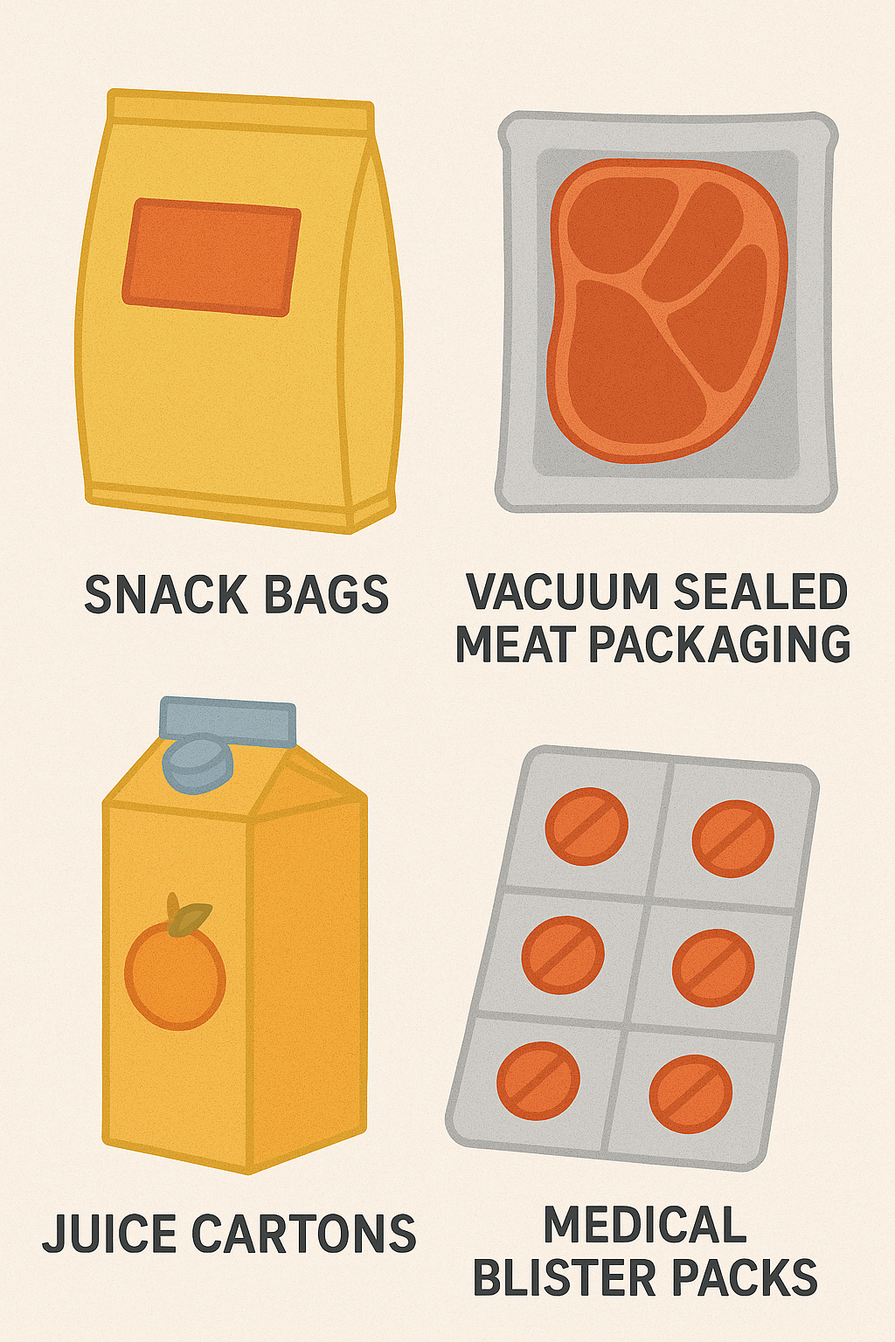
What are multilayer plastics used for? Intro
Widely used in food and medical packaging
Provide barrier protection, flexibility, strength and heat salability
Non-recyclable due to the presence of adhesive tie-layers

Slide 4
Why are multilayer plastics considered not-recyclable Intro
Different material layers require specific recycling conditions; i.e. PE (polyethylene), PET (polyethylene terephthalate), aluminum, etc.
Delamination (separation of layers) is therefore needed to treat each layer separately
Layers are tightly bonded together with adhesives making delamination difficult.
Notes:
Meaning you cannot recycle each layer in the exact same way

Slide 5
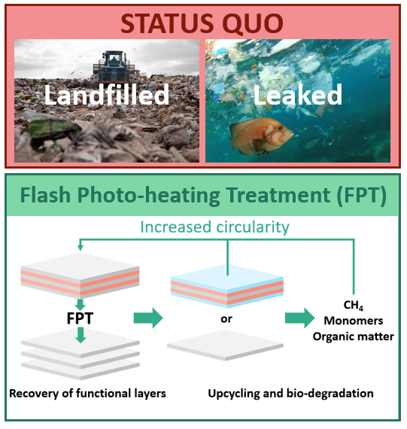
Our proposal to recycle and upcycle multilayer systems Intro
Production is increasing although non-recyclable
normally landfilled or leaked in the environment
We propose a Flash Photo-heating Treatment (FPT) to delaminate multilayer systems
Reuse of recovered layers
Recycling of recovered layers
Breakdown to valuable chemical feedstock
Notes:
Since these plastics are widely used in the food and medical industry there is an abundance of this material.
leaked via the ocean or air pollution
Target adh layer to delaminate or target functional layer and make monomers and use it to make new polymer films to make an entirely new product

Slide 6
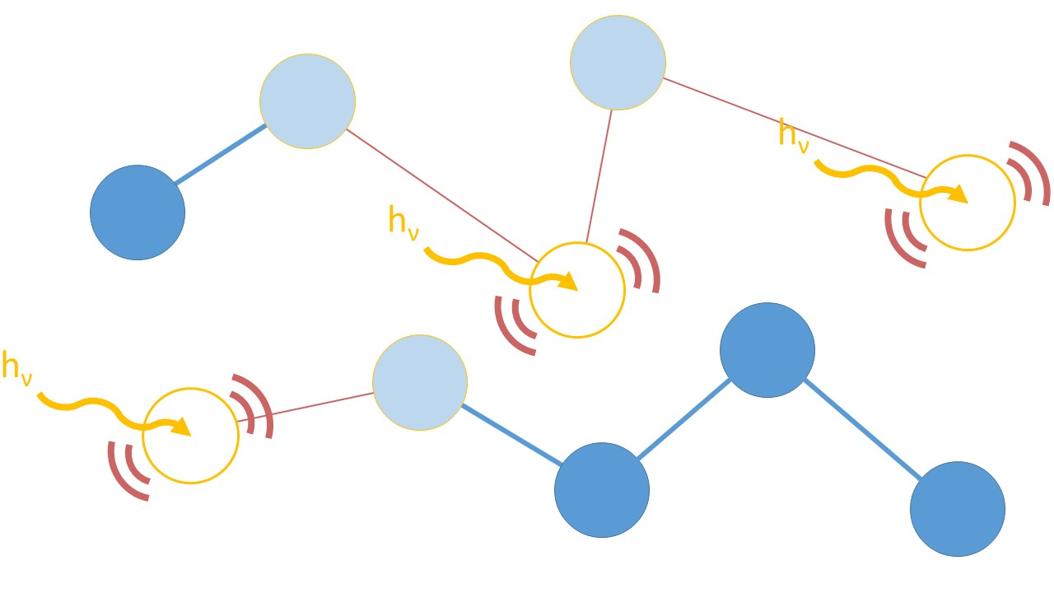
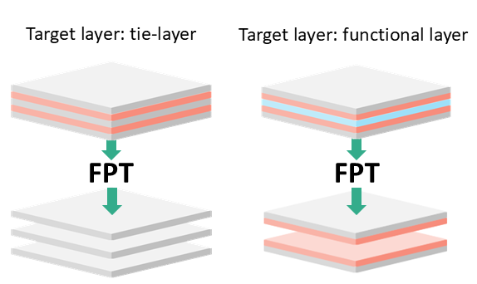
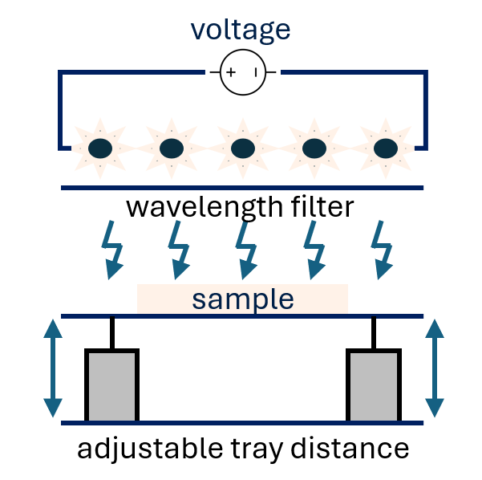
FPT – how does it work
Photothermal effect
Temperature increase in the layer causes melting or degradation
FPT schematic
Notes:
Were transforming light into temperature
Talk about being able to control the voltage ( ie 1-4 joules of energy) which control the lamps which send the heat
And the adjustable parameters such as tray distance, a filter, amount of voltage which effects the energy were sending out
If we can convert light and increase the temp enough, we can either melt or degrade one of the layers
2 outcomes-
directly melt adh layer
target either the PE or PET functional layers in order to achieve delamination and then we can reuse those layers and make a new multilayer system

Slide 7
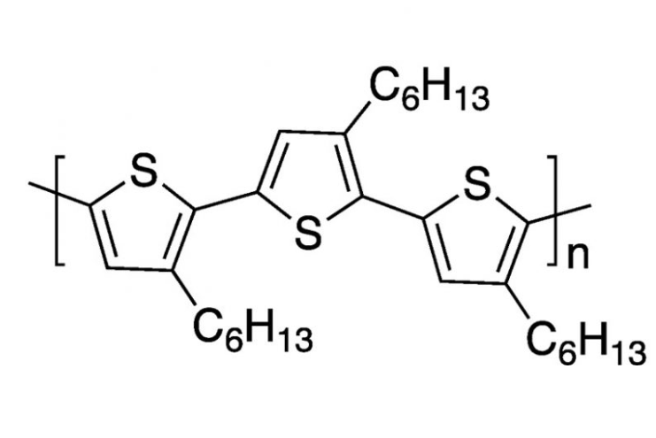
Research goals
Investigate the effect of light on a single layer
A high-absorbing model polymer is selected to understand light modification effects
Poly(3-hexyltiophene) (P3HT) is not present in commodity plastic multilayer films
It provides a solid example to understand how FPT works
Notes:
Chemical formula for p3ht
Using p3ht so we can understand the light modification effects of fpt so we can take that knowledge to other polymers and apply the same techniques to reach our goals

Slide 8

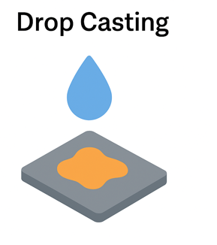
Sample Coating Methods
A wire-wrapped metal rod is used to spread the P3HT solution evenly across a substrate
Rod pulled across the surface to create thin film
Consistent thickness and larger area coverage
A droplet of P3HT solution is placed directly onto the substrate
The solvent evaporates, leaving behind a solid polymer film
This setup is similar, but it is better for quick testing

Slide 9
Methods
Technique | What It Measures | Why It Matters Post‑Irradiation
XPS | Elemental composition, oxidation or contamination states | Compares chemical shifts, monitors oxidation, shows if the material is degrading or crosslinking
Raman Spectroscopy | Vibrational spectra, bond structure, crystallinity, defects | Reveals bond-breakage or alteration, monitors crystallinity
Notes:
X-Ray Photoelectron Spectroscopy

Slide 10
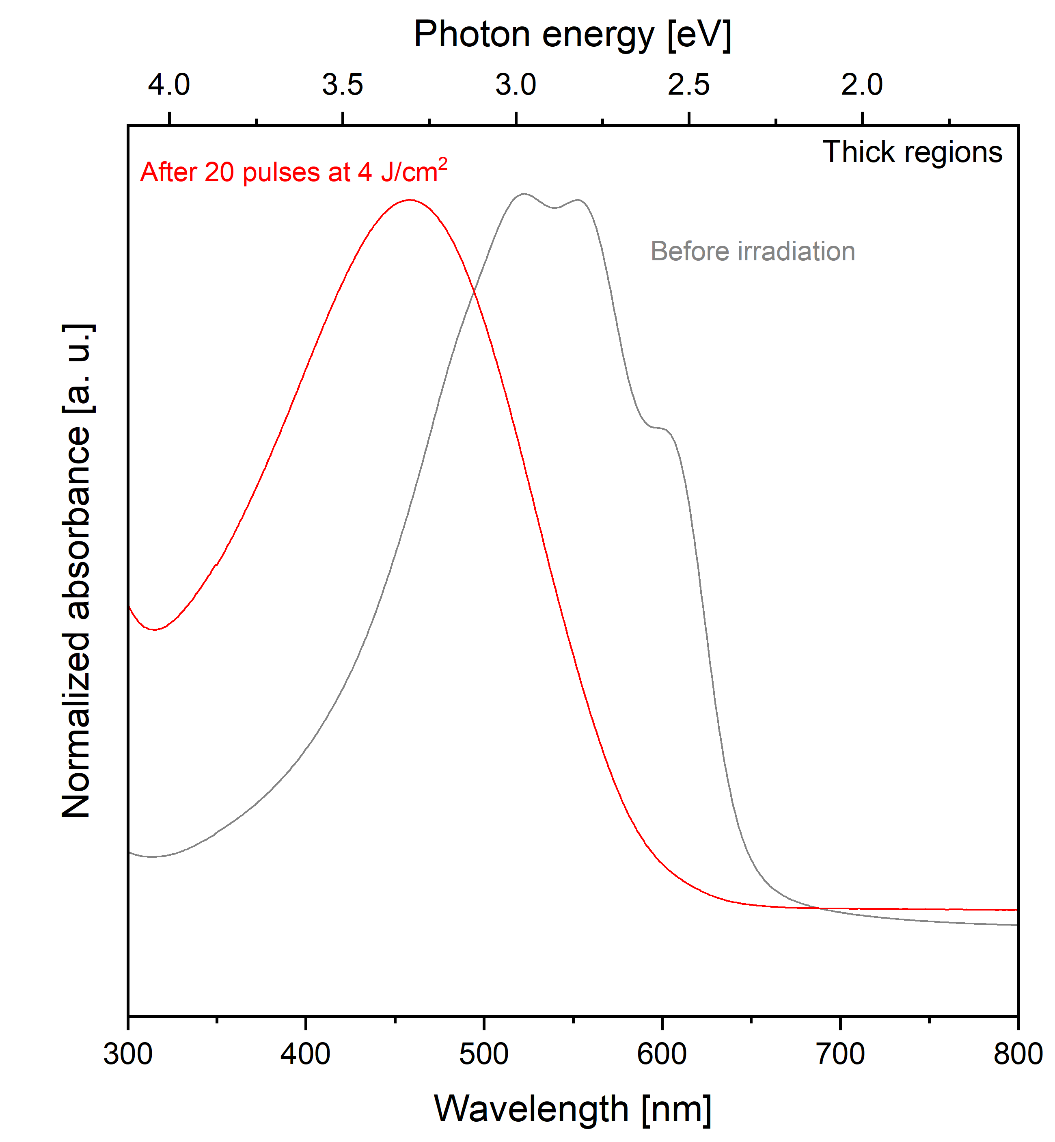
UV-Vis data suggests loss of conjugation UV-Vis
The shift in the spectrum can be due to loss of conjugation
This can be caused by increased ‘disorder’ in the molecular chains
Notes:
Before is gray
After is red
After is shifted to the left meaning might be a loss of conjugation which means the backbone chain is no longer flat but twisted
This can come by breaking bonds or increasing disorder and we think we are increasing disorder
meaning the bonds are being altered in a way that they don’t work as well as before

Slide 11
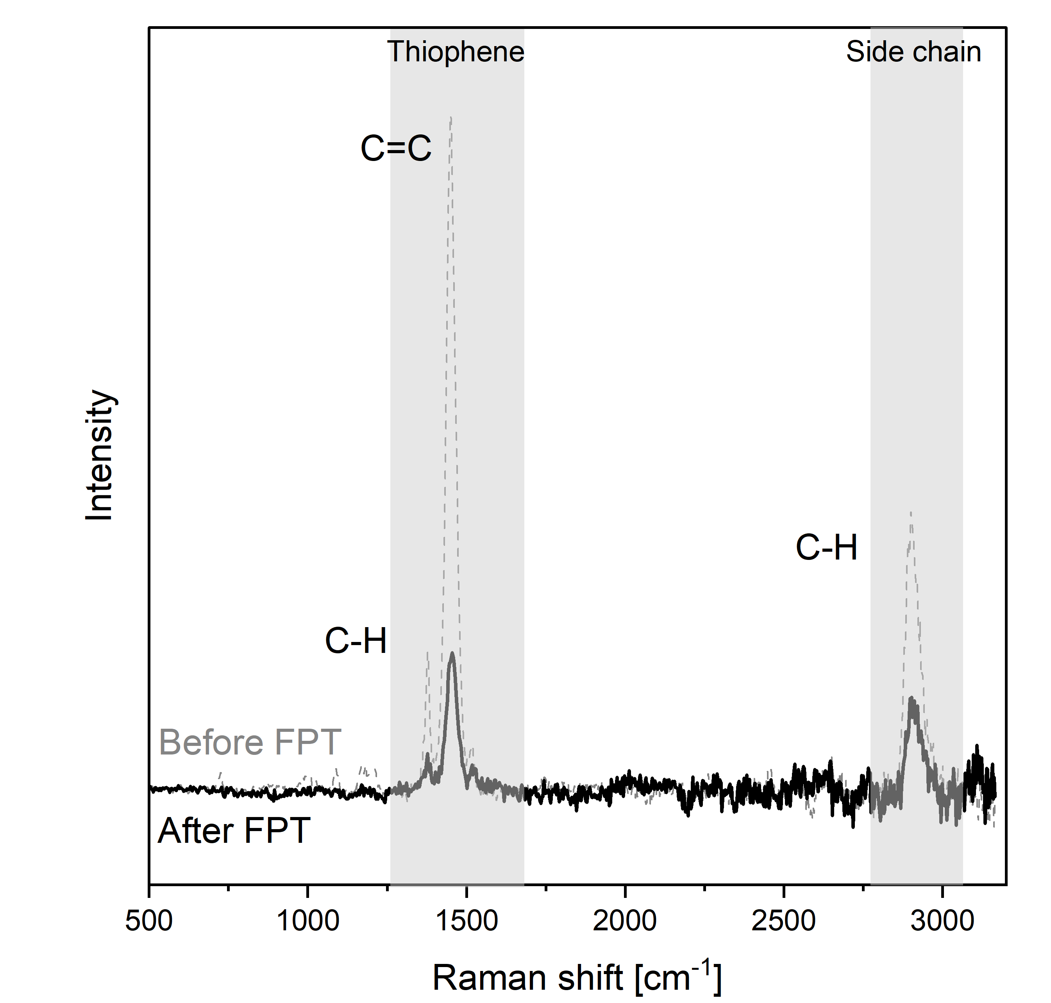
Raman suggests a more disordered P3HT configuration Raman
Loss of conjugation by C=C breaking should produce peak shift
Decreased C=C peak intensity and no shift suggest a more disordered sample
Hypothesis: side chain cleavage produces more disordered configuration
Notes:
There is a decrease in intensity
We have a disordered sample, which is what is causing the loss of conjugation
We know we are not breaking any bonds because there is no horizontal shift
We believe we are cutting the side chains which gives us a more disordered sample

Slide 12
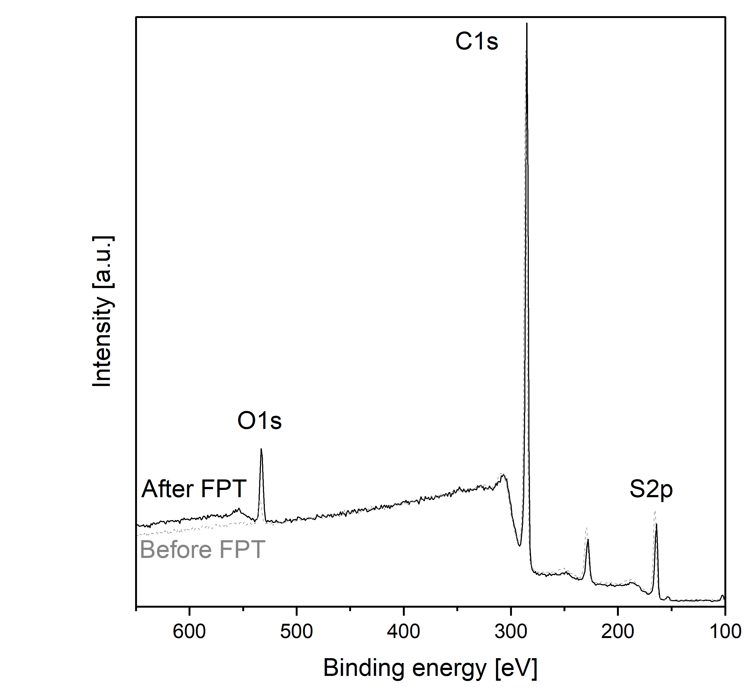
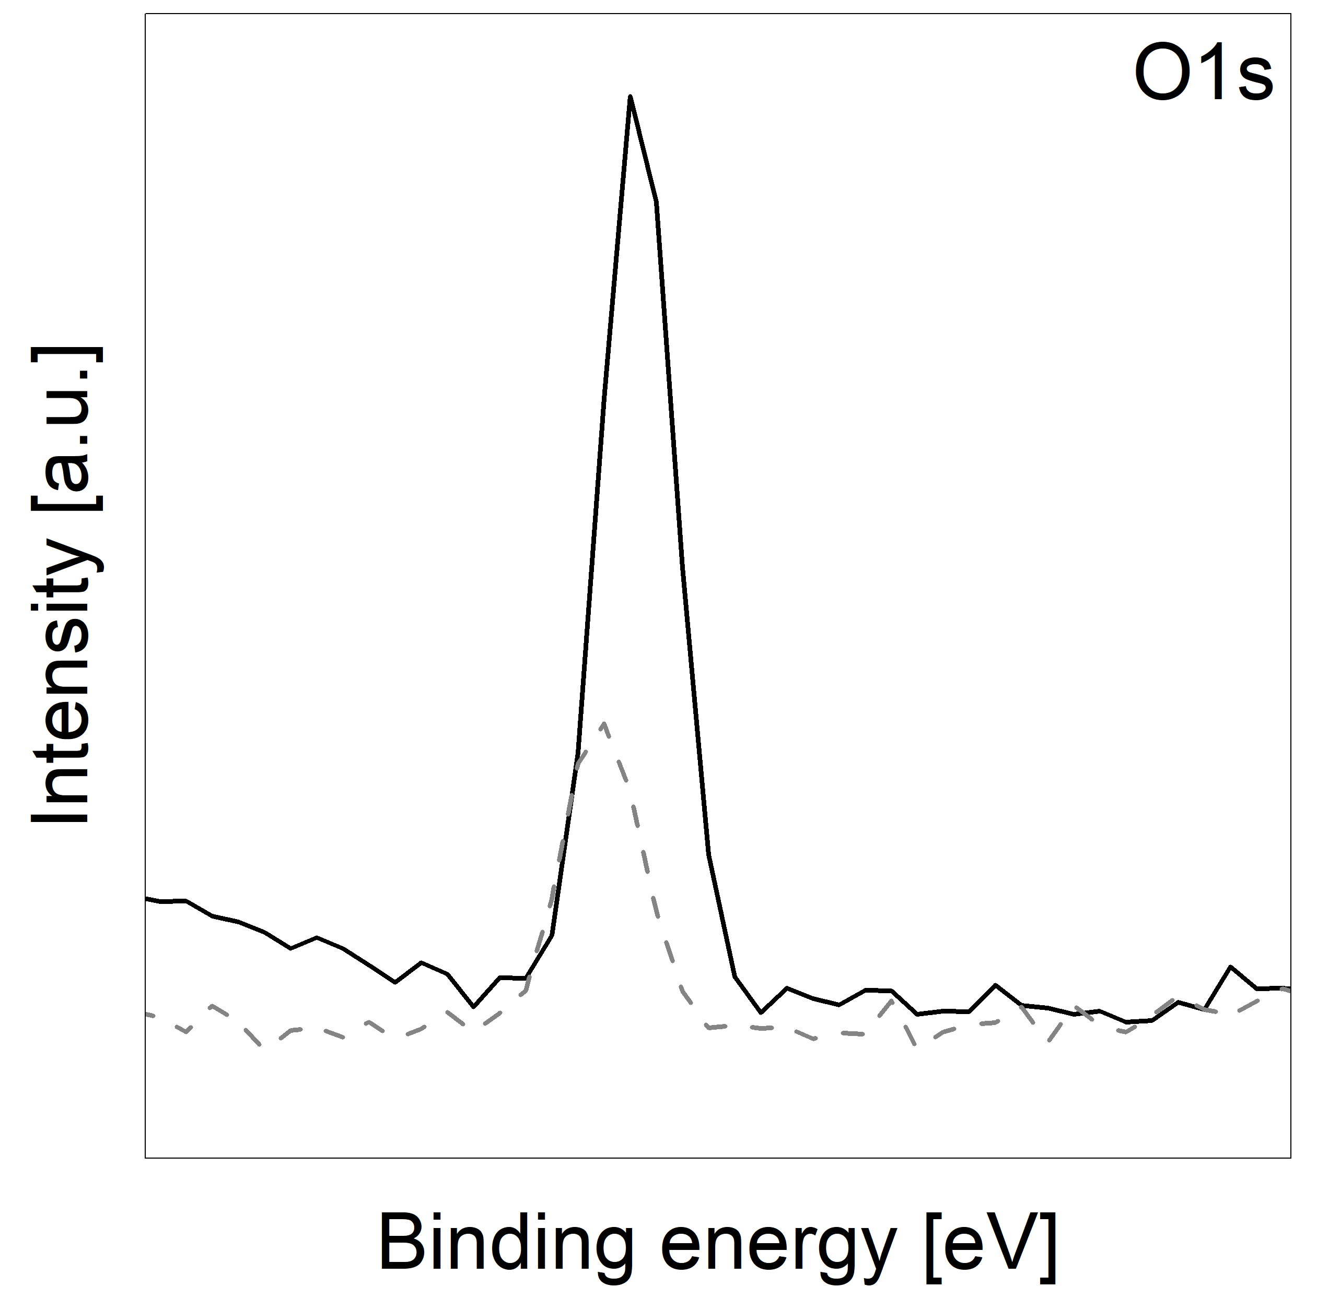
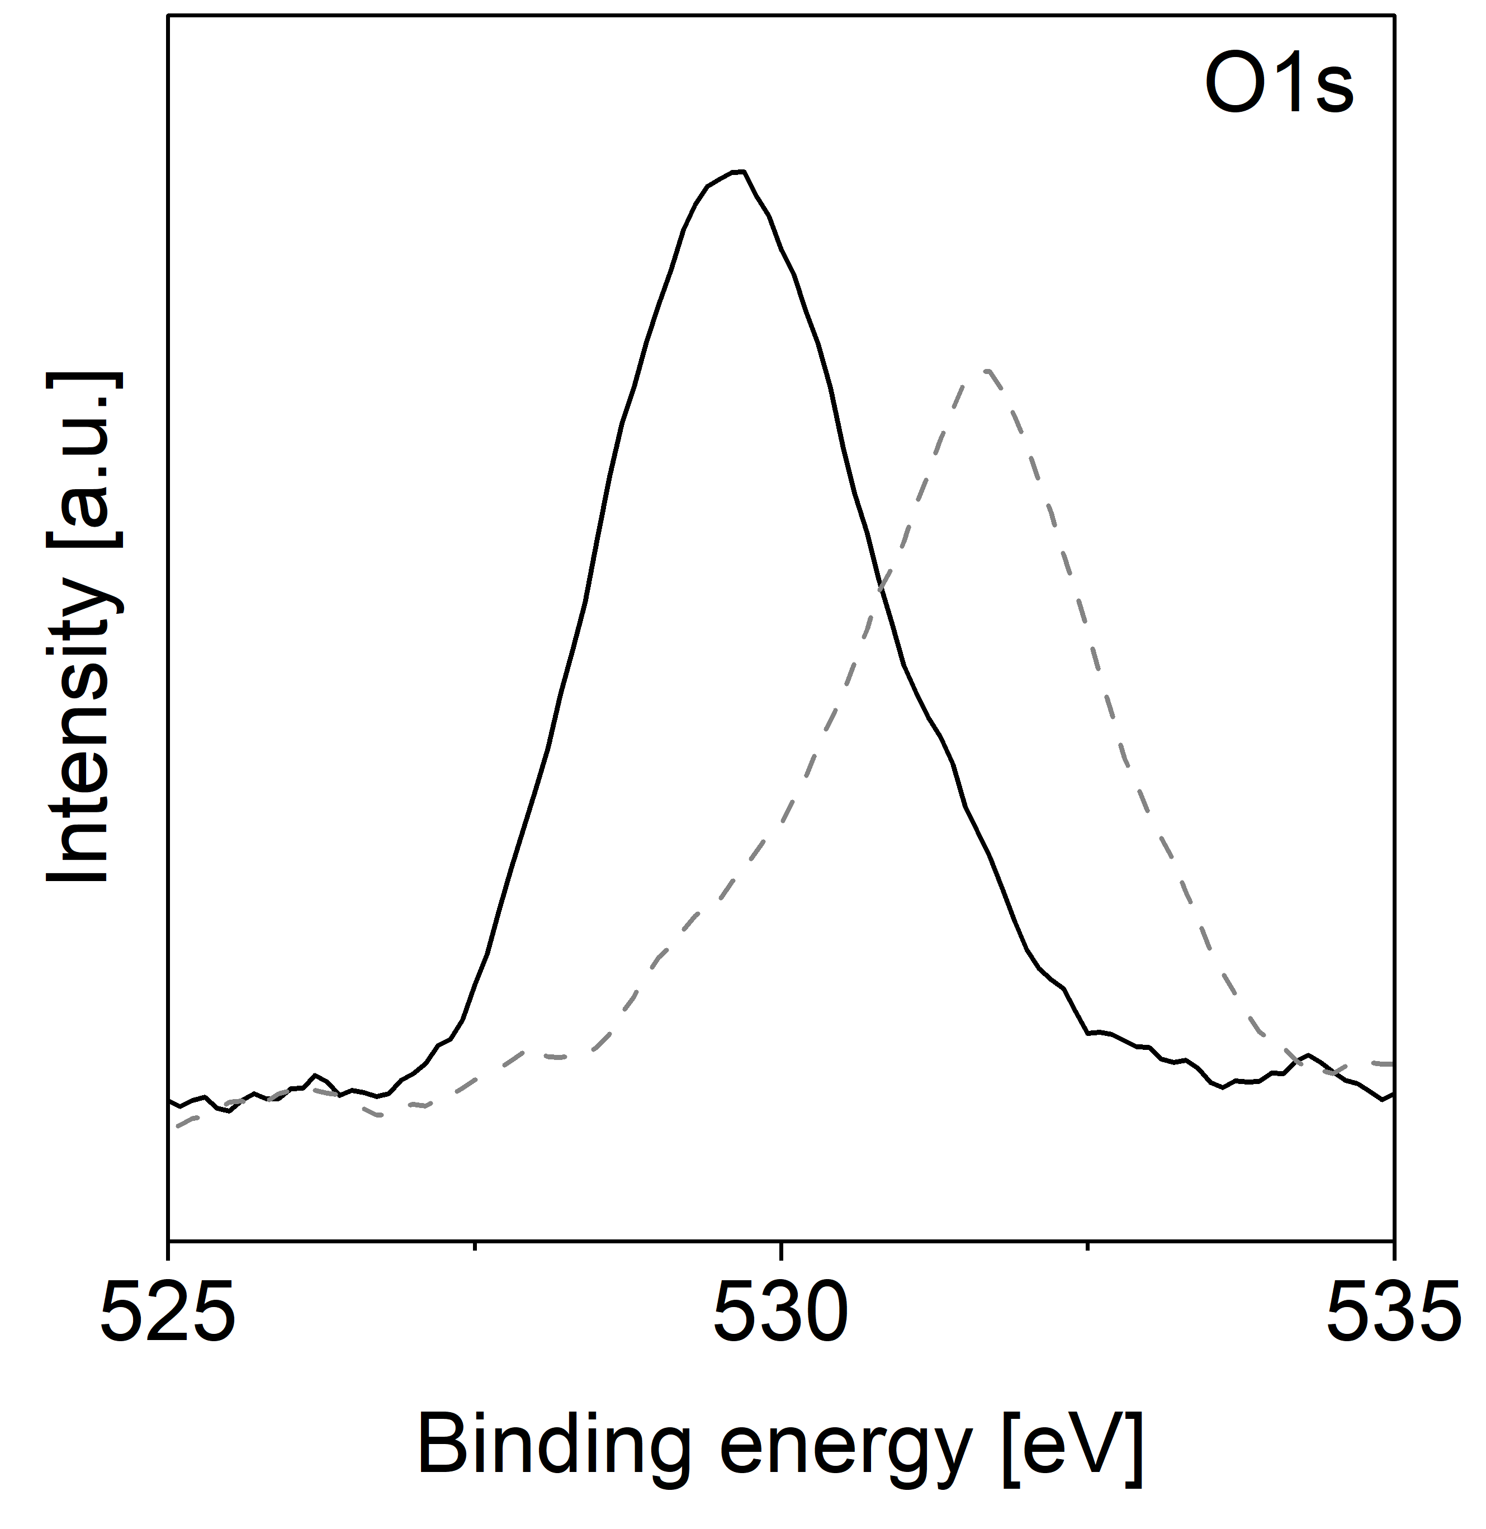
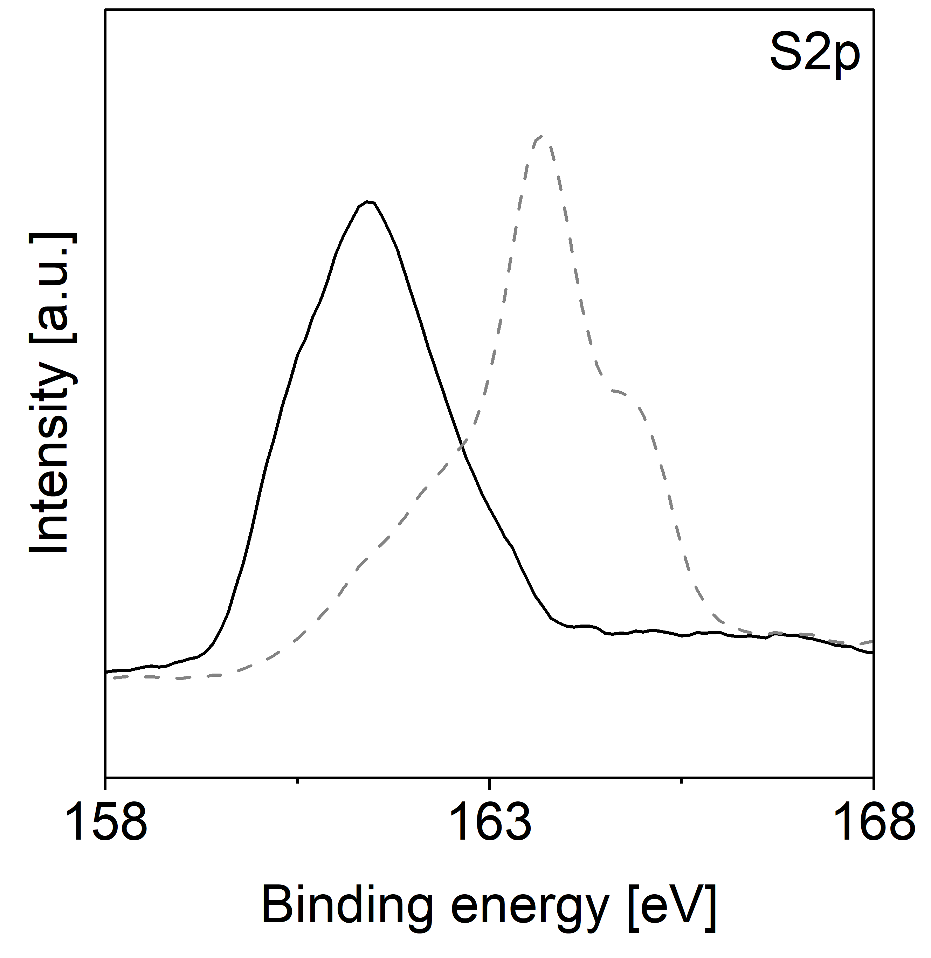
XPS might confirm sidechain cleavage and backbone oxidation XPS
Oxygen content increases after irradiation
High-res scan peak shift confirm new bonds are forming
Notes:
Unlabeled peak is a reaction product from the polymer; it is something synthesized or some type of residue from the synthesis
Our sulfur and carbon stayed the same pretty much but oxygen increased by a lot after fpt
We didn’t do the deconvolution, ie, peak fitting and charge correcting because we ran out of time but we see the shapes changing meaning we have different bonds forming before and after fpt meaning the entire polymer is changing
Mention the high res scans showing a shift in peaks and change of shape as well

Slide 13
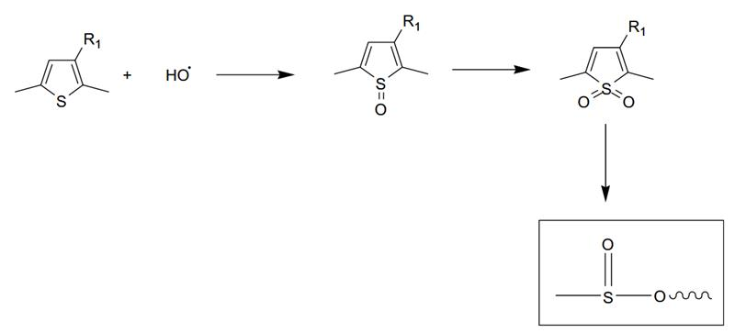
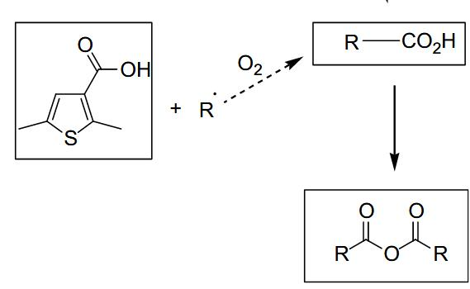
These reactions might cause loss of conjugation and crosslinking of P3HT
Side chain cleavage increases molecular disorder
Backbone sulfur oxidation decreases conjugation
Whether these reactions cause P3HT cross-linking is still argument of debate
Manceau et al., Polymer Degradation and Stability 2009, 94 (6), 898-907
Notes:
Loss of conjugation can come from either the oxy or sul
Here is the side chain being modified/ oxidized (which is why we see an increase in oxygen) the part we cut is the R, meaning it is now reactive and can react with other things in the polymer
The sul is also changing because it is being oxidized which also decreases conjugation
Not sure whether this causes cross-linking just yet
Only if someone asks what is cross-linking: Cross-linking is when a sidechain reacts with another side chain essentially creating a web of polymers instead of having singular chains

Slide 14
Summary
P3HT irradiation produces a loss of conjugation
Known side chain cleavage and backbone oxidation are known to cause disruption of conjugation along the backbone
Cross-linking might also explain the loss of conjugation
Future work:
Investigate the presence of crosslinking in irradiated P3HT
Explore irradiation of non-conjugated materials

Slide 15
References
Manceau, M.; Rivaton, A.; Gardette, J.-L.; Guillerez, S.; Lemaître, N. The Mechanism of Photo- and Thermooxidation of Poly(3-Hexylthiophene) (P3HT) Reconsidered. Polymer Degradation and Stability 2009, 94 (6), 898–907. https://doi.org/10.1016/j.polymdegradstab.2009.03.005.
Adam, Hissein Bechibo, et al. “Recycling of Multilayer Polymeric Barrier Films: An Overview of Recent Pioneering Works and Main Challenges.” Macromolecular Materials and Engineering, 16 Apr. 2025, https://doi.org/10.1002/mame.202400414
Mieth, Anja, et al. “Guidance for the Identification of Polymers in Multilayer Films Used in Food Contact Materials.” JRC Technical Reports, no. EUR 27816 EN, 2016, https://doi.org/10.2788/10593.
Chatani, Shunsuke, et al. “The Power of Light in Polymer Science: Photochemical Processes to Manipulate Polymer Formation, Structure, and Properties.” Polym. Chem., vol. 5, no. 7, 2014, pp. 2187–2201, https://doi.org/10.1039/c3py01334k.
Ciawi, Yenni, et al. “Multilayer Packaging Recycling: Challenges, Current Practices, and Future Prospects.” Academia Environmental Sciences and Sustainability, vol. 2, no. 1, 26 Feb. 2025, https://doi.org/10.20935/acadenvsci7521.

Slide 16
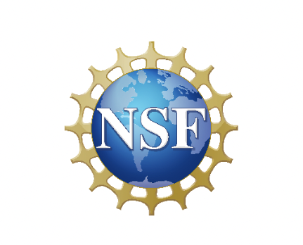



Thank you / Acknowledgements
Special thanks to Leslie O’Neill and Dr. Mikkel Thomas for making all of this happen!
Special thanks to my mentor Matteo Palesati and PI Dr. Natalie Stingelin!

Slide 17

Questions?

