Slide 1
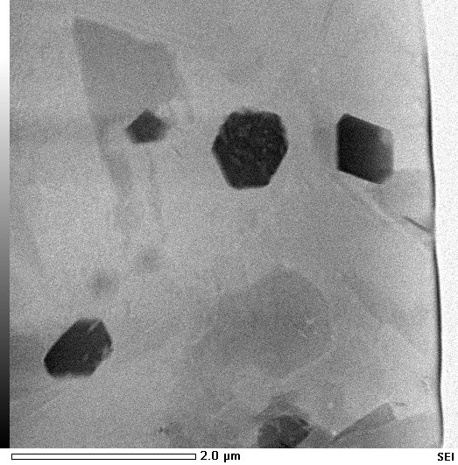
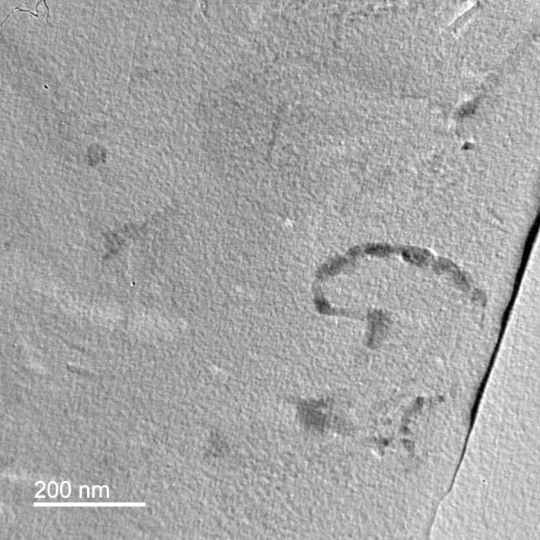


Nanoscale characterization of frictionally generated fault rocks from western Greenland
Hunter Midkiff and Joseph Allen
Department of Physical and Environmental Sciences
Concord University
Athens, WV

Slide 2
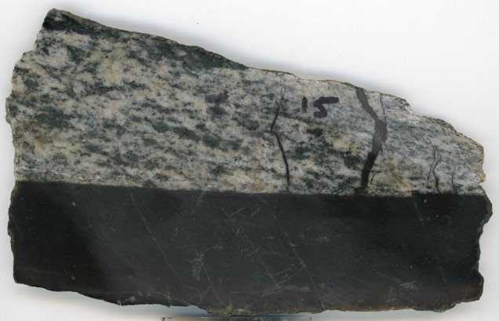
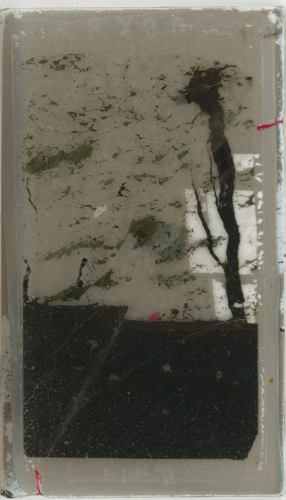
Goal of Study
Characterize mesoscale, microscale, and nanoscale mineralogy and fabrics of pseudotachylyte
(earthquake generated, frictionally melted fault rock)
Mesoscale: Horiba XGT 5200 micro-XRF at Concord University
Microscale: ARL SEMQ electron microprobe with EDS spectrometer at Concord University, Helios FIB SEM at Virginia Tech NanoEarth, FE-SEM at Virginia Tech NanoEarth
Nanoscale: JEOL JEM 2100 TEM at Virginia Tech NanoEarth with assistance of Dr. Charis Horn
Sample slab (tonalite gneiss wall rock at top, black pseudotachylyte bottom) and 2.5 cm thin section

Slide 3
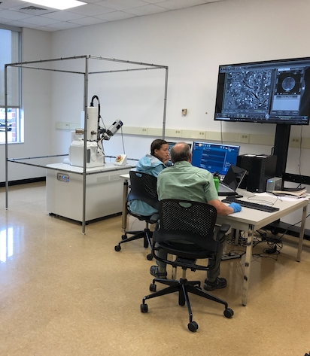
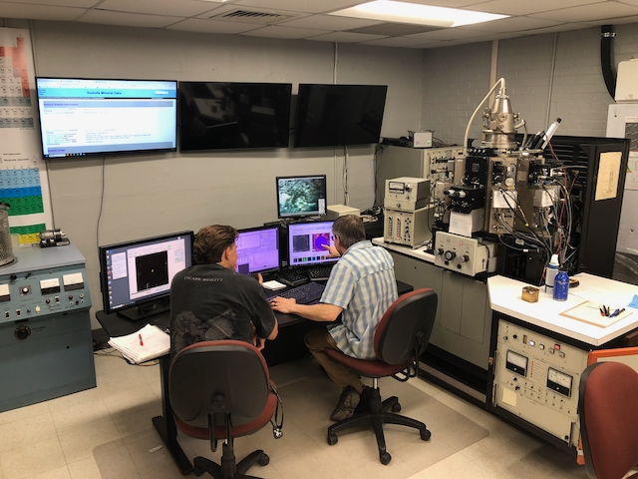
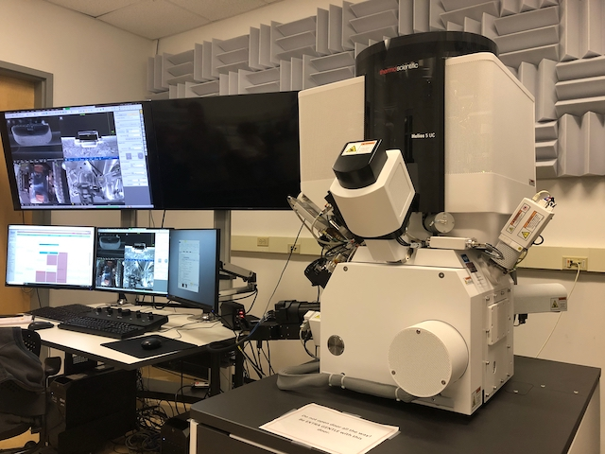
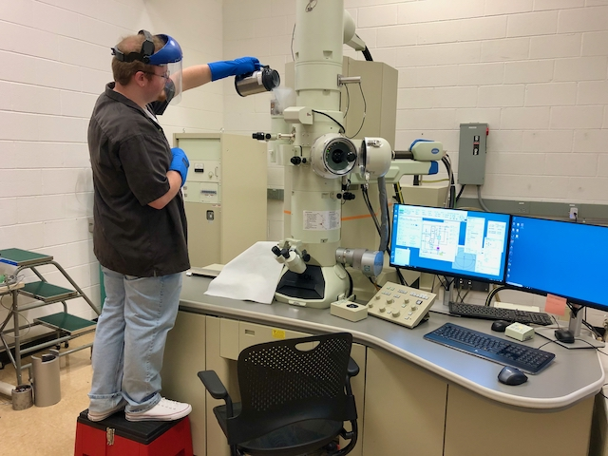
Instrumentation

Slide 4
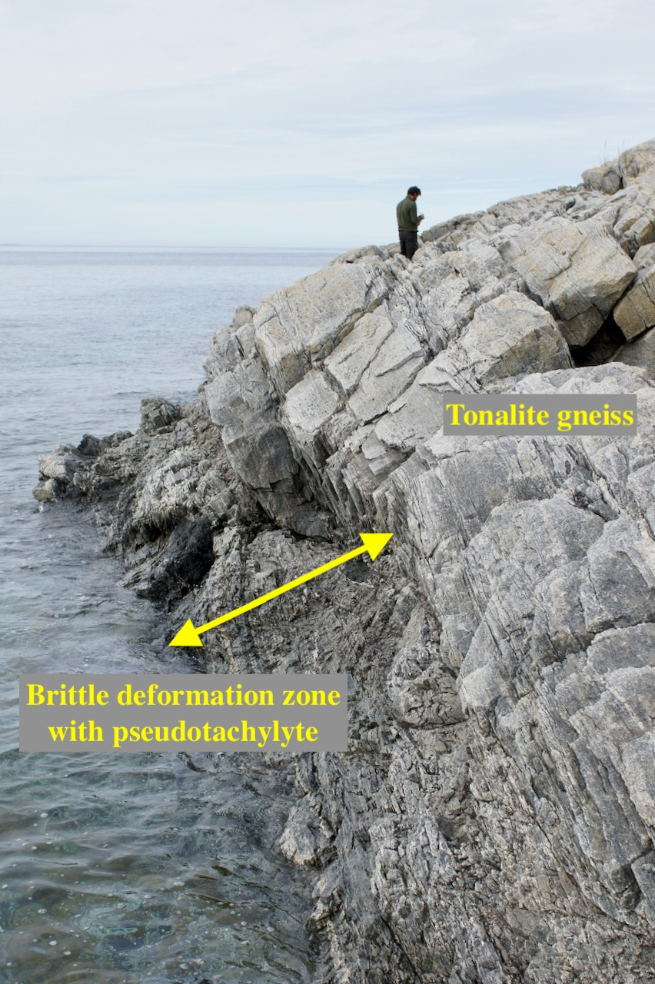
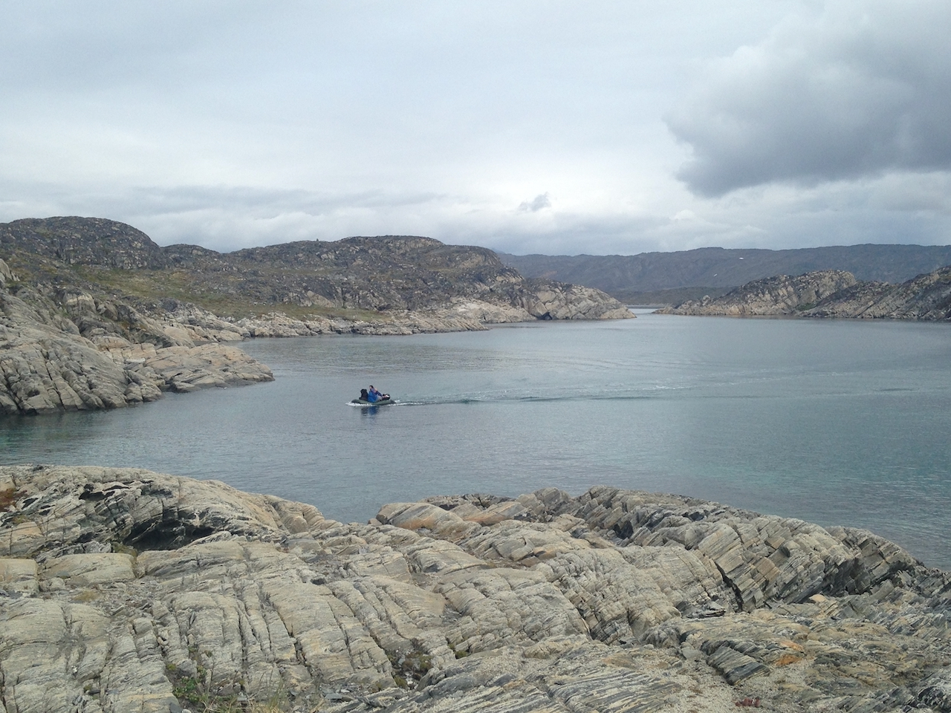
Geologic Setting
Ikertôq shear zone (located at blue arrow) – Lower-crustal (>20-30 km deep), granulite-grade supracrustal gneisses cut by upper-crustal (<10-15 km deep), seismically active, brittle deformation zones

Slide 5
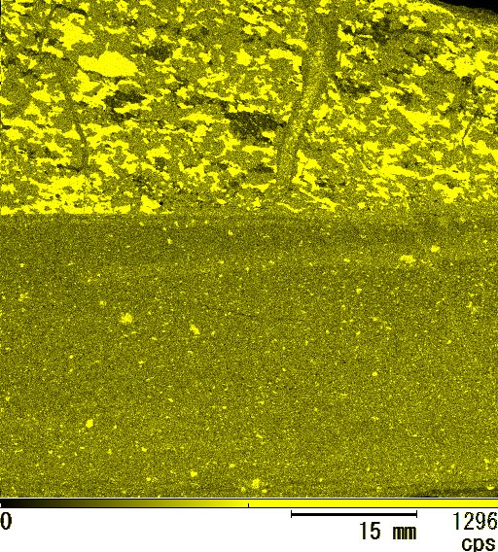
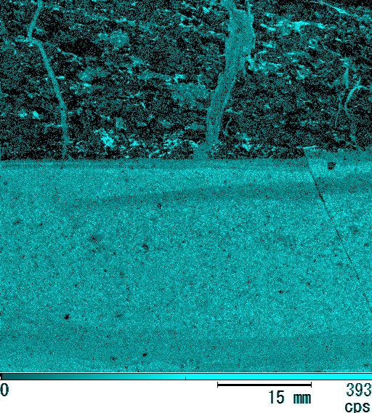
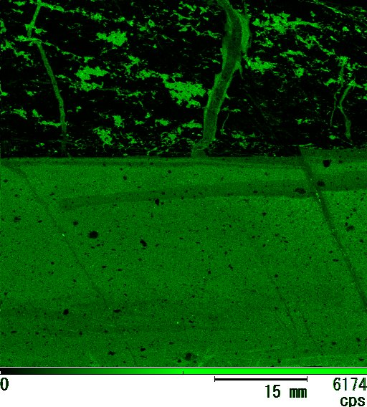
Mesoscale
Features
Mesoscale: Micro-XRF EDS maps showing visible quartz survivor clasts and local silica-enriched bands (yellow); Fe (green) and K (blue) enrichment in the matrix with banding showing local depletion of the two elements

Slide 6
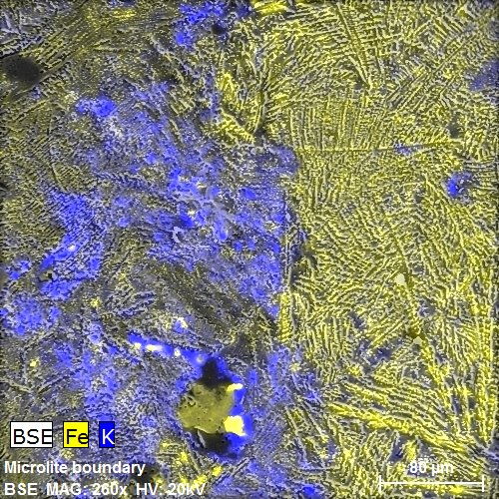
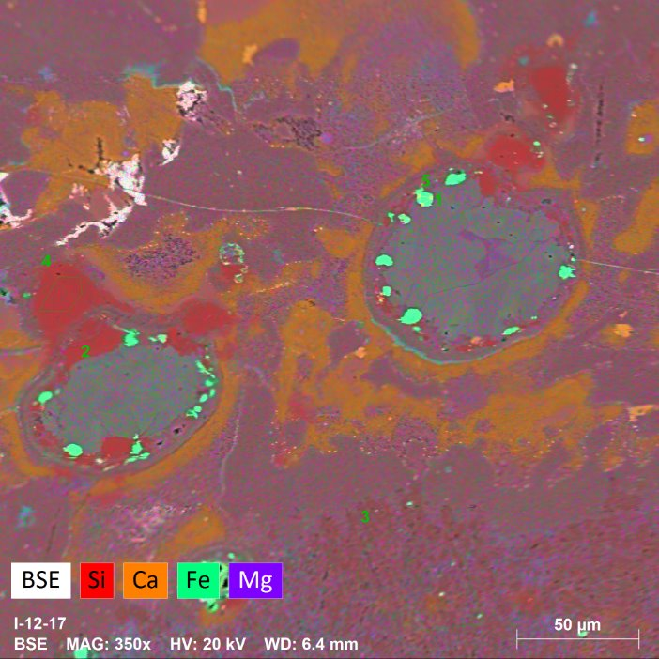
Microscale
Features
Microscale: Electron microprobe EDS element maps showing clustering of elements, microlites 1 to 100 µm in length which are Fe and Ti oxides, amphiboles, plagioclases, calcite, and micas.

Slide 7
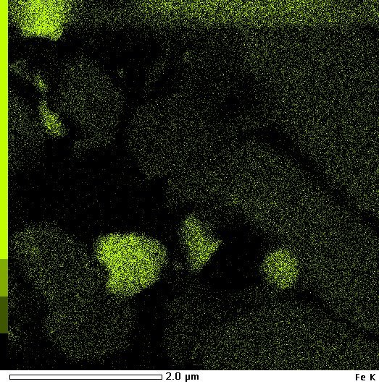
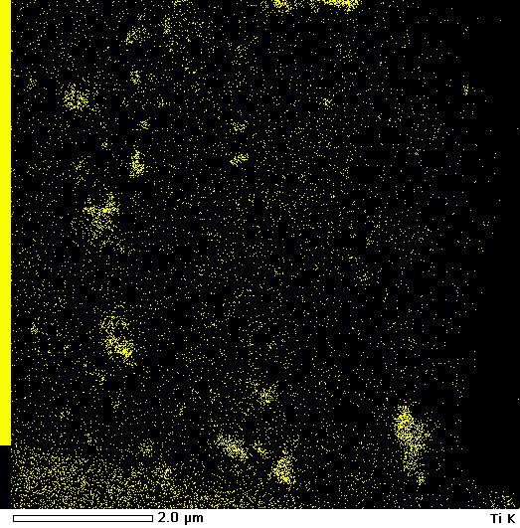
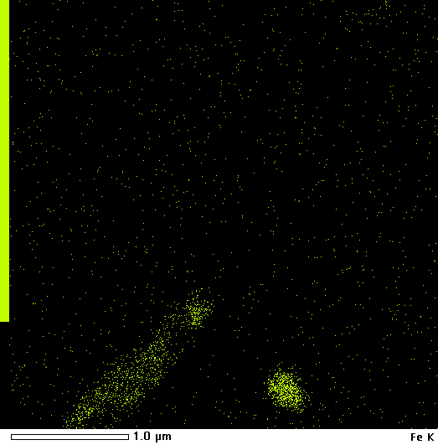
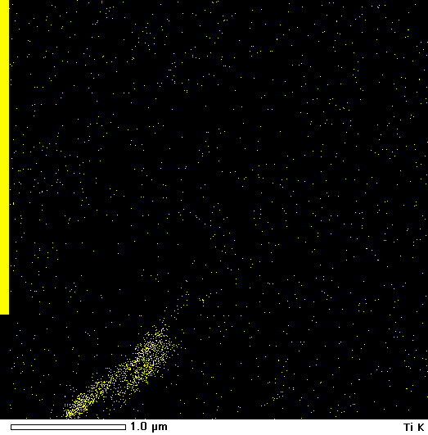
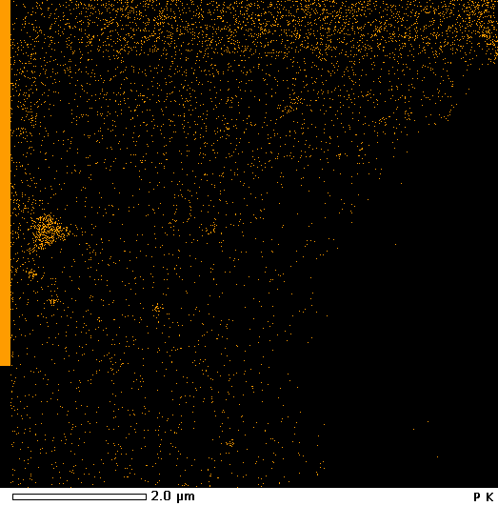
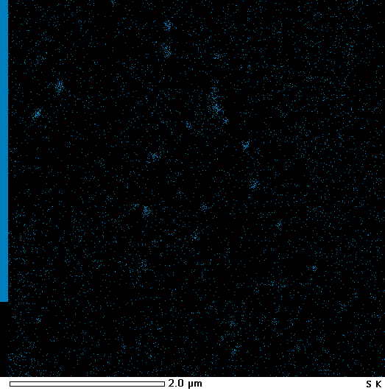
Nanoscale Features
FeO
TiO₂
FeTiO₃
Apatite
Pyrite

Slide 8
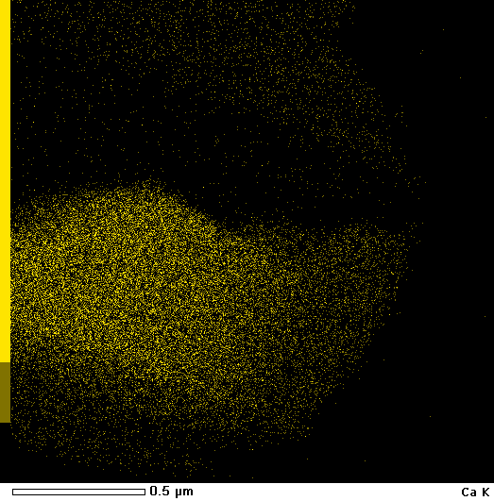
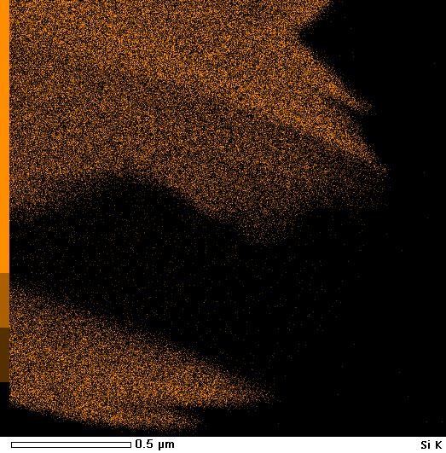
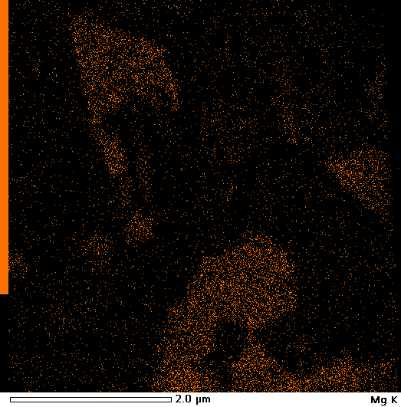
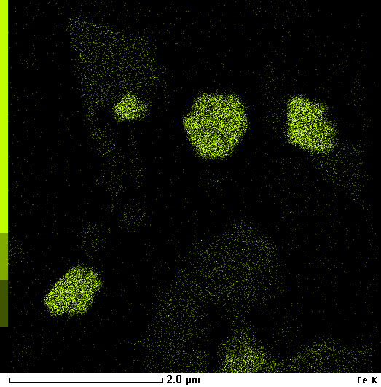
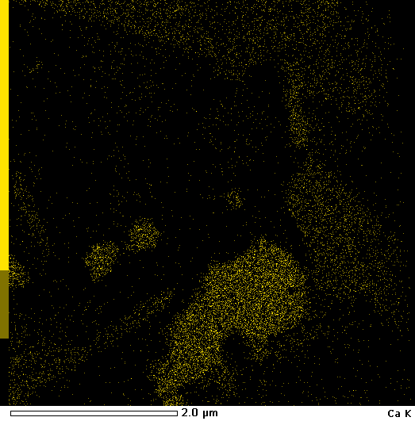
Nanoscale Features
Calcite: CaCO₃
Dolomite: CaMg(CO₃)₂

Slide 9
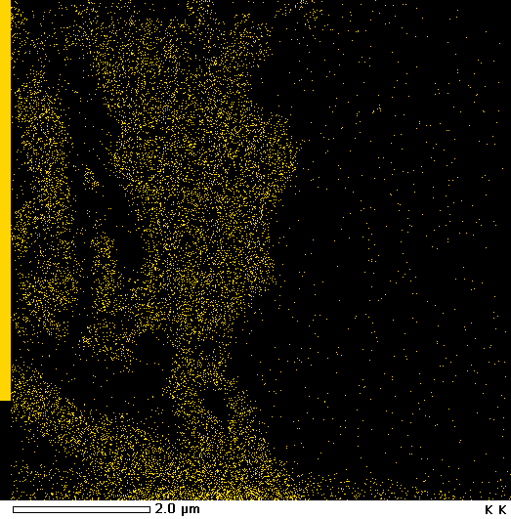
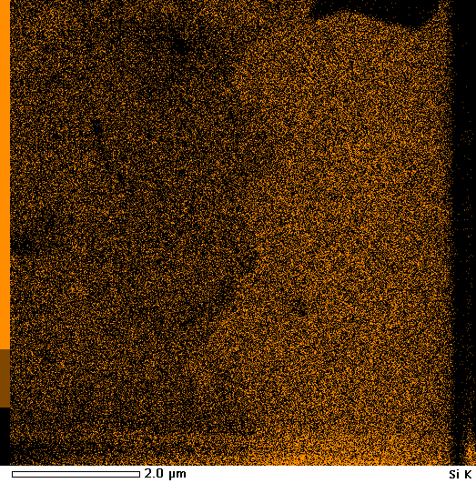
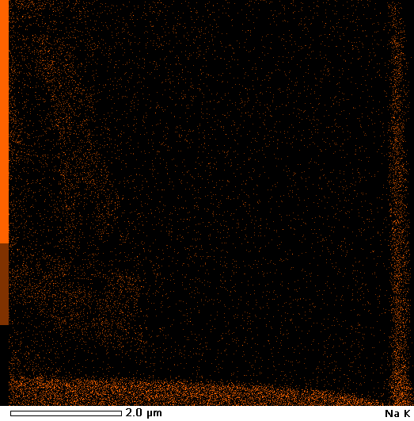
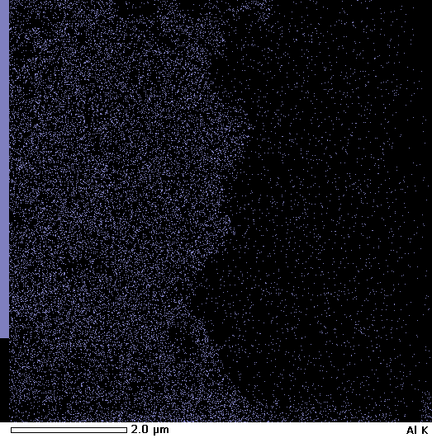
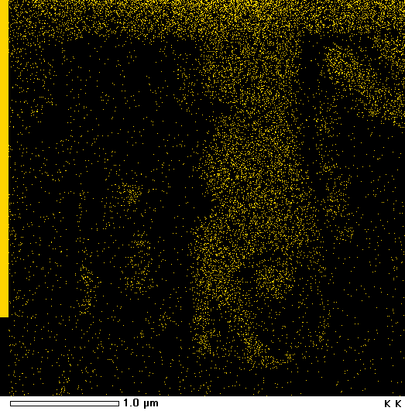
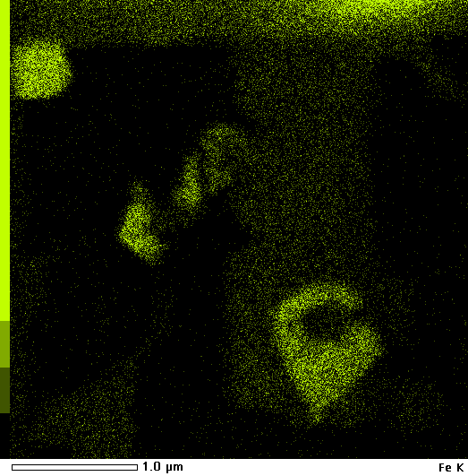
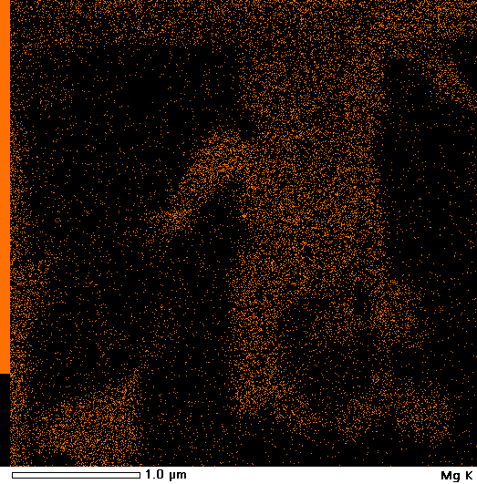
Nanoscale Features
K-Spar: KAlSi₃O₈
Quartz: SiO₂
Albite: NaAlSi₃O₈
Phengite:
K(Al,Mg)₂Si₄O₁₀(OH)₂

Slide 10
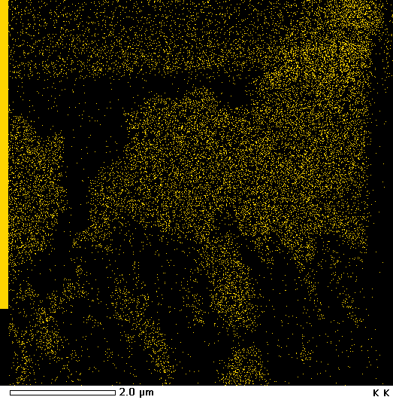
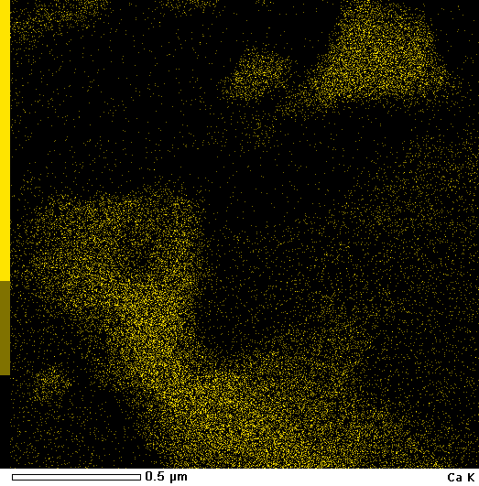
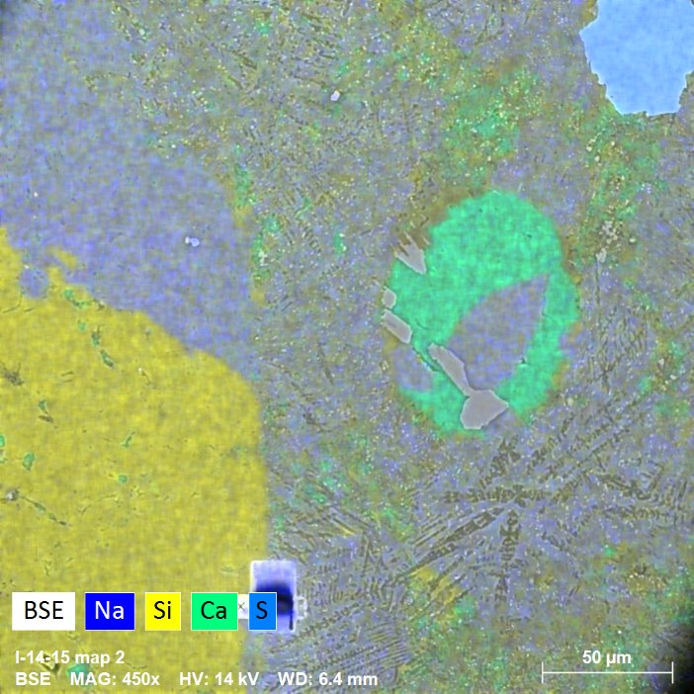
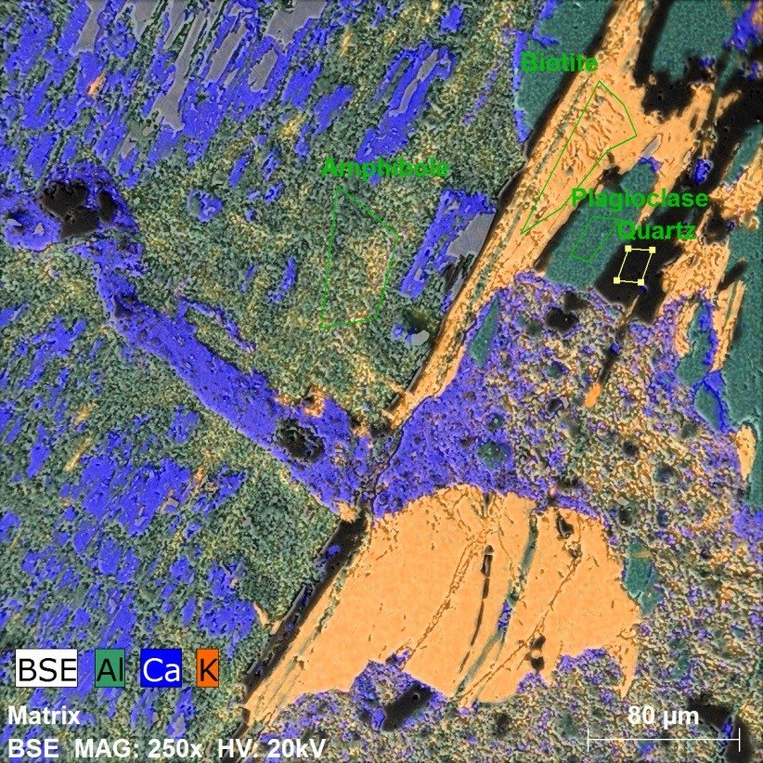
Hydrothermal Infill
-Interpreted history of rock suggest: (1) frictional flash melting (scale 1-2 seconds) creating black glassy matrix and unmelted survivor clasts of quartz and feldspar; (2) 10s-micron-scale microlites grown in 10s of seconds during rapid cooling; (3) two phases of later hydrothermal mineralization.
-The first phase of hydrothermal mineralization was likely a silica-rich fluid which formed k-feldspar and phengite dispersed in pore spaces
-The second was a calcite and barite fluid which filled in remaining space including amygdules (filled vesicles) and veins
-The early phengite exhibited an interesting structural feature rarely observed in geologic materials: Ripplocations

Slide 11
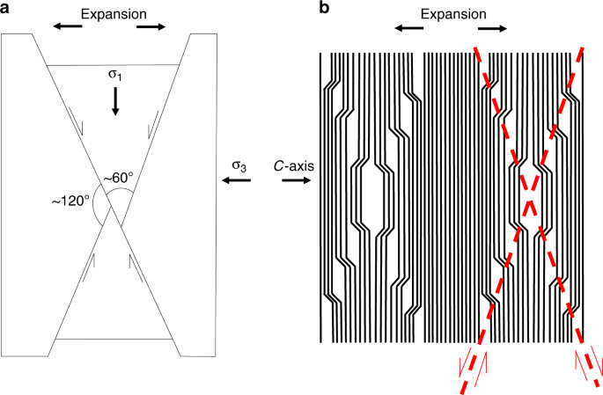
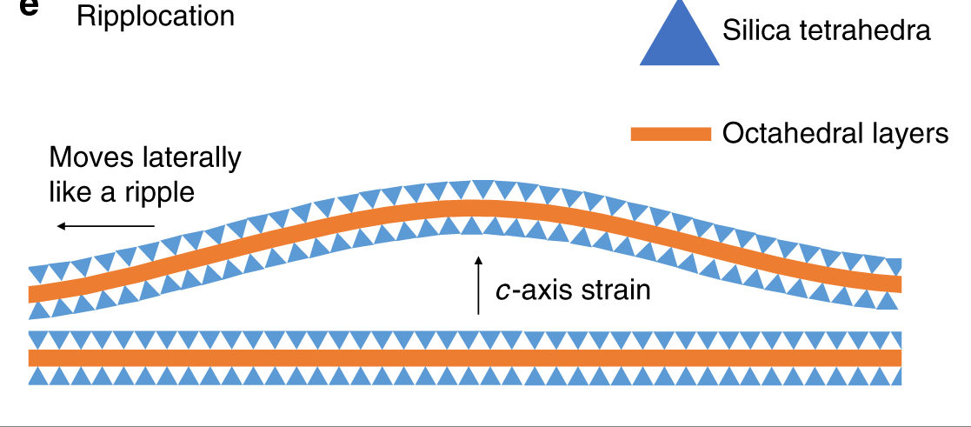
Ripplocations: Theory
Ripplocations are reversible atomic dislocations formed by placing c-axis strain in layered materials.
Figures from Aslin et. Al. 2019

Slide 12
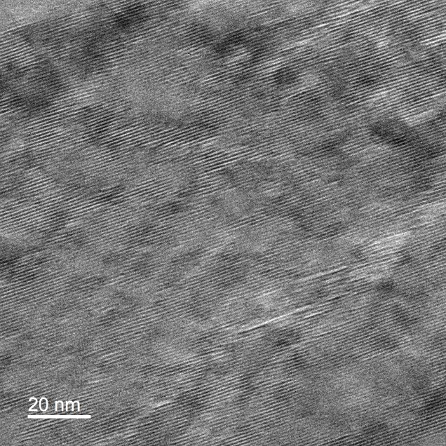
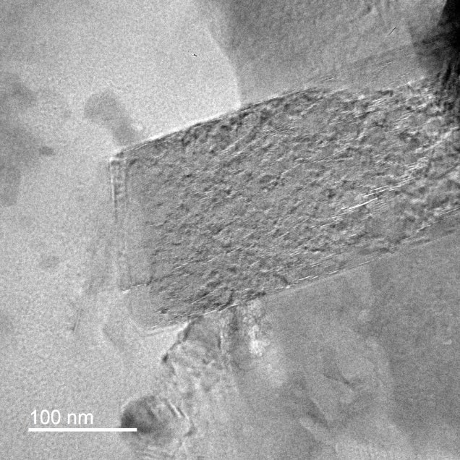
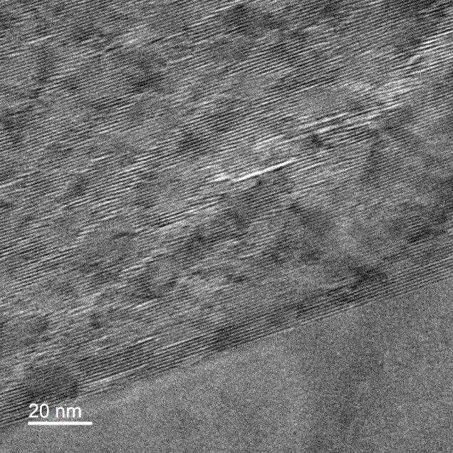
Ripplocations: Images
V-shaped array structure serves as proxy for the presence of ripplocations that become defined during TEM sample preparation.

Slide 13
Summary and Conclusion
Minerals at the nanoscale: quartz, albite, amphibole, plagioclase, Fe-Ti oxidies, pyrite, apatite, k-spar, phengite, calcite, and dolomite.
Hydrothermal alteration in two waves:
  1st: K-Spar and Phengite mineral infill
  2nd: Calcite and Barite infill in veins and amygdules
Ripplocation formed in phengite determined from 80 nm arrays. The atomic dislocation accommodated strain from recrystallization and may have provided space for later hydrothermal flow.

