Slide 1




DROPLET EVAPORATION ON MICROFLUIDIC PEDESTALS
Isaiah Jones, University of Kentucky
Stuart J. Williams, University of Louisville
NSF REU Award ID #2348869
NSF NNCI Award ID#: 2025075

Slide 2
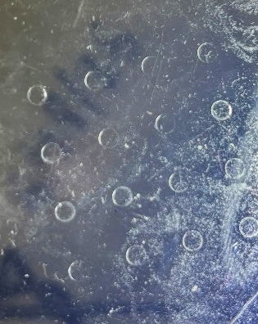
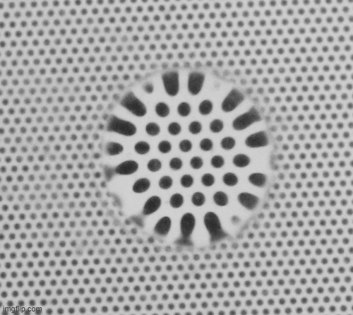
Goal
Measure the evaporation rate of multiple constrained microliter droplets
Objectives:
Fabricate the micropedestals
Assemble visualization platform
Use digital image analysis to measure evaporation rate
(timelapse)
Created PDMS pedestals (0.1 mm height)
Droplet is constrained due to
pedestal “sharp edges”
Droplet magnifies
underlying objects

Slide 3
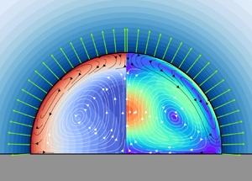
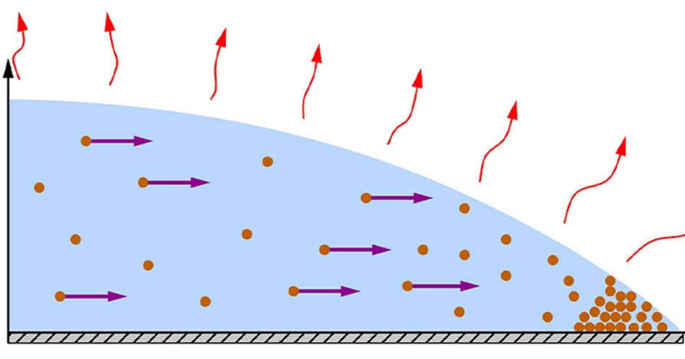
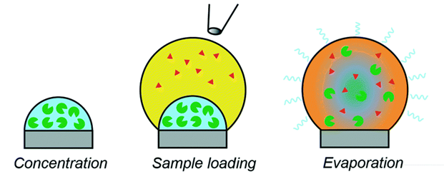
Background
Sessile droplets are single droplets whose shape is influenced by gravity and surface tension
Drying of complex fluids involves a variety of physics (fluid dynamics, heat transfer, transport phenomena, organization of non-volatile substances, …)
Applications: coatings, sprays, lab-on-a-chip, …
There is a need for controlled, experimental observation of these phenomena
JFM (2021) 920, A54
Lab Chip (2017)17, 2150-2166
JFM (2021) 914, A23
Depiction of competing internal flows
Coffee-ring effect
Droplet-based enzyme analysis

Slide 4
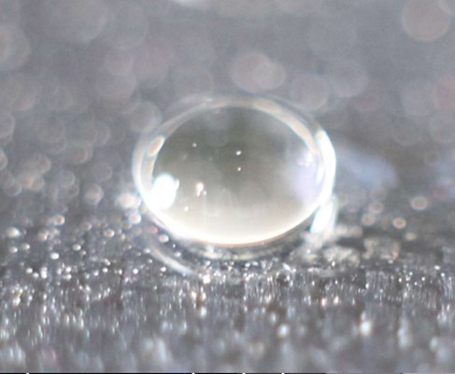
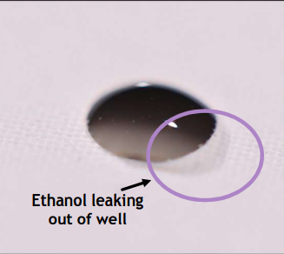
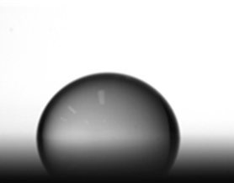
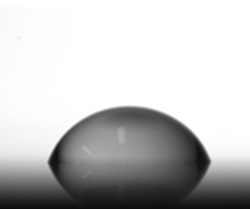
Motivation
Challenge #1: Droplet spreading influences evaporation (due to change of surface area)
  Solution: constrain droplets for better experimental control
Evaporation rate of similar sized droplets can be better compared
Challenge #2: Traditional side-view monitors single droplets
  Solution: top view observation to monitor multiple droplets simultaneously
Only one droplet can be monitored at a time with traditional side-view
Wetting liquids (like ethanol) will spread, even on Teflon surfaces
Sharp edges can constrain droplet

Slide 5
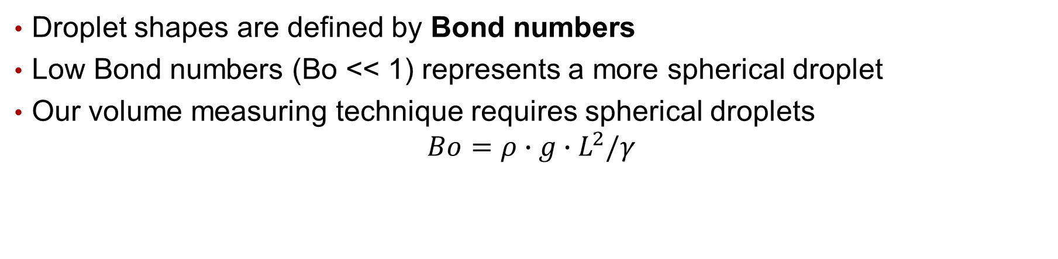
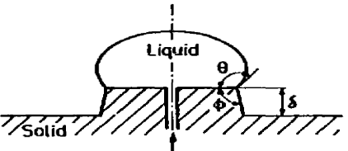
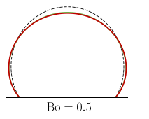

Sessile Droplet Physics
surface tension
density
gravity
pedestal radius
Mori, Y. H., et al. (1982). "Resistance to spreading of liquids by sharp edged microsteps." COLLOIDS AND SURFACES 4(1): 1-15.

Slide 6

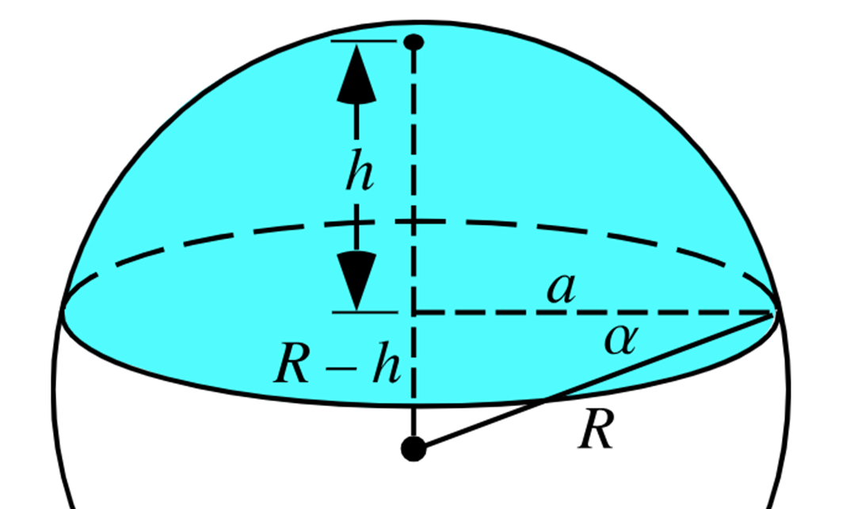
Droplet Shape and Relation
Volume of constrained droplet (sharp edge and spherical):
Droplet height (h) will be measured
using a visualization technique
a: pedestal radius
Change in droplet volume = evaporation rate
Oliver, J. F., et al. (1977). "Resistance to spreading of liquids by sharp edges." JCIS 59(3): 568-581

Slide 7
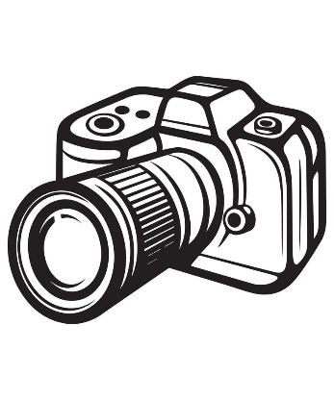

Experimental Setup
(timelapse)
Camera/Lens
PDMS Pedestals
(0.1 mm height)
Droplet
Magnified pattern
Base PDMS thickness
(~0.1 mm)
Plate with patterns (0.1 mm circles)
Light

Slide 8


Measuring Droplet Height
Droplet acts as a spherical lens
Magnification of underlying objects is a function of droplet volume (i.e. height)
Magnification will be measured using digital image processing
M = pattern magnification
a = base radius (pedestal)
h = droplet height
n = ratio of refractive indices (liq./PDMS)
l = PDMS thickness
Kilbride, J. J., et al. (2023). "Pattern-Distortion Technique: Using Liquid-Lens Magnification to Extract Volumes of Individual Droplets or Bubbles within Evaporating Two-Dimensional Arrays." PHYSICAL REVIEW APPLIED 19(4).

Slide 9
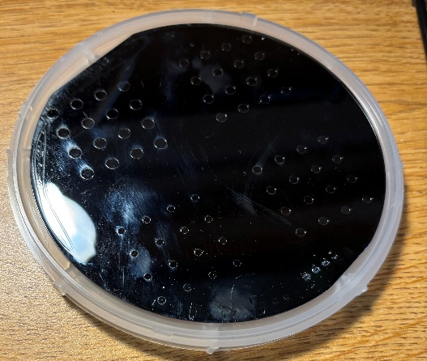
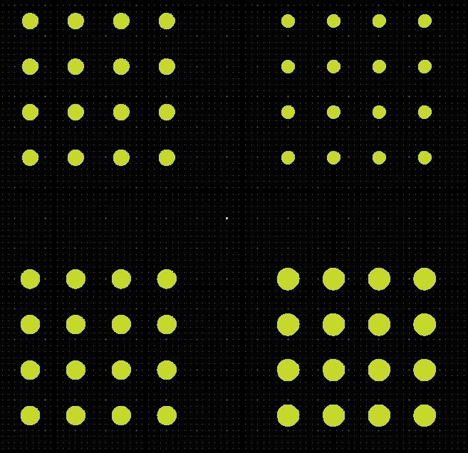
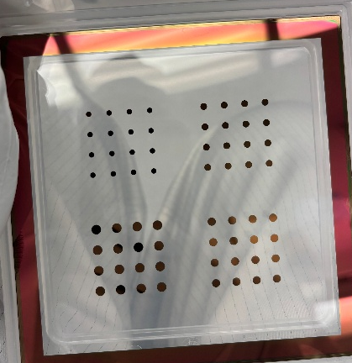
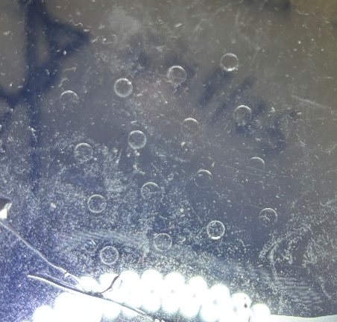
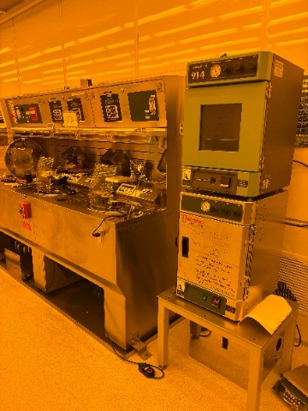
Methods
Objective 1: Fabricate the micropedestals
Make SU8 master mold (reusable)
Create PDMS pedestals (transparent)
Designing a Mask using LayoutEditor.
Mask containing pedestal shapes ranging from 2000 to 3500 micrometers
Su8 containing pedestal shapes
PDMS Pedestals created
Making the Su8 in the cleanroom.

Slide 10
Methods (Continued)
Steps of creating PDMS Pedestals
(a)
Photoresist
Silicon Wafer
UV Exposing
Mask
Photoresist
(b)
Silicon Wafer
(c)
Silicon Wafer
Pour PDMS
(d)
Silicon Wafer
(e)
PDMS

Slide 11
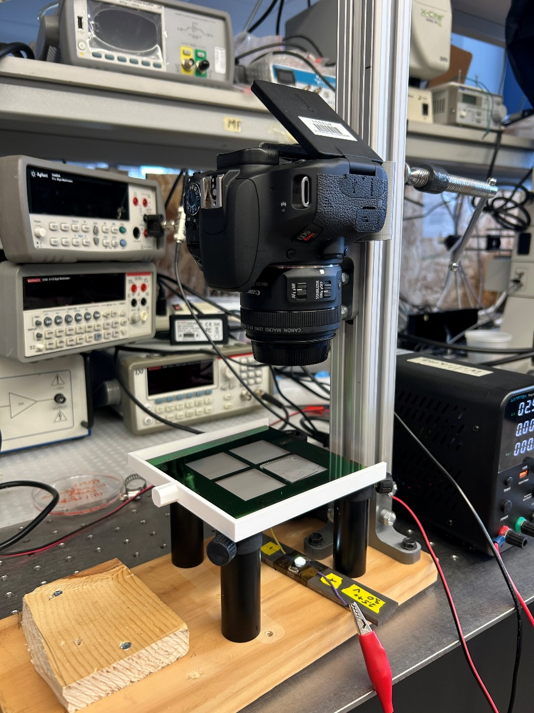
Visualization Platform
Camera
Droplets placed manually on pedestals via micropipette
2-14 μL droplets placed on various pedestal diameters (2.0, 2.5, 3.0 mm)
Images acquired every 30 seconds
Power supply for LED
PDMS Pedestals
LED Light
Plate with pattern

Slide 12
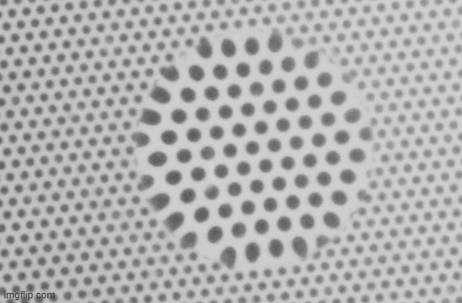
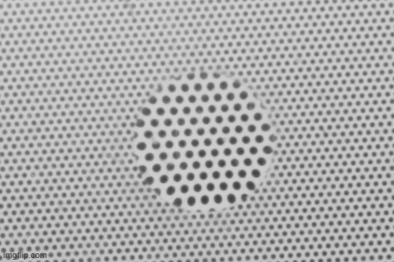
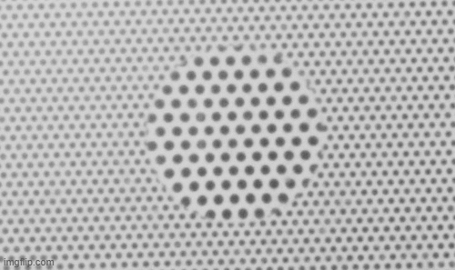
Evaporation of the Droplets
Water
Time Lapse: 36 minutes
Ethanol
Ethanol and Water Mix
(22% ABV)
Time Lapse: 29 minutes
Time Lapse:14 minutes
Bourbon (22% ABV)
Time Lapse: 30 minutes

Slide 13
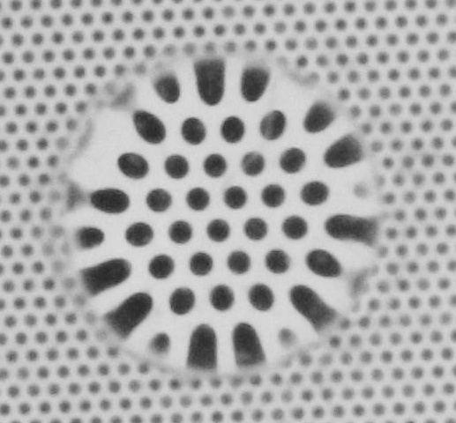
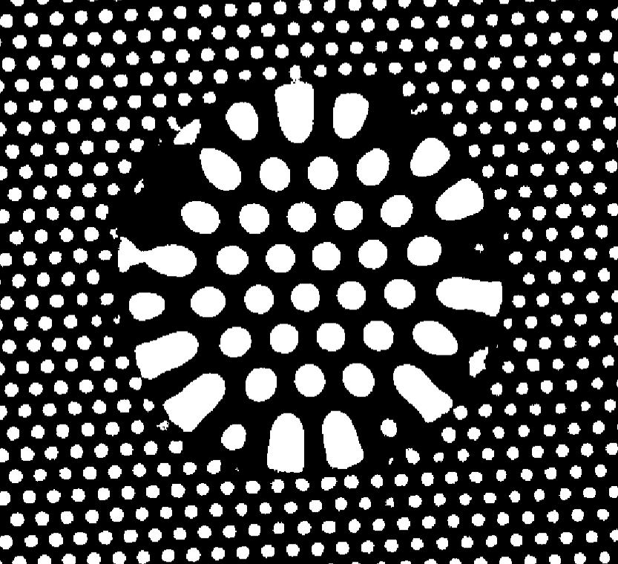
Digital Image Analysis
Custom MATLAB program
Applied to each frame (until droplet is de-pinned)
Eccentricity filter (keep circles)
Calculate magnification
Calculate height and volume
Crop original image set
Convert to binary

Slide 14
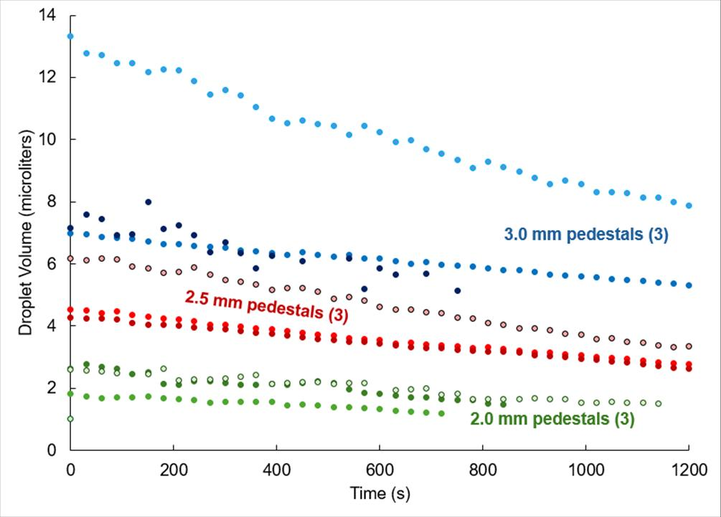
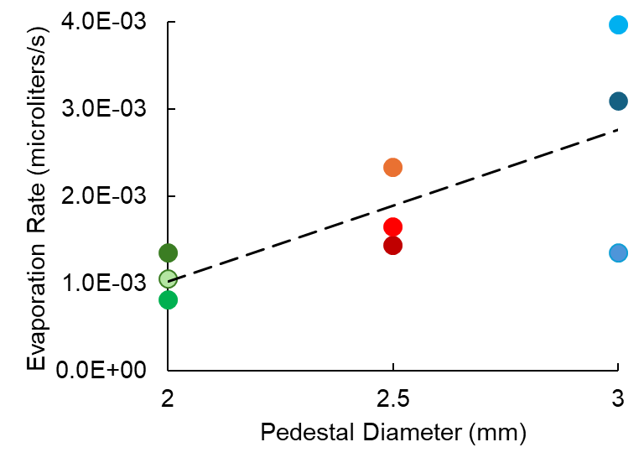
Experiment Results (Water)
Evaporation rate was constant
Evaporation rate was greater for larger pedestals
Evaporation rate could be proportional to pedestal radius
Droplet volume change with time for different pedestals
Compare evaporation rates with pedestal size

Slide 15
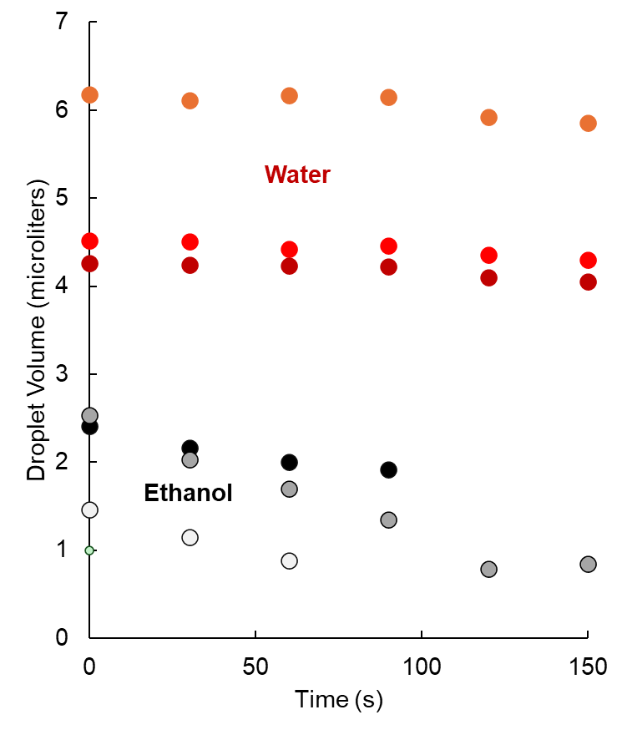
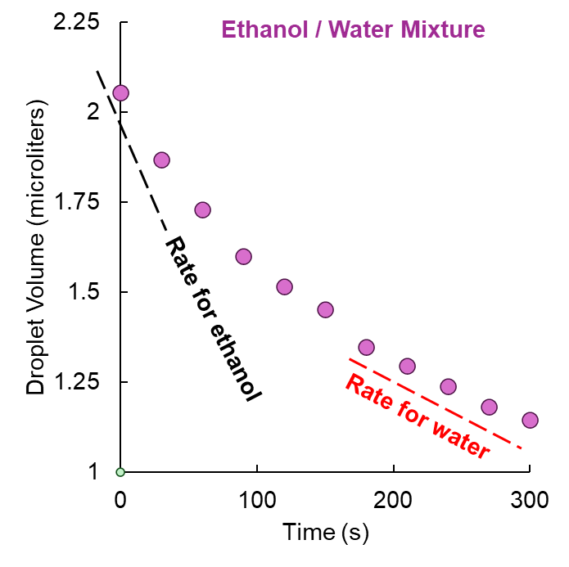
Experiment Results (Ethanol, mixture)
Evaporation rates of homogeneous liquid (water, ethanol) was linear.
Evaporation rate of mixture (ethanol + water, 22% ABV) was non-linear evaporation
Suggests a correlation between mixed droplets and rate of their homogeneous components
Water and ethanol trials (first 150 seconds)

Slide 16
Questions or Feedback?
Conclusions
The results of the experiments were the same as the work of Birdi and Vu (1988) who proved that linear evaporation rates are proportional to the contact radius
Only spherical drops were analyzed, future work would explore different methods for non-spherical droplets
Resolution can be improved with better lens, magnification, and reduced noise
Future research can investigate other mixed droplets
Thank You!

