Slide 1
Novel TiN–Al₂O₃–TiN Josephson Junction for Improved Superconducting Qubit Performance
Student: Miguel A. Alvarado
Mentor: Peter G. Lim
PI: Vinayak Dravid, Ph.D.

Slide 2
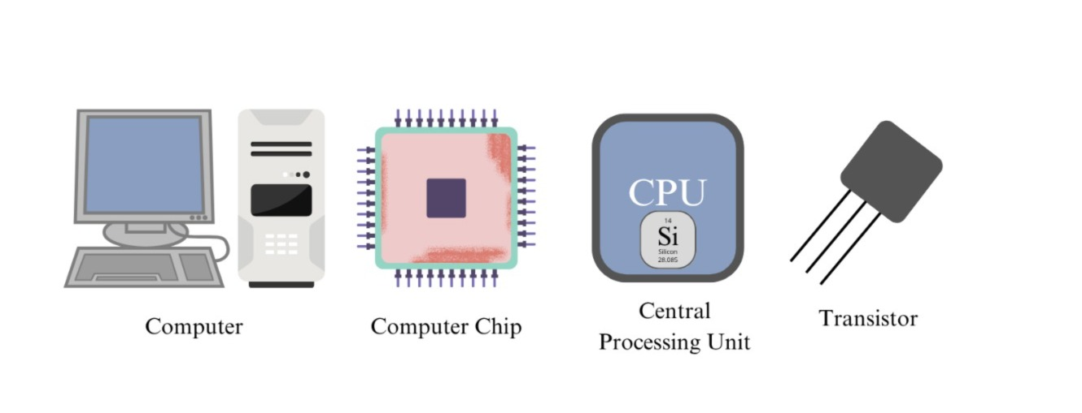
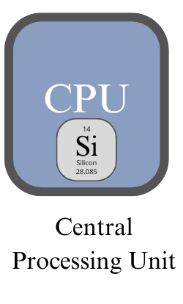
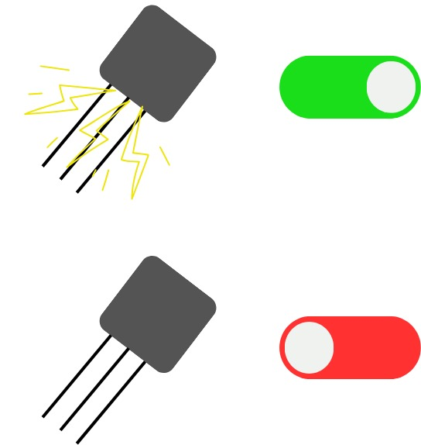
How Do Computers Work?
Transistors act like tiny switches that control the flow of electricity. They are either on or off.
This switching behavior is used to represent binary digits (bits):
  1 = ON (current flows)
  0 = OFF (no current)

Slide 3
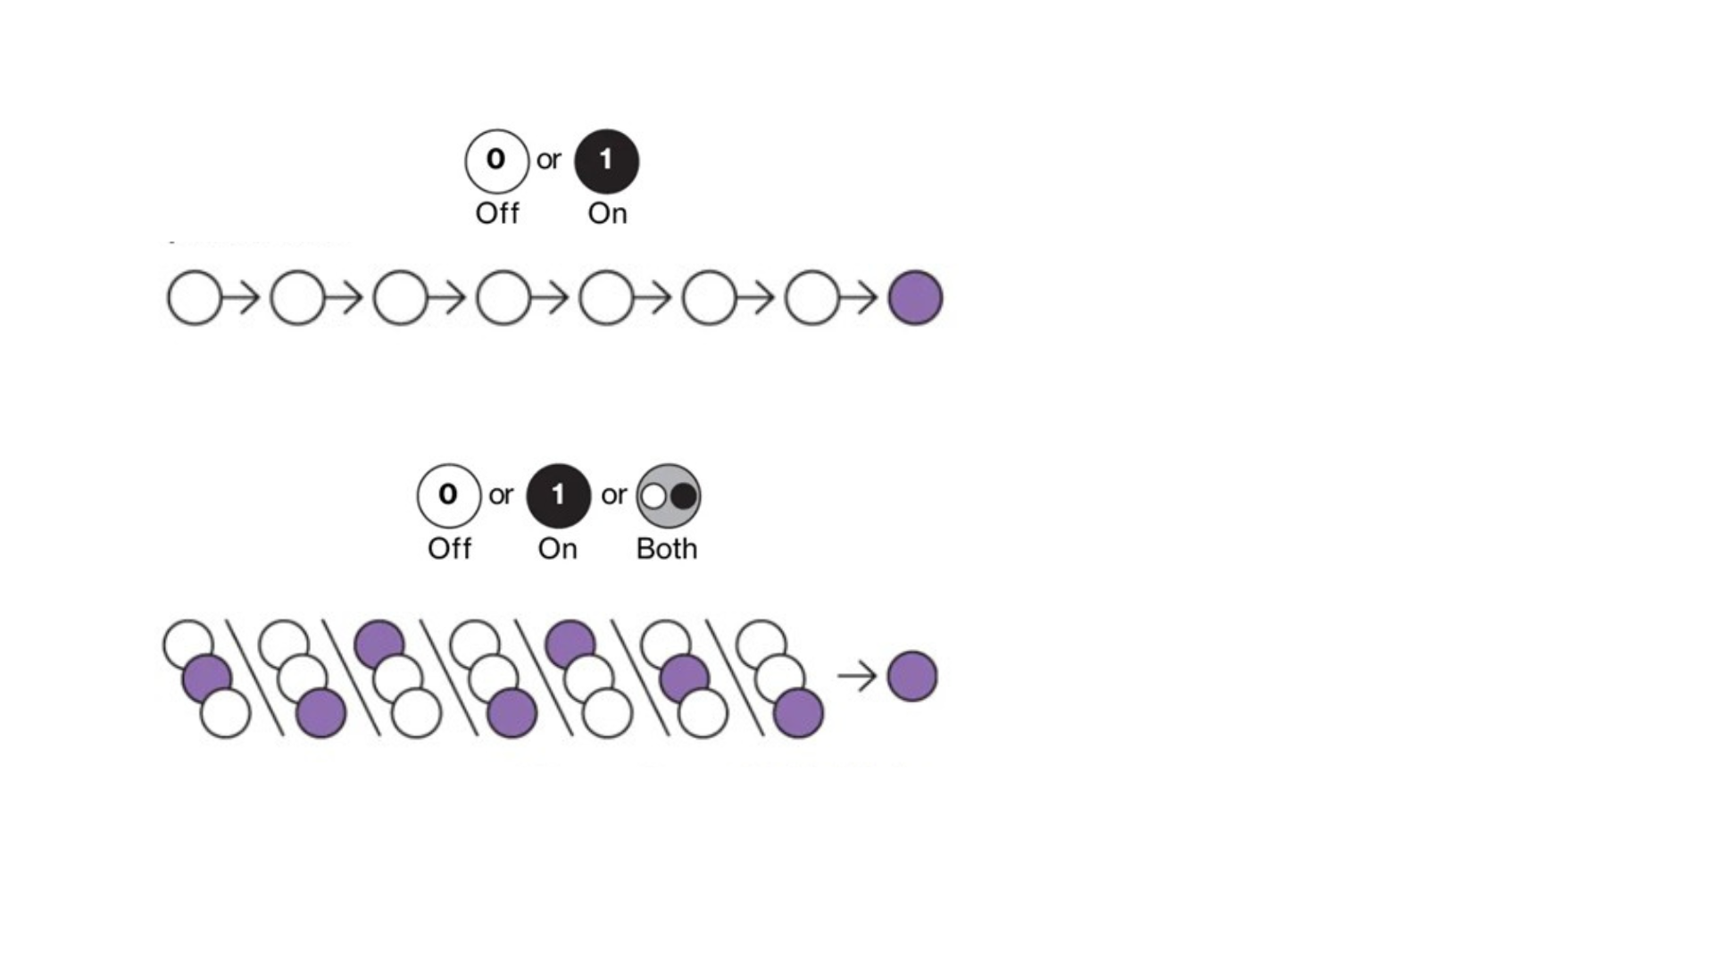
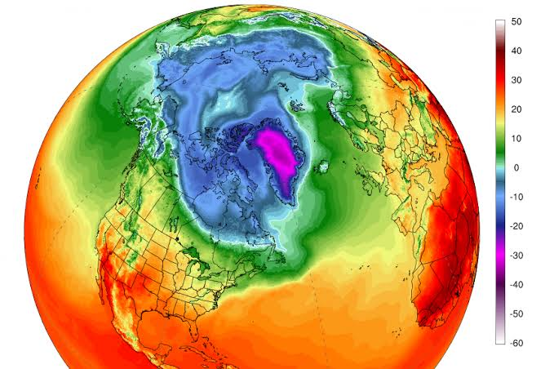

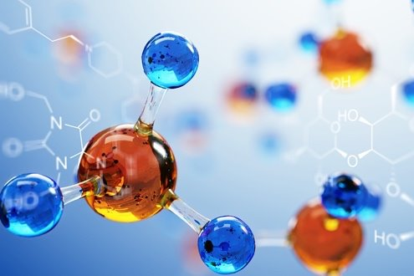
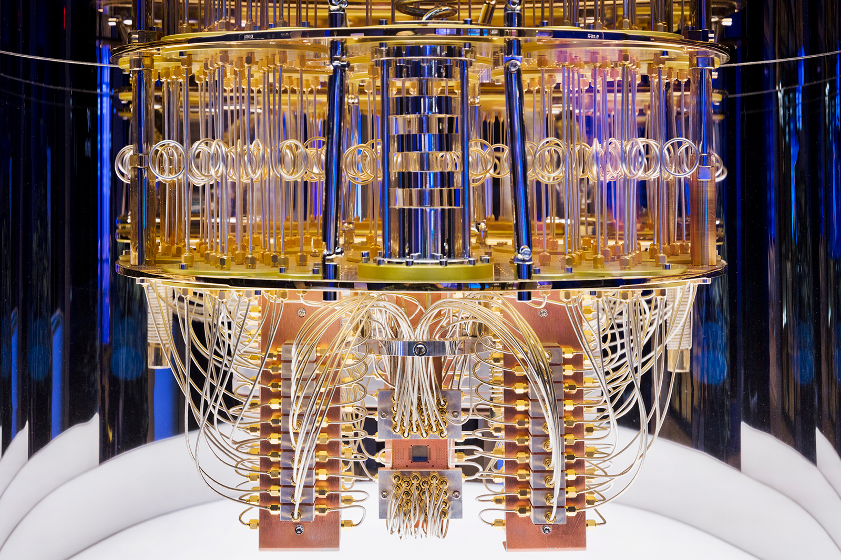
From Transistors (Bits) to Qubits
Computer:
Quantum Computing Applications:
Quantum Computer:

Slide 4
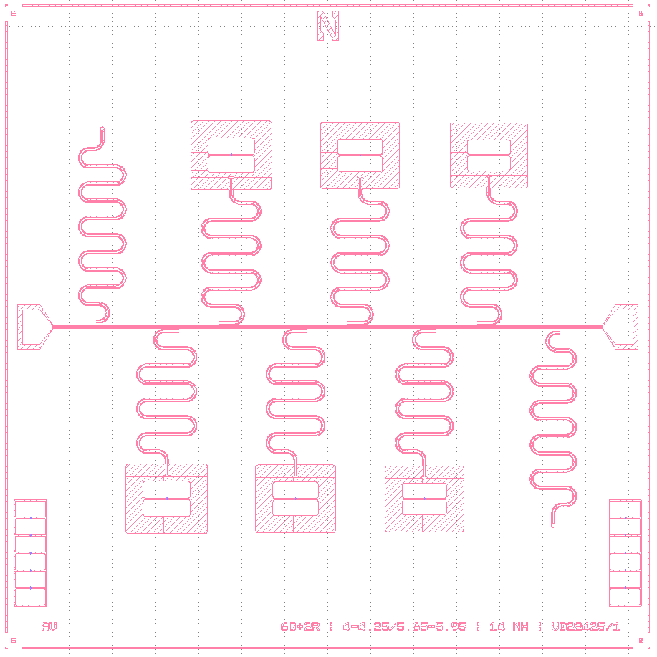
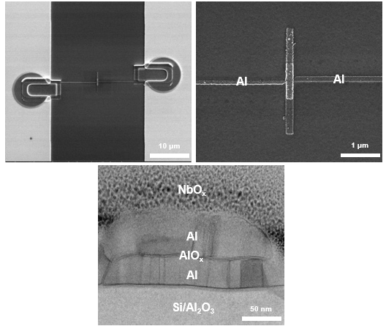

Challenges in Superconducting Qubits
Capacitor
Substrate
Al
Al
10 μm
1 μm
Resonator
NbO_{x}
Al
AlO_{x}
Al
Si/Al₂O₃
Al
50 nm
AlOx
A key limitation of traditional Al-AlOx-Al superconducting qubits is decoherence, the loss of energy and quantum information caused by material defects.

Slide 5
Imaging and Elemental Analysis
Scanning Electron Microscopy (SEM) & Energy Dispersive X-ray Spectroscopy (EDS):
100 μm
30 μm
5 μm
Ti
N
Al
O
10 μm
10 μm
10 μm
10 μm

Slide 6
Atomic-Level Structure and Composition
Transmission Electron Microscopy (TEM) & Energy Dispersive X-ray Spectroscopy (EDS):
Airbridge Al
Ti
N
Al
O
Substrate Al₂O₃
Al
Al
AlOx

Slide 7
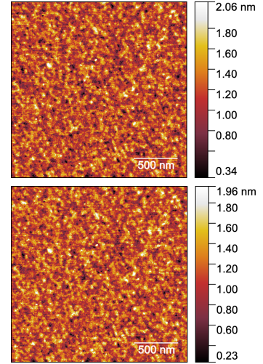
Surface Topography
Atomic Force Microscopy (AFM):
TiN top surface is ~10× smoother, with RMS roughness = 0.27 nm
Aluminum has a roughness of around 2–3 nm due to pattern transfer from the resist.
AlOx

Slide 8
Depth-Resolved Analysis of Oxides and Interfaces
X-ray Photoelectron Spectroscopy (XPS):
Al
Al

Slide 9
Performance Measurement
Insulating material in Josephson junction | Device stack | Measured performance ("Quality factor") figure of merit that quantifies performance of qubit | Reference
Epitaxial Al₂O₃ (PLD) [“Thick” t = 58.3 nm] | TiN-Al₂O₃-TiN on sapphire | > 25,000 | This work
Epitaxial Al₂O₃ (PLD) [“Thin” t = 13.5 nm] | TiN-Al₂O₃-TiN on sapphire | > 14,000 | This work
Amorphous AlO_{x} [t = 480 nm] | AlO_{x}-Nb on silicon | ~ 300 | Pappas, D. P. et al. IEEE Transactions on Applied Superconductivity 21, 871 (2011)
Amorphous AlO_{x} [t = 50 nm] | Al-AlO_{x}-Al on silicon | > 4,500 | Brehm, J. D. et al. Applied Physics Letters111, 112601 (2017)
Al
Al
AlOx

Slide 10
Conclusions & Future Work
SEM and EDS confirmed correct material deposition and bridge placement without structural damage.
TEM cross-sections revealed clean, well-defined interfaces, with elemental maps validating Ti, N, Al, and O layers.
AFM results showed our TiN films are ~10× smoother than aluminum, helping minimize surface-induced decoherence.
XPS depth profiling confirmed the chemical structure and sharp transitions between TiN, Al₂O₃, and TiN layers.
Finally, performance tests showed that our TiN–Al₂O₃–TiN qubits achieved quality factors >25,000, outperforming traditional amorphous AlOx junctions by over an order of magnitude.
Fabricate full Josephson junctions using the TiN–Al₂O₃–TiN trilayer and optimize the Al₂O₃ growth process to reduce interfacial oxides and two-level-system defects, enabling direct testing of qubit performance and coherence times.
Al
Al
AlOx

Slide 11
References
Shankman, S. Arctic Heat Surges Again, and Studies Are Finding Climate Change Connections - Inside Climate News. Inside Climate News.
Nic Fleming. How artificial intelligence is changing drug discovery. Nature.com.
Pathstone; Pathstone. Quantum Computing for a Chemical World | Pathstone. Pathstone.
Fritz, S. et al. Structural and Nanochemical Properties ofalOXLayers inal/alOX/al-Layer Systems for Josephson Junctions. Physical Review Materials 2019, 3 (11).
Müller, C.; Cole, J. H.; Lisenfeld, J. Towards Understanding Two-Level-Systems in Amorphous Solids: Insights from Quantum Circuits. Reports on Progress in Physics 2019, 82 (12), 124501.
Altoé, V. P. et al. Localization and Mitigation of Loss in Niobium Superconducting Circuits. 2022, 3 (2).
Clinic, C. Cleveland Clinic and IBM Unveil First Quantum Computer Dedicated to Healthcare Research. Cleveland Clinic.
Al
Al
AlOx

Slide 12

