Slide 1

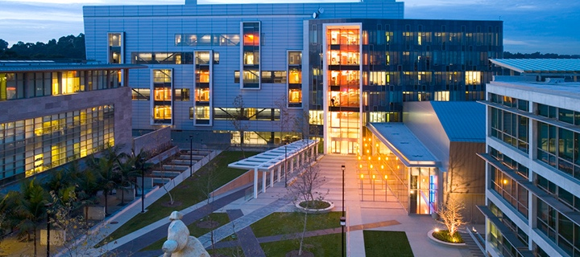




3D Bioprinting Glioblastoma for Disease Modeling
By
Grace Lu
University of California, San Diego &
San Diego Nanotechnology Infrastructure (SDNI)
Faculty PI: Shaochen Chen, Department of Nanoengineering, UC San Diego
Mentor: Emmie Yao, Department of Nanoengineering, UC San Diego
Presented at the 2025 NNCI REU Convocation, University of California San Diego, CA
August 4-5, 2025
Notes:
Hi everyone, my name is Grace Lu, and I’m an undergraduate researcher at UC San Diego in Dr. Shaochen Chen’s lab. Today, I’ll be sharing our work on developing a 3D bioprinted glioblastoma model to better replicate the tumor microenvironment and support more accurate disease modeling.

Slide 2
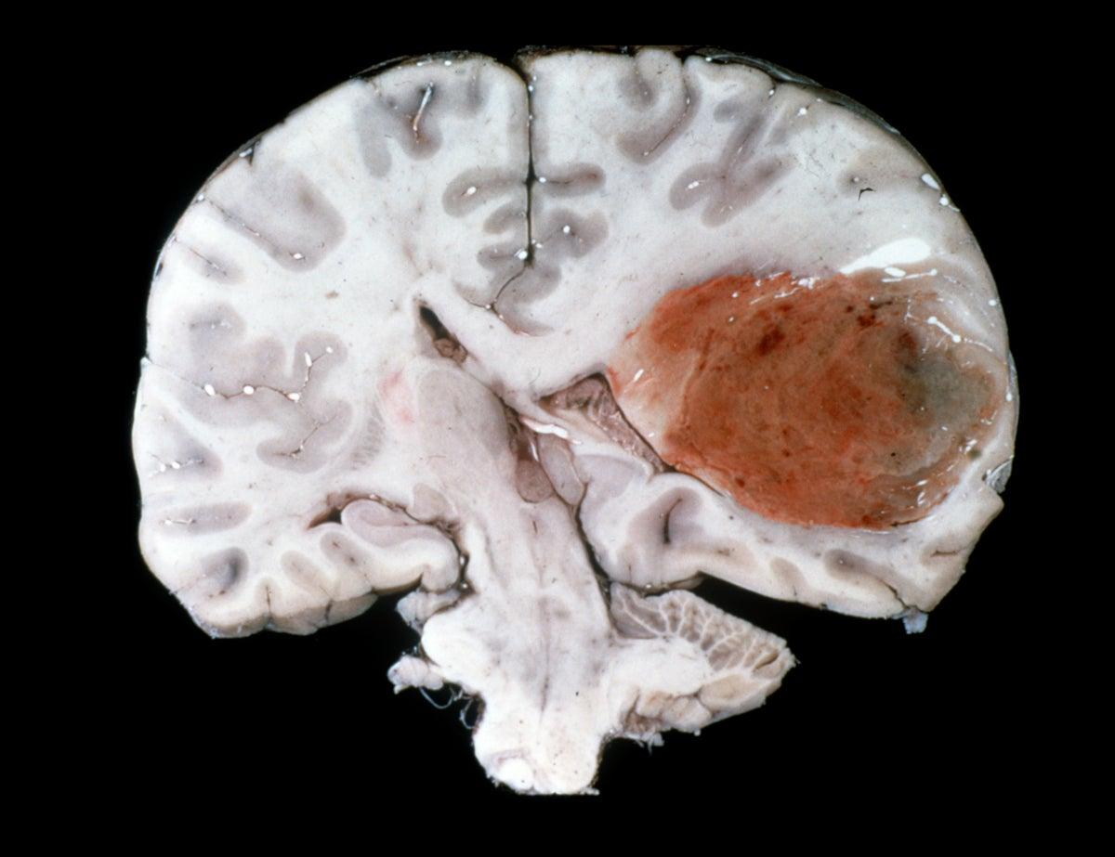
What is Glioblastoma?
Glioblastoma (GBM) is an aggressive form of brain cancer that affects the central nervous system (CNS).
5-year relative survival rate of 6.8%^{[1]}
High relapse rates and poor prognosis
[1] National Brain Tumor Society
[2] Stetka, B. (2019)
Notes:
Glioblastoma, or GBM, is one of the most aggressive and lethal forms of brain cancer.
Current treatments are limited by tumor heterogeneity, invasion, and resistance to therapy.
A big challenge in research is creating disease models that truly represent how these tumors behave in the body.

Slide 3
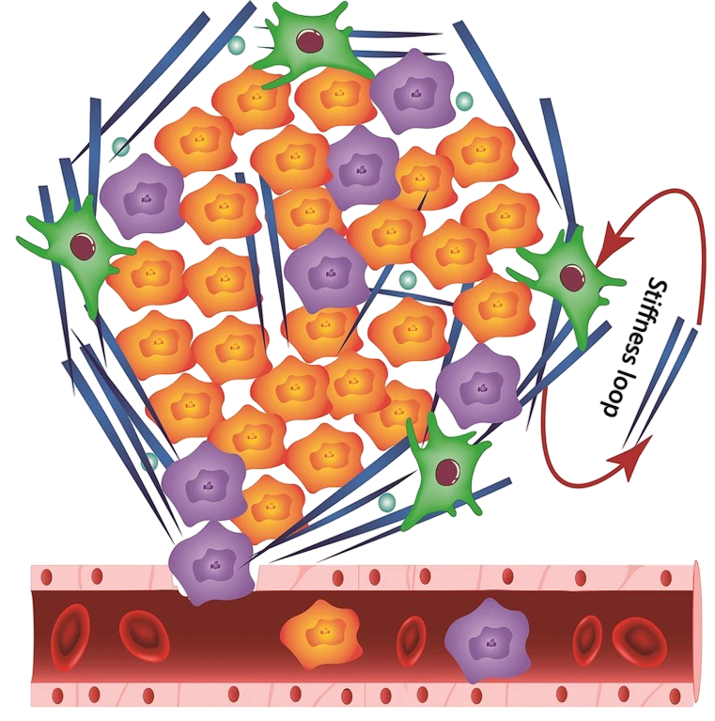
Tumor Density and Stiffness
High cell density
↓
“Leaky” blood vessels
↓
Metastasis^{[3]}
[3] Chiang, S. (2016)
[4] Safaei, S. (2023)
Notes:
To better understand GBM, we must look beyond genetics and consider the tumor’s physical environment. One key factor is increased cell density in advanced tumors. As cells grow more densely, nutrient access decreases and compressive stress rises. This pressure damages normal blood vessels, causing “leaky” vasculature that promotes tumor spread and metastasis. These bioMECHANICAL changes significantly influence tumor progression, therapy resistance, and invasion.
Advanced tumors also exhibit decreased tissue stiffness, which affects cell migration, drug diffusion, and signaling pathway activation. Replicating this mechanical softness in vitro is important for modeling realistic tumor behavior.

Slide 4
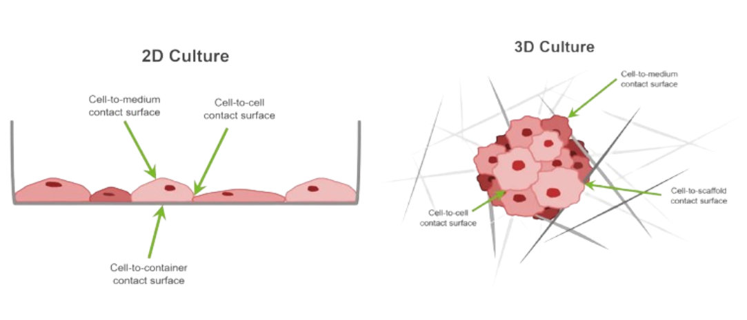



Traditional vs 3D Models
2D Modeling
3D Modeling
Cell-to-medium contact surface
Cell-to-cell contact surface
Cells cultured independently
in plastic flask
Cell-to-container contact surface
Cell-to-medium contact surface
Cells cultured in 3D configuration
Realistic cellular interactions
Cell-to-scaffold contact surface
Cell-to-cell contact surface
[5] UPM Biomedicals
Notes:
Traditional 2D modeling is an isolated culturing method, in which flattened cells grow in a monolayer in a flask. Although this method provides us with important information about how GBM cells behave independently, it reduces cell-cell interactions, exposes cells to excess nutrients due to increased surface area, and offers limited control over cell density.
To address these drawbacks, we have utilized a physical 3D model that provides us with more realistic cell-cell interactions. The cells in a 3D model can come in contact with each other from all sides of the cell. This allows us to observe more authentic cellular interactions.

Slide 5
Goals and Objectives
Aim 1
Aim 2
Aim 3
Mechanical and structural authenticity
Validation of physiological authenticity
Drug therapies vs. cancer resistance
Notes:
With this in mind, our research is focused on three main objectives, each aimed at improving the accuracy and authenticity of our 3D GBM models.
Our first goal is to create 3D GBM models with structural and mechanical authenticity. We want to create models that mimic the true physical characteristics seen within GBM tumors.
To ensure the accuracy of our model, we'll use a combination of characterization techniques to support the validity of our GBM models. We plan to use qPCR and cell viability assays to validate the cellular expression within our models.
Finally, we would test our model under various chemotherapies and radiotherapy conditions. Our goal is to explore how varying cell densities, and subsequently changing tumor environment, contributes to the resistance, and possibly the regeneration, of GBM cells.

Slide 6
Methodology Overview
Cell Culture
Mechanical Testing
3D Bioprinting
Characterization
Notes:
Here is an overview of the experimental workflow we followed to achieve these goals.

Slide 7
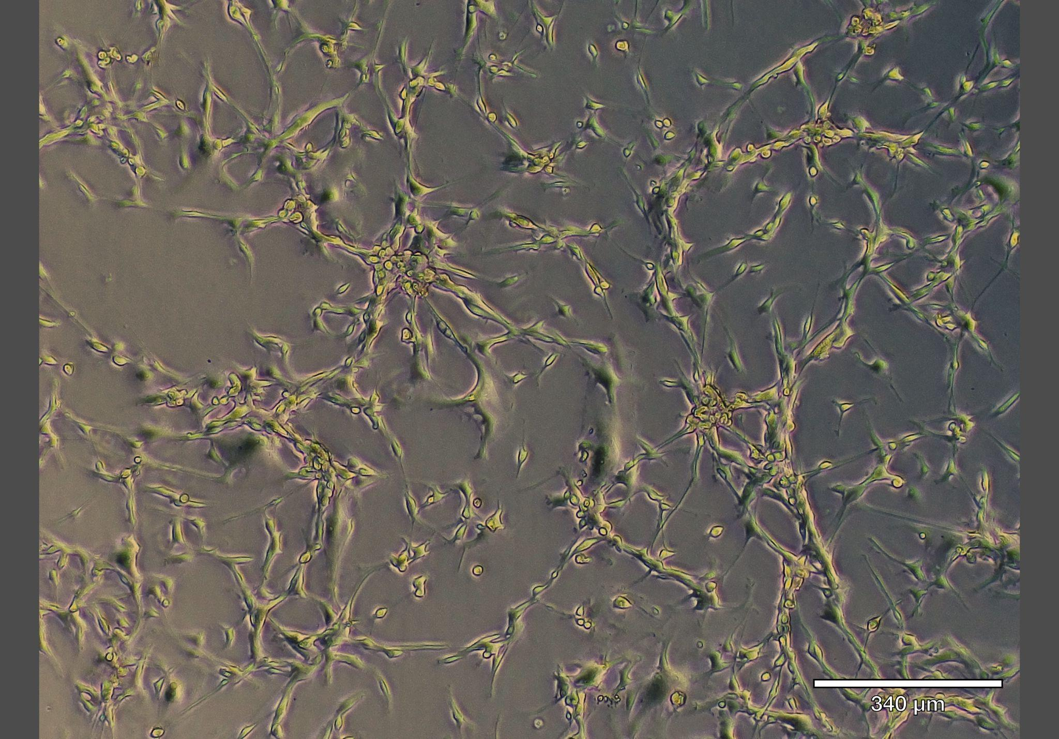
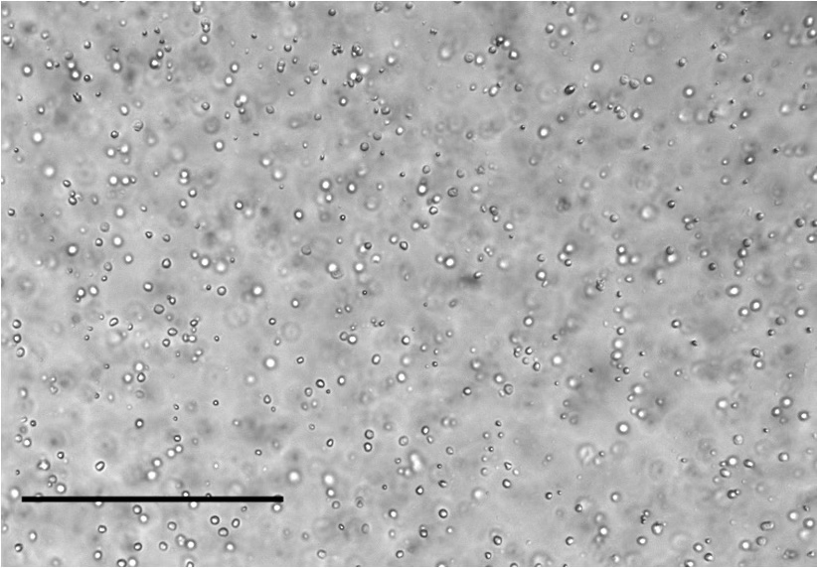
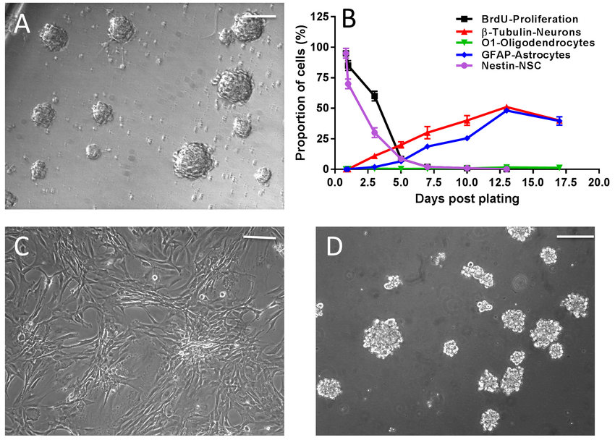
Cell Culture
2D U87
2D CW468
2D TS576^{[6]}
[6] Allani, S. (2018)
Notes:
To address GBM’s high heterogeneity, we cultured various cell lines.
U87 cells, which are an immortalized human gbm cell line. They are adherent cells, meaning they attach themselves to the flask they are grown in.
And CW468 and TS576 cells, which are both taken directly from a patient. These are suspension cells that grow while floating in their growth medium. The clumping of TS576 cells is natural GBM cell behavior that allows them to be more resistant.
We chose multiple types of glioblastoma cells to mimic the heterogeneity of GBM tumors, which, as previously mentioned, are part of the reason GBM is so difficult to treat.

Slide 8
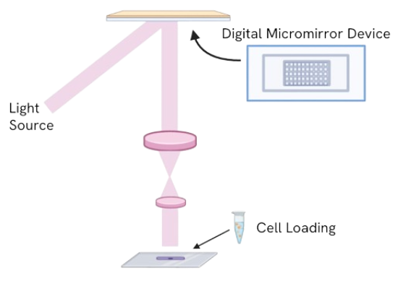
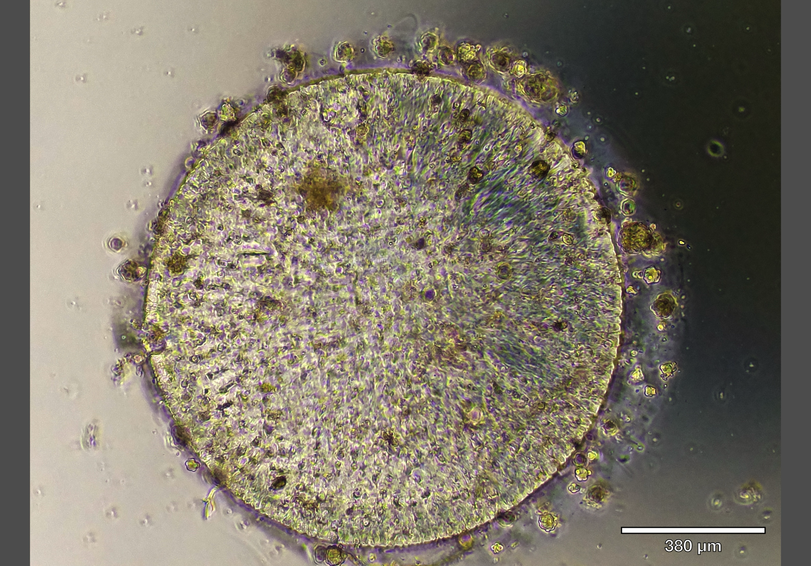
DLP 3D Bioprinting
Created with BioRender
Notes:
Following the cell culturing process, we 3D bioprinted our models using Digital Light Processing, or DLP. This technique allows us to efficiently create high-resolution physical 3D models.
We mix a gelatin-based prepolymer with the cells, add a digital mask, and expose it to UV light via a digital micromirror device (DMD). The UV light polymerizes the material and produces a solid structure. With this DMD technology, it takes around 20 seconds to create a singular print. This allows us to quickly yet accurately create these 3D biomimetic models.
On the right is a top-down picture of one of our printed structures. These structures are usually 500um in diameter. And though these structures are small, they are able to retain their structure structure and cells are uniformly embedded throughout the print.

Slide 9
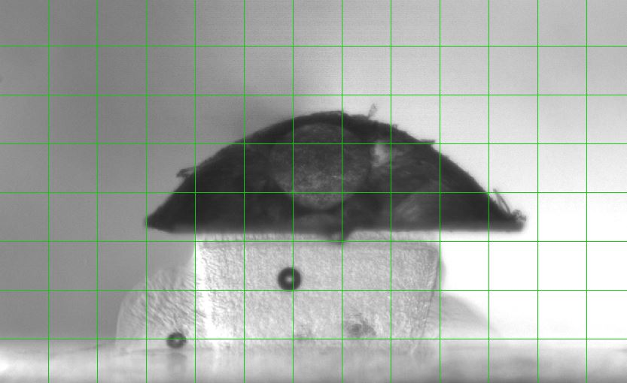
Mechanical Testing
Normal tumor: 7-26 kPa^{[7]}
Increased density: 0.6-1 kPa
Condition | Cell Density
Base density model | 1M cells per mL
High cell density model | 80M cells per mL
[7] Wang, C. (2020)
Notes:
Our goal was to replicate the stiffnesses of tumors observed in clinical trials, which defines normal tumors with stiffness of 20kilopascal and further developed tumors around 1kilopascal.
We used Microsquisher compression testing to measure the stiffness of each print.
During this process, we altered the density of cells per print to tune the stiffness of our structures to fall within this physiological range.
The image on the right also provides a side-on view of our 3D printed structure.

Slide 10
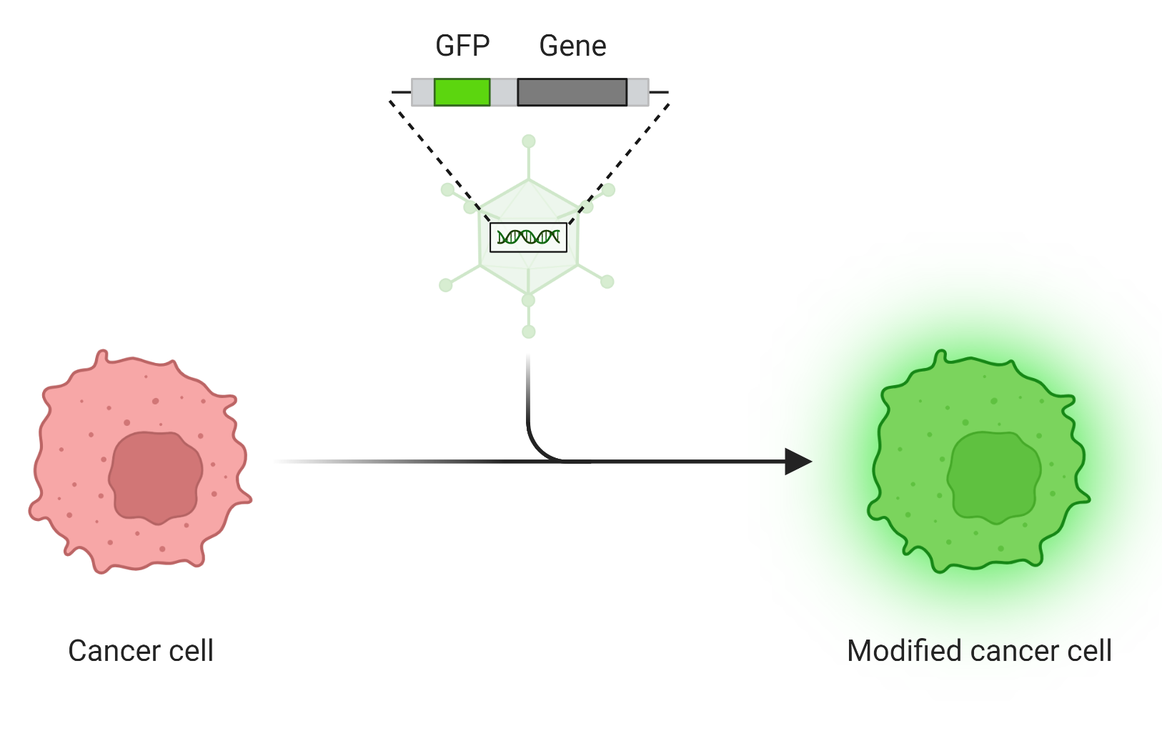
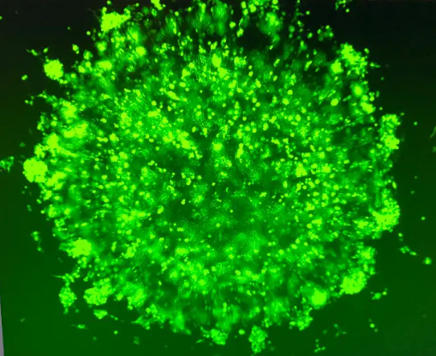
GFP Staining
[8] Ona, S.
Notes:
To verify that cells remained viable and evenly distributed within the constructs, we used GFP staining.
We observed strong and uniform fluorescence throughout the bioprinted constructs, indicating that the cells were successfully encapsulated and remained viable.

Slide 11
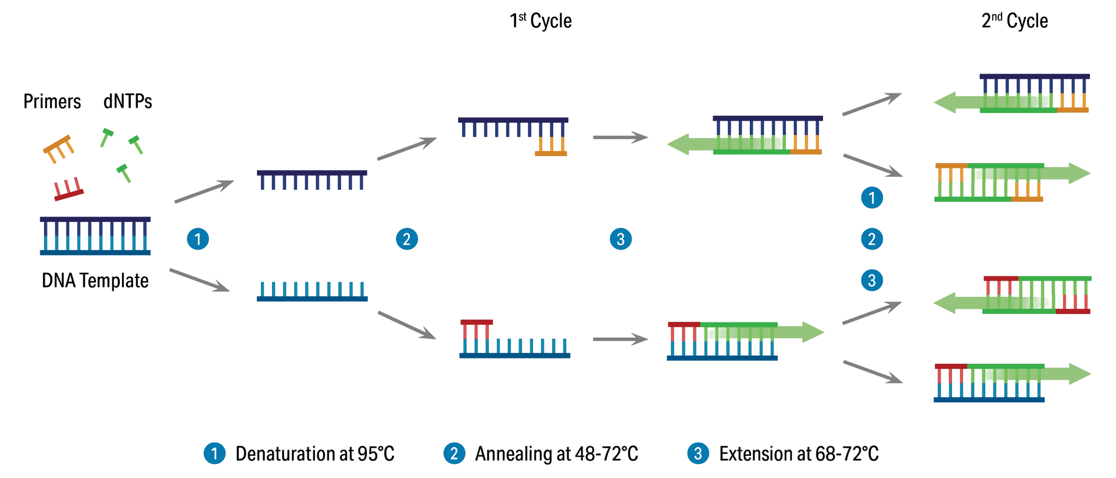
qPCR
[9] AAT Bioquest
Notes:
Upon determining that our printed structures were able to sustain viable cells, analyzed gene expression using qPCR. This process allows us to amplify specific DNA sequences.

Slide 12
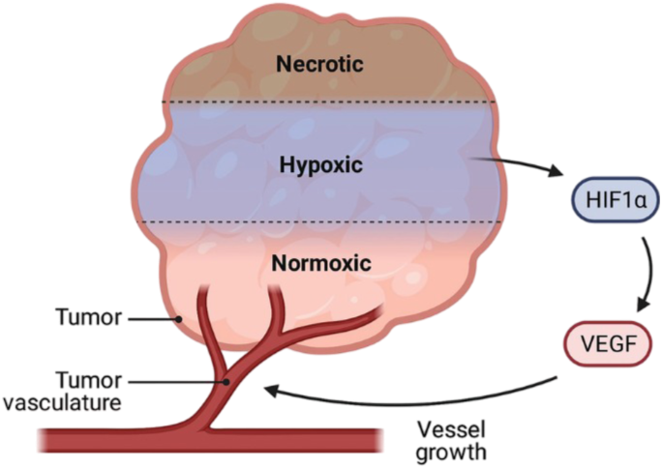
Relevant Markers
HIF-1a
Upregulated in low oxygen
VEGFA
Stimulates angiogenesis
CXCL12
Drives cell migration
[10] Farhangnia, P. (2023)
Notes:
We focused on markers relevant to GBM’s invasive and vascular environment.
HIF-1α is upregulated in low-oxygen, high-density tumors.
VEGFA stimulates the formation of new, often abnormal and leaky blood vessels that supply nutrients to support rapid tumor growth and contribute to disease progression.
CXCL12 promotes cell migration, aiding tumor invasion and metastasis.

Slide 13
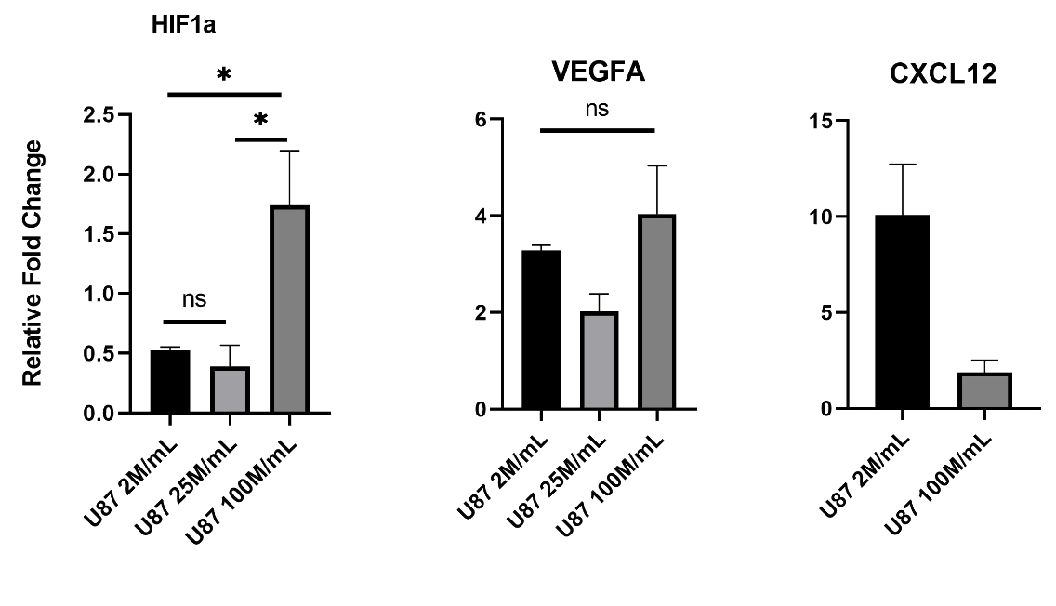
qPCR Results
Notes:
Upon conducting the qpcr process, we observed a statistically significant increase in expression for HIF1a and VEGFA in the HCD condition compared to the low-density condition.
Surprisingly, we saw higher levels of CXCL12 in the low-density prints, which suggests that the way cells communicate and signal to each other might change depending on how tightly packed they are.
These results suggest that higher cell density in our 3D model activates signaling pathways linked to GBM aggressiveness, highlighting its relevance for studying tumor behavior.

Slide 14
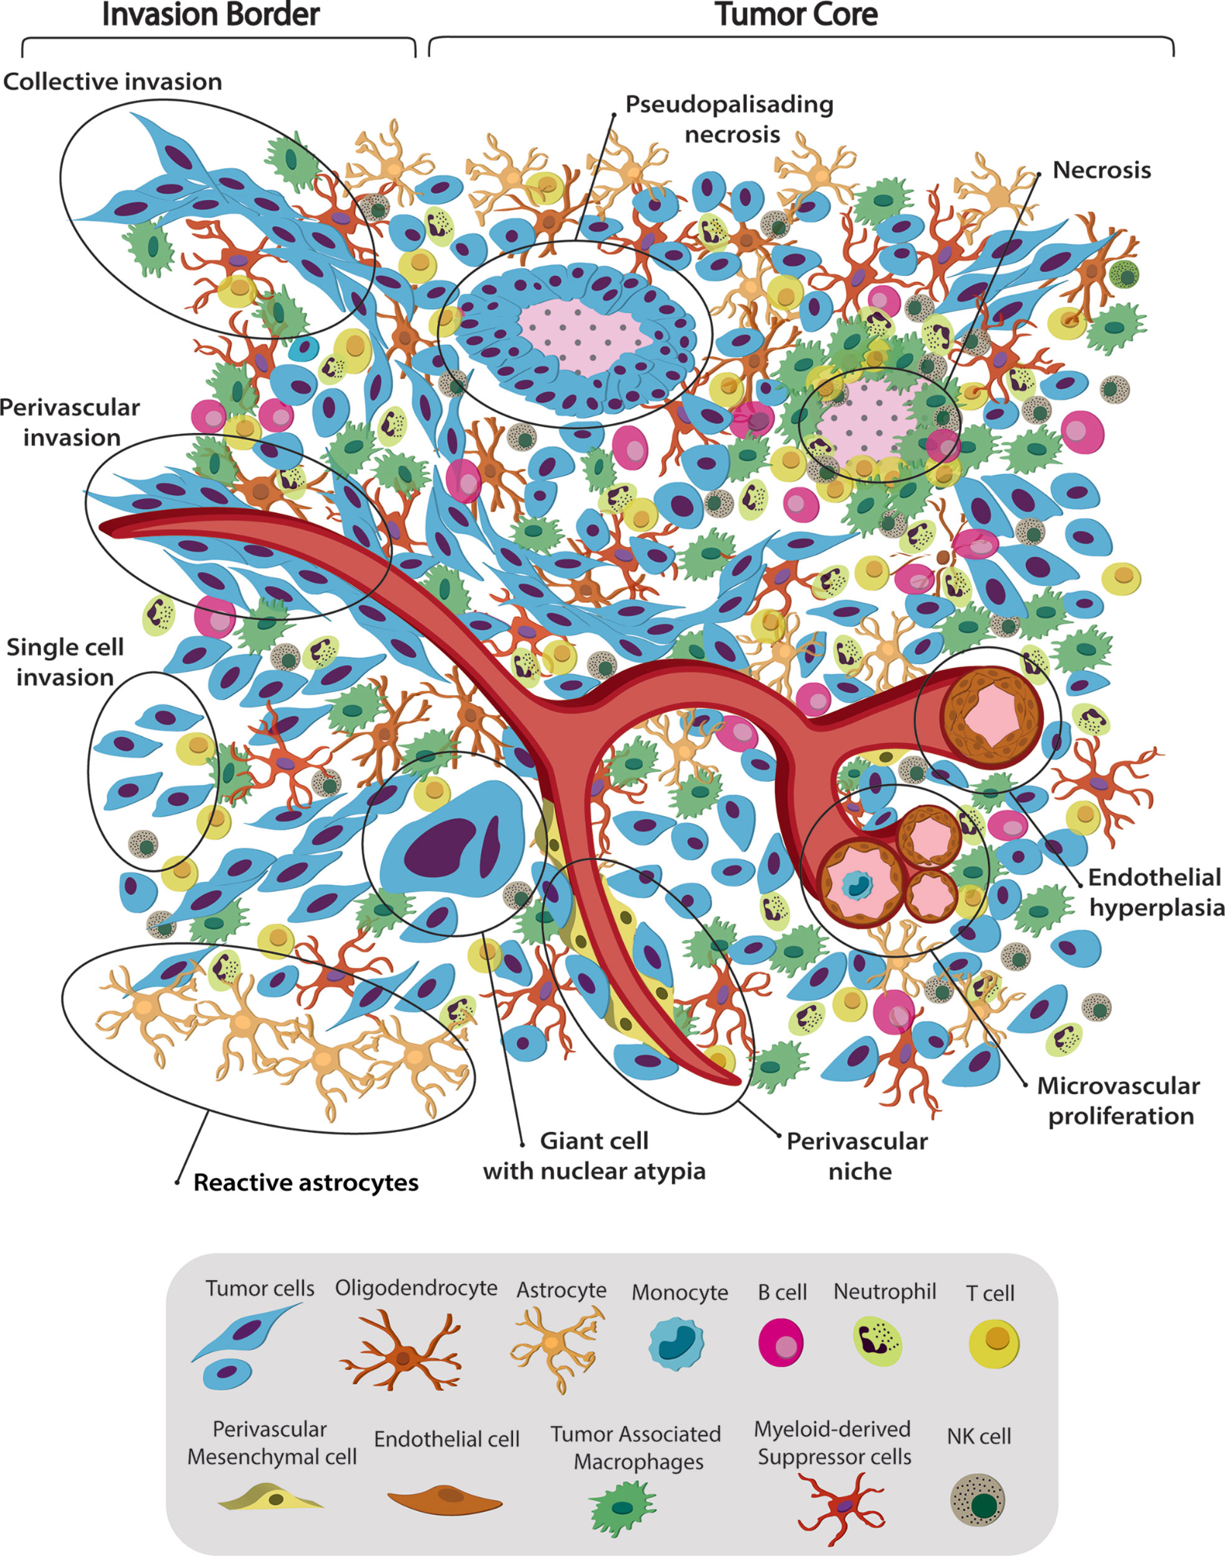
Conclusion
Established a 3D bioprinted model
  Decreased stiffness
  Maintained cell viability
  Promoted expression of disease-relevant genes
Aim 3: Drug testing and treatment resistance
Further incorporation of diverse cells
[11] Comba, A. (2021)
Notes:
So far, we have developed a 3D bioprinted GBM model with decreased stiffness that maintains cell viability and promotes expression of disease-relevant genes.
Moving forward, we aim to explore how varying cell densities affect GBM resistance and potential regeneration.
Additionally, given the extreme heterogeneity of GBM microenvironments, as illustrated in the figure, further incorporating patient-derived cells and native neural components to enhance the model’s clinical relevance.

Slide 15
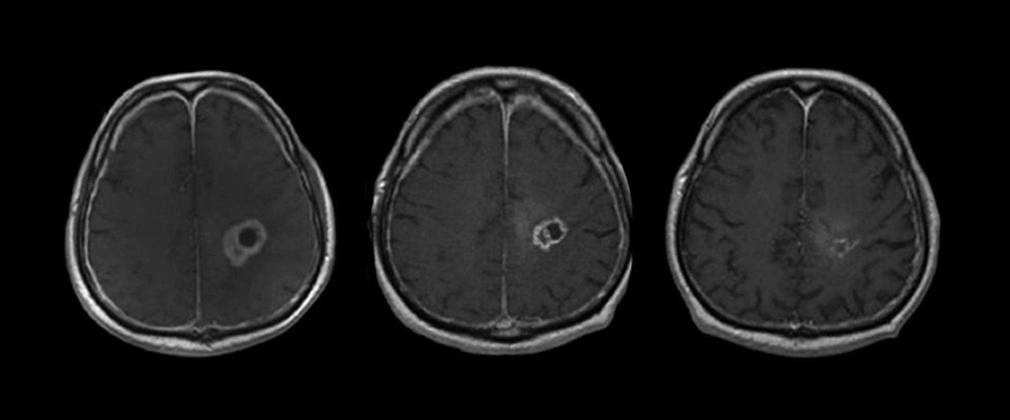
Broader Impacts
Key insight into GBM interactions and mechanisms
Future treatment research and testing
Improving the prognosis and survival rate for GBM patients
[12] Fishman, L. (2023)
Notes:
This 3D bioprinted model offers a promising platform for studying glioblastoma in vitro by better mimicking the tumor’s physical and biological environment.
It can support drug testing, investigation of tumor behavior, and analysis of cell signaling.
With patient-derived cells, it may also aid in developing personalized therapies.
Ultimately, this model could improve our understanding of GBM progression, contribute to more effective treatment strategies, and, one day, improve survival outcomes for GBM patients.

Slide 16
Acknowledgements
I would like to sincerely thank:
The National Science Foundation
Our host, University of California San Diego
San Diego Nanotechnology Infrastructure (SDNI)
Dr. Shaochen Chen, Faculty PI
Emmie Yao, Mentor
Yves Theriault, SDNI Executive Director, Education and Outreach
Yuhwa Lo, SDNI Faculty Director
The audience for listening and for their time!
This program was supported by NSF grant ECCS 2025752
Notes:
I’d like to thank the NSF, UC San Diego, and SDNI for supporting this project.
Special thanks to Dr. Chen, Emmie, Yves, and Dr. Lo for their mentorship.
And thank you all for your time today.

Slide 17
References
About Glioblastoma - National Brain Tumor Society. (2024, July 11). National Brain Tumor Society. braintumor.org/events/glioblastoma-awareness-day/about-glioblastoma/
Stetka, B. (2024, February 20). New Strategies Take on the Worst Cancer--Glioblastoma. Scientific American. www.scientificamerican.com/article/new-strategies-take-on-the-worst- cancer-glioblastoma/
Chiang, S. P. H., Cabrera, R. M., & Segall, J. E. (2016). Tumor cell intravasation: Mechanisms and regulation. American Journal of Physiology–Cell Physiology, 311(1), C1–C14. doi.org/10.1152/ajpcell.00238.2015
2D vs 3D cell culture | Learning Center. (n.d.-a). 2D Vs 3D Cell Culture | Learning Center | UPM Biomedicals. https://www.upmbiomedicals.com/resource-center/learning-center/what-is-3d-cell- culture/2d-versus-3d-cell-culture/
Allani, S., Weissbach, H., & Lopez‑Toledano, M. A. (2018). Sulindac induces differentiation of glioblastoma stem cells making them more sensitive to oxidative stress. Neoplasma, 65(3), 376–388. doi.org/10.4149/neo_2018_170404N245
Safaei, S., Sajed, R., Shariftabrizi, A., Dorafshan, S., Zanjani, L. S., Manshadi, M. D., Madjd, Z., & Ghods, R. (2023). Tumor matrix stiffness provides fertile soil for cancer stem cells. Cancer Cell International, 23(1). https://doi.org/10.1186/s12935-023-02992-w
Wang, C., Sinha, S., Jiang, X., Murphy, L., Fitch, S., Wilson, C., Grant, G., & Yang, F. (2021). Matrix Stiffness Modulates Patient-Derived Glioblastoma Cell Fates in Three-Dimensional Hydrogels. Tissue Engineering Part A, 27(5–6), 390–401. doi.org/10.1089/ten.tea.2020.0110
Ona, S. (n.d.). Green Fluorescence Protein (GFP) reporter in cancer cell [Template]. BioRender. Retrieved August 1, 2025, from www.biorender.com/template/green-fluorescence-protein-gfp-reporter-in-cancer-cell
Real-Time PCR (qPCR) | AAT Bioquest. (n.d.). https://www.aatbio.com/catalog/real-time-pcr-qpcr
Farhangnia, P., Delbandi, A. A., Aghamohammadi, N., Safdarian, A. R., & Akbarpour, M. (2022). The Role of Intra-Tumor Hypoxia in Cancer Cells Immune Escape Mechanism. In Springer eBooks (pp. 1–50). https://doi.org/10.1007/978-3-030-80962-1_61-1
Comba, A., Faisal, S. M., Varela, M. L., Hollon, T., Al‑Holou, W. N., Umemura, Y., Nunez, F. J., Motsch, S., Castro, M. G., & Lowenstein, P. R. (2021). Uncovering spatiotemporal heterogeneity of high‑grade gliomas: From disease biology to therapeutic implications. Frontiers in Oncology, 11, Article 703764. doi.org/10.3389/fonc.2021.703764
Fishman, L., & Fishman, L. (2023, August 5). A New Approach for Treating Glioblastoma. NewYork-Presbyterian. https://healthmatters.nyp.org/new-approach-for-treating-glioblastoma/

