Slide 1
NNCI REU Convocation 2025
Effect of Salt Concentration on the PFAS Removal by 3D Printed Graphene-Polymer Aerogels
Kana Fukazawa^{1,2}, Zaki Alam Pushan¹, Nirupam Aich¹
¹Department of Civil and Environmental Engineering, University of Nebraska- Lincoln, Lincoln, NE, USA
²Graduate School of Chemical Science and Engineering, Hokkaido University
^{Date: 4 August 2025}
U N I V E R S I T Y O F N E B R A S K A - L I N C O L N
Notes:
Hello everyone. My name is Kana Fukazawa, and I’m from Hokkaido University in Japan.
This summer, I traveled over 5,000 miles to work on the development of 3D-printed graphene aerogels for PFAS removal from water.

Slide 2
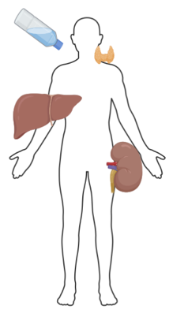
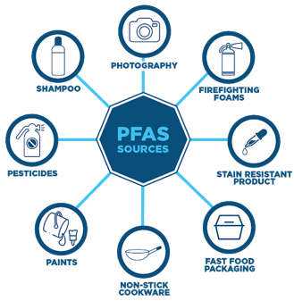

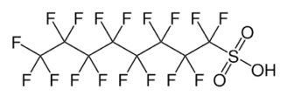
What is PFAS?
Per- and polyfluoroalkyl substances (PFAS) are a group of synthetic organofluorine compounds
-Extremely stable due to strong C-F bonds.
-Widely used in products like non-stick pans and firefighting foams
-Persistent in the environment → ” Forever chemicals ”
-Accumulate in the environment and human body
→ Water pollution / Cancer / Endocrine disruption
Thyroid disease
Liver damage
Perfluorooctanoic acid (PFOA)
Kidney cancer
Perfluorooctanesulfonic acid (PFOS)
Reference: Regenesis
Notes:
PFAS stands for per- and polyfluoroalkyl substances. They are a group of more than 15 thousand synthetic chemicals. Here, you can see two of the highly used PFAS compounds: PFOA and PFOS. As you can see these compounds have strong carbon-fluorine bonds. On top of that, the carbon chain is hydrophobic, and the terminal functional group is hydrophilic. These characteristics makes them extremely stable and hard to break down.
They have been widely used in many products, such as non-stick cookware and firefighting foams.
Because of their stability, they persist in the environment and don’t degrade easily- that’s why they’re often called ‘forever chemicals.’
PFAS can accumulate in water, soil, and even in the human body, causing serious health concerns like water pollution, cancer, and endocrine disruption.

Slide 3
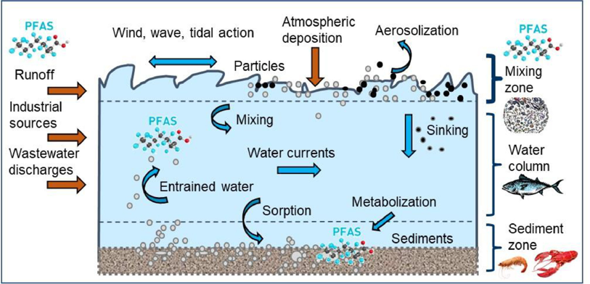
PFAS in seawater Environments
PFAS is a serious environmental issue spreading in seawater
Salt concentration affects adsorption behavior, making evaluation under saline conditions essential
Reference: Env. Challenges (2024), 14, 100861
Notes:
PFAS is not only a problem in fresh and drinking water—it also spreads into the ocean. That’s especially important in coastal areas like San Diego. And because salt can influence how PFAS interacts with adsorbents, we tested our aerogels under different salts with different concentrations.

Slide 4
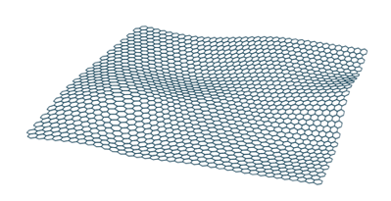
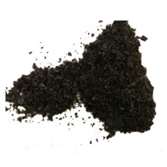
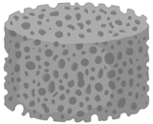
How to remove PFAS?
Graphene:
-High specific surface area and chemical stability
-Ability to adsorb contaminants via electrostatic and hydrophobic interactions
O
OH
COOH
Graphene Oxide (GO)
Problem
Colloidal stability of graphene disperse them in water.
Difficult to separate and reuse.
Processing graphene into “3D porous structures (aerogels)”
-Easily recoverable and reusable in water
-Mechanically stable and can be used while retaining its shape
GO Powder
aerogel
Notes:
To remove PFAS from water, we focused on using graphene. Graphene has a high specific surface area, which allows it to adsorb contaminations through electrostatic and hydrophobic interactions. However, powdered graphene can disperse in water, making it hard to separate and reuse.
So, we processed graphene into a 3D porous structure, called an aerogel. Aerogels are lightweight, porous solid structures made by replacing the liquid in a gel with air while keeping its structure.
These mechanically stable 3D structures are ideal for pollutant removal and can be easily recovered and reused in water treatment.

Slide 5
Why 3D Printed Graphene Aerogels?
Additive manufacturing offers unique advantages over top-down manufacturing
  Lowered material cost and waste
  Flexibility to design complex structures with high precision
  Combine material functionalities for improved applications
PDA and BSA
Notes:
Since graphene ink alone is hard to print and unstable in water, we added polydopamine and BSA.
They help with viscosity, printability, water stability—and even improve PFAS removal.

Slide 6
Objectives
3D print Graphene-Polymer Aerogels
Evaluation of this aerogels for PFAS removal in presence of different concentration of monovalent (NaCl) and divalent (CaCl₂) salt
Elucidating the PFAS removal mechanism
Notes:
Based on this background, my research has three objectives.
First, to 3d print the graphene-polymer aerogels.
Next, evaluate how effective the graphene-polymer aerogels are in removing PFAS in different salt concentration.
lastly, to understand the removal mechanism-
In Other words, how these aerogels interact with PFAS molecules and what factors influence the process.

Slide 7
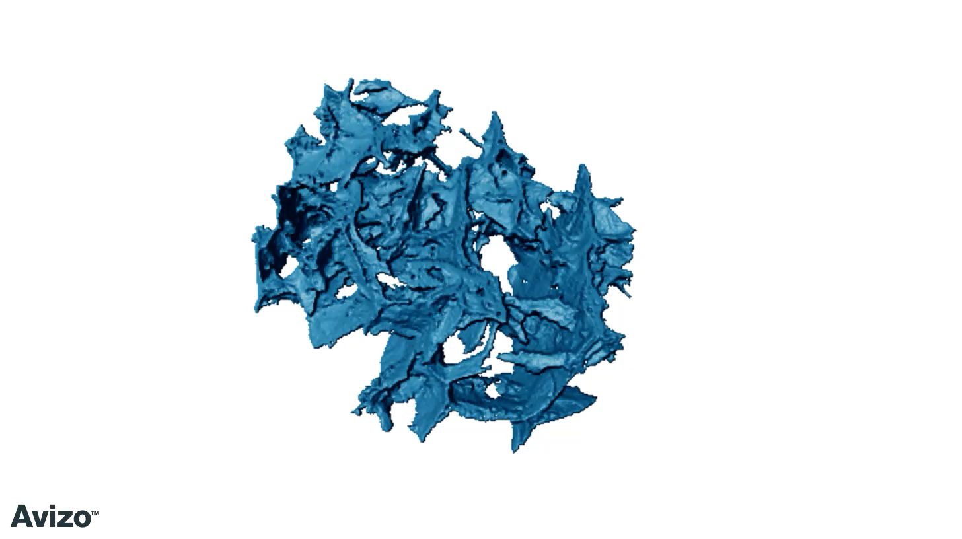
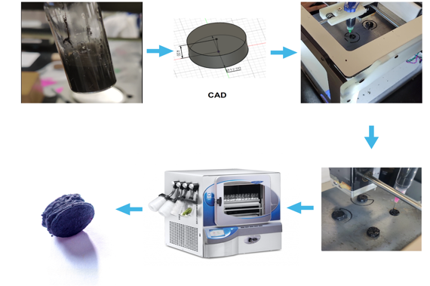


Method
3D printing
Nano-CT
G-PDA-BSA Gel
CAD
3D Printing
Nano-CT is non-destructive characterization of 3D interconnected porous network in the Graphene-biopolymer aerogel
G-PDA-BSA
aerogels
Freeze drying
3D printed
hydrogels
Highly porous and interconnected network
→Efficient PFAS diffusion and adsorption
Notes:
First, I prepared a graphene-polymer gel using GO, PDA, and BSA.
This gel was then 3D printed into designed shapes,
freeze-dried, and thermally cured to produce the final aerogels.
We used Nano-CT to confirm the aerogel’s porous structure, which helps PFAS diffusion and adsorption. I have a small video from the nano CT. where you can see the interconnected pores inside the aerogel.

Slide 8

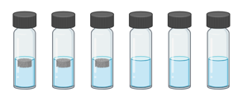
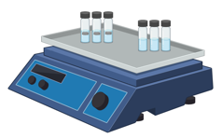

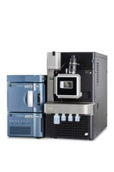


Method
Batch adsorption
Stock solutions of PFOA & PFOS is prepared in methanol.
100 ppb aqueous solutions of PFOA & PFOS are made from the stock solution.
Aerogels are weighed and put on vials with PFOA & PFOS solution.
Vials are put on the orbital shaker.
Aliquots taken at different time intervals.
Upon collection, supernatant is collected after immediate centrifugation and stored in 4 ⁰C.
Samples were forwarded for LC-MS analysis.
100 ppb PFAS solution
With aerogel
Control
Orbital shaker
Centrifuge machine
LCMS
Notes:
For the batch adsorption test, we prepared 0.1 ppm PFAS solutions from methanol stocks. This lower concentrations are selected for environmental relevancy.
We added the aerogels into the vials and shook them.
Samples were taken at different time intervals and stored at 4°C for LC-MS analysis.

Slide 9
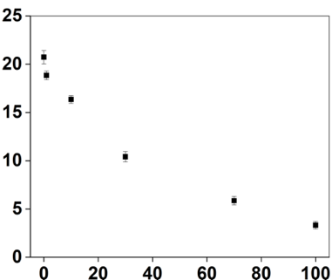
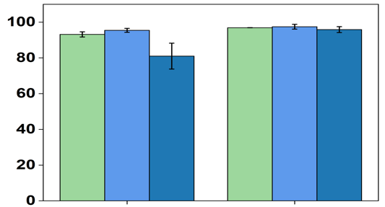


PFOA & PFOS Removal in NaCl
t = 30 min
PFAS Removal Efficiency (%)
Zeta Potential (mV)
Ionic Strength (mM NaCl)
Very fast removal noticed for all conditions for both PFAS compounds
PFOS with sulfonic acid group were removed more due to increased hydrophobicity compared to PFOA with carboxylic acid group
In presence of NaCl, removal is consistent with zeta potential value of aerogels
Concentration of NaCl
Zeta potential of aerogel
Removal
Notes:
We evaluated the performance of the graphene-polymer aerogels for removing PFOA and PFOS under different ionic conditions.
Under NaCl conditions, we observed that the zeta potential of the aerogels became less positive as the NaCl concentration increased.
PFAS removal also decreased accordingly, suggesting that electrostatic repulsion may inhibit adsorption.
Between the two, PFOS consistently showed better removal than PFOA, likely due to its higher hydrophobicity.

Slide 10
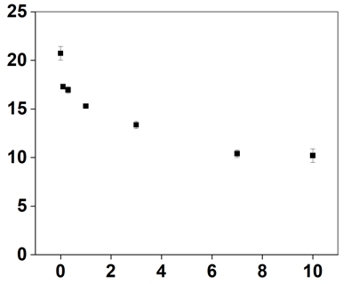
PFOA & PFOS Removal in CaCl₂
t = 30 min
PFAS Removal Efficiency (%)
Zeta Potential (mV)
Ionic Strength (mM CaCl2)
Zeta potential decreased with increasing CaCl₂ concentration
But PFAS removal was lowest at 0.3 mM
→More analysis required
CaCl₂ forms bridges with PFAS molecule and increases removal with increasing concentration
Notes:
We examined how different concentrations of CaCl₂ affect the removal of PFOA and PFOS by the graphene-polymer aerogels.
We found that the zeta potential decreased as CaCl₂ concentration increased, indicating more charge screening.
However, PFAS removal showed a different trend: it was lowest at 0.3 mM CaCl₂, then increased at higher concentrations.
This suggests that CaCl₂ can form ionic bridges with PFAS molecules, enhancing adsorption at higher concentrations.
More detailed analysis is needed to fully understand this behavior.

Slide 11
Conclusion
PFAS are harmful, persistent pollutants, also found in seawater
Graphene has great adsorption, but powdered form is hard to recover
3D-printed graphene-biopolymer aerogels are recoverable, reusable, and stable
Nano-CT revealed a highly porous and interconnected structure
PFOS showed higher removal efficiency than PFOA, likely due to greater hydrophobicity
Future plan
LCMS analysis of adsorption at different time frame
Explore PFAS–Ca²⁺ interaction mechanism
Removal in higher salt concentrations
Notes:
To summarize,
PFAS are harmful, persistent pollutants—even in seawater.
Graphene is a promising adsorbent, but in powder form, it’s hard to recover.
So, we developed 3D-printed graphene-biopolymer aerogels that are stable, reusable, and effective in water.
Nano-CT showed their highly porous structure, which supports PFAS diffusion.
In our tests, PFOS was removed more efficiently than PFOA, likely due to its greater hydrophobicity.
For future work,
we plan to analyze time-dependent adsorption, study PFAS–calcium interactions,
and test the aerogels under higher salt and different water chemistries.
With more time, these steps will help clarify the removal mechanisms.

Slide 12







Acknowledgements
Dr. Nirupam Aich
Richard L. McNeel Associate Professor
Civil and Environmental Engineering
University of Nebraska - Lincoln
Zaki Alam Pushan
Graduate Research Assistant
Civil and Environmental Engineering
University of Nebraska - Lincoln
Notes:
Thank you so much for listening.

