Slide 1
Durability of Metal Halide Perovskites in Simulated Space Environments
Zoe Bell, Arizona State University
Principal Investigator: Nicholas Rolston, Arizona State University
Graduate Mentor: Saivineeth Penukula, Arizona State University

Slide 2
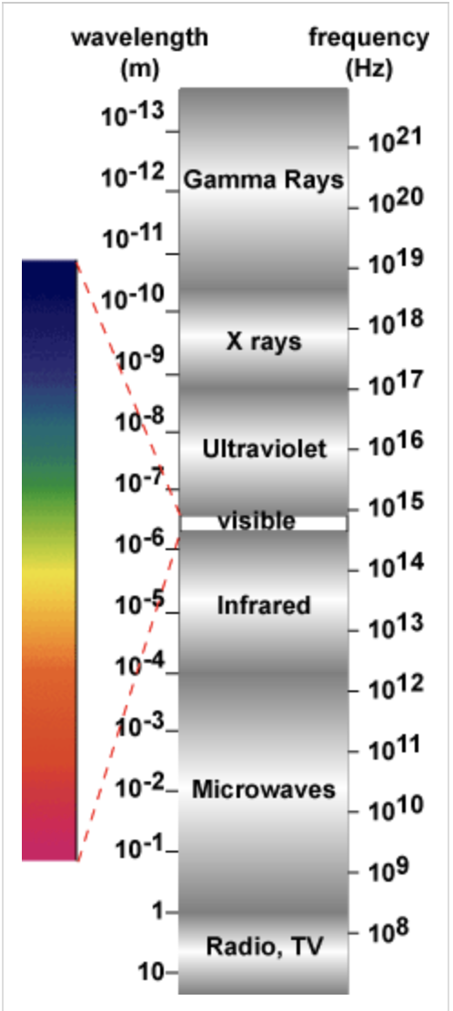
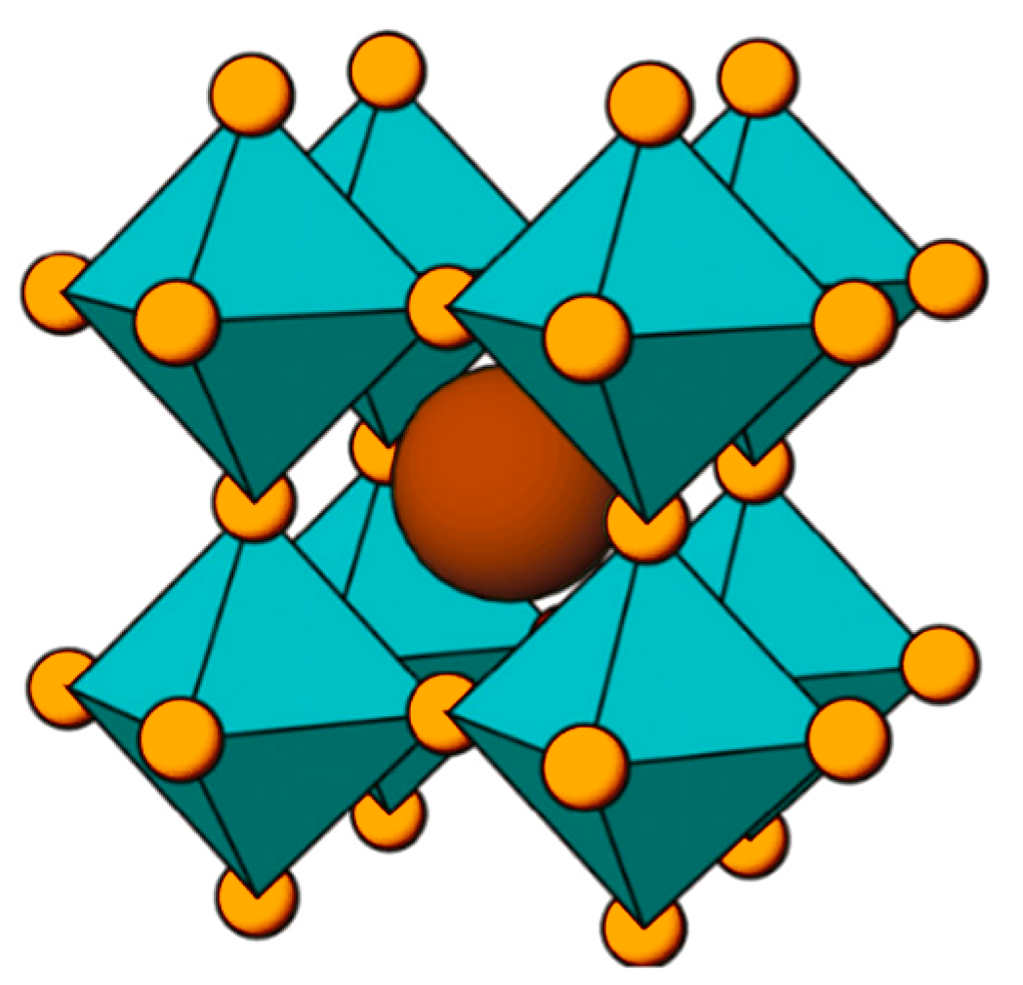
Metal Halide Perovskites (MHPs)
MHPs
  Perovskite solar cell
  Power conversion efficiency
  Thin and lightweight
Must withstand stressors such as high radiation exposure across the solar spectrum
Figure 1. Image of perovskite atomic structure
Honsberg, C., & Bowden, S. (n.d.). Properties of light. In Properties of sunlight. PV Education. Retrieved July 28, 2025, from https://www.pveducation.org/pvcdrom/properties-of-sunlight/properties-of-light
Notes:
Metal halide perovskites (MHPs) are thin, lightweight ionic conductors emerging as a promising material for photovoltaics. Compared to traditional solar cells made of silicon or group III-V elements, MHPs are more affordable, flexible, and offer competitive power conversion efficiency. For space applications, however, they must withstand stressors such as high radiation exposure across the solar spectrum, including UVA, UVB, and UVC.

Slide 3
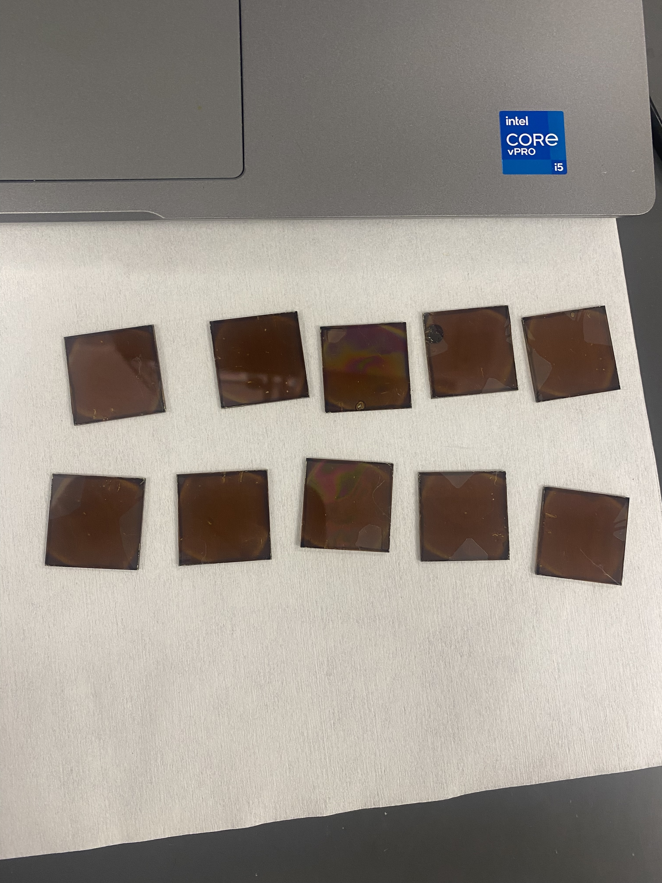
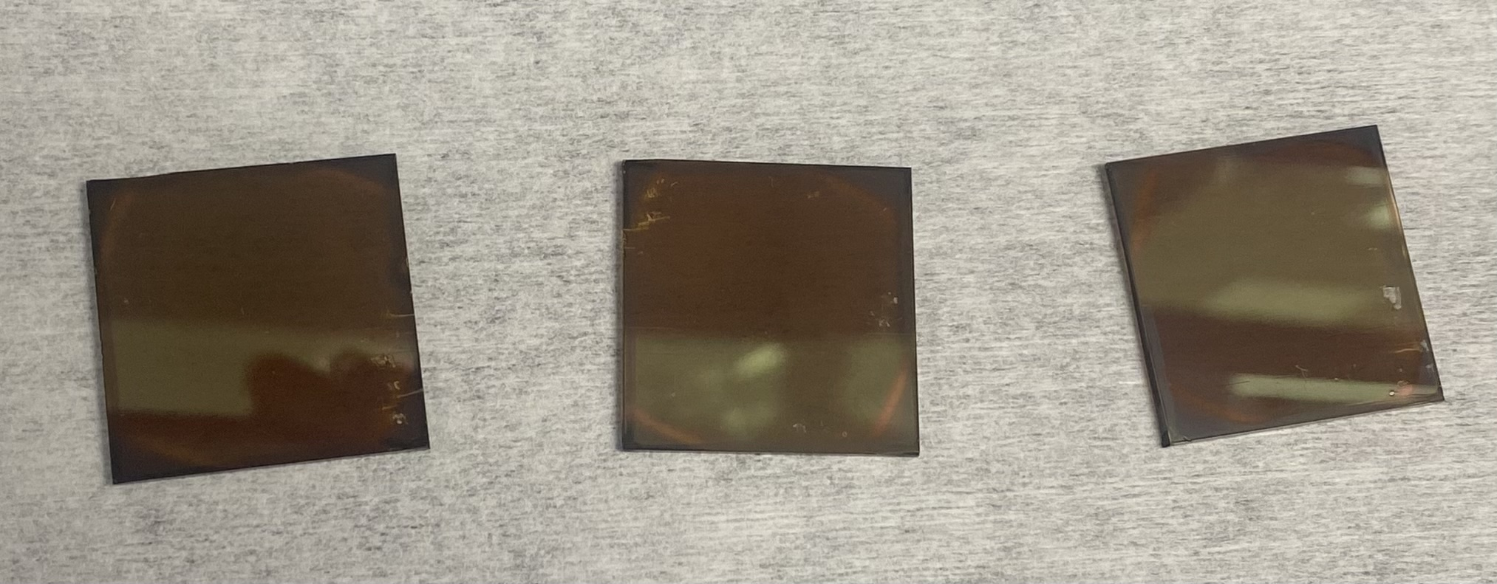
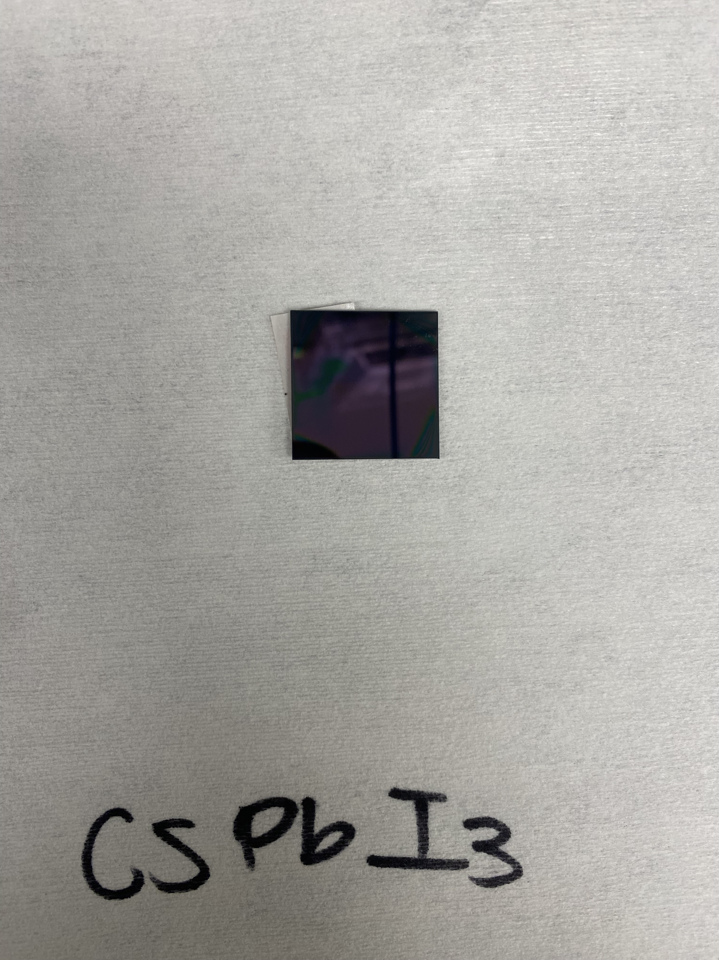
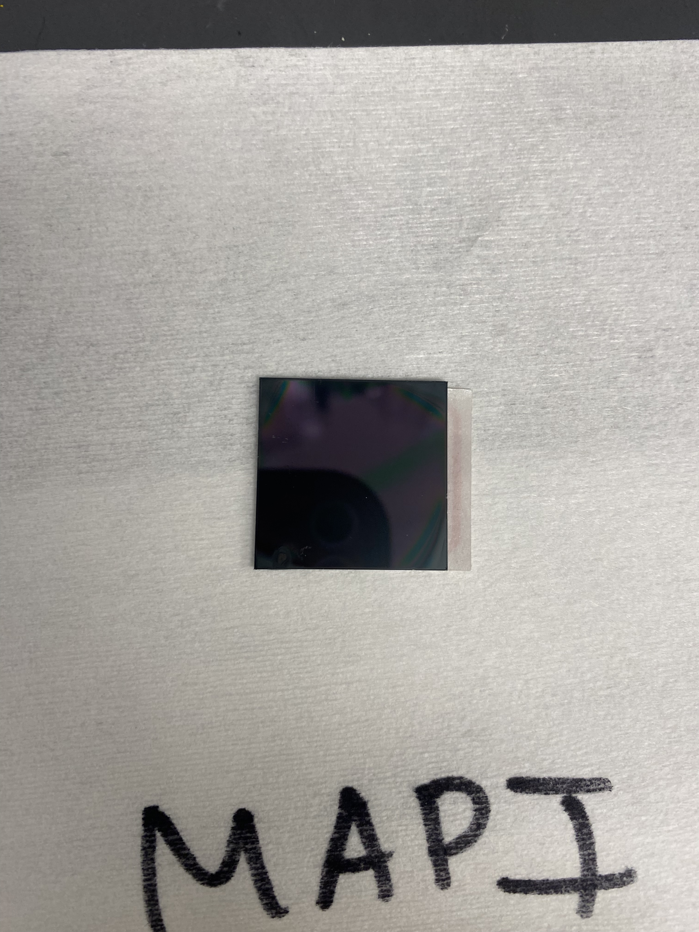
Perovskite Exposure to UVA, UVB, UVC
$CsPbI_{3} 5\% PVP$ IPA Submersion $CsPbI_{3} 5\% PVP$ Nonsubmerged$Cs_{0.2}FA_{0.8}PbI_{3} MAPbI_{3}$
UVA
UVB
UVC
0 hr
12 hr
24 hr
48 hr
72 hr
96 hr
100 hr
Acknowledgement: This material is based upon work primarily supported by the National Science Foundation under award No.ECCS-2025490.
Notes:
In my study, I prepared four perovskites—CsPbI₃ with 5% PVP (submerged in IPA), CsPbI₃ with 5% PVP (non-submerged), MAPbI₃, and CsPbI₃∙FAI—and exposed each to UVA, UVB, and UVC radiation, documenting their characteristics over 100 hours.

Slide 4
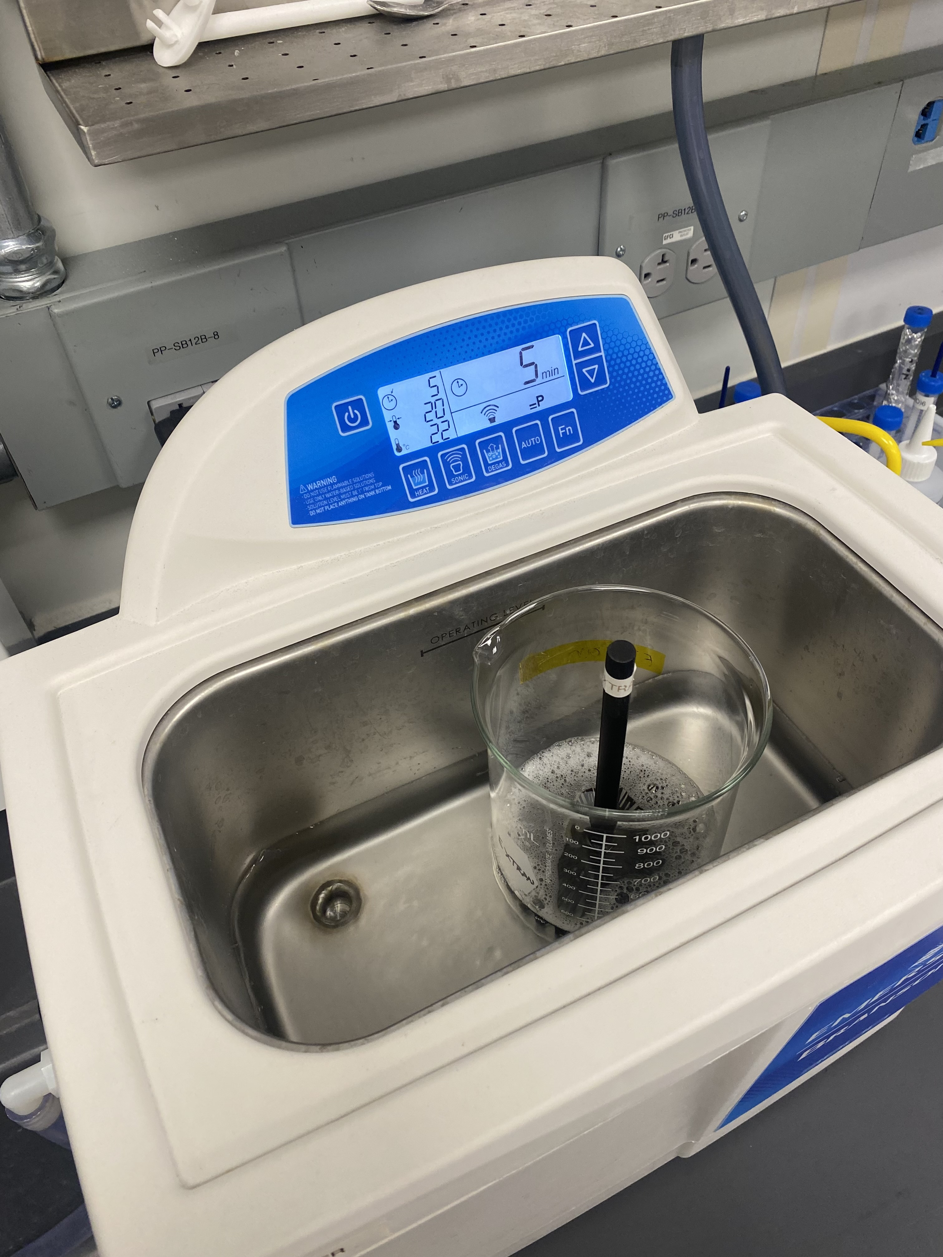
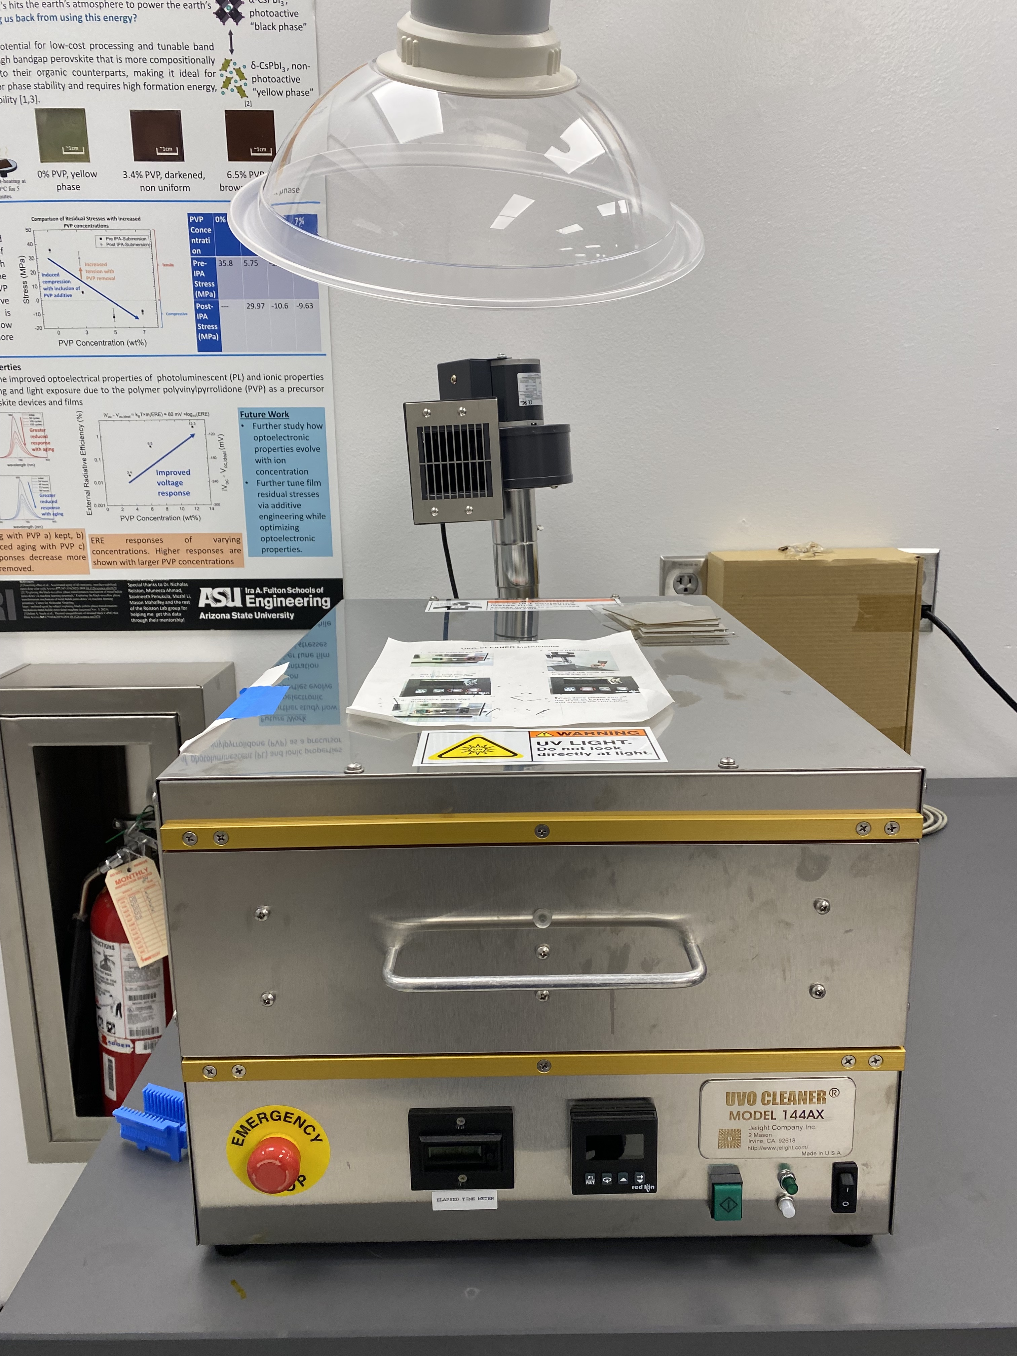
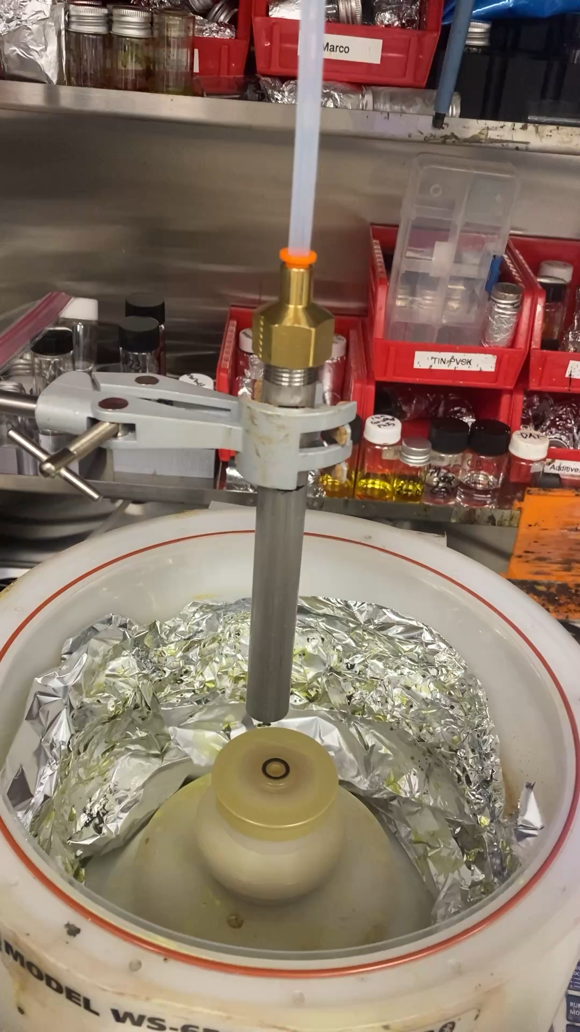
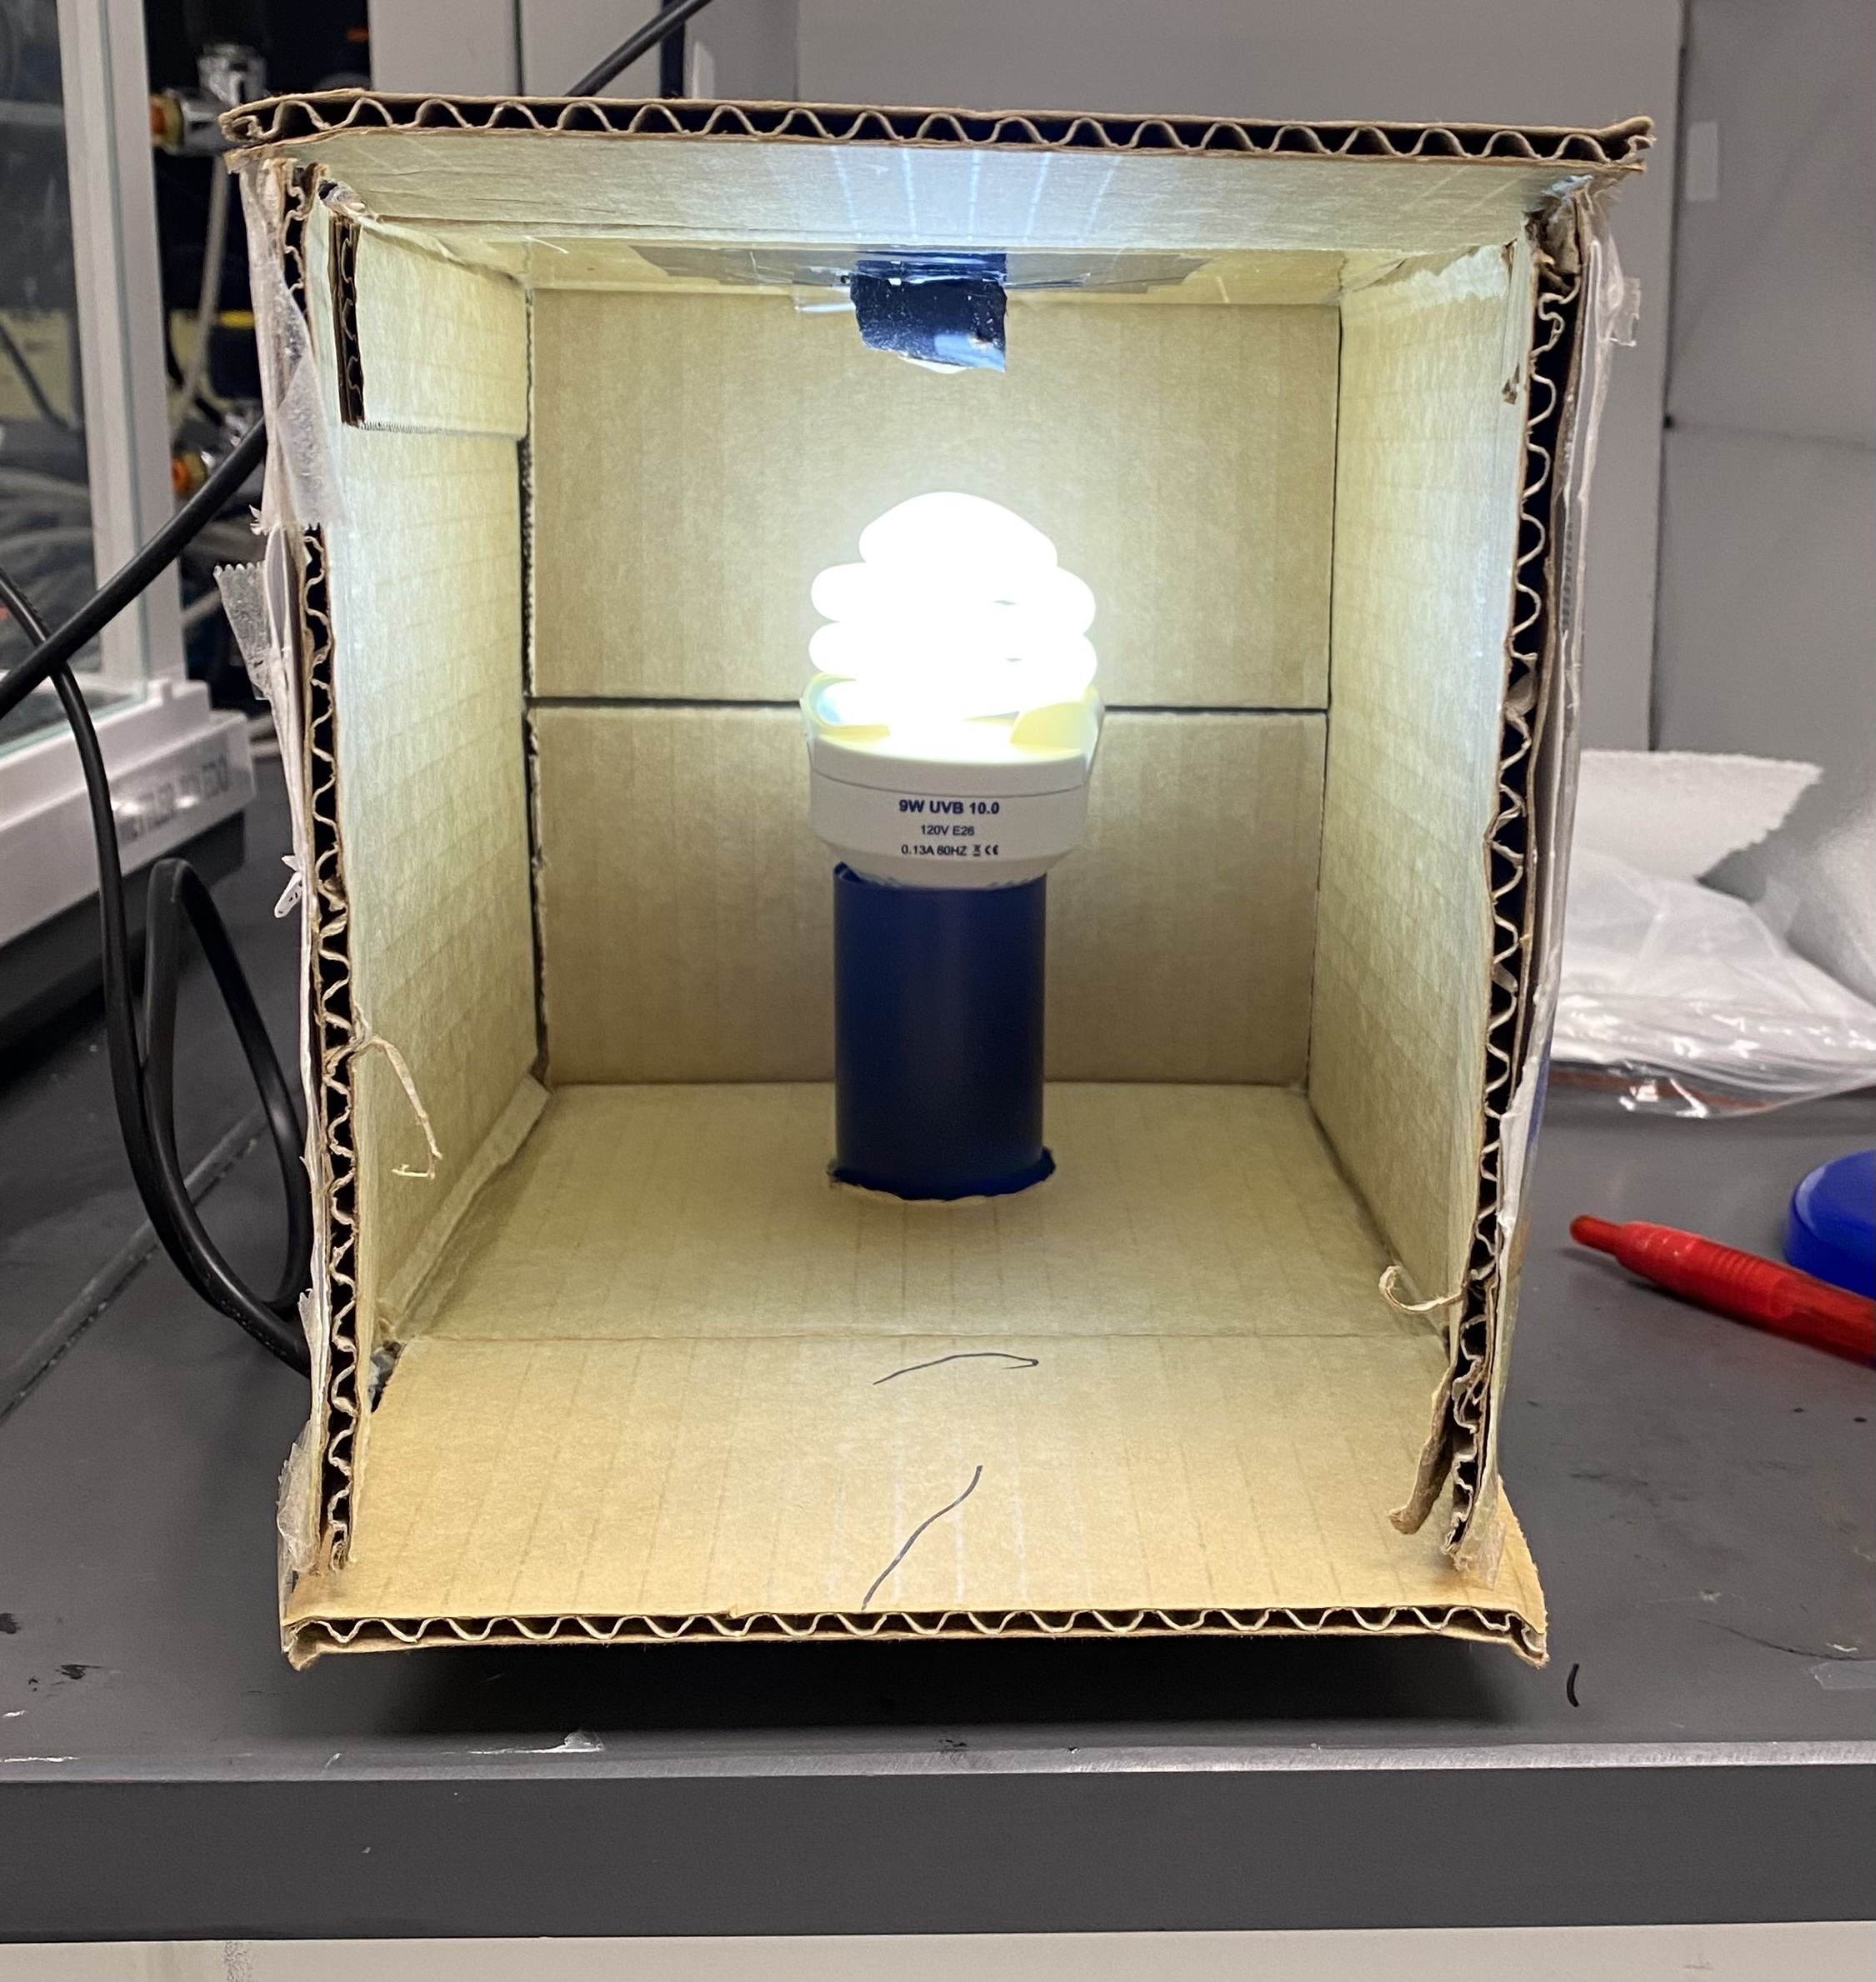
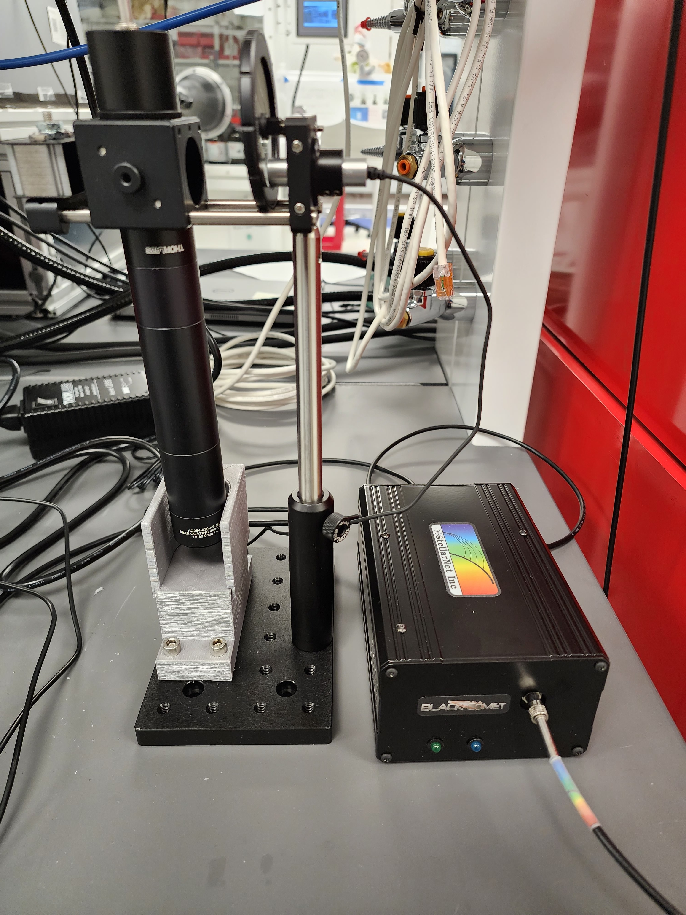
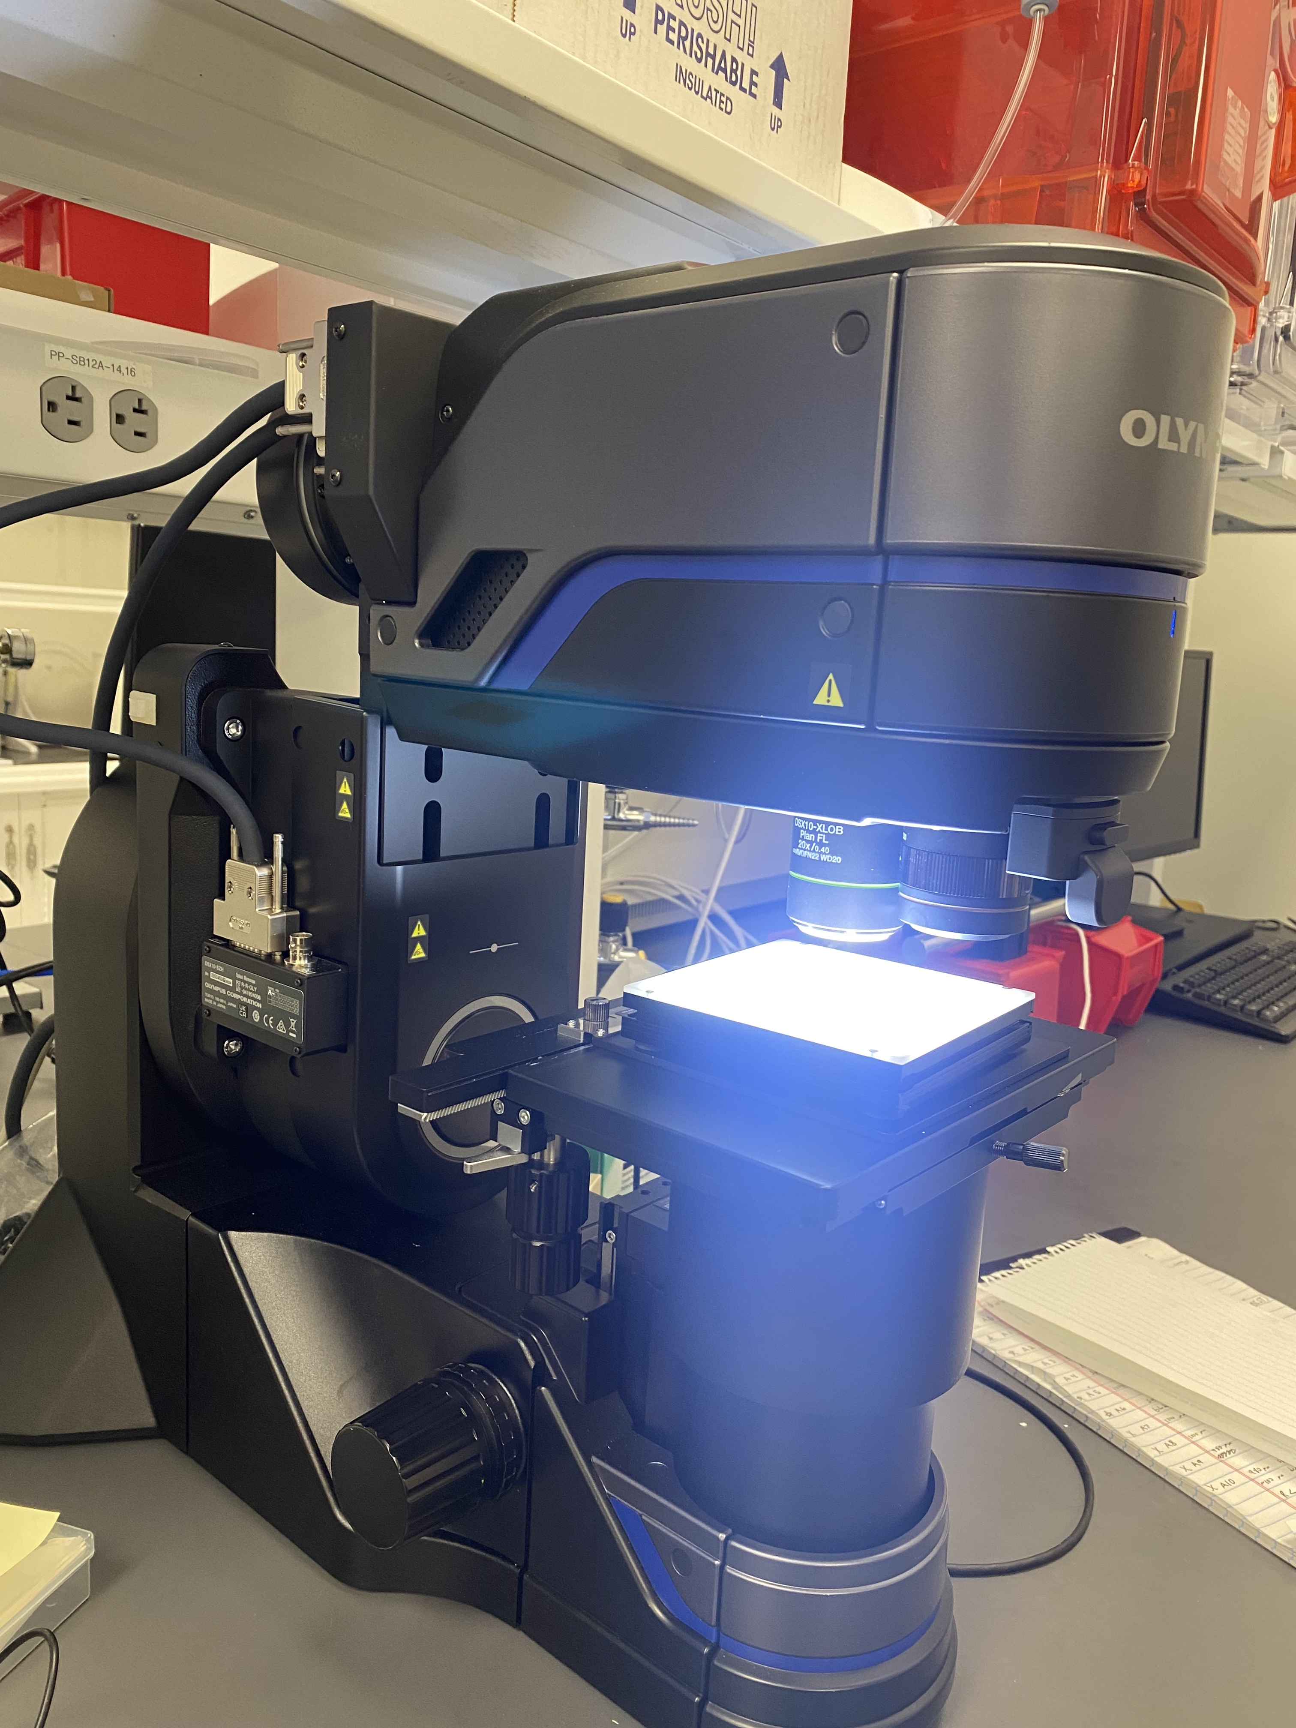
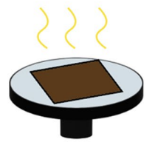
Creating a Uniform Film
Figure 2. Ultrasonic Cleaner
Figure 3. UVO Cleaner
Figure 4. Spin Coater with Gas Quenching
Figure 8. UVB Lamp
Figure 7. Photoluminescence (PL) Spectrometer
Figure 6. Olympus Microscope
Figure 5. Annealed Substrates
Notes:
The two perovskites solutions I made were Cesium Lead Iodide doped with Formamidinium Iodide and methylammonium lead triodide.
To prepare the substrate, ITO coated glass slides were initially cleaned with an industrial-grade soap solution of extran and water. After sonication, the ITO-coated glass was cleaned with deionized water and a brush to remove the residual soap. . Then, the ITO-coated glass was cleaned with IPA and acetone for 10 min in that order. Finally, the ITO-coated glass was cleaned with UV Ozone treatment for 15 min.
After that, the ink is prepared inside of a nitrogen glove box. Perovskite on top ITO-coated glass and glass was fabricated using spin coating and gas quenching. 200 µL of perovskite precursor solution was deposited on the cleaned substrate, which was then spin-coated and gas quenched at pressure of 50 psi. The films were annealed on a hot plate for 15 minutes. Finally, PVP was applied via spin coating.
Adding small layer of PMMA to prevent moisture to simulate space condition

Slide 5
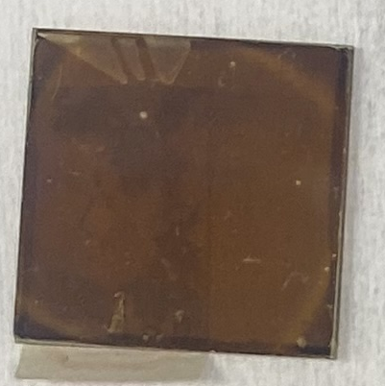
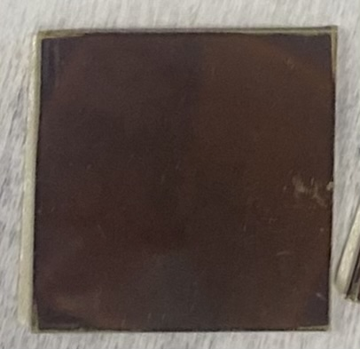
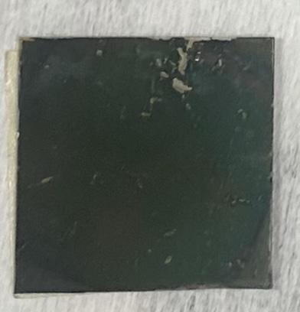
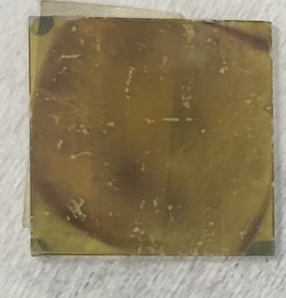
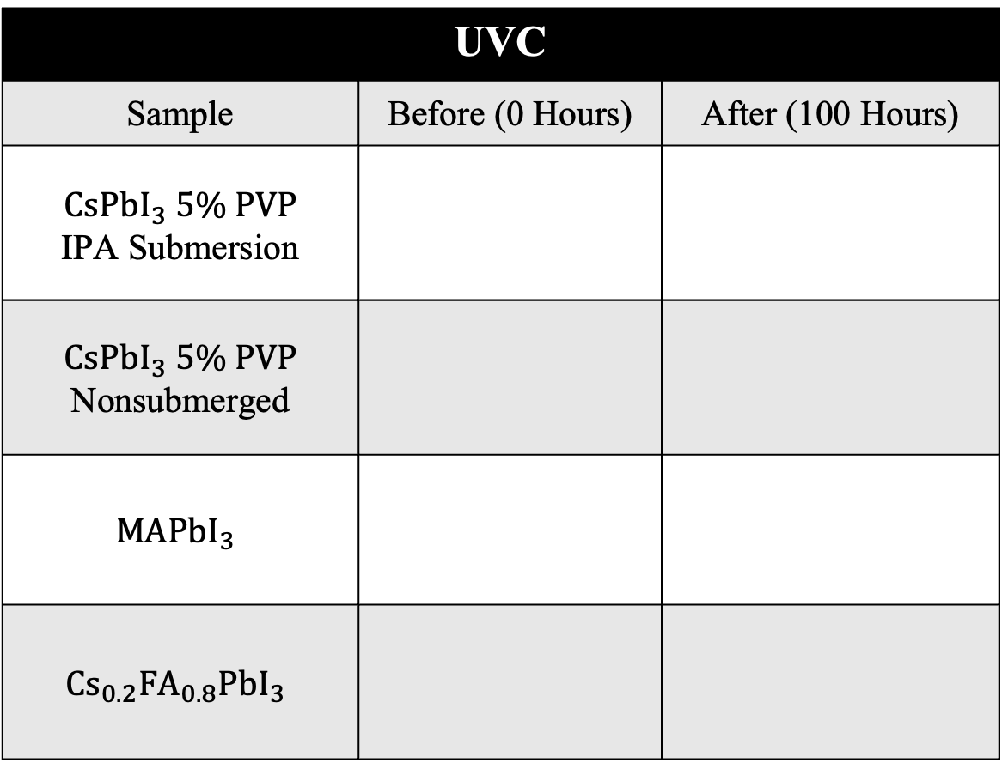
Visual Impact of UVC Exposure
Polymethyl methacrylate (PMMA) applied via spin coating
Direct exposure
  No protective structure such as glass
Color change signaled degradation
UVC
Sample | Before (0 Hours) | After (100 Hours)
$CsPbI_{3} 5\% PVP$ IPA Submersion
$CsPbI_{3} 5\% PVP$ Nonsubmerged
$$MAPbI_{3}$$
$$Cs_{0.2}FA_{0.8}PbI_{3}$$
Acknowledgement: This material is based upon work primarily supported by the National Science Foundation under award No.ECCS-2025490.
Notes:
The most damaging UV condition was UVC. Before testing, the perovskite films were coated with polymethyl methacrylate (PMMA) via spin coating. Their dark black color indicated that the films were in their most efficient, light-absorbing form. When CsPbI₃∙FAI turned yellow, it signaled degradation into lead iodide—a non-functional phase for solar cells.The samples had direct exposure to the light. None of the samples had protective layers like glass, which would absorb light and shield the perovskite.

Slide 6
PL Changes in UVC
UVC Range: 100 nm – 280 nm
Acknowledgement: This material is based upon work primarily supported by the National Science Foundation under award No.ECCS-2025490.
Notes:
While observing results from the photoluminescence (PL) spectrometer, I focused on a shift in wavelength either decreasing or increasing and observed the degradation of the peaks over time. UVA (315–400 nm), UVB (280–315 nm), and UVC (100–280 nm) represent increasing radiation energy levels, simulating conditions found in low Earth orbit.

Slide 7
Wavelength Shifts of Perovskites
A wavelength shift signals instability and compositional change
Acknowledgement: This material is based upon work primarily supported by the National Science Foundation under award No.ECCS-2025490.
Notes:
Our goal is to see no shift in wavelength and either consistent or increasing PL intensity. A shift in wavelength indicates that the perovskite is degrading. Since UVC caused the greatest amount of wavelength shifting, this supports the conclusion that UVC was the most damaging of the three radiation types. MAPbI₃ showed the least amount of wavelength shifting, while CsPbI₃∙FAI showed the most.
MAPbI₃ showed the least amount of wavelength shifting, while Cs_0.2 FA_0.8 PbI_3 showed the most across all UV exposures.

Slide 8
Degradation Rate of Photoluminescence (PL) Intensity Over Time
Sharp increase due to temporary trap state formation
Notes:
The significant increase in the degradation rate of CsPbI₃∙FAI may reflect the temporary effects of trap state formation during degradation. Shallow trap states can act as radiative recombination centers, leading to increased PL despite ongoing degradation. However, it is important to note the wavelength shift and the change in film color, as these indicate that degradation products will continue to form until the PL eventually drops.

Slide 9
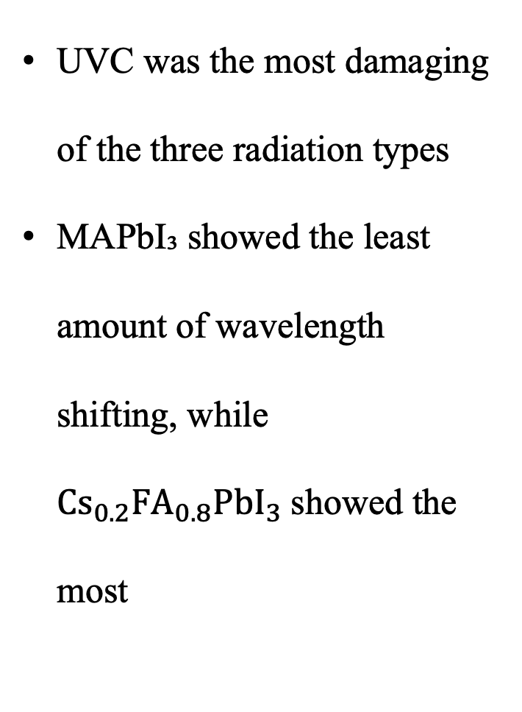
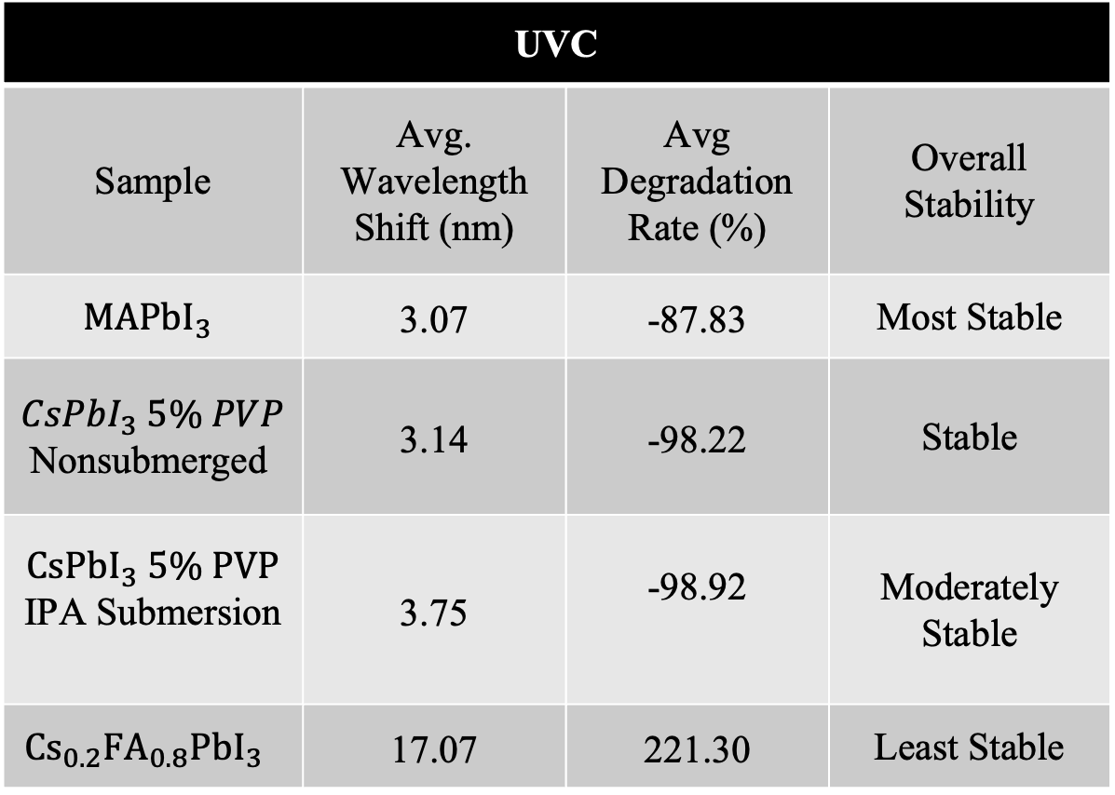
Final Observations
UVC was the most damaging of the three radiation types
MAPbI₃ showed the least amount of wavelength shifting, while $Cs_{0.2}FA_{0.8}PbI_{3}$showed the most
UVC
Sample | Avg. Wavelength Shift (nm) | Avg Degradation Rate (%) | Overall Stability
$$MAPbI_{3}$$ | 3.07 | -87.83 | Most Stable
$CsPbI_{3} 5\% PVP$ Nonsubmerged | 3.14 | -98.22 | Stable
$CsPbI_{3} 5\% PVP$ IPA Submersion | 3.75 | -98.92 | Moderately Stable
$$Cs_{0.2}FA_{0.8}PbI_{3}$$ | 17.07 | 221.30 | Least Stable

Slide 10
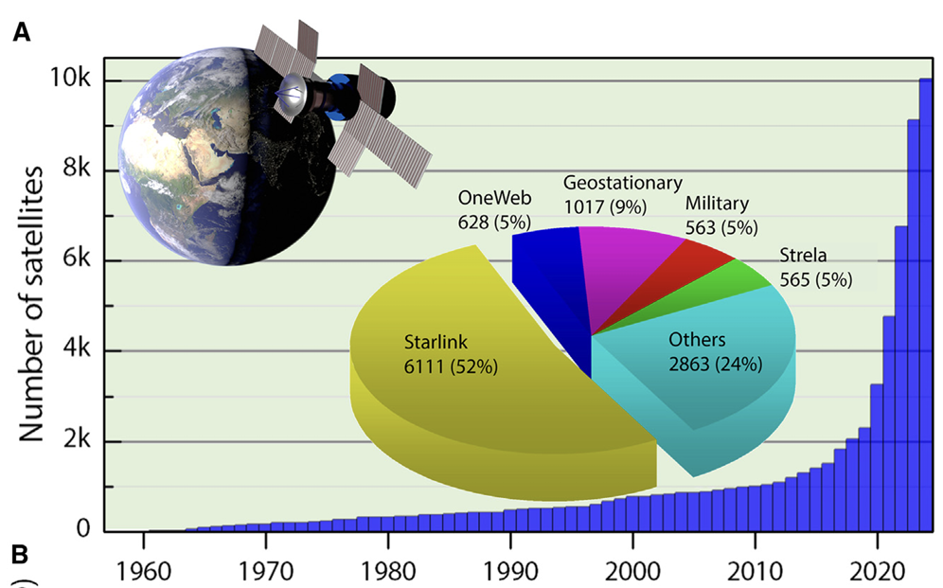
Next Steps
Material selection for space-based solar applications
Tailoring MHP compositions for specific radiation environments
Kirmani and Sellers, Are metal-halide perovskite solar cells really radiation tolerant?, Joule (2025), https://doi.org/ 10.1016/j.joule.2025.101852
Acknowledgement: This material is based upon work primarily supported by the National Science Foundation under award No.ECCS-2025490.
Notes:
UVC caused the greatest wavelength shifts, the most noticeable color changes, and a rapid, sharp drop in photo response across all compositions. These results support the conclusion that UVC was the most damaging of the three radiation types.

Slide 11
Acknowledgements
I would like to thank Nicholas Rolston and Saivineeth Penukula for scientific guidance and helpful discussions.
This material is based upon work supported by the National Science Foundation under award No. ECCS-2025490. Experimental work was conducted at Arizona State University Research Park MacroTechnology Works facility.
Acknowledgement: This material is based upon work primarily supported by the National Science Foundation under award No.ECCS-2025490.

Slide 12
References
Kirmani, A. R., & Sellers, I. R. (2025). Are metal-halide perovskite solar cells really radiation tolerant? Joule, 9(3). https://doi.org/10.1016/j.joule.2025.101852
Masi, S., Canale, C., Ferretti, A. M., Manca, M., & Listorti, A. (2023). Atomic arrangement in (a) CsPbI₃ and (b) MAPbI₃ elementary cell [Figure]. ResearchGate. https://www.researchgate.net/figure/Atomic-arrangement-in-a-CsPbI3-and-b-MAPbI3-elementary-cell_fig1_371566593
Nguyen, H., Penukula, S., Mahaffey, M., & Rolston, N. (2024). All inorganic CsPbI₃ perovskite solar cells with reduced mobile ion concentration and film stress. MRS Communications. https://doi.org/10.1557/s43579-023-00510-7
Segovia, R., Qu, G., Peng, M., Sun, X., Shi, H., & Gao, B. (2018). Evolution of photoluminescence, Raman, and structure of CH₃NH₃PbI₃ perovskite microwires under humidity exposure. Nanoscale Research Letters, 13(1), 79. https://doi.org/10.1186/s11671-018-2470-0
Xiong, H., DeLuca, G., Rui, Y., Qia, J., Li, Y., Zhang, Q., Wang, H., & Reichmanis, E. (n.d.). Modifying perovskite films with polyvinylpyrrolidone for ambient-air-stable highly bendable solar cells. Unpublished manuscript.

Slide 13
PL Changes in UVA
UVA Range: 315 nm – 400 nm
Notes:
While observing results from the photoluminescence (PL) spectrometer, I focused on a shift in wavelength either decreasing or increasing and observed the degradation of the peaks over time. UVA (315–400 nm), UVB (280–315 nm), and UVC (100–280 nm) represent increasing radiation energy levels, simulating conditions found in low Earth orbit.

Slide 14
PL Changes in UVB
UVB Range: 280 nm – 315 nm

Slide 15
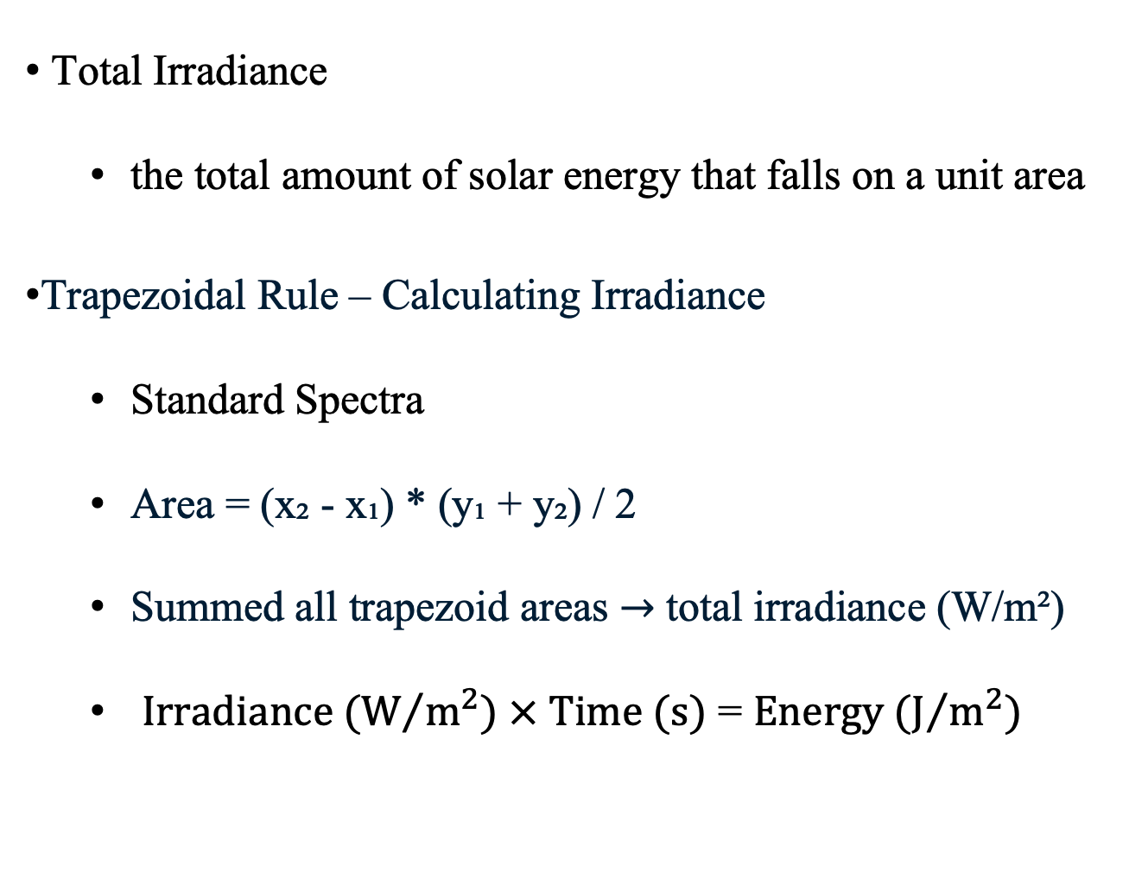
Solar Energy Estimate for LEO
Total Irradiance
  the total amount of solar energy that falls on a unit area
Trapezoidal Rule – Calculating Irradiance
  Standard Spectra
  Area = (x₂ - x₁) * (y₁ + y₂) / 2
  Summed all trapezoid areas $→$ total irradiance (W/m²)
  $Irradiance (W/{m^{2}) × Time (s)}$ = $Energy (J/{m^{2}})$
Notes:
The unit W*m⁻²*nm⁻¹ represents spectral irradiance, which is the power of electromagnetic radiation per unit area per unit wavelength. Specifically, it measures the radiant power (in Watts) incident on a surface per square meter (m²) and per unit wavelength (in nanometers (nm)). It essentially quantifies the amount of radiant power at a specific wavelength arriving at a surface.
Sticker on bottom, film side up.
UVB restesting for PL
Only the 2 hour submersion, PMMA iw
Check every 12 – 16 hours.
Take out
MAPI (2)
CsPbI_3
With PVP PMMA
Without PVP all with PMMA

Slide 16
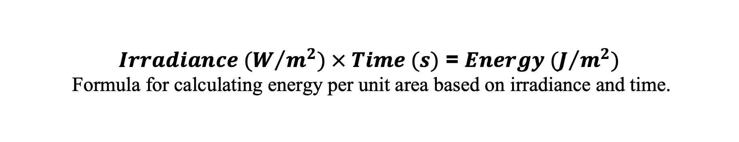
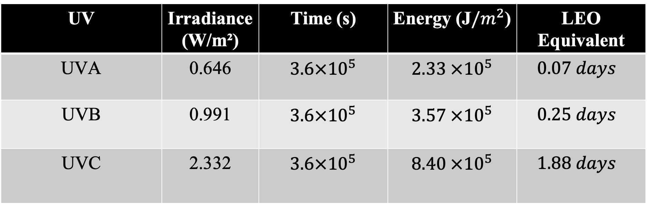
UV Exposure vs. LEO Environment
UV | Irradiance (W/m²) | Time (s) | Energy (J$/m^{2}$) | LEO Equivalent
UVA | 0.646 | $3.6×{10}^{5}$ | $2.33 ×{10}^{5}$ | $$0.07 days$$
UVB | 0.991 | $3.6×{10}^{5}$ | $3.57 ×{10}^{5}$ | $$0.25 days$$
UVC | 2.332 | $3.6×{10}^{5}$ | $8.40 ×{10}^{5}$ | $$1.88 days$$
$Irradiance (W/{m^{2}) × Time (s)}$ = $Energy (J/{m^{2}})$
Formula for calculating energy per unit area based on irradiance and time.
Acknowledgement: This material is based upon work primarily supported by the National Science Foundation under award No.ECCS-2025490. 16

