Slide 1
Designing and Fabricating Piezoresistive Pressure Sensors
MSU ECE REU Site Summer 2025 Project Presentation
Presenter: Brian Robinson
Mentor: Dr. Andy Lingley

Slide 2
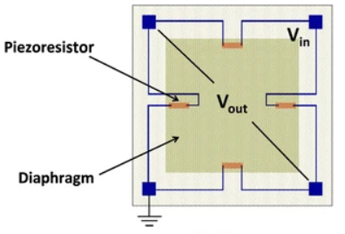
Introduction
Motivation:
  Pressure sensors were one of the first commercially viable MEMS devices
  They provide a simple median between mechanical phenomena and electrical signals
  MSU would like to develop a MEMS course comprising of one semester of design and one semester of in-lab fabrication
MEMS: Micro Electrical Mechanical Systems
  Microscopic mechanical system that can either change electrical properties within the system, or be physically controlled by electricity
Piezoresitive Pressure Sensor: Uses a change in resistance due to an external physical force to determine applied pressure
  Can be sensed with a Wheatstone bridge circuit configuration
Applications:
Elevation Meter
Flowmeter
Pressure Tuned Laser Cavities
Image: https://doi.org/10.1007/s00542-014-2215-7

Slide 3
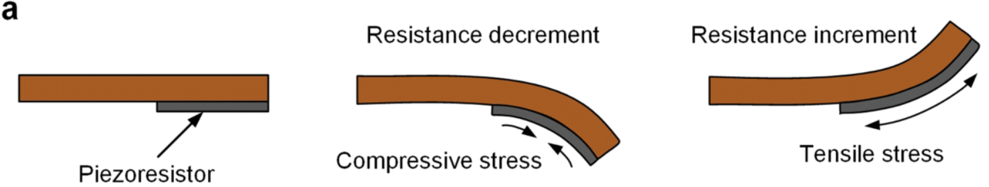
Sensing Mechanism
Image: https://doi.org/10.1186/s40486-019-0085-6
Piezoresistor: Resistor that changes based on the stress applied
  Tensile: Resistance increases
  Compressive: Resistance decreases
  Doped Si has piezoresistive properties
Wheatstone bridge: Two voltage dividers in parallel
  Voltage in each divider is used for the output references

Slide 4
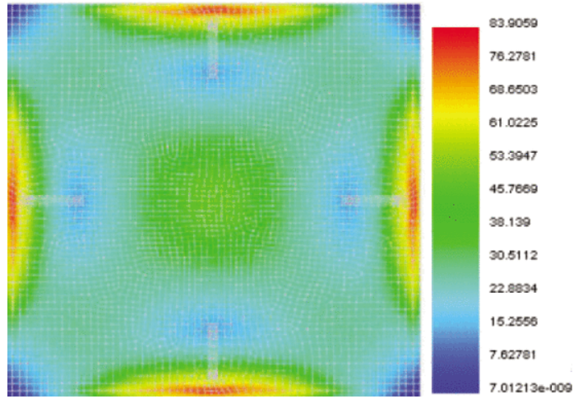
Sensing Mechanism
Uses the deflection of a membrane to induce stress on piezoresistors in a wheatstone bridge
Major points of stress occurs on the center of each side
For a square member and the most ΔΩ, resistors should be placed on the center of each side, facing inward, longitudinal
Resistors must have different change in resistances, or else the reading will always stay the same
Solutions: Have a pair of set resistors, or transverse piezoresistors that will have a smaller change in resistance compared to the longitudinal resistors
Image: https://doi.org/10.1109/ICPEICES62430.2024.10719057

Slide 5
Research Question
What is the pressure sensitivity we can reliably achieve with a closed seal absolute pressure sensor, given the fabrication process and constraints of the MEMS fabrication course?
Potential impact:
  Characterizing the manufacturing process for sensors will take away a lot of the guessing/research that future students would have to do to ensure their design will work.
  Understanding the achievable pressure sensitivity will also give students a better idea of what they can design their own sensors to do.

Slide 6
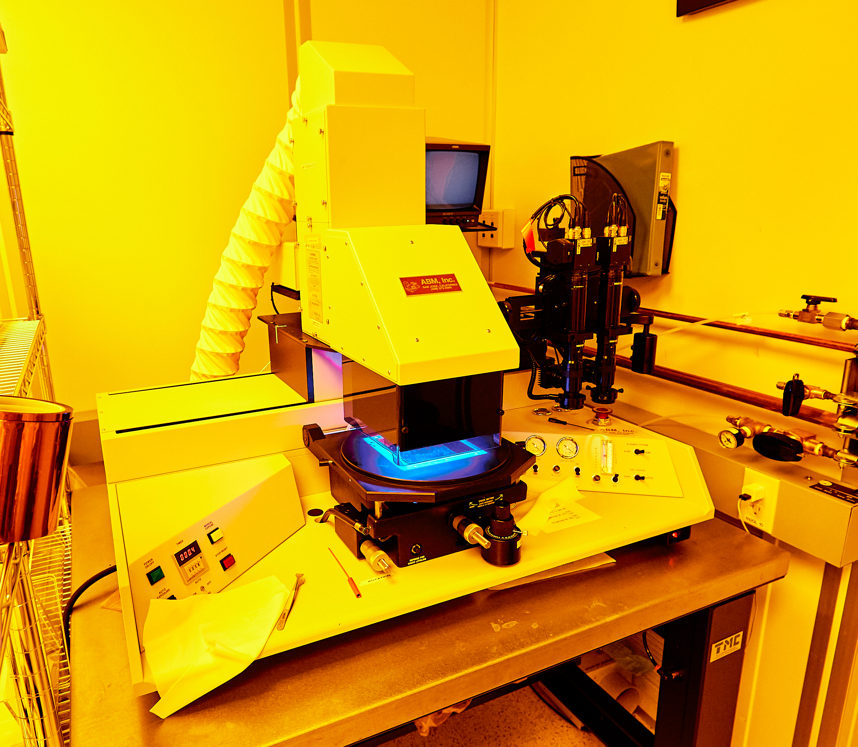
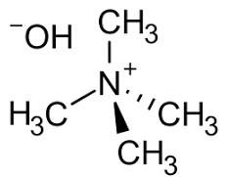
MEMS Fabrication Course Constraints
Contact Aligner
An introductory fabrication class should be simple, time efficient, and high throughput
Lithography resolution: ~2 um with chrome masks
Membrane creation requires etching, which can be done through chemical immersion (wet), or other physical (dry) processes
TMAH wet etching is simple, cheap, and has higher throughput
Boron doping will be done using a diffusion oven
Electrical interconnects will be formed using a patterned aluminum thin film
TMAH
TMAH Image: https://en.wikipedia.org/wiki/Tetramethylammonium_hydroxide
ABM Image: https://mmf.montana.edu/about/equipment/lithography/ab-m-contact-aligner.html

Slide 7
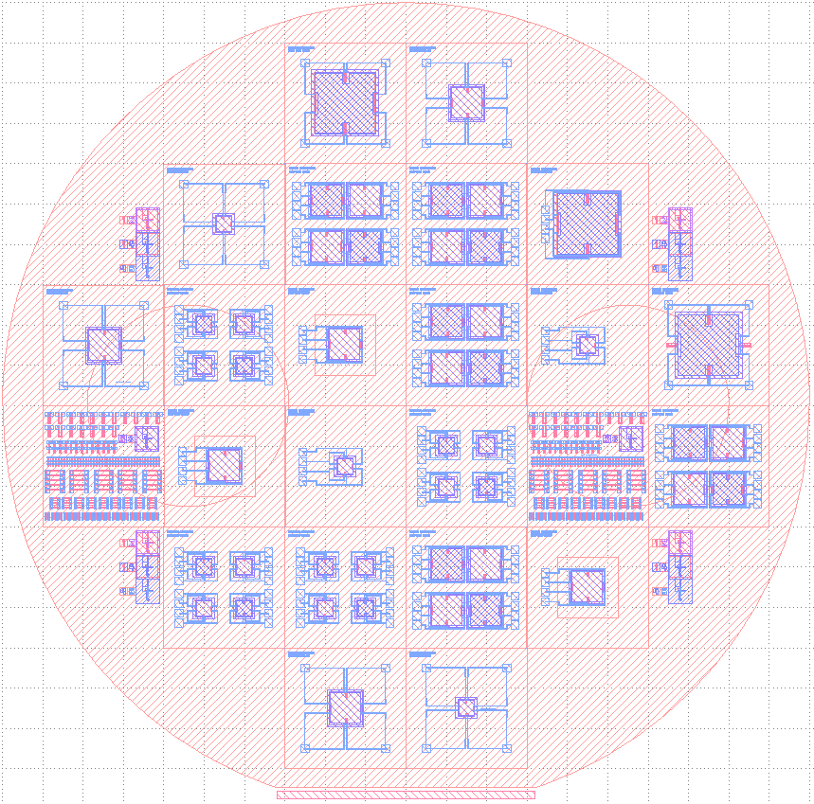
Full Wafer Design
300mm diameter wafer
Contains 24 15mm x 15mm cells
Contains 49 individual pressure sensors, and two cells worth of piezoresistor test structures
Fully made with 5 separate masks
  Diffusion
  Backside Alignment Marks
  Membrane Etching
  Contacts
  Metal

Slide 8
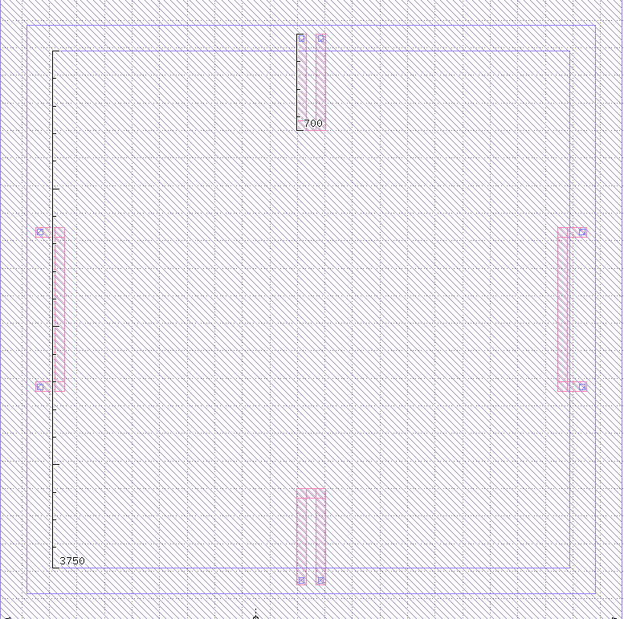
Sensor Designs
Membrane Sizes
  7.5mm; 3.75mm; 1.875mm
Membrane Thickness
  ~100um; 75um
Piezoresistor Sizing
  Longitudinal piezoresistors have a length of 18.66% of the side length
  Width is 10% of longitudinal length
  Transverse piezoresistors contain the same number of squares as the longitudinal resistors
    Squares: dimensionless unit representing the ratio of the resistor's length to its width
3.75mm membrane and 700um long longitudinal resistors

Slide 9
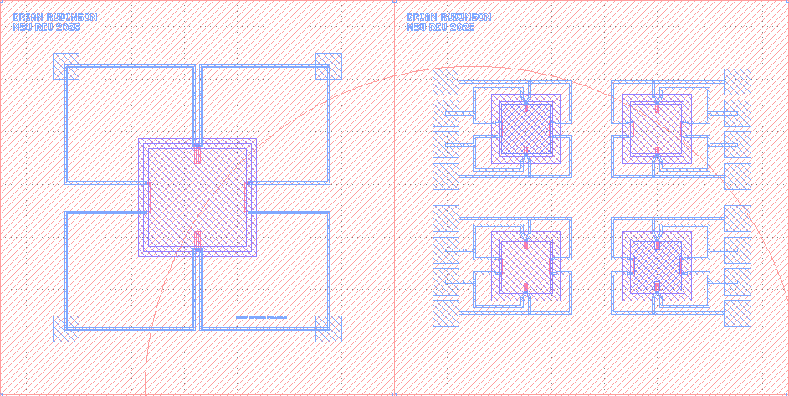
Sensor Designs
Wiring Setup
  Pads at each corner: Standardized to large membrane for ease of testing
  Pads at a single side: Saves overall space, and also has standardizing sizing for all cells
Bonding Setup
  Borofloat 33 glass was bonded to the wafer at about 1e-4 mbar

Slide 10
Fabrication Process
Begin with a double side polished, n type silicon wafer
N-type Si wafer
525 um, <100>

Slide 11
Fabrication Process
Grow oxide in furnace
SiO₂
N-type Si wafer
525 um, <100>

Slide 12
Fabrication Process
Pattern and etch piezoresistor openings
SiO₂
N-type Si wafer
525 um, <100>

Slide 13
Fabrication Process
Use oven to diffuse boron into oxide openings, creating the piezoresistors
SiO₂
N-type Si wafer
525 um, <100>

Slide 14
Fabrication Process
Strip oxide
SiO₂
N-type Si wafer
525 um, <100>

Slide 15
Fabrication Process
Grow second layer of oxide to isolate piezoresistors
SiO₂
N-type Si wafer
525 um, <100>

Slide 16
Fabrication Process
Etch holes on the backside for the membrane
SiO₂
N-type Si wafer
525 um, <100>

Slide 17
Fabrication Process
TMAH etch membrane
SiO₂
N-type Si wafer
525 um, <100>

Slide 18
Fabrication Process
Pattern and etch contact holes, alongside the backside oxide to prepare for bonding
SiO₂
N-type Si wafer
525 um, <100>

Slide 19
Fabrication Process
Deposit Al, then pattern wires and contacts
Al
SiO₂
N-type Si wafer
525 um, <100>

Slide 20
Topside view:
Fabrication Process
Bond glass wafer to backside, vacuum sealing the membrane
Al
SiO₂
P+
P+
N-type Si wafer
525 um, <100>
Borofloat 33 Glass
500mm

Slide 21
Al
SiO₂
P+
P+
N-type Si wafer
525 um, <100>
Borofloat 33 Glass
500um

Slide 22
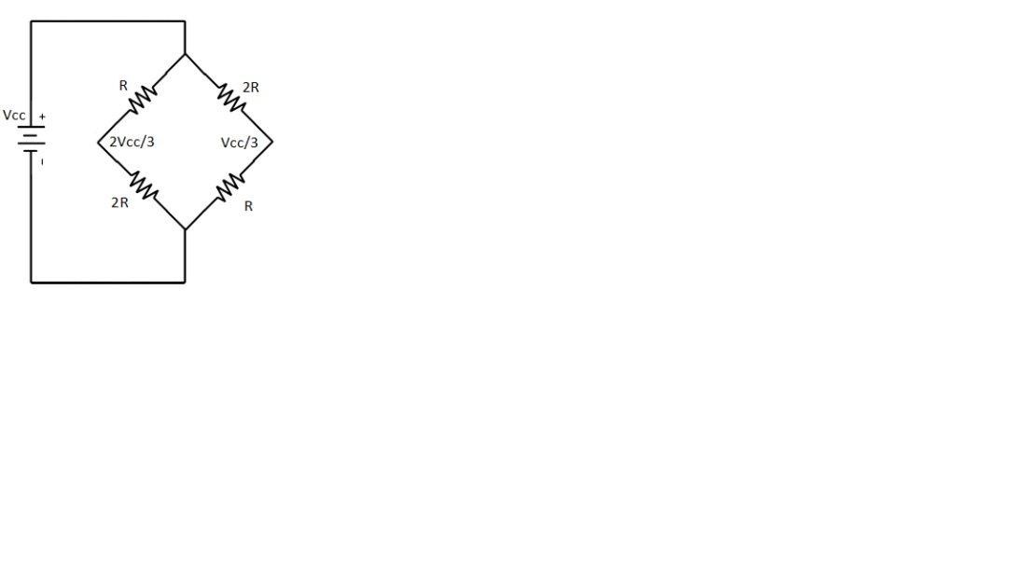
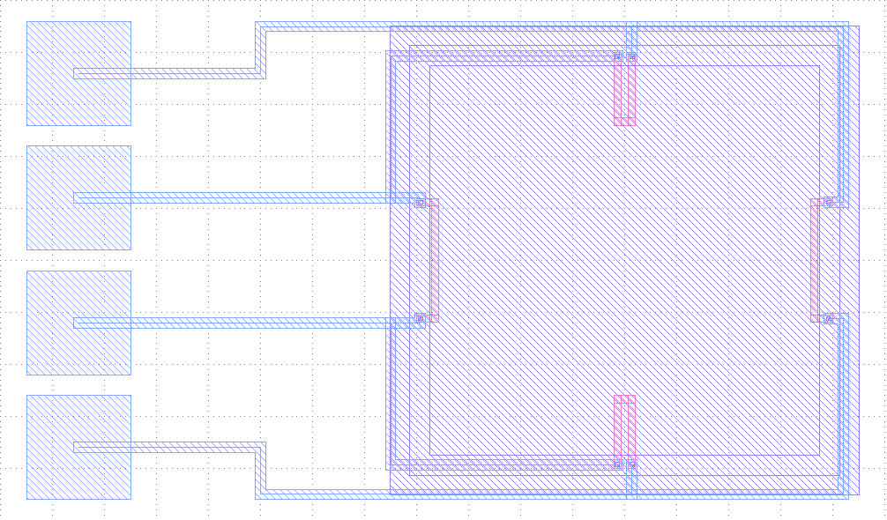
Methodology
Image: https://doi.org/10.1007/s00542-014-2215-7​
After fabrication, sensors were connected to a 5V source, and the output voltage was measured using an oscilloscope
Pressure was applied to the membrane using a pair of tweezers
Membrane deflection was measured using an optical profilometer
Ch1
R
R
5V
5V
Ch1
Ch2
Ch2
R
R
C
GND
GND

Slide 23
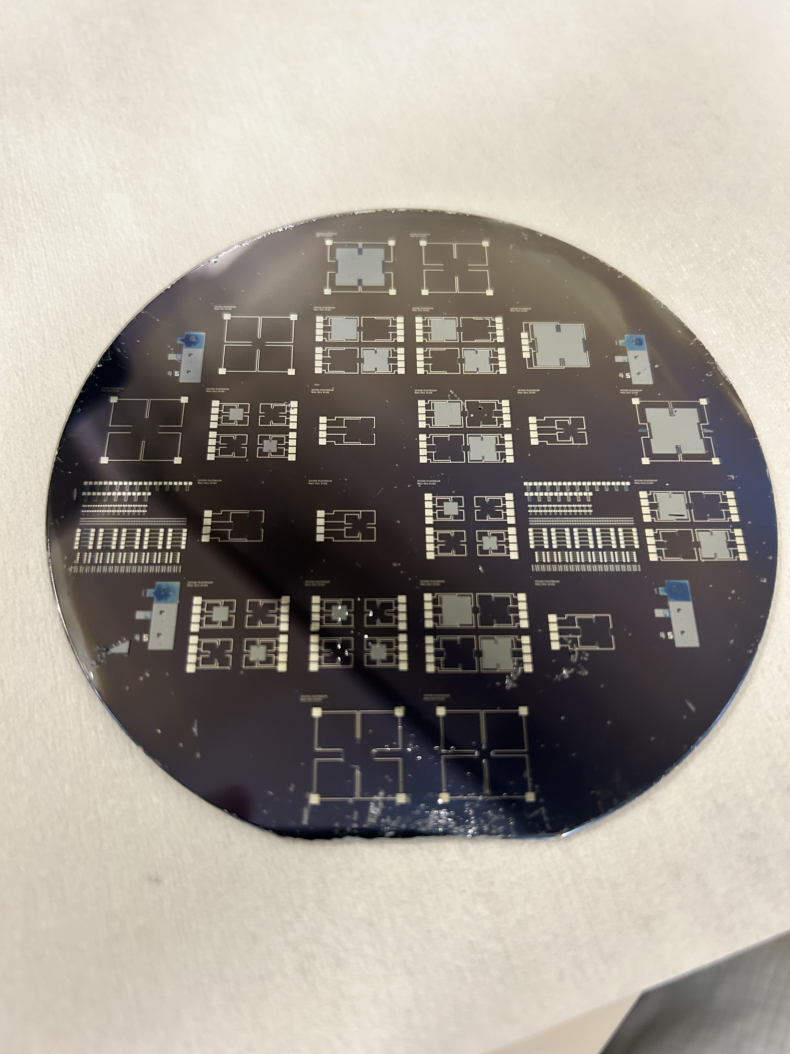
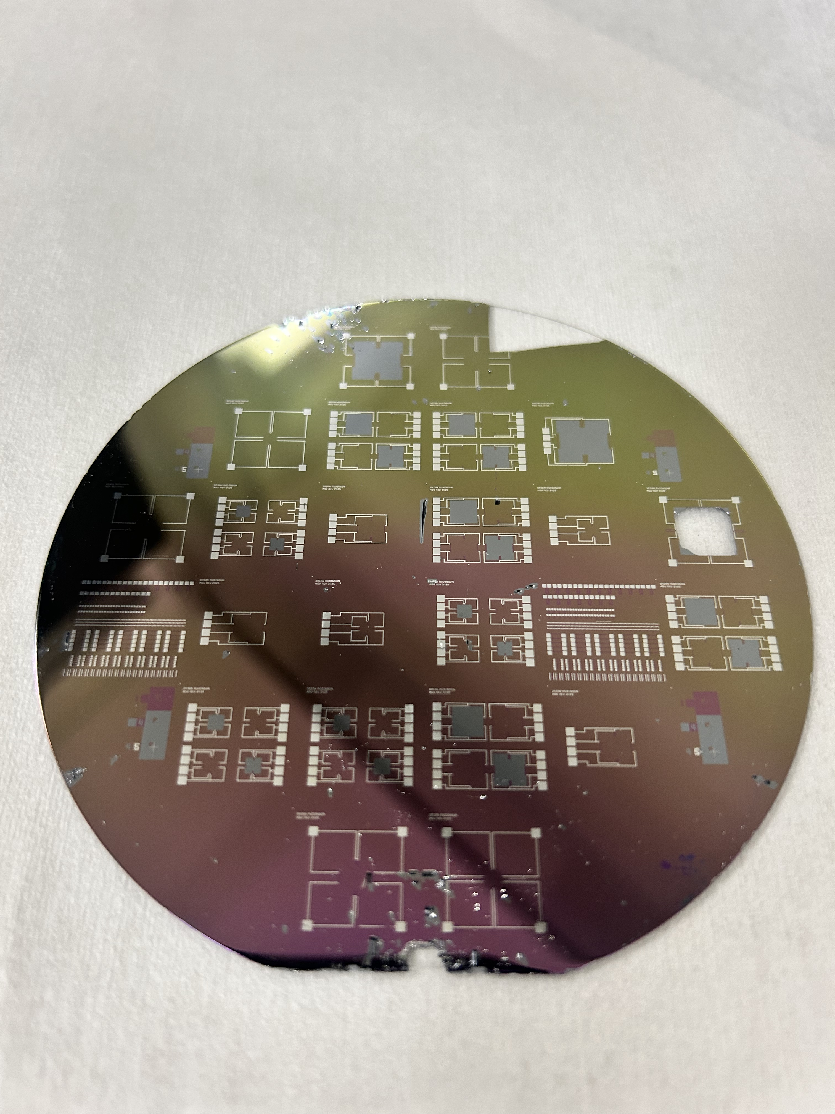
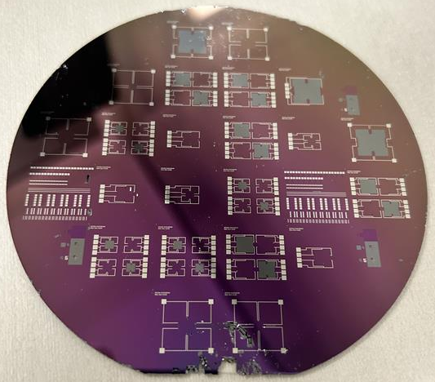
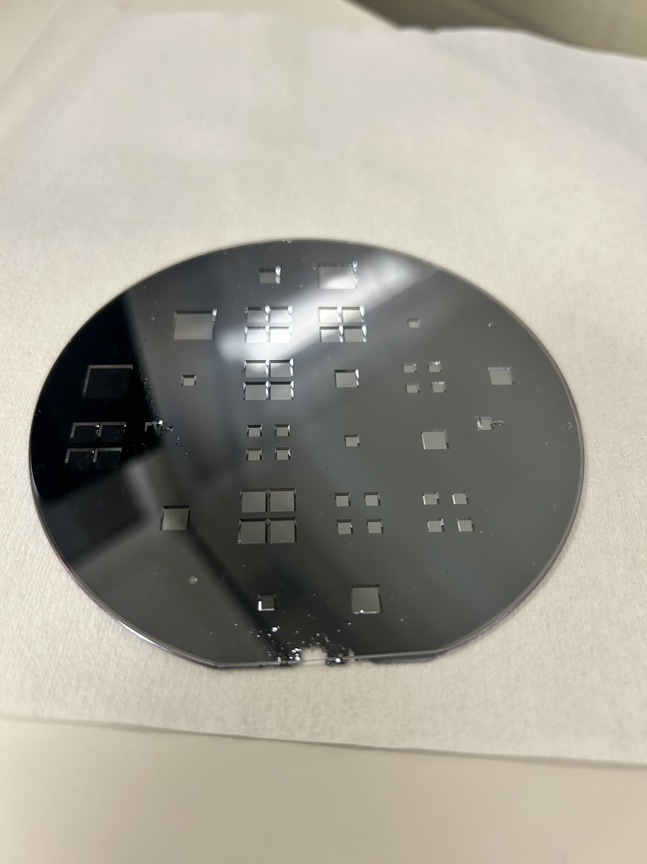
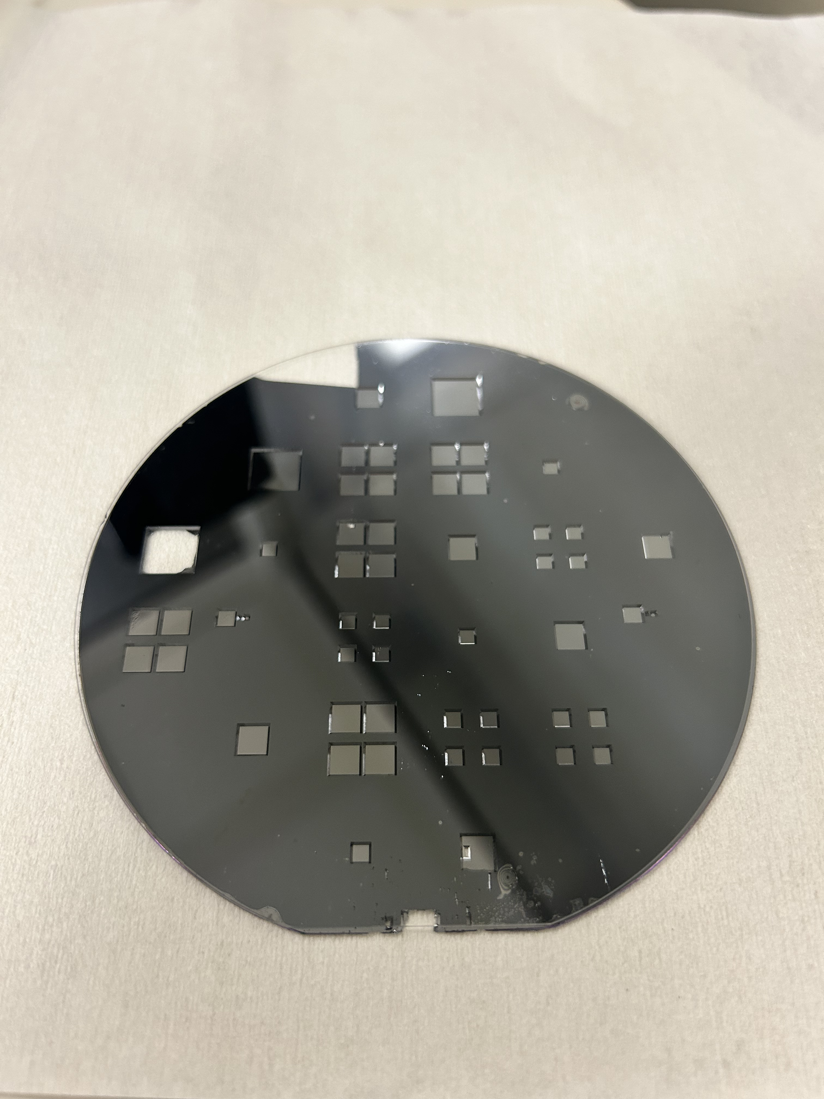
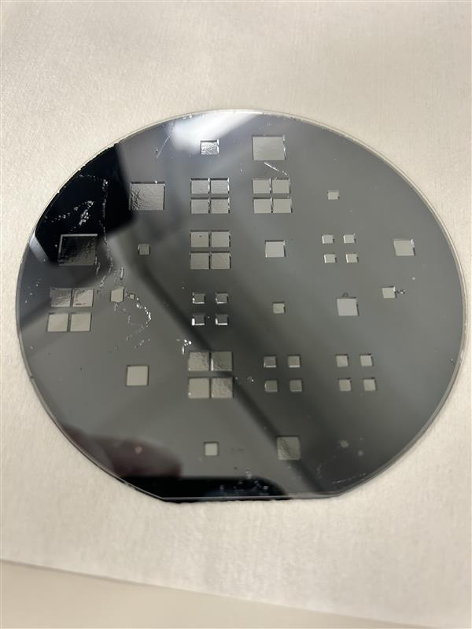
Fabrication Results
Wafer 1
Wafer 2​
Wafer 3

Slide 24
Sensor Readout: No additional pressure applied
Membrane Size | Oxide/No Oxide | Ch1 (V) | Ch2 (V) | |ΔV| = |Ch1 – Ch2|
3.75mm | N | 2.7 | 2.9 | 0.20
3.75mm | N | 2.33 | 2.61 | 0.28
3.75mm | Y | 2.65 | 3.07 | 0.42
7.5mm | Y | 4.9 | 4.08 | 0.82

Slide 25
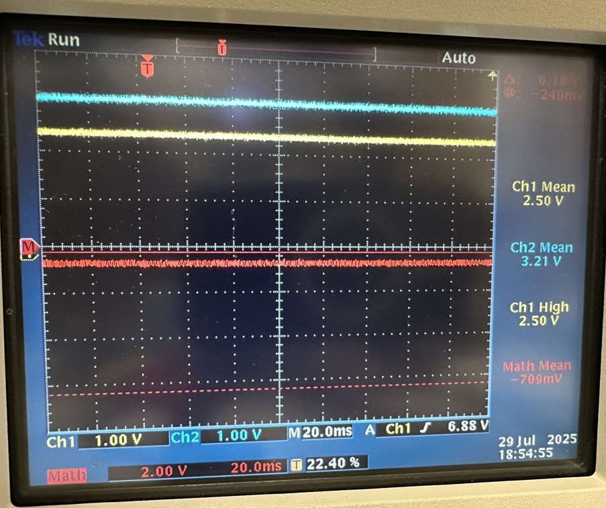
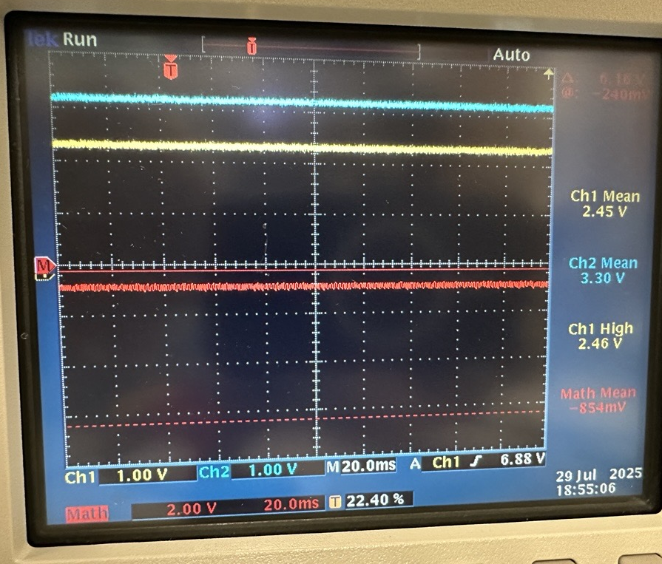
Sensor Readout: Pressure Applied on 3.75mm
Before: -709mV
Before: -854mV
|ΔV| = 145mV

Slide 26
Conclusions
While functional devices were fabricated, extensive testing could not be completed, so the pressure sensitivity of the different devices are unknown
Feasibility of 5 mask layer pressure sensor fabrication was confirmed
Detailed process traveler was developed, providing a clear and repeatable guide for the fabrication process.
Future Directions:
Pressure sensitivity characterization using a known good pressure sensor
Etching thinner membranes to increase sensitivity

Slide 27
Acknowledgments
This material is based upon work supported by the National Science Foundation under Grant No. 2349091.
This work was performed in part at the Montana Nanotechnology Facility, an NNCI member supported by NSF Grant ECCS-2025391.
Mentor: Dr. Andy Lingley
Trainers: Kelsey Bushard, Trevor Carl, Rachel Conrad , Peja Gitomer, Alexandra Houseworth, Mario Oblad, Erik Tomten
Operational Support: Owen Bunn
Emotional Support: Ryan Michael Otten-Reimer

Slide 28
References
Boston University. "Mechanics of Materials: Beam Buckling." College of Engineering, Mechanical Engineering. Accessed 6/17/25. https://www.bu.edu/moss/mechanics-of-materials-beam-buckling/
Kumar, S.S., Pant, B.D. Design principles and considerations for the ‘ideal’ silicon piezoresistive pressure sensor: a focused review. Microsyst Technol 20, 1213–1247 (2014). https://doi.org/10.1007/s00542-014-2215-7
Kumar, S.S., Pant, B.D. Effect of piezoresistor configuration on output characteristics of piezoresistive pressure sensor: an experimental study. Microsyst Technol 22, 709–719 (2016). https://doi.org/10.1007/s00542-015-2451-5
M. Suresh, S. Singh, N. Rakshit, A. Santhosh, V. R. S and R. Singh, "Computational Analysis and Performance Optimization of Square Membrane Piezoresistive MEMS Pressure Sensor," 2024 IEEE Third International Conference on Power Electronics, Intelligent Control and Energy Systems (ICPEICES), Delhi, India, 2024, pp. 1050-1055. https://doi.org/10.1109/ICPEICES62430.2024.10719057
Tran, Anh Vang, Xianmin Zhang, and Benliang Zhu. 2018. "Mechanical Structural Design of a Piezoresistive Pressure Sensor for Low-Pressure Measurement: A Computational Analysis by Increases in the Sensor Sensitivity" Sensors 18, no. 7: 2023. https://doi.org/10.3390/s18072023
Song, Peishuai, Zhe Ma, Jing Ma, Liangliang Yang, Jiangtao Wei, Yongmei Zhao, Mingliang Zhang, Fuhua Yang, and Xiaodong Wang. 2020. "Recent Progress of Miniature MEMS Pressure Sensors" Micromachines 11, no. 1: 56. https://doi.org/10.3390/mi11010056

