Slide 1





Assessing the behavior of freeze-dried red blood cells flowing through microchannels using microfluidics
<some info about our upcoming plans>
Your research project this summer will focus on characterizing the structure and function of freeze-dried red blood cells. The title of your project can be “Assessing the function and structure of freeze-dried red blood cells using microfluidics and microwell imaging.”
There are two parts to your summer‹#›project.
You will help us fabricate and operate PDMS microfluidics devices for a capillary model to assess the deformability of freeze-dried red blood cells in flow conditions
You will help us develop optimized methods to acquire microscopy images of freeze-dried red blood cells in microwells to assess their cellular structure before and after the freeze-drying process
You will work with John Moore on both parts of the project. Next week he plans to work on an SU8 mold for the capillary model that will be used for PDMS microfluidics devices, so you can go with him into the cleanroom to see the process we are using. The other task for you to work on involves optimizing our methods for imaging freeze-dried red blood cells in microwells. John can help you with this part of the project as well.
I see that you have lunch seminars on many days during the program. Since it will take some time to travel between the Belknap campus and the Health Sciences Campus, I recommend that you remain on Belknap campus in the mornings when you have lunch seminars and then come to our lab in the afternoon when there are tasks you can work on there. During the mornings when you are on Belknap campus, you can review relevant journal articles, prepare experimental methods protocols, and work on your presentation slides.
Today, you can just review journal articles and then join our meeting on Microsoft Teams at 4pm. If you have any questions let me know anytime.
Thanks,
この夏の研究プロジェクトは、凍結乾燥赤血球の構造と機能の特性評価に焦点を当てます。プロジェクトのタイトルは「マイクロ流体工学とマイクロウェルイメージングを用いた凍結乾燥赤血球の機能と構造の評価」とします。
夏のプロジェクトは 2 つの部分から構成されます。
流動条件下での凍結乾燥赤血球の変形性を評価するための毛細血管モデル用のPDMSマイクロ流体デバイスの製造と操作を支援します。
凍結乾燥プロセスの前後の細胞構造を評価するために、マイクロウェル内の凍結乾燥赤血球の顕微鏡画像を取得するための最適化された方法の開発に協力していただきます。
プロジェクトのどちらの部分も、ジョン・ムーア氏と一緒に作業していただきます。来週は、PDMSマイクロ流体デバイスに使用する毛細管モデル用のSU8鋳型の作成を予定していますので、クリーンルームに同行して、私たちが使用しているプロセスを見学していただけます。もう一つの課題は、マイクロウェル内の凍結乾燥赤血球をイメージングするための手法の最適化です。ジョン氏はこの部分でも協力してくれます。
プログラム期間中、多くの日にランチセミナーがあるようですね。ベルナップキャンパスとヘルスサイエンスキャンパス間の移動には時間がかかるため、ランチセミナーがある午前中はベルナップキャンパスに残り、午後にラボで作業できる課題があるときにお越しいただくことをお勧めします。ベルナップキャンパスにいる午前中は、関連ジャーナル論文の査読、実験プロトコルの準備、プレゼンテーションスライドの作成などにご活用ください。
今日はジャーナル記事をレビューして、午後4時からMicrosoft Teamsでミーティングに参加してください。ご質問があればいつでもご連絡ください。
I want to provide a little more detail about the 2nd part of the project, which involves optimizing methods for imaging freeze-dried red blood cells in microwells. We want the red blood cells to stick to the PDMS microwells so that we can image them throughout the process, but we do not have a reliable method to do that right now. We have been using a fibrinogen coating which works for other cell types but seems to be less effective with red blood cells. Today, I suggest that you review journal articles about methods to adhere red blood cells to PDMS to see if there are any methods that we could try to use for our project. If there are any materials we will need to purchase, I can order them today and we can test them next week. If you have any questions, let me know anytime or feel free to ask John Moore as well.
プロジェクトの^{後半}部分、つまりマイクロウェル内の凍結乾燥赤血球を画像化するための最適化手法について、もう少し詳しく説明したいと思います。私たちは、赤血球をPDMSマイクロウェルに付着させて、そのプロセス全体を通して画像化できるようにしたいと考えていますが、現時点ではそれを実現する確実な方法がありません。これまではフィブリノゲンコーティングを使用してきましたが、これは他の細胞種には有効ですが、赤血球にはあまり効果がないようです。そこで、PDMSに赤血球を付着させる方法に関する学術論文を調べて、私たちのプロジェクトに使用できる方法があるかどうかを検討することをお勧めします。購入が必要な資材があれば、本日注文し、来週テストすることができます。ご質問がありましたら、いつでもご連絡ください。また、ジョン・ムーアにもお気軽にお問い合わせください。
ありがとう、
Your Home School Logo
Yuki Imou¹, John Moore², Dr. Kopechek²,
¹University of Hyogo, ²University of Louisville
NSF REU Award ID #1960137
NSF NNCI Award ID # 2025075

Slide 2
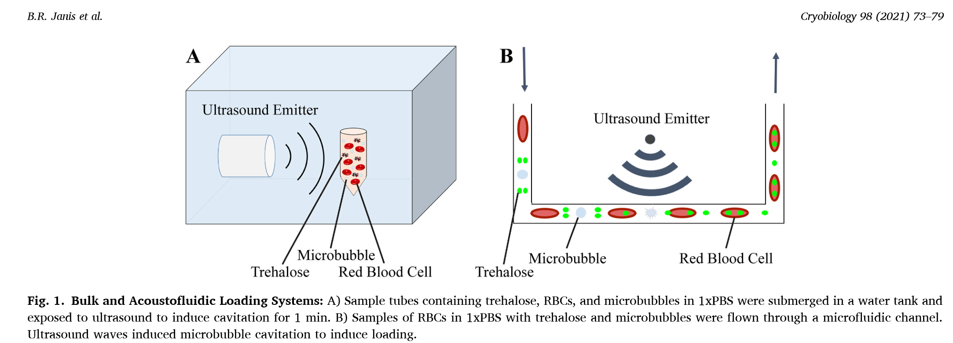
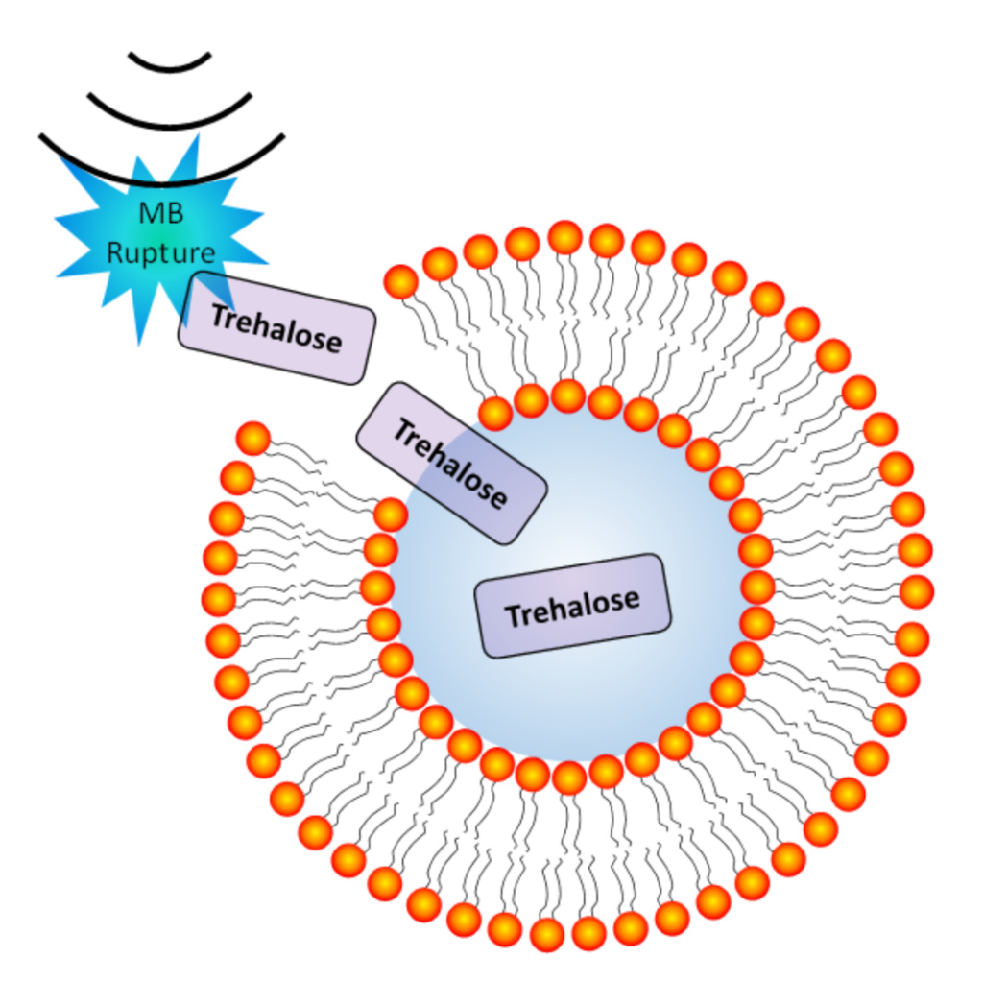
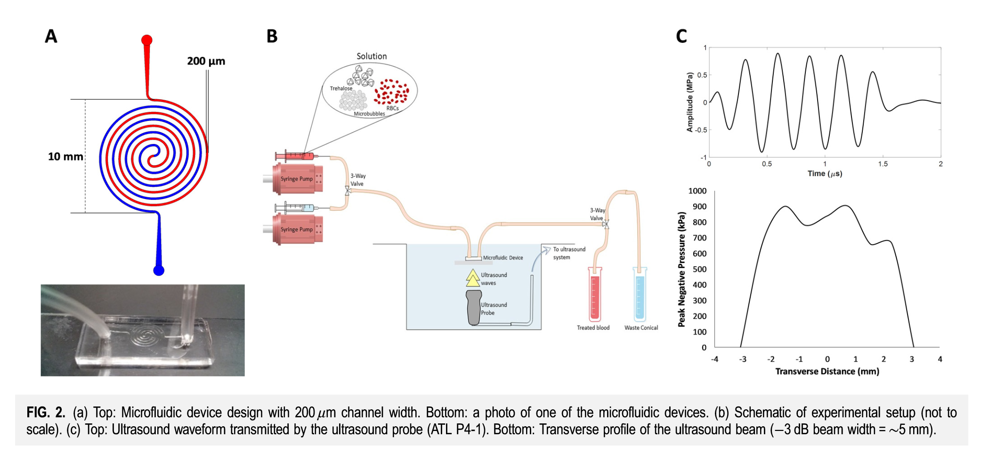
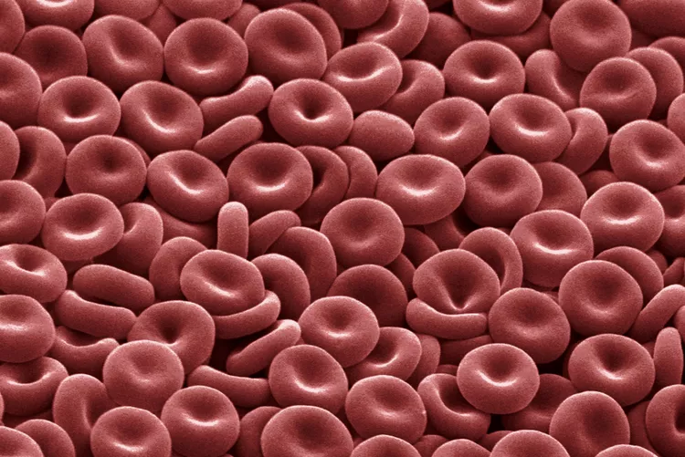
Previous Study in Dr. Kopechek’s Lab
Introduction and Background Material
RBCs are about 7–8 μm in size, but since some capillaries are only 5 μm wide, RBCs need to squeeze and deform to pass through. That’s why we use deformability as a key indicator in our study.”
focus on biomedical ultrasound and microfluidics for therapeutic and diagnostic applications
The team explores innovative approaches such as ultrasound-mediated drug delivery, red blood cell analysis using microfluidic devices, and the development of lab-on-a-chip systems.
The lab combines engineering, biology, and medical science to improve healthcare technologies.
Red blood cells (RBCs)
Biomedical Ultrasound
・Transport oxygen throughout the body
・Flexible disk shape
・Deform and pass through narrow capillaries
microfluidics
Explore innovative approaches such as
・Ultrasound-based methods to load preservative compounds into red blood cells
・Red blood cell analysis using microfluidics
https://www.thoughtco.com/red-blood-cells-373487

Slide 3
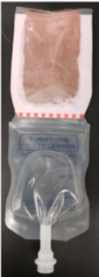
Goal and Purpose
Characterizing the Structure and Function of Freeze-Dried RBCs
Freeze-Dried RBCs
・Standard RBC products are widely used for transfusion, but freeze-dried RBCs are only experimental right now and have not been used in human transfusion
・Dehydrated for long-term preservation
Fabricate and operate PDMS microfluidic devices for a capillary model to assess the deformability of freeze-dried RBCs in flow conditions
Dehydrated porcine RBCs packaged in clinical grade plastic dual chamber bag for rapid rehydration in a closed system.
After rehydration, it is important to assess how well they retain their original structure and function.
Notes:
Red blood cells are widely used for transfusion in clinical settings, disaster zones, and military operations. However, they have a limited shelf life of about 42 days under refrigerated conditions (at 4°C), and strict cold-chain logistics are required for transportation and storage.
Freeze-drying offers the potential for long-term, room-temperature storage of RBCs, which could greatly improve accessibility and safety of blood supplies, especially in resource-limited settings.
Therefore, it is critical to assess how well the structure and function of RBCs are preserved after freeze-drying and rehydration.

Slide 4


Capillary Model Mask Design
1024
capillary channels
flow
3.9 µm wide and
0.5 mm long
RBCs will be passed through small channels to evaluate their deformability under flow conditions.

Slide 5
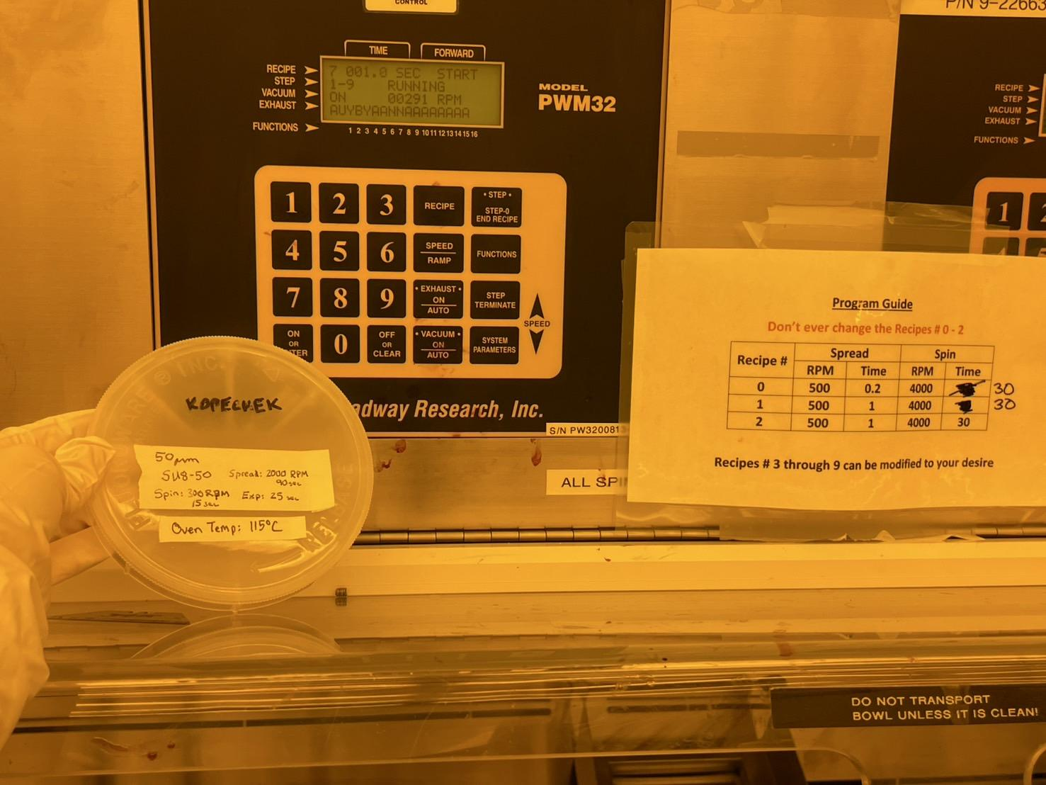
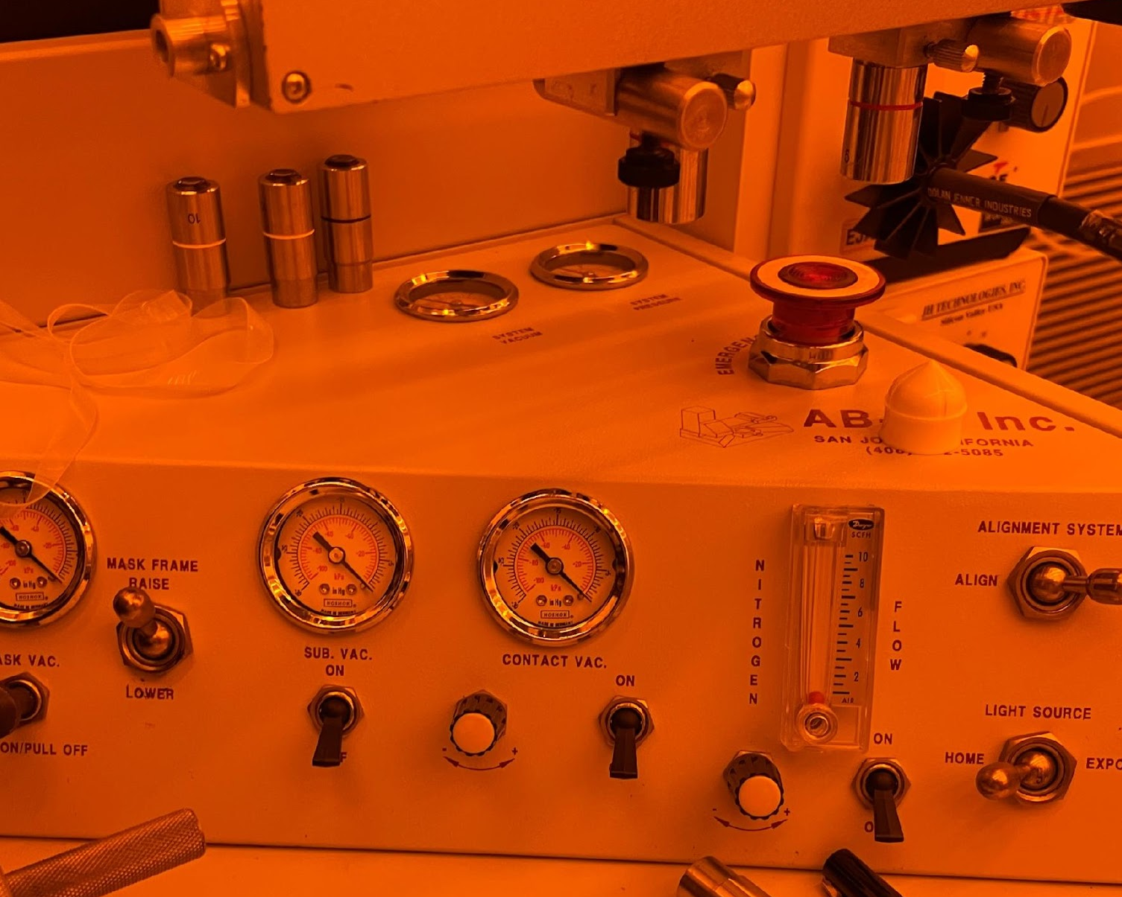
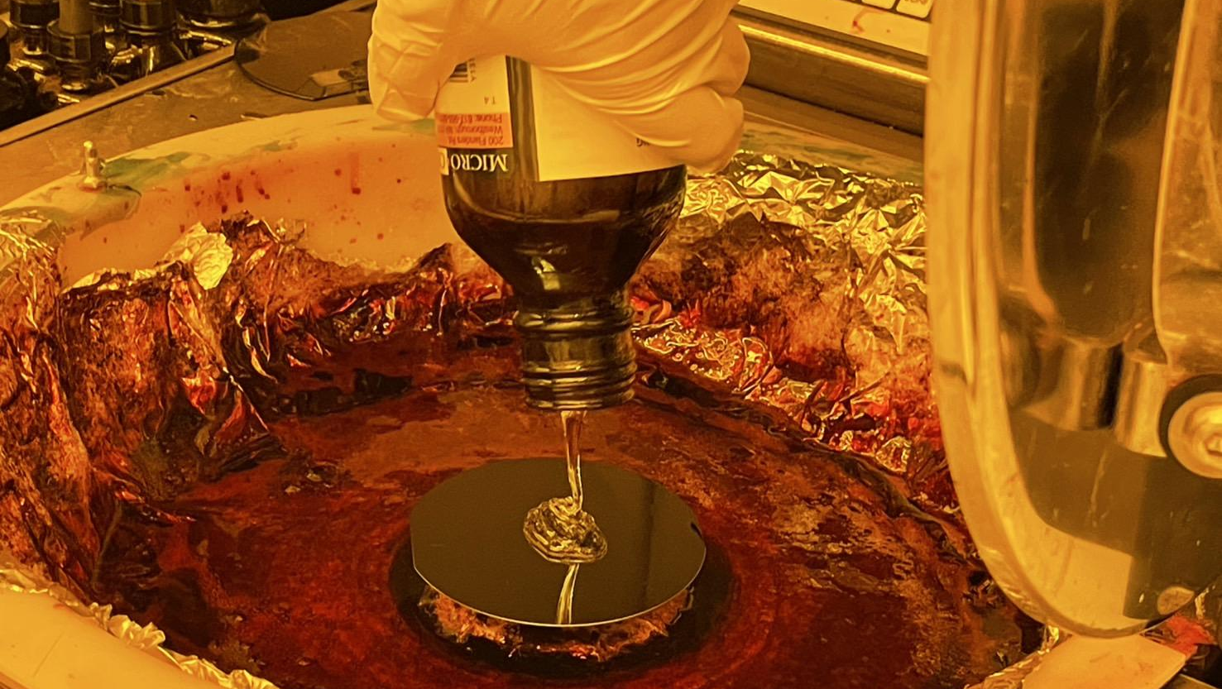
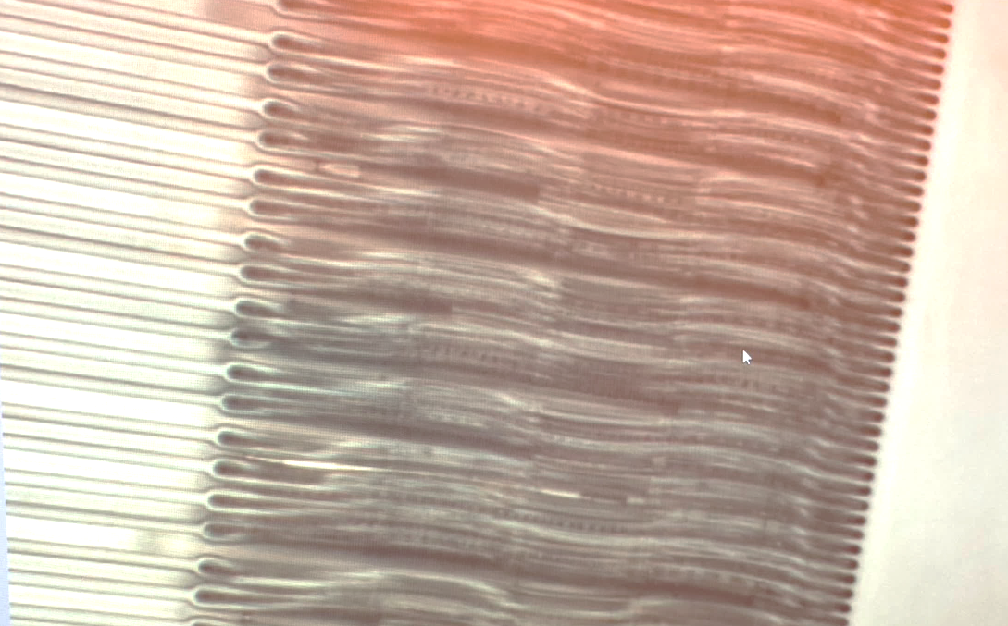
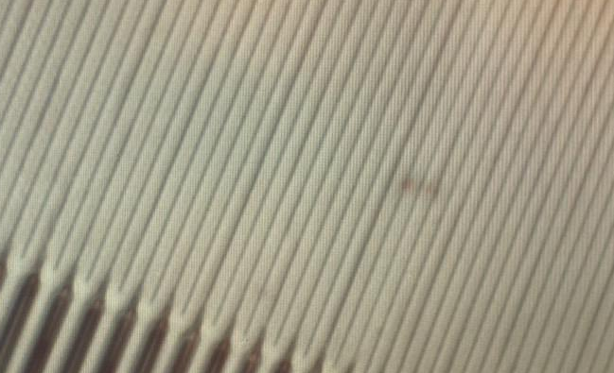
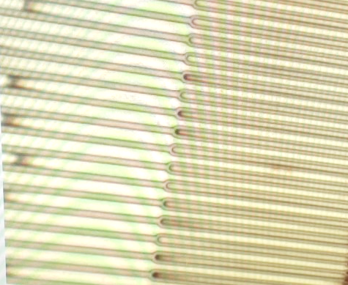
Make SU8 mold Using Photolithography
Work on an SU8 mold for the capillary model ( that will be used for PDMS microfluidics devices )
▷Compared processes using SU8-50 and SU8-2015
UV
UV
Mask
Wafer
Spin Coat
Bake
Bake
Development
SU8-50
(50 μｍ)
SU8-2015
(25 μｍ)
1
Spin coat(spin:300 rpm, 15s
Speed:2000rpm, 90sec)
2
3
Fig1. spin coating of SU8.
Fig2. small features delaminated with initial photolithography process(SU8-50).
Fig3. Successful fabrication of features using SU8-2015
Notes:
First, I fabricated an SU-8 mold using photolithography, which is used for PDMS microfluidic devices.
I compared two types of SU-8 materials. One type resulted in too thick, and I couldn’t form separate microchannels.
The other type had about half the thickness, which allowed me to form proper microchannel structures.
We attempted to fabricate the narrow capillary structures in the microfluidics, but the process was not completely successful.
The SU-8 layer we used had a thickness of about 50 μm, and the width of the capillary channels was very narrow.
We suspect that the aspect ratio (height to width) was too high, that made it difficult for proper UV exposure to reach the bottom of the features.
In high aspect ratio designs, issues such as limited light penetration, diffraction, and mask-to-resist gap can cause exposure failures and pattern distortion.
Next week, I plan to try a different type of SU-8 photoresist and adjust the spin-coating parameters (speed and duration) to reduce the SU8 thickness to approximately 25 μm, which is about half of the current thickness.
This should improve the aspect ratio between the channel height and width, allowing for better UV light penetration during exposure and more reliable pattern formation in the capillary model.

Slide 6
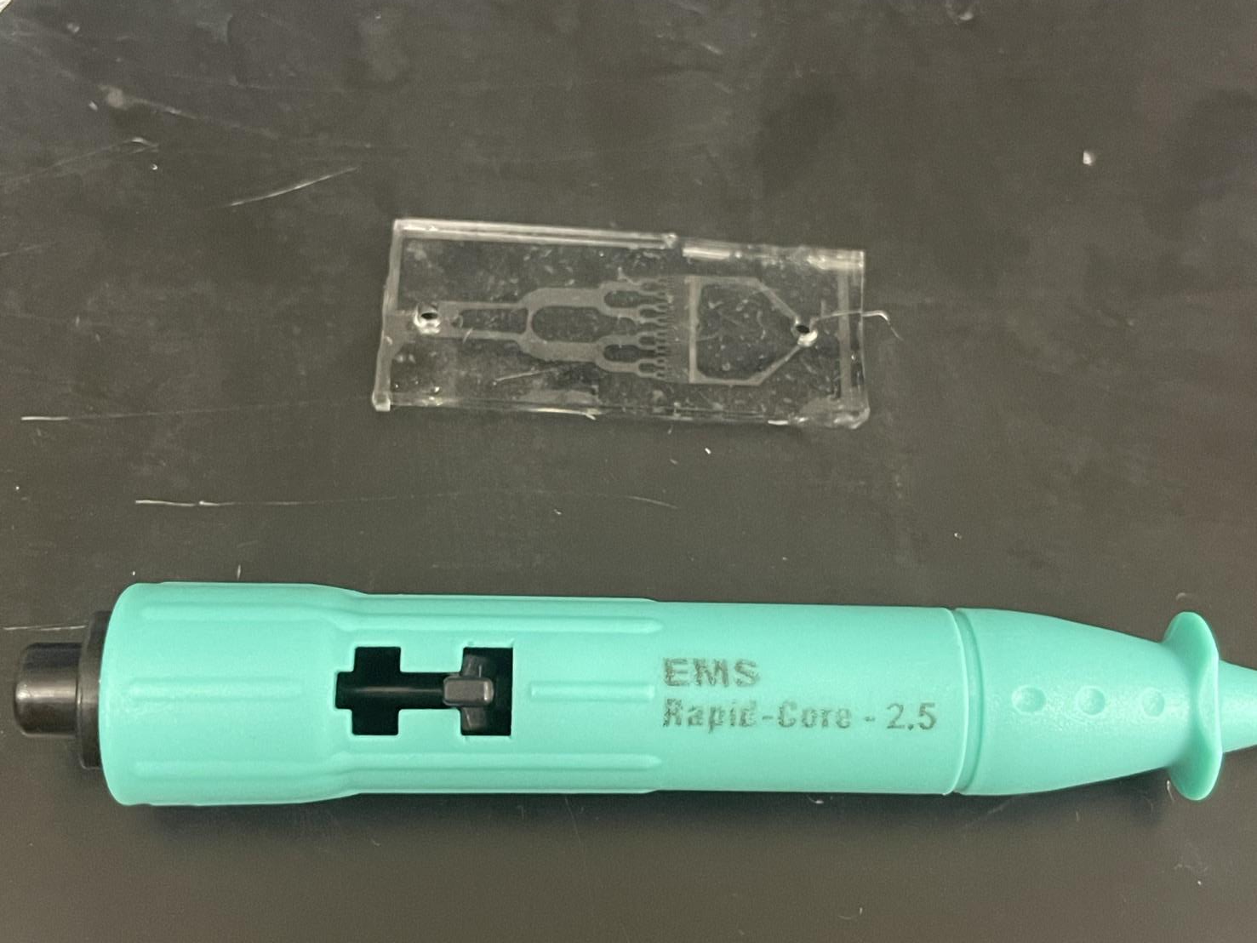
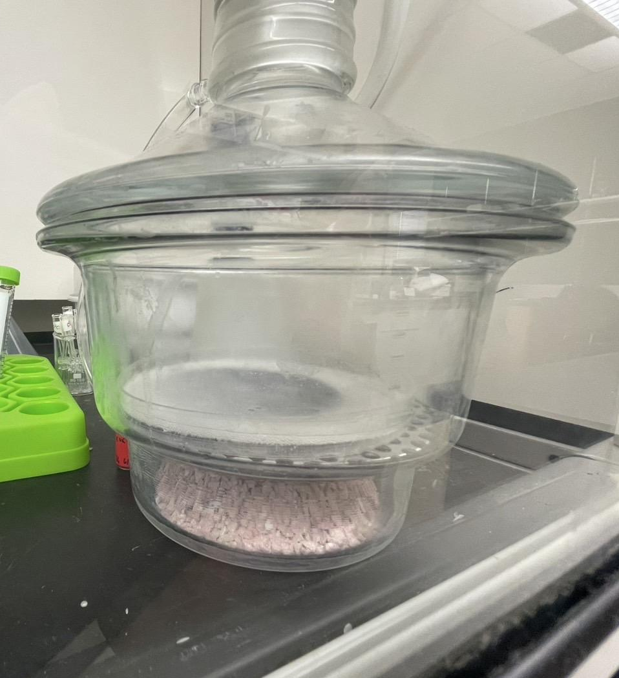
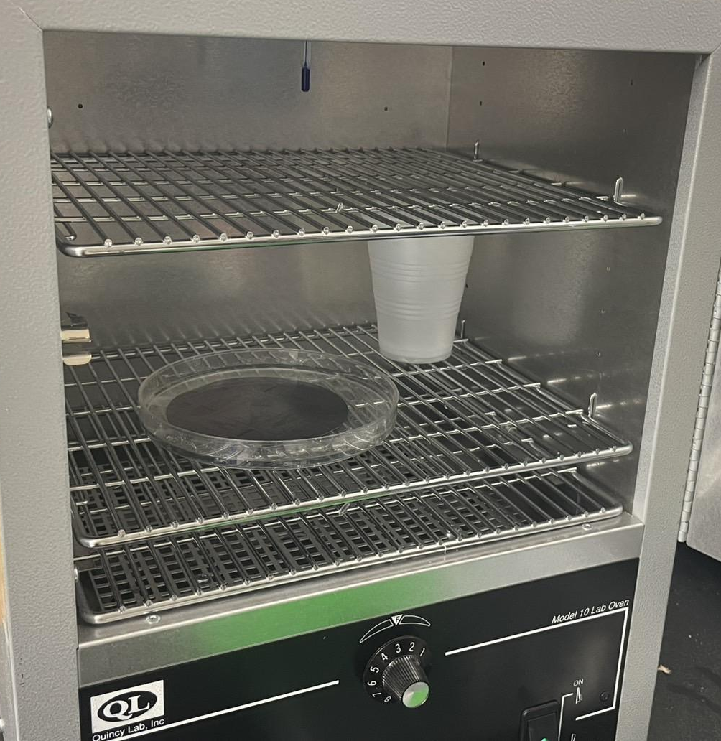
Fabricate PDMS microfluidics Using mold
Work on an PDMS for the capillary model
Mix the PDMS base and curing agent (10:1 ratio) ▷ Pour the mixture onto the mold
Inlet
Outlet
1
2
3
Fig1. Vacuumed PDMS on the SU8 mold to remove the air bubbles (1hour at room temperature)
Fig2. Baked PDMS on the SU8 mold in the oven (at least 2 hours for 55℃)
Fig3. Cut and holed PDMS hole diameter: 2.5 mm or 3.0 mm
Notes:
Next, I fabricated the PDMS devices using the SU8 mold.
I mixed the PDMS base and curing agent in a 10:1 ratio, poured the mixture onto the mold, and degassed it in a desiccator to remove air bebbles.
Then, I cured it in an oven. After full curing, I cut the PDMS into the required size and used a corer to punch holes for the inlet and outlet.

Slide 7
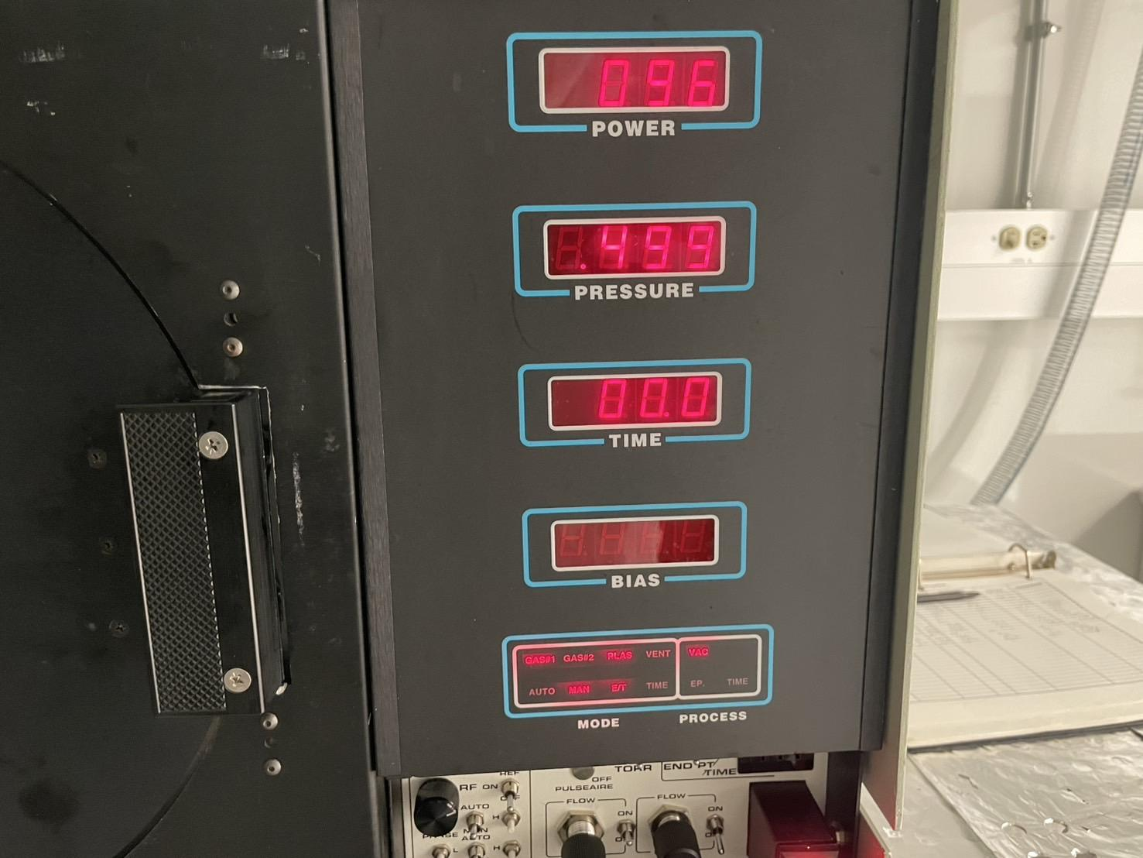
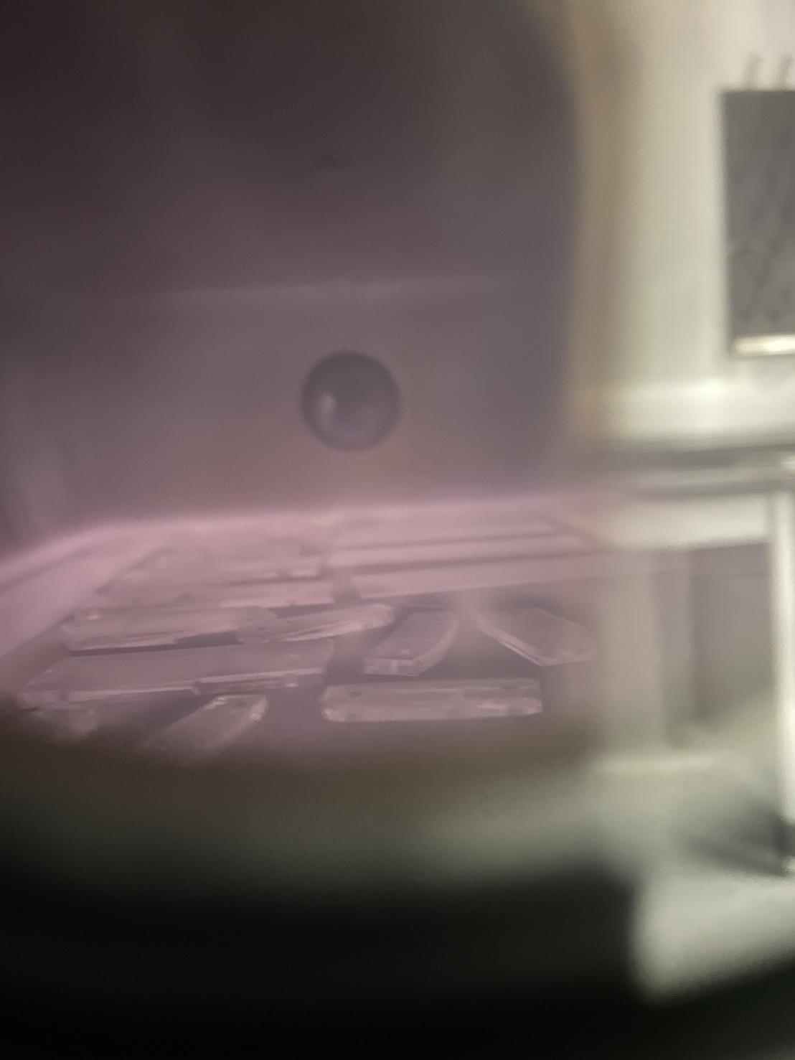
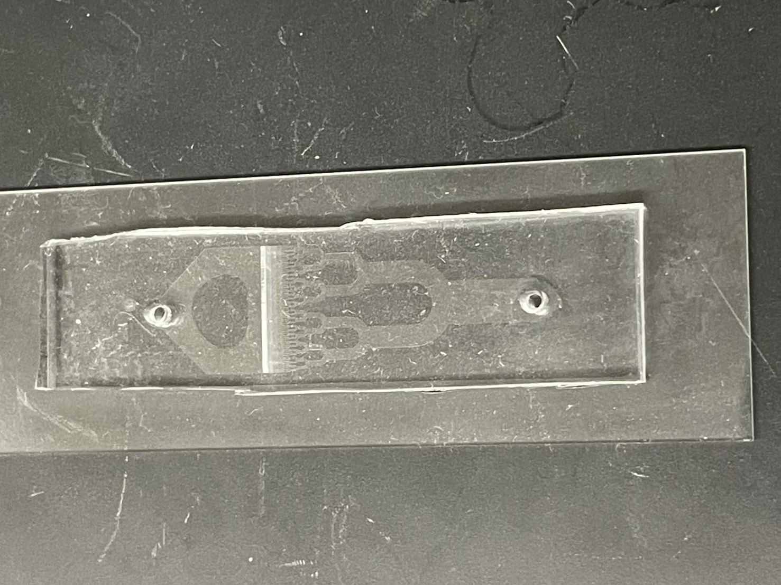
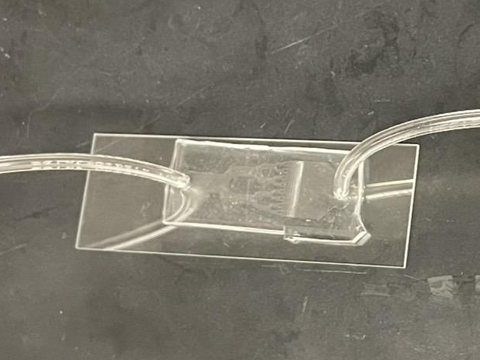
Plasma Bonding
How to perform plasma bonding using plasma asher
① Prepare PDMS and a glass substrate
② Expose both surfaces to oxygen plasma
③ Immediately bring the surfaces into contact
Exposure
Bonding
Tubing
Exposure Time: 30sec
Power : 100 W
Notes:
After that, I moved on to plasma bonding using a plasma asher.
The surfaces of PDMS and glass were exposed to oxygen plasma, and then brought into contact to bond together.
Finally, I attached tubes to the inlet and outlet.
As I will show in the next slide, I’m currently optimizing the exposure time to improve the bonding strength.
**Plasma bonding（プラズマ接着）**
PDMSとガラスのような基板を強力かつ永久的に結合させるための技術です。酸素プラズマ処理によって、表面に水酸基（–OH）が導入され、直後に基板同士を接触させることで、縮合反応によって共有結合（Si–O–Si）が形成されます。この方法により、マイクロ流体チップなどで必要な、漏れのない強固な接合が得られます。
🔸 英語での説明：
Plasma bonding is a technique used to create strong, permanent bonds between surfaces such as PDMS and glass. By exposing the surfaces to oxygen plasma, hydroxyl (–OH) groups are introduced. When the treated surfaces are brought into contact immediately, a condensation reaction forms covalent Si–O–Si bonds. This results in a leak-proof seal ideal for microfluidic applications.
必要であれば、もっと短くした説明や、スライド用の見出し表現も作成できます。

Slide 8
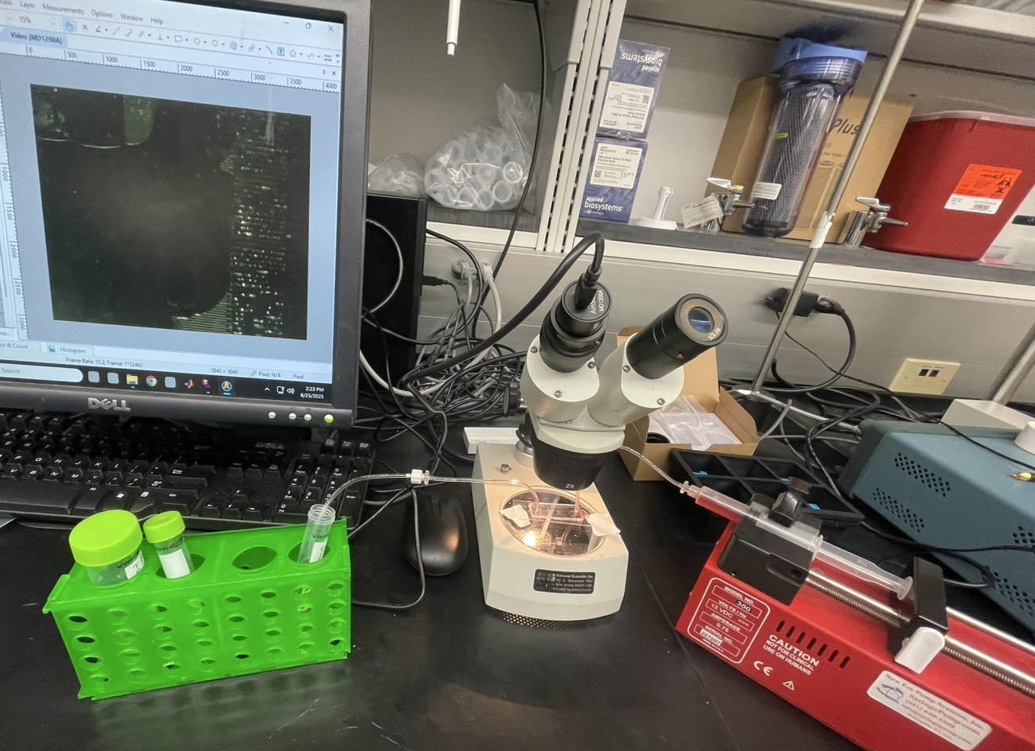
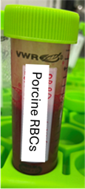
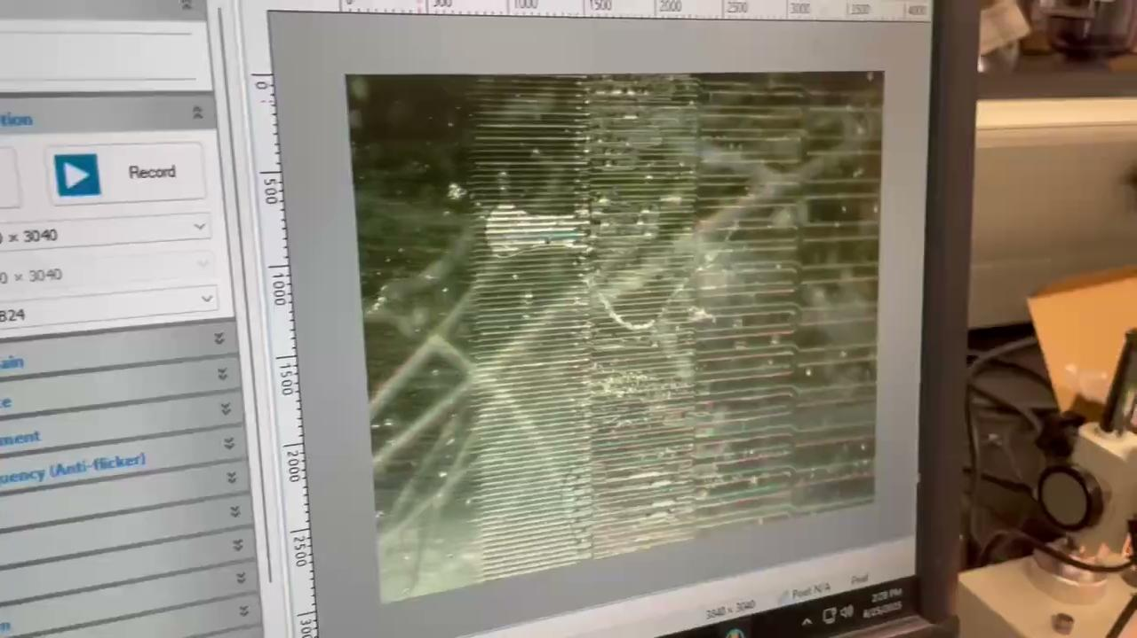
Microscopy Image Acquisition
Dilute them with PBS (phosphate-buffered saline) to reach the desired concentration.
Gently mix the suspension to ensure uniform cell distribution.
Load the prepared cell suspension into a syringe, which will be used for further experiments such as injection into microfluidic devices
Experiment Setup
RBCs in flow condition
Microscope
Flow
types of glass slide
・soda lime glass
・borosilicate glass
Syringe pump
① Dilute RBCs in PBS to prepare a suspension
② Load it into a syringe and introduced it into the device using a syringe pump
RBCs flow through microfluidic channels
(1.0 mL/min)
Notes:
Using the completed PDMS microfluidic devices, I acquire optical microscopy images of porcine red blood cells.
First, I diluted the RBCs in PBS to prepare a suspension.
Then, I loaded the suspension into a syringe and introduced it into the device using a syringe pump.
Here is an actual video.
As you can see, the RBCs flow through the microfluidic channels.
However, in some channels, air bubbles are trapped or bonding is incomplete.
So, I’m continuing to optimize the PDMS bonding process.

Slide 9
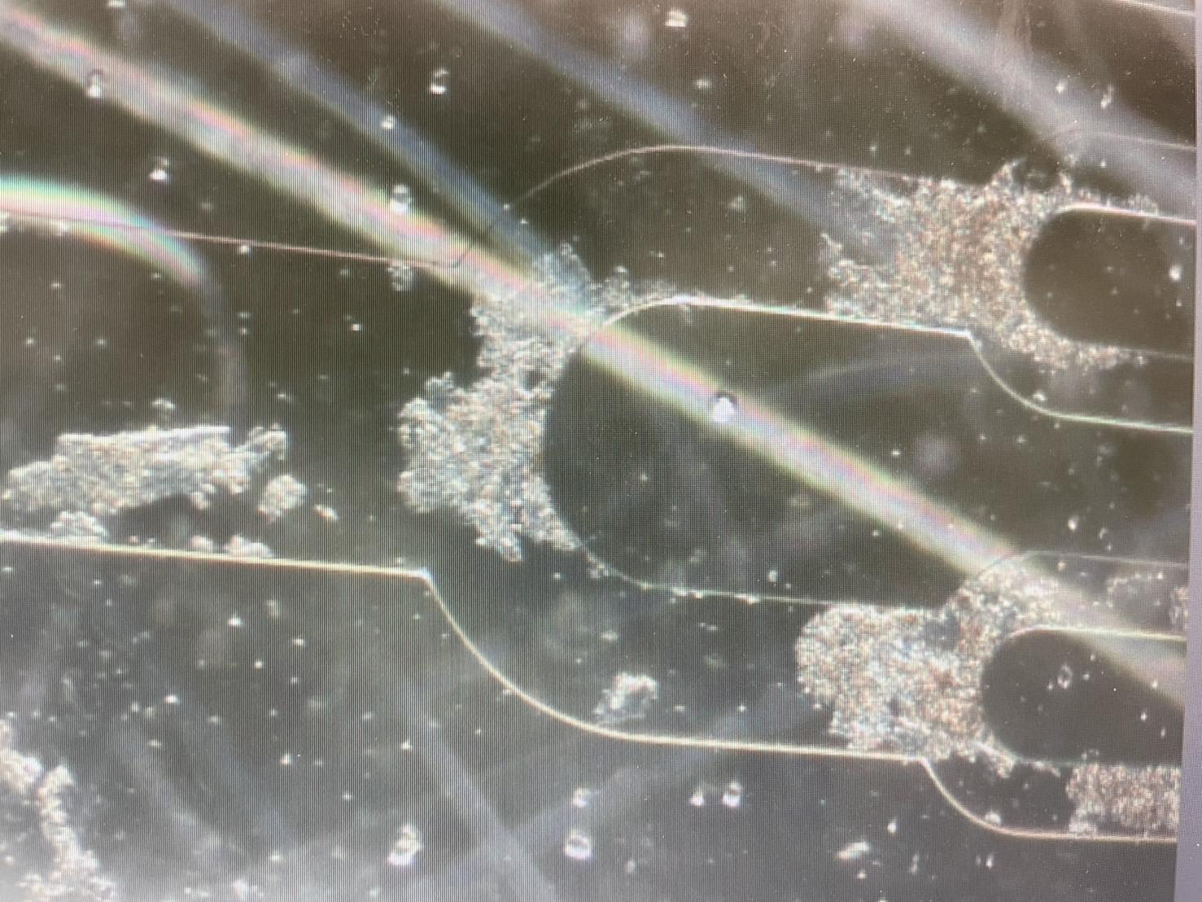
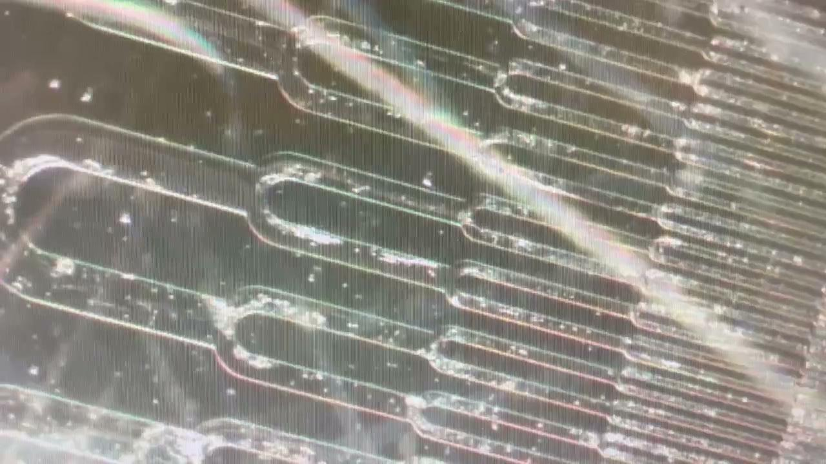
RBC Recovery Comparison Experiment ①
Fixed RBCs in flow condition
RBCs were fixed with formaldehyde as a positive control to change them to a non-deformable structure for comparison with normal RBCs
Just to clarify why we are testing fixed RBCs, the fixation process should cause the fixed RBCs to lose their flexibility/deformability, so we can use them to confirm that the capillary device is able to show differences in cell deformability properties. By showing that normal RBCs can mostly pass through the capillary network, but fixed cells get trapped within the channels much more often, we confirm that the device can be used to detect differences in RBC properties. Then we can use this method to test the performance of RBCs after freeze-drying and rehydration
固定赤血球を試験する理由を明確にしておきますと、固定処理によって固定赤血球は柔軟性／変形性を失うため、毛細管デバイスが細胞の変形特性の違いを検出できるかどうかを確認することができます。通常の赤血球は毛細管ネットワークをほとんど通過できますが、固定された細胞はチャネル内に捕捉される可能性が非常に高いことを示すことで、デバイスが赤血球特性の違いを検出できることを確認できます。その後、この方法を用いて、凍結乾燥および再水和後の赤血球の性能を試験できます
Protocol for Fixation of RBCs Using formaldehyde
Add 2.5 mL of 4% formaldehyde to a 15-mL centrifuge tube
Add 2.5 mL of PBS to the same 15-mL centrifuge tube
Add 50 μL of porcine RBC stock solution to the same 15-mL centrifuge tube
Seal the tube and mix by inverting and swirling by hand for a minute
Centrifuge tube to pellet cells (1500g for 5min, room temp or 4℃ are both ok)
Aspirate supernatant, then add PBS to a total volume of 5 mL
Introduce the RBCs into the capillary device to test in flow condition
Notes:
より詰まりが多いように見える

Slide 10
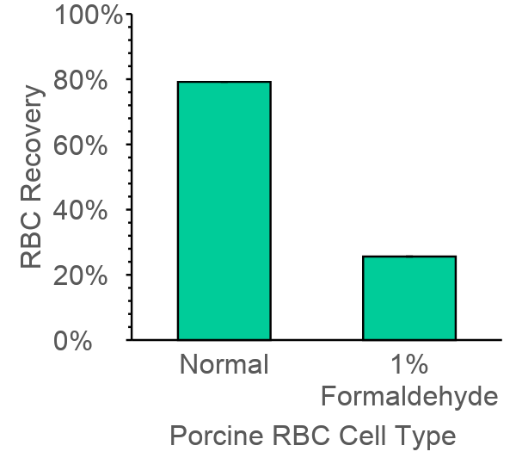
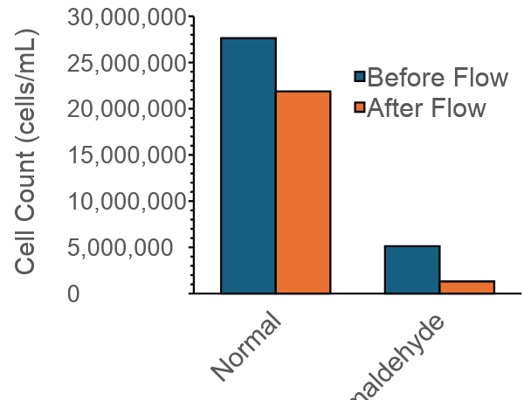
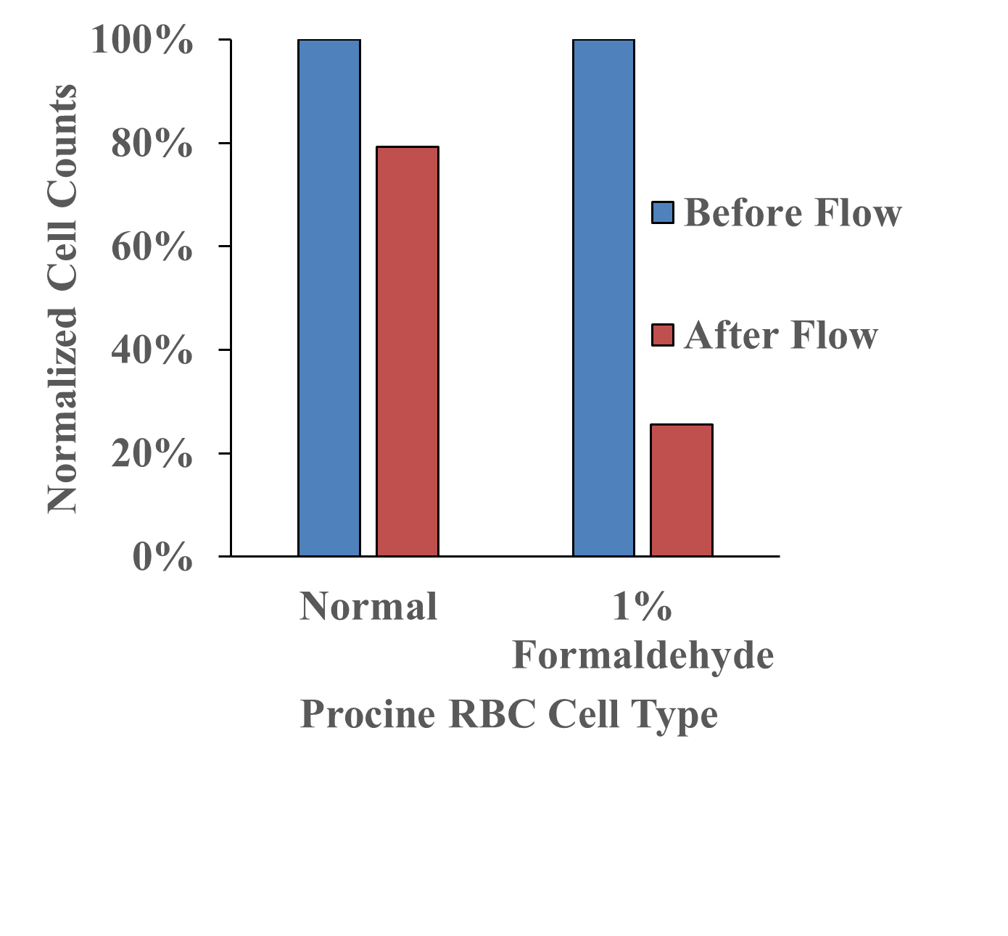
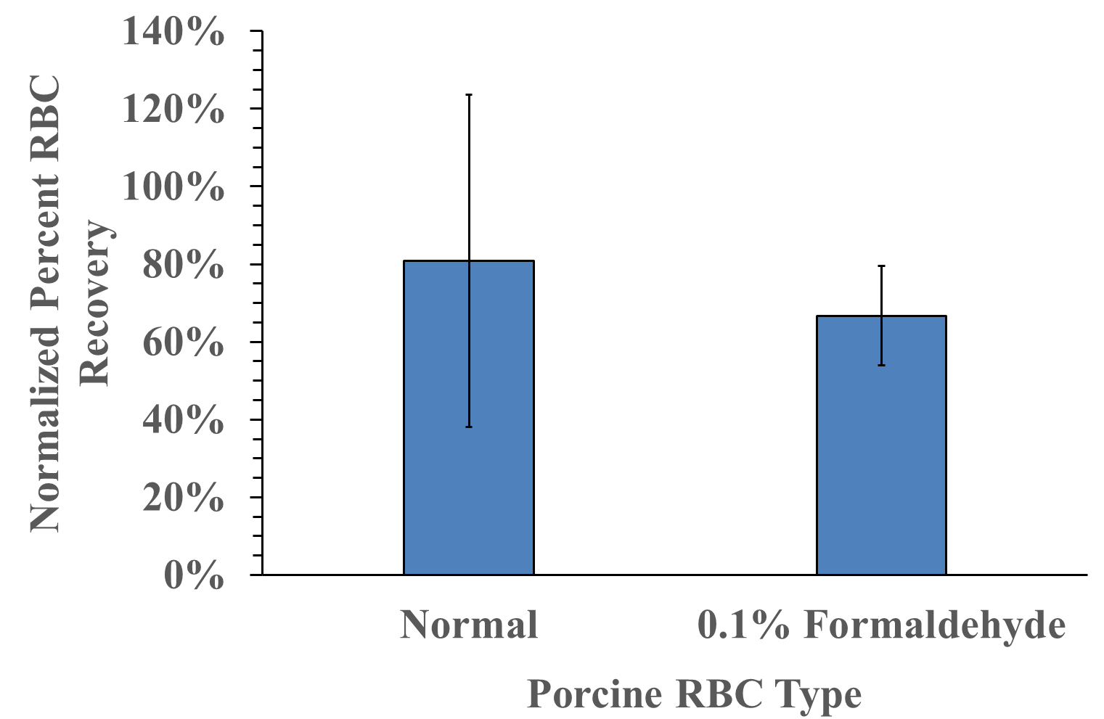
Comparison of Recovery Cell Count
: Fixed vs. Normal RBCs
Comparison of Recovery Rates
: Fixed vs. Normal RBCs
Result : RBC Recovery Comparison
The fixation process should cause the fixed RBCs to lose their flexibility/deformability.
By showing these results, normal RBCs can mostly pass through the capillary network, but fixed RBCs get trapped within the channels much more often. Therefore, we think that the device can be used to detect differences in RBC properties.
Just to clarify why we are testing fixed RBCs, the fixation process should cause the fixed RBCs to lose their flexibility/deformability, so we can use them to confirm that the capillary device is able to show differences in cell deformability properties. By showing that normal RBCs can mostly pass through the capillary network, but fixed cells get trapped within the channels much more often, we confirm that the device can be used to detect differences in RBC properties. Then we can use this method to test the performance of RBCs after freeze-drying and rehydration
Notes:
We compared the recovery rates of formaldehyde-fixed RBCs and untreated (normal) RBCs after flow through our PDMS microfluidic device. As you can see, the recovery rate for the fixed cells was significantly lower—around 25%—compared to approximately 80% for the normal cells. ➡This suggests that fixation may alter the cells’ behavior during flow, possibly increasing their tendency to adhere to channel surfaces or aggregate. We suspect that the smaller channel dimensions and potential surface interactions play a role, especially for fixed cells. To confirm this, we plan to repeat the experiments and vary parameters such as device cleaning protocols and flow order. These results highlight the importance of considering cell properties when evaluating device performance.

Slide 11
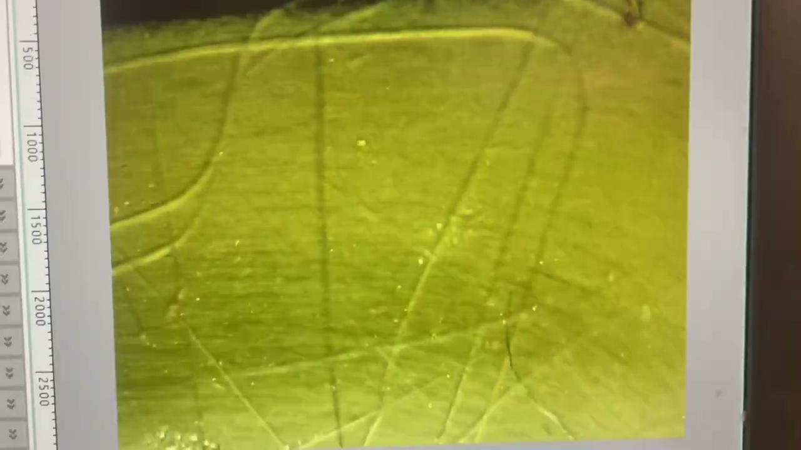
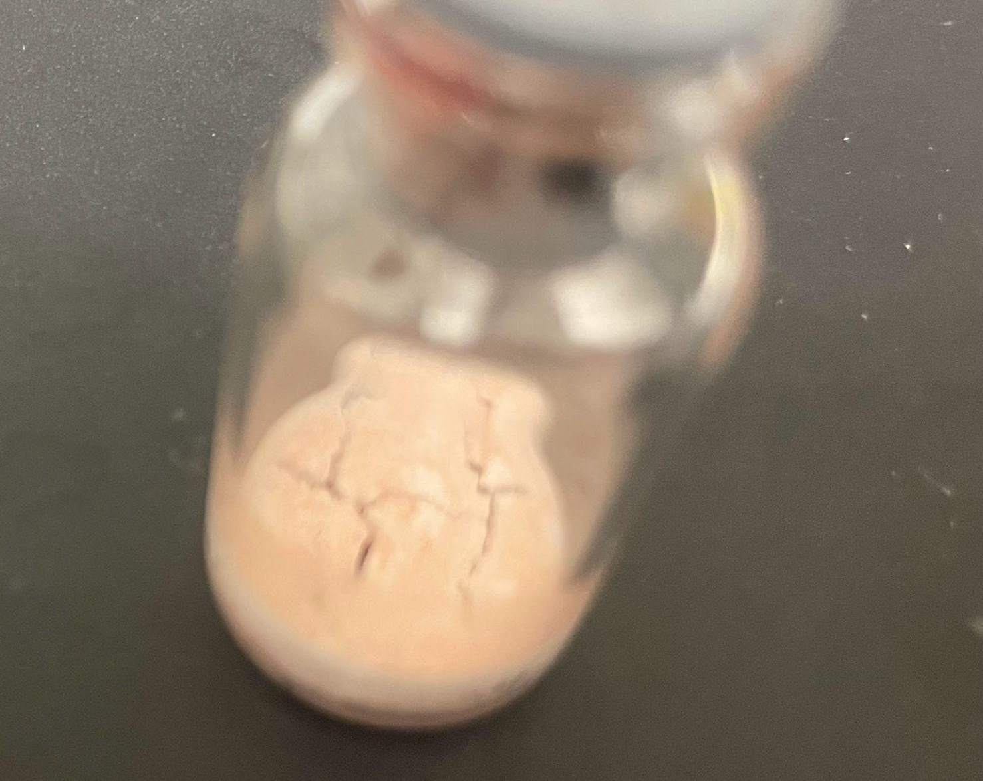
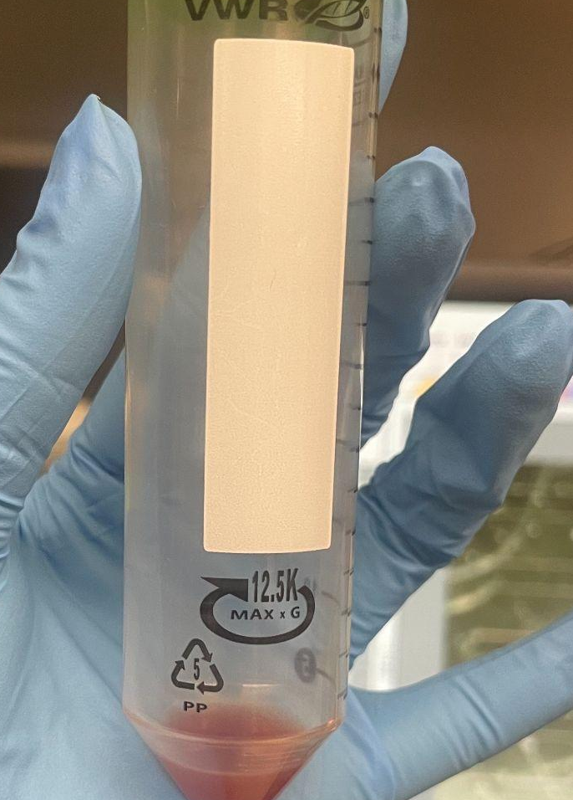
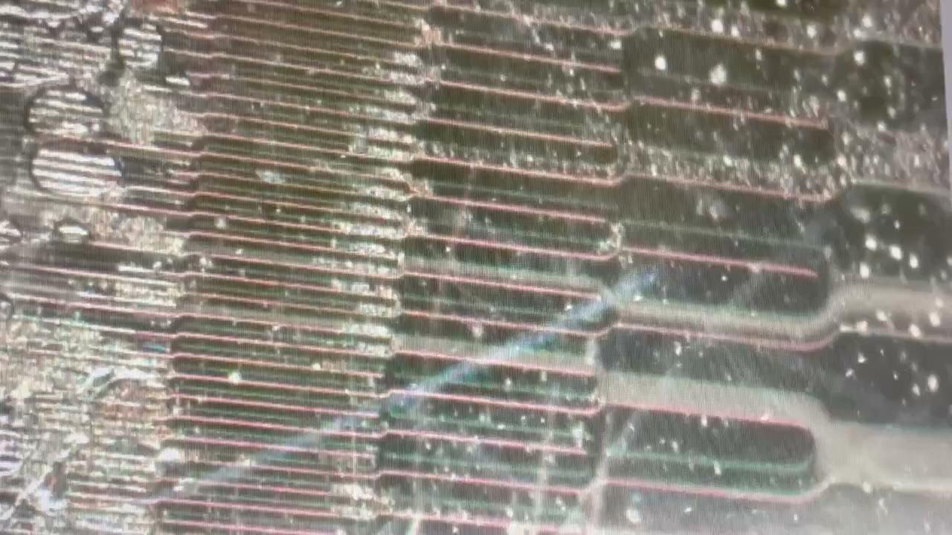
RBC Recovery Comparison Experiment ②
RBCs were freeze-dried with lyophilization buffer and rehydrated with PBS
[A] Rehydrated RBCs in flow condition
Just to clarify why we are testing fixed RBCs, the fixation process should cause the fixed RBCs to lose their flexibility/deformability, so we can use them to confirm that the capillary device is able to show differences in cell deformability properties. By showing that normal RBCs can mostly pass through the capillary network, but fixed cells get trapped within the channels much more often, we confirm that the device can be used to detect differences in RBC properties. Then we can use this method to test the performance of RBCs after freeze-drying and rehydration
固定赤血球を試験する理由を明確にしておきますと、固定処理によって固定赤血球は柔軟性／変形性を失うため、毛細管デバイスが細胞の変形特性の違いを検出できるかどうかを確認することができます。通常の赤血球は毛細管ネットワークをほとんど通過できますが、固定された細胞はチャネル内に捕捉される可能性が非常に高いことを示すことで、デバイスが赤血球特性の違いを検出できることを確認できます。その後、この方法を用いて、凍結乾燥および再水和後の赤血球の性能を試験できます
Protocol for rehydration of freeze-dried RBCs
Add 3.0 mL of PBS to rehydrate the dehydrated RBCs
➡[A]
Centrifuge that to wash out lyophilization(1000g, 5min, 4℃)
Aspirate supernatant, then add PBS to a total volume of 3.0 mL
Introduce the RBCs into the capillary device to test in flow condition
➡[B]
[B] Rehydrated RBCs in flow condition
Add PBS
Dehydrated RBCs
Rehydrated RBCs

Slide 12
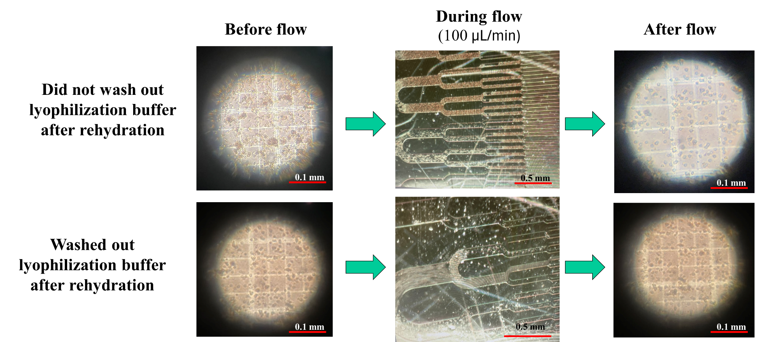
Result : RBC Recovery Comparison
Rehydrated RBCs were tested behavior with or without washing out the lyophilization buffer
[A]
Did not wash out lyophilization buffer
Wash out lyophilization buffer
[B]
Rehydrated RBCs aggregated in microchannels, but washing out the lyophilization buffer reduced aggregation
Notes:
Rehydrated RBCs aggregated in microchannels, but washing out the lyophilization buffer reduced aggregation

Slide 13
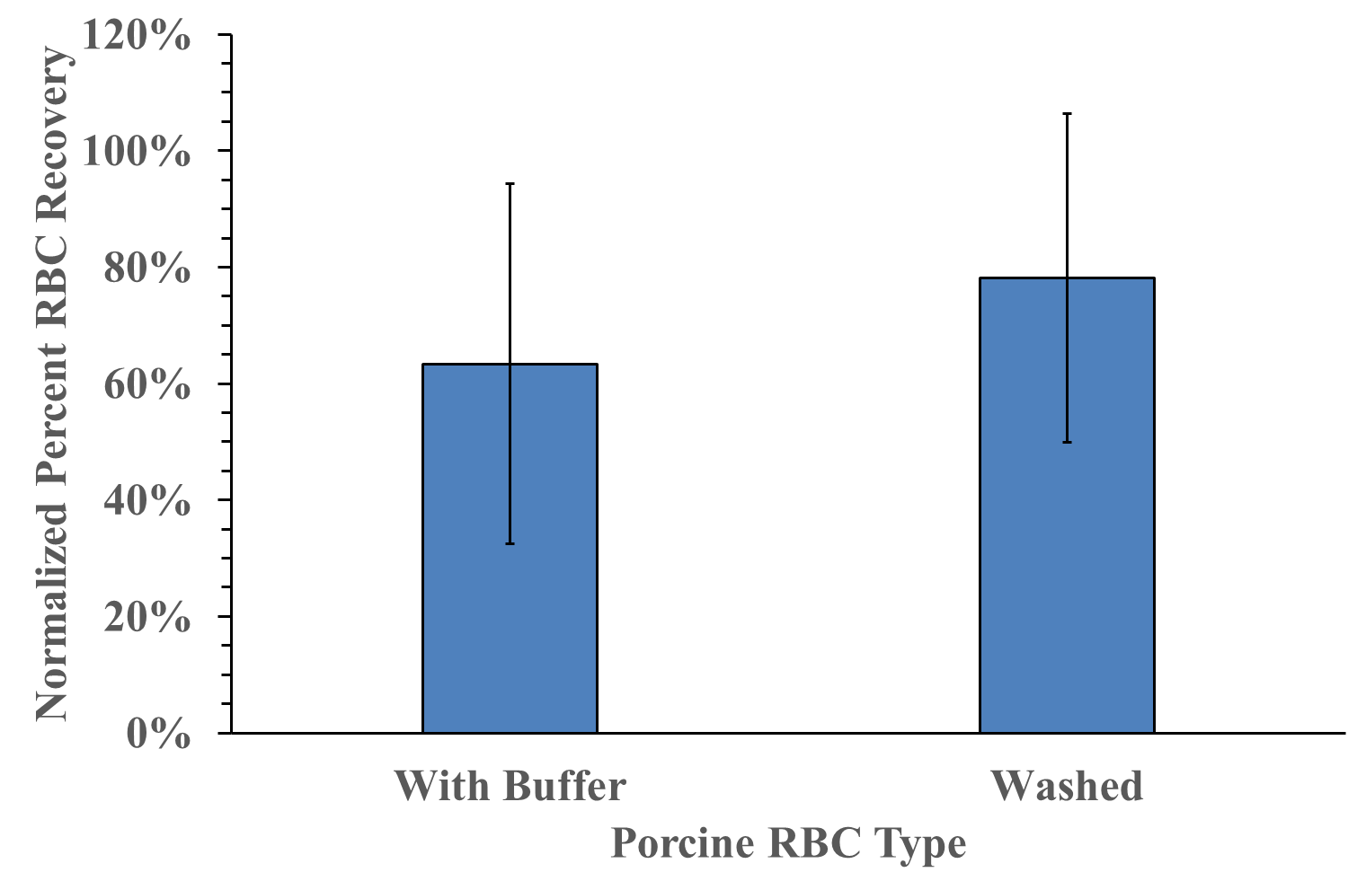
Result : RBC Recovery Comparison
Rehydrated RBCs with buffer exhibited a significantly lower recovery, suggesting channel blockage due to cell aggregation.
In contrast, washing out the lyophilization buffer before rehydration improved recovery, indicating reduced aggregation and better flow through the microchannels.
Notes:
Rehydrated RBCs aggregated in microchannels, but washing out the lyophilization buffer reduced aggregation

Slide 14
・Optimized SU8 thickness and 25 µm SU8 thickness was successful in producing functional microfluidic devices with microchannels
・RBCs fixed with formaldehyde were more likely to remain trapped inside the microchannels compared to normal RBCs
・ Microfluidic device can be used to detect RBC behavior in microchannels after fixation with formaldehyde
・ Freeze-dried and rehydrated RBCs aggregated in microchannels, but washing out the lyophilization buffer reduced aggregation
Conclusion

Slide 15
Thank you so much for Listening!
Do you have any questions or feedback?

Slide 16
Protocol for coating microwell structure
with gelatin and collagen
Prepare Gelatin (2% w/v) for Microwell Structure Coating:
2. Prepare Collagen (5mg/cm²) for Microwell Structure Coating
3. Prepare Microwell Structure for Gelatin/Collagen Coating
a : Rinse PDMS microwell structure in petri dish with DI water three times
b : Let microwell structure air dry at room temperature
4. Gelatin/Collage Incubation on Microwell Structure
Gelatin: Add gelatin mixture (from Step 4) to a petri dish
Immerse PDMS microwell structure in gelatin mixture
· Air dry PDMS for 2 hours
b. Collagen:
· Add Collagen mixture (from Step 5) to petri dish
· Soak PDMS microwell structure in collagen mixture for 2 hours
· Wash with PBS
5. Seeding 600k RBCs per mL Dilution on Microwell Structure:
a. Once PDMS microwell structures (from Steps 7a&b) have dried, place microwell structures into fresh petri dishes
b. Add 600k RBCs/mL dilutions (from Step 2c) to each petri dish
c. Incubate at room temperature for 30 minutes
6. View RBCs on PDMS Microwell Structures on Lab Microscope
Microwell imaging
microwell is coated for better imaging RBCs
Protocol for coating microwell structure with Gelatin or Collagen
Prepare Gelatin (2% w/v) and Collagen (5mg/cm²) for Microwell Structure Coating
Prepare Microwell Structure for Coating
a : Rinse PDMS microwell structure in petri dish with DI water three times
b : Let microwell structure air dry at room temperature
Gelatin/Collage Incubation on Microwell Structure for 2 hours
Seeding 600k RBCs per mL Dilution on Microwell Structure
a : Once PDMS microwell structures have dried, place microwell structures into fresh petri dishes
b : Add 600k RBCs/mL dilutions (from Step 2c) to each petri dish
c : Incubate at room temperature for 30 minutes
View RBCs on PDMS Microwell Structures on Microscope

Slide 17
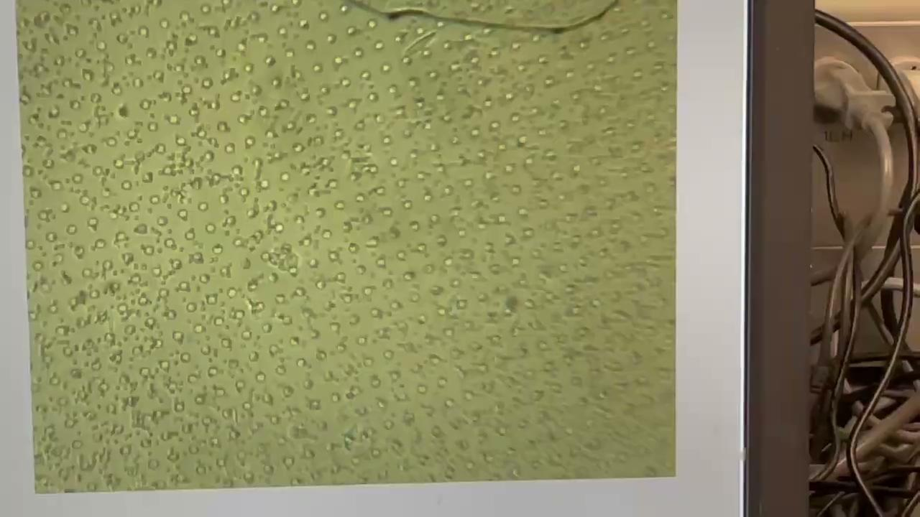
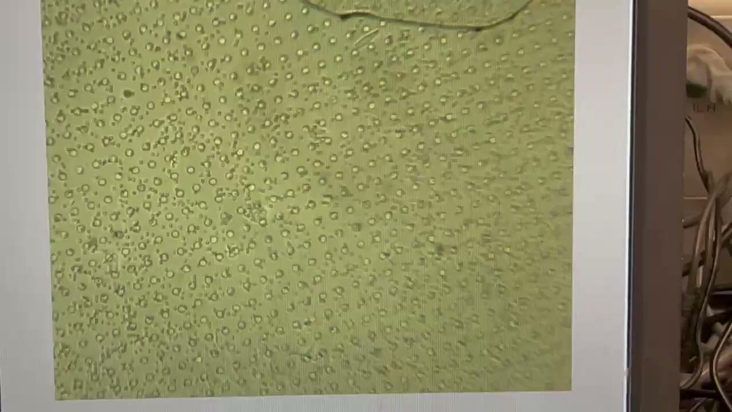
Microwell imaging
microwell is coated for better imaging RBCs
coating microwell structure with Gelatin
coating microwell structure with Collagen

Slide 18
Experimental Method
1
Make SU8 mold using Photolithography
SU8
Wafer
2
Fabricate PDMS microfluidics using mold
PDMS
3
Plasma Bonding Between PDMS and Substrate
4
Induce Cell from Inlet
Substrate
Acquire Microscopy Images
Channel
Notes:
We attempted to fabricate the narrow capillary structures in the microfluidics, but the process was not completely successful.
The SU-8 layer we used had a thickness of about 50 μm, and the width of the capillary channels was very narrow.
We suspect that the aspect ratio (height to width) was too high, that made it difficult for proper UV exposure to reach the bottom of the features.
In high aspect ratio designs, issues such as limited light penetration, diffraction, and mask-to-resist gap can cause exposure failures and pattern distortion.
Next week, I plan to try a different type of SU-8 photoresist and adjust the spin-coating parameters (speed and duration) to reduce the SU8 thickness to approximately 25 μm, which is about half of the current thickness.
This should improve the aspect ratio between the channel height and width, allowing for better UV light penetration during exposure and more reliable pattern formation in the capillary model.

Slide 19
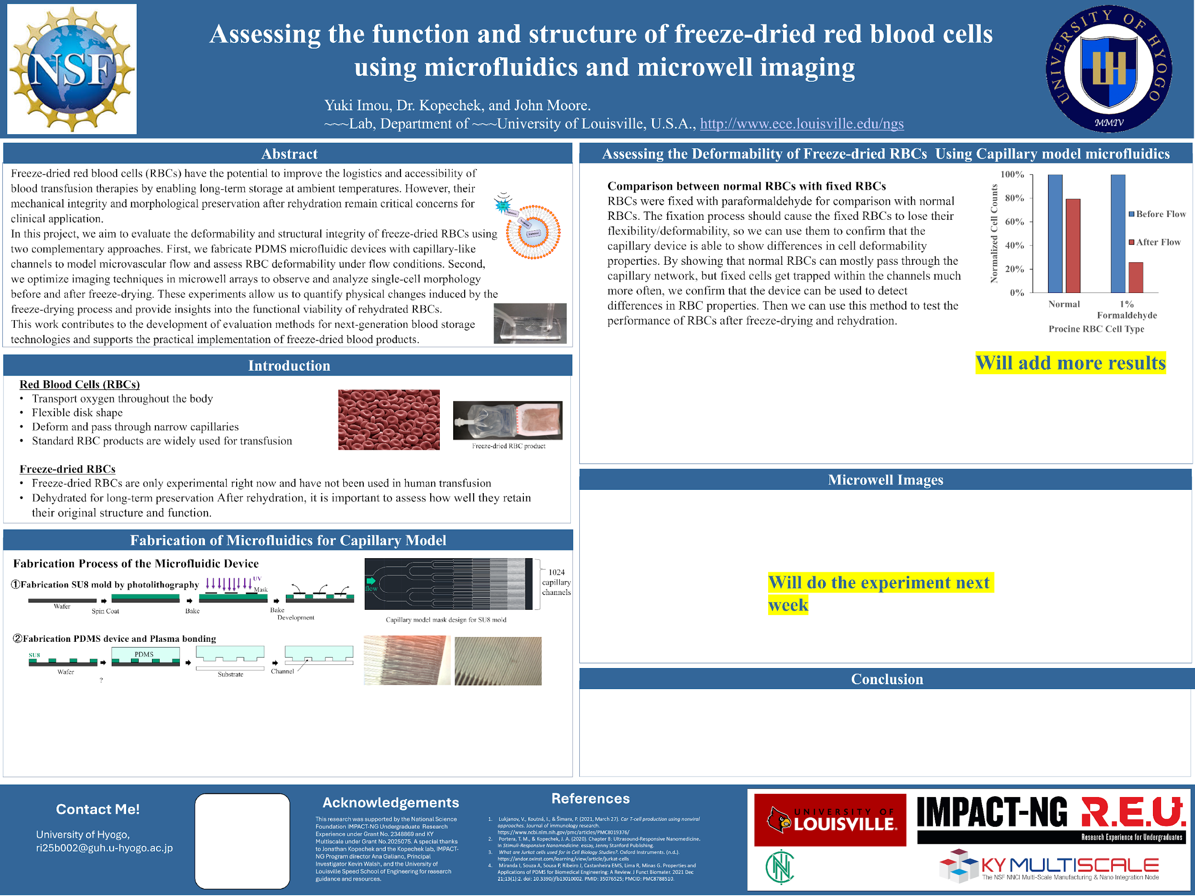
Notes:
We attempted to fabricate the narrow capillary structures in the microfluidics, but the process was not completely successful.
The SU-8 layer we used had a thickness of about 50 μm, and the width of the capillary channels was very narrow.
We suspect that the aspect ratio (height to width) was too high, that made it difficult for proper UV exposure to reach the bottom of the features.
In high aspect ratio designs, issues such as limited light penetration, diffraction, and mask-to-resist gap can cause exposure failures and pattern distortion.
Next week, I plan to try a different type of SU-8 photoresist and adjust the spin-coating parameters (speed and duration) to reduce the SU8 thickness to approximately 25 μm, which is about half of the current thickness.
This should improve the aspect ratio between the channel height and width, allowing for better UV light penetration during exposure and more reliable pattern formation in the capillary model.

Slide 20
Experimental Method
Make SU8 mold using Photolithography
UV
Mask
Fabricate PDMS microfluidics using mold
Wafer
Bake
Spin Coat
Bake
Development
Plasma Bonding Between PDMS and Substrate
SU8
PDMS
Induce Cell from Inlet
Wafer
Substrate
Channel
Acquire Microscopy Images
?
Notes:
We attempted to fabricate the narrow capillary structures in the microfluidics, but the process was not completely successful.
The SU-8 layer we used had a thickness of about 50 μm, and the width of the capillary channels was very narrow.
We suspect that the aspect ratio (height to width) was too high, that made it difficult for proper UV exposure to reach the bottom of the features.
In high aspect ratio designs, issues such as limited light penetration, diffraction, and mask-to-resist gap can cause exposure failures and pattern distortion.
Next week, I plan to try a different type of SU-8 photoresist and adjust the spin-coating parameters (speed and duration) to reduce the SU8 thickness to approximately 25 μm, which is about half of the current thickness.
This should improve the aspect ratio between the channel height and width, allowing for better UV light penetration during exposure and more reliable pattern formation in the capillary model.

Slide 21
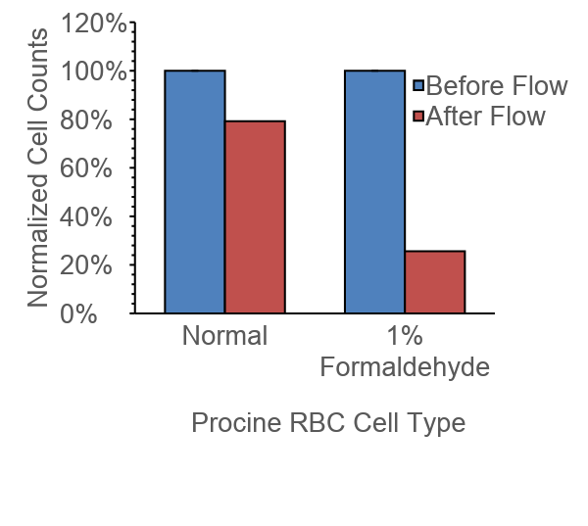
Result : RBC Recovery Comparison
Comparison of Recovery Cell Count
: Fixed vs. Normal RBCs
Comparison of Recovery Rates
: Fixed vs. Normal RBCs
Notes:
We compared the recovery rates of formaldehyde-fixed RBCs and untreated (normal) RBCs after flow through our PDMS microfluidic device. As you can see, the recovery rate for the fixed cells was significantly lower—around 25%—compared to approximately 80% for the normal cells. ➡This suggests that fixation may alter the cells’ behavior during flow, possibly increasing their tendency to adhere to channel surfaces or aggregate. We suspect that the smaller channel dimensions and potential surface interactions play a role, especially for fixed cells. To confirm this, we plan to repeat the experiments and vary parameters such as device cleaning protocols and flow order. These results highlight the importance of considering cell properties when evaluating device performance.

Slide 22
Comparison two types of substrate glass
types of glass slide
・soda lime glass
・borosilicate glass

Slide 23
EGCG

Slide 24
Summary and future outlooks
What I learned in this week
・Learned how to optimize the PDMS plasma exposure time to improve the quality of bonding between substrate and PDMS
・Learned how to acquire microscopy imaging of RBCs in microfluidic channels
What I plan to work on next week
・Will evaluate different inlet/outlet hole sizes (2.5 mm vs 3.0 mm) in PDMS microfluidic devices
・Will evaluate PDMS microwell substrate coating methods for cell adhesion to image changes in RBC structure under different conditions
Thickness | Indirect effect
Very thin (< 0.5 mm) | Too soft and flexible → prone to wrinkles, deformation, or trapped air bubbles during bonding.
Very thick (> 10 mm) | Less flexible → may not conform well to the glass surface, increasing the risk of imperfect sealing.
Moderate thickness (2–5 mm) | Offers good flexibility and contact → usually leads to reliable and uniform bonding.

Slide 25
Plasma Bonding
How to Bond
Plasma Exposure
Immediate Contact
Plasma Bonding – Step-by-Step
① Before Plasma
Hydrophobic PDMS with –CH₃ groups
② Plasma Exposure
Plasma introduces –OH groups (silanol)
③ Bonding
Si–OH condense to form Si–O–Si bonds
④ Bonded
Strong covalent bond – leak-proof
O
OH
O
O
o
o
o
Si
Si
o
o
o
substrate
substrate
substrate

Slide 26
Here are 2 suggestions for the Outline of your Final 8-minute PPT Talk.
・Fab Related Research
Title Slide
Outline Slide (can possibly skip this for an 8 minute talk)
Major Sections for the Following Slides
Goal or Purpose
Introduction and Background Material
Design or Device Design (can include modeling or modeling can be a separate section)
Fabrication
Testing and Results
Conclusion and possibly Recommendations (for future work)
Acknowledgement Slide
・Traditional Research
Title Slide
Outline Slide (can possibly skip this for an 8 minute talk)
Major Sections for the Following Slides
Goal or Purpose
Introduction and Background Material
Materials and Methods
Results
Conclusion and possibly Recommendations (for future work)
Acknowledgement Slide

Slide 27
Results

Slide 28
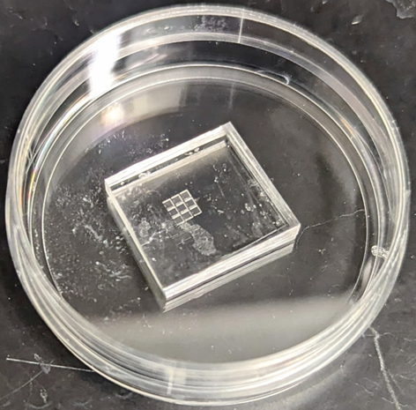
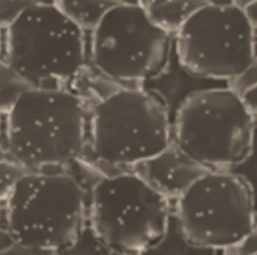
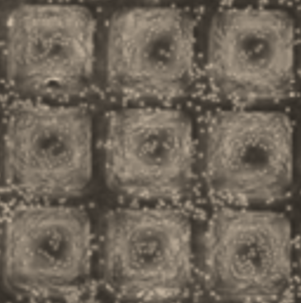
Microwell Study (Older Design)
400 wells, 20µm sides
600k RBCs per mL
6M RBCs per mL

Slide 29
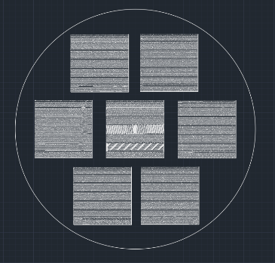


Microwell Mask Design
640,000 wells
10µm diameter

Slide 30
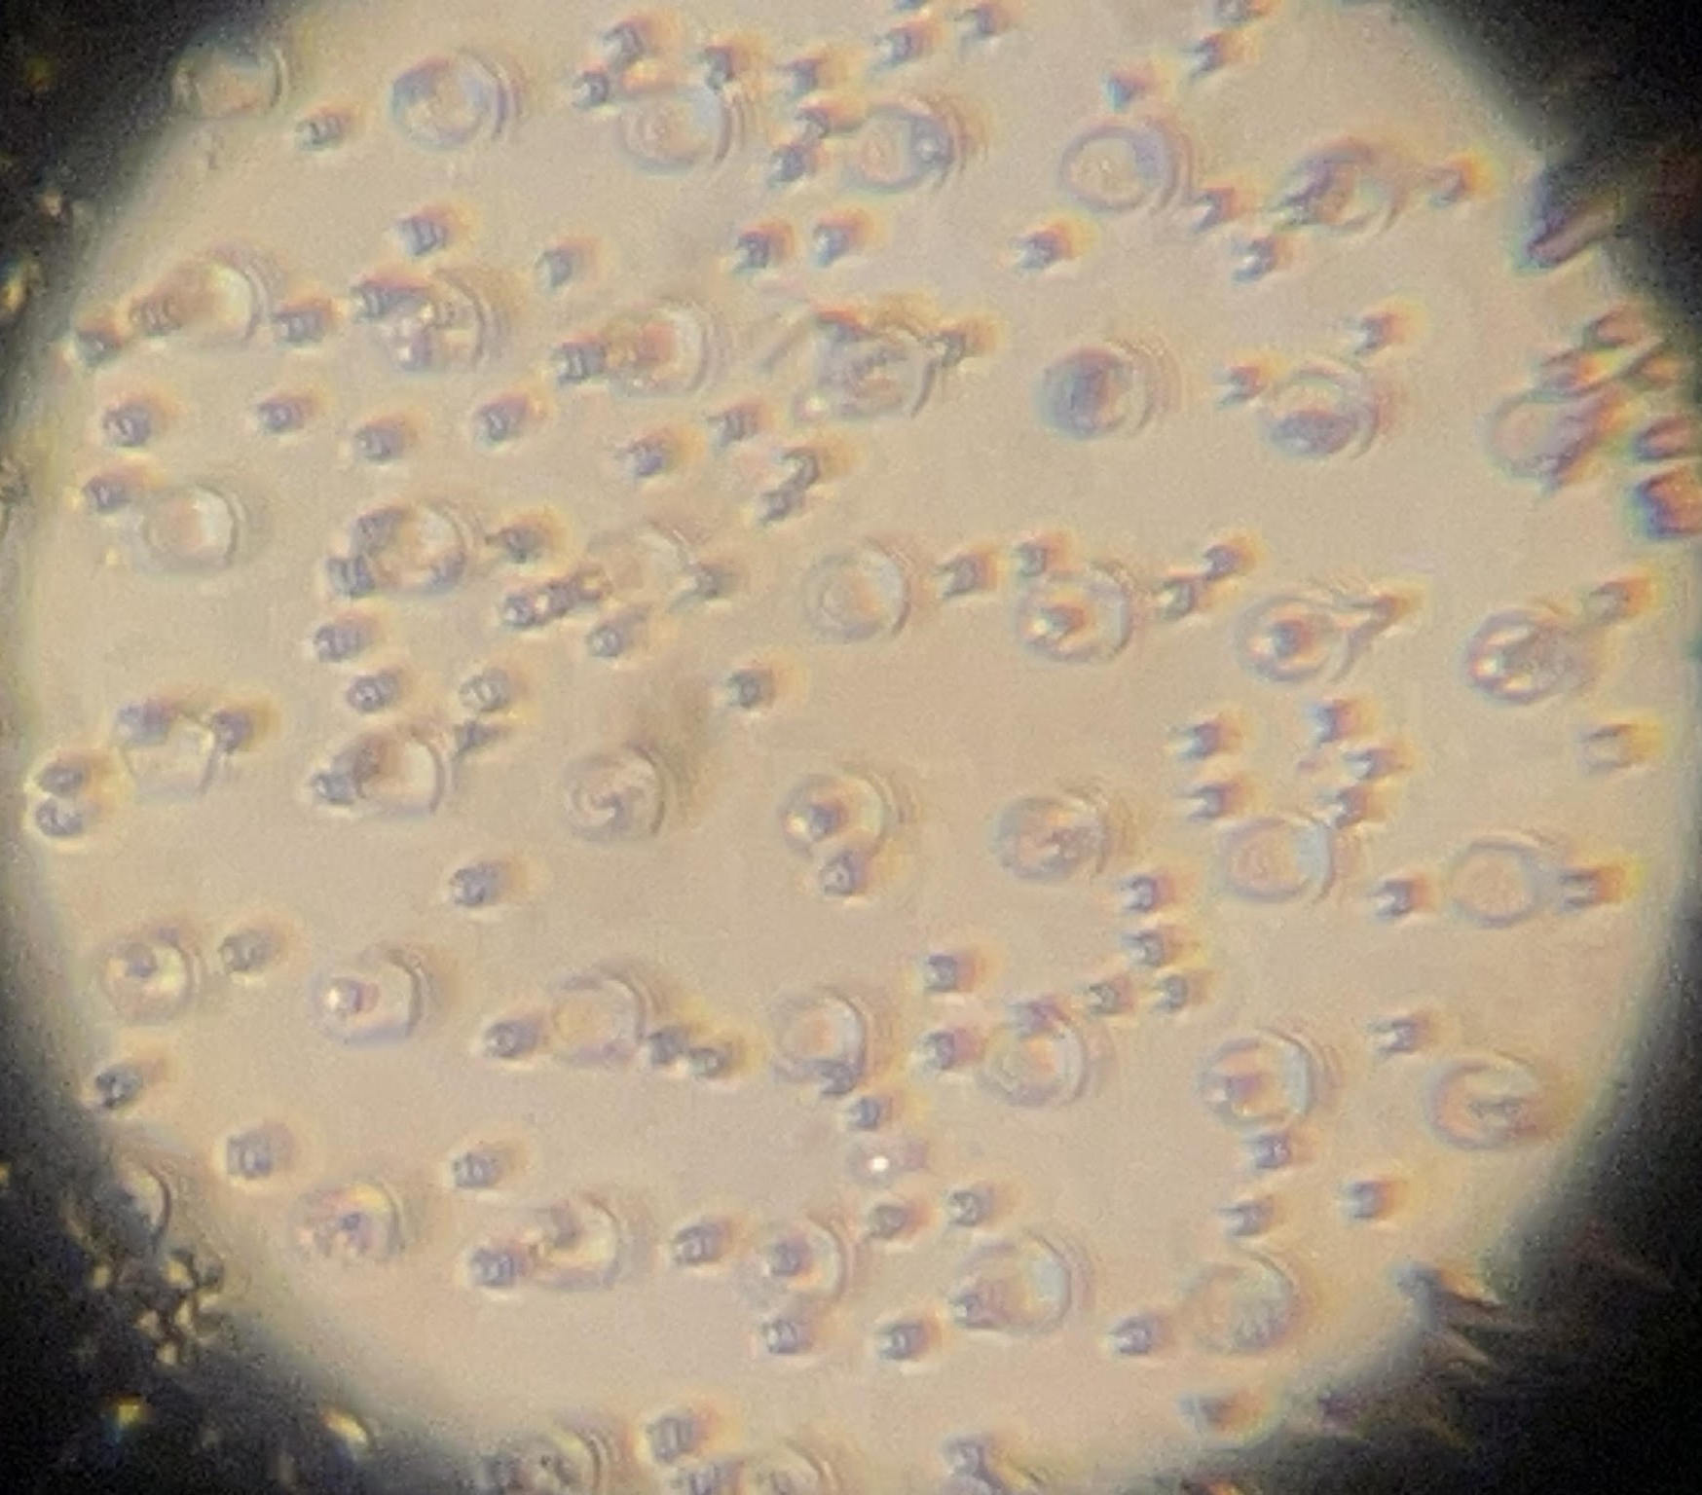
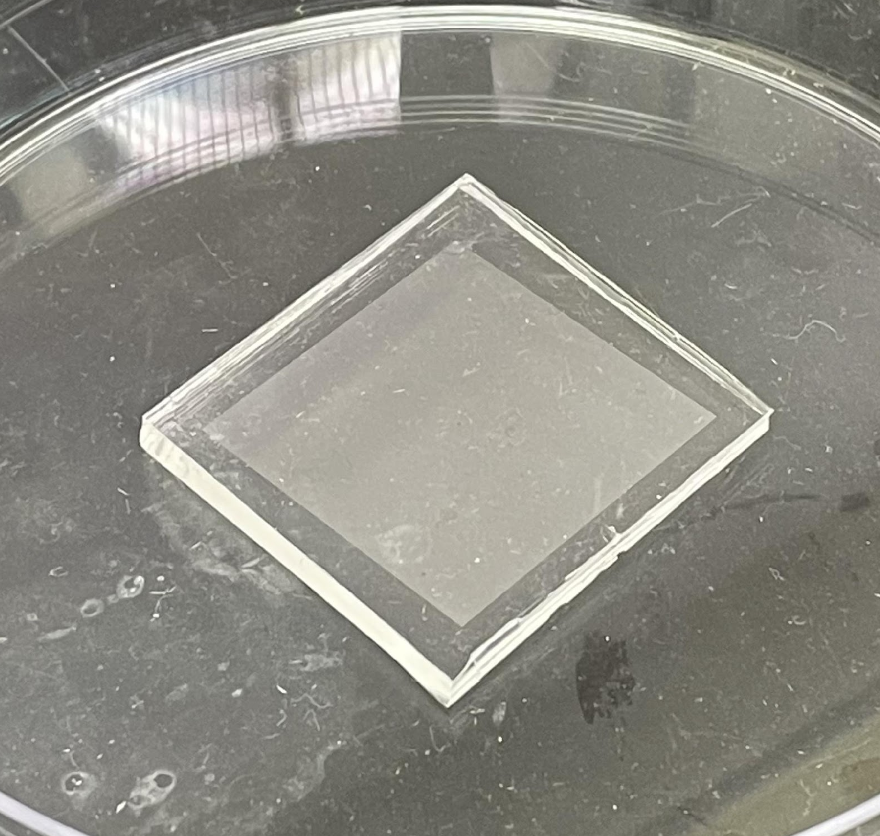
well
cell
200k RBCs per mL

Slide 31
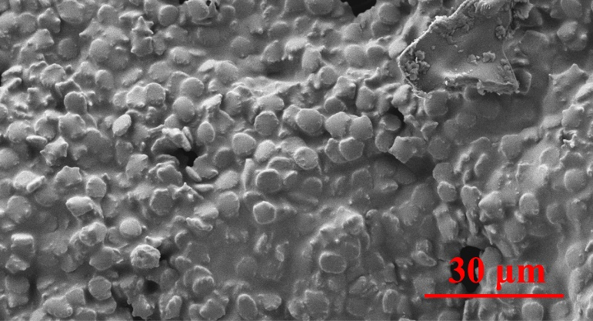
Scanning electron micrographs indicate that intact RBCs are encased in trehalose which protects the cells during dehydration (images acquired at University of Louisville MNTC).
Dehydrated porcine RBCs packaged in clinical grade plastic dual chamber bag for rapid rehydration in a closed system.

