Slide 1





Optimizing Perovskite Solar Cells with Tin Oxide Atomic Layer Deposition (ALD)
By: Emery Allen
PI: Dr. Jaun-Pablo Correa-Baena
Mentor: Chudi Yue

Slide 2
Background

Slide 3
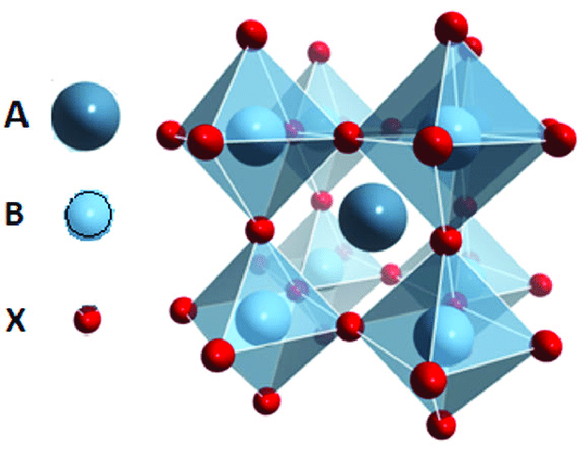
What is Perovskite?
Photovoltaics is the conversion of light into electricity (i.e. Solar Cells).
Perovskite is a relatively new material in the world of photovoltaics.
Perovskites have a ABX₃ structure:
  A- Organic Cation (E.g. methylammonium or formamidinium)
  B- Metal Cation (E.g. Tin or Lead)
  X- Halide Anion (E.g. Iodide, Bromide, or Chloride)
(Masood, 2020)

Slide 4
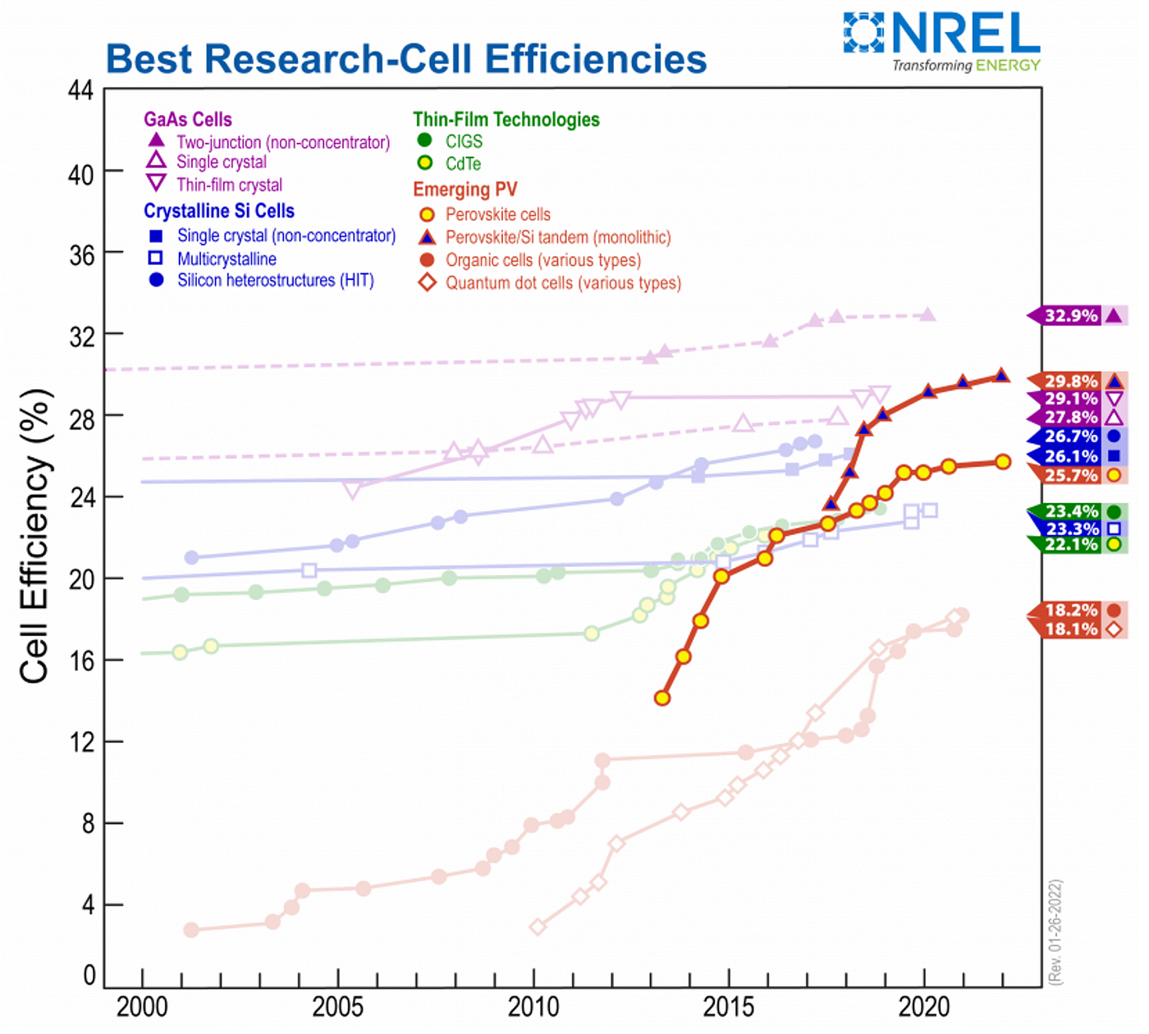
Perovskite Solar Cell Attributes
This structure gives perovskites many desirable properties.
  Versatile- The structure accommodates many elements.
  Tunability- Customizable bandgap, stability, magnetism, and conductivity.
  Low Cost- Uses cheaper materials and solution based methods
  High Efficiency- Rapidly growing Power Conversion Efficiency
(Ali, 2023)​

Slide 5
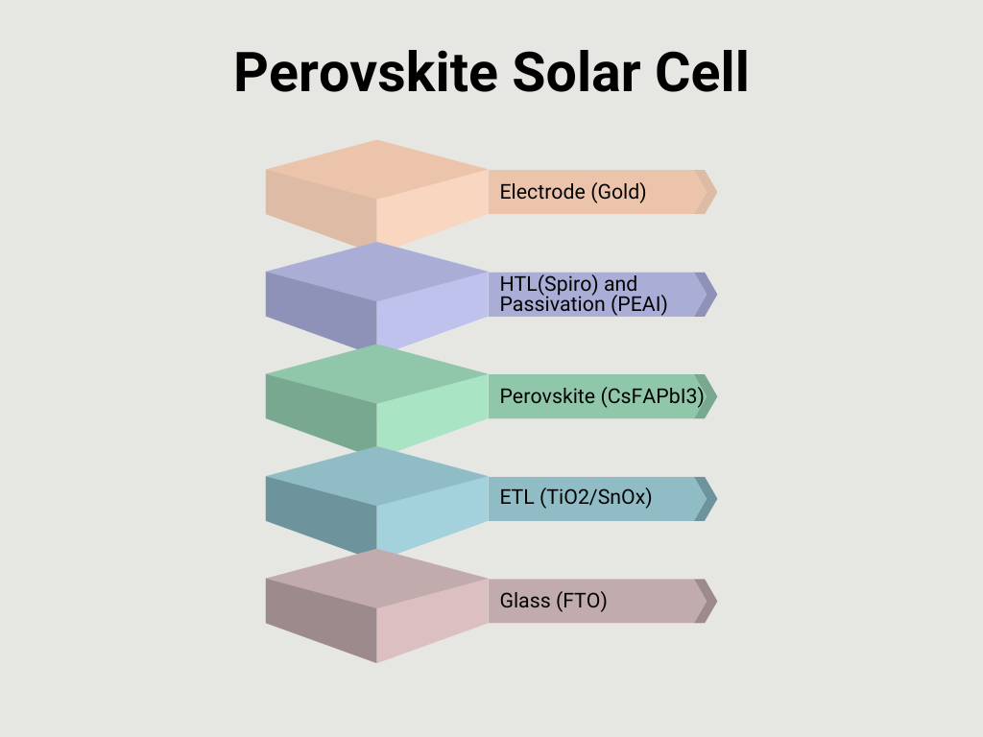
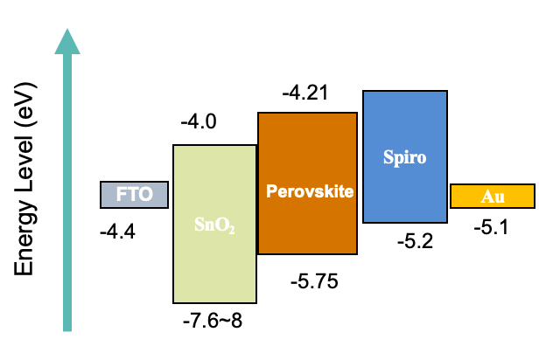
Perovskite Solar Cell Diagram
Electrons
Holes

Slide 6
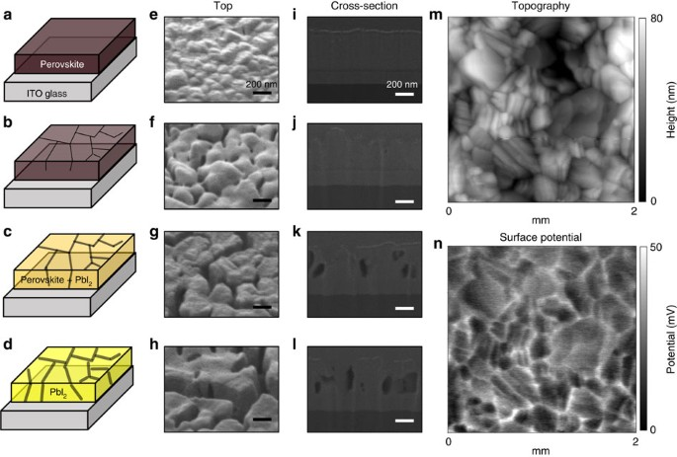
Perovskite Solar Cell Drawbacks
Perovskites unfortunately suffer from a few main issues.
  Short Lifespan- Only lasts about a year.
  Instability- The material can degrade under heat, moisture, light, etc.
  Trap-Recombination- The electron and hole recombine in the Band Gap
(Ahn et al., 2016)​

Slide 7
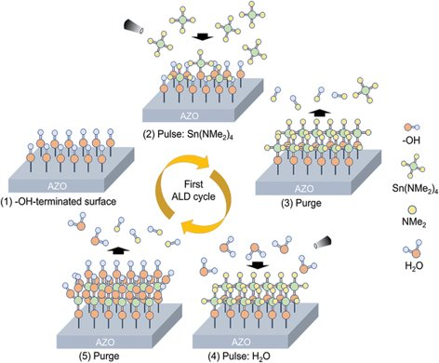
Atomic Layer Deposition of Tin Oxide
Atomic Layer Deposition (ALD) is a method of chemical deposition that can provides a few benefits in the context of solar cell fabrication.
  Low Temperature Deposition- Prevents the cell from accumulating too much heat stress.
  Uniformity- Deposits one layer of atoms across the cell.
  Controllability- The amount of gas, layer thickness, chamber pressure, and temperature are configurable

Slide 8
Goals

Slide 9
Objectives and Goals
Increase the performance, efficiency, and overall stability of a cell using Tin Oxide ALD.
Test intrinsic properties of ALD Tin Oxide.
Study how the equipment parameter could change the material and device performance.

Slide 10
Procedure

Slide 11
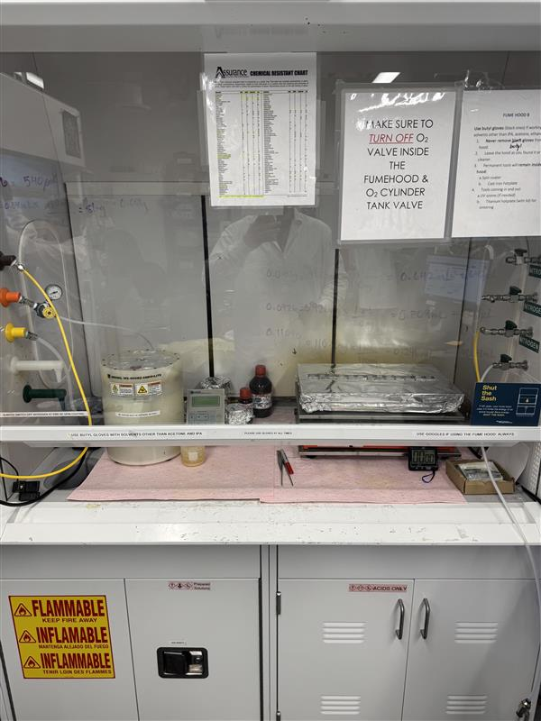
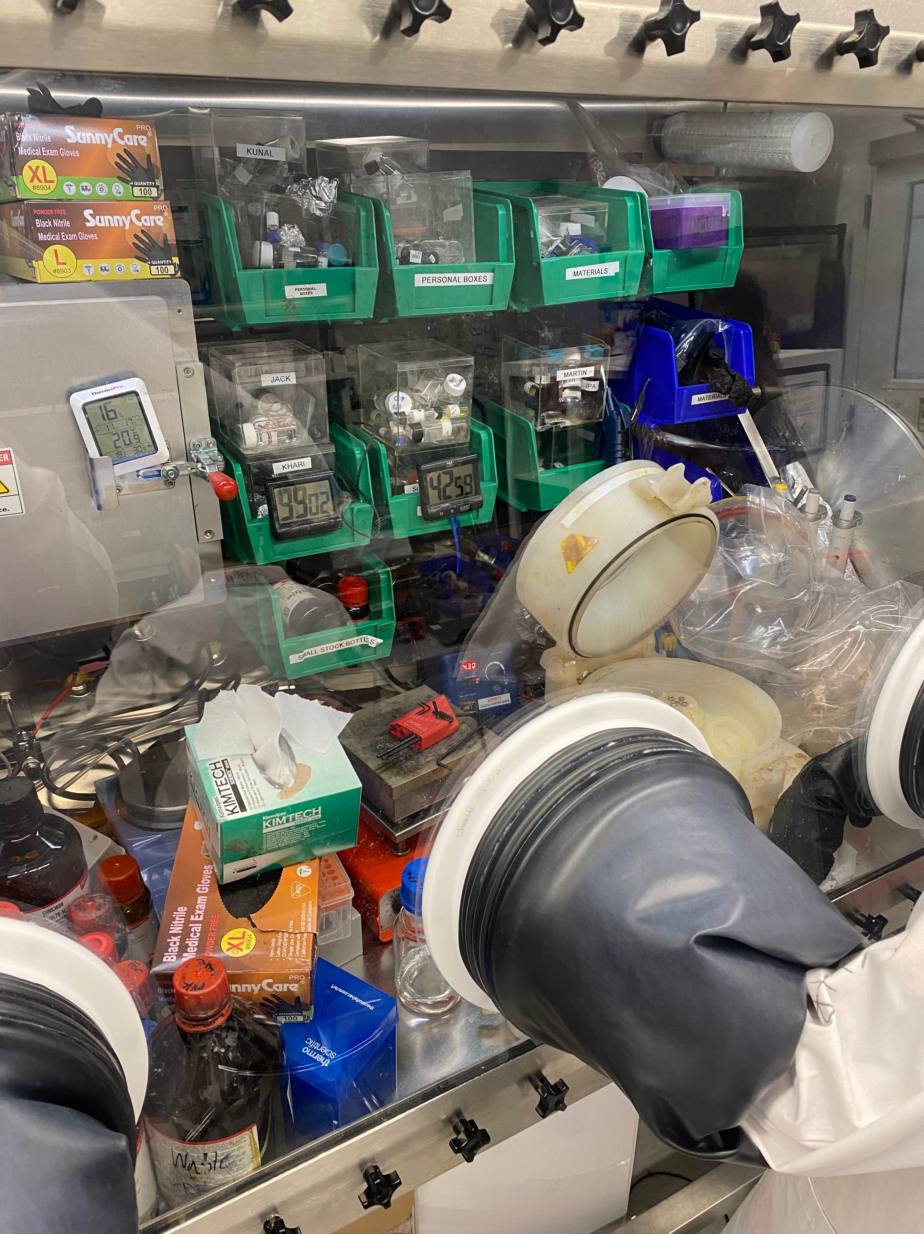
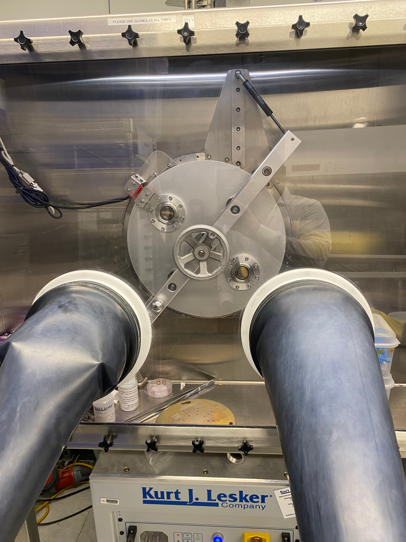
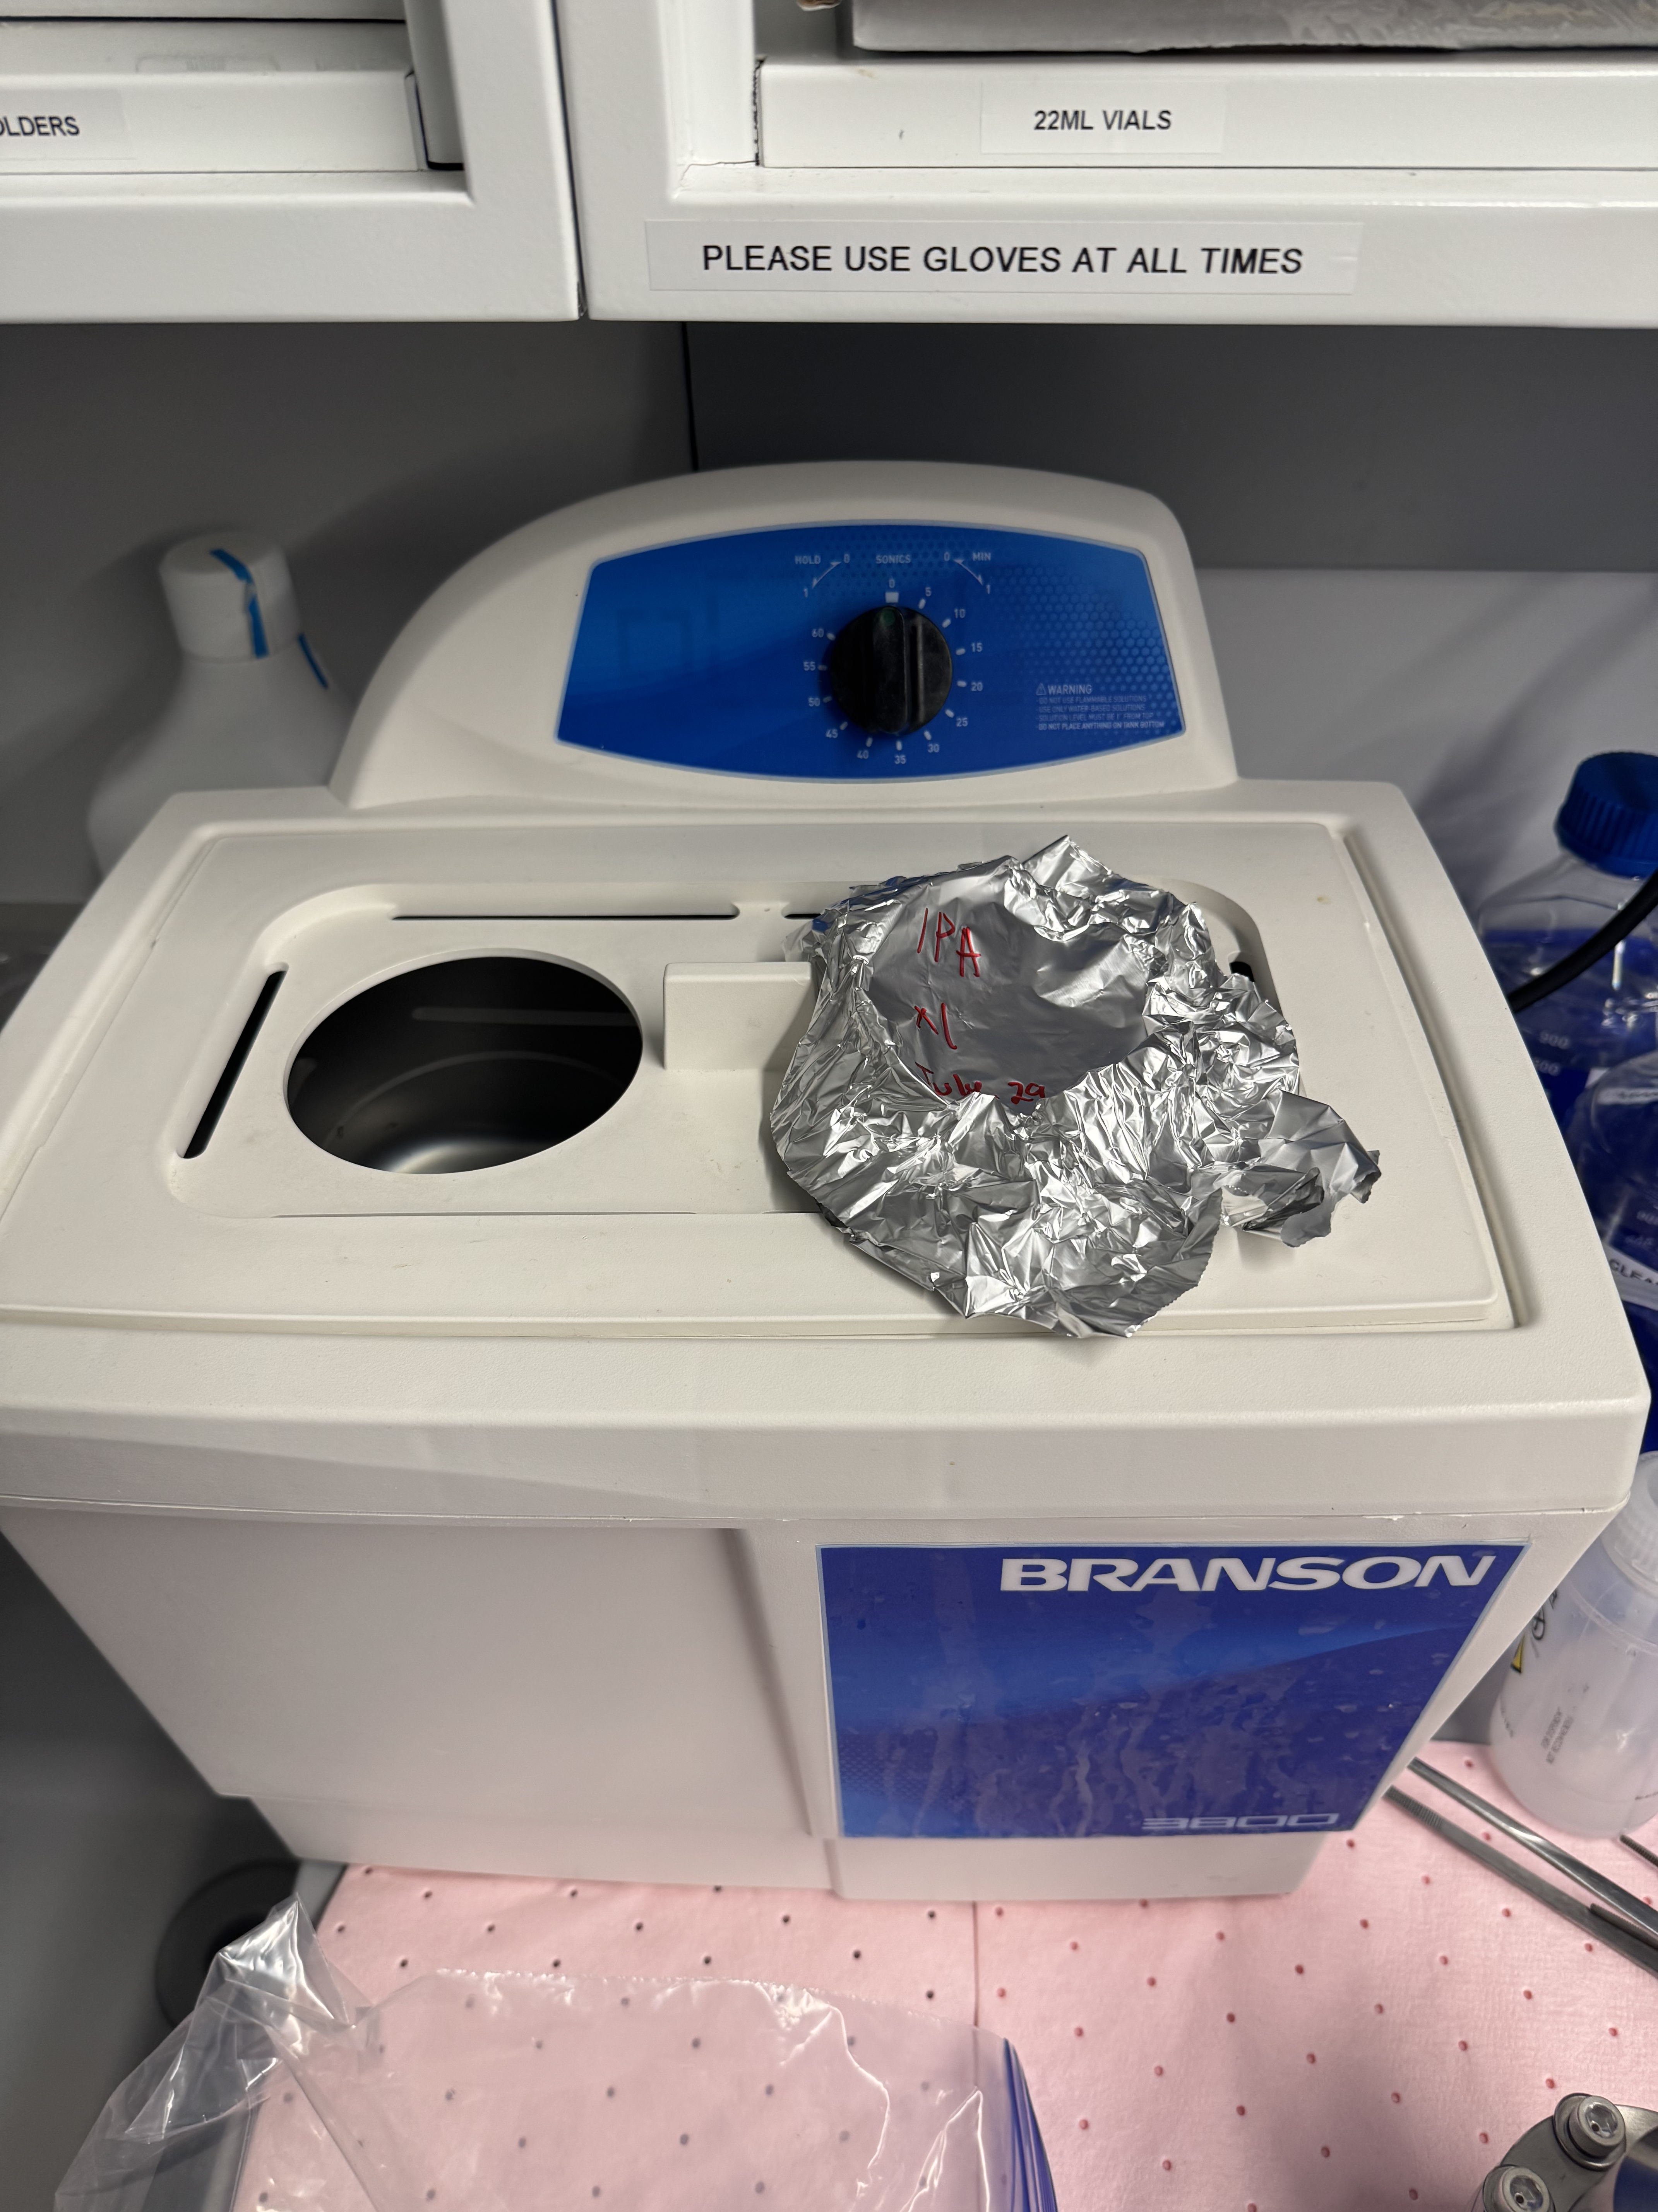
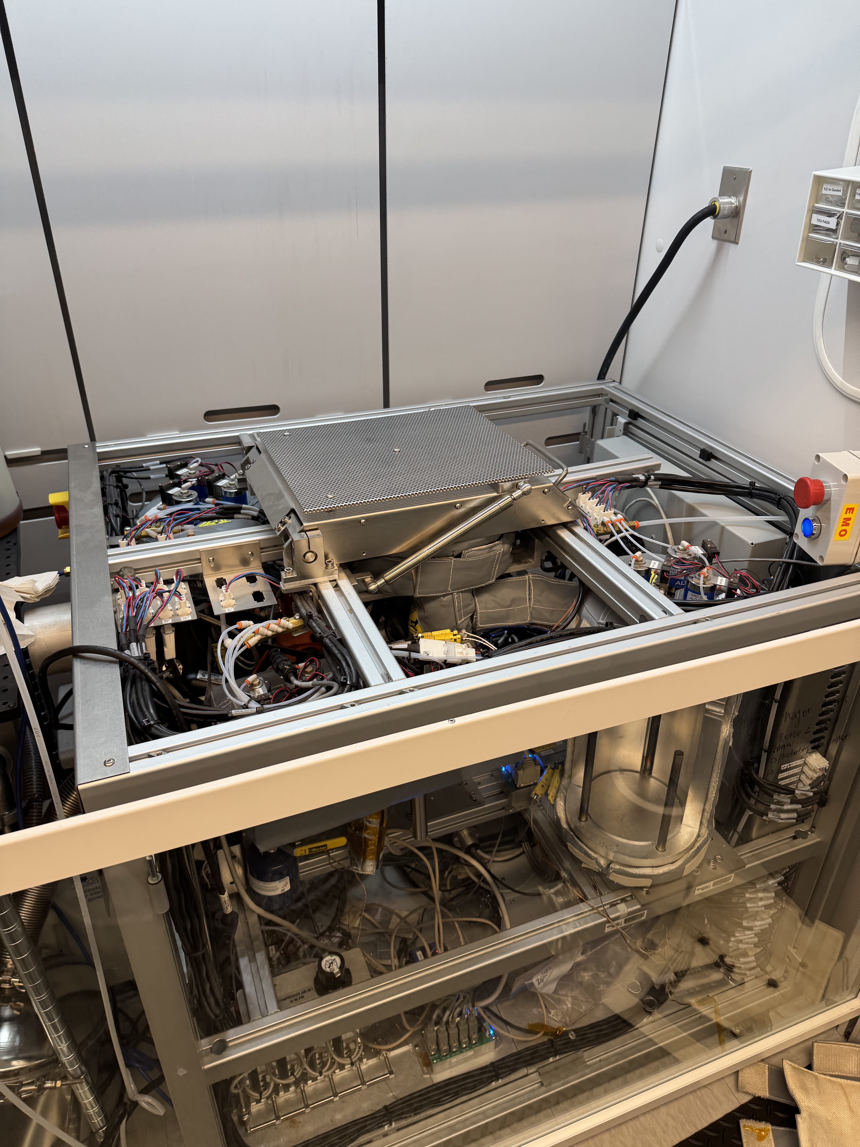
Procedure
ETL (SnOx)
Clean (FTO Substrate)
Perovskite (CsFAPbI3)
Passivation (PEAI)
HTL (Spiro)
Electrode (Gold)
Measure
ETL (TiO2)
(PEAI)​(PEAI)

Slide 12

Results

Slide 13
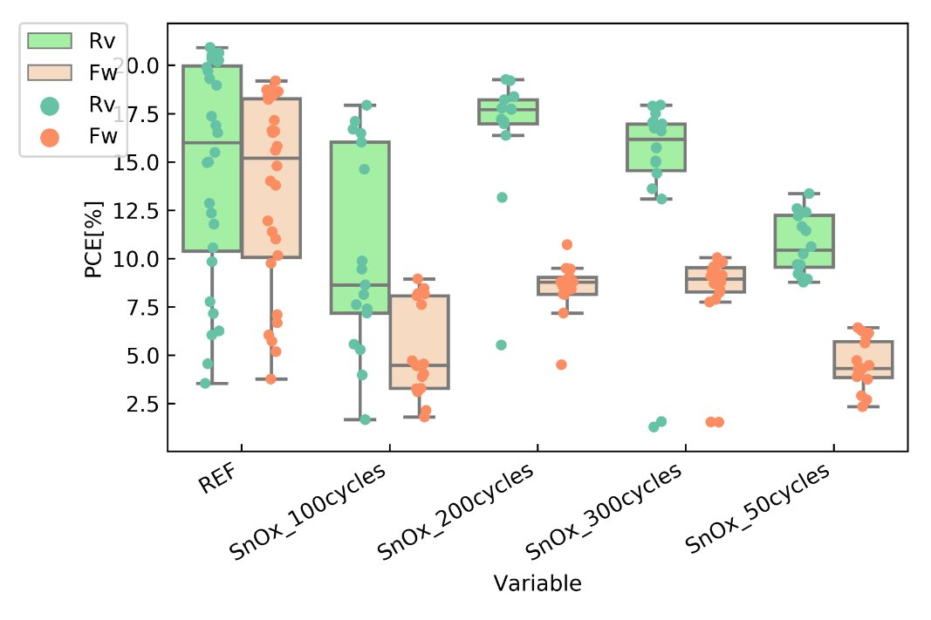
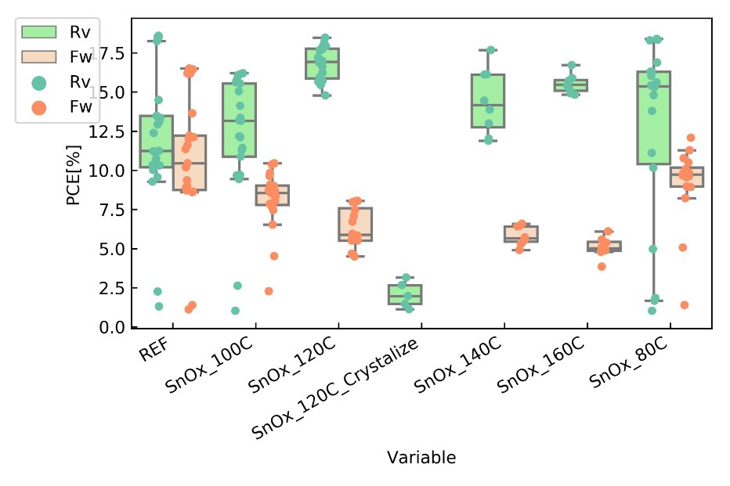
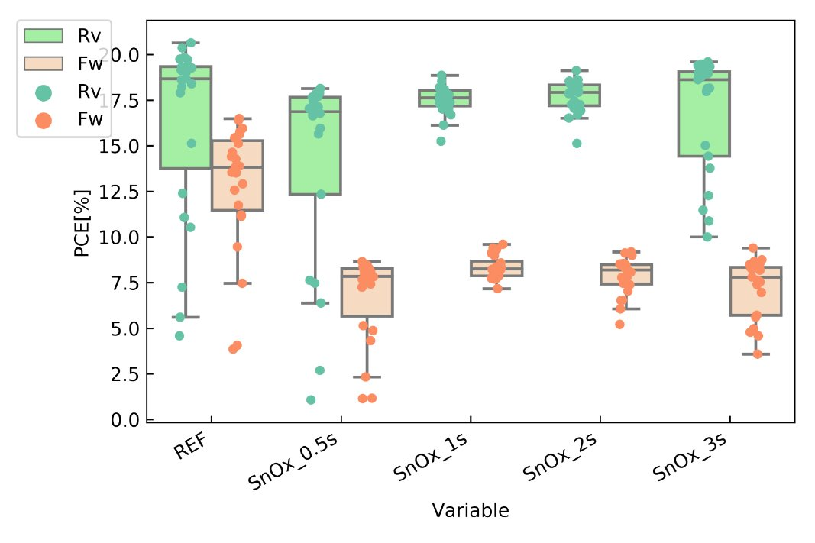
Results – Power Conversion Efficiency
Layer Thickness
Temperature
Pulse Time

Slide 14
Conclusion

Slide 15
Results
Tin Oxide as a perovskite solar cell is comparable with the typical electron transport layer Titanium Oxide and performs more consistently than the reference.
After optimization, we got the best performance with one second of pulse time, 200 cycles, and 120 °C.
Tin Oxide perovskite solar cells still has high hysteresis which needs to be figured out in the future.
Future Work
Improve the interfacial quality between ALD Tin Oxide and Perovskite.
Introduce different materials to use in conjunction with ALD Tin Oxide.
Explore other possibilities of ALD in Perovskite Solar Cells.

Slide 16
Thank You!

Slide 17
Acknowledgments and Special Thanks
I would like to thank the following individuals for making this research possible.
Dr. Juan-Pablo Correa-Baena
Dr. Liqiu Zheng
Leslie O'Neil
Dr. Mikkel Thomas
Chudi Yue

Slide 18
Sources:
Masood, Muhammad Talha. (2020). Solution-Processable Compact and Mesoporous Titanium Dioxide Thin Films as Electron-Selective Layers for Perovskite Solar Cells.
Muhammad Ali, Ph.D. “Solar Cells with the Highest Efficiency.” Medium, ILLUMINATION, 30 July 2023, medium.com/illumination/solar-cells-with-the-highest-efficiency-bdf4ff19fa0d.
Ahn, Namyoung, et al. “Trapped Charge-Driven Degradation of Perovskite Solar Cells.” Nature News, Nature Publishing Group, 10 Nov. 2016, www.nature.com/articles/ncomms13422.
C.B.Honsberg and S.G.Bowden, “Photovoltaics Education Website,” www.pveducation.org, 2019.

